Slide 1

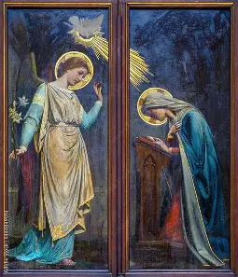
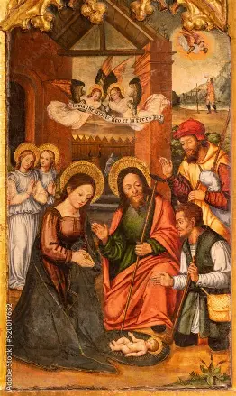





Religious Education Class 7: Triple the Blessings: Praising God in the Blessed Trinity
Thursday, March 5, 2026
Katie Sadakierski

Slide 2

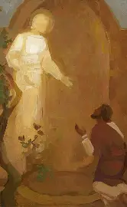
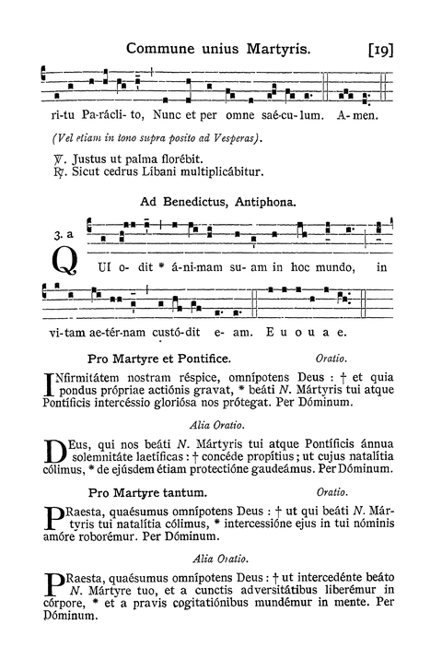
Outline: Religious Education Class 7
  Welcome and Introduction
  Opening Prayer
  Overview of monthly theme & activities
  Learning Centers:
    Grades PK-2: Giving Glory to God the Father, God the Son, and God the Holy Spirit with St. Patrick, and Preparing to Receive the Holy Trinity in Holy Communion
    Grades 3-6: Being Soldiers for Christ like St. Patrick: Putting on the Armor of God to Be Strong and Courageous, Following the Good Shepherd and Fighting the Good Fight with Love for God
    Grades 7-9: Preparing for Easter with the Saints: Finishing Lent Strong
  Announcements
  Closing Prayer
  Visit to the Blessed Sacrament

Slide 3
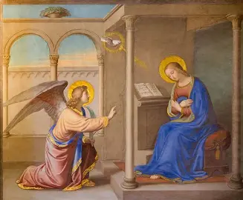
Opening Prayer: The Angelus
V. The Angel of the Lord declared unto Mary.
R. And she conceived of the Holy Ghost.
Hail Mary…
V. Behold the handmaid of the Lord.
R. Be it done unto me according to thy word.
Hail Mary…
V. And the Word was made flesh.
R. And dwelt among us.
Hail Mary…
V. Pray for us, O holy Mother of God.
R. That we may be made worthy of the promises of Christ.
Let us pray: Pour forth, we beseech Thee, O Lord, Thy grace into our hearts, that we to whom the Incarnation of Christ, Thy Son, was made known by the message of an Angel, may by His Passion and Cross be brought to the glory of His Resurrection, through the same Christ Our Lord. Amen.

Slide 4
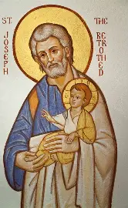
Overview: Monthly Theme (March 2026)
March: Month of St. Joseph
March 19 is the feast day of St. Joseph, who was Jesus’ earthly father, his adopted father who raised Jesus with Mother Mary. It is believed that March 19 is the day on which St. Joseph entered Heaven. Saint Joseph was the soul chosen to tell all of the souls waiting in Limbo, waiting to get into Heaven, that Jesus, the Savior, was coming to bring them to Heaven soon. Saint Joseph was a carpenter who taught Jesus in the workshop, preparing Him for His biggest mission, to make souls into masterpieces ready for Heaven. He teaches us, too, helping us to polish our souls just as he perfected all of the pieces of wooden furniture that he made in stages. Through St. Joseph’s help, we are gradually led to Heaven, as he teaches us how to love Jesus and Mother Mary, and to share the good news of God’s love, of how God saves us, so that everyone can have the hope and joy of knowing Jesus. Saint Joseph is our father, too, so we can always go to him to help us, just as Jesus did

Slide 5
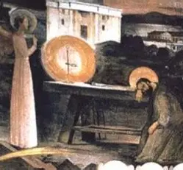
Monthly Patron Saint and Prayer (March 2026)
Patron saint: Saint Gabriel the Archangel (feast day: March 24; the day before the Feast of the Annunciation on March 25)
  Saint Gabriel the Archangel is the holy angel who appeared to Our Lady to bring her the message that she was chosen by God the Father to become the Mother of God the Son. He gives us the first line of the “Hail Mary” prayer, “Hail, Mary, full of grace, the Lord is with thee,” because he greeted Mother Mary with this line when he appeared to her. He teaches us to honor Mother Mary, because Jesus is always with her, and is always with us, because Our Lady is our spiritual Mother who helps us to be like her Son, to bring Christ’s love into the world, and to remember to always treat Jesus and each other with respect, because He is always Present, within and around us
Monthly prayer: “Jesus, with us always, have mercy on us.”
  This month, we honor Jesus for always being with us in the Holy Eucharist, just as He came to be with Mother Mary when Mother Mary said “yes” to God’s plan for her to be the Mother of Jesus. We can say “yes” to God by doing all that we can to love and follow Him, to live out His rules, His Commandments, to be ready to receive Him in Holy Communion. Because Jesus is with us, we can always have hope. He will never leave us, but will keep helping us

Slide 6
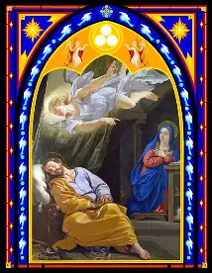
Grades PK-2: March 2026 Activities
Week 1: Practicing the virtue of patience like St. Joseph during Lent; walking with Jesus step-by-step, and practicing special Lenten traditions to help us in patiently completing this walk
Week 2: Giving praise and love to God the Father, God the Son, and God the Holy Spirit as we receive, and prepare to receive; God in the sacraments
Week 3: Loving God for His patience and gentleness with us, as reflected by St. Joseph and Jesus, the Lamb of God
Tonight’s learning center (parish hall): Making St. Patrick’s Day one-decade rosary chaplets in honor of the Blessed Trinity; making stained-glass window scenes to let the light of God’s love into our hearts as we give glory to God the Father, God the Son, and God the Holy Spirit

Slide 7
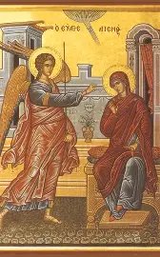
Grades 3-6: March 2026 Activities
Week 1: Practicing patience like Jesus, and looking to symbols of God’s love as reminders to be patient: loving the Cross, and loving God the Father, God the Son, and God the Holy Spirit for leading us to it, to become closer to them as one family
Week 2: Learning from St. Patrick how to be patient, and rejoice in patiently following God’s plan by receiving Him in the Holy Eucharist, remaining in the circle of His love forever in union with the Persons of God in the Blessed Trinity
Week 3: Practicing patience with St. Joseph and Mother Mary: saying “yes” to God’s plan with faith, hope, and love, as we practice Lenten traditions together, looking forward to God’s blessings with open hearts
Tonight’s learning center (parish library): Bible scavenger hunt to learn the story of St. Patrick through symbols: the shield of the soldier and the staff of the shepherd, as we strive to imitate St. Patrick’s virtues, and call down his protection and blessings on us, making Scripture shields to honor his breastplate prayer

Slide 8
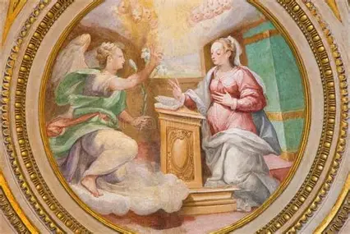
Grades 7-9: March 2026 Activities
Week 1: Growing in patience with the love of God the Father, God the Son, and God the Holy Spirit as we await Confirmation, preparing in union with our patron saints
Week 2: Imitating the patient love of the Persons of God in the Blessed Trinity, just as St. Patrick did, and looking to Our Lady of Knock as a model of patience reflecting the Holy Trinity
Week 3: Living up to our Confirmation patron saint names and reflecting the patience of St. Joseph and Mother Mary with our heavenly friends who praise God for them, and bless Our Lord for His infinite patience and love
Tonight’s learning center (church): Reflective journaling on the Holy Spirit’s Gift of Knowledge, and how St. Patrick lived out this Gift, teaching us to do the same

Slide 9
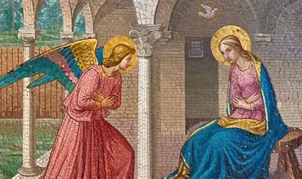
Announcements (1): Confirmation
Confirmation retreat: Saturday, March 14, 2026, 8:00 a.m. to 12:00 p.m., meet in parish hall: day will include Holy Mass, Holy Rosary recitation, Eucharistic Adoration, and presentation (with service opportunity options available)
  Open to all Confirmation candidates, sponsors, and family members; students who attended retreat in the autumn may attend again
  Retreat required by diocese; fulfill equivalent retreat experience if unavailable to participate the day of the retreat
    Saint Joseph consecration workshops
Confirmation rehearsal: Friday, March 20, 2026, 6:00 p.m., church
  Practice for Holy Mass; bring sponsors or proxies if sponsors are not available; attend Confession; and submit service log
Mass of Confirmation: Tuesday, March 24, 2026, 6:00 p.m., church
  Reception: 7:00 p.m., parish hall
    All are welcome to attend the Holy Mass and reception

Slide 10
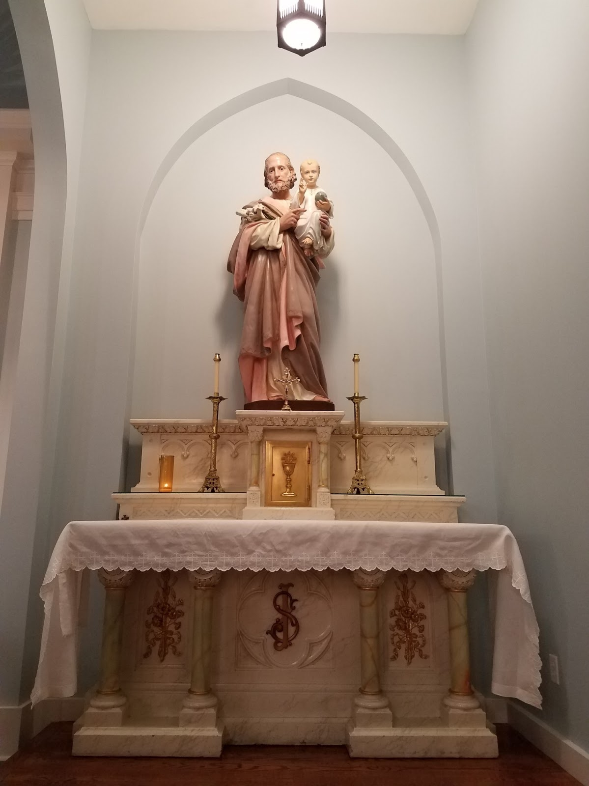
Announcements (2): Confirmation
Confirmation service opportunities: complete by Friday, March 20, 2026
  Saint Joseph consecration workshops: Wednesday, March 11, 2026, and Wednesday, March 18, 2026, at 6:30 p.m. in the parish hall; assist with food drive and making cards for the homebound/sick
  Preparation for Knights of Columbus scholarship breakfast: Saturday, March 7, 2026, 9:00 a.m. to 11:00 a.m. (setup); contact Bob Sass for more information at Bob.Sass@kofc.org
  Knights of Columbus scholarship breakfast: Sunday, March 8, 2026
    8:00 a.m. to 11:45 a.m., assistance with table management/cleaning; replacing place settings
    11:45 a.m. to 1:45 p.m., cleanup
Women’s Club Gilda Burnett scholarship: for graduating high school seniors entering 2- or 4-year college in the autumn
  Opened March 1, 2026; submit by Thursday, April 30, 2026 (to parish office or to religious education class 8)
    Applications available on parish website

Slide 11
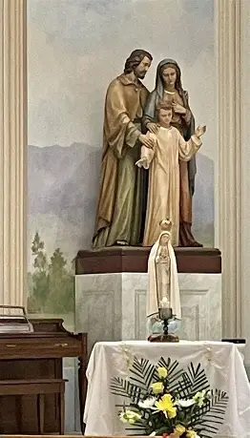
Announcements (3): First Holy Communion
First Holy Communion retreat: Saturday, April 11, 2026, 11:00 a.m. to 2:00 p.m., parish hall
  First Confession rehearsal
  Brown scapular investiture
  Learning centers: Eucharistic pilgrimage; prayer practice; Eucharistic saints
  First Holy Communion pew banner-making station; choose family photos, supplies to personalize
First Confession: Thursday, April 16, 2026, 6:00 p.m., church
First Holy Communion rehearsal: Thursday, April 23, 2026, 6:00 p.m., church
Collect flyer with all upcoming dates from the sign-in table

Slide 12
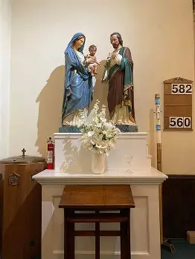
Announcements (4): Parish-wide
Next First Sunday Eucharistic Adoration: Sunday, April 12, 2026 (second Sunday; First Sunday is Easter Sunday)
  Divine Mercy service (not a three-hour period of Adoration)
Next blessing of sacramentals: Saturday, April 11, 2026
  9:30 a.m., church (second Saturday)
    Blessing of Easter food: Saturday, April 4, 2026, 11:00 a.m., parish hall (no First Saturday blessing of sacramentals)
Next First Friday Latin Mass: Friday, March 6, 2026, 6:00 p.m., church
Lenten devotions:
  Father Sliwa’s Lenten sermon series on prayer: Monday, March 16, 2026 and Monday, March 23, 2026 at 5:30 p.m. in the church
  Gorzkie Zale: Wednesdays in the church at 5:30 p.m. through Wednesday, March 25, 2026
  Stations of the Cross: every Friday through Friday, March 27 (except Friday, March 20, 2026 and Friday, April 3, 2026) at 5:00 p.m. in the church

Slide 13
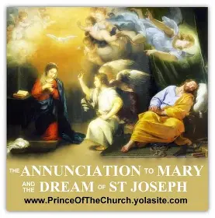
Announcements (5): Religious Education
Food drive: Bring donations until Wednesday, March 11, 2026, to the parish hall; place in labeled boxes by the food drive giving tree; pasta, peanut butter, and soup are most needed by the Easthampton Community Center
  Ongoing: bring donations for Bethlehem House (size 6 diapers most needed)
Take & Eat ministry coloring sheet menus: available for all students and families to complete; April menus ready
  Service hours will be granted for Confirmation students
    Submit completed menus at religious education classes, or to parish office
      See Take & Eat coordinator Lisa York at the back of the parish hall
Religious education class 8: Thursday, April 9, 2026, 6:00 p.m., parish hall; bring completed activities
  No religious education class during the first week of April (Holy Week)
Women’s club Gilda Burnett scholarship: available to students entering Catholic a high school for the first time (between grades 8 and 11)
  Email sadakierski.olv@gmail.com for more information, visit the Women’s Club tab on the parish website (in the “Organizations” category), or reach out to Anita Ulshoeffer, Women’s Club president, at aulshoeffer5354@charter.net

Slide 14
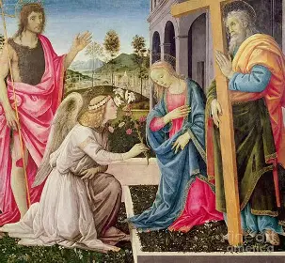
Closing Prayer: Collect Prayer for the Thursday in the Second Week of Lent
O God, Who delights in innocence and restores it, direct the hearts of Your servants to Yourself, that, caught up in the fire of Your Spirit, we may be found steadfast in faith and effective in works. Through our Lord Jesus Christ, Your Son, Who lives and reigns with You in the unity of the Holy Spirit, God, for ever and ever. Amen.

