Slide 1
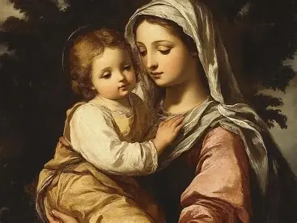
Seven Sisters Apostolate Book Club 2, Session 3
Sunday, February 8, 2026
Katie Sadakierski

Slide 2
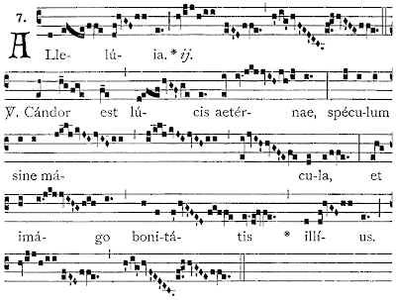

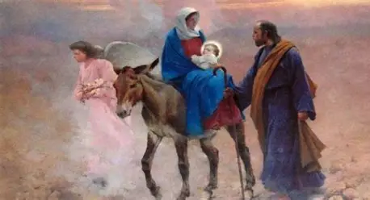
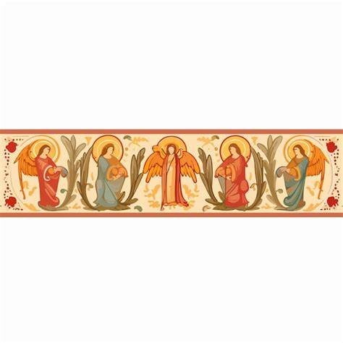
Outline: Seven Sisters Apostolate Book Club 2, Session 3
I. Opening prayer
II. Presentation
  a. Key insights from Introduction & Chapters XII-XIX (pages 101-148)
      i. Honoring Our Lady as Our Lily: Emulating the Purity of Our Lady through Poverty in Spirit, and Richness in Christ
    12. The Journey to Bethlehem
    13. The Nativity
    14. The Adoration of the Shepherds
    15. The Circumcision
    16. The Adoration of the Magi
    17. The Purification
    18. The Flight to Egypt
    19. The Holy Family in Egypt
  b. Reflection prompts
    Group-wide discussion
III. Announcements
IV. Closing prayer
V. Q & A

Slide 3
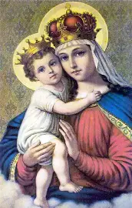
Opening Prayer: Novena Prayer to Our Lady of Good Remedy (1)
O Queen of Heaven and Earth, Most Holy Virgin, we venerate thee. Thou art the beloved Daughter of the Most High God, the chosen Mother of the Incarnate Word, the Immaculate Spouse of the Holy Spirit, the Sacred Vessel of the Most Holy Trinity.
O Mother of the Divine Redeemer, who under the title of Our Lady of Good Remedy comes to the aid of all who call upon thee, extend thy maternal protection to us. We depend on thee, Dear Mother, as helpless and needy children depend on a tender and caring mother.
Hail, Mary...

Slide 4
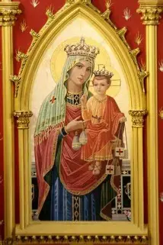
Opening Prayer: Novena Prayer to Our Lady of Good Remedy (2)
O Lady of Good Remedy, source of unfailing help, grant that we may draw from thy treasury of graces in our time of need.
Touch the hearts of sinners, that they may seek reconciliation and forgiveness. Bring comfort to the afflicted and the lonely; help the poor and the hopeless; aid the sick and the suffering. May they be healed in body and strengthened in spirit to endure their sufferings with patient resignation and Christian fortitude.
Hail, Mary...

Slide 5
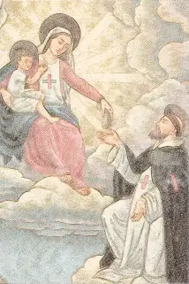
Opening Prayer: Novena Prayer to Our Lady of Good Remedy (3)
DEAR LADY OF GOOD REMEDY, source of unfailing help, thy compassionate heart knows a remedy for every affliction and misery we encounter in life. Help me with thy prayers and intercession to find a remedy for my problems and needs, especially for...
(Indicate your special intentions here).
On my part, O loving Mother, I pledge myself to a more intensely Christian lifestyle, to a more careful observance of the laws of God, to be more conscientious in fulfilling the obligations of my state in life, and to strive to be a source of healing in this broken world of ours. Dear Lady of Good Remedy, be ever present to me, and through thy intercession, may I enjoy health of body and peace of mind, and grow stronger in the faith and in the love of thy Son, Jesus.
Hail, Mary... . .
V. Pray for us, O Holy Mother of Good Remedy,
R. That we may deepen our dedication to thy Son, and make the world alive with His Spirit.

Slide 6
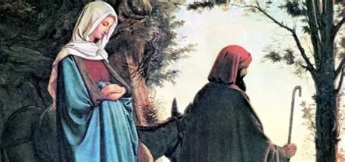
What are some spiritual takeaways from Chapter Twelve of The Life of Mary as Seen by the Mystics? (1)
Saint Joseph and Our Lady set out for their journey to Bethlehem at 6:00 a.m. Guiding the donkey on which Our Lady rode, St. Joseph was permitted to walk for the duration of the quest, holding his staff with his left hand, and the donkey with his right. Carried on the journey are some corporal provisions, including bread, fruit, and fish, along with the linens that Our Lady made to clothe Jesus. The journey there is cold and perilous. Our Lady suffers very much physically, but ten thousand of her holy angels surround her, consoling her, and uniting with her and St. Joseph in singing songs of praise for God. On the first evening of their travels, Our Lady and St. Joseph rested in a valley, where they pitched a tent next to a fountain. By a miracle of God, Our Lady was warmed from within, and shared the warmth with St. Joseph, placing her hands in his. When they continued on their journey the next day, Our Lady began to walk at noon, when the donkey became too fatigued to continue supporting her. Saint Joseph attempted to uplift the spirits of the suffering Mary by describing the beautiful lodging that they were sure to find upon reaching their destination. He and Our Lady stayed at a farm; Saint Joseph toured the gardens, while Our Lady stayed and instructed the children of women who were present, resting during the Sabbath. The children were so transfixed by the beauty, truth, and goodness of God reflected in Our Lady, that they could not look away from her. The holy couple went on, traveling twelve miles before seeking rest. Many were touched by Our Lady and St. Joseph, but some envied them; one woman refused to give them shelter because she was jealous of how beautiful Our Lady was, but years later, when she was crippled, Our Lord would forgive and heal her. Although St. Joseph had been confident that they would find lodging, there was none to be had, but while they made frequent stops, Our Lady trusted in God the Father’s plans, praying for the people that she met, and using the opportunity to be a healing and edifying presence, inspiring the people with her simplicity, piety, and humility while she sat under a tree, awaiting St. Joseph’s return as he went from house to house, seeking lodging; Our Lady would have preferred to be without shelter than to keep going on door-to-door in her condition, but she followed St. Joseph patiently. He had registered for the census, affirming that he was not a property owner, but worked as a manual laborer. Although he sorrowed in not finding lodging for Our Lady, shedding tears when he returned to her at 9:00, St. Joseph accepted Our Lady’s counsels to embrace poverty, and to thank God; she agreed to take rest in a shepherd’s shelter, and while there, prayed and sang, joyfully awaiting the Birth of Jesus after enjoying a light meal with St. Joseph

Slide 7
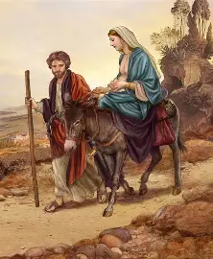
What are some spiritual takeaways from Chapter Twelve of The Life of Mary as Seen by the Mystics? (2)
When we reflect on the schedule of the Holy Family, we can see how it became a template for our daily prayers, i.e. the Angelus and Divine Office, with the journey beginning at 6:00 a.m. (when we typically pray the Angelus). These prayers guide us towards spiritual rebirth. Saint Joseph used his right hand to guide the donkey, and the right signifies special authority, like the Son of God being seated at the right hand of the Father. Through humility, we come to be near the throne of God. The provisions of fruit, bread, and fish are symbolic, anticipating the Birth of Jesus, the Fruit of Our Lady’s womb and True Bread, the Fisherman of souls. Our Lady teaches us to always bring the love of the Sacred Heart to others, which is meant to be shared. We pass on the warmth of Christ’s Heart by exhibiting His generosity and selflessness. A valley represents a kind of double-blessedness, as it receives water from above and below to nurture it. Water is a persistent theme in these chapters, as Our Lady herself serves as a kind of fountain of grace in bringing forth Christ. As our Savior, the living water, He redeems us, so that we need never thirst for more in life. Saint Joseph applies the virtue of hope, demonstrating to us that we are always to look to Heaven, to have faith in what will come, instead of despairing over the present situation. Just as we read of St. Anne eating before giving birth to Our Lady, we read of the light meal that St. Joseph and Our Lady shared before the Nativity of Our Lord. They show that we are always to be nourished by Christ, and that we can only take action, being equipped to serve God, because of the spiritual food that He gives us. Saint Joseph owned no property, just like the Levite priests who were to make their home in God’s Heart, going to show that we can only have shelter in Christ. When St. Joseph and Our Lady went on to the shepherd’s shelter, it was 9:00, the hour of the Holy Spirit; the Holy Spirit was inspiring their actions, leading them to where they needed to be

Slide 8
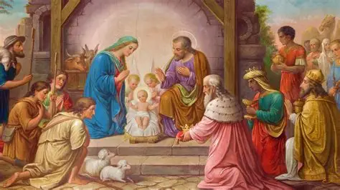
What are some spiritual takeaways from Chapter Thirteen of The Life of Mary as Seen by the Mystics? (1)
Prior to giving birth, Our Lady prayed, and radiated the most brilliant rays of light, like flames surrounding her. Our Lady was kneeling, looking heavenward, with her arms crossed over her Immaculate Heart in prayer, while St. Joseph prepared the manger for the Christ Child, placing straw and moss on it as a soft covering for Jesus. Holy angels came down like fire, surrounding Our Lord as He was born. When Our Lord was born, Our Lady experienced no pain. The Lord appeared to be aglow with the most resplendent light when He came forth. Animals in the shelter, including an ox and donkey, breathed gently on Our Lord to warm Him in the cold. As the holy angels sang, Our Lord shone, embodying perfect purity. It was as though His Body was already glorified. Our Lady adored Christ after He was born, welcoming Him in word and action, immediately covering His Sacred Body with a cloth. As she adored Him, Our Lady was joined by thousands of holy angels who prayed on their knees in humble submission to the Lord, their Creator. Our Lord’s human frailties were exemplified as He cried; to soothe Him, His Mother held Him close to her Heart, and an hour after His Birth, brought Him to St. Joseph to hold. Saint Joseph kissed Our Lord’s Feet with great tenderness and reverence; so overjoyed was he, that he wept. Saint Joseph helped Our Lady to swaddle Jesus by handing her the handmade linens that she used to clothe Him. Afterwards, they knelt by the holy crib of the Christ Child in adoration, and Our Lady went to a rest spot that St. Joseph made for her beside the holy manger of her Son

Slide 9
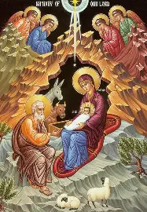
What are some spiritual takeaways from Chapter Thirteen of The Life of Mary as Seen by the Mystics? (2)
Our Lady’s preparation for birthing Christ was like a preparation for Holy Mass, a preparation to receive the Holy Eucharist. Saint Joseph took action while Our Lady engaged in contemplation, so they balanced each other out. Moss was used with straw to make a soft resting place for the newborn Savior. Though at first, moss may seem an unusual choice, it represents something of what Our Savior’s role is going to be. Moss is used as a kind of natural fertilizer; it nourishes soil; and absorbs water. Providing a natural refuge for wildlife, it also prevents erosion. Likewise, Our Lord nourishes us, and takes on suffering so that we will not have to suffer eternally, enriching the soil of our hearts, and facilitating our growth, in pouring out the Precious Blood and living water from His Sacred Side to heal us. Christ’s Heart is a refuge that keeps us from eroding spiritually. When the holy angels are present, their fiery forms suggest the burning charity that they have for Christ, reflecting His Heart of burning love. They prefigure Pentecost, when the Holy Spirit will come down like flames upon the apostles to give them the spiritual gifts needed; Our Lord’s Birth is illuminated with light like fire, because Our Lord is the long-awaited Gift from the Eternal Father. Christ is consoled when we keep Him close to our hearts. He longs to be near us, thirsting for our souls. We are meant to console Christ together through our love, by putting on Christ’s self-giving love, enveloping others in His kindness and charity. When the animals breathed on Our Lord, it was like the breath of life that God gives to us, representing the new life that Christ leads us to. It was reminiscent of the traditional Holy Baptism ritual, when the priest breathes on an infant in the shape of the Cross, or at the Easter vigil from before 1955, when the priest would breathe on the holy water in the shape of a Cross, preparing for Holy Baptism

Slide 10
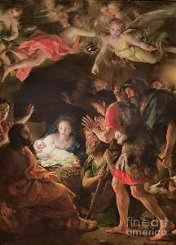
What are some spiritual takeaways from Chapter Fourteen of The Life of Mary as Seen by the Mystics? (1)
On the night of our Savior’s Birth, many parts of the world rejoiced; flowers blossomed, springs gushed forth water, and all of the land celebrated; animals were frolicking in delight, too. Announcements of the Savior’s Birth were brought by the holy angels to certain holy souls, such as St. Ann and St. Joachim while they waited in Limbo; the archangels St. Michael and Gabriel helped to carry this news onward. Such souls as Anna and St. Simeon were enlightened as to the glorious news of the Savior’s Birth. The righteous felt a sense of happiness, knowing instinctively that it meant that the long-awaited fulfillment of God’s Promise to send a Savior was taking place. The Three Kings set out on their journey to meet Jesus, following the Star. Saint Elizabeth and St. John the Baptist exulted, with St. John waving his arms delightedly. His mother expressed her joy by sending money and linens to Our Lady as a gift. The first adorers chosen to see Jesus after His holy parents were the shepherds, because of their humility and simplicity. The holy archangel St. Gabriel appeared to three shepherd leaders to tell them of Christ’s Birth, descending on a cloud of light. Then, the holy angels appeared to two other groups of shepherds, bringing them the joyful message. Before going to visit Jesus, the shepherds gathered gifts for them, bringing chickens and goats that were given to St. Joseph when they arrived by the manger at dawn. Simply looking at the Christ Child, receiving His humble gaze of love, was enough to transfigure the shepherds, who were forever transformed by beholding Him. In adoration of Christ, the shepherds sang the songs of praise that the holy angels had taught them, holding their staffs as they prayed and prostrated themselves before Christ. They cried tears of joy, remaining from dawn until noon in adoration, at which point, Our Lady fed them. She also nourished them spiritually, giving them words of encouragement in their spiritual journeys, urging them to persevere in their faith. Neighbors visited the Christ Child after the shepherds told others about His Birth; they brought gifts of eggs and honey, helped to furnish the grotto where Our Lord was cradled, making it a more comfortable dwelling place. Women assisted Our Lady with cooking and washing. Children were brought to adore the Lord, too. Our Lord was loved with the most tender affection by His parents; Our Lady reverently genuflected three times and kissed the ground before approaching Him. She asked permission from Christ to nurse Him or to kiss His Holy Face, often kissing His Sacred Feet. Saint Joseph, the holy angels, and Mother Mary composed songs of love for the Lord, singing them most affectionately, which Our Lord responded to sweetly, placing His arms around Our Lady’s neck. Our Lady rejoiced the Heart of St. Joseph by referring to Jesus as “our Son.” They worshipped Him together, with the greatest reverence and piety, though Our Lady always felt some sorrow with her joy, seeing the pure Hands and Feet of Jesus that would one day be pierced. When Our Lord saw the sorrow in His Mother’s eyes, He was sorrowful, too, feeling so much pain, that He could have expired right then, but Our Lady loved Him so much, that she totally conformed her will to His. Our Lady revealed the beauty of poverty in softening hearts to embrace Christ, in seeing the harsh conditions into which He was born

Slide 11
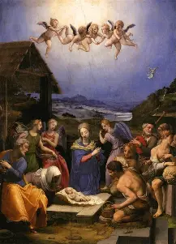
What are some spiritual takeaways from Chapter Fourteen of The Life of Mary as Seen by the Mystics? (2)
Saint John the Baptist was imitating Christ in time, waving his arms to celebrate the Birth of Christ, just like the Christ Child waving His arms to express His joy for the visit of the magi. The holy angel’s cloud that appeared before the wisemen leads us to think of the cloud hovering over the Ark of the Covenant to protect it, and the Holy Spirit hovering over Our Lady, overshadowing her, the New Ark of the Covenant. Clouds also can signify the rain to come, and here, anticipates the Birth of Jesus, the living water. The three shepherd leaders to whom the message of Christ’s Birth was revealed reflect the love of the Blessed Trinity; in total, there were three groups of shepherds who cane, as well. These shepherds arrived at the dawn of a new day, for Christ brings us the new, light-filled day. They demonstrate to us that we are always to go to Christ with something to share our love, to never be empty-handed, but to be at the ready to give, just as Our Lord gives to us. The shepherds demonstrate that we are to always emulate the holy angels, and to honor Our Lord by sublimating our will to the Father’s will, being united with Him in His humility. A staff is a sign of authority, a symbol of the shepherds, and of kings. So many of these sacred events, especially visits to Christ, happened before or at noon, and in the life of Christ, during the Passion specifically, this was the hour on which He was nailed to the Cross. We meet the souls that Christ so loved, that He would give His life for them. Our Lady fed the shepherds, because she satiates us by bringing forth Christ, the True Bread. Being human, Our Lady was not without human emotion, including sadness. She felt all very deeply within her pure Heart, and was already compassionating and praying for those who do not yet know Christ, and our reason for hope. Our Lord likewise compassionates with us; everything goes back to His Cross, the purpose for which Our Lord was born, just as our purpose is to united with Christ on this Cross, to carry it for the salvation of souls, including our own. Shepherding souls means first allowing ourselves to be shepherded, before guiding others, to evangelize through how we live out and receive Christ’s love

Slide 12
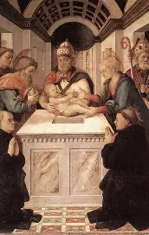
What are some spiritual takeaways from Chapter Fifteen of The Life of Mary as Seen by the Mystics? (1)
Our Lady awaited the Circumcision of Our Lord with some trepidation, anticipating with worry the pain that He would feel. She prayed to take on His suffering, and even considered leaving the grotto during the Circumcision, but she bravely chose to stay, and to hold the Christ Child on her lap while the sacred event took place. She kept a linen cloth close to her Heart to warm it, then unrolled it on her lap, so that the Christ Child would have a comfortable place on which to be seated amidst the cold. She wept when the Christ Child did over the pain, but also, for the hardened hearts of men that would lead her Son to have to break His Body for them. For days after the procedure, the Christ Child was in pain, continuing to shed tears, but never simply for His own sake; truly, He wept for the pain of men, always knowing that His mission was to save them from the pain caused by sin. Three priests came to the manger to perform the ritual on Our Lord; it was too premature yet to return to the Temple. Also in attendance were two shepherds. While the priests prayed, two candles were lit by the entrance to the grotto, where the ritual was transpiring. Our Lady bid the priests to be as gentle with the Lord as possible, while they used a flint knife to complete the procedure. After the Circumcision, St. Joseph and Our Lady gave the priests who performed the circumcision ritual a gift of candles as a remuneration for their sacred service to God. Saint Joseph and Our Lady revealed to each other that they had both heard from God that they were to name their Child Jesus; this was affirmed by the holy angels, who wrote the Child’s Name on shields presented to the holy couple, and then on a block of wood to the priests. Our Lord humbly and lovingly submitted to the Circumcision as a purification ritual uplifted to God the Father, a first offering anticipating His Bloodshed during the Passion. Our Lord was to shed His Blood as our Savior; His Name was revealed to underscore this, for His Name means “God saves.” Our Lady gave the visitors a meal, and then nursed Our Lord, lowering her veil; she cradled the Christ Child to comfort Him. When the poor came to visit the grotto, St. Joseph gave them charitable donations, but the poor persons were ungrateful, seeking more; others came to bring Our Lord gifts, which the holy couple gave to Bethlehem’s poor. Saint Elizabeth came to visit Our Lady, compassionating deeply with her. When the Lord was experiencing residual pain from the Circumcision, Our Lady and St. Joseph sang to Him

Slide 13
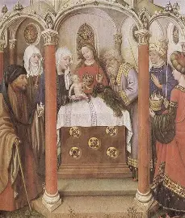
What are some spiritual takeaways from Chapter Fifteen of The Life of Mary as Seen by the Mystics? (2)
Here, we see Our Lady’s growth, for this sacred event of the circumcision would prepare her to stand by Our Lord’s Cross during the Passion. She would go from trepidation to total confidence in God, rooted in His strength. Three priests and two shepherds (five people collectively) would be present for the sacred event, representing how clergy and lay people alike are saved by Christ’s self-sacrificing love, healed by His five holy wounds, which were taken on to redeem all. The two lighted candles suggest the Presentation at the Temple that is to come, when Christ’s light will shine, hinting at His Transfiguration that flows from His love, a love reflected in the unity between His two natures, both human and divine, and between the Old and New Testaments, collectively forming one continuous movement of God’s love through time, with Christ unifying all things in shedding His Blood for the universal Church. Our Lord lights the way through sacrifice, which sheds light on the path of love that we are to take, and prefigures the baptismal candle held at Holy Baptism. Flint was used to complete the circumcision ritual, and likewise, flint is used to start the Easter bonfire during the vigil in the pre-1955 ritual. Through His Sacrifice of love, the Lord ignites deep love for Him in hearts. We strive to bring Christ the gifts of love from our hearts, that a brighter flame of love would be continually lit within us, to illuminate the way forward to Heaven with Him, as we strive to detach ourselves from sin, so as to attach ourselves to Christ, embracing new life in Him. Our Savior would choose to keep pouring out His love for us to save us in time, regularly making sacrifices so as to keep us fed. Praising God heals us, and consoles the pierced Heart of Jesus; there is always something to thank Him for, as even the challenging times uplift and strengthen us, preparing us for the next steps in our lifelong mission to save souls. Our Lord never stops pouring out His love; there is always more to give, for His love is infinite, and equips us to share. The wooden blocks and shields on which Christ’s Name was written signify that Christ protects and saves us through the wood of the Cross, shielding us from further pain and punishment by severing us from past sin, bringing us into the light of renewal and redemption when we live in His Holy Name. Our Lord was circumcised where He was born, because we are brought to new life through sacrifice, reborn into Heaven through death to the world with Christ

Slide 14
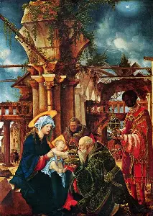
What are some spiritual takeaways from Chapter Sixteen of The Life of Mary as Seen by the Mystics? (1)
Through special insights from God, Our Lady knew that the magi would soon arrive to adore the Lord, having been aware that the holy angel announced Christ’s Birth to them, so she and St. Joseph set about preparing the grotto to welcome the Three Kings. The Star of Bethlehem, formed by the holy angels, guided the Three Kings. Shining from the center of the Star were the Madonna and Child, the Holy Cross of Christ radiating light splendidly therewith. Although the Three Kings received their revelation from the holy angel separately, their paths would converge; they would all wind up in the same place, continuing their journey to Bethlehem together. Even during the day, the Star remained visible to them. Each King knew that the other Kings had received the revelations from the holy angel that Christ was born, and as they traveled, coming to know each other, their hearts were ignited with an even greater love for Christ. They had prepared gifts, provisions, and servants for the journey, and were eagerly awaiting when they would meet Jesus. The Kings were filled with yearning to see the King, and were guided by this longing for Him, knowing that He waited for them beyond the mountains. Altogether, the journey took a month, and was participated in by two hundred people, with each King bringing at least four to five relatives with him, along with many servants. When they arrived in Jerusalem, the magi were anxious, because they had expected that they would see the people rejoicing in Christ’s Birth, but no one was aware of it. They lost sight of the Star, which was fading from view. The Kings had a difficult time sleeping, pacing and searching restlessly as they anticipated their audience with King Herod. After consulting with the priests, who insisted that if the Savior had been born, there would be knowledge of it throughout the city, King Herod decided against making any sort of announcement or decision just yet, receiving the magi to confer with them, though he still could not see the Star that he sought, having heard of miraculous events such as this. The Three Kings were untrusting of Herod, and did not accept the refreshments that he had laid out for them, even when he suggested that it was his plan to determine the location of the newborn King, so that he could adore Him. After leaving Judea, the Three Kings ate their first meal by a spring that suddenly burst forth. While the Star disappeared from view for awhile, it appeared again, and a fiery light emerged over the hill where Christ had been born. The Kings found the stable, and recognized Our Lady and Our Lord from the vision that they had received in the Star, putting on white vestments to adore Christ in a special ceremony, going on a procession to meet Him. When the Three Kings met Christ, they, like the shepherds, would have the opportunity to hold Him. They saw the holy angels surrounding Christ, and would prostrate themselves before Our Lord, even removing their sandals and turbans to enter into His Presence. When He greeted the magi, the Lord had His arms crossed over His chest in prayer; weeping with pure joy and wonder, the Three Kings consecrated themselves and all that they had to Christ, enthroning Him in their hearts. The Christ Child waved His arms happily as the Three Kings presented gifts to Him, including bars of gold; a golden censer with green incense; and a flowering myrrh plant. After spending three hours in Adoration, the Three Kings permitted their servants to go to adore Christ in groups of five.

Slide 15
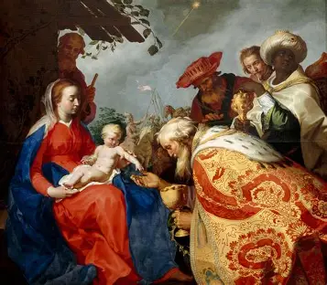
What are some spiritual takeaways from Chapter Sixteen of The Life of Mary as Seen by the Mystics? (1)
Enjoying a light meal of vegetables, honey, bread, and fruit with St. Joseph, the magi rejoiced after having prayed their evening prayers around a magnificent tree, and St. Joseph wept in awe of all of the blessings given to him, rejoicing in how his Son had been adored as He was meant to be. The magi gave to the poor after presenting their gifts to Christ, loving all those born into poverty like the Lord. Before departing to return home, the magi consulted Our Lady about matters of faith, including what their spiritual practices were to be, and she shared such gems of wisdom, that they were loath to depart from her, and offered her further gifts, such as precious jewels and a house, but she politely declined, embracing the life of poverty that God had chosen for her family. At the door, the magi requested prayers from St. Joseph and Our Lady. Our Lady gave them her yellow veil as a gift to treasure. Immediately prior to taking leave, the Three Kings recited their evening prayers, and listened to the holy angels’ message to leave right then, and to avoid crossing through Jerusalem. They obediently took heed, preparing for their leave-taking in under an hour, with a holy angel to guide them on their travels back. Our Lady revealed that everyone is called to give spiritual gifts of gold, frankincense, and myrrh to Christ, for He rejoices when we offer Him our love, which is gold; our prayers, which are like incense; and our patient acceptance of suffering, including poverty, which is a gift like myrrh

Slide 16
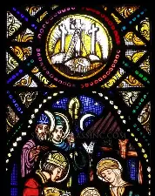
What are some spiritual takeaways from Chapter Sixteen of The Life of Mary as Seen by the Mystics? (2)
Our Lord was born in a grotto, which draws parallels to how Our Lady of Lourdes appeared in a grotto. A spring would flow forth from the ground beneath the grotto. Amidst the rockiness of life, Our Lord and Our Lady bring forth sweet refreshment to cleanse us. Our Lady and the Christ Child are our guiding stars to lead us safely home to Heaven, in eternal light, where we can adore the Lord like the Three Kings did. The Star is always visible, if we open the eyes of our souls, and our hearts, to seeing it. When souls join together to honor the Lord, to adore Him, they can serve as guiding lights to others, like guardian angels. We illuminate more of Christ’s light when we do so as one family united in His Heart. Our Lord will bless us for persevering in our journeys to Him, as we look past the mountains, not as obstacles to our journeys, but as means to the summit, to our eternal salvation, with the Most High, Jesus Christ. Like the wisemen, we will be rewarded for orienting our yearning towards Christ, and continuing to seek Him for fulfillment, because only He can nourish us in the ways that we need. When we see with eyes of faith, we can always see reason to rejoice. When we sacrifice and pray with Christ the King, we can blossom, and become golden, like Him. Five is the number of love, and the number of Our Lord’s holy wounds; when we go together to adore Christ, we can console His pierced Heart, returning love with love, being wounded with Christ for our ultimate healing; we are wounded by Christ’s love when we experience the greatest longing for Him, and patiently await the fulfillment of this yearning in Heaven. In Christ, we receive much sweetness, and are filled, that we would grow in faith, and invite others to be rooted in Him with us, spreading our roots to extend to others. The most precious treasures are in Christ’s Heart, and the greatest treasures we can give Him are our hearts of faith, hope, and love

Slide 17
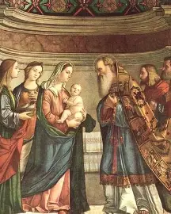
What are some spiritual takeaways from Chapter Seventeen of The Life of Mary as Seen by the Mystics? (1)
Our Lady and St. Joseph determined to share one third of the magi’s gifts with the poor; another third to the priest who had circumcised Christ; and the last third to the Temple. Our Lady called herself unworthy of the gifts. When it came time to leave the stable, the Holy Family sorrowed to go, treating the sacred place with reverence, having cleaned it meticulously, but went on their way to the Temple. Our Lord called Our Lady “my dove,” just like God the Father, and bid her to make her Heart like His. When Our Lady met poor mothers and their children, she instructed them most patiently in profound matters of faith, gently guiding them when they did not understand. Our Lady never questioned that she would undergo her own purification, because she was touched by how her Son offered Himself so totally to God the Father. Saint Joseph and Our Lady went to the grotto a final time, kissing the ground where Our Lord had been born and circumcised. Before departing, Our Lady asked St. Joseph for his blessing, but he bid her to receive it from Our Lord, and while granting her request to walk on the journey, did not permit her to go barefoot because of the weather conditions, which were wintry. Our Lady prostrated herself before the grotto, thanking God for the blessings that she had received there, praying that the sacred site would always be honored, and went on her way with St. Joseph, holding the Christ Child close to her Heart to shelter Him from the fierce winds, sleet, and cold, which made Our Lord cry. Our Lady and St. Joseph walked five miles, taking rest at the home of an elderly couple without children. Saint Joseph made a donation of the Three Kings’ gifts to the Temple, but did so anonymously out of humility. Our Lady spent the eve of the Purification in prayer, asking that after offering Christ as a living Victim at the Temple, that God’s mercy be poured on humankind. Saint Simeon, a priest, received a vision through which he learned that the first child to enter the Temple would be the Savior; he had known through the Holy Spirit’s inspiration that he would hold the Christ Child before dying, and now, learned that he would hold the Child at long last. Shortly thereafter, he would die with joy, his mission having been fulfilled. Wearing a blue robe, yellow mantle and white veil, Our Lady entered the women’s court of the Temple, kneeling with Christ in her arms. Thousands of chanting holy angels had accompanied her there. Anna was given the two turtledoves from St. Joseph as a sacrifice, while St. Simeon took the Christ Child, cradling Him near to his heart. Set up on the altar were two baskets and a receptacle comparable to a container. Lamps forming the shapes of pyramids were arranged in the hall. Our Lady placed the Christ Child in the cradle on the altar, wrapping Him in a blue veil. She then went behind a grille with other mothers and approximately twenty children. Heavenly light filled the Temple as the priests prayed over the Christ Child, and Anna gave Our Lady a basket of fruits and coins. Saint Simeon sang a canticle of praise to God the Father as he held the Christ Child again, expressing the perfect peace and fulfillment he felt; he and Anna would both pass away after waiting so long to behold the Savior. Saint Simeon gave Our Lady the prophecy prefiguring Our Lord’s Passion, saying that Our Lady’s Heart would be pierced as though by many swords, but she was at peace, even while feeling a sense of grief for the rest of her life about the scorn that would be shown to her Son, by those who did not accept Him, for she knew that she had nothing to fear, trusting in God, Who is our light and salvation; when He heard St. Simeon’s prophecy, the Christ Child bowed His head in acceptance of the Father’s plan for salvation, demonstrating how all are to respond to God’s will with resignation

Slide 18
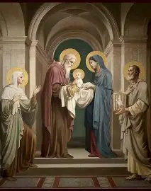
What are some spiritual takeaways from Chapter Seventeen of The Life of Mary as Seen by the Mystics? (2)
Our Lord’s purification prefigured the purification of Our Lady, and shows us that there is redemption from being purified through suffering, especially when offering it out of love together, in union with the Eternal Father, Who Himself made a sacrifice in giving us His only Son. The Holy Family teaches us to share our love in honor of the Persons of the Blessed Trinity, Who loved us first. Like the Holy Family, we can embrace every opportunity for spiritual rebirth, and can give glory to God in all of the places He calls us to in order to know Him, to grow in friendship with Him. The very places or situations that would seem to be most trying can be the ones that uplift us the most, that we come to appreciate in having led us to love God more. Our Lady and Our Lord are always offering their instruction, when our hearts are willing to receive it. We are not so much constantly departing, as coming closer to home with God. Twelve miles were walked by the Holy Family on the way to Bethlehem at one point, representing the Church, and how the Holy Family reaches out to us, bringing us together as one family, but in this chapter, they walk five miles to the Temple, five being the number of love, the virtue that leads Our Lady to humbly undergo her purification, and Our Lord to be consecrated to God the Father. We come to belong to God in a special way, to be purified by Him, through consecration, which is healing and purifying unto itself, as we are given to Him to belong more deeply to His Heart. Our Lady returns to her roots, remembering the origins of her pure Heart, developed in the womb of her mother, as she stays at the home of a childless elderly couple resembling, in a situational and spiritual sense, her own parents who were barren before the Lord sent them Our Lady. Growth, and purification, only happen through God’s love. Our Lady took on a kind of priestly role of sacrifice; she would be further purified in uniting with her Son in making a sacrifice, offering Him to God the Father, even though this would mean embracing God’s plan for Christ’s Passion and Death; Our Lady would offer up any of her own suffering to spare her Son from it. It is natural to feel anxiety about the unknown, but as Our Lady shows, we need not be consumed by it, because God always provides, and will show us the way forward to reach Him; He wills our salvation, and this life is a matter of uniting ourselves with that will, in order to truly live. Our Lady wore blue for her loyalty to God, while the yellow and white garments prefigured the liturgical vestments colors of the Easter and Christmas seasons, suggesting the joy and triumph that comes from purity lived out with Christ. We know that Christ must bring about purification for us through His Death, but also, know that we will secure eternal life through His Resurrection, which also purifies us with hope and love, as we are refreshed by the Fruit of Our Lady’s womb. When Our Lady and the other mothers were enclosed behind the grill, they prefigured nuns who would embrace solitude and simplicity in their communities, silence, hiddenness, and interiority, a sharing in the mission and gift of the Divine Prisoner, offered entirely to God, that we would be freed from sin

Slide 19
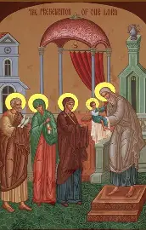
What are some spiritual takeaways from Chapter Eighteen of The Life of Mary as Seen by the Mystics? (1)
For nine days after the Purification, Our Lady and St. Joseph remained in Jerusalem. They did so to renew the offering made at the Temple, praying from noon until midnight each day. On the fifth day, God informed Our Lady that she was to depart with St. Joseph before the nine-day period had concluded, so that they could escape King Herod. God warned Our Lady of the sufferings to come, but reassured Our Lady of His constant Presence. Our Lady affirmed her accordance with His will, but still wept for the Christ Child, heartbroken over the hatred that men showed to Him. A holy angel visited St. Joseph to tell him to collect the Christ Child, and bring Him with Our Lady to Egypt to save the Christ Child from the malicious plot of King Herod. Before midnight, the Holy Family set out on their journey. Our Lady had provided St. Joseph consolation in reminding him that so long as they carried the Christ Child, they would be safe, for He is their “country,” encouraging him to do God’s will with confidence, together. As they were passing through the city gate in Jerusalem, the holy angels turned the night into day for the Holy Family, shining God’s light brightly. Although Our Lady wanted to visit the grotto where Christ had been born, she was told by a holy angel that it was not God’s will, and accepted it, fearing placing her Son in further danger. Our Lady sent her holy angel to bring a message to St. Elizabeth to hide St. John the Baptist, so they would be safe, concealing themselves in the desert. Our Lady was saddened by her Son’s suffering, and wept as they took shelter in a cave, but as she prayed, a spring miraculously let forth water, and a goat appeared on the scene to produce milk. When they crossed through the desert, the Holy Family depleted their supply of water, and thirsted, but St. John the Baptist sensed their suffering, and prayed, extending his arms in a cross-like shape. Gifts of money, food, and clothing were sent by St. Elizabeth to the Holy Family, which were shared with the poor. Our Lady healed sick and crippled women that she met. At night, the Holy Family was buffeted by winds, but St. Joseph built a tent with sticks and his cloak to protect them. Snakes slithered about the desert, and the Holy Family prayed, offering their suffering up to God the Father, in union with the holy angels who accompanied them in their prayers. During the journey, the Holy Family members supported each other with love and kindness, consoling each other; Our Lady and the Christ Child wept for humanity’s suffering and sins together, sharing in each other’s pain, which was itself a kind of consolation. Amidst a sandstorm, Our Lady prayed, and the Lord commanded His holy angels to bring them food, as they suffered from hunger, thirst, and exhaustion. Our Lady thanked Jesus for making her His Mother, and nursed Him three times each day. Saint Joseph kissed the Christ Child’s Feet, praying for His blessing. Our Lady sang in praise of God with her holy angels; she sang lullabies to the Christ Child with the birds, as she had power over nature, and counseled them to thank God for their beauty, and the food He provided for them daily on the ground. The Holy Family reached an encampment of robbers, who initially intended to do them harm, but upon seeing the Christ Child, were so touched, that they abandoned these plans. Our Lady was given water in which to bathe Christ. When one of the robbers brought forth his leprous son, the child was healed upon being bathed in the water that Christ had used. The robber chief would be the good thief delivered by Our Lord when he was crucified beside Him. Our Lady prayed fervently for them, and counseled them on the way of virtue, guiding the robbers towards salvation in her Son. At the end of the ten-day voyage into Egypt, Our Lady prayed, and a spring once again flowed forth water for them, and a date tree bent towards them that they would pick its fruits. Our Lady revealed that sometimes, God wills that we avoid persecution to further His Kingdom, and that He will always bring us help, even if it does not come immediately

Slide 20
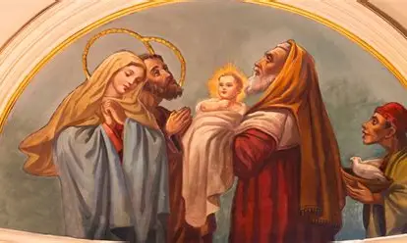
What are some spiritual takeaways from Chapter Eighteen of The Life of Mary as Seen by the Mystics? (2)
Like Our Lady and St. Joseph, we are called to keep renewing the graces that God gives us, to keep opening our hearts to continued purification and healing. There is always further opportunity for restoration. Sometimes God calls us to new aspects of His unfolding mission, uprooting us from home, from comfortable and familiar places and routines, in order to keep us rooted in Him, reminding us that our only stability, our eternal life, is in Him, in Whom we can always place our trust without fear. When God speaks into our hearts, we are to take action, that His plans would be fulfilled. We always have a home with Christ, Who is eternal, and Whose love is all-encompassing, gathering all of the people of the world into His Heart, without dividing lines. Our loyalty is to be to Him, and not to nations that are fleeting entities in this world, whereas the Kingdom of Heaven is forever. Our Lady teaches us to put God’s will before our own, to trust that His will is for our good, and that it will allow us to enjoy the fruits of Christ’s Sacrifice all the more, to grow as close to Him as possible. A mother’s Heart, so reflective of the nurturing Heart of Jesus, calls down so many blessings, so much mercy from God the Father, Who is so caring in making every provision for us; Our Lady’s prayers help us to grow and to accept God’s will, to be filled with grace that comes from perfect love like hers, a love that does not know fear, but trusts, being at peace in the Heart of Love that is God. Our prayers, through God’s grace, help each other, and through prayer, we are kept on the path to salvation; Our Lord humbly accepted prayers, receiving every gift with love. Being a sharer in Christ’s love and sacrifice, Our Lady, through the prayers of her pure Heart, so united to the Heart of Jesus, could also share in His healing work, His comforting Presence. The Holy Family, in their steadfastness, shelters us from the spiritual dangers of the world, leading us to the desert to be fruitful, to serve as oases to comfort and uplift others. The refreshing water of Christ’s love heals and repairs, cleansing us of sin, to be pure vessels of love for God the Father like Our Lady. Receiving the graces of the sacraments, namely, Holy Communion, our souls can be kept clean; the Holy Family is always engaged in cleaning their dwelling places, making even the humblest offerings the most pure and luminous, because they were offered with such love, devotion, and care. We can go to them for our cleansing to make our souls beautiful dwelling places for the Blessed Trinity, shelters and refuges from the affronts of the world, protecting other souls from storms by leading them to the calm that is Christ. Ten is the number of happiness, and across the journey to Egypt, the Holy Family shows that we find happiness when we praise God in even the most challenging circumstances, opening the eyes of our souls to see His loving Presence everywhere. When we bow humbly before God, lowering ourselves, He will reward us, stooping down low, like Christ from the Cross, to heal us and nourish us. In our suffering, the holy angels bring us joy, and help us to reflect God’s love as they do, that we would bring souls consolation in times of suffering, too

Slide 21
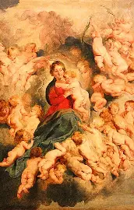
What are some spiritual takeaways from Chapter Nineteen of The Life of Mary as Seen by the Mystics? (1)
Our Lord prayed that God the Father would give the Holy Innocents the crown of martyrdom; because of King Herod’s anger at being deceived, missing the Christ Child, in a fit of rage, he decreed that all male children of two years of age or younger be slaughtered in a courtyard before their mothers, pierced. Their mothers, appalled, were screaming and tearing at their own hair. Our Lord and Our Lady united in prayer for the children’s souls. Saint John the Baptist was protected, living in a cave, and remaining there even after his mother’s passing from this life when he was four years of age. He conversed with the animals, and received infused knowledge from the Holy Spirit. The Holy Family went to live in a three-room home in Egypt that Our Lady set to cleaning immediately. She kissed the ground in thanksgiving to God for this gift of a place to live. Saint Joseph begged for food, and Our Lady took up sewing to support the family. Our Lord developed a rule of life for her that would allow for a balance of work and prayer. The Holy Family ate all meals together, and commemorated special anniversaries of sacred events in prayer, Our Lady usually undertaking nine days of prayer to remember such sacred mysteries as the Annunciation. At age one, Christ spoke to St. Joseph for the first time, calling him “father,” and revealing His mission. He had spoken to Our Lady first, some time before this, but they also conversed mystically. Our Lady sewed for Christ a seamless garment that He would wear for the rest of His life, as it would accommodate His growth as He increased in age and stature; Our Lord revealed that as an infant, He accepted being swaddled tightly, because He knew that He would be bound as a prisoner to redeem humankind from sin. He wore sandals as a child, but when His public ministry began, would go barefoot. Our Lord invited Our Lady to join Him while He prayed, urging her to learn from Him, and also helped His parents with their work, delivering needlework Our Lady completed to their neighbors, and bringing back bread; He also visited the sick and suffering with His Mother, weeping for sinners and sufferers that He saw when He went out. He also carried water for her, and helped St. Joseph by giving him the wood and tools that he needed for his carpentry projects. Our Lord helped the other children by teaching them, and ultimately instructed adults in the way of holiness through His actions, too. While praying, He would sweat Blood and weep in anticipation of His Passion, and the holy angels would surround Him with their sweet song and light

Slide 22
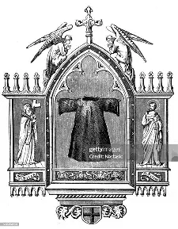
What are some spiritual takeaways from Chapter Nineteen of The Life of Mary as Seen by the Mystics? (2)
Our Lady helps to sew all things together for us, to make life seamless by helping us to conform to Christ’s image, to grow with Him in faith, hope, and love. Living in a three-room house, the members of the Holy Family were constantly reminded of the Presence of the Blessed Trinity, which they reflected, modeling to others how to embody faith, hope, and love. The Holy Family models to us how to live a life of the spirit, a liturgical life, in which we commemorate the sacred mysteries with novenas, and share meals together to honor how Christ ultimately nourishes us. We see how everything in Our Lord’s life has a beautiful purpose, having prepared Him for each new stage of salvation history, and preparing us to transition through different seasons in life with holiness and love. Our Lord has a spirit of welcome, inviting Our Lady to pray with Him; we, too, can serve as spiritual mothers not only by praying for other souls, but inviting them to pray with us, as one family united in love for God. Our Lord always nourishes and refreshes us, bringing us the tools that we need. He demonstrates that it is never too late or too early to begin serving God by serving others. Our Lord instructs the child in all of us; the more we trust in our Eternal Father, the more we can come to reflect the Christ Child in true spiritual wisdom, a wisdom of the heart that is filled with wonder and love for God

Slide 23
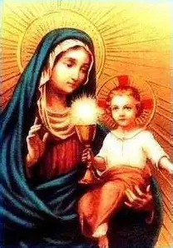
Reflection Question 1:
Throughout these chapters, we see how Eucharistic piety is developed through the example of Our Lady, and her response to the Christ Child. How does Our Lady exemplify to us how we are to reverence Our Lord? Specifically, how does she teach us how we should express and grow in our devotion to the Holy Eucharist? Which spiritual practices does Our Lady undertake, and how might we emulate her in fulfilling them? Why is Eucharistic piety so essential to our spiritual growth? How did we see it formed in others throughout these chapters, as they encountered the Christ Child, and how did this allow them to fulfill their missions?

Slide 24
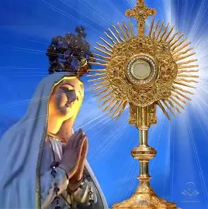
How does Our Lady exemplify to us how we are to reverence Our Lord? Specifically, how does she teach us how we should express and grow in our devotion to the Holy Eucharist? Which spiritual practices does Our Lady undertake, and how might we emulate her in fulfilling them? Why is Eucharistic piety so essential to our spiritual growth? How did we see it formed in others throughout these chapters, as they encountered the Christ Child, and how did this allow them to fulfill their missions?
Our Lady genuflects before Christ just as we do when passing by the tabernacle. While visiting the sacred site of the grotto, Our Lady knelt and prayed in the areas where Christ had been born and circumcised; she would kiss the ground where Christ had walked, the ground that God had blessed, with total reverence. She responded to these holy places like someone would if they were in an area of a church where a Sacred Host had fallen, adoring Christ there. Our Lady kissed the Feet and Face of Jesus, for when we receive the Holy Eucharist, we receive the kiss of Jesus. She rested by the manger, like someone keeping vigil with Our Lord in the Blessed Sacrament by the tabernacle. Holy things are veiled, and the Holy Eucharist is so sacred, that a veil is placed over the tabernacle, ciborium, and the monstrance on various occasions. Our Lady placed a cloth over Our Lord after He was born; she would wrap Him in linens, so that they served as the first corporals. She acknowledged the holiness of Christ as the True Bread from the very beginning. When others encountered Christ, like the Three Kings or the shepherds, they would prostrate themselves before Christ, weep, and present Him with gifts. Likewise, we can place ourselves spiritually before the tabernacle, offering Christ all that we have within on the altars of our hearts, that He would transfigure us with His divine light of love, praising Him for giving us the greatest Gift of His life. They would go on to evangelize, to share the good news of Christ’s life-giving gift, and to invite others to know Christ, so as to be healed and saved by His love. Whenever others held the Christ Child, they received His light, coming to reflect it; simply seeing His love would touch hearts, transforming them so that they were inspired to love like Our Lord. Eucharistic piety rightly orders us, helping us to embrace the natural order of things, of going to the Feet of our Savior with wonder, where we are meant to be in order to grow in love, rooted in piety that guides us to reach His Heart. Our Lady teaches us Eucharistic piety through her humility; she is the Mother of God, but never exalts herself, recognizing that her identity is rooted in the Father, as His spiritual daughter. We grow in our devotion to the Holy Eucharist and express it through humility, because a Eucharistic love is one of generous self-sacrifice; Our Lord gave His life to us, coming down from Heaven as a Child, submitting to every pain and indignity during the Passion, then coming to remain with us in the altar bread out of pure love. He teaches us to pour out our love as servants, that others would be fed by His loving Presence that shines from us, and welcomes souls into friendship with Him, just as Our Lord shines through the Holy Eucharist. Our mission starts and ends at the tabernacle, because love starts and ends there, with Christ, the Alpha and the Omega, God, Who is love

Slide 25
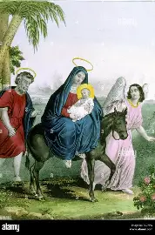
Reflection Question 2:
Across these chapters, the presence of the holy angels was a constant. What do the holy angels teach us about how we are to adore the Lord; what did they do in response to Jesus and His holy parents? How did Our Lady and St. Joseph unite with the holy angels in adoring Christ? How did they, and others, reflect the holy angels in how they honored Christ? What would it mean for us to be like the holy angels in practicing our devotions to the Lord, and fulfilling our missions from God? How do we share in the angelic mission?

Slide 26
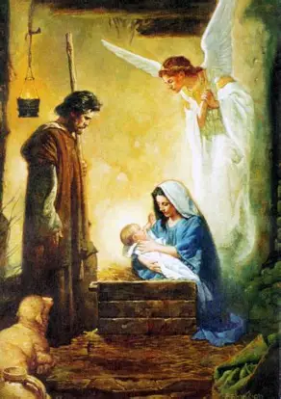
What do the holy angels teach us about how we are to adore the Lord; what did they do in response to Jesus and His holy parents? How did Our Lady and St. Joseph unite with the holy angels in adoring Christ? How did they, and others, reflect the holy angels in how they honored Christ? What would it mean for us to be like the holy angels in practicing our devotions to the Lord, and fulfilling our missions from God? How do we share in the angelic mission?
The holy angels are obedient to God the Father, remaining faithful to Him in completing the missions that He calls them to do, bringing the messages that He gives them to deliver. No matter what the mission may be, they always shine His light. Throughout it all, they sing in praise of God. They fall down on their faces, bowing their heads, kneeling in reverent awe, before God. Providing friendship and clarity, sweet consolation and encouragement that strengthens our souls, the holy angels are our companions on the road to Heaven. The holy angels always surround what is pure, and accompanied the pure Hearts of Jesus and Mother Mary on their journeys, serving as guides; they show us God’s light in all things, bringing us happiness, so that we need never experience the darkness of life without Christ. Our Lady and St. Joseph adored Christ with the holy angels, praised God in song with them, and were faithful to their God-given vocations, fulfilling God’s will. They reflected the light of God with their love and mercy, never becoming embittered by their suffering, but offering all to God, praising Him at all times. Going to God the Father for everything, they trusted Him as their Provider, just as the holy angels did not question God’s plan for salvation, but affirmed their willingness to serve Him, to remain by Him out of love. For us, sharing in the angelic mission means evangelizing, bringing the message of God’s love everywhere, and embodying it by radiating His light to shine for all time. It means having the purity of heart that the holy angels adore, to have a pure love for God like they do, that all we do would be part of our mission for God, always circling back to the Presence of Christ that inspires our action to make Christ, our Friend, known to others

Slide 27
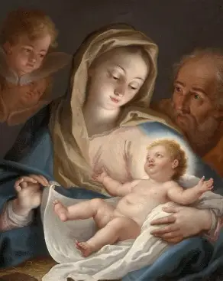
Reflection Question 3:
A prevailing theme in this range of chapters is one of the spiritual beauty of poverty, and the importance of accepting it, especially as we read about the harsh conditions that the Holy Family experienced through their many journeys in these chapters. Why do you think that poverty is one of the evangelical counsels, one of the frameworks for our spiritual state of life? How does it help us in our spiritual development, as the example of the Holy Family demonstrates? What does it mean for us to be like “Mother Most Poor”? How does God enrich us, and how can we, as a family in Christ, the Church, guide souls towards fulfillment in the treasury of Christ’s Heart?

Slide 28
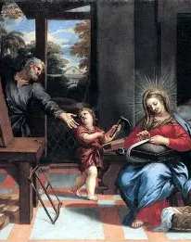
Why do you think that poverty is one of the evangelical counsels, one of the frameworks for our spiritual state of life? How does it help us in our spiritual development, as the example of the Holy Family demonstrates? What does it mean for us to be like “Mother Most Poor”? How does God enrich us, and how can we, as a family in Christ, the Church, guide souls towards fulfillment in the treasury of Christ’s Heart?
There is freedom in poverty, in not being too attached to the things of the world. In poverty, living without the distraction of material goods, we can focus on God. The simplicity of a life of poverty means that one can grow in the deepest wisdom, focusing on drawing from the reserves of inner knowledge of God, of the experience of being united mystically with Him. Poverty eradicates our pride, helping us to rely upon God, to appreciate His Providence, and see what a gift, not a given, everything is. For the Holy Family, poverty meant a closer association with God’s suffering people. They could deeply compassionate with people in need, and gave whatever they had to them. Traveling with little to sustain them on their journey, they developed deeper bonds with such friends as St. Elizabeth and the holy angels, who helped to nourish them in their times of need; the deepening of humility could allow for a strengthening of love. Being like “Mother Most Poor” means embracing poverty for the sake of the Kingdom, not searching for more of what the world can offer, but realizing our need for God, and seeking Him out for fulfillment. God enriches us with His undying love, giving us new opportunities to receive and share it. As a family in Christ, we can guide others towards fulfillment in the treasury of Christ’s Heart by modeling His joy, choosing to praise God and to be happy with what we have, which draws others to want to know God, who gives us all of our joy, regardless of what our economic status may be. We can do charitable works like the Holy Family, treasuring Christ in our hearts, and storing up treasures in Heaven, looking forward to meeting Him there

Slide 29
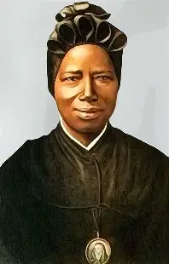
How does the holy life of St. Josephine Bakhita deepen our understanding of the sacred mysteries experienced by the Holy Family?
Born in Sudan, Saint Josephine Bakhita, whose feast day we celebrate on February 8, was kidnapped and sold into slavery as a child, but would not despair over her life of poverty and abuse, instead blessing her captors, because through them, she would come to find Our Lord, Jesus Christ, and become His bride. Saint Josephine is united with the members of the Holy Family in rejoicing in every opportunity to be close to God, to be humbled in this life so as to be uplifted in the next. Her glory was in serving God, opening the doors to Heaven for others, in leading them through the doors of Christ’s Heart, exemplifying His love and mercy in all times. She demonstrates that in poverty, we come to be filled with the deepest wisdom, and to receive of the richest treasures that God wishes to give us, which can never be taken away, just as no one could take St. Josephine’s dignity, her faith, hope, and love; she would be inspired to know God in seeing the beautiful heavens that He made, and would follow the Star to Him; in her poverty, she had treasured these eternal gifts that inspired her with reverence for the Creator of all things, knowing that God made her for a definitive purpose, to inherit the Kingdom of Heaven, and be with the Creator of the stars forever. Like St. Joseph, she could look forward to the beauty of the home to come, where there would be room in Christ’s Heart for everyone

Slide 30
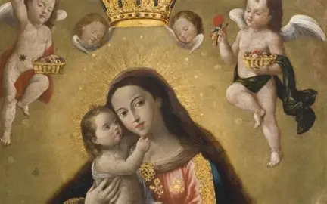
Announcements
Next Seven Sisters Apostolate book club meeting (4):
  Tuesday, February 24, 2026
    3:30 p.m., parish library
      Readings: chapters 20-28, pages 149-199
Seven Sisters Apostolate special book club session:
  Monday, February 9, 2026
    6:00 p.m., parish hall
      Book club discussion focal point: Christmas Blossoms book

Slide 31
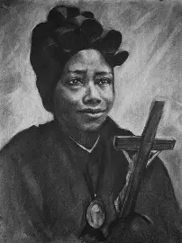
Closing Prayer: Prayer in Honor of St. Josephine Bakhita
Loving God, rewarder of the humble, You blessed St. Josephine Bakhita with charity and patience. May her prayers help us, and her example inspire us to carry our cross and to love You always. Pour upon us the spirit of wisdom and love with which You filled St. Josephine Bakhita. By serving You as she did, may we please You by our faith and our actions. Grant this through our Lord Jesus Christ, Your Son, Who lives and reigns with You and the Holy Spirit, one God, for ever and ever. Amen.

