Slide 1
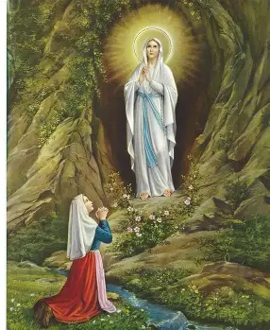
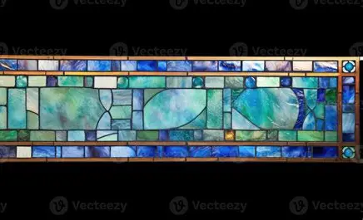
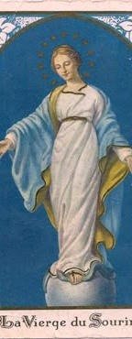

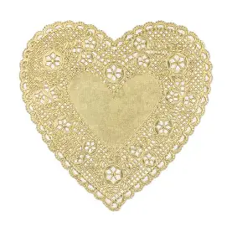
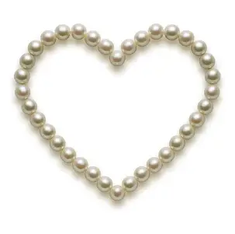
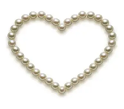


Loving the Lord with Our Lady of Lourdes: Reflecting the Immaculate Heart of the Immaculate Conception like Our Lady of Lourdes’ Saintly Friends
Tuesday, February 10, 2026
Katie Sadakierski

Slide 2

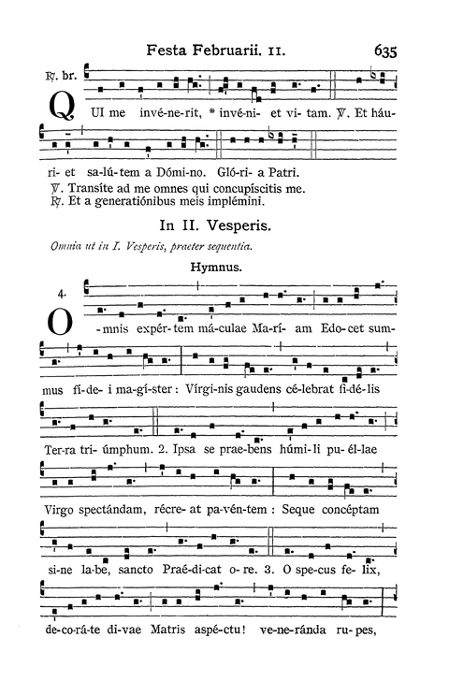
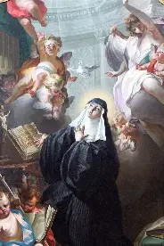

Opening Prayer: Collect Prayer for the Feast of St. Scholastica
As we celebrate anew the Memorial of the Virgin Saint Scholastica, we pray, O Lord, that, following her example, we may serve You with pure love and happily receive what comes from loving You. Through our Lord Jesus Christ, Your Son, who lives and reigns with You in the unity of the Holy Spirit, God, for ever and ever. Amen.

Slide 3
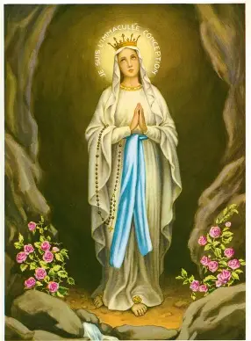
Who is Our Lady of Lourdes? What was, and is, the significance of her apparition?
Our Lady appeared 18 times in Lourdes, France, in the year 1858, beginning on February 11, and ending on July 16. This was 28 years after Our Lady appeared to St. Catherine Laboure (in Paris, France in 1830) to request that the Miraculous Medal, an image of the Immaculate Conception, be made and distributed. Our Lady of Lourdes would identify herself as the “Immaculate Conception,” the last words that she ever spoke to St. Bernadette, because under this title, there would be no mistaking who she is, and it is what we are called to remember about her, because when we know that Our Lady’s Heart is Immaculate, we can trust that she will love us purely, and that we need not fear to approach her. Our Lady of Lourdes is a special patroness for healing, because when she appeared, she asked St. Bernadette, the seer of the vision, to build a shrine at the site of her apparition, under which a spring would flow. When the earth was dug up under the grotto where Our Lady had appeared, a spring did indeed bubble forth, even though the ground was otherwise so rocky, and not conducive to such life. Now, many visitors to the Shrine of Our Lady of Lourdes have reported healing miracles from having bathed in the spring, so Our Lady of Lourdes is a special patroness for the sick, so February 11 is World Day of the Sick (designated so by Pope St. John Paul II in 1992), a day of prayer for all those in need of healing. She guides us to the healing we need in her Son, the living water; she shows us the remedies for our inner wounds, calling us to come near to her for access to the cure that is her Son’s love. When she first spoke to St. Bernadette, Our Lady told her that what she was going to say to her need not be written down; she addressed St. Bernadette in a personal way, acknowledging her presence with respect and dignity, establishing that their conversation would be as a mother to a daughter, heart-to-heart, for deep inner healing. Saint Bernadette’s response to Our Lady demonstrates how we can be touched by Our Lady’s grace, too. When they met, Our Lady spoke in St. Bernadette’s Spanish dialect, for St. Bernadette could not speak French fluently, living in a half Spanish, half French part of the country of France, and being of Spanish descent herself. Our Lady can always speak our language, and be understood by each of her spiritual children, helping us all to grow. Saint Bernadette would be filled with peace, strength, and courage from Our Lady, who would help her to withstand the trial of not being believed by those around her, who questioned her testimonies, sometimes even working to sabotage her, especially out of doubt about the Immaculate Conception, which was a new dogma at the time. Our Lady had invited St. Bernadette into her Heart, and would keep her there; St. Bernadette trusted in her and loved her. She listened to Our Lady’s message to pray for sinners, and therefore, for the salvation of all souls. When she dealt with the challenges of fame, she prayed for all those who sent her letters, humbly requesting their prayers, too, and would overcome the struggle to fulfill her vocation, as she longed to enter the convent, but was continually rejected due to poor health, fame, poverty, and lack of an education. Even so, St. Bernadette was wise and calm, a prudent soul like Our Lady who, as a sick person, would come to heal others; she received the sacrament of last rites and was anointed four times in a few years, but recovered, being promoted to new roles each time, even being given duties in the hospital. Our Lady looked to Heaven and clasped her hands in prayer when she introduced herself as the Immaculate Conception, going to show that we become immaculate when we focus on eternity with God, and persist in prayer, not giving up on God’s answers to our prayers. We are healed when we spiritually participate in Christ’s sacred mysteries, His saving work, with Him, for in this way, we share in His love, just as St. Bernadette, during Our Lady’s apparition, would portray the scenes of stages in salvation history, praying a kind of living rosary, as she crawled to the back of the grotto to embody Christ’s Incarnation; ate bitter roots and drank the dirty water of the grotto to share in Christ’s Agony in the Garden; and smeared mud on her face to recall Christ’s Passion, as He took on our sins for us. Being with Christ in these mysteries, consoling His Heart, is the key to healing, and Our Lady teaches us how to do this; she would teach St. Bernadette how to make the Sign of the Cross, how to pray with true reverence and love for God

Slide 4
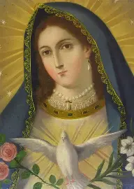
Who is Our Lady of the Doves? What does this title and feast day reveal to us about the Immaculate Conception?
Our Lady of the Doves is the title used to honor a touring pilgrim Virgin statue that was attended by three snow-white doves on a procession in Bologna, Italy. We celebrate the feast day of Our Lady of Doves on February 10, the eve of the Feast of Our Lady of Lourdes. During the procession, the doves, which appeared seemingly out of nowhere, settled by the feet of Our Lady, remaining close to her. When the procession reached the cathedral where Holy Mass would be celebrated, the doves flew inside, soaring to the high altar during the consecration, and perching on the high crucifix. They would take their leave when the faithful were dismissed from the Holy Mass with the celebrant’s words “Ite, missa est,” meaning “Go, the Mass is ended.” Our Lady was lovingly referred to by God as “my dove,” in honor of her purity. Our Lady of Doves underscores the power over nature that Our Lady has because of her purity; all of the creatures of God respect Our Lady as the greatest creation of His. As the created Immaculate Conception, Our Lady is so pure, so filled with the Holy Spirit, the uncreated Immaculate Conception Who is the dove making her holiness take flight, that she is honored universally, inspiring and guiding us all on our processions through this life. A dove, a sign of peace, is drawn to Our Lady, because she soars with heavenly grace, transcending this life, in being without sin; she has true peace, because there is nothing within her, no blemish whatsoever, to separate her from God. She is like a turtledove, a pure sacrificial offering made to please the Lord, as she offers herself in unity with Christ, for our healing and redemption, that we, too, would soar to the heavenly altars

Slide 5
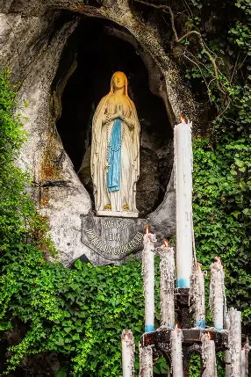
What is the Shrine of Our Lady of Lourdes?
Nearly five million pilgrims visit the Shrine of Our Lady of Lourdes each year, though the town of Lourdes itself remains small, with just 15,000 inhabitants. In 1866, the first Holy Mass was celebrated there. On the Feast of Our Lady’s Assumption, August 15, 1871, the Church of the Immaculate Conception at the Lourdes shrine was blessed. The first national pilgrimage to Lourdes took place in 1872, and in 1876, the image of Our Lady there was crowned. A nightly Holy Rosary procession takes place at the shrine, reminding us that we all are called to journey to Heaven with Our Lady together. During the thirteenth apparition of Our Lady of Lourdes, she had requested that priests and faithful go on procession to meet her at the grotto, in a spiritual sense; she was requesting that people spiritually accompany each other, supporting each other in growing nearer to the Two Hearts. At least 72 miracles have been approved at the Shrine of Our Lady of Lourdes, but it is estimated that as many as 7,000 healings have occurred there. A medical bureau at Lourdes was formed in the late 1800s to authenticate reports of healings as miracles, which must have no natural scientific explanation. When visitors go to the shrine, they may bathe in the miraculous springs, and light devotional candles at the grotto, which are kept burning, honoring Christ’s eternal love, and the blessed candle that St. Bernadette brought, not being burned on. We can spiritually go on a pilgrimage to Lourdes, bringing the Lord, through Our Lady, the petitions of our hearts like candles held in our hands on a procession of love, praying that Christ would heal all wounds within ourselves, and all of God’s children throughout the world. Immersing ourselves in prayer, we can spiritually descend into the healing waters of the springs, allowing ourselves to be enveloped in Christ’s Heart, the refuge where the Precious Blood and living water refresh us with peace and hope, as though we were suspended in the water of Our Lady’s womb, poised to grow like Christ, into flowers of virtue

Slide 6
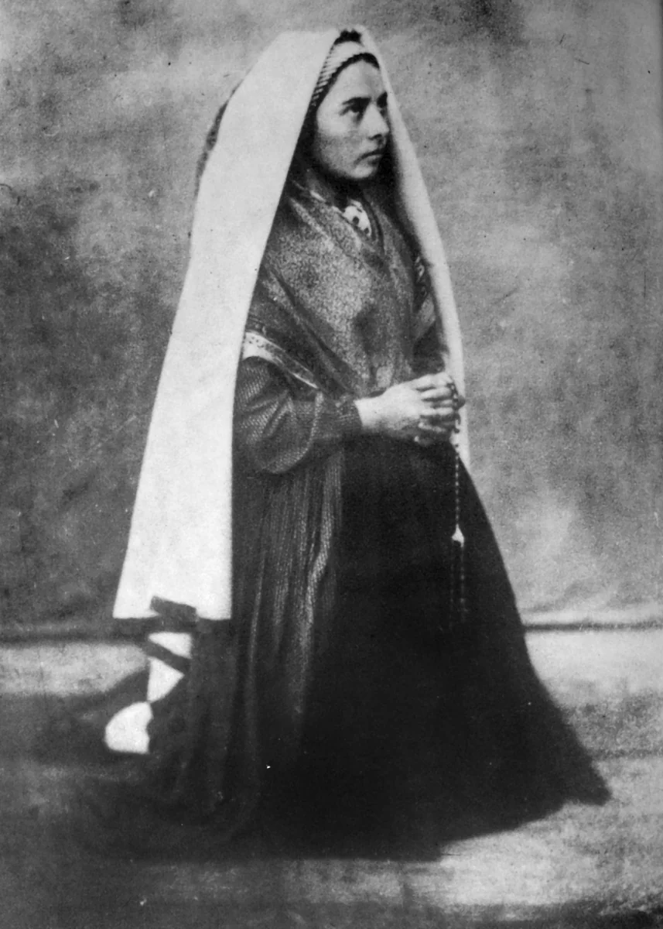
What is the connection between Our Lady of Lourdes and St. Therese?
When St. Therese’s mother, St. Zelie Martin, had breast cancer, she went to the Shrine of Our Lady of Lourdes in June of 1877, seeking a cure, but would twist her neck after a fall, which only exacerbated things, leaving her with a pain that would not dissipate, even after being immersed in the baths at Lourdes four times. Saint Zelie would respond with faith, believing in the promise of the Resurrection, referencing when Our Lady told St. Bernadette that we are not promised happiness in this life, but in the next; St. Zelie treasured Our Lord and Our Lady most, and so, serenely accepted her situation, standing by her Cross like Our Lady, peacefully looking forward to the life to come, having been healed of anxiety, as she was essentially baptized into the next life. In 1865, she first began to experience breast pain, just seven years after Our Lady appeared in Lourdes; she would pass away from breast cancer in August 1877, nineteen years after Our Lady of Lourdes’ apparition, and just a few weeks after her visit to the shrine. It was also the nineteenth wedding anniversary of St. Zelie and St. Louis, for they were married on July 13, 1858; three days before Our Lady of Lourdes appeared to St. Bernadette for the last time, on the Feast of Our Lady of Mount Carmel, the patroness of St. Therese’s Carmelite order. Their marriage, in producing such holy children as St. Therese from their hearts united in love for God and each other, would be a source of healing in the world. She had been praying for healing, so that she could continue to care for her family, but after visiting the healing springs of the shrine, St. Zelie found that she was not cured of her physical affliction. However, St. Zelie was most certainly healed spiritually, entrusted into the hands of Our Lady, after having consecrated all of her own children to Our Lady, and nurtured them so lovingly, as a reflection of the Blessed Mother. From this experience, the Martin children would learn about resiliency, about having faith in the work that God is doing to prosper and sustain us, even when we may not receive the answers to prayers that we had hoped for. When St. Therese was growing up, her family had a statue of Our Lady of Victory that was based on an image of the Immaculate Conception used for the Miraculous Medal (and based on a statue destroyed during the French Revolution, going to show that God’s love can never die); Our Lady of Lourdes would introduce herself as the Immaculate Conception. The children in her family would kiss the hands of the statue with such devotion, that multiple replacements of the hands were needed, and spare sets were kept around the house. They also decorated the statue with flowers, representing how we can be like Our Lady in coaxing growth through patient, steady love and kindness, taking the time to care for all of God’s creations, and to promote our own spiritual growth through spending time with Our Lady. As a family, they all would pray together before the statue. Once she became very ill as a ten-year-old child, St. Therese looked to this image of Our Lady, which waited beside her bed, and, after offering fervent petitions to Our Lady for healing, with great faith, hope, and love in her heart, she was healed, being renewed and restored from within by the smile of Our Lady. After experiencing the vision, St. Therese began to cry when she could no longer see Our Lady. We can bring healing to souls by always showing them the image of Our Lady by reflecting her in our love and kindness, so that she need never leave others, but something of her presence would always be felt. Saint Zelie had received, as an answer to her prayer to discern how to support herself before she had children, the insight from Our Lady that she should become a lacemaker on the Feast of the Immaculate Conception. Our Lady of the Smile would reveal St. Therese’s vocation to her, too, showing her that she was called to love, to bring a heart pf pure love to the world

Slide 7
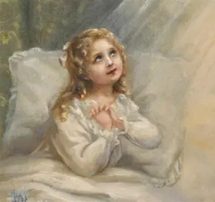
What is the connection between Our Lady of Lourdes and St. Therese?
Her sisters and father had been gathered around her, united in prayer, and most certainly, St. Zelie would have been spiritually joining them in prayer, too; the healing love of a family would wash over St. Therese like so many little waves of spring water. When she was most severely ill, St. Therese could not so much as open her eyes, but internally, was filled with the most grotesque visions, beholding cliffs around her bed, but Our Lady would lift her up to ascend these mountains, and bring her closer to Jesus; the dangerous cliffs would become like the rocks of the grotto of Lourdes, smoothed by spring water under God’s hands that soften our hearts to fill the mold of His tender, merciful Heart. Saint Therese would be used by God as a channel of mercy and grace, too; this experience would prepare her to fulfill that mission. Saint Therese, while not demonically possessed, was being spiritually attacked after dealing with the trauma of being separated from her sister, Pauline, a surrogate mother for her, after Pauline went to the Carmel to respond to her vocation to be a Carmelite bride of Christ. Our Lady’s love, her smile, a reflection of the light that radiates from Christ’s Heart, is enough to make demons flee, because it is so good, so pure and holy, flowing from a maternal, Immaculate Heart that reaches out to uplift and heal all of her children, even to the point that Our Lady underwent the Passion spiritually with Christ, being interiorly wounded with Him for our sake. The more immaculate we become, like Our Lady, being cleansed of sin and opened to God’s grace, the more that we are healed. Victory over sin, death, and darkness comes from purity, for in purity, we are united with Christ and Our Lady. When St. Therese had lost her sister and her mother, she turned to Our Lady, trusting in her as our ultimate spiritual Mother, and was healed by this childlike trust, this pure love that would lead her deeper into Christ’s Heart, as she expressed something of what He would have felt for His Mother

Slide 8
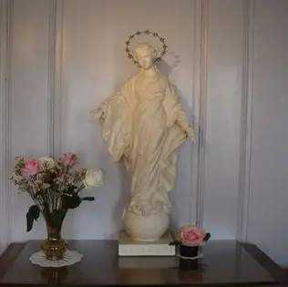
How did Our Lady of Lourdes shape the spirituality of St. Therese? (1)
Our Lady of Lourdes is a healing and motherly presence. She prays in union with us, expressing her care not only through exterior actions, but through interior dialogue with our souls, for her Spouse is the Holy Spirit, and when we are close to Our Lady, we open ourselves to the movement of the Holy Spirit within us, the inspiration of the Holy Ghost, becoming more like Our Lady, who said “yes” to the Holy Spirit filling her with Christ’s Presence, that she could bring His light outward, to shine on all people. Our Lady prayed the Holy Rosary with St. Bernadette, but only the “Glory Be,” because Our Lady gives glory to God the Father, God the Son, and God the Holy Spirit, but would give any glory to herself by saying the “Hail Mary,” or, by saying the “Our Father,” acknowledge herself as a sinner, someone in need of forgiveness for trespasses, when she is the Immaculate Conception, totally without sin. Saint Therese, too, prayed with and for others. She was present as a spiritual mother to bring consolation to all in need, a friend healing souls with the smile of kindness, of thoughtfulness and generosity of spirit. Saint Therese would befriend religious sisters in her community who had challenging personalities or behaviors, and who otherwise did not have any close companions. Exhibiting patience and compassion when she was doubted or accused, she was like the Lamb in opening not her mouth, but trusting that God knew her heart. She wrote letters of spiritual direction to priests who were struggling with their vocations, and were in need of encouragement. Saint Therese held everyone in her heart in prayer, praying for conversion with all of her strength, never seeing a soul as hopeless, or beyond reach. Dedicated to the Holy Trinity in a profound way, St. Therese made the Act of Oblation to Merciful Love, giving herself to the Blessed Trinity for God’s purposes, placing herself fully at the three Divine Persons’ disposal. While not free of sin completely like the Immaculate Conception, St. Therese could love with a pure heart, because she had not committed any mortal sins, as her confessor affirmed

Slide 9
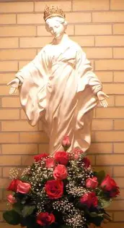
How did Our Lady of Lourdes shape the spirituality of St. Therese? (2)
Our Lady of Lourdes shaped both the spiritualities of St. Therese and St. Bernadette, the visionary whose life experiences were not far-removed from those of both St. Zelie and St. Therese (in fact, after being beatified, St. Bernadette’s body was exhumed in 1925 to retrieve her relics, and found to be incorruptible, truly immaculate, just a month before St. Therese was canonized). A childlike soul, St. Bernadette had dealt with serious health conditions, namely, those affecting the lungs, throughout her childhood, which had prevented her from pursuing formal education with any regularity; Saint Bernadette had failed her catechism, and lived in a town where 80% of the inhabitants were illiterate. She was an earnest, trusting soul who industriously and obediently went about the works that God called her to. When she saw Our Lady, St. Bernadette was concerned initially that the apparition may be a deception of Satan. To check, she sprinkled holy water at the apparition, knowing that if it were a demon, it would flee; when Our Lady simply smiled, it was clear that the apparition was authentic. Both St. Therese and St. Bernadette received the gift of Our Lady’s smile, because they were souls of such innocence and simplicity, qualities that Our Lady loves, because they are reminiscent of the Christ Child, her beloved Son; Saint Therese, too, had not received advanced schooling, beyond intermediate/early secondary education, but had true wisdom of the soul, in being so open to being filled with Christ, the Incarnate Wisdom, the embodiment of God’s genius, which flows from perfect love. Both Saint Therese, St. Zelie, and St. Bernadette would deal with serious illness, but offer it to the Lord, and experience spiritual healings, even while the physical conditions were not resolved, not because they had not merited healing, but because God had a bigger plan for them, and would use their suffering to bring about greater grace for other souls, rewarding them richly in Heaven for being united with Him spiritually in His Passion. It was when St. Bernadette, her sister, Toinette, and their friend, Jeanne, were out gathering firewood by the cold river that Our Lady appeared, a reminder that grace comes from the wood of the Cross, as it is there that we experience most closely the warmth of Christ’s Heart beating near our hearts. Saint Bernadette, knowing that she was in fragile health, had initially decided against going into the river where her sister and friend were wading, but was about to enter when Our Lady appeared, and St. Bernadette heard a sound like a storm. Our Lady was protecting St. Bernadette from going into the river, but also, was responding to St. Bernadette’s leap of faith, because faith is what is needed to see God, and to be healed by Him. Opening her heart to the warmth of the Sacred Heart would transform St. Bernadette; although she had not been raised with wealth and prosperity, she would come to have a regal dignity that came from closeness to the Queen of Heaven. During her first seven visits with Our Lady, her face would be radiating light. When she held a blessed candle, cupping her hand over its flame to protect it from the wind, her hand was not burned; when she was in ecstasy, visiting with Our Lady, she could not be wounded, only taking in the holy light of Our Lady; it was full-circle, a mark of St. Bernadette’s spiritual rebirth, for when she was but an infant, her mother had burned herself on a candle, injuring her breast so much, that she could not feed St. Bernadette, so she would be nourished by a wet nurse. The milk of Our Lady’s kindness would come to strengthen her; nothing would burn her, even when others did not believe her, and were cruel, even amidst her suffering with sickness. When we have Christ’s blessing, doing all in union with Him, we can be protected from harm., the light shining within being kept intact. Strong and humble, St. Bernadette stood her ground, and was truly like Our Lady, choosing a hidden life away from the spotlight after fulfilling Our Lady’s requests

Slide 10
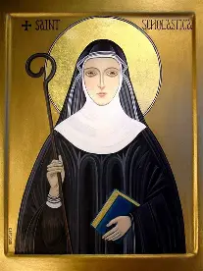
How does St. Scholastica reflect Our Lady of Lourdes?
Born in 480 A.D. in Italy, Saint Scholastica, the twin sister of St. Benedict (the father of Western monasticism who composed the Rule of St. Benedict), was a virgin consecrated to God as a religious sister, who would form Benedictine communities for women. She reflected the purity of heart of Our Lady, her faithful love. So overjoyed was she by the opportunity to visit with her twin brother, whom she did not see often, since the two were bound to their own monastic communities, that when it came time for them to part, she begged St. Benedict to stay longer to continue their rich conversation, but when he would not relent, she prayed with all of her might for God to intervene. By a miracle, a storm struck with a vengeance, preventing St. Benedict from leaving, and necessitating that he extend his stay. When St. Scholastica would pass away not long thereafter, he would better understand God’s wisdom and Providence, which shone through St. Scholastica. Saint Scholastica’s soul would ascend like a dove up to Heaven, as St. Benedict saw, for St. Scholastica had always been open to the Holy Spirit’s Presence, and in being transfigured by Him from within, would be a pure vessel. The more we allow ourselves to be led by the Holy Spirit, the purer we can become, for His inspirations are holy ones that lead us closer to Christ, the Divine Physician. In this way, we become more like Our Lady of Lourdes, the Immaculate Conception. Saint Scholastica is a patroness of nuns, schools, tests, and reading. She is also invoked against storms. She reminds us that when we are close to Our Lady, the Model of Catechists, and read her soul of holiness, we can pass tests of faith, thriving in the school of Christ’s Heart, and sailing smoothly through storms with His help. Saint Benedict admired his sister for having been his spiritual friend, a person who accomplished and helped much, because she loved much. The story of St. Benedict and St. Scholastica reflects the story of St. Therese and Our Lady of the Smile, as well as that of St. Bernadette and Our Lady of Lourdes, because these stories of friendships in Christ teach us something of the friendship of Jesus and Mother Mary that we are called to share in for our healing, strengthening, and overall growth

Slide 11
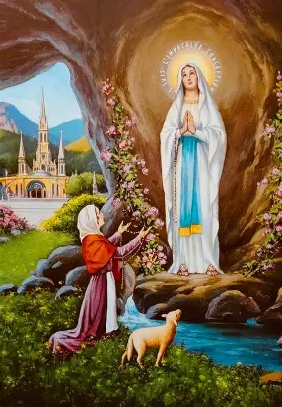
Reflecting on the spiritual themes of her feast day, what may we do to honor Our Lady of Lourdes, emulating her spirit?
When Our Lady of Lourdes appeared, she wore a white dress with a blue girdle; there were yellow roses on her feet (the color of friendship); and she held a set of rosary beads, a spiritual crown of roses. She demonstrates to us that when we have pure hearts that see God, we can accomplish much for Him, because we see things as they really are, and can draw forth beauty, truth, and goodness to reflect that of God. We can blossom in holiness when our hearts are pure and open to it. To show honor to Our Lady of Lourdes, we can be like St. Therese, the Little Flower, in looking to Our Lady and petitioning her with total confidence that she will bring our petitions to Christ, the True Flower. Emulating the spirit of Our Lady of Lourdes would mean having a spirit of pure love, which comes from treasuring the things of God in our hearts, all that He makes and does out of pure love. This means that we contemplate Christ, the Lamb of God, and serve as His lamblike followers by receiving instruction with faith, as St. Bernadette did from Our Lady of Lourdes. Keeping our souls like grottos in which Christ may dwell, we invite the Lord to clear away the rocky soil that prevents us from growing spiritually, so that flowers of faith, hope, and love may blossom therein. When something is consecrated to God, it is made glorious; it is prepared for the next life. The Lourdes grotto had originally been a haven for pigs, but would become an oasis of godly love and spiritual renewal, a sacred site, like the cave where Our Lord was born. We reach out to Our Lady of Lourdes, inwardly holding a candle like she did outwardly, that we may see Our Lady’s purity all the better, and emulate her in reflecting Christ’s light without ever seeking to obscure it in fear. Christ, the Lamb of God, held out His hands to be bound; the Divine Prisoner went as a Lamb to win our salvation for us, to triumph over the prison that is sin and darkness, in order to draw us into the light of eternal life. We put out our hands to pray and praise, and to receive Christ, that He would lead us home safely. Similar to Our Lady, the enclosed garden, we can be spiritually inviolate, not allowing any darkness of the world to flow into our hearts, not being disturbed, but remaining serene and hopeful, keeping Christ’s light shining safely within us, the flame of love preserved, to keep lighting the way forward. The grottoes of our hearts can be enclosed gardens in which Christ’s love may thrive within us, so that we can nurture others in cultivating the gardens of their hearts

Slide 12
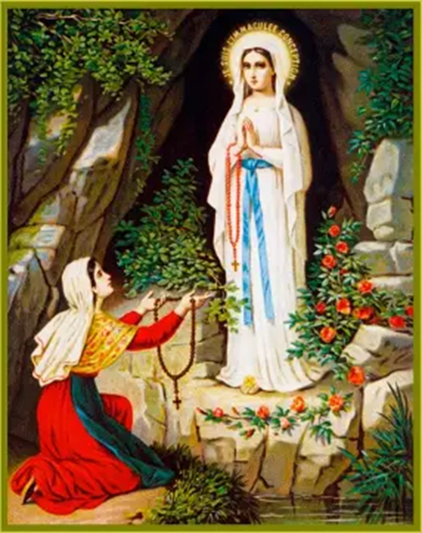
Why and how do we honor the intertwined mysteries of Our Lady’s Immaculate Conception and perpetual virginity on the Feast of Our Lady of Lourdes?
Our Lady introduced herself as the Immaculate Conception on the feast day of the Annunciation, March 25, the sixteenth visit she made to St. Bernadette. The Feast of the Annunciation commemorates when Our Lady received the message from the holy angel St. Gabriel that God had chosen her to be the Mother of His only Son, Jesus. On the Annunciation feast day, Our Lady’s “yes” to God’s invitation for her to accept His plan, to be filled with His grace, unlocked the gates of Heaven as Our Lord, our Redeemer, was conceived within her through the power of the Holy Spirit, Who overshadowed her, allowing her to fully live out the glory of motherhood, while not losing the glory of virginity. Our Lady was chosen to become the Mother of God the Son, because she is the Immaculate Conception: in having been preserved from sin in being immaculately conceived, she was the perfectly pure vessel in which Christ could dwell and grow. In being immaculate, Our Lady was disposed to say “yes” to God, because there were no sins preventing her from embracing God’s love, so she could be totally receptive to it, becoming all the more purified by His Presence. The story of Our Lady of Lourdes reminds us that healing and growth come from spiritual virginity, from saying “yes” to allowing God to touch our lives, that we would be made chaste, but remaining untouched by evils in the world. Our Lady of Lourdes teaching us to say “yes” to God by never doubting in His power, but having faith that, from His pierced Heart, He can draw water from even the most hardened hearts, irrigating our hearts to compassionate with Him and others, to feel His love, and blossom for eternity with Our Lady, whose Immaculate Heart is perfectly united to the Heart of Jesus. We open our hearts to hearing announcements of God’s love all around, and responding to them with trust, knowing that He can bring forth flowers from the barren earth, like the greatest Fruit, the Christ Child, from the womb of a virgin, using us all to brighten and enrich His heavenly garden, a garden of delights pointing back to His goodness, joy, and mercy

Slide 13
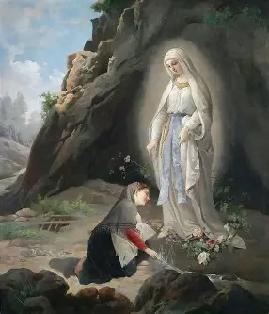
What does it mean to love the Lord with the Immaculate Conception’s Immaculate Heart?
Our Lady appeared at Lourdes just four years after the Immaculate Conception was made dogma by Pope Pius IX in 1854, affirming the truth that had been codified as infallible doctrine within the wider scope of Church teaching, a bedrock foundation of our Faith. She came amidst so much historical turmoil, many revolutions, including the French Revolution, as new political regimes were coming to power, persecuting and oppressing Christians, disallowing the true freedom to practice the Catholic Faith; between La Salette and Knock, prefiguring Fatima and her apparition to the poor and humble shepherd children, Our Lady came to bring comfort, to provide a message of God’s love, an invitation to say “yes” to being faithful to God, to bringing Christ into the world by repenting, praying the Rosary, and purifying our hearts by letting Our Lady into them. She provided hope of another opportunity to start anew, to set things aright, and harmonize with God, bringing order and balance, restoration, to a fallen world by centralizing Christ, the New Adam, our Redeemer, and Our Lady, the New Eve and co-redemptrix, in our hearts and world. Teaching us to make reparations, she showed that the brokenness surrounding us can only be repaired when we are made whole inside, and our friendship with God is healed. Loving the Lord with the Immaculate Conception’s Immaculate Heart means loving Him with faithful, obedient, humble, patient, and courageous hearts that follow where He leads, that we would ultimately lead enriching and joyful lives of hope and peace. We can bring the smile of Our Lady to others when we say “yes” to what Our Lord, through Our Lady, asked us to do, as we purify our hearts through repentance, pray the Holy Rosary with Our Lady, giving glory to God, consoling the Heart of Jesus, and the hearts of all of God’s children by bringing Our Lady’s sweet, maternal presence to others, radiating compassion. A smile of love brings healing, reflecting God’s tenderness, His forgiveness that mends the breaks in our hearts, filling them with nourishment when we are encountering loss. Loving the Lord with the Immaculate Conception’s Immaculate Heart means to be receptive, to stretch out our hands to receive the graces that Our Lord wishes to give us through Our Lady; it is to kneel before her in wonder, for we love the Lord best when we love His Mother, as He would want; and to receive her healing hands in ours, to braid crowns of prayers together like roses to offer Christ, our King; it means to reach out to others to guide them to healing in Christ and Our Lady, to welcome others into the heavenly garden with a smile of encouragement, witnessing to how Christ’s love has transformed our souls and brought them joy. The four gifts of Lourdes include the waters, strength and healing, reconciliation, and friendship. To have a heart like Our Lady’s Immaculate Heart is to bring these gifts, to refresh others in uplifting their spirits with hope and friendship, strengthening and bringing healing through sweetness and love

Slide 14
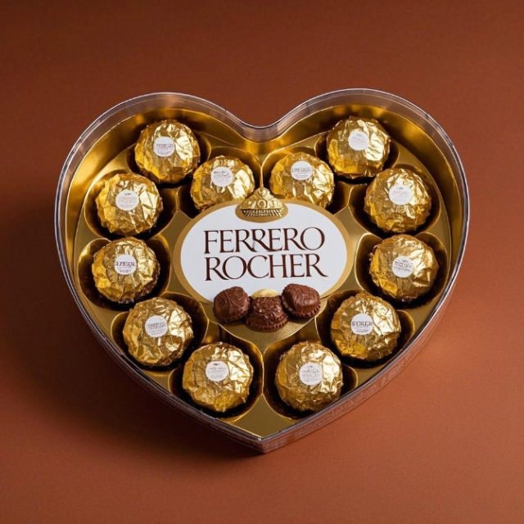
What is the connection between Ferrero Rocher and Our Lady of Lourdes? What does this reveal to us about God’s sweetness?
Michele Ferrero dedicated his chocolate company to Our Lady of Lourdes, its patroness. The third-largest chocolate-producing company in the world, Ferrero Rocher also acquired such brands as Nutella and Kinder. A statue of Our Lady is in each of the production facilities that the company has throughout the world, a reminder that their works are uplifted to Jesus through the hands of Our Lady. He attributed his success as a chocolatier to her, and would go on pilgrimages to the Shrine of Our Lady of Lourdes annually to express his gratitude to Our Lady. The word “rocher” in “Ferrero Rocher” refers to “rock” in French, and the hazelnut chocolates themselves are meant to resemble the rocks in the grotto at Lourdes. When we reflect on this sweet connection, we consider how God brings sweetness, hope, and joy even from rocky times. After revealing the messages from Our Lady of Lourdes to others in her town, St. Bernadette was doubted, but Our Lady would guide hearts to be opened, and would find the perfect way to affirm the reality of her presence so that the shrine she requested to honor her Son would be built, even while it may have seemed like an impossible prospect for a time, as St. Bernadette was dealing with such fierce opposition. She revealed herself as the “Immaculate Conception,” because when St. Bernadette was asked to give the name of the Lady whom she met, those around her would know that she was telling the truth, because as someone who had never had extensive formal education, she would not have been familiar with such a title for Mother Mary otherwise. When we have a solid faith, making our hearts like houses built on rock, then we will not be buffeted by wind or water, but will be sheltered by Christ, under Our Lady’s mantle; when we go to Christ as small children, weak and helpless, He fills us with His strength, until we cannot be broken by the burdens of the world. Saint Therese, Our Lady, and St. Bernadette may have all seemed like lowly little flowers at first, or at least, perceived themselves as such, but they were made into mighty trees, flowering with the most magnificent blossoms, through the touch of the Divine Gardener. He showed His power by working healing miracles in them, not always physical healings for their bodies specifically, but healings for others’ souls through their maternal hearts of love that would guide others to flourish, in having experienced God’s sweetness, His abiding love that cannot be consumed, like a rock that stands tall amidst crashing waves, not lost beneath the tide. Through His sweetness, Our Lord cracks open our hearts of stone to make them hearts of gold with the greatest treasures inside, just like the gold foil-wrapped Ferrero Rocher chocolates. Before Michele Ferrero passed away in 2015, a flood damaged part of the sanctuary at Lourdes, and Michele pledged to donate funds to repair it. His children would fulfill his wish, and see to it that the damage was healed. Floods of grace are unleased by God when we open our hearts with love to receive more of His loving kindness; nothing can destroy God and His love. Additionally, Ferrero Rocher candies each have a single roasted hazelnut in the center, enveloped in a coating of chocolate. This is a reminder of Our Lord, the sweet Gift for our souls’ refreshment that is hidden in the womb of the Blessed Virgin Mary. Our Lady was kept free of the stain of sin, so that she could deliver the spotless Host, the Son of God, bringing healing through His grace, and helping others to be living tabernacles containing His great love, too. The more we seek God, and trust that He will help us to find what we are looking for, the more layers of His love we can uncover

Slide 15
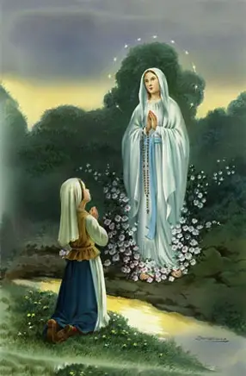
Closing Prayer: Collect Prayer for the Feast of Our Lady of Lourdes
Grant us, O merciful God, protection in our weakness, that we, who keep the Memorial of the Immaculate Mother of God, may with the help of her intercession, rise up from our iniquities. Through our Lord Jesus Christ, Your Son, Who lives and reigns with You in the unity of the Holy Spirit, God, for ever and ever. Amen.

