Slide 1
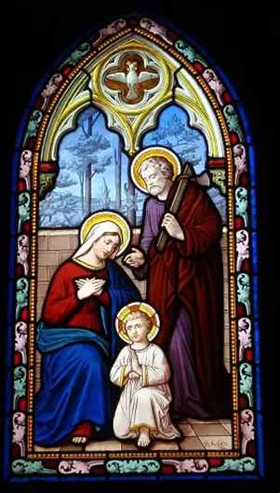

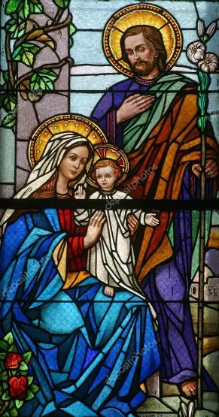

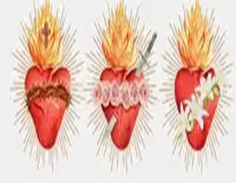
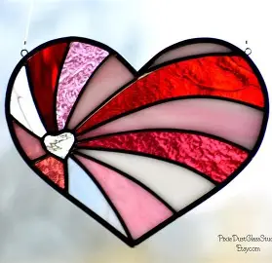

OLV 2025-26 REY: Religious Education Class 6
Opening Our Hearts to the Sweetness of the Lord!
Thursday, February 5, 2026
Katie Sadakierski

Slide 2
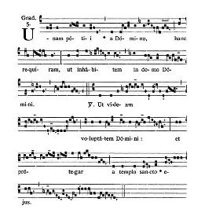
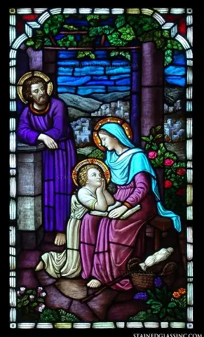
Outline: Religious Education Class 6
Welcome & Introduction
Opening Prayer
Overview of monthly theme & activities
Learning Centers:
  Grades PK-2: Placing Ourselves with Trust in the Palms of Jesus’ Hands, and Opening Our Hearts to Welcome Jesus at Holy Communion
  Grades 3-6: Embracing the Lenten Mission like the Apostles: Being Sent Out to Do God’s Work, and Making Our Lives like Letters of Love to Send to God
  Grades 7-9: Observing Lent with the Saints
Announcements
Closing Prayer
Visit to the Blessed Sacrament
  Uniting our Hearts in Prayers of Love for the Heart of Jesus: Three “Hail Mary” prayers

Slide 3
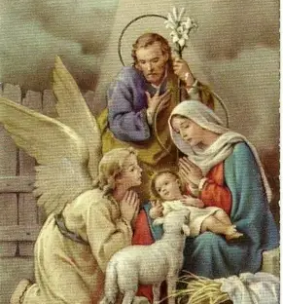
Opening Prayer: The Angelus
V. The Angel of the Lord declared unto Mary.
R. And she conceived of the Holy Ghost.
Hail Mary…
V. Behold the handmaid of the Lord.
R. Be it done unto me according to thy word.
Hail Mary…
V. And the Word was made flesh.
R. And dwelt among us.
Hail Mary…
V. Pray for us, O holy Mother of God.
R. That we may be made worthy of the promises of Christ.
Let us pray: Pour forth, we beseech Thee, O Lord, Thy grace into our hearts, that we to whom the Incarnation of Christ, Thy Son, was made known by the message of an Angel, may by His Passion and Cross be brought to the glory of His Resurrection, through the same Christ Our Lord. Amen.

Slide 4
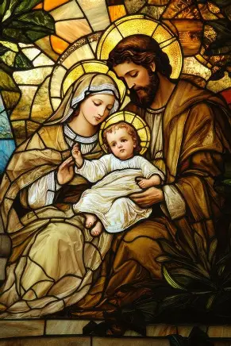
February 2026 Monthly Theme and Patron Saint
This month’s theme is the Holy Family, because we celebrate Candlemas on February 2, and when we celebrate Candlemas, we remember when the entire Holy Family journeyed to the Temple to present Jesus there, dedicating Him to God the Father to serve Him with love. We pray that we would support each other as members of God’s family to grow in love, and serve Him well. On Candlemas, we have candles blessed, remembering that Christ is the Light of the World, and that He helps us to shine when we love God, and do all things out of love for Him, giving our lives in service to Him.
This month’s patron saint is Saint Dorothy, whose feast day is celebrated on February 6. Living during the early Church at a time when Christians were not allowed to practice their Faith, to live out their beliefs, in the open, St. Dorothy had to be brave to choose her Faith, to choose her love of God over any fear of what could happen if she was found out to be a follower of Christ. Saint Dorothy would give her life for Jesus, and would convert other people. She would help others to grow in faith, including a man named Theophilus, who had doubted in God, and made fun of St. Dorothy for being a Christian. Saint Dorothy forgave him, just as Jesus forgave those who hurt Him, and had her holy angel bring back flowers and apples from Heaven to Theophilus in the winter, which led him to believe in God’s greatness, and to choose to be a Christian, too. Saint Dorothy brought about flowers and fruit out of love for God by tending to souls, planting seeds of faith, hope, and love, with care; she could be like a beautiful rose, and help others to become like roses, because she had so much love and compassion in her heart, inviting everyone to be part of God’s family

Slide 5
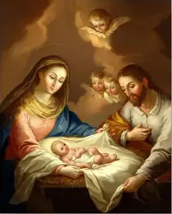
February 2026 Monthly Prayer
“Sacred Host, Sacrament of love, we adore You.”
  This month, we thank Jesus for the gift of His love that He gives us in the Holy Eucharist. When we receive the Holy Eucharist, we receive Christ’s Body, His life that He gave for us from the Cross. Our Lord made this Sacrifice out of love to save us from our sins, so that we could be cleansed by God’s love, have the gates of Heaven opened to us, and come to live with God, Who is love, in Heaven forever. As we receive Jesus in the Holy Eucharist, we receive more of God’s love, and are prepared to love like He does, with hearts like the Hearts of Jesus and Mother Mary. This month, we can pray to see God’s love all around us, to see God in every person so that we can love them more, and to receive Jesus in the sacraments with the greatest love that we can, so that we will have even more to share with others.

Slide 6
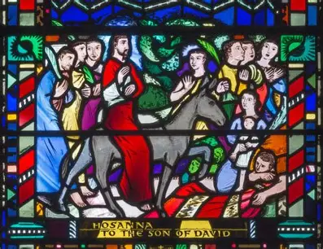
February 2026 Grades PK-2 Activities
Week 1: Loving God by loving all whom He gives to us, and receiving the strength to love through God’s love in the Holy Eucharist; preparing to receive this gift at Holy Communion to receive Jesus with as much love as we can
Week 2: Understanding how God shares His love throughout our Church, especially during Lent, and how we may respond to it with hearts of love
Week 3: Receiving God’s love and forgiveness so that we can bring joy to the Heart of Jesus, and love the Cross like the saints, becoming closer to God through every opportunity that helps us to know Jesus, as well as the love He has for us to have gone on the Cross for us
Tonight’s learning center (parish hall): Making paper palm branch fans and paper palm crosses; preparing to welcome Jesus into our hearts at Lent, and at Holy Communion, with love and joy

Slide 7
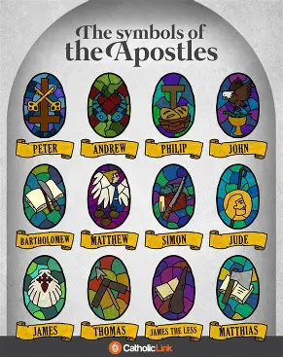
February 2026 Grades 3-6 Activities
Week 1: Understanding how God communicates His love to us throughout the liturgical year, including at Candlemas (the close of the Christmas season) and Lent, so that we may reciprocate His love
Week 2: Going to Our Lady of Lourdes (feast day February 11) for her intercession to help us to grow in virtue (holiness) during Lent, that, through prayer offered in response to Jesus’ love, we would uphold the goals that we set, fulfilling the mission that God has designed for us
Week 3: Starting anew at Lent, spiritually resetting ourselves, and imitating the love of the saints as we learn about their holy lives lived out of love for God, in thanksgiving for His great love
Tonight’s learning center (parish library): Completing a Bible scavenger hunt in honor of the apostles; learning about how they completed their mission of love for Christ, and how we may continue it in using our unique gifts to share God’s love, sending out messages of God’s love like valentines for Christ

Slide 8
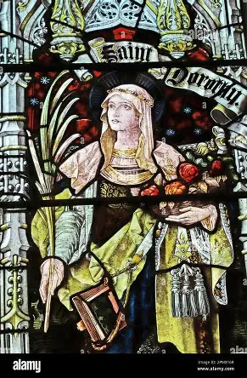
February 2026 Grades 7-9 Activities
Week 1: Growing in understanding of God’s perfect love through the lens of Christ’s saving action at Candlemas, and how to share His love like the Sacred Heart of Jesus does, not only now, but always, to shine the way to Heaven
Week 2: Practicing Lent as a season of love: Appreciating the beauty and goodness of Christ’s Sacrifice; responding to the love flowing into it and from it with love in turn; carrying forward Christ’s lessons of love during Lent to always share His love
Week 3: Reflecting on the new life Christ gives us; how we reach this new life through making sacrifices at Lent; and how the saints model to us what it means to love Christ, as we share our love for God by loving the saints in turn, as they have loved God and us
Tonight’s learning center (church): Walking the Stations of the Cross with Christ through Our Lady’s eyes: Loving Jesus like Mother Mary did, and serving Him with true wisdom that Our Lady and St. Dorothy exemplified; reflective journaling on God’s love for us, and what it means to live with a wisdom of the heart

Slide 9
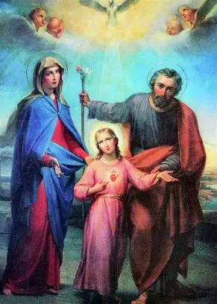
Announcements (1): Parish-wide
Next First Friday Holy Masses: Friday, February 6, 2026
  8:00 a.m. (English) with Eucharistic Adoration to follow
  6:00 p.m. (Latin)
Next First Saturday Holy Masses: Saturday, February 7, 2026
  9:00 a.m. and 4:00 p.m.
Next First Saturday recitations of the Holy Rosary: Saturday, February 7, 2026
  8:30 a.m. (church) and 10:00 a.m. (parish library; session to be live-streamed)
Next blessing of sacramentals: Saturday, February 7, 2026
  9:30 a.m. (after Holy Mass); bring devotional items such as rosaries, crucifixes, candles, and statues for your valentine (to honor Jesus as the greatest Valentine!)
Next First Sunday Eucharistic Adoration: Sunday, March 1, 2026
  1:00 p.m. to 4:00 p.m., Exposition at 1:00 p.m., Holy Rosary recitation at 3:00 p.m., and Benediction at 4:00 p.m.

Slide 10
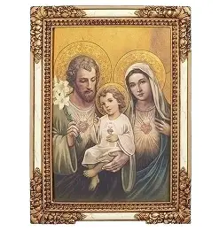
Announcements (2): Confirmation
Confirmation sponsor and saint name forms deadline: Friday, February 13, 2026; forms available in file folders on bulletin boards in church
  Submit via email to sadakierski.olv@gmail.com (scan or photograph completed forms)
  Or submit via mail/drop-off to parish office at 33 Adams St.
    Service logs and service essays may be submitted at Confirmation rehearsal on Friday, March 20, 2026
Service project day: Tuesday, February 17, 2026, 9:00 a.m. to 3:00 p.m. (school vacation week); meet in parish hall
  Complete two hours of service to Bethlehem House; remain for presentation and devotions
Spring retreat: Saturday, March 14, 2026, 8:00 a.m. to 12:00 p.m., meet in parish hall
Saint Joseph consecration: First session on Sunday, February 15, 2026, at 4:30 p.m.
  Service project and presentation; five sessions total on Wednesdays at 6:30 p.m. until, March 18, 2026 (excluding Ash Wednesday on February 18); consecration will take place on Thursday, March 19, 2026 after the 6:00 p.m. Traditional Latin Mass
Take & Eat coloring sheet menus: March 2026 available
  Complete for service hours

Slide 11
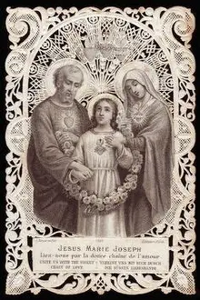
Announcements (3): Religious education & parish
Ash Wednesday Holy Mass and Confession schedule: Wednesday, February 18, 2026 (start of Lenten season)
  Confession: 7:30 a.m., 11:30 a.m., 7:00 p.m.
  Holy Mass: 8:00 a.m., 12:00 p.m., 6:00 p.m.
Next religious education class (7):
  Thursday, March 5, 2026, 6:00 p.m., parish hall
    Snow date: Thursday, March 12, 2026, 6:00 p.m., parish hall

Slide 12
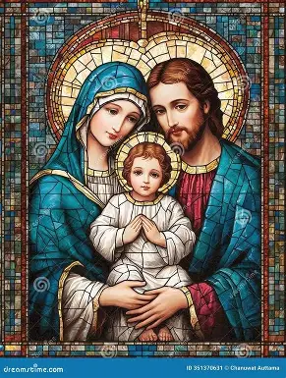
Closing Prayer: Collect Prayer for the Fifth Week in Ordinary Time
Keep Your family safe, O Lord, with unfailing care, that, relying solely on the hope of heavenly grace, they may be defended always by Your protection. Through our Lord Jesus Christ, Your Son, Who lives and reigns with You in the unity of the Holy Spirit, God, for ever and ever. Amen.

