Slide 1
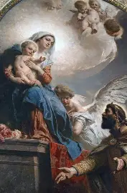
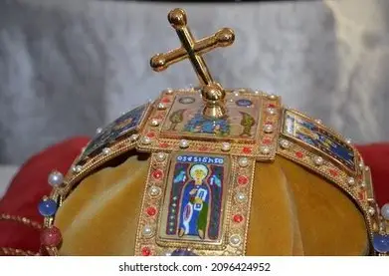
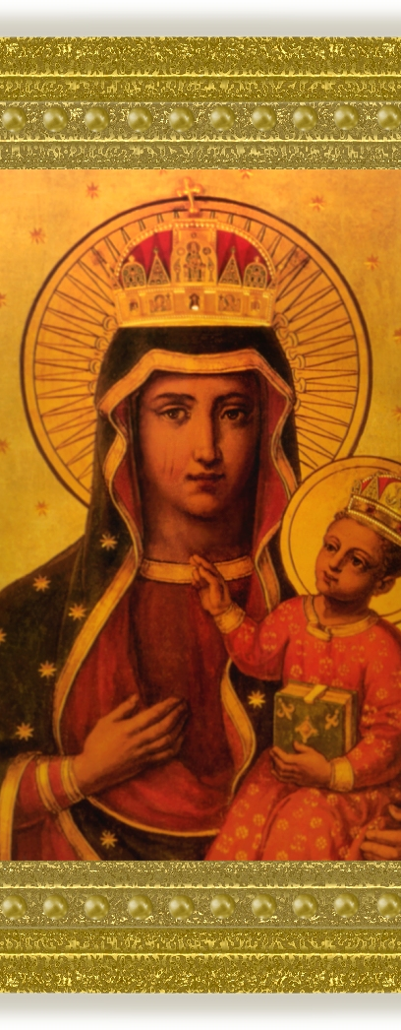
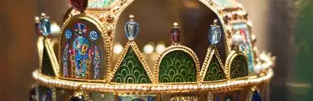
Hungary for the True Bread: What the Saints of Belgium, Austria, Hungary, Czech Republic, and Germany Teach Us About Spiritual Nourishment from the Sacred Heart: Part I
Friday, February 6, 2026
Katie Sadakierski

Slide 2
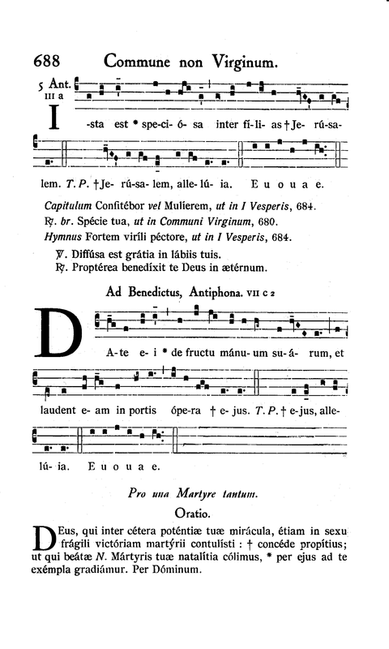
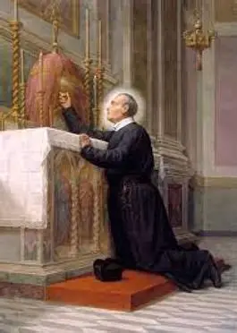

Opening Prayer: Prayer to St. Clement Mary Hofbauer
Gracious God, our God of care and compassion for humanity, you filled St. Clement Mary Hofbauer with a special zeal for the well-being of people, especially those who are poor or troubled in spirit. In St. Clement you revealed the richness of your loving kindness and mercy. Through his intercession, help us to remain true to the Catholic faith, which he so nobly taught. Let us walk in the path that St. Clement marked out by his own life. Hear and answer us, God, through Christ our Lord. Amen.

Slide 3
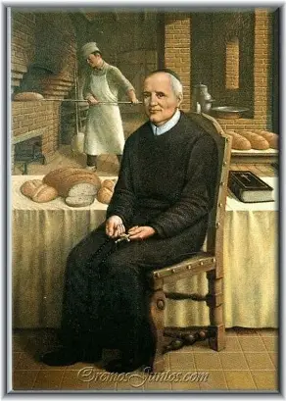
Who is St. Clement Mary Hofbauer? What does he teach us about the geography of the soul, and the way to Christ?
Country of origin: Czech Republic (Moravia); ministered in Austria
Years of life: 1751-1820
Feast day: March 15
With a Czech father and German mother to raise him in his Faith as the ninth of the twelve children born from their union, St. Clement Mary Hofbauer was rooted in rich traditions, all linked through Our Lady, her mantle placed over everything, to transcend any dividing lines, bringing all together. Known as the “Apostle to Vienna,” St. Clement Mary Hofbauer brought the spirit of St. Alphonsus Liguori’s Redemptorist order to the people living north of the Alps. It was the dream of St. Clement’s heart as a child to become a priest, but in his large family, money was scarce, so St. Clement worked as a baker to support his studies, finally coming to secure a job baking at a monastery, where he developed an agreement permitting him to study in the monastery school. After the abbot passed away, the situation at the monastery changed, and St. Clement would find himself back out in the world, altar serving at the Cathedral of St. Stephen. God was always providing for him, and some wealthy benefactresses would come to fund his seminary studies, until he was ordained in 1785 at the age of 34. Although the plan had been to return to Vienna, St. Clement was forced to go to Poland to escape religious persecutions. In Poland, he encountered German-speaking Catholics who had no priests to serve them, due to their Jesuit priests being suppressed. To reach the people, each day, St. Clement Mary Hofbauer preached five sermons, two in German and three in Polish. With one of his former seminary classmates, he established schools and orphanages. By the time he returned to Vienna, there was still difficulty with religious tolerance, to the extent that St. Clement would be silenced from preaching, and attempts to banish him from the city altogether would be made, but these would be unsuccessful; nothing could stop him from doing God’s work, which included caring for the sick, building a Catholic college, hearing confessions from people of all classes of life, and counseling those with authority and rank. After having been expelled from Poland, where he was imprisoned for a time when the French invaded, St. Clement was equipped to deal with the persecution in Austria, in knowing that the soul is made for God, not for temporal, earthly things; he recognized that the map of the soul leads to God, and followed this way, keeping his sights fixed on his eternal home in the Heart of Jesus. Saint Clement, named “John” at birth, always remained close to Christ’s Heart in his simplicity and self-sacrificing love, nourishing souls first as a baker, then as a priest to sustain souls eternally with the True Bread, that they need never hunger for more, but would be content as he was

Slide 4
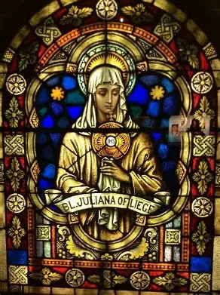
Who is St. Juliana of Liege? What does she teach us about the geography of the soul, and the way to Christ?
Country of origin: Belgium
Years of life: ~1192-1258
Feast day: April 6
After being orphaned at the age of five, St. Juliana went to live at a Norbertine monastery, where she quickly discovered a love of the spiritual classics and their authors, being especially drawn to St. Augustine of Hippo and St. Bernard. Saint Julianna was deeply inspired by the writings that she encountered, and developed a profound devotion to the Blessed Mother, who would lead her to love Christ’s Passion, and the Holy Eucharist, which we have because Our Lady gave Christ His Flesh to be given up for us, and resurrected, that we would receive it and have new life, too, rising with Christ in spirit. When she herself became a nun, St. Juliana began to serve the sick with great love. She would come to understand more about the life-giving Presence of Christ in the Holy Eucharist, the Word made Flesh, seeing the Crucified Christ, in a spiritual sense, in the broken bodies of those whom she served, but so, too, would St. Juliana know what it means to be broken-hearted, and to reach out those who are emotionally wounded. She would strive to establish a feast day dedicated to the Body of Christ, but amidst this great mission given to her by God, she was challenged with many trials that would test her faith, but ultimately, strengthen her. Those in her community would elect her as the superioress, in recognition of her holiness, but from thereon out, she would be harassed and defamed publicly by a monk who sought to sow division, and incite hatred for her. Although for a time, things were calmed when the monk was deposed, things would escalate again when he regained power, obliging St. Juliana to go to live in seclusion with her friend, Blessed Eva of Liege .Saint Juliana not only had a person devotion to the Holy Eucharist, but had received private revelations from Our Lord, seeing the moon with a black stripe across it that represented the liturgical calendar without a feast day for Jesus’ Body. Although St. Juliana felt that she was unworthy of this mission, and prayed for someone more qualified to take on the role to institute the Corpus Christi feast day, she accepted God’s will, and kept reaching out to her superiors to work on implementing the feast day, recognizing its importance at a time when so many were feeling themselves to be unworthy of Jesus’ Presence, that they never received It, until one of the Church’s Lateran councils made it a precept of the Church to receive Holy Communion at least once per year, at Easter. After St. Juliana passed away, her friend, Eva, continued her mission, seeing the institution of the Corpus Christi come about in 1264. Saint Thomas Aquinas would compose and compile texts for the liturgies for Corpus Christi, using them to catechize at a time when the corporal nature of the Host was being questioned. Through his music, He would attest to the fact that Christ is real, and human, our best Friend and advocate that we can always go to in the Holy Eucharist. Saint Juliana shows that the way to holiness is the way of friendship, that we navigate the soul not on our own power, but together, for He has given us all different talents and limitations to use to glorify Him, to the utmost when we join as a family in love for He Who lived in a family. The Holy Eucharist sustain these efforts. Many souls would come to be converted through St. Juliana’s example, her pious love shining through her heart, a heart united with the Eucharistic Lord in service

Slide 5
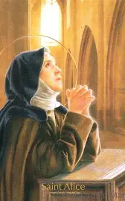
Who is St. Alice? What does she teach us about the geography of the soul, and the way to Christ?
Country of origin: Belgium
Years of life: 1204-1250
Feast day: June 15
A patron for the paralyzed and the blind, St. Alice was seven years old when she went to live at a Cistercian abbey (a community that is a branch of the Benedictine order), where she was set apart in her holiness, no more so than when she contracted leprosy, then lost her ability to walk, as well as her sight, offering up all of her suffering for the holy souls in Purgatory. Saint Alice is remembered for her joyfulness in the midst of great pain, as she found all of her consolation in the Holy Eucharist. In being blind to material things, the things of the world surrounding her, St. Alice could focus on what was most precious: the Presence of Christ, coming down to save and heal her in her afflictions. Saint Alice received a vision of Our Lord in which He reassured her that He was always with her, and that it was permissible for her to receive Holy Communion under one species, rather than both, because He is fully Present in the Sacred Host; Saint Alice not only had dealt with physical pain, but also, the spiritual pain of being denied the chalice of Precious Blood, the opportunity to drink from the cup at Holy Communion, due to her superiors’ concerns about contagion if she were to do so. Our Lord saw St. Alice’s loving heart, and rewarded her with many consolations for applying the Precious Blood to the souls in Purgatory in need of refreshment. Saint Alice shows that the terrain of the soul is most simple, beautiful, clear, and navigable when it is focused solely on Christ, from which order and balance flow. When we realize our own blindness, relying on Christ to show us the way, we begin to see the path forward illuminated for us. In her girlhood, St. Alice was distinguished for both her physical and spiritual beauty. She would become most transfigured through her spiritual union with Christ as His bride, as she took on suffering with Him for the salvation of souls, living with her pain for over twenty-five years, but uplifting the Cross with gratitude, as she experienced its sweetness through closeness to Christ

Slide 6
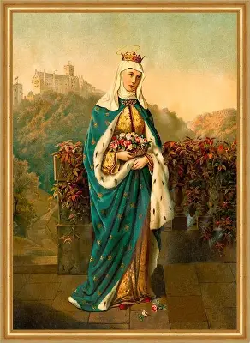
Who is St. Elizabeth of Hungary? What does she teach us about the geography of the soul, and the way to Christ?
Country of origin: Slovakia; ministered in Hungary
Years of life: 1207-1231
Feast day: November 17 (modern); November 19 (traditional)
A patron saint of nurses, bakers, and tertiaries (especially those in the Franciscan order), Saint Elizabeth of Hungary distinguished herself in service to the poor, sick, and all those in need of God’s love, through both corporal and spiritual works of mercy. At age four, St. Elizabeth of Hungary was betrothed to Louis IV of Thuringia, whom she married at the age of fourteen. Rooted deeply in their shared faith, a common mission to give glory to God, the couple was eternally connected in a heavenly love transcending the earthly bond. When St. Elizabeth was criticized for her works tending to those suffering out in the world, especially by members of the royal court who believed this work was beneath her, and an embarrassment to the royal family, she was supported and defended by her husband, who would sometimes accompany her on her pious errands, always showing an interest, and pride, in her charitable deeds undertaken to bless the souls in their kingdom. Once, when St. Elizabeth was approached by her husband on her travels to deliver bread that she had baked for the hungry, Louis asked her what she was holding in her apron. When she unfurled it, not bread, but roses, descended from the apron, cascading like a waterfall of graces to attest to God’s good pleasure at the love that St. Elizabeth had shown to people in need; she had seen God blossoming in their hearts, and to her, they were as precious flowers in God’s garden. Having looked with God’s eyes at His children, she could respond with love to His Presence in each person, exercising the greatest compassion; she even had allowed a leper to sleep in the castle; while it was more difficult for her husband to accept that a leper had been sleeping in their bed than it was for him to embrace St. Elizabeth’s ministry of baking for the poor, he would come to be enlightened with an understanding of true charity when he experienced a mystical vision, seeing the leper as Christ Himself, realizing that his wife was serving the Lord through her selfless acts of mercy. After Louis went to fight the good fight in the Sixth Crusade, only to contract the plague and pass away, Saint Elizabeth, though devastated, continued on, becoming a third-order Franciscan completing spiritual works of mercy, praying always for others. While caring for her three children, St. Elizabeth would still serve as a spiritual mother to others, ensuring that they were fed, clothed, and sheltered, most of all, by Christ. Though she was remarkably active, even funding the construction of a hospital in Germany to serve people in need, whom she would personally care for, St. Elizabeth’s spiritual director commented on how contemplative she was.. Saint Elizabeth did all things with love for God, bravely pioneering forward, being sweetness and light to others, going out to visit souls in need, like Our Lady going in haste to visit her cousin, St. Elizabeth. Saint Elizabeth of Hungary refused her earthly crown in order to embrace the heavenly one. Four years after Louis’ death, at age twenty-four, St. Elizabeth of Hungary herself passed away. She shows that the soul is meant to be balanced if we are to see God at work in our lives, and to journey closer to Him; the way of Christ is one of order and harmony, contemplation and action, all offered for God’s glory

Slide 7
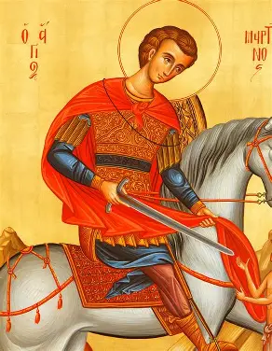
Who is St. Martin of Tours? What does he teach us about the geography of the soul, and the way to Christ?
Country of origin: Hungary
Years of life: 316/333-397 A.D.
Feast day: November 11
Conscripted into military service as a young man, St. Martin of Tours was the first conscientious objector in history. He wrote a letter requesting to be discharged from military service, because he was a soldier for Christ in the spiritual battle, and therefore, could not engage in mortal combat. However, St. Martin would do God’s will, remaining in the service for as long as he was called to, serving as an example to other soldiers through the high moral standards that he upheld. Once, while still a soldier, St. Martin encountered a beggar in the cold, and so moved with compassion for the man was St. Martin, that he cut off half of his cloak to clothe the man out in the cold. In this mystical experience, St. Martin then saw the beggar transform into Christ Himself. Amazed, St. Martin would then pursue preparation for and reception of the sacraments, going on to become a priest and bishop, leaving behind military service, but not the good fight for God’s glory. As a bishop, St. Martin continued to serve souls humbly, catechizing those in the rural lands who had never heard the Gospel message. Gradually, St. Martin of Tours traveled, touring the countryside, saving souls, reconciling them to God so that they would know true inner peace. Traditionally, peace treaties have been signed on St. Martin of Tours’ feast day, as he shows us that the way to Christ is one of serenity, of calmly accepting God’s will, and trusting in Him to give us the graces to fulfill it. He shows us that the terrain of the soul is only rough when we attempt to navigate it without God, and therefore, without direction, but when we follow God with a willingness to be instructed and polished, we are perfected in His time. As soldiers for Christ, we need not fear the way ahead, but can have hope in God’s faithfulness, as he gives us the gifts that we need to win the battle for Heaven, for a crown with Him

Slide 8
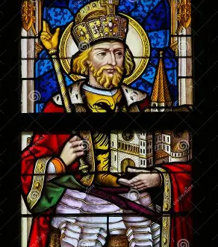
Who is St. Wenceslaus? What does he teach us about the geography of the soul, and the way to Christ?
Country of origin: Czech Republic
Years of life: 907-929
Feast day: September 28
When he was thirteen years old, St. Wenceslaus’ father, the Duke of Bohemia, passed away while in battle, leaving the rule of the land to St. Wenceslaus’ mother, a pagan who initiated a campaign of persecution of Christians. Raised by his grandmother, a devout Catholic who would herself become a saint, Ludmilla, St. Wenceslaus was determined to bring order to his country by Christianizing it. After his mother had his grandmother killed, St. Wenceslaus deposed his mother, and ascended the throne himself, working with the Church to restore freedoms to Christians, which had been taken away while his mother was in power. Churches were built, and priests who had been exiled were returned to their homeland under the reign of “Good King” Wenceslaus, who was admired by his people for his kindness, charity, and generosity, as well as the wisdom shown by such a devout leader at the tender age of eighteen. Caring personally for his subjects, who were truly his friends and spiritual children, St. Wenceslaus had a priestly heart that reached out to bless and love everyone. He attended the funerals of the poor, ensuring that they were lovingly remembered; freed slaves; and spent time with prisoners to console them, for he spoke to the pierced Heart of Jesus reflected in everyone who was suffering, compassionating with them deeply. A deep Eucharistic piety inflamed the good heart of St. Wenceslaus, who was led to bake his own altar bread and to press the grapes for the sacramental wine. With the poor, he experienced spiritually the sacred mysteries with Christ, being crushed like the grapes in order to be molded all the more to Christ’s soft and tender Heart, the Heart of a lion that is brave enough to love and protect those entrusted to Him. Saint Wenceslaus would walk barefoot in the snow, carrying firewood on his back to the poor, leaving trails of blood behind him, so willing was he to give of himself, to pour out his love, for love of the Precious Blood given for the salvation of souls. Saint Wenceslaus shared in the mission of Christ the King, a salvific one motivated by the deepest paternal love. Having consecrated his virginity to God, vowing to remain a single celibate, St. Wenceslaus could still live a contemplative life dedicated to God in the world, purifying his heart to love more like Christ, and could always find the way forward by going to the Eucharistic Lord, from Whose Heart in the Blessed Sacrament, the purest light would shine. Spending many sweet hours in the Eucharistic Adoration chapel, St. Wenceslaus’ heart was so afire with love for God, that after Adoration, his footprints in the snow emitted heat, warming his cold servants who traveled with him. King Wenceslaus was everyone’s servant, being like Christ, who came to serve, not to be served. In the year 929, when the German king warned that he was planning to invade Bohemia, St. Wenceslaus accepted, brokering peace instead of division, but his brother was so angered by this decision, that he killed St. Wenceslaus on the way to Holy Mass. As he was dying, St. Wenceslaus forgave him, praying for his brother. He would be the first Slavic saint to be canonized, having shown that the way to Heaven is the way of the True Bread, the wheat that dies to produce fruit. Saint Wenceslaus had died to himself, serving others each day, and could know the greatest happiness, being very fruitful for God

Slide 9
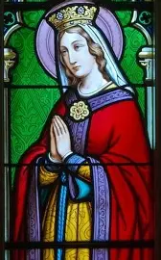
Who is St. Amelia? What does she teach us about the geography of the soul, and the way to Christ?
Country of origin: Belgium
Years of life: 741-772 A.D.
Feast day: July 10
Renowned for her beauty, St. Amelia was born into nobility, and was admired as a most eligible woman by such dignitaries as the man who would become King Charlemagne. Consumed by his infatuation with her, he proposed marriage to her, but St. Amelia declined, because she was already committed to Christ as His bride. Her aim was ultimately to become a religious sister. Frustrated, the future King Charlemagne tightly grasped St. Amelia’s arm, attempting to convince her to go with him, to leave the church where she was devotedly praying, but she remained in place, to the point that her arm was broken in the struggle. The pure love in the heart of the consecrated virgin St. Amelia would be a healing force, perfectly resetting her broken arm, and healing the soon-to-be King Charlemagne as well. Now, St. Amelia is not only a patron saint for arm pain and broken arms, but is a model of faithful persistence in prayer and the fulfillment of one’s God-given vocation. She shows us that the way to Christ is one of steadfastness, that we navigate the terrain of the soul when we are still, listening to and watching for God’s cues to guide us, that we would come to be united with the Two Hearts, Hearts that carry and stand by the Cross unswervingly, out of staunch love for God the Father. Keeping Christ the King at the center of her heart, St. Amelia would be undisturbed, remaining spiritually inviolate like Our Lady as well, so that nothing could disrupt her prayer or break her faith in God

Slide 10
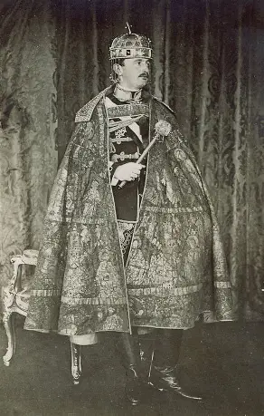
Who is Blessed Karl of Austria? What does he teach us about the geography of the soul, and the way to Christ?
Country of origin: Austria
Years of life: 1887-1922
Feast day: October 21
Christ’s Body was broken so that all would be fed by the True Bread, so that people divided by their sin would be redeemed, and unified by God’s grace. Blessed Karl of Austria understood his mission as being united with that of Christ’s, as he would serve as a peacemaker and unifying force to bring his people together in love for God. He would offer up his suffering for the reunion of his people, sharing in Christ’s saving work, uniting his sacrifices with the Sacrifice of Christ for peace that can only come when we are united in the Sacred Heart, sustained by the True Bread, Our Lord, and not pulled away by worldly things competing for our love and attention. It was in the midst of World War I, in 1916, that Charles, also known as Blessed Karl, became king, the last emperor of the Austo-Hungarian Empire. When the archduke Franz Ferdinand, an uncle of Blessed Karl, was killed, along with Franz’ father, Blessed Karl would rise to the throne, because he was the closest living heir. Committed to restoring harmony from the very beginning, Blessed Karl worked to extricate Austria-Hungary from the conflict, following the seven-point peace plan proposed by Pope Benedict XV, the only world leader to honor the pope in such a way, but was unsuccessful, as his endeavors would not be accepted. After the war, secular leaders joined forces to break apart Catholic monarchies, including that of Austria-Hungary, in order to fulfill their agenda for a kind of world reset, a new world order, so Blessed Karl and his family would be exiled, and the Austrian monarchy would be dismantled. Never giving up, Blessed Karl made attempts to return to the throne, but would fall ill while exiled in Portugal, and would pass away at age 34 from pneumonia, survived by his wife and eight children. Blessed Karl always did what God called him to do, never putting aside his devotions, but keeping Christ at the center of his rule, ordering his whole day around sustenance found in Christ’s Presence, especially the Holy Eucharist, making several visits to the chapel each day to be with Our Lord, Whom Blessed Karl could love so deeply, in loving Our Lady, a devotion to whom he exercised through recitation of the Holy Rosary, wearing the scapular, participating in Our Lady’s Confraternity, and recitation of the Litany of the Blessed Virgin Mary.. In being ruled by Christ, Blessed Karl would be a wise and balanced leader, a loving father to all, but his goodness would not be recognized universally. Blessed Karl not only suffered physically in the end, but would be rejected like Christ, though he trusted that God knew his heart, focusing only on consoling the Hearts of Jesus and Mother Mary, which he surely did in helping to guide souls to true nourishment in Christ that transcends earthly politics, showing us that we are only happy when we are subject to Christ, the most perfect Ruler, our Friend and Redeemer

Slide 11
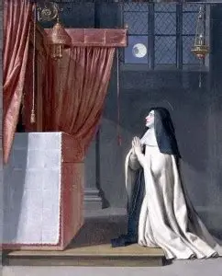
Collectively, what do these saints teach us about their region, and what does their cultural expression of the Catholic Faith reveal about the Heart of Jesus? The Heart of Mary?
These saints, beset by so much war and division, show us a spiritual map to true and lasting peace in Heaven. They accepted God’s will, calmly submitting to Him like the Lamb of God, and sacrificed themselves lovingly and joyfully with the Lamb, surrendering through the graces given to them in Holy Communion. They brought peace and nourishment to others by being so filled with the love of Jesus in the Holy Eucharist. Their collective cultural expression, rooted in Eucharistic piety, reveals the self-sacrificing love of Jesus and Mother Mary, their parental love in nurturing and providing the food that our souls need. These saints were excellent spiritual parents, because they were excellent spiritual children to God, serving Him obediently and faithfully, with great love, giving their “yes” to God with confidence in the triumph of the Two Hearts, the promise of the shared victory to come for their devotees

Slide 12
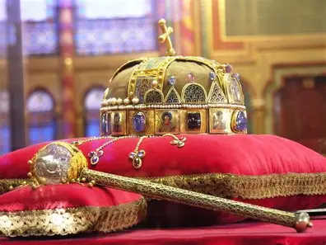
What is the Holy Crown of Hungary? What does it teach us about being crowned with Our Lady?
In the year 1000, St. Stephen of Hungary (not to be confused with St. Stephen the protomartyr) became the first king of Hungary. Prior to that, when St. Stephen defeated pagans to defend his crown, Pope St. Sylvester II gifted him the Sacred Crown, which St. Stephen would wear as a sign of his commitment to Christianizing his nation, that it would be truly unified; he would recognize that it was not his nation at all, but God’s, and therefore, would entrust it to God’s treasure, Our Lady, who would pour many graces onto it through her hands, always opened to do the will of God the Father, always shaping souls with greater love for Him. At his coronation Mass, St. Stephen held the crown up to Our Lady and Our Lord so that a divine covenant would be sealed: it was understood that Our Lord would rule the Hungarian nation through him, that he was simply an instrument of God’s love. Between 1031 and 1038, the year of his passing from this life, St. Stephen of Hungary would entrust Hungary to Our Lady several times, so the whole nation is dedicated to her, such that the country has been called “the Kingdom of Mary” since the 1700s. One of the dedications took place during an invasion of Hungary, going to show that we have peace and victory in battle, overcoming the suffering of war, when we are united with Our Lady, going to her in order to know true union with Christ. Marian devotion would spread among monarchs through the influence of German clergy, not only in Hungary, but in neighboring nations. Kings would be enthroned on Marian feast days, such as Candlemas and Our Lady’s Nativity; even the backs of St. Stephen’s coins would feature Our Lady’s likeness. Our Lady helps us to become treasures, too, by guiding us to treasure Christ in our hearts like she does, that we would be transfigured by Him. In 1945, the Holy Crown of Hungary was shipped out of Hungary to the United States to protect it from the German and Soviet invaders, to be kept in the U.S. Gold Reserve at Fort Knox. In 1978, President Jimmy Carter would return the Crown to Hungary. Because Our Lady and Our Lord treasure us in the vaults of their Hearts, we are preserved, and can trust them to help us to earn our heavenly crowns. When we reserve our hearts for them, we can be assured that all that we treasure therein will be blessed. Blessed Karl would be the last monarch to wear the Sacred Crown of Hungary; in the nation’s history, over fifty monarchs would wear it. Still, we can spiritually put on this crown, being reminded that we offer all of our works and prayers for God to use to bring about good, giving ourselves to God, that He would reign over us, using all that we give to the greatest possible effect. The crown, a relic, has a crooked cross on top, because when the crown was being placed in its encasement in the 1600s, it was closed in before being fully settled into the receptacle, so it was damaged. This reminds us of humanity’s imperfection, and our need for God, Who can write straight with crooked lines, polishing what we give Him to realize His purposes, to craft the finest masterpiece, making us into saints. An image of Jesus being enthroned is at the center of the crown, which features over 400 pearls and other gemstones, not faceted, but left rounded, as was the past practice. The rounded stones remind us of God’s unending love, which is more valuable than all of these gemstones combined, truly priceless. Enthroning Christ in our hearts means that we enthrone the greatest treasure therein, and can be enthroned with Christ the King in Heaven someday, adoring Him now to praise Him forever. Images of the apostles surround the crown, reminding us to go out and serve Christ the King faithfully to help others to enthrone Him in their hearts, and to keep praying for our priests, who help to strengthen our devotions, leading us to victory as they spearhead the spiritual battles of this life. An anointing crown, the crown was not historically worn every day, but was meant to serve as a symbol of initiation. It reminds us that when we are anointed, as at Confirmation, God gives us a special mission that will help us to inherit a place in the Kingdom of Heaven, through the help of Our Lady, who helps us to put God first as she did, that we would be crowned with her by God

Slide 13
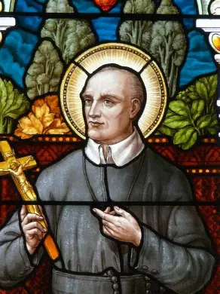
Closing Prayer: Prayer to St. Juliana of Liege
Glorious St. Juliana, by your deep love for Jesus Christ, our Eucharistic King, you spent countless hours worshiping before the Blessed Sacrament and established a world-wide feast to honor this most holy of mysteries, the Feast of Corpus Christi. By your prayers and example may we too develop a deep appreciation, joy and heartfelt longing to spend time adoring Jesus Christ, our Lord, hidden and veiled in the little form of heavenly bread. Amen.

