Slide 1
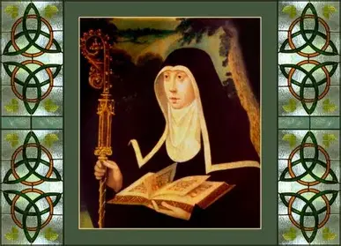
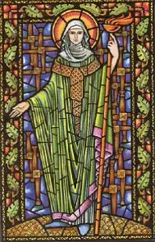
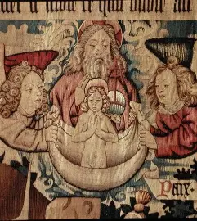

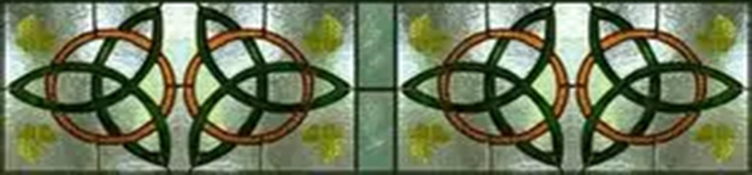
Bridging Heaven and Earth: Celebrating Saint Brigid and her Marian Heart
Sunday, February 1, 2026
Katie Sadakierski

Slide 2
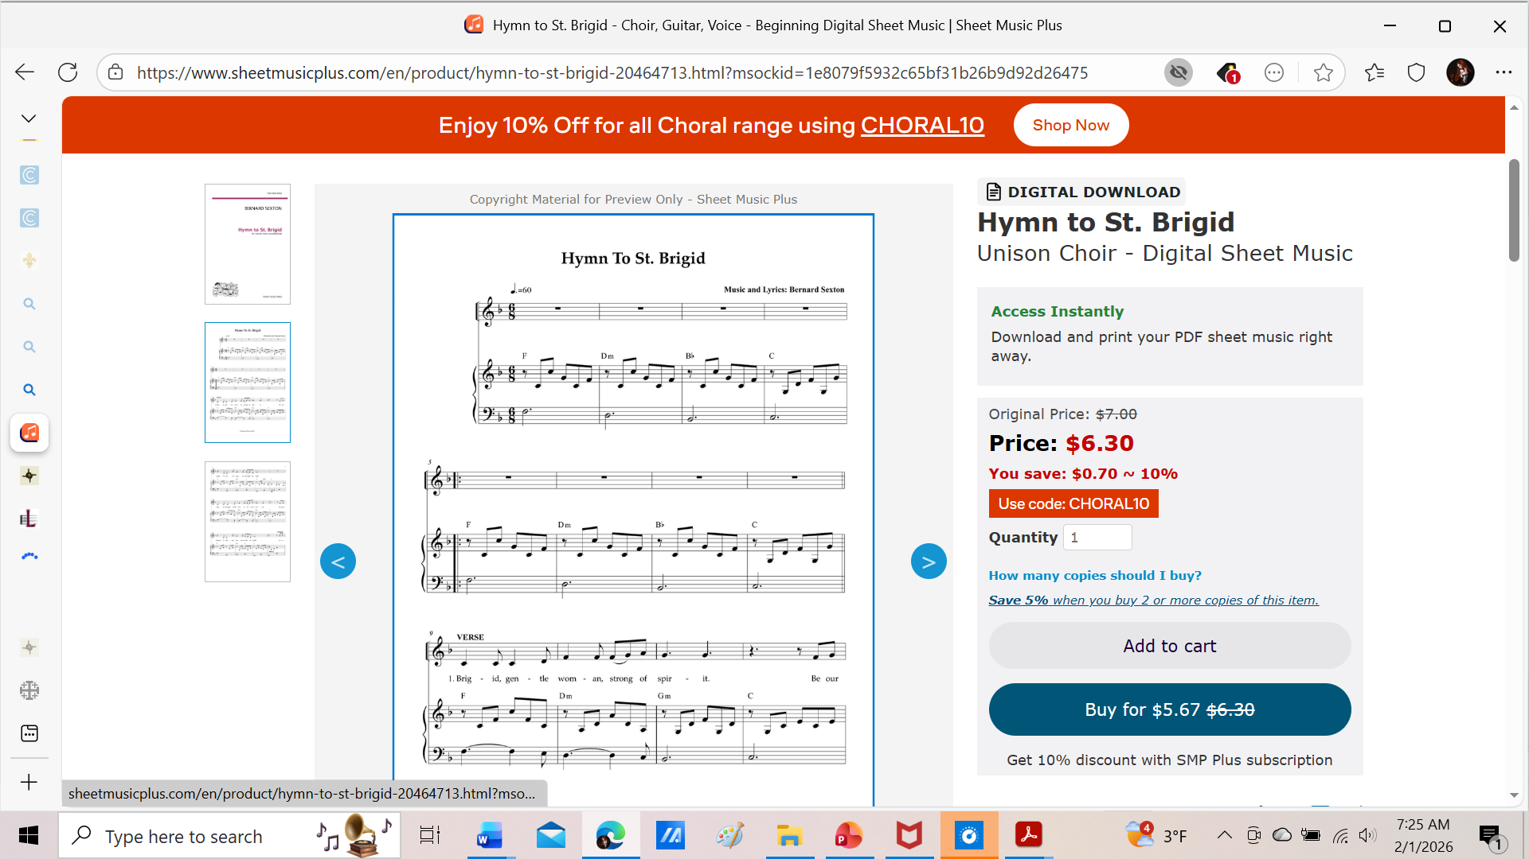
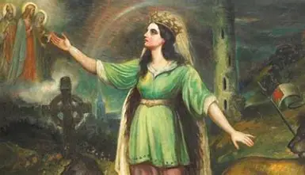
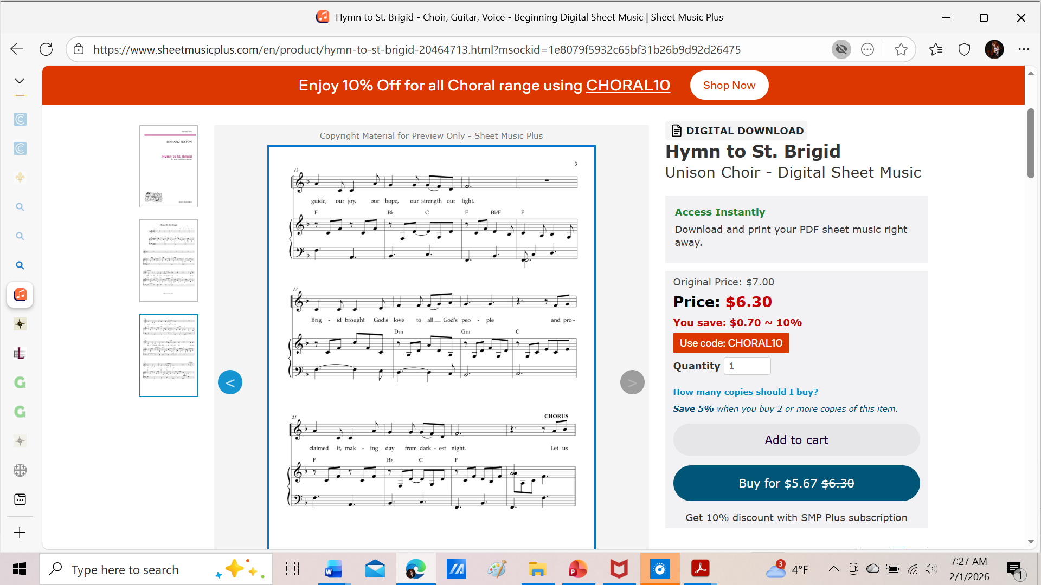
Opening Prayer (1): Collect Prayer for the Feast of St. Brigid of Kildare
V. Pray for us, O glorious Saint Brigid:
R. That we may be made worthy of the promises of Christ.
Let us pray. O God, Who dost rejoice with the memory of the blessed Saint Brigid, Thy virgin and abbess, mercifully grant that we may be assisted by her merits, by whose chastity we are illumined. Through Jesus Christ Thy Son Our Lord.
R. Amen.

Slide 3
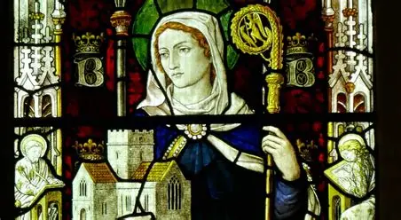
Opening Prayer (2): St. Brigid Hearth Keeper Prayer
Brigid of the Mantle, encompass us,
Lady of the Lambs, protect us,
Keeper of the Hearth, kindle us.
Beneath your mantle, gather us,
And restore us to memory.
Mothers of our mother, Foremothers strong.
Guide our hands in yours,
Remind us how to kindle the hearth.
To keep it bright, to preserve the flame.
Your hands upon ours, Our hands within yours,
To kindle the light, Both day and night.
The Mantle of Brigid about us,
The Memory of Brigid within us,
The Protection of Brigid keeping us
From harm, from ignorance, from heartlessness.
This day and night,
From dawn till dark, From dark till dawn.

Slide 4
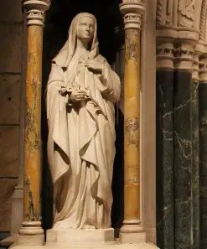
Who is St. Brigid of Kildare? (1)
A patron saint of artists, writers, and musicians, Saint Brigid, remembered for her grace-filled soul that followed the inspiration of the Holy Spirit, was born in the fifth century (~453 A.D.) near the Northern Irish border to a chieftain and a slave woman. When the slave woman, St. Brigid’s mother, was sold to appease the wife of the chieftain, St. Brigid went to live with her, but her father expected that St. Brigid would be returned to him one day, because he still had a parental claim over her. Although St. Brigid’s mother was poor, and possibly, unable to nurse St. Brigid, a cow from the dairy in the home where she worked came to watch over St. Brigid, bringing her food that she needed for her growth. This cow was rare, in that it was white with red ears, and represents the uniqueness of St. Brigid’s pure soul. The earliest accounts of the life of St. Brigid state that her parents were both Christians, but later lives of St. Brigid began to state that her father was a pagan, while her mother was a Christian. However, it is likely that St. Brigid’s father was a Christian convert whose pagan ways had not been fully eradicated. He named St. Brigid after a pagan goddess of light, who was celebrated on February 1, the start of spring in Ireland (St. Brigid’s natural birthday and heavenly birthday, the beginning and the end), and whose name means “poetry.” In the poem of her life, a beautiful prayer to offer to God, St. Brigid, in union with Christ, would redeem her name, reclaiming it for Jesus, in Whose Holy Name, by the light of His Holy Face, she did all things. It is possible that St. Patrick himself baptized St. Brigid and her family members. Tradition holds that St. Brigid was born in the doorway of her home, which is very telling, also leading us to think of Our Lady, the Gate of Heaven, our means to entering into Paradise with Christ. Along with St. Columba and St. Patrick, St. Brigid is one of the patron saints of Ireland, because she helped to complete the mission started by St. Patrick, converting the rest of the Irish to Catholicism through her works and prayers, deepening the faith where it had already taken root, promoting ongoing conversion, whereas St. Patrick had initiated the first wave of conversions. Saint Brigid would lead Ireland through a time of transition; she was born at a pivot point in her motherland’s history, and would help to usher the nation into a new era, one born under Our Lady’s mantle

Slide 5
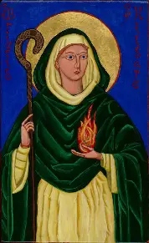
Who is St. Brigid of Kildare? (2)
While working at a mission, St. Brigid entered a room where the bishop had been speaking to another person about a dream he had of Mother Mary, and when he saw St. Brigid, he remarked that it was she that he had seen in the dream. It had been predicted by a member of St. Brigid’s father’s household that one would be born soon who would be another Mary, and from her earliest youth and adolescence, St. Brigid was proving this prediction to be true, living out the vision that God had for her to mirror His most perfect creation, that others would come to reflect this pure image, too. Once she had matured into a young woman, St. Brigid was sent to live with her father again, but the two faced conflict when St. Brigid’s father railed against her for having given his food and other belongings to the most destitute in her community; when in charge of the dairy, St. Brigid was offering all that she produced to the poor, angering her father. He also forbid her from visiting her mother, but Saint Brigid would continue her pious deeds, and be rewarded by God for it. When visiting her mother, she performed a miracle through the grace of God in which a depleted butter supply was totally replenished, causing her mother to be freed by her master, because he was so impressed by the feat. These miracles would happen after St. Brigid prayed; her soul was so united with God in contemplation, that from it, perfect charity would flow into her actions. While her mother worked in the dairy, St. Brigid would help her, churning out thirteen portions of butter for Christ and His twelve apostles, giving the largest portion to the poor, in need of enrichment from the love that flows from the treasury of Christ’s Heart. Returning to her mother after living with her father, leaving behind his wealth out of love for her mother, St. Brigid continued to give away food that she produced to the poor, but the storehouse of goods was always replenished miraculously, so that they were never wanting for anything. Saint Brigid went back to her father’s home with her mother, but he was so furious, that he attempted to sell St. Brigid to a king of a neighboring community, but the king, seeing St. Brigid give away her father’s jeweled sword to a poor person in need, was so touched, that he convinced St. Brigid’s father to free her. Once St. Brigid was free, her father set his sights on finding a suitor for St. Brigid and giving her hand in marriage, but St. Brigid declined, affirming that she was espoused to Christ, the Divine Bridegroom, and would become a nun

Slide 6
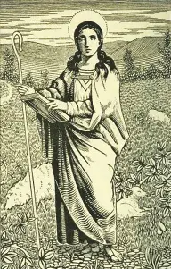
Who is St. Brigid of Kildare? (3)
In St. Patrick’s time, as the Church was developing, more young women, the daughters of chieftains especially, were being drawn to pursue religious life, becoming “virgins for Christ,” as they were called. Even before St. Brigid, women were consecrating themselves to the Lord, but it would be St. Brigid who would foster the growth of religious life, as she would start the first formal religious community for women in Ireland. Saint Brigid would realize the dream of her heart, and be given the veil of a bride of Christ by St. Mel, the nephew of St. Patrick. It was St. Mel who had met St. Brigid’s mother while she was pregnant with St. Brigid, and predicted that she would have a child who would be great. When he consecrated St. Brigid, along with seven other women, making St. Brigid the first nun in Ireland, he would see the fulfillment of his prophecy. Initially, St. Brigid had attempted to remain behind so that she would be consecrated last, in her humility, but a pillar of fire rose over her head, marking her as set apart; the Holy Spirit made His Presence within her known. Like Our Lady, St. Brigid was so fruitful, because she was open to receiving the Holy Spirit, Who dwelt within her, helping her to bear good fruit through God’s grace. When he consecrated her, St. Mel unintentionally used the form for ordaining a bishop; it was God’s will that St. Brigid should be a great leader, though she would serve as a religious superior in her convent for women, not as a bishop. So that suitors would not pursue her as she sought out Christ, the beautiful St. Brigid had prayed to lose her beauty, and tradition holds that it was then that her face became disfigured, but when she was consecrated, St. Brigid’s beauty returned; her greatest beauty was in her soul, a reflection of Christ in His radiance. After being wed to the Lord, St. Brigid went about building a home in which she could live out her mystical marriage, and invite other brides of Christ to join her in adoring the Lord. She would establish a monastery in Kildare, where the bishop St. Conleth, a talented metalworker, would preside. Together, they developed a double monastery: a religious community led by St. Conleth for men, and a religious community led by the abbess St. Brigid for women. This monastery would be called the “Church of the Oaks,” and would raise up men and women of faith to be like mighty oaks, standing tall and strong for Christ, but providing a gentle and peaceful shelter for those in need of renewal in the Lord

Slide 7
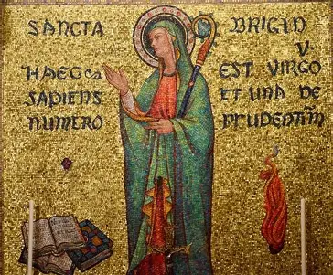
Who is St. Brigid of Kildare? (4)
Rather than remaining at the Church of the Oaks, St. Brigid would spread the roots of this motherhouse, going out to serve spiritual children everywhere by traveling Ireland to build monasteries for women religious, planting the seeds for many daughter houses. Much like St. Patrick, she was a kind of missionary soul, going out to the people to bring God’s love, and to equip them to share His love, too. A talented counselor, St. Brigid nurtured and guided souls on the path to Heaven, including St. Brendan; it is believed that she even hung her cloak on a sunbeam. Shining the light of Christ, she wrapped others under Our Lady’s mantle, opening the door to Heaven for them. Showing souls the tender maternal love of Our Lady, with her heart for the poor, and anyone who was otherwise unseen or unknown, in a spiritual way, St. Brigid welcomed everyone to take shelter under her cloak, near to her loving, generous heart, and would heal the blind and deaf, opening the eyes of souls, as well as the ears of hearts, to absorb God’s goodness, expressed through the Word made Flesh, Whose light was reflected in St. Brigid. In 525 A.D., St. Brigid passed from this life into the next, after having illuminated so many lives with the love of Christ. Her memory would be spread far and wide by missionaries who carried on her legacy, and inspired others to come to Christ through his dear bride, St. Brigid, a reflection of Our Lady, and Christ’s Bride, the Church, in that St. Brigid had united souls in Christ’s Heart out of love for Him, as members of His Mystical Body. Pious legend holds that the relics of St. Brigid were moved to join the mortal remains of St. Patrick and St. Columba to protect them from desecration during an impending Viking attack, so St. Brigid is joined in a reflection of the Blessed Trinity, which she and her fellow Irish patrons, teachers of the Faith, honored in their missionary activity, their every ministry of love for Christ

Slide 8
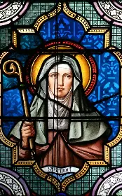
How does St. Brigid of Kildare reflect Our Lady? (1)
Saint Brigid came to be called “Mary of the Gaels,” because she was so frequently compared to Mary, the Mother of Jesus, in her ability to heal, especially through applying her wisdom, a wisdom of the mind and of the spirit. Having founded schools of metallurgy and illumination (of manuscripts with illustrations), St. Brigid was also one to illuminate the mind, heart, and soul with greater understanding of the Lord, in showing them the love of Our Lady, His reflection. (The Book of Kildare, called an “angelic” work that may have been similar to the Book of Kells, was made in St. Brigid’s monastery, but was lost.) As an abbess, St. Brigid developed a rule for her community, but it has not survived. It is believed that the word “bride” derived from her name, because husbands would call their wives after Brigid to compliment them, honoring their Brigid-like goodness, or would pray for a bride who was like St. Brigid in virtue. Our Lady is the bride of the Holy Spirit, opened totally to His grace, and so, in saying “yes” to God’s plan for her to become the Mother of God the Son, could be filled with the Holy Spirit, conceiving Christ in her, that His Light would be born into the world to heal it. Saint Brigid committed herself totally to Christ, not fearing her father’s reaction to her vocation, but pursuing it at any cost. Saint Brigid held Christ, the King and Unifier of all, in her heart, and served as a bridge between past and present, drawing pagan Irish people into Holy Mother Church, heralding the dawn of a new Ireland, a sanctified motherland consecrated to the Blessed Mother. Similarly, Our Lady held Christ within her womb, and in making Our Lady His Mother, the spiritual mother of all redeemed by Him, Christ made Our Lady into a bridge between the Old and New Testaments, the fulfillment of all of the past prophecies. Both Saint Brigid and Our Lady guide souls into the light of the future, the light of what they can become in Christ, by helping them to understand the past, and where they stand in the present

Slide 9
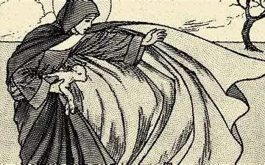
How does St. Brigid of Kildare reflect Our Lady? (2)
Saint Brigid is like Our Lady in that she is animated by charity. She was a contemplative and active soul whose prayers fueled her works of mercy to aid other souls. Like Our Lady, St. Brigid went out to the poor, to anyone in need, to touch their souls, to bring them hope and healing where it was most needed. Longing for Christ’s Heart to be consoled, for His yearning for souls to be fulfilled, St. Brigid traveled on missions to bring Christ’s loving Presence to others, teaching about Him at every available opportunity. In a similar way, Our Lady is a model of catechists who teaches us how to love Christ with a pure heart, how to evangelize with gentleness and compassion, so that souls will be drawn to His Heart for healing. Our Lady prayed for the success of the apostles’ missions so that they would win many souls to Christ, bringing them the graces of the sacraments, through which they would receive God’s love. Saint Brigid drew others under the mantle of Mother Mary, sheltering others with her cloak, showing them a home in the Heart of Christ, nourishing them to show them how Christ sustains forever. Saint Brigid and Our Lady inspire souls to go to Christ’s Heart of burning charity for mercy, to draw living water from His pure Heart, that their hearts would be cleansed, refreshed, and renewed eternally

Slide 10
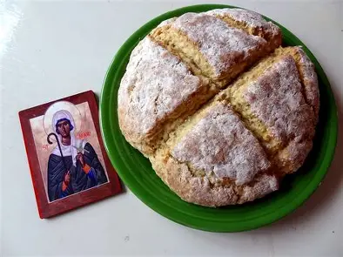
What are some special traditions celebrated in honor of St. Brigid? (1)
Two hymns composed by saints (St. Ultan and St. Broccan) in St. Brigid’s honor in the seventh century are the earliest known surviving works to refer to Saint Brigid; it was the Catholic Church that introduced to Ireland the practice of preserving writing through manuscripts in the first place. In the Middle Ages, offices of prayers and songs were composed in celebration of St. Brigid’s feast day. A hymn was also written in 1911 by one of the Brigidine sisters, called “Hymn to St. Brigid.” One might choose to sing in praise of St. Brigid on St. Brigid’s Eve while weaving crosses or baking bread (with buttermilk, since St. Brigid is a patron of dairy workers) to share in honor of St. Brigid. Because St. Brigid is known for her works of charity, she is honored on her feast day through serving people in need, namely, by making baskets of treats baked to share with the poor, such as bread and cake. An oaten bread for St. Brigid is typically made to be blessed on St. Brigid’s feast day with the crosses, reminding us that through the Cross, we can receive our eternal salvation, our everlasting nourishment, in Christ, the True Bread, Who came down to us to remain with us in the altar bread after His Passion, Death, and Resurrection, as His Death made the sacraments efficacious, meaning that we receive graces that make a real impact, that have a true effect, on our souls, particularly, when we receive the center, the crowning glory, of all of the sacraments, the Holy Eucharist. On St. Brigid’s Eve, families may leave out butter and salt for St. Brigid to bless, as it was traditionally believed that St. Brigid would walk through Ireland on the eve of her feast day with her cow, bringing blessings to Catholic families whom she visited. Families would create a bed of rushes in their home for St. Brigid to rest upon in between house visits, and would leave a candle and oaten cake for St. Brigid to show hospitality, to repay her for how she brings us to the warmth and nourishment of Christ’s Heart. We are reminded that, as we open our hearts to the friendship of the saints, they can help us to be receptive to God’s grace, which will allow us to be the salt of the Earth, to bring flavor and meaning to life by bringing God’s Presence to others (hay or corn may even be left out to feed St. Brigid’s cow, too!)

Slide 11
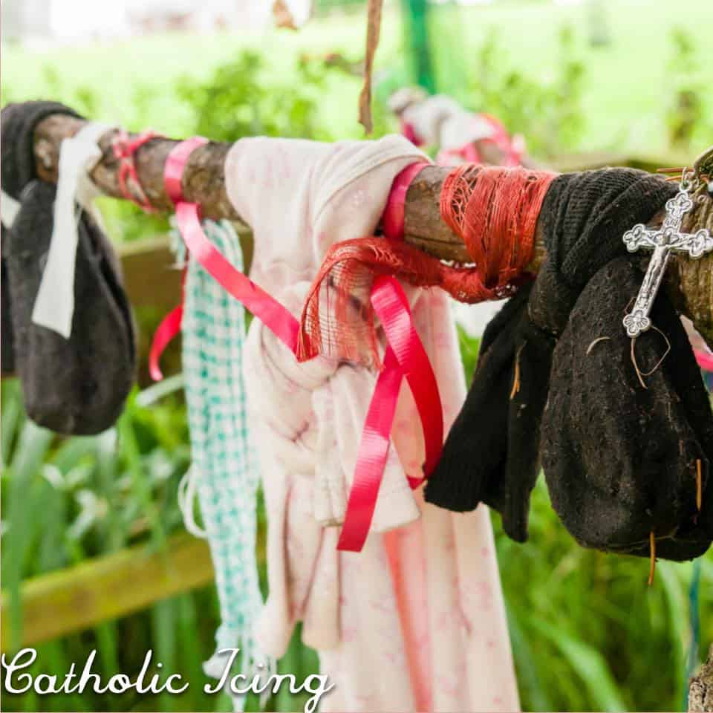
What are some special traditions celebrated in honor of St. Brigid? (2)
Tradition holds that when St. Brigid was seeking to build a new monastery, she asked the king about having a parcel of his land; she was interested in this particular area, because of the beautiful oak tree on it, a symbol of the gentleness and strength of Holy Mother Church, of Christ and Our Lady who invite us to be in the family of God through entering into Holy Mother Church. Laughingly, the king told her that she could have as much land as her cloak could cover, seeing how small her garment was. Trusting in the Lord to provide, St. Brigid agreed to this offer, and placed her cloak on the ground. Four assistants would help her by spreading the corners of the cloak across the land, gradually unfolding it. This goes to show that we all are to work together to envelop the whole world in Christ’s love, helping them to put on the garments of the Lamb, to bring His gentleness and sweetness everywhere. We are all meant to go to the four corners of the Earth, to bring the Gospel message to everyone. The cloak would keep growing, until it covered the whole swath of land that St. Brigid would need for her community. Saint Brigid remained under Our Lady’s mantle, and therefore, remained in God’s grace, standing by Him like Our Lady, with much faith, a level of trust that would convert the king, who would become a patron of the monastery, seeing the greatness of Christ the King at work there, and coming to believe in His glory. On St. Brigid’s Eve, the St. Brigid’s mantle custom is practiced, in which families leave pieces of cloth, ribbon, or scarves on a clothesline (or a tree, commemorating the Church of the Oaks that St. Brigid founded), so that God would bless the various linen squares through the intercession of St. Brigid. These squares, as an added measure, could be brought to priests to be blessed, so that they would serve as sacramentals, reminding us of how Jesus and Mother Mary envelop us in their love as we receive God’s grace in the sacraments. The pieces of St. Brigid’s mantle are placed on the sick, or women in labor, to call down Jesus’ healing, all of God’s blessings, through the intercession of St. Brigid. Typically, the pieces of St. Brigid’s mantle are used to heal headaches and sore throats; they are rubbed on the head, throat, or another ailing part of the body, three times in the Name of the Father, and of the Son, and of the Holy Spirit. Saint Brigid continues to enfold us in her cloak, the cloak of Christ, as she prays for us, leading us to Christ, her Spouse, Who reaches out His Hands to heal and bless us. Another special tradition on St. Brigid’s Eve is for young children to make corn husk or yarn dolls resembling St. Brigid, which would be carried door-to-door by girls dressed as St. Brigid (in a tradition similar to trick-or-treating) to present to neighbors in exchange for treats, as they remembered St. Brigid’s childlike love for God reflecting the humble love of the Christ Child, and would be inspired to reward the children for bringing joy like St. Brigid

Slide 12
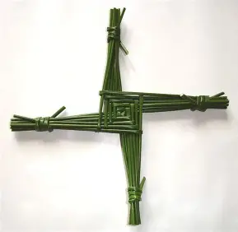
What is the St. Brigid Cross?
Saint Brigid is believed to have been visiting the home of a dying chieftain who was in spiritual danger, still being a pagan, when she was inspired to weave a Cross from the straw floor. Taking up pieces of straw to sew the story of salvation together for the dying man to see, St. Brigid told the story of Christ’s victory over the Cross. So moved was the man, that he converted before he passed away, kissing the Cross in reverent veneration, and receiving the sacrament of Holy Baptism. Some maintain that the man that St. Brigid converted was her own father, whom she led to God the Father with her patience and goodness. Today, it is a popular custom to hang up a new St. Brigid’s Cross each year, in the home and/or the barn to usher in God’s blessing in the new year, through the power of the Holy Cross of Christ. This story goes to show us that everything from God is a gift, so in meeting souls where they are, working with what we have, we can make a positive impact on souls, in union with God; God weaves us together to share His love and witness to His redemptive power, His mercy and goodness. Our Lord gave His life for everyone, and will help us all with His grace, which He dispenses through Our Lady, a channel of salvation leading like a stream to His Heart. With Our Lady, we can unite our hearts to the Heart of Jesus on the Cross. Traditionally, St. Brigid’s crosses are made on the eve of St. Brigid’s feast day (January 31), to be brought to Holy Mass to be blessed on the Feast of St. Brigid (February 1), then exchanged between family and friends, that the blessing of St. Brigid would be extended to others in an unbroken circle, the circle of Christ’s love. Once blessed and shared, the St. Brigid’s Cross is placed in a barn or home to protect it from fire. Saint Brigid helps us to remain in God’s grace, away from the eternal fires, to receive all of God’s love in the light of Heaven. Woven from left to right, the positioning of the cross is meant to echo that of the sun in the sky on January 31. When making the cross, one prays for a different person on each rush, or on each arm of the cross. On the four arms, one prays for, respectively: those God placed in our path in the past to shape us; those who will be placed on our path in the future; the healing of those who have passed on; and our reunion in Heaven with the souls we have loved. All of these petitions are placed in the Heart of Jesus, Who is at the center, keeping everything together

Slide 13
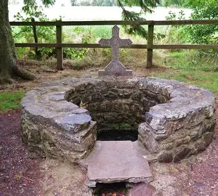
What is St. Brigid’s Well?
Well, I am glad that you asked! In Ireland, there are over 3,000 wells dedicated to holy saints. Of these, one hundred are devoted to St. Brigid. Near Kildare is the “official” St. Brigid’s well, located proximally to the site where St. Brigid had constructed her. double monastery, where men would give obedience to a bishop, and women to the abbess, St. Brigid. (In having been “ordained” a bishop, St. Brigid could lead both communities. Her crosier in artwork identifies her authority as an abbess, a shepherdess of souls like Our Lady.) It was here that St. Brigid would use the water for emergency baptisms to baptize pagans, bringing them into Holy Mother Church. Because it is believed that the holy water in the well can provide healing, people would dip rags into the water, using them to wipe faces, especially for the purpose of helping the eyes. Afterwards, the people traditionally would say seven “Our Father,” seven “Hail Mary,” and seven “Glory Be” prayers every day for seven days. Then, on St. Brigid’s feast day, the faithful would gather by her well to pray the Holy Rosary in the candlelight, remembering the woman Ireland loves for reflecting Mother Mary (so much so, that a popular greeting became “Brigid and Mary be with you”!. Feeding the well is an underground spring from which flows a stream. Marking this channel are stations aboveground, at which the faithful are invited to pray (namely, the Holy Rosary), to travel spiritually with Christ as St. Brigid did in her travels, and spiritually participate with Christ on His walk, drawing from the well of His Heart for redemption, as an oasis in the desert. Saint Brigid was a channel of grace like Our Lady, inviting others to come to know Christ, and to find refreshment in His Heart, which contains all that we need to be spiritually rejuvenated, as we go to the altar of God to receive the joy of our youth, the sense of fulfillment that we need; every experience that God gives us is meant to pour more grace into our hearts, that the dams of our hearts would burst, any walls being broken, so as to permit Christ to enter. At St. Brigid’s well, the faithful are to circle the cross five times prayerfully, before going to the well for prayer. If we are to receive heavenly refreshment, then we are to unite with Christ in His life-giving love on the Cross, being interiorly wounded with the Lord in order to be most deeply healed, to share with Christ in taking on the five holy wounds of His love, so as to share in His glory, His triumph over the Cross and death. Pilgrims visiting St. Brigid’s well also encircle the statue of St. Brigid, which depicts the saint holding a flame, a reminder that we are all called to be like candles burning ourselves out for Christ, being purified by His love as we open ourselves to being held and carried by Our Lady, that we would grow like the Christ Child in the womb, and be made clean of heart by growing near the Immaculate Heart of Mary. Like the spring beneath the well, St. Brigid was hidden, initially living a cloistered life, but even in serving the world, safeguarded the treasure of her heart, which was given to God, and stewarded the gifts that He had given her, revealing the thoughts of her heart to Him, not becoming too attached to the things of the world, but remaining rooted in the Heart of Jesus, not to be distracted or disturbed by external forces

Slide 14
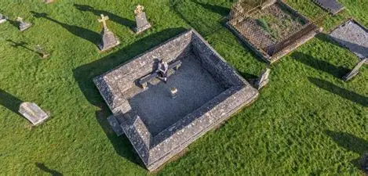
What is St. Brigid’s Fire?
Prior to the Christianization of Ireland, a fire was kept burning unceasingly by pagan priestesses. When St. Brigid founded her first monastery, believed to be the very first monastery for women in all of Ireland, she decided to burn a fire that would honor the new light of understanding, a new knowledge of truth, given to Ireland through conversion to Catholicism. Marking a new beginning, St. Brigid’s fire would be kept burning continuously by her community of Brigidine sisters until the 1500s. This ongoing fire represents how, when we live for God, embodying His Spirit of love and shining His light, we can illuminate others’ lives, enkindling flames of faith, hope, and love in their hearts, so that souls everywhere can be united in adoration of God, their hearts burning with love for Him. The fire of charity spreads with just one spark, when one person is willing to initiate is, and is open to carrying the torch, that it would be passed along to many others. Our Lady, by first saying “yes” to God’s plan for her to bring Christ into the world out of love, would ignite love for God in others, inspiring other souls to bring Christ into the world by saying “yes” to God’s plan. When we take up the wood of the Cross, the kindling, God will give us a deeper share of His love, helping us to have a broader capacity to love others, as we unite with Christ in His Sacrifice; He will keep the flames going

Slide 15
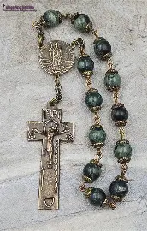
What is the Chaplet of St. Patrick?
The Chaplet of St. Patrick consists of twelve beads, one for each of the apostles, whom St. Patrick emulated in his missionary work, going out to souls to teach them about Christ. On each of the twelve beads, one prays the “Glory Be,” giving glory to God for St. Patrick’s life, and honoring St. Patrick for having taught about the Blessed Trinity, glorifying God the Father, God the Son, and God the Holy Spirit in using the three-leaf clover to instruct others in the beauty, truth, and goodness of God, His love that connects each Person of the Trinity, and each of us. (Fittingly, the twelve prayers may be divided into four groups of three.) Prior to praying the Chaplet, one says the Apostles’ Creed, and in concluding it, one says the Breastplate Prayer of St. Patrick, praying to go out as a soldier for Christ to defend the Faith; the prayer is meant to be a kind of shield calling down the protection of Christ

Slide 16
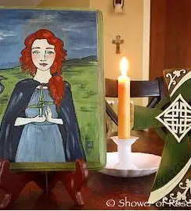
How does St. Brigid help us to celebrate Candlemas?
The beeswax candles that we have blessed on Candlemas are made by virgin bees. Candle tapers themselves represent Christ’s pure Body, which was broken out of love for us, but glorified in Heaven, risen, that we would receive His love in the sacraments, to rise with Him in glory forever. In reparation to God the Father, on our behalf, Christ took on our sins of the flesh with all of His Body, that we would be purified, and after His second coming at the end of time, would be glorified in body, our bodies and souls made whole, transfigured by God’s grace. The wick and flame of the candle represent Christ’s Soul and Divinity. In her life as a nun, a virgin bride of Christ, St. Brigid reflected Christ in His purity of body and soul, so that His godly love could live within her, and be radiated outward to heal other souls. As an abbess, St. Brigid oversaw the spiritual growth of souls at a monastery, nurturing a beehive of activity oriented towards glorifying God. Saint Brigid helps us to celebrate Candlemas by embracing the blessings that God gives to us, and shining the joy and gratitude we feel for God’s Presence in our lives out to others, that they would embrace God’s love, too. Saint Brigid helps us to illuminate the way to God, to blaze new trails for Him without fear, leading the candlelight procession to Him, to Heaven. Saint Brigid had fortitude in going out to new territories to build monasteries; in pursuing her vocation in the first place, due to opposition from her father; and in choosing to live for Christ each day, to do what was countercultural, and experience a kind of spiritual martyrdom in uniting herself with Christ on the Cross, not seeking comfort and consolation in the world, or in the sacrament of marriage, within a family. Rather, through the grace of God, she built her own spiritual family, and sustained it through the spiritual union she had with Christ, receiving His love openly in order to share it, to equip others to respond to God’s loving Presence in their lives, with purity of heart like that of Our Lady

Slide 17
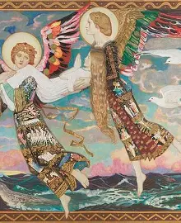
How did St. Brigid bridge Heaven and Earth?
Saint Brigid is a link between seasons: Christmas and Lent, helping to drive out winter’s darkness and usher in springtime light, like Chirst. In being like Our Lady, St. Brigid serves as a bridge; she mirrors Mother Mary’s “strength and gentleness,” which is the motto of the Brigidine Sisters. Carrying the light of Christ into the world, bearing testimony to His light, requires strength, the courage to be a pioneer, a pilgrim, going forth to speak the Truth, to guide others to embrace the eternal love of the Lord, the promise of eternal happiness to come through the wood of the Cross, rather than the temporal comforts of the world; so too, is gentleness needed, to touch souls with Christ’s love, leading them to seek out friendship with Him. Saint Brigid supports us in carrying the candle of faith from the Christmas season into Lent, guiding us to love with childlike hearts of trust in the Eternal Father, to take up the Cross with Christ, that we would humble ourselves like Jesus coming down from Heaven as a child in the manger to feed us, then going on the Cross for our eternal nourishment, making Himself vulnerable as He was pinned under the nails for our salvation. Through all seasons, including those of penance, the winters of our lives, St. Brigid helps us to maintain hope in the miracles, the wonders, that God will work out of love, that we would never stop reflecting His light, but would come to shine it eternally in Heaven, through humbly receiving into our hearts all that God has given us, humility being the key to journeying from Earth to Heaven. Saint Brigid teaches us that even in dying, there is rebirth, namely, when we die to sin, so as to rise to pure love with Christ. A patron of nursing mothers, babies, farmers, and dairy workers, Saint Brigid teaches us about celebrating new life in Christ, the greatest Gardener and spiritual Farmer Who plants every seed, and helps us to produce good fruit, that we would always bring the life and hope of the Christ Child into the world (there is even a pious legend that St. Brigid was carried miraculously by the holy angels to Bethlehem to serve as Our Lady’s midwife as she prepared to give birth to Christ. Now, St. Brigid is spiritually midwifing us into Heaven). Saint Brigid helps us to see God’s heavenly Presence in the everyday, to appreciate how He treasures us, and gives us so much to treasure in our hearts. Saint Brigid was a creator, a cultivator of God’s gifts who could contribute to the growth of seeds of virtue; through everything she did, God’s life was breathed into souls. She made crosses from grass, from rushes and reeds, things that grow, to teach us that the Cross of Christ is not a dead thing, but that, because Christ is alive, having conquered the Cross, we can carry our Crosses, which are our means to Heaven, to the inner growth and spiritual transformation needed to get us there, in bringing us close to Christ and the Holy Eucharist, at times when we most need their heavenly graces

Slide 18
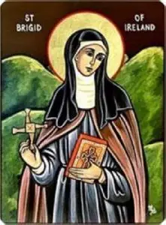
Announcements
Traditional Latin Mass for the Feast of Our Lady’s Purification
  Monday, February 2, 2026, 6:00 p.m., church
Seven Sisters Apostolate Book Club: Christmas Blossoms
  Monday, February 2, 2026, 7:15 p.m., parish library
Traditional Latin Mass for the First Friday of February
  Friday, February 6, 2026, 6:00 p.m., church
Around the World with the Saints Presentation: Bavaria
  Friday, February 6, 2026, 7:00 p.m., parish hall
Blessing of sacramentals
  Saturday, February 7, 2026, 9:30 a.m., church
Holy Rosary Confraternity Prayer Group Session
  Saturday, February 7, 2026, 10:00 a.m., parish library

Slide 19
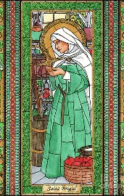
Closing Prayer (1): Litany of St. Brigid of Kildare
Holy Mary, Queen of virgins, Pray for us.
Saint Brigid, Pray for us.
Mary of the Gael, Pray for us.
St. Brigid, Patroness of Ireland, Pray for us.
St. Brigid, shining light of virtue and sanctity, Pray for us.
St. Brigid, consecrated spouse of Jesus Christ, Pray for us.
St. Brigid, foundress of Kildare, Pray for us.
St. Brigid, cornerstone of the monastic institute in the Isle of Saints, Pray for us.
St. Brigid, great model of Irish virgins, Pray for us.
St. Brigid, mother of religious, Pray for us.
St. Brigid, pattern of religious perfection, Pray for us.
St. Brigid, intercessor for the Irish Church, Pray for us.
St. Brigid, mediatrix for the Irish race, Pray for us.
St. Brigid, protectress of the holy faith planted by Saint Padrig, Pray for us.
St. Brigid, enjoying with him the clear vision of God, Pray for us.
St. Brigid, whose one desire was to satisfy the poor, drive out hardship, and spare every miserable man, Pray for us.

Slide 20
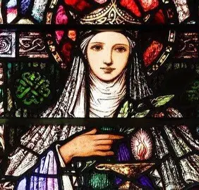
Closing Prayer (2): Saint Brigid Prayer of Blessing
May Brigid bless the house wherein you dwell
Bless every fireside every wall and door
Bless every heart that beats beneath its roof
Bless every hand that toils to bring it joy
Bless every foot that walks its portals through
May Brigid bless the house that shelters you.

Slide 21
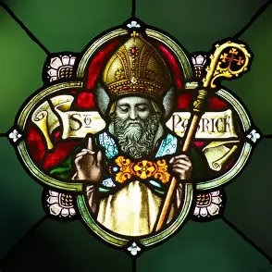
Breastplate of St. Patrick Prayer
Christ as a light,
Illumine and guide me!
Christ as a shield, overshadow and cover me!
Christ be under me! Christ be over me!
Christ be beside me, On the left hand and right!
Christ be before me, behind me, about me;
Christ this day, be within and without me!

