Slide 1
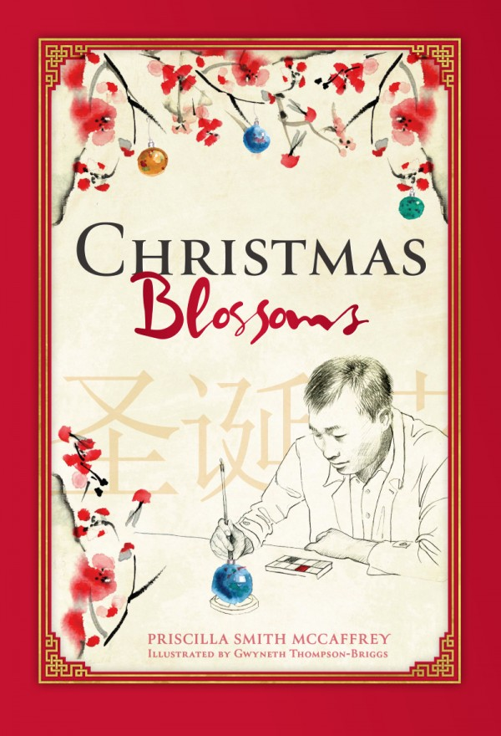
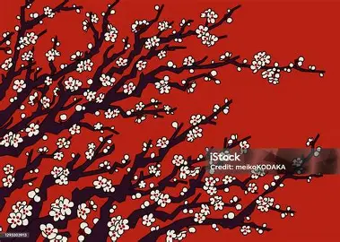
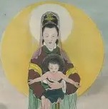
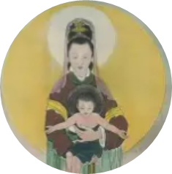
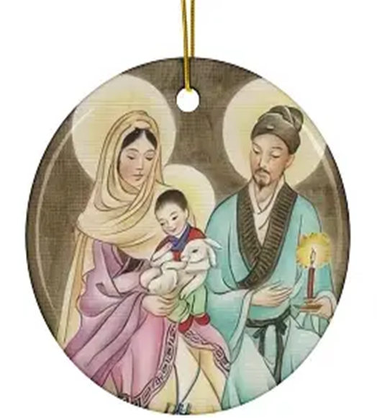
Blossoming with Christ Beyond Christmas: Carrying Forward Bouquets of Spiritual Takeaways from Christmas Blossoms
Monday, February 2, 2026
Katie Sadakierski

Slide 2
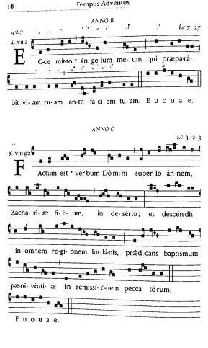
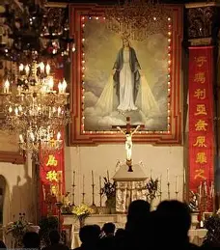
Opening Prayer: Collect Prayer for the Feast of the Presentation of Our Lord at the Temple
Almighty ever-living God, we humbly implore Your majesty that, just as Your Only Begotten Son was presented on this day in the Temple in the substance of our flesh, so, by Your grace, we may be presented to You with minds made pure. Through our Lord Jesus Christ, Your Son, Who lives and reigns with You in the unity of the Holy Spirit, God, for ever and ever. Amen.

Slide 3
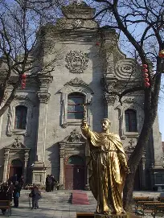
What was the Cultural Revolution in China? How did this set the stage for the story Christmas Blossoms?
The Cultural Revolution, which took place between 1966 and 1976 in China, was the result of a Communist rise to power. As socialism replaced religion, the Chinese people underwent a program of reeducation, as they were taught to unlearn what they knew about faith; the government attempted to “purify” its citizens by ridding them of any “Western” influence, including Christian belief, so that the Chinese people could be as they were before incursions by Europeans and other foreigners into the country. During this time, churches and other devotional items were destroyed; Catholics were persecuted, being denied services, including medical care, due to their faith, even wearing cards identifying them as Catholics; priests were imprisoned; the Chinese language was simplified, making it difficult for Chinese language-speakers to translate older works, such as the Holy Bible; and the Red Guard government workers attempted to rid souls of their sense of God’s beauty, truth, and goodness; past professors were sent to work in the fields; and the truth was suppressed, rather than being shared to empower souls to do as their conscience demanded. Freedoms of the people were violated; they could not openly live out their religious beliefs. A militaristic culture emerged, but soldiers for Christ would fight on, not totally relinquishing their faith in order to be safe. Catholic missionaries to China had come as early as the 1200s; even after the Cultural Revolution, such Catholic gems as the Cathedral of the Immaculate Conception, the oldest Catholic church in China, and a gift to souls constructed in the Ming dynasty (between approximately the 1300s and 1600s) honor of Our Lady’s purity, have survived, for Our Lord and Our Lady have hearts of pure love that will never stop beating; their inner light will not be extinguished. In front of the cathedral is a statue of Matteo Ricci, a Jesuit priest who helped to convert the Chinese to Catholicism in the 1600s, which is inscribed with the phrase “Wan fu,” meaning “Hail Mary.” This prayer, this invocation reverencing and welcoming Our Lady in union with the holy angels, is the root of growth. It is within this context that we meet the characters of Christmas Blossoms, who have been affected deeply by the political regime in China, and are cautiously taking steps to reclaim their Catholic heritage, after having been in hiding for so long. They are preparing to emerge from beneath the snow and ice, to fully bloom above the surface. Zhang Jian, after having been separated from his parents as a child due to their adherence to the Catholic Faith amidst persecution, losing them to the government, is relearning to trust in God, Whom he has always held in his heart, but is afraid to fully abandon himself to, after having faced tragedies that include infertility, the loss of his wife, and the loss of his infant child who was growing within his wife’s womb. Having worked as a painter of Christmas ornaments, Jian knew about the celebration of light and hope, of gifts and good fortune, but would have to reconcile past and present to embrace his future, coming to terms with his grief, and hiding within the wounds of Christ, so as to most fully grow into who he was called to become, a healer of others, one who uses his art to touch hearts. After going through the motions, Jian would open himself to feeling once again, to hoping and believing, from being absent, to being present, as Our Lord had always been for him, even in the tragedies

Slide 4
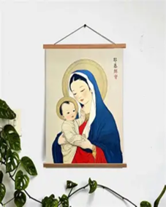
Discussion Question 1:
In the novella Christmas Blossoms, we see a kind of salvation arc at play in the narrative, as we learn about Jian’s relationship with Christ over the years. In the end, we see how Jian represents his relationship with Christ in art with the plum blossom motif.
How did Jian grow throughout the story Christmas Blossoms? How did you see Christ at work in his life? What would it mean for us to blossom? How may we carry forward the flowers of spiritual takeaways we gathered in the Christmas season?

Slide 5
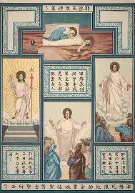
How did Jian grow throughout the story Christmas Blossoms? What flowers of virtue grew in his heart? How did his evangelization approach change? How did you see Christ at work in his life? What would it mean for us to blossom? How may we carry forward the flowers of spiritual takeaways we gathered in the Christmas season? (1)
Initially, Jian was of a more reserved and reticent nature. A flame of love for Jesus burned brightly in his heart, but Jian experienced fears about sharing it for all to see. Awaiting the fulfillment of his dreams, he had a sense of longing; all of his life, he remembered in his heart the treasured memories of his family celebrating Christmas, knowing the warmth and brightness of Christ’s Heart in the way that his family’s missionary priest friends would come to sing Christmas hymns to them, making an effort to speak their language, to understand their neighbors, by singing a carol in Chinese. Once they did, they were invited in. Jian would learn to speak Christ’s language of love, of trust and self-sacrifice, in order to let Christ into his heart, and to enter into Heaven, where he could be united with Christ’s Heart. Jian yearned to replicate the past in the present, to create his own family, and was devastated when, after a long period of infertility, his wife would pass away, killed during an earthquake while she was expecting their son. Grief numbed Jian at first, closing off his heart, but Jian was patient, courageous, and humble. He kept going, not despairing, because he carried Christ in his pocket, but would come to embody Christ’s Heart, absorbing Him totally into his soul. Jian never had a sense of entitlement, demanding answers from God about why he had to suffer; nor was he arrogant in trying to play God, or to distance himself from Him. Rather, John’s hesitation to trust kept him from becoming as close to Christ as he could be. There was still a sense of unease in his heart, a need to be completed, to be part of a family once again, when tragedy left him a widower, alone in the world. When Jian drew others to him as his family in Christ, like Renshu, believing in his soul, and wanting him to be saved, to the point that Jian risked rejection by witnessing to Christ’s love aloud, he demonstrated his growth in faith, and it became all the more apparent that he had fully embraced the Holy Family, becoming a part of it, as he trusted that God would fulfill his every need, even while he missed his earthly family. The song in Jian’s heart would not be silenced; he would come to sing it with Christ in thanksgiving

Slide 6
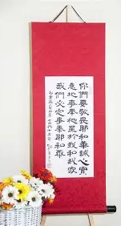
How did Jian grow throughout the story Christmas Blossoms? What flowers of virtue grew in his heart? How did his evangelization approach change? How did you see Christ at work in his life? What would it mean for us to blossom? How may we carry forward the flowers of spiritual takeaways we gathered in the Christmas season? (2)
Whereas before, Jian spoke generally, and was a kind of everyman surviving and fitting in, he would come to more boldly proclaim the truth, to share his love for Jesus more wholeheartedly, to the point that he catechized his friend, Renshu, about Jesus. He embraced what God had given him in the present, choosing to love and minister to the friends around him, instead of dwelling in the past. Jian’s art would follow, also becoming a tool for evangelization. Prior to his deeper conversion, Jian painted generic winter scenes inside of his glass ornaments, not overtly spreading a message about God through these wares made for Western consumers, simply to feed a demand, but would soon come to share the nourishment he received from Christ, the True Wheat, so as to feed the souls of others, which are hungry for beauty, truth, and goodness. God used Jian’s memories, which had once been painful to him, to heal him, recalling to his mind the gentle devotion of his wife, who reverently kissed the Christ Child figure after removing the figure from Jian’s pocket, ensuring that when she washed his clothes, the figure would not be destroyed. Jian had always been careful in his life, but after losing everything, began to share all of his love without holding back. He would spiritually kiss the Christ Child to honor his wife, who had nurtured his soul so much, and whom he wanted to be united with again, to be forever sustained by God’s love. For us to blossom means to be receptive like Our Lady, to have an open heart to whatever God may will for our purification, as we welcome the opportunity to love more deeply, to place ourselves in the manger with the Child to be healed by Him, as we offer ourselves to His service in like manner to how He offered Himself to God the Father’s service, in coming to serve us. Going forward, we can carry on our Christmas spirit of hope in the Christ Child, actively waiting not with dread or fear, but with confidence in Christ, knowing that when He loves us so much so as to come down from Heaven to save us, there is nothing He will not do for our salvation, so we can trust in Him to keep reaching out and saving us. This means that we can keep reaching back, taking steps to openly shine Christ’s light, without fear

Slide 7
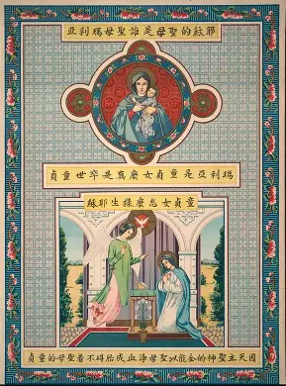
Discussion Question 2:
Christmas Blossoms underscores to us the central role that family plays in our spiritual development, and in honoring the Presence of the Christ Child in the Christmas season, makes a case for life.
How can we read Christmas Blossoms as a pro-life work? How does it argue for and celebrate life? What does it mean for us to support and promote life in our ministry, and in general?

Slide 8
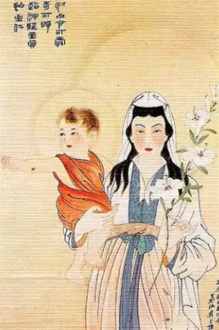
How can we read Christmas Blossoms as a pro-life work? How does it argue for and celebrate life? What does it mean for us to support and promote life in our ministry, and in general? Why is the plum blossom such a fitting symbol for this story, and for the pro-life movement?
Every soul is unique, just like the ornaments created by Jian and his coworkers. In a consumerist culture that devalues human life, treating it as a commodity, we are called to respect the dignity of each human life, which is unrepeatable and irreplaceable. This work speaks to the fact that we all can blossom, at each stage of life, because God is the master Gardener giving us what we need to grow. Only He knows what our cycle of growth is to be, and only He can decide when we have learned all that we can from this life, and are ready to be brought to the greenhouse of Heaven, to receive the light of the Son to help others to grow, as we pray for souls on Earth and in Purgatory. Jian is drawn to the traditional Catholic churches that pray for the dead; he longs to celebrate life, to remember and treasure the gift of each life that God has given us. He also longs for a child, and then, to return to his childlike innocence. Always, the gift of family, of lives coming together in love, is cherished by Jian. Christmas Blossoms attests to how much life means, as we see the wound that losing his wife and unborn child, not to abortion, but to a natural disaster, has inflicted upon Jian, and consider how meaningful it would be for a couple facing infertility, like Jian and his wife, to be able to adopt a child. We see the pain that unnatural policies like the one-child law in China have on families, which are meant to always be open to God’s plan for life, to all of the blessings that He wishes to give them, which are infinite, uncountable. This story underscores that when we are closed off to the life that God wishes to give us, in both our natural and spiritual families, we experience a kind of spiritual death, and need to remain as branches connected to the True Vine in order to keep growing and being fruitful. Distancing ourselves from God, failing to keep Him at the center, means that we do not receive our true nourishment; God is love, and therefore, life, because life begins with love; God loved us first, and created us out of this love. It is a gift to share in God’s creativity, and God gives this gift out of goodness. In the book, we see what an impact one life can make, as we follow Renshu’s journey to Catholicism, which was initiated by Jian, a role model of faith. Renshu is poised by Jian to inspire future conversions to the Faith, so from the seeds of hope that one man planted, after having been touched by the Christ Child, Whose love he shared with everyone in need of it, giving them his figurine and prayers to say in the Divine Child’s honor, many souls would come to believe, and to be reborn in Christ

Slide 9
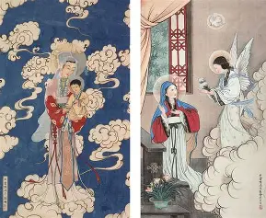
How can we read Christmas Blossoms as a pro-life work? How does it argue for and celebrate life? What does it mean for us to support and promote life in our ministry, and in general? Why is the plum blossom such a fitting symbol for this story, and for the pro-life movement? (2)
Supporting and promoting life in our ministries, and in general, means loving souls with a pure heart like that of the Christ Child, and treating everyone with dignity, seeing the Christ Child dwelling lovingly in all of them. The plum blossom is a fitting symbol for the story, because it blossoms even in the winter. It symbolizes the springtime to come, the growth that happens when we persevere, continuing on even in the winter; from barrenness, growth and renewal can always come. Plum blossoms signify strength, the beauty of resting in Christ’s strength in order to fully bloom as He calls us to. The plum blossom is a fitting symbol for the story, and the pro-life movement, because in a culture that often chooses death and despair over life and hope, the mighty flower teaches us that life persists, and is always possible, because God sustains it; there is beauty and meaning even in the times of sorrow and desolation. Consolation waits around the corner, when we patiently journey to Jerusalem, and then on to the New Jerusalem in Heaven, with Christ. Every life, like a flower, is precious and special, made by God for a purpose, to reflect His beauty, truth, and goodness. When we come together as spiritual parents, we can use our talents to bring souls to life in Christ, just as Jian served as a spiritual father to others in his single lay life as a widower. He built a family, and his life still had meaning, even though he could not be a natural father, because every vocation comes from God, and what comes from God is good, given out of His love. The brushstrokes forming the calligraphic Chinese characters remind us of how we tell the most beautiful and impactful story as one family, not only as individual names in the Heart of the Word, Who is Christ. In the book, we learn that the Chinese words for “harmony” and “calm” form the word for “peace.” Only when we live in harmony with God, calmly accepting His will for our happiness, can we have true peace that can never be taken away; living in harmony with God and His Commandments means embracing life, namely, life in Christ, as we receive His love in the Holy Eucharist, as the word for “harmony,” made up of the words “grain” and “mouth” reminds us. Receiving Jesus in the Holy Eucharist gives us the graces to live in harmony with Him, to be happy and calm, as members of the Mystical Body of Christ living and learning together. We can all be like guardian angels to each other, bringing the message of God’s love that can help us to live in peace, as mirrors of Mary who reflect the light of Christ’s loving Face, beholding us with such tenderness and affection, mercy and joy

Slide 10
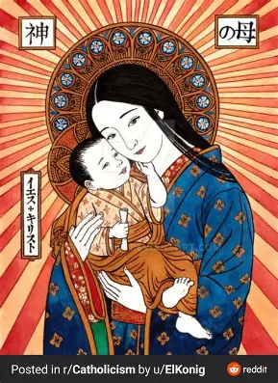
Discussion Question 3:
Jian, the protagonist of Christmas Blossoms, is a complex figure whose story shows us that it is never too late to be saved, that Christ is always present with us. In this way, he guides us to contemplate our own connection to Christ, and how we are opening ourselves to salvation in Him.
What does Christmas Blossoms reveal to us about what our attitude towards suffering ought to be? How does it juxtapose joy and sorrow? How does Jian reveal a kind of priestly heart to us in this novella, in his response to the joys and sorrows of his life? To Christ’s role within these intertwined mysteries?

Slide 11
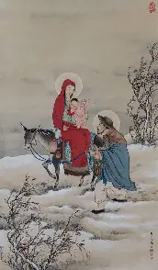
What does Christmas Blossoms reveal to us about what our attitude towards suffering ought to be? How does it juxtapose joy and sorrow? How does Jian reveal a kind of priestly heart to us in this novella, in his response to the joys and sorrows of his life? To Christ’s role within these intertwined mysteries? (1)
Through suffering, Jian truly comes to dwell within Christ’s Heart, to be painted within the canvas of His Soul, this masterpiece of divine love, like a scene painted within one of his ornaments. He sees that the Christmas mystery is ongoing, that we can be born into the bitter cold and the bitterness of wounded souls in the world, but remain in Christ’s light, without being touched by embitterment, just like Our Lady, who would never lose her sweetness, her innocent love for all of God’s creation, for her love for God would prevail. Jian demonstrates how we can find beauty in suffering, as it allows for us to be united with Christ most deeply, and to open our broken hearts to receiving other people with love, that they would be mended. Our attitude towards suffering ought to be one of hope and faith, without despair. We can look forward to the good that Christ will bring from it, and can still rejoice in the opportunity to offer up what we are going through for His glory, that others would come to believe in God’s Providence through our faithful witness to Him. This story shows us the joy that comes from trusting in Jesus, and to opening our hearts to being purified by Our Lady, the channel of grace connecting us to her Son. It is when Jian first sees children at the Midnight Mass playing with a Mother Mary figurine that he is inspired to give the Christ Child figure he carries with him to the children, that they would always know Our Lord’s love, and come to love Him in return with a heart like Our Lady’s. He is teaching them to embrace childlike wonder, to never lose hope in the miracles God works, as He always brings us right to where we are meant to be, leading us to our fulfillment, and completing us, in assembling our families, all connected by Christ’s Precious Blood, within the Church. From having experienced sorrow, Jian can love more deeply. In knowing the empty and desolation of losing all of his family, he can better appreciate how the Holy Family fills his heart, that he need never be empty. Trusting in them, knowing his place within the Holy Family, adoring the Christ Child with St. Joseph and Mother Mary, he can be at peace, just as the Holy Family does not lament that they are without a home, but find home in the Heart of God, right where they are, rejoicing in the gift of life that He has given them. Joy grows from experiencing the Lord’s Presence among us through our suffering. Jian came to realize that life is about more than fortune; life is what we make it, and when we live it with Christ, then there are always blessings, because the Christ Child is always reaching out to feed us. He came to give His life for us so that we would never be hungry, never having to want for anything

Slide 12
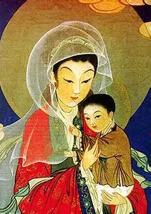
What does Christmas Blossoms reveal to us about what our attitude towards suffering ought to be? How does it juxtapose joy and sorrow? How does Jian reveal a kind of priestly heart to us in this novella, in his response to the joys and sorrows of his life? To Christ’s role within these intertwined mysteries? (2)
Jian reveals a priestly heart to us in this novena, in the sense that he gives himself entirely to God. He detaches himself from the world, after having been so attached to his family, to his dreams, and his memories, painful and joyful alike. Like a priest, Jian willed what God willed, ultimately, because he willed the happiness of others out of love. He took delight in imagining the joy and wonder that recipients of the Christmas ornaments he made would feel, and painted the most beautiful scenes that he could. Love motivated him to do and be his best, like a priest being so on fire with love for God, that he is driven by apostolic zeal, doing all that he can to save souls, envisioning them in Heaven with God, and being spurred on to realize this dream of bringing people to Christ’s Heart. Humble, he did not exalt himself as a master artist or teacher, choosing to learn and serve, but would humbly offer his works to God, coming to trust that God would use him as an instrument to share God’s love with others, even though he did not believe in his teaching or evangelization abilities. Jian did all things out of love for God, and persevered in his faith. He was willing to make sacrifices, giving not only a Christ Child figure to children, but bringing them Christ’s self-giving spirit, as Jian gave what was dearest to his heart, so that others could have hope, new life in Christ. He became childlike, relying entirely upon God, feeling not anxious, but serene about passing into the next life. With gratitude, he received God’s blessings, not wanting for anything, making his final ornament just for God, to thank Him, not for love of creatures, but for love of the Creator. In fighting for souls, moving outside of his comfort zone to guide his friend, Renshu, to know Christ, Jian demonstrated the godly love that inflames a priest’s heart. Jian would respond to Christ’s movement in his life with true faith, no longer needing visible things to help him in his belief in the invisible reality of Christ’s loving Presence. Recognizing that he alone could not save, Jian gave what he had to God, trusting that Our Lord would complete the story, finishing the masterpiece. He rejoiced in being nourished by Christ alone, not any temporal comforts, and strove to bring others to the heavenly wedding banquet, to know this everlasting nourishment. The final ornament scene that Jian creates says everything about how he has come to understand suffering, and to unite himself with the Suffering Servant completely. Jian sees that being wounded with Christ allows us to become like the Christ Child, to have golden hearts that empathize with others, and reach out to console Christ, to depend upon Him alone for our salvation, not ourselves, as we recognize that God is always doing His saving work, never ceasing to love us, never stopping in His mission to plant seeds of love in our hearts, that they would continue to blossom, drawing others into the heavenly garden

Slide 13
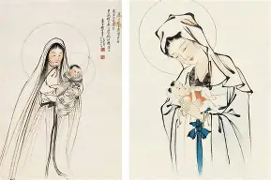
How does Christmas Blossoms connect to the celebration, and spiritual themes, of Candlemas? (1)
On Candlemas, we remember Our Lord’s Presentation at the Temple. Our Lady and St. Joseph brought Our Lord to the Temple in Jerusalem forty days after He was born, per the Jewish custom for sons. Rather than making the journey right after Christ’s Birth, for forty days, Our Lady had remained away from the Temple, as it was the Jewish law that women who had just given birth were to return to the Temple only after a period of purification (forty days, as forty is the number of purification and renewal), because childbirth was seen as ritually unclean. Our Lady, though already immaculate, chose to undergo the ritual out of humble love. She is our key to purification, to the salvation and healing that we need, as she prepares us to be united with Christ in humility, the root of true charity. When the Holy Family arrived at the Temple, they were greeted by St. Simeon, who had waited all of his life to meet the Savior, never losing hope that God’s promise to him, that he would see the Redeemer before dying, would be fulfilled. Saint Simeon was rewarded for his faith, for his perseverance, as he would come to hold Christ within his arms, cradling the pure Child Who had come to purify us all. When St. Simeon meets the Christ Child, he praises God with a canticle, a song of love from his heart; having seen that our trust in God is never misplaced, St. Simeon sang that since his eyes had seen salvation, in the form of Christ the Lord, an innocent Child with a pure Heart of perfect love, he could be at peace; having served God in his faithfulness, he could be dismissed, sent on the next mission, to Heaven. The light of faith never goes out in St. Simeon, and he is so filled with love for God, that he presents himself to God to be brought to eternal light in glory, where he can behold God with love forever, praising Him for His fidelity. Similarly, in Christmas Blossoms, Jian is a humble and patient servant of God who faithfully awaits Christ, until he opens his heart to bringing Christ more fully out into the world, and more deeply into his soul. He lights a candle at the end of his earthly life, symbolic of how he is no longer allowing his light to shine under a bushel basket. He learns that to carry Christ does not mean to carry Him in devotional items, material things alone, but to hold Him centrally within our hearts, to permit Him to carry us, as we humble ourselves with Him, making ourselves vulnerable, surrendering to God, and showing Him all of the love in our hearts, as we embrace His plan for us to broaden our capacity to love to the utmost. Jian awaits renewal in his time of grief, his long solitude, but finds relief when he finally lets go of the hold that his pain has on his heart, unclenching it to offer all to Christ on an open palm that is extended to accept Christ’s hand in friendship. Jian shows us how to have peace in Christ by realizing that we are only reborn with Christ when we die with Him, sacrificing our sense of security as we take a leap of faith to be with Jesus, just as St. Simeon could have peace in receiving the gifts that God had given to him, not seeking more or less, but being content with what God gave to him for his salvation

Slide 14
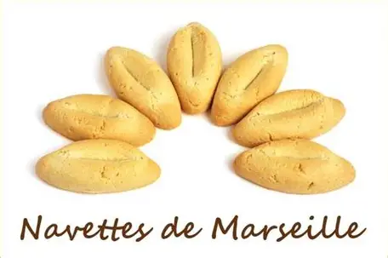
How does Christmas Blossoms connect to the celebration, and spiritual themes, of Candlemas? (2)
Tradition holds that on February 2, the day that we celebrate Candlemas, Saint Martha, Saint Mary Magdalene, and Saint Lazarus arrived in France by boat. It was St. Martha and St. Mary Magdalene who served Jesus, as St. Martha cooked a meal for Him, and St. Mary Magdalene sat by His Feet, being Present with Him in prayer, with the two sisters demonstrating the balance between action and contemplation. Saint Lazarus was the brother of these two sisters who was raised from the dead by Our Lord. To commemorate the arrival of the three siblings in France, it is a special French custom to make boat-shaped cookies called “navettes,” which are given in packages of a dozen with the candles blessed at Candlemas. There are twelve of the cookies given, because they represent the twelve months of the calendar year. This also is the number of the Church, so we are reminded that, to grow and prosper as a Church, we are to journey through the liturgical year together, in union with Christ. Christmas Blossoms conveys this theme strongly, in that it captures how richly blessed we are when we share the mission to love and serve God, to bring souls to life in Him, navigating storms by recognizing that we are in the same boat, and that God is our guide, and Our Lady, the Star of the Sea. God is with us not only at Christmas, but year-round, responding to us in all of our various needs

Slide 15
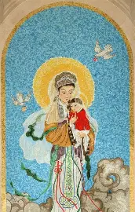
Closing Prayer: Traditional Collect Prayer for the Feast of the Purification of Our Lady
Almighty and everlasting God, we humbly beseech Thy Majesty, that as Thine only-begotten Son was this day presented in the temple in the substance of our flesh, so Thou wouldst cause us too to be presented unto Thee with purified hearts. Through the same Jesus Christ, Thy Son, our Lord, Who lives and reigns with Thee in the unity of the Holy Spirit, God, forever and ever. Amen.

