Slide 1
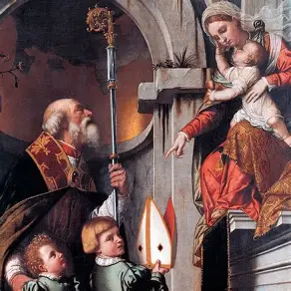
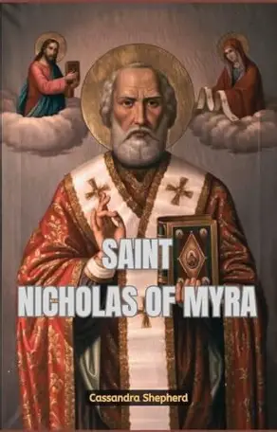
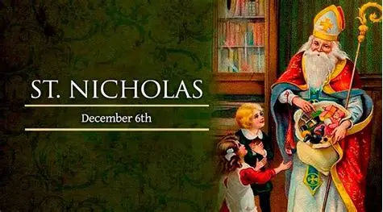
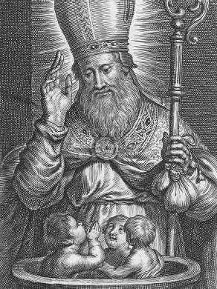
In the Nick of Time: Optimizing Our Time During Advent to Celebrate Our Lord’s Nativity Wholeheartedly with St. Nicholas
Sunday, December 7, 2025
Katie Sadakierski

Slide 2
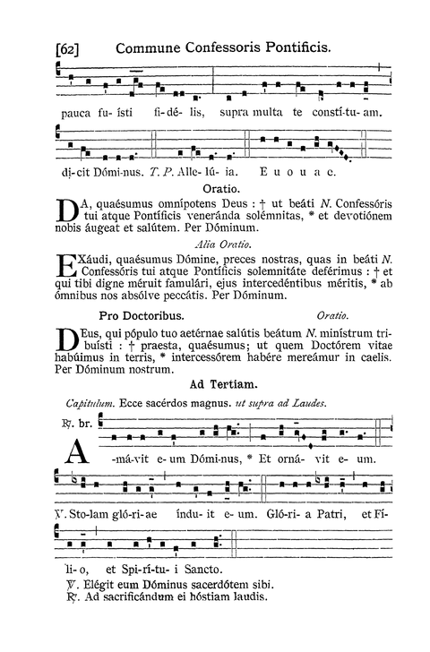
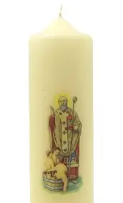
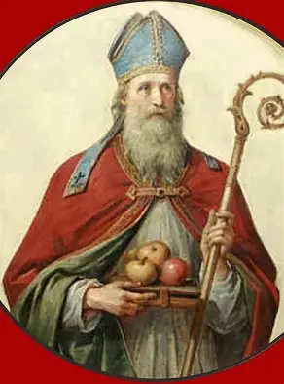

Outline
Welcome & Opening Prayer
Presentation
  I. The Gift of St. Nicholas’ Holy Life Lived for Jesus and Mother Mary
  II. The Gift of Celebrating St. Nicholas’ Holy Life to Honor Jesus and Mother Mary in Present Times
  III. The Gift of Emulating St. Nicholas to Open Our Hearts to Jesus and Mother Mary
Announcements
Closing Prayer
Q & A
Recitation of the Liturgical Rosary: Commemorating St. Nicholas of Myra
Workshop: Making St. Nicholas shoes and cards/letters to the Christ Child

Slide 3
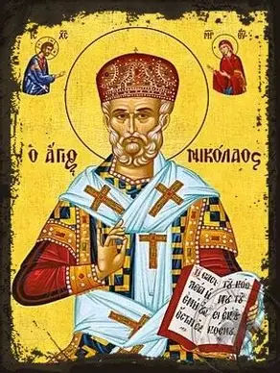
Opening Prayer: Collect for the Feast of St. Nicholas
We humbly implore Your mercy, Lord: protect us in all dangers through the prayers of the Bishop Saint Nicholas, that the way of salvation may lie open before us. Through our Lord Jesus Christ, Your Son, who lives and reigns with You in the unity of the Holy Spirit, God, for ever and ever. Amen.

Slide 4
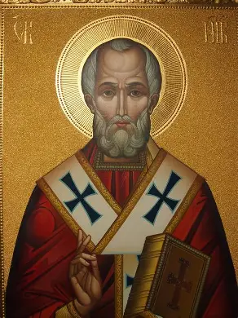
Who is St. Nicholas of Myra? When do we celebrate his feast day?
Saint Nicholas of Myra (270 A.D. - 346 A.D.) was born within Asia Minor (present-day Turkey), and was orphaned at a young age. Far from despairing, he would use his inheritance to help the poor and sick. He is a patron saint of bakers, sailors, glassmakers, and children, remembered especially for his charity to young people
While still a young man himself, St. Nicholas traveled to parts of the Holy Land, namely, Palestine, and would then become a bishop. In his time, St. Nicholas was beloved, and remains a cherished saint in our tradition; in monasteries, medieval plays reenacting events from his life may still be performed
In the year 325 A.D., St. Nicholas participated in the Council of Nicaea, becoming so incensed with the heretic, Arius, who was present, that he slapped him across the face. Arius was spreading the heresy of Arianism, promoting false teachings about the natures of Christ (His humanity and divinity) and Mother Mary (questioning whether she was the Mother of Christ, the God-Man, i.e. whether she was only the Mother of the human, versus the divine, Christ)
Saint Nicholas was dedicated to his Faith, and as a spiritual father, wanted to protect his spiritual children from what would harm their souls, so he courageously defended the Faith from any attacks. Today, we celebrate St. Nicholas’ feast day on December 6

Slide 5
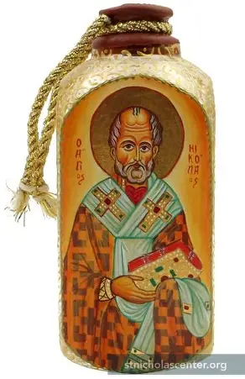
From St. Nicholas’ life, what do we learn about honoring God at Advent? (1)
Today, oil oozes forth from the relics of St. Nicholas in his tomb. Saint Nicholas’ relics were brought from Turkey to Bari, Italy in a time of persecution so that they would be protected, but the relics would eventually be returned to Turkey
The sweet-smelling oil that is secreted from the tomb of St. Nicholas is collected into bottles, beginning on May 9, when the translation of St. Nicholas’ relics is commemorated. The oil of St. Nicholas is used in healing, and is called “manna,” like the bread from Heaven God gave the Israelites to feed them when they were wandering through the desert. Saint Nicholas’ manna reminds us of how St. Nicholas was a force for healing in the world, because he reached out to perform both corporal and spiritual works of mercy, to ensure that everyone had what they needed to do their best physically and spiritually, to consecrate their minds, bodies, and souls to God for His glory
Like St. Nicholas, we can spread the fragrance of Christ’s holiness through our actions, and can guide them towards Christ, the True Bread

Slide 6
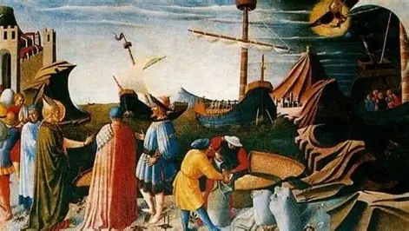
From St. Nicholas’ life, what do we learn about honoring God at Advent? (2)
Between the years 311 and 312, as well as in the year 333, the town of Myra experienced a great famine due to crop failure. During this difficult time, Saint Nicholas not only helped those hungering in body, but fed souls that were starved for mercy by showing them immense kindness and generosity that gave them much hope. Saint Nicholas learned of ships anchored in the harbor that were set to bring supplies of wheat to Alexandria, Egypt. The exporters would make a profit in bringing this large supply to their destination, but meanwhile, people in their own homeland were suffering. Saint Nicholas requested that the exporters offer a small measure of grain from their supply, so that the people in Myra would be fed. They refused, saying that every grain of wheat had already been measured, and could not be given away. However, St. Nicholas did not give up, promising that if a measure of the grain was given to him, the exporters would not feel the loss in their supply; no measure would be missing from the final count of grains. With just a small measure of the grains, St. Nicholas would feed people for two years, and the sailors would discover that no measure of grain was absent from their count whatsoever. This miracle would lead them to thank God, to praise St. Nicholas for being His instrument. Christ always nourishes us, expanding even our seemingly smallest efforts to love Him, and to share this love. The True Wheat, Christ, gives His life to feed us forever; in being charitable to others, we do not experience loss, only gain

Slide 7
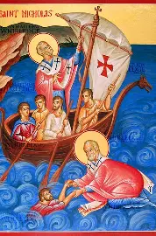
From St. Nicholas’ life, what do we learn about honoring God at Advent? (3)
Invoked against shipwreck, St. Nicholas is a patron saint of sailors, because he helps us to chart our course to Christ, to remain on a godly path. He illuminates the way to Heaven, helping us to follow the Star that is Our Lord. When he traveled to the Holy Land as a young man, St. Nicholas prayed that he could have the grace of sharing in the sufferings of Our Lord, the Fisherman of souls, so as to compassionate with Him more deeply. While out at sea on the voyage, a storm arose. Praying with all of his heart, much like Our Lord, St. Nicholas interceded for his people, and the winds died down, the seas calming. Offering his love and trust to the Lord, St. Nicholas would share in Christ’s healing gifts, soothing storms, and helping souls to navigate the tempests that beset us in life, that we would have peace and trust in the Lord like he had. Our Lord has power over nature, and would answer the prayers of St. Nicholas’ heart to keep them safe amidst what would otherwise have been a natural disaster, the flooding of the ship. Instead, St. Nicholas helps our hearts to be flooded with Christ’s Presence, showing us how to receive it gratefully

Slide 8
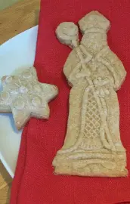
What are some special traditions associated with St. Nicholas’ feast day? (1)
In the Netherlands, speculaas cookies are made. These are spice cookies cut into shapes that relate to the life of St. Nicholas, usually, symbols of his rank of bishop, such as the miter (his hat), and the crozier (his staff). Each of these symbols reminds us that St. Nicholas was, first and foremost, a spiritual father, a shepherd to guide his people away from sin, and into God’s grace, into the light of Christ, that they would radiate His love everywhere they went, just as he did. “Saint Nicholas” is called “Sinterklaas” in Dutch, so it is from this name that “Santa Claus” is derived. The spices used in the “Sinterklaas” cookies reminds us that Our Lady was fragrant like the spices, as the Wisdom literature in the Old Testament tells us, so if we are to be like Christ, we are to reflect Our Lady in spreading the sweetness of God’s love, drawing others to follow Him, as though following the aroma of spice cookies baking. Variety is the spice of life, so the cookies also call to mind the truth that, through both sorrows and joys, we can truly taste glory. Had it not been for the sorrowful times when they were facing challenges, the poor whom St. Nicholas served would not have come to meet St. Nicholas, and have the opportunity to be so inspired by this holy wonderworker

Slide 9
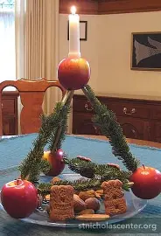
What are some special traditions associated with St. Nicholas’ feast day? (2)
Since the 1400s, in central Europe, some friends of St. Nicholas put out the “Klausenbaum” rather than a traditional Advent wreath or Christmas tree. The “Klausenbaum” is a pyramid-shaped configuration that is wrapped with evergreen. At the top of the structure, one candle is placed. Reminding us of the Blessed Trinity, the triangular base reflects that we may only be uplifted, only supported, by God, when we have Him as our foundation. He holds us up, helping us to shine. Our Lord came down to Earth, lowering Himself by becoming man, so that He could elevate us, making us godlier, and bringing us up to Heaven to be with the Blessed Trinity. Looking at the “Klausenbaum,” which is named for St. Nicholas, we remember that God’s love is everlasting; St. Nicholas reflected this love in how he gave to people in need, demonstrating that God always provides

Slide 10
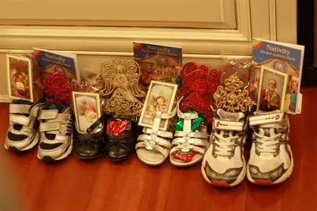
What are some special traditions associated with St. Nicholas’ feast day? (3)
On the eve of St. Nicholas’ feast day, December 5, children leave out their shoes to be filled with treats by the generous St. Nicholas. They also offer food for St. Nicholas’ horse, most often, carrots. Saint Nicholas may bring them items that represent events from his holy life, when he gave from his heart with love, such as apples, oranges, and gold coins (usually, chocolate gold coins). Holy cards with images of St. Nicholas may also be provided to recall the Christ-centered mission of St. Nicholas’ life, a life offered as a prayer for his people, God’s children

Slide 11
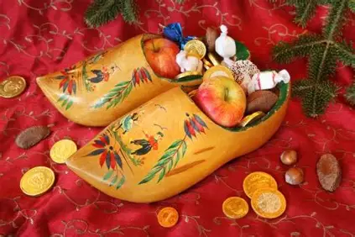
What are some special traditions associated with St. Nicholas’ feast day? (4)
Sometimes children leave out special hand-painted wooden clogs for St. Nicholas to fill
The apples in the clogs represent an act of mercy and charity in St. Nicholas’ life. Saint Nicholas had learned of three children passing away, and raised them from the dead. When they were resurrected, he gave them apples, which turned into gold. This event teaches that acts of love perfect us, making an otherwise challenging or sorrowful situation golden. Love brings hope and new life. Our Lord helps our hearts to become golden by pouring His love into us. Saint Nicholas emulated Jesus by raising others up through faith

Slide 12
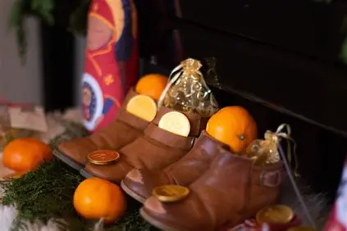
What are some special traditions associated with St. Nicholas’ feast day? (5)
On the feast day of St. Nicholas, children may awake to find gifts of oranges left for them. Oranges are blessed in some parishes on St. Nicholas’ feast day. In the past, oranges were very precious, very rare delicacies that were enjoyed, because they had to be imported from warmer regions, and in the wintertime, brought to mind images of tropical paradises that would warm the hearts of those otherwise shivering in the cold. Now, oranges are much more common, but still remind us of the treasures that St. Nicholas shared. In artwork depicting St. Nicholas, the pouches of gold that he carried resembled bags of oranges, which is how the tradition of leaving bags of oranges out as gifts for his feast day began. Saint Nicholas brought hope and delight to other people, warming their hearts when they were otherwise left to despair in the coldness of the world. He was like a ray of sunshine from Christ’s burning Heart

Slide 13
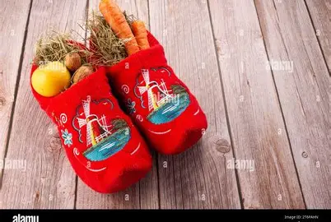
What are some special traditions associated with St. Nicholas’ feast day? (6)
The tradition of putting out shoes for St. Nicholas to fill was inspired by another story of St. Nicholas’ kindness. When he learned of a family with three daughters that had fallen into financial ruin, St. Nicholas set out to help them. To respect the dignity of the family, and to avoid calling attention to himself, St. Nicholas went out at night on his mission of charity to offer the family financial support. From outside, he tossed bags of gold coins up through the windows of the family’s home. These pouches of coins landed in the daughters’ stockings, which is where the custom of putting out stockings for Santa Claus came from. Sometimes when St. Nicholas tossed the coins through the windows of the homes of the poor, the coins landed near or in shoes that were left out by the hearth to be warmed and dried after having worn them to walk in the snow, so now, children put out their shoes for St. Nicholas to fill with coins. This special tradition reminds us that St. Nicholas was truly blessed, because he rejoiced in doing what would bring joy to others, never engaging in any act of kindness for thanks or recognition. He teaches us to give with love wholeheartedly, like Christ did, and to have faith that Christ is walking alongside us, not leaving us in the cold, but leading us to Heaven, where we will always know the warmth of His loving Heart. Because St. Nicholas also dropped gifts down chimneys for the poor, the tradition of preparing children for a visit from Santa, who comes down the chimney to bring gifts, was developed

Slide 14
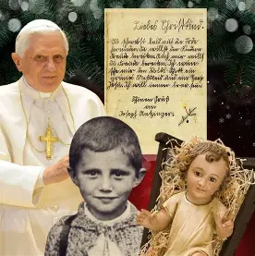
What are some special traditions associated with St. Nicholas’ feast day? (7)
Children may leave out their letters to the Christ Child with their St. Nicholas shoes. This is a reminder that it is Christ Who fills our hearts with every good gift from His Heart, when we open ourselves to receiving Him. After writing a letter to the Christ Child, asking Him for special gifts, then making Advent resolutions, reflecting on special gifts that one may offer to Christ in the season, children leave their letters on the window sill, or in front of a manger, for the holy angels to carry up to Heaven. Saint Nicholas is also a messenger who may bring the letters back to Our Lord. Connected to this special tradition is the Christkindl tradition, in which we draw a name of a family member or friend from a box or hat, and dedicate our Advent season to caring for them spiritually, by praying for them and doing kind things to bless them. We treat them as we would the Christ Child, with great tenderness and gentleness, offering them our support, as we strive to carry them with us, like Our Lady carrying the Christ Child. Like St. Nicholas, we share our time, talent, and treasure to help God’s children, treating them as our spiritual children

Slide 15
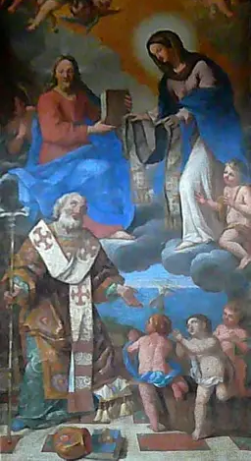
Why is it fitting that we celebrate St. Nicholas of Myra so close to the feast day of the Immaculate Conception? What is his connection to Our Lady?
Saint Nicholas was deeply devoted to Our Lady. After he slapped Arius across the face during the Council of Nicaea, he lost his faculties, and was stripped of the office of bishop. However, God would reward St. Nicholas for his faithfulness. In a dream, St. Nicholas saw Our Lady and Our Lord come to return to him his vestments signifying his authority as bishop, including his stole, which Our Lady placed around his shoulders. Our Lady kept St. Nicholas under her protection, as he had defended her from heretical attacks, preserving his spiritual children’s devotion to her
As a Christian, St. Nicholas faced persecution, and is a special patron of those who are persecuted. Our Lady and Our Lord appeared to him in a vision, freeing him from his chains as a prisoner. When the chains were broken, he was freed. Likewise, Our Lady helps us to remain pure like her, that we would be set free from the chains of sin, and come to enter into our heavenly home. In his life, St. Nicholas helped to free people from impoverishment, and earthly sufferings or privations flowing from it, so that they could most fully worship God, and be inspired by His unfailing Providence, by how He helps and feeds us, even in the most dire situations when we are starving not only for corporal food, but for spiritual reinforcements. In defending the Truth, St. Nicholas also kept souls away from sin and error, helping to keep them free of eternal punishment

Slide 16
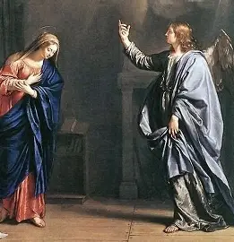
Who is St. Ambrose? What is his connection to St. Nicholas of Myra and Our Lady?
Saint Ambrose (340-397) was born in Germany, but when his father passed away, his mother would relocate the family to Rome. After he became the Bishop of Milan, St. Ambrose would baptize St. Augustine of Hippo, who famously wrote Confessions about his spiritual conversion, and would himself become a bishop, like his mentor, St. Ambrose. December 7 is the date on which St. Ambrose was consecrated as bishop, so it is kept as his feast day, in between the feast days of St. Nicholas of Myra and Our Lady’s Immaculate Conception
A Doctor of the Church, St. Ambrose wrote many theological treatises about Our Lady, defending the truth of her Immaculate Conception and perpetual virginity
Saint Ambrose wrote remarkably well. His eloquence flowed from his deep love of Our Lady, who herself had blessed speech that was honey-sweet. A patron saint of honey, candlemakers, and beekeepers, St. Ambrose is remembered for his words that were a balm, like honey, affirming the heavenly realities promulgated in the Church’s teachings. As an infant, bees swarmed around St. Ambrose’s mouth, but he was unscathed; it was an early sign that he had been set apart in a special way by God, Whose plan was for St. Ambrose to bless others with the prayers of love inscribed in his pure heart. Like St. Nicholas of Myra, St. Ambrose brought sweetness to others’ lives by leading them to Jesus through Mary, and through imitating the example of Jesus and Mother Mary, in treating others with generous love emanating from childlike hearts of joy

Slide 17
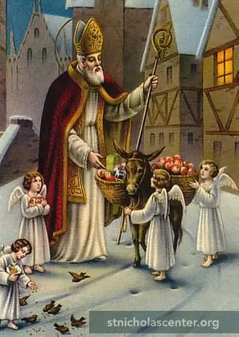
What does today’s Divine Office readings reveal to us about St. Nicholas’ life and mission? How may we imitate him in our spiritual lives?
When St. Nicholas was chosen to become the new bishop in his region, it was the hour of Matins, the start of a new day, with the first office in the set of eight canonical hours. The conclave of bishops had gathered to elect the new bishop, and the bishop with the greatest wisdom was given an insight from the Holy Spirit that the first man named “Nicholas” to enter the church would be the new bishop. Sure enough, St. Nicholas was the first to arrive, and was named the new bishop. Today, when we pray the Divine Office for St. Nicholas, at Vespers, the evening prayers when we give thanks to God, we see the text: “The Lord loved him, and adorned him.” Indeed, St. Nicholas was adorned with many virtues in his soul, because he was always receptive to God, doing his good work in all of the ways that he could. He did not live for his own enrichment, but to bless others. His soul was adorned with every virtue, because he gave his life to helping others to lead virtuous lives, to adorn the souls of others with gems of virtue, that their hearts would be filled with all of Christ’s treasures. In our spiritual lives, we may practice good works, offering prayers of goodwill, to bless others, enriching their lives with kindness and love; we focus on making our souls like beautiful castles in which Christ the King may dwell, encrusted with jewels that shine for Him, namely, gems of faith, hope, and love that delight the King. We can open ourselves to loving God and others in all of the ways that He calls us to, so that we may receive all of the Lord’s love to share

Slide 18
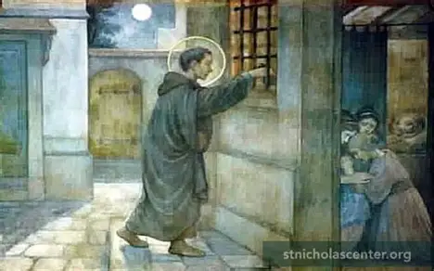
Closing Prayer: Collect for the Second Sunday of Advent
Almighty and merciful God, may no earthly undertaking hinder those who set out in haste to meet Your Son, but may our learning of heavenly wisdom gain us admittance to His company. Through our Lord Jesus Christ, Your Son, Who lives and reigns with You in the unity of the Holy Spirit, God, for ever and ever. Amen.

