Slide 1
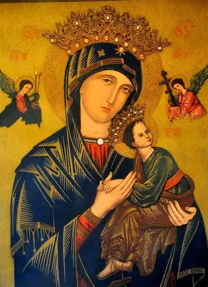
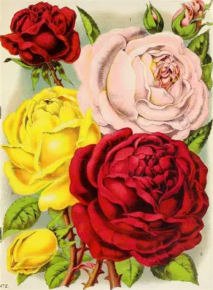
Our Help is in the Name of the Lord: Radiating Christ’s Light like Our Lady of Perpetual Help and St. Lucy
Saturday, December 13, 2025
Katie Sadakierski

Slide 2
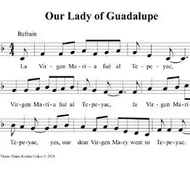
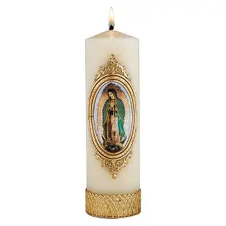

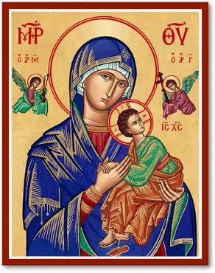
Outline
Social
  Light refreshments will be served
PowerPoint presentation
Opening prayer
Presentation:
  The Luminous Life of Saint Lucy: How Saint Lucy Shone Christ’s Light
  Shining a Light on Saint Lucy’s Feast Day Traditions
  How We Shine Christ’s Light: Emulating St. Lucy in Catechesis, and Applying Takeaways from her Treasured Feast Day Traditions
Closing prayers:
  Recitation of the Chaplet of Our Lady of Perpetual Help (one decade; five decades, time permitting)
  Recitation of the Saint Andrew Novena Chaplet

Slide 3
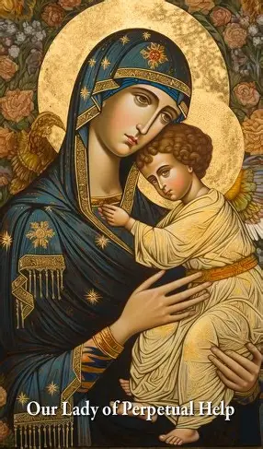
Opening Prayer: Collect Prayer to Our Lady of Perpetual Help
O Mother of Perpetual Help, grant that I may ever invoke thy most powerful name, which is the safeguard of the living and the salvation of the dying. O Purest Mary, O Sweetest Mary, let thy name henceforth be ever on my lips. Delay not, O Blessed Lady, to help me whenever I call on thee, for, in all my needs, in all my temptations I shall never cease to call on thee, ever repeating thy sacred name, Mary, Mary.
O what consolation, what sweetness, what confidence, what emotion fill my soul when I pronounce thy sacred name, or even only think of thee. I thank God for having given thee, for my good, so sweet, so powerful, so lovely a name. But I will not be content with merely pronouncing thy name: let my love for thee prompt me ever to hail thee, Mother of Perpetual Help.

Slide 4
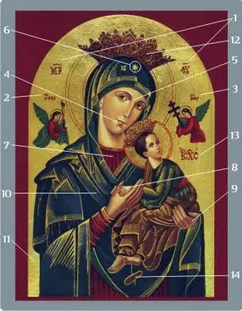
Who is Our Lady of Perpetual Help? How does she shine Christ’s light, and inspire us to do the same? (1)
The icon of Our Lady of Perpetual Help depicts Our Lady holding the Christ Child. The Christ Child holds on to the hand of His Mother. His hand is laid down flat, while Our Lady cups His hand within hers, representing that she receives His grace, and passes it on to us, as the Mediatrix of All Graces. Our Lady wears a blue cloak, as blue was worn by mothers in Palestine. She wears a red tunic underneath, symbolizing Christ’s humanity, His Precious Blood, while blue suggests His divinity. Blue and red are combined to create purple, the color of penance, as we repent of past sins that wounded Christ, the God-Man, during Advent. Our Lady guides us to new beginnings through her help. She opens us up to receiving God’s grace. Our Lord has one sandal dangling off of His Foot. This represents His divinity; He transcends the earthly. Meanwhile, the Foot fully encased in the sandal represents His humanity, as He is fully among us, walking in our shoes, taking on Flesh to heal us, to redeem us

Slide 5
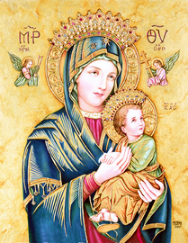
Who is Our Lady of Perpetual Help? How does she shine Christ’s light, and inspire us to do the same? (2)
Christ is missing a sandal, to represent that, after learning of His Passion, receiving insight into what He would experience, He hurried to His Mother for consolation, going to her for protection. In His haste, one of His shoes fell off. In a similar way, we are called to go to Our Lady for comfort and shelter when we are carrying our crosses. Our Lady gives us refuge in the busyness of life. Our Lady of Perpetual Help is celebrated on June 27, two days after Johnsmas, which is Summer Christmas, in marking the halfway point to Christmas, on the Nativity of St. John the Baptist, but we are always to go to her for help, to receive the spiritual gifts that we need to be replenished, filled up with Christ’s grace and love, that we may then share it with others. Our Lady of Perpetual Help looks at us, beseeching us to go to her, too, to receive the consolation that her Son does. Her eyes are large, representing that she sees us in all of our challenges, and that she holds the whole world in her Heart, seeing the needs of all of her children. Her lips, meanwhile, are small, representing that she listens rather than speaks, humbly praying and offering her “yes” to God, in her willingness to serve Him and His people, sharing His grace with them, taking all of their sufferings into her Heart to heal them. Surrounding Our Lady and Our Lord are the holy angels, who hold the instruments of Christ’s Passion, including the sponge with gall, and the nails. The Greek inscriptions underneath the holy angels alert us to the fact that they are two of the holy archangels: St. Gabriel and St. Michael. The holy angels foretell what Christ will experience, but the holy angels bring joy and peace amidst suffering; they will comfort Christ, too. They foretell the glory that He will bring

Slide 6
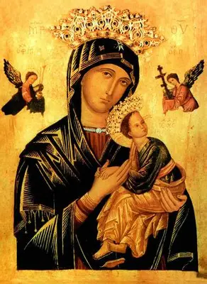
Who is Our Lady of Perpetual Help? How does she shine Christ’s light, and inspire us to do the same? (3)
Our Lady of Perpetual Help shines Christ’s light, because she radiates His compassion, His abundant mercy. She invites us to receive her love. This image of Our Lady of Perpetual Help reminds us that by being in the Presence of Jesus and Mother Mary, placing ourselves as children in the arms of our Mother, we can be more present for others, showing them the love that we receive from Jesus and Mother Mary. Through the help of Our Lady, we become more like Christ in our confidence and trust in God, our sense of hope and humility in going to God for our every need, by first going to Our Blessed Mother to carry forward our petitions. We can come to see the Christ Child in everyone, knowing that each person is going through their own Passion, but that together, we can make earthly life heavenly, by helping each other to uplift the crosses, serving as catechists in teaching Christ’s way of the Cross, the way of love and forgiveness, as Christ shines the way to Heaven through the warmth and light radiating from His Sacred Heart, a Heart that welcome everyone. Like Our Lady, we can have listening hearts that take in all of God’s children, as we listen to His voice with the ears of our hearts, using our words to bless others, like Our Lady, from whose lips grace was poured forth, as she used her honey-sweet words like a balm to soothe others, to point the eyes of their soul back to Christ, the Source of all sweetness, from Whom every grace flows

Slide 7
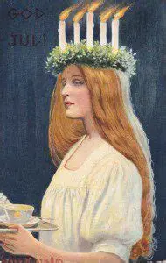
How is St. Lucy similar to Our Lady of Perpetual Help?
Celebrated with a feast day on December 13, Saint Lucy was a virgin martyr of the early Church who would go into the Catacombs, bringing food to the people who worshipped Christ secretly there, underground. To facilitate her journeys into the Catacombs, freeing her hands to carry trays of food, St. Lucy wore a crown of candles on her head. The candlelight helped her to see where she was going in bringing refreshments to the persecuted Christians. Saint Lucy, patroness of the eyes, whose very name means “light,” was a catechist, in that she taught by example, modeling Christ’s way of self-sacrificing love. Like Our Lord, she brought light, refreshment, and hope to others. Our Lord goes out to us, coming down from Heaven to feed us with His life, His Body, which is the Bread of Heaven. He sacrifices Himself out of love, teaching His way of mercy in shining His light wholeheartedly, that everyone would see the way to Heaven; He does not shut out anyone. No one is left to remain in the darkness of sin; Christ knew what it was to be rejected, having had the doors to the inn closed to Him, so the doors of His Heart are always open to receive us with love. Likewise, St. Lucy had the doors of her heart open. She was like Our Lady of Perpetual Help in bringing Christ’s mercy to others, evangelizing by drawing people into a relationship with Christ through her presence of love and care, flowing from a very maternal heart, in which Christ was treasured. She risked her own life to help others, to share in their suffering, that they would be consoled, and brought even more deeply into Christ’s Heart. Her example would convert sinners, not only edifying Christians who had already embraced Christ as their Savior, because her angelic sweetness would draw others into the light, inspiring them to seek out heavenly things, to have faith in what would come after their Passion in this life. Saint Lucy trusted in the perpetual help of God, not concerning herself solely with the things of this life, so she had faith that was palpable, and transmitted it to others. Miracles have been attributed to St. Lucy, including the provision of wheat during a famine. Our Lady of Perpetual Help guides us to the remedy for our every ailment, leading us to be fulfilled by Christ’s love, to no longer hunger for temporary fulfillment, but to have eternal life in Christ. Both Our Lady of Perpetual Help and St. Lucy lead us to our heavenly crowns by helping us to be enfolded in the embrace of Christ, Whose love is full-circle, unending; like an evergreen wreath reminding us of Christ’s love that goes on forever, to encircle our hearts always like the crown of glory that He places upon the heads of those who love Him in Heaven

Slide 8
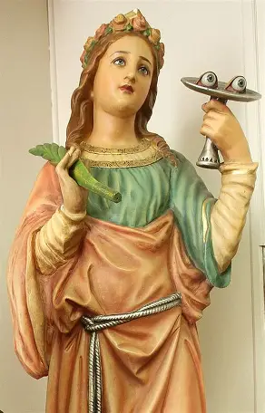
Closing Prayer: Collect Prayer for the Feast of St. Lucy
May the glorious intercession of the Virgin and Martyr Saint Lucy give us a new heart, we pray, O Lord, so that we may celebrate her heavenly birthday in this present age and so behold things eternal. Through our Lord Jesus Christ, Your Son, Who lives and reigns with you in the unity of the Holy Spirit, God, for ever and ever. Amen.

Slide 9
Our Lady of Perpetual Help Chaplet (1)
On the crucifix, say the “Hail, Holy Queen” prayer. Then say the Apostles’ Creed and the “Glory Be.”
On each of the large single (“Pater”) beads say: “Mary can help us, Mary will help us, Mary wants to help us, Mary must help us.”
On each of the three preparatory beads, pray the “Hail Mary” prayer. Say the “Glory Be” after.

Slide 10
Our Lady of Perpetual Help Chaplet (2)
On each of the small (“Ave”) beads in the groups of ten, say: “Mother of Perpetual Help, pray for us.”
Say the concluding prayers, starting with the “Memorare” prayer to Mary.
Then, say the Act of Confidence: “O Holy Virgin Mary, who to inspire us with boundless confidence, hast been pleased to take the sweet name of Our Mother of Perpetual Help, I implore thee to come to my aid always and everywhere in my temptations, after my falls, in my difficulties, in all the miseries of life, and above all, at the hour of my death. Give me, O loving Mother, the desire and the habit always to have recourse to thee trusting that thou wilt be faithful and come to my assistance. Obtain for me this grace of graces, the grace to pray to thee without ceasing and with childlike confidence, that I mayest ensure thy perpetual help and final perseverance. O Mother of Perpetual Help, pray for me now and at the hour of my death. Amen.”

Slide 11
Saint Andrew Novena Chaplet
Hail and blessed be the hour and moment in which the Son of God was born of the most pure Virgin Mary, at midnight, in Bethlehem, in the piercing cold. In that hour vouchsafe, I beseech Thee, O my God, to hear my prayer and grant my desires, [here mention your request] through the merits of Our Savior Jesus Christ, and of His blessed Mother. Amen.

