Slide 1
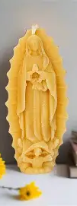
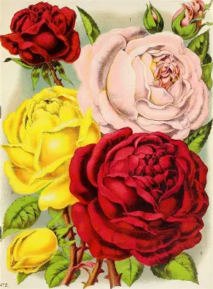
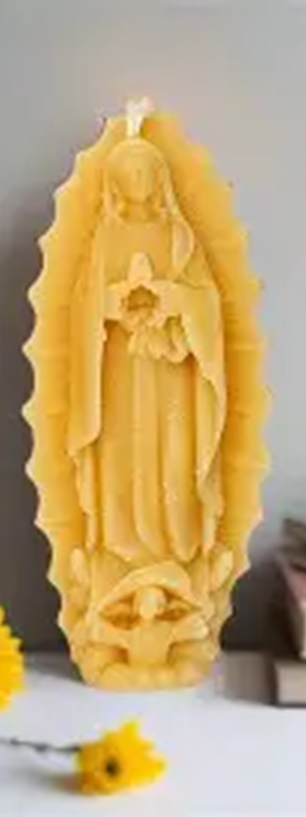
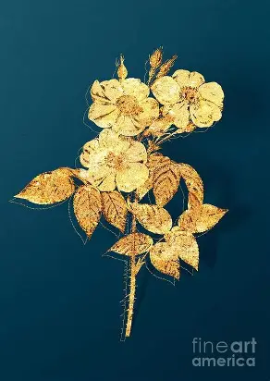
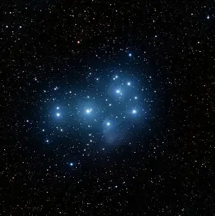
Clothed in the Sun and Crowned with Stars: Reflecting Christ’s Light with Our Lady of Guadalupe and St. Lucy
Friday, December 12, 2025
Katie Sadakierski

Slide 2
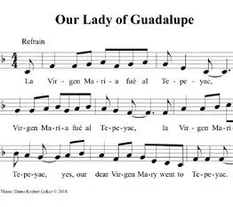
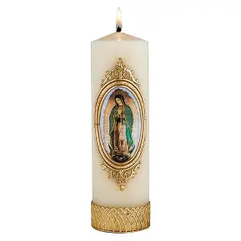

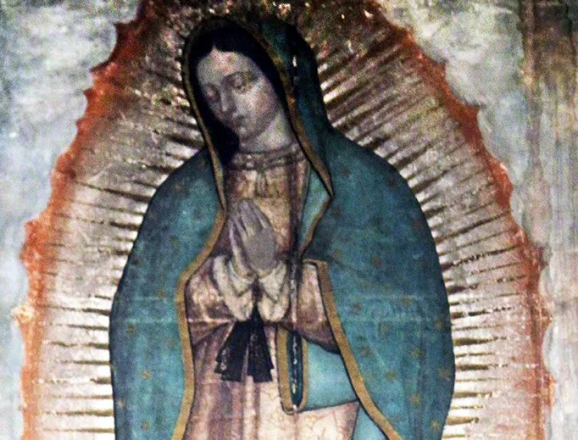
Outline
Meeting presentation
  Welcome & Opening Prayer
    I. Meeting a Rose of Christ’s Heart: Our Lady of Guadalupe, Mystical Rose
    II. Meeting another Rose of Christ’s Heart: Saint Lucy
    III. Being a Rose in Christ’s Heart: Practicing Feast Day Traditions for Our Lady of Guadalupe and St. Lucy, and Growing in Love for God like Them
  Announcements
    Saint Michael Consecration Information
  Closing Prayer
  Q & A
Workshop:
  Marian flower crown-making
  Saint Lucy candle crown-making
Recitation of prayers:
  Christmas Rose Novena Chaplet
  Chaplet of St. Michael the Archangel

Slide 3
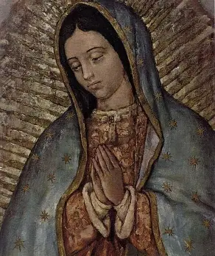
Opening Prayer: Collect Prayer for the Feast of Our Lady of Guadalupe
O God, Father of mercies, Who placed Your people under the singular protection of Your Son’s Most Holy Mother, grant that all who invoke the Blessed Virgin of Guadalupe, may seek with ever more lively faith the progress of peoples in the ways of justice and of peace. Through our Lord Jesus Christ, Your Son, Who lives and reigns with You in the unity of the Holy Spirit, God, for ever and ever. Amen.

Slide 4
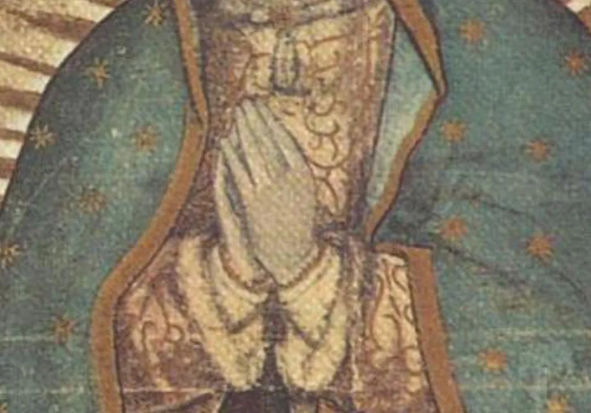
Who is Our Lady of Guadalupe? How did she shine Christ’s light? (1)
Our Lady of Guadalupe is the star of the new evangelization. She appeared to St. Juan Diego, an indigenous Mexican laborer, four times in 1531. The last apparition was on December 12, which we commemorate as Our Lady of Guadalupe’s feast day. Appearing in an area that is now known as Mexico City, Our Lady of Guadalupe was named the patroness of the Americas by Pope St. John Paul II in 1999. Within the seven years following the visit of Our Lady of Guadalupe, eight million native Mexicans converted to Christianity, approximately 95,000 souls per month, or 3,000 people converted per day. Shining Christ’s light, Our Lady would reach many souls through her maternal love. The patroness of the unborn, Our Lady of Guadalupe appeared as an expectant mother. Her turquoise cloak communicated to the native Mexicans that she was royalty, while the black sash around her waist conveyed that she was with child. Her loose hair was in the style worn by unmarried women, signifying her virginity, and conveying to the Aztecs the miracle of Our Lady’s divine maternity and virginity. Our Lady’s rose-colored dress represented the humanity, the Precious Blood, of the One being carried in her womb, while the blue-green of her cloak represented the new life brought through the Divine Child. Bowing her head, she showed humility, her adoration of One greater than herself. Her bent knee represented that she was dancing, which in Aztec culture, was the highest form of worship. Dancing is a sign of joy; Our Lady was inviting the native Mexicans to know the joy of dancing in harmonious step with Our Lord and the holy angels in Heaven. Just as she went in haste to visit her cousin, St. Elizabeth, carrying the Christ Child within her, and bringing His Sacred Heart to bless St. Elizabeth and St. Zechariah, Our Lady of Guadalupe went to reach her spiritual children in Mexico, to heal and purify them of past wounds, by bringing her Son, Jesus, carried within her, near to her Heart. Our Lady was sending a message to the native peoples of Mexico that she would bring them to spiritual rebirth, carrying them to new life with her Son. She was offering an alternative to the Aztec peoples’ culture of death, their warlike ways of human sacrifice

Slide 5
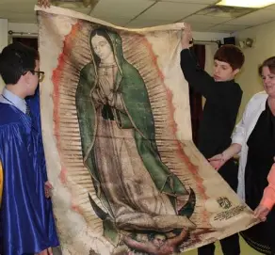
Who is Our Lady of Guadalupe? How did she shine Christ’s light? (2)
After Our Lady of Guadalupe came, the native peoples would abandon their past ways, embracing a culture of life in Christ. Human sacrifice would end, and people would instead unite their spiritual sacrifices to the Sacrifice of Our Lord, Jesus, on the altar. Bringing Christ’s love and peace, Our Lady of Guadalupe would bring souls together at a time of colonization, when there were tensions between the European settlers coming to Mexico (namely, Spanish conquistadors), and the native Mexicans. She would open their hearts to being conquered by Christ’s love, rather than by passions for worldly things. Our Lady presented herself as our universal Mother. She appeared in a way that would be recognizable to both the Spanish and the Mexicans: appearing as the Immaculate Conception, she was familiar to the Spanish, who had a celebrated history of painting the Immaculate Conception, as an expression of their strong devotion to her. The Immaculate Conception is the fulfillment of every prophecy of the Old Testament, in having said “yes” to bearing the Savior, Who will fulfill all of God’s promises. In wearing the symbols of Our Lady in the Book of Revelation, in which she and St. Michael battle and defeat the dragon threatening her Son, the image of Our Lady of Guadalupe, the Immaculate Conception, demonstrates that she and Our Lord fulfill the prophecies, as revealed by God. Conquistadors would place images of Our Lady of Guadalupe in the areas that they conquered in New Spain. Our Lady of the Immaculate Conception would become the patroness of the United States, and was taken as a kind of patroness for missions, because we can only fulfill our missions from God when we say “yes” to following Him, to putting Him first and consecrating all of our works to Him, that they would be done with love, just as in the case of Our Lady

Slide 6
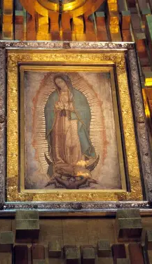
Why is Our Lady of Guadalupe called the “Mystical Rose”? How does this connect to the Christmas Rose Novena? (1)
Our Lady of Guadalupe asked that a shrine be built on the hill where she appeared in Mexico. Anticipating that the local bishop would question the validity of her apparition and the request that she gave, she gave St. Juan Diego a sign of her presence: roses. The roses that Our Lady of Guadalupe arranged in the tilma, a cactus fiber cloak given to St. Juan Diego, were significant not only in that they grew during the wintertime, but because they were not native to the region: they were Castilian roses. Castilian roses are known for their fragrance, and are a hybrid flower. This is telling, in that Our Lady came to unite people under her mantle, under her patronage, so that they would be united in Christ’s Heart, and in Heaven. She spread the fragrance of holiness so that many would be inspired to follow Christ, to be converted to His Heart. Our Lady of Guadalupe spread the message of Christ’s love by speaking the language of both the Spanish and the Mexicans: in the markings on the tilma, she provided a key that the Aztecs would understand. They would read the code with the eyes of their souls, coming to see that Jesus and Mother Mary are the keys to Heaven. The code on the tilma would guide them to unlock the gates of Heaven. The Castilian roses would also convey Our Lady’s love for her spiritual son, the bishop, whose permission St. Juan Diego sought to build the church for Our Lady, because the bishop was from Castille, Spain. The Castilian roses are believed to have their origin in Damascus, having been brought to Spain from there. Saint Paul had been on his way to Damascus when he experienced his conversion. Every aspect of Our Lady of Guadalupe’s visit pointed to conversion. She had come to help her spiritual sons, the priests, who were coming from Europe to Mexico to convert souls. The bishop had prayed for the conversion of the people, asking Our Lady for a sign of the fulfillment of his prayers: Castilian roses. Our Lady brought them as a sign that she had heard his prayer, and placed it into the hands of Christ, like a bouquet. The Christmas Rose Novena is prayed twelve times each day for twelve days in a row, beginning on Our Lady of Guadalupe’s feast day, December 12, for the 12 years of Christ’s Childhood, that in imitating the love of the Christ Child, and welcoming Him into our hearts, we would bear good fruit for Him, the Fruit of Our Lady’s womb. It is completed on Christmas Eve. We say this novena prayer for the intercession of St. Therese, who experienced a miracle of conversion on Christmas Eve. Saint Therese promised to spend her Heaven doing good on Earth, to send roses to people who pray a novena to her as a sign that she had answered their prayers; she says that she will shower forth blessings like roses, so we offer the Christmas Rose Novena in honor of St. Therese, a reflection of the Mystical Rose, Our Lady, in the way that she always pointed back to Christ, prayed for conversion, and bore good fruit in bringing the love of the Christ Child into the world, shining His light through her littleness, her humility, like that which St. Juan Diego showed in believing that he was too ordinary for such an extraordinary task as that which Our Lady had given him, but who, like Our Lady, said “yes” to God’s plan, to being a humble servant out of love

Slide 7
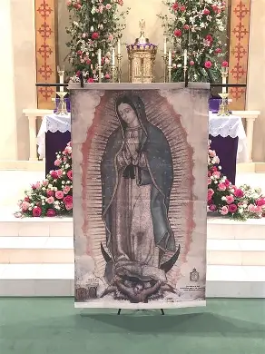
Why is Our Lady of Guadalupe called the “Mystical Rose”? How does this connect to the Christmas Rose Novena? (2)
After St. Juan Diego brought the Castilian roses to the bishop, having emptied the tilma to provide proof that Our Lady had come, he had further evidence of Our Lady’s visit, because the open tilma revealed an impression of Our Lady’s face. Our Lady had imprinted her image on the garment, an image that has proven unerasable, surviving an acid spill in the 1700s, then a bomb in the 1920s. Analyses have shown that the image was not created by human hands: there are no brushstrokes on the tilma. In a similar way, when the Shroud of Turin was analyzed, it was found that the image of Christ’s Face impressed upon it could not be recreated; it had not been created by hand, but seemingly, by an explosion of light, like a photograph being taken. Christ’s light leaves an impression on our souls, helping us to open ourselves to reflecting and radiating it outward. The more we receive Christ into our hearts, and His love is imprinted upon us, the more we can shine His light. Our Lady teaches us to be patient in preparing us to receive Christ’s light, so that we may shine it to the utmost. Salvation history unfolds gradually, one petal at a time, according to God’s divine timing. He knows when to open the rose to give off the greatest fragrance, and spread it to all. “Guadalupe” means “hidden river,” and in a similar way, Our Lady helps us to receive living water from Christ, Who is hidden in the Blessed Sacrament, that we would receive His grace, and be carried to Heaven. Jesus is hidden in the womb of Our Lady, a small Child, but He is a mighty river to propel us forward, and Our Lady, in her hiddenness, shows the quiet strength and power of God working in humble hearts opened up to Him as well; just one little flame can light the whole world on fire with love for God

Slide 8
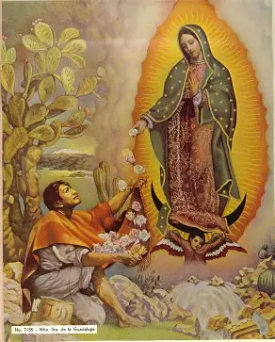
Why is Our Lady of Guadalupe called the “Mystical Rose”? How does this connect to the Christmas Rose Novena? (3)
Further analyses would reveal many symbols in the tilma; Our Lady spoke to native Mexicans in pictures. Some symbols included the impressions of the flowers themselves: these connected to the flower world prophecy of the Aztecs, who looked forward to a kind of heavenly garden in the afterlife, and would discover that all is fulfilled only in Christ, the True Flower, through His Mother, the Mystical Rose, our guide to Heaven helping us to grow. Flowers on the tilma correlated with the alignment of volcanoes in Mexico, reminding us that when we blossom in holiness with Christ, we can avoid eternal fire, any eruptions of sin that would cause us to be severed from God’s grace. Stars on the tilma, representing Our Lady in Revelation, who is described as wearing a crown of twelve stars, aligned with the grouping of stars on the night that Our Lady appeared. Our Lady appeared as she did in the Book of Revelation, standing on the moon, and clothed in the sun. In standing on the moon, Our Lady was communicating that she served humbly as the moon to Christ’s sun, reflecting His light. She also was sending a message about converting Muslims, as the crescent moon is an Islamic symbol. When the Battle of Lepanto happened, pitting the Christians against the Ottoman Turks in 1571, forty years after the Our Lady of Guadalupe apparition, the Muslim Turks would see the image of Our Lady of Guadalupe standing on the moon, because a copy of the tilma, which had been touched to the original tilma, was hung as a banner on one of the Christian’s battleships, a symbol of victory in Christ. Through Our Lady’s intercession, the battle would be won, and as a token of gratitude to Our Lady, King Philip II of Spain would give her a lantern; we, too, can offer our light to Our Lady, to help us shine it forth for Christ. In standing on the moon, a symbol of the Aztec moon god who threatened the order of things, Our Lady was communicating that she and Our Lord would restore order by casting out the false gods of old. Our Lady of Guadalupe had come to convert all peoples to Christ, to evangelize through shining Christ’s light, guiding all to be clothed in the sun, to garment themselves in Christ’s love, and be sheltered in His Heart, a Heart that gives off warmth and brightness, helping us to see, and to feel, that we would live by the Truth, and by love. On Our Lady’s robe, right over her womb, there is a four-petaled flower. Four is the number of Our Lady’s apparitions to St. Juan Diego: it is the biblical number of nature, of humanity: there are four natural seasons, and four corners of the Earth. Jesus, the True Flower, would bud forth from Our Lady’s womb to bring together the four corners of the Earth, and to remain with us to nourish us in all seasons. In the image of Our Lady, we see that the holy angels surround her, lifting the edges of her cloak; they teach us that to evangelize, we are to remain near to Jesus and Mother Mary, spreading their joy, and inviting others to place themselves under the mantle of Mary, under her maternal protection. In Aztec culture, eagles carried sacrifices to God, and the angels in the image of Our Lady have eagle wings, carrying Our Lady and Our Lord, to represent the end of the age of human sacrifice

Slide 9
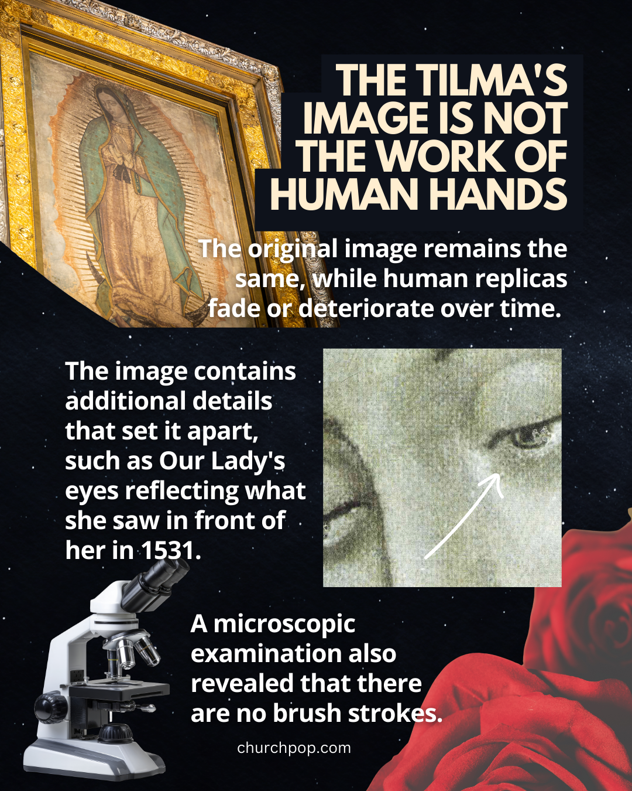
Why is Our Lady of Guadalupe called the “Mystical Rose”? How does this connect to the Christmas Rose Novena? (4)
Upon magnifying the eyes of Our Lady in the tilma image 2,500 times, it was discovered that there were figures in her eyes: she was looking at the thirteen people who had been present in the room when the tilma was opened to reveal her image to the bishop that St. Juan Diego went to visit. Thirteen is the number of Christ and His apostles. Our Lady had come on a kind of apostolic mission to spread the message of Christ’s love, the good news of salvation in Him, like the apostles had; she was also equipping future apostles to lead their neighbors into friendship with Christ. Mother Mary looks at us, always keeping us in her sight, because she loves us; she sees her Son shining through each of us, and wants to lead us to Him. She helps us to keep our eyes fixed on Heaven, on Christ, as well. Families of people were seen in Our Lady’s eyes, further emphasizing her pro-family mission: she had come to preserve and protect all of life, to encourage us to join together in sharing the message of God’s love. Our Lady had come to welcome us to be absorbed into her Holy Family, to be embraced by her as her spiritual children, through God’s grace. Our souls are meant to magnify the Lord, to reflect Him, so that as we come to be more like Him, we can see like He does, too, with great love and mercy

Slide 10
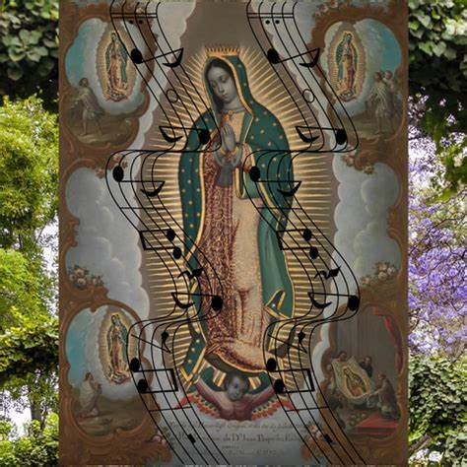
Why is Our Lady of Guadalupe called the “Mystical Rose”? How does this connect to the Christmas Rose Novena? (5)
Also revealed in the tilma analysis was that the symbols aligned in such a way, that perfect shapes were created: The golden rectangle theory applied to this case: the stars formed a perfect rectangle, which was “golden” in that, when a square was added or removed, another golden rectangle would be formed, having total balance, flawless symmetry. Music is created through symmetry; there is harmony in music, so it was discovered that there was a song hidden in the perfectly symmetrical stars of the tilma. On each side of the tilma, surrounding Our Lady, are 23 stars, or 46 stars in total. When a vertical line was drawn through the stars, they were discovered to be musical notes on a staff. Our Lady’s song on the tilma has since been performed and recorded; several instrumental versions of the song are available, including a violin rendition. This special gift from Our Lady’s Heart reminds us that we shine Christ’s light by singing His song of love, praising Him through our lives, when we live them with joy, purpose, and hope, a sense of trust in the Lord’s goodness. Life is golden when lived in harmony with Christ’s golden Heart; He helps us to hit all of the right notes, keeping our souls in tune, by keeping them aligned with the rhythms of His Heart. Our Lady was golden for having reflected God’s light, and only became more golden when Christ was given to her, conceived in her womb, where His golden Heart would form; He was like the square added to the golden rectangle, only further perfecting it. We are all like stars, connected by Christ in a constellation. Our Lady is our north star bringing us to Heaven, charting our course to Christ: she shows us the way to the Way, the Truth, and the Life. She helps us to say “yes” to bringing Christ and His light into the world, a light that can never be extinguished, that lives on in each of us

Slide 11
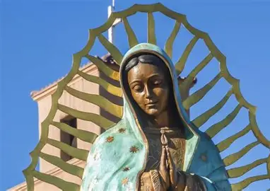
Why is Our Lady of Guadalupe called the “Mystical Rose”? How does this connect to the Christmas Rose Novena? (6)
All of these findings were consistent with Our Lady’s first apparition on December 9, 1531, bringing it to life. Our Lady had appeared to the layman St. Juan Diego on the hill when he was walking to Holy Mass. This served as a reminder that we open ourselves to great grace, including greater friendship with Our Lady, when we walk to Calvary Hill with Christ, just as Our Lady did. Our Lady and Our Lord call all of us to promote their message of love, regardless of our state of life, whether lay, or clerical. When St. Juan Diego saw Our Lady, he heard melodious music, and saw a great light shining. To reflect Christ’s light is to be like Our Lady, teaching Christ’s way of harmony with God the Father’s will. On December 10, St. Juan Diego saw Our Lady again. She promised to give him a sign to bring to the bishop to fulfill the request she had made for a church to be built on December 9. Our Lady loves her Son, and wants to console His Heart by bringing souls to Him, so she wished to have a church built to lead souls to know and receive her love, the love flowing from the Heart of her Son, to whom Our Lady is united. Because his uncle was sick, St. Juan Diego did not meet Our Lady on the hill on December 11, seeking a cure for his uncle, but she appeared to him on another pathway, reassuring him that his uncle had been healed, and asking St. Juan to gather flowers. Our Lady meets us wherever we are, asking us to gather flowers for her Son by offering our works and prayers to Him with love. She leads us all to the Heart of her Son, the Divine Physician, for healing; the True Flower is the remedy for every need, greater than all of the flowers in the world, with all of their medicinal properties. Our Lady had appeared to St. Juan Diego’s uncle, too. After St. Juan Diego did his part, collecting the flowers, they would be brought to the bishop the next day, and Our Lady would embellish his efforts, giving the gift of her image on the tilma, too. This image has remained intact for 500 years, when it should have faded after 20. Likewise, the love of Jesus and Mother Mary never dies, always withstanding the test of time, helping our souls to remain fresh and bloom, that we may be eternal blossoms with Our Lady and Our Lord in Heaven

Slide 12
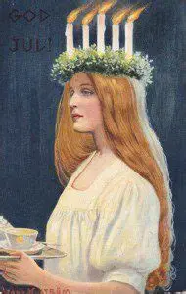
How is St. Lucy similar to Our Lady of Guadalupe?
Celebrated with a feast day on December 13, Saint Lucy was a virgin martyr of the early Church who would go into the Catacombs, bringing food to the people who worshipped Christ secretly there, underground. To facilitate her journeys into the Catacombs, freeing her hands to carry trays of food, St. Lucy wore a crown of candles on her head. The candlelight helped her to see where she was going in bringing refreshments to the persecuted Christians. Saint Lucy, patroness of the eyes, whose very name means “light,” was a catechist, in that she taught by example, modeling Christ’s way of self-sacrificing love. Like Our Lord, she brought light, refreshment, and hope to others. Our Lord goes out to us, coming down from Heaven to feed us with His life, His Body, which is the Bread of Heaven. He sacrifices Himself out of love, teaching His way of mercy in shining His light wholeheartedly, that everyone would see the way to Heaven; He does not shut out anyone. No one is left to remain in the darkness of sin; Christ knew what it was to be rejected, having had the doors to the inn closed to Him, so the doors of His Heart are always open to receive us with love. Likewise, St. Lucy had the doors of her heart open. She was like Our Lady of Guadalupe in bringing Christ to others, evangelizing by drawing people into a relationship with Christ through her presence of love and care, flowing from a very maternal heart, in which Christ was treasured. Saint Lucy was truly crowned with stars and clothed in the sun, too, in a spiritual sense, since she mirrored Our Lady in reflecting Christ. Like Our Lady of Guadalupe, St. Lucy helps to open the eyes of our souls to see the Presence of Christ everywhere, to appreciate His beauty radiating through all things. Because St. Lucy was consecrated to God, much like the Immaculate Conception, she could bring forth spiritual life and hope. Miracles have been attributed to St. Lucy, including the provision of wheat during a famine. Our Lady of Guadalupe fed the spiritually impoverished native Mexicans by leading them to be fulfilled by Christ’s love, to no longer hunger for temporary fulfillment, but to have eternal life in Christ. Both Our Lady of Guadalupe and St. Lucy lead us to our heavenly crowns by helping us to be enfolded in the embrace of Christ, Whose love is full-circle, unending; like an evergreen wreath reminding us of Christ’s love that goes on forever, to encircle our hearts always like the crown of glory that He places upon the heads of those who love Him in Heaven

Slide 13
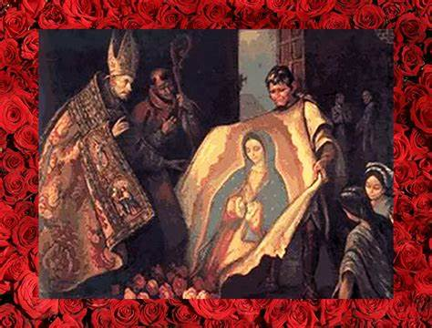
What does Our Lady of Guadalupe teach us about shining Christ’s light? How has Our Lady of Guadalupe inspired her spiritual children to reflect Christ’s light? How can she lead us closer to the Light of the World, helping us to emulate Him?
Our Lady of Guadalupe teaches us to place our confidence in God the Father, just as Our Lord did. She encourages us to go with childlike trust to God the Father, just as the bishop that St. Juan Diego consulted had given his petition for conversion of the souls in his flock to God, through the intercession of Our Lady. God brings all things together for His good, working out everything in accordance with His plan; we can trust that He will answer our prayers in time. We offer all that we have and are to God, consecrating it to Him, for His glory, and He responds with love, bringing us the gifts that our souls most need. We reflect Christ’s light when we offer that light back to the Father, going with humble hearts of love to Him, to recognize Him as the Source of all light, life, and hope
Our Lady of Guadalupe demonstrates that we all are called to evangelize, to be catechists, and can all be stars of evangelization, when we entrust our efforts to her. She equipped St. Juan Diego for his mission, which he succeeded in, because he was so devoted to Our Lady, and did all that she asked out of love, with trust, even though he struggled with personal doubts about his efficacy. He would overcome his anxieties by placing his hope in God, believing that God would uplift the lowly, as He had for Our Lady. Our Lady took the rough cactus fiber of the tilma, and made it into a masterpiece that would endure. God takes raw material and polishes it. God will teach us through every experience, and equip us to teach His way well, in every season

Slide 14
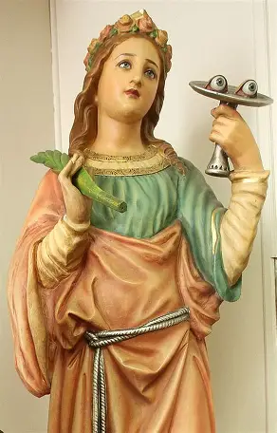
Closing Prayer: Collect Prayer for the Feast of St. Lucy
May the glorious intercession of the Virgin and Martyr Saint Lucy give us a new heart, we pray, O Lord, so that we may celebrate her heavenly birthday in this present age and so behold things eternal. Through our Lord Jesus Christ, Your Son, Who lives and reigns with you in the unity of the Holy Spirit, God, for ever and ever. Amen.

Slide 15
Christmas Rose Novena Prayer
Remember, O Gracious Little Rose Queen, your promise to spend your heaven in doing good on earth and even, if necessary, to come down to help those who ask your aid. If it is God’s Holy Will, and my dispositions are pleasing to Him by their honesty and true desire for goodness, keep your promise to shower roses and send me some visible sign of your heavenly friendship for me and for those I love. In memory of the great interior enlightenment you received on a certain Christmas of your early life, ask God for a “Christmas Rose” for me in these my urgent needs, that I may experience an increase in faith, hope and confidence. (Meditate here upon your petitions so that St. Therese can understand why you are asking her to assist you.) I desire to know and to accept real objective truth about life and death. Give me assurance that you understand and will remain my heavenly friend, so that one day we may be together with God. Keep your promise to give some answer! Amen.

Slide 16
Saint Michael the Archangel Chaplet (1)
Make the Sign of the Cross. Kiss the St. Michael medal.
State your special intentions. On the medal, pray:
"O God, come to my assistance! O Lord, make haste to help me!”
On the first preparatory bead, say a “Glory Be”
On each of the next three preparatory beads, say a “Hail Mary”
On the first large bead, pray:
  "By the intercession of St. Michael and the Celestial choir of Seraphim, may the Lord make us worthy to burn with the fire of perfect charity. Amen."
  Say an “Our Father”
  On each of the next three small beads in the sequence, say three “Hail Mary” prayers

Slide 17
Saint Michael the Archangel Chaplet (2)
On the second large bead, pray:
  "By the intercession of St. Michael and the Celestial choir of Cherubim, may the Lord vouchsafe to grant us grace to leave the ways of wickedness and run in the paths of Christian perfection. Amen."
  Say an “Our Father”
  On each of the next three small beads in the sequence, say three “Hail Mary” prayers
On the third large bead, pray:
  "By the intercession of St. Michael and the Celestial choir of Thrones, may the Lord infuse into our hearts a true and sincere spirit of humility. Amen."
  Say an “Our Father”
  On each of the next three small beads in the sequence, say three “Hail Mary” prayers

Slide 18
Saint Michael the Archangel Chaplet (3)
On the fourth large bead, pray:
  "By the intercession of St. Michael and the Celestial choir of Dominions, may the Lord give us grace to govern our senses and subdue our unruly passions. Amen."
  Say an “Our Father”
  On each of the next three small beads in the sequence, say three “Hail Mary” prayers
On the fifth large bead, pray:
  "By the intercession of St. Michael and the Celestial choir of Virtues, may the Lord preserve us from evil, an suffer us not to fall into temptation. Amen."
  Say an “Our Father”
  On each of the next three small beads in the sequence, say three “Hail Mary” prayers

Slide 19
Saint Michael the Archangel Chaplet (4)
On the sixth large bead, pray:
  "By the intercession of St. Michael and the Celestial choir of Powers, may the Lord vouchsafe to protect our souls against the snares and temptations of the devil. Amen."
  Say an “Our Father”
  On each of the next three small beads in the sequence, say three “Hail Mary” prayers
On the seventh large bead, pray:
  "By the intercession of St. Michael and the Celestial choir of Principalities, may God fill our souls with a true spirit of obedience. Amen."
  Say an “Our Father”
  On each of the next three small beads in the sequence, say three “Hail Mary” prayers

Slide 20
Saint Michael the Archangel Chaplet (5)
On the eighth large bead, pray:
  "By the intercession of St. Michael and the Celestial choir of Archangels, may the Lord give us perseverance in faith and in good works, in order that we gain the glory of Paradise. Amen."
  Say an “Our Father”
  On each of the next three small beads in the sequence, say three “Hail Mary” prayers
On the ninth large bead, pray:
  "By the intercession of St. Michael and the Celestial choir of Angels, may the Lord grant us to be protected by them in this mortal life and conducted hereafter to eternal glory. Amen."
  Say an “Our Father”
  On each of the next three small beads in the sequence, say three “Hail Mary” prayers

Slide 21
Saint Michael the Archangel Chaplet (6)
Pray another four “Our Father” prayers, one in honor of each of the three archangels (Michael, Gabriel, and Raphael), and your guardian angel. You may use four of the preparatory beads.
Complete the chaplet by praying the following prayers:
  "O glorious Prince St. Michael, chief and commander of the heavenly hosts, guardian of souls, vanquisher of rebel spirits, servant in the house of the Divine King, and our admirable conductor, thou who dost shine with excellence and superhuman virtue, vouchsafe to deliver us from all evil, who turn to thee with confidence, and enable us by thy gracious protection to serve God more and more faithfully every day. Amen."
    V. Pray for us, O Glorious St. Michael, Prince of the Church of Jesus Christ.
    R. That we may be made worthy of His Promises.

Slide 22
Saint Michael the Archangel Chaplet (7)
  "Almighty and everlasting God, who by a prodigy of Goodness and a merciful desire for the salvation of all men, has appointed the most glorious Archangel St. Michael, Prince of Thy Church, make us worthy, we beseech Thee, to be delivered by his powerful protection from all our enemies, that none of them may harass us at the hour of our death, but that we may be conducted by him into the august presence of Thy Divine Majesty. This we beg through the merits of Jesus Christ our Lord. Amen."
Kiss the St. Michael medal, and make the Sign of the Cross, again.

