Slide 1
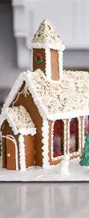
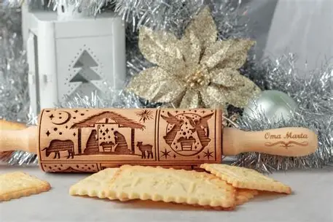
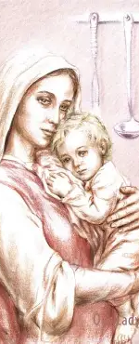
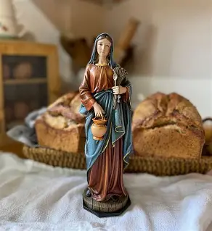
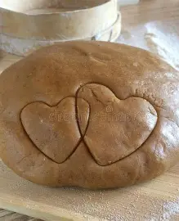
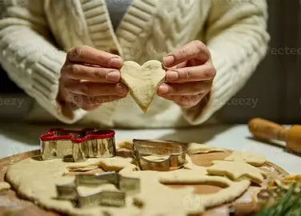
Advent Learning Series Session 3: A Taste of Heaven: Advent and Christmas Culinary Traditions
Tuesday, December 16, 2025
Katie Sadakierski

Slide 2
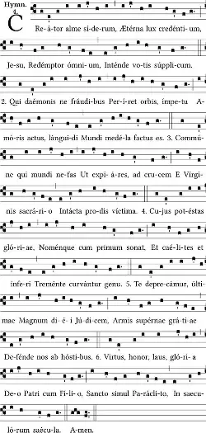
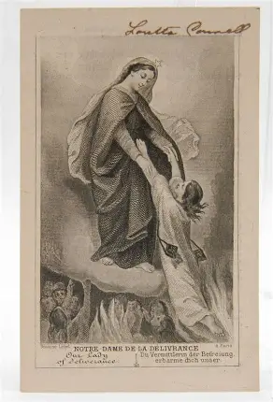
Outline: Advent Learning Series Session 3
Welcome & Opening Prayer
Meeting presentation
  I. Preparing and Measuring the Ingredients: Discovering Why We Celebrate Christmas with Culinary Traditions
  II. Mixing the Ingredients and Shaping the Cookie Dough: How We Practice Christmas Culinary Traditions, and their Catholic Significance
  III. Baking it All Together: Carrying Forward the Spirit of Christmas, and Continuing to Bring the Ingredients for Eternal Joy into the Mix
Announcements
Closing Prayer
Q & A
Recitation of the Chaplet of Our Lady of Expectation
Recitation of the Chaplet of the Infant of Prague

Slide 3
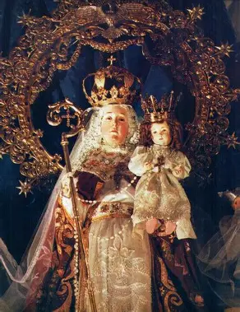
Opening Prayer: Collect Prayer for the Tuesday in the Third Week of Advent
O God, Who through Your Only Begotten Son have made us a new creation, look kindly, we pray, on the handiwork of Your mercy, and at Your Son's coming cleanse us from every stain of the old way of life. Through our Lord Jesus Christ, Your Son, Who lives and reigns with You in the unity of the Holy Spirit, God, for ever and ever. Amen.

Slide 4
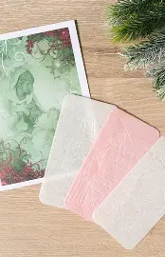
Why do we incorporate so many food-related traditions into our Christmas celebrations? What is the spiritual significance of these practices?
As we prepare for Christmas during Advent, we prepare to receive the True Bread, Our Lord, into our hearts. Before wheat can become bread, it undergoes a process of growth and preparation. Wheat must die in order to bear fruit. In a similar way, God uses our preparations at Advent to strengthen us, so that we will be equipped to celebrate Christmas, and can anticipate new life, eternal joy, in heavenly splendor. Throughout the penitential season of Advent, we die to ourselves, in order to be filled with more of Christ’s light, grace, and sweetness. Jesus gives us the ingredients that we need to fit the mold of His Sacred Heart, a Heart of total love: He gives us opportunities to pray, fast, and sacrifice, practicing penance in order to grow in love and mercy, to imitate Christ in His self-giving love. God is the greatest culinary artist, who takes the raw ingredients of our souls, and makes them into the finest confections. We go through trials by fire, but these polish us and shape us into our best selves. God uses all of our experiences to bring out the optimal flavor, helping us to be our best. God cuts away what is no longer needed, so that we may shine, just like how recipes need a balance of certain ingredients, not too much bitterness or sweetness, in order to taste perfect. God gives us a taste of Heaven, in showing us His love, and shining His love through us, as He molds us more closely to His image. Our Advent food-related traditions that we undertake in preparation for the Christmas feast, after a season of fasting and penitence, remind us to always have an abundance mindset as we trust in God, our Provider, as we celebrate how He brings us His only Son to nourish us in all seasons, helping us to produce good fruit like He does. We are reminded that we are ultimately sustained by the True Bread, the Bread of the Angels, our greatest gift, and that we need nothing else but our daily bread, the transubstantiated bread; one cannot live on bread alone, but one can live on the True Bread alone, Who gives us all of the nutrients our souls need to be harvested in Heaven. Our meals that we take together remind us that Christ sustains us through His love: the love we share as a family in Christ sustains us, as we gather around His table to receive and share the gifts of His goodness

Slide 5
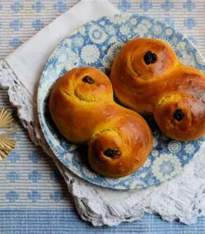
What are the culinary traditions associated with St. Lucy’s feast day? What do they reveal to us about God’s love at Advent and Christmas? (1)
Making Lussekatter (“Lucia cats”), an S-shaped saffron bun, is a special tradition associated with St. Lucy’s feast day. Saffron was the most in-demand spice of the Middle Ages, when so many Catholic traditions were developing and spreading, particularly, due to the rise of monastic life. It came to be associated with wealth, prosperity, and special occasions. As we prepare for Christmas, it is the perfect treat to remind us that God gives us all life experiences to prosper us, to help us to gain Heaven, and to store up treasures there, that our wealth would be in Him, not in the things of the world. Originating in Sweden, this treat was given its name, because the shape of the bun resembles a cat curled up before the fire, or a cat’s curled tail; cats were also seen as heralding good fortune, but with Christ, we do not need good luck, only His grace, which is the greatest blessing. It is meant to represent how this feast day, celebrating St. Lucy, whose name means “light,” provides warmth in the darkness and cold of winter, as we recall how St. Lucy brought hope to those dealing with the darkness of persecution. Saint Lucy shone Christ’s light by risking her life out of love to bring food to persecuted Christians practicing their Faith in the Catacombs, wearing a crown made up of candles, so that her hands would be free to transport food to those who would otherwise have none, in having to remain concealed in order to practice their Faith. When we remain curled close to Christ’s Heart, we can receive the warmth and light of His love. Also called the “eyes of St. Lucy,” these buns are often baked with raisins, currants, or dates, as St. Lucy is the patron saint of eyes, helping us to open the eyes of our souls to see God’s love all around us, healing us of spiritual blindness. She reflects Our Lady in her purity of heart, bringing us closer to Christ, that we may see God’s love most fully, and behold the beauty of God’s Presence everywhere, seeing things as they really are

Slide 6
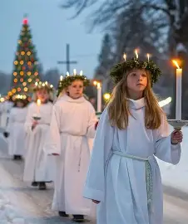
What are the culinary traditions associated with St. Lucy’s feast day? What do they reveal to us about God’s love at Advent and Christmas? (2)
While this culinary tradition began in Sweden, it was spread to other nations, including Denmark, where it was popularized during World War II, as the people sought the light of hope amidst the darkness of war. On St. Lucy’s feast day, it is customary for churches and schools, or individual homes, to choose a woman or girl to dress as a “Lucia bride” in a white dress with a red sash, with the white symbolizing St. Lucy’s purity as a virgin, and the red representing her martyrdom, the shedding of her blood for love of Christ. The Lucia bride leads a procession in singing the Neapolitan song “Santa Lucia,” which may be rewritten with regionally-appropriate lyrics, as they carry candles or lanterns to unite together in bringing light into the world, rallying in love as one community brought together by Christ. In homes, Lucia brides, usually the eldest daughters, sing the song as they carry breakfast to their family members, lighting the way and starting the day on a high note by not only bringing the sunshine of their souls, but also, the saffron or cinnamon buns they baked, to relatives. Saffron is the most expensive spice, a special delicacy, and has a unique, earthy flavor that is not comparable to anything else. We celebrate St. Lucy’s feast day with this treat, because it reminds us of Christ, Who has no equal, and lights our darkness in having been born to redeem us from sin, that we would behold Him in the light of Heaven forever. God’s eyes are always on us, looking at us with love. He goes out to us to bring us nourishment, having come down from Heaven to feed us, and to be fed, in coming as a baby; He shoes us how to humbly receive His love, to rely on Him as spiritual children, never fearing to go to Him for the food our souls need. God’s love is a priceless treasure. Since saffron takes on a golden hue, it reminds us of the treasures that Christ offers to us form His Heart, so that we may receive them all in Heaven. We are also reminded of the sun’s rays shining through the winter months, and think of how there is no place that Christ cannot reach to touch with His grace, making hearts golden like His own Heart

Slide 7
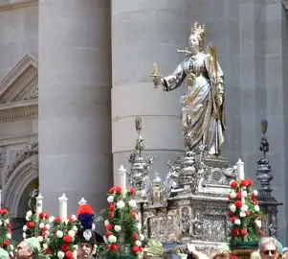
What are the culinary traditions associated with St. Lucy’s feast day? What do they reveal to us about God’s love at Advent and Christmas? (3)
The procession that is undertaken to sing songs and carry food on St. Lucy’s feast day leads us to recall Our Lady going on procession, journeying to Bethlehem with St. Joseph, to prepare to deliver Our Lord (in Sicily, a silver statute of St. Lucy is processed). We process with the Holy Family in this season, and can all carry Christ in our hearts as we travel together on the road to Heaven, supporting each other in growing in holiness. It is also tradition that the eldest daughter who leads the Santa Lucia procession bring her parents the breakfast first, mirroring St. Lucy in being a faithful spiritual daughter to God the Father. Our Lord was born a helpless infant needing the care of His parents, but would nourish His own parents with His loving Presence. At universities, students bring the treats to their teachers, honoring Christ the Teacher, Who refreshes our minds with His truth. We all can guide souls to nourishment in Christ through sharing His love. Like Christ, we sing in loving praise of God the Father, joining our voices in harmony to glorify Him. Because the processions begin in the pre-dawn hours, when it is still dark, it recalls Our Lady serving as the dawn to herald the new day of Christ’s coming, as He overcomes the darkness with His great love that radiates from His Heart. In the Julian calendar, used before the new Gregorian calendar was adopted, December 13 was the shortest day (and longest night) of the year, so it was designated as St. Lucy’s feast day, representing Christ bringing the light to a world otherwise darkened by sin. Santa Lucia traditions began in households in 1764, but were spread primarily during the twentieth century. While St. Lucy was native to Syracuse, Italy, devotion to her increased most notably in Scandinavia. On the shortest day of the year, it was believed that there was heightened demonic activity, so to counteract evil, light was shone brightly through the candlelight processions, and to fortify themselves in fighting against the darkness of sin and evil, the people adopted food traditions that would help them to stay awake. In the mornings, they would eat as many as seven to nine breakfasts. Lucia brides leading the processions are accompanied by handmaidens, star boys, and gingerbread men. Children participating in the procession are dressed as elves. This recalls how Our Lady is the handmaiden of the Lord who is the Mother of us all, accompanying us each on our spiritual journeys. Christ is the Star that she guides us to follow. Only St. Lucia wears a candlelit crown, while her handmaidens wear plain evergreen wreaths, and the star boys wear all white, carrying star-decorated sticks, followed by the gingerbread men who carry lanterns. All of these attendants reflect the faithfulness of Christ, shining His light for all of us, with His sweet Heart leading the way

Slide 8
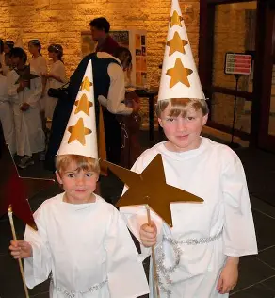
What are the culinary traditions associated with St. Lucy’s feast day? What do they reveal to us about God’s love at Advent and Christmas? (4)
Besides saffron buns, almonds, raisins, and gingerbread cookies are served by Lucia brides. Spices and almonds are symbols of Our Lady. Almonds are symbols of divine favor in the Holy Bible, symbolizing that Our Lady was chosen by God in a special way to carry the Son of God, having been favored with God’s great grace and love as a gift for her faithfulness. They have a sweet flavor, as well as a hard shell, symbolizing how Our Lady is a human being, but enclosed within her is the sweet Divine Child. In artwork, Our Lady may be enclosed in a shell that has a similar shape to an almond. Almonds are considered to be the Queen of nuts, and Our Lady is the Queen of Heaven. In the Old Testament, specifically, in the Wisdom literature, Our Lady is described as being fragrant like the spices; she spreads the fragrance of holiness in her love and kindness. Just as St. Lucy was strengthened by faith, hope, and love to be martyred for Christ, we support each other in being strengthened to fight the good fight for Christ. Saint Lucy spread the fragrance of holiness like light by setting an example of fortitude. She taught that we are meant to live this life to the fullest, blessing others now through sharing God’s gifts; to be more in awe of God than of man, focusing on pleasing Him; and to be a pure temple for the Lord, because if we are pure, the Lord will be happy to fill our souls, but if we are not pure, then we can only be filled with a spirit of darkness. Saint Lucy teaches us to open ourselves to being filled with light, with the food of God’s love that keeps our souls alive forever, rather than sustaining us temporarily. Saint Lucy lived in the third and fourth centuries, in an area that had once been a Greek city. The emperor, Diocletian, was seeking to gain power and glory, restoring Rome’s military might, and went to war with other empires, but these conflicts would not bring peace, only stirring further anxiety. In this environment, St. Lucy was a source of light and hope, bringing peace to Christians who waited anxiously in the Catacombs, praying for the freedom to worship God freely in an otherwise pagan Rome. Since her father passed away when she was young, St. Lucy was raised by her mother, who was very sickly. When she became afflicted with a blood disorder, her mother decided to arrange a marriage for St. Lucy to ensure that she would be provided for, but St. Lucy had made a private vow of virginity to God. So inflamed with love for Christ was she, that she visibly glowed. Saint Lucy went to pray to St. Agatha, another martyr, at her tomb, and received a vision in response to her petitions for her intercession. Saint Agatha reassured her that her mother would be healed, but that she had to have faith; her faith would heal her, and her mother

Slide 9
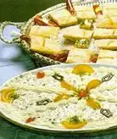
What are the culinary traditions associated with St. Lucy’s feast day? What do they reveal to us about God’s love at Advent and Christmas? (5)
Saint Lucy took St. Agatha’s words to heart, and would cling to her faith. Her mother broke off the arranged marriage for St. Lucy, and the women donated the dowry to the poor. It had always been St. Lucy’s practice to give to people in need. Furious, her jilted fiancé reported St. Lucy to the emperor for being a Christian. When she refused to renounce her Faith, she was sentenced to be burned alive, but the fire did not consume her; her love for Christ was stronger. Then, St. Lucy’s eyes were removed, but her sight was restored miraculously. She did not pass away until she had been given the last sacraments. Saint Lucy had seen with true sight, because she saw beyond this life, looking to the reward of being united with Christ, her Spouse, in the next, so she never wavered in her Faith. Saint Lucy would come to the aid of those who prayed to her, just as St. Agatha had once aided her. She interceded for children who were afflicted with an eye disease in Italy in the 1300s, and from then on, devotion to her grew in Italy. In some regions of Italy, children write letters to St. Lucy on the eve of her feast day, December 12, and leave her donkey hay to eat, along with cookies and milk or coffee for St. Lucy (wine may be left for her helper, Castaldo), in preparation for her visit to bring them gifts. They are taught to close their eyes tight when they go to bed, so that their eager curiosity in opening their eyes to see St. Lucy will not result in ashes being thrown in their eyes. Saint Lucy is also credited with helping people in Italy who were starving during a famine. After they prayed for her intercession, she appeared in a boat on the lake, shining light, and carrying baskets of bread. They would be given wheat to cure their hunger during the famine, and from thereon out, would abstain from eating wheat bread on St. Lucy’s feast day out of respect for her, instead having wheat berry porridge sweetened with honey. This all further emphasizes that it is Christ Who is the True Wheat, that His bride, St. Lucy, wed to Him in martyrdom, leads us to partake of. When processions of people singing in honor of St. Lucy go out on her feast day, they are meant to represent the choirs of virgins in Heaven surrounding Our Lady, singing in adoration of God; sometimes, the women in Lucia processions are dressed as holy angels, for this reason. Star boys represent the stars that shine in the winter night, like the Star of Bethlehem pointing the way to Christ, and also are meant to represent St. Stephen, the protomartyr (the first person martyred for Christ) that we celebrate on December 26, the day after the Birth of Christ, the greatest Martyr. The star boys, whose roles were inspired by Christmas pageants, sing about St. Stephen’s five horses, five being the number of love, representing Christ’s five holy wounds that He took on out of love for us. The public, formal Lucia Day processions began in 1927 in Sweden

Slide 10
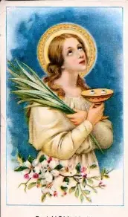
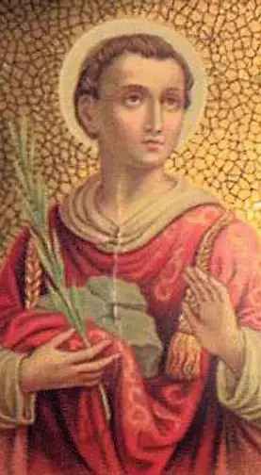
What are the culinary traditions associated with St. Lucy’s feast day? What do they reveal to us about God’s love at Advent and Christmas? (6)
Saint Stephen is honored in a special way during the St. Lucy processions, because of the tradition that holds that St. Stephen worked in King Herod’s stable, and gave his horses water to drink when he saw the Star of Bethlehem in the sky. He rejoiced in the living water coming into being, and went to announce to King Herod that the Christ Child was born, but when King Herod learned of the truth of this announcement, he was so angered, that he sentenced St. Stephen to be executed. Saint Stephen had believed in the Light of the World from the very beginning, and teaches us to follow Christ as our star, too. Lucia brides have crowns made from lingonberry branches to symbolize new and eternal life in Christ, and they have seven candles in their crowns to represent perfection and completion that we come to through Christ, especially through His Presence in the seven sacraments that lead us to unending life. There may be five or nine candles, as an alternative; nine being the number of prayer, and angelic choirs, and five being the number of love. These candles also remind us that earthly nor eternal fires would consume St. Lucy, because she had Christ in her pure heart. In Eastern European countries like Croatia, wheat is planted on St. Lucy’s day, so that it will grow in time for Christmas, representing the arrival of new life in Bethlehem when Our Savior was born, that we all would grow by being rooted in His love. Original St. Lucy processions had young people dressed in white, as holy angels, or as representations of the cherubic Christ Child, serving cookies, cakes, and other treats to small children. The celebrations point back to the Christ Child as the Source of our every joy that we need for our hearts to be full, for our happiness to be complete, and reminds us that we are all children of God who need to look to the Christ Child to learn how to serve others, and how to be served by God, to receive His love that He extends to us. We are to pass on the torch that God gives us, to keep sharing the light, that others would see by His truth, like St. Lucy did, we are to be public witnesses to His love, as she was. Two of the S-shaped buns made for St. Lucy’s feast day are crossed to create a Christmas cross shape, representing Christ’s triumph over darkness through the cross. Originally, the saffron buns were called “devil’s cat” buns, because there was a pious legend that the Christ Child would give saffron buns to protect children from the deceptions of Lucifer, as the golden hue of the buns, calling to mind the light of Christ, would scare away evil. As we celebrate the Light of the World, we celebrate Christ’s continued victory. When people stayed up on St. Lucy’s Day, they kept vigil, like Christ’s apostles keeping vigil with Him in the garden; this evokes the spirit of the candlelight Easter vigil Mass, as we look forward to the light dawning with the new day. In some Scandinavian towns, St. Lucy figures are elected each year, and the woman who is elected completes charitable works honoring the generous spirit of St. Lucy. We all can carry forward this spirit in treating others like the Christ Child, with kindness and love

Slide 11
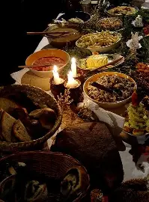
What is oplatki? What is Wigilia? What do these special food-related traditions reveal to us about God’s love at Advent and Christmas? (1)
During the “Wigilia,” when Polish families sit down for Christmas Eve dinner together, keeping vigil with Christ, they share oplatki, breaking the bread together, in splitting off pieces of this Christmas wafer, usually pink or white in color, and topped with honey (representing the sweetness of the words of blessing to be offered like sweet honey), to give to each other with words of blessing. (Usually, the white oplatki is for people, while the colored oplatki is for pets, who are also included in the Christmas celebration, like the animals present by the manger for Christ’s Birth.) Family members and friends pass along messages of love and forgiveness as they keep a continuous offering of the bread going, just like Christ continuously extending Himself to us, the Word Incarnate giving us His love and mercy. After a day of fasting, the Polish Wigilia begins when the first star has risen in the sky, marking the Birth of Christ, the rising of Christ’s star, and the promise of spiritual resurrection to come in Christ. The feast enjoyed on Christmas Eve is meatless, in honor of Christ, Who has taken on Flesh with which to feed us. Sometimes an empty place at the table is kept for Christ, through Whom the feast is made possible; it is available for an unseen guest, offered to welcome anyone who may arrive unexpectedly, as we aim to honor the Presence of Christ in each person, and to hold their intentions in our hearts, as we remember those unspoken petitions of people suffering around the world. We include Him in our celebration, for He is the purpose of our celebration, and we pray to have a place at the heavenly banquet table with Him, in using our traditions to honor Him, and the abundant life He gives us, the many blessings, through His own life. Before feasting, family members engage in the oplatki tradition, remembering that love covers every sin, so Christ broke His Body to bless all of us, healing us of our sins. It is the head of the household who begins breaking the bread, usually, a father sharing the bread with his wife, begging her pardon, and sharing words of goodwill with her. She may reciprocate his words, offering her own encouragement to him. These exchanges that are passed around the table, uniting everyone, start the new year off on a loving note, and most deeply welcome Christ into hearts, allowing for His mercy to reign. This tradition has its roots in the Middle Ages, when flatbread would be shared as a sign of love and hospitality, a true gift to visitors, as bread was less abundant, considered to be more of a delicacy than a commodity

Slide 12
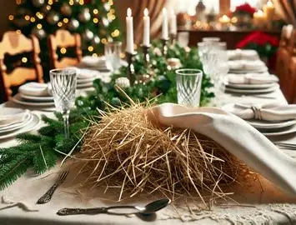
What is oplatki? What is Wigilia? What do these special food-related traditions reveal to us about God’s love at Advent and Christmas? (2)
Even during World War II, the tradition persisted, with family members mailing each other oplatki to keep the tradition alive. Oplatki are baked with flour and water, showing that even the simplest offerings can be the most profound, when given with great love. They have withstood the test of time, connecting generations. Wigilia looks forward to the Eucharistic celebration that family members will be united in, in celebration of Christ’s Birth, as He is reborn on the altar during the Holy Sacrifice of the Mass. “Oplatki” means “bread of love,” and comes from the Latin “oblatum,” referring to the sacrifice, the sacred altar bread that is transubstantiated, but the oplatki is not sacramental, consecrated bread. Often, oplatki are embossed with images of the Holy Family, the Nativity scene; heated irons press the images onto the bread, reminding us that through our purification process in this life, which involves light and heat, sharing in Christ’s love, the impression of His Heart may be imprinted upon us. Oplatki had its origins in the year 966 A.D., shortly after Christianity came to Poland. The Polish king would help to facilitate the spread of the tradition, which involves saving any remaining bread for the year to come, expressing that we can always share more of Christ’s love, keeping it in our hearts beyond Christmas. Christmas carols are sung by the light of the Christmas tree after the meal to express joy, after enjoying a balanced sequence of courses of food (usually, twelve dishes, for the twelve apostles fed by Christ, the twelve stars of Our Lady, the twelve years of Christ’s childhood, and the twelve days of Christmas) that are bitter or sweet in taste; stewed vegetables, vegetable soup, and fish are often served; even the bones of the fish are arranged in the shape of the Cross, all pointing back to the Sacrifice that Christ was born to make. A white tablecloth laid our represents Christ’s purity, while the hay laid on the table represents the straw of the manger that Christ laid upon as He would lie upon the wood of the Cross, to cover our sins with love; He is the living bread of love

Slide 13
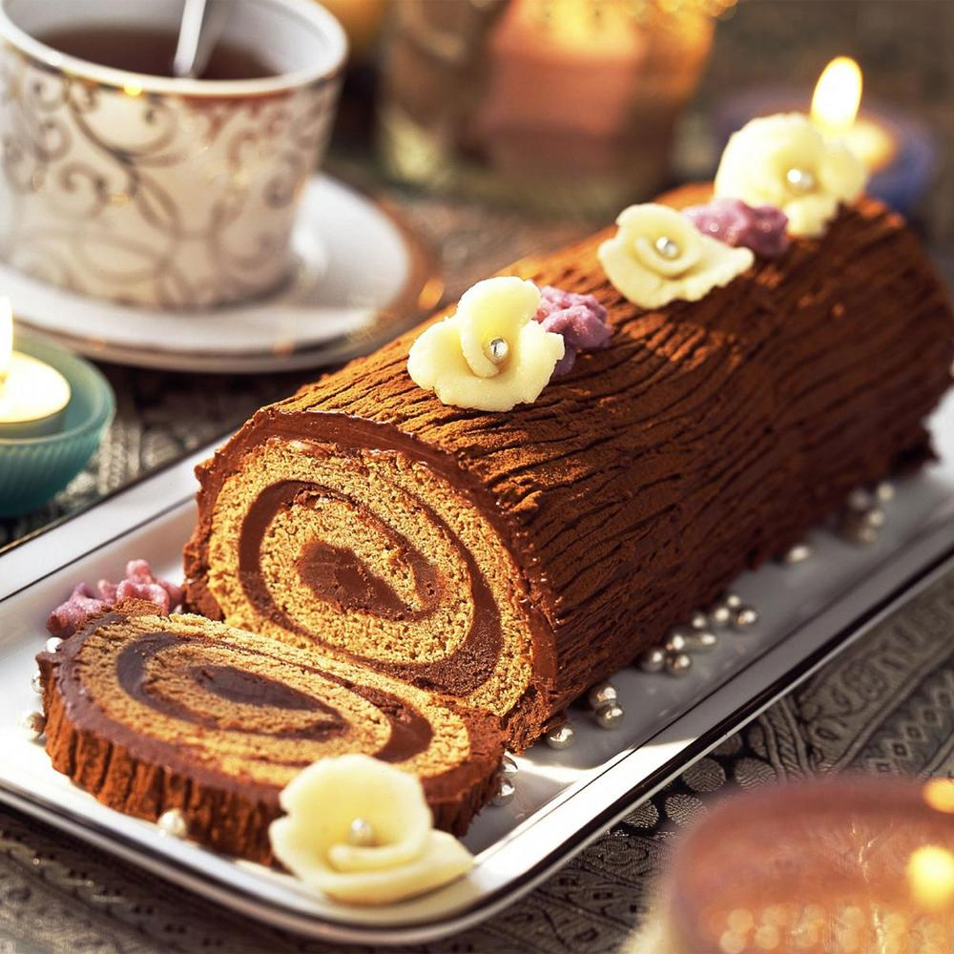
What is buche de noel? What does this special culinary tradition reveal to us about God’s love at Advent and Christmas?
A symbol of the birth of Christ, the yule log cake originated in France in the 1800s, but the burning yule log itself has its roots in the Middle Ages, when it was customary for a yule log to be burnt to scare away evil spirits, any forces of darkness, which would be consumed by the light. The yule log cake was inspired by the past custom of bringing in a large log of wood on Christmas Eve to be burnt for good fortune. Originally, it was a honey bread honoring the sweetness of the Lord. During the twelve days of Christmas, the yule log was burnt continuously, celebrating Christ’s light that endures, never to be extinguished, but continuing to guide us to Heaven, away from eternal fire. Even the ashes from the yule log were kept, as they were believed to have healing properties. This reminds us of the ashes and sackcloth put on in the Old Testament of the Holy Bible as a sign of repentance for sin. When we repent, and go to God for His mercy, we can be healed, rolled up in Christ’s Heart and protected from evil through His goodness. A jellyroll-style sponge cake (like angel food cake) made with a hazelnut or chocolate mousse layer, alternatively, filled with buttercream, this dessert has evolved over the years according to personal preferences of bakers, and regional tastes. Whichever flavor profile the yule log cake has, what remains the same is its appearance: it is always topped with chocolate ganache that is stylized to resemble bark, usually, by dragging a fork’s tines through the chocolate to create a coarse texture. Woodland creatures made from fondant, or marzipan decorations, might be used to adorn the cake, which also may be topped with flowers and evergreens. The buche de noel log cake has a cake base that does not crumble or break, so that it may roll easily, and hold its shape; it is soft and light, rather than dense; the filling is similarly airy and smooth. This cake reminds us of how Christ, with His love, helps us to conform to His image, to roll with the punches easily, without breaking, and to be smoothed and refined over time, so that we are not roughened by the world, but made interiorly untouchable, like Our Lady, who is spiritually inviolate, having remained faithfully by the Cross without succumbing to despair, or even the slightest temptation to commit a venial sin. When Christ fills us, we are made sweet. Now, yule log cakes are often made, and then shared with, family and friends, representing the gift of Christ’s warm and radiant Heart that we share with others through works of mercy, feeding those who hunger for His friendship. Around the world, the tradition of burning a yule log persists. Usually, the whole log is burnt until there is none left; anything remaining may be used for the next year; a small piece could be used as kindling for the lighting of the log to come. In Portugal, the log would be lit after midnight Mass. In one region of Spain, a hollowed-out log would be filled with candies and nuts, or other small gifts, by children, and families would gather around it to exchange gifts at Christmas, singing and tapping the log with a stick until a gift falls out to be given. In France, the youngest child in the family would choose the largest log from the barn, while the oldest family member would “anoint” the log with mulled wine, singing a song asking God to help the family to see the log in the new year, to always behold its light. This tradition leads us to think of Christ going on the wood of the Cross to help us to see His love and truth, making of Himself a whole burnt offering to give to us as a Sacrifice of total charity, to warm our hearts with hope of Heaven

Slide 14
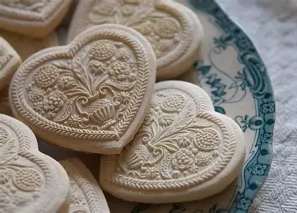
What is springerle? What does this special culinary tradition reveal to us about God’s love at Advent and Christmas?
Springerle is a type of anise (licorice)-flavored cookie that was developed in Germany in the 1300s. Authentic springerle are made without butter, and in place of baking powder, baker’s ammonia is used. The earliest-known springerle molds were developed in Switzerland in the 1500s. Molds were made with religious images that would be pressed upon the springerle cookie dough. So prized are these molds, that German immigrants to the United States would make room in their suitcases just to fit their springerle molds, treasured heirlooms from home. While springerle cookies have a hard outer shell, they are soft on the inside. Their name, meaning “little jumper” honors the little “feet” that jump up under the cookies when they are baked. The raised images on the cookies, which are left to dry for a period of time (usually at least 24 hours) before being baked, remind us of the Resurrection that Christ is born for, and that we are born for, through spiritual union with Christ, which we come to gradually, with much patience. Before being baked, the springerle are moistened on the bottom, reminding us that if we are to rise up with Christ, we are to receive the living water to cleanse us. It was in the 1800s and 1900s that springerle cookies came to be associated most closely with the Christmas season, so that now, they are baked almost exclusively at this time. Besides molds, springerle designs are made by using specialty rolling pins, which have sequences of images on them, usually, of the Nativity scene and related pictures from Christ’s life, which are imprinted onto sheets of dough. The dough squares are then cut out and baked, to be given as gifts to friends and family. These special cookies remind us of the beautiful impression that Christ makes when we open our hearts to Him, allowing Him to touch our souls. Christ helps us to be raised up, to spring up on our feet, to reach the heights of Heaven; He uplifts us through His love. When we keep the Nativity of Our Lord in our hearts, we can always be reborn in Christ’s love. When springerle were first being developed, it was incumbent upon baking apprentices to not only demonstrate their skills in baking, but in woodcarving, as they carved their own cookie molds, too. Christ carves into our hearts, reaching in deeply to heal our wounds; He polishes us, cutting away what will prevent our future growth. He is a spiritual carpenter, a teacher of the craft of service to God; when we are His apprentices, we can learn most fully how to honor the Eternal Father. These wafer-like cookies given on such occasions as weddings remind us of the love that Christ exchanges with us, as He is born to give His life for our rebirth in Heaven, and we use our Advent season to give Him more of ourselves

Slide 15
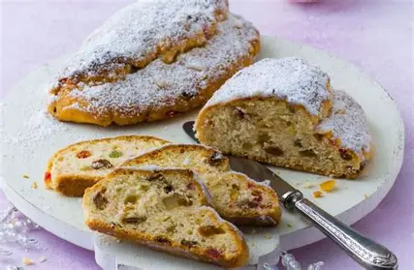
What is stollen? What does this special culinary tradition reveal to us about God’s love at Advent and Christmas? (1)
In the 1300s in Germany, this fruitcake-like bread was developed. Made from flour, water, and salt, stollen was created in response to the Church’s fasting guidelines, as Catholics abstained from butter and milk during the penitential season of Advent. Over the years, after the ban on butter and milk was lifted during this season, the bread recipe was adapted, and now includes sugar, many rich spices, and fruits, making it an optimal sweet bread option for the Christmas season. Raisins and currants baked into the bread are meant to symbolize the Eucharistic grapes, the winepress that Christ was born to be put through in order to shed His Precious Blood for our salvation. Meanwhile, the poppyseeds and nuts symbolize abundance, the lifegiving mission of Christ. The very act of baking bread in this season is an expression of community and love, a sense of belonging as we all are united as members of Christ’s Mystical Body, coming together in sharing the meal of Christ’s Body in the sacrament of Holy Communion. As the dough for stollen rests for several weeks, bakers exercise patience. We express our gratitude for God Who is patient with us as we grow, and become more like the Son of God, our Lord, Jesus, that we may be together with the True Bread forever in Heaven. The word “stollen” comes from the German word “stollo,” meaning “stone,” because of the flat shape of the bread. When we look at this bread, we can think of the stones cast at the persecuted, like St. Stephen, and of how these friends in Christ were not weighted down by despair, but buoyed by hope in Christ, their Savior, Who is our cornerstone. The Church is built upon Christ, Who holds us all together. The full name of “stollen” is “Christstollen,” as the bread covered in powdered sugar is meant to represent Christ lying in the manger in swaddling clothes. Families break off pieces of the bread to share with each other, a reminder of how Christ gives Himself to each of us to sustain us, that we would never hunger. Stollen was transformed from a rock-hard bread eaten purely for subsistence to a rich, aromatic dessert that would delight the senses, a symbol of how Christ’s love transforms us, making our hearts of stone into hearts of flesh

Slide 16
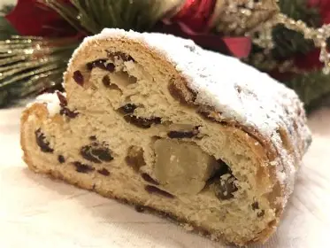
What is stollen? What does this special culinary tradition reveal to us about God’s love at Advent and Christmas? (2)
In 1491, Pope Innocent VIII innocently created a revolution when he wrote the “Butter Letter,” freeing bakers from the ban on butter and milk in their baked goods during the penitential seasons. They now were not restricted to oil, and could make their pastries richer, so long as they paid a tax to the Church to support the building of new cathedrals. Unlike fruitcake, stollen is made from a dough, not a batter. It is not meant to be refrigerated or reheated in a microwave, but is meant to be enjoyed patiently, truly cherished. The powdered sugar on top of the bread seals it. Likewise, we are meant to be sealed in Christ’s love; Our Lord sets a seal on our hearts, and when we are enfolded in Christ, we can quietly immerse ourselves in the wonder and grace of the season, placing ourselves by the manger, without yielding to the pressures of this time; in this way, we have freedom of spirit, the lightness that comes from the Lord. A marzipan center, usually, a heart, represents Christ at the Heart of everything, the Sacred Heart of God hidden within the womb of Our Lady. The fruits and nuts represent provisions given to pilgrims on their journey, just as Christ reaches out to feed each of us on our pilgrimage to Heaven. The soft cradle shape of the manger reminds us to go to Our Lady, that we would be kept under her mantle, practically swaddled in it, so as to remain in grace. Spices in the bread represent the roads to the East taken, calling us to take these roads spiritually to be with the Christ Child in Bethlehem, that we would know the contentment of being in His Presence. This bread reminds us that we may carry our gifts to Christ, too, nourishing ourselves with His Presence in this season, so that we will have much to give Him. Raisins in the bread signify the small steps we take to Christ, while the yeast represents hope rising with Christ; the many spices, like roads covering great distances, are all brought together under the mantle of powdered sugar, like Our Lady drawing us all into the folds of her Heart, as she did the Christ Child, under the sheltering light of the star, represented by candied citrus. Traditions connected to the bread include having it blessed on Epiphany; some families may bake it for St. Nicholas’ feast day, or on Christmas Eve after midnight Mass; others reserve the first slice for a guest, honoring Christ, the newborn King, a stranger in the world Who would serve as our greatest Friend

Slide 17
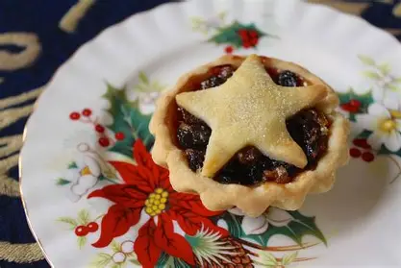
What does the mincemeat pie-making tradition reveal to us about God’s love at Advent and Christmas? (1)
Mincemeat pie-making as a Christmas custom dates back to the Middle Ages, during the Crusades. Crusaders brought back this tradition from the Middle East, where it was common for meat to be mixed with fruits in a pie both sweet and savory in flavor; figs and raisins could be combined with salmon, for an elaborate dish meant to honor the Christmas holy day with great festivity. In the late 1300s, recipes were appearing in English cookbooks for pie shells filled with such variegated fillings as pork, rabbit, bird, and many spices, including saffron, a Christmas spice. The pies were called “flesh” tarts as an homage to Christ, Who came down from Heaven, taking on flesh, to walk among us, and save us from sin. Shaped into hand-pies, the dish came to be called a “mince” meat pie, coming from the Latin word “mince,” meaning “small.” Likewise, Christ, the Incarnate Word, took on flesh (meat) as a tiny baby, a small child to teach us that we become great in Heaven by becoming small, allowing ourselves humbly to be held by God, our Father. Mincemeat pie crusts were decorated with beautiful patterns, reminding us to adorn our souls with virtues for Christ. The mincemeat pies were served during the twelve days of Christmas in wealthy homes for large gatherings, as a way to denote status. In England, the mincemeat pies, representing gluttony and frivolity to the Puritans, would be banned for a time by Oliver Cromwell, who sought to reduce the celebratory aspects of the season, to solemnize it more. Over time, the mincemeat pies would come to be less associated with meat than with fruits, becoming handheld fruit pies. Before the Protestant Reformation, mincemeat pies were molded into oval shapes to represent the manger in which Christ was born, and in which we are called to be spiritually reborn by imitating Christ, taking on His Flesh, and walking in His shoes, that we may be molded into His humble, loving image of service and generosity. Atop the mincemeat pies shaped like mangers, a Christ Child figure would be placed

Slide 18
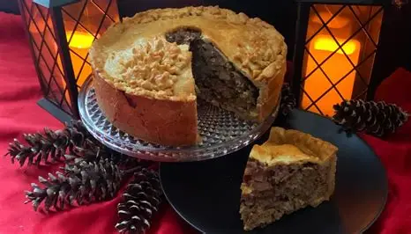
What does the mincemeat pie-making tradition reveal to us about God’s love at Advent and Christmas? (2)
Usually made from pie dough, the Christ Child figure was given to children to teach them about the Lord being born in a stable, and adored by Kings, for their redemption. The pastry top was used to represent the swaddling clothes of Christ. Sometimes, the pie was said to be shaped like a “coffin,” because Our Lord was born to give His life for us, that we would never die. In being filled with so many spices, mincemeat pies recall the story of the Three Kings carrying special gifts to the Christ Child, including spices, to show their love for Him as their King and Redeemer. At least three spices (cinnamon, cloves, and nutmeg) are used in the pie to represent the Three Kings. It is not uncommon to see baked goods and other gifts decorated with garnishes of holly (or dough shaped like holly on the mincemeat pies); the holly branches represent Christ as the branch, the True Vine, and the root of Jesse. We are called to remain rooted in Christ by partaking of His Body, that we would be cleansed by His Blood, and continue to grow in love of Him. In some places, these branches are not cut until Holy Week during Lent, as they represent the branches waved by the people who welcomed Christ into Jerusalem on Palm Sunday. Protestants ultimately had banned the Christmas custom because of how overtly Catholic it was, but celebrations of Christmas would return when King Charles II ascended the throne. It had been customary to eat one mince pie on each of the twelve days of Christmas, so as to have many blessings in the twelve months of the new year. Twelve is the number of the Church, so in observing this custom, we pray for all of the Church, that everyone in it would be blessed by Christ, Who took on flesh to give His life for us all, that we would have eternal life. Mutton used in the earliest mincemeat pies represented the shepherds and the sheep they herded in the flock. Truly, the mincemeat pies are a kind of Epiphany treat, with the stars made from dough on top representing the Star of Bethlehem that led the Three Kings to discover the Word made Flesh in the manger, their True King Who would go to any length to save His people out of love. Traditionally, the mincemeat is prepared several weeks before Christmas, sometimes, on Gaudete Sunday, the day of rejoicing that marks the halfway point to Christmas. The pies are placed in a cool, dark place to “rest,” so that the flavors will deepen, becoming richer over time. This is called the “maturation” period, and represents how, we, too, are called to spiritual maturity through abiding with Christ, learning to crawl and walk with the Christ Child, taking each baby step with Him, so that our faith can mature, and we may surrender. Sometimes it is in the challenging times that feel dark when we mature the most, but in those times, Christ is shining His light most, preparing us for a rich feast with Him in Heaven. We can always rejoice in Christ shining His light through the darkness; every time of our weakness is an opportunity for God to show His strength

Slide 19
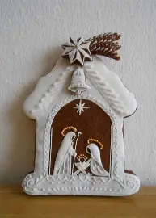
What does the gingerbread-making tradition reveal to us about God’s love at Advent and Christmas? (1)
It was in the year 992 A.D. that gingerbread arrived in Europe from the Middle East via the Armenian monk St. Gregory of Narek, an archbishop who would become a hermit, contemplating God in nature, and living off of natural roots and honey; the literal fruits of his contemplation would be shared with others, that they would know the sweetness that comes from following the Holy Spirit’s inspirations. It was in the small village in France where he lived for the last seven years of his life that he taught the inhabitants to make gingerbread. It is believed that a fourth wiseman was set to go to adore Christ, but was ill, and would pass away in Syria, but before dying, he entrusted a chest of ginger roots to a man to bring to the Christ Child. This man, a rabbi, would build miniature houses of bread in honor of Christ, and used ginger roots to flavor them. Gingerbread houses, then, came to be connected to the adoration of the Christ Child in this season, as we remember that our spiritual lives only have structure when they are rooted in Christ, that we may only be built up when the builder is Christ. Gingerbread makers even had their own guilds that were separate from those of other bakers, making their craft into a true art form in honor of God, Who made His home among us to give us an eternal home in Heaven. Originally, gingerbread was more comparable to a cake than a cookie, mixed with honey and breadcrumbs to thicken the mixture. To be fortified spiritually, we are called to unite with Christ, the True Bread, and our means to Heaven; His virtues form our spiritual armor that we are to put on to be safe from evil. In the 1400s and 1500s, German nuns baked gingerbread in their convents to share with members of their outlying communities. While they were in enclosures, totally cloistered, and therefore, without worldly contacts, they nonetheless shared Christ’s love and kindness with those around them by preparing gingerbread to have delivered to their neighbors. They reminded their brothers and sisters of Christ’s Presence among them, even when not visible, by making devotional gifts to share, such as rosaries, which could be delivered with gingerbread, called “lebkuchen.” The nuns procured spices from spice merchants to bake the gingerbread, such as galangal, pepper, saffron, ginger, nutmeg, and cinnamon. They learned new recipes, trying them with honey, to diversify their offerings. Their religious superiors were given gingerbread made with saffron, which was the most expensive spice. In England, early gingerbread recipes were colored with red, while “white gingerbread” was made with marzipan. Both types of gingerbread remind us of Christ, as white and red symbolize purity and martyrdom, respectively, and Christ was martyred for His pure Heart of love that was not understood by the world. Molasses would come to replace honey in gingerbread, especially as ingredients such as sugar became less expensive, and the gingerbread would become more like a cookie in consistency, allowing for the dough to be pressed into molds, after a period of allowing the dough to soften, reminding us that we are made to fit Christ’s mold most closely when our hearts are softened to resemble His sweet Heart

Slide 20
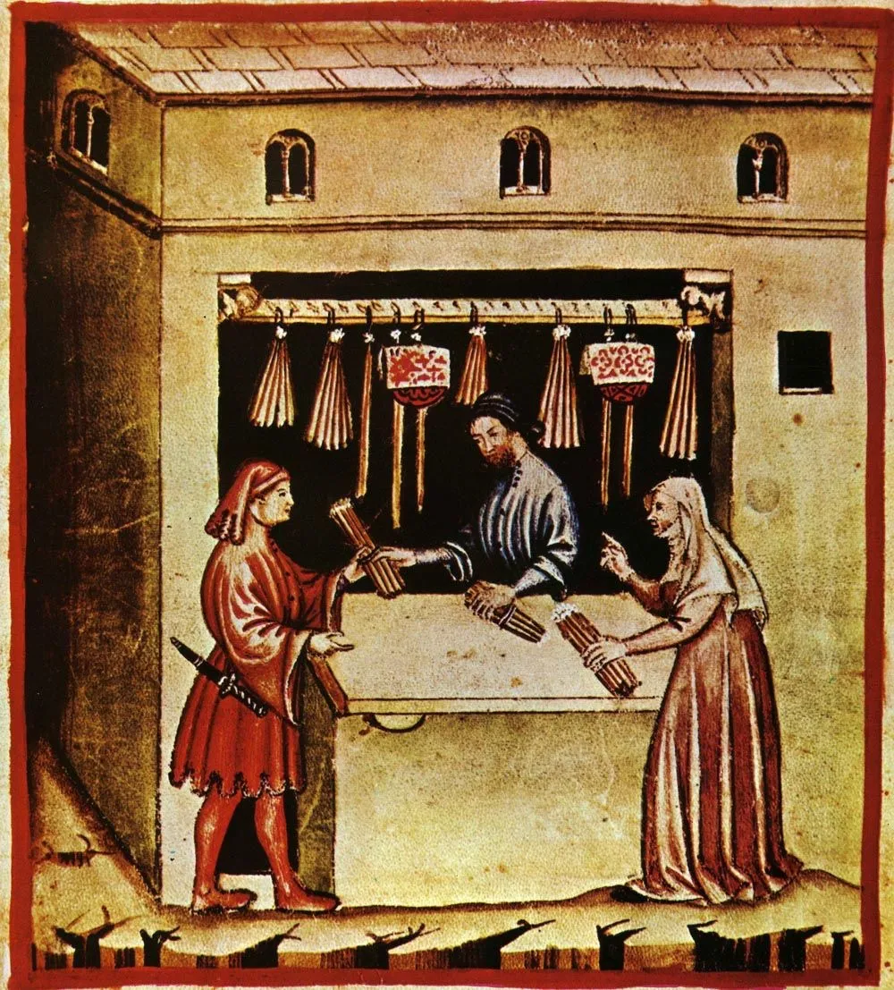
What does the gingerbread-making tradition reveal to us about God’s love at Advent and Christmas? (2)
All of the spices obtained by the nuns could be costly, but their gifts were to express the immeasurable love of Christ, like the offering of St. Mary Magdalene, who poured out all of the expensive oil that she had to show her love for her Savior. In their gifts of love, the nuns were reflecting something special about Christ, Who goes to any length, including becoming a child, to save us. Seven pounds of gingerbread were reserved for clergy, and were distributed to other groups in descending order; a group’s status would determine the color, weight, and shape of the gingerbread that they received. Children received the smallest gingerbread slices. Women from other convents nearby received medium portions; generally, only the highest-ranking groups, such as the priests, received colored gingerbread (containing saffron). Christ, however, is undiscriminating; He pours out His love for all of us. Ultimately, the nuns extended their charity as a sign of friendship, because while they could not meet face-to-face with their spiritual children in the world, they could communicate their love through their actions of kindness, reminding their spiritual children of their ongoing prayers and support. Gingerbread offers many health benefits, as nuns such as St. Hildegard would affirm, so in sending gingerbread, the nuns conveyed that we all may be healed and strengthened by going to the sweet Christ Child, the Divine Physician and the True Bread Who contains every remedy for our ailments, having come to redeem us from every sin with all of His Precious Blood. A minister even wrote an account at this time of how the elements of the gingerbread, or the process of gingerbread baking, teach us about Christ’s Birth, Passion, and Death, such as the cloves in the gingerbread being like the nails Christ bore on the Cross, or the animals who came into the kitchen while the gingerbread was baking, following the aroma, were like the animals coming by the manger to adore Christ. We all are called to follow Christ’s fragrance of holiness, to spread it ourselves, in absorbing it deeply in being by the Christ Child in the manger, learning from His example. As trade routes expanded, spices used in gingerbread were exchanged more widely; gingerbread would be made to be bartered, given in exchange for a service, to repay a debt. This further serves as a reminder of how Our Lord paid the debt incurred by our sins with His life, taking on the suffering for our sins so that we would know the sweetness of Heaven. Before there were gingerbread houses being widely circulated, monasteries made gingerbread nativities, calling us back to the manger to receive the sweet love of the Divine Child’s Heart, opened to all of us, that we would be healed and reborn through Him. In medieval times, fresh fruits were scarce in the winter, so making such delicacies as mincemeat pies and spice cookies was a special way to show love, namely, the extravagant love of our Savior, Who makes grand gestures to show His love, even when there is scarcity of faith, hope, or love in the world. Through Christ, it is revealed, and made abundant

Slide 21
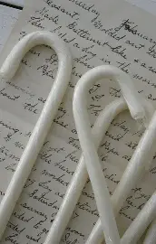
What are the Catholic roots of the candy cane?
In 1670, the candy cane was developed by a choirmaster at Cologne Cathedral to keep children occupied, and therefore, remaining quiet, during Holy Mass. Originally all white to represent the purity of the Christ Child, the candy cane later had red stripes added to represent the stripes that Christ took on for us during the scourging, shedding His Precious Blood for our salvation. Striped candy canes were popularized in the early 1900s. A hook was added to the candy cane so that it would resemble a shepherd’s hook, and the protection of the Good Shepherd over all of God’s children. With his hook, Christ reins us in, keeping us away from sin, and in His grace, that we may have pure hearts like Him, the Christ Child, with which to treasure His sweetness. Candy canes were bent into this shape also in honor of the shepherds present for Christ’s Birth. It was during the living nativity, a Christmas pageant of sorts, that the choirmaster at Cologne Cathedral in Germany was inspired to give candy canes to the young singers in his choir, while they were waiting during spoken or silent parts of the show. The bent sugar sticks could also be placed on Christmas trees, which were spread throughout Germany due to the influence of St. Boniface, who famously cut down a pagan oak tree, felling it in the shape of a Cross, and teaching Germans to replace their pagan customs with the tradition of decorating a tree in honor of the Christ Child. The first all-white candy cane in the U.S. made its debut in 1847

Slide 22
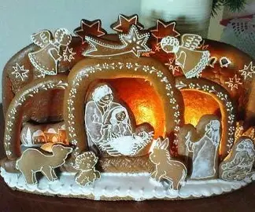
What do all of these traditions collectively reveal to us about the sacred mysteries of God that we celebrate at Advent and Christmas?
All of these culinary traditions remind us that God wills our eternal happiness. He made our bodies to need food, so that we could enjoy the experience of creating and sharing food together. A family meal can be a joyful occasion, during which we rejoice in the beauty of each other’s souls, sharing about the things that gladden our hearts, laughing, and breaking bread to fill each other’s stomachs, while remembering that the company of friends, reflecting Christ, our greatest Friend, is what feeds our souls. God’s humble love is at the center of all of the mysteries we contemplate in this season. Jesus was born in a manger, a feeding trough, to humbly offer His life to feed us all. He was born in Bethlehem, meaning “house of bread.” Jesus gives us His Body, the True Bread, so that we may have a home in Heaven. In partaking of the True Bread together, we share a home in God’s Kingdom on Earth in this life; Christ builds us up through His love, that we may make our hearts into mangers for Him, and guide others to be fed by His Presence, which we point back to with our own presence of love. We only have a house built on rock, a house that will remain standing and protect us, giving us shelter so that we may share glad tidings over meals inside, when our foundation is the True Bread, when it is Christ Who holds everything together, like a binding ingredient that completes the whole recipe. The foods we cook and bake in this season take time; they are made with care, with special details that show much love. Likewise, God perfects us gradually, in His time. Our sanctification is a process, but all good things take time, and the reward will be great when we are patient, just like how our meals are best enjoyed when they have had time to marinate, to deepen in the richness of their flavor. We can look forward to heavenly rewards, like the gratification of a sumptuous feast that refreshes us after we have labored to prepare it. The outpouring of love has the savor of the sweetest success; God calls us to journey slowly to treasure each ingredient, each flavor, that He uses to confect us into His perfect masterpieces. Jesus, too, as a human being, took time to learn and grow, to be strengthened, and it is His sacrament of love, Holy Communion, that strengthens us for our journeys in this life, towards the next

Slide 23
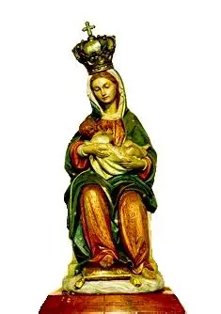
What is the Feast of Our Lady of Good Deliverance, and what does it reveal to us about the sacred mysteries of God that we celebrate at Advent and Christmas?
December 16 is the feast day of Our Lady of Good Deliverance. This special title honors Our Lady for helping to deliver us to Christ, to our eternal salvation, as she guides us to spiritual rebirth in Heaven. On this feast day, we remember in a particular way the patronage of Our Lady of La Leche, or “Our Lady of the Milk,” after whom the shrine built in St. Augustine, Florida, the site of the first celebration of Holy Mass and Thanksgiving meal on United States soil, was named. The title of “Our Lady of Deliverance” pays homage to Our Lady for nurturing us, just as she nursed her Son (“nurse” means “nourish” in Latin), Jesus, giving Him the milk He needed to grow, and similarly, giving us the sweet refreshment of her maternal love that we need to grow more like Christ in faith, hope, and love. On this feast day, we begin our novena in anticipation of Christmas: we are nine days out from the celebration of Our Lord’s Birth, and are remembering the nine months during which Our Lady was expecting Our Lord, waiting patiently for His arrival. Our Lord took time to “cook” within Our Lady, and when delivered, brought the greatest joy. In this life, we are still growing, still cooking, but through Our Lady’s help, will be delivered safely into Heaven, where we can enjoy the fruits of our labors. Our Lady leads us to receive the sustenance we need in her Son, so that our deliveries into Heaven will be good: we will be judged to be spiritually-healthy, good and faithful servants, well-fed by Christ’s love reflected in Our Lady. In this season, we can renew our prayers of gratitude for Our Lady’s deliverance of us into safe port with her Son, and for continuing to ensure that we are sustained by His Presence through her own closeness, her maternal guidance, and can focus on sharing Christ’s love with others, that our neighbors would be refreshed even amidst spiritual deserts. Before Christ could pour our His Precious Blood and living water for us, Our Lady poured forth milk, and comforting words like honey, to sweeten life for her Son, so that when He poured out His love for us, it would be like milk and honey for us to rejoice in, to fill us up with much goodness. In this season, we are given the food that we need in order to reflect the angelic sweetness of Our Lord and Our Lady, and to be strengthened for our sacrifices of love, that we would pour out the greatest gifts to give glory to God the Father, just as Jesus did. Our Lady helps to build a feast within our souls by guiding us to cultivate the virtues within, that would make us more like her Son. If we are to receive God’s nourishment, we are to remain close to Our Lady, whom He uses as a channel of grace, through which He dispenses many blessings

Slide 24
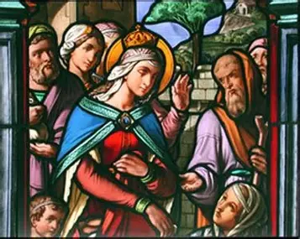
Closing Prayer: Collect Prayer for the Feast of St. Adelaide of Burgundy
V. O Lord, hear my prayer.
R. And let my cry come unto thee.
Let us pray: All-loving God, Thou didst call Blessed Adelaide to seek Thy kingdom in this world by serving Jesus Christ and His Blessed Mother. With her prayers to give us courage, help us to go forward with joyful hearts in the way of Thy love. Through Jesus Christ, Thy Son our Lord, Who liveth and reigneth with Thee, in the unity of the Holy Ghost, God, world without end.
R. Amen.

