Slide 1
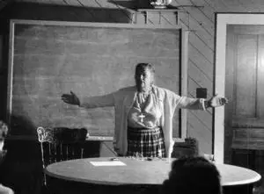

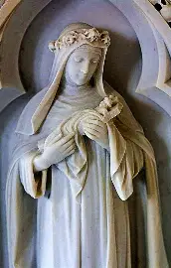
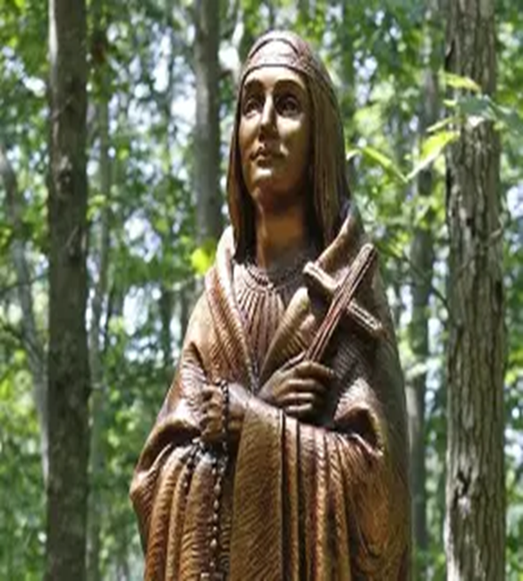
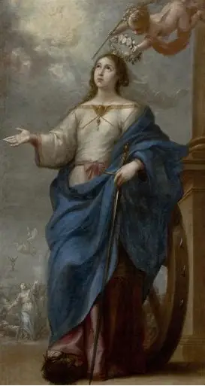
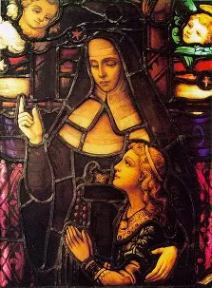

The Kates of Heaven: How the Intercession of the St. Catherines (and Katharines!) Opens the Gates of Heaven to Us
Katie Sadakierski
Sunday, November 9, 2025

Slide 2
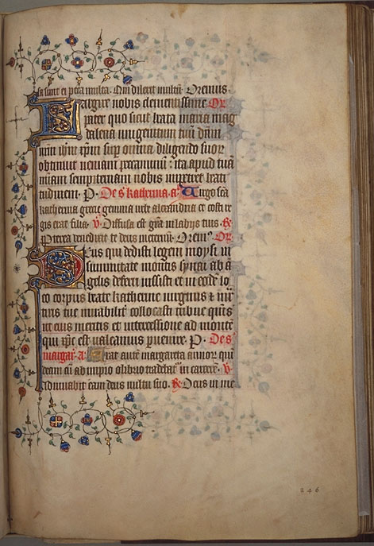
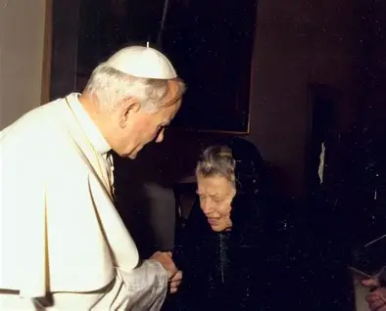
Outline: Sunday Seminar 3
Welcome & Opening Prayer
Meeting presentation
  I. Meeting at the Gate: Introducing the St. Kates: Discovering Catherinian Spirituality
  II. Journeying with the St. Kates to the Gates of Heaven: Observing Embodied Catherinian Spirituality
  III. Entering through the Gates of Heaven with the St. Kates: Applying Catherinian Spirituality in our Sanctification Process
Announcements
Closing Prayer
Q & A

Slide 3
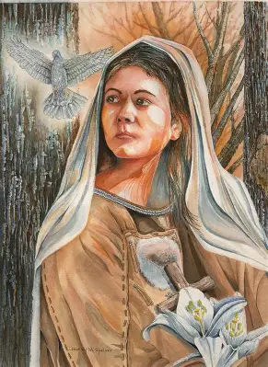
Opening Prayer: Collect Prayer for the Feast of St. Kateri Tekakwitha
O God, who desired the Virgin St. Kateri Tekakwitha to flower among Native Americans in a life of innocence, grant, through her intercession, that when all are gathered into Your Church from every nation, tribe and tongue, they may magnify You in a single canticle of praise. Through our Lord Jesus Christ, Your Son, Who lives and reigns with You in the unity of the Holy Spirit, God, for ever and ever. Amen.

Slide 4
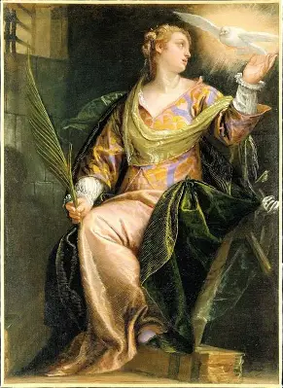
What does the name “Katherine” mean? What does this communicate about our Faith, and how we are to live it?
The name “Katherine” comes from the Greek “katharos,” meaning “pure” and “clean”
The original Greek name was “Aikaterine,” or “Ekaterine.” An early Coptic form of the name translated to “consecration”
The name may also derive from the word “hekataros,” meaning “each of the two”
The multilayered meaning of the name “Katherine” reminds us that we are purified in uniting with the Two Hearts, absorbing something of each of the two into our own hearts. From consecration to Jesus through Mary, we are made pure, as we learn to imitate Our Lady in reflecting Christ, in treasuring Him in our hearts. From Our Lady, we discover how to be like Christ, Who is our ultimate Model and Teacher
Our goal is purity of heart, to be cleansed by the Precious Blood of the Lamb in this life, in order to love Him and be nourished totally by His love in the next life. A pure heart allows us to see God; it is what leads us to Heaven. A pure heart is a Marian heart that perceives things as they truly are, seeing in the light of eternity

Slide 5
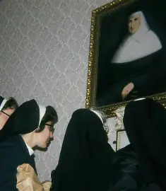
Who are the saints named “Catherine”? How many saints and blesseds, venerables, and servants of God are there with this name?
There are at least thirteen saints by the name of “Catherine” (or a variation of it)
At least six blesseds are named “Catherine”
There is at least one venerable named “Catherine,” and at least one servant of God named “Catherine”
This makes for a total of 21 saintly figures, whether canonized, or on the road to canonization, who are named “Catherine”
Among the St. Catherines, there are: 4 married laywomen; 4 tertiaries; 10 religious sisters; 3 consecrated virgins

Slide 6
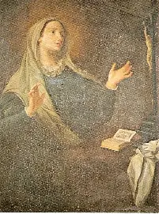
Who is St. Catherine of Genoa?
Country of origin: Italy
Years of life: 1447-September 15, 1510 (63 years)
State of life: Married laywoman
Feast Day: September 15
Patronage: Hospitals (particularly, those in Italy)
Canonization date: 1737

Slide 7
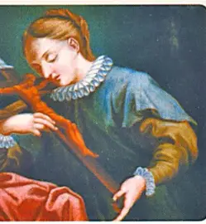
How does St. Catherine of Genoa help to open the gates of Heaven to us?
Saint Catherine of Genoa was born to a family of five children. Her lineage was impressive; she was related to 72 cardinals and 2 popes. With this kind of heritage, St. Catherine of Genoa was destined to become a great saint. She began her life on a high note, exemplifying great love for the divine. It was only natural that at age thirteen, she reached out to the religious sisters at her blood sister’s Augustinian convent, requesting entry. When she was denied, she would come to accept a different pathway for her life. After her father passed away, she was married. While it was believed that her marriage would help to end family feuds, it only created more division, as her husband was an unkind and prodigal man who lived a life totally devoted to the world. In time, St. Catherine of Genoa, greatly disheartened, began to live her life in the world, too, but not to an extent that she lost God’s friendship. She partook in innocent diversions, but for a soul as pure as hers, this would be a detriment, because she soon was reduced in her fervor, becoming complacent and lukewarm, though she continued to pray, while dealing with depression, that God would uplift her from the sorrow, helping her to return to her passion for her Faith. God answered her prayers, because while at Confession at her sister’s convent, St. Catherine received a revelation that helped her to see the magnitude of her sin in relation to God’s mercy. She would see the depth of God’s love, and the breadth of His goodness, which would lead her to convert. Having turned away from her past life of sin, St. Catherine of Genoa embraced dying with Christ. Learning that her husband had squandered all of their material wealth, she came to store up treasures in Heaven, working with her husband to enrich him spiritually. Once she had converted him, they went to live and work at a large hospital. Not long thereafter, St. Catherine’s husband passed away, and she continued working at the hospital for 21 years, overseeing the women’s division, until her own passing from this life. While caring for the sick, she continued to engage in penances and all of her spiritual exercises. Receiving Holy Communion daily fueled her works for God, which were offered with boundless love. During the plague, she tended to the sick with great love; four-fifths of the population in Genoa would pass away from the plague, but courageously, St. Catherine of Genoa continued to work for their relief, completing every work of mercy to heal and bless them. While experiencing their suffering with them through her spiritual accompaniment, she also began to receive visions of Purgatory, seeing that the souls still wounded by sin are purified not by punishments, but by love. She would write a treatise on Purgatory, as well as a dialogue between the soul and body. What sets her mystical writing on Purgatory apart from other writings is that hers focuses on the joy that souls in Purgatory feel, in being cleansed in order to see God, Whose clean Heart longs to embrace them forever. Saint Catherine of Genoa teaches us that life is a series of conversions, and that we can keep opening the doors of our hearts to them in order to be purified. Every time we turn to God, we are purified by the flames of His love, and are so touched by these brilliant rays, that we can come to radiate them outward in love for others

Slide 8
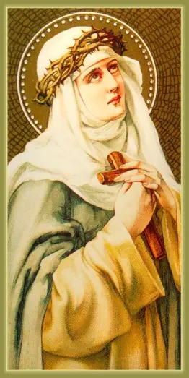
Who is St. Catherine of Siena?
Country of origin: Italy
Years of life: March 25, 1347-April 29, 1380 (33 years)
State of life: Dominican tertiary (third-order)
Feast day: April 30 (traditional); April 29 (modern)
Patronage: Nurses; Italy; the United States; people ridiculed for their piety; the sick; Europe
Canonization date: 1461

Slide 9
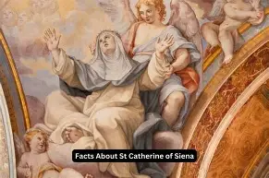
How does St. Catherine of Siena help to open the gates of Heaven to us?
Born to a family of 25 children, many of whom passed away before reaching adulthood (including her twin), St. Catherine of Siena grew in her generous spirit of service, treating her parents as she would Jesus and Mother Mary, and responding to her brothers as though they were the apostles. God responded to St. Catherine with much affection: her spiritual gifts were many. Holy angels could be seen carrying her up the stairs as a child. Given to penance and sacrifice out of love, she cut off her hair while still very young to rid herself of vanity, and to make clear that she had given herself to God, having consecrated her virginity to Him, and renounced marriage to anyone but Christ. She never received a formal education, but would be infused with knowledge through the Holy Spirit, to the point that, as an adult, she would learn to read and write immediately, despite not having had formal instruction. A prolific writer, she composed hundreds of letters to anyone in need of counsel, and wrote to the pope to persuade him to return from Avignon to Rome, rather than accepting bribes from French political figures to remain in their country. Speaking from the heart, she compelled the pope to take up his post in the throne divinely appointed to him by God in Rome, the heart of Holy Mother Church. Her letters were bold and courageous, but written with patience and charity, as St. Catherine consecrated all that she did to God, referring to Our Lord as “sweet Jesus, Jesus love” in her letters, because it was for love of Jesus that she completed every endeavor. Saint Catherine never lost sight of her mission, and helped others to remain on the track to Heaven, too, completing corporal and spiritual works of mercy alike, balancing the contemplative and active, cleansing souls with God’s love by day, and cleansing clothes when she did the laundry at night. Like her book, a transcription of her mystical conversations with God, her life was a continuous dialogue between her soul, and Christ. She spoke of the Sacred Heart as a classroom, and received the greatest instruction there. Favored with mystical visions since childhood, she learned that she was chosen in a special way to minister to priests, namely, the pope, as she received a vision of St. Peter and St. Paul on their feast days. They stood beside Christ the King, seated on His throne. Throughout her life, St. Catherine would be made increasingly pure, because she rejoiced in the opportunity to serve the King (her childhood nickname was “joy”), and enthroning Him in her heart. She would see Our Lord’s Sacred Heart being crushed, squeezing the Precious Blood out over the world. Saint Catherine’s mission would be to bring souls to be refreshed by Christ’s outpouring of love by spending herself in charity, too. The patron saint of nurses, she tirelessly cared for the sick, even drinking from open wounds on the bodies of her patients. Though her body recoiled, her spirit sang at the opportunity to minister so lovingly to others, in whom she saw the Presence of Christ, even receiving a vision that she was drinking of the Precious Blood from Christ’s wounds. Invisibly, St. Catherine would bear the stigmata, including a wound over her heart that was impressed upon her after her mystical exchange of hearts with Christ. A bride of Christ, she received a wedding ring as a sign of her commitment to Christ, though it would not be visible to the world. As a bride of Christ, this Dominican tertiary served Christ’s people out in the world, traveling to them to heal and teach. A band of students accompanied her, referring to her as “mother,” and a team of priests followed suit, offering sacramental Confession to the many souls that St. Catherine converted. Afte having fed so many souls with God’s love, St. Catherine of Siena would come to be sustained by the Holy Eucharist alone for many years before her passing from this life at the age of 33, which she had lived totally in union with Christ. Saint Catherine was a presence of purity in always clearly following God’s Commandments, and bringing others a sense of clarity, too, with her gift of counsel, which would guide other souls to defend and honor the Truth, too. She opens the gates of Heaven to us by helping us to receive the sacraments passionately and reverently, aiding us in recalling that the sacraments, and the priests who administer to them, are immersed in the Precious Blood that cleanses us. Though not every soul is called to the holy priesthood, everyone is sent on a mission to bring Christ into the world, and needs His love in the sacraments in order to share this love that purifies souls. Her last words were “the Blood, the Blood,” a message reinforcing that Christ gives us every gift from His Heart, pouring out His Blood for our salvation. The chalices of our hearts must receive that Blood in order to enter Heaven. Saint Catherine taught that purification is gradual, as we are purified the closer that we come to Christ’s Heart, ascending the ladder to Heaven by progressing closer to His Body, His Eucharistic Heart, for Christ’s Body is itself a bridge to Heaven. Her devotion to Our Lady would be instrumental in her path to Heaven, because she saw the Madonna and Child, the Sorrowful Mother with Christ Crucified, and the Immaculate Conception, learning that every experience can purify us, when we offer it to God with love, for Him to bring good out of the situation

Slide 10
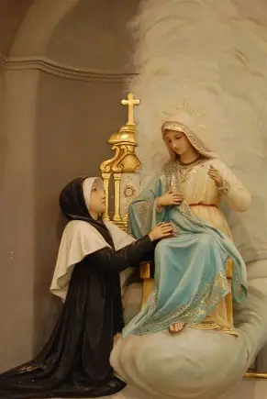
Who is St. Catherine Laboure?
Country of origin: France
Years of life: May 2, 1806-December 31, 1876 (70 years)
State of life: Religious sister; Daughters of Charity
Feast day: November 28
Patronage: the Miraculous Medal; the elderly and infirm
Canonization date: 1947

Slide 11
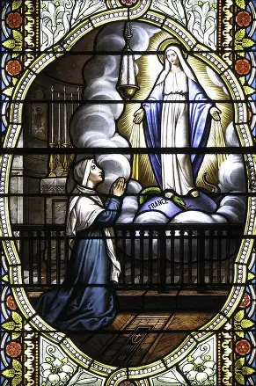
How does St. Catherine Laboure help to open the gates of Heaven to us?
Born the ninth of eleven children in a farming family, St. Catherine Laboure, a beautiful young lady, would lose her mother at the age of nine, and would embrace Our Lady as her Mother. She would be responsible for caring for the household, but in doing so in union with the Blessed Virgin Mary, would succeed in offering it all to God, fulfilling her obligations obediently and faithfully. Unusually devout as a child, St. Catherine soon began to experience mystical visions. One included St. Vincent de Paul, who revealed to her that she was called to become a nun in his order, and to care for the sick. Attempting to dissuade her from entering religious life, her father sent her to serve at her uncle’s eatery for poor workers, but St. Catherine only grew to love the poor with greater tenderness, and formally entered the convent, after declining offers of marriage to marry Christ, the Beloved Whom she had once seen in His kingly garments in the Blessed Sacrament. On July 19, 1830, St. Catherine was sleeping when she heard a child’s voice calling out to her. She responded to the voice, meeting a holy angel who beckoned her to the convent chapel. Though it was midnight, she saw bright light stretching from the chapel, as though it were daytime (there was no electricity in these days). In the chapel, St. Catherine met Our Lady, placing her hands in her lap like the affectionate and humble daughter that she was. Mother Mary revealed to St. Catherine that she had been chosen for a special mission that, while difficult, would be blessed by God, Who would help her to fulfill it by giving her the necessary graces for the monumental task. Our Lady warned at the suffering that would come to France in another revolution, alluding to the fact that St. Catherine would be instrumental in alleviating the suffering that would come. In November of 1830, Our Lady appeared again to St. Catherine, answering St. Catherine’s fervent prayers to know her mission from God. She had first appeared to her to prepare her soul for her mission. Now, she appeared to St. Catherine to give her the mission she had spoken of. Our Lady appeared in an oval frame. Within the frame, she stood upon the world, her hands outstretched, offering many graces to the world, which were represented as rays of light. The prayer “O Mary, conceived without sin, pray for us who have recourse to thee,” appeared around the oval frame. Then, Our Lady requested that St. Catherine tell her confessor about the images, and have them impressed upon medallions for people to wear in order to open themselves to receiving the graces that God wished to give the world through Mother Mary. Imitating Our Lady in her humility, St. Catherine did not reveal her identity, so that she would not call attention to herself as a mystic, which is why she chose to reveal everything only to her confessor, not face-to-face to anyone. Initially, her confessor did not believe her, but after two years, he spoke to the archbishop about the revelations that St. Catherine received. The archbishop ordered that 2,000 medals be struck, in fulfillment of Our Lady’s request. Distributed widely and swiftly, the medals, originally called “Immaculate Conception medals,” soon came to be called “Miraculous Medals,” because they were so efficacious; even their production had been a miracle. For the remaining 40 years of her life, St. Catherine would care for the sick, but she had best cared for spiritually sick and wounded souls by bringing them to Our Lady, who reached out with her healing hands to bring every grace to souls in need. In caring for the sick during serious epidemics, St. Catherine and her religious sisters gave them the medals, which were worn with great faith and hope by the sick, the patients who would attribute their healings to the intercession of Our Lady; besides physical healings, spiritual conversions would take place in connection to the Miraculous Medal, including that of a former bishop who had fallen away from the Faith. The purity of the Immaculate Conception, which St. Catherine reflected so well, would be the means of healing those wounded by sin, sickness, and doubt. It was discovered that St. Catherine’s body was incorrupt after her passing from this life. Saint Catherine Laboure teaches us that we are purified by obedience to God through faithfulness to the requests of our Blessed Mother, and that when we give God an innocent heart of hope and trust, we open ourselves to being filled with graces that come from the innocent Lamb of God Himself, for it was in Christ’s innocence that He opened the gates of Heaven to us. Saint Catherine reminds us that the gates of Heaven are opened to us when we ask; there are many graces available to us, and we need only to request them. Like St. Catherine, we can cooperate with God’s grace, that in His mercy, He would welcome us into Heaven, giving us the graces needed to get there

Slide 12
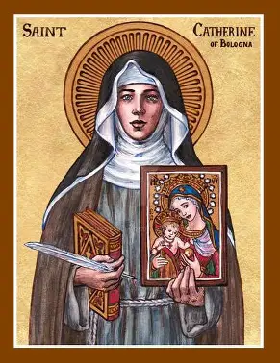
Who is St. Catherine of Bologna?
Country of origin: Italy
Years of life: September 8, 1413-March 9, 1463 (49 years)
State of life: Religious sister (Poor Clare; Franciscan order)
Feast day: March 9
Patronage: Artists; the arts; invoked against temptations
Canonization date: 1712

Slide 13
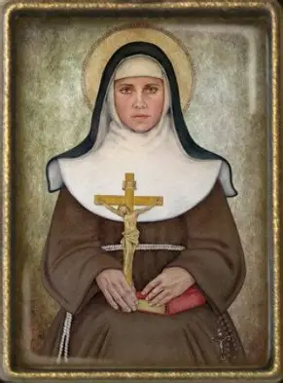
How does St. Catherine of Bologna help to open the gates of Heaven to us?
As a child, St. Catherine was raised in a royal court. Brought up in the midst of great wealth and privilege enjoyed by the nobility, she came to the aid of a nobleman’s daughter, instructing her. Everyone learned from St. Catherine, from whose pure heart flowed great wisdom and knowledge, of not only spiritual writings and teachings like those of the Church Fathers, but of how to live with love, to apply the teachings in the image of Christ, as she certainly did, being described as more of an angel than a person. When the daughter left the royal court to marry, St. Catherine discerned that it was time for her to pursue her religious vocation. She lived in a community of women that had just assembled, and was debating on whether to follow the Augustinian rule, or the Rule of St. Francis of Assisi. Amidst disagreement over which rule of life to follow, St. Catherine departed from the community with a band of other sisters to form a new Poor Clares monastery. As a sister at the monastery, St. Catherine would embrace even the most humble roles, among them, caring for animals, doing laundry, and baking. Through gradual perfection that came with patience and love, St. Catherine excelled in all things, including in training the novices, teaching them to be perfected, too. A peacemaker, she united everyone in Christ’s enduring and patient love. While exercising leadership as she climbed the ranks in her religious order, overseeing many other souls as a guide, St. Catherine continued to lead souls to Heaven through her artistic talents, painting devotional images and writing spiritual poetry reflecting the beauty, truth, and goodness of God. Presently, her painting of St. Ursula hangs in a gallery in Venice. One of the treatises that St. Catherine wrote was on spiritual weapons needed for the spiritual battle. She used all of God’s gifts as spiritual weapons to help to equip others in the battle, serving as a kind of guardian angel. One of the visions that she received, in which she cradled the Baby Jesus in her arms, after being handed the Christ Child by the Blessed Virgin Mary, would no doubt continually inspire her, and permeate its divine light into her works, that she would renew the spirit of love that the Christ Child conveyed, sharing that sweetness with all. Before St. Catherine was born, tradition holds that the Blessed Virgin personally gave a special message about St. Catherine to St. Catherine’s father, telling him that St. Catherine would be a bright light in the world. Saint Catherine would shine a pure light, because it was in reflection of Our Lady. She would lead others to spiritual rebirth by purifying them with fortitude rooted in love, guiding them to a perfect love without fear. She helped souls to persevere in the battle, to embrace opportunities for sanctification while dealing with trials, especially temptations, and to lean on Christ, our everlasting refreshment, the True Bread to sustain us. Once, while serving as a baker in the monastery kitchen, St. Catherine was called to prayer by the ringing bells, and had just put her bread loaves in the oven. Knowing that it would be some time before she returned from the prayer service, she commended the breads to the Lord, and five hours later, saw that, far from being burnt, they had been perfected. In a similar way, she placed confidence in God to help to perfect souls, to make them the perfect offerings. Because of her great purity, St. Catherine was greatly spiritually attacked, but she remained undisturbed, because her love for Christ, and trust in His power, was stronger than any fear. After her passing, St. Catherine’s body would be exhumed, as a sweet odor could be discerned from her gravesite. Despite being buried without a coffin, St. Catherine’s body was incorrupt, and emitting the fragrance of sanctity in honor of her holy life. Her spirit of love and peace would continue to spread like light. The music of the angelic choir that she had once heard as a gift from God to help her through her temptations was still playing on in the legacy that she left

Slide 14
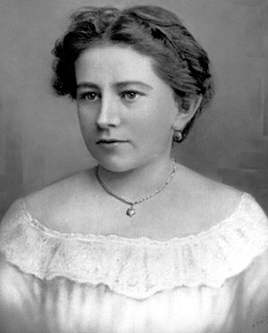
Who is St. Katharine Drexel?
Country of origin: United States of America (Pennsylvania)
Years of life: November 26, 1858-March 3, 1955 (96 years)
State of life: Religious sister (Sisters of the Blessed Sacrament)
Feast day: March 3
Patronage: Philanthropists; justice
Canonization date: 2000

Slide 15
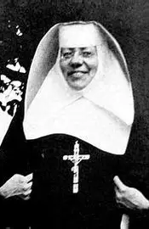
How does St. Katharine Drexel help to open the gates of Heaven to us?
Five weeks after her birth, St. Katharine’s mother passed away. She would be raised by her father and his new wife, both of whom were faithful Catholics. They taught St. Katharine and her two sisters about how to live with true charity. Three times each week, they opened their home to the poor, giving them food, clothing, medicine, and any other necessities to help them to get back on their feet. Encouraged to practice devotions daily to become closer to Jesus and Mother Mary, especially the Holy Rosary, and participation in the Holy Mass, St. Katharine wrote resolutions to grow in holiness. She identified her goals to overcome sins, and develop virtues. While in her twenties, St. Katharine lost her parents, and inherited their vast wealth. She had helped to care for her stepmother, who was truly a surrogate mother to her, when she was dying from cancer, and had learned that even with all of their wealth, they could not totally avoid all suffering and death, so St. Katharine was imbued with an even stronger resolve to use her wealth not for passing things of the world, but to prepare souls for eternity. These resources would be allocated to serving God. After traveling to the Western states and learning about the suffering that Native Americans were facing, in living in dire poverty, and not having access to advanced educational opportunities, St. Katherine determined to use her wealth to bless the Native American peoples in need. At private audiences with Pope Leo XIII, St. Katharine requested that the pope send more missionaries to help Native Americans, but the pope suggested that St. Katharine serve as a missionary. To nourish the souls of underserved and marginalized peoples, St. Katharine began a new religious order, the Sisters of the Blessed Sacrament, that would bring Christ’s love to African Americans and Native Americans in a special way. Although others in her circle questioned her ability to give up her wealth, and the world, St. Katharine was unbending when it came to following God’s will. Keeping her eyes on eternity, she fulfilled her dream to become a religious sister, and not only to enter Heaven herself, but to bring many other souls there, too. Across the United States, St. Katharine constructed mission churches and boarding schools, overcoming discrimination to serve God’s people. She applied her wisdom to do God’s work, buying school buildings through third parties, because when sellers learned that Mother Drexel was interested in buying from them, they refused to sell to her, knowing that she would use the properties for the education of people of color. In New Orleans, Mother Drexel founded a teacher’s college that would become Xavier University, one of the first colleges in the U.S. to admit black students. Saint Katharine Drexel was successful in her missions to souls, because she purified their process of spiritual learning and growth by leading them to Christ the Teacher in the Blessed Sacrament, Who, in His place in the consecrated altar bread, teaches us His sweetness and humility, how we, too, may know the enormity of Heaven in making ourselves like little children, as He did

Slide 16
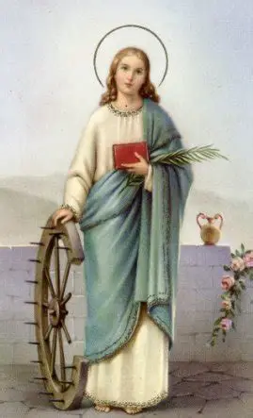
Who is St. Catherine of Alexandria?
Country of origin: Egypt
Years of life: ~287 A.D. - ~305 A.D. (~18 years)
State of life: Consecrated virgin
Feast day: November 25
Patronage: Preachers, philosophers, universities, millers, lacemakers, weavers, wagonmakers, students, legal professions; invoked against head ailments, unmarried women
Canonization date: Pre-congregation

Slide 17
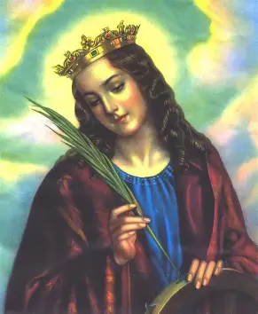
How does St. Catherine of Alexandria help to open the gates of Heaven to us?
Born into a flourishing cultural center of scholarship, art, and faith, Alexandria, Egypt, to a noble family, St. Catherine of Alexandria was likely a princess, and at that, a very well-educated and poised one. Emboldened by Christ’s strength that filled her soul, St. Catherine of Alexandria did not hide from pagans persecuting Christians, but personally approached the emperor herself to rebuke him for his cruel treatment of Christians. She had received a vision at the age of fourteen in which she saw the Mother of God holding the Christ Child, and was so moved, that she had converted to Christianity. This image was always in her heart, guiding all of her words and actions, that she would mirror Our Lady and Our Lord in their love and wisdom. Rather than martyring her on the spot, the emperor, amused by the boldness of St. Catherine, summoned no less than fifty orators and philosophers to debate St. Catherine. His goal was to humiliate her and dismantle her Christian beliefs, but his plan would be thwarted. Far from being humiliated, St. Catherine humbled all present. Her eloquent responses were inspired by the Holy Spirit. The great knowledge and depth of thought that she exhibited would lead some of the philosophers and orators to convert to Christianity right then and there. When St. Catherine could not be defeated in the battle of wits, the emperor sent her to be tortured and imprisoned. In prison, St. Catherine converted many souls, including the emperor’s wife, so it is believed. While being scourged, St. Catherine offered up the suffering in union with Christ. After she had withstood this torture so bravely, the emperor made one final attempt to detach St. Catherine from her Christianity. He asked her to marry him, but she refused, asserting that she had consecrated her virginity to God. Enraged, the emperor ordered that St. Catherine be executed on a wheel, but when she was brought to the wheel, it broke as soon as she touched it. Her purity had shattered this barbaric instrument. Saint Catherine would eventually be martyred, but her spirit was deathless, bringing countless souls to Christ. She purified hearts with her childlike trust in God, a rare level of confidence that demonstrated her full faith in the Lord, an undying love that would go on forever, in an unbroken circle. Tradition holds that the holy angels carried St. Catherine’s relics to Mount Sinai, where Moses received the Ten Commandments, after having received God’s message in the burning bush that was a sign of His Presence. A monastery dedicated to St. Catherine is built on the site, reminding us that St. Catherine mirrored Our Lady, Mother Most Pure, in being like the burning bush that could not be consumed, or touched by the world, being only ignited from within by God’s love

Slide 18
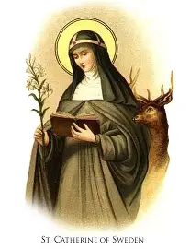
Who is St. Catherine of Sweden?
Country of origin: Sweden
Years of life: 1331-March 24, 1381 (50 years)
State of life: Religious sister (Order of the Most Holy Savior; Bridgettine order)
Feast day: March 24
Patronage: Pregnant women; mothers and families; high-risk pregnancies; invoked against abortion and miscarriage
Canonization date: 1484

Slide 19
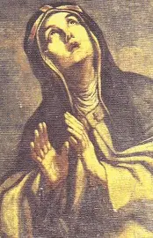
How does St. Catherine of Sweden help to open the gates of Heaven to us?
Saint Catherine of Sweden, the daughter of St. Bridget of Sweden, was married, but took a vow of perpetual virginity alongside her husband, so they lived in a chaste marriage that was never consummated. She had grown up in a convent, and been educated by the nuns therein, but as a teenager, her father had arranged a marriage for her. The virtuous man whom she married shared her goal to pursue a life of perfect purity, and opened his heart to being further purified by St. Catherine. After her beloved husband passed away, St. Catherine traveled with her mother to help souls in need, going on pilgrimages to holy sites, including to venerate the relics of martyrs. Despite receiving many offers of marriage, having been widowed before she was even twenty years old, she would not remarry, choosing instead to commit herself to Christ in a mystical marriage. Her special ministry was counseling women who had lost children in miscarriages, or who had dealt with illnesses during their pregnancies. She counseled women dealing with anxiety about their pregnancies, helping them to open their hearts with courage and hope as they prepared to bring new life into the world, and to accept God’s plan for their families. Although St. Catherine had never had children, she was a spiritual mother to mothers, generously sacrificing herself to care for the suffering. While dealing with her own grief from the loss of her spouse, she could compassionate deeply with women mourning their miscarried babies, and brought them much consolation, even writing a Scripture-based devotional called “Consolation of the Soul.” She brought this to life in how she lived and served the Lord each day, and carried on her mother’s mission after St. Bridget’s passing, ensuring that the Bridgettine order continued to fulfill St. Bridget’s vision. Saint Catherine worked on opening the cause for her mother’s canonization, but the process was delayed due to the schism that was happening in the Church, when antipopes attempted to lay claim to the throne of St. Peter. During this time, St. Catherine of Sweden appeared before a judicial commission and spoke out against the antipope. She was fighting the same good fight as St. Catherine of Siena, and became close friends with her. In the last 25 years of her life, St. Catherine of Sweden went to sacramental Confession daily to purify her soul

Slide 20
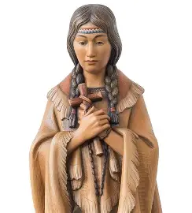
Who is St. Kateri Tekakwitha?
Country of origin: United States of America (New York)
Years of life: 1656-April 17, 1680 (24 years)
State of life: Consecrated virgin
Feast day: July 14 (U.S.); April 17 (Canada)
Patronage: People persecuted for their faith/ridiculed for piety; World Youth Day; ecology; children who have lost their parents; Canada; people in exile; consecrated virgins; Native Americans
Canonization date: 2012

Slide 21
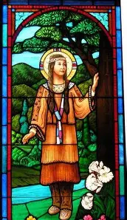
How does St. Kateri help to open the gates of Heaven to us?
An open heart would be St. Kateri’s key to Heaven, for she would be receptive to the catechetical instruction of the Jesuit fathers who came to visit her village, through an agreement that the French, namely, the traders, made with the Mohawks. Receptivity is the feminine genius; it is the way of Our Lady. Saint Kateri would practice forgiveness and compassion, learning the way of gentleness from the priests who embodied Christ’s love, showing her His mercy. Throughout her life, St. Kateri had been alone, an outsider, always set apart through differences such as her blindness. A talented artisan, and an obedient, diligent worker, she mastered all of the practical arts, including cooking, but also excelled in creative projects, such as sewing and beadwork, serving her community through all of her talents. Embracing the Cross, St. Kateri embraced Christ’s spirit of vulnerability, accepting the mockery that she was subjected to, placing her confidence in Christ. Even before she moved to a Catholic community where she could thrive in the expression of her Faith, she found happiness in the Cross, which led her to realize her spiritual gifts most fully. She would lead everyone to rejoice in each opportunity to come closer to Christ, developing outdoor stations of the Cross, catechizing children, and praying the Divine Office with the hunters, sanctifying her whole day through her interior union with Christ that she brought out into her interactions with her neighbors. Having consecrated her virginity to God, she was a bride of Christ purified by penances, such as consuming ashes, but ultimately, by her all-consuming love for Christ that burned so brightly within her heart. Saint Kateri teaches us that detachment from sin purifies us. When we simplify ourselves, embracing Christ and not simply avoiding sin, being led by fear, shame, or anxiety, but focusing on cultivating virtues to please God, weaving together holy qualities like the most vibrant fibers to create a beautiful blanket, a garment of love for God, or adorning that which we sew for His glory with beads of faith, hope, and love, we experience joy, that we may uplift the Cross, not dragging it along. We pray to see as St. Kateri did, without distraction, that in seeing Christ’s Presence around and within us, we would treasure all the ways in which He has made this life heavenly, and draws us to Him in eternal splendor. Even the most painful wounds can be transfigured through God’s love, as St. Kateri shows us. As she passed from this life, her light was not extinguished, but only came to be more radiant, as her face was cleared of her smallpox scars, showing us that, while opening our hearts to God can mean that we are persecuted by others, like St. Kateri was by members of her tribe who threw stones at her, it also means that we open ourselves to receiving the greatest love and healing, such that we become vessels of God’s healing light and love, too; the gates of Heaven are opened to us when we are open to Christ, like Our Lady was. Saint Kateri lost food and friends when she became a Christian, as her tribesmen would not permit her any food on Sundays when she refused to work, and they ridiculed her for her piety, which led her to move away from them physically, though they would never be cast out of her heart. Her life of prayer was surely dedicated to their conversion, for St. Kateri would want every heart to be open to receiving the joy that she did in Christ. Nourished by Christ, St. Kateri received Holy Communion so reverently, so eloquently expressing her beliefs in her actions to honor her beloved Spouse in the Blessed Sacrament, that others learned to reverence the Eucharistic Lord by observing her behaviors. When we are open to Christ, serving as living tabernacles that treasure and preserve His Presence within us, offering the Sacred Heart refuge within our own hearts, we can inspire and touch others’ hearts simply with our presence, for it reflects Christ’s Real Presence in the Holy Eucharist that we receive

Slide 22
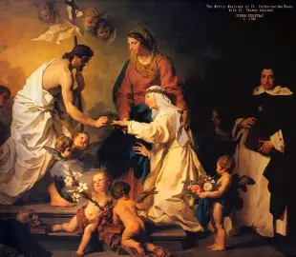
Who is St. Catherine de Ricci?
Country of origin: Italy
Years of life: April 23, 1522-February 2, 1590 (67 years)
State of life: Religious sister (Dominican)
Feast day: February 13
Patronage: The sick
Canonization date: 1746

Slide 23
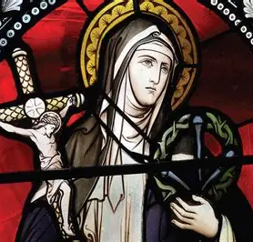
How can St. Catherine de Ricci help to open the gates of Heaven to us?
As an infant, St. Catherine de Ricci lost her mother, and was brought by her father to be raised by her aunt, a nun, at her convent, where she would become a spiritual daughter to all of the religious sisters therein. Saint Catherine de Ricci would love religious life, finding to be heavenly, but as a teenager, her father would remove her. With his permission, she would enter a different convent, and would profess her religious vows, when just fourteen years old. While undergoing intense physical sufferings, she united herself entirely with Christ in His Passion, and received much consolation and healing. She would come to cultivate a perfect spirit of prayer, a sense of holy detachment from worldly things that would allow her much serenity, in her spiritual union with Christ, the Prince of Peace; when she prayed, a ring symbolizing her mystical betrothal to Christ would appear. Through her suffering, she was purged of any affections that would otherwise separate her from Christ. Having developed a reputation for holiness, she was visited by popes and bishops who sought her counsel. Her pure wisdom and love flowed from her unity of heart with the Crucified Christ, as she meditated on the Passion of Our Lord every day, but most especially, between noon each Thursday, and 3:00 p.m., the hour of Our Lord’s Death, on Fridays, when she spiritually participated in the Passion with Our Lord, having received the stigmata. A friend of St. Philip Neri, with whom she had maintained a longtime correspondence on spiritual matters, St. Catherine de Ricci had not met St. Philip Neri in person, but appeared to him in a vision. Her spiritual friendship transcended time and space, because it flowed from a heart like Jesus’ and Mary’s Hearts, which overflow with an infinite love. Saint Catherine de Ricci’s purification came from imitation of Our Lady in faithfulness to the Suffering Servant; her heart, in being offered with love to God in this expression of devotion, her steadfastness by the Cross, was like Our Lady’s, and therefore, could be deeply united with the Heart of Jesus

Slide 24
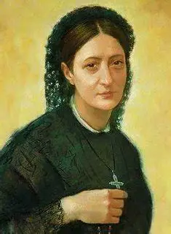
Who is St. Caterina Volpicelli?
Country of origin: Italy
Years of life: January 21, 1839-December 28, 1894 (55 years)
State of life: Tertiary (third-order Franciscan) and foundress of religious order (Maids of the Sacred Heart of Jesus)
Feast day: January 22
Patronage: Maids of the Sacred Heart of Jesus
Canonization date: 2009

Slide 25
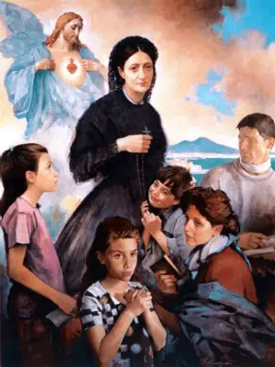
How can St. Caterina Volpicelli help to open the gates of Heaven to us?
Growing up, St. Caterina Volpicelli was captivated by the usually worldly amusements among young people in her circle, namely, the theater and ballet. She had received an excellent education, and could appreciate these art forms. While there was nothing objectionable in loving the arts, or to socialize, St. Caterina was advised by her priest to focus solely on the Sacred Heart of Jesus. He recommended that she make reaching Christ’s Heart her aim, directing all that she did to His Heart, serving Him for His glory, namely, as a third-order Franciscan, which St. Caterina would do, remaining in the world to evangelize through her Sacred Heart-led way of life. Her spiritual director challenged her to advance in holiness by using every opportunity to bring those in her social circle to Christ. Through fishing for souls to bring to the Sacred Heart, in loving obedience to her spiritual director, St. Caterina soon discerned a religious vocation, but poor health prevented her from fulfilling it. Disappointed, but not despairing, St. Caterina channeled her sadness over not being able to pursue her vocation to religious life to living out her calling in a different way, by founding a new congregation of religious sisters, which would care for the sick during an epidemic, and start a lending library for the poor, among other charitable initiatives. It was after departing from the convent that she learned about the Apostleship of Prayer, and how to dedicate every task to the Sacred Heart, finding the Sacred Heart beating in all things each day. Cultivating a loving appreciation for Christ’s Heart, the greatest masterpiece, all around her, she would become more deeply in love with the Lord, especially in the Blessed Sacrament. Time spent in His Eucharistic Presence opened her eyes to seeing His love even more. Saint Caterina applied all that she learned from her brief time as a religious sister in the Congregation of Perpetual Adorers of the Blessed Sacrament to adoring the Lord, and orienting others towards adoration of the Sacred Heart of Jesus in the Holy Eucharist, too. Saint Caterina would participate in the first National Eucharistic Congress in Naples in the late 1800s. Her life was dedicated to igniting hearts aflame with love for Jesus within families everywhere, that this love would spread throughout society. Saint Caterina teaches us that hope purifies, and opens the gates of Heaven, because she never gave up, even when her vocation was not realized in the way that she had expected or hoped for. Our Lord’s Heart always remained with her, to guide and bless her, warming her heart when she would otherwise be left cold by life’s crosses. Union with the Eucharistic Heart of Jesus purifies us, helping us to give more from our hearts

Slide 26
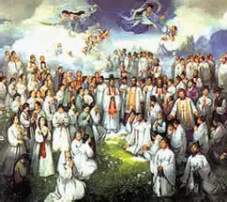
Who is St. Catherine Yi?
Country of origin: Korea
Years of life: 1783-September 1839 (~56 years)
State of life: Married laywoman; mother
Feast day: September 20
Canonization date: 1984

Slide 27
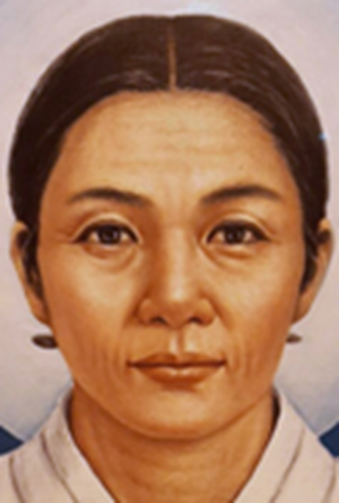
How can St. Catherine Yi help to open the gates of Heaven to us?
Raised in a Catholic family, Saint Catherine Yi was not educated in the Faith extensively, but would help to pass it on by example, instructing her husband and children to the extent that their hearts would be turned towards Christ, too. Of her children, St. Catherine’s daughter, Magdalene, was the most open to learning about the Lord, and would become a canonized saint alongside her mother. Magdalene became a consecrated virgin, and expressed her devotion to Christ in waking early to pray, as well as through dedicatedly serving her family, especially by helping her mother with sewing and weaving. Saint Catherine Yi attempted to convince her daughter to marry a Catholic man, so that she would be protected from government persecution, knowing that if her daughter remained single, authorities might suspect it was for a religious reason. Magdalene offered all of her works to God, moving from the countryside to the city to live out her vocation by serving as a spiritual mother, helping catechumens in learning about the Faith, baptizing pagan children on the brink of death, and caring for the sick. Saint Catherine Yi would go to live with her daughter, even though it was more dangerous to practice the Faith in the city. When they learned that their bishop was in danger of being arrested, they, along with some other Catholic women in their circle, agreed that if the bishop was arrested, they would give themselves up to the authorities, to be martyred with their bishop. When the bishop was arrested, the women revealed their Christianity to authorities, and were imprisoned as well, but before they could be martyred, they would pass away from sickness while in prison. Even so, they were martyred spiritually, having bravely offered themselves to God alongside their shepherd. The life of St. Catherine Yi demonstrates that we are purified through sharing God’s love with others; Saint Catherine’s daughter, Magdalene, is a reflection of her own sainthood, a precious gift that St. Catherine gave to the world. She would help to open the gates of Heaven through her daughter, who tended to many souls. Likewise, she teaches us that we get to Heaven by accompanying others on the way there

Slide 28
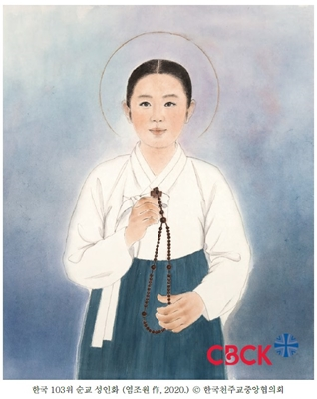
Who is St. Catherine Chong Chor-Yom?
Country of origin: Korea
Years of life: 1817-September 20, 1846 (29 years)
State of life: Married laywoman
Feast day: September 20
Canonization date: 1984

Slide 29
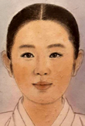
How can St. Catherine Chong Chor-Yom help to open the gates of Heaven to us?
Born to a servant woman, St. Catherine Chong Chor-Yom is believed to have possibly been baptized Catholic as an infant; if not then, she would have been baptized as a teenager. While dates of her reception of the sacraments may not be certain, what is certain is that she embraced her Catholic faith wholeheartedly, giving her life for Christ with much love. She witnessed to Christ in her fortitude, and in her kindness to others. As a twenty-year-old, St. Catherine Chong Chor-Yom declined to take part in a pagan ritual, a winter solstice ceremony, and for her refusal, was physically abused by her master, who wounded her so badly, that she was unable to do hard work thereafter. Once her wounds had healed, she escaped to a Catholic home, where she could practice her Faith more freely, even while remaining hidden amidst the government’s persecution of Catholics. After she was situated in her new domestic church, she began to work for a priest as a housekeeper, but before long, would be arrested and tortured for practicing her Faith, along with several other women, all of whom refused to give up their beliefs. Throughout their imprisonment and martyrdom, they showed the greatest heroism, witnessing to Christ’s immense bravery and love. Saint Catherine Chong Chor-Yom demonstrates that the greatest strength flows from a pure heart, which is united to Christ’s, and can sacrifice with the utmost love. Suffering purifies, when it is offered to Christ out of love, as it helps us to compassionate with Him, to appreciate His Sacrifice more

Slide 30
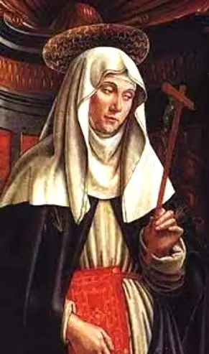
Who is St. Catherine of Palma?
Country of origin: Spain
Years of life: May 1, 1531-April 5, 1574 (42 years)
State of life: Religious sister (Augustinian)
Feast day: April 5; July 27 & 28 (Spain)
Patronage: Mallorca, Spain
Canonization date: 1930

Slide 31
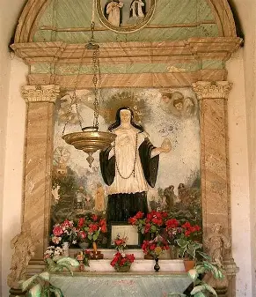
How can St. Catherine of Palma help to open the gates of Heaven to us?
Born into a peasant family with seven children, St. Catherine of Palma was set apart from her earliest years by her love of solitude, spirit of quiet recollection, and deep devotion to Our Lady. Losing her parents at the age of seven, she went to live with her father’s brother, but was not treated well in her new home, where she was given the most menial tasks to complete, even though she was the youngest. Even so, she remained cheerful and sweet. As a teenager, she received visions of St. Anthony and her patroness, St. Catherine, and spoke to a priest about the vocation that she was discerning. He encouraged her to wait, which required her to be patient. While she waited prayerfully, her family members treated her worse, in their frustration over the possibility that they would soon lose her excellent service. Her spiritual director found a new home for her to live with a pious family as their servant, and the teacher of their daughter. Without a dowry, it was difficult for her to find a convent that would accept her, but eventually, she did, and became an Augustinian nun. Saint Catherine of Palma was beloved by the nuns in her community, who admired her holiness, goodwill, humility, and constant readiness to serve. Her seemingly ordinary life was made extraordinary by God’s grace. Between thirteen and fifteen days before the feast day of St. Catherine of Alexandria, she would enter into a trance, and after receiving Holy Communion, could remain in ecstasy for nearly a week. She had the gift of prophecy, and correctly foretold the date of her passing from this life. Brought up simply and humbly, St. Catherine of Palma had a profound spiritual wisdom that transcended her modest background. She dedicated her life to contemplative prayer, penance, and service to God and others as a religious sister, taking the name “Sister Catherine of St. Vincent Ferrer” as her name in religion. Receiving many spiritual favors, St. Catherine received visions of the holy angels, saints, and Our Lord, conversing with them regularly, but in her humility, did not believe that she was worthy of these gifts, and did not call attention to herself for the wonders that she wrought. Caring for the sick and poor with great generosity of spirit, kindness, and love, St. Catherine was tireless in her efforts, and became known throughout Mallorca for her charity, as she eased the suffering of others, while bearing her own suffering with joy, patience, and love. Amidst suffering, St. Catherine could experience joy, because she united her suffering with that of Christ, her Beloved. Following her passing from this life, she was discovered to be incorrupt. Saint Catherine reminds us that there is beauty and wonder in everything, for God touches all with His love, and that humility is the key to opening the gates of Heaven, as it opens us to receiving every good gift from God, not being closed off to any of them by pride. Humility purifies our hearts of self-love

Slide 32
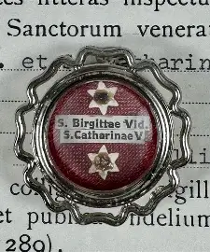
What do the Kates of Heaven have in common? What do all of the Kates of Heaven teach us about sanctity? What lessons may we apply from their lives?
All of the St. Kates of Heaven bloomed where they were planted; three were married laywomen; three were tertiaries, so they could bring Christ’s Presence out into the world, where God called them to serve. They were open to following God’s will: their hearts received Him with love. Even when they suffered, they continued to pursue Him, reaching out. Their purity of heart meant that they were not disillusioned, but clung to their faith and hope, believing that with Christ, the best was yet to come. They teach us that true sanctity lies not in doing great things, but in doing all things with love, and persisting with Christ in each step of the journey, no matter how seemingly small. Because Christ is with us, every step on the way to Heaven is essential, contributing to our growth, and our attainment of eternal joy. The Kates of Heaven were women of fortitude who boldly chose to love, and were committed to Christ until the very end. In all things, they were united with Our Lady in order to be united with Christ, learning purity of heart from her receptivity, her openness to receiving the treasures of Heaven, which she kept in her Heart to ponder, and share with others. In recognizing that Our Lady is the gate of Heaven, they came to have Heaven opened to them, cradling the dear Christ Child in their hearts, serving Him in all that they did out of love. At least six of the St. Kates of Heaven were born naturally or spiritually (into Heaven) on Marian feast days, or in the month of Mary. They were often caregivers and teachers who found fulfillment in living out the Dominican and Franciscan charisms, unifying people in their communities’ spirit. The St. Kates were patient, finding joy in being in Jesus’ Presence each day, making their hearts like sanctuaries in which to welcome Christ. We, too, can learn from Christ’s Heart through union with Our Lady’s Heart, and be purified by receiving their love, that we may give it to others. We are sanctified in community, in being spiritual mothers and daughters present for each other; we become saints through friendship with Christ that is expressed in friendship with each other. Together, with the help of many hands, minds, hearts, and souls, we open the gates of Heaven, recognizing that it is not on our own power that we do this at all, but through the grace of God, Who opens His Heart to us most when we give our hearts to Him entirely, opening them up humbly to receive His Presence with grateful affection. All of the St. Kates had their own mountains to climb to grow holier, and now, can help us to reach the summit with Christ, too. They help to illustrate the manuscripts of our lives with Christ with much love

Slide 33
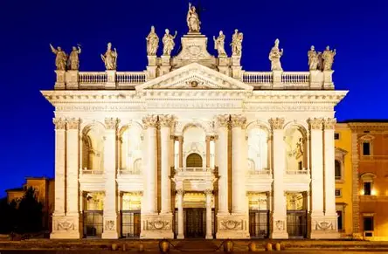
How does the feast day of the dedication of the Lateran Basilica relate to our celebration of the Kates of Heaven?
The Lateran Basilica in Rome is the greatest of the four major basilicas. It is the mother Church of Holy Mother Church, the first public Catholic church to be dedicated (in 324 A.D. by Pope Sylvester I), and the church where the people would be baptized; it was named in honor of St. John the Baptist, and therefore, is a mother, in bringing our ancestors, and therefore, us, to spiritual rebirth, new life in Christ. This basilica was the first Catholic church to be built after the Emperor Constantine’s edict gave Christians the freedom to openly practice their Faith in 313 A.D. When a church is dedicated, it is baptized, communed, and confirmed, like people are. It is prepared for the celebration of the sacraments, consecrated entirely to God. In a similar way, the St. Kates consecrated their lives to God, and became mothers spiritually to others, helping them to prepare to meet God in Heaven, especially by leading them to encounter God’s love in the sacraments, on an ever-deeper level. Their hearts were mother churches in which Jesus, Our Lady, and all of God’s people were welcomed with love, with Christ enthroned at the center. We can build up Christ’s Church as living stones, helping others to set a strong foundation of faith

Slide 34
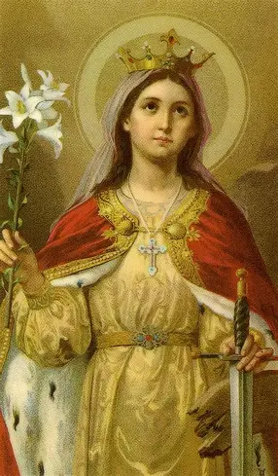
Closing Prayer (1): Collect Prayer for the Feast of St. Catherine of Alexandria
Almighty ever-living God, Who gave Saint Catherine of Alexandria to Your people as a Virgin and an invincible Martyr, grant that through her intercession we may be strengthened in faith and constancy and spend ourselves without reserve for the unity of the Church. Through our Lord Jesus Christ, Your Son, Who lives and reigns with You in the unity of the Holy Spirit, God, for ever and ever. Amen.

Slide 35
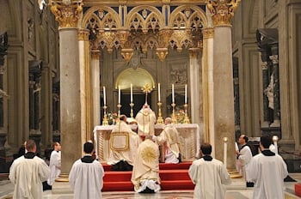
Closing Prayer (2): Collect Prayer for the Feast of the Dedication of the Lateran Basilica
O God, who from living and chosen stones prepare an eternal dwelling for your majesty, increase in your Church the spirit of grace you have bestowed, so that by new growth your faithful people may build up the heavenly Jerusalem. Through our Lord Jesus Christ, your Son, who lives and reigns with you in the unity of the Holy Spirit, God, for ever and ever.

