Slide 1
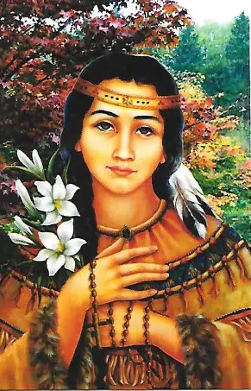
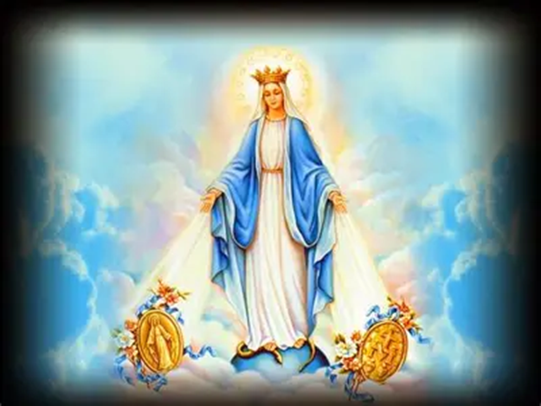
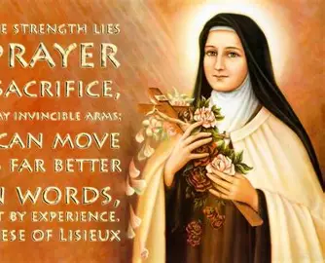


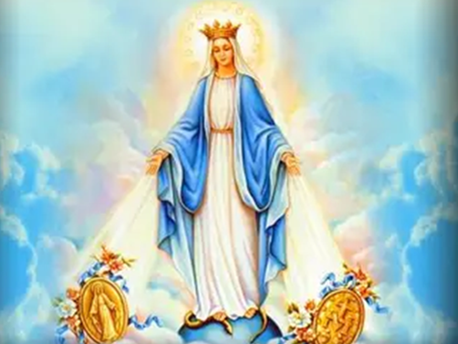
Giving Thanks for God’s Heavenly Gifts with our Heavenly Friends, the Saints
Saturday, November 29, 2025
Katie Sadakierski

Slide 2
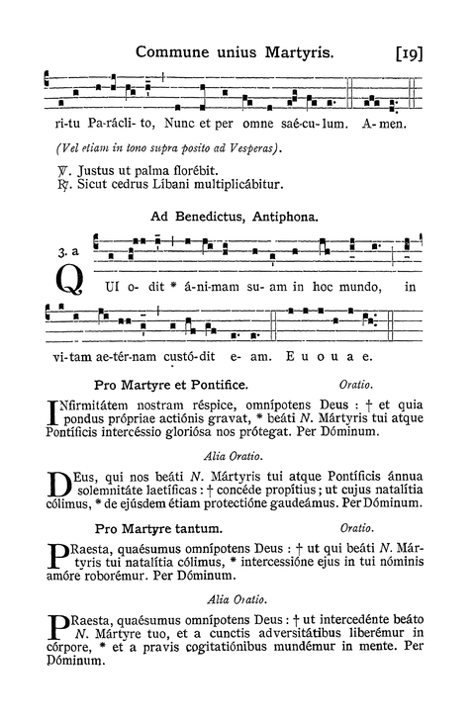
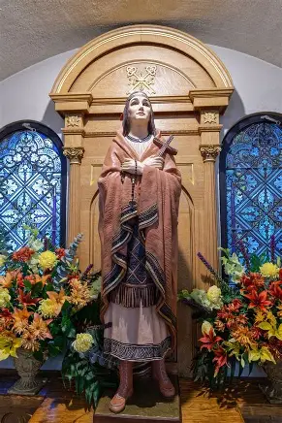
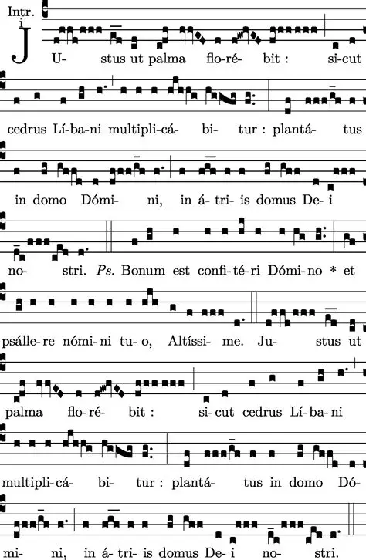
Outline: Thanksgiving Devotions
Giving thanks for our pastor: Prayers for Fr. Sliwa’s intentions
  Angelus
  Saint Kateri Chaplet recitation
  Saint Therese Chaplet recitation
  St. Therese’s Prayer for Priests
Catholic Thanksgiving presentation
  Carrying the spirit of the season forward with the saints
Thanking God for All of His Gifts: Making St. Kateri Crosses

Slide 3
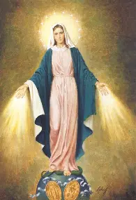
Opening Prayer: Collect Prayer for the Feast of Our Lady of the Miraculous Medal
God, You cause us to rejoice in Your great goodness, through the immaculate Virgin Mary, so inexpressibly united with Your Son. As we are supported by her motherly protection, may we never be without Your providential love, and be always dedicated to the mystery of Your redemption with unbounded faith. We ask through our Lord Jesus Christ, Your Son, Who lives and reigns with You and the Holy Spirit, one God, for ever and ever. Amen.

Slide 4
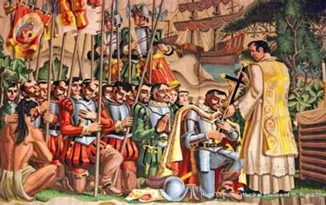
What was the first Thanksgiving like? When was it celebrated, and what were its Catholic roots?
A crew of Spanish explorers, which included a priest, sailed to the mainland United States, arriving in Florida, on August 28, 1565, the feast day of St. Augustine of Hippo. In thanksgiving for the saint’s intercession, the leader, Aviles, named their landing spot “Saint Augustine.”
The first Thanksgiving was celebrated in St. Augustine, Florida, on the Nativity of Our Lady (September 8) in 1565. A cross was planted in the soil, claiming it for Christ. The land was consecrated to Him in a special way, as His Cross was taken up for the salvation of the people, offered to Him for His glory. The chaplain of the expedition celebrated the first Holy Mass in what is now the United States, offering the Holy Sacrifice of the Mass in thanksgiving for God’s goodness in bringing the crew, which was comprised of 800 settlers, soldiers, and sailors, safely to their destination
The first Thanksgiving was given in gratitude to God. It was the celebration of the Holy Eucharist, a word which itself means “Thanksgiving,” and was offered in thanksgiving for Christ’s Sacrifice of love. From this sacrifice, the good works of the expedition would flow; all would be offered for Christ to thank Him for His love, as the future efforts of the expedition were entrusted to God through the hands of Our Lady. Thanksgiving for spiritual rebirth in Christ was lifted up in celebration of the birth of Our Lady, who brings us to new and eternal life in Christ. Indigenous peoples joined for the Holy Mass, which prefigured the wedding feast of the Lamb in Heaven, and preceded a feast among the people, consisting of pork, wine, beans, bread, and other foods local to the region. This was the first shared meal between Europeans and Native Americans, predating the Plymouth feast by at least 50 years. Our Lord had brought this family together to unite in His love, to be fed by His gracious Presence, that they would guide each other on the way to Heaven, and one day give thanks to Him as one community there

Slide 5
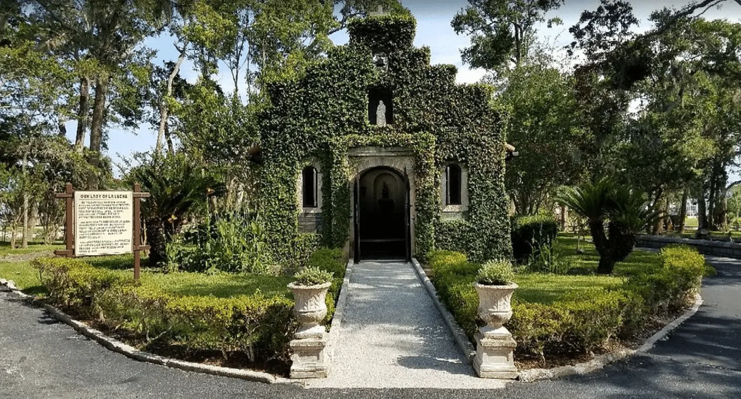

Slide 6
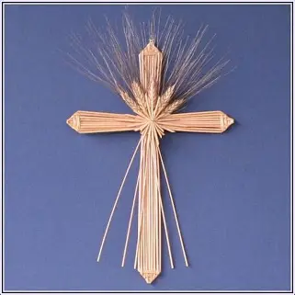
What Catholic significance does Thanksgiving have?
We are all connected by Christ’s Body and Blood, which was spilled for us, for our redemption. Jesus’ love transcends time and place; His Heart reaches out to us to heal and nourish us in every age. Because Christ first loved us, we can love Him, and give thanks in general. Before His Passion, Our Lord ate a feast with His apostles (the Last Supper), and sang hymns of praise to thank God the Father. Our Lord teaches us that we may thank God in all times, because all that God gives us is a gift to strengthen us. He knows what we need in order to embrace eternal nourishment in Heaven, and gives us the sustenance we need for the journey there

Slide 7
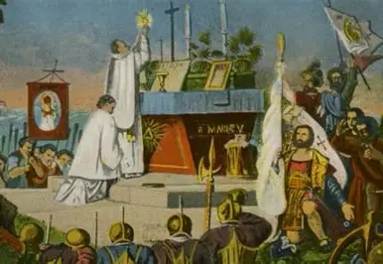
What does it mean to pray in thanksgiving to God?
Thanksgiving is one of the four ends of prayer, one of the core purposes of prayer. We pray in order to thank God for His blessings, because this follows the natural order of things. God is our Creator, and we are His creations, so we are meant to praise Him. Thanking God means not only uplifting our voices in vocal prayer, the prayers we say aloud to express our love for God in words, but also consists of acts of gratitude. Whenever we serve God and His people with love, we thank Him, offering Him back the gifts that He has given us. After we receive the Holy Eucharist, we make our thanksgiving to God, and can renew this thanksgiving in all that we do, through all time, not only immediately after Holy Communion. Prayers of good will, our good works, are expressions of thanks, for we demonstrate to God that His Word has entered into our hearts, and that we are so grateful for His Presence among us, that we are fulfilling His Commandments, imitating His love, and conforming to His image
Every day, we may thank God for the Gifts that He has given us from His Sacred Heart, namely, Our Lady, the Holy Eucharist, and the holy priesthood, through which we come to know God in His Presence in Our Lady (spiritually) and in the Holy Eucharist (sacramentally)
Uniting our sufferings and good works with the Holy Sacrifice of the Mass every day is the ultimate way to show our thanks to God for the graces that He extends to us in His abundant mercy. We thank God by receiving what He wants to give us to bless us with love, by being gracious in opening ourselves to Him, just as Our Lady wants us to by participating in such spiritual practices as wearing the Miraculous Medal

Slide 8
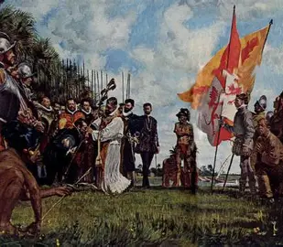
How may we unite with our priests in giving thanks to God? How may we thank our priests?
We may unite with our priests in giving thanks to God by praying the Holy Mass with them. The faithful gather in the nave in union with Our Lady to pray the Holy Mass interiorly. Like Our Lady, we give thanks by lifting up the chalice of Christ’s Precious Blood spiritually, offering Him all that we have and are like the most beautiful flowers gathered from the gardens of our hearts, in which Our Lady plants seeds to grow, for the remission of sins and the salvation of souls. This shows our thanks, because we are giving God the Father the most perfect offering of love, Christ’s Sacrifice; He will look at us in the light of His Son, connecting Christ’s Sacrifice to our offerings placed on the altar. Joining with our priests in this greatest prayer, offering the Holy Mass for their intentions, that the fruits of Christ’s Sacrifice would be applied to them to bless them, is the best way in which we may be united through Christ’s love, a love that inspires us to give thanks, and allows us to emulate our priests in making sacrifices joyfully, giving thanks for His mercy that enables such sacrifices. We may thank our priests by living well for God, keeping His Commandments, which are always for us to love, which will console their hearts in demonstrating that we have taken to heart what they have taught, living out the love that they modeled to us. We thank our teachers, in this case, Christ the Teacher, by bearing their mark, reflecting their image, and bringing their teachings out into the world, in how we make a positive impact

Slide 9
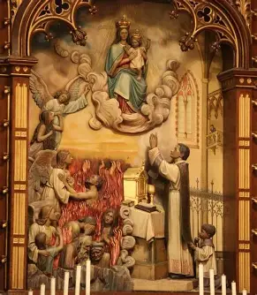
How may prayers of thanksgiving be offered for the holy souls? How do the holy souls model what it means to give thanks?
Prayers of thanksgiving may be offered for the holy souls as we reflect on the lives of our loved ones, thanking God for the blessings He brought, and continues to bring, through their lives, for their love persists in our hearts through God, Whose goodness prevails, in that He won eternal life for us through the Sacrifice of Christ on the Cross, with an outpouring of love transcending sin and death. We may offer the graces of the Holy Eucharist that we receive to the holy souls to show our thanks to God for our suffering friends in Purgatory, and may offer our thanksgiving after Holy Communion for the holy souls, uplifting our good works for their benefit to express gratitude to God for the opportunity to share in His saving work, to participate in salvation history by spreading His love, which the holy souls may no longer receive sacramentally otherwise. The holy souls model what it means to give thanks, because they are so grateful to have seen God, and to be preparing to enter Heaven to receive Him, as well as His abundance of graces, that they willingly suffer for their purification. They are patient in their purification process in their great love for God, showing us that we may show our thanks for God by patiently embracing His will, which is done for our sanctification, for God so loves us, that He wills our salvation, our eternal happiness with Him. Our confidence in the Heart of Jesus is the greatest way in which we can thank Him; it consoles His Heart most, as an expression of true faith and hope, our trust that is a sign of our friendship, the strong shared foundation we have

Slide 10
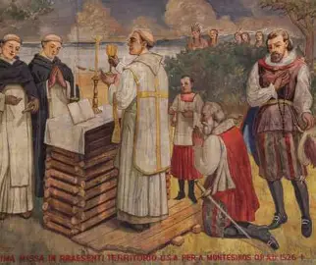
What do the saints teach us about giving thanks?
The saints show us that we give thanks best by being who God made us to be, and offering all that we do for God’s glory. We show our gratitude to God for all that He has given us by using everything as a means to grow closer to Him, and to lead others closer to Him through sharing His love, serving as channels of His grace in imitation of Our Lady. The saints gave thanks in how they lived their lives with joy and praise, no matter what the circumstances, for they demonstrated their unfailing trust in God’s unfailing Providence, a thankfulness for all that He gives, even in the difficult times when it may seem that there is nothing to sustain. They showed that there is always something to be grateful for, because we always have God; God is love, and God’s love is undying

Slide 11
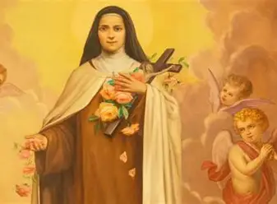
How do St. Therese and St. Kateri model a spirit of thanksgiving? (1)
Saint Therese loved the Holy Eucharist, and in this way, could share in Christ’s perpetual thanksgiving, His constant outpouring of love for souls, out of gratitude for God the Father’s mercy which is expressed in the Holy Cross and the Holy Eucharist, the keys He offers to us through His Son for our salvation. She remained faithful to God through to the end; any source of suffering that others might see as discordant in their song of life was offered as the sweetest melody to Christ by St. Therese. Grateful for the opportunity to receive Christ in even the most trying circumstances, especially in the difficult times, St. Therese modeled thanksgiving in making sacrifices out of love for Christ, in thanks for His Sacrifice for her, using sacrifice beads to count good deeds offered as presents to Christ’s Heart, sacrifices made in gratitude for Christ’s total self-gift, even delaying her treatments for her tuberculosis so that she could observe the Eucharistic fast, receiving Jesus. Putting Him first allowed St. Therese to have joy in living in perfect harmony with His plan for self-sacrificing love, that love that perfects us and prepares us to love God forever in Heaven. Through her joy, she praised God, for God wants us to be happy; a cheerful giver is one with a heart of thanksgiving, for when we are happy, we are at peace, free to love fully, and when we love fully, we do as He wills; this shows our thanks for Him, for if we were ungrateful, we would reject God’s plan and His gifts, despairing of them

Slide 12
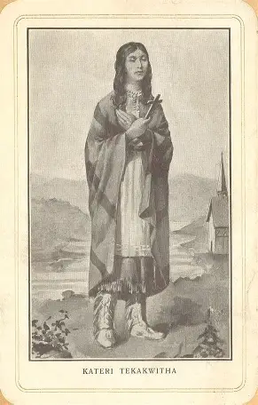
How do St. Therese and St. Kateri model a spirit of thanksgiving? (2)
Saint Kateri remarked that the Cross was her only happiness in this life. She was not joyful in spite of the Cross, but because of it. Rejoicing in the opportunity to share in Christ’s suffering in order to share in His outpouring of love, and to be with Him in glory, she embraced sacrifice for the salvation of souls, for deeper spiritual union with her Beloved. Saint Kateri embraced the Cross to embrace Christ, loving Him unconditionally, in the manner in which He loves us: not only in the fair-weather seasons, but always. Saint Kateri blessed even those who persecuted her, throwing stones at her, modeling a spirit of thanksgiving by being grateful for every opportunity to live for God, to reflect His love and inspire others to accept His love into their hearts, to journey towards Heaven to Him

Slide 13
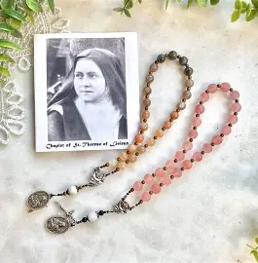
Why are the St. Therese and St. Kateri Chaplets fitting devotions for Thanksgiving?
When we pray the Saint Therese Chaplet, we say 24 “Glory Be” prayers, one for each glorious year of St. Therese’s life. As we give glory to God for the life of St. Therese, we thank Him for the gift of her life, for having created her out of love, to inspire and guide us to love Him, as well as to receive His love. We thank God for the opportunity to imitate St. Therese in her attitude of gratitude, which allowed her to make her life a rich, full offering for God, like a chalice being poured of sweet wine for His sake. The Saint Kateri Chaplet, too, inspires us to give thanks, for we thank God for His natural creation, and all that it teaches us about treasuring His Presence in our hearts, that we would be beautiful creations reflecting His goodness, like Our Lady, who is compared to such natural treasures as valleys, flowers, and mountains. In praying the St. Kateri Chaplet, we glorify the Blessed Trinity with Our Lady, giving thanks for each of the three Divine Persons, as we pray the “Glory Be” eight times. We thank God for Our Lady in saying the “Hail Mary” eight times, and we thank God for the sustenance He provides to us corporally and spiritually by praying the “Our Father” eight times. Our 24 total prayers, grouped into three sets of eight, remind us of God’s infinite love, eight being the number of spiritual resurrection, so we pray in thanksgiving for the eternal life that God offers us through Christ, meditating on the threefold gift of the Cross, Our Lady, and the Holy Eucharist, for which St. Kateri gave thanks through her life of devotion. The circular chaplets, unending, remind us to never cease in praising God, including through our faithfulness, much like Christ, as well as for how we links our souls, that we would know the great joy of praising Him together, as one voice

Slide 14
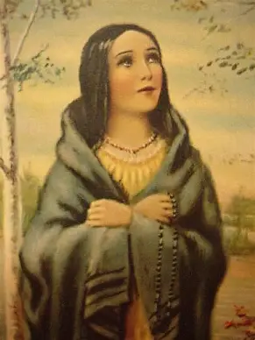
What do pilgrimages teach us about giving thanks?
Pilgrimages are sometimes undertaken as a means of giving thanks to God for answered prayers. Other times, pilgrimages are taken to petition God for an urgent request, and one may express their thanksgiving in the works they offer to Him afterwards, whether their prayers are answered in the manner in which they had hoped, or not. All of life is a pilgrimage to Heaven; the Holy Mass is a pilgrimage to Calvary. We can regard our lives as perpetual thanksgivings to God for His blessings, each day a new opportunity to renew our thanksgiving for His Presence with us in the Holy Eucharist. Each step of our pilgrimage can be used to thank Our Lord for His compassion that led, and leads, Him to walk with us, forever accompanying us. We are pilgrims on the road to Heaven, travelers guided by Christ. Every day, we can thank God for guiding us, so that we need not walk alone, but can have the joy of a companion, and food for the journey, reinforcements that we need to be our best, to live well

Slide 15
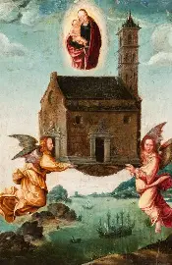
What do the pilgrimages that St. Kateri and St. Therese took in their lives teach us about giving thanks?
Saint Therese went on a pilgrimage from her native France to Italy, traveling to such sacred sites as the Holy House of Loreto and the Vatican for an audience with Pope Leo XIII. She was willing to go to any length to fulfill God’s mission that He gave her, even approaching the pope personally to request that he give her permission to enter the Carmel at the age of 15, when normally, women did not become religious sisters until at least age 21. Her fortitude further exemplifies to us that our confidence is the ultimate way to give thanks to God: we express our love for Him by conveying that we believe in His love, returning it with our own bold steps to follow Him, no matter the risks
Saint Kateri traveled from her tribal village in New York among her fellow Mohawks to dwell in a Christian settlement in Canada where she could more fully and openly practice her Catholic Faith, to which she had converted, encountering persecution from her tribesmen for her choice. In trusting in God to guide her through this transition, St. Kateri showed her thanks for God’s blessings, because her willingness to undertake a difficult journey in order to better honor God exhibited her great love
Both saints were like the Holy House of Loreto, being carried by holy angels to the location where they would best give glory to God for housing them in His Heart, where they could always be joyful, and radiate this joy outward to others by inviting them on the pilgrimage to Heaven, to take up residence forever in Christ’s Heart. When we are rooted in Christ, we can bloom where we are planted, wherever we may go

Slide 16
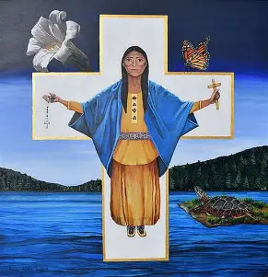
How is the Holy Mass a prayer of thanksgiving?
The Holy Mass fulfills all four ends of prayer (thanksgiving, adoration, reparation, and petition). Some prayers within the Holy Mass, such as the “Gloria,” individually fulfill all of these ends. In particular, the Holy Mass is a prayer of thanksgiving, because we assemble to worship God, to recognize Him as being greater than ourselves, and to honor Him for all of the blessings that He has given us, that we could not otherwise have on our own. In the “Gloria,” we tell God that we give Him thanks for His great glory. The fact that we join together to express our love for God, fulfilling His plan for us to worship in community, shows our thanks for Him, that we want to please Him

Slide 17
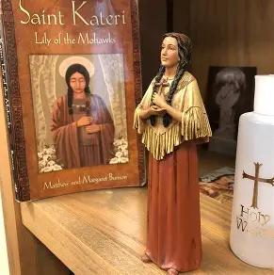
How may we give thanks to God before and after Holy Mass?
Before and after Holy Mass, we may be united with the holy angels in going to the tabernacle to thank God for helping us to complete our missions for Him, and for the opportunity to receive His love, to reciprocate it at all, by being given a mission, through which we may use our gifts for His glory. We may pray acts of faith, hope, and love before Holy Communion, and afterwards, applying the virtues in order to show God our thanks for helping us to live them out, and conform to His image. We may unite with Our Lady in giving glory to God, saying the “Magnificat” to thank God for uplifting us, for dwelling in our souls, that we may magnify His light. It is also laudable to give thanks to God for Our Lady, honoring His most perfect creation, and by thanking her directly for bringing Christ into the world to feed us, to demonstrate to us how to thank God best by doing His will, saying “yes” to His plan with faith, hope, and love

Slide 18
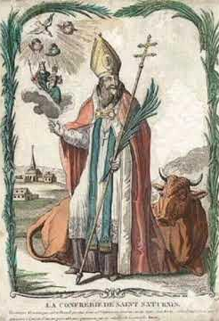
Closing Prayer: Collect Prayer for the Feast of St. Saturninus
O God, Who grantest us to be gladdened by the Heavenly birthday of blessed Saturninus, Thy martyr, vouchsafe that we may be helped by his merits. Through our Lord Jesus Christ, Thy Son, Who liveth and reigneth with Thee in the unity of the Holy Ghost, one God, world without end. Amen.

