Slide 1
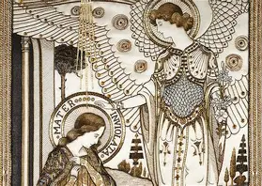
The Incorruptible Heart: Remaining Faithful to God through the Intercession of the Incorruptible Saints
Sunday, November 16, 2025
Katie Sadakierski

Slide 2
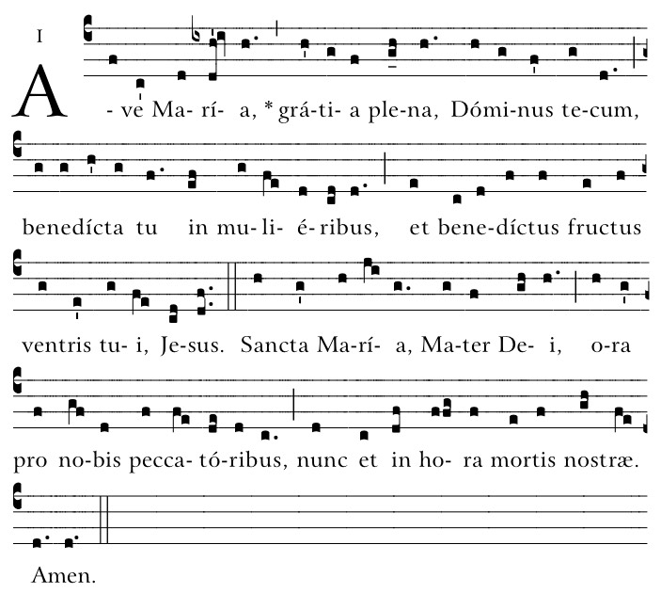
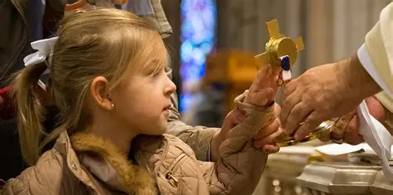
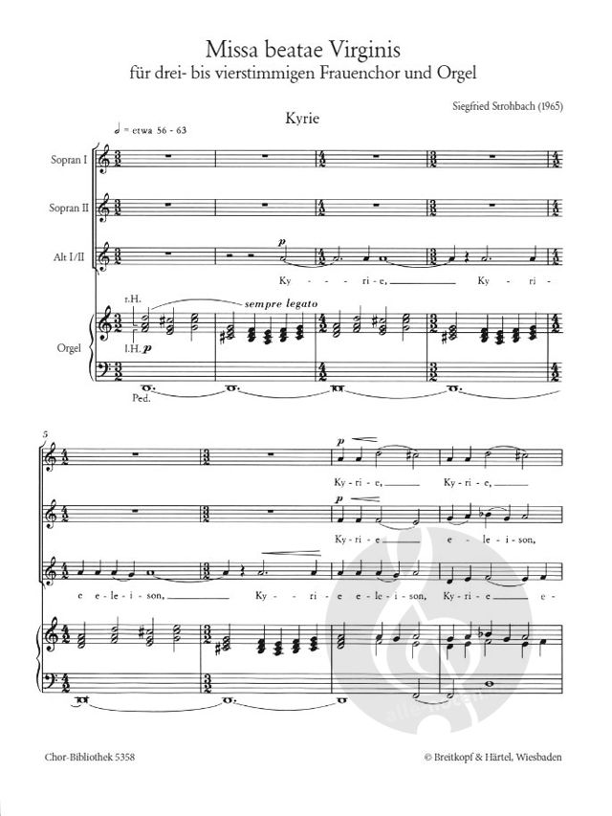
Outline
Welcome & Opening Prayer
Meeting presentation
  I. Relishing relics: Discovering why and how we venerate relics
  II. Introducing the Incorruptibles: Honoring saints’ relics that have withstood the test of time
  III. Living with Incorrupt Hearts: Emulating the Incorruptible Saints on our Paths to Heaven
Announcements
Closing Prayer
Q & A

Slide 3
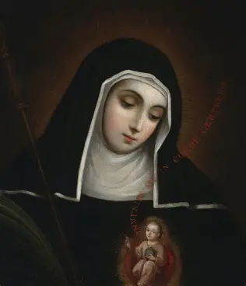
Opening Prayer: Prayer for the Intercession of St. Gertrude the Great
Lord Jesus Christ, You endowed Your servant Gertrude with special charity and were pleased that a new family should flourish in Your Church through her. Grant that at her intercession we may become worthy to enjoy the happiness of heaven. Through Christ, our Lord. Amen.

Slide 4
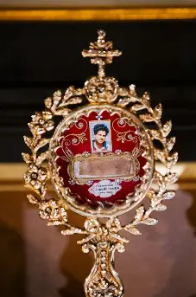
What is a relic?
The word “relic” is a derivative of the Latin “relinquere,” which means “to leave behind.” We see this root word in the English term “relinquish,” which means to “give up” or “abandon”
Relics are material objects left behind by saints, which may be their possessions, or their physical remains. A relic is a tangible reminder that the saints walked among us, just like Christ, and that while they may have left behind temporal things, they were not abandoned by God, Who helped to lead them up to Heaven, and Who will not abandon us, either, but will help to make us saints, too. Because the saints never abandoned their faith, they left behind a legacy of everlasting love for God that cannot be taken away, never to fade with time’s passage

Slide 5
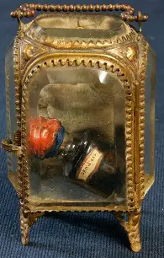
Why do Catholics preserve relics?
Relics remind us of the communion of saints: we use them in our prayers, because they keep us connected to other members of the Church, namely, the saints in Heaven who are praying for us, that we may join them in Heaven. Venerating relics encourages us to pray for the intercession of the saints
When Christ and the apostles touched objects, they were considered sacred, because they could bring about healings. Therefore, we venerate relics of those who lived with love for Christ, conforming to His image, and sharing in His saving work, continuing His mission of healing. Relics are directly linked to holy figures who imitated Christ, and radiated His love outward, sometimes even being favored with spiritual gifts that allowed them to work miracles through God’s grace, just like Our Lord
A relic helps us to recall that Christ ultimately preserves our souls. Worldly things are passing, but the things of God are eternal. God can do what is otherwise impossible. Through Him, we can have eternal life in Heaven, where nothing will ever die or decay. Heaven’s treasures are everlasting

Slide 6
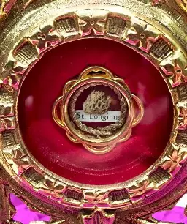
What are first-class relics?
First-class relics are parts of a saint’s body. Pieces of bone and hair are examples of first-class relics; a saint’s entire body is itself a relic. An exception to this rule is the True Cross, or other objects in connection to Christ’s Passion: fragments of the Cross on which Our Lord was crucified are considered to be first-class relics, because they touched His Body and Precious Blood
In 2016, the Vatican banned the sale of first-class relics as a preventive measure, a way to ensure that sacred items would not be used sacrilegiously in the future. Second-class relics also may not be sold. In curbing private ownership of relics, keeping closer oversight of them, the Vatican could ensure that relics were being venerated appropriately, with much reverence, and preserved for the future

Slide 7
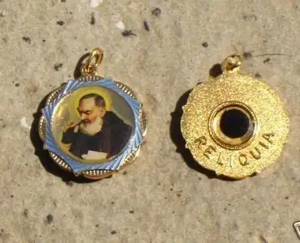
What are second-class relics?
Second-class relics are items that belonged to a saint, and that they used directly, such as their articles of clothing, rosary beads, books, or fragments of these items. Instruments of torture used to martyr saints are also considered to be second-class relics, because they touched the saints’ bodies. A priest saint’s vestments would be second-class relics. Pieces of wood from a saint’s coffin are also considered to be second-class relics
Second- and third-class relics are considered to be nonsignificant relics, whereas first-class relics are significant. For a first- or second-class relic to be certified a relic, it must be first authenticated by the bishop of a diocese. Oftentimes, saints’ relics come into the ownership of the diocese in which the saint worshipped. Body parts must be scientifically proven to be human remains before they may be publicly venerated

Slide 8
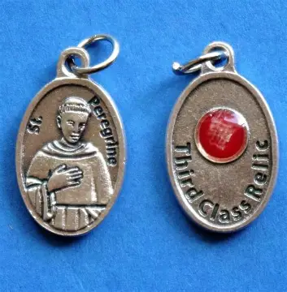
What are third-class relics?
Third-class relics are items, usually pieces of fabric, or prayer cards, that were touched to a saint’s body, or another first-class relic. They are not items that were directly used by a saint while they were living, but that came into contact with them afterwards. When you touch your rosary beads directly to a first-class relic, your rosary beads become a third-class relic
There is no certification process for third-class relics

Slide 9
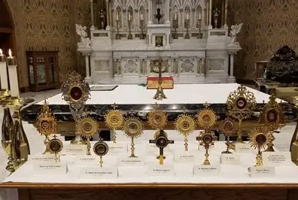
What are reliquaries?
Reliquaries are special receptacles, cases, for relics that are often very ornate, typically made from precious metals such as gold, and bejeweled to show true reverence for the holy items held inside, as reflections of the holiness of Christ the King
These containers resemble monstrances, the receptacles holding the Sacred Host during exposition of the Blessed Sacrament. Because they do not hold Christ like a monstrance does, they are smaller and less opulent, but often mimic the sun-shaped design of the monstrance, reminding us that the saints reflected Christ’s light, touching others with His love and mercy, still reaching out to us now through their prayers
Some reliquaries are shaped like the body parts they hold, imitating them, such as reliquaries that hold arm bones, and have a metal hand at the end to resemble a real human arm. Other reliquaries may be calendar-shaped, and hold a relic from a saint for every day of the liturgical year, a relic associated with each saint on their feast day. Once a reliquary is sealed, it may never be opened. This is in respect for the sacredness of the relics contained therein; open reliquaries would cast doubt upon the authenticity of their contents as well

Slide 10
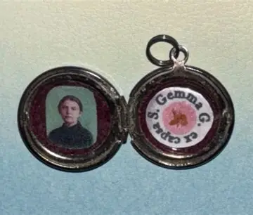
What do the Latin inscriptions on relic encasements signify?
The Latin inscriptions around the borders of a relic encasement clue us into what the relics are; they tell us from where the relics were taken. The inscription “Ex capsa” on the locket containing the St. Gemma relic informs us that the relic is from the coffin of St. Gemma, the casket. “Ex ossibus” means “from the bone,” while “ex capillis” means “from the hair,” and “ex carne” means “from the flesh.” Other common descriptions are “ex corporis,” or “from the body,” and “ex sanguine,” or “from the blood.” Latin inscriptions remind us that we all come from God, that we are made in His image, but that unlike God, we are finite beings who need His undying love in order to enjoy Heaven as immortal souls. The more we can be like Our Lady, from whom Christ received His Body and Blood, the more we can bring Christ’s Spirit into the world, helping other souls to discover that they come from God, Who loves them, and that we all must head towards God if we are to be saved, to treasure eternal happiness with the Hearts of Jesus and Mother Mary

Slide 11
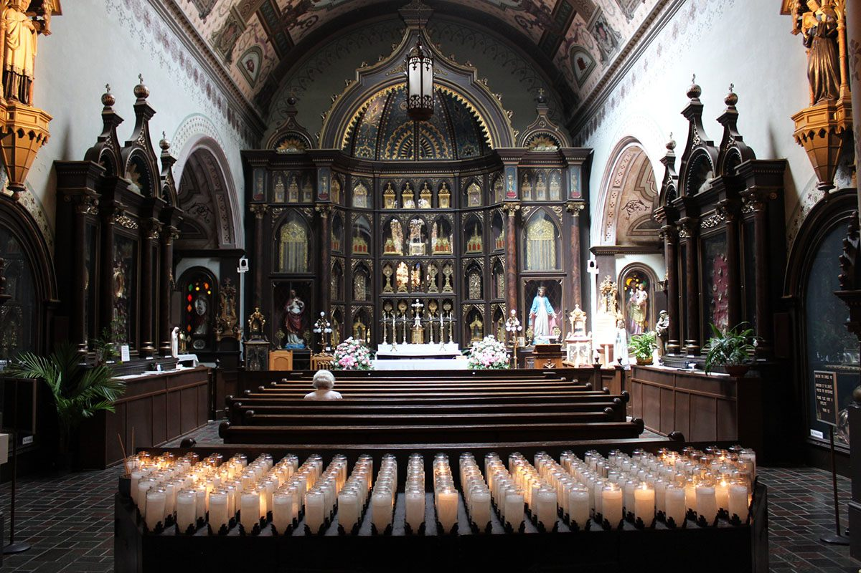
Where may we visit to venerate relics?
Laypeople are permitted to own relics, and to keep them in their private homes, but it is recommended that relics be kept in churches or shrines so that they may be publicly venerated, opening as many people as possible to receiving God’s grace through this practice. The Church will only issue relics to churches, shrines, and oratories, not to individuals, whether laity or clergy, for private use. Some significant relics cannot be given away without the permission of the Vatican

Slide 12
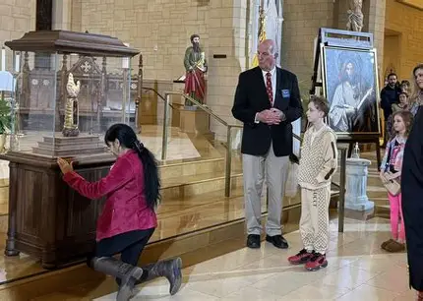
What does it mean to venerate relics? How and why should we do this?
To “venerate” is to show reverence, a level of respect, that is not the same as the adoration to which is given God alone. We venerate Our Lady and the saints, but do not adore them as we do the Lord, because they were not divine. While venerating relics may help to open us to receiving God’s grace that we need for healing, relics themselves do not cause miracles; rather, God works through the relics to perform the miracle. He chooses to do so out of love, to encourage us to learn from and look to our saintly brothers and sisters to heal and live holy lives; He communicates to us that Heaven is within reach
We venerate relics as a way of honoring the saints for their holy lives of devotion to, and sacrifice for, God out of love. Veneration builds humility, the root of love, in us
In honoring the creations of God, we ultimately give glory to the Creator Who enabled them to live such holy lives. We adore God more by venerating His friends, the saints
Venerating a relic can mean kissing the relic when it is carried by a priest in a reliquary, and brought to the faithful at the altar rail; kneeling reverently before the relic; making the Sign of the Cross; bowing the body or head; or a similar sign of respect, especially when it is enclosed in a glass case
We also venerate relics, because it is a traditional practice with a biblical basis. The hemorrhaging woman touched the hem of Jesus’ cloak for healing, and a man’s corpse was touched to the bones of the prophet Elisha, which raised the man back from the dead

Slide 13
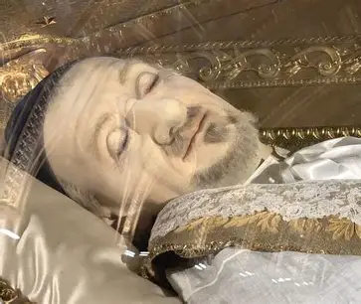
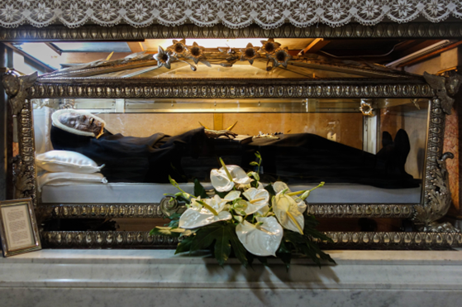
What is an “incorruptible”?
An incorrupt body is one that did not naturally decompose, but defied the natural process, remaining totally intact. A person’s body may be fully or partially incorrupt. Only when a body is exhumed, may it be found to be incorrupt, so there may be many other cases of bodies being incorrupt that are unknown, because these bodies have not been exhumed. When a person is canonized, it is announced whether they are incorrupt
“Incorruptibles” are people whose whole bodies, or parts of their bodies, were not subjected to decay. Not all incorruptibles are canonized saints, but incorruptibility can be a sign of sainthood, of God’s grace preserving not only the soul, but the body. “Incorruptible” also refers to the fact that, once a person’s soul is in glory, it can no longer be corrupted by sin; it is made perfect, so when a person’s body is incorrupt, we often hold it to mean that their soul is in Heaven, and therefore, incorruptible
Guidelines for identifying an incorruptible were established in 1734. To be considered an “incorruptible,” one’s body must remain flexible and lifelike, with natural color, for many years, even if they do not stay incorrupt forever. Sometimes after exhuming a body once, when it was found to be incorrupt, on subsequent occasions, parts of it were found to be decayed, because exposing the body to the elements affected it

Slide 14
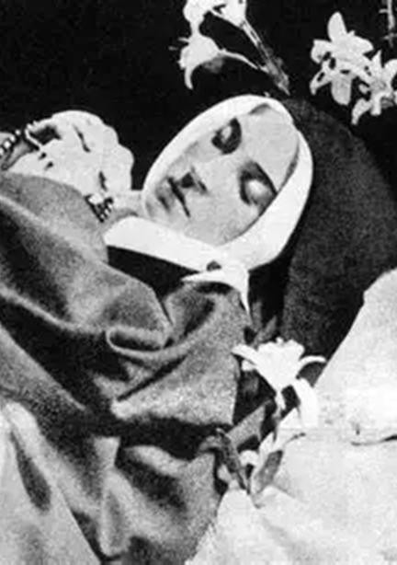
What do the incorruptibles reveal to us about God and His role in our lives?
The incorruptibles reveal to us that God is always at work in our lives. He does not abandon His beloved souls that He creates, and gives special rewards to those who are faithful to Him, using them as vessels to reflect His incorruptibility, the beauty and goodness of His Heart of total love. Incorruptible bodies of the saints reflect the beauty of perfect love to us, of hearts untainted by sin, in being most united to Jesus and Mother Mary. Seeing the miracle of incorruptibility that defies natural explanation shows us the greatness of God, Who transcends His created world, and is capable of doing the impossible. Incorruptible saints affirm the truth of Catholicism, the realness of God, Who intervenes in our lives to help us. He renews our faith by showing us the incorruptible bodies of the saints to give us hope in Heaven, in His love that is always with us, among us in the flesh

Slide 15
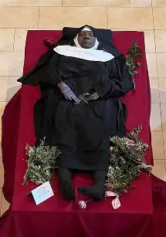
How many incorruptibles are there? Who are some of the incorruptibles?
There are just over one-hundred people who have been declared incorruptible by the Church. Some of these incorruptibles include:
Saint Padre Pio
Saint Agatha
Saint Nicholas of Tolentino
Saint Bernardino of Siena
Saint Angela Merici
Saint John of God
Saint Josaphat
Saint Stanislaus Kostka
Saint Madeleine Sophie Barat
Saint Peter Julian Eymard
Saint Albert the Great
Saint Peregrine
Saint Clare of Assisi
Saint Vincent de Paul
Saint Margaret Mary
Saint Charles Borromeo
Saint Francis Xavier
Saint Germaine Cousin

Slide 16
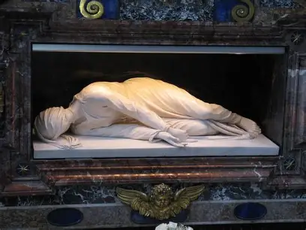
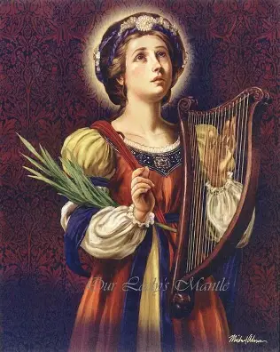
Who is the incorruptible St. Cecilia? Where are her relics located?
Saint Cecilia (d. 177), patron saint of music, was a virgin martyr of the early Church, and the first known incorrupt saint. She was married, but informed her husband, Valerian, that she had vowed herself to Christ, having offered her virginity to the Divine Spouse, which he accepted. Because she heard the heavenly music of the holy angels in her heart at her wedding, she teaches us all to harmonize our lives with Christ’s as songs of praise for Him. Her body was found to be incorrupt when she was exhumed 1,500 years after her passing from this life. Saint Cecilia would risk her life catechizing others in the Catacombs during a time of intense persecution at the hands of pagan Romans
Located in Rome, the Basilica of St. Cecilia holds the saint’s remains. The basilica was built over the remnants of what was believed to be the saint’s family’s mansion.
When her body was first exhumed, St. Cecilia was found to be in the same position in which she was martyred. She had been sentenced to suffocation in a vapor bath when she was found to be practicing the Catholic Faith, but survived this attempt on her life. She remained alive after the second attempt on her life, and was lying on the floor of the bath with three of her fingers extended to express her love of the Holy Trinity, the Three Persons of God. A hairshirt, a penitential garment, was found under her dress, which was still intact. Her neck wound and the veils used to collect her blood could be seen as well. The Basilica of St. Cecilia houses a statue above the cypress casket which resembles the positioning of St. Cecilia’s body exactly

Slide 17
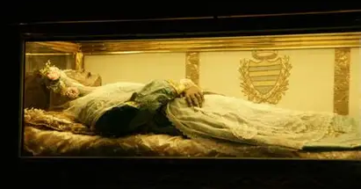
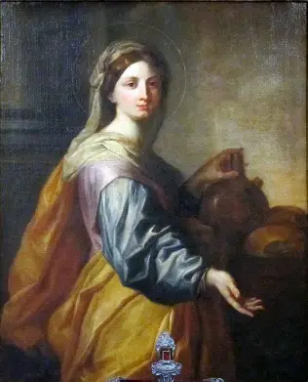
Who is the incorruptible St. Zita? Where are her relics located?
Saint Zita (1218-1278) is a patron saint for domestic workers, household chores, and lost items, especially keys
Taught by her mother to find the will of God in all things, St. Zita always remembered God’s Presence with her, even in difficult circumstances, and therefore, could remain faithful. In cultivating a rich life of prayer, she could offer all of her work to God, seeing it as being to serve Him above all else. As a twelve-year-old, she was sent to serve a merchant family as a domestic, and was subjected to cruel treatment, even to the point of abuse, but continued to persevere, making sacrifices out of love for God. Her example would inspire conversion, as everyone came to appreciate her excellent service and virtuous way of life. Saint Zita was compassionate and forgiving. When promoted to a position of greater responsibility, she was kind and patient with those who served under her leadership. Once, when called away from her work baking bread on an errand of charity, it was discovered that in her absence, the holy angels were baking the bread for her! She attended Holy Mass daily (waking up very early to do so), gave her food and care to the poor and sick, and even gave her bed to homeless women so that they would have a place to sleep. The very family that had abused her would contribute to her cause for canonization, vouching for her steadfastness in following God. Well before her canonization, the people of her town became to call Lucca “Santa Zita” in her honor
Entombed at the Church of St. Frediano in Lucca, Italy, her body was exhumed three times, and her whole body was initially discovered to be incorrupt, but it has since been mummified

Slide 18
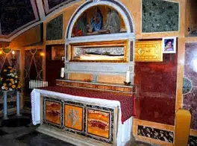
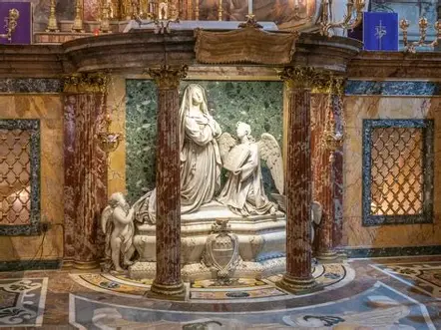
Who is the incorruptible St. Frances of Rome? Where are her relics located?
Saint Frances of Rome, a patron of motorists (drivers), wives, and widows, had wanted to be a religious sister, but God called her to marriage. She would go through a series of tragedies, including the loss of her husband and son, but would be consoled by the visible sight of her holy guardian angel. Later in life, she would found her own branch of the Benedictine order, the Olivetans, and realize her dream of forming a community of religious in which to adore God, but at the time of her passing from this life, she would be with her sickly son. Her deep love of the Holy Eucharist had sustained her throughout her life, and uplifted other people, as she gave generously from her heart
The body of Saint Frances of Rome (1384-1440) was exhumed after her canonization, upon which it was discovered that she had been perfectly preserved. Her body was still emitting a holy fragrance like it had been when she first passed away. The second time that her body was exhumed, only St. Frances’ bones were found. She is buried at the former Santa Maria Nuova Church, which is now named in her honor, Santa Francesca Romana, in Rome, Italy

Slide 19
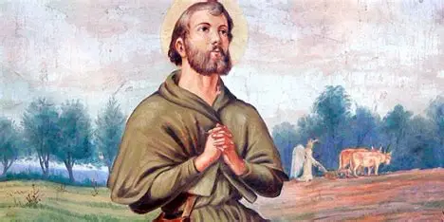
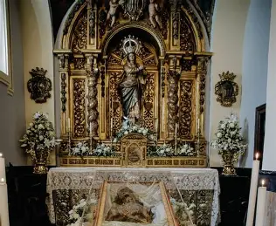
Who is the incorruptible St. Isidore the Farmer? Where are his relics located?
Saint Isidore the Farmer (1080-1172) was born to a poor, devout family who taught him to follow the Commandments of God lovingly. Taking his parents’ lessons on the good life to heart, St. Isidore went to Holy Mass daily before completing his farm chores for the day. When he was in prayer, the holy angels plowed the fields for him. Though he was reported for lateness to work, his chores were all completed on time, because he always put God first, so everything was perfectly balanced. Miracles involving multiplication of food are associated with St. Isidore, who always ensured that he was fed by Christ above all else. He and his wife lived in perfect chastity, as brother and sister, after losing their only son. Their lives would be dedicated totally to God. The head of St. Isidore’s wife, Maria, was incorrupt, and continues to be venerated today, processed through the streets in times of drought, that she would intercede to bring the rains needed for crops to thrive
In 1969, St. Isidore the Farmer’s 800-year-old body was processed through the streets of Madrid, Spain, during the bicentennial celebration of the anniversary of St. Isidore’s relics being translated to the Cathedral of Madrid. The pope was petitioned to make St. Isidore a patron of laborers; he remains a patron of farmers. Although St. Isidore’s body has been blackened over the years due to natural causes, it remains well-preserved

Slide 20
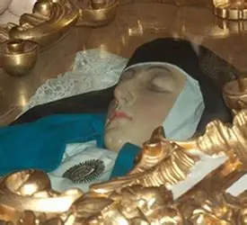
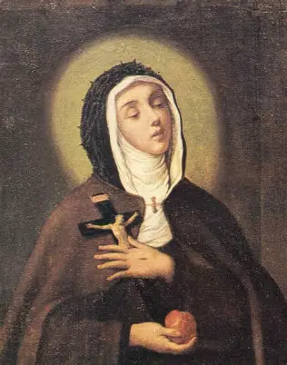
Who is the incorruptible St. Veronica Giuliani? Where are her relics located?
Saint Veronica Giuliani (1660-1727) had the five holy wounds of Christ, the stigmata. She and her siblings had each been entrusted to a different wound of Christ when her mother was dying. Her mother entrusted her to the wound on Christ’s Sacred Side, the one opening His Heart. Saint Veronica would indeed bring Christ’s Heart of love to others, and embody His sweetness in how she compassionated with Christ, reliving His Passion, and offering up her experiences to Him with love. When she was a young woman, she had joined a strict religious order following the Rule of St. Clare, and dealt with many challenges, not only in adjusting to religious life, but interiorly, as she underwent spiritual battles. These crosses would make her more like Christ, opening her heart increasingly, as she counseled other sisters kindly and wisely. She has been compared to St. Teresa of Avila in her style of leadership, her ability to manage well, with her strong mind, while never losing heart. Upon receiving the stigmata, the authenticity of the wounds was tested, as the bishop put St. Veronica Giuliani to the test, forbidding her from receiving Holy Communion, but St. Veronica would prevail, and it became evident, when her wounds opened up or closed on command, that she had been given a true spiritual gift. After her death, her body was found to be incorrupt, but was destroyed when the Tiber River flooded. Even so, her incorrupt heart remained intact, and is preserved in a reliquary. Before her passing, St. Veronica had filled ten volumes with spiritual insights from Christ’s Passion that she experienced, among other revelations, also drawing an image of her heart with symbols of the Passion that she lived with Christ, much like her namesake, St. Veronica, compassionating with Him. When her heart was examined, it was found that it truly had the symbols she had drawn; St. Veroncia had lived out the Passion of Christ with all of her heart, quite literally. Her relics have been kept under the main altar at her monastery in Citta di Castello, Italy

Slide 21
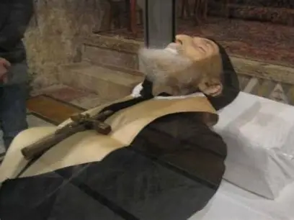
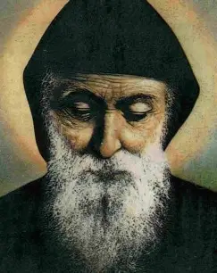
Who is the incorruptible St. Charbel Makhlouf? Where are his relics located?
Many miraculous healings have been attributed to Saint Charbel (1828-1898), who was a healing presence in this life as well, in having embraced a life of simplicity, of total surrender to God. Raised in a farming family in Lebanon, St. Charbel chose to become a monk, secluding himself completely from the world, but keeping the people of the world in his heart entirely in prayer. When St. Charbel would pray, it was observed that he radiated light, clearly, serving as a reflection of Christ, Who is the Light of the World. A vegetarian, St. Charbel practiced self-denial, communicating his love for God through penance, which he offered in reparation. Saint Charbel was sustained by the Holy Eucharist, which transfigured him, and allowed him to be a powerful intercessor who could bring others to their healing by leading them to Christ. He would spend all of the morning preparing to celebrate Holy Mass, then spend the rest of the day in thanksgiving. All of his life was centered on the Holy Eucharist, the greatest gift. Honoring Christ’s Heart in such a beautiful way meant that he could remain pure in heart like Christ, embodying self-sacrificing love that would preserve Him unto life everlasting. In keeping with the monastic custom, St. Charbel’s body was not embalmed, or put into a coffin, when he was buried after his passing from this life. He had been celebrating Holy Mass when he fell very ill, and the Holy Eucharist had to be pried from his hands. Truly, nothing could take Christ from St. Charbel; clinging to Christ for his whole life meant that he could reflect him in the next life, too. His body was found to be fully incorrupt, and remains very lifelike. Saint Charbel was exhumed, because a bright light was shining from his tomb even forty-five days after his passing from this life, and continues to do so today. Saint Charbel lived in such close spiritual union with Christ, that his body continued to sweat blood, like Christ’s did during the Agony in the Garden. His body has since been reduced to bone (which was discovered in 1965, after 67 years of incorruptibility; St. Charbel’s remains had even survived much flooding in the region). Saint Charbel’s bones are kept in the Monastery of St. Maroun where he lived, and remain a reddish color from the blood that he released

Slide 22
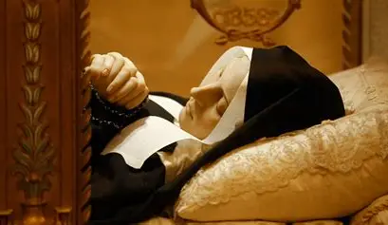
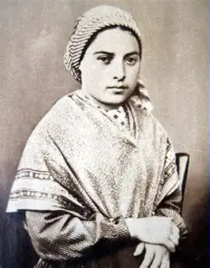
Who is the incorruptible St. Bernadette? Where are her relics located?
Known best for having been the visionary at Lourdes to whom Our Lady appeared, St. Bernadette Soubirous (1844-1879) dealt with health conditions throughout her life, namely, those affecting the lungs. Although many physical healings at Lourdes have been reported, St. Bernadette was never physically healed, though certainly, her spirit was touched by the graces of Our Lady. Saint Bernadette relied on St. Joseph as a spiritual companion after the eighteen apparitions of Our Lady of Lourdes. Saint Joseph is the savior of the Savior, having preserved Our Lord from harm. In a similar way, he would surely help to preserve St. Bernadette, because he teaches us to preserve Christ in our hearts, to always cradle the Christ Child close to us, as he did. Saint Bernadette would keep Christ close to her, namely, through devotion to the Holy Eucharist. She was delayed in receiving her First Holy Communion due to her fragile health as a child. It was shortly after her First Holy Communion that she was visited by Our Lady. If we are to be spiritually preserved, then we need closeness to Our Lady and St. Joseph, who keep us close to the Christ Child. When she was first visited by Our Lady, St. Bernadette had been out gathering firewood. If our souls are to be preserved unto life everlasting, then we are to keep gathering souls to Christ, that they would feel the brightness and warmth of His Heart, ignited with a deeper love for God to burn forever in their hearts. The incorruptible saints help to lead us to the firewood that we need to build up in our hearts to be preserved, to be illuminated by Christ’s love, and come to dwell within it in Heaven. Saint Bernadette persevered with tuberculosis in her final stages of life, and offered everything to God, until her last breath. She would be buried at a chapel named for St. Joseph, the patron of the departed and the dying. It was discovered twice, on the occasions when her body was exhumed, that she was incorrupt. Saint Bernadette’s hands still held rosary beads, and aside from some slight discoloration in the skin of the face, she was perfectly preserved; some wax covering has since been placed over her face, but St. Bernadette still clearly reflects the shining Face of Christ. Saint Bernadette’s relics are housed in the Chapel of St. Bernadette at her convent in Nevers, France

Slide 23
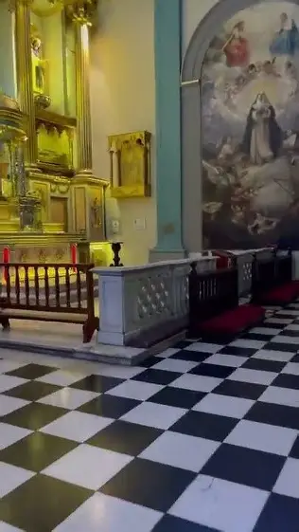
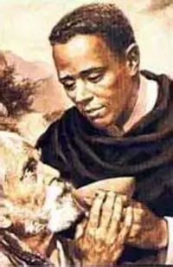
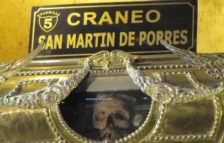
Who is the incorruptible St. Martin de Porres? Where are his relics located?
Saint Martin de Porres (1579-1639) was the illegitimate son of a Spanish man and an African woman who was a former slave. Rejected by his own father, St. Martin de Porres would remain close to the Eternal Father, Who embraced Him fully. The first multiracial saint to be canonized, St. Martin de Porres would become a light to all nations, for like Christ, his heart was never corrupted by bitterness or anger. Like Our Lord, he was rejected and treated as an outsider, but in spiritually uniting with Christ in this experience, St. Martin de Porres would come to love more, opening his heart to accept everyone in need of care. Twenty-five years after his passing from this life, it was discovered that his body was incorrupt. Saint Martin de Porres’ relics are preserved in the Convent of Santo Domingo, the Shrine of St. Rose de Lima and St. Martin de Porres, in Lima, Peru, where visitors may see his skull

Slide 24
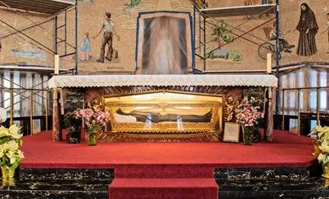
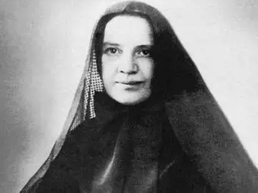
Who is the incorruptible St. Frances Xavier Cabrini? Where are her relics located?
Saint Frances Xavier Cabrini (1850-1917), the first U.S. citizen to be canonized, was born Maria Francesca, had always dreamed of becoming a missionary, from the time she was floating paper sailboats down the water, imagining when she, like the flowers she placed in the boats, would come to visit far-off lands to convert souls to Christ, her Beloved. While her initial dream had been to go to China to bring the Gospel to souls there who had never heard it, Pope Leo XIII advised her to “go West, not East,” so Mother Cabrini would go to serve Italian immigrants in New York who were in need of direction and unification, namely, in their faith communities, which were all but nonexistent as the immigrants grappled with adjusting to American ways of life, aiming simply to survive amidst harsh conditions, exacerbated by the persecution and discrimination they faced for their religious and ethnic identities. When she was a child, there were no female missionaries, but Mother Cabrini would dress her dolls as nuns and send them out on missions; she would come to live out the childhood imaginings she had, never having been deterred, instead, always trusting that God would make a way for her. Saint Frances Xavier Cabrini would follow the will of God, saying “yes” to each new twist and turn along the trail she blazed for future generations of women with hearts on fire with love for the Lord. Saint Frances Xavier Cabrini had a deathly fear of water resulting from a childhood drowning incident, in which she fell into the water while playing with sailboats, but would overcome this fear out of love for Christ, crossing the ocean at least thirty times over the span of thirty years. In 35 years, she would help to construct 67 Catholic institutions, including convents, schools, orphanages, and hospitals staffed by her Missionary Sisters of the Sacred Heart (the first community of female missionaries), the order she had founded. Saint Frances Xavier Cabrini was motivated by love for the Sacred Heart, which led her in her journeys, so her heart was never corrupted by despair for the difficult circumstances she faced personally, in managing such enormous tasks, or those she witnessed others facing while suffering in poverty, illness, strife, and mistreatment. Rather, Mother Cabrini had true faith, the strong heart of Our Lady, and would keep forging ahead, standing faithfully by every Cross. Her relics are located in New York City, where she served immigrants so tirelessly. Her remains may be viewed under the main altar’s glass encasement at the Saint Frances Cabrini Shrine in Manhattan’s Washington Heights section. While as a baby, she was baptized immediately due to concerns that her life would be short-lived, the baby being in such fragile health, Mother Cabrini would live a triumphant 67 years, Christ’s intrepid Heart beating within her. Her body, too, was preserved, persisting even after dying; she was found to be partially incorrupt after she passed away. Mother Cabrini was born into eternity shortly after having worked on preparations for a children’s Christmas party; she had been making candy for them, bringing sweetness to life unto her very last breath, after which she would breathe new love for Christ into hearts through her heavenly intercession

Slide 25
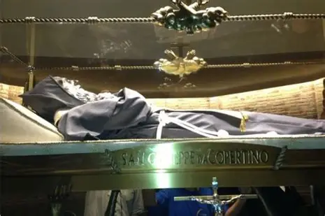

Who is the incorruptible St. Joseph of Cupertino? Where are his relics located?
Saint Joseph of Cupertino (1603-1663) is considered to be an incorruptible, and, indeed, his heart was never tainted by the cruelty of those around him who did not understand his innocent, childlike spirit, just as Christ was not understood or accepted by all, in His perfect purity that was totally unworldly. Possessed of a heavenly wisdom, St. Joseph would encounter difficulty in academics, which meant that he very nearly was not ordained to the holy priesthood, but his spirit of simplicity, his love of Jesus and Mother Mary, transcended all, quite literally. So uplifted by love with the Two Hearts was St. Joseph of Cupertino’s heart, that he would levitate in the air while celebrating Holy Mass, even flying up to join the holy angels for the Holy Mass celebrating Our Lord’s Nativity. Saint Joseph of Cupertino’s relics are located in his monastery in Osimo, Italy, formerly the San Francesco, now called the Basilica of St. Joseph of Cupertino. When St. Joseph’s body was examined after his passing from this life, it was discovered that the tissue around his heart was shrunken, drawn away from the heart. The heart itself was dry, and contained no blood. Saint Joseph of Cupertino had prayed throughout his life that Christ would take his heart and burn it. This was evidence that Christ had answered his prayer, and would use St. Joseph’s heart burning with love, so united to His own Sacred Heart, to inflame other hearts with a pure love for the Lord, that they would come to join Him in Heaven

Slide 26
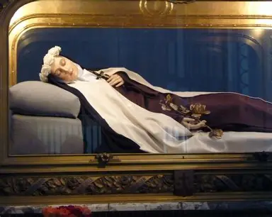
Why is it that not all of the saints are incorruptibles?
Incorruptibility may no longer count as a miracle in the canonization process; it is not always an identifier of sainthood. Other religious groups have made claims that practitioners of their religion are incorrupt
Some saints, such as St. Therese, requested from God that they not be incorruptible, because they wanted to teach that holiness is accessible to all, that we have a universal call to sainthood, which is possible, even without extraordinary spiritual gifts. Saint Therese predicted that her prayer would be answered, so all that would remain of her would be her bones, and she was correct. Her body was exhumed in 1923, because when she passed away in 1897, her city required that the bodies of the Carmelite nuns at St. Therese’s convent be buried in the municipal cemetery, not in the cloister, but then, the Carmelite nuns were permitted to bring her remains back to the Carmel, so her relics would be transferred. When St. Therese was buried in the municipal cemetery, hundreds of thousands of people would visit her grave, which welcomed significant graces into their souls. Now, pilgrims to the Carmel of Lisieux convent can see St. Therese’s tomb. Standing near St. Therese’s remains is the original statue of Our Lady of the Smile, through whose intercession St. Therese was healed as a child, preparing her for her mission to heal many souls on the road to Heaven. Nearby the convent is the Basilica of St. Therese, the second-largest, most-visited pilgrimage site in France after Lourdes. The basilica may accommodate up to 4,000 pilgrims
Saints like Therese who are not incorrupt, or who are partially incorrupt, may have their bones encased in wax figures made to resemble them
If a saint is not incorrupt, it does not mean that they are less holy; it may be a sign of their humility. God has a plan, and knows what will bring about the greatest grace. There is more to sainthood than preservation of the body; it may reflect that a soul has been preserved in Heaven, but preservation of the soul unto life everlasting is still most important
At times, bodies are exhumed during the canonization process; God knows what is needed for a saint to be recognized in the Church, and will raise certain souls to the altar of sainthood to lead other souls to Heaven, so sometimes, He makes people incorruptibles to attest to their sainthood, helping them in the canonization process

Slide 27
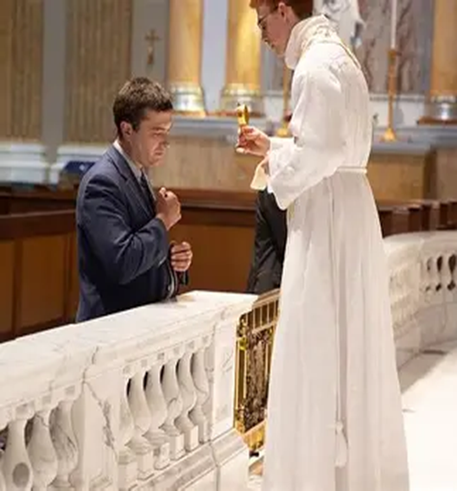
Which country is home to the most incorruptible saints? The highest number of relics?
The highest number of incorruptible saints is in Italy. France is also home to many popular incorruptible saints; these are two countries that have some of the highest numbers of canonized saints in general
The highest number of relics is kept at the Vatican in Italy, but St. Anthony’s Chapel in the United States, located in a suburb of Pittsburgh, Pennsylvania, is the location with the second-highest number of relics after the Vatican: 5,000. Most of these relics are first- or second-class. There are an estimated 22 splinters of the True Cross there; a splinter of the table from the Last Supper; part of St. Anthony’s tooth; and fragments of the bones of the apostles. A reliquary resembling an altar at the chapel holds 700 relics, reminding us that we become saints with legacies of holiness to leave behind when we work together, as friends in Christ
Saint Anthony’s Chapel was constructed by a Belgian priest who had come from a wealthy family, and studied medicine. After he was ordained to the holy priesthood, he was sent to Pittsburgh because of the large German population there, needing a German-speaking priest. He received many relics from Germany when, in the 1800s, during a time of persecution, reliquaries were being smashed, their relics destroyed by iconoclasts, German religious sent him relics overseas to keep safe in the United States, where they remain to this day. Altars in churches have saint relics beneath them (the main altar must have at least one first-class relic), as our faith is built on the foundation of the souls who have witnessed to Christ and passed their Faith on to us; priests would traditionally carry in altar stones with relics when processing into Holy Mass as well, because the saints walk with us and guide us to Heaven. Many parish churches have their own relics for veneration, but often, churches have relics associated with local saints, such as in Italy, where many churches were part of procession routes honoring saints on their feast days, and so, contain relics of the saints who were so honored

Slide 28
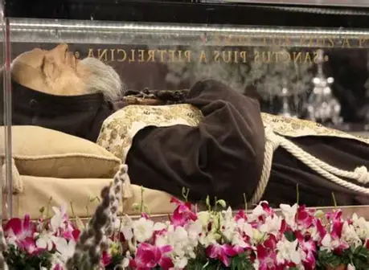
What does it mean for us to be “incorruptible” in our spiritual lives? How may we practice this going forward?
To be “incorruptible” in our spiritual lives means to remain at peace, to dwell in Christ’s serenity, and be undisturbed, untouched, by the things of the world. Our Lady, whom we honor with the title “Inviolata,” “inviolate,” is our model of how to remain untouched by the things of the world, to remain in God’s grace by treasuring Christ in our hearts, keeping our focus on Him. By trusting in God, Who is in control, we need not fear, and can foil Satan in his plans to distract us from our purpose with anxiety and doubt in God’s love. Putting full confidence in the Sacred Heart that does all things out of love for us, that is sacrificed for us out of total charity, means that we may remain incorruptible in spirit. We can practice this level of trust by saying such aspirations as “Jesus, I trust in You,” “Jesus, I love You,” or saying the surrender novena, asking Jesus to take over, that He may lead us to do what is right. We may say this prayer as part of the rosary of abandonment

Slide 29
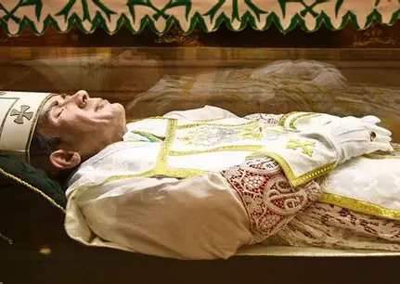
What do all of the incorruptible saints teach us about living out our Faith?
All of the incorruptible saints teach us that living our faith, staying close to Jesus, preserves us. At Holy Communion in the traditional rite, the priest prays that our souls would be preserved “unto life everlasting.” This means that he prays that through Christ’s salvific Presence in the Holy Eucharist, we would be brought to eternal life in Heaven. The incorruptible saints teach us to rely on Christ in order to feed us, to sustain us forever, and that the only way in which we can preserve ourselves spiritually is through Christ’s love, because in this life, all things pass away, but the things that are true, that are of God, are eternal. Jesus is the Way, the Truth, and the Life Who leads us to embrace God’s true love forever in glory

Slide 30
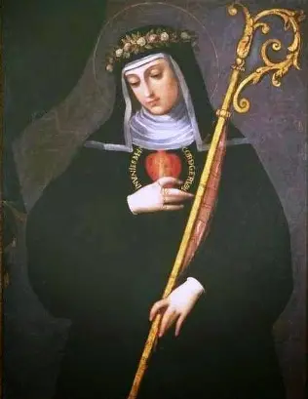
What does St. Gertrude, whose feast day we celebrate today, teach us about keeping an incorruptible heart?
Saint Gertrude kept the Christ Child in her heart, which meant that her heart could remain pure like His. Keeping the Christ Child ever in our hearts, we think of the innocence of the Lamb led to slaughter, Who obediently followed His Father’s plan, trusting in the love of God, our Eternal Father, Who knows what is best and most needed for our salvation. An incorruptible heart is one that is like Christ’s, that trusts in Him and hopes, never giving up or losing sight of Christ’s light. Saint Gertrude kept her eyes fixed on Heaven; she received visions that teach us that our prayers are like gems, because Jesus treasures them in His Heart, which beats with love for us. In praying with all of the love in her heart, making intercession for others, St. Gertrude opened her heart to Christ’s love, and all of the riches of it that He wanted to give her, so she could have a pure and self-giving heart like Christ’s Heart, a heart so filled with love, love that purifies, that St. Gertrude did not have room for sin in her heart. Believing in Christ’s love, placing our hope in the Resurrection, knowing that there is a life beyond this one with many rewards, means that we do not have to be disillusioned and corrupted. Because God is love, Who came into the world as a child out of love for us, the heart that loves God is a childlike heart of innocent love like that of the Christ Child. Saint Gertrude honored Jesus’ Childhood in a special way, and saw in a vision that the Christ Child accepted her prayers of love for His holy Childhood with much affection. To keep our hearts safe from corruption, we, like St. Gertrude, can invite the Christ Child into our hearts by meditating on twelve mysteries of Christ’s Childhood, saying a “Hail Mary” for each one, and offering ourselves to God in a childlike manner, learning from Christ’s example by reading Sacred Scripture, taking the written word of God into our hearts to take the Word made Flesh into our hearts

Slide 31
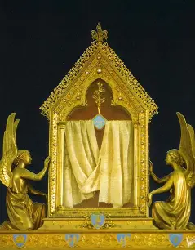
Closing Prayer: In Honor of the Incorruptibles by Katie Sadakierski
God our Father, we pray in thanksgiving for the beautiful souls You were pleased to preserve from natural and spiritual decay, to keep in a state of grace, that they would give glory to You through their purity of mind, heart, body, and soul. We bless You for the incorruptible saints, and those on the road to canonization, who inspire us to remain close to You, that we, too, would remain incorrupt in heart, in conforming to You, the incorruptible God, Whom we love above all else. Guide us to treasure You in our hearts, that we may enter into Your Kingdom to adore You eternally, and become as treasures in the crown of Christ the King, reflecting the spiritual beauty of Our Lady, Queen of Heaven. Through Christ our Lord. Amen.

