Slide 1
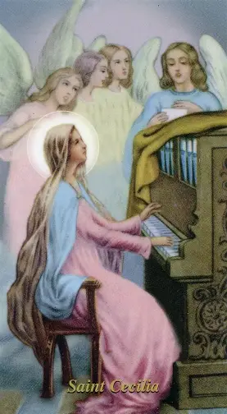
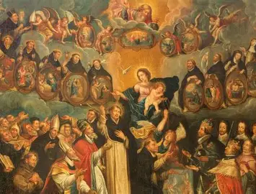
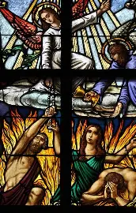
Souls for Souls: Going Souling with the Saints
Saturday, November 22, 2025
Katie Sadakierski

Slide 2
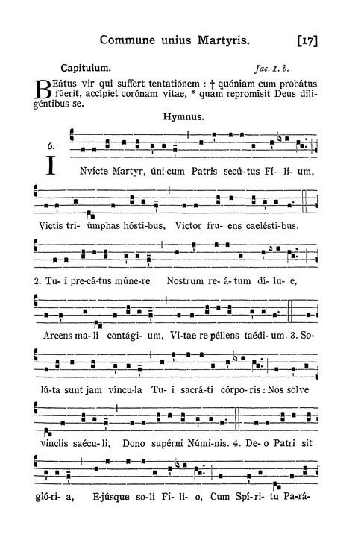
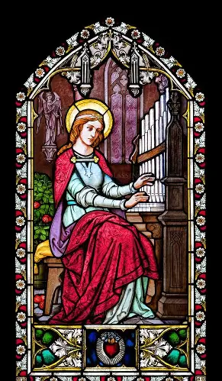
Outline
Welcome & Opening Prayer
Meeting presentation:
  I. Honoring the Holy Souls in November: All Souls’ Day Traditions and Carrying Forward the Light of the Holy Souls
  II. Treasuring the Holy Souls in our Hearts with the Saints: Emulating the Virtues and Practices of Saints with Special Devotions to the Holy Souls
  III. Being Holy Souls on Earth: Uniting in Prayer with the Communion of Saints
Closing Prayer
Announcements
Q & A

Slide 3

Opening Prayer: Collect Prayer for the Feast of St. Cecilia of Rome
O God, who gladden us each year with the feast day of your handmaid Saint Cecilia, grant, we pray, that what has been devoutly handed down concerning her may offer us examples to imitate and proclaim the wonders worked in his servants by Christ your Son. Who lives and reigns with you in the unity of the Holy Spirit, God, for ever and ever. Amen.

Slide 4
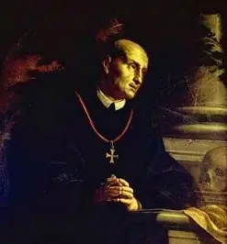
What is All Souls’ Day, and what are some common All Souls’ Day traditions, and what do they teach us about the spirit of this season?
On November 2 (transferred to Monday, November 3 when All Souls’ Day falls on a Sunday), we gather in remembrance of departed loved ones, praying for the holy souls in Purgatory
Between 998 A.D. and 1030 A.D., the abbot Saint Odilo instituted All Souls’ Day, which was observed on the day after All Saints’ Day, November 1. He engaged the monks at his abbey, the Benedictine monastery of Cluny, in praying together for the faithful departed, uniting in memory of their loved ones
Many customs evolved in celebration of All Souls’ Day, such as praying the Holy Rosary as a family at dusk on All Saints’ Day, gathering around the Candlemas candles, with the men leading the first parts of the prayers, and the women responding, offering their intentions for the departed. Families would bring picnics to the cemeteries to visit loved ones and to pray for them, giving food (especially loaves of bread), to the poor who were congregated by the cemeteries, to honor the memories of their loved ones, and to feed souls, in the way that they prayed their departed souls would be fed. Souling was another more active way of remembering the departed, compared to the otherwise more contemplative practices used to honor the deceased faithful
Such practices remind us that the communion of saints is united through God’s love. Our bond with our loved ones, including those in the Church Suffering, is strengthened through God’s love, which is eternal. Because of Christ, we can continue to gather, and be nourished at the wedding feast of the lamb, helping to lead each other to spiritual union with Christ. We go to the saints for their prayers for our sanctification, and we pray for the holy souls in Purgatory as they are being sanctified; they, too, pray for us, so that a continuous cycle of God’s love persists across the states of the Church, transcending time and place. This season is one of hope, in which we look forward to spiritual rebirth in eternity, so our traditions in this season reflect that spirit, in drawing souls together to pray in thanksgiving to God for the gift of life that He gives

Slide 5

What is “souling”?
Souling was a Catholic practice that served as a precursor to the contemporary custom of “trick-or-treating,” which originated prior to the Protestant Reformation, likely, in the early sixteenth century, particularly, in countries within the United Kingdom, especially in Ireland, Scotland, and Wales. Traditionally, the poor (both children and adults) would go door to door visiting their wealthier neighbors for alms. They would offer to say a prayer for the souls of the departed family members at the home they visited, in exchange for food, usually a small treat such as a cake (called a “soul cake,” a type of spice cookie that reminds us of Our Lady, who goes to the holy souls to refresh them, and spreads the fragrance of holiness like spices). Soul papers with the names of the departed for the soulers to pray for were provided with the cakes. At times, the soulers would sing songs of praise to honor the generosity of the donors. Neighbors helped each other: through prayer (spiritual works of mercy), soulers helped the holy souls in Purgatory, and through provision of food to the soulers (a corporal work of mercy) homeowners helped their less fortunate members. Together, they nourished each other; through sharing God’s love, we feed each other

Slide 6
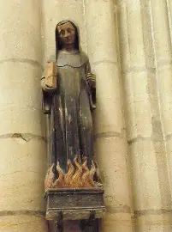
How does souling relate to St. Martin’s Lent? How does it prepare us for Advent?
While not an official liturgical season like Great Lent, St. Martin’s Lent is a time of spiritual renewal that prepares us to observe Advent, a penitential season, with great peace of spirit and strength of soul, a prevailing sense of hope and confidence in the Sacred Heart of Jesus, in the faithfulness of the Lord, that we ultimately may celebrate Christmas wholeheartedly, with abundant joy. In fasting and offering similar penances during St. Martin’s Lent, or adding spiritual practices that augment our friendship with Christ, we can prepare our souls to receive the pure love of our newborn Savior. Cultivating clean hearts that embrace the Eternal Father with childlike trust, we may be further prepared to receive the redemptive love of the Risen Savior at Lent, for crucified love is redeemed love. In this season, we remember that Christ was born to give His life for our salvation, that we would come to live with Him forever in Heaven. Named for St. Martin of Tours, who lived in the period of the early Church, and was raised in a pagan Roman family, the season of St. Martin’s Lent celebrates the conversion of St. Martin of Tours, a worldly soldier who became a soldier for Christ, practicing the corporal and spiritual works of mercy to honor the light of Christ in every person, and to therefore, reflect the light of Christ’s love. His feast day, celebrated on November 11, is extended into a season lasting from November 12 through Christmas. In union with St. Martin of Tours, we die to sin, the self, and the world, in order to rise with Christ, welcoming Christ more deeply into our hearts with a spirit of ongoing conversion. The first coming of Christ at Christmas anticipates His second coming, so we look forward to the total fulfillment of God’s will, and offer all that we do and are as a gift, to do the Father’s will perfectly out of love. Together with the holy souls, we pray with patience, actively awaiting heavenly glory, and perfect spiritual union with Christ. We help to make that a reality, receiving a foretaste of Heaven, when we care for souls as Christ would, and as St. Martin did when he clothed the beggar, who was Christ, shivering in the cold. By going “souling” spiritually, reaching out to souls in prayer to heal and bless them, we emulate St. Martin, and therefore, imitate Christ, preparing for Advent in being purified with the souls. We embrace new beginnings, inviting Christ into our hearts each day, reaffirming our commitment to Him, not closing the doors of our hearts to the Child in the manger Who shivers in the cold, but enveloping Him in the mangers of our hearts, warming Him with our love, that He, in turn, may brighten and warm our lives with His undying light

Slide 7
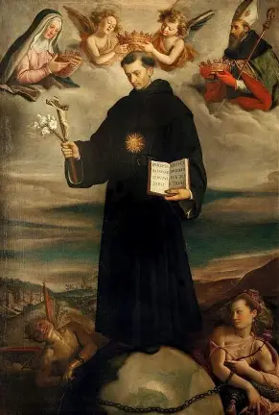
Who is St. Nicholas of Tolentino? What does he teach us about souling?
Saint Nicholas of Tolentino (1245-1305) had a deep devotion to Our Lady, which meant that he could love with a Marian heart that reached out to the holy souls, who are also beloved spiritual children of Mother Mary. Once, while he was feeling unwell, St. Nicholas of Tolentino received a vision of Our Lady, in which she told him that, in order to receive healing, he would need to eat bread dipped in water. Saint Nicholas heeded her message, and was healed of his infirmity. When he brought bread to the poor, he dipped it in water and prayed over it for the intercession of Our Lady, just as Our Lady had taught him, in order to extend the blessing of healing that Our Lady had brought. Saint Nicholas of Tolentino was a friend to the holy souls (and is currently one of their patrons), having received visions of them, and responding to their requests to celebrate Holy Masses for them. After having said Holy Masses for the holy souls, he would see them ascending into Heaven. He prepared with great care to celebrate daily Mass at the earliest time possible each morning, and spent the rest of his time in thanksgiving. In connecting all things to the Sacrifice of the Holy Mass, he could give with the greatest love, providing true sustenance to others. Saint Nicholas of Tolentino would spiritually renew souls through the kindness and love he shared, which flowed directly from his friendship, his union, with the Risen Lord in the transubstantiated bread, through which he brought others to eternal life. Over 100 children would be raised from the dead by St. Nicholas of Tolentino; they would be revived when he placed bread to their lips. Throughout his life, St. Nicholas shared spiritual nourishment from Christ that he received, going out to help the poor with his family while still a child; then encouraging his fellow Augustinian religious brothers to give while still a novice; and finally, breaking and blessing the altar bread as a priest, bringing souls the Real Presence of Christ, the True Bread. He teaches us that going souling is to bring the presence of Jesus to others by bringing them the presence of Our Lady, His reflection, nurturing souls in need, for we are all broken, and in need of restoration, redemption and healing from Our Lord, Jesus. Saint Nicholas of Tolentino was named after St. Nicholas of Myra, after whom Santa Claus was patterned, and shared his namesake’s spirit of generosity. Saint Nicholas of Tolentino’s story teaches us that we enter into new life, are rejuvenated, when we go to the altar of God, Who gives joy to our youth, with childlike hearts, so that we can be lifted from the deadness of sin and the world, to be restored to baptismal innocence, healed by the life-giving waters of Holy Baptism

Slide 8
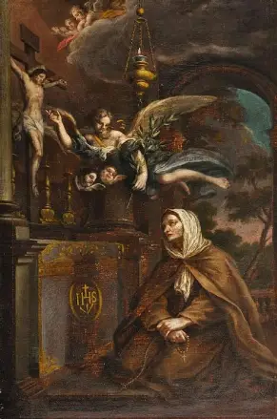
Who is St. Margaret of Cortona? What does she teach us about souling?
Saint Margaret of Cortona (1247-1297) lived a life away from the Church, not in harmony with Christ’s teachings, having fallen away after the trauma of her mother’s death when she was a child, and her father’s remarriage to a stepmother who treated her unkindly. She cohabitated with a wealthy nobleman for some time, and had an illegitimate child with him. Her repeated requests for her son’s father to marry her were declined, until one day, St. Margaret learned that her beloved had been a victim of homicide. Distraught, she was converted, turning back to Christ, in realizing the brevity of this life, and the need to focus on eternal things, to make this life count for eternity, living it to the fullest. Going to live within a Franciscan community as a tertiary, St. Margaret completely turned her life around; her son would formally enter the order years later. Setting a positive example for her son, she would become a model of holiness. In her time away from the Church, St. Margaret of Cortona had never stopped praying. God had heard her prayers, and liberated her from the snares of sin in which she had become so entangled. Saint Margaret would live a life of penitence in reparation for her worldly pursuit of vices, offering all of her penances for the holy souls. Just before she passed away, St. Margaret saw a band of souls come down to carry her up to Heaven: these were the souls she had prayed for and released from Purgatory, who had arrived to bring her up to glory with them. In her example of repentance, St. Margaret of Cortona teaches us that to go souling is to have humility, to walk among others with compassion and patience, in recognizing that we all are sinners in need of God’s mercy, and can help each other to choose the right path, the path to Heaven, especially by uniting to help other souls, namely, the souls in Purgatory who rely on our prayers. Charity covers many sins, so in going to God, Who is love, making sacrifices to honor Him, we can embrace His Heart of forgiveness. Saint Margaret teaches us to remain open when God comes souling, seeking out our souls, so that we can receive His love; God is always reaching out to us, and when we have hope, never despairing of whether He will forgive us, then we can reach back, and become channels for the grace of God’s compassion, helping the holy souls to fully be healed from sin, opened entirely to God’s grace as well

Slide 9
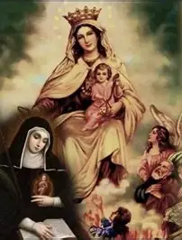
Who is St. Gertrude the Great? What does she teach us about souling?
Saint Gertrude the Great (1256-1302) is the only female saint to be called “great,” and so much of her greatness was in her charity, her humble compassion for others, namely, the holy souls in Purgatory. Offering her Holy Communion to the holy souls, St. Gertrude was rewarded by Christ for her generosity in sharing the grace that she was given to souls so much in need of it. In a mystical vision, Christ would bring her down to release souls from Purgatory with Him. What astonished St. Gertrude during this experience was how many more souls Christ released from the flames than she would have dared to request. This demonstrates that the depth of Christ’s mercy is unfathomable to us; His justice demands that souls attached to sin be purified in Purgatory, but His mercy does not want it. Christ wants to release souls from Purgatory, because His Sacred Heart longs for union with them, to pour His love into their hearts. Saint Gertrude the Great, who composed a prayer offering the Precious Blood of Jesus to God the Father for the remission of sins, the release of souls from Purgatory through the sprinkling of their purifying Blood on their souls, teaches us that going souling means giving from our hearts to bless others, sharing the treasures of Christ’s Heart with others to bring them joy and peace, the fulfillment that comes only from Jesus. She had received two visions honoring the treasury of Heaven where prayers for souls are kept, reflecting the treasury of virtue, of love, that is Christ’s Heart. In one of the visions, St. Gertrude saw golden coins being piled on a table; Jesus placed an especially shiny coin on the top of the pile, which He revealed was a “golden Hail Mary” prayer, said with true love for Our Lady, slowly and meditatively, from the heart. In a similar way, St. Gertrude received visions of pearls on a golden table, representing the prayers said for souls in Purgatory, which she saw ascend into Heaven like sparks. From St. Gertrude, we learn that because Christ treasures us, He is longing to pull us from the depths, and gather us to Him; the souls in Purgatory suffer, because, as revealed to St. Faustina, they yearn for union with God, and as they come to be purified, sharing in God’s love more, they come to experience the longing that He does for souls. The purifying flames will allow for this thirst to eventually be quenched; the souls are cleansed of the sins that they pursued in order to quench their thirst in their earthly lives. The more we unite with Our Lady in prayer and honor her, the more golden our souls can become, and the better our offerings can be to the holy souls, whom we can refresh in our prayers, until they come to fully experience the treasures of Heaven with Our Lady. Saint Gertrude, in loving Our Lady, could be close to Christ’s Heart, even resting her head on His open Side, His pierced Heart, so she could follow the Holy Spirit’s inspirations to draw souls to Him. She received her first visions when she sang a hymn welcoming the Holy Spirit, so when we invite the Holy Spirit into our hearts, we can invite all of God’s spiritual children to our hearts, opening ourselves to loving more

Slide 10
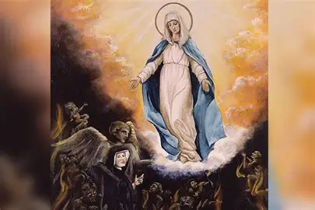
Who is St. Faustina Kowalska? What does she teach us about souling?
Saint Faustina Kowalska (1905-1938), the messenger of Divine Mercy, received mystical visions of Purgatory, and in one of them, traveled into its depths to see the holy souls therein. She witnessed Our Lady going down to the souls to console them, to keep them company and encourage them, uplifting their spirits while suffering, out of her mercy. In seeing Our Lady, the holy souls were refreshed, because they could look forward to joining her in Heaven with Christ. Amidst the darkness, they could see a glimpse of the eternal light that they would soon come to share in. From her visions, St. Faustina learned that the holy souls call Our Lady the “Star of the Sea,” because she is a light that illuminates the way for them through the darkness of the Purgatorial abyss. Through St. Faustina’s experience, we learn that we come to experience the ocean of God’s mercy after the ocean of cleansing fire that is Purgatory, and that in keeping our eyes on the image of Our Lady, we can always keep in mind what purity we are meant to have in order to enter Heaven; we go through Purgatory in order to be purified, and become like Our Lady, that we may share in her glory in eternal life. Saint Faustina was visited by the soul of a sister who had been in her religious community, and learned that she was suffering greatly in Purgatory. Although St. Faustina and her religious sisters had never stopped praying for the soul, the sister told her that their prayers were not alleviating her suffering. Even so, St. Faustina kept praying fervently, and when the sister returned a third time, she revealed that soon, she would be in Heaven; because St. Faustina had applied herself to praying for the sister with great love, and was not despairing, not giving up on her prayers, she had helped to bring the soul to glory. When we persist in prayer with love, exercising faithfulness like God’s fidelity towards us, souls are rewarded; through God’s grace given to us in mercy, we can help each other, because God wills our salvation, in His love. Imitating Our Lady in patience, mercy, and charity, especially towards the holy souls, means that we can see the holy souls flying up to Heaven, like the doves that St. Faustina saw flying from the altar at Holy Mass, representing the released souls

Slide 11
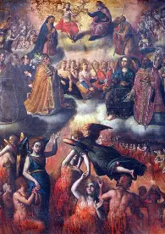
Who is St. Therese of Liseux? What does he teach us about souling?
Saint Therese of Lisieux (1873-1897) taught that God’s mercy is greater than any person’s sin, so if we are to avoid Purgatory, then we are to believe in His mercy, trusting that this will heal our wounds. Because it hurts Christ’s Heart most when we do not trust in Him, to trust in Him is how we can avoid the sins that lead us to need to make reparations in Purgatory. Rather than wounding Christ’s Heart by assuming that we are to go to Purgatory, that Christ cannot overcome our sins, consuming us with His love, we can have hope in Him, doing our very best, and trusting that God will do the rest. Initially, St. Therese was questioned for this teaching by a religious superior in her convent, but after receiving a vision of the superior in Purgatory, who conceded that she should have had the level of trust in Christ’s Heart that St. Therese had taught, it became evident that the little way of holiness, the humble and childlike way of trust embodied by St. Therese, was the right way. To go souling is to visit other souls with hope, guiding them towards surrender to God’s mercy, abandonment to His will, without fear. Going souling means rescuing souls from doubt and anxiety, that they may remain focused on their purpose, and rooted in God’s love, without being paralyzed by fear, like Satan would want

Slide 12
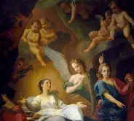
Who is St. Catherine of Genoa? What does she teach us about souling?
Saint Catherine of Genoa (1447-1510) led a life of holiness, but her burning passion for God turned lukewarm after marrying a wealthy and worldly man who led St. Catherine to some level of despair, of complacency, as she, too, yielded to her inclinations towards fleeting amusements, rather than to fulfillment in God alone. After going to Confession, St. Catherine received a vision in which she was given to understand the depth and breadth of God’s mercy, seeing how it encompasses us. She came to comprehend more about the greatness of God’s love in comparison to our sin, His vastness and transcendence in contrast to our littleness, which led her to embrace a penitential life. After converting her husband, the couple having been cast into financial ruin because of St. Catherine’s husband’s gambling debts, St. Catherine went to live with her husband at a hospital where they spent themselves in caring for the sick. Saint Catherine would write a treatise on Purgatory after receiving visions of it, having learned that Purgatory is truly more of an interior experience than a purely exterior one, in which we are cleansed with a purifying fire, the fire of God’s love, from within, until our hearts burn with the charity that His Heart does. Our past sins leading us to Purgatory result from our coldness towards God, so for us to become like God, and be prepared to enter Heaven, means that we are inflamed with love. When we enter Purgatory, we are in darkness, but as we are purified, we come to see more of the Light of the World that shines in Heaven; the grime obstructing our vision is cleared away from the windows. Saint Catherine of Genoa teaches us that to go souling is to visit souls with greater clarity, to help them to see the truth, and to love it fully, to mirror it fully by bearing the truth and goodness of God within their souls, so that they may be ready to share in the beatific vision that is Heaven. While the separation from God that is Purgatory may be painful, St. Catherine shows us that God’s redeeming mercy is the defining experience of Purgatory, which is what makes it so painful; we see His love, and repent of our sins that wounded Him, but ultimately, want to be purified, and rejoice in being perfected, resembling the One in Whose image we are made, that we so love

Slide 13

What is St. Patrick’s Purgatory? What does it teach us about souling?
An island in Ireland (formally called “Station Island”), St. Patrick’s Purgatory is where the bishop and missionary St. Patrick is believed to have received visions of Heaven, Hell, and Purgatory. Saint Patrick had prayed for direction from God in this place, discerning how best to convert the people of Ireland. He received the visions in order to guide the people to understand the Four Last Things, and to embrace salvation in Christ. In the past, monks lived on the island, living in cells dug deep underground, which were only tall enough to allow for kneeling, that the monks would offer penances for souls; these cells were meant to simulate the experience of being down deep in Purgatory. Six steps led down to them, six being the number of mercy, and of incompletion, because we need God’s mercy to be completed, and can receive it when we humble ourselves with Christ, Who poured Himself out as a Sacrifice to make reparations for our sins out of mercy. Now, pilgrims visit the island to offer up penitential practices for the purification of their souls, and those in Purgatory. At the island, penitents fast for at least three days, living just on one meal each day of bread and hot tea or black coffee. They go without sleeping for at least one night, praying all day. Penitents complete cycles of prayer, which may take hours to complete, walking barefoot to “stational beds,” the former cells of the monks, and offer their spiritual exercises to God to call down His mercy. It is as though they go through the Stations of the Cross for purification, spiritually participating in Christ’s Passion, going without in order to go with Christ, to be fed on a deeper level, and fulfilled in soul, so as to savor the gift of Christ’s Body sacrificed for us on the Cross out of love. Saint Patrick’s Purgatory teaches us about using our experiences that purify us to heal and teach others, to turn their hearts towards Christ, and to keep walking towards sanctification, discovering beauty and nourishment in self-gift, in offerings to Christ given with great love. In the suffering, we come to appreciate the joy of Heaven, and can grow in the virtue of hope. Going to God, we are judged individually, and are like islands, alone with Christ alone, but through prayer, we grow in connection, in communion; we are to walk through the Stations, ever walking towards Christ, to experience this closeness, this spiritual union. Combining physical and vocal prayer, the three-day St. Patrick’s Purgatory pilgrimage reminds us that all experiences can be used for our sanctification, that uniting our bodies, minds, and souls in one continuous prayer to God can purify us; all that we do may be offered to the Three Persons of God in the Trinity with love. The 1,000-year-old prayer tradition that follows certain sequences of formal prayers, such as the Creed, reminds us that we all are on one journey towards God together, going through different stations, namely, Earth, Purgatory, and Heaven, to receive and share God’s love. God revealed this holy site to St. Patrick, and during the persecutions in Ireland, when churches were closed, it was a refuge. Now, it reminds us to seek refuge in Christ’s Heart, as we recall that every site can be part of our pilgrimage, every experience part of our gift. God chooses places for all of us in which we may grow, blooming where we are planted, among other flowers who can help us to flourish right where we are, for His glory, that other souls would be spared of the pains of Purgatory. Immersed in the interior life on the island, we come to know God, in order to reach out to others with his love

Slide 14
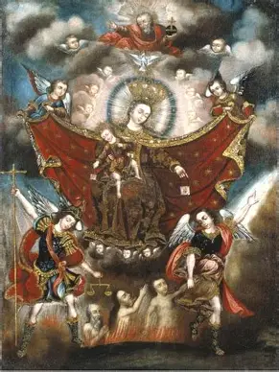
What are All Souls’ Saturdays? How may we honor them?
In the Eastern Catholic Church, All Souls’ Saturdays are five Saturdays set aside for praying for the deceased in a special way. Whereas in the Roman Catholic Church, the month of November is dedicated to the holy souls, in the Eastern Church, every Saturday is a special day to memorialize the deceased, but five in particular, which are not consecutive, are devoted to prayers for the faithful departed. The first All Souls’ Saturday takes place before Great Lent, in preparation for the fast. During Great Lent, three All Souls’ Saturdays are offered, and after Great Lent, on the Saturday before Pentecost, the fifth All Souls’ Saturday is celebrated. By scheduling the five All Souls’ Saturdays around Lent, the faithful are reminded that they may offer their penitential practices to benefit the holy souls, and that in fasting, we prepare ourselves for the feast of Heaven, being spared of the long fast from God that is the experience of Purgatory. Fasts may be offered in thanksgiving for life, as we recall that, beyond the needs of the body, the needs of the soul are paramount; while the body may be deceased, and while we may mortify our flesh through fasting, preparing for a holy death, we look forward to eternal life, to the continuation of the life of the soul, which elevates the body. Because we honor Our Lady every Saturday in the Roman Catholic Church, we can observe All Souls’ Saturdays by saying prayers to Our Lady to intercede for the holy souls. While the Eastern Catholic liturgy always includes prayers for the dead, on All Souls’ Saturdays, there are additional concluding prayers that integrate the names of the departed faithful. Like our brothers and sisters in the Eastern Catholic Church, we, too, can keep the names of our departed friends in our hearts, praying for their journey to Heaven. Five is the number of love, so it is meaningful to offer five Saturdays with love for the departed, as we recall God’s love for them, and pray that it would be a consolation to the suffering souls in Purgatory. Christ took on five holy wounds out of love for us, so we pray that by these wounds, the holy souls would be healed for when they wounded Christ

Slide 15
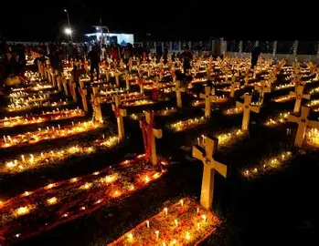
How may we support priests in “souling”? What does it mean for us to spiritually go “souling” in the future?
Our priests have an ongoing ministry of “souling,” because they go out to souls to feed them with Christ’s love, bringing His sacramental Presence to others, and reflecting the spiritual beauty, truth, and goodness of Christ’s soul to inspire other souls to draw into friendship with Christ. They visit people like Our Lady visiting her cousin, St. Elizabeth, meeting them where they are, and leading their souls to join in the heavenly banquet, praying for them, and drawing up seats at Christ’s table for them. Our priests help us to become the sweetest and purest offerings that we can, as we place our souls before the altar of God. As shepherds, priests care for all of their spiritual children, including the deceased, to bring them to the heavenly pasture with Christ, where they may be fed eternally by the Good Shepherd. They remember Christ’s people, treasuring them in their hearts, that the name of each member of their flock would be inscribed upon the Hearts of Jesus and Mother Mary. We may support our priests in their mission of souling by praying for the priests in Purgatory, remembering that they make constant intercession for us, because they are priests forever, and still pray for us while in Purgatory. We may pray for our priests to be led to glory for helping to bring other souls to glorious union with God, offering the Glorious Mysteries of the Holy Rosary for them as we meditate on the Resurrection of Our Lord. We also can spiritually go souling with our priests, by making a spiritual pilgrimage to Purgatory daily, praying for the souls there, asking Our Lady to intercede for them, and praying to uplift them, offering St. Gertrude’s prayer for souls. In our daily acts of charity, our prayers for all souls suffering on Earth, going out to people in need, remembering the spiritual children that God has given us, we support our priests in their ministry of presence and care. Through joyful hearts that remain rooted in God’s grace, in hope, by purifying ourselves sacramentally with Christ’s love in Confession and Holy Communion, remaining close to the Eucharistic Lord through Our Lady, we can give the greatest self-gift. We adore God like our priests as we serve souls generously, going “souling” by sustaining others in prayer, sacrifice, and love, instilling hope in their hearts by sharing what we receive from our visits with Christ, when we go to His Body, Blood, Soul, and Divinity in the Holy Eucharist to refresh souls like Our Lady does. We receive much from Our Lord in the Blessed Sacrament, and help souls by offering them the treasures that we receive, namely, the spiritual insights and fruits of the Holy Spirit given through contemplation, including peace, that they would experience it unto eternity

Slide 16

How does the tradition of souling relate to the feast day of St. Cecilia?
All Saints’ Day was originally celebrated as the Feast of All Martyrs. The pagan temple, the Pantheon, located in Rome, was sacralized and dedicated to Our Lady, Queen of Martyrs, in 609 A.D. Relics of martyrs were translated to the church newly consecrated to, and named for, Our Lady. All of our lives are processions, as we journey closer to God together, with the saints and the holy souls, towards Heaven. Observing All Souls’ Day, and continuing our devotion to the holy souls throughout the month of November and beyond, allows us to practice works of mercy like the saints did, that we may support each other in becoming saints, especially as we offer our prayers to Jesus through Mary, Our Lady of Suffrage, for a swift release of the holy souls from Purgatory. We become saints through our witness: the word “martyr” means “witness,” so while God may not call us to be martyrs through bloodshed, in a corporal sense, we all can be spiritual martyrs in making sacrifices, special offerings of our love, that witness to God’s love each day, the love that strengthens us and keeps us moving forward. We share in the mission of mercy that Our Lady had, in being a spiritual martyr interiorly wounded with Christ, for she offered up Christ’s Precious Blood in thanksgiving to the Father, receiving His pure Sacrifice into her Heart with love, in union with Christ during His Passion, while not shedding blood herself. As we witness to Christ, we can convert souls, and can offer our works for the release of the holy souls. Going “souling,” going to each soul on Earth that we meet to witness to Christ’s love, showing them His mercy and sweetness, we can inspire them to turn to Christ, that they may be purified and strengthened by His love, and we can go to the holy souls, too, opening the doors of our hearts to them, that many others would be inspired to do the same, for their purification. Like St. Cecilia, an early Church virgin martyr, and the patron saint of music, we can offer the songs of our hearts to God with love, praising Him through lives given to Him for His glory, that others would join in the chorus with us, harmonizing their lives with His now, for the benefit of the souls in Purgatory who are being healed from times when they did not live in accordance with God’s rhythm, and are preparing to be united with the song of His Heart in Heaven. Saint Cecilia risked her life to teach others about the Faith in a time of persecution, and passed into eternity while still teaching and expressing her love for God, in that she outstretched three fingers in honor of the Blessed Trinity, always pointing back to the Blessed Trinity as the Source of her joy and love. We, too, can pray to bring souls to the Heaven of the Blessed Trinity, teaching about the love of the Three Divine Persons in how we live for them, in their honor

Slide 17
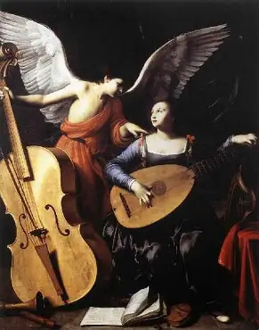
Closing Prayer
God our Father, we pray that You would inspire us with an ever-brighter, warmer flame of love in our hearts to burn for the souls in Purgatory, unto eternity, just as the sanctuary lamp in every church burns unceasingly in thanksgiving for Your inextinguishable love. Help us to be more deeply united with our friends in the Church Suffering, that we would grow in their virtues of patience and long-suffering love that is offered out of love for You, in honor of the love that You have given so generously to us as an outpouring from Your Heart. May the flames of love consuming the Heart of Your Son, Christ the King, that led Him to immolate Himself on the Cross, lead us to sacrifice joyfully in praise of You, dear Father, and may we join You in Heaven to forever sing Your praises with the holy angels. Guide us as instruments of Your love, speak Your message of consolation through our hearts to the holy souls, and through our prayers of love and compassion, help us to become holier souls. Sing Your song of mercy into our souls, that we would harmonize more closely with the rhythms of Your voice that so softly and tenderly expresses Your paternal care, and convey Your charity to others, including the souls for whom we pray in Purgatory. Thank You, God, for the opportunity to share in Your saving mission by praying for the holy souls, and thank You for the circuit of Your grace that makes it possible for the holy souls to pray for us, too, that together, we would glorify You for Your greatness. God, we love You beyond measure, but Your love surpasses all. Help us to treasure it now with all of our hearts, that we may embrace and reflect it in eternal glory. Open our hearts to perfection now, that we may see it in You in Heaven, never to be separated from You. Lead us to adore You as the holy angels do, with purity of intention, and carry our prayers of love on their wings to all of Your dear children, uniting us through the Precious Blood of Your Son, the white Blood of the Lamb that sanctifies us, preparing us for the wedding feast of the Lamb, at Whose table we will never hunger, but will be filled with every good gift, in Your Providence. May we always trust in Your unfailing care, Your faithfulness, welcoming every opportunity to place our confidence in Your Heart, consoling it most sweetly, as You do for us. Through Christ our Lord. Amen.

