Slide 1
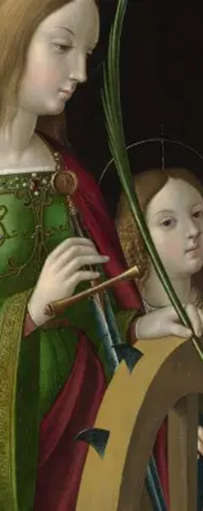

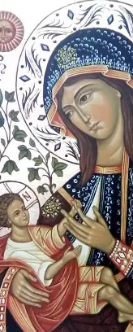

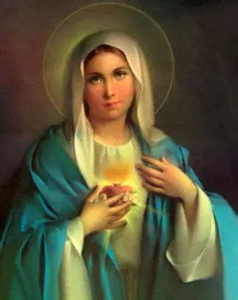

Kates of Heaven Part 2
Tuesday, November 25, 2025
Katie Sadakierski

Slide 2
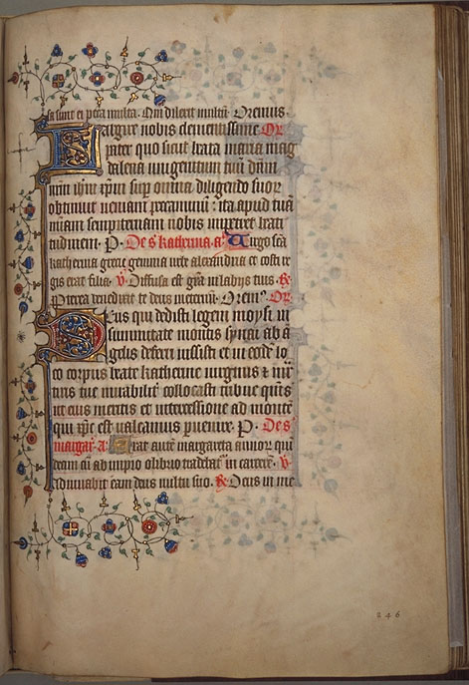
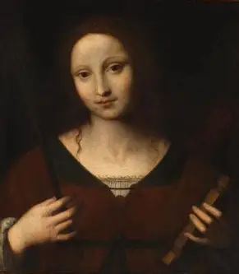
Opening Prayer: Collect Prayer for the Feast of St. Catherine of Alexandria
Almighty ever-living God, who gave Saint Catherine of Alexandria to your people as a Virgin and an invincible Martyr, grant that through her intercession we may be strengthened in faith and constancy and spend ourselves without reserve for the unity of the Church. Through our Lord Jesus Christ, your Son. who lives and reigns with you in the unity of the Holy Spirit, God, for ever and ever. Amen.

Slide 3
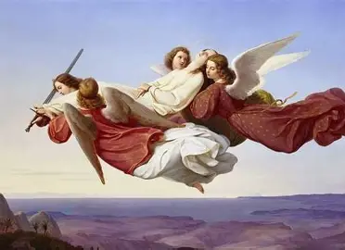
Who is St. Catherine of Alexandria? What is the significance of St. Catherine of Alexandria’s feast day being on a Tuesday this year? (1)
Tuesday is the day of the week dedicated to the holy angels. Saint Catherine of Alexandria (290-307 A.D.), born into Heaven on November 25, was surrounded by the holy angels throughout her life. The holy angels give us strength and joy in our suffering, just as St. Gabriel came to console the Lord when He was suffering in the Garden of Gethsemane, awaiting His eventual imprisonment, and the events of the Passion to come. In living up to the meaning of her name, Catherine, which is “pure,” St. Catherine of Alexandria reflected the holy angels, embodying their faithfulness and fortitude in remaining true to the Lord, never leaving His Side. Living between the third and fourth centuries A.D., St. Catherine was born a royal. Her father, the king, was the half-brother of Constantine, and her mother was the queen of Egypt, but St. Catherine would come to love Christ the King above all else. Growing up in an academic and cultural center, Alexandria, Egypt, she had access to excellent scholarly works and instruction, learning from the finest tutors, so that, even while still young, she would become very learned, wise beyond her years. While she was encouraged to marry because of her exceptional beauty, knowledge, and noble bearing, St. Catherine expressed that she was seeking a spouse who was far greater than herself, and through the help of a Christian hermit, would come to realize that the Spouse she sought was Christ. He was of the noblest rank that she was searching for, and could help her to advance, in bringing her to the heights of Heaven. Saint Catherine was converted to Christianity when she heard the hermit’s vision of Our Lord and Our Lady: he had come to give her the message from Our Lord that if she wanted the greatest husband, she could only find these perfect qualities that she was seeking in Him. Saint Catherine then dreamed that, with the heavenly angels, she appeared in the heavenly court of Our Lord

Slide 4

Who is St. Catherine of Alexandria? What is the significance of St. Catherine of Alexandria’s feast day being on a Tuesday this year? (2)
When Saint Catherine had seen a picture of Our Lord, she was consumed with love for Him, and knew that she wanted to be united with Him, so when He told her in the dream that she was not yet fair enough for Him, she was devastated. Determined to grow in holiness in order to be espoused to Christ, St. Catherine inquired of the hermit what she was to do in order to be worthy of mystical marriage to Christ. The hermit responded that she would need the sacraments to be brought into union with the Lord, so St. Catherine and her mother were baptized. Following her Holy Baptism, Our Lord appeared in a new vision to St. Catherine, telling her that she had been cleansed by the baptismal water, and was made new. He smiled upon her, and placed a ring on her finger as a symbol of their mystical union. Upon awaking, St. Catherine was ecstatic, and thought only of when she could join her Divine Spouse in glory. Upon learning that the emperor, Maxentius, was implementing a campaign to persecute Christians, she approached him to counsel him out of making this decision. Besides protecting Christians, ensuring that their dignity was honored, St. Catherine was showing concern for the soul of the emperor, wanting him to follow God’s Commandments to love Him and each other. Initially amused by the impressive courage and wisdom that St. Catherine exemplified, Emperor Maxentius summoned fifty of his pagan philosophers to debate St. Catherine, but far from confounding her, they would be converted by St. Catherine’s heroic witness to the Lord, and martyred for their conviction, though St. Catherine would fortify them with encouragement, giving them reason to rejoice in telling them that while they could not be baptized, their blood shed for love of God would serve as their Holy Baptism, and when they were sentenced to burn for their beliefs by the emperor, the flames of Christ’s love would overcome them, forging crowns of glory for them in Heaven. Like the holy angels, St. Catherine gave Christians joy amidst suffering, reaching them on the deepest level, speaking in union with her mystical Spouse, Our Lord. Their hearts, minds, and souls were so touched by her spiritual gifts, not only her intellect, mirroring the level of angelic intelligence, but by her spirit of heavenly charity, which transcended all. Angered by St. Catherine’s triumph, and her refusal to marry him, on account of her marriage to Christ, when he proposed as one final attempt to draw St. Catherine of Alexandria away from her Christian beliefs, he sent her to a prison cell to starve

Slide 5
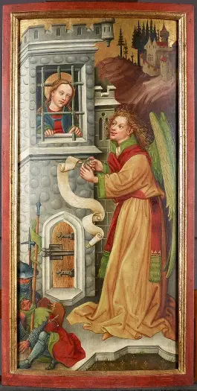
Who is St. Catherine of Alexandria? What is the significance of St. Catherine of Alexandria’s feast day being on a Tuesday this year? (3)
Amidst her imprisonment, St. Catherine turned the souls of over 200 of her visitors to Christ, including the emperor’s wife, who would be martyred for her conversion. After twelve days, St. Catherine emerged from the prison like the Risen Lord emerging from the tomb, looking refreshed and beautiful, having been nourished by the holy angels. She teaches us that God always provides when we have the wisdom to put our faith in Him, to rely on His Wisdom above all else; true wisdom comes from the Lord, our Light, Who illuminates truth for us. Only His love can sustain us, and when we receive it with the love of the holy angels, we can use this heavenly nourishment to become more like Our Lord, and Our Lady, the Queen of the Holy Angels. Tuesday is also the day of the week dedicated to the twelve apostles of Christ. Twelve is the number of the Church, and like the apostles, when she was imprisoned for twelve days, St. Catherine of Siena would be united Jesus, the Divine Prisoner, and strengthened for battle, a battle she would win in union with Christ, in not being distracted from her purpose, but instead remaining rooted in the Lord, doing all things to build up His Church by laying down her life for Him. After St. Catherine returned radiantly from the prison, she was sentenced to execution by the wheel, a spiked instrument of torture that meant certain death. However, when St. Catherine touched the wheel, it would be shattered. No wheel could carry her away or trample her, because she was following God’s will, loving the Creator so much, that His will was her own, and this love would be victorious. Finally, the wheel was consumed by the flames of a holy angel; the holy angels are pure spirits, reflections of God’s divine perfection, His light, so they cast the wheel ablaze, just as St. Catherine of Alexandria would set the world afire with love for Christ by attesting to His faithfulness, wisdom, and goodness with her life consecrated entirely to Him

Slide 6
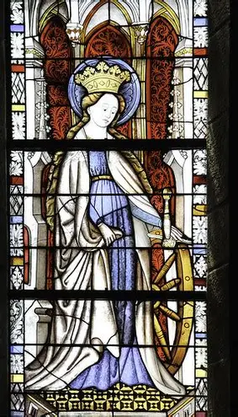
Who is St. Catherine of Alexandria? What is the significance of St. Catherine of Alexandria’s feast day being on a Tuesday this year? (4)
Saint Catherine was saved for having reflected Christ’s light. She would eventually be martyred by scourging and decapitation, but rather than bleeding, her wounds let forth milk, a testament to how St. Catherine’s sacrifice was life-giving. After she was buried, her body would emit oil that was attributed to healings. She reflected Our Lady in the purity of her heart that was ablaze with a burning charity like that of Jesus, and so, would nourish spiritual children with her love, bringing many souls to Christ through the example of her agape love, the total self-gift, that she set. The oil of gladness that her heart poured out would heal many. Like the holy angels and their Queen, she always said “yes” to God, trusting in His plan, serving Him in all that she did, in having presented Him with her talents, returning all that He had given her, for His glory. When she offered her suffering and passage from this life for Christ’s glory, St. Catherine of Alexandria united herself entirely with Him. She would experience the joy that the holy angels bring, because the holy angels are always near Christ, adoring Him, so as she became more deeply united with Christ in His Sacrifice, St. Catherine of Alexandria came to experience more of His joy in sharing His love, pouring out His Heart for the good of other souls. After the passing of St. Catherine from this life, the holy angels carried her body to Mount Sinai, where Moses had received the Ten Commandments, for St. Catherine had lived them out with all of her heart, mind, soul, and strength, and would serve as an inspiration to others to climb their steepest mountains of adversity, to carry their crosses, and keep fighting the good fight for Christ. Saint Joan of Arc heard St. Catherine’s voice delivering her the message from God that she was to fight for France, and many artists, such as Raphael, would create devotional paintings honoring St. Catherine, further spreading her light. After the Crusades, when soldiers for Christ went to defend the Holy Land from Islamic invaders, they would be inspired to keep fighting the good fight by such saints as St. Catherine of Alexandria. Before being martyred, St. Catherine prayed that anyone who devotes themselves to her would receive special blessings, and a heavenly voice was heard to respond that those who practice devotion to her will indeed be blessed in Paradise, so we can honor St. Catherine best by being angelic messengers of her story of love for Christ, offering our prayers and actions of good will to bring other souls to Christ through her intercession, that we all would be in Paradise together. Saint Catharine’s College in Cambridge, England was founded by a priest in devotion to St. Catharine. He gathered his priests to pray every day, and now, the college commemorates St. Catherine on her feast day by supporting girls and women around the world, increasing awareness of violence against them. November 25 is International Day for the Elimination of Violence Against Women, and a perfect time to pray for persecuted Christians everywhere, especially women

Slide 7
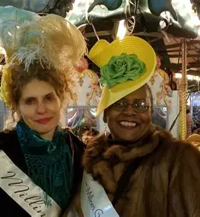
What is “Cattern’s Day”? Which traditions are associated with this feast day? (1)
“Cattern’s Day” refers to St. Catherine’s Day in regional dialect. Many special traditions are associated with Saint Catherine of Alexandria’s feast day, as a strong following of St. Catherine of Alexandria developed in the Middle Ages; Saint Catherine of Alexandria is one of the four capital virgins, the most popular virgin martyrs of the early Church among the medieval faithful. She appears in Church imagery, i.e. sculpted architectural designs in columns (the capitals), and in paintings, wherein she is flanked by Jesus and Mother Mary
One of the traditions associated with St. Catherine of Alexandria’s feast day is to wear green and yellow accents, especially on hats, with these colors representing faith and wisdom
Saint Catherine’s Day marks a special pivot point in the transition into Advent, as it is one month away from Christmas Day, when we celebrate the Birth of Jesus, our Savior. We are reminded that we may be spiritually reborn when we have faith like St. Catherine’s that flows from a pure heart, open to receiving Christ, so that every day may be like Christmas. The color green associated with St. Catherine’s feast day is the color of new life, reminding us of the evergreen decorations put out at Christmas, and of the everlasting love of Christ, Who was born to give His life for us, that we might live forever with Him in His love

Slide 8
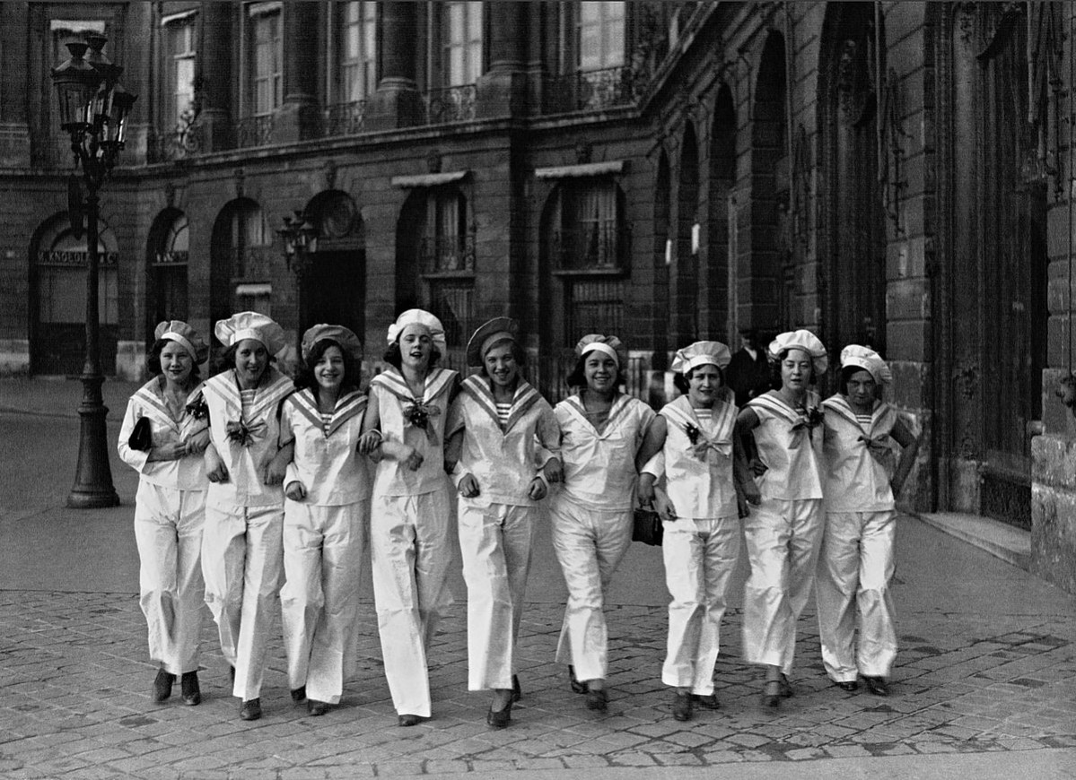
What is “Cattern’s Day”? Which traditions are associated with this feast day? (2)
Saint Catherine is a patroness of milliners, which may be in part because of the similarity of the word to “miller,” as millers work with water wheels at the mills to do their work, and St. Catherine was sent to be martyred on a wheel. Because her martyrdom involved trauma to the head, she is patroness of any head-related occupations, including hat-making, since hats cover the head. (For this same reason, she is also invoked against migraines.) On her feast day, it was customary to celebrate with hat parades (beginning in the early 1900s with Parisian fashion houses), as milliners showcased their new styles for the season. “Catherinettes,” usually single women over the age of twenty-five, would be feted with special hats; hats of yellow and green were usually created for them, and they would create crowns of flowers and ribbons, which they would place on statues of St. Catherine of Alexandria to renew their devotion to her, so as to flower in glory like her, to blossom in virtue, until making new crowns the next year. They would ask her to help them to find them husbands, lest they become “spinsters.” Hats made for the Catherinettes were worn by them when they went to special galas, dances at which they were to woo suitors with their coiffures, and perhaps find a suitable spouse. The hats signified that they were single, and based on how ornate they were, could communicate their wealth or social class. In the years to come, during the early stages of suffrage, and the women’s movement, young single women would begin to make their own hats, purely for amusement. Remembering that St. Catherine’s crowning glory was her wisdom, a spiritual wisdom of the heart, which is the seat of love, they would honor St. Catherine for how she earned her heavenly crown, and pray to follow her in earning their eternal crowns. Catherinettes would send each other postcards on St. Catherine of Alexandria’s feast day, as a way of honoring St. Catherine for her eloquence, her oratorical skills flowing from her pure mind, a mind in which Christ was enthroned, that would transform others from within, leading them towards Christ. Saint Catherine of Alexandria’s feast day is a special day to celebrate female friendship, particularly, how we are all brought into Our Lady’s pure heart, in which we may honor her Son through our commitment to Him, so in this sense, it is a day on which we thank God for spiritual friendship, for the opportunity to enter into communion with others through communion with Him. Since St. Catherine enthroned Christ in her mind and heart, she emulated Our Lady, because she conceived of Christ in her mind before she conceived Him in body, saying “yes” to God’s plan for her to give birth to Him, so when we imitate Our Lady in giving ourselves totally to Christ, we, too, can bring His Spirit into the world, just as St. Catherine of Alexandria did

Slide 9
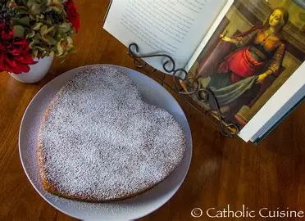
What is “Cattern’s Day”? Which traditions are associated with this feast day? (3)
Saint Catherine of Alexandria is a patron saint of maidens, especially a protectress of virgins. In the past, celebration of her feast day would involve gatherings of women to converse and share treats. Teas in honor of St. Catherine were popular; it was at this time that Cattern’s cakes and similar delicacies could be shared. Traditional Catholic culture emphasized the vocation of sacramental marriage, and so unwed women over the age of twenty-five would pray to find a husband, going to St. Catherine of Alexandria for her intercession, that they would marry Christlike men. In France, it was customary to give unmarried women over the age of twenty-five cakes shaped like hearts to encourage them not to give up on discovering the spouse that would fulfill the dreams of their hearts, but Christ alone brings the greatest joy and fulfillment to every heart, so now, this day unites souls in Jesus’ and Mary’s love. The heart is a traditional symbol associated with St. Catherine, because her heart was given entirely to Christ’s Sacred Heart, to the extent that she was martyred for love of Him. As the wheel has a connotation with St. Catherine’s feast day, spinners, who use spinning wheels in fiber arts, are honored in a special way, but because the word “spinster” sounds similar to “spinner,” single women of a certain age are commemorated on Saint Catherine of Alexandria’s feast day

Slide 10

What is “Cattern’s Day”? Which traditions are associated with this feast day? (4)
Saint Catherine is a patroness of wheelwrights, because of the attempt on her life via the spiked wheel. Her holy life also reminds us that with Christ, all things come full-circle. He is the Beginning and the End, so when we give our lives for Him, we do not die, but enter into eternal life, because He first gave His life for us out of love. Because of St. Catherine’s association with the wheel, it is customary to make wheel cookies on her feast day, which are called “Cattern’s Cakes.” These cakes, dating back to Tudor times, may be made with yeast, like breads, but most involve rolling spiced dough into a log, and slicing cookies that are left with a pinwheel impression. Saint Catherine is also a patroness of knife-sharpeners, perhaps because one may use a sharp knife to incise a pinwheel shape on the surface of the cookie. Other times, the cookies themselves simply serve as rounds, and there are no impressions made in them, but the typical ingredients are still used in the cookies, namely, caraway seeds and currants. Currants were used by the lacemakers who often made the cookies as special treats in honor of their patroness; the currants were an indulgence that they enjoyed. Pies are also made in honor of St. Catherine of Alexandria, usually apple pies, which were baked with apples collected while catterning, an early form of trick-or-treating. Celebrated as a harvest or agricultural festival, St. Catherine’s feast day is observed with harvest fare like apples and beer. Those who make the wheel-shaped (round) apple pies for St. Catherine cut slices to give others as the “spokes” of the wheel. A popular French saying associated with St. Catherine of Alexandria’s feast day is that trees take root at this time, so this day is one for planting trees, to ultimately plant seeds of growth in faith, hope, and love in the future, through the example of commitment to Christ that we set. Between November and February, depending on one’s geographic location, the ground is damp, but not yet frozen, prime for planting and rooting tree and shrub cuttings. Our faith takes root in the hearts of such saints as Catherine of Alexandria; she is like a towering oak inspiring us to reach higher and dig deeper, too, that we may shelter others in the loving Heart of Christ, and be pillars of strength in our faith

Slide 11
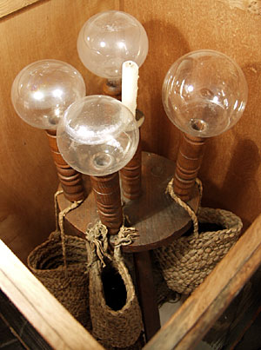
What is the connection between St. Catherine of Alexandria and St. Zelie Martin? (1)
Saint Catherine of Alexandria is a patroness of lacemakers, because she is a patroness of young single women, and many unmarried women would become lacemakers. During the Protestant Reformation, to draw people away from celebrating saints, Protestants reframed the St. Catherine feast day celebrations, honoring Catherine of Aragon, the first wife of King Henry VIII, instead. They wove a tale in which Catherine of Aragon burned all of her lace in order to give work to lacemakers when they were financially struggling, and also provided for lessons to lacemakers. Saint Catherine of Alexandria nonetheless came to be associated with lacemaking. On St. Catherine’s feast day, lacemakers danced together, rather than with the men, who simply provided the music, either by fiddling or whistling. The women “washed the candle block,” which meant that they had tea parties, sharing cakes and stories together, honoring the day as a community feast, as they prepared to work by candlelight to make lace in the evening (sometimes, at more rambunctious gatherings, they even leapt over the candle block!). Saint Zelie Martin was herself a lacemaker, having learned the skill after being denied entry into the convent due to poor health, and needing to support herself with a marketable trade

Slide 12
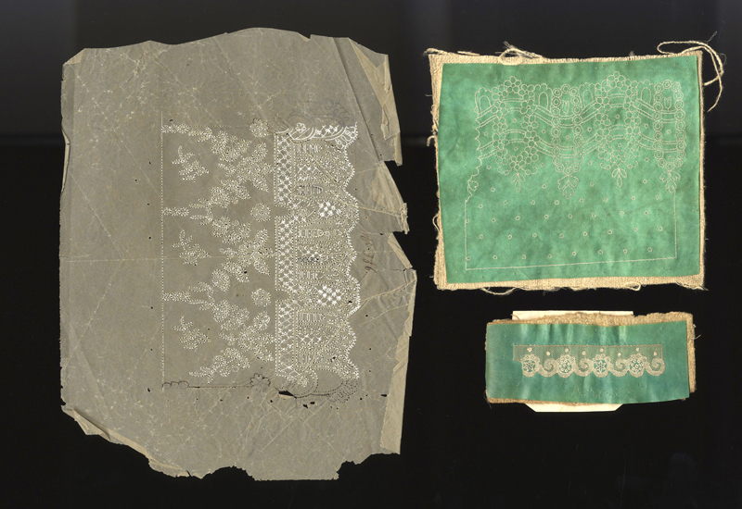
What is the connection between St. Catherine of Alexandria and St. Zelie Martin? (2)
Saint Zelie would come to know her future husband, St. Louis Martin, when his mother took a lacemaking class with her; God had woven their lives together like separate pieces of lace stitched into one. Being from France, she would have had a different way of celebrating the Feast of St. Catherine than with these British customs, but St. Zelie did carry forward St. Catherine’s spirit in her intelligence, love, and patience that she applied to her vocation, not only as a lacemaker, but as a mother, in tending painstakingly to beautiful masterpieces for God, human souls who would become saints. She had mastered the fine art of Alencon lacemaking, crafting the most delicate, intricate lace designs; even a small lace sample the size of a postage stamp could take eight hours to complete, but St. Zelie was a gifted artisan, and guided other women in this art, leading the women in her employ at her business. Saint Zelie would raise all five of her daughters to be brides of Christ, much like she had once wanted to be, before she discovered her vocation to sacramental marriage. The Martin daughters were deeply committed to Christ, their Eternal Spouse, much like St. Catherine of Alexandria was. Saint Catherine’s life was a masterpiece like the finest lace, offered like a bridal trousseau to Christ, the Divine Bridegroom

Slide 13
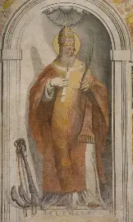
What is “Old Clem’s Night”? How do the traditions on this feast day relate to Cattern’s Day? (1)
Old Clem’s Night is celebrated on November 23, when we observe the feast day of St. Clement, specifically, Pope St. Clement I, who lived between 35 and 97 A.D. Festivities in honor of St. Clement began as early as the 1500s. Many special traditions of the Catholic faithful originated during the Protestant Reformation as a way to reclaim the Faith and live it out more boldly and joyfully, amidst such division and confusion. As catechism improved as a result of the Council of Trent, sparking the Catholic Counter-Reformation, Catholics were better equipped to celebrate the liturgical year, honoring all of the saints remembered within it. Living in a time of Christian persecution, Saint Clement was martyred by being cast out to sea with an anchor, so he is a patron saint of those who forge anchors. In being a patron of blacksmiths, St. Clement has inspired festivities involving fire, since blacksmiths use fire to shape metal, to cast molds. Similarly, trials by fire can test our faith, but God uses our experiences to shape us, to help us to fit His mold, the perfect image of Him that we are called to conform to. God shapes us into our best selves through the purifying flames of His love. On Old Clem’s Night, it was a past tradition for blacksmiths to fill the holes in their anvils with gunpowder, and strike them with hammers, creating an explosive sound, and sending forth a shower of sparks. This was not simply for entertainment, but had a practical purpose, because it was a way to test the durability of the anvil. The practice reminds us that tests of faith help us to grow in strength, and test our own durability, but for our good, that we may merit eternal glory with the strongest saints, among the greatest Martyr, Our Lord, Jesus

Slide 14
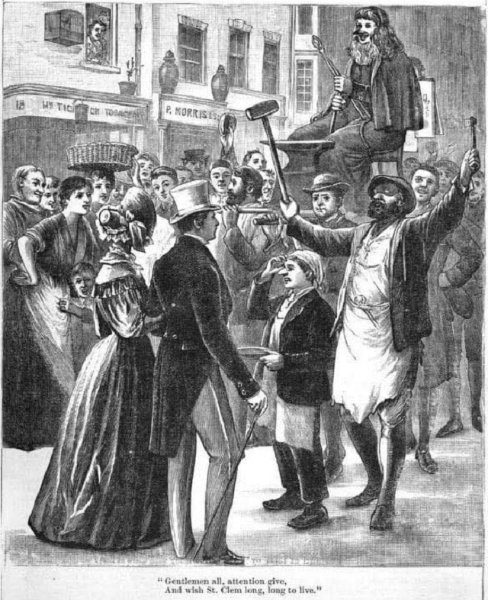
What is “Old Clem’s Night”? How do the traditions on this feast day relate to Cattern’s Day? (2)
Fireworks and bonfires may be used to celebrate Old Clem’s Night, as the faithful prepare to start the new liturgical year with a bang, looking forward to Christmas, when the Light of the World will be born, and inflame our hearts with deeper charity like His, a level of love that would lead Him to give His life for us, the very purpose for which He was born. (There is, in fact, a firework named after St. Catherine, too; she was an early figure demonstrating what it means to be inflamed with love for Christ, and to share that spark with others.) Blacksmith guilds would appoint a man to dress as St. Clement with a wig and beard. He would walk through the streets to collect monetary donations for the poor, to show them God’s clemency, or to raise money for a feast for the guild. These funds would help to prepare the poor for gift-giving at Christmas, and reminds us of the gifts that St. Catherine and St. Clement gave in thanks for Christ’s gift of life, also setting a feast anticipating the wedding feast of the Lamb, that we come to join in by showing mercy and love to others like Christ. Saint Clement wrote that we should cling to Christ by clinging to His saints, because the saints are the innocent ones chosen by Christ, demonstrating to us how to live pure and holy lives worthy of Heaven. This encourages us to cultivate devotion to the saints to help us to remain pure in our love, and in God’s grace, especially through friendship with St. Clement and St. Catherine

Slide 15
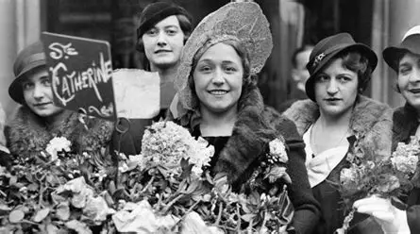
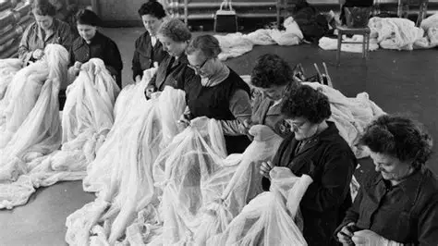
What do both St. Clement and St. Catherine of Alexandria teach us about entering through the gates of Heaven like the Kates of Heaven? (1)
On St. Clement’s feast day, the poor would go “clementing,” asking their wealthy neighbors for alms as they went door-to-door, seeking the citrus fruits associated with St. Clement and his name, namely, oranges and lemons, or “clementing cakes” that were baked with citrus fruits. Orange peel was a standard seasonal ingredient that anticipated the Advent and Christmas baking seasons. A common saying among “clementers” was, “Oranges and lemons, say the bells of St. Clement’s.” This was a reminder that God calls us to share His treasures with each other in charity, just as St. Clement gave his life as a witness to God’s generosity, His goodness and mercy. God refreshes us with the fruits of Christ’s Sacrifice, and we, too, can offer up good fruits for God, making lemonade out of the lemons that He gives us. None are ever too sour to use, as we can learn from every experience. When people went door-to-door seeking refreshment, they were reminded that when Christ knocks on the doors of our hearts, we must respond in order to receive His mercy most fully, and that responding means continuing to seek out Christ, because only He can give us everything that we need, in His love and mercy. The word “clement” means “merciful,” so this feast day reminds us to go “clementing” to others, to show Christ’s mercy through all that we do, visiting our neighbors with the presence of Christ’s loving Sacred Heart

Slide 16
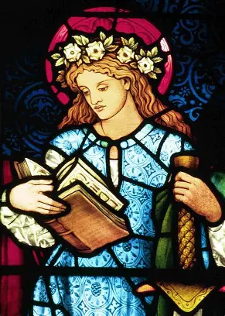
What do both St. Clement and St. Catherine of Alexandria teach us about entering through the gates of Heaven like the Kates of Heaven? (2)
Being a harvest festival time, the late-November feast days of Clementide and Catterntide, as they were called, in honor of St. Clement and St. Catherine of Alexandria, were met as opportunities to share the abundance of the harvest with one another, to join in thanksgiving for God’s graciousness in providing for us to feed our bodies and souls with His love. Those going “catterning” would also request apples and beer, or nuts and pears, in honor of St. Catherine. One of the songs that those going clementing or catterning would sing was: “Clementing, clementing once a year, apples and pears are very good cheer. One for Peter, two for Paul, and three for Him who made us all. Up wit the hatchet and down with the shoe, if you have no apples, money will do, money will do, money will do.” Another clementing song was “Cattern and Clemen be here, here, here, give us your apples and give us your beer. One for Peter, two for Paul, Three for Him Who made us all. Clemen was a good man, Cattern was his mother: Give us your best, and not your worst. And God will give your soul good rest.” This song honors St. Catherine as being a spiritual mother who would lead many souls to Heaven, so this song calls us to be like her in giving from our hearts with love and mercy, even though St. Catherine was a virgin martyr, and not the mother of St. Clement (he predeceased her, too). The clementing tradition builds upon the souling tradition, reminding us that to live well is to prepare to die well, in a state of grace, by living with God’s love, and showing His mercy to others, especially by praying for both the living and the deceased, that we would all be united in Christ’s Sacred Heart

Slide 17
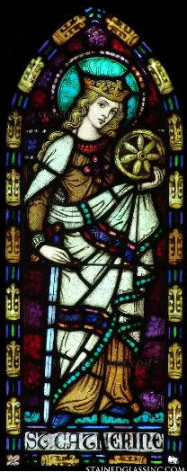
What do both St. Clement and St. Catherine of Alexandria teach us about entering through the gates of Heaven like the Kates of Heaven? (3)
If we are to enter through the narrow gates of Heaven, then we are not to come with a wealth of material riches, but of spiritual ones that are held not in our hands, but in our hearts. Sharing with the poor, including those who are spiritually impoverished, is how we can honor the merciful spirit of St. Catherine, who was led to confront the emperor out of love. Rather than fearing for her own life, knowing that it was dangerous to reveal herself as a Christian, she challenged the emperor to choose Christ, to follow Him, much like St. Andrew, the date of whose feast day the first Sunday of Advent hinges, invited his brother, St. Peter, to come and follow Christ. Saint Catherine had true love and mercy in her heart, because she was compelled to defend her fellow Christians, to save their lives, even though the cost would be her own life. Like Christ, she loved without measure. Saint Clement, too, was a martyr, the fourth pope of our Church, who is believed to have been ordained by St. Peter himself. He had initially run from persecutors, putting wool in his sandals to aid his escape. The friction created meant that the wool became felt, so St. Clement is associated with the felting industry in a special way. Saint Clement may have felt afraid at first, but he overcame these feelings to bravely give his life for Christ, to keep his faith, and buoy the faith of others, especially seafarers. Saint Clement serves as a guide of how to live with faith, to no longer run from crosses, but to embrace them; he clung to the cross in the end, literally and figuratively, because the anchor is a cross. He teaches us, in union with St. Catherine, to be rooted in Christ, to embrace Him as our anchor Who never leads us astray. When we are close to Christ, we do not sink, but can receive His mercy, being uplifted to Heaven. Nothing can shatter us when we are united with He Who is unbreakable. Once a year, it is believed that the sea recedes enough that the remains of St. Clement may be seen, beneath the shrine built over his resting place. Ultimately, when we are open to Christ, we can be consumed by the ocean of His mercy that puts out flames of sin, cleansing us like the baptismal waters that washed over St. Catherine, allowing her to experience Christ’s love totally, and to give it completely as well; when the eyes of our souls are opened and cleansed, we can see Christ remaining in us and around us everywhere, and we can see the need of the brothers and sisters around us, helping to lead them to Christ, and to open the gates of Heaven to them

Slide 18
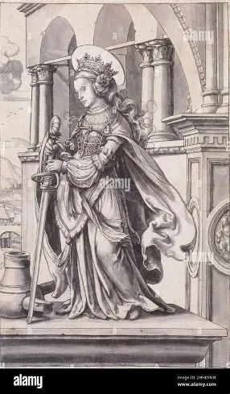
What does Mary, Mother Most Pure Teach us about Carrying Forward the Heavenly-Mindedness of a True Catherinette? (1)
A special style of round windows in churches is named after St. Catherine of Alexandria. Like a stained-glass window, St. Catherine of Alexandria let the light of Christ shine through her. She shows us that the purer our hearts are, the more brightly we can shine for Christ, because we become totally transparent, revealing Christ’s spark of love, not having souls that are obscured and darkened by sin that would otherwise prevent light from shining through. In coming to see as things are when our vision is clear, we can see Christ shining in others, too, and love more deeply and purely. In reflecting Mary, Mother Most Pure, Saint Catherine of Alexandria teaches us that when we have hearts of simplicity and purity, we can keep the eyes of our souls on Heaven, on what matters most, and not become distracted by material things, worldly garnishes that decorate life, when we are truly called to adorn our hearts with Christ’s virtues, to remain wise by remaining in His friendship faithfully. Yellow is the color of friendship, green the color of life, so when we beribbon the spirit with the colors of St. Catherine, we are reminded that we enter into life through friendship with Christ, the wisest course, and the only course to Heaven, where our friendship with Christ, the mystical marriage to the Bridegroom, never ends. All of us can be Catherinettes, following St. Catherine of Alexandria on the way to the wedding banquet of the Lamb of God. The prayers from the pure heart of St. Catherine, a guileless heart that could not be deceived by the world, shines like the Immaculate Heart of Mary, in being united to the Heart of Jesus, and help us to love Christ more, to carry forward His flame of charity to brighten the lives of everyone around us, that they would see Christ’s Presence, too

Slide 19
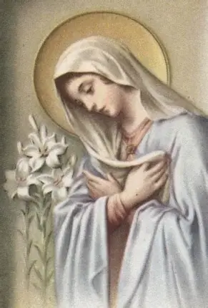
What does Mary, Mother Most Pure Teach us about Carrying Forward the Heavenly-Mindedness of a True Catherinette? (2)
On the eve of St. Catherine’s feast day, November 24, lacemakers prepared to honor their patroness by putting out a candle block and water globes. The candle block, comparable to a large three-legged stool, was only used for special occasions, usually, on the darkest nights when more light was needed to see the lace being stitched. As many as eighteen lacemakers could see by the light of the candle block, which had holes around the edges, so that globes filled with water could be placed within them. In the center of the block was one candle, so the light of the candle was magnified around the room, shining through the water globes. In a similar way, St. Catherine was one soul, but she touched many by remaining rooted in Christ alone, loving Him above all else; her soul magnified the Lord, like Mother Mary’s did, so everyone would come to see by her light, the light of Christ. She trusted in God to do the rest when she gave Him her best, and He did, so He reached many more people through her when she cooperated with His grace, than if she attempted to do good works without relying upon God to guide her, or consecrating her works to Him. We all can make a great difference by opening our hearts to being filled by God’s infinite love, like globes being filled with the living water to refresh us. When we celebrate St. Catherine’s feast day, we are clothing ourselves in her spirit of mercy, like the lacemakers washing the water globes to prepare for their lacemaking session on St. Catherine’s feast day. The cleaner and purer the glass globes were, the better light they could give off; likewise, the more we are cleansed and purified by Christ’s love, the better we can shine His light, mirroring Him, until any smudges on the mirrors of our souls are totally removed, and we can illuminate others’ hearts with Christ’s love perfectly. We are cleansing ourselves by filling our minds with the memory of St. Catherine’s purity, and emulating her, in preparation for welcoming the pure love of the Christ Child into our hearts at Christmas. We can only stand when we stand with Christ, keeping Him at the center of our hearts, and resting on the strength, the support, of each of the Three Persons of God in the Blessed Trinity. None of us are alone when we are wed to Christ in our hearts. Since candles were very costly and precious, only on the darkest days, could they be used to illuminate the workspaces of the lacemakers. Christ’s love is priceless; He redeemed us, paying the debt incurred by our sins, and pours out every treasure from His Heart for us. He is the light that we can always see by, overcoming even the darkest days; we are never too poor to go to Christ, and to become rich by being filled up with His love. The water globes and candle blocks were used from St. Catherine’s feast day until Candlemas, the Feast of Our Lady’s Purification, reminding us that we can only be purified if we have humble hearts of love like Our Lady’s, that say “yes” to receiving the light from the flames of the Holy Spirit, pouring out His gifts upon us

Slide 20
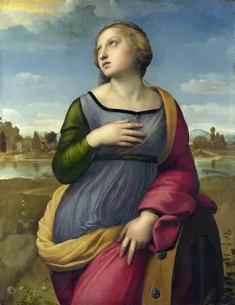
Closing Prayer: Kates of Heaven Litany
St. Catherine of Genoa, pray for us!
St. Catherine of Siena, pray for us!
St. Catherine Laboure, pray for us!
St. Catherine of Bologna, pray for us!
St. Katharine Drexel, pray for us!
St. Catherine of Alexandria, pray for us!
St. Catherine of Sweden, pray for us!
St. Catherine de Ricci, pray for us!
St. Caterina Volpicelli, pray for us!
St. Catherine Yi, pray for us!
St. Catherine Chong Chor-Yom, pray for us!
St. Catherine of Palma, pray for us!
St. Catherine (Kateri) Tekakwitha, pray for us!
Blessed Catherine Jarrige, pray for us!
Blessed Caterina Cittadini, pray for us!
Blessed Catherine of Pallanza, pray for us!
Blessed Catherine Troiani, pray for us!
Blessed Catherine of Racconigi, pray for us!
Blessed Catherine of St. Augustine, pray for us!
Venerable Catherine McAuley, pray for us!
Servant of God Catherine Doherty, pray for us!
Mary, Mother Most Pure, pray for us!

