Slide 1
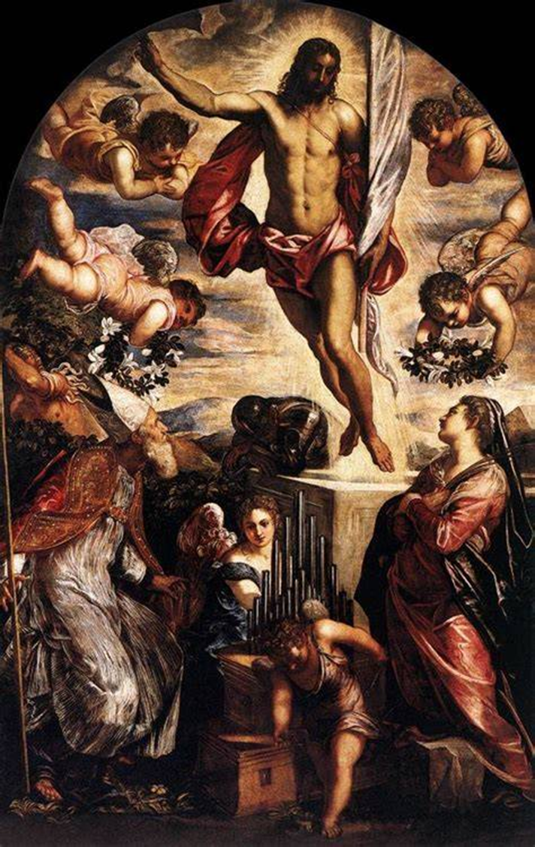
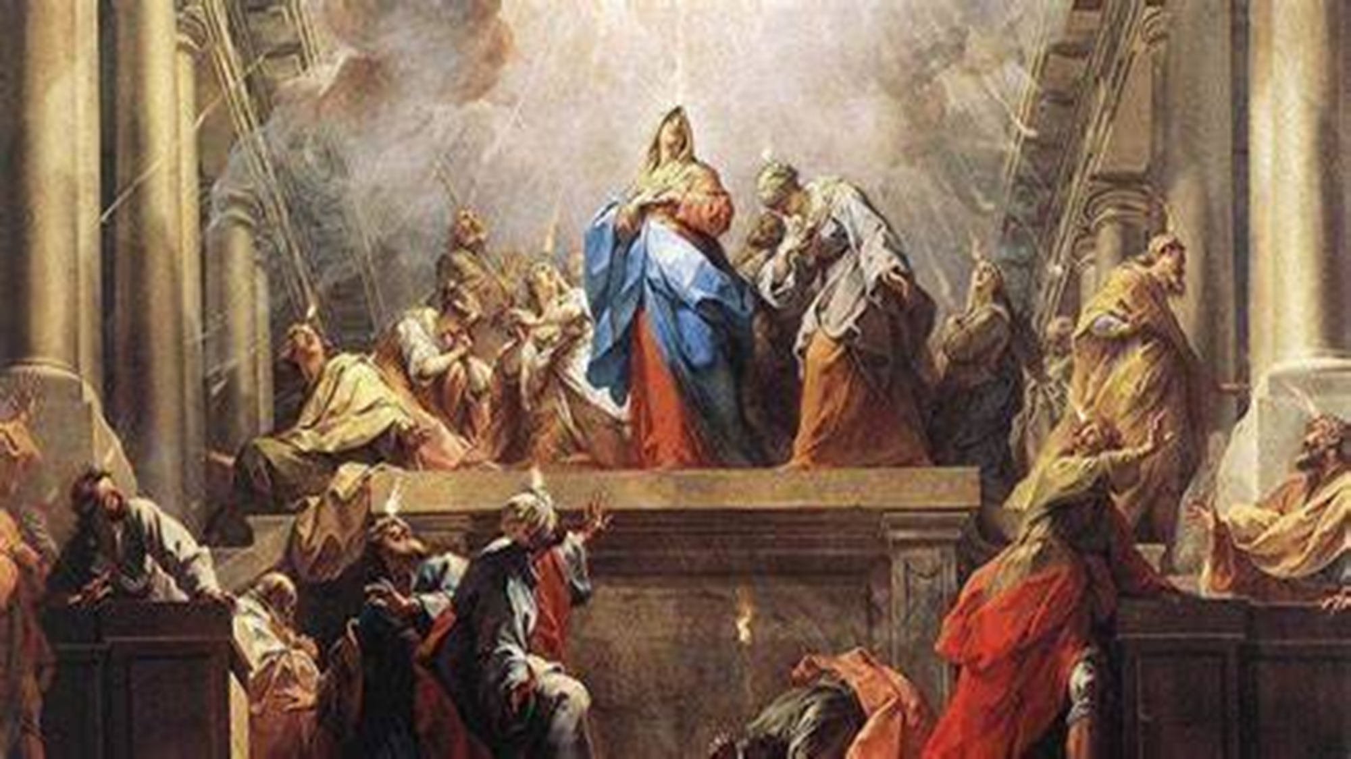
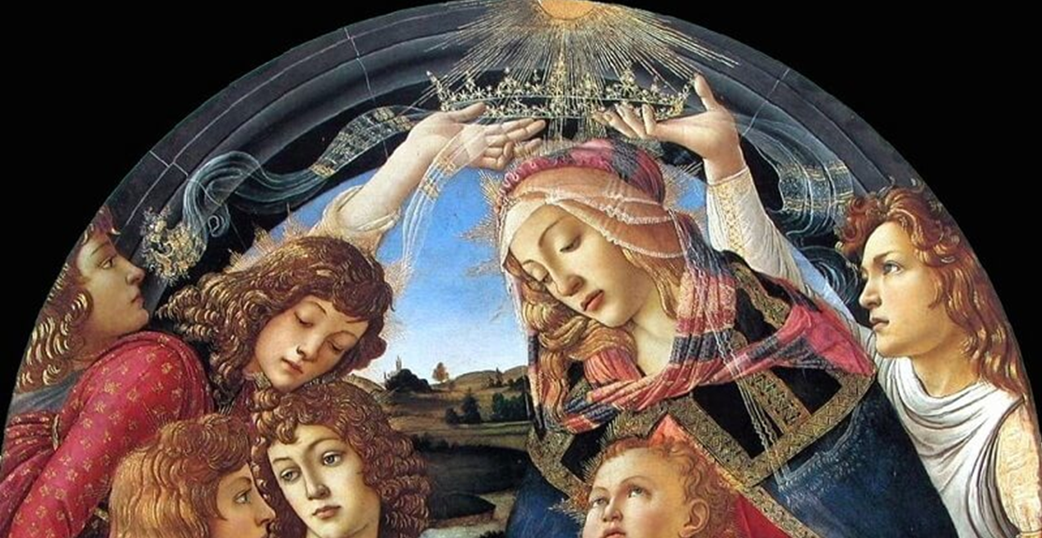
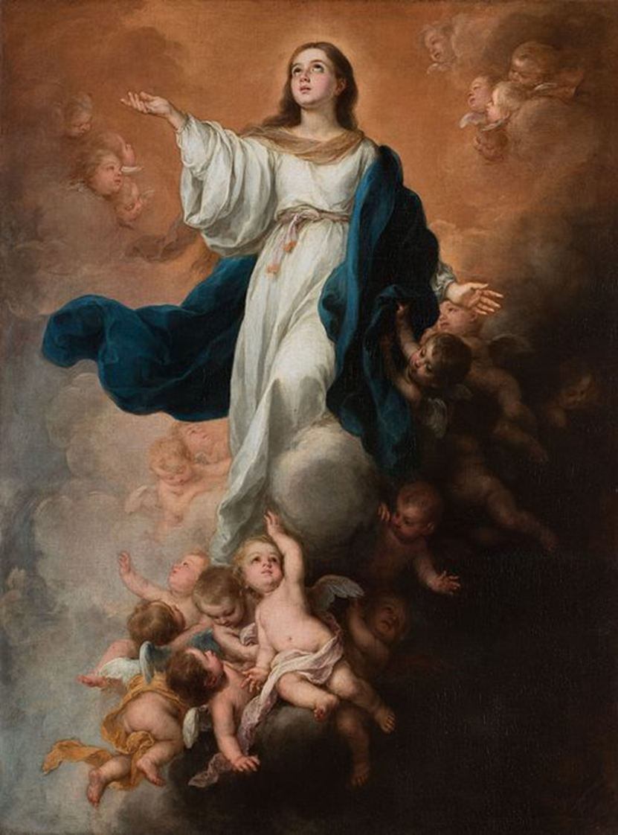
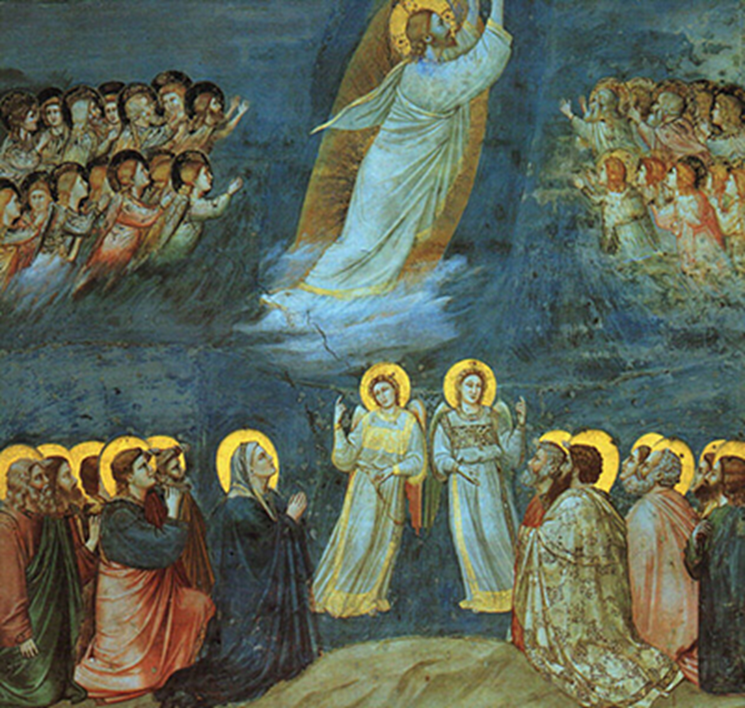
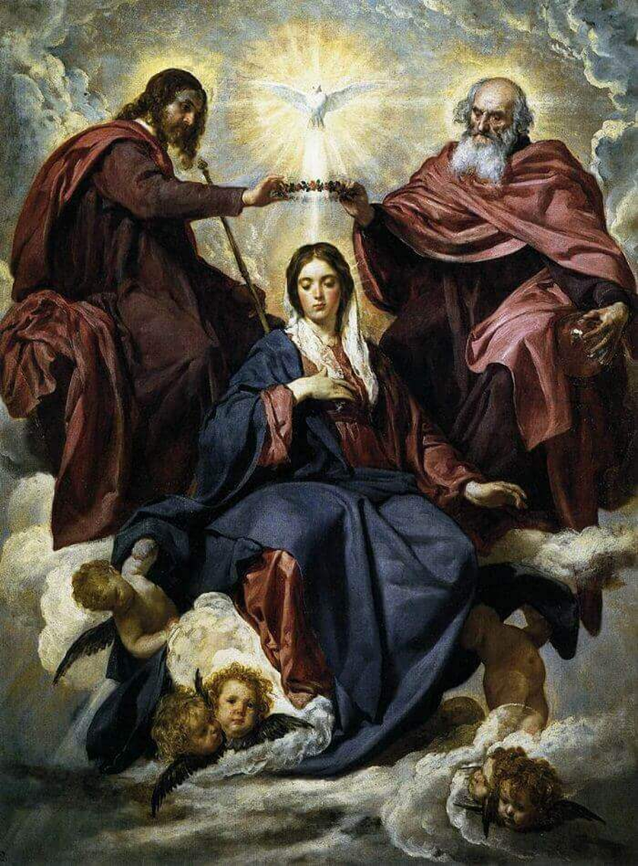
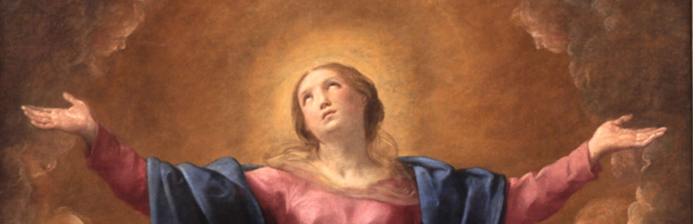
The Holy Rosary through Art Session 4: Glorifying God through Contemplation of the Glorious Mysteries Depicted in Sacred Art
Tuesday, October 28, 2025
Katie Sadakierski

Slide 2
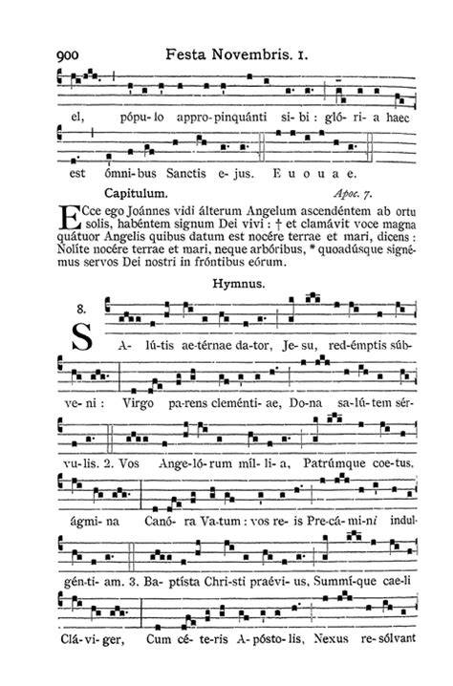
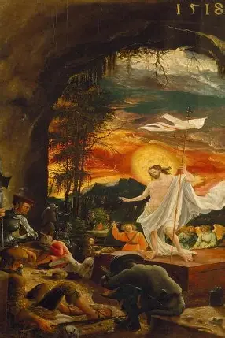
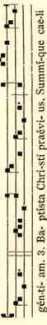
Outline: Holy Rosary Through Art Session 4
Welcome & Opening Prayer
Meeting presentation
  I. The Glorious Mysteries: Why We Meditate on These Mysteries with Our Lady, and Why We Benefit from Engaging with Sacred Art Depicting the Glorious Mysteries
  II. Discovering the Glorious Mysteries through Sacred Art
    The Resurrection of Our Lord in Art
    The Ascension of Our Lord in Art
    The Descent of the Holy Ghost in Art
    The Assumption of Our Lady in Art
    The Coronation of Our Lady in Art
  III. Applying Our Knowledge with Our Lady: Understanding How we may Pray the Glorious Mysteries of the Holy Rosary More Lovingly as we Come to Treasure the Divine Artist’s Revelations Given to Us through Sacred Art Depicting the Glorious Mysteries
Closing Prayer
Announcements
Q & A

Slide 3
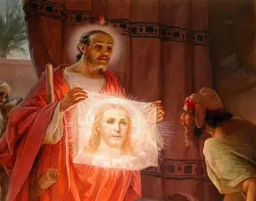
Opening Prayer: Collect Prayer for the Feast of St. Simon and St. Jude Thaddeus
O God, who by the blessed Apostles have brought us to acknowledge your name, graciously grant, through the intercession of Saints Simon and Jude, that the Church may constantly grow by increase of the peoples who believe in you. Through our Lord Jesus Christ, your Son, who lives and reigns with you in the unity of the Holy Spirit, God, for ever and ever. Amen.

Slide 4
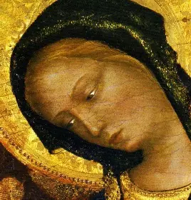
What are the Glorious Mysteries of the Holy Rosary? Why do we pray them?
The Glorious Mysteries of the Holy Rosary include the Resurrection of Our Lord, the Ascension of Our Lord, the Descent of the Holy Spirit, the Assumption of Our Lady, and the Coronation of Our Lady. These sacred mysteries honor the events that transpired after Christ rose from the dead; they all celebrate the heavenly glory that comes from spiritual union with the Father through the Son, through loving self-sacrifice offered up to glorify Him. We pray these mysteries to remind us of the purpose of our joys and sorrows: to sanctify us, thereby bringing us to glory with God. They help us to grow in the virtue of hope, to place faith in Christ our Redeemer, and to love God more for the glorious life in eternity that He promises to us. These mysteries keep our eyes on eternity, reminding us to store up treasures in Heaven by treasuring Jesus with Mother Mary

Slide 5
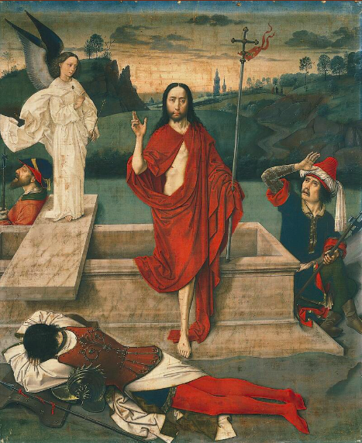
What is the Resurrection of Our Lord?
The first Glorious Mystery, the Resurrection of Our Lord, refers to when Our Lord rose from the dead on the third day, after having been crucified, giving His life on the Cross to redeem us from our sins. When Our Lord resurrected, He conveyed to us that we, too, may be raised up when we remain close to Him, doing all things in union with Him. Our Lord kept His promise, demonstrating that God is faithful. After He rose, He came to tend to His apostles and disciples, preparing them to carry on His mission in order to be raised up, and to lead others towards the Resurrection, too. It is believed that Our Lord appeared first to Our Lady, then to St. Mary Magdalene. He made His disciples into evangelists, and gives us a similar call to share the good news of salvation in Him, of undying happiness in His Heart

Slide 6
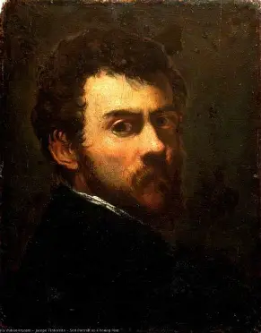
Who is Jacopo Tintoretto? How and why did he depict the Resurrection in art?
Jacopo Tintoretto (1518/19-1594) painted in the Mannerist style, which was characteristic of the late Renaissance period. Born “Jacopo Robusti” to a cloth dyer, he was surrounded by artistry from the time he was an infant, and would grow up saturated in color, even choosing the name “Tintoretto” for himself as an homage to his roots, as this word means “little dyer.” Tintoretto would start his career by painting chests of drawers, painting large scenes onto the chests, through which he would develop his expansive, far-reaching approach to painting, suggesting the wide reach that Christ has in coming down to die for everyone, to extend His healing hands to all souls. Though his painting style was too radical to be accepted by his peers initially, being considered to be incomplete, in that his paintings resembled sketches (foreshadowing the Impressionists to come in later centuries) Tintoretto would make a comeback, becoming one of the most beloved painters of his time. His competitors were his former teacher, Titian, and Titian’s protégé, Veronese. Tintoretto would be challenged by other artists, but would remain focused on his creations, continuing to employ his unique style that anticipated Baroque and modern art, in creating high contrast, hierarchizing elements (layering levels of the scene), and using rather abstract forms. Beyond conveying emotion through the faces of his figures, Tintoretto painted his subjects so expressively, that they told the story of the painting with their whole form, all contributing to the narrative of the scene. The Resurrection would have no doubt been meaningful to Tintoretto, in facing adversity, and looking forward to rising above it. Just four years before his passing from this life, he lost his daughter when she was giving birth; this would make the promise of the life to come all the more consoling. Several of Tintoretto’s children also became artists, carrying on the mission of his studio, and would resurrect his work, like the apostles continuing Jesus’ saving work on Earth. In dying to sin, we are bathed in true color and life, the life of Christ, Who illuminates everything with His light, dying our souls white to match the purity of His own, drenching us in the Precious Blood to purify our hearts

Slide 7


Slide 8
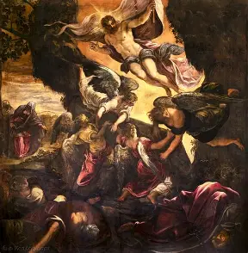
What does Tintoretto’s painting of the Resurrection reveal to us about this sacred mystery?
In Tintoretto’s painting, we see Christ placed above the other figures. Hierarchies are used to establish the focal point of the painting: Christ is placed at the top of the chain, to centralize Him as the main focus. Christ rises from the tomb, which resembles the altar, anticipating when Christ’s Sacrifice would be re-presented at every Holy Mass, that souls could come to rise with Christ, in receiving His Body, the key to Heaven. The musical instrument that a holy angel in the foreground plays, like an organ, resembles candles used at Holy Mass. Saint Cecilia’s body is turned towards Christ as she looks at Him adoringly. A holy angel places a crown on St. Cecilia’s head, anticipating her coronation in Heaven that would come through being martyred for Christ, sharing in His suffering to share in His glory; Saint Cassian, also a martyr, looks on, clothed in the garments of a bishop. Holding the palm of martyrdom and being crowned with flowers, St. Cecilia, the patron of music, is present in the scene to remind us that in dying with Christ, we come to blossom in holiness, and to harmonize the songs of our hearts with the song of Christ’s Heart, the Heart of a martyr, a witness to the love of God the Father. The painting, with its flurry of activity, reminds us of all that is accomplished through Christ’s Death and Resurrection, through which we are offered new life, that we may be crowned in heavenly glory, in following Christ from death to the world to life in the Spirit. Contrast is created between the values in the painting; in particular, Christ’s Body is glorified, reminding us that we receive Jesus’ resurrected Body, made present on the altar, in the Holy Eucharist, which the holy angels surround. Christ’s Face, however, is in shadow, communicating to us that we cannot behold the Holy Face in its full glory until we are in Heaven with Jesus, after ourselves rising. The red and white drapery surrounding Christ communicates His martyrdom and purity, His love and sacrifice that purifies us, leading us to Heaven. Christ holds the burial shroud like a flag marking His victory, His Kingship, as He reigns, triumphing over sin and death. There is even a kind of chest in the foreground, a nod to Tintoretto’s humble roots painting chests, and a further reminder to store up treasures in Heaven, to be enriched through closeness to Christ’s Heart, rather than becoming attached to earthly things

Slide 9
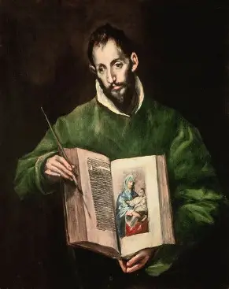
Who is El Greco? How and why did he depict the Resurrection in art?
For the Greek painter El Greco (1541-1614), the theme of freedom, namely, freedom from earthly limitations, from temporality, and the confines of the body, was one of interest in his art. In his painting of the Resurrection, we see that the body is not something to be escaped, but to be perfected and glorified in receiving Christ’s resurrected Body. Our Lord gives us true freedom through His love, in having poured out His Heart for our salvation from His place on the Cross, shedding His Precious Blood for our redemption. Freedom comes from union with Christ, Who redeems all things. The resurrected body is freed from material wear and tear, to be united with the Body of Christ; this painting reminds us to look forward to when Christ will come again in glory to judge the living and the dead, when our bodies will be glorified, joining with our souls in Heaven, for God created the body, and therefore, it is good, participating in good actions that are used to glorify God. In having been an outsider, an expatriate moving between places, El Greco could look forward to finding his eternal place in Heaven, in belonging with Christ, in the home that is His Heart

Slide 10
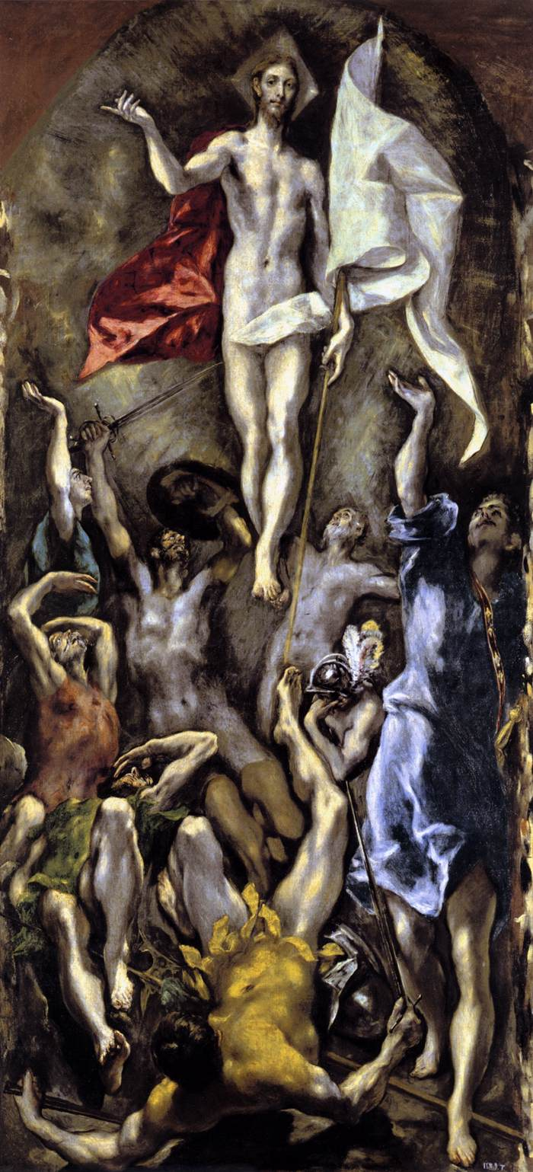

Slide 11
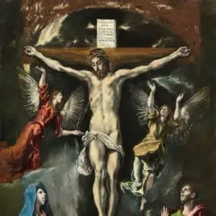
What does El Greco’s painting of the Resurrection reveal to us about this sacred mystery?
Whereas Tintoretto’s painting had holy angels surrounding Christ on all sides, and human figures below, suggesting the unity that Christ brings between Heaven and Earth through His Resurrection, and the powerful love in His Heart propelling His saving work, El Greco’s painting places all figures beneath Christ, establishing that He is transcendent, rising above all others, doing what no one else naturally could: coming back to life after dying. The figures that lift their arms up to Christ have an otherworldly appearance, as though they are already rising with Christ. Their bodies, moving like those of dancers, express the jubilation they feel for Christ’s Resurrection. The hands that reach up to Christ convey that we are to keep seeking God, to keep going to Him, reaching out, in order to be raised up with Our Lord. Lines created by the uplifted hands draw our eyes to look at Christ, Who is placed above all of the other figures, at the top of the painting. Light radiates in a circle around Him, recalling the shape of the tomb that He has broken from, and also, eternity, in forming a circle that goes on forever, reminding us that Christ’s love is deathless, bringing us all together eternally; He is the beginning and the end. The white glow emanating from Christ’s Body suggests His purity, a pure love that would lift Him up from the grave. The otherwise dark, muted colors around Him draw the eye to the soft tones of His Body. Jesus points, as though gesturing to the Father, signifying that to go to Heaven, we must trust in the will of the Father, as He did. One of the figures in the foreground, bowled over, with his feet kicking the air, suggest the amazement the people felt for the miracle Christ worked, also symbolizing that Christ upended the natural order of things with His supernatural might, reversing the course of sin

Slide 12
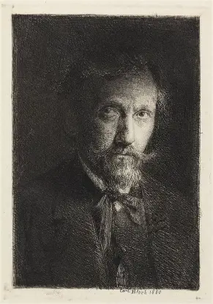
Who is Carl Bloch? How and why did he depict the Resurrection in art?
Active in the Academicism movement, the painter Carl Bloch (1834-1890) applies meticulous detail to his painting of the Resurrection, as was typical of his movement. The painstaking classical style reflects Christ’s perfection, and the perfection He leads us to, in guiding us to Heaven with Him, to be raised up and glorified in union with Him. Carl Bloch was commissioned to paint 23 scenes of Christ’s life for a castle chapel, a sacred undertaking which would take 14 years. He would be inspired by the experience of painting Christ, which would lead him to a deeper relationship with Our Lord, a kind of resurrection in his spiritual life

Slide 13
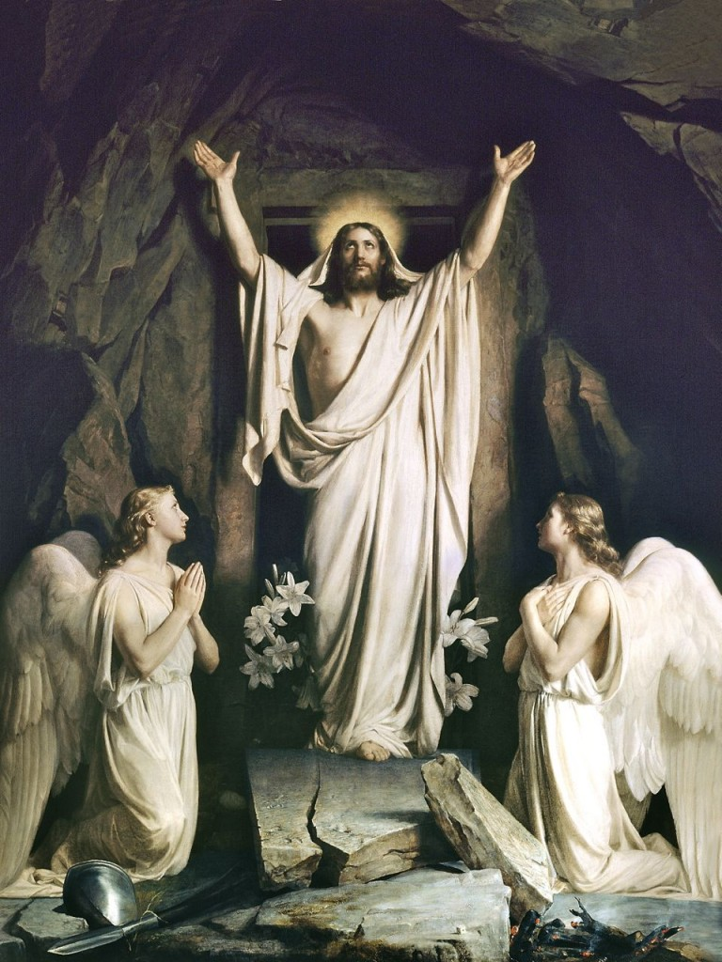

Slide 14
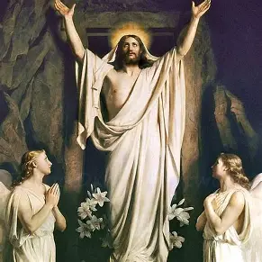
What does Bloch’s painting of the Resurrection reveal to us about this sacred mystery?
In Bloch’s painting, we see the immediate action of the Resurrection. Christ has just rose, and uplifts His arms in victory, forming a kind of triangular shape, as though to remind us of the love of the Blessed Trinity. His eyes lifted up to Heaven communicate that He is giving glory to God the Father for the triumph. No human figures surround Jesus, but holy angels kneel in reverent wonder for Christ; sprays of lilies bloom from behind Christ’s feet, recalling that we blossom when we humbly begin our spiritual journeys at Christ’s feet, that we may ultimately rise with Him in the end. Our Lord stands in front of the tomb, consuming the rectangular opening; He seems almost larger than its frame, further communicating His triumph. Another kind of triangle is formed by the grouping of Christ and the holy angels, and the rock over the tomb, too, forms a kind of awning, as though it is a house. We are reminded to make our homes in the Heart of Jesus, among the Persons of God in the Trinity, so as to reach our heavenly home that Christ raises our eyes and hearts to with His posture of praise. The absence of other figures or decorative elements reminds us to be purified in simplicity, in centralizing Christ in our lives, rather than being distracted by the world. We are to adore the Risen Lord like the holy angels, wholeheartedly trumpeting our love for Him, not only in words, but in action, by being with Him to acknowledge His Real Presence, which crushes death and breaks the prison of sin, exemplified through the broken slab that Christ stands upon. Bloch models the figures, casting them in ethereal white light, in contrast to the darker tones around them

Slide 15
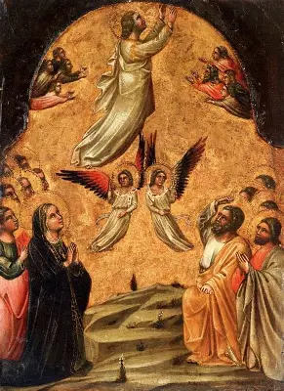
What is the Ascension of Our Lord?
The Ascension of Our Lord, the second Glorious Mystery, refers to when Our Lord rose up to Heaven. Forty days after He resurrected, Jesus would ascend into Heaven. Across the forty days, He spent time with His apostles and disciples, preparing them to keep building up His Kingdom after His departure from this life. Since forty is the number of purification, this was a period of time during which Christ’s followers could be purified, and prepared for their mission to share Jesus’ pure love with others. As He rose on His own power, Jesus blessed His apostles congregated on the ground, a sign that He would continue to help them in their journey to join Him in Heaven, and to bring others there with Him

Slide 16
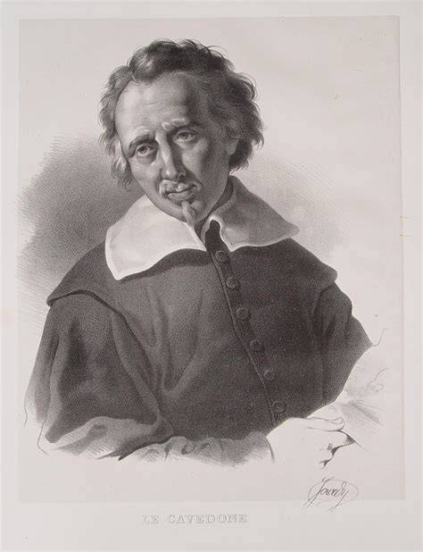
Who is Giacomo Cavedone? How and why did he depict the Ascension in art?
Giacomo Cavedone (1577-1660) was an Italian painter who was taught by the artist Annibale Carracci. He became active in the Bolognese School movement, and assisted the painter Guido Reni in his work. Because of the reforms made at the Council of Trent, Bologna was a hotspot for Catholic art. The Bolognese style was a return to the trademark Renaissance style, deviating from the more abstract Mannerist approach. Bolognese school adherents employ realism with such elements and principles of design as proportion. Cavedone suffered many crosses in his life, having lost his wife and child to the plague, and falling from scaffolding while painting. His sacred art would celebrate the glory of the Ascension, in looking forward to release from earthly woes, and triumph in Heaven, with the Ascended Lord; the figures in his painting of the Ascension form a kind of staircase, anticipating the steps we take to ascend into Heaven

Slide 17
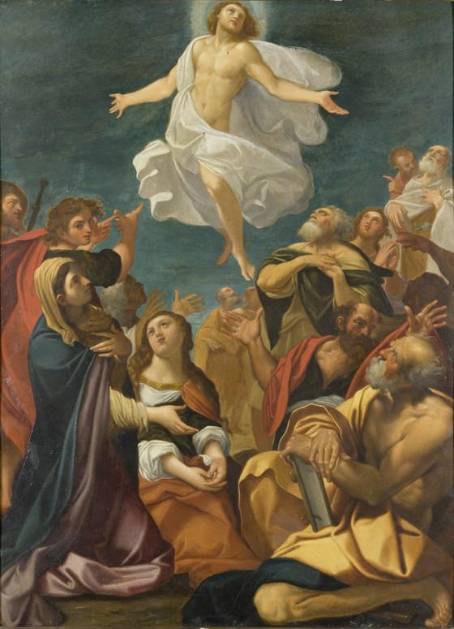

Slide 18
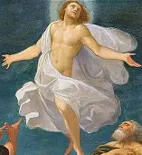
What does Cavedone’s painting of the Ascension reveal to us about this sacred mystery?
In this painting, we see that Christ is not rising from the dead, but rising up to glorious eternal life in Heaven, because He does not hold His burial shroud, or stand near the tomb, but rises above His apostles and disciples, who look to Him in splendor as He radiates light. Mother Mary reaches out a hand, surely anticipating when she will hold her Son’s hand in Heaven, being reunited with Him forever. Her expression is a trusting and hopeful one that is a model for the attitude that all believers should have. Each person in the crowd responds differently, some looking to Our Lady for guidance, others looking directly at Christ, and being touched by His divine power, His glorious beauty and goodness, evidenced by their thoughtful expressions of awe and admiration, as well as by their reverent postures, such as their hands placed on their hearts to communicate their love for God. The swell of figures, like an ocean wave rolling under Christ, suggests the temporal nature of this life, which recedes in time, whereas Christ is eternal, drawing us up to a Paradise that can never be swept away. Christ does not lift one hand in a blessing, but sweeps His arms out to encompass all, embracing the world and inviting everyone to ascend to Heaven by following Him. Christ is within reach: figures are grouped closely to Him, suggesting that Jesus remains close to us in spirit to guide us to be with Him forever in glory. The softness and smoothness of the painting, the curving feminine lines that are used, give a sense of serenity to the painting, a gestural flow that guides our eyes across the canvas, suggesting the gentle rhythms of Christ’s Heart, and the peace that is brought when we follow Him on the pathway to Heaven

Slide 19
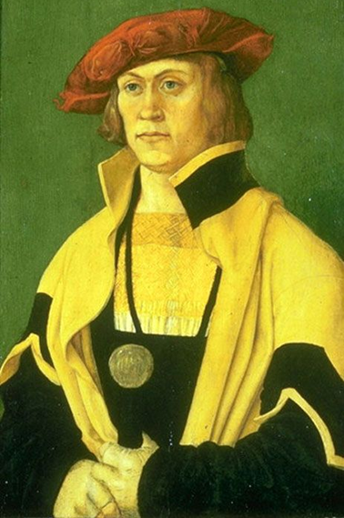
Who is Hans Kulmbach? How and why did he depict the Ascension in art?
A student of Albrecht Durer, Hans Kulmbach (1485-1522) adapted the painting of the Ascension from one of Durer’s woodcuts. This gifted student would become a teacher in his own right, operating his own workshop as an independent master of art. He would produce altarpieces and stained-glass designs, helping to beautify churches to celebrate God’s glory. His decorative and devotional art for churches would inspire souls to ascendancy, guiding them to uplift the prayers of their hearts to Heaven

Slide 20
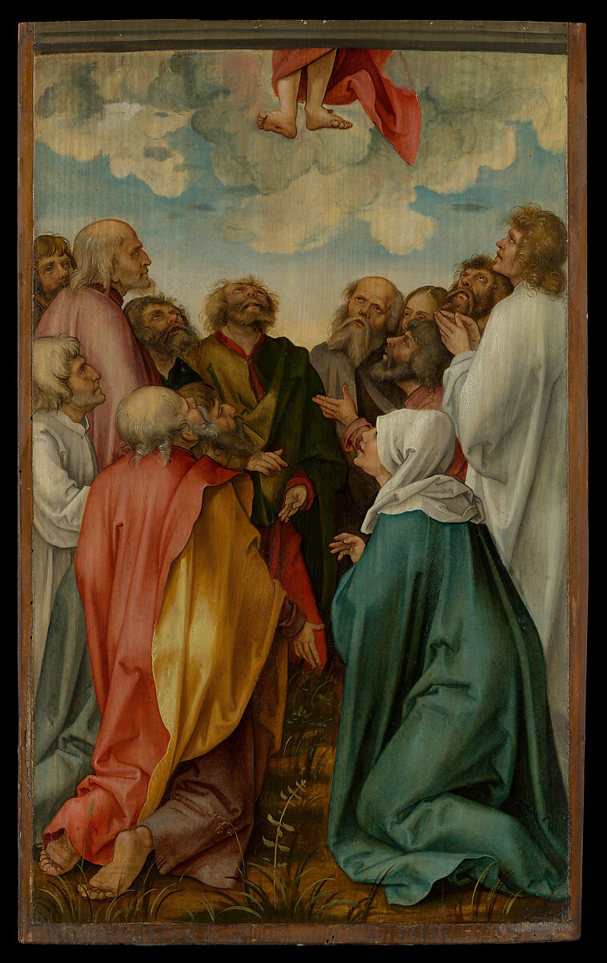

Slide 21
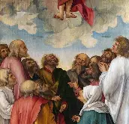
What does Kulmbach’s painting of the Ascension reveal to us about this sacred mystery?
In Kulmbach’s rendering of the Ascension of Our Lord, only Christ’s feet are visible. Clouds ringed around Christ’s feet amidst the soft blue of the sky draw our eyes to the Lord. A sense of seriousness pervades the painting: the people grouped below Christ do not reach out to Him or react exuberantly, with very animated expressions of joy, but remain quietly congregated in prayer. Their facial expressions are calm and focused; it is a contrast to the rejoicing that took place in response to the Resurrection of Our Lord. The people seem to be resolutely facing the reality that now, they will live without Christ’s physical Presence on Earth, still having His Presence among them in the Holy Eucharist that the apostles will bring to nourish souls, but not experiencing the Lord in the same way as before. We are reminded to keep striving for Heaven to see Christ, to remain humble, at Christ’s feet, in order to love and serve Him in glory. The two kneeling figures in the foreground, in being at a lower height than the standing figures in back, guide our eyes to the bottom center of the painting, where, in between the two kneeling figures, we see a plant growing. This little sprout is a reminder that Christ will continue to nurture our growth, that we may ascend to Heaven with Him someday; growth happens through humbly following Christ. The kneeling figure to the right of the plant is Our Lady, recalling to our minds that Our Lady leads us to Christ, shaping our growth

Slide 22
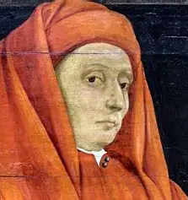
Who is Giotto di Bondone? How and why did he depict the Ascension in art?
Giotto di Bondone (1267-1337) was a foremost painter of the early Renaissance, training in art in the late Middle Ages. Taught by the artist Cimabue, he learned about producing iconography, but would deviate from this path in his artwork, which is clearly inspired by the Eastern iconographic tradition, while remaining distinct, in treating figures as three-dimensional rather than two-dimensional. Giotto’s treatment of the Ascension was part of a cycle of frescoes depicting the life of Christ. The Ascension image was painted in blue to honor Our Lady, and to suggest the vastness of the heavens, the skies enfolding the figures, which was a great homage, considering that blue was one of the most expensive pigments at the time. In painting full-bodied rather than flat figures, Bondone speaks to the Ascension as being something substantial and real that we are all called to, to progress in spirituality with the Lord, that we may rise up to join Him in Heaven

Slide 23
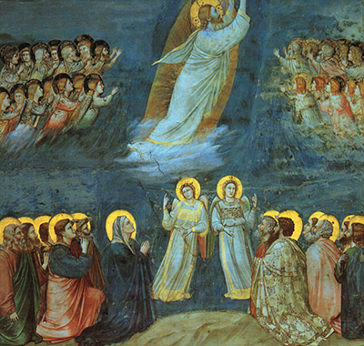

Slide 24
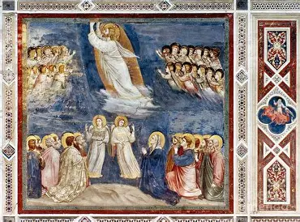
What does Giotto’s painting of the Ascension reveal to us about this sacred mystery?
In Giotto’s painting of the Ascension of Our Lord, we do not see Christ facing the viewers directly, but behold Him in profile. Distinct hierarchies are created in the painting: the figures remaining on Earth are in the lowermost reaches of the painting, while the holy angels are parallel to Christ, further above, though Christ is still taller than all of the figures, placed highest above. The soft diagonal lines painted in white over Christ’s feet resemble windswept waves of the ocean, while the golden oval over which the figure of Christ is placed suggests the tomb that Christ rose from; we are reminded of all that Christ overcame to ascend into Heaven, walking on water, calming stormy seas, and undergoing the Crucifixion, only to come back to life, conquering death, darkness, and sin. This image communicates Christ’s power, and reminds us to keep turning to God, turning away from the things of the world to receive the grace that God wishes to give to us, and to experience the power of His love, that we, too, may be guided on calm seas to Heaven, breaking from the tombs of the world. Balance is created by the complementary groupings of figures around Christ, all of whom look to Him, guiding us to honor the Lord, too. The golden haloes of the figures stand in sharp contrast to the darker blue background, reminding us of the glory that Christ, outshining the darkness, leads us to through His Heart of charity (a Byzantine, or Eastern Catholic, influence is evident in the goldleaf detailing of the painting)

Slide 25
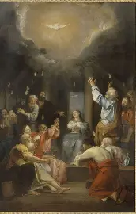
What is the Descent of the Holy Spirit?
The Descent of the Holy Ghost, the third Glorious Mystery, is also called “Pentecost,” for on the fiftieth day after Easter Sunday, the tenth day after the Ascension, we celebrate when the Holy Spirit descended upon the apostles to bring them the spiritual gifts that they would need to continue Christ’s mission of divine, redemptive love on Earth. The apostles were equipped to serve Christ’s people as priests, just as Our Lord, the Eternal High Priest, had, whereas Our Lady received the graces she would need to serve as our universal spiritual mother, guiding all of the apostles, and guiding those the apostles met to know Christ. Our Lady and the apostles awaited the coming of the Holy Spirit in the upper room, praying the first novena for nine consecutive days. When He descended, the Holy Spirit would be as wind and tongues of flame, igniting the apostles with a deeper love for Christ

Slide 26
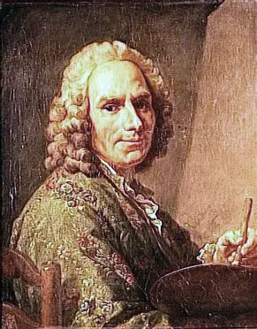
Who is Jean Restout? How and why did he depict the Descent of the Holy Spirit?
The French artist Jean Restout (1692-1768) was raised in a family with much artistic talent. Born to an architect father and painter mother, Restout would bridge the creative gifts of his parents by building scenes with an architect’s eye for design, for solid composition, and with painterly detail. He would be commissioned for religious art, especially by monasteries and convents, even painting the dining room for the Saint Denis abbey in France. His painting of the Descent of the Holy Spirit would resemble a ceiling painting, reminding us to keep our gaze heavenward, to reach past the ceilings to God, like incense wafting upward with our prayers

Slide 27


Slide 28
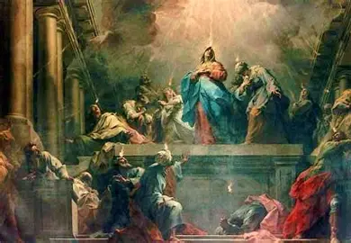
What does Restout’s painting of the Descent of the Holy Ghost reveal to us about this sacred mystery?
In this painting of the Descent of the Holy Spirit, Our Lady stands at the center, appearing visibly taller than the other figures, who are bowed towards her, or who are congregated further in back, to centralize her as a focal point of the painting, an anchor to which the eye is drawn, as the arched lines of the figural groupings around her lead the viewer to behold Our Lady. This is all to serve as a reminder that to use the Holy Spirit’s Gifts, we are to look to Our Lady as our teacher, for she opened her Heart to receiving the Holy Spirit, and at the time of the Annunciation, was overshadowed by Him, so that she could bring Christ into the world. In a similar way, if we are to use the Holy Spirit’s Gifts to bring Christ into the world, then we are to imitate Our Lady in virtue. She and some other figures are elevated on a platform above the rest conveying that we are raised to Heaven, closer to Christ, in shining His light, reflecting His love by using the Holy Spirit’s Gifts to glorify Him. The tongues of flame over the apostles’ heads are very small, being consumed within the broader glow of light that emanates from the top of the painting downward, recalling that we are not the source of the light ourselves, but are meant to bear testimony to Christ, the Light of the World, like Our Lady does. The columns that recede diagonally into the background create a sense of perspective, communicating that the things of the world all fall away, crumbling to dust with time, whereas the things of God that are true, that are bathed in His light, last forever

Slide 29
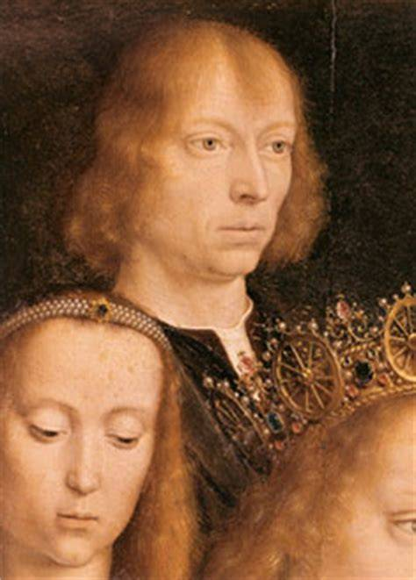
Who is Gerard David? How and why did his followers depict the Descent of the Holy Ghost in art?
Living between 1460 and 1523, Gerard David applied a realist style to his painting, active within the Bruges School, per the teaching of the master Van Eyck and Rogier van der Weyden. Painting with precision and detail, he brings a quiet, yet powerful, mystical quality to his work that is reminiscent of iconography. The soft colors and courtly style of the Bruges School paintings imbue their subjects with a sense of regal dignity. Followers of Gerard David, perhaps members of his workshop, would have created the painting of the Descent of the Holy Ghost. Highly sought-after artists who received many commissions would employ other painters in helping to complete their works, but likely, this painting was completed by someone simply employing David’s style of painting. Bruges School paintings convey something of the grace of God, of His tenderness, in their gentle depictions of events in salvation history, reminding us that the Holy Spirit is always moving throughout our lives to bring us His love and mercy, to inspire us to cooperate with God’s grace

Slide 30
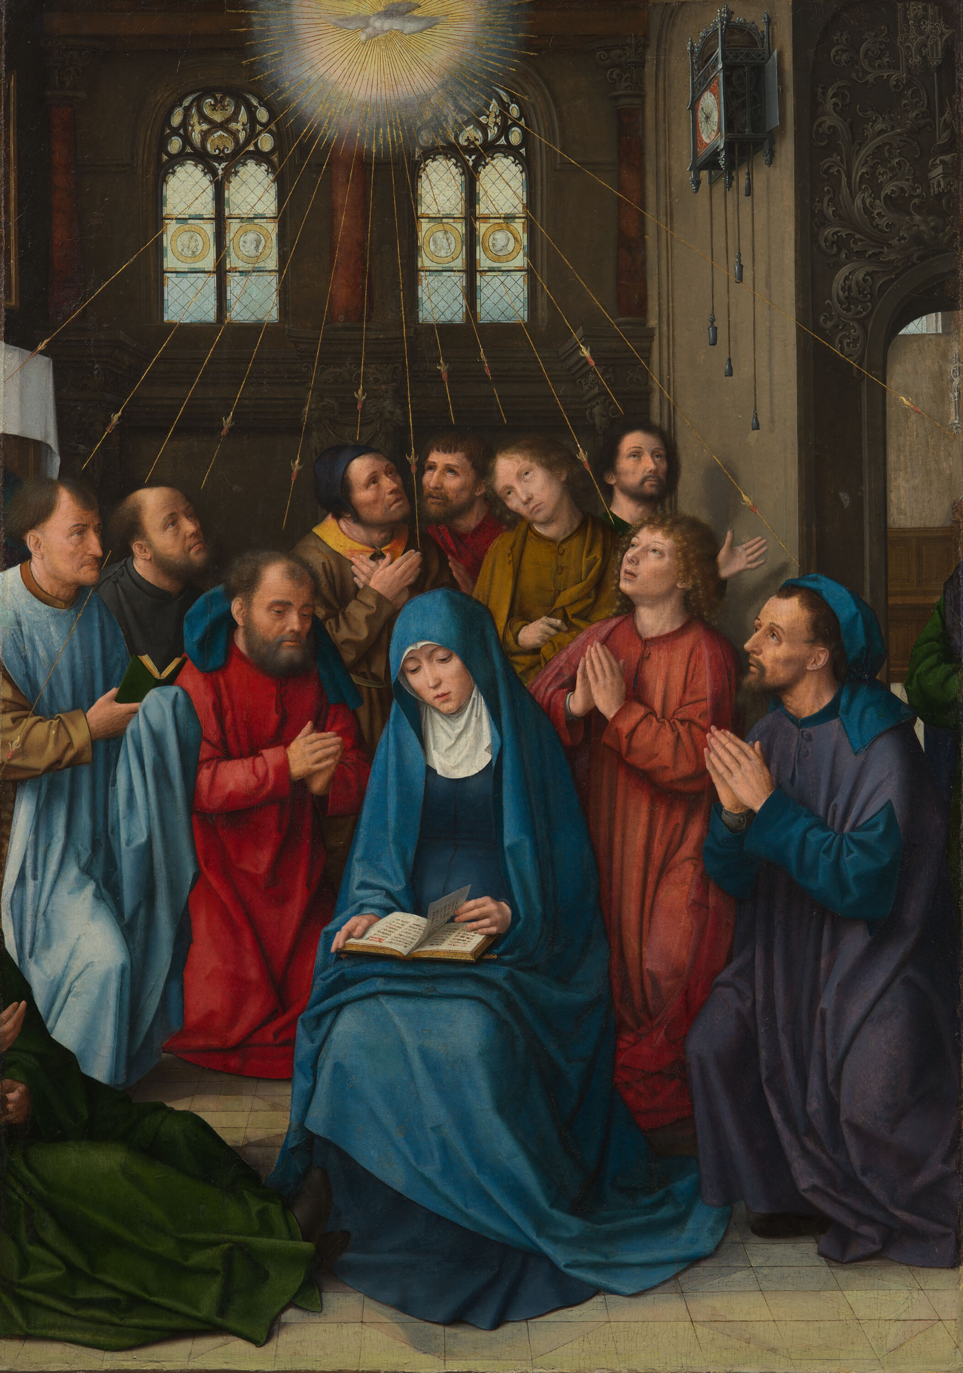

Slide 31

What does the painting of the Descent of the Holy Ghost by David’s followers reveal to us about this sacred mystery?
This painting of the Descent of the Holy Ghost by Gerard David’s followers place the figures in the social context of their own time, situating them in the setting of a fifteenth-century Dutch church, rather than in the upper room. In this way, we are reminded that we are always called back to the cenacle to receive the Holy Spirit with open hearts, and to share God’s love that we receive with others. It is telling here that Our Lady looks to a book, reading in deep prayer as she contemplates this sacred mystery. She treasures this mystery in her Immaculate Heart, reminding us to similarly take the Incarnate Word into our hearts, to receive the Holy Spirit, that we may welcome Christ into our souls, being led closer to Our Lord by the Holy Spirit. We treasure Sacred Scripture in order to treasure Sacred Tradition more deeply, to understand our roots, and to open our hearts to the inscriptions that the Divine Author wishes to write upon them, marking us, with His grace, as His followers. Light enters in through the stained-glass windows in the background, reflecting how we are to keep our hearts as windows through which to receive the light of the Holy Spirit’s inspiration, but the gold lines that emanate from the dove at the top center, the Holy Spirit, point to God as the true Source of light, from which arrows of grace, of love, are sent to the apostles. In contrast to Restout’s more dynamic painting in which the apostles were in action, in this painting, the smooth layers of paint convey a restfulness, a sense of completion, and the close grouping of figures around Our Lady, the focal point, allow for visual balance. The apostles, all kneeling in prayer, are clearly united by Our Lady, the reflection of Christ, as they emulate her tranquility. All grouped towards the bottom of the painting, rather than at the top, a clear hierarchy is established, as they are distanced from the Holy Spirit, suggesting that through the Gifts that they receive, they will strive towards Heaven, towards union with God, but are not yet on that level, right now, sharing in Christ’s humility in order to one day share in His glory

Slide 32
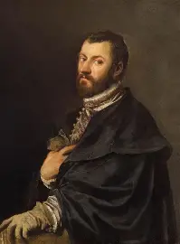
Who is Titian? How and why did he depict the Descent of the Holy Ghost in art?
Titian, born Pieve di Cadore, lived between 1490 and 1576. His very name, “Tiziano,” derives from “Titianus,” meaning “honorable” or “dove.” Commissioned for a variety of works, Titian was a painter in royal courts who would also become connected to the pope. He would complete publicly-displayed religious paintings of great scale, especially for church altars, but would adopt a much freer, less formal, style of painting later in life, experimenting with abstract and “magic Impressionist” styles of art. In his painting of the Descent of the Holy Ghost, Titian represents the Holy Spirit with light, but the light forms the shape of a dove, reminding us that, in being led by the light of the Divine Artist’s love, we can be touched by God’s rays of grace. Using the Gifts of the Holy Spirit to give glory to God, we can illuminate others’ lives, coming to reflect the Holy Spirit ourselves, like doves of peace soaring out into the world

Slide 33
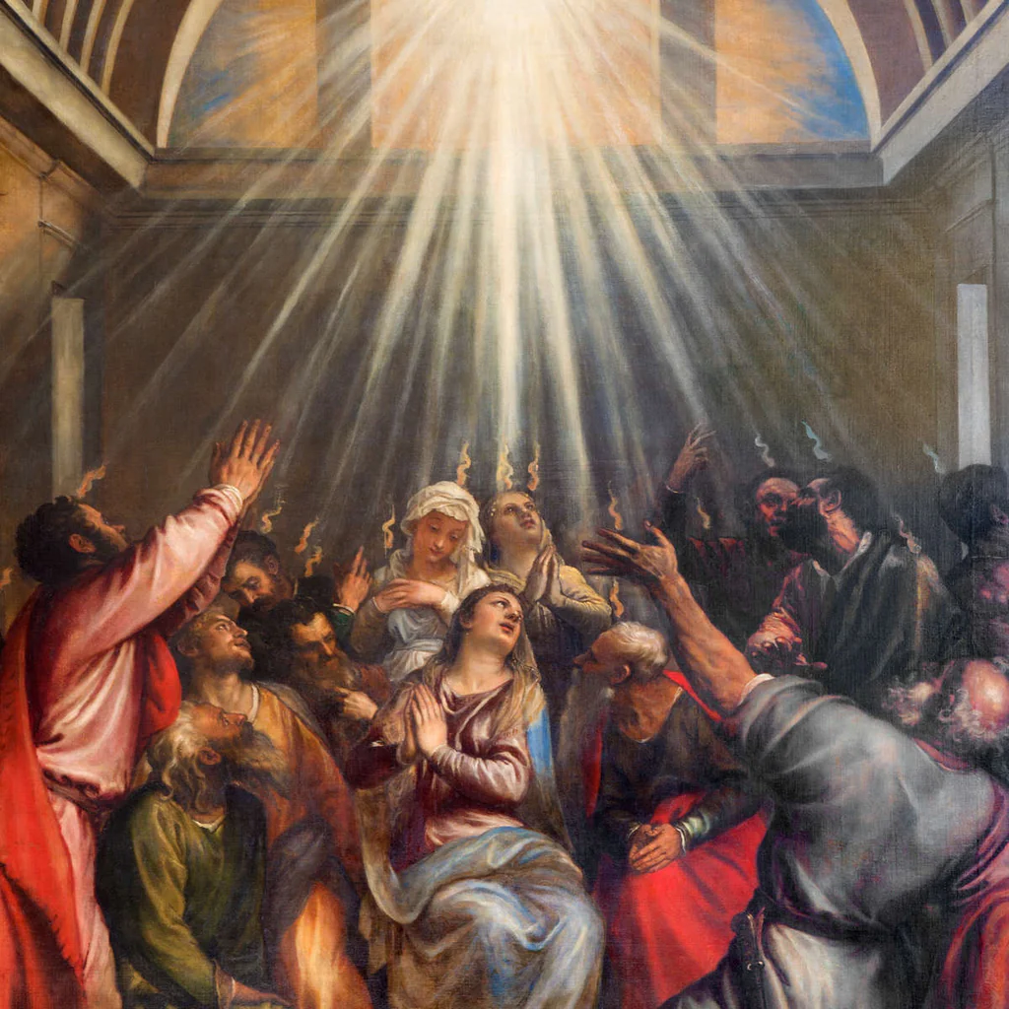

Slide 34
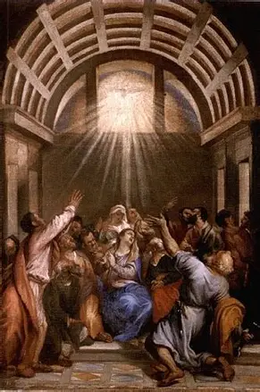
What does Titian’s painting of the Descent of the Holy Ghost reveal to us about this sacred mystery?
Titian is known for his unique shade of red paint, but here, only flashes of it are caught, like reflections of the Holy Spirit’s tongues of flame. Using accents of red, rather than making red the dominant color, remind us of the Holy Spirit’s love, which we receive through His Gifts in this life, so that we may be led to most fully experience this love in Heaven. Red, the color of martyrdom, is a reminder that, in becoming soldiers of Christ by receiving the Gifts of the Holy Spirit, we are to serve as Christ’s witnesses, pouring out our lives out of love for Him, like the light of God pouring forth. We do not see the Holy Spirit represented as a dove here, but as the sun, with rays of light streaming outward like a fan to touch each of the figures grouped below: not only the apostles, but other disciples, including women, all receiving the Holy Spirit’s Gifts. This is to communicate the universality of the Church, born on Pentecost, and of God’s love, in which the Church is rooted. Our Lady, seated at the center of the painting, with negative space created around her in order to establish her as the focal point, draws our eyes up to the light of God, which is directly above her. She is its purest reflection, and therefore, does not have a flame above her head in this painting, for she already radiates the light from within. The hand of an apostle in the right foreground leads us to look upon Our Lady, as the hand is parallel to her, creating an arc of movement that our eyes follow to see the reverence of Our Lady that we are called to imitate, much like the gentle woman standing behind her, clearly emulating Our Lady’s love and peacefulness. The half-dome shape over the scene calls Heaven to mind, reminding us that we do not yet fully experience Heaven in this life, and are not yet complete, until fully united with God. The Holy Spirit helps to lead us to spiritual union with God in Heaven

Slide 35
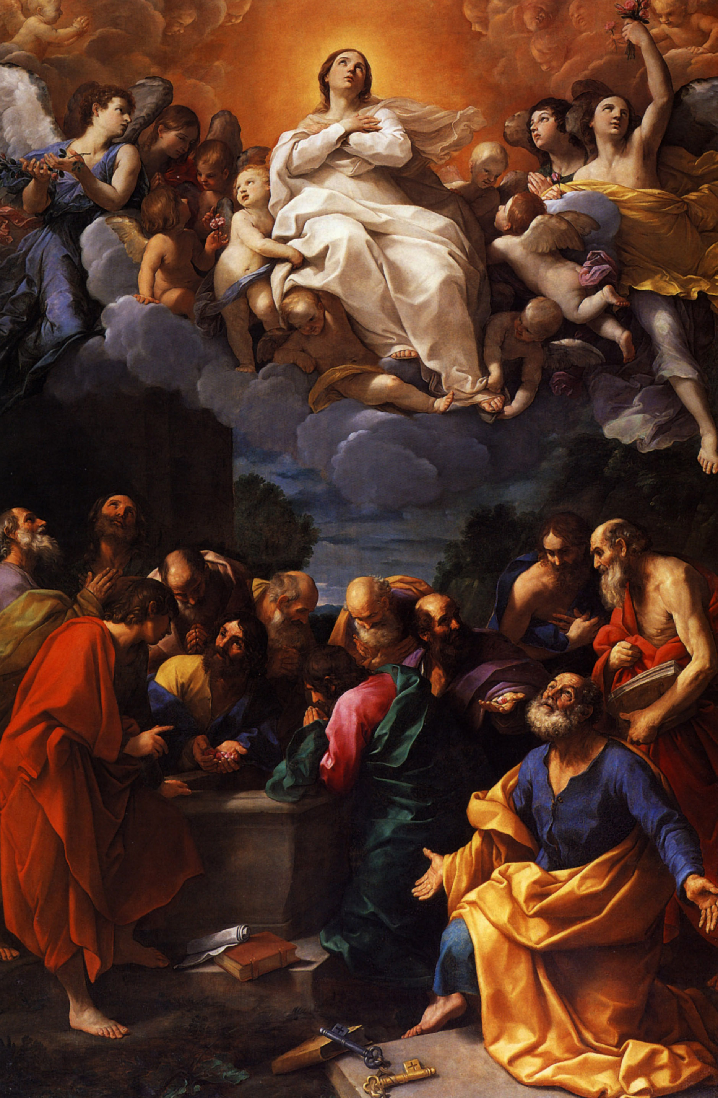
What is the Assumption of Our Lady?
The Assumption of Our Lady is the fourth Glorious Mystery, and refers to when Our Lady was assumed into Heaven, brought into glory, through Christ’s power. She was assumed into Heaven after approximately six decades of earthly life, nearly fourteen years after Christ’s Ascension. Our Lady’s Assumption is referred to in the Eastern Church as her “Dormition,” because she is believed to have simply “fallen asleep” rather than having died naturally, in being free of the consequences of original sin, including natural death. However, mystics write that Our Lady chose to die a natural death in order to be as spiritually united with her Son as possible, since He experienced natural death

Slide 36
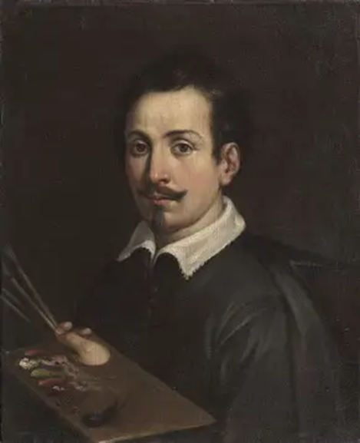
Who is Guido Reni? How and why did he depict the Assumption of Our Lady in art?
In his painting that conveys emotionality in the expressive gestures of the figures, Guido Reni (1575-1642) captures the glory of the Assumption. The contrast between lights and darks, cool colors and warm colors, in his painting communicates that Our Lady crushes evil under her heel, triumphing with Christ, as the New Adam and the New Eve, Our Lord and Our Lady, undo the destruction of sin and disobedience with their goodness and fidelity, imbuing the world with light and warmth that emanates from the Two Hearts. Commissioned to complete works of art for the pope, Reni would decorate rooms of the Vatican Palaces, frequently painting saints such as Cecilia and Michael to great advantage

Slide 37


Slide 38
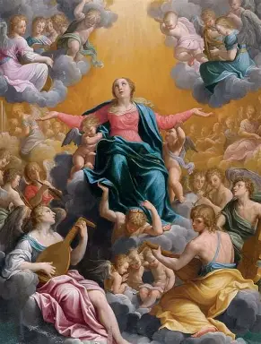
What does Reni’s painting of the Assumption reveal to us about this sacred mystery?
In his painting of the Assumption, Guido Reni creates a sense of hierarchy by placing the darkest tones of the painting on the very bottom. The eye is drawn upward to behold Our Lady being assumed into Heaven by the tones that gradually lighten as they ascend. Our Lady looks to Heaven, her arms outstretched, to express that she invites all of her spiritual children to draw near to her, to be enfolded in her all-encompassing maternal embrace, in order to be uplifted to Heaven with her. The warm light enveloping Our Lady calls the Book of Revelation to mind, as we remember that Our Lady is the woman clothed in the sun. Billowing blue drapery gathered around Our Lady, and the softly flowing lines of her dress, rose-colored for joy, create a gentle sense of movement that suggests the movement of God’s grace in our hearts, touching them and transforming them through Our Lady, the Mediatrix of All Graces, a channel of God’s grace. The circular shapes around Our Lady echo the shape of her halo, suggesting the radiance of grace that extends outward from her Heart, to lead everyone to eternal glory with Christ. Our Lady stands on a cloud carried by holy angels, but the cloud almost resembles a rock formation, or the world on which Our Lady of the Miraculous Medal stands, recalling to our minds that when we stand with Our Lady, we are houses built on rock, solid and steadfast, strong in our faith. Because Our Lady has stood upon the serpent, crushing him underfoot, she can stand in Heaven. The leftmost holy angel wears a sash that, in being draped diagonally, resembles a slice of crescent moon, evoking the image of Our Lady as having “the moon under her feet.” This only further solidifies that Our Lady reflects Jesus, the Son, and therefore, can enter into the glorious light of Heaven with Him

Slide 39
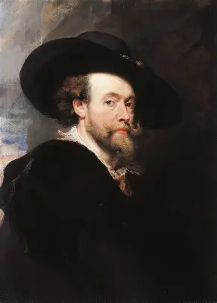
Who is Peter Paul Rubens? How and why did he depict the Assumption in art?
Peter Paul Rubens (1577-1640) was born in Germany, but after his father passed away, his family would move to the Spanish Netherlands (now Belgium). As a young man, Rubens would travel to Italy, where he would study the works of the greatest Renaissance artists, from Titian and Tintoretto to Michelangelo and Raphael. In Italy, he would begin to receive commissions to paint churches, but would return to Belgium, developing his own studio after marrying his wife. Rubens showed great versatility as an artist, a certain ease in approaching a wide range of subjects, and in this way, would reflect something of the universality of Mary, our Mother. Able to work on a large scale, and to design scenes with many groupings of figures that would otherwise be complicated to depict, organizing details with heavenly order, Peter Paul Rubens reminds us of how Our Lady can bring us all together, and work on a large scale to convert souls, sharing the message of God’s love to guide all of her spiritual children to Him

Slide 40
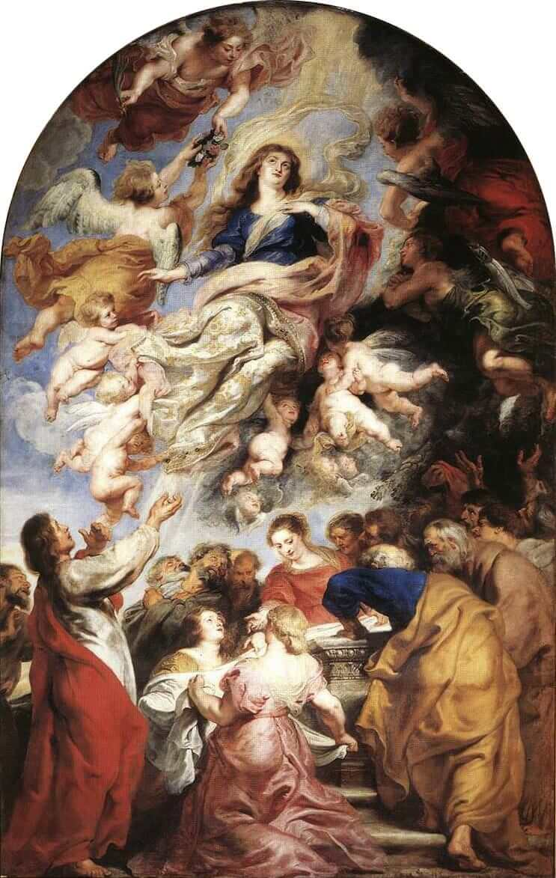

Slide 41
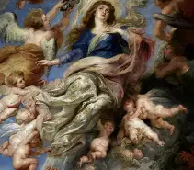
What does Rubens’ painting of the Assumption reveal to us about this sacred mystery?
In Rubens’ painting of the Assumption, we see two scenes unfolding at once, reminding us that God works outside of time, for time measures change in the created world, while eternity is the measure of changelessness, for in eternal glory, God’s love, which is unchanging, is experienced forever. Our Lady rises above her own tomb, figures congregated around her to greet her. She is always in the role of a teacher, guiding and instructing, beckoning others to follow her in learning from Christ. On the Earth below, there is activity, a sense of frenzied joy and amazement, as the people wonder at the mystery of Our Lady rising up to Heaven, while above, the holy angels respond with equal joy as they carry up Our Lady, anticipating her coronation as they prepare a crown of flowers to place upon her head. Negative space separates the two scenes, a circular shape being created by the figures above, which reminds us that Our Lady is the key to our movement towards eternal glory, towards the unbroken line of saints immersed in God’s love

Slide 42
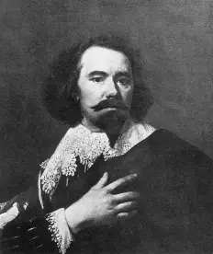
Who is Bartolome Esteban Murillo? How and why did he depict the Assumption in art?
Bartolome Esteban Murillo (1617/18-1682) was a successful painter of religious art who had a certain fondness for Our Lady, conveyed through the gentleness and softness with which he painted her. Murillo’s paintings of the Madonna and Child include details that are true to life, capturing the humanness of the mother and child in an endearing, relatable manner that would touch hearts. Murillo’s painting of the Assumption was also thought to be an image of the Immaculate Conception, because it communicates Our Lady’s purity. It is, indeed, the pure Heart of Our Lady that leads her to be assumed into Heaven, and forever united with the Sacred Heart of Jesus, overflowing with pure love

Slide 43


Slide 44
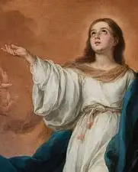
What does Murillo’s painting of the Assumption reveal to us about this sacred mystery?
Unlike in Rubens’ painting, in Murillo’s depiction of the Assumption, we do not see Our Lady surrounded by human figures, but by angelic ones. Even so, they do not dominate the scene, but simply frame Our Lady, forming a diagonal line by her feet, making a kind of staircase with their bodies, as though to signify that we reach Heaven by climbing the stairs of virtue with Our Lady, in union with the holy angels. The blues, golds, and whites of the palette suggest celestial glory and peace; the soft tones accentuate and reflect the innocent, childlike expression of Our Lady, whose uplifted hand is open to receive God, to give glory to Him, but also, to invite all of her spiritual children to receive His love by accompanying her on the way to Heaven. Curiously, the scene of the Assumption does not include Our Lord, though Our Lady, in being human, and not divine, would not have been assumed into Heaven on her own power; she did all in union with Christ, her Son, in her earthly life, and would go to the next life with Him, too

Slide 45
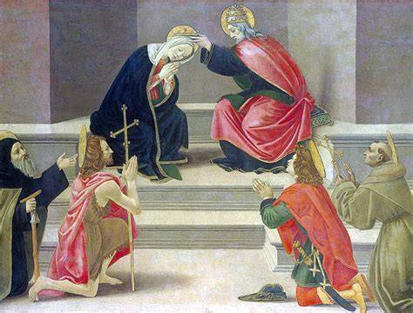
What is the Coronation of Our Lady?
The fifth Glorious Mystery, the Coronation of Our Lady, refers to when, following her glorious assumption into Paradise, Our Lady was crowned in Heaven, having received her heavenly crown through embodying every virtue, being filled with grace that allowed her to perfectly exemplify the application of the theological, or godly, virtues of faith, hope, and love. Our Lady came to be crowned as Queen of Heaven, because she is the Mother of God, of Christ the King, and in the Jewish tradition, the Queen is the mother of the King, rather than his wife

Slide 46
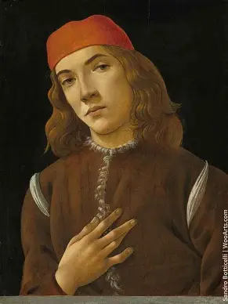
Who is Sandro Botticelli? How and why did he depict the Coronation in art?
At the time he painted it, the image of the Coronation of Our Lady was Botticelli’s most celebrated work. Sandro Botticelli (1445-1510) had a talent for conveying the angelic sweetness and beauty of Our Lady, who follows the direction of the Christ Child in writing the “Magnificat” prayer in her book, right next to her inscription of the Canticle of Zechariah, the “Benedictus” prayer. The “Magnificat” is a song of praise that continues the thread, emphasizing Our Lady’s faithfulness and humility, in transcribing what is dictated to her by the Lord, and in so doing, receiving her heavenly crown, the reward for her humility, her obedience like that of God’s servants, the holy angels. As an artist, Botticelli would have understood something of this obedience, in painting what he was asked to by those who commissioned his work, and in using his talents to glorify God, to give praise to the One Who created him, thereby magnifying the Lord in his soul

Slide 47


Slide 48
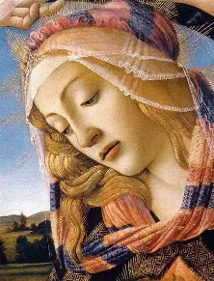
What does Botticelli’s painting of the Coronation reveal to us about this sacred mystery?
In Botticelli’s painting, Our Lady still appears to occupy space in an earthly domain; we see a river, trees, and rolling hills of the created world in the background behind her. She links Earth and Heaven, calling her spiritual children on the Earth to join her in Heaven, where they may experience greatness and beauty beyond what the created world can offer. Ribbons flow from the crown placed on Our Lady’s head by the holy angels, reflecting the movement of the river, itself a reminder of how Our Lady serves as a kind of tributary of God’s love, a river flowing from the ocean of mercy. Sun shines above the crown placed on Our Lady’s head, a reminder that we only earn our heavenly crowns in reflecting the light of Christ the Son, the luminous Source of all that is good. Further affirming this truth, Christ guides the hand of Our Lady as she writes the Magnificat prayer in her book, attesting to the fact that she is crowned, because God has lifted up the lowly handmaiden, doing miraculous things for His glory, through His great grace. This serves as a promise of the life to come, of God lifting us up, too, to assume royal places in Heaven

Slide 49

Who is Diego Velazquez? How and why did he depict the Coronation in art?
Diego Velazquez (1599-1660) was a royal court painter who was commissioned to create altarpieces for chapels in the kingdom, including oratories belonging to royal family members. Velazquez lived in a time when the Immaculate Conception of Our Lady was being celebrated, amidst the Catholic Counter-Reformation giving glory to God, affirming Catholic teachings, and celebrating the Mother of our Church, the triumph brought to the world through the Redeemer, and Mary, His Mother. Therefore, he chose to paint Our Lady as being coronated for her purity: she is given a wreath of roses, and is painted with a youthful face that is meant to honor her as having remained pure, retaining childlike innocence, throughout her life. We are called to share in the heavenly reward, in the reception of the eternal crown, through closeness to Our Lady, and her pure Heart of love that sanctifies us

Slide 50


Slide 51

What does Velazquez’s painting of the Coronation reveal to us about this sacred mystery?
In Velazquez’s painting of the Coronation, Our Lady is not crowned by holy angels, but by God the Son and God the Father. Hovering above the crown, shining His light onto it, is the Holy Spirit. Our Lady is seated upon a kind of throne of clouds, bathed in the light of Heaven, just as the Persons of God in the Holy Trinity are, albeit, to a lesser degree, as she is their complement, but not a Person of God herself. The triangular shape created by the Persons of God and Our Lady, with Our Lady as the point of the pyramid, establishes Our Lady as the focal point of the scene, reminding us that she is completed by the Persons of God, and that we may be coronated in Heaven, too, when we receive the Persons of God with love in our hearts, connecting all that we do to them, for their glory. Our Lady humbly places a hand on her Heart to signify that she has given her Heart to God; this is essential to being coronated in Heaven

Slide 52

Who is Gentile da Fabriano? How and why did he depict the Coronation in art?
An influence on the artistic style of such luminaries as Fra Angelico and Bellini, Gentile da Fabriano (1370-1427) would have a major role in the development of the late Gothic style. Best known for his altarpiece depicting the magi adoring the Christ Child, Fabriano would be an innovator in creating three-dimensional structures within his scenes, while using natural lighting to impart added realism, model figures, and create perspective, also lending a heavenly quality to the light-infused images he created, offset by striking natural landscapes. His image of the Coronation would show an architectural eye for design in composing the arrangement of the figures with such precision, while also adding a decorative quality to the scene in experimenting with pattern, balance, and contrast. Through his painting, he teaches us that we are coronated when we are oriented towards Christ, repeating His actions of faith, hope, and love in our lives, patterning our works after His, ordering our lives according to His Commandments in order to experience the greatest sense of rhythm and harmony

Slide 53


Slide 54

What does Fabriano’s painting of the Coronation reveal to us about this sacred mystery?
In Fabriano’s image of the Coronation, we see Our Lord crowning His Mother, while several angelic figures look on from below, in the presence of the Holy Spirit, symbolized here as a dove in the air directly above the heads of Jesus and Mother Mary. Our Lord gives the crown of glory to Our Lady for having spiritually worn the crown of martyrdom with Him, in compassionating with Him when He suffered the Passion. Arrayed in garments of rich patterns, Our Lady and Our Lord are adorned with flowers, conveying that we come to blossom in heavenly splendor when we have loved with all of our hearts, cultivating seeds of faith, hope, and love in our earthly lives. The scale of the painting conveys much, in that the holy angels are significantly smaller, almost imperceptible, compared to the figures of Our Lady and Our Lord, which dominate the canvas. The all-encompassing gold background suggests that everyone is called to Heaven, to be glorified; it also suggests the Presence of God the Father that surrounds and embraces, because while Christ is the Face of God the Father, the Father is not a material being that is visible; instead, His grace is revealed in outward signs, such as through His perfect creation, Our Lady

Slide 55

What do all of the sacred art masterpieces that we have learned about teach us about the Glorious Mysteries of the Holy Rosary?
All of these sacred art masterpieces teach us that humility is the key to glory. Sharing in Christ’s life in Heaven, His glory, means sharing humbly in His sorrows and joys, deriving joy from the opportunity to serve He Who came to serve us out of love. Jesus came down humbly from Heaven to bring us eternal joy, to take on our sorrows, and redeem them, to heal us of our wounds. Imitating Christ, and sharing in His glory like Our Lady, means imitating His humility, the root of love

Slide 56

Closing Prayer: Collect for the Feast of the Assumption of Our Lady
Almighty ever-living God, who assumed the Immaculate Virgin Mary, the Mother of your Son, body and soul into heavenly glory, grant we pray, that, always attentive to the things that are above, we may merit to be sharers of her glory. Through our Lord Jesus Christ, your Son, who lives and reigns with you in the unity of the Holy Spirit, God, for ever and ever. Amen.

