Slide 1
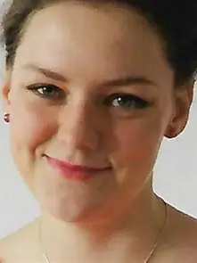
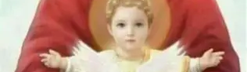
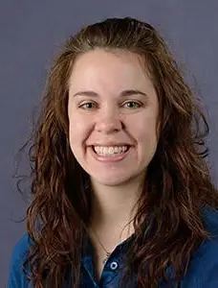
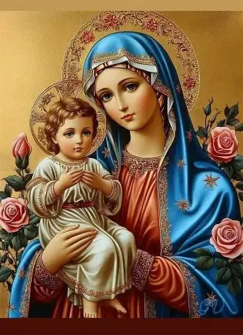
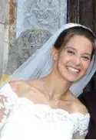
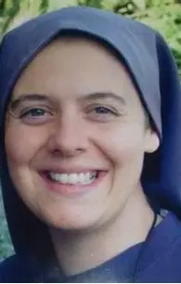
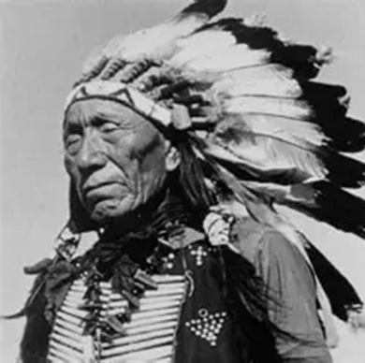
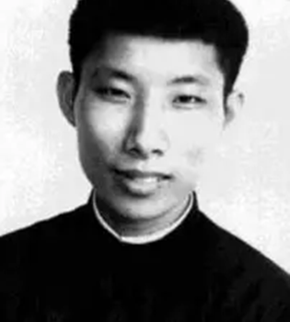
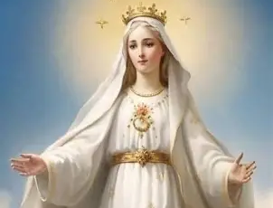
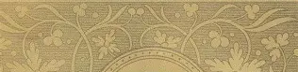
Journeying on the Highway to Heaven with our Soon-to-be Saints, Part One: Servants of God on the Road to Canonization
Sunday, October 12, 2025
Katie Sadakierski

Slide 2
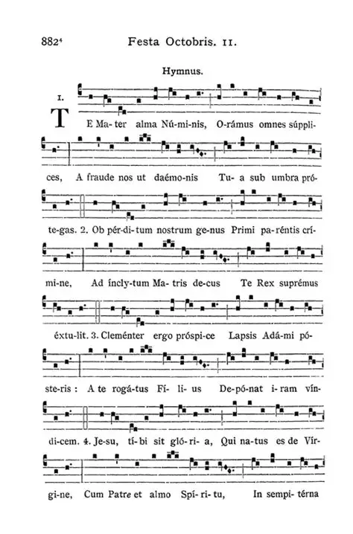
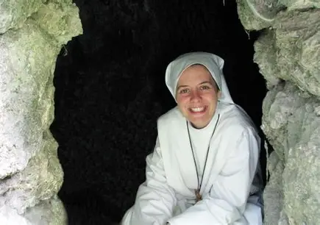
Outline: Serving God like the Servants of God
Opening Prayer
Presentation
  I. Defining the stages of the canonization process: The gift of being declared a “servant of God”
  II. Meeting servants of God awaiting canonization: The gift of bearing witness to God as His servant, and to bearing witness to the witnesses
  III. Serving God in serving the servants of God: The gift of emulating and praying for servants of God awaiting canonization
Announcements
Closing Prayer
Q & A

Slide 3
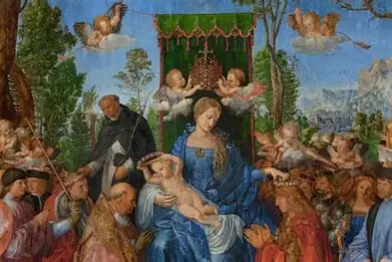
Opening Prayer: For the Intercession of the Servants of God
God our Father, we thank You for the opportunity You have given us through our unique life experiences to serve You and Your people, just as Your dear Son, Jesus, and Your precious daughter, Mary, did. We pray that You would help us to lead other souls to serve You, that we all may praise You in the glory of Heaven, with the holy angels who sing with love for You endlessly. May the songs of our hearts be harmonized with the songs of the souls You have deigned be named servants of God, for Your glory, that we may console the Hearts of Jesus and Mother Mary, as You are adored with much love, as You so deserve to be. Grant, dear Father, that our servants of God would be canonized in Your time, to inspire countless other souls to pour out their hearts in loving service to You, embodying Your boundless well of charity, Your Heart of treasures offered to enrich all, like our servants of God did. Thank You, Eternal Father, for building up the most beautiful treasury of souls in Heaven, and for guiding us to a place there. You knew each of us before time, having designed our souls for a special purpose. We praise You for this gift of life to be given to You, praying that we would always remember that this life is not our own, our time is not our own, but Yours, that we would live it to the fullest, to the utmost, that You may be glorified to the greatest extent, until we may be united with You forever in Heaven. God, we bless You for Your servants who have gone before us to illuminate the pathway to this union, for showing us that only You may perfect and complete us, giving us the eternal joy we seek. Through Christ Our Lord. Amen.

Slide 4
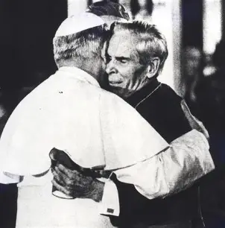
What are the stages of the canonization process?
Pre-Diocesan
  Grassroots movement/popular devotion; a petition to open the cause for canonization is started
Servant of God: the life of the candidate for canonization is examined, generally, starting five years after their passing from this life (though the waiting period may be waived by the Pope). Witnesses will be called to be questioned by the tribunal, and documents connected to the candidate will be analyzed. The diocese will send its report to the Vatican, and nine theologians will vote on whether the candidate lived a heroic life or suffered martyrdom
  Diocesan
  Roman
Venerable: once the findings of the investigation have been brought forward, and the theologians vote in favor of moving forward with a candidate, the candidate may be declared “Venerable” if they have lived a virtuous life, or “Blessed” if they have been martyred; the pope will make the final decision. A venerable is beatified once a miracle has been attributed to them
Blessed: after beatification, a venerable becomes a “blessed,” and is officially canonized when a second miracle is attributed to them
Saint: once canonized, a person may be publicly venerated (officially recognized and honored) by the Church

Slide 5
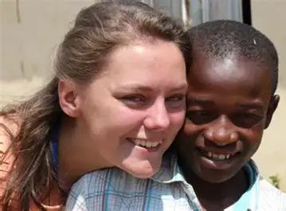
What is a “servant of God”?
The first stage of the canonization process involves being declared a “servant of God.” When the cause for canonization is opened, accepted for review by the responsible department at the Vatican, a person is declared a “servant of God,” which begins with the diocesan (local) phase, and can then advance to the Roman (universal) phase. At the local phase, the cause is opened in the candidate’s home diocese, and the diocesan bishop researches their life for evidence of the application of faith, hope, and love (the virtues), interviewing those who knew the candidate. The petitioner is the person who initially brings forward the petition to open the cause, whereas the postulator is one who further oversees the process of investigating the candidate’s life at the diocesan level (the postulator may be a clergy member or a layperson). Then, when the diocesan phase is closed, the findings from the investigation are sent to the Vatican, and a prefect appoints a postulator to oversee the next steps in the process

Slide 6
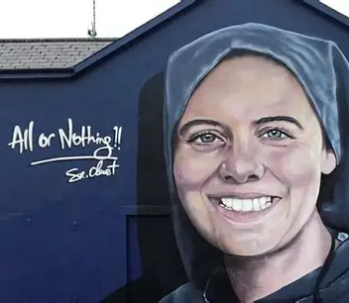
Who are some servants of God on the road to canonization at this time?
Michelle Duppong
Sister Clare Crockett
Chiara Corbella Petrillo
Nicholas Black Elk
Marcel Van
Brother Joseph Dutton
Father Edward J. Flanagan
Father Willie Doyle
Father (Don) Dolindo Ruotolo
Maria de la Luz Camacho
Leonie Martin
Adele Brise
Helena Kmiec
Father John Hardon
Father Joseph Kentenich

Slide 7
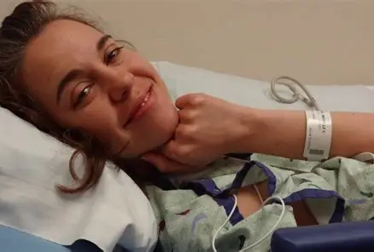
Who is Servant of God Michelle Duppong? How did she witness to Christ? (1)
Country of origin: United States of America
  Hometown: Haymarsh, North Dakota (born in Wheat Ridge, Colorado)
Years of life: January 25, 1984-December 25, 2015 (31 years)
State of life: Laywoman; unmarried
Occupation: FOCUS missionary and diocesan adult faith formation director (Bismarck)
Date of canonization cause opening: November 1, 2022
Resources about Michelle: “Radiating Joy” documentary; Radiating Joy: Journey of Hope book (compilation of writings)
Website for canonization cause: https://michelleduppongcause.org/ (Michelle Duppong Guild)

Slide 8
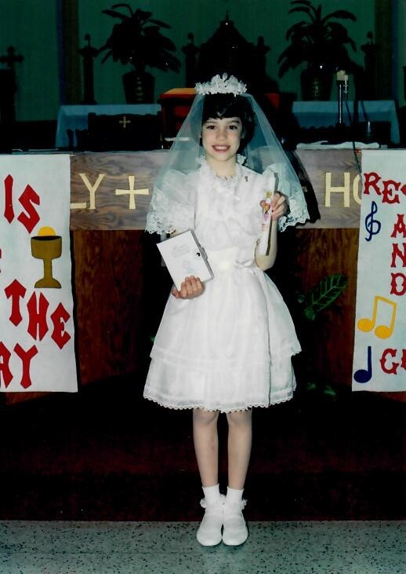
Who is Servant of God Michelle Duppong? How did she witness to Christ? (2)
How Michelle reflected Christ’s light: While battling cancer, Michelle offered up her suffering for souls. When visited by others, she did not focus on her own pain, but asked after others, praying with and for them, offering counsel, and being present for her neighbors. She demonstrated what it means to spiritually accompany people on their journey to Heaven, even praying the Holy Rosary over the phone with others while sick, and continuing to sing in praise of God. As an undergraduate, Michelle studied horticulture, having grown up on her family farm. She understood what it meant to patiently plant seeds, and nurture growth. Growing up, Michelle was a wholesome, intelligent, and vibrant young lady with a compassionate heart and a strong work ethic. She completed her farm chores, excelled in school (serving as the valedictorian of her senior class), and was involved in family life, helping her parents and five siblings. After Holy Mass on Saturday morning, she sold extra vegetables from the garden that she had grown with her family. On the farm, she herded sheep and bottle-fed the lambs. In a similar way, she would nourish and shepherd souls by helping them to be good disciples of Christ. With college students she mentored as a FOCUS missionary, she danced the waltz and cooked pasta, but also would go to the cemetery to pray for the holy souls in Purgatory, to whom she had a devotion. In a college speech class, she spoke in defense of the holy priesthood amidst the abuse crisis. In her genuine, warm, and engaging way, with simplicity, honesty, and delight, she brought others to embrace Christ, including through the Cross

Slide 9
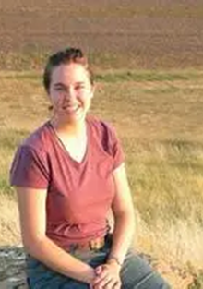
Who is Servant of God Michelle Duppong? How did she witness to Christ? (3)
Michelle had an attitude of joy and gratitude, accepting Jesus’ plan for her, and was proud that her birthday fell on the feast day of St. Paul’s conversion, because she loved sharing in his mission of evangelizing and bringing about conversion, not only through speaking aloud her testimony, but teaching through her actions of love and kindness. Putting her heart into all that she did, Michelle took part in a pro-life writing and art contest as a teenager, teaching herself calligraphy just for the contest, in order to create the most beautiful offering she could that would touch souls; she created a Nativity scene with lights at her family home for the Knights of Columbus, and prayed for the intercession of Our Lady when she undertook tasks, including when she lost a gift she had gotten for someone, going to Our Lady of Mount Carmel, who helped her to find the missing watch; Michelle always redeemed her time well, using it to glorify God; none of it was lost. Michelle participated with her family in attending conferences that involved Catholic witness speakers and Eucharistic Adoration. In her work as a faith formation director, she would develop similar offerings, including her diocese’s THIRST Eucharistic Conference. She made videos, wrote, offered symposia, and as many Eucharistic encounters as possible to adults to deepen their love for the Eucharistic Lord. When she attended holy hours, she would place herself humbly on the floor before the Eucharistic King. She did not have advanced degrees in theology, but demonstrated true wisdom of the heart in how she lived her life with such great charity, making a total self-gift with grace. Two months before she passed away, Michelle wrote a letter to Jesus thanking Him for her life, and for all of the souls He had given her, praying that He would fill them up in her absence, drawing them to know His love

Slide 10
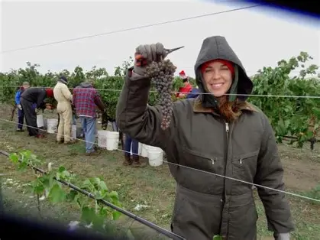
Who is Servant of God Michelle Duppong? How did she witness to Christ? (4)
One of the gifts from Michelle that Michelle’s mother treasures most is her relic medal from the Shrine of the North American Martyrs in Auriesville, NY. Michelle believed that all of the faithful should be ready to spiritually participate in martyrdom with Christ, out of love for Him, so as to bear witness to His great love, His heroic self-sacrifice. Michelle had a sense of zeal for souls, an infectious passion for her Faith that would touch others’ hearts. When teaching about penance, she used a toy armor set, writing types of mortifications on the pieces, like fasting, and gave them to the students with whom she worked, asking them to offer up the penitential practices for each other, praying for their classmates while completing the penances; in this way, she would instruct them in the way of self-giving love that she would embody with her life. She was a modern martyr who inspires us to similarly have hope, just as she did, never looking at death as the end, but to new beginnings that are constantly offered to us through Christ. This young woman who would climb hay bales and pick grapes in vineyards would come to mount Calvary Hill, uniting herself with Christ on the Cross, and pouring out her love for Him, just as Our Lord poured out His Precious Blood for our salvation. She would inspire countless others to do the same, offering their sacrifices and sufferings with Christ’s Sacrifice. Michelle would pass away from ovarian cancer; she had wanted to have children, but would offer her cross of illness for the conversion of students, lifting up her life to God for her spiritual children. Michelle, who had been a daily Mass-goer (walking from her apartment to 6:30 a.m. Holy Mass every day), brought the spirit of the liturgy, of self-sacrificing love, to other people, who said that visiting her was like going to a chapel. Now, women dealing with infertility who have prayed a novena for her intercession have received the gift of children from God

Slide 11
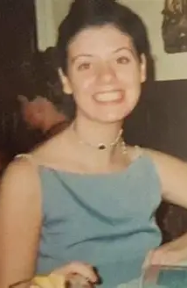
Who is Servant of God Clare Crockett? (1)
Country of origin: Northern Ireland
  Birthplace: Derry
    Place of passing: Ecuador
Years of life: November 14, 1982-April 16, 2016 (33 years)
Occupation: Actress
State of life: Religious sister (Servant Sisters of the Home of the Mother, Spain)
  Name in religion: Clare Maria of the Trinity and the Heart of Mary
Date of canonization cause opening: January 12, 2025
Resources about Clare Crockett: “All or Nothing” movie; Sister Clare Crockett: Alone with Christ Alone book

Slide 12
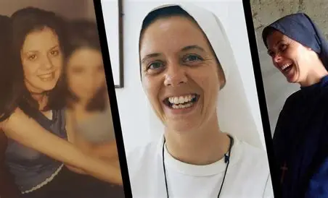
Who is Servant of God Clare Crockett? (2)
How she reflected Christ’s light: Raised in a culturally Catholic home, Clare received the sacraments of initiation, but wrote that her house was one where the Faith was practiced politically rather than religiously. In Northern Ireland, those who supported a unified Ireland were Catholic, and those who did not support a unified Ireland were Protestant, so Clare’s family was Catholic due to their political leanings, rather than by sincere religious sentiment. In pursuit of her dream to become an actress, Clare joined a talent agency at age 14, acted in stage plays, then began to land TV roles, including an opportunity to present for Nickelodeon. With her burgeoning theater and television career, however, came a lifestyle contrary to Catholic values. Drinking heavily and partying by the time she was sixteen, Clare lived dangerously, continuing to dream of walking the red carpet in Hollywood, but would soon begin to feel the emptiness of her life, and come to realize that the sorrow she felt could only be lifted by Christ, the Source of true happiness. Clare would come to give up everything for the One Who gave His life for her, leaving nothing for herself, and therefore, coming to gain everything. Sister Clare would come to be remembered as a friend, because she could radiate the love of our greatest Friend, Our Lord, Jesus Christ

Slide 13
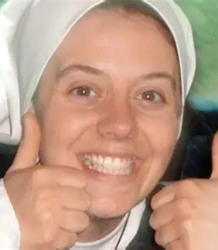
Who is Servant of God Clare Crockett? (3)
It was by pure happenstance that she was sent on a pilgrimage to a monastery in Spain in the year 2000; believing that she was going on vacation to the beach, she came to find that there had been a mix-up, and that she would really be going on a religious retreat. Accepting it, Clare later noted that she had been happy during the trip, and that her conversion would come about as a result of it; everything had been designed by God. On Good Friday, during the veneration of the Cross, Clare experienced a profound inner awakening, a spiritual transformation, as she kissed the feet of Christ, realizing that He had given His life for her. She understood this on the deepest level, as a personal gift, and would change her way of life as a result of it. Sister Clare made her profession of vows on September 8, 2010, the feast day of the Nativity of Our Lady, which was appropriate, for in sharing Our Lady’s joyous Heart of love, she would lead others to rebirth in Heaven, inspiring future vocations (she had entered the convent as a candidate on August 11, 2001, just a year after she first discerned her call, and on the feast day of St. Clare, her namesake! Like St. Clare, she would shine Christ’s light). Her parents had initially opposed her vocation, because her lifestyle change was so sudden and drastic, that they questioned the sincerity of it, but Sr. Clare persevered, saying and showing that Jesus had stolen her heart. In her ministry as a religious sister, she would come to serve over 400 underprivileged children who would not otherwise have access to Catholic education; she would share God’s love with them in every way, from playing soccer with them to strumming songs on the guitar for them

Slide 14
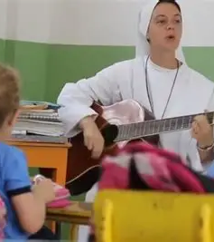
Who is Servant of God Clare Crockett? (4)
Clare would discern God’s call for her to become a nun, and would answer the call. She would use her talents in performing arts as a voiceover actress for a children’s television program called “Hi, Lucy!” on the Catholic channel EWTN. Her sparkling personality and gifts in acting would captivate her audiences, including preschoolers who retained her catechetical lessons, thanks to her engaging style of presentation. She would also contribute beautiful vocals to worship songs, singing until she lost her voice, and in spite of migraines that she experienced. Her heart was that of a self-sacrificing servant, deeply united with the Heart of Jesus. She offered all to Him, joyfully completing every task, never with any complaint, and went wherever He called her to go to
In 2016, Sister Clare was preparing to pray the Holy Rosary after having given music lessons to students when an enormous earthquake hit Ecuador, the country where she had been serving; they would be placed in Our Lady’s hands still, spiritually participating in the sacred mysteries in a deeper way. Several days prior to the earthquake, there had been a flood that weakened the foundation of the building where the lessons took place, so the students were eager to return. It had been their first time attending Holy Mass there since the flood. God would cleanse and purify through this experience, preparing the way for future saints. The earthquake would kill hundreds, including Sister Clare, who was attempting to go down a flight of stairs when killed; anyone on the staircase did not survive, whereas those on the floors above did. Other sisters in her order were pulled safely from the rubble; one of her sisters had gone upstairs to save the Blessed Sacrament from the tabernacle, and not only rescued Our Lord, but was rescued by Him, in that she survived the earthquake with just a broken ankle
Notebooks filled with Sister Clare’s writings would later be found, providing insight into the holy life of this saintly young woman whose conversion story is an inspiration for all. Sister Clare began her life in Ireland, and served as a missionary in other territories, but now, her mission has returned to Ireland; her goal had been to evangelize there, too, and she continues to, as a following has grown from devotion to her, especially in Derry, where she was from; she has breathed new life there, inspiring others to run into the outstretched arms of God as she did. To the very end, St. Clare would be oriented towards the beginnings that we have in Christ, thinking only of serving Him, as she helped others down the stairs, but truly, was helping them to ascend the stairs to Heaven

Slide 15
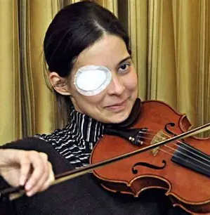
Who is Servant of God Chiara Corbella Petrillo? (1)
“The second St. Gianna Beretta Molla”
Country of origin: Italy
  Hometown: Rome
Years of life: January 9, 1984-June 13, 2012 (28 years)
Occupation: Public speaker
State of life: Married; mother
Date of canonization cause opening: June 12, 2017
Resources about Chiara Petrillo: Chiara Corbella Petrillo: A Witness to Joy book
Canonization website: https://www.chiaracorbellapetrillo.org/en/

Slide 16
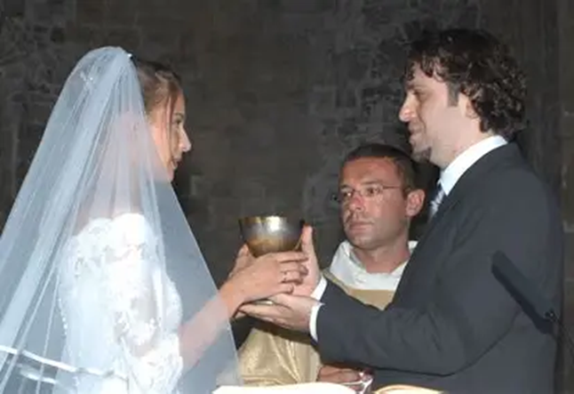
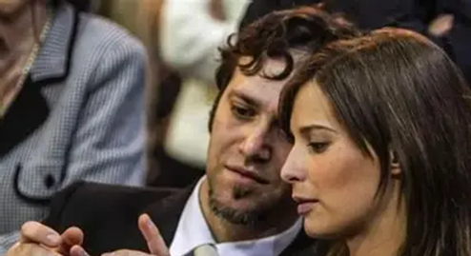
Who is Servant of God Chiara Corbella Petrillo? (2)
How she reflected Christ’s light: Chiara Corbella, remembered as a cheerful, smiling young woman, began attending prayer groups with her mother as a child. She learned to relate to Jesus as her friend, and turned to Him for everything. As a young adult, she began dating Enrico Petrillo after meeting while in Croatia. They both began to receive spiritual direction, which guided them through difficult times in their relationship. Their mutual friend was Fr. Vito, a Franciscan friar. Franciscan spirituality was at the heart of Chiara’s and Enrico’s shared faith. They joyfully accepted their crosses, uplifting them for God’s glory. After the couple married, Chiara became pregnant with their first child, but soon thereafter, learned that the baby was not developing typically. Their daughter, Maria Grazia Letitia, would pass away less than an hour after Chiara gave birth to her

Slide 17
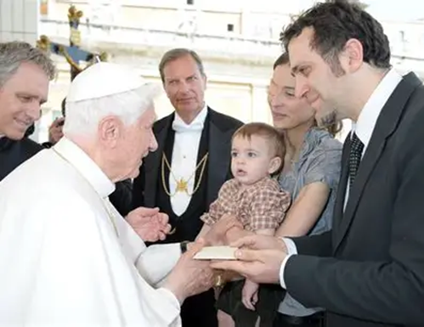
Who is Servant of God Chiara Corbella Petrillo? (3)
The couple’s second baby, Davide, would pass away under similar circumstances, also less than an hour after his birth. Both losses strengthened the faith of the couple, who came to realize that the children were not created by God for this life, but for the next, and that they belonged to Him, which allowed them to respond to their losses with peace and thanksgiving for the gift of life. Chiara and Enrico became pro-life speakers, sharing their story with other couples, who would come to choose life like they had. When developmental complications were detected by doctors, they had advised Chiara to abort her babies, but she chose life. Chiara loved her children as creations of God; no matter how short their lives, or her own, an impact was made, for Our Lord was Present within them. While Chiara’s third child would be healthy, born without complications, she learned during her pregnancy with her third child, Francesco, that she had cancer. Even so, she would still bring life to other souls, for her life came from that extended to her spiritually by Christ, as Chiara received Holy Communion, the Bread of Life, every day

Slide 18
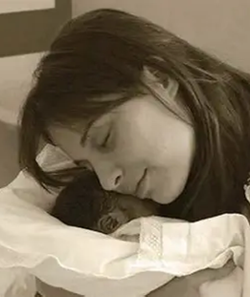
Who is Servant of God Chiara Corbella Petrillo? (4)
Still, she chose to delay treatment until after Francesco was born. Knowing that she would pass away not long after his birth, she entrusted Francesco to the Blessed Mother, taking him to Assisi, which had been a special place for her and Enrico. She had even met Enrico on the feast of Our Lady of Angels, August 2, the day on which the Portiuncula indulgence is granted, in honor of St. Francis of Assisi’s favorite chapel. In a letter written to her son, Francesco, Chiara told him to stay with his father, while she would be waiting for him in Heaven, caring for his brother and sister there. Even her parting words to him were to glorify God, to remind him that he was made for eternity. Enrico would choose a special tribute to Chiara for her memorial prayer cards, writing, “We are born to never die,” the perfect testament to the godly life of love, an undying love, that Chiara lived. Chiara and Enrico had a sense of serenity, surrendering all to God; they carried their crosses through His grace, doing all in union with Him

Slide 19
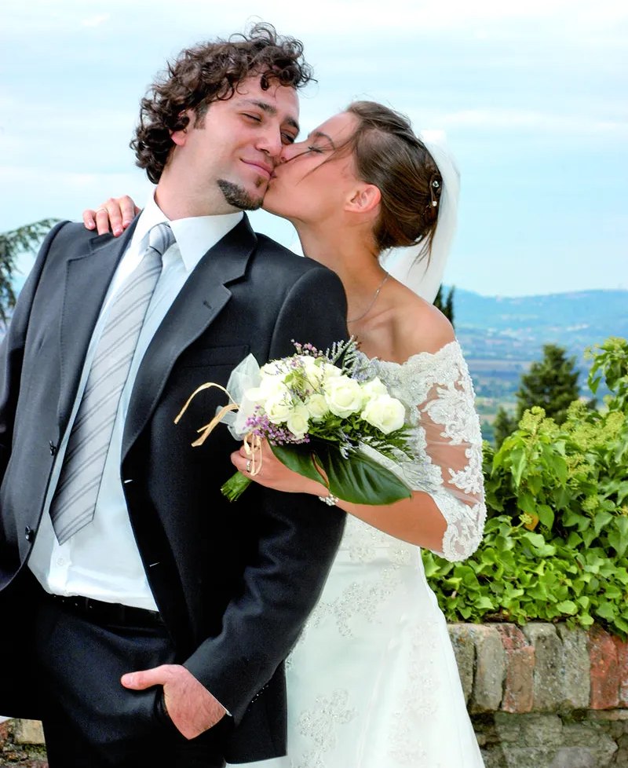
Who is Servant of God Chiara Corbella Petrillo? (5)
Before her babies, Maria and Davide, passed into the next life, Chiara and Enrico gave them tau cross necklaces in honor of St. Francis. The tau cross has three rather than four points; it makes a “t” shape, without a top vertical beam, to remind us that we are only completed when we go to Heaven. Chiara’s life was a witness to this truth, as she wrote about all being a gift from God. She told her husband that the cross was sweet, and died happily, after telling all of her family members and friends that she loved them. Her life of heroic maternal love would lead many others to choose life out of love, too; though her cancer caused her to lose sight in one eye, she never lost sight of what was most important, using her time impactfully. She did not complain, but offered everything for God’s glory; her family members knew that she was suffering, but she did not show it. Enrico did not respond to Chiara’s terminal illness with anger, but acceptance; Chiara had inspired him, so he responded to her illness and passing with her grace, saying that he could not be angry, in knowing that she would go to be with God, Who loves her more than anyone. Chiara radiated Christ’s light, because she saw it shining everywhere; she related her experience of cancer to the experience of the Emmaus disciples who only recognized Jesus when He broke the bread; she wrote about coming to recognize Jesus in the cross of cancer that He gave her. Chiara would pass away in her wedding gown; it was a testament to her love of love, of serving God lovingly through the sacrament of marriage, which helped to make her into a saint, and through which she would form future saints, too

Slide 20
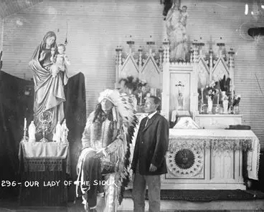
Who is Servant of God Nicholas Black Elk? (1)
Country of origin: United States of America
  Birthplace: Wyoming; hometown: Pine Ridge/Manderson, South Dakota
    Tribe: Oglala Sioux (Lakota)
Years of life: December 1, 1863-August 17, 1950 (87 years)
Occupation: Catechist (role similar to permanent deacon)
State of life: Married; father
Date of canonization cause opening: October 21, 2017
Resources about Nicholas Black Elk: Nicholas Black Elk: Medicine Man, Catechist, Saint book

Slide 21
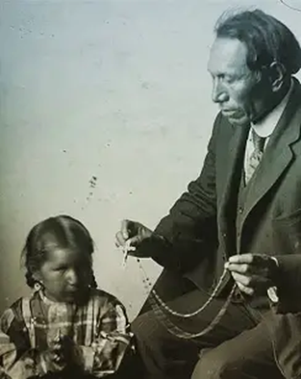
Who is Servant of God Nicholas Black Elk? (2)
How he reflected Christ’s light: A holy man, Black Elk would be baptized with the name “Nicholas” on his feast day, December 6, professing the Catholic Faith. He said he believed the words of the Creed, and had chosen to become a Catholic. In a large territory where priests would serve as circuit riders, celebrating Holy Mass once a month at some parishes, Nicholas would serve in the interim as a kind of permanent deacon, seeing to the needs of the people in the absence of a priest, which is permitted in a time of critical shortage. As a lay catechist, he instructed others in the teachings of the Church, most effectively by living them out. Nicholas underwent a deep conversion, for he was born at the time of westward expansion, when white settlers were making incursions into Native American territories, battling with them for ownership of the land. Participating in the Battle of the Little Big Horn in 1876, Nicholas Black Elk was a cousin of the warrior Crazy Horse, and would, at one time, boast about the soldiers he had scalped in the battle, but would come to embrace all people as children of God, supporting his neighbors in the spiritual battle, fighting the good fight for Christ. Prior to his conversion, he acted in Buffalo Bill’s Wild West Show, which offered reenactments of famous battles. His biography “Black Elk Speaks” would be a transcription of interviews published in the 1930s, which covered his cultural ways as a Native American; the book would become popular in the 1960s with a revival of interest in ancient tribal wisdom, but would leave out any mention of the conversion that Nicholas had, though Nicholas protested this omission of information, lamenting that he had trusted the compiler of the volume, only to be betrayed. While Nicholas had been a warrior for a brief interval, he was a holy man at heart, continuing his father’s and grandfather’s tradition of serving as a medicine man; he had begun to experience visions while still quite young. At the Battle of Wounded Knee, he went out to heal the wounded people rather than to fight. Walking right into enemy fire, he emerged unscathed. Already, at that point before converting to Catholicism, he was embodying the Christlike fortitude and charity needed to live out the Faith authentically. Drawn to Ignatian spirituality, Black Elk would practice the Ignatian spiritual exercises, and guide others on retreats using these tools
In the 1890s, Black Elk married a Catholic convert, who passed away in 1903. That same year, he had been called by a family whose son was severely ill, at the point of death. The child was baptized Catholic, but in desperation for healing, the family called both Black Elk, the medicine man, and a priest. Black Elk began the healing ceremonies, beating drums that the priest would cast out. Jesuit priests had come to form the Holy Rosary Association at Pine Ridge, and condemned any pagan practices, but invited Black Elk to the Holy Rosary Association to learn. He was impressed by the priests, not becoming angered by their condemnation of his practices as a medicine man. He remarried another Catholic convert, and himself converted. Nicholas would come to be a leader, and mobilize other Native Americans to practice the Catholic Faith, inspiring them to have hope in God, Who transcends earthly boundaries, and is perfect peace and unity, amidst war and strife. He would empower other Native Americans to teach the Faith, going out to tribes on other reservations to share God’s love with them. As they lost their homes to white settlers, and were pushed onto reservations, Native American tribes out west could find their homes in Christ, coming to trust in Him when they could not trust settlers who failed to keep their promises. Black Elk’s dedicated service to them would reflect God’s Providence, and the unfailing service of Christ

Slide 22
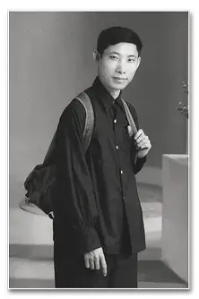
Who is Servant of God Marcel Van? (1)
Baptismal name: Joachim
Country of origin: Vietnam
Years of life: March 15, 1928-July 10, 1959 (31 years)
State of life: Redemptorist lay brother
Date of opening of cause of canonization: 1997
Resources about Marcel Van: Marcel Van: The Triumph of Love book; The Autobiography of Marcel Van book; Marcel Van: Hidden Apostle of Love movie

Slide 23
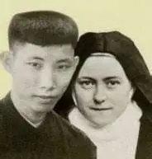
Who is Servant of God Marcel Van? (2)
How he reflected Christ’s light: Marcel Van was born into a Catholic area of Vietnam. Aa a whole, seven percent of the country is currently Catholic. Marcel’s efforts would help to further Christianize the country. Marcel Van would receive special revelations from the Sacred Heart, and would share what Jesus taught him, namely, that His love is meant for us all. His mother would foster in him a tender love for our heavenly Mother, Mary, leading Marcel to a deep love of the Holy Rosary and other special devotions he happily practiced with his family. As a child, he organized processions to honor Our Lady. At age six, Marcel Van made his First Holy Communion; he would later make a vow of virginity in honor of the Blessed Virgin, and would form a group at school called “Angels of the Resistance,” who would strive to model Christian behavior to classmates, namely, purity, and resist temptations
Called the “Little Redemptorist,” and the “little brother” of the “Little Flower,” Marcel Van received visions of St. Therese beginning at age fourteen, when, as a student in the minor seminary, he had been seeking a suitable book to read, and discovered St. Therese’s autobiography, The Story of a Soul. He had been praying that the Blessed Virgin Mary would guide him to choose the best possible reading material to help him to find direction in his life, for Marcel Van very much wanted to become a saint, but was in need of good examples of how to become one. Up to this point, Marcel Van’s only reference point for sainthood for extreme ascetic examples, but St. Therese would give him the “little way” that he needed. When Marcel opened up his heart to her, loving this pure saint and choosing her to be his sister, as he had never had a friend in whom he could confide before, but felt connected to St. Therese, she responded in kind, telling Marcel that he would be her brother, and bringing him messages from God. When he was distraught, expressing his anguish in tears, St. Therese would gently chide him not to cry, and would even sing to him. Their friendship would show that to grow in holiness, we need the saints, whom we may always call upon; serving God means serving with others. It was St. Therese who delivered Marcel the news that he was not chosen to become a priest, but to be an apostle to the apostles, an apostle of love. Like Our Lady, he was to have a hidden apostolate, in which he would be a missionary to missionaries, revealing the heart of the priesthood in how he ministered to others, bringing them Christ’s Heart of service and self-sacrifice. When in a work camp, he would minister to other prisoners as though serving members of a parish; he listened to their anxieties, prayed with them, and counseled them, telling them that when their burdens were too heavy to carry, they could give them to Our Lady. As part of their labor, they were forced to move stones; all during that time, Marcel Van would move mountains with his faith, and would help others to trust in Christ, the cornerstone

Slide 24
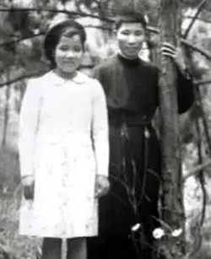
Who is Servant of God Marcel Van? (3)
He had been chosen by God to be the second Little Flower. Saint Therese had brought souls closer to Christ, and Marcel Van would help to lead them to Our Lady so that they could come near to Jesus. After receiving a vision of St. Alphonsus Liguori, founder of the Redemptorists, blessing and enfolding him in a fatherly embrace, Marcel chose to enter the Redemptorist order, which had a special devotion to Our Lady, especially Our Lady of Sorrows. Taking the name “Marcel,” he began his life as a religious, and wrote a spiritual text that would number nearly 900 pages; a priest would translate the work from Vietnamese into French. His final profession of vows was made on September 8, 1952; as a lay brother, Marcel would serve as a tailor, and would help souls to become tailor-made to Christ; incidentally, his father had also worked as a tailor. Saint Therese had always dreamed of serving as a missionary, especially in Vietnam, where her spiritual hero, St. Theophane Venard, had served, but instead, would be a spiritual missionary to the young Vietnamese man, Marcel Van, helping him to find his way to Heaven. While Marcel Van had wished to become a priest, he would be a spiritual father in a different way, ministering to prisoners of war with great love and gentleness, guiding them with hope towards a difficult time, as they faced their potential martyrdom. He was overheard in conversation with Jesus, Mother Mary, and the saints, listening to them faithfully. In his life, Marcel would face many traumas, including clerical abuse, and even a time of homelessness, but like St. Therese, would bring others to love Christ for his joy amidst suffering, his willingness to carry the Cross lovingly and cheerfully along the little way of humility and simplicity that God chose for him, and which he adapted to when it was not the pathway that he had expected. Marcel shows us that when we are friends with Jesus and Mother Mary, we can be a true friend to all. Experiences of suffering that could have left him bitter only made him better, as he placed them into the hands of Jesus and Mother Mary to make beautiful for their glory. Abused by envious classmates, and subjected to turmoil in his home, caused by the anxiety of crop failure on their farm, his father’s alcoholism, and the disability of his brother, Marcel Van could be sanctified through all that he experienced, because he lived it in union with Our Lord, the Crucified Christ. For going to communist northern Vietnam in the effort to convert souls there to Christ, Marcel would be sentenced to imprisonment for fifteen years, including forced labor, but would face this with hope and cheer, too, choosing to continue to serve God, to keep the Divine Prisoner company in His cell

Slide 25
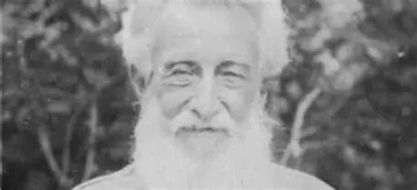
Who is Servant of God Joseph Dutton? (1)
Name at birth: Ira
  Baptismal name: Joseph
Country of origin: United States of America
  Hometown: Stowe, VT; place of passing: Honolulu, Hawaii
Years of life: April 27, 1843-March 26, 1931 (87 years)
State of life: Layman
Occupation: Orphanage director; medic; carpenter; repairman
Date of canonization cause opening: 2022
Resources about Joseph Dutton: Joseph Dutton: His Memoirs book; Joseph Dutton: His Life, His Service, His Legacy book
Canonization website (Joseph Dutton Guild): https://www.josephdutton.org/

Slide 26
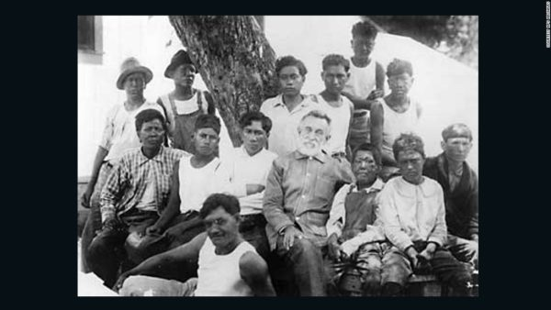
Who is Servant of God Joseph Dutton? (2)
How he reflected Christ’s light: While not actually a religious brother, Joseph Dutton was known as “Brother” Joseph, because he was a friend to all, and was a Franciscan tertiary. Raised Protestant, he would be baptized a Catholic at age 40, taking the name “Joseph,” because he admired the humble carpenter and father so much. As a young man, he had been married, but after his wife’s infidelity, and her eventual departure, he was heartbroken; always hoping that she would return, he did not file for divorce until years after her abandonment of him. Relying on alcohol to self-medicate amidst this emotional pain, exacerbated by the traumas he experienced while serving as a soldier in the Civil War, Joseph Dutton continued working in many different capacities, including on the rails; at a distillery; in cemeteries; in various business endeavors; and in the war department, handling claims made against the government. When the war had broken out, he had been teaching Sunday school and working in a bookstore

Slide 27
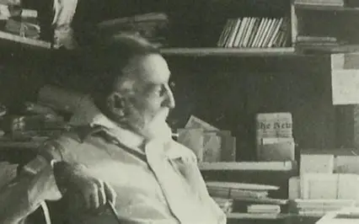
Who is Servant of God Joseph Dutton? (3)
Eventually, Joseph would realize the damage that his alcoholism was doing to himself, and would turn away from this habit, towards God for healing. After his conversion and reception into the Church, he joined the Trappist Gethsemani Monastery in Kentucky, where Thomas Merton had been, but would depart after nearly two years, realizing that God had not called him to contemplative life. Having read about the Dutch priest St. Damien de Veuster’s ministry to lepers in their colony on the island of Molokai, Hawaii, he determined that God was calling him to make reparations for his past sins by serving those with Hansen’s disease alongside St. Damien

Slide 28
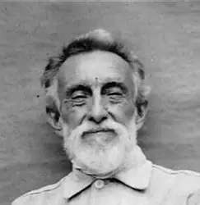
Who is Servant of God Joseph Dutton? (4)
Upon arriving at Molokai, Joseph greeted St. Damien with the words that St. Damien himself had said when he arrived: “I am here to help. I am here to stay.” With the heart of a servant leader, like Christ, Joseph served capably as an administrator, becoming the director of the orphanage for boys with leprosy, while St. Marianne Cope served girls with leprosy at their orphanage on the island. He bandaged wounds, built and fixed structures, managed, and taught. A persuasive writer and talented businessman, Joseph Dutton wrote letters seeking funds to support the leper colony, even befriending Theodore Roosevelt, who helped the cause. He would even contribute his own two pensions from his precious occupations to enable the work of the leper colony, providing needed materials. His labors were completed joyfully; no one had ever witnessed him losing patience, or heard him raising his voice. Joseph was a person of peace who embodied love in his actions, much like St. Joseph the Worker. For 44 years, he served the lepers, who had become his family. These souls abandoned and ostracized by society had been loved and embraced by a man who himself knew the pain of abandonment and exclusion, similar to Christ. When St. Damien was preparing to pass into the next life, he said he could do so with peace, because everything would be entrusted to “Brother Joseph,” a preserver of the family that everyone could count on, comparable to St. Joseph

Slide 29
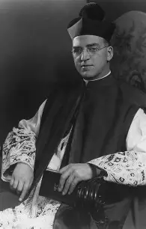
Who is Servant of God Edward J. Flanagan? (1)
Country of origin: Ireland
  Birthplace: County Roscommon
Years of life: July 13, 1886-May 14, 1948 (61 years)
State of life: Priest
Date of canonization cause opening: March 17, 2012
Resources about Fr. Edward Flanagan: Legacy of Devotion book
Canonization website: https://fatherflanagan.org/

Slide 30
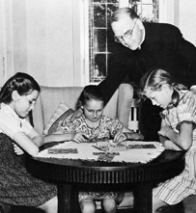
Who is Servant of God Edward J. Flanagan? (2)
How he reflected Christ: Edward Flanagan grew up in a devout home where he could often be found praying the Holy Rosary; he was the eighth of eleven children. Coming into the world prematurely, he was held by his grandfather close to his heart while they sat near the hearth, wrapped in blankets, in an effort to keep the baby at a healthy internal temperature. The warmth and brightness of Christ’s Heart would guide him forward, and ignite a deep love of the Lord in Him for the rest of his life. Dealing with frail health throughout his life, during his childhood, Edward was given the task of being a shepherd, which was less physically demanding than other chores, and would come to shepherd souls in his adulthood. Even in the rain, Edward and his father would go out looking for lost sheep with their rosary beads in hand. From his father, he would learn what it meant to be a spiritual father, to keep searching for Christ, and to guide His people to know Him, to keep pursuing His Sacred Heart, because no one is too lost, too far-gone, to be found by the Good Shepherd. It was at the age of six that Edward first discerned a call to the holy priesthood
In 1904, Edward and his sister, Nellie, came to the United States of America. Edward would go to seminary in Maryland, being ordained in 1912. He moved in Nebraska with his family to improve his health, after having lived in New York City for a time. His studies as a seminarian had taken him from Rome, Italy to Austria and Germany
When a tornado ripped through Omaha, Nebraska, Fr. Flanagan worked to help the survivors (also gathering the dead and burying them), creating shelters for them, and bringing them needed supplies. The shelter would become permanent, as he began to care for the homeless, and to house drifters during World War I. Ministering to the people, he encountered common themes, noting that unhoused adults often had experienced trauma as children, typically coming from broken homes. He began to study social theories, and to apply them to his work with children in the juvenile justice system, aiding them in establishing healthy routines. He would discover that God was calling him to this work full-time, and would begin his ministry to children in need by founding homes for them; with religious sisters, he would develop an academic program for them
The founder of Boys Town, Fr. Flanagan converted a former farm into a home for boys, with five buildings dedicated to housing and serving the boys, who would learn from their spiritual father how to honor God, especially in prayer. Father Flanagan had a devotion to the Divine Office and Our Lady, praying the Holy Rosary every day, and would always be the first person in the chapel, encouraging all of the boys to pray, but to choose the devotions they would use to pray. Father helped to reform youth care institutions, including in his native Ireland. At least 89 different institutions around the world have models inspired by his, and while in his lifetime, over 6,000 youth were in his care, now, there are certainly many more being impacted. Calling his work “God’s work,” Father Flanagan assured others that after his death, his work would continue, because God would see to it that it did; he trusted in God, and showed that to serve God is to serve with faith and humility, to realize that the service is only possible because of God, to be shepherded by the Lord, that we may be shepherded by others

Slide 31
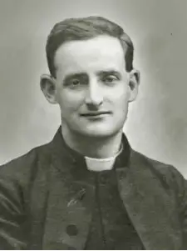
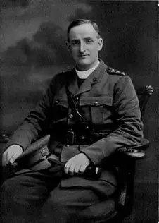
Who is Servant of God Fr. Willie Doyle? (1)
Country of origin: Ireland
  Birthplace: County Dublin
Years of life: March 3, 1873-August 16, 1917 (44 years)
State of life: Priest; military chaplain
  Religious order: Society of Jesus
Date of canonization cause opening: October 27, 2022
Resources about Fr. Willie Doyle: To Raise the Fallen book
Canonization website: https://williedoyle.org/ (Father Willie Doyle Association)

Slide 32
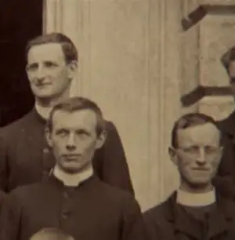
Who is Servant of God Fr. Willie Doyle? (2)
How he reflected Christ’s light: Born into a family of seven children, Fr. Willie’s family was known for their great love, which was expressed through acts of charity to all out of love for God, including service to the poor, who would congregate at the Doyle home at Christmastime, knowing that the family would greet them with true good will and compassion, in celebration of the Birth of Christ, the Light of World Who came to redeem us all, born into material poverty to enrich us spiritually. As a child, Fr. Doyle enjoyed activities typical to children his age, including cricket and swimming, but also continued his family’s legacy of service by aiding the poor, especially by painting and cleaning their houses. When he knew that a neighbor was dying, and had not yet confessed his sins to a priest, the young Willie Doyle stayed with him for eight hours until he agreed to go to Confession, and did, before dying. Father Willie Doyle’s dream was to become a Jesuit martyr. Writing his intentions down in a prayer, a kind of consecration, to Our Lord through Our Lady in 1893, he signed his name in blood in a document. He even scratched the name of “Jesus” onto his heart with a knife, offering his future martyrdom to Our Lady; he would participate in a kind of spiritual martyrdom with her through persevering in denying himself and working diligently. Once ordained a priest, he traveled throughout Ireland to preach missions, and served those with emotional wounds, helping anyone who was marginalized, hurting, and in need of Christ’s self-giving love. Father Doyle contributed in a particular way to the movement to evangelize to workers, creating opportunities for them to go on retreat and learn about their Faith; he would wait outside of the factories and docks to speak with the laborers there and help them. Besides all of these activities, Fr. Doyle promoted abstinence as part of an association, helped to found the Poor Clare convent in Cork, created an association for the spiritual support of priests, and raised significant funds for the missions, including those to Africa. While Fr. Doyle would not fulfill his dream of going to Africa to serve as a missionary, he would complete missions to those immediately surrounding him

Slide 33
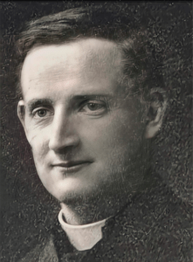
Who is Servant of God Fr. Willie Doyle? (3)
Completing exacting penances that he offered up for God, Fr. Willie Doyle would subject himself to such mortifications as extreme cold, kneeling on the floor for long periods of time or lying prostrate amidst harsh elements
Throughout his life, Father Doyle would deal with a digestive ailment, as well as with anxiety, as when he had a nervous breakdown following a fire in his novitiate, but he would transcend his battles by going into battle as a military chaplain, fighting for the salvation of souls, especially by showing them Christ’s self-sacrificing love, the love of the Lamb that never stopped fighting for them. Father Doyle was a joyful man who could appreciate practical jokes, but also, was serious and compassionate, feeling deeply for others. He would never rest, serving people constantly, all with an upbeat, hopeful attitude; his sufferings while in the trenches with soldiers (despite having the rank of “captain”) would be offered in reparation for the sins of priests. Besides tending to souls in his immediate care, he would write letters of wise counsel to others, spiritually ministering to souls in numerous capacities, receiving dozens of letters every day
All that he did was in preparation to become a martyr for Christ. Inflamed with love, he would serve others patiently, tenderly, and cheerfully, dashing from soul to soul like “an angel on the battlefield” to care for each soldier in his ministry as military chaplain during World War I. He would pass away in going to the frontline to help Protestant Northern Irish soldiers, never discriminating against anyone, but seeing all as people of Christ in need of love. Saints such as Teresa of Calcutta would be inspired by Fr. Doyle, who, not unlike St. Therese, approached the pursuit of holiness gradually, through being perfected in little things

Slide 34
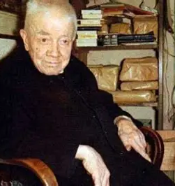
Who is Servant of God Father (Don) Dolindo Ruotolo? (1)
Country of origin: Italy
  Hometown: Naples
Years of life: October 6, 1882-November 19, 1970 (88 years)
State of life: Priest
  Franciscan tertiary
Petition for the canonization of Don Dolindo: https://www.dolindo.it/en/

Slide 35
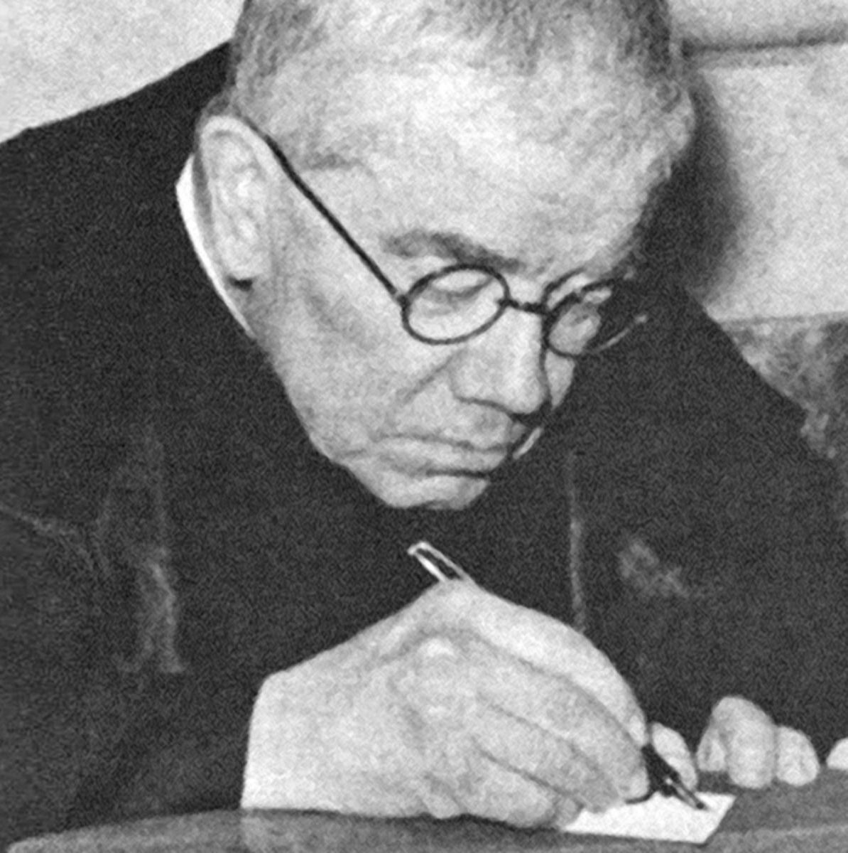
Who is Servant of God Father (Don) Dolindo Ruotolo? (2)
How he reflected Christ’s light: Named “Dolindo,” meaning “pain,” Don was chosen by Jesus to undergo a martyrdom of the heart. At the age of one, Dolindo’s suffering began, as he underwent painful surgeries to correct his hands, and to remove tumors. He would hide from his abusive father in a drawer. Refusing to properly care for his children, depriving them of adequate food or clothing, Dolindo’s father required Dolindo and his ten siblings to memorize information by rote rather than sending them to school, physically abusing them even when they correctly memorized passages. Once Dolindo’s parents separated and he was sent to school, he was so traumatized by his experiences, that he could not retain information, even though he could memorize it. Praying for the grace to learn so that he could become a priest, if it was God’s will, he went to Our Lady, who answered his prayer at age thirteen; he had been looking at an image of Our Lady, and praying the Holy Rosary, when he offered her his intentions for the grace of knowledge and wisdom. Infused with supernatural knowledge, Don could write the most articulate and beautiful poems and plays, also deftly explaining complex theological concepts. From thereon out, he would excel academically, coming to be known for his spiritual wisdom. Don Dolindo, in sharing in the mystery of Christ’s Passion, would come to love with His compassionate Heart, too, forgiving his father for his trespasses, because God the Father forgive all of our trespasses

Slide 36
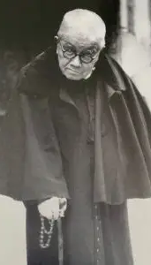
Who is Servant of God Father (Don) Dolindo Ruotolo? (3)
Dolindo would have a devotion to Our Lady, calling himself “the Madonna’s little old man.” Favored with many graces and mystical visions, Don Dolindo was rewarded for his heart opened entirely to Christ, which was filled with trust, and could therefore be filled with many gifts from God. He even had the gift of prophecy, correctly predicting the papacy of John Paul II. Dolindo spent hours in Eucharistic Adoration, speaking heart-to-heart with Christ. He received deep insights into the Heart of Jesus. Our Lord revealed to him that He wanted people to place confidence in His Heart by going to Him with their struggles. Rather than attempting to work through issues on their own, or to pray for specific resolutions, prescribing their own remedies, Our Lord said that He wanted His faithful to offer one simple novena, offering all to Him, the Divine Physician, for their cure: the prayer He gave others to pray was the 11-word invocation “O Jesus, I surrender myself to You. Take care of everything.” This surrender novena devotion that Dolindo developed in response to Our Lord’s request grew in use among the faithful, who learned that Jesus kept His promise to respond to His people’s prayers of entrustment by giving them everything they needed, for He wants to take over for us, and to help us, since He is our Savior, and the only One Who can help. Jesus wants us to have the cure we are seeking. From the novena, Dolindo would develop the Rosary of Abandonment, which involves praying the surrender novena on each of the beads in every decade, alternating with the invocation “Mother Mary, guide me”

Slide 37
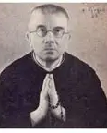
Who is Servant of God Father (Don) Dolindo Ruotolo? (4)
Dolindo’s admirer, St. Padre Pio, would remark to a group of pilgrims who came to see him from Naples that he could not understand why they would leave Naples to see him when they had Don Dolindo. Saint Padre Pio called Don Dolindo a “saint,” attesting to his miracles
In 1997, 27 years after Dolindo’s passing from this life, a monsignor, Pappalardo, was preparing for Holy Mass, but was running late. He worked for the branch of the Vatican that investigates canonization causes, helping to canonize people as saints. While in the sacristy preparing for Holy Mass, the monsignor noticed an elderly man seated by himself; he noticed that the man carried a bag of stones. He asked the man if he would like his Confession heard; the man called him a “little angel,” but told him he was running too late to be able to hear confessions. When the man learned that the monsignor worked on canonizing people, he asked if Pappalardo would canonize him. Pappalardo explained that a person cannot be living to be canonized, but the man simply laughed in response. Following Holy Mass, Pappalardo did not see the man in person again, however, he met someone who showed him a picture of Don Dolindo, whom Pappalardo recognized as the man he had seen in the sacristy. He learned that Dolindo had been a spiritual director to his new acquaintance, and that he had been deceased for nearly three decades. Pappalardo also learned that Don Dolindo carried bags of stones with him to offer as penance for sinners, in reparation to Christ. He thought of the stones as treasures to store up in Heaven

Slide 38
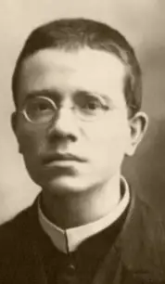
Who is Servant of God Father (Don) Dolindo Ruotolo? (5)
Dolindo did not suffer complainingly, but with great love. With his deep devotion to the Passion of Our Lord, he could compassionate greatly with Our Lord, and was happy to suffer with Him, seeing every cross to carry as a great gift from God, a source of joy allowing him to be sanctified, giving him access to many heavenly rewards
One of the forms of suffering that Don experienced was an emotional one, as he was punished for criticizing the historical-critical method of biblical scholarship, which he believed was a modern error. His 10,000-page, 33-volume commentary on Sacred Scripture would even be banned, but after being suspended (barred from exercising his priestly faculties) for 19 years, undergoing countless Vatican trials during which ludicrous accusations were made against him, he would be cleared of any charges. Throughout it all, he remained obedient, offering up his suffering for the Church. He said that receiving Jesus in the Blessed Sacrament was his key to strength, and that we all should love the Church, for the Church is Christ. He had been ordained at age 23 in 1906, but was not fully reinstated until 1937, when he was again permitted to celebrate Holy Mass, by Pope Pius XI
Like St. Padre Pio, Don Dolindo had the stigmata, the holy wounds of Christ. Available to suffer with everyone, and to offer them healing through Christ, he “prescribed” abandonment to God’s will, with daily drops of “Hail Mary” prayers, as the ultimate cure, and would encourage people to visit his tomb, and to knock on it when seeking answers to their petitions, so that he could continue to help by praying for them from his place in the next life

Slide 39

Who is Servant of God Father (Don) Dolindo Ruotolo? (6)
As Don suffered greatly during his suspension, being totally interiorly united with Christ on the Cross, saying that the True Cross is one that drags behind us, leaving us humiliated, his spiritual life underwent three stages: initially, he had prayed only for suffering, making himself a victim soul in 1910, and renewing his prayer in the early 1920s. Then, in his second stage of growth, as the crosses became heavier, he would pray only to do God’s will. In in the third stage, he would pray in thanksgiving to Christ, whether in times of relief or suffering, coming to love God so deeply, that he requested only what God wanted of him, and could rejoice even in his weakness, when Christ would show His great strength. The more Dolindo suffered, the more humble, beautiful, and Christlike his soul became. He remained joyful, hopeful, and sweet, kissing the hands of the poor who came to visit him, and begging their pardon. He covered the sick with his cloak so that they would be sheltered in the peace and security of Christ’s Heart; he was like St. Joseph, whose holy cloak the Holy Infant, Jesus, would have been nestled against. As his physical suffering increased, between his arthritis, and his ulcerous, wounded legs, then paralysis for the last ten years of his life, he only became more grateful and loving, all the more like Jesus; he was consoled by the presence of his holy guardian angel, and his reception of Holy Communion, the sweetness of Christ’s Presence being the remedy that blessed his dear soul with the balm of Jesus’ love

Slide 40

Who is Servant of God Father (Don) Dolindo Ruotolo? (7)
Don Dolindo loved Our Lord in the Blessed Sacrament so much, that he was chosen by Jesus to pray in a special way for a wayward priest to return to Jesus; St. Gemma Galgani would be the first heavenly messenger to visit Don Dolindo (the holy angels would be the second), just six years after her passing from this life in 1909. She would guide the conversion of the priest, Cantelmo, in partnership with Don Dolindo. Their prayers would lead Cantelmo to return to Christ in the Blessed Sacrament, and to be converted. Jesus would reveal the depth of love of His Eucharistic Heart to Don Dolindo, which embraced everyone; Jesus surrendered His life to the Father so that we could be surrendered to Him, and go to Heaven to be in His loving Presence forever. Through going to the Lord’s feet at Eucharistic Adoration, one is led to His Heart to be treasured there forever, the Lord would reveal to Don Dolindo, and may be purified, in being in the Presence of the Suffering Servant, Who purifies us with the love poured out from His wounded Heart

Slide 41

Who is Servant of God Maria de la Luz Camacho? (1)
Country of origin: Mexico
Years of life: May 17, 1907-December 30, 1934 (27 years)
Occupation: Catechist; parish treasurer
State of life: Franciscan tertiary

Slide 42

Who is Servant of God Maria de la Luz Camacho? (2)
How she reflected Christ’s light: During the Cristero War, when the Mexican government effectively banned the practice of Catholicism, preventing Holy Masses and devotions from being publicly or privately celebrated, churches would be kept open, but were not to be used by the faithful for their pious practices. Priests were directed to depart the country, or to assume new lives as laymen, but some would choose to stay secretly among their flocks. Lay and religious would work together to ensure that the Faith lived on. Maria de la Luz Camacho, a catechist, continued to instruct others in the teachings of the Church, spearheading the Catholic Action organization; she would serve as a parish center treasurer for over 2,300 children, even leading her group from within her own home. She generously passed on all that she had learned when educated by Dominican sisters growing up. When the Red Shirts, a communist group, attempted to invade and destroy the church where her apostolate was active, and her catechism classes would be taking place, she blocked the doors with her body, like Blessed Miguel Pro making the shape of the Cross with his body when he was killed by a firing squad. She, too, would be martyred for her brave defense of God’s people, and her fidelity to God, serving as the first female martyr for Catholic Action, the resistance group

Slide 43

Who is Servant of God Leonie Martin? (1)
Name in religion: Sister Francoise Therese
Country of origin: France
  Birthplace: Alencon (Normandy)
Years of life: June 3, 1863-June 17, 1941 (78 years)
State of life: Religious sister (Visitandine)
Date of canonization cause opening: January 24, 2015
Resources about Leonie Martin: Leonie Martin: A Difficult Life book

Slide 44

Who is Servant of God Leonie Martin? (2)
How she reflected Christ’s light: The sister of Therese Martin, better known as St. Therese of the Child Jesus, the beloved “Little Flower,” Leonie was the godmother and Confirmation sponsor of St. Therese, with whom she enjoyed a close sisterly friendship. Leonie, who is believed to have had learning disabilities, or possibly, a developmental disorder such as autism spectrum disorder, experienced many challenges in her life, but through her perseverance, a love for God that prevailed over everything, she would transcend them. Whereas things seemed to come easily to her sisters, socially and academically, Leonie dealt with emotional outbursts sometimes, likely, because of her frustrations with her studies, which her difficult for her. Leonie was a very loving child, but could be resistant; she would willingly make sacrifices, and wanted to improve her behaviors, praying to be “cured.” She did not engage in willful disobedience, but needed support and guidance. As a child, she also dealt with the pain of being emotionally and physically abused by a servant to whom her care had been entrusted; she was manipulated at times because of her special needs. When her mother, St. Zelie, learned of this, she permitted the servant to remain, since she had no other home, but barred her from any contact with Leonie. Leonie would forgive the servant later in life, accepting the apology she gave, even thanking her for helping to care for her mother

Slide 45

Who is Servant of God Leonie Martin? (3)
Inspired by her aunt, a Visitation nun who was a teacher and helper to Leonie, a true mentor, Leonie began to discern her religious vocation, and to pray for its fulfillment. Her family members united in praying for this intention, which would guide her towards greater growth and spiritual perfection. Saint Zelie would have a breakthrough with Leonie, using the months before her passing from this life to teach Leonie life skills and provide further guidance to her according to the methods which God had enlightened her to use to reach her child. Around the time that Saint Zelie died of breast cancer, her sister, Leonie’s aunt, the Visitation nun, Sr. Marie-Dosithee, would also pass away from illness, but the prayers of both holy women would shape Leonie into a future saint, too. After being rejected by religious orders, finding that she was not suited to the Poor Clares, Leonie would finally find her home in the Visitation order; she would even visit Paray-le-Monial in honor of the 200-year anniversary of St. Margaret Mary Alacoque’s passing from this life

Slide 46

Who is Servant of God Leonie Martin? (4)
Leonie would continue to receive counsel from St. Therese, whose instructions were received happily by Leonie. After Therese’s cause for canonization was opened, Leonie would help the cause, providing witness testimonies about her sister’s holy life, affirming that she had lived with heroic virtue. Leonie would see her Carmelite sisters, Marie, Pauline, and Celine, again throughout this process, an unexpected blessing, as they could not normally leave their convents to see each other. Leonie could be a perfectionist, being hard on herself, because as she put it, she came from a “family of saints,” and did not want to tarnish the family name, but to instead honor it. Humbly, when she served as the portress of her convent, she did not tell others when it was she answering the door, always giving credit to others, especially her mother, for teaching her humility, and raising saints. Leonie could be overshadowed by her famous sister, St. Therese, but was not hurt by this, instead happily granting anyone’s requests for prayers for her sister’s intercession. When she was preparing to pass from this life, Leonie would be brought a replica of the statue of Our Lady of the Smile that had healed her sister. She would open her arms to it, returning the smile and leaning towards it, as writings of St. Therese were read aloud to her, and the intercession of her sister, St. Therese, for her soul was prayed for by her religious sisters. Leonie was ready to embrace her sister again in Heaven, after having walked with her spiritually on the path to sainthood; Saint Therese’s prayer for Leonie to have a religious vocation, and Leonie’s prayer to become a “true religious,” meaning a saint, would be answered

Slide 47

Who is Servant of God Adele Brise? (1)
Country of origin: Belgium
  Place of passing: United States of America (Wisconsin)
Years of life: January 30, 1831-July 5, 1896 (65 years)
State of life: Tertiary (Sisters of Good Help); teacher
Open date of canonization cause opening: June 14, 2024
Canonization website: https://adelebrice.org/

Slide 48

Who is Servant of God Adele Brise? (2)
How she reflected Christ’s light: Permanently blinded in one eye after an accident involving lye when she was a child, Adele Brise ultimately would be a different kind of seer, a visionary who beheld the apparition of Mother Mary in Wisconsin, where the Shrine of Our Lady of Champion now stands. A Belgian immigrant, Adele had intended to become a nun, but her plans were changed when her family moved to the United States, which a priest had advised her to accept. She was walking in the woods one day with some companions when she saw Our Lady, dressed in white with a gold sash around her waist, appear amidst the trees, though her friends could not see Our Lady. Mother Mary, introducing herself as the “Queen of Heaven,” reached out to bless the young girls, and gave Adele the message of her mission: she instructed Adele to teach the children their catechism, because the immigrant families in her region did not know their Faith, and therefore, could not practice it. Her role was to prepare the children to receive the sacraments with reverence, and to teach them to make the Sign of the Cross

Slide 49

Who is Servant of God Adele Brise? (3)
Adele would be faithful to Our Lady’s requests, traveling as far as 50 miles, even in snow and cold, or rain, to teach the children as a lay sister who wore a modified habit as an expression of her commitment to God. When a severe fire, the Peshtigo Fire of 1871 (the most destructive fire in U.S. history, in terms of the thousands of casualties), taking place twelve years after Our Lady’s last apparition in Wisconsin, swept through the region, destroying everything in its path, the people, including Adele, prayed to Our Lady, going on processions with her statue. After praying the Holy Rosary, singing hymns, and processing (on the anniversary of Our Lady’s apparition), the rains would come, helping to extinguish the fires; their prayers would be answered. While the fence outside of the convent, school, and chapel buildings built in honor of the apparition was charred, all of the buildings escaped damage, whereas everything else in the vicinity had been totally burned; the area surrounding the grounds was utterly destroyed, and the only surviving livestock was cattle led to the chapel by farmers. Adele had never been formally educated herself, but had taught her people well about what it meant to be faithful by going to Mary, Mother Most Faithful, as they called on Our Lady of Perpetual Help to guide them. When the strong winds blew during the fire, threatening to suffocate those who had been praying, they simply turned in another direction, and continued to pray; in a similar way, when sin and darkness threatens to overtake us, or our anxiety about the world situation, we can turn to Christ, facing away from the darkness, in order to embrace the light; we can always adapt, making new pathways according to where God calls us to do His work

Slide 50




Who is Servant of God Helena Kmiec? (1)
Country of origin: Poland
  Birthplace: Krakow
  Place of passing: Bolivia
Years of life: February 9, 1991- January 24, 2017 (25 years)
Occupation: Missionary; flight attendant; volunteer/teacher
State of life: Laywoman
Date of canonization opening: May 10, 2024
Resources about Helena Kmiec: Helena’s Mission Continues book (Polish)
Canonization website: https://helenakmiec.pl/zyciorys-proces-beatyfikacyjny/

Slide 51

Who is Servant of God Helena Kmiec? (2)
How she reflected Christ’s light: As a child, Helena Kmiec said that she had three mothers: her biological mother, her stepmother, and the Blessed Mother. Six weeks after she was born, Helena lost her biological mother. Her father would remarry, and Helena would be raised in a faithful home with a sister to whom she was very close. Remarking on her life of virtue, Helena’s sister noted that she had never seen her sister refrain from receiving Holy Communion, and that she went to Confession frequently to remain in a state of grace; while in school, she would receive the Holy Eucharist almost daily. A talented scholar, Helena skipped a grade and received a scholarship to attend high school in England, but would return to Poland for college to study chemical engineering. Following her graduation, she would become a flight attendant, traveling the world. She intended to marry her boyfriend and start a family, but would discover her true vocation as a lay volunteer, going on missions to other countries such as Zambia to teach. Her many talents included singing and playing guitar; all of Helena’s gifts were used to help others to open themselves to receiving God’s gifts. She was inspired by the words of a man who is currently on the path to canonization, Blessed Francis Mary of the Cross Jordan, who said that if there is even just one soul who does not yet know Christ, then we must not rest, and must lead them to know Christ, because every soul is precious. Helena lived with the clarity of soul to see this, and to treasure each person uniquely, as a reflection of Christ, to the point that she gave her life in service to them, risking her own safety to serve Jesus, just as He gave His life for her

Slide 52

Who is Servant of God Helena Kmiec? (3)
Putting her love of God ahead of any fears for her safety, she took leaps of faith to care for others and spread the message of God’s love, saying that her purpose was to use the gifts and graces that God had given her to serve Him, ensuring that others would learn about Him and serve Him, too. A piece of paper with her goals written on it would be discovered after her passing. The note listed her goals as being to learn Spanish to further evangelize, to organize a Catholic ministry to flight attendants, and to become a saint. In pursuit of this goal for sainthood, Helena went on a mission to Bolivia, where she would be killed by a man attempting to rob the Catholic orphanage where she was serving. When her cause for canonization was opened, it was found that she was not martyred, as her killer’s motive was not faith-related, but nonetheless, she died with Christ, and had been in a state of grace, having received Holy Communion the evening prior. Now, her emails and social media posts, along with her photography blog, are being factored into the investigation for her open cause, as her many methods of evangelizing are taken into consideration. Helena used every channel of communication available to her to spread the good news of Jesus’ love, the self-sacrificing love that she witnessed to unto death

Slide 53


Who is Servant of God John Hardon? (1)
Country of origin: United States of America
Years of life: June 18, 1914-December 30, 2000 (86 years)
State of life: Priest
  Religious order: Society of Jesus (Jesuit)
Date of canonization cause opening: 2005
Resources about Fr. John Hardon: A Spiritual Autobiography book
Canonization website: https://hardonsj.org/

Slide 54

Who is Servant of God John Hardon? (2)
How he reflected Christ’s light: While still a toddler, John Hardon’s 27-year-old father would be killed in a construction accident, while attempting to help another worker in an act of charity, as scaffolding fell on him. John Hardon’s widowed mother, a 26-year-old, would work as a cleaning woman to support John as a single mother, never remarrying, due to her concerns about how a stepfather might affect John’s pursuit of his vocation. When she was not working nights, she took John to all-night Eucharistic Adoration. Resting on the pew in the Presence of Jesus, John was immersed in the Eucharistic Heart. He would receive His Holy Communion at age six, beginning a lifelong devotion to the Holy Eucharist. Having learned from his instructor, a nun, that anything he requested of God on his First Holy Communion would be given to him, he prayed that he would become a priest. Two years later, at age eight, he would be confirmed, then would pray to be a martyr for Christ. His two prayers would be answered, first, as he became a priest in the Jesuit order at the age of 33. He had delayed entering seminary to complete degrees (later earning a doctorate in sacred theology), and had pursued a dating relationship, but did ultimately choose to fulfill his God-given vocation to the holy priesthood

Slide 55

Who is Servant of God John Hardon? (3)
While John Hardon would not experience a martyrdom by blood, he would offer up his struggles throughout his life, especially the persecution he faced from within his own order for remaining faithful to traditional practices amidst the changes implemented after Vatican Council II. A beacon of light, he spoke softly, but powerfully, conveying his brilliant mind and gentle, loving heart through his teaching. Writing prolifically, he authored many books, including catechist manuals, and spearheaded efforts to promote Eucharistic and Marian devotions. Serving as a consultant to the Vatican in Rome, Fr. John Hardon was highly respected for his brilliant mind, and called upon for help. For instance, once, through his efforts, $60,000 would be raised to allow for bishops to attend a conference, within a short period of time
However fatigued he or others may have been, he always made time to pray the Holy Rosary, calling everyone to kneel in prayer to Our Lady. He was the humble witness to a Eucharistic miracle as well, having celebrated a Holy Mass during which the Holy Face of the Lord appeared in the Holy Eucharist. In being so devoted to Our Lady, it was only natural that Fr. John would come to love the Holy Eucharist, for to love with a heart like Our Lady’s is to love the ultimate life-giver Whose Body and Blood, Whose very Heart, we receive in the Holy Eucharist. He would live a Eucharistic life in pouring himself out in his prolific writings and excellent scholarship to bless and feed others, generously sharing his knowledge
Father John Hardon was a stellar example of loving service to God, flowing from a deep wisdom of the heart, conveyed through the eloquent words crafted from his brilliant mind. Sharing in the mystery of Christ’s suffering, he could compassionate with others, speaking to their minds and hearts to guide them to know the wisdom of God in His love, with His plan for our suffering being for our good

Slide 56

Who is Servant of God Joseph Kentenich? (1)
Country of origin: Germany
  Birthplace: Cologne
Years of life: November 16, 1885-September 15, 1968 (83 years)
State of life: Priest
  Religious order: Pallottine
Date of canonization cause opening: February 10, 1975
Resources about Fr. Joseph Kentenich: Mary’s Prophet: A Life of Father Joseph Kentenich book
Canonization website: https://www.pater-kentenich.org/en/canonization/

Slide 57

Who is Servant of God Joseph Kentenich? (2)
How he reflected Christ’s light: While he was born an illegitimate son to his mother, Katharina, Joseph Kentenich was always loved. Without the means to care for him, Katharina brought Joseph to an orphanage after consecrating him to the Blessed Mother. Joseph would become a priest, a Pallottine father (in the order started by St. Vincent Pallotti). On October 18, 1914, in Schoenstatt, Germany (meaning “beautiful place” in German), he would begin the Schoenstatt movement, making a covenant of love to Our Lady, a form of entrustment, alongside his students. He had been serving as a teacher, instructing his students in love for Mary, and would help them to strengthen their relationships with her by making the covenant of love with her. He had taught them that Our Lady is a bridge leading us to Heaven by bringing us to her Son. A Marian apparition is not associated with the Schoenstatt Shrine in Germany, the original site of the movement’s founding. The Marian devotion promoted through the movement is open to everyone, communities of laity and clergy alike, to practice, that each person may make their heart a beautiful place in which Our Lady and Our Lord may dwell. In having entrusted himself and his spiritual family to Our Lady, Fr. Kentenich would be saved, because after being arrested by the Gestapo, he would survive imprisonment in the Dachau concentration camp

Slide 58

Who is Servant of God Joseph Kentenich? (3)
The image of Our Lady of Schoenstatt is known as “Mother Thrice Admirable,” honoring Our Lady’s faith, hope, and love, the perfection of these three theological virtues in her soul, and her closeness to each Person of God in the Holy Trinity: God the Father, God the Son, and God the Holy Spirit. In the image, we see Our Lady cradling Our Lord, the Christ Child, close to her Immaculate Heart. The Two Hearts overlap; our covenant of love involves uniting our hearts with the Hearts of Jesus and Mother Mary, that they all would overlap in one embrace of love. Schoenstatt shrines are like houses holding the image of the Madonna and Child, which may be dedicated as places of prayer in one’s home. Father Kentenich’s vision was for each person to be a heel of Mary, crushing evil with her, through serving God in union with her, with great faith, hope, and love
Father Kentenich embodied the spirit of Christ the Teacher, in being so close to the Immaculate Heart of Mary, our catechist and model, which is united to the Heart of Christ. He would guide others to be more like Christ in beholding their mother, embracing, and becoming the image of her, of faith, hope, and charity, that they contemplated, that they would each be an “altera Maria.” He teaches us to admire Our Lady more than thrice!

Slide 59

What do these servants of God on the road to sainthood teach us about the pathway to becoming saints?
Our servants of God teach us that to serve God is to approach Him humbly with a heart of love open to being filled by His grace. To serve God, then, is to offer Him a Marian heart, a heart of “yes” that seeks to do His will, that prays to fulfill it, and then accomplishes it in cooperation with His grace
The Lord seeks simplicity from us, our trust in Him. He seeks our presence; not exclusively our works, but simply ourselves. He loves us immeasurably, and invites us to receive this immeasurable love. His servants gave themselves wholeheartedly to serving Him by offering all that they were to Him, and would be; they put all into His hands, not simply choosing what they wanted to give Him, but allowing Him to lead their service, that they would ultimately come to serve Him in Heaven, for to serve God is to love Him; God is love, and wants our confidence, the expression of our love
The servants of God served God best by being with Him: spiritually participating in the sacred mysteries alongside Him, suffering with Him, and others, for the sake of the Kingdom. They most embodied Christ in being humble vessels offered for the fulfillment of God’s saving work. Becoming a saint is about a ministry of presence, of being, not solely about doing; it requires a certain feminine genius, a Marian spirituality, in receiving from God in order to give most fully

Slide 60

Closing Prayer: Litany of the Servants of God
Servant of God Michelle Duppong, pray for us!
Servant of God Sr. Clare Crockett, pray for us!
Servant of God Chiara Corbella Petrillo, pray for us!
Servant of God Nicholas Black Elk, pray for us!
Servant of God Marcel Van, pray for us!
Servant of God Joseph Dutton, pray for us!
Servant of God Fr. Edward Flanagan, pray for us!
Servant of God Fr. Willie Doyle, pray for us!
Servant of God Don Dolindo Ruotolo, pray for us!
Servant of God Maria de la Luz Camacho, pray for us!
Servant of God Sr. Leonie Martin, pray for us!
Servant of God Adele Brise, pray for us!
Servant of God Helena Kmiec, pray for us!
Servant of God Fr. John Hardon, pray for us!
Servant of God Fr. Joseph Kentenich, pray for us!

