Slide 1


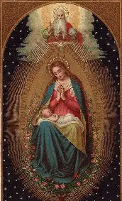
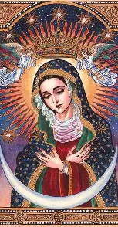

Seven Sisters Apostolate
Book Club Session 3:
Mirror of the Blessed Virgin Mary
Saturday, October 25, 2025
Katie Sadakierski

Slide 2
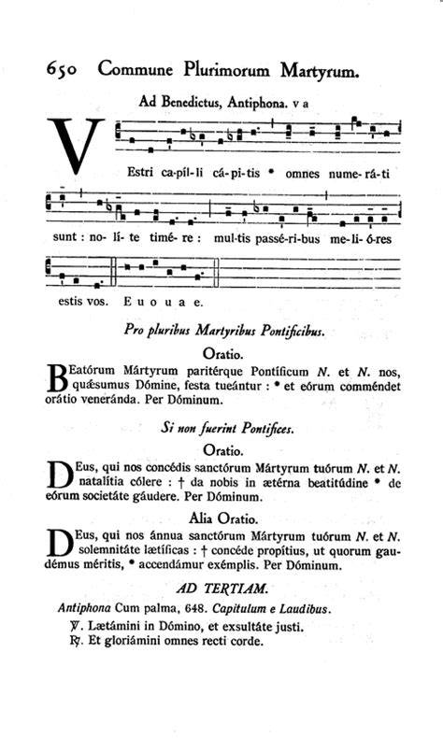
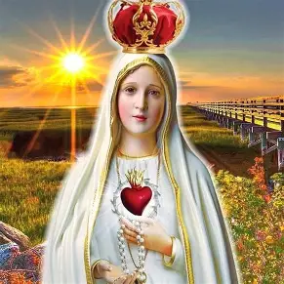
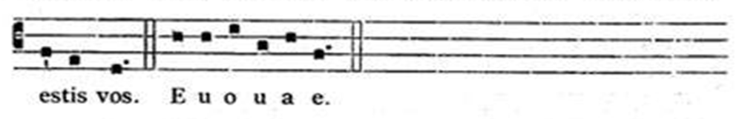
Outline: Seven Sisters
Apostolate Book Club Session 3
I. Opening prayer
II. Presentation
  a. Key insights from chapters X-XIII (pages 107-155)
    i. Saint Bonaventure and the Image of Mary
    ii. What it means to conform to Our Lady’s image, to reflect her as the saints do
  b. Reflection prompts
    i. Small group discussion (breakout session)
    ii. Group-wide discussion
III. Announcements
IV. Q & A
V. Closing prayer

Slide 3
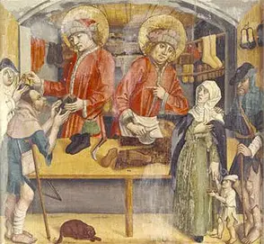
Opening Prayer: For the Intercession of Sts. Crispin and Crispinian
Sts. Crispin and Crispinian, faithful brothers and martyrs for Christ, pray for us that we may sanctify our work, live generously, and remain faithful in times of trial. Intercede that we may use our daily lives to bear witness to the Gospel with courage and love. Amen.

Slide 4
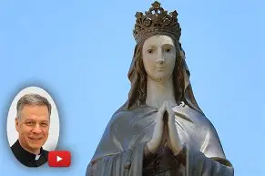
What were key takeaways from our second book club discussion on Mirror of the Blessed Virgin Mary?
No one can entirely live up to Our Lady’s Holy Name, but we can be perfected in continuing to strive towards mirroring Mary, and can do all things in her Holy Name
In Our Lady’s Heart, there is everything to love, and her Holy Name reflects her greatness; she is truly beloved. Our Lady’s Name stands for Christ’s love and mercy, too
Our Lady’s strength is in her humility. Her Name speaks to how pure she is, in being bitter to demons, such a beautiful and grace-filled creation of God, totally immaculate, that she crushes evil, having been opened to receiving only God’s goodness
Mary is our Mother; we can go to her for our every petition, knowing that she will respond with tenderness and gentleness, giving us what our souls need to be nourished

Slide 5
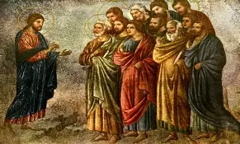
What are some key spiritual takeaways from chapter ten of Mirror of the Blessed Virgin Mary?
Mother Mary is the handmaid of God, because Christ is the servant; we can be handmaids to the Handmaid, and servants to the Servant
A greater Mother than Mary, or a greater Son than Christ, could not have been made
A servant thinking themselves better than the master comes to loathe and resent the master, but with a spirit of humility like Mary’s, there is only love. Agar had a sense of pride and hatred for Sara when Agar became pregnant after Sara could not
Mother Mary is a handmaid to the servants of the Lord, too (apostles, etc.)
Mother Mary lowers herself like Christ; this is the reflection of her greatness. She does not need to prove herself, but lives to glorify God. Our Lady has the spirit of the holy martyrs in doing all things out of charity, sacrificing herself to serve God and His people, that they may live eternally. Her joy is in doing all for God, giving of herself entirely, in thanksgiving for His gifts. A martyr is a witness to God’s love. Witnessing to Christ means serving as He did

Slide 6
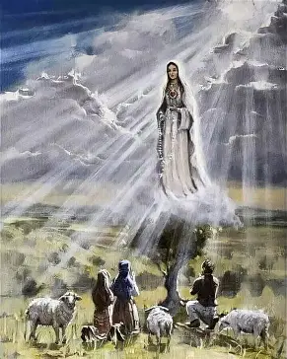
What are some key spiritual takeaways from chapter eleven of Mirror of the Blessed Virgin Mary? (1)
Mother Mary is the aurora: she breaks the darkness, heralding the light, the dawn of a new day (her Son brings about this new day through dying for us and giving us life; He is the Light of the World shining the way to Heaven)
Mary is the dawn: she pursues grace, grows in it, like light stretching across the sky, and spreading to envelop all of us in her embrace, that we may be healed by the rays of Christ’s mercy
Jesus is the burning bush igniting the heart with charity; Our Lady’s womb is a burning bush, and so is her Heart; she is inviolate, consumed only by love, not by sin. She reflects Christ in His sinless perfection
Our Lady is the dawn, because she burns away the night of guilt; she enlightens us with her bright conversation; she brought forth the sun of justice; and she was gloriously assumed into the light of Heaven
Our Lady received Our Lord spiritually, corporeally, and eternally: she received Christ into her body and her soul in this life, and is united with Him in the next; in receiving God, she received what is eternal; she could never lose Christ, for God can never truly die; His love lasts forever
Holy martyrs bring light amidst darkness. Their lives are testaments to how we can experience hope, joy, and love, even where there is hate, because Christ is stronger than any cross, having triumphed over death

Slide 7
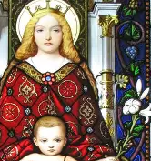
What are some key spiritual takeaways from chapter eleven of Mirror of the Blessed Virgin Mary? (2)
Our Lady’s mind is a throne; we are to enthrone Christ, too, to contemplate Him; we come to His peace in this way. When Christ, the Prince of Peace, is at the center of our minds and hearts, He rules over us, leading us to do only what would profit us for eternity, giving us lasting peace
The saints are not shining light in quite the same way as Our Lady, because they were born with sin. Through Our Lady’s help, the outpouring of her grace, however, they can reflect Christ’s light; but Our Lady shines most brilliantly, and in the closest conformity to the light of the sun, like overlapping stars
The blessing of peace is given by the holy angels through Mary, who reconciled us to them; at dawn, the holy angel blessed Jacob, stopped wrestling with him. The holy angel said to Our Lady, “Blessed are you among women.”
The soul is the spouse of God; spiritually, we can be united with God, when we are open to receiving His grace like Our Lady, the Spouse of the Holy Spirit
Our Lady’s womb is a paradise from which water flowed; Heaven is the universal Paradise. The more we go to Our Lady to be nurtured, the more that our souls can become like other Heavens, reflecting Paradise, for we welcome Christ to dwell therein, and can be filled with the gifts we need in order to receive our treasures in Heaven. The greatest treasure, Jesus, was born from Our Lady’s womb, so if we are to be treasures of Christ’s Heart, then we are to go to the Immaculate Heart, which Jesus so loves, and be nurtured in the womb of Mary, near her Heart

Slide 8
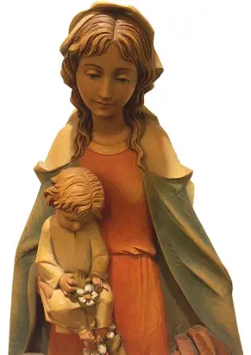
What are some key spiritual takeaways from chapter eleven of Mirror of the Blessed Virgin Mary? (3)
If we fear the Lord, we neglect nothing; we do all we can to show love. Our Lady had such a sense of wonder and awe for God, that she was animated by charity to do all things for Him, and to share this wonder with others, in testifying to all that God had done for her, uplifting the lowly and bringing about what was otherwise impossible
We need tranquility of mind to contemplate Christ. Like Our Lady, when we are peaceful and undisturbed, we can take in things as they really are; understanding can dawn in our minds, and we can see clearly
Our Lady’s light of virginal purity shines; beyond being a physical purity, this purity is a spiritual virginity, as Our Lady’s soul is inviolate, not tainted by sin, or filled with the darkness of doubt and fear . Our Lady is a worker. She always served the Lord; workers start at dawn, as the sun rises. Demons flee from the light. Our Lady is always working to build up the Kingdom of Heaven and increase love for her Son
In how we live, we, too, can herald the coming of Christ, pointing back to Him, bringing color and life, light and hope, to everywhere we go. Being a mirror of the Blessed Virgin Mary is being a clear reflection, unpolluted by sin, unclouded by vice

Slide 9
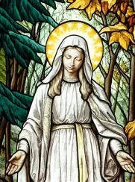
What are some key spiritual takeaways from chapter twelve of Mirror of the Blessed Virgin Mary? (1)
The sun is always with the dawn; the stem is with the flower; Jesus buds forth from Our Lady, the root of Jesse. Our Lady remains close to Jesus, so if we are to bear fruit, and to shine light, then we are to remain close to Him, too; we can do nothing apart from Christ. Our Lady had wisdom in knowing this
Our Lady is the rod of smoke (incense) to those who are new to the Faith; she is sweet, calling people to prayer; she inspires invocations, uplifts the heart, and burns away sin; myrrh signifies contrition. She is the rod of wood to those advancing in the Faith, because wood burns, charity ignites, and grows it into an inferno. She is a rod of gold to those being perfected, and a rod of iron to the incorrigible and to demons (she is hard, will not let demons pass). Our Lady is a flowering rod, spiritually fruitful. She like a goldenrod flower. When Queen Esther grew faint, the king held out a golden scepter to her for support. Likewise, Our Lady gives us support, helping us to become golden. When we love God much, we are overwhelmed, and need strength; we grow faint with ecstasy, and are wounded by love; Our Lady strengthens us. Our Lady is strong, so she can be many things to many people, filling them with her strength; her strength comes from God, to Whom she is totally open
Esther means “raised up,” or “hidden.” We are raised up when we are humbly hidden in Christ like Our Lady

Slide 10
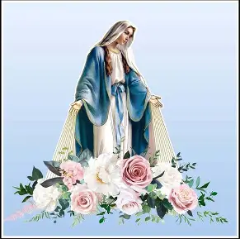
What are some key spiritual takeaways from chapter twelve of Mirror of the Blessed Virgin Mary? (2)
Mary is a fourfold flower: she has the flower of virginity, fecundity, immortality, virtuous reputation. She is the lily of purity, the violet of humility, and the rose of charity. Our Lady bears fruit in being virtuous, having total faith, hope, and love like that of Christ, because growth can only happen if we trust in God and keep cooperating with His grace, following Him out of love. Our Lady bears fruit in her purity, because only from healthy soil can there be growth, and in her purity, Our Lady is not poisoned by sin, but is a clean vessel that can receive the clean water of grace that we need to live. Our Lady can flower forth, because she said “yes” to God, and in so doing, she opens herself to the eternal, for God is immortal; His love is deathless
Many flowers (virgins) blossom from Our Lady’s purity, being inspired by her
Flowers’ stems are flexible in their love, bent down by prayer (humility). The rod of the flower (stem) represents Our Lady’s integrity. The flowers grow under the light of the sun, the day heralded by the dawn; we grow through the help of Jesus and Mother Mary. Our Lady and Our Lord are merciful, but to be flexible does not mean to compromise our beliefs; it means to be open to doing God’s will, adapting our plans to follow His plan. We bend down to mirror Christ, Who bends down to us from the Cross out of love, and Who came down from Heaven to feed us with His love
Jesus is the true flower of the field; in the open, He is accessible to all; He welcomes all, as Our Lady welcomed Him. Jesus beckons us to grow as flowers in the field of Heaven
The rod of Aaron bore both flower and fruit; the flower is Our Lady’s glorified body (virginity and maternity) and the fruit is her glorified soul. She could bear fruit in having consecrated her body to God out of love; she came to glory through having borne Christ and suffered with Him as He gave His Body, Flesh of her flesh, for our salvation

Slide 11
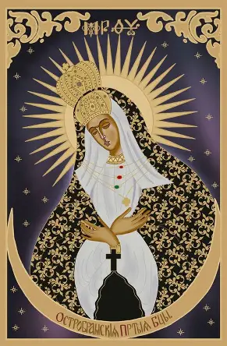
What are some key spiritual takeaways from chapter thirteen of Mirror of the Blessed Virgin Mary? (1)
Our Lady went forth by being born without sin. Our Lady makes progress, advances by grace. Three perfections shine in Our Lady: she is like the dawn, the moon, and the sun; she holds the sun within her womb, reflecting the light of Christ the Son. She is clothed in the sun, because she reflects Christ, and she has the moon under her feet, because she is most like the moon, in reflecting the sun, and stands on the moon to show her humility; the moon recedes that the sun may shine, and similarly, Our Lady gives all of the glory to God, content to remain by Christ’s Side, to bear testimony to His light. In this way, she truly shines
The holy angels are always associated with virginity, for they are totally pure spirits, always in the light, and a virgin can be a vessel of light, like Our Lady, in receiving only God
Jacob supplanted his brother, was blessed by the holy angel, had a chaste spirit
Our Lady receives light from the sun, and in this way, is like the moon; she not only points us back to the sun, but all that she has in the first place is from the sun. She points us back to the sun, so that we may receive all of the graces that she has
Our Lady entered into Heaven without obstacle; she was with a caravan (all whom she has helped to lead to Heaven). The Queen of Saba prefigured her, entering into Jerusalem with spices and train; Our Lady reaches Heaven, the New Jerusalem, after having been in Jerusalem with Christ, suffering (with the holy angels)

Slide 12
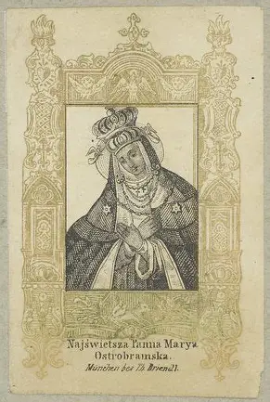
What are some key spiritual takeaways from chapter thirteen of Mirror of the Blessed Virgin Mary? (2)
She leads us to glory with them; she spreads the fragrance of her holiness to lead others to Heaven
It is not only against nature for a virgin to bear a child, but to bear God
Those who love Our Lady can be confident of entering Heaven with her, and with the holy angels. The angelic host came to see Our Lady when she entered Heaven. They can attend at saints’ deaths, too. The king is always with the queen; Our Lady surpasses all saints in virtue; she is super-plena, not only full of grace, but overflowing with it, not only for her sake, but for our sakes. Our Lady is with us
Our Lady’s intelligence is higher than that of the holy angels

Slide 13
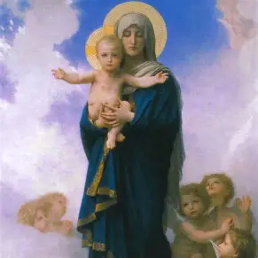
Reflection Question 1:
Saint Bonaventure compares Our Lady to the dawn. What would it mean to spread light like Our Lady does? How have the insights from chapters 10 through 13 shed new light on Our Lady’s identity, the role she has in our spiritual lives, and how we may mirror her?

Slide 14
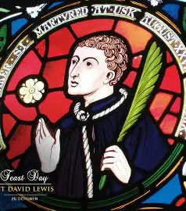
Saint Bonaventure compares Our Lady to the dawn. What would it mean to spread light like Our Lady does? How have the insights from chapters 10 through 13 shed new light on Our Lady’s identity, the role she has in our spiritual lives, and how we may mirror her?
To spread light like Our Lady means to humbly receive it from God. It means opening ourselves to hearing His voice in prayer, and following where He leads. Contemplation informs our actions. Being in God’s Presence, opening our hearts to be filled by His love, means that we have love to share with others. We cannot give what we do not have, so we go to God for our nourishment. He is the artist from Whom we receive the colors that we need to paint the dawn across the canvas of our soul, like a sky; Our Lady guides our hands; we truly are more like the paintbrushes that God leads than the painters ourselves. Humbly embracing this role as a servant of God is how we can be like Our Lady, for in so doing, then we can offer more, being filled with God’s infinite love, and not being restricted by our own limitations and shortcomings as human beings
The chapters we have read illuminate for us that Our Lady is both receptive and active. She receives from God in order to take action for Him. Our Lady is a gentle stem that bends towards God, leaning in to do His will, but that also is firm, in not being bent back to conform with the world. She remains true to God. Being like Our Lady is being balanced, moving in accordance with the music of Christ’s Heart, which is in perfect order and harmony

Slide 15
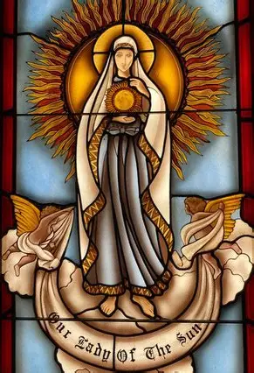
Reflection Question 2:
Saint Bonaventure illuminates the closeness between Our Lady and Our Lord, comparing them to the dawn and the sun, the stem and the flower, which are always together. Why do you think that their collaboration is so essential to our spiritual growth, and what does this reflect about what our journeys of faith together should be? Why and how is God be calling us to work together to grow in virtue, spiritual mothers and fathers alike? What would it mean for us to mirror Mary in collaborating with Christ?

Slide 16
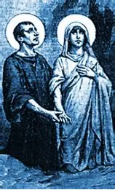
Saint Bonaventure illuminates the closeness between Our Lady and Our Lord, comparing them to the dawn and the sun, the stem and the flower, which are always together. Why do you think that their collaboration is so essential to our spiritual growth, and what does this reflect about what our journeys of faith together should be? Why and how is God be calling us to work together to grow in virtue, spiritual mothers and fathers alike? What would it mean for us to mirror Mary in collaborating with Christ?
God is love, and love is not solitary: it is meant to be shared. This means that God is unity: there is balance in Him. The Blessed Trinity is itself a family. God’s love is expressed to us through the Three Persons of God: God the Father, God the Son, and God the Holy Spirit. Our Lady, in being a reflection of God, a complement of the Trinity, is a relational being, too, a woman whose love is rooted in community. We are complex beings who need the love of father and mother to nurture us, for we are made in God’s image, and God lives in community, so we need a community of people to raise us. To grow, we need both Jesus and Mother Mary, paternal as well as maternal love, which speaks to the two halves of our hearts, which were brought into being by a mother and father. Adam and Eve brought sin into the world, so the New Adam and the New Eve provide counterbalance, leading us out of sin, that we may shine like the sun, and grow like a flower. Our journeys of faith together should be complementary. We were all made interdependent, so all of us need support with certain tasks. None of us can do everything, or has every talent, so we all need each other, and can recognize that working together does not mean that, individually, we are weak or unfaithful, but that we truly grow into Christ’s strength and fidelity by supporting each other in carrying our crosses, just as Simon of Cyrene helped Jesus to carry His Cross. We can achieve more in pooling our talents and uniting in a shared mission; our prayers are more powerful when united. To mirror Mary in collaborating with Christ means taking an active role by taking a contemplative role, praying with and for our priests, in order to support their efforts. We stand by the altar, and receive the graces from the Sacrifice of the Holy Mass, in order to contribute better offerings to God; being filled with His grace, we can better reflect and honor Him. Being a vessel of light means being a channel from which others may draw, and be led to Christ; it means sheltering them in Christ’s light, reaching out to touch hearts with the healing rays of mercy that radiate from Christ’s Heart

Slide 17
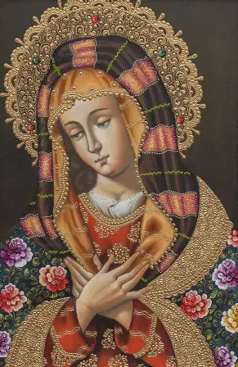
Reflection Question 3:
Saint Bonaventure compares Our Lady to a rod, explaining how she serves as a different kind of “rod” to her spiritual children, according to the stage of the spiritual journey they are in. He writes that Our Lady is like a rod of smoke calling people to prayer when they are new to the Faith; a rod of wood to those advancing in holiness; and a rod of gold to those being perfected. How have you seen Our Lady serving in these roles, in your life, in the lives of the saints, or in Sacred Scripture? Which image of Our Lady most resonates with you, ringing truest, and why? What would it mean for us to support others by reflecting these qualities of Our Lady in our friendships with them?

Slide 18
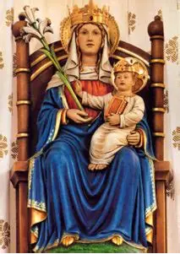
Saint Bonaventure compares Our Lady to a rod, explaining how she serves as a different kind of “rod” to her spiritual children, according to the stage of the spiritual journey they are in. He writes that Our Lady is like a rod of smoke calling people to prayer when they are new to the Faith; a rod of wood to those advancing in holiness; and a rod of gold to those being perfected. How have you seen Our Lady serving in these roles, in your life, in the lives of the saints, or in Sacred Scripture? Which image of Our Lady most resonates with you, ringing truest, and why? What would it mean for us to support others by reflecting these qualities of Our Lady in our friendships with them?
Our Lady is united with Christ, and He is the field that encompasses all of the flowers, so in this sense, she is not a separate kind of flower, or rod, but harmonizes all things; she is a flower with many beautiful petals, or a bouquet of many types of flowers. In her, all of the graces are drawn together, fused perfectly, just as Christ is both fully human and fully divine, a sacred mystery. She is our universal Mother, drawing us all under her mantle simultaneously. Our Lady is like a rod of smoke, by drawing us to seek out Christ, to follow the fragrance of holiness to discover Him; she invites us to pray the Holy Rosary, such as when she appeared at Fatima and Lourdes, that we would come to know Christ through praying with her, treasuring all of Him in our hearts. She helps us to move towards Heaven, like the incense wafting up to the sky. Our Lady is a rod of wood that is burnt for our purification, that we may absorb the sweet fragrance of her maternal kindness. She teaches us to receive the will of the Divine Artist with serenity, that even when we are made to take on the shape of the Cross, to conform to it, carved into with various kinds of suffering that polish us, we can have a sense of peace, being adaptable and receptive. As a rod of gold, Our Lady helps us to be melted down, our sins burnt away, that we may become treasures, leaving behind only what is shining for Christ. The Fatima children took on sacrifices, especially St. Jacinta, embracing the Cross to make reparation for those who did not, and in so doing, was herself perfected, entering into glory at a young age. The image that rings truest is Our Lady as the rod of gold, for she is the treasure of Christ’s Heart that we are all meant to reflect, that we may reflect Him, shining in the light of the sun, like gleaming gold. Gold is malleable, touched by light and warmth; we are to respond to the light and warmth of Christ’s Sacred Heart like gold does, like Our Lady does, with open hearts. In this way, we can come to offer up prayers and works, the incense and wood of the Cross, as the most beautiful treasures. To support each other by reflecting these qualities of Our Lady would mean to pray with and for others, to invite others into friendship with Christ by showing them His patience and kindness, listening to others, and responding in the unique ways that their hearts need to understand Jesus’ Presence in their lives. It is to be present with others, wherever they may be in their journey, having patience, and celebrating every step

Slide 19
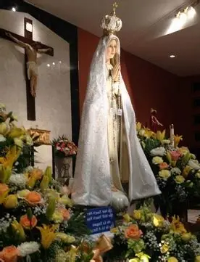
Reflection Question 4:
Comparing Our Lady to a bouquet of flowers, St. Bonaventure says that Our Lady is a lily of purity, a violet of humility, and a rose of charity. How does Our Lady reflect each of these flowers in her application of these virtues? How might we similarly be like these flowers in our application of virtue? Which flower do you believe best reflects Our Lady, and why? Why is a bouquet of virtues to present to Jesus so essential? How do the different blossoms of virtue complement each other?

Slide 20
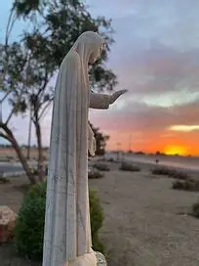
Comparing Our Lady to a bouquet of flowers, St. Bonaventure says that Our Lady is a lily of purity, a violet of humility, and a rose of charity. How does Our Lady reflect each of these flowers in her application of these virtues? How might we similarly be like these flowers in our application of virtue? Which flower do you believe best reflects Our Lady, and why? Why is a bouquet of virtues to present to Jesus so essential? How do the different blossoms of virtue complement each other?
Our Lady has a pure heart; it is not only that she is physically untouched, but her heart is untouched by bitterness. She remains pure in her hope and faith, which is poured out from her Heart of love, a sweet Heart that is our salvation, because it is our pathway to Christ, Whose love redeems. In this way, Our Lady is like the lily; in her purity, she does not exalt herself, but trumpets the good news of salvation in Our Lord. A violet of humility, she shrinks away from praise, that she may give glory to God, opening eyes to behold His greatness. This is all because she is a rose of charity, who blooms and lets forth a sweet fragrance, in sharing in Christ’s crown of thorns, that she may open Heaven to others, helping them to bloom fully, to receive the light they need to blossom. We, too, can be like the lilies in sharing our pure love for Jesus, evangelizing by word and action, showing in how we live that we have been saved and freed by Christ, and can therefore, have the greatest joy and hope. Like the violet, we can humbly give the glory to God, pointing back to Him as the Source of grace, and like the rose, we can find the beauty in the thorns, and can be united with Christ in suffering, in order to be united with Him in glory. Lilies represent our faith we proclaim; violets symbolize our hope in the Lord (which is so great, that we need not place hope in ourselves alone, but can be at peace, humbly trusting that God will bring about all good, in accordance with what we need); and roses represent love, because amidst pain and struggles, they still bloom gloriously, just as a loving heart continues to praise God and grow for Him, even when carrying the Cross. Roses reflect Our Lady particularly well, because they have a timeless beauty and distinct fragrance that makes them the queen of all flowers, just as Our Lady rises above the rest, helping all other flowers to blossom their best for God, and to best accentuate His beauty with their own. Presenting a bouquet of virtues to Jesus means that we can reflect Him better, because His perfections are many and great. This allows us to glorify Him most, and to know the greatest happiness, in being continually perfected by growing in many virtues. Every virtue flows from love; they all depend upon this foundation, for love is our reason for growing, the seed that is planted to encourage the rest

Slide 21
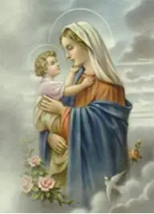
Reflection Question 5:
Looking at the makeup of a flower, St. Bonaventure writes that Our Lady is like a flower’s stem, comparing her to the rod in terms of her spiritual qualities. Why do you think St. Bonaventure makes this comparison? What similarities do you see? From this analogy, what is revealed to you about how we are to mirror Mary?

Slide 22
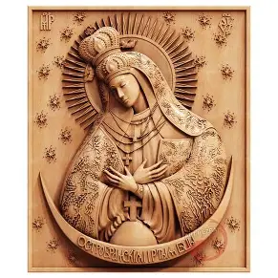
Looking at the makeup of a flower, St. Bonaventure writes that Our Lady is like a flower’s stem, comparing her to the rod in terms of her spiritual qualities. Why do you think St. Bonaventure makes this comparison? What similarities do you see? From this analogy, what is revealed to you about how we are to mirror Mary?
Our Lady has the perfect balance of gentleness and fortitude. She is solid and unbreakable without having a hardened heart. Her heart remains soft to receive the impression of God’s love, which means that she does everything she can with His grace to protect the treasures of our Faith, including all of her children. Our Lady never compromises her faith, always remaining strong in her belief, her hope in God the Father, so she is never even the slightest bit inclined to react wrathfully, but instead, is compassionate. She forgives without giving up who she is in God; she reaches out to others, and receives their prayers. The Presence of God in her can never be withdrawn, for she is full of grace. She had the grace to keep journeying on, down every twist and turn on the road, whether to Bethlehem, to Egypt, and Calvary, or back again, not in spite of the fact, but because, she is so resolute in following God’s will. Her Heart is totally open to hear God, and therefore, to listen to the cries of her spiritual children, without being consumed by the deafening sound of the world, for Our Lady is always centered in her inner sanctuary with her treasured memories of her Son, Who breaks through any clouds. Saint Bonaventure shows us that, to be a stem, like the stem of a chalice that represents hope, Mother Mary had to be open to being uplifted by God, and to being a support; rather than being the flower itself, she bears fruit, giving birth to Christ, the True Flower, Whom she raises from childhood. Our Lady lifts us up, because she is strong in God, Whose Presence never leaves her, but her strength comes from tenderness, humility, and love, the recognition that she is weak, and therefore, needs God, Who gives her His courage and power, for she is a channel of His love, and nothing can overcome this light. We are to mirror Mary by humbly receiving God’s gifts, having humility, in order to be strengthened by the greater outpouring of love that God lets flow into us. We can support everyone in blossoming; to love and to help, or to open ourselves to being loved and helped, is not to lose our strength, but to gain it more deeply by living it in union with Christ, the Lamb brave enough to keep choosing love

Slide 23
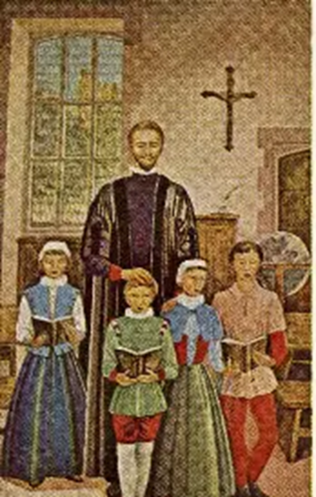
What overall takeaways can we apply from our first three book club discussions?
From our first three book club discussions, we have learned that to reflect Our Lady’s Immaculate Heart, and to live up to her Holy Name, is to reflect Christ’s Sacred Heart, and to honor His Holy Name, adoring Him, because to do so is to have a heart of humility like Our Lady’s, that we may rejoice in God’s greatness, and be filled with His love, sharing in His glory. Humility is the root of love, and the key to Heaven, because it is the way of Our Lord and Our Lady. Martyrs humble themselves; they make the greatest sacrifices, because they will not sacrifice their integrity, remaining true to their greatest Friend, Our Lord, Jesus. In vulnerably going on the Cross with Christ, opening ourselves up, we open ourselves up to healing, that we may be freed of sin that takes us further away from Christ, and filled with peace that unites us with Him. Having humility means we open our hearts to receive, and to become like, Christ, so it is the path of perfection

Slide 24
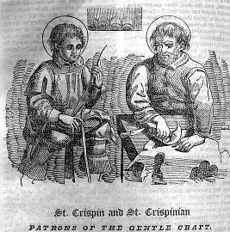
What do the feast days of St. Crispin and St. Crispinian, St. Daria and Chrysanthus, as well as the Six Welsh Martyrs, illuminate for us about Our Lady? The holy priesthood and spiritual motherhood? (1)
Saint Crispin and St. Crispinian were brothers who were martyred for Christ. By day, they served God as evangelists, going out in the light to proclaim His goodness. Setting out in the daytime, without being under the cover of nightfall, was dangerous, in that the brothers, who lived in the 200s A.D., were opening themselves to persecution, but still, they carried on their mission, because their hope rested in Jesus, the Light of Truth. Their fearlessness showed others that their friendship with Christ was real, because they truly placed all of their trust in Him. At night, the brothers worked as cobblers. They helped people to walk with Christ, to follow in His footsteps, treading in His shoes; they repaired and built, cushioning the steps others took, so that they would reach Heaven. They teach us to meet Christ on the way to Calvary, to soldier on alongside Him, like Our Lady, and to work together as brothers and sisters in Christ to deepen our friendship with the Lord, Who can cobble together all that we are, to build something great that can withstand the test of time, the rough roads, in order to ascend the royal pathway to Heaven. Our Lady is our guide, our travel companion, making us feel as though we are encased in slippers that make each step pleasant and smooth, for she enfolds us in the sweetness of her Heart. Being a spiritual parent is spiritually accompanying others, and encouraging their growth, working together and humbly recognizing that we are all learning, all in need of support; it is receiving support, too, like Our Lady or Esther resting on the arms of her handmaidens as they go forward. Advancing in holiness means advancing together, receiving the dawn of spiritual understanding as one family, taking in the light together, offering our flowers of virtue as a single bouquet to console the Two Hearts. Together, we can get a strong foothold on our mountain climb up to glory

Slide 25
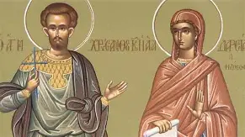
What do the feast days of St. Crispin and St. Crispinian, St. Daria and Chrysanthus, as well as the Six Welsh Martyrs, illuminate for us about Our Lady? The holy priesthood and spiritual motherhood? (2)
We each go through our Passion with Christ; being like Our Lady means spiritually participating in the sacred mysteries with Christ, fully present, to receive His Presence that He offers to us, and to be fed by Him eternally, with the true Food that sustains us. Saint Daria and Chrysanthus were living in a chaste marriage, after Chrysanthus converted Daria to Christianity. At a time of persecution, they both refused to give up their beliefs. Daria would not give up her purity, and therefore, was sentenced to death, but a lion came to protect her from those who threatened her chastity. Both Daria and Chrysanthus would be buried alive. They remind us that when we die to sin, we are alive in Christ, so when we are buried with Him, going in the tomb with Him after going on the Cross with Him, we come to join Him in eternal life. Our Lady and Our Lord protect us like the lion that watched over Daria, helping us to remain pure, and to avoid sin. Being a spiritual parent means helping each other to remain in grace, and away from spiritual dangers; we can serve as each other’s guides and protectors. The six Welsh martyrs lived during the Protestant Reformation, and did not yield to pressures to renounce their Catholic beliefs, so they were punished. Spiritual mothers and spiritual fathers can work together to defend the treasures of our Faith, our Catholic beliefs that we stand for, and can be spiritual martyrs in offering everything up for God’s glory. The dawn gives way to the day; likewise, we can give of ourselves in order to open others to receiving Christ, letting go of our own inclinations to serve ourselves, in order to serve Christ, and to preserve His Church. This is to be a mirror of Mary, in reflecting Christ the King, the greatest martyr, giving everything out of love. He gave Himself, and to give Himself was to give His love, for God is love. Even without going through physical martyrdom, we all can be united in giving Christ’s love

Slide 26
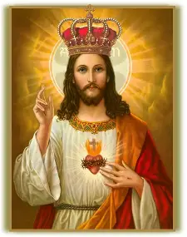
Announcements
Christ the King Feast Day Gathering
  Sunday, October 26, 2025
    2:15 p.m., parish hall
      Bring materials for crown-making (natural or artificial) for personal and decorative touch
      Complete survey on Thanksgiving initiative for Father
Holy Rosary through Art session 4, Glorious Mysteries
  Tuesday, October 28, 2025
    5:00 p.m., parish hall
Next Seven Sisters Apostolate Book Club session (4):
  Friday, November 21, 2025
    6:00 p.m., parish library
      Chapters 14-18, pages 157-232

Slide 27
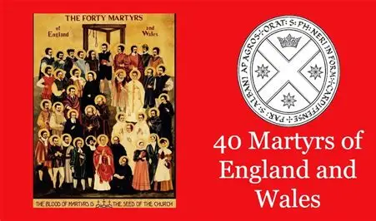
Closing Prayer: Prayer Honoring the 40 Martyrs of England and Wales on the Feast of the Six Welsh Martyrs
O God, in whom there is no change or shadow of alteration, you gave courage to the Holy Martyrs. Grant unto us, we beseech you, through their intercession, the grace to always value the Holy Mass. May we be strengthened to serve you in imitation of the courage of these Holy Martyrs. We ask this through Jesus Christ, Your Son, who lives and reigns with You in the unity of the Holy Spirit, forever. Amen.

