Slide 1
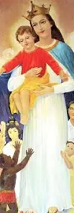
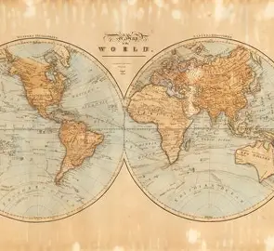
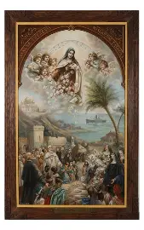
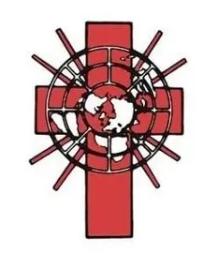

Mission Possible: Continuing Christ’s Mission of Love with St. Therese of Lisieux on Mission Sunday and Always
Katie Sadakierski
Sunday, October 19, 2025

Slide 2
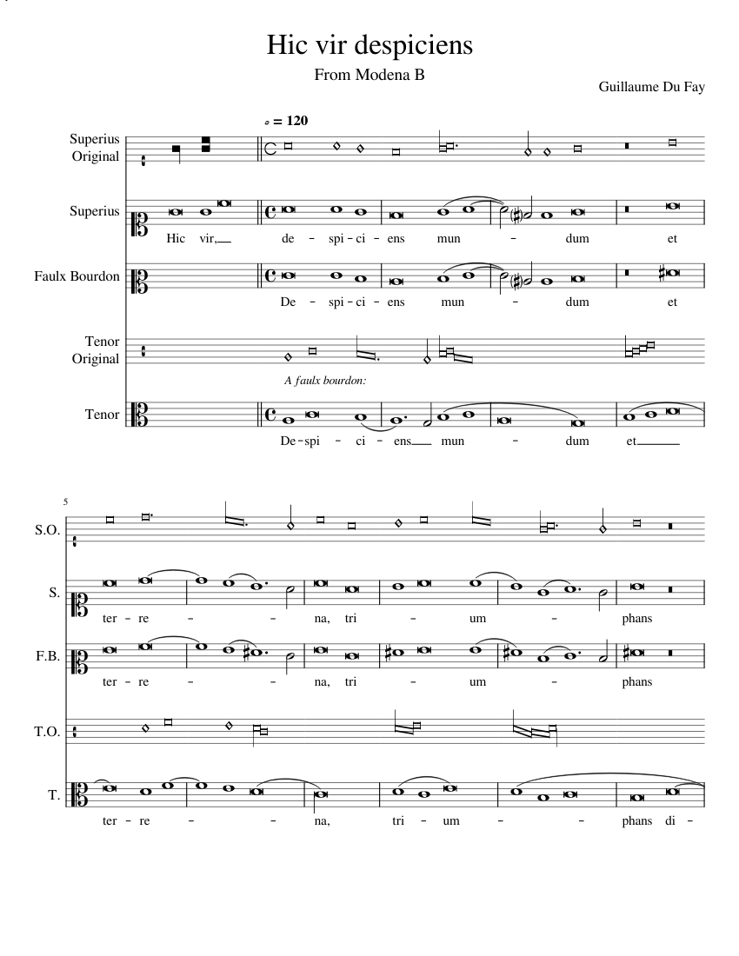
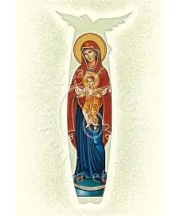
Outline: Sunday Seminar 2
I. Opening prayer
II. Presentation:
  a. What Saint Therese teaches us about being a spiritual missionary
  b. What Saint Therese’s heavenly friends teach us about being spiritual missionaries
  c. How we may serve as spiritual missionaries
III. Announcements
IV. Closing prayer
V. Recitation of the Joyful Mysteries of the World Mission Rosary
VI. Q & A

Slide 3
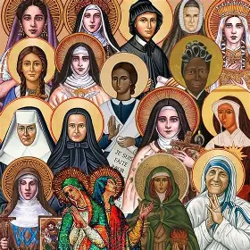
Opening Prayer: Prayer for World Mission Sunday
Almighty God, you sent your Son Jesus Christ to reconcile the world to yourself: We praise and bless you for those whom you have sent in the power of the Spirit to preach the Gospel to all nations. We thank you that in all parts of the earth a community of love has been gathered together by their prayers and labors, and that in every place your servants call upon your Name; for the kingdom and the power and the glory are yours for ever. Amen.

Slide 4
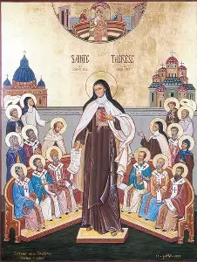
Who is St. Therese of Lisieux? Why do we commemorate her on October 19?
Saint Therese of Lisieux (1873-1897) was a Carmelite nun who had dreamed of being a missionary. Normally, a woman could enter the convent at the age of 21, but St. Therese requested permission to become a nun at age 15, which was granted. Serving God as a nun for just under a decade, St. Therese passed into eternal life at the age of 24, having poured out her love entirely for God, ministering to all those whom He sent her to share Our Lady’s maternal Heart with in her care
On October 19, we commemorate a number of special occasions connected to St. Therese. It was on this day in 1997, one hundred years after her passing from this life, that St. Therese was declared a Doctor of the Church by Pope St. John Paul II, the only person that he would make a Doctor of the Church during his papacy of nearly three decades. October 19 is also World Mission Sunday this year, just as it was the year in which St. Therese was declared a Doctor of the Church. In the modern calendar, we observe the feast day of the North American martyrs, Jesuit missionaries, on this day, whereas in the traditional calendar, their feast day was celebrated on September 26

Slide 5
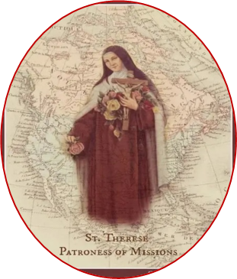
Why is St. Therese the patroness of missions?
While St. Therese would not complete active missionary work abroad, having applied to serve at a Carmel in Vietnam, only to be rejected due to poor health, St. Therese was nonetheless named a patroness of missions, because she served as a spiritual missionary. Saint Therese covered much ground in the mission territory of each soul, inspiring others to deeper conversion and love for Christ through her words of counsel and actions taken to console the Heart of Jesus. Like a missionary, St. Therese made many sacrifices in her life out of love for Christ, heroically going through her spiritual martyrdom in union with Christ, and offering up all that she had and did for the success of priests, missions, and all of her spiritual children. Saint Therese persevered in her ministry to souls, never giving up on any spiritual child, but remaining with them. Similar to a missionary, she dealt with privation and discomfort, in not being permitted to receive the Holy Eucharist as regularly as she would like to, due to restrictions at her monastery, and in enduring her illness, her bout with tuberculosis. Most like a missionary, St. Therese lived out the Gospel message joyfully, laying down her life for her Friend, Jesus, and all of His friends, out of love, the greatest love that one could have. She would not simply preach the Gospel message, but embody it, so that all could hear Christ’s heartbeat in her. She mapped out the “little way” to Heaven through doing all things with great love, going step-by-step on the journey to Heaven. As a missionary would have learned, she knew to take things gradually, to be patient with spiritual progress made in God’s time. Saint Therese is a supportive soul uplifting other people in prayer, bringing souls, no matter how far away they may otherwise be, close to Christ’s Heart. She can cover any distance through cooperation with God’s great grace, because of her Marian openness of heart, her receptivity, and therefore, is a patroness of missions

Slide 6
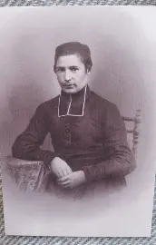
Who are missionary saints who inspired St. Therese of Lisieux?
Saint Joan of Arc
  While not a missionary abroad in a traditional sense, St. Joan of Arc ministered to her own French countrymen as a missionary, in that she demonstrated what it means to be obedient to God, to remain faithful, and be illuminated by a burning love for Christ within, a light that leads the way to Heaven
Saint Jean-Theophane Venard
  A French priest who joined the Society of Foreign Missions, St. Therese read about the life of St. Jean-Theophane Venard, and was inspired to imitate him, as he lived out the “little way,” and could therefore do extraordinary things by offering up the ordinary with great love. Saint Therese commented that she preferred reading about the life of St. Jean-Theophane Venard to the life of St. Aloysius Gonzaga, because St. Aloysius’ life was marked by such otherworldly holiness that may be too exacting or inaccessible for some, whereas St. Jean-Theophane Venard blazed a trail to Heaven that everyone could follow; he was a universal missionary

Slide 7
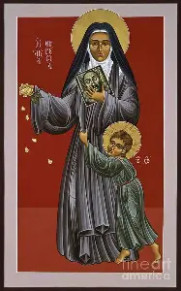
Which missionaries would St. Therese inspire and support spiritually?
Marcel Van
  A young Vietnamese man hoping to enter the holy priesthood, Marcel Van was a soul of much innocence and simplicity who was persecuted by his classmates for his piety. After having read St. Therese’s spiritual autobiography, he was inspired to offer up his acts of charity, no matter how small, for the glory of God, for he would not be chosen to be a priest, but would give his sacrifices for God’s glory, and serve as a priest in a different way, not sacramentally, but spiritually, in care for others, works of mercy that were never too little to communicate great love
Saint Teresa of Calcutta
  Saint Teresa of Calcutta, baptized “Agnes,” would choose her name in religion in honor of St. Therese of Lisieux, who inspired her to care for souls like little flowers, reflections of Christ, the True Flower, with Jesus’ immensity of love. No person was too small for St. Teresa to love; everyone was significant and special, beloved to Christ, and therefore, precious to her, so she nurtured each tenderly

Slide 8
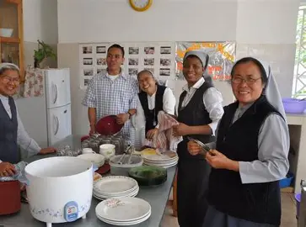
What does it mean to be a missionary?
Being a missionary means bringing the spirit of Christ to one another, feeding souls by leading them to the True Bread Who can always nourish us: Jesus Christ. It means that we lead others into friendship with Christ, a living relationship that lasts forever
Serving as a missionary wherever we may be means that we share and model God’s love to each other, boldly proclaiming the Gospel message with an Easter spirit that focuses on the Resurrection, keeping the Risen Christ in our hearts, and looking forward to reuniting with each other in Heaven, where we may experience God’s love forever. We guide others in turning away from sin, dying to the world in order to rise with Christ, to transcend the limitations and privations of this life, in order to have every treasure in Heaven

Slide 9
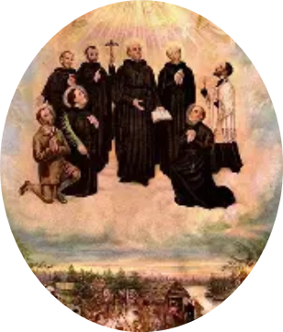
Why do we honor the North American Martyrs on October 19? What do they teach us about what it means to serve as missionaries?
The eight North American martyrs are collectively honored on October 19, because this is the date on which St. Jean Lalande was martyred; he was the last of the Jesuit missionaries to be martyred in this group
In their forgiveness, the missionary martyrs show us what it means to serve as a missionary, to be present with others in their suffering, and console the Heart of Jesus, a wounded Heart. Even after having been tortured at the hands of Native Americans he was seeking to convert, St. Isaac Jogues returned to continue his missionary work. His companions were faithful and patient as well, willing to undergo the greatest tests to be united with Christ in His suffering, fully expressing their love for Him

Slide 10

How may we serve as missionaries spiritually like St. Therese?
Saint Therese’s feast day readings in the Divine Office relate to the laborers in the vineyard, conveying something of St. Therese’s priestly mission. She is also honored with the hymn written specifically for brides of Christ. These readings reflect how St. Therese spiritually served as a missionary by making constant intercession for people, praying for them unceasingly, and without being wearied, just like Jesus, the Eternal High Priest. In being wed to Christ spiritually, she lived out the greatest love and commitment to Jesus and His Church. In a similar way, we may pray for the universal Church with a priestly heart that offers sacrifices for God out of love, and with a motherly heart, a bridal heart, that seeks to receive Christ’s love, so as to share it generously with others in word and deed. Serving as a spiritual missionary means recognizing that we are on a continual pilgrimage to Heaven, and that we have a great blessing in being given the opportunity to spiritually accompany each other on it, taking each step gradually, as we progress from bead to bead on the Holy Rosary, all of the sacred mysteries being united in our hearts as we offer our experiences lovingly for the fulfillment of Christ’s mission, on this one journey together

Slide 11
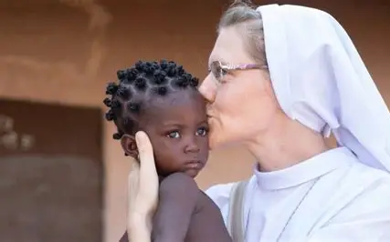
How may we spiritually support the missions?
Spiritually supporting the missions means offering our labors for the laborers in the vineyard, and the exaltation of Holy Mother Church. We share Christ’s kiss of peace in praying for each other, harmonizing our prayers for the one universal mission, the universal vocation, of love
We may spiritually support the missions by offering our Holy Communion for the intentions of missionaries; praying the World Mission Rosary, with intentions for the missions on every decade; offering prayers on the beads of our Holy Rosary for missionaries by name; and praying for the intercession of missionary saints such as St. Francis Xavier and St. Therese of Lisieux, especially by praying the St. Therese chaplet, in which we invoke St. Therese as patroness of the missions. She is of the Child Jesus, and therefore, brings a childlike heart of love and simplicity to her prayers, in praying for all of God’s children. We can place all of God’s children spiritually into His hands by saying prayers of entrustment, bringing St. Therese’s spirit of love to our prayers

Slide 12

What is World Mission Sunday? When and why is it celebrated?
World Mission Sunday’s goal is to unite souls in bolstering the Church’s missionary efforts to countries around the world through financial and spiritual support: this day promotes generosity in giving to the missions in sharing one’s time, talent, and treasure. Prayer for the missions is a major focus of World Mission Sunday
World Mission Sunday was instituted in 1926 by Pope Pius XI, and is always on the second-to-last Sunday of October, often being chosen as the day of canonization of new saints, because saints serve as missionaries who teach others how to complete their God-given missions. The collection for the missions in the universal Church was taken up for the first time the following year. After the destruction and division of the first World War, it was particularly essential that souls be uplifted and brought back to Christ, Who unifies us all, bringing His peace to heal all brokenness in the world
Today, we live in an increasingly interconnected society due to advancements in technology, so it is all the more important that we use our platforms to preach the Gospel message. We all can be missionaries, whether serving God virtually, or in person. The Holy Eucharist connects us all, for Jesus gave His life for us all, so the purpose of World Mission Sunday is to fulfill our universal mission of guiding souls to Christ’s love in the Holy Eucharist

Slide 13
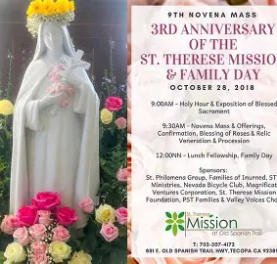
How does St. Therese’s role as a spiritual missionary relate to her role as Doctor of the Church?
A Doctor of the Church is a teacher of holiness, as the word “doctor” comes from the Latin “docere,” meaning “to teach.” The root word of “education,” “educere,” means “to lead” in Latin
Missionaries are leaders, because they are teachers of faith in Christ. They entrust their missions to God, making themselves vulnerable, like Christ on the Cross, in order to walk among His people who have not yet met Him. A missionary teaches humility, going where they are not known, entering into a new, unfamiliar way of life, to teach about the love of God that connects us all, transcending any difference and overcoming any distance, no matter where we may be. Saint Therese taught holiness in her willingness to go out to any soul, to compassionate with them, in offering her life to prayer and sacrifice for their salvation, going to the greatest lengths out of love, even in her spiritual martyrdom with Christ, her long suffering that was joyfully offered for others. Without traveling outside of her convent, St. Therese taught the way of the missionary, because the missionary receives instruction within the classroom that is the Heart of Jesus Crucified, the self-sacrificing Heart of a Shepherd. A missionary is a guide to Heaven, which St. Therese certainly was, in teaching the little way, in order to give direction to souls seeking guidance and meaning, which they could only receive from Christ the Teacher

Slide 14
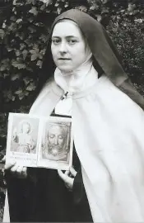
How did St. Therese spread the Gospel message?
Saint Therese spread the Gospel message by living it out, namely, by applying the Beatitudes. She took the lowest place for herself, that she would be lifted up like Our Lady was, serving as a handmaiden of the Lord to be an instrument of God. She prayed for the living and deceased, completing works of mercy through prayer, to exercise charity like Christ, pointing souls back to the redemption brought about by Our Lord, which makes all love possible. Guiding souls back to the Holy Face, which looks upon all people with love, with signs of God’s love in the form of wounds taken on for our healing, St. Therese spread the Gospel message by taking souls by the hand to God the Father, to behold His Face in Heaven. Saint Therese prayed for conversion, always believing in God’s mercy, so that she never gave up on praying, but offered prayers and sacrifices for everyone she embraced as her spiritual child, including the prisoner Pranzini and the apostate priest Fr. Loyson. She visited prisoners, fed the hungry, gave drink to the thirsty, taught those who did not fully know God, and counseled the doubtful in prayer, in her letters of love speaking God’s mercy into others’ hearts

Slide 15
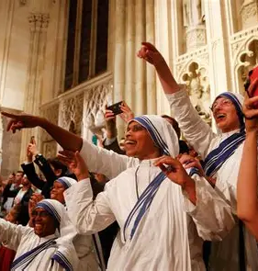
How may we live out the Gospel message in our lives?
Living out the Gospel message means having patience. Missionaries do not always see the fruits of their work immediately; their ministries require patience as they await the harvesting of the seeds they plant in God’s time, trusting that He will produce good fruits from what they sow in the mission field
Patiently following Christ, going where He leads us in our missions, and traveling with each other, means that we live the missionary life, which is one of hope and faith, as we continue to pursue ongoing conversion, serving as a role model to others, learning and growing alongside each other in receiving the messages of Christ the Teacher

Slide 16
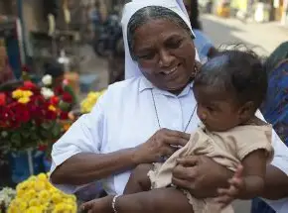
What do today’s Divine Office readings teach us about how we may spread the Gospel message?
Today, in the traditional Divine Office, we celebrate the feast day of St. Peter of Alcantara. One of the readings reminds us that those who give up the world, detaching themselves spiritually from it, in order to store up treasures in Heaven, ultimately triumph, for the worldly things are temporal, while the things of Heaven are eternal. Missionaries make sacrifices out of love for Christ, knowing that the greatest reward is to be with Jesus, among His people who reflect Him in this life, and with all in Christ’s family who love Him and shine His light all the brighter in Heaven. A true missionary embraces each person as a treasure of God, using their gifts from God to bring that treasure up to Heaven to be with Jesus, by focusing their efforts on showing that soul God’s love wholeheartedly, unselfishly. We spread the Gospel message by treasuring every experience that God gives us as a gift, and serving as a missionary by embodying joyful, self-sacrificing service to God

Slide 17
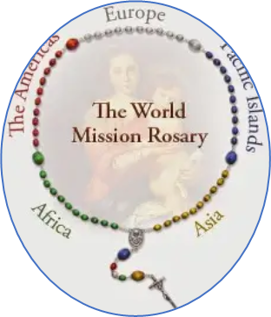
What is the World Mission Rosary?
The World Mission Rosary was designed by Venerable Fulton Sheen in 1951 when he worked as the national director for the Society of the Propagation of the Faith in New York City. Each decade of the Holy Rosary is devoted to prayers for a different continent or combined continents/regions of the world, with special intentions being offered for the missions in connection to each Mystery of the Holy Rosary. Each decade of the World Mission Rosary is a different color, reflecting something about the spirit or topography of a different region, but always pointing souls back to the knowledge that Our Lord brings color and life everywhere through the unique souls He breathes His light and love into, all of whom are valuable in the masterpiece created by the Divine Artist. We unite in prayer throughout the universal Church by praying this special rosary

Slide 18

What are the Pontifical Mission Societies?
The Pontifical Mission Societies include four interconnected societies, which share the purpose of supporting the missions to countries worldwide, that the Gospel message may be spread, in order to bring souls to Christ through the Catholic Church, His Bride. Each society serves a unique group of souls, targeting spiritual care to their needs. Under the auspices of the Pontifical Mission Societies are four different organizations: the Society for the Propagation of the Faith; the Society of St. Peter the Apostle; the Missionary Childhood Association; and the Missionary Union of Priests and Religious. This network of interrelated societies supports the pope in prayer and charitable donations, that he may carry out his mission to serve all of Christ’s people on Earth, including those most in need, so that all funds may be distributed equitably across dioceses

Slide 19
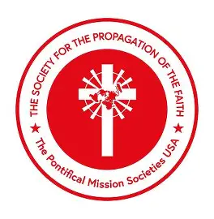
What is the Society for the Propagation of the Faith?
The Society for the Propagation of the Faith, which took up its first collection for the missions in 1822, is present in 1,100 dioceses worldwide. Its aim is to provide support to efforts to evangelize internationally. The Society for the Propagation of the Faith fulfills needs of the people in developing countries that are being led to Christ by hearing the Gospel message. This society supports evangelistic activity through funding catechetical programs, healthcare, transportation, communications, and the construction of new churches, that God would be glorified everywhere, and His people enriched by His love

Slide 20
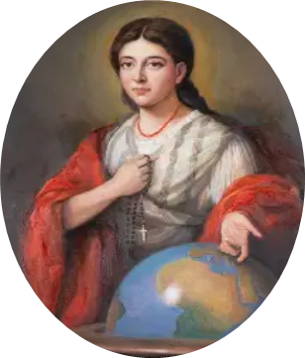
Who is Blessed Pauline Jaricot? How does her life spiritually connect with the life of St. Therese?
In the early 1800s, Blessed Pauline Jaricot was inspired by letters from her brother about the missions to form a group, now known as the Society for the Propagation of the Faith, committed to the financial and spiritual support of missionaries. She would gather people together to offer a small weekly donation to the missions, the equivalent of a penny, and to uplift daily prayer for the success of missionary activity to God. Blessed Pauline was a consecrated virgin with a deep love for God, which she would translate into forming societies of prayer, uniting people in love for God and mobilizing them to share it. Blessed Pauline worked with ordinary people, laborers, the factory workers of her time, because she could see the extraordinary in them, and in believing in the power of Christ’s love within them, helped them to do great things out of love for God. Together, they achieved their mission of glorifying God and saving souls, because they were united in the effort to share His love. Blessed Pauline was a missionary to souls, much like St. Therese, because she supported priests and lived a life centered on the Holy Eucharist, bringing Christ’s spirit of love outward. A French bride of Christ, albeit, not a cloistered one, Blessed Pauline was a spiritual mother like St. Therese who could touch souls deeply with her fortitude, wisdom, and piety. She was a friend of St. Jean Vianney, a spiritual companion to priests, who would help to lead him to his friendship with St. Philomena, whose healing Blessed Pauline Jaricot received while sick

Slide 21
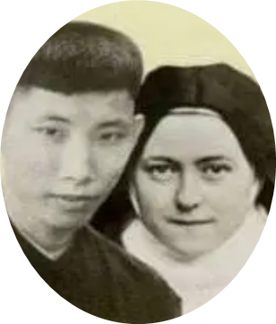
Who is Marcel Van? How does his life spiritually connect with the life of St. Therese?
Marcel Van began to receive visions of St. Therese after he prayed that Our Lady would help him to find suitable reading material to guide him in becoming a saint, and he chose The Story of a Soul, learning the “little way” from St. Therese
Saint Therese had dreamed of being a missionary, and Marcel Van dreamed of being a priest. Both did not fulfill the dreams that they had intended, but came to realize their goals in a deeper way, in accordance with God’s vision. Saint Therese would encourage and support Marcel Van in uplifting his crosses for God, and embracing God’s dream for him. In mystically serving this Vietnamese holy man, helping him on the road to Heaven, St. Therese would serve as a missionary, and Marcel Van would serve as a kind of brother priest to St. Therese, as well as to others, in being present for them in their sufferings, supporting them in accepting God’s will, by teaching them the little way as well

Slide 22
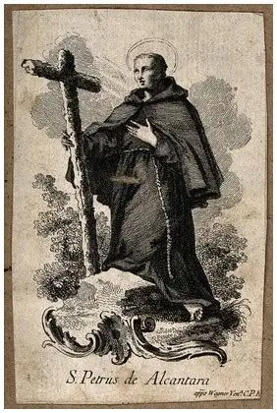
Who is St. Peter of Alcantara? How does his life spiritually connect with the life of St. Therese?
Saint Peter of Alcantara was a Franciscan who observed a strict form of the Rule, and would help to reform his order. As a reformer, he supported the reform efforts of St. Teresa of Avila, who was working to strengthen the Carmelite order. He would serve as a spiritual director and confessor of St. Teresa of Avila, helping to guide her mission
Saint Peter of Alcantara is a special patron of Brazil, as the emperor of Brazil had a special devotion to him. In this sense, St. Peter has served as a kind of missionary to souls, touching their hearts everywhere. He slept very little (up to 90 minutes per night), covering much ground in prayer. We celebrate his feast day in the traditional calendar today, October 19. Being a missionary means taking gradual steps to love God on the journey to Heaven, to draw souls to Christ’s garden there, which St. Peter of Alcantara did, in offering penitential acts every day. In this way, he was united with missionaries’ sacrifices spiritually, much as St. Therese was spiritually united to missionaries in her suffering, offered for the salvation of souls

Slide 23
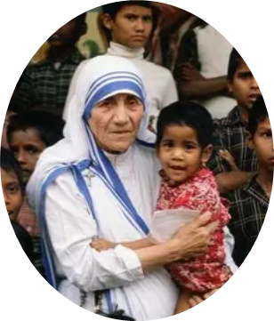
Who is St. Teresa of Calcutta? How does her life spiritually connect with the life of St. Therese?
Saint Teresa of Calcutta served the poor, reading the maps of the hearts of all of the sick, dying, suffering, and spiritually-impoverished. She would go any distance to serve them, to show them the depth of Christ’s self-giving love, which can reach even the most hardened and despairing of hearts with His charity. Saint Teresa teaches us how much ground is covered when we minister in the missionary territory immediately surrounding us, blooming where we are planted, just like St. Therese. She had a missionary heart that spiritually reached out to people beyond Calcutta, praying the World Mission Rosary by offering a decade of her Rosary, each a different color for each continent/region of the world. The rosary beads were constantly in St. Teresa’s hands; her life was one continuous offering of loving prayer for souls, given completely to God

Slide 24
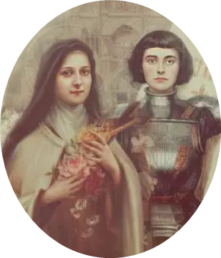
Who is St. Joan of Arc? How does her life spiritually connect with the life of St. Therese?
Saint Joan of Arc led her troops into battle successfully, to defend the French monarchy, the King and the Church, by uniting her soldiers around love for Jesus and Mother Mary: she carried banners to keep them united as one front, together in the battle, and the battle standards had images of Our Lady and Christ the King, reminding them who they were fighting for
Spiritual missionaries like St. Therese and St. Joan of Arc remind us of who we are fighting for, uniting us in the spiritual battle, that we may be victorious with Christ. They bring all of the soldiers together to fight the good fight. Saint Joan of Arc was an inspiration for St. Therese, who wrote a play about her, and learned how to live with fortitude, to be driven by love for Christ without measure, from St. Joan

Slide 25
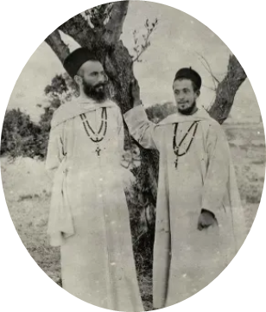
Who is Fr. Maurice Belliere? How does his life spiritually connect with the life of St. Therese?
In 1895, Maurice Belliere wrote to St. Therese’s mother superior requesting a nun’s prayers for his ministry, and would be given St. Therese for his spiritual friend. When she learned of her new mission, St. Therese was thrilled, unable to contain her joy in her heart. She had written to her sister, Celine, that she believed that God wanted them to pray for priests, to offer sacrifices for them, that this would be their mission in life, especially in serving God within the Carmelite order. Having lost her two older brothers before she was born, St. Therese longed for a brother who would become a priest, and God would fulfill the dream of her heart. Saint Therese had been praying for Fr. Maurice for a year before she began to write to him, only writing to him when her mother superior was ill, and unable to do so, but afterwards, when she requested permission to continue writing to him, it would be granted. It was St. Therese’s belief that the ministry of prayer for priests was greater than the ministry of preaching itself, because the prayers would form the preachers, preparing them for their works. Saint Therese was helping her priest friends to prepare for their greatest mission, the mission to Heaven, in their ministries to lead other souls there. On the day that St. Therese passed into the next life, September 30, 1897, Fr. Maurice would depart on his mission to Africa. Saint Therese’s prayers would sustain him while there. Her encouragement had helped to lead him on his mission, that he would fulfill his overarching mission to love God, just as St. Therese had fulfilled her vocation to love. As she was dying, St. Therese had found joy and affirmation of her faith in writing to Fr. Maurice, dispelling his doubts and strengthening his trust in God, showing him the “little way” of holiness as he grappled with his decision to become a priest, struggling to believe that he could fulfill what God asked of him. Saint Therese would be a beacon of light. The two friends would help to illuminate the way to Paradise for each other

Slide 26
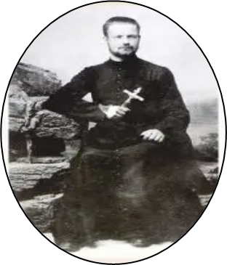
Who is Fr. Adolphe Roulland? How does his life spiritually connect with the life of St. Therese? (1)
When she spiritually met Fr. Adolphe Roulland, St. Therese had already been ministering to Father Maurice Belliere, having written him letters to encourage him in his pursuit of the holy priesthood. In 1896, a month before his priestly ordination, Fr. Roulland wrote to St. Therese’s mother superior requesting prayers and counsel from one of the religious sisters. The mother superior chose St. Therese to be Fr. Roulland’s pen pal, so the two began corresponding by letter. Humbly requesting that Fr. Roulland pray for her, too, St. Therese asked specifically that Fr. Roulland pray at his first Holy Mass that a greater love for God be enkindled in her heart, so that she could spread it to others, a moving flame igniting everyone in a burning love for the Lord. Father Roulland not only prayed for this intention when celebrating his first Holy Mass, but at every Holy Mass he said thereafter. He also had written to St. Therese’s mother superior, requesting to celebrate his first Holy Mass at the Carmel, a permission that was granted. He would meet St. Therese when she served as a sacristan at his first Holy Mass. It would be the only meeting between the spiritual friends in this life, but Fr. Roulland and St. Therese would keep writing to each other, with Fr. Roulland telling her that he had prayed for God’s blessing on their shared apostolate, their ministry to save souls. Knowing that St. Therese was praying for his missionary work was a great consolation to Fr. Roulland, who called St. Therese his “little sister in Jesus,” while St. Therese called Fr. Roulland “brother of my soul.”

Slide 27
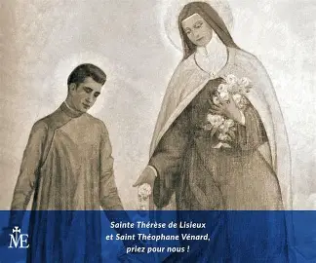
Who is Fr. Adolphe Roulland? How does his life spiritually connect with the life of St. Therese? (2)
When the brother and sister in Christ shared their vocation stories with each other, they learned that the day that Fr. Roulland had been having serious doubts about entering the holy priesthood, but then received the grace of clarity, confidence, and strength that he needed to pursue it, was the same day on which St. Therese made her profession of vows, and prayed that God would send her a priest to pray for: this was on the Feast of the Nativity of Mary, September 8, 1890. On this day, St. Therese would more deeply become a spiritual mother. When Fr. Roulland, who had been preparing to go as a missionary to China, was finally sent there, he wrote to St. Therese about the trials he experienced, including illness, but assured her that he wanted only to know how to suffer well for God, not to avoid it entirely, so they would pray for many graces for him as he suffered for Christ. Father Roulland had believed that he would predecease St. Therese, dying a martyr, but she would pass into glory before him, having gone through a spiritual martyrdom. He had been writing to her about the suffering of his people to whom he ministered, sharing about the serious famine they faced, and the acts of desperation that they took in response to the hunger they experienced, especially in terms of crime. Father Roulland did not know of St. Therese’s death until months after her passing, and had written to her about his joy over the conversions that were suddenly blossoming in his people. No doubt, the prayers of St. Therese from Heaven were nurturing this growth. Saint Therese called herself Fr. Roulland’s “little sister for eternity,” and was certainly still praying for him and his mission; she was fulfilling her mission to prayer

Slide 28
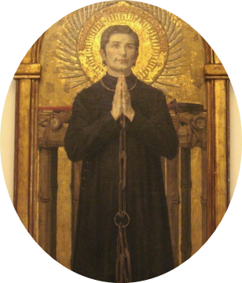
Who is St. Jean-Theophane Venard? How does his life spiritually connect with the life of St. Therese? (1)
Born in 1829 on the feast day of Our Lady’s Presentation, Saint Jean-Theophane Venard lived a humble and simple life of extraordinary courage and love in union with Jesus through Mary. As a child, he read about a French missionary to Vietnam who was martyred, and announced to his family that he, too, wanted to be martyred in Vietnam as a missionary priest. He would pursue his dream to share God’s love at home and abroad, going to seminary and being ordained a priest, even receiving his ordination early, at age 22, in 1852. Shortly after ordination, he was sent to Vietnam to minister to those who had never heard the Gospel message. As a priest, St. Jean-Theophane was much-beloved, often being thanked by his parishioners for his tireless, loving work. Fatherly, gentle, and kind, St. Jean-Theophane balanced the qualities of his devout Catholic parents, embodying his mother’s sweetness, as well as his father’s strength, steadfastness, and determination. After his mother’s passing from this life, Saint Jean-Theophane remained close to his sister, exchanging letters with her frequently, confiding in her about the spiritual life, including the joy of serving God. He even received a dream in which his mother was welcomed into Heaven by the holy angels, and learned all the more to place his confidence in the Heart of Jesus, which wants us to join Him in eternal glory, giving us the means to do that, according to what we need for our personal salvation. While he battled severe illness, nearly dying at some points, St. Jean was happy to be fulfilling his dream of being a missionary and caring for God’s people, who were so dear to his heart, that he would offer his life for them

Slide 29

Who is St. Jean-Theophane Venard? How does his life spiritually connect with the life of St. Therese? (2)
Christians were persecuted very harshly already in Vietnam, but new laws would impose even greater penalties on Christians. Saint Jean-Theophane, along with other priests, could only emerge at night to minister to his people, having to hide in a cave for much of his time. When he was discovered by civil authorities, he was arrested, and had to live in a cage, but was joyful nonetheless, continuing to preach and write about the Lord, even going to his martyrdom singing. He was asked what he would be willing to give up to reduce the severity of the tortures he would receive, but he did not attempt to better his situation temporally, instead, keeping his eyes on eternity, and saying that a longer punishment would be of lasting value. With joy and hope, he accepted and embraced the opportunity to suffer with and for Christ. Martyred on Candlemas, the Feast of Our Lady’s Purification in 1861, at age 31, St. Jean-Theophane would inspire others to greater purity of heart, a love for Jesus motivated only by sincere charity. He would inspire St. Therese, who said that she related to St. Jean-Theophane’s simplicity of soul. She, too, had wanted to go to Vietnam as a missionary, but imitated St. Jean-Theophane in willingness to follow God’s will. Her name “the Little Flower,” would, in part, be inspired by St. Jean-Theophane, who had written to his father before his martyrdom that God plucks his little flowers in His time. Saint Therese would come to trust in God’s Providence and perfect timing as well

Slide 30
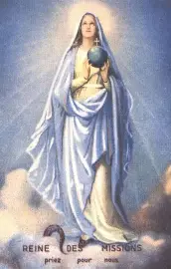
What does Our Lady teach us about supporting the missions?
Our Lady teaches us that we support the missions best by praying for their success. After the Ascension of Our Lord, Our Lady remained for at least fourteen years in this earthly dwelling place, offering her prayers for the apostles, and meriting for us. She modeled what it means to remain faithful to Christ unto the end. Going through further spiritual martyrdom in living without the physical Presence of Our Lord, Our Lady demonstrated true love for her spiritual children, whom she remained with to minister to. Our Lady was nourished by Christ’s Eucharistic Presence, praying that the apostles would be successful in their efforts to bring her Son’s Presence in the Holy Eucharist to others, that they would come to know Jesus, being converted and healed by His love. Supporting the missions spiritually means that we can be missionaries to everyone, everywhere, not limited by time and space, but serving as spiritual participants in the mystery of Christ’s saving work, of His infinite love that embraces all

Slide 31
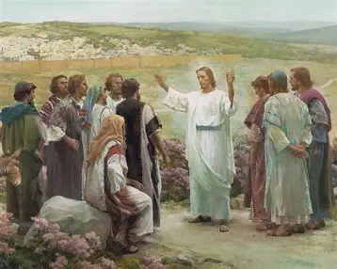
How did Our Lord serve as the greatest missionary?
Our Lord is the greatest missionary, because He not only served souls directly, going out to preach to the people in His public ministry, and to teach them how to pray to God the Father, but He also equipped souls to minister to others. He taught His apostles how to spiritually feed His people, healing them, breaking bread with them, forgiving sins, and casting out demons. Our Lord taught the apostles how to be missionaries to souls, and prepared such disciples as St. Mary Magdalene to evangelize by spreading the Gospel message of salvation in Christ, redemption through His loving Sacrifice. Jesus sent forth His apostles on their missions; He not only fulfilled His mission to God the Father, but led others to fulfill their missions through sharing His love so generously

Slide 32
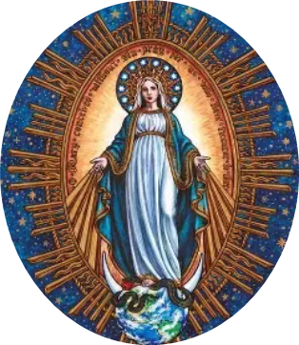
Who is Our Lady, Queen of Missions?
Our Lady is Queen of Missions, because she is our universal Mother, the Queen of us all. When we make her the queen of our hearts, she becomes the heart of our Church, linking us all
Our Lady went before us, showing us how to honor God through fidelity to Him. She stood by the Cross of Christ, and remained loyal to God the Father in staying close to Him even after Our Lord’s Ascension, not despairing, but having hope, looking forward to when she would be reunited with Christ forever in Heaven
Missionaries go before us, serving as teachers who show all people the way to Christ, speaking to her children in their unique languages, but always, in a language of love that can be understood within the heart. Our Lady blesses missionary work offered in the Holy Name of her Son, Jesus. She stands on the globe, watching over us, and extending her graces to all

Slide 33
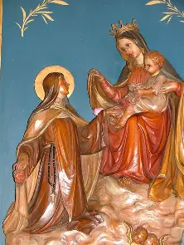
How did St. Therese imitate Our Lady in serving as a missionary? What does it mean for us to serve God’s priests and people as spiritual missionaries? (1)
Saint Therese, like Our Lady, lived a hidden life. Our Lady did not enter the cloister, so to speak, but lived in the Cenacle for a time, and in the house that St. John built her at Ephesus. She did not seek glory for herself, but prayed for souls to enter into glory with Christ, that His Heart would be consoled. Like Our Lady, St. Therese prayed in support of Christ’s priests, His apostles, that their missions would be successful. Both St. Therese and Our Lady lived entirely for God, giving themselves to Him in love as they pursued Eucharistic lives of charity and self-sacrifice. Saint Therese received the Carmelite habit of Our Lady, wearing her mantle and covering others in God’s love, just like Our Lady did. Our Lady and St. Therese cultivated God’s garden with their love and prayer that would plant seeds of virtue in other souls, helping them to blossom through their encouragement

Slide 34
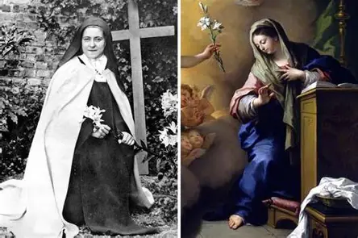
How did St. Therese imitate Our Lady in serving as a missionary? What does it mean for us to serve God’s priests and people as spiritual missionaries? (2)
Our Lady is Queen of the Apostles, and likewise, St. Therese linked her ministry to the ministries of the priests, creating one spiritual apostolate through unity in prayer and sacrifice
For us to serve God’s priests and people as spiritual missionaries means to unite in love for Christ, going to Our Lady, Queen of Missions and Queen of Apostles to guide us into deeper union with Christ

Slide 35
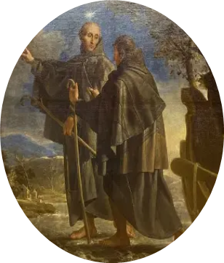
Closing Prayer: Collect Prayer for the Feast of St. Peter of Alcantara
O God, who didst vouchsafe to make blessed Peter, Thy confessor, glorious by the gift of a wonderful spirit of penance and most lofty contemplation, grant us, we beseech Thee, that, through his interceding merits, being mortified in the flesh, we may the more easily understand the things of heaven. Through our Lord Jesus Christ, Who lives and reigns with You in the unity of the Holy Spirit, one God, forever and ever. Amen.

