Slide 1
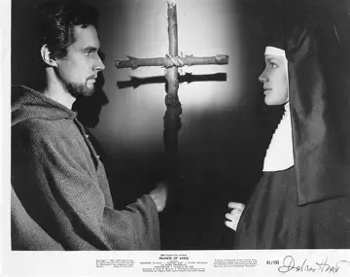

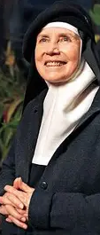
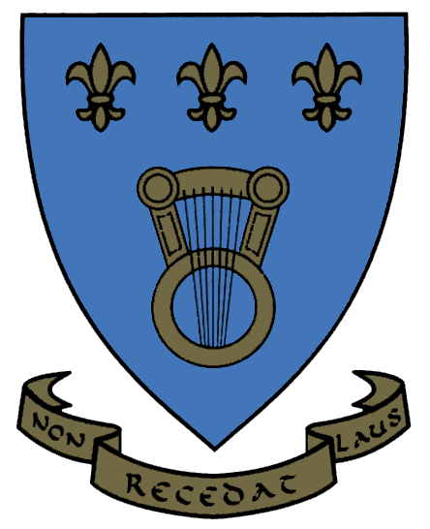
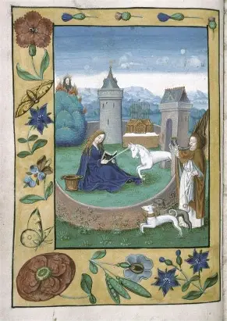
Heart for Hart: Celebrating Mother Dolores Hart’s Birthday
Monday, October 20, 2025
Katie Sadakierski

Slide 2
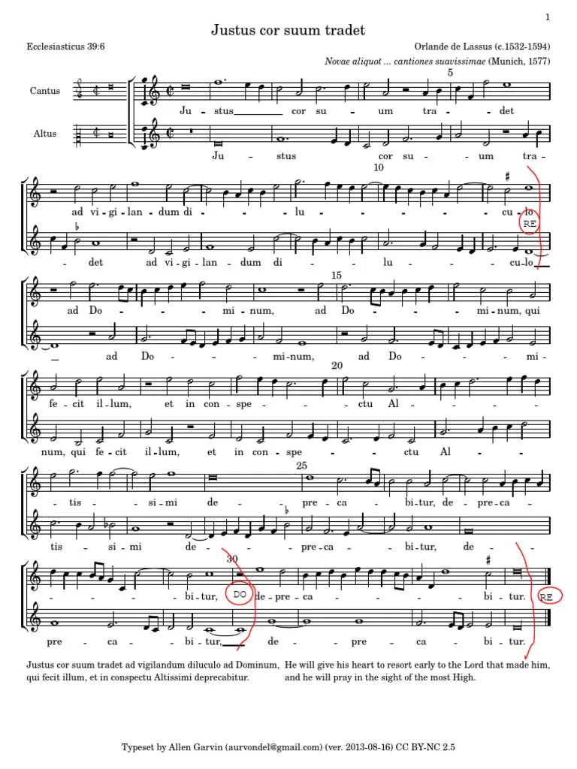
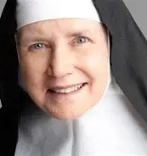
Outline
I. Opening prayer
II. Presentation:
a. Heart to Heart: Hearing the Story of Mother Dolores Hart
b. Heart to Heart: Hearing the Story of Christ Working in Mother Dolores Hart
c. Heart to Heart: Hearing the Story of How the Two Hearts Work in Our Lives, Speaking to our Souls
III. Announcements
IV. Closing prayer
V. Screening of Mother Dolores Hart’s 1961 film Francis of Assisi
VI. Q & A; Discussion (film reflection questions)

Slide 3
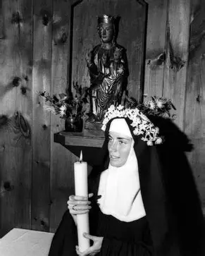
Opening Prayer: Collect for the Feast of St. Paul of the Cross
May the Priest Saint Paul, whose only love was the Cross, obtain for us your grace, O Lord, so that, urged on more strongly by his example, we may each embrace our own cross with courage. Through our Lord Jesus Christ, your Son, who lives and reigns with you in the unity of the Holy Spirit, God, for ever and ever. Amen.

Slide 4
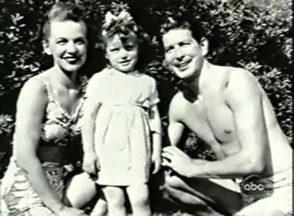
Who is Mother Dolores Hart? (1)
Born on October 20, 1938, Mother Dolores Hart’s passion for the arts would be cultivated in her by her parents. Teenagers at the time of her birth, they were both Hollywood hopefuls, living in California and auditioning for television and film parts, but the sense of competition between the actors, coupled with the instability and uncertainty of their lives, put a strain on their marriage
When Dolores’ parents were on the brink of separation, she was sent to live with her grandparents. While living with her grandparents, she attended a Catholic school, though her family was Protestant. At school, the young Dolores noted that her Catholic classmates would go to Holy Mass in the morning, then eat breakfast at school after having observed the Eucharistic fast, and received Holy Communion. Wanting to eat breakfast with her classmates, who dined happily on such fare as chocolate milk and donuts, Mother Dolores informed the religious sisters at school that she, too, would like to eat bread with the children

Slide 5
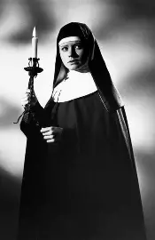
Who is Mother Dolores Hart? (2)
When the religious sisters received Dolores’ request, they interpreted her question as being about receiving Holy Communion, the Eucharistic bread, and asked her if she would like to begin receiving religious instruction
At home, Dolores spoke to her grandmother about the formation, saying that if she took additional classes at school, she could receive breakfast with the children. Her grandmother would approve the request, and Dolores would begin to partake in preparation for First Holy Communion. She began to visit the chapel at school to pray, having found that she enjoyed the religion classes she took
When she was younger, Dolores had been brought by her mother to her great aunt’s investiture; her aunt, named Sister Dolores Marie, was a nun, after whom Dolores had been named. Her mother asked that the priest baptize Dolores, but he refused, responding that the family was obliged to become Catholic first. At age ten, when Dolores was received into the Catholic Church, her mother was delighted

Slide 6
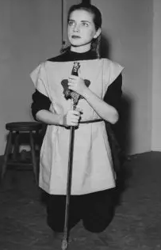
Who is Mother Dolores Hart? (3)
When she was confirmed, Dolores chose St. Therese of Lisieux as her patron. She admired St. Therese’s boldness, saying that it was evident that St. Therese was worthy of the title of Doctor of the Church, because of how she could pursue her call so determinedly
After her parents formally separated, and Dolores’ mother remarried, building a blended family, Dolores would move back to California to live with her mother, and would pursue undergraduate studies in acting there
As a college freshman at the Catholic college, Marymount, Dolores would emulate her patron, St. Therese, in that she played the lead role of St. Joan of Arc in her drama department’s production on the life of the saint, just as St. Therese had written her own show about St. Joan to act in

Slide 7
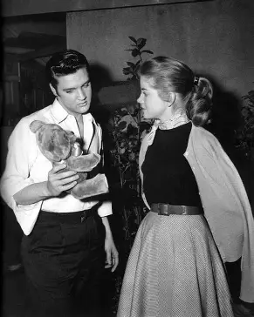
Who is Mother Dolores Hart? (4)
Although Dolores would not have the opportunity to play Joan of Arc in film, her portrayal of the saint led to her talent being discovered, and would open up new opportunities for her, namely, acting in films with Elvis. All of Dolores’ dreams were coming true: she was becoming an actress, pursuing the career she was passionate about; seemingly, she had received everything that she wanted, but something was still missing from her life
Mother Dolores particularly respected St. Therese’s perseverance in seeking to enter the convent at fifteen, and to receive permission from the pope. In a similar way, Mother Dolores was a pioneer, taking a difficult road to say “yes” to God, in having broken from the pathway expected of her. She would choose to enter religious life, instead of continuing on her journey to film stardom as a Hollywood actress

Slide 8
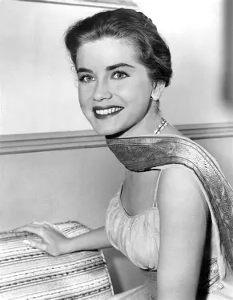
How did Mother Dolores Hart discern her calling? (1)
After a particularly hectic and strenuous experience acting in a Broadway show, which was draining her, Dolores opted to go on a retreat for a change of scenery. She had spoken to a friend, who recommended Regina Laudis Abbey as the ideal location for time away from the frenetic pace of daily life, that would allow for contemplation and restoration, revitalization in the midst of such busyness. Located in Bethlehem, Connecticut, the abbey was close enough to New York City that Dolores could easily travel there for weekend sojourns
While initially, Mother Dolores was reluctant to meet nuns, whom her friend wanted to introduce her to, she came to enjoy being with the nuns, and was left with none of her initial trepidation. Her visits to the abbey for solitude and tranquility would be short-term, but eventually, she found that the abbey had become her home. She compared the sense of certainty she felt at the abbey to the sense of certainty that one would have when they met the person they were going to marry

Slide 9
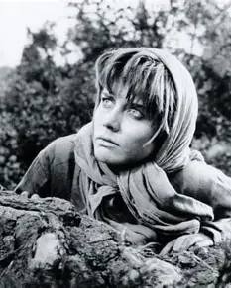
How did Mother Dolores Hart discern her calling? (2)
In five years, beginning in 1957, Dolores had made ten films, and would have many offers flowing in to keep building up her already impressive career acting in movies with some of Hollywood’s most beloved stars. She was engaged to a successful architect, Don Robinson, who loved her deeply, but she sensed that something was not right, that while still living a faithful Catholic life, she was not embracing everything that God was calling her to
While acting in a movie about the life of St. Francis of Assisi made in 1961, portraying St. Clare, Dolores was touched by the beauty and timelessness of the town of Assisi, where they filmed on location. Stepping into the role of St. Clare was transformative as well, since Mother Dolores would emulate her fortitude in turning away from worldly status, material wealth, and outward beauty to embrace inner transformation in Christ, just like St. Clare had
Likewise, portraying a Holocaust survivor in the 1962 film Lisa was a watershed moment for Dolores, who began to reflect all the more on the human condition, our mortality, and the legacy we leave behind in the world. Touched by the heroism of survivors, Dolores would be drawn to pay homage to such true heroes by living her own life meaningfully, to the fullest

Slide 10
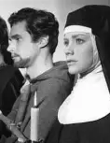
How did Mother Dolores Hart discern her calling? (3)
After having filmed Francis of Assisi, Dolores met Pope John XXIII, introducing herself to him as “Dolores.” The pope corrected her, calling her “Chiara.” He was identifying her by the saint she had portrayed in the film, as though prophesying that Dolores would live in total imitation of St. Clare, and become another “chiara,” another “light” shining for Christ as His bride. This experience shaped Dolores’ formation, inspiring her to embrace her vocation, for she knew that the pope had seen something deep within her soul, a mark of God, and that the Lord was speaking to her through the pope. Her blossoming acting career had led others to call Dolores “another Grace Kelly,” but all along, she had been meant to be another Chiara; she was meant to be herself, to shine Christ’s light as He personally called her to do
When Dolores finalized her decision to enter religious life at Regina Laudis in 1963, arriving at the monastery in a limousine, she shocked all of Hollywood. Many were unsupportive of her, and her fiancé was devastated. He would never marry once their engagement was broken, but would come to visit Dolores every year at the convent until his passing from this life, assisting at the abbey in any way that he could. Dolores remained faithful to God, standing by her decision, no matter how much others criticized or misunderstood her. Like St. Clare, she would embrace God’s call with much courage, not fearing the road ahead, but journeying down it with hope and faith, entrusting herself to God, the true Director of her life

Slide 11
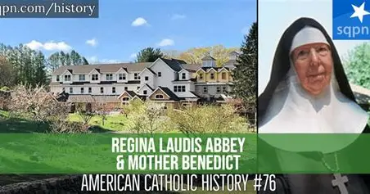
What is Regina Laudis Abbey? (1)
Located in Bethlehem, Connecticut, a rural town of under 4,000 residents, Regina Laudis Abbey is known for its exquisite 300-year old Nativity creche, believed to have been a gift to a king when he was coronated, in honor of Christ the King. Made in 1720, it is a true work of art that is 16 feet wide and 6 feet deep, attesting to how deeply and broadly God loves us, in having come down from Heaven to save us, as well as to how souls living at or visiting the abbey are reborn in the love of Christ that is so powerfully expressed throughout the community. The creche was donated to the abbey in 1949, having been brought to the United States from Italy in 1948. Every figure in the creche reacts uniquely to the Christ Child, just as at the abbey, every soul discovers how they are meant to respond uniquely to God’s love. The 1940s film Come to the Stable tells something of this story, bringing to life the nuns who originally came to help to found the abbey
The only monastery of its kind in the nation, Regina Laudis Abbey is a fully-enclosed contemplative Benedictine monastery for women religious that is also a self-sustaining community offering a fully-operating farm. Living in accordance with the Rule of St. Benedict, the nuns at Regina Laudis balance work and prayer, engaging in lectio divina, a form of contemplation of God through spiritual reading of Sacred Scripture, to inform their action, bringing forth the Gospel message into their works undertaken with love
Forty women live at Regina Laudis Abbey, which has a diverse community of religious, members who enter with considerable professional experience, and who have continued to pursue advanced degrees, often, doctorates, learning any skills needed to keep the farm thriving

Slide 12
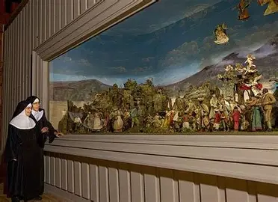
What is Regina Laudis Abbey? (2)
Founded in 1947 by an American woman, Vera Duss (named “Sister Benedict” in religion) who traveled to France to become a medical doctor, before finally becoming a nun, Regina Laudis is place for women to embrace the unique call given to them by God, to use their talents as a family for His glory. Mother Benedict’s story is immortalized in a book published in 2007 by Ignatius Press. She had embraced God’s call for her to found a monastery after World War II, when she was inspired by the fraternal bond between soldiers, and sought to replicate such a sense of community for women, who could unite in the shared purpose of glorifying God
At Regina Laudis, in true Benedictine fashion, the nuns engage in agricultural labors to bring forth a good harvest for God, Who all the more tenderly plants seeds of faith, hope, and love in their hearts. Cultivating the farmland, a reflection of the spiritual cultivation of souls that they complete, the religious sisters produce world-famous cheese, operate a bakery, tend gardens and orchards, care for sheep and cattle, weave, sculpt, and serve as carpenters. As the women religious are led by God in their pursuits for His glory, He tends to their souls, helping them to open themselves all the more to His care, that they may be shaped to fit the mold of Mary, and therefore, that of Christ, the Son. The “Cheese Nun” is a household name, having pursued doctoral research in optimum cheese-making techniques, which she applied with perfect precision, with excellent results. Each nun, in humbly following the course God set for her, is perfected gradually, doing even the seemingly smallest or simplest tasks with great love and beauty, an impeccable grace, like that of Our Lady

Slide 13
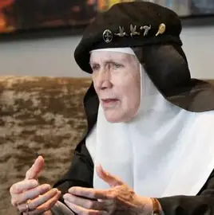
What spiritual takeaways may we apply from Mother Dolores’ life? (1)
Mother Dolores’ names signify so much about who she is. The name “Dolores” refers to sorrows, coming from the Latin “Mater Dolorosa,” honoring the Mother of Sorrows, Our Lady, who suffered spiritual martyrdom with Christ as He was crucified. Mother Dolores was not without sorrow in her life, experiencing some level of abandonment by her parents; her father was abusive to her mother, which contributed stress and anxiety to her childhood. When her mother developed dependency on alcohol during Dolores’ young adulthood, Dolores would attempt to persuade her mother to abstain from alcohol, but her mother was largely resistant. Harriet, Dolores’ mother, was always returning to the bottle for comfort amidst stresses in her new marriage to a restaurant owner, and her frustrated dreams of becoming an actress

Slide 14
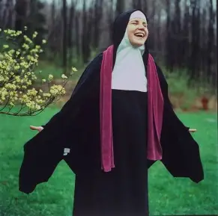
What spiritual takeaways may we apply from Mother Dolores’ life? (2)
When Dolores announced her intention to become a nun, Dolores’ mother engaged in self-blame, believing that Dolores had chosen not to marry because of her childhood trauma. Even when Dolores assured her that this was not the case, mother and daughter had a strained relationship that would cause Dolores heartache, especially when seeing her mother dealing with substance abuse. In understanding much about the sorrows of life, in experiencing it within her own family, and in her found family made up of Hollywood actors with whom she had closely worked, creatively collaborating in sometimes very emotional dramatic films that required them to dig deep within, channeling their own emotional experiences, Dolores could be very empathetic to others, and could use her sorrows to bring joys to others by consoling and counseling them in challenging times. As a nun, she would become a director of education helping to guide young women in their spiritual development, and would provide a medium through which they could grow closer to God in theater, an emotional outlet to creatively explore their relationship to the Creator. Dolores had always been devastated when the film crews would wrap, missing the sense of community once the movie production was over, but in embracing Christ, Dolores would enter a family that would always be united, an unending, undying love

Slide 15
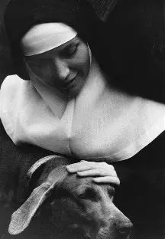
What spiritual takeaways may we apply from Mother Dolores’ life? (3)
Mother Dolores’ last name was “Hicks,” but she changed it to “Hart” when she began her acting career. The opening line of the Rule of St. Benedict is St. Benedict’s directive to “listen” by opening up the “ears of the heart.” As an actress, Mother Dolores would have known how to take direction. She had watched carefully as a child, learning how to act not through formal classes, but through studying the techniques of the actors that she saw in films her grandfather showed at the movie theater in his job as a projectionist. While he napped on a cot in the projector booth, Dolores would assist in operating the films, waking him when it was time to change film reels. Just as she watched details so closely as a child, as an adult, she would learn how to listen closely, too; she would open her ears to hear God’s voice speaking within her heart, and would take direction from Him in order to know how best to act in this life, to follow God sincerely and to become who He intended, not playing a part, but being authentic, true to what God called her to be and do. Before entering religious life, so much of Mother Dolores’ life was self-directed; she was independent and successful, but in opening her heart to God, she would come to receive His love, not simply to take action, but to treasure all things in her heart, being receptive to how God would lead her to use those treasures, so as to shine as a brighter star, one in Our Lady’s crown, not another one in the constellation of Hollywood stars alone

Slide 16
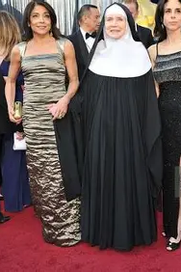
What spiritual takeaways may we apply from Mother Dolores’ life? (4)
Initially, Mother Dolores was given the name “Judith” as her name in religion, but “Sister Judith” did not remain her name. She would be permitted to take her original name back. Her past would never be entirely abandoned; she would come to integrate all of the distinct dimensions of her identity, and to embrace all of what God had intended for her to be. Mother Dolores would lean into what she had learned as an actress, and would continue praying for all of the actors with whom she had worked. She was even permitted to continue voting on films to win Academy Awards, the only nun on the panel of voters. In serving on the panel, Mother Dolores would receive copies of the films in contention, and would show them at the monastery on special occasions as a bonding experience for the religious sisters, who would request certain films

Slide 17
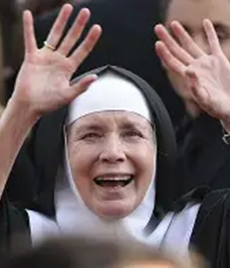
What spiritual takeaways may we apply from Mother Dolores’ life? (5)
In the Old Testament, Judith was a type of Mary. She rescued her people from danger, opening them to freedom. Wise and courageous, Judith deceived the Assyrian leader, Holofernes, who had plans to battle Judith’s Jewish people and persecute them. A beautiful widow, Judith would dress herself resplendently to visit Holofernes’ tent in the Assyrian encampment, and would slay him, saving her people from the oppression he had intended to subject them to. A holy angel would guide Judith on her journey, protecting her from Holofernes, whose intentions were less than honorable
While Our Lady would not have resorted to deception, or to slaughter of any kind, Judith prefigured Our Lady in her fortitude applied to the redemption of her people. Mother Dolores is similar to her original namesake, Judith, in her willingness to be faithful to God’s call at any personal cost, for the greater good. Though initially recognized for her outward beauty and status, like Judith, she would come to be esteemed for her inner beauty. Judith sang a song of praise to God for His Providence in delivering her people and protecting her. Mother Dolores would offer her life as a song of praise to God, even entering an abbey named in Latin for the “Queen of Praise.” In her joy and zest for life, her creativity and zeal, brightness and warmth, boldness and expressiveness, Mother Dolores would mirror Mary in uplifting her heart in total praise of God

Slide 18
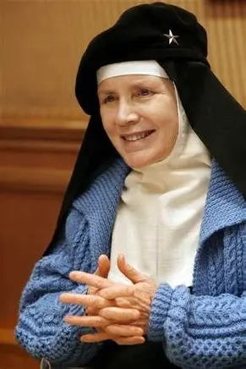
What spiritual takeaways may we apply from Mother Dolores’ life? (6)
Upon entering the convent, Mother Dolores had her challenges, initially dealing with sadness and doubt about her vocation, as she questioned whether to return to the world, believing that she was potentially unfit for religious life. Just as she would prepare to honor the lives of people she portrayed in film in order to do them justice, training for her parts, she applied herself to honoring God, imitating Our Lady and Our Lord in her steadfastness. Initially grappling with learning Latin and how to chant it, Mother Dolores would come to love the opportunity to praise God eight times each day by chanting the Divine Office in Latin, honoring the tradition of the Church. As an actress, Mother Dolores always most loved the opportunity to develop friendships with other actors in bringing stories to life, all contributing their own stories of God working in their lives to their art, so as a nun, she would love the opportunity to unite with the universal Church, and the sisters in her community, in praising God, and praying that other souls would come to praise God, too. Mother Dolores would come to embody the meaning not of simply her own name, but the name of her community, because she would come to be defined by her identity in Christ, His bride, a member of His whole Church, a spiritual mother to all of God’s children entrusted to her care as prioress at the abbey, a position she was elected to in 2001 to assist the abbess, the leader of the monastery

Slide 19
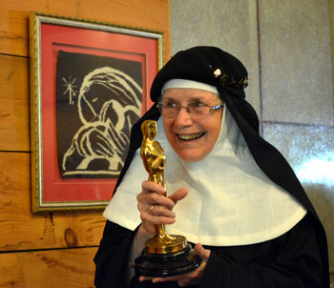
What spiritual takeaways may we apply from Mother Dolores’ life? (7)
Regina Laudis’ abbey crest has an image of a lyre, a musical instrument. The motto for the abbey is from the Book of Judith, “Let praise never cease.” Mother Dolores shines Christ’s light by never ceasing to praise God, for she inspires others to join her in praising God through all seasons, that they may praise Him forever in Heaven
Mother Dolores kept her eyes on eternity, embracing the greatest award, which is that of the heavenly crown. She is pictured at her golden jubilee celebration holding the Oscar awarded to her friend, Gary Cooper (whose daughter, Maria, Mother Dolores was very close to), but could return this token at the end of the day, knowing that she had already received the greatest treasure, that of God’s love, and that all of her life would continue to be dedicated to praising God for the treasures He gave, until embracing these treasures eternally

Slide 20
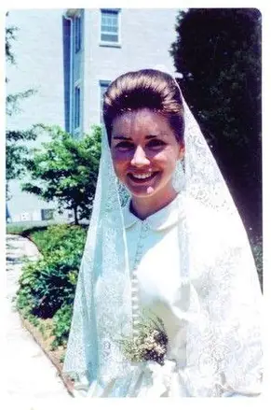
What do the Benedictine vows taken by Mother Dolores and her community of nuns teach us about what our spiritual lives are to be?
Obedience:
  Mother Dolores and her fellow Benedictines take vows of obedience, expressing that they will listen to their religious superiors, respecting them as spiritual parents given to them by God. To do one’s assigned “work” is to practice their “obedience.” Being obedient to God above all else is an act of love; we can obey God by faithfully and lovingly fulfilling the service He calls us to each day, in our prayers and works. Obedience helps us to grow in love, as we learn perseverance and stability, rooting out pride in our hearts through dedication to a ministry
Conversatio morum:
  Benedictines take a vow of “conversion of life.” They strive for continual spiritual growth, recognizing that life is a series of conversions, and that we can always turn closer to Christ. This ongoing conversion comes about through persistence in prayer and work offered for God. Mother Dolores had a major conversion, undergoing a drastic change in her life, but from there, kept taking gradual steps to keep purifying her love for Christ, and growing in friendship with Him. Our spiritual lives are to be relationships with Christ, commitments of service that are eternal, for God’s love is eternal. To hear God speaking His words of love, we are meant to keep opening the ears of our hearts each day
Stability:
  Members of the Benedictine order promise to remain at their monastery, in their particular community. This is out of recognition that we bloom where we are planted, receiving the nourishment that God wishes to give us, wherever we may be. Mother Dolores has remained at Regina Laudis, serving her family in Christ faithfully out of love, supporting her sisters in their continued growth. Wherever we may be, we can bring Christ’s love wholeheartedly; even without traveling, we can radiate Christ’s Presence, and serve Him

Slide 21
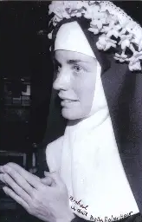
What does Mother Dolores’ profession of vows teach us about the spiritual life? (1)
Mother Dolores professed her final vows in 1970. Prior to that, when entering the monastery, and making temporary vows, she wore a wedding dress as a representation of her deep commitment to God as His bride. At her final profession of vows, she would receive a ring and carry a candle. This teaches us that to be spiritually united to God means to shine His light always, to be a living flame, a candle that is carried out into the world, or whose light is radiated even when remaining within the cloister, bright enough for all to see, and fanned on the winds of prayer, carried forward through the loving petitions offered to God

Slide 22
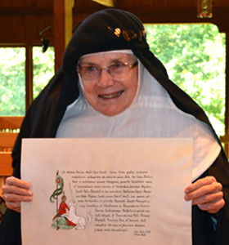
What does Mother Dolores’ profession of vows teach us about the spiritual life? (2)
On the occasion of the jubilee of her final profession of vows, marking fifty years of consecrated life, Mother Dolores renewed her vows, using the illuminated manuscript she had made when she first professed her vows. She had illuminated the manuscript with an image of a unicorn, a Catholic symbol that represents Christ, for He is unique as a unicorn, the only being to be both fully human and fully divine. Tradition holds that the unicorn is only tamed when it rests its head in the lap of a virgin. Likewise, the world is redeemed through the collaboration of Christ and the Blessed Virgin Mary; Jesus teaches us to come to rest in His Mother’s Heart, like He does. Mother Dolores’ heart is like a manuscript illuminated with love for Christ, which she projects outward for us to see, like a film playing out the events in Christ’s life, reflecting His great love. Mother Dolores opened herself to being polished and healed by Our Lord, the God-Man, the only One Who could bring her the fulfillment she sought, and demonstrates to us how to open our hearts with similar faith. Over the years, Mother Dolores came to understand the unicorn as a symbol of protection; she would see that Our Lady and Our Lord protect the souls in the enclosure. Mother Dolores would share in the Lord’s mission by overseeing the care of the souls He entrusted to her, consecrated virgins in the enclosed garden that is Our Lady’s womb, her inviolate body in which the spiritual children grow

Slide 23
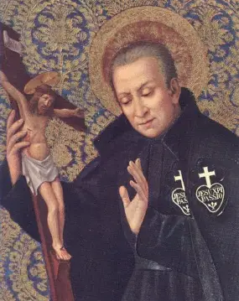
What is the significance of the feast days celebrated on Mother Dolores Hart’s birthday? (1)
Saint Paul of the Cross (1694-1775):
  Saint Paul of the Cross founded the Passionist order, which honors the Passion of Our Lord. Passionists take a fourth vow besides those of the usual three evangelical counsel of poverty, chastity, and obedience: they promise to spread devotion to the Lord’s Passion, to help souls to remember Christ’s love in meditating on His Passion. Merciful and kind, St. Paul of the Cross embodied Jesus’ love. He embraced God’s call for Him to spread the memory of Christ’s Passion by preaching on it and performing works of mercy for souls going through their own Passion. Touching others’ hearts through his tender words and dedicated service, St. Paul of the Cross, a former soldier, led others to serve as soldiers for Christ, that they would faithfully fight the good fight with Christ, and console His wounded Heart. Saint Paul helped others to see the Passion as an unfolding expression of Christ’s love. The feast day of St. Paul of the Cross was the perfect day on which Mother Dolores could be born, because she has a similar spirituality, in seeing the love of God in all things, and understanding her vocation as one to love, much like St. Therese perceived. Mother Dolores said that to “find God is to find love. To understand God is to understand love.” Mother Dolores sees all love as flowing from God, Who is love, and embraced a life of service as a life of love for God being poured out from the heart. With compassion, she helps others to embrace their crosses, and to carry them joyfully and lovingly for God, educating others in the way of Christ, the way of love

Slide 24
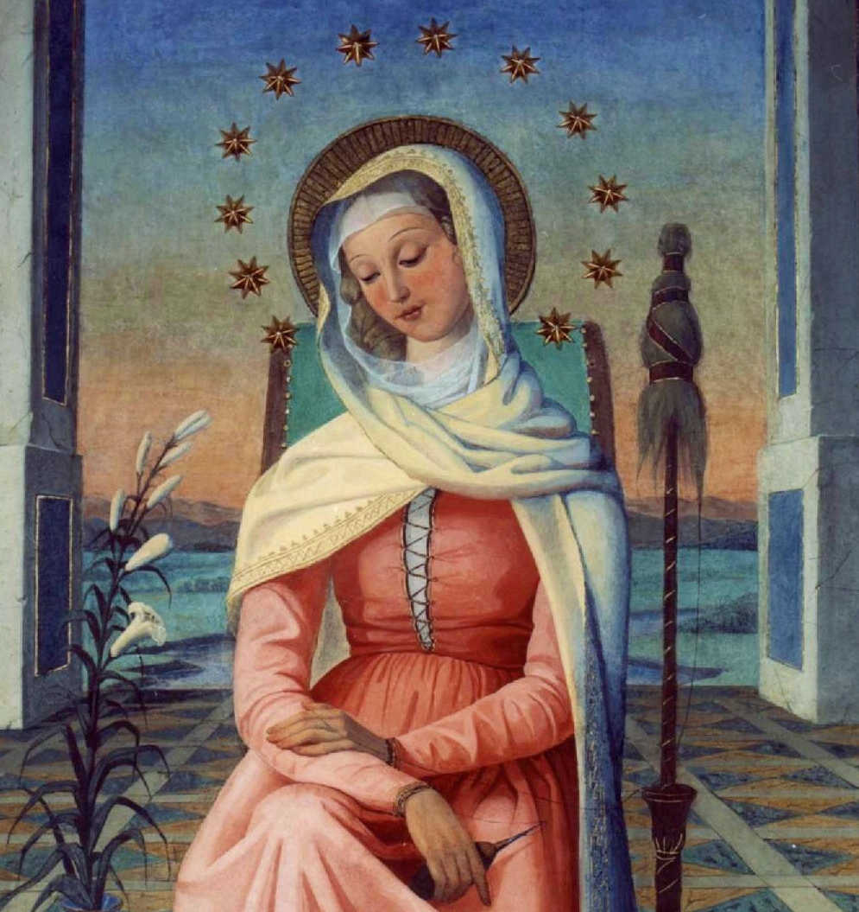
What is the significance of the feast days celebrated on Mother Dolores Hart’s birthday? (2)
Mater Admirabilis: In 1844, Pauline Perdrau, a postulant in the Society of the Sacred Heart, determined to paint an image of Our Lady to honor her. Joyfully offering this act of love with all of her heart, Pauline painted Our Lady in rose-colored garments, because as a child, Pauline had worn a pink dress that was particularly special to her. Embracing Our Lady as her Mother with a childlike heart, Pauline poured all of her love into her painting. Because it was her first artistic endeavor, she did not have experiential knowledge of how paints behave on canvas, and, in following the advice of another to use vivid colors, had painted the work too brightly. The effect of the painting after it dried would not be vivid, but garish, leaving Pauline horrified and disappointed, perceiving that she had fallen short of honoring her Blessed Mother. Placing drapery over the painting to let it further dry, Pauline would not unveil the painting until asked to by Pope Pius IX, who, upon seeing the painting that had miraculously softened in color, perfectly accentuating the gentle and serene face of the Blessed Virgin, remarked that the image of the Blessed Mother was “most admirable.” Now, Holy Masses may be celebrated before the image of Mother Most Admirable on her October 20 feast day, in admiration for the Blessed Mother who gives us her Son, Jesus

Slide 25
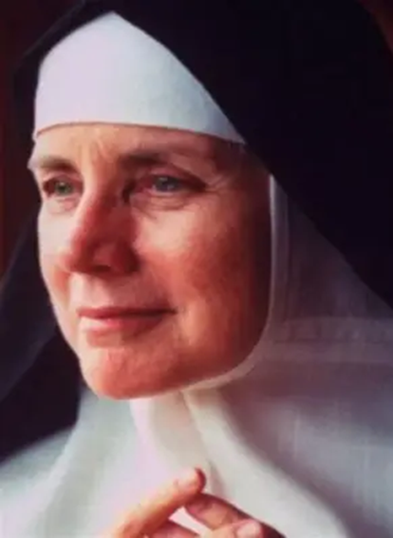
What is the significance of the feast days celebrated on Mother Dolores Hart’s birthday? (3)
Our Blessed Mother is most admirable, because she reached out to assist a dear spiritual daughter who was in need of her gracious assistance, consoling her, and rewarding her for her work of love, helping to shape the work into the perfect masterpiece, under her grace-filled hands, which did all in union with God, the Divine Artist. We can admire our Blessed Mother for doing all things with joy and hope, guiding us to do the same, out of love for God. Our Lady embellishes our efforts when we entrust them to her to give to God. Likewise, Mother Dolores joyfully embraced the gift of His love that God offered to her through the opportunity for deeper conversion and grace that he gave her. She opened her heart to receiving this joy, and shares it with others, helping them to give God their greatest masterpieces, their works of love created from the heart. In the image of Mother Most Admirable, we see our Blessed Mother framed by lilies for purity, a book for her dedication to learning, and a staff for her love of work. Our Lady treasures Our Lord in her Heart, and offers all of her prayers and works to glorify Him, as we see in the painting, which is like a portrait of Mother Dolores’ soul that so treasures Jesus, adoring Him in every prayer and work, which purify the heart with His love, as we imitate Christ and Our Lady in praying and working for the Eternal Father, that all would know the joy of joining His Kingdom in Heaven. Mother Dolores is a mother most admirable, too, because she admires and emulates Our Lady in praising God

Slide 26
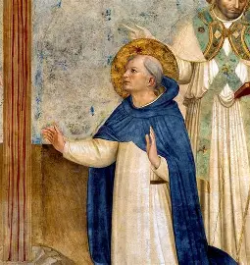
What is the significance of the feast days celebrated on Mother Dolores Hart’s birthday? (3)
Saint John Cantius (1390-1473):
  A Polish priest, St. John Cantius began his ministry as a university professor. He had a solid relationships with students based on mutual respect and trust, but other professors envied the success of St. John Cantius, a gifted instructor, and spread falsehoods about him, defaming his character. As a consequence, St. John was sent to a small, remote parish to exercise his ministry, while he was further investigated. Initially, St. John was anxious about his new placement, but, trusting in Divine Providence and opening his heart to God’s plan, he transitioned into his new role. His parishioners became so fond of him, that when, after eight years, St. John was finally cleared of any charges, they were devastated, as his acquittal meant that he would be sent back to the university. Saint John believed in correcting any errors spread about the Faith, but in responding to others with patience, love, good humor, and kindness. Like Mother Dolores, St. John made a significant life transition, but faced it bravely, doing what God was calling him to do, in order to spread His love. His response was one of joy and faith, generosity and grace, the same qualities that Mother Dolores would embody. Similar to Mother Dolores, he could build community wherever he went, in having a heart like that of Jesus, in Whom we find perfect unity

Slide 27
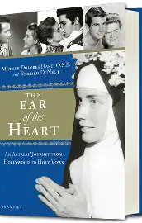

Where may we learn more about Mother Dolores Hart?
The Ear of the Heart (2013)
  Published by Ignatius Press, Mother Dolores’ autobiography is written as a series of responses to questions posed to her in an interview with her longtime friend, Richard DeNeut, a fellow actor and writer. Retracing Mother Dolores’ steps on the road to conversion, and ultimately, to eternal life in Christ, this book captures what it means to open the ears of our hearts
God is the Bigger Elvis (2012)
  Produced by HBO, this documentary was nominated for an Oscar. It follows the Regina Laudis community, highlighting the community life of the Benedictine nuns, with a special focus on Mother Dolores Hart

Slide 28

How has Mother Dolores shone Christ’s light since entering religious life? (1)
Theater and film: In 1986, as a collaborative effort with her friend, the actress Patricia Neal, Mother Dolores founded “The Gary- The Olivia” open-air theater on the grounds of Regina Laudis Abbey, where the public may visit to take in performances put on each year. Built in 1982, the back of the theater is open, revealing the scenic natural landscape behind, the trees created by God, and the many birds inhabiting them. This open theater is a reminder of the beauty and grace that we may be filled with when we open ourselves to the love of God, our Creator; this openness allows the light in, that as we receive the Son, we may shine His light, too
In serving as the dean of education at the abbey, Mother Dolores has used the stages of the creative process to guide women religious to further understand and express their relationship with Christ through the arts, and to discern how He is working in them to make them into His masterpieces, as well as to equip them to accompany others in fulfilling God’s vision for their lives. She also has documented the way of life practiced by the women at the abbey through film, preserving their works of love for God, to inspire future generations to join them in honoring the Lord through consecrated life, or in supporting consecrated life
Mother Dolores was inspired to use theater to aid her women religious in their spiritual development, because traditionally, monks would use theater, reenactments of Gospel stories, to communicate the Gospel message to the illiterate religious, who could not otherwise read the prayers they awoke to say at Matins in the middle of the night. She sought to honor the rich traditions of the Church that make the Gospel message, the message of Christ’s love, accessible to everyone

Slide 29
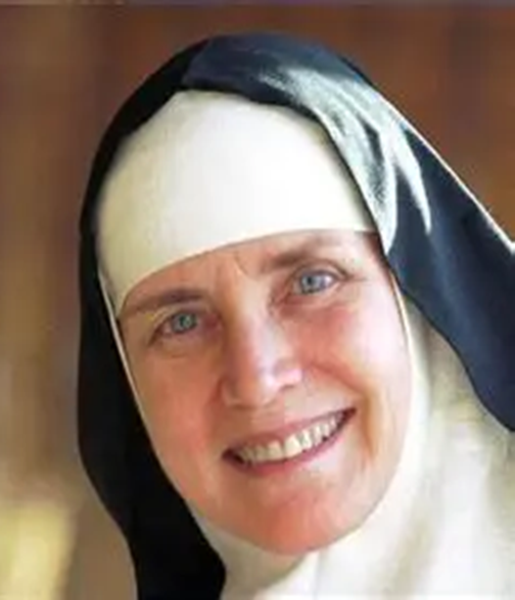
How has Mother Dolores shone Christ’s light since entering religious life? (2)
Neuropathy advocacy: In the late 1990s, Mother Dolores underwent two root canals, but they would trigger an autoimmune reaction affecting her peripheral nerves. Nerve damage to her hands and feet would leave her in severe pain. Mother Dolores, however, would not be deterred, instead choosing to channel her pain into endeavors that would serve others and honor God, as she began to advocate for further research into treatment options for peripheral neuropathy, gathering her contacts from Hollywood together to support efforts to spread awareness of peripheral neuropathy, which affects between 15 and 20 million Americans. She would become an official spokeswoman in the early 2000s

Slide 30
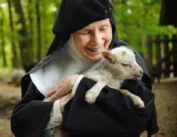
How has Mother Dolores shone Christ’s light since entering religious life? (3)
Consecrated virgins can follow the Lamb of God wherever He goes, in sharing in the mystery of His virginal purity. Mother Dolores leads the women in her religious community to follow the Lamb unto eternity, showing them how to faithfully follow His will, finding joy even in the painful twists and turns on the road to Heaven, when souls may partake of the wedding feast of the Lamb, being nourished by His love, shed through the Precious Blood, forever. Mother Dolores had seen her journey to the Lord as a marital search, and would make a total self-gift to Him to accept His proposal, the mystical marriage that He offered to her

Slide 31
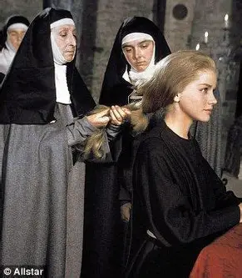
How has Mother Dolores shone Christ’s light since entering religious life? (3)
Shedding new light on what it means to be a bride of Christ: Mother Dolores sees it as a gift to give the body to God in consecrated life. As a child, her grandmother told her not to cut her hair, unless it was out of love. When she was on the set of Francis of Assisi, Mother Dolores wore a wig that was cut during the scene when St. Clare enters the Franciscan order and consecrates herself to God, but would eventually have her own hair cut out of love for God when she became a nun herself. In speaking about the feminine beauty and genius of consecrated life, Mother Dolores shines a light on the many ways to love, and the depth of love with which one may offer their heart to God. Her former fiancé loved her until his passing from this life, but as he commented, not all loves “wind up at the altar.” He meant this in the context of marriage, and yet, even without marrying another person, our hearts of love can always be placed on the altar, for spiritual union with God. To love God involves making sacrifices, because we are united with God the Son, Who is love, and sacrifices His life for us out of love, but each sacrifice is a gift that can be given joyfully, and that can flood our hearts with all the more joy and contentment. Mother Dolores writes about how sacramental marriage exists so that new lives may be created out of love, but illuminates for us that, in a similar way, we can be brought into new life through God’s love, made into new creations, when we are spiritually wed to Him, and as spiritual mothers, can draw souls to new life in Christ, bringing them to His Heart for their restoration and healing

Slide 32
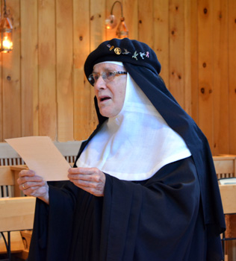
Closing Prayer: Saint Ignatius’ “Suscipe” Prayer
At her jubilee, when she renewed her vows, Mother Dolores would chant the “Suscipe” prayer, a prayer of self-abandonment to God, which Mother Dolores had sung in her heart throughout her life, having offered herself totally to God out of love.
Take, Lord, and receive all my liberty, my memory, my understanding, and my entire will, all I have and call my own.
You have given all to me. To you, Lord, I return it.
Everything is yours; do with it what you will. Give me only your love and your grace, that is enough for me.

