Slide 1
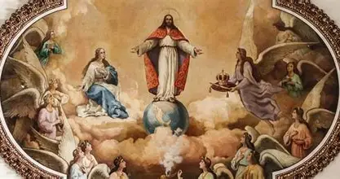
Basking in the Heavenly Glory of Christ the King: Enthroning Jesus in our Hearts with Our Lady, Queen of Heaven
Sunday, October 26, 2025
Katie Sadakierski

Slide 2
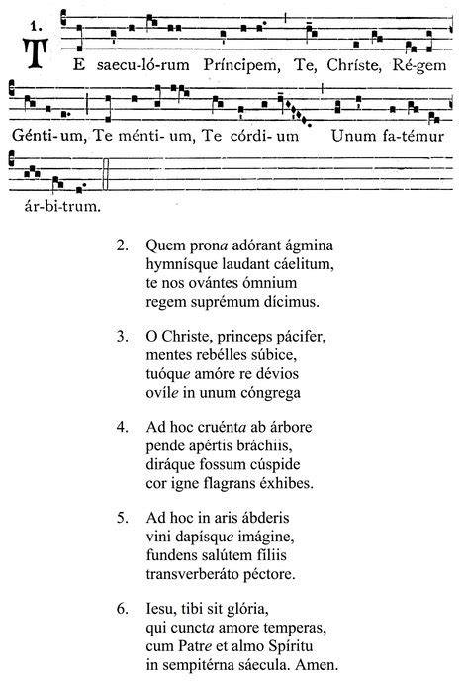
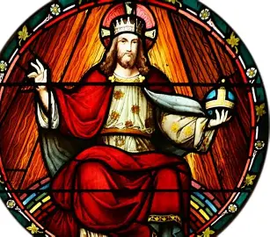
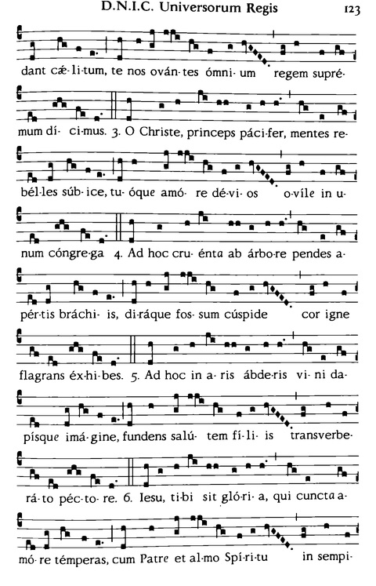
Outline
Opening prayer
Meditation on the lives of royal saints
  Saint Wenceslaus’ feast day and the “open house” tradition
    Provision of refreshments
Recitation of the Franciscan Crown Rosary
Presentation: Flower theology, the history and tradition of crowning images of Our Lady, growth in virtue, and how we may crown Our Lady in our hearts
Workshop: Creating original flower crowns
  Learning to make paper flower crowns
    Honoring the royal dignity of Jesus and Mother Mary: Setting spiritual goals with our November feast day saints
Crowning of Mary (outdoor Mary grotto)
  Praise in song:
    Salve Regina
    Regina Caeli
Closing prayer

Slide 3
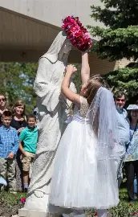
Opening Prayer: For the Intercession of Mary, Mystical Rose (Part One)
Mystical Rose, Immaculate Virgin, Mother of Mercy, I venerate thee that I might honor thy Divine Son and thereby win His mercy. I ask for thy help in the clemency of thy Maternal Heart in all confidence that I will be heard.
  Hail Mary…
Mystical Rose, Mother of the Savior, Queen of the Holy Rosary and Mother of the Church, Christ's Mystical Body, I beseech thee on behalf of a war-torn world enslaved by sin, be merciful to those about to be lost for all eternity, especially those who have no one pray for them, and pray for us, your children through consecration.
  Hail Mary…
Mystical Rose, Queen of the Apostles and the clergy, grant to priests hearts docile to thee and thy Motherly Heart, holy zeal for souls and a love of poverty in union with thee and Jesus Christ. I beg thee on behalf of those priests who know you little and seek not thy friendship in the Holy Rosary: pour on them thy mercy and solicitude.
  Hail Mary…

Slide 4
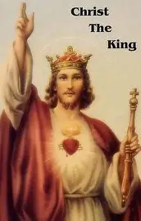
When do we celebrate the feast day of Christ the King, and why?
In the traditional liturgical calendar, we celebrate Christ the King on the last Sunday of October. This was meant to coincide with the closing of the liturgical year, and All Saints’ Day, as we recall that we become saints through following the rule of Christ the King, that He may reward us when He comes again in glory
The feast day of Christ the King falls on the last Sunday of November in the modern calendar, as this is closer to Advent, and the start of the new liturgical year
The feast day of Christ the King was instituted by Pope Pius XI in 1925 in order to combat erroneous ideologies being spread, especially socialism. Centering Christ as King would be a reminder to the people to remain true to their Faith
After the division and destruction created by World War I, it was essential to bring souls back to peace and unity that comes only from Christ, the Prince of Peace who gave His life for us all, and rules over everyone
Christ’s Kingdom is universal, and He has royal rule over all, because He won our salvation through His Precious Blood

Slide 5
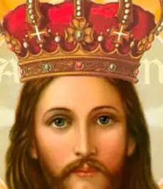
How do we celebrate the feast day of Christ the King?
We typically celebrate the feast day of Christ the King with Eucharistic Adoration, even a Eucharistic procession, because to honor the King of Heaven and Earth is to honor His Heart, Christ rules from the love in His Heart, teaching us to be similarly led by His charity, to open our hearts to receiving His love. The Holy Eucharist contains Christ’s Heart, so it is only natural that we would adore the Sacred Heart of Jesus in the Blessed Sacrament on the feast day of Christ the King, so as to make Our Lord the center of our hearts, offering sacrifices such as He did. On the feast day of Christ the King, the Act of Consecration of the Human Race to the Sacred Heart of Jesus is recited, as all of Christ’s people are dedicated to Him, placed under His sovereign rule in a special way, given to His Heart, that He may lead their hearts to Heaven. This consecration is coupled with exposition of the Blessed Sacrament, and a period of Adoration

Slide 6
Which saints do we celebrate in November?
All of the saints that we celebrate in November are like flowers in the heavenly garden reflecting something of Our Lady, in how they enthroned Christ the King in their hearts. We can blossom in virtue by imitating their example:
Saint Martin de Porres (November 3)
Saint Charles Borromeo (November 4)
Saint Martin of Tours (November 11)
Saint Frances Xavier Cabrini (November 13)
Saint Albert the Great (November 15)
Saint Gertrude the Great (November 16)
Saint Rose Philippine Duchesne (November 18)
Saint Elizabeth of Hungary (November 19)
Saint Cecilia (November 22)
Saint Catherine of Alexandria (November 25)
Saint Sylvester the Abbot (November 26)
Saint Catherine Laboure (November 28)
Saint Andrew the Apostle (November 30)

Slide 7
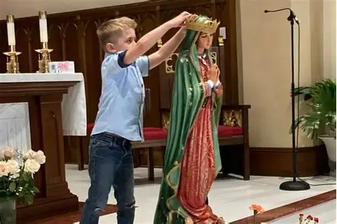
What is a “May crowning”?
A “May crowning” typically refers to a crowning of an image of Our Lady by the people. The template for the crowning is very flexible, but usually involves a procession to an image, namely, a statue of Our Lady, which may be indoor or outdoor. The faithful sing as they carry the crown to Our Lady. They may complete their prayers and hymns first, before placing the crown on Mother Mary. Often, hymns such as “Immaculate Mary” or “Bring Flowers of the Rarest” are sung, along with the Litany of the Blessed Virgin Mary. Participants in the crowning may be consecrated to Our Lord through Our Lady as they offer a prayer of entrustment to the Blessed Mother. When a priest celebrates the holy ritual, he may impart a blessing upon the people at the end
It became customary to crown an image of Our Lady in May, because it is at this time in the liturgical year that we are often celebrating Easter and Pentecost, rejoicing in the Resurrection with Our Lady, and the Descent of the Holy Ghost, mysteries that involve her maternal presence, revealing something about her relationship to God, and how she is to serve as Queen of our lives, too, in being present with us to help us to receive God into our hearts with love, that we may rise with Christ to receive our heavenly crowns, and be like the apostles in receiving special graces that guide us to our eternal coronation with Our Lady
In May, a wide range of Marian feast days are celebrated, including that of Our Lady, Queen of Apostles (the Saturday after Ascension Thursday); Our Lady of the Blessed Sacrament (May 13); Our Lady of Fatima (May 13); Our Lady, Help of Christians (May 24), and Our Lady’s Queenship (May 31), so we honor Our Lady in a special way during this month. It is also one of the most colorful months of the year, when everything is in bloom, and we think of Our Lady helping us to blossom in holiness
May is also when we celebrate Mother’s Day, so it is an appropriate time to show reverence for the Lord by honoring His Mother, our universal Mother

Slide 8
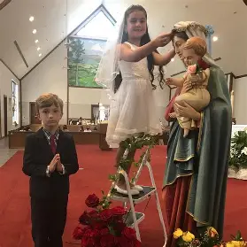
What is a “May crowning”? (2)
Often, Masses of First Holy Communion would take place in April (the Month of the Holy Eucharist) or May, and First Communicants would wear their finery to crown Our Lady, as a reminder that Our Lady leads us to Our Lord in the Blessed Sacrament, that we may be brought to Heaven to wear our crowns with Christ the King and Our Lady, Queen of Heaven forever. Besides First Holy Communion, at Easter and Pentecost, candidates may receive the other sacraments of initiation, Holy Baptism and Confirmation, so the crownings in May serve to affirm that Our Lady is the Mother of us all, who guides us into Holy Mother Church through her Son, Who delivers us from sin and death, to bring us new life by His loving Presence in the sacraments He instituted for our salvation
In 1987, Pope John Paul II composed a ritual text for the crowning of Mary with prayers, hymns, and Scriptural verses that may be recited during the event. This encouraged groups, such as parishes, schools, and families, to conduct their own crownings of Mary
A crowning of Mary need not take place in May; in some countries, including in the Southern hemisphere, the crownings may take place in November. It is also common to crown Our Lady in August, when we celebrate her Assumption into Heaven, and therefore, her coronation as Queen of Heaven
There is a separate liturgical ritual for the coronation of an image of Mary that is distinct from the more informal crownings that take place each year in Catholic settings. Popes may canonically crown images of Our Lady that are widely venerated in settings such as major basilicas and cathedrals. Only a few images of Our Lady are so crowned around the world, with gold crowns that are bejeweled ornately. A pope issues a decree when he completes a canonical crowning

Slide 9
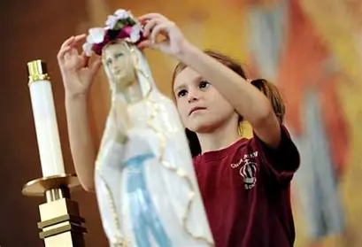
How did the “May crowning” originate?
Early Church icons include gold crowns placed over Our Lady’s head, suggesting the longstanding tradition of enthronement of Our Lady, if not tangibly, then spiritually in the heart
Coronations of images of Our Lady by the pope took place as early as the 700s A.D., when Pope Gregory III crowned an image of Our Lady in St. Peter’s Basilica in Rome with a golden tiara
Members of the Servite order crowned an image of Our Lady on Holy Saturday, beginning in the 1300s
In the 1600s, during the Protestant Reformation, crownings of Our Lady became more popular, as a way to affirm Catholic teachings, and centralize Christ the King and Our Lady, Queen of Heaven, looking to them to help us to work towards eternal glory, as a reminder that Our Lord, the Way, the Truth, and the Life, triumphs over all. Crownings were also made possible on a larger scale when a special foundation was established to fund crownings of images of Our Lady
A Jesuit priest named Father Latomia, of the Jesuit College in Rome, made May the month of Mary in the 1700s, and the practice of venerating Mother Mary by crowning an image of Our Lady spread throughout the Jesuit colleges. Father Latomia instituted this practice to counteract infidelities he observed among his students. Making Our Lady the Queen of their hearts would help them to remain faithful children of God like Our Lady was and is

Slide 10
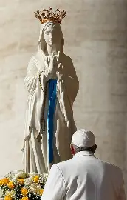
Why do we coronate images of Our Lady? (1)
Our Lady earned the crown of glory, of righteousness, by participating spiritually in the Passion of Christ the King, standing faithfully by His Cross; there is no salvation without the Cross, so this is our key to Heaven, to eternal glory. Our Lady is also royal, because she is from the line of King David
The Book of Revelation describes Our Lady as wearing a crown of twelve stars, which reminds us of how Our Lady unites us all by bringing us to Christ, our universal Redeemer who brought about objective salvation through His Sacrifice
In Jewish tradition, a king’s mother, not his wife, serves as Queen, which is why we honor Our Lady as the Queen, in being the Mother of Christ the King
The custom of using a wreath of flowers to crown an image of Our Lady is drawn from the tradition of the bridal wreath, for Our Lady is the Spouse of the Holy Spirit who was assumed into Heaven for her commitment to God, her faithfulness, which is an example to the faithful of what it means to be mystically wed to God
In 1815, Pope Pius VII granted a partial indulgence to those who practiced devotions to Our Lady in May. Pope Pius IX would elevate it to a plenary indulgence in 1859. As a result, more of the faithful began to partake in crownings of Our Lady

Slide 11
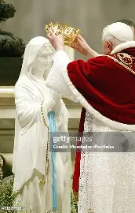
Why do we coronate images of Our Lady? (2)
Following this papal action, a series of Marian apparitions occurred: Our Lady appeared to St. Catherine Laboure asking her to have the Miraculous Medal produced in 1830; Our Lady of La Salette appeared to two children, speaking to the importance of repenting of sins against the second and third Commandments in 1846; Our Lady of Lourdes appeared to St. Bernadette 18 times in 1858; and Our Lady of Fatima appeared to the three children in 1917. This reinforced the need for us to look to Our Lady as our perfect model of how to follow Christ, Who is the crown of creation, and therefore, come to join Him by His throne in Heaven
Pope Paul VI published a document in 1965 urging the faithful to return to devotion to Our Lady, especially crownings of her image in May, but in the 1970s and 1980s, crownings of Mary would be less frequently practiced, due to Vatican Council II’s deemphasis on Marian veneration
Coronating images of our Blessed Mother allows us to grow in spiritual childhood, to express childlike love for Our Lady by giving her gifts from our hearts to show reverence for her exalted place in Heaven, which she gained through being such a loving Mother, by accepting God’s plan for her divine maternity

Slide 12
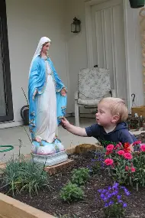
Why do we crown Our Lady with flowers? (1)
Flowers reach up to Heaven, leaning towards the sun, just as Our Lady always oriented herself towards Christ, observing and learning from His behaviors, which she treasured in her Heart, in order to lead us to spiritual growth
The life cycle of a flower, dying and rising, is patterned after Christ’s dying and rising, reminding us to die to sin in order to live forever with Christ, as Our Lady, the sinless Virgin, does
Flowers rely on God’s Providence to grow, receiving light and water from Him. We are similarly to trust in God’s goodness, and to open our hearts to receiving Him, like Our Lady
Flowers are beautiful and spread their fragrance, like Our Lady reflecting God’s beauty, truth, and goodness, and spreading the fragrance of her holiness to draw us to follow Jesus
Flowers are associated with trees and vines. Jesus gave His life on the Tree to save us from sin, and in remaining connected to the True Vine as branches, we can grow

Slide 13
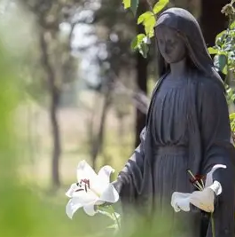
Why do we crown Our Lady with flowers? (2)
Flowers blossom; like Our Lady, we can blossom in staying close to Christ, and in opening our hearts to receiving God’s grace, can be filled with His love, so as to bring Christ’s Spirit of love into the world. We can plant seeds of hope, faith, and love in union with Our Lady, by trusting in God and receiving from Him what He wants us to sow
Often, flowers have a number of petals that has biblical significance, i.e. three leaves for the Blessed Trinity, reminding us of God’s Presence, His love that is echoed in His creation
The garden flowers remind us of the Garden of Eden, and the Garden of Gethsemane, as we recall Jesus and Mother Mary, the New Adam and the New Eve who redeem us from sin, that we may grow
Jesus uses many nature-based parables, especially related to gardening and farming, that provide for us a template for our growth

Slide 14
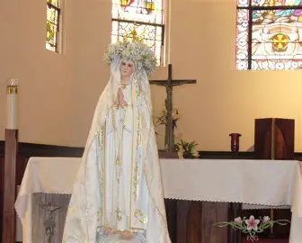
Which flowers are most commonly used to crown Our Lady, and why?
Hawthorn flowers were most often used for May crownings, because they represent hope, and therefore, are often in bridal bouquets. Our Lady is our model of mystical marriage to God, of hope that persists, that springs eternal, and of undying fidelity, like what Our Lady modeled in remaining by the Cross of Christ
Lilies of the valley, another May birth flower, represent Our Lady’s tears, her sorrows, by which she would come to share in Christ’s glory, having shared in His suffering. These flowers represent the promise of happiness to come, of a return, a homecoming, like Christ resurrecting, and bringing Our Lady to Heaven with Him

Slide 15
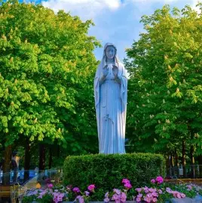
What is the Marian symbolic meaning of certain flowers and fruits?
The stages of rose growth represent the stages of salvation history; the rosebud represents Christ’s divine Infancy, whereas the rose in full bloom represents the Resurrection. Our Lady teaches us to spiritually participate in Christ’s stages of life, to grow with Him in her womb. Roses figure into an Old Testament prophecy about the Divine Word coming into being, becoming incarnate, within a rose, for Our Lady is the pure rose in which the seeds God plants take root. Roses symbolize Our Lady’s crown
The daisy represents the innocence and purity of Jesus and Mother Mary; it is “Mary’s Flower of God” (the Lord, the Fruit of her womb)
The ladyslipper represents Our Lady’s visitation to her cousin St. Elizabeth
Called the “virgin flower,” the periwinkle, with its pure blue hue, is reminiscent of the mantle of Our Lady, the Blessed Virgin
The pansy is called the “trinity flower,” as the Blessed Trinity was first revealed to Our Lady
The zinnia is called the “Little Mary” flower, and grows very easily
Forget-me-nots represent Our Lady’s eyes
Petunias are cheerful flowers honor Our Lady for her spirit of welcome and gratitude; they are called “Mary’s praises”

Slide 16
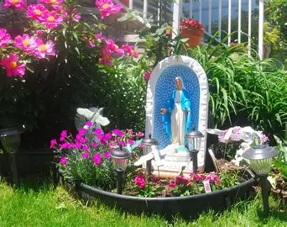
What is the Marian symbolic meaning of certain flowers and fruits? (2)
Columbine flowers represent the dove, the Holy Spirit, that overshadowed Our Lady
Marigolds were named by St. Hildegard to honor Our Lady’s Queenship, her crown of gold, and are called “Mary’s gold”
Morning glories can be blue or red, representing Our Lady’s mantle, and her angelic sweetness. They open at dawn to greet the morning, and close throughout the day
The strawberry plant can be in flower and bear fruit simultaneously, so strawberries represent Our Lady’s virginity and divine maternity
Violets represent Our Lady’s humility, because they shrink back, like Our Lady deflecting praise to give glory to God
The white “Annunciation lily” represents how Our Lady announced the coming of Christ through her own embodiment of His virtues, especially His purity; Our Lady received the lily from the holy angel, as we see in artwork, at her Annunciation, representing the pure Christ Child she would receive
The geranium represents fruitfulness, Our Lady’s role as Bride of the Holy Spirit
The sunflower represents how Our Lady adores Jesus, the Son of God
Irises honors Our Lady’s obedience, as the flowers represent swords, like those piercing Our Lady’s Heart

Slide 17
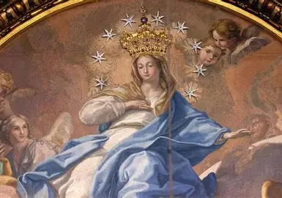
What does the coronation of Our Lady, the fifth Glorious Mystery of the Holy Rosary, teach us?
From the fifth Glorious Mystery of the Holy Rosary, we learn that Our Lady earned her heavenly crown through doing all things in collaboration with Christ, for she was assumed into Heaven through His power, and was coronated thereafter. We earn our heavenly crowns by walking alongside Christ, doing all things with Him, for His glory, just as Our Lady did

Slide 18
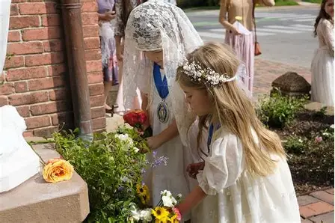
How may we bring forward the spirit of the coronation?
Bringing forward the spirit of the coronation of Mary means continuing to enthrone her in our hearts, giving her a special place therein, and acknowledging her throughout the day. It means having her heart of “yes” that always crowns God as the sovereign King, taking direction from Him
We continue to look to Our Lady as Mother and Queen, bringing her flowers of love like children with simplicity, sincerity, and trust, offering her the virtues we apply in imitation of her, the prayers and works of our hearts that treasure Christ

Slide 19
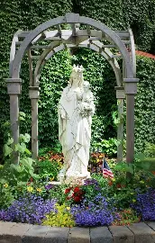
Closing Prayer: For the Intercession of Mary, Mystical Rose (Part Two)
Hail, Holy Queen…
Mystical Rose,
Help of Christians, pray for us.
Mystical Rose of the Immaculate Conception,
protectress of priests and the consecrated,
win them the favor of Jesus Christ! Amen.

