Slide 1
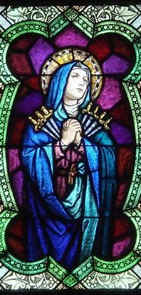

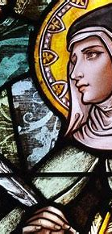
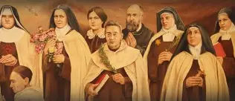
Women Doctors of the Church Learning Series 2: Learning from, and Being Captured by, the Heart of the Queen with St. Teresa of Avila, Patron of Chess, and Devotee of Our Lady, the Queen of Angels
Katie Sadakierski
Monday, September 15, 2025

Slide 2
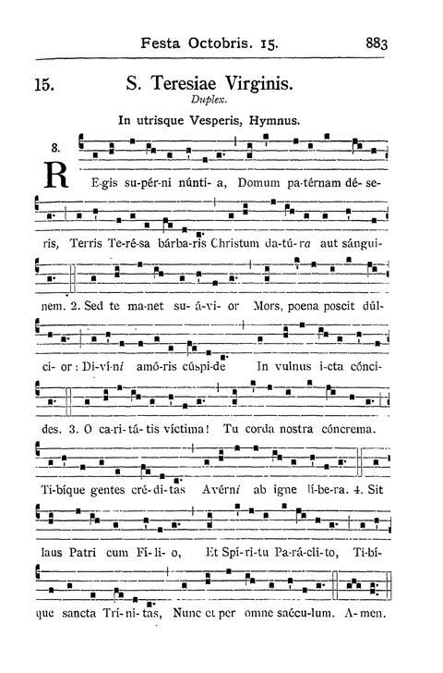
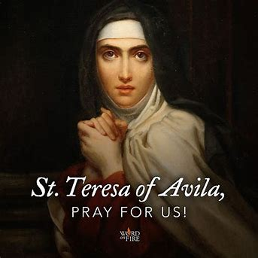
Outline: Women Doctors of the Church Session 2
Introduction
Outline
Opening Prayer
Presentation
  I. Saint Teresa of Avila as a Teacher of Holiness
  II. Mother Mary as St. Teresa of Avila’s Teacher
  III. What We Learn from St. Teresa of Avila about Teaching Holiness
Closing Prayer
Q & A

Slide 3
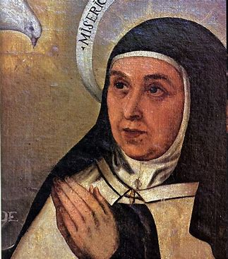
Opening Prayer: St. Teresa of Avila’s Bookmark Prayer
Let nothing disturb you;
Let nothing frighten you.
All things are passing.
God never changes.
Patience obtains all things.
Nothing is wanting to him who possesses God.
God alone suffices.

Slide 4
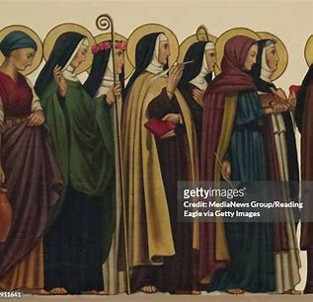
Who is St. Teresa of Avila? When did she become a Doctor of the Church?
Saint Teresa of Avila was a Spanish Carmelite nun who lived between 1515 and 1582
  She was canonized in 1622
On September 27, 1970, St. Teresa of Avila and St. Catherine of Siena were made Doctors of the Church together by Pope Paul VI
  This marked the first time that women were named Doctors of the Church

Slide 5
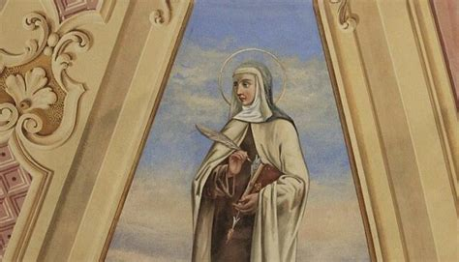
What are some spiritual lessons from the classroom of St. Teresa of Avila’s heart? (1)
Saint Teresa of Avila was born into a wealthy family, but did not embrace the things of the world, choosing spiritual riches over material wealth
As a seven-year-old, St. Teresa attempted to run away to become a missionary and martyr. She was unsuccessful in her attempt, which was thwarted by her uncle
  Saint Teresa’s life teaches us that we cannot choose our crosses; the best crosses in life, the ones that strengthen us most, are those we do not choose. When we entrust ourselves entirely to God and His plan, we are sanctified according to what our souls most need
  Not to be deterred, St. Teresa teaches us not to give up in our pursuit of holiness: after she was prevented from pursuing martyrdom, she and her brother, with whom she read The Lives of the Saints, built hermitages in the nearby orchard, determined to keep working towards sanctity, this time, as hermits; but when she grew, St. Teresa would learn that God does all of the work, and we are His vessels; everything is according to His good pleasure

Slide 6
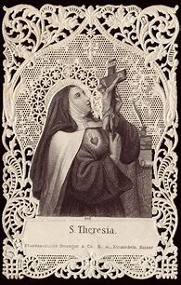
What are some spiritual lessons from the classroom of St. Teresa of Avila’s heart? (2)
As a young woman, St. Teresa entered the convent, even though her father opposed her vocation, which was very painful, since she was close with her father, especially after having lost her mother. She dealt with illness at the outset of her life as a nun, contracting malaria. So ill was St. Teresa, that her religious sisters had dug a grave for her, anticipating that she would not withstand her illness
Saint Teresa placed herself in the hands of God the Father, following His will for her. Her love for God exceeded all things
She teaches us to persevere in prayer, and to offer our hearts to God with great hope. When very ill as a young woman, to the point that she was paralyzed for three years, she had to cease her prayer altogether: at least, in terms of vocal prayer, but in offering herself to God, she made herself a living prayer, and was revived by His love, restored to health by joining her heart with the suffering Heart of Jesus. Saint Teresa communicates to us that words are not needed to pray; we simply bring our hearts to God to fill with His love. He understands what we cannot put into words, because love surpasses spoken or written words; God’s language is one of the heart. Christ did not simply tell us that He loved us, but showed us that in giving His life for us, then permitting that His Side be pierced to teach us that there is no limit to His love, which continues, unto death

Slide 7
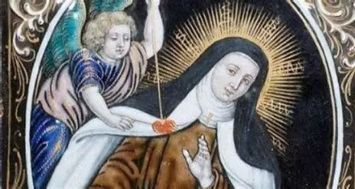
What are some spiritual lessons from the classroom of St. Teresa of Avila’s heart? (3)
In her early forties, St. Teresa of Avila began to experience mystical visions. We read of saints who had special spiritual gifts given to them at a very young age; Saint Teresa of Avila reminds us that at any time in our lives, when we open our hearts to God, and embrace His timing, we can grow dramatically in faith, and advance in spiritual wisdom
The most well-known mystical experience that St. Teresa of Avila had was when a holy angel pierced her heart, so that she could share in the outpouring of love from Christ’s Heart, which was interiorly pierced by emotional suffering that came from the rejection of His people, while His Sacred Side was also pierced to reveal the depth of love in His Sacred Heart

Slide 8

What are some spiritual lessons from the classroom of St. Teresa of Avila’s heart? (4)
From St. Teresa of Avila, we learn to trust in God. She began her first religious community with her niece and three other nuns, but her impact would grow beyond what could ever be imagined. Teaching holiness goes beyond making conscious decisions to instruct; we do not simply make plans about how we would like to teach others, but give ourselves to following God’s will, because He knows what will reach souls most widely and deeply, transcending anything that we may have imagined for ourselves
Saint Teresa remained open to other teachers so that she could continue to learn, and help others to learn from Christ. She worked with St. John of the Cross to create religious communities for men within the reformed Carmelite order, ensuring that men could pursue vocations to religious life in accordance with the reforms to the Carmelite order. She also received spiritual guidance from such saints as St. Peter of Alcantara; when she had questions about whether her visions and mystical experiences were from God, or were deceptions from Satan, she went to her priest companions, who led her to understand the truth, showing her that God had favored her with spiritual gifts to do His work. In consulting with her spiritual friends, St. Teresa could move forward with confidence in her mission

Slide 9
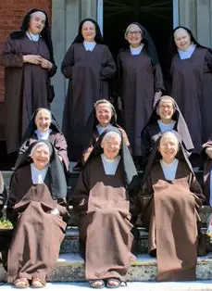
What are some spiritual lessons from the classroom of St. Teresa of Avila’s heart? (5)
At age 47, St. Teresa founded her first Carmelite convent. Her mission in life was to reform the Carmelite order. Saint Teresa’s Carmelites would be discalced: shoeless
The discalced Carmelites stepped into Christ’s shoes through humility, wearing sandals, much like He would have
They remained down-to-earth; St. Teresa herself did not regard herself as above any of her spiritual daughters, but this foundress of convents would spend time cooking and baking with her spiritual daughters, assisting with any chores needing to be done; she lightened the load, and helped the sisters to experience the Cross’ sweetness in every way

Slide 10

What are some spiritual lessons from the classroom of St. Teresa of Avila’s heart? (6)
Across Spain, St. Teresa founded seventeen different Carmelite communities
She reformed the Carmelite order, so that in Carmelite communities, there would be a greater emphasis on mental prayer, poverty, and austerity. Her vision was for Carmelite communities to return to their traditional roots, to their deep interiority
Saint Teresa would help to breathe new life into her order, bringing about a kind of spiritual resurrection for it through the grace of God, and the help of Our Lady; there is a traditional dessert enjoyed on St. Teresa’s feast day called “yemas,” candied egg yolks, that reflect something of St. Teresa’s mission, in that she restored sweetness to her order by drawing souls to go back to Calvary with Christ, to the starkness and bareness of the Cross, in order to then rise with Him, His tomb being broken open like an egg, to reveal that He had triumphed over death, rising again to bring us with Him by cracking open our hearts to receive His love

Slide 11

What are some spiritual lessons from the classroom of St. Teresa of Avila’s heart? (7)
Saint Teresa of Avila is remembered for her writings, which are spiritual classics. They are giants in Catholic literature, like the works of St. Augustine or St. Thomas Aquinas
  Saint Francis de Sales and St. Alphonsus Liguori would learn from St. Teresa of Avila; their works would be influenced by hers
  Saint Teresa of Avila taught that mystical union with God is open to everyone; all can be united deeply with Christ. She would influence St. Francis de Sales’ Introduction to the Devout Life, which operates on the premise that everyone is called to holiness, regardless of state of life, and can attain it with God’s grace
The most famous works of St. Teresa of Avila are The Interior Castle and The Way of Perfection, but her spiritual autobiography is well-known and appreciated as well

Slide 12
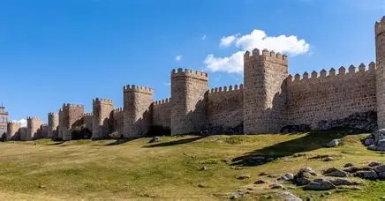
What are some spiritual lessons from the classroom of St. Teresa of Avila’s heart? (8)
Avila, Spain, was one of the first Spanish towns to be Christianized, thanks to the evangelization of priests ordained by Sts. Peter and Paul, the “seven apostolic men” who were sent on a mission to Spain to share God’s love. It is believed that the inspiration for The Interior Castle was the wall surrounding the town of Avila, which was built by the Romans prior to the Fall of Rome. After invasions that proceeded the Fall of Rome in 576 A.D., the wall needed to be rebuilt. Restored, this architectural marvel provided inspiration to St. Teresa of Avila, in standing for the fortification that our souls receive from Christ. Our Lady is the Tower of David, the Turra Davidica, our strong defense tower protecting us from any spiritual danger, and keeping our souls safe, that we may not be broken by sorrows, but made stronger, just like the walls that were broken, but rebuilt to become even more beautiful

Slide 13
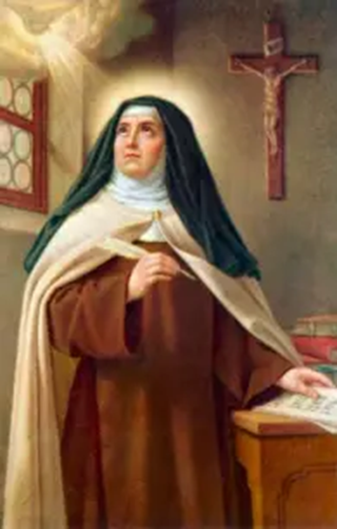
What are some spiritual lessons from the classroom of St. Teresa of Avila’s heart? (9)
Saint Teresa was a loving spiritual mother who helped to protect her spiritual children by teaching them to strengthen their souls through closeness to Jesus and Mother Mary, to be inviolable like both of them, through prayer. She sheltered them under the mantle of Our Lady
In reforming the Carmelite order, St. Teresa helped to protect her spiritual children from a worldly influence. In her time, wealthy women could enter the convent, and continue their lives of luxury, bringing their servants with them to their religious communities, but Saint Teresa helped to reform her order, so that it would revive the past spirit of simplicity and detachment from the world, for a total spiritual union with Christ in His humility and poverty, His total self-gift in being emptied of the world

Slide 14
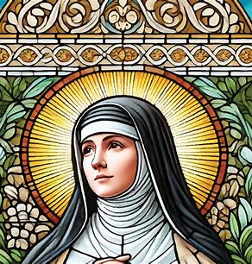
What was St. Teresa of Avila’s path to holiness? (1)
“Carmel” means “God’s garden,” and refers to the range of mountains in the Holy Land where prophets would set out from to preach, and where monks found refuge in caves for prayer and contemplation. Saint Teresa’s goal was for the Carmelite communities to become true gardens of God, reflecting something of the original Carmelite communities
The Carmelite order is a deeply Marian one, with Our Lady of Mount Carmel as its patroness. Saint Teresa helped to return the Carmelite order back to its Marian roots. Our Lady is very interior, treasuring all things in her Immaculate Heart, and St. Teresa of Avila guided her spiritual children to treasure all of the things of God in their hearts in union with Our Lady, for Our Lady’s Heart is the most beautiful garden, in which love for Christ, the True Flower, grew, and in which we find the nutrients we need in order for faith, hope, and love to blossom within our souls
Saint Teresa’s path to holiness was one of guiding others on their paths to Heaven
  She would touch souls beyond those in her immediate care, helping everyone to cultivate the gardens of their hearts, to welcome Christ. She had the path of a spiritual gardener, tending to souls with great patience and care, namely, by leading them in the steps of prayer, that they would climb the stairs to Heaven

Slide 15
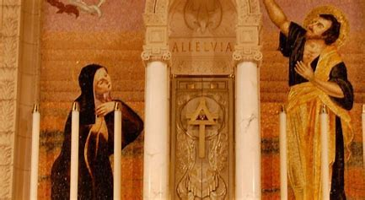
What was St. Teresa of Avila’s path to holiness? (2)
To become a teacher of holiness, St. Teresa of Avila learned from Mother Mary, the greatest teacher of Christlike charity, of how to unite the heart with the Heart of Jesus through self-sacrificing love
Saint Teresa of Avila worked to reform her Carmelite order by purifying it: namely, of worldly influence, so she went to Our Lady, who has perfect purity of heart mirroring that of Christ’s. Our Lady underwent the Purification ritual, in accordance with Jewish law; likewise, when it came to purifying the Carmelite order, Saint Teresa returned to Catholic tradition, honoring God’s unchanging law

Slide 16
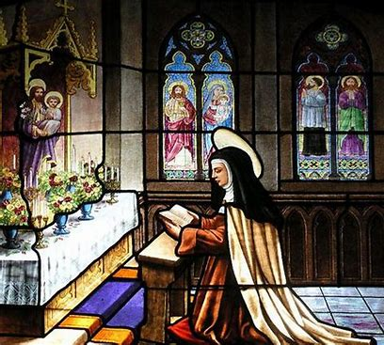
What was St. Teresa of Avila’s path to holiness? (3)
Saint Teresa took St. Joseph as her spiritual father, and therefore, promoted devotion to him among her spiritual daughters. Her reformed order of Discalced Carmelites uses the Primitive Rule of St. Joseph. The pure Heart of St. Joseph would go out to her, and help her to reform the Carmelite order, that every Carmel, every garden of God, could be like the Holy Family’s house, a truly vibrant and flourishing house of love and prayer

Slide 17
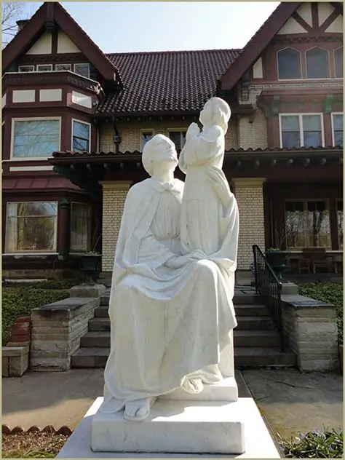
What was St. Teresa of Avila’s path to holiness? (4)
Humbly, St. Teresa relied on St. Joseph to help her, much as Our Lady would have humbly received support from St. Joseph, who provided for the Holy Family, shouldering crosses with Our Lady, as she cared for the Family in her own special way, and journeyed with St. Joseph through sorrows, knowing the shared pain of wounds that would be inflicted upon Jesus
A Carmelite tradition is to put an item that is in low supply, i.e. eggs from the kitchen, before a statue of St. Joseph, that he may increase the supply, providing what is lacking. Saint Teresa would dedicate her convents to St. Joseph, after having received a vision of him, and realizing that he answered all of her prayers, being the savior of the Savior, the one who protected Christ from harm, and who therefore has special power with Christ, protecting us Christians, “little Christs,” from spiritual danger as well
At least 13 of the convents St. Teresa founded were named after St. Joseph, and they all had statues of St. Joseph over the door, for he helps us to open the doors of our hearts to receive Christ, much like he and Mother Mary did

Slide 18
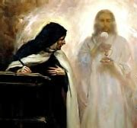
What was St. Teresa of Avila’s path to holiness? (5)
Saint Teresa imitated Our Lady in her devotion to St. Joseph and the Christ Child; through uniting with St. Joseph’s Chaste Heart, she could better compassionate with the Hearts of Jesus and Mother Mary, which were so deeply loved by St. Joseph
In loving St. Joseph, a treasured member of Our Lady’s Family, St. Teresa could express her love for Our Lady, in bringing joy to Mother Mary’s Heart, because Mother Mary, whose Heart overflows with charity, is pleased when we love her whole Family; we become a deeper part of it, and can share in their joy in that way, because we come to dwell in the House at Nazareth, which was a perpetual Adoration chapel. Saint Teresa’s convents became like perpetual Adoration chapels, where the community members could be focused on loving Christ’s Heart with hearts like Our Lady’s

Slide 19
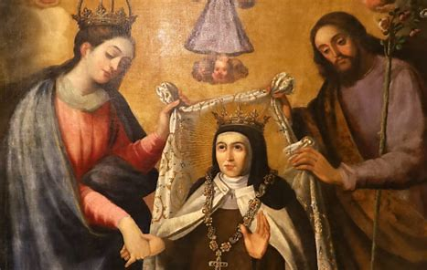
What was St. Teresa of Avila’s path to holiness? (6)
To purify broadly, St. Teresa began by purifying deeply; she taught souls that if we are to reach the innermost part of the castle that is our soul, the most beautiful chamber for Christ the King to dwell in, we must be purified by passing through stages of prayer that help us to be cleansed, to be polished of any dust from the past. As we move through stages of prayer, we are transitioning from focusing on the self to God, learning to accept His will, to love His will as our own, and to receive His grace, cooperating with it. Our Lady grew gradually, too, alongside Christ, her Son

Slide 20
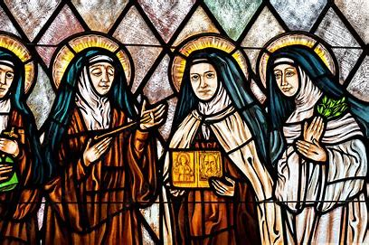
What was St. Teresa of Avila’s path to holiness? (7)
Saint Teresa’s stages of prayer needed for purification, for house-cleaning of the soul, that it may ascend to God, are as follows:
  Heart’s devotion
    Our Lady teaches us how to move through these stages. Her heart was devoted to Christ, and sorrowed when He was lost at the Temple
  Devotion of peace
    Our Lady would experience spiritual martyrdom with Christ, but would accept the Cross, offering the chalice of suffering to God the Father
  Devotion of union
    Our Lady would remain united with Christ in choosing to make a sacrifice like He did, deciding to remain on Earth while Christ ascended into Heaven, so that she could merit for us; this was a sacrifice made out of love for us, that we may learn from her, and gain the graces needed to go to Heaven
  Devotion of ecstasy/rapture
    Our Lady would be assumed into Heaven after having patiently received all as a gift from God to treasure in her Immaculate Heart, totally united with Our Lord

Slide 21
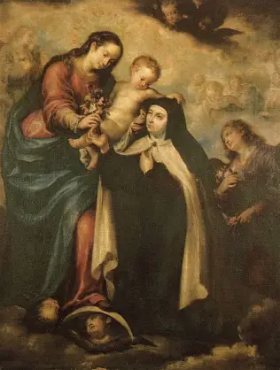
What was St. Teresa of Avila’s path to holiness? (8)
We take steps to reach the innermost chamber of the heart through prayer, because we seek to find our dearest Friend, Christ, that we may keep sharing in His experiences, being purified by His love by spiritually participating in the sacred mysteries with Him. Saint Teresa’s understanding flowed from her personal encounters with Christ, her mystical experiences. If we are to teach love for God, then like St. Teresa of Avila, we are to spend time alone with Him in conversation, heart-to-heart, that we may then share Christ’s Heart of love with others. Our Lady was present with Christ: she was not distracted while with Him, but absorbed all that He was doing into her Heart. Likewise, we are called to be present with Christ, that we may see most fully how He is Present among us, reaching out always

Slide 22
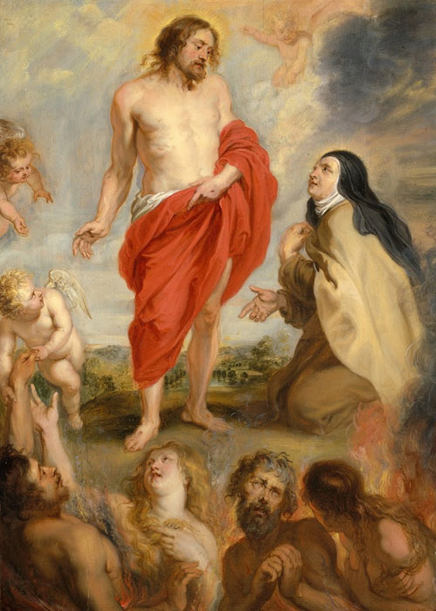
What was St. Teresa of Avila’s path to holiness? (9)
Participating in Eucharistic Adoration, or visits to the tabernacle, when the Blessed Sacrament is not exposed, allow for such personal encounters with Christ. Saint Teresa saw all of life as a pilgrimage, a continuous journey to grow closer to God, as we maintain hope and faith in Christ’s love, which is not fixed in time, but eternal, transcendent, and boundless, not limited to one place or stage in life. We can continue to take steps closer to Christ by walking with the Risen Lord, receiving the Eucharistic Heart, like the Emmaus disciples, in welcoming Christ to be with us in our hearts, accepting His invitation

Slide 23
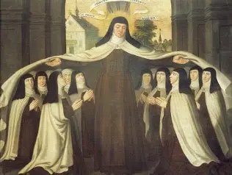
What was St. Teresa of Avila’s path to holiness? (10)
Saint Teresa helps us to spark a burning love for God in our hearts, that we may never want for anything, but may be filled totally with God, having the peace of knowing that God alone suffices
The Carmelite family celebrates a special feast day commemorating when the heart of St. Teresa of Avila was transfixed: August 26; sorrow is the dart that may wound the heart, but in this way, Christ wounds with His love, for He gives crosses to His friends, that in feeling His pain, we may know His compassion, His mercy, that led Him to take on such pain for us, temporary pain that would allow for eternal glory

Slide 24
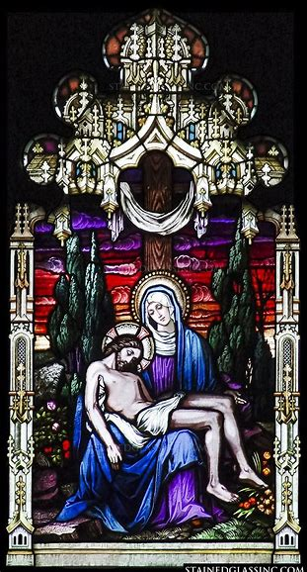
What was St. Teresa of Avila’s path to holiness? (11)
Saint Teresa demonstrates to us that being alone with God in our sorrows, uniting with Jesus in His pain, does not mean isolating ourselves, but broadening our capacity to love, so that we can empathize with the suffering of others, and go through the Passion as a whole Church, alleviating the weight of the Cross by shouldering it together; she called herself a “daughter of the Church” as she was dying, declaring her love for all of God’s people, Christ’s whole Body, and in this way, linked herself to Mary, Mother of the Church, the bright star by which we are guided to Christ

Slide 25
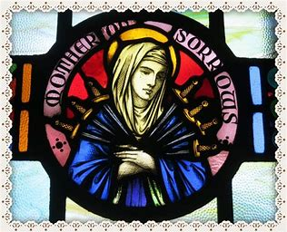
Why is September 15 a significant date associated with St. Teresa of Avila? How do the spiritual takeaways from this day relate to St. Teresa and her way of teaching holiness? (1)
September 15 is the feast day of Our Lady of Sorrows, since it follows the Feast of the Exaltation of the Holy Cross, when we compassionate with Our Lady by the Cross, consoling her Heart
The feast day of St. Teresa of Avila is one month later, on October 15
Fifteen is the number of progress and ascent; if we are to make progress, then we are to experience crosses, sorrows that help us to compassionate with Christ and others, that we may be softened and perfected by His love, sweetened by it

Slide 26
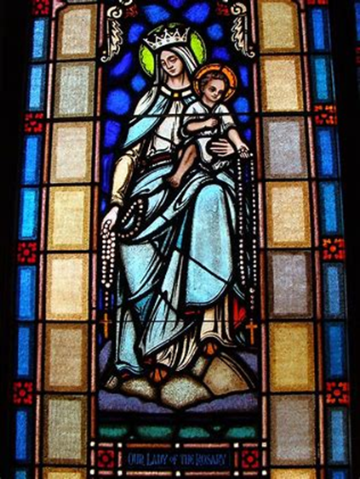
Why is September 15 a significant date associated with St. Teresa of Avila? How do the spiritual takeaways from this day relate to St. Teresa and her way of teaching holiness? (2)
When she lost her mother as a child, St. Teresa of Avila asked Our Lady to be her mother. In her grief, she turned to Mother Mary for healing. Our Lady would teach St. Teresa how to bear the absence of a loved one by adoring Christ’s Presence, especially through the Holy Eucharist; she would continue to grow close to Christ through praying the Holy Rosary, a chain linking Heaven and Earth, as she saw it, in that it united her with the Two Hearts, and her mother, Beatriz, who was devoted to the Holy Rosary. Through the Holy Eucharist, St. Teresa could meet her departed loved ones, for in Christ, there is life eternal, for Our Lord is love, and love is deathless. In the Sorrowful Mysteries of the Holy Rosary, we can be united with Christ in His Passion, but can look forward joyfully to the Resurrection with Our Lady, as St. Teresa did

Slide 27
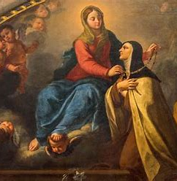
Why is September 15 a significant date associated with St. Teresa of Avila? How do the spiritual takeaways from this day relate to St. Teresa and her way of teaching holiness? (3)
As St. Teresa shows, to go forwards, we must go backwards, recalling the past, and reflecting on our experiences, in order to know where we are going, and to follow the way of Christ in the future
Her reforms to the Carmelite order helped to restore it to its traditional roots that allowed it to reclaim its essence, to return its focus to the most integral aspects, that it would not lose its center point. She helped souls to concentrate on the core tenets of our Faith, especially Our Lady and the Holy Eucharist

Slide 28
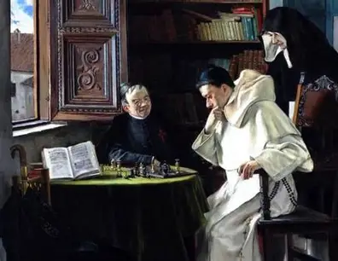
What makes St. Teresa of Avila unique as a Doctor of the Church? (1)
Saint Teresa of Avila is the Mystical Doctor of the Church, the Doctor of Prayer
While other Doctors of the Church had written about mystical theology, St. Teresa of Avila is the Doctor who put teachings into order, helping others to understand theological concepts in a clear, systematic way. She conveyed her piety, which is the order of the soul, a sense of deep harmony, into her works, which would help others to organize their spiritual lives in the way best honoring God; her reforms would allow for the Carmelite order to become better-ordered as well, more closely-oriented towards God
She is a patron of chess, and shows us how to take steps in harmony with the greatest chess master, God, Who is in control, and captures our hearts by giving us the Heart of the Queen, Our Lady, our life, our sweetness, our hope, and our pathway to salvation in Christ

Slide 29
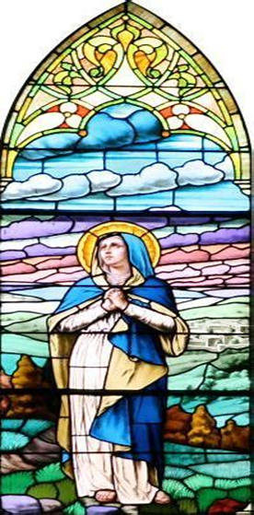
What makes St. Teresa of Avila unique as a Doctor of the Church? (2)
Saint Teresa would be a shining light of clarity amidst questions caused by the Protestant Reformation, when the faithful needed affirmation of Church teaching, as so much change was taking place in the world. She showed that when we begin from within, making changes inwardly, starting with the individual soul, and reaching out more broadly to entire communities, like her convents, we can illuminate the world with faith in Christ’s Presence, drawing souls back to Him, to embrace the Light of the World, that His light may reach into hearts everywhere, converting them to Him, dispelling darkness. When Protestants formed their own denominations, and sought to remove Catholic influence from their churches, they excised Our Lady from their practice of religion, and therefore, St. Teresa helped to keep Catholic eyes fixed on Our Lady as the Morning Star shining the way to Christ, the sun, clarifying confusion by restoring Marian devotion as a central part of the Carmelite order, and our Faith in general

Slide 30
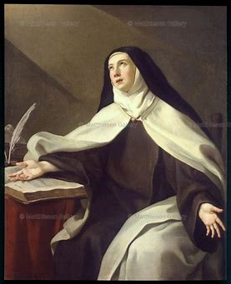
How may we imitate St. Teresa of Avila in our lives, teaching the way of Christ as well?
We may open our hearts to learning from Christ the Teacher by seeing Him in every person He gives us to serve, and in reverencing His reflection in our holy saints. Teaching the way of Christ is to teach humility, which begins with realizing that we all are students, all learners kneeling by the tabernacle, at the feet of Christ, like St. Mary Magdalene
  As a teenager, Saint Teresa of Avila learned from her ailing uncle, being edified by his holy acceptance of death, and his happy passage from this life that resulted in taking preparations for his soul, such as spiritual reading. She had been absorbed in the vanities of the world, focusing on external appearances and frivolity, but from witnessing her uncle’s faith, and awakening to the reality of dying, she came to die to the world, and live in Christ
We may trust in God as St. Teresa of Avila did in order to model to others what it means to live with true peace, joy, faith, and hope
  She called St. Joseph “father,” and emulated him; she learned in his workshop how to build faith in others through teaching by example. Saint Joseph lived a humble and quiet life of trust in God, serving Him by serving Jesus and Mother Mary, listening to the angelic messages God sent to him in dreams, and following where God led him on the journey to protect his family. Saint Teresa persisted trustingly in the journey, too, showing us that we can place confidence in God, Who is faithful and good to us, just as He was to St. Joseph, giving him the blessing of closeness to Jesus and Mother Mary

Slide 31
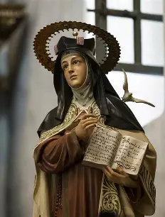
How did other Doctors of the Church shape St. Teresa of Avila?
The writings of St. Jerome led St. Teresa of Avila to pursue religious life
Reading St. Augustine’s Confessions helped St. Teresa in developing her own thought on mental prayer. She read this classic while recovering from her illness, and during that time, grew in devotion to St. Joseph, who would help to heal her, as she applied what she learned about mental prayer from St. Augustine to her own prayers

Slide 32
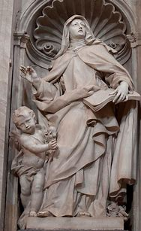
What does St. Teresa of Avila reveal to us about Mary, Mother Most Sorrowful? (1)
When St. Teresa’s heart was pierced in a mystical vision, she emphasized the sweetness of this experience over the pain. She discovered the sweetness of sharing in Christ’s pain, and of coming to love Him more through it
Saint Teresa could unite with Christ in His longing for souls: she could know His pain that came from aching for souls to receive His love, to not distance themselves from Him, but to draw near to Him, to feel His burning charity in His Heart
Amidst sorrows that come from suffering, there is the sweetness of knowing that Christ is near, and that we can offer up our sorrows to Him

Slide 33
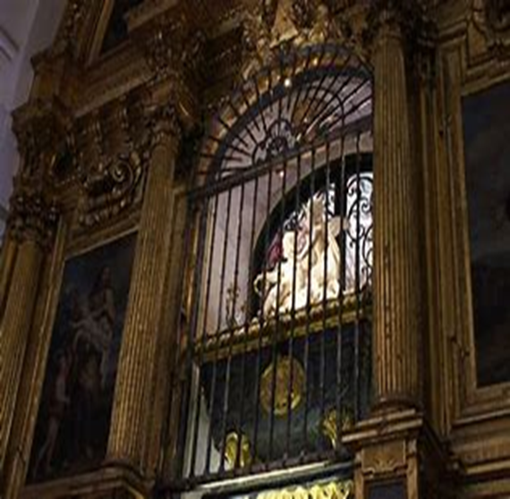
What does St. Teresa of Avila reveal to us about Mary, Mother Most Sorrowful? (2)
When St. Teresa of Avila’s body was exhumed, it was confirmed that her heart had been physically pierced; her heart had been pierced on a spiritual level, but her incorrupt heart bore the mark of a spear as well. Saint Teresa’s heart never yielded to natural decay, but was left totally pure, untouched by nature. Her experiences of pain had purified her heart, allowing her to know the Lamb of God’s purity of Heart, the magnitude of His love for her
Likewise, Mary, Mother Most Sorrowful knew the sorrow of suffering with Christ, but she also could lift the Precious Blood of her Son up to God the Father, in a spiritual sense, and know the sweetness of sacrificing all for God, to glorify Him entirely. She did not give in to her pain by sinning in any way, but carried it with grace and strength, for she bore it with love, to save souls

Slide 34
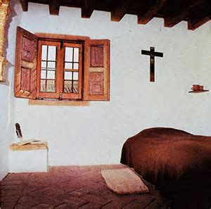
What does St. Teresa of Avila reveal to us about Mary, Mother Most Sorrowful? (3)
Saint Teresa dealt with spiritual dryness, a sense of desolation, and battled against the spirit of the world
Christ was St. Teresa of Avila’s refreshment. Fortified by the Holy Eucharist, she did not lack for anything, but found the remedy that cured every ill. Had it not been for her distractions that might otherwise be seen as frustrations, or obstacles, St. Teresa would not have learned how to focus her heart on Christ’s suffering, and to enter so deeply into it spiritually, that she would come to know His glory, too, and keep her eyes fixed on eternity, her heart centered in the promise of the Resurrection

Slide 35
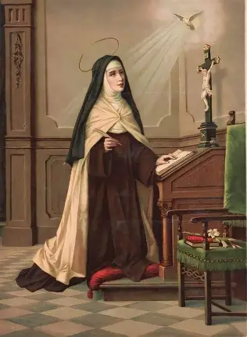
What does St. Teresa of Avila reveal to us about Mary, Mother Most Sorrowful? (4)
Saint Teresa learned to look to every challenge as an opportunity to begin anew with Christ, to be spiritually fruitful not only personally, but in guiding others to receive the Holy Spirit’s inspirations, follow them, and bring Christ into the world, just as Our Lady had. Through St. Teresa, we see that it is never too late to begin learning about Christ, or taking His hand on a new phase of the journey; she shows that each step taken with Christ gets better and better; the best is yet to come

Slide 36
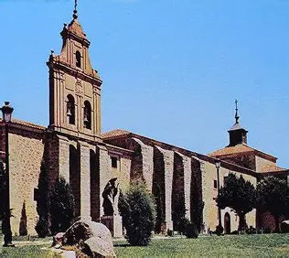
What does St. Teresa of Avila reveal to us about Mary, Mother Most Sorrowful? (5)
At age 52, St. Teresa of Avila set out on arduous journeys through Spain to found her new religious communities, to nurture new seeds of faith, starting afresh over and over. She traveled by mule or ox-cart, and no doubt, could have related to Our Lady, traveling to her cousin, St. Elizabeth. While there were sufferings in the journey, St. Teresa could rejoice in becoming more deeply united with Christ, in making sacrifices and working diligently, pouring blood, sweat, and tears, into all of her works for Him, all causes for joy, in that they served as chances to help others to experience Christ’s love, to be transformed by His mercy, His faithfulness to us that persists through every age

Slide 37
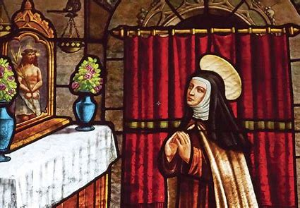
What does St. Teresa of Avila reveal to us about Mary, Mother Most Sorrowful? (6)
Saint Teresa of Avila bore good fruits for God amidst her pain. She shared these good fruits with others. She wanted everyone to know the sweetness of His love amidst their sufferings in life, so she wrote from the deep love for God in her heart that was pierced like the Hearts of Jesus and Mother Mary, teaching others to pray and embrace perfection in Christ that comes from suffering with Him, so as to receive the graces from it. Even in her death, when St. Teresa’s body was exhumed, it was found to be emitting a sweet fragrance. In our sorrows, when our hearts are broken open, open to embrace the suffering of others and share in it with them, in love and solidarity, we can come to spread Christ’s sweetness, so that we can have new life in Him together, not being ended by natural death, but remade

Slide 38
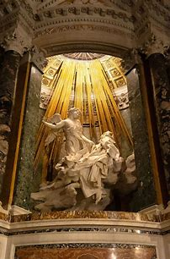
What does St. Teresa of Avila reveal to us about Mary, Mother Most Sorrowful? (7)
For St. Teresa of Avila, the way of perfection was a way of humility and surrender to God’s will. Mary, Mother Most Sorrowful, teaches this way perfectly. She humbled herself entirely, offering herself to God as a “handmaiden of the Lord” to serve Him with all of her heart, mind, and soul. Saint Teresa emulated Our Lady’s surrender, in accepting the crosses that God gave to her; she had wanted to be a martyr as a child, but as an adult, would be spiritually martyred in different ways, especially through illness, and the pain of opposition from those questioning her work, her capability, everything that she had been doing out of pure love for God
The way of perfection may be painful, as God shapes us, helping us to conform to His beautiful image, which is one of perfect humility, and therefore, perfect love, but its sorrows will bring joys in being united with God, Whose love is eternal and redemptive; when we can love like God, we will know most deeply how He loves us, and be filled by His burning charity, incandesced from within, that we may always bear His torch of light forward, never to be extinguished

Slide 39
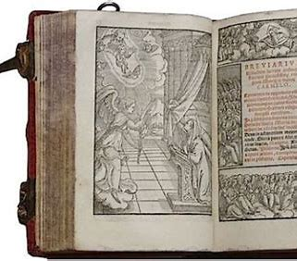
What does St. Teresa of Avila reveal to us about Mary, Mother Most Sorrowful? (8)
Saint Teresa is a patron saint for writers. We learn from her life that God is the Divine Author Who writes sorrow into our lives, so that there can be a happy ending, eternal paradise for us. We do not ride off into the sunset, but into the sunrise, a new beginning; from sorrow, can come great grace, for after St. Teresa dealt with spiritual dryness and sickness, in the low valleys of life, she would receive her spiritual awakening, and know the heights of ecstasy, of spiritual union with God that would transfigure her inside, helping her to teach others to embrace Christ’s eternal light

Slide 40
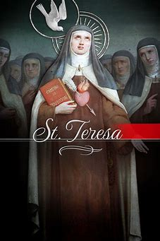
What does St. Teresa of Avila reveal to us about Mary, Mother Most Sorrowful? (9)
Saint Teresa passed away in the arms of her secretary. To die to sin, and enter into new life, we are called to be secretaries of Jesus and Mother Mary, to record all that they do out of love in our hearts, that we may always remember and treasure their love, just as Our Lady pondered all that Our Lord did in her Heart, learning from His actions of love, in order to reflect them
In this life, St. Teresa experienced such deep longing for God, having had her heart wounded by His love, pierced by it, that she had an all-consuming desire to enter into eternal life; it was a sorrow and hardship to bear to be not yet fully united with Christ, and to be patient to receive it; this would make the joy of ultimately being with God much greater

Slide 41
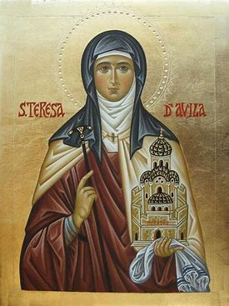
Closing Prayer: Collect for the Feast Day of St. Teresa of Avila
O God, who through your Spirit raised up Saint Teresa of Jesus to show the Church the way to seek perfection, grant that we may always be nourished by the food of her heavenly teaching and fired with longing for true holiness. Through our Lord Jesus Christ, your Son, who lives and reigns with you in the unity of the Holy Spirit, God, for ever and ever. Amen.

