Slide 1
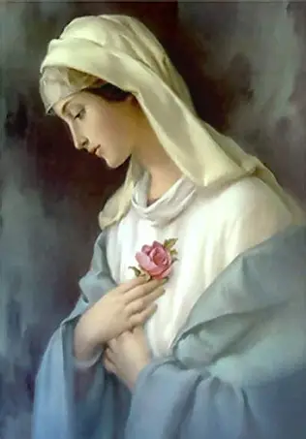

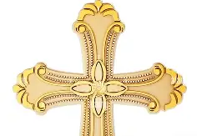

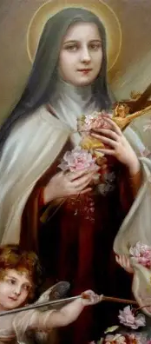
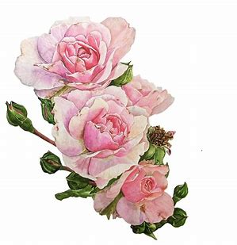

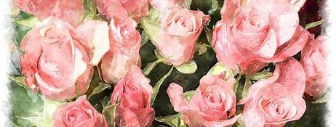
Women Doctors of the Church Learning Series 1: The “Little Flower” Power of St. Therese of Lisieux
Katie Sadakierski
Monday, September 8, 2025

Slide 2
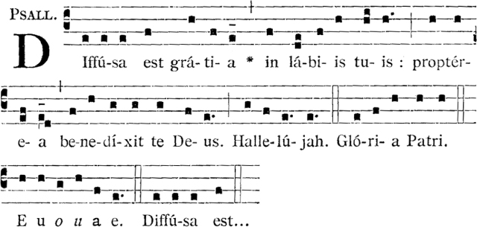
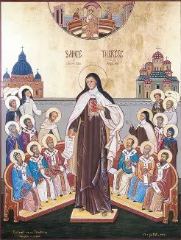
Outline: Women Doctors of the Church Session 1
Introduction
Outline
Opening Prayer
Presentation
  I. Teachers of Holiness: Why We Have Doctors of the Church
  II. Saint Therese as a Teacher of Holiness
  III. What We Learn from St. Therese about Teaching Holiness
Closing Prayer
Q & A

Slide 3
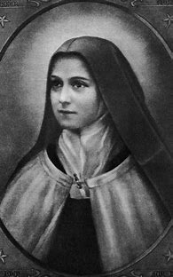
Opening Prayer: Miraculous Invocation to St. Therese
O Glorious St. Therese, whom Almighty God has raised up to aid and inspire the human family, I implore your miraculous intercession. You are so powerful in obtaining every need of body and spirit from the Heart of God. Holy Mother Church proclaims you “Prodigy of miracles the greatest saint of modern times.” Now I fervently beseech you to answer my petition (mention in silence here) and to carry out your promises of spending heaven doing good on earth. of letting fall from Heaven a Shower of Roses. Little Flower, give me your childlike faith, to see the Face of God in the people and experiences of my life, and to love God with full confidence. St. Therese, my Carmelite Sister, I will fulfill your plea “to be made known everywhere” and I will continue to lead others to Jesus through you. Amen.

Slide 4
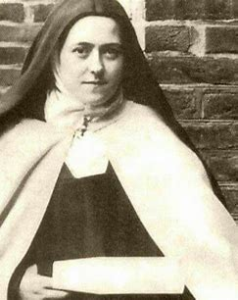
What is a “Doctor of the Church”?
A “Doctor of the Church” is a teacher of holiness
The word “doctor” comes from the Latin “docere,” meaning “to teach”
When we think of a “doctor,” we usually think of a medical doctor, but academic doctors who have demonstrated mastery in their academic subjects also are like medical doctors, in that they heal, but rather than healing the body, they help others to heal spiritually, leading them to a deeper knowledge of God and His love
Doctors of the Church are souls who mastered the science of holiness, because they recognized that they had not mastered anything on their own, but accomplished everything solely through God’s grace
A Doctor of the Church is someone who opened themselves to being perfected by God in this life, and could therefore be made totally perfect in Heaven, through God’s love
Someone who is a Doctor of the Church has been proclaimed one by a pope, in recognition of their life and writings of holiness, which have contributed to others’ understanding how to pursue a life of holiness that reflects the faith, hope, and love of Our Lord, Jesus

Slide 5
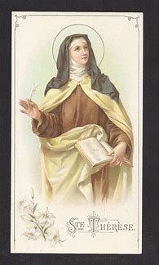
Which criteria must a person meet in order to become a Doctor of the Church?
A person must meet three criteria in order to be named a Doctor of the Church:
  They must have lived a life of outstanding holiness and heroic virtue (this is a criterion for canonization, so they are to be a saint in the Church). Doctors of the Church are teachers of life, demonstrating to us how to live a good life for God through the examples of their own holy lives of service to the Lord
  They must demonstrate deep understanding of the Faith through their works (eminent learning). Their works should reflect that their spirit of understanding flows from divine inspiration, closeness to God allowing for the application of the Holy Spirit’s Gift of understanding. Their writings must be proven to be sound in doctrine, meaning that it must be orthodox, reflecting the tradition of the Church, and not contradicting Church teaching. The works in question must have shaped theological thought, and influenced the faithful, being universally impactful
  Their works should have universal benefit, reaching people across ages and cultures
    A Doctor of the Church is someone who is so filled with God, that like Him, their love transcends time and place, being reflected through their scholarship conducted for God’s glory
      The authority to make a person a Doctor of the Church rests with the pope and an ecumenical council gathered with him; this is in accordance with canon law

Slide 6
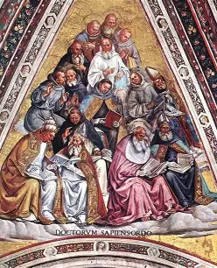
How many Doctors of the Church are there? Who are they? (1)
Among thousands of saints who have been canonized (recognized formally as souls in Heaven by the Church), there are 37 Doctors of the Church currently, but at a time appointed by Pope Leo XIV, our thirty-eighth Doctor of the Church, St. John Henry Newman, will be proclaimed
Many of the Doctors of the Church are Church fathers and other men who were priests or religious. Four of the Doctors of the Church are women: St. Therese of Lisieux, St. Teresa of Avila, St. Catherine of Siena, and St. Hildegard von Bingen. They all were added to the family of Doctors of the Church in the twentieth century
The Doctors of the Church are people whose teachings illuminate our Faith for us, capturing all of the rich layers of meaning and beauty. Their works to honor God are timeless, shaping minds and hearts through the generations, for their works were not only intellectual, but spiritual, coming from souls filled with love for God, and God’s love is eternal

Slide 7
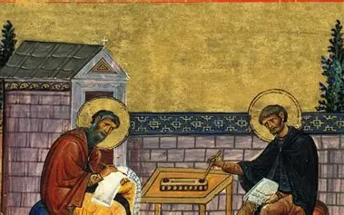
How many Doctors of the Church are there? Who are they? (2)
Originally, there were eight Doctors of the Church who were given this title between the 1200s and 1500s
The four from the Western Church were St. Ambrose, St. Augustine of Hippo, St. Jerome, and St. Gregory the Great; they were proclaimed Doctors of the Church by Pope Boniface VIII in 1298
The four from the Eastern Church were St. Basil the Great, St. John Chrysostom, St. Gregory Nazianzen, and St. Athanasius
The other 25 include St. Thomas Aquinas, St. Bonaventure, St. Anselm of Canterbury, St. Bernard of Clairvaux, St. Alphonsus Liguori, St. Francis de Sales, St. Isidore of Seville, St. Albert the Great, St. Robert Bellarmine, St. John of the Cross, and St. Anthony of Padua

Slide 8
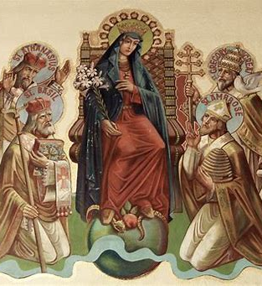
How have the works of the Doctors of the Church aided our practice of the Faith?
The Doctors of the Church defended the truth of Catholic teachings at ecumenical councils in times when heresies were being spread
They explained very nuanced aspects of theology, helping others to understand what it means to live a Catholic life, as a spiritual union with God
Doctors of the Church have aided the faithful in practicing the Faith by illuminating how to apply Church teachings in every day life, and follow what God calls us to do

Slide 9
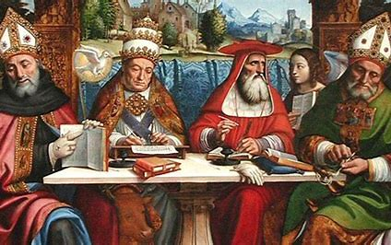
What is the process of becoming a Doctor of the Church like?
The process of making a person a Doctor of the Church may only be initiated by the pope, but requests may be brought forth for the pope to consider. In April 2024, the Superior General of the Discalced (shoeless) Carmelite order brought forward a request for St. Teresa Benedicta of the Cross (St. Edith Stein) to be proclaimed a Doctor of the Church (a similar request was brought to Pope John Paul II in 2000, so it is not guaranteed, but is an outcome we may pray for!)
Postulators, people who send forward letters to the pope petitioning him to consider certain saints for the reception of the title of “Doctor of the Church,” are often religious superiors, conferences of bishops, or rectors of universities. The pope may then choose to move the process of consideration forward
For much of the Middle Ages, the process of becoming a Doctor of the Church was not formal, but the process was formalized in the thirteenth century, and a list of the Doctors of the Church was produced
Pope Francis I made two people Doctors of the Church: St. Gregory of Narek in 2015 and St. Irenaeus in 2022
This process is guided entirely by God. He ensures that saints are given this title, that through their works of love for Him, God’s love may be spread, reaching hearts and inspiring them to love Him back

Slide 10
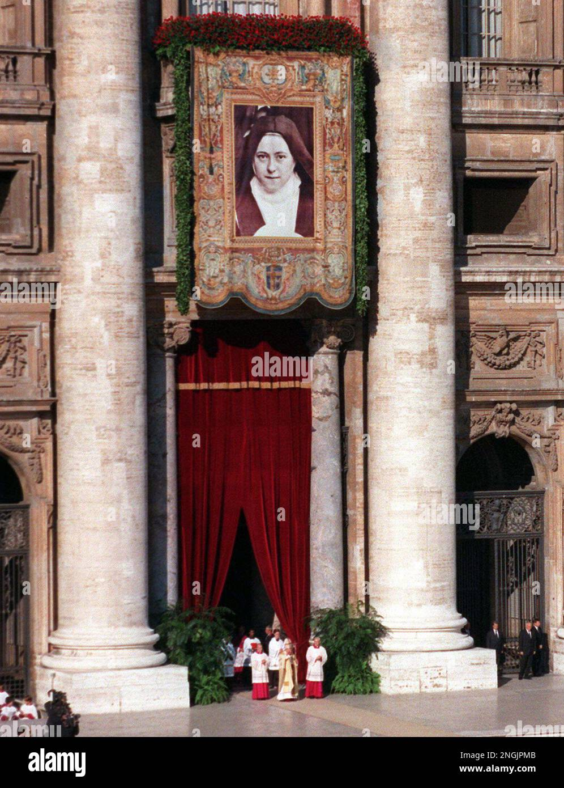
Who is St. Therese of Lisieux? When did she become a Doctor of the Church?
Saint Therese of Lisieux (1873-1897) was a French Carmelite nun, and the most recent Doctor of the Church to have lived. She was also the youngest at the time of her death, as she passed from this life at the age of 24
  Saint Therese was like the adolescent Lord, Who taught the elders at the Temple. From her, we learn that to be little, to be humble, is to be the most like Christ, and that from opening our hearts to learning from each other, we open ourselves to much more wisdom and understanding than if we judged. Saint Therese’s religious sisters judged her for being so young when she entered the convent, at age fifteen, but she would end up teaching the whole world the Little Way of holiness, bringing many souls to Heaven through this brilliant model of spiritual growth
On October 19, 1997, St. Therese was named a Doctor of the Church by Pope St. John Paul II on World Mission Sunday
  Saint Therese had dreamed of being a missionary, but submitted entirely to God’s will, and in following it, serving Him as a nun cloistered in the convent, she grew within God’s garden, and built up His garden in Heaven, doing more within the cloister than if she had traveled the whole world, for in her union with God, she could broaden her capacity to love, reaching souls everywhere. Saint Therese had a priestly character to her mission in making constant intercession for others, offering her chalice of suffering in union with Jesus and Mother Mary to God the Father, and could teach how to be holy and happy in making a total self-gift to God

Slide 11
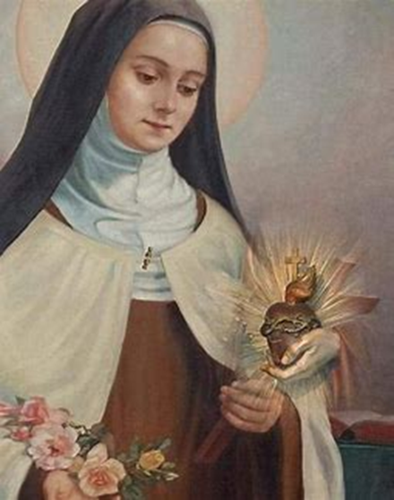
What was St. Therese’s path to becoming a Doctor of the Church?
The first word St. Therese read on her own as a child was “Heaven.” Her last words were “My God, I love you.” Saint Therese followed a consistent path without deviation. She remained focused and steadfast. By fixing her eyes on Heaven from the very beginning, she kept a steady course, for she was totally guided by God’s love, which she treasured in her heart until the very end, when she would go forth to embody it all the more fully with Him in Heaven, and guide others to a similar love. A Doctor of the Church never stops teaching; St. Therese continues to teach us now, assisting Our Lady, Model of Catechists and Christ the Teacher. Heaven is where we can most perfectly express our love for God, and receive the greatest expression of God’s love poured out from the Sacred Heart; we discover that Heaven is in the Sacred Heart, which is a mansion with room enough for everyone, a garden with plots for every flower
Saint Therese pursued the path of Our Lady, choosing a life hidden in Christ, reflecting and following his light. She allowed herself to be instructed by Christ in the crosses, which she took as gifts, and could therefore instruct others in His Way. Saint Therese remembered Our Lady, and asked Our Lady to remember her, so that she could remember others in her prayers, living with love for them. As a child, she once decorated a special Marian altar with candles, and asked her nurse to pray the “Memorare” with her at the altar. Her joy was always to pray in love and thanksgiving for the Christ Child to Our Lady, His Mother, to whom she went for guidance in how best to remember and glorify God in her every word and action

Slide 12
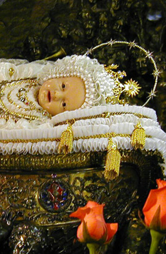
Why is September 8 a significant date associated with St. Therese, and what do the special traditions on this day teach us about her way of holiness? How does this relate to her status as a Doctor of the Church? (1)
September 8 is the birthday of Mother Mary, called the Feast of the Nativity of Our Lady. A special tradition associated with Our Lady’s birthday is the Maria Bambina one, the “baby Mary.” A waxen image of Our Lady as an infant was made by a Franciscan nun before the year 1730, and was then given to the Sisters of Charity in Italy. It would only be exposed on September 8 for veneration. Those who devoted themselves to the Holy Infant Mary would be rewarded. In the late 1800s, members of the Sisters of Charity who were sick received the image to kiss, and were healed. The waxen image had been so weathered, that the skin of the Holy Infant Mary was ashen, but when the sisters kissed the image, the coloring returned to that of its original state, taking on a rosy glow. The sisters, too, were healed, in having expressed a faith in God that was similar to the childlike trust Our Lady exhibited throughout her life, retaining the innocence she had as a holy infant
The Sisters of Charity in Italy, now also called the Sisters of the Bambina, touch a piece of cotton to the image when they venerate it, and give the cotton pieces as sacramentals to devotees of the Holy Infant Mary

Slide 13
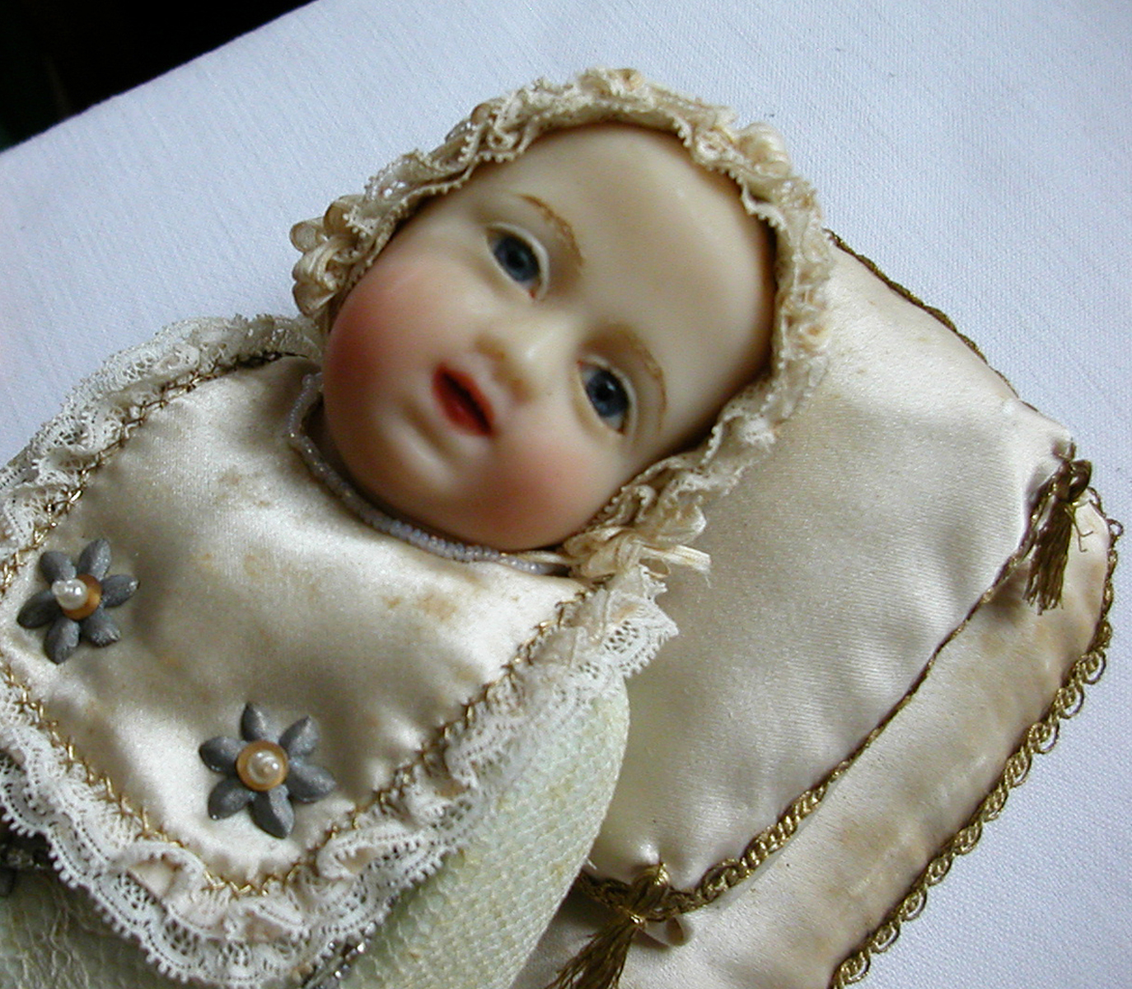
Why is September 8 a significant date associated with St. Therese, and what do the special traditions on this day teach us about her way of holiness? How does this relate to her status as a Doctor of the Church? (2)
The Carmelites, too, had a similar tradition of venerating a waxen image of Our Lady as a holy infant on her birthday. Saint Therese made her profession of vows on the feast day of Our Lady’s Nativity, as the Carmelite order has Our Lady as its patroness, and often sets the dates of professions on Marian feast days. Saint Therese was espoused to her Savior on the day that Our Lady was born for the purpose of giving birth to Our Lord, St. Therese’s mystical Spouse. Saint Therese of the Child Jesus would learn to love the innocent Christ Child with the childlike Heart of Mary that was a reflection of Christ’s own Sacred Heart. She would carry this spirit forward into all of her teachings in the future
Like Our Lady, St. Therese teaches us the importance and dignity of living out the purpose for which we were born: like Our Lady, we are called to bring Christ into the world through gifts of His love to others, especially prayer and sacrifices. We are to die to sin with Christ, and compassionate with Him, just as Our Lady suffered with Christ, to be made immaculate, and prepared as flowers for the heavenly altar. Saint Therese’s final battle, which was with the physical suffering caused by tuberculosis, and the darkness of Satan’s spiritual attacks, desolation in this time of pain, was won through closeness to Jesus and Mother Mary, which left her still joyful; she died totally to herself, in order to enter into eternal life, just as Our Lady gave herself totally to God, even choosing to die a natural death fourteen years after Christ to be totally united in Heart with Him, despite being free of the consequences of original sin

Slide 14
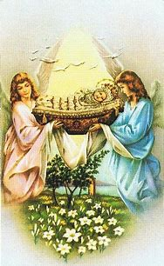
Why is September 8 a significant date associated with St. Therese, and what do the special traditions on this day teach us about her way of holiness? How does this relate to her status as a Doctor of the Church? (3)
Seeds are blessed on the feast day of the Nativity of Our Lady, and when the Little Flower professed her vows, she was planting seeds for the future, receiving the graces she would need to help others to blossom. She was a Doctor who taught the way of love for Christ, because all that she did was as a present to her Beloved, as a bride of Christ; she revealed something about the receptiveness and faithfulness of Our Lady, and the Church, the Bride of Christ, in her mystical marriage to the Lord, teaching the faithful how to devote themselves to Jesus by offering Him many acts of love, like kisses to return the gentle Kiss of the Divine Child, Our Lord in the Holy Eucharist. The blessing of seeds on September 8 marks the beginning of a new planting season at the end of the summer. Saint Therese teaches us that we always begin anew with Christ, and are to renew our commitment to Him each day, just as He offers Himself to us on the altar at Holy Mass each day, pouring out His love for us, that we may reciprocate it. She could embrace each new trial as a new planting season, a fresh opportunity for Christ to implant His love in her heart more deeply, so that everyday could be like a birthday. In her attitude of joy and hope amidst suffering, she helped all others to embrace new life in Christ
Saint Therese always began anew in union with Our Lady, who kept going, always journeying with God the Father, even after Our Lord passed from this life. She went to Our Lady to clear the debris from her soul, and prepare the soil of her heart for the seeds of God’s love to be planted. Saint Therese teaches us that to grow in holiness, we are to entrust ourselves into the hands of Our Lady, who can draw forth the most beauty from a garden, bringing the loveliest blossoms from the dirt, that we may rise above this earth, and reach the light of Heaven with Our Lord

Slide 15
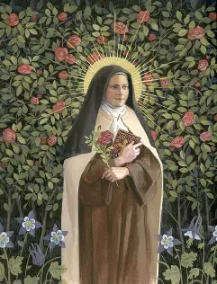
Why is September 8 a significant date associated with St. Therese, and what do the special traditions on this day teach us about her way of holiness? How does this relate to her status as a Doctor of the Church? (4)
Saint Therese would teach others how to plant seeds of faith, hope, and love by offering all of their works, no matter how seemingly small, with total devotion to Christ, out of the deepest wells of charity in their hearts
In her holy example, St. Therese teaches us spiritual motherhood as a way to Heaven, a science of holiness. She was the mistress of novices, helping other religious sisters to learn and grow, helping to guide them closer to Christ. Through her friendships, her spiritual care for others, she lived out the way of Mary, of personally tending to the garden of each soul, coaxing forth the most beautiful flowers through her patience and steadfastness. She loved so deeply that she not only wanted union with Christ herself, but sought to teach the way to His Heart to everyone, that they, too, may know His love, and console the Heart of Jesus, Whom she loved above all else, and wanted to rejoice. Saint Therese could love the Presence of God in others, and admire how God was shining uniquely through them, so she wrote of the beauty of variety in God’s garden, and helped each soul to praise God according to how He intended for them to do so, for His glory

Slide 16
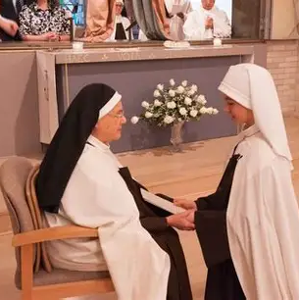
What does St. Therese’s profession ceremony teach us about living a life of holiness, and teaching the way of Christ to others? (1)
When St. Therese made her profession of vows, there were three key parts of the ritual that we may learn from in applying lessons from how this Doctor of the Church approached her wedding to Our Lord, her commitment to Him:
  The profession note: She kept her intentions close to her heart, handwritten on a piece of paper pinned near to her, emulating Christ, in treasuring our petitions within His Heart with Our Lady, that souls may be brought to Him. We may similarly be living profession notes, carrying the petitions of others to the altar in our hearts, teaching holiness through perpetual love and adoration of God, continued commitment to Him and ongoing conversion

Slide 17
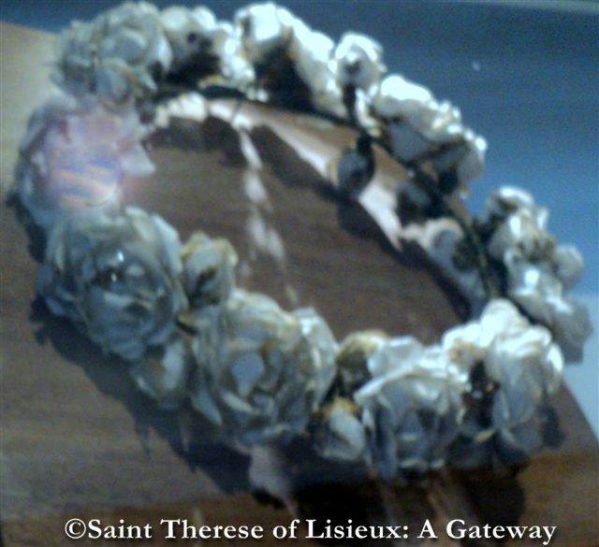
What does St. Therese’s profession ceremony teach us about living a life of holiness, and teaching the way of Christ to others? (2)
  The crown of flowers: We may weave all of our works of love and prayer like flowers in a crown, that we may be coronated in Heaven, with crowns gilded with gems of virtue, braided together with those of others who have touched our hearts, for St. Therese teaches us that the Little Way is one of great love, of friendship, that is not solitary. She spiritually directed others, counseling and consoling fearful hearts, that they may learn confidence in God, regarding all trials as seeds for growth, producing the most beautiful fruits. The white roses remind us that we are purified in suffering with and for Christ, in union with Our Lady. We teach holiness in outward actions, in standing by the altar, and interiorly participating in Christ’s Sacrifice with love

Slide 18
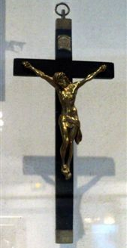
What does St. Therese’s profession ceremony teach us about living a life of holiness, and teaching the way of Christ to others? (3)
The profession crucifix: We are taught in the School of Christ Crucified, Who teaches us perfect love in His forgiveness. We stand by the Cross with all for whom Christ gave His life, and are reminded to unite ourselves with Christ on the Cross to live lives of holiness, lives of love and joyful sacrifice that allow for the greatest fruits to be produced; we put our professed beliefs into practice in this way, and offer our sufferings for the intentions of others, that they may grow in holiness, and come to teach it, too. We live for the intention of nurturing new disciples, new learners, of Christ and His Way of love. In wearing the profession crucifix over the heart, Carmelites are reminded to treasure the love of Christ in their hearts; we can spiritually impress the crucifix on our hearts, to always learn from Christ’s love that is nowhere better taught than on the Cross

Slide 19
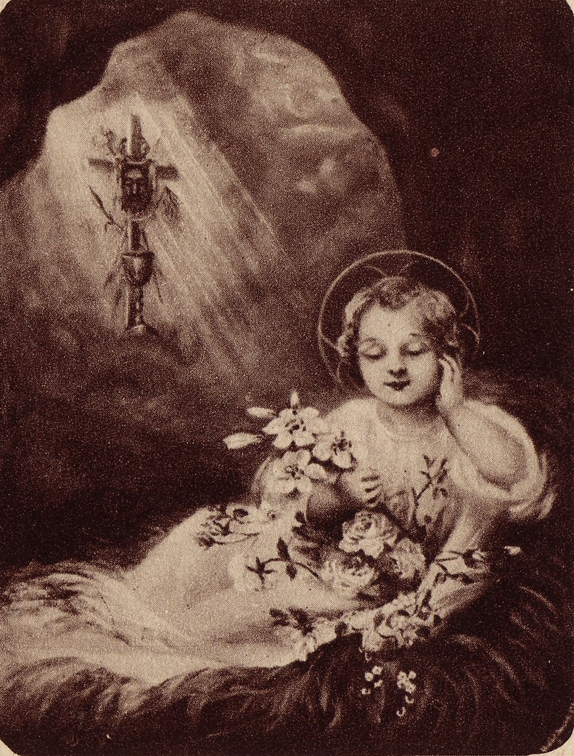
How did St. Therese master the science of holiness? (1)
Saint Therese mastered the science of holiness through littleness. She kept herself always open to learning and growing, never seeing herself as overgrown, but as small enough to keep growing and reaching for God. As a result, she never saw herself as above God, and could avoid mortal sin, recognizing the gift in her identity as a child of God. She identified most closely with Christ, the One Who came down to us as an Infant, and Who remains in humble bread that is transubstantiated into His Body on the altar
Saint Therese humbled herself with Our Lord, Who humbly submitted Himself to being carried with His Mother in the womb, according to where she chose to go. Saint Therese spiritually grew alongside Christ in the womb, opening herself to being nurtured by Our Lady. Saint Therese had the wisdom to recognize that the little ones who are pure of heart can see God, and receive true understanding of His ways, so her spiritual age exceeded her biological age

Slide 20
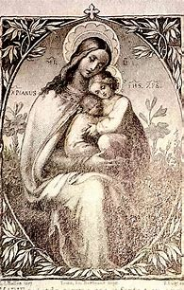
How did St. Therese master the science of holiness? (2)
Like Our Lady, she had true faith that the Lord would uplift the lowly, and give great grace to those willing to be filled with it, recognizing their own weakness and limitations, their great need for God. She was a living embodiment of the “Magnificat” prayer, bringing it to life in her “Little Way” of humility, which seeks only to love God, not for any merit or gain, but simply to offer Him our hearts in joyful gratitude for the sweetness of His love that He refreshes us with from His Sacred Side, opened to pour forth the nectar of His Precious Blood, droplets like gems to collect in the treasuries of our hearts
The Little Way is a Marian Way of the Cross, of humbly taking up suffering out of love, and giving everything as a gift to God, with peace and happiness in the heart that comes from loving and serving Christ sincerely, without expectation of receiving something in return. Saint Therese had true, self-sacrificing love, a wisdom transcending worldly transactions, and reflecting the beauty of the Beatitudes, of Christ’s Kingdom that follows the rhythms of Heaven

Slide 21
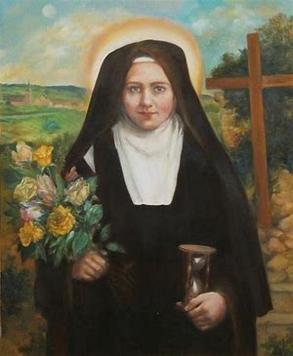
What makes St. Therese unique as a Doctor of the Church?
Many Doctors of the Church wrote extensive theological works, namely, treatises, academic treatments of subjects related to the study of God. Saint Therese had a brilliant mind that she used in a different way, in that she wrote a spiritual autobiography, The Story of a Soul, that is accessible to all, not only academics, as well as many other creative works, including poems and plays about Our Lord, Our Lady, and the saints. She also evangelized through artwork, creating paintings revealing insights she had received through her spiritual friendship with Jesus and Mother Mary
Saint Therese teaches us that true depth and wisdom is in simplicity. Our Lady seeks simplicity from us, because this is the way of her Child. Saint Therese, then, differed from other Doctors of the Church, in distilling the most profound and complex truths down to their very essence, that everyone could smell the roses, seeing the beauty in the simple joys of our Faith, of being close to the One Who came down from Heaven for our salvation, taking the wood of the Cross from the wood of the manger, as Christ gave Himself to God the Father with total childlike trust, a love that was completely pure
Saint Therese is a Doctor of Evangelization, because she evangelizes through her actions of love that speak God’s goodness most loudly, leading others to see and feel the good news of Christ’s love that is stronger than death, that they may be led to pursue friendship with Him, and share the good news, too

Slide 22
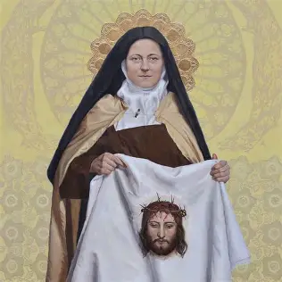
How can we imitate St. Therese in our lives, teaching the way of Christ as well? (1)
Giving gifts from our hearts to Our Lady
  Consecrating ourselves to Jesus through Mary, that she may embellish our works, and present them all the more beautifully to God
Consecrating ourselves to the holy angels, and emulating them in service to Christ
  Associating closely with our holy angel guardian in order to be a guardian angel to others, leading them to Our Lord through Our Lady, who is the Queen of the Angels, and faithfully adoring the Lord as they do. When we are aware of the presence of our holy guardian angel, we may respond all the more lovingly, remembering that Heaven is close at hand, imbuing everything with its luminous splendor
Looking to the Holy Face as our model of love, and radiating that light from within
  Seeing the Face of Christ reflected in others, and loving each person He sends to us, making everywhere we go our mission field

Slide 23
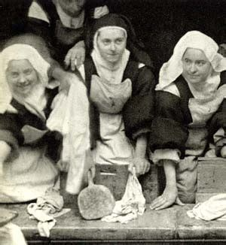
How can we imitate St. Therese in our lives, teaching the way of Christ as well? (2)
Devoting ourselves to the Holy Eucharist
  Saint Therese attended daily Mass with her parents, and was a frequent communicant at a time when this was rare, before Pope Pius X, the Eucharistic pope, would promote daily Communion and lower the minimum age for First Holy Communion. All of the seeds of Our Lord’s love, faith, and hope were planted in the Little Flower when she received the Light of the World, the living water, in receiving Jesus, the Son of God, in the Holy Eucharist. As a child, St. Therese visited the Eucharistic Adoration chapel during her school recess, and scattered rose petals on the ground before the Eucharistic processions, when Christ, Present in the Sacred Host, would be carried by the priest through the streets in the monstrance. Saint Therese continued her Eucharistic devotion, even when she was not permitted to receive Holy Communion every day while at the Carmelite convent, which had fallen prey to Jansenist tendencies to avoid receiving the Holy Eucharist, due to an overemphasis on human depravity, and unworthiness to receive. Saint Therese believed wholeheartedly in God’s mercy, even calling God “Papa,” going to Him with total childlike trust, so that every time she could receive the Holy Eucharist, it was with the greatest love. She carried forward her spirit of Eucharistic piety, doing the spiritual equivalent of acknowledging the Presence of God with roses, by offering many spiritual bouquets to Him, giving gifts to God through her services of kindness and compassion. She counted her good deeds on sacrifice beads, a one-decade rosary with beads that she could slide down to the crucifix to mark when she had completed good works of charity for God, to mirror the self-giving spirit of Christ, Who offers every gift from His Heart to us. It is only because of Our Lord’s love that we can offer anything to God at all, and unite ourselves lovingly with the Father through union with the Son, on the Cross, where we are nearest to His Heart of love

Slide 24
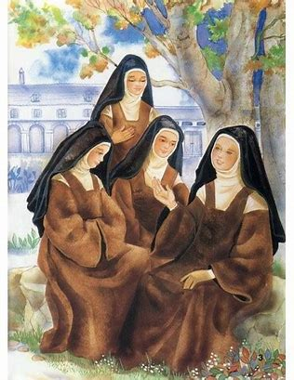
How can we imitate St. Therese in our lives, teaching the way of Christ as well? (3)
Growing spiritually in becoming more childlike, and learning from the Christ Child
  Saint Therese did not simply throw away the things of childhood as she got older, but learned how to use them to more deeply and maturely honor God. She honored her roots, the traditions of her Faith passed on by her parents, and retained her profound joy, wonder, and love for God that she had as a child. Saint Therese continued to practice special devotions, and only was strengthened in her virtues, as she learned to trust in God entirely, and overcame any childhood tendencies towards venial sins that she had
  When she was a child, St. Therese’s teachers called her “Little Doctor.” She continued to apply herself diligently to learning about and promoting love for God, allowing herself to be led by God, so as to tell the story of His love all the more deeply

Slide 25
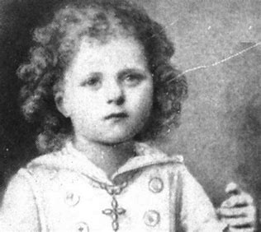
How can we imitate St. Therese in our lives, teaching the way of Christ as well? (4)
  As a child, St. Therese would use holes in her garden wall to create altars decorated with the flowers. She could discover the sacred in everything, using even the smallest things to give glory to God. Saint Therese could always bloom where she was planted, offering all that she had to God
  While immersed in God’s creation as a child, St. Therese would gather seeds and tree bark, crushing and combining them to make paint-like mixtures. In her own little way, she was imitating the Lord in using all things as a canvas for His beauty, as a palette from which to draw beautiful works for His glory. She offered the mixtures to her father, pretending that they were like teas at a tea party; St. Therese had a sense of delight in all things, and wanted to share it, an impulse she brought forward in her adulthood, when she would sacrifice herself to share Christ’s love with everyone, showing them all of the colorful gems of virtue within His Heart, the most perfect masterpiece, like a sky transfigured by the sunrise, promising new light and new hope

Slide 26
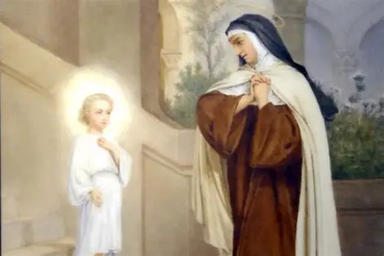
How did other Doctors of the Church shape St. Therese? (1)
Saint Teresa of Avila was a spiritual mother of the Carmelite order, reforming it so that it would allow for Carmelites to grow in deeper holiness in following a more rigorous, disciplined way of life in keeping with past traditions. Saint Therese would become a Carmelite, benefitting from the fruits of St. Teresa of Avila’s contemplation, which shaped the order through such works of hers as The Interior Castle
Saint Therese enthroned Christ in her heart, making it an interior castle for the King. She treasured every experience deeply in her heart, like Mother Mary, drawing meaning from it by seeing the beauty and goodness of God shining through everything, both joys and sorrows. She once visited the Loreto House, where Our Lady was born, visited by the holy angel St. Gabriel, and raised Our Lord. While there, St. Therese touched her rosary beads to a dish that had been used by Our Lord. She could appreciate all that was touched by Christ’s Presence, and opened her heart to being touched by His love as well. Her heart became a kind of Loreto house, in which Our Lady was born anew each day, said “yes,” to God, and raised up Christ, because St. Therese did God’s will with love

Slide 27
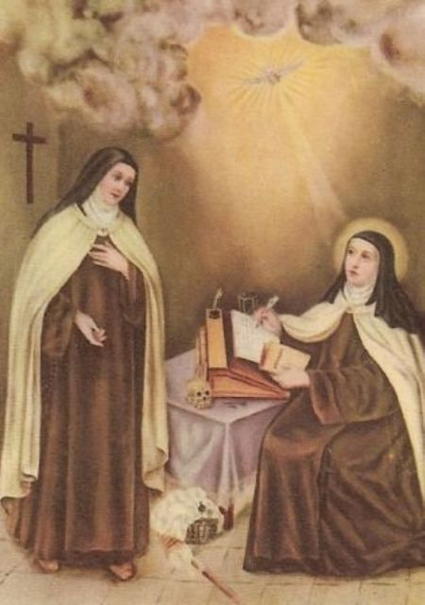
How did other Doctors of the Church shape St. Therese? (2)
Saint Teresa of Avila wrote about advancing in the stages of prayer, and St. Therese lived out this progress. Although she preferred mental prayer, and was very interior, like Our Lady, she offered up many other kinds of prayer out of love, engaging in vocal prayer with her religious sisters, praying the Holy Rosary (even though it was challenging for her, and she might become distracted at times), and offering all that she did as a prayer, including her interactions with sisters who had difficult personalities, and with whom others did not always engage. Saint Therese showed that she had mastered the science of holiness in the depth of her love; when one sister was trying her patience by fidgeting while praying, St. Therese reframed every sound as a kind of music, finding joy within what might otherwise be frustrating, by offering it to Christ as a beautiful gift, and patiently bearing it with His level of gentleness and sweetness
Saint Therese would write “JMJT” at the top of her letters. These initials stood for “Jesus, Mary, Joseph, and Teresa,” because St. Therese was offering her works for Jesus and Mother Mary, through the intercession of St. Joseph and her spiritual mother, St. Teresa of Avila. This alone showed the impact that St. Teresa of Avila had on her soul, because St. Teresa, too, went to St. Joseph to help her in reforming her order, and offered everything with him to Jesus and Mother Mary

Slide 28
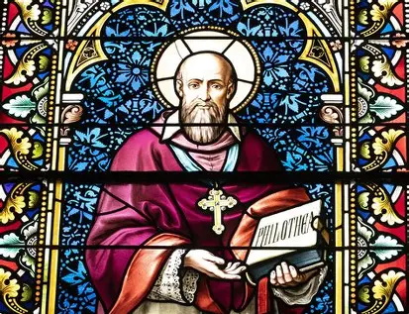
How did other Doctors of the Church shape St. Therese? (3)
Saint Francis de Sales was an influence on St. Therese. In Introduction to the Devout Life, he taught that we all are called to holiness, and can live devoutly, regardless of our state of life, for everyone is called by God to a vocation to love Him and others, not exclusively priests and religious
Saint Therese was named for St. Francis de Sales. Her full baptismal name was “Marie-Francoise Therese.” She lived up to her namesake, as her “Little Way” of holiness, a spiritual pathway she developed, encourages all to pursue advancement in holiness through gradual steps, little offerings of love that, when taken together, are quite enormous. She taught that everyone can offer something to God, that no one is too little to love Him greatly, to receive His great love, and be lifted up by Him

Slide 29
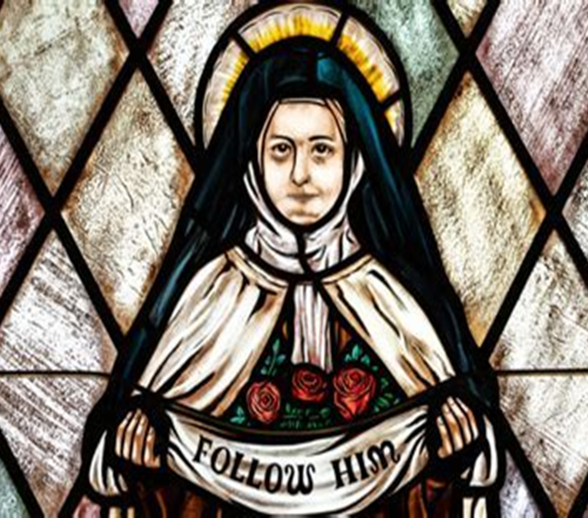
How did other Doctors of the Church shape St. Therese? (4)
Saint Francis de Sales taught that we should hold on to a Scriptural verse, or meditation on Our Lord, to keep returning to throughout the day, like a flower that we continually gaze upon, or whose fragrance we absorb gradually. Saint Therese teaches us to similarly remain focused on Christ’s love, on our friendship with Christ, not being distracted by the things of the world, but storing up treasures in Heaven. Saint Therese did not despair at the end of her earthly life, but looked forward to only continuing to glorify God in the next life, vowing to use her Heaven doing good on Earth, showering down blessings like roses on souls until the end of time. We, too, can devote ourselves to making earthly life heavenly through many actions of kindness and charity, that we may be prepared to love forever in Heaven. Our works now can give glory to St. Therese, too, so that when Christ comes again in glory to judge the living and the dead, and her full influence will be known, she can earn even more heavenly rewards, in having had a good influence on us, and impacting our pathways to Heaven by inspiring us to pursue the Little Way. When we keep looking upon the Little Flower, we are inspired to imitate her in being like Our Lady, the Mystical Rose, and Christ, the Divine Flower, Whom St. Therese always remained near to, absorbing His beauty and life

Slide 30
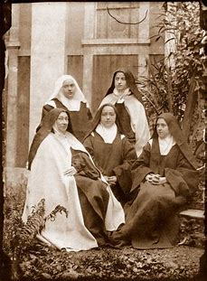
How did other Doctors of the Church shape St. Therese? (5)
Saint Therese prayed this morning offering that revealed a Salesian influence: “O my God! I offer You all my actions this day for the intentions and for the glory of the Sacred Heart of Jesus. I desire to sanctify every beat of my heart, my every thought, my simplest works, by uniting them to His infinite merits; and I wish to make reparation for my sins by casting them into the furnace of His merciful love. O my God! I ask You for myself and for those whom I hold dear, the grace to fulfill perfectly Your holy will, to accept for love of You the joys and sorrows of this passing life, so that we may one day be united together in heaven for all eternity. Amen.”
Saint Francis de Sales, together with St. Jane Frances de Chantal, founded the Visitation order of religious sisters to spread devotion to the Sacred Heart and Immaculate Heart of Mary. Their vision was for their spiritual daughters to reflect the Immaculate Heart of Mary in union with the Sacred Heart of Jesus, by carrying His Heart of love to all in prayer, like a torch being brought forth to shine the way to Heaven. One of Saint Therese’s sisters would become a Visitation nun, and her mother, Zelie, too, loved the Visitation order. Saint Therese adored the Holy Eucharist, and therefore, loved the Eucharistic Heart of Christ that she received; Saint Francis de Sales would shape her in guiding her heart of love for Christ, helping her to visit others with His love widely, from within her place in the cloister, living out the mystery of Our Lady’s Visitation to her cousin, St. Elizabeth. Saint Therese was animated by similar charity, journeying in prayer on missions to save souls, much like priests. She taught perseverance in prayer, never succumbing to temptations, but bringing everything into the light, giving it all to God

Slide 31
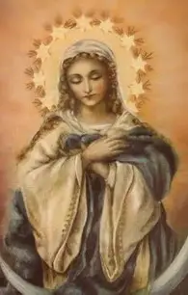
What does St. Therese reveal to us about Mary, Mother Most Prudent? (1)
Just as Doctors of the Church have titles, Our Lady has very many special titles honoring her wisdom not only of the mind, but of the Heart. One of the titles we honor Our Lady with is “Mother Most Prudent.” Our Lady was wise, for she treasured the things of Christ in her Heart, pondering all that He did, and learning from Him. Everything she said and did flowed from her unity with God, from her great love
Saint Therese was like Mary, Mother Most Prudent, because like Our Lady, she did not rely on her own strength, but went to God for her fulfillment, and was equipped with the wisdom and fortitude she needed through the graces received in the Holy Eucharist. Just as Our Lady always pointed back to Jesus as our Source, and went to God for direction, to do His will, St. Therese went to Jesus and Mary; this teacher could teach souls so well, because she learned from the greatest teachers. Going to Mary, Mother Most Prudent, was a prudent choice unto itself

Slide 32
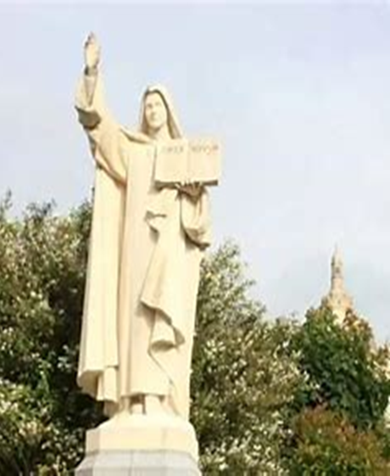
What does St. Therese reveal to us about Mary, Mother Most Prudent? (2)
Saint Therese wrote: “You did not even deem it imprudent, Mother, to tell me one day that the divine Master was enlightening my soul and granting me the experience of years. I am too little now to fall into vanity, I am too little still to start coining beautiful phrases to give the impression that I have a great deal of humility. I would rather acknowledge simply that ‘He that is mighty hath done great things to me.’”
Saint Therese recognized that it is always prudent to give glory to God, like Our Lady did when she praised Him in the “Magnificat” prayer, and that we can take every opportunity to magnify the Lord, and to rejoice in Him in our souls, because He can transform, transfigure, and expand even a mustard seed of faith, the most apparently small work into the greatest act of love. The only imprudent thing would be to miss an opportunity to glorify God, Who is at work within each of us. We are not to hide our light under the bushel basket with a spirit of false humility, but can boldly and bravely shine His light, recognizing that it is not solely ours, but His, which we bear testimony to

Slide 33
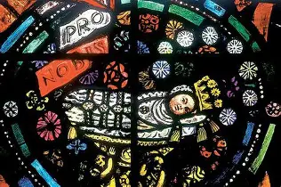
Closing Prayer: Prayer to Maria Bambina
Hail, Infant Mary, full of grace, the Lord is with thee, blessed art thou forever, and blessed are thy holy parents Joachim and Anne, of whom thou wast miraculously born. Mother of God, intercede for us.
We fly to thy patronage, holy and amiable Child Mary, despise not our prayers in our necessities, but deliver us from all dangers, glorious and blessed Virgin.
V. Pray for us, holy Child Mary.
R. That we may be made worthy of the promises of Christ.
Let us Pray: O almighty and merciful God, Who through the cooperation of the Holy Ghost, didst prepare the body and soul of the Immaculate Infant Mary that she might be the worthy Mother of Thy Son, and didst preserve her from all stain, grant that we who venerate with all our hearts her most holy childhood, may be freed, through her merits and intercession, from all uncleanness of mind and body, and be able to imitate her perfect humility, obedience and charity. Through Christ Our Lord. Amen.

