Slide 1
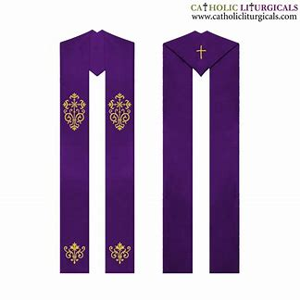
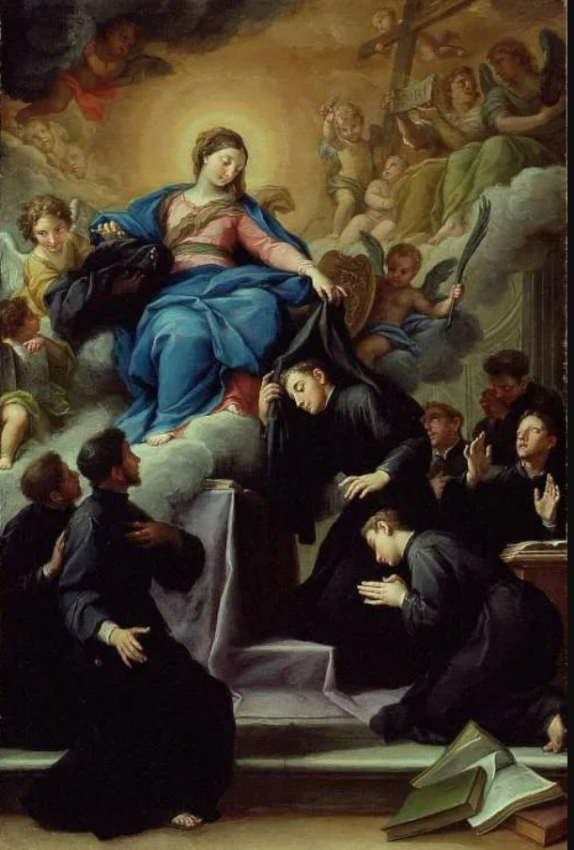
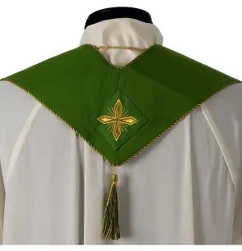

Seven Sisters Apostolate Gathering 10: Promoting Vocations
Katie Sadakierski
Friday, August 29, 2025

Slide 2

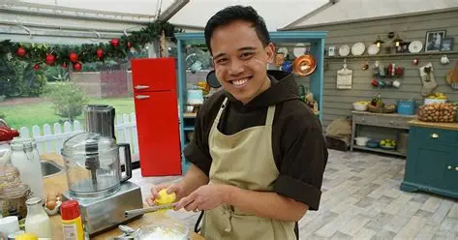
Outline: Seven Sisters Apostolate Gathering 10
I. Liturgical Rosary: 4:30 p.m., parish library
  a. Prayers on the occasion of a Holy Baptism and Confirmation
    i. Joyful Mysteries; for the intention that all would uphold their baptismal promises in fulfilling their vocations
II. Holy hour for vocations: 5:00 p.m., church
III. Presentation on promoting vocations: 6:00 p.m., parish hall
  a. Opening prayer
  b. Overview of topics
    i. Our universal vocation and the need for each kind of vocation in our Church
    ii. Spiritually vesting with the priest: Putting on Christ’s garments of love and living out our vocations
    iii. Applications: What it means to promote and support vocations
  c. Q & A
  d. Closing prayer

Slide 3
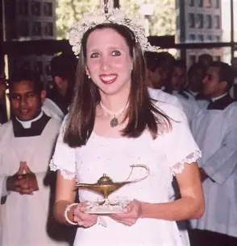
Opening Prayer: In Thanksgiving for God-Given Vocations by Katie Sadakierski
Heavenly Father, thank You for the gift of each vocation that You give to reveal something about Your love, that we may know the fullness of Your charity that overflows from Your Heart for us, calling us back to You, to love and praise You in turn. Thank You for giving us the opportunity to serve You, and to discover who You made us to be, out of the love in Your Heart, as we discern Your call, responding to it. We thank You for Our Lady, who guides us to her Son’s Heart and nurtures each vocation with her maternal love, having responded with all of her Immaculate Heart to Your call for her. Help us all to bring Christ, Your Son, into the world in response to Your call, just like Our Lady, and to support each other in living out our vocations. Lead us to follow the Holy Spirit’s inspirations to keep seeking You out, that we may totally embody Your charity, reflecting it with all of the brightness of the Son, as we serve You like the holy angels each reflecting one of Your divine perfections. Through Christ our Lord. Amen.

Slide 4
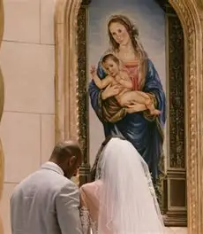
What is a “vocation”?
The word “vocation” comes from the Latin “vocare,” which means “to call.” A vocation, then, at its very core, is a calling
When we think of a “vocation,” we may immediately associate this word with religious vocations, or vocations to the priesthood, in particular, but a vocation is much broader than that. We have a universal call to holiness: we are all called to be holy, to pursue God and to become like Him, regardless of specific state of life
We are all called to follow God’s Commandments (His signified will) to love Him and each other. A vocation is how we are uniquely called, according to God’s will for us personally, to fulfill His Commandments, and the evangelical counsels of poverty, chastity, and obedience, which are lived out differently according to state of life

Slide 5
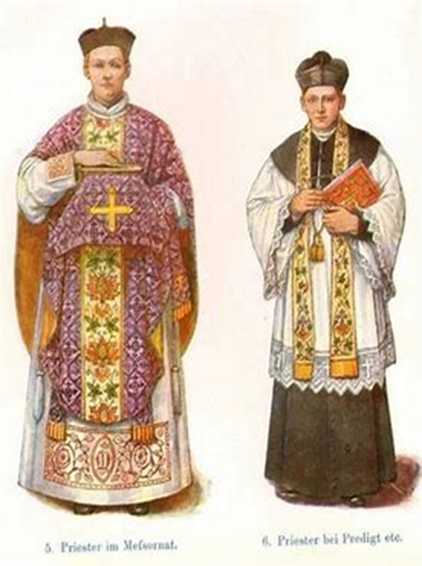
What does it mean when the priest “vests,” and how does this relate to how we fulfill our vocations? (1)
As the priest “vests,” he puts his vestments, his garments, on for Holy Mass, which differ from his everyday clerical attire. He puts the vestments on over the clerics, reminding him that when we embrace God, we open our hearts to being transformed from ordinary to extraordinary through His grace
The priest enters into the sacred space within when he puts on his vestments, preparing to go into the sanctuary of the soul, where he will offer his sacrifice with Christ. He clothes himself in Christ’s love, dressing like Our Lord in clothes that symbolize Jesus’ love, His way of life, to serve as the hands and feet of Christ, as Our Lord’s representative, when he makes the Sacrifice on the altar

Slide 6
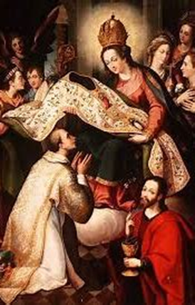
What does it mean when the priest “vests,” and how does this relate to how we fulfill our vocations? (2)
The priest’s own heart is like a vesting case in the sacristy, which he enters to attire himself in the garments of God’s love; he is entering into the treasury of Christ’s Heart, putting on Our Lord’s garments outwardly to be like him inwardly, because what we do or wear on the outside can shape our inner disposition, affecting how we feel and think. It is as though the priest prepares for a wedding when he vests for Holy Mass, dressing himself as Christ, the Bridegroom of the Church, in order to bring about spiritual union through the Holy Sacrifice of the Mass, transubstantiating the bread into Christ’s Body in order to lead people to Heaven, and bring them into perfect union with the Son of God. This reminds us that every person is called to a marriage, because we all have bodies, but some of us are called to offer our bodies to God in religious and consecrated life by living out a mystical marriage to Our Lord, while others are called to sacramental marriage. All of us are called to put on the garments of God’s love interiorly to share His love, to have souls that radiate His light, and encourage other souls to follow the Son, being led to His loving Heart

Slide 7
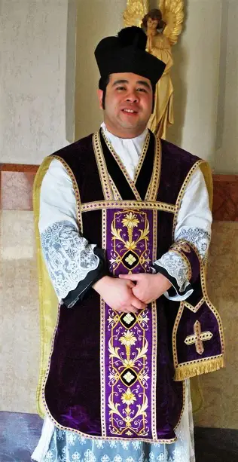
What does it mean when the priest “vests,” and how does this relate to how we fulfill our vocations? (3)
When we embrace our vocation, what God is calling us to do, we put on the armor of God. We accept the graces He is giving us to fight the good fight and win the spiritual battle, according to the state of life that will best allow us to gain Heaven. God provides us with what we need to be well-equipped for triumph over the Cross
Sometimes to complete a certain job, a person puts on a uniform, but vestments are not part of a uniform. They are an extension of the inward disposition, an outward manifestation of the priest’s inner spirit, that conveys something of the interior life, his spiritual life as a priest of Christ. Vestments are the garments of Christ
We all can spiritually vest with the priest, not only before Holy Mass to prepare ourselves to offer sacrifices in union with the priest, but as we begin each day, and go out into the world to shine Christ’s light and fulfill our universal vocation to love
We are all called to sainthood, and the saints are our spiritual parents, so we interiorly clothe ourselves as spiritual mothers and spiritual fathers, respectively, arraying our hearts in the holy qualities that allow us to most reflect the Two Hearts that guide and nurture us

Slide 8
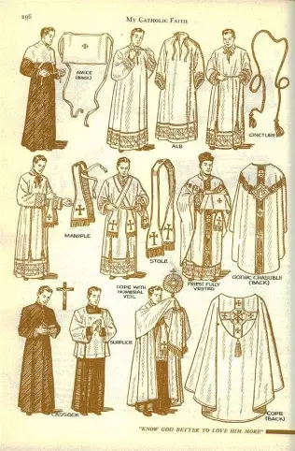
What does it mean when the priest “vests,” and how does this relate to how we fulfill our vocations? (4)
When we interiorly vest, we dress our souls; when we prepare to go to Holy Mass, we are encouraged to wear our “Sunday best,” our clothes that reflect our dignity as people made in the image and likeness of God, and to honor Our Lord
Clothes may be a sign of status or authority. There are different ranks in life, as there are in Heaven, but spiritually, we all have the opportunity to open our hearts to receiving God’s grace; even if outwardly, we may be attired simply, inwardly, we can adorn our souls with the most luminous and beautiful gems of virtue. Our inward dress transcends what we wear on the outside
Putting on the garments of Christ spiritually with the priest prepares us to put on the robes of the elect in Heaven, to be cleansed in the Precious Blood of the Lamb, that we may be dressed in the white garments of purity at the wedding feast of the Lamb, coming to receive the True Bread

Slide 9
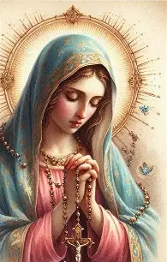
What is our threefold baptismal calling?
The sacramental priesthood differs from the common priesthood. Men who are sacramentally ordained as priests are given the power of Christ, the authority to celebrate Holy Mass and administer the sacraments. They have consecrated hands to use in doing Christ’s work, and receive special graces to fulfill it. They wear vestments to offer the Holy Sacrifice of the Mass, signifying their special authority given only to priests of Christ
The common priesthood is universal; it is what we are all called to. We are called to resemble Christ, to radiate His Spirit outward, by living in the spirit of a priest, prophet, and king, the three roles that Christ lived out. Our threefold baptismal calling is to live as priest, prophet, and king, just as Our Lord was brought three gifts by the magi, the gold, frankincense, and myrrh, representing his life as a king, prophet, and priest. The Israelites carried three sacred items in the ark of the covenant, the manna from Heaven, Aaron’s staff, and the Ten Commandments, which also represented Our Lord’s life as priest, king, and prophet. Inwardly, we are called to live out our baptismal promises by faithfully serving as a priest, prophet, and king like Christ, carrying this threefold gift of God’s love, of identity in Christ, within our souls
To live as a prophet means to share the good news of salvation to Christ, to evangelize, and repent, that others may make reparations and proclaim God’s goodness, His mercy, too. To be a king is to be a leader in faith, to be strong in how we lead lives of holiness. Living out the common priesthood means praying for each other, and supporting each other in the journey to Christ’s Heart. The sacramental priest more than resembles Christ; he acts in persona Christi, in the person of Christ, and is an alter Christus, another Christ. We interiorly put on the garments of priest, prophet, and king with Christ, without outwardly wearing the vestments specific to a priest

Slide 10
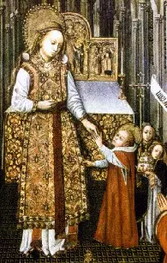
What are our baptismal rights as Catholics?
When we are baptized into Holy Mother Church, we are given certain rights as Catholics, namely, the right to learn about our faith (to be catechized in the Church), the right to be prepared for reception of the holy sacraments (and to have access to the sacraments, that we may receive their graces), and to fulfill our vocation (to be supported in doing what we are called to do by God, not being impeded from participating in certain ministries or other opportunities allowing us to answer God’s call)
When these rights are fulfilled, we can fully live out our baptismal promises, because we will have come to know God through catechism and the sacraments, and will have a vocational means through which we may come to be sanctified, and saved by God’s love. A vocation helps us to reach Heaven; it is our means to salvation, and when our baptismal rights are fulfilled, we are brought closer to eternal life with Christ, that we may reflect His light, remaining in the state of grace, of baptismal innocence, that most closely associates us with Christ, allowing us to be like the innocent Lamb, a pure offering

Slide 11
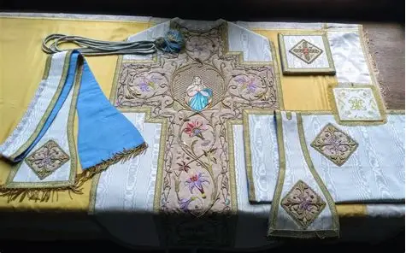
Why must priests vest before Holy Mass? (1)
There is a Scriptural basis for vesting. Priests are called to honor the longstanding tradition of the Church, just as Our Lord did not come to abolish the law, but to fulfill it
In the Old Testament, we read that God the Father required the Levites, the priests, to wear sacred garments. A priest entering the Temple, the Holy of Holies, dressed in the attire appropriately befitting the sacred occasion, the ritual to take place. In the New Testament, this tradition is continued. As the Bride of Christ, the Church is to come before the altar in beautiful attire that anticipates the splendor of Heaven. Being members of Christ’s Mystical Body, the Church, this means that we are all called to interiorly vest, to unite ourselves inwardly with Christ, putting on His garments of love; it is as though we put on Christ’s Flesh, preparing to be wounded with Him, and sacrificed with Him, to be glorified in body and soul with Him in Heaven. We are prepared to receive Our Lord’s resurrected Flesh, to rise with Him
Jesus put on human Flesh to come down to save us, to sacrifice Himself for our salvation. God became human so that we could become more godly. The priest robes himself in the divine in order to uplift his heart and soul to God, to prepare to guide us all to Heaven. We humbly sacrifice ourselves with the One Who came down from Heaven in humble human skin, in the frail vessel of a human body, to redeem us from sin. We all best glorify God when we take the time to interiorly vest, to prepare ourselves to adore Our Lord in the Holy Mass

Slide 12
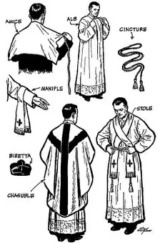
Why must priests vest before Holy Mass? (2)
The Holy Mass is not an ordinary experience, but is elevated, transcending the everyday. It is a foretaste of Heaven, which is not earthly and temporal, not limited by the constraints of time and space, but eternal, so the garments the priest vests in to celebrate Holy Mass communicate something of this eternal glory. He dresses in garments that are not of this age and place, but that are timeless and glorious, reflecting the extraordinary beauty of the Holy Mass
The priest’s vestments are blessed, for this very reason; they are used for a sacred purpose, for prayer. In a similar way, we vest interiorly to give ourselves to God for His use; we are consecrating ourselves to Him for a holy purpose, that He may dwell within us, and work in us as His instruments to share His love, calling others to His Heart, to Heaven, that they, too, may know the extraordinary grace with which He blesses us

Slide 13
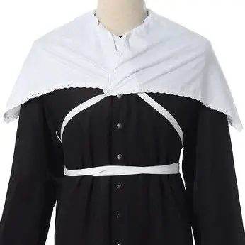
What is the first vestment that a priest puts on in preparation for Holy Mass? What does it teach us about how we are to live out God’s call for us, and to help others to live out their callings? (1)
Each of the priest’s vestments represents a stage of Christ’s Passion, and communicates something about his vocation to sacrifice himself with Christ, to be spiritually united with Our Lord in His Passion
First, the priest puts on his amice, which is a symbol of the blindfold worn by Christ when He was being mocked before His Passion. The amice is a white garment reflecting Christ’s purity, His lack of spiritual blindness, and a reminder to the priest to keep the eyes of his soul always open to see, and therefore, reflect, Christ’s Presence. He looks to see Jesus in each person, and can then make a true sacrifice of love for them at the altar, gathering all of their intentions into his heart
The amice is a cloth that covers the shoulders and is tied around the waist. “Amice” is derived from the Latin word “amicire,” which means “to cover.” The amice is meant to be a kind of shield, to cover the priest in Christ’s love, and protect him from evil. He is meant to be like Our Lord, the Good Shepherd, in covering his people with charity, the virtue that can cover us in expiating our sins, and sheltering us from evil, for when we enter into the Sacred Heart and know Christ’s love, we are changed forever, and can never go back

Slide 14
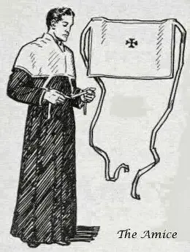
What is the first vestment that a priest puts on in preparation for Holy Mass? What does it teach us about how we are to live out God’s call for us, and to help others to live out their callings? (2)
When he puts on the amice, the priest puts on the garment of faith, and also consecrates his voice to God to use in singing His praises, and proclaiming the good news of the Gospel. He is putting on his spiritual helmet to be a leader like Christ, the Head of the Church, and prays: “Lord, set the helmet of salvation on my head to fend off all the assaults of the devil,” so that as he gives his mind to worship God, as he thinks about God’s love, he may speak it aloud, and live it out, guiding others to do the same as they fulfill their vocations, communicating love for God in all that they do
Our Lord showed great courage in not fighting back or hurting those who mocked Him in turn; He was compassionate, sweet, and kind instead, whereas the people who hurt Him were blind to His goodness. He was not blind to the cruelty of His persecutors, and was also not blind to their woundedness, seeing their need for His love. His sinless Heart, a pure Heart of perfect love, meant that Our Lord was not blinded by fear, pride, or anger, but could instead see each soul very clearly, and reach out to them with mercy. When the priest puts on the amice, he is living out his vocation to extend Christ’s merciful love, to blind himself to judgment, and to instead have an open heart that sees not the worldly things, but the eternal truths of God’s love, so that he may celebrate Holy Mass with total reverence and devotion, in the Spirit of Christ

Slide 15
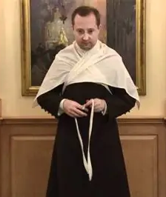
What is the first vestment that a priest puts on in preparation for Holy Mass? What does it teach us about how we are to live out God’s call for us, and to help others to live out their callings? (3)
We promote vocations by living with fortitude: the Gift of courage and strength that ultimately means living out our vocation to love, because choosing to love rather than to be embittered, to hate, or to love ourselves alone, requires strength; it means that we transcend our human nature to sin, and put on something of the divine, for it is a godly thing to forgive, to be gentle and patient, to humbly and quietly follow the Lamb in making a total self-gift, without counting the cost. True courage is rare, and is what allows us to remain faithful to God through the end, so we inspire vocations in living out this rare gift, which touches souls, and leads them to be curious about what compels us to give all for Christ, to be spiritually martyred with Him
We pray to open the eyes of other souls to see Christ’s love, which we can reflect when we spiritually vest in the amice
At this stage in our spiritual vesting process, we ask Our Lord to bless our priests for courageously teaching about Him in word and action, embodying the strength of the Word made Flesh by proclaiming the Word of God the Father as Jesus did. We also imitate our priests in making intercession for others, praying for those who are discerning or living out vocations to dedicated single life as single celibates living in the world, that they would be blessed for courageously choosing to live in union with Christ, to give themselves to Him, while remaining in the world

Slide 16
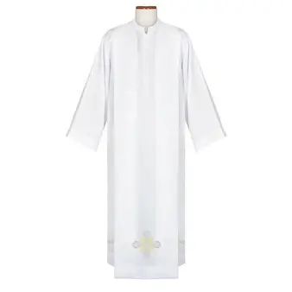
What is the second vestment that a priest puts on in preparation for Holy Mass? What does it teach us about how we are to live out God’s call for us, and to help others to live out their callings? (1)
Next, the priest puts on the alb, a long white garment that signifies purity; “alb” is Latin for “white,” speaking to the cleanness, the spotlessness, of soul we are called to have, like the spotless white Sacred Host that cleanses us from within with Jesus’ love. This represents the garment placed on Christ by Herod to mock Him. When the priest puts on this garment, he is reminded of the purity of heart needed to celebrate Holy Mass, to be like Christ in putting on the garment of charity that will allow him to receive His people, with all of their needs and petitions, with an open heart. He is reminded to be led by the intention to adore Christ; he prays for his intentions to be purified, in order to operate only out of a sincere desire to share God’s love
When the priest puts on the alb, he puts on a garment of peace, channeling Christ’s Spirit of trust in God the Father’s goodness that allowed Him to have serenity in accepting the Father’s plan, and believing so entirely in His faithfulness to His promises, that there is no inclination to give in to worldly impulses to retaliate persecutors, but instead, to pray for persecutors, hoping in the mercy of God, peacefully placing all in the hands of God, the just Judge Who alone knows the hearts of others entirely

Slide 17
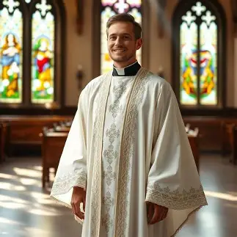
What is the second vestment that a priest puts on in preparation for Holy Mass? What does it teach us about how we are to live out God’s call for us, and to help others to live out their callings? (2)
We are reminded to put on Christ’s Spirit of trust in God, that we may not presume upon ourselves to bring justice or restore all things to order, but that we may have peace and hope in God’s plan, going to Him for our needs, and entrusting others to Him, that we may remain pure of heart in our love, and be untouched by the spirit of the world, which often puts an emphasis on our own power, and on individualism, personal rewards and justice, whereas the purehearted love of God unites us all in adoration of the divine, in awe of what transcends ourselves. We pray to vest ourselves in this Spirit of fear of the Lord, that souls may be drawn to a similar sense of awe for God, and want to honor His greatness in how they live out their vocations, using their Gifts to glorify Him
As he puts on the alb, the priest prays: “Purify me, Lord, and cleanse my heart so that, washed in the Blood of the Lamb, I may enjoy eternal bliss.” To enjoy eternal bliss means to love each other so much, to have such a zeal for souls, that we strive to love with the purest hearts of compassion for others, and lead them to glory, too. We are cleansed of past wounds, and opened to forgiveness when we open our hearts to being purified by the Lamb of God; removing obstacles to our love, to our forgiveness, means that we can be fully opened to receiving God’s grace, and live out our vocation most wholeheartedly, that we may help others to live out their vocations as well
When we spiritually vest with the priest, we can pray that as he puts on the alb, he will always be blessed for living with a heart of pure love for God, and inspiring others to have purity of heart like his, too. We can also unite with our priest in praying for others, asking that God would help all those who are living out a vocation to consecrated and religious life, bringing themselves in all of their purity of body and soul to the altar with hearts of self-sacrificing love. We pray for all those discerning vocations to consecrated and religious life as well

Slide 18
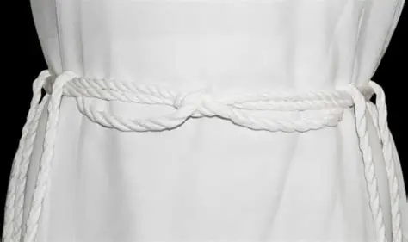
What is the third vestment that a priest puts on in preparation for Holy Mass? What does it teach us about how we are to live out God’s call for us, and to help others to live out their callings? (1)
The priest then puts on the cincture, the belt roped around the alb, the tunic, that he wears. This cincture that secures the alb symbolizes the cords used to bind Our Lord in the Garden of Gethsemane, when He was taken as a prisoner, and recalls to mind the scourging of Our Lord
The cincture is a reminder to the priest of the chastity that he lives out in his state of life, as he prays to be kept away from sins of the flesh, and to remain in a state of grace, in perfect purity mirroring that of Our Lord, the Eternal High Priest. The priest prays to be like Our Lord in making a total self-gift; the priest gives his heart completely to Our Lord out of pure love, just as Our Lord gave His Heart to us all in His Sacrifice, pouring out all of His love from it
Soldiers, travelers, and laborers would adjust their clothes to facilitate movement as they were working and journeying onward, so when the priest adjusts his cincture, he is reminded to keep journeying towards Christ, to be released from worldly attachments that constrain him, in order to remain secure in Christ’s love, and free from what would bind him to the world, keeping him away from eternal things

Slide 19
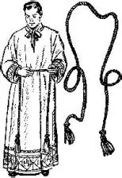
What is the third vestment that a priest puts on in preparation for Holy Mass? What does it teach us about how we are to live out God’s call for us, and to help others to live out their callings? (2)
We pray to be secure in our identities in Christ, in our friendships with Him, so that we may not be tempted to doubt His love, but would instead confidently place our petitions in His hands, adjusting ourselves in order to better fulfill God’s will, and remaining open with trust to what God calls us to do. We pray to live out a full confidence in God, a sense of humble, childlike trust, that would invite other souls to similarly place their lives in the hands of Christ, and live out their callings, knowing that He will give them what will make them happiest and lead them to salvation
The priest prays as he puts on the cincture, “Lord, gird me with the cincture of purity and extinguish my fleshly desires, that the virtue of continence and chastity may abide within me.”

Slide 20
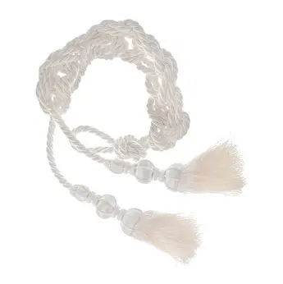
What is the third vestment that a priest puts on in preparation for Holy Mass? What does it teach us about how we are to live out God’s call for us, and to help others to live out their callings? (3)
As we spiritually vest with the priest at this stage, we pray that God would continue to renew our priests’ zeal, and inspire them with joy for their special calling to be united in purity of heart with the priestly Heart of Jesus; we pray that they would be rewarded for trusting in God by pursuing their vocations from Him, as well as for guiding other souls to secure their salvation by faithfully following Christ, remaining bound to Him in love. We echo our priests in praying for vocations to sacramental marriage, praying for married people to remain strong together in faithful love, in bring bound to Christ, by Him. In our prayers, we ask God to bless our priests for laboring in the vineyard for Him, for nourishing souls on their journey to total fulfillment in Christ’s Heart of love, and for accompanying us in our travels to Heaven. We pray for everyone using their gifts to honor God in their professional vocation as well, which is its own kind of spiritual vocation, when offered for God’s glory, for our work sanctifies us, helping us to give ourselves to the service of others like Christ did and does

Slide 21
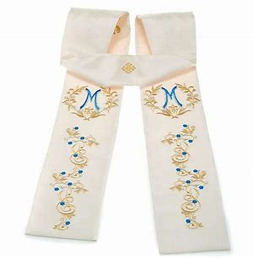
What is the fourth vestment that a priest puts on in preparation for Holy Mass? What does it teach us about how we are to live out God’s call for us, and to help others to live out their callings? (1)
After the cincture, the priest puts on the stole. The stole is a band placed around the neck as a symbol of the Cross that Christ shouldered, and also, of the lost sheep that the Lord carries
When the priest puts on the stole, he is reminded that Christ carries the Cross with Him, and that Christ will uplift him, that he may gaze upon the Face of God in Heaven, for having been united with Christ in shouldering the weight of the Cross
The priest wears the stole as a sign of his love, his willingness to carry Christ with him, like St. Christopher bearing the Christ Child across the river. He does not see the lost sheep as a burden, but places the stole on his neck to recall the blessing of being carried by Christ in his journey to care for souls, and of helping others to carry their crosses, that they may know the strength of Christ’s love that will bear them up in all times

Slide 22
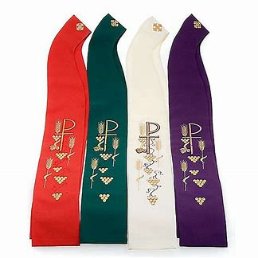
What is the fourth vestment that a priest puts on in preparation for Holy Mass? What does it teach us about how we are to live out God’s call for us, and to help others to live out their callings? (2)
This vestment reminds us that our vocation to love involves praying with and for our priests, as we pray that God would bring them many joys to lift up their hearts when they are carrying their crosses, surrounding them with His love, that they may not be wearied by their travels, but fortified by the life-giving grace of God. We pray for all those who are carrying crosses, that they may persevere in fulfilling their vocations, feeling the sweetness of Our Lord’s nearness that helps to lighten the burden of the Cross. We also pray that we would have a sense of joy and hope when we carry Crosses, and support each other in carrying them, knowing that the Cross is a gift from God that brings us close to Him. Our prayer is to help those who are lost to be found, as they discover what God is calling them to do to know and love Him
When he puts on the stole, the priest prays: “Lord, restore the stole of immortality, which I lost through the collusion of our first parents, and, unworthy as I am to approach Thy sacred mysteries, may I yet gain eternal joy.” We pray that God would reward our priests for continuing the mission of Christ in leading others towards the balance, restoration, and order that come only from union with God, Who perfectly harmonizes everything according to His will, His plan for our good, that we may be joined with Him eternally in glory

Slide 23
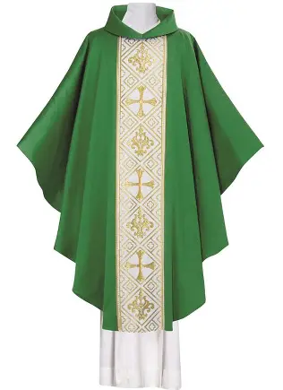
What is the fifth vestment that a priest puts on in preparation for Holy Mass? What does it teach us about how we are to live out God’s call for us, and to help others to live out their callings? (1)
Once the priest has put on the stole, he may put on the chasuble. The word “chasuble” comes from the Latin “casula,” meaning “house.” The priest’s outermost garment identifies him as a priest of Christ, serving as a reminder that he creates a special dwelling for Christ in his soul, and in his church where he serves others made in the image of God, helping them to be good dwelling places for the Lord, too
As we spiritually vest with our priests, we exercise our vocations as spiritual mothers to pray for many blessings on our priests for all that they do to make the parish a beautiful place in which we may dwell in God’s love. We pray that God would reward them for helping us to become living tabernacles like Our Lady, that as Christ is housed in our hearts, we may welcome all to know and glorify Him, to reach our true home together in Heaven

Slide 24
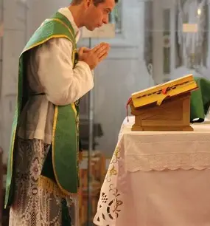
What is the fifth vestment that a priest puts on in preparation for Holy Mass? What does it teach us about how we are to live out God’s call for us, and to help others to live out their callings? (2)
The chasuble is a symbol of the violet robe placed on Christ to mock His Kingship. The front of the chasuble symbolizes love of God, while the back symbolizes love of neighbor. The priest’s vocation is to put on the garment of charity, like a veil covering holy things and signaling the presence of the sacred, to lead others to love God, to be touched by His kindness and mercy that is exemplified by the priest
Both the front and back of the chasuble have crosses. The cross on the front of the chasuble represents the sins of the priest, while the cross on the back represents the sins of the people. When the priest ascends the altar, he goes to sacrifice himself with Christ, recognizing the need for Jesus’ love to heal us and forgive us of our sins; we all go to Him for purification, for redemption. The priest, with the Lord, offers his life out of love. When he vests in the chasuble, the priest prays, “O Lord, who has said, ‘My yoke is sweet and My burden light,’ grant that I may so carry it as to merit Thy grace.” Our prayer when we spiritually vest with the priest is that we would rejoice in God favoring us with Crosses to carry for His glory, and that we would carry them faithfully to testify to the power of God that gives us strength to bear them in the first place, that others would be inspired not to suffer alone in this life, but to respond to God’s calling for them to help others through their suffering, to shelter them in His love like an embrace, inviting them into their hearts as homes in which Christ, dwelling within His servants, may find refuge from the pains of the world

Slide 25
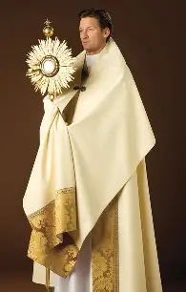
Which special liturgical garments besides those five used for Holy Mass may be worn by the priest, and for which occasions?
Surplice:
  The surplice is a white garment that is worn in place of the alb. It is shorter than the alb, has short, wide sleeves, and is worn over the cassock, the priest’s ordinary black clerical garment. The surplice is donned for occasions outside of the Holy Mass, namely, when a priest is administering a sacrament such as Confession. The stole may be worn over the surplice for sacraments
Cope:
  The cope is a special vestment worn over the chasuble, in the liturgical color for the occasion, outside of the Holy Mass, namely, when the priest goes on a procession, or blesses sacramentals, such as on Palm Sunday or Candlemas. The front of the cope is closed with a clasp; it is a long garment that covers the entire back
Humeral veil:
  The humeral veil has long sleeves with inner pockets in which a priest places his hands in order to hold the monstrance during Benediction following Eucharistic Adoration. The priest wears the humeral veil, because holy things are veiled, and he shows humility towards Our Lord in the Blessed Sacrament, as Our Lord is Present in the Sacred Host placed within the monstrance. The priest imitates the holy angels, who cover their faces in adoration of the Lord, except in this case, his hands are covered, rather than his face; veiling his hands to touch the Lord conveys the sanctity of the occasion, and reminds us that it is Jesus Who wraps us in His love and blesses us

Slide 26
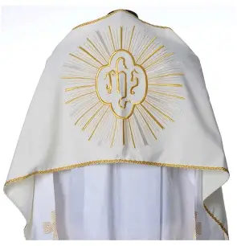
What do the liturgical colors of the priestly vestments teach us about fulfilling our vocations to love?
Rose-colored vestments, worn for Gaudete Sunday in Advent and Laetare Sunday during Lent, signify joy
Black vestments signify mourning; priests wear black in mourning for souls who do not yet know Christ, and are used during Requiem (funeral) Holy Masses, as well as for All Souls’ Day
White vestments signify purity, and honor feast days of Our Lord and Our Lady, as they symbolize triumph, so they are associated with the Christmas and Easter seasons. Gold vestments are also worn for Christmas Day and Easter Sunday, signifying God’s glory
Red vestments symbolize the Holy Spirit, love, and martyrdom, for Our Lord was martyred for us out of love, and commended His Spirit to God when He gave His life for us on the Cross. Red is worn for such occasions as Pentecost, and Confirmation, which recalls the sacred mystery of Pentecost. It is also worn for the feast days of martyrs
Green vestments symbolize life, and are therefore worn in the seasons after Epiphany and Pentecost to represent the new life given through the Infant Christ, born for our salvation, and the Resurrected Lord, reborn for our redemption, that we may have spiritual rebirth in Heaven, too
Violet vestments symbolize penance, sorrow for our sins, and are associated with the penitential seasons of Advent and Lent. It is also worn for vigils of feast days, as we express contrition for our sins, in preparation for celebration, and full rejoicing, on feast days; we rejoice in God’s mercy that frees us from sin, and allows us to have joy after being cleansed through His Blood of the guilt of sin
All of these liturgical colors communicate different aspects of God’s love, reminding us that in all seasons of life, His love carries us, and helps us to convey His love to others, to help them in all seasons

Slide 27
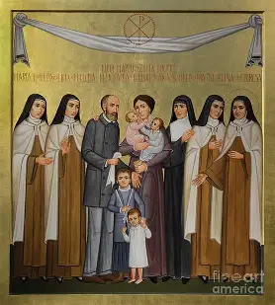
What are some special approaches taken to promoting vocations? (1)
The USCCB includes a list on their website of 20 different ways in which parishes and schools may promote vocations. Some ideas include:
  Praying one decade of the Holy Rosary before parish ministry meetings for the intention of seminarians or for vocations in general
  Praying a prayer for vocations after each Holy Mass (privately, or aloud as one community)
  Hosting priests and men and women religious to speak about vocations
  Offering a holy hour for vocations (i.e. one hour during our three-hour Eucharistic Adoration period)

Slide 28
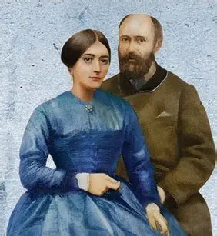
What are some special approaches taken to promoting vocations? (2)
  Sending spiritual bouquets to seminarians to encourage them in the pursuit of their vocation to the sacred priesthood
  Holding an essay or poster illustration contest for religious education students to promote vocations
  Including interviews from priests or religious in the parish bulletin (or including quotes from priest/religious saints)
  Including a page on the parish website about vocations
  Holding an altar server appreciation night to encourage altar servers in learning more about the priesthood; a priest may address the servers
  Displaying a collage of priests and religious connected to the parish community, and encouraging prayers for them

Slide 29
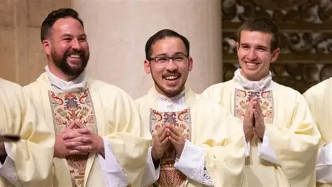
What are some special approaches taken to promoting vocations? (3)
  Celebrating ordination anniversaries of priests
  Celebrating the lives of saints who represent a variety of states of life, from married saints to women religious saints; participating in Holy Masses on their feast days
  Holding a Communion breakfast with a vocations speaker (i.e. the diocesan director of vocations)
  Asking 30-31 parishioners to pray the Holy Rosary or attend Holy Mass for the intention of vocations on a designated day, so that on each of the 30-31 days of the month, there will be someone praying for vocations
  Praying for all of these opportunities to promote vocations to be brought about, and praying that hearts will be touched by these efforts, so that souls will be drawn to discern their God-given vocations; our Seven Sisters Apostolate members can each pray in thanksgiving for our priests’ vocations, and can pray to God to help us to faithfully live out our states of life

Slide 30
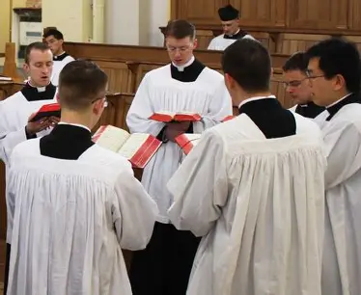
When are the national and universal Church days of prayer for vocations? (1)
World Day of Prayer for Consecrated Life: Feast of the Purification of Our Lady (February 1-2)
  Instituted in 1997 by Pope St. John Paul II, this day is dedicated to thanking God for the gift of consecrated life, and thanking men and women religious who have consecrated themselves to God. February 2 is Candlemas, when we recall Our Lord being consecrated to God the Father in the Temple, and when we have our candles blessed. We pray for many blessings on our religious who, in consecrating themselves to God, shine His light for all to see, that many others may be drawn to radiate His love as well
World Day of Prayer for the Sanctification for Priests: Feast of the Sacred Heart of Jesus (moveable; the Friday after Corpus Christi)
  Established in 2002 by Pope St. John Paul II, we offer prayers for our priests to persevere in their vocations on this special day, that they may continue to grow in holiness as they help others to grow holier. We thank Our Lord for the gift of the holy priesthood that He gave from His Sacred Heart, and specifically, for our priests, who embody the love in His Heart in a special way. We entrust to the future sanctification of our priests to the Sacred Heart of Jesus

Slide 31
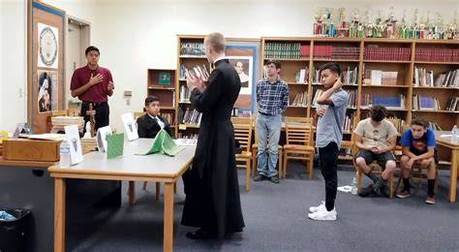
When are the national and universal Church days of prayer for vocations? (2)
Good Shepherd Sunday (fourth Sunday of the Easter season in the new calendar): World Day of Prayer for Vocations
  We thank Our Lord, the Good Shepherd, for guiding each member of His flock to know their special vocation that He chose for them to live out to love Him, and we pray for all those discerning vocations, that they would be given the insight and understanding to know where God is calling them to serve Him
Catechetical Sunday (third Sunday of September; moveable)
  We celebrate catechists serving God in the Church, and all who teach God’s love by example, including our priests and religious, through a special Holy Mass, and often, a blessing of catechists. It is through catechists that our Faith is passed on, enabling others to respond to their vocations. Pope Pius XI instituted this special day in 1935

Slide 32
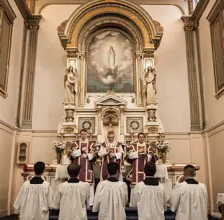
When are the national and universal Church days of prayer for vocations? (3)
Priesthood Sunday (last Sunday of September; moveable)
  Around the time we honor the holy archangels on September 29, we celebrate our priests, who are messengers just like the holy angels, guarding and defending the Church, to preserve and treasure our Faith. We pray for priests on this special day, thanking God for the gift of their lives, sacrificed lovingly for His glory with Christ on the altar. Serra USA, a lay organization, arranged the celebration of this day
National Vocations Awareness Week (first full week of November; moveable)
  November is when we celebrate Thanksgiving here in the U.S., so we express our thanks to God for the vocations He gives us to honor Him, and increase awareness of different types of vocations, praying for many more souls to discover their callings to these vocations, that they, too, may rejoice in thanksgiving for the gifts God gives through these callings. This week of prayer for, and promotion of, vocations was established by the U.S. bishops in 1976, but was not moved to the first full week of November until 2014

Slide 33
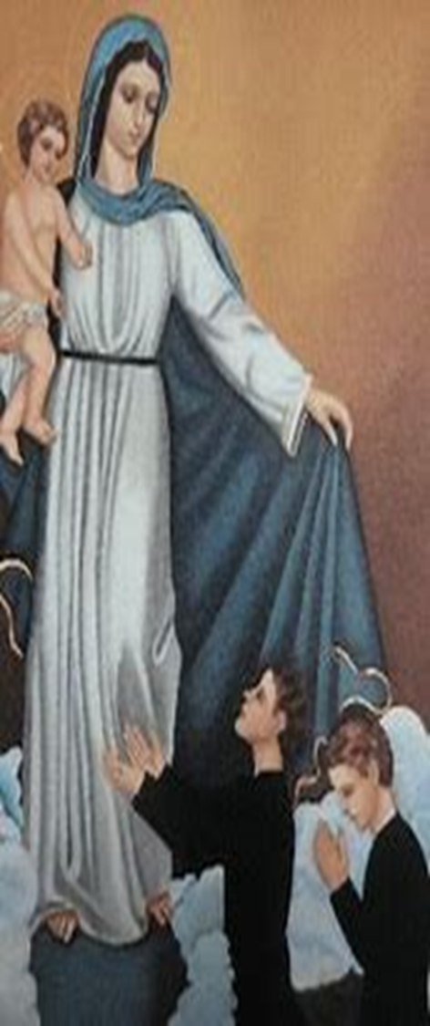
Which steps may we take to promote vocations? (1)
We best promote vocations in how we live our daily lives. Teaching by example touches the hearts of other people. In living out our vocation to love God with all of our hearts, minds, souls, and strength, and to love our neighbors as we love ourselves, we most promote the vocation to love
As spiritual mothers, we can interiorly put on the mantle of Mary, dressing our souls with her grace and angelic kindness. Inwardly, when we resemble our heavenly Mother, we can outwardly share her grace and love, drawing others to go to Our Lady’s Immaculate Heart, and place themselves under her protection, under the shelter of her mantle

Slide 34
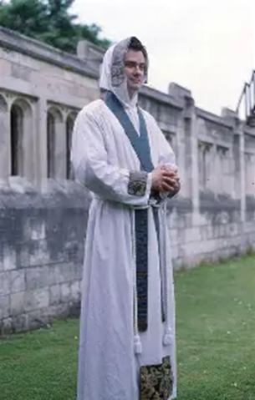
Which steps may we take to promote vocations? (2)
Part of our vocation is to help others to live out their vocations, and to encourage them to persevere in holiness. We pray for the ongoing sanctification of priests, not only for an initial response to a vocation, but for faithfulness to it. Our prayer is for priests to reflect Our Lord in His faithfulness. Vestments remind us of God’s Providence, of how He clothes and covers us with all that we need, so that we need not hide in shame like Adam and Eve, but may shine with the inner beauty, the strength and dignity, of Christ, from identification with Him that is reflected in how we wear our faith
Spiritually vesting with our priests allows us to pray all the more deeply for them, to ask that Our Lord would reward them for how they reflect His love in a way that goes beyond the outward, but is deep within their souls. We share in our priests’ saving work, and can support their ministries with greater love, and a sense of wonder for the genius of God, of the Wisdom of His love
As we reflect on the vestments of the priest, and their deep meaning, we pray for everyone to use their personal Passion that they go through in life to give glory to God, as they unite themselves with Christ in fulfilling the vocation to sacrifice out of love. We pray that every soul would spiritually vest with the priest, putting on their armor of God in order to fight the good fight for Him as they fulfill their vocation that God designed for them to win the spiritual battle according to their unique path

Slide 35
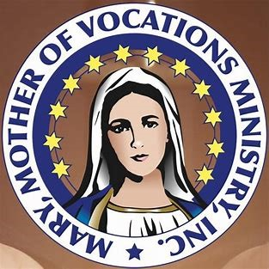
Announcements
Two Hearts Guild Meeting 9:
  Friday, September 5, 2025
    7:00 p.m., parish hall (following 6:00 p.m. First Friday Latin Mass)
Blessing of sacramentals
  Saturday, September 6, 2025
    Approximately 9:30 a.m. (following 9:00 a.m. Holy Mass), church
Seven Sisters Apostolate Book Club Session 2:
  Friday, September 12, 2025
    6:30 p.m., parish library
Fasting Brothers/Seven Sisters Apostolate Stations of the Cross:
  Friday, September 26, 2025
    5:00 p.m., church

Slide 36
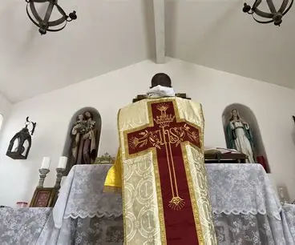
Closing Prayer: For Perseverance in Fulfilling Our Vocations
God our Father, we pray that You would help us to put on the garments of Your charity each day, that we may be equipped to win the spiritual battle through true love and compassion that is poured out from Your generous Heart. You loved us first, so that we may love You, and well before we were born, You chose us to follow You; You created us uniquely, knowing what our vocation would be. Help us to live in wonder of Your love each day, that we may be energized to keep praying with zeal for souls, spiritually caring for each other, and continuing Your mission of love, until we all be united in Heaven, in fulfillment of Your plan, and pray for souls on Earth striving to answer Your call. Grant us, in Your mercy, the graces we need to persevere in living with charity, that we may fully realize who You called us to be, glorifying You as one family. Amen.

