Slide 1
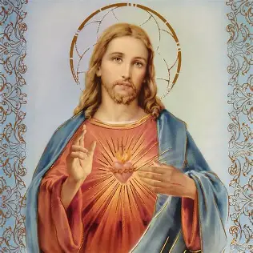
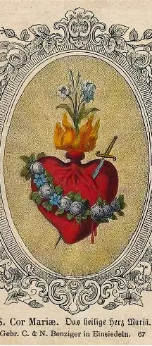
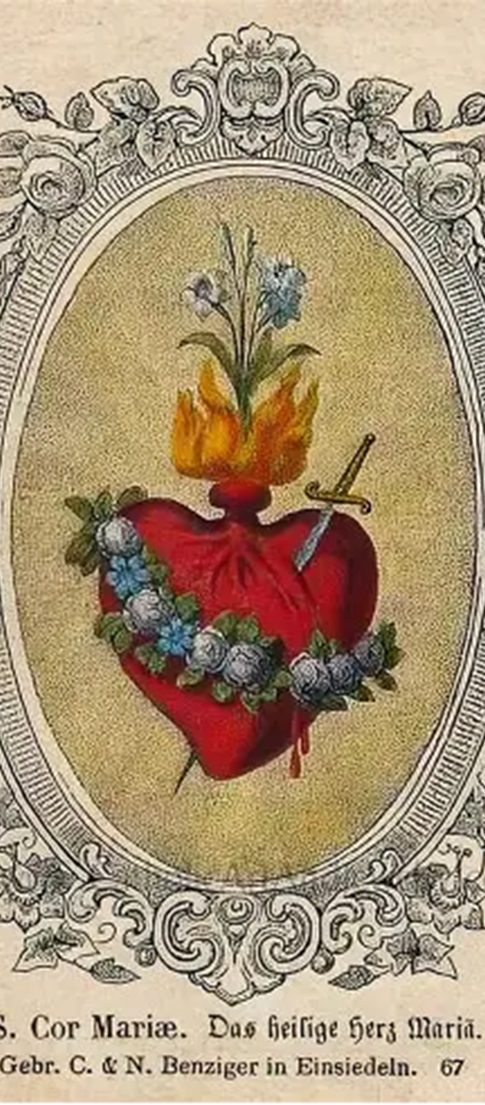
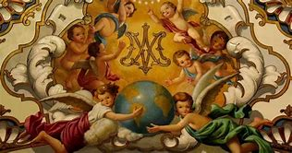
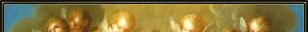
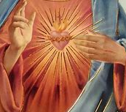
Seven Sisters Apostolate Book Club Session 1: Mirror of the Blessed Virgin Mary
Katie Sadakierski
Friday, August 22, 2025

Slide 2
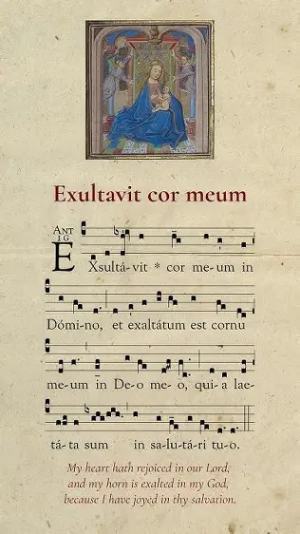
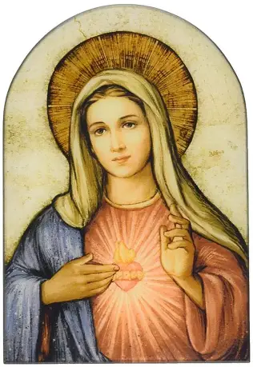
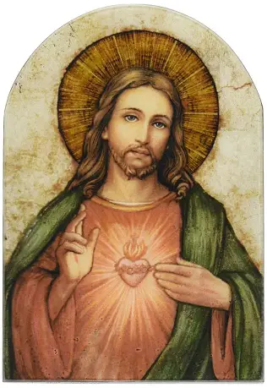
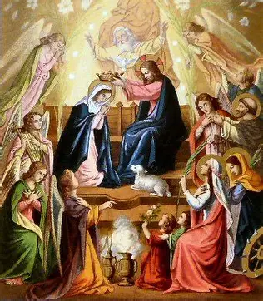
Outline: Book Club Session 1
Opening prayer
Presentation
  Key insights from chapters I-V (pages vi-56)
    St. Bonaventure and the Immaculate Heart
    How we can mirror the Immaculate Heart of Mary
  Reflection prompts
    Small group discussion (breakout session)
    Group-wide discussion
Q & A
Closing prayer

Slide 3
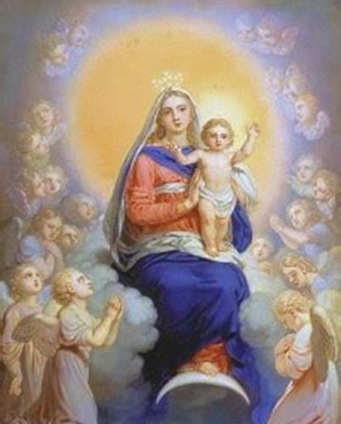
Opening Prayer: A Prayer for Spiritual Illumination by Katie Sadakierski
God our Father, we bless You and thank You for the opportunity to gather in Your Name today as we open our hearts to learning and sharing about Your love. Illuminate our minds and hearts with understanding, that we may imitate the example of Your precious daughter, Mary Immaculate, the Queen of Heaven, bringing her Heart of service to You into all that we do. We pray to glorify You in mirroring Mary, and praise You for having created a human of such grace and beauty of soul as she to lift our hearts with hope and joy. Help us to honor Your Son in consoling the Heart of His Mother, and to reflect Your light in reflecting Mary, our Mother, that as we come to more closely resemble our Blessed Mother, we may be loving spiritual mothers to all, including the priests for whom we pray. In Your goodness and generosity, heavenly Father, we thank You for the gift of each priest, as well as each sister praying for them, and ask that You would guide us all to unite our prayers and talents in continuing Your mission of love in this life, that we may all be united with the Hearts of Jesus and Mother Mary in the next. Amen.

Slide 4
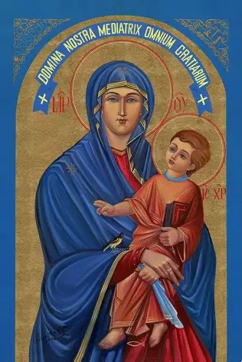
What are some key spiritual takeaways from the prologue and chapter one of Mirror of the Blessed Virgin Mary?
Chapter one celebrates the beauty of the “Hail Mary” prayer, as we prepare ourselves to mirror Mary by joining with the holy angels, who teach us how to serve the Lord joyfully and faithfully, much like Our Lady, who has the virtue of angelic kindness
Saint Bonaventure prefaced this chapter with his prologue, conveying that, while as sinners, we are unworthy, we can approach God with Our Lady, who is full of grace. He emphasizes that we should still lift our voices in praise of God and Our Lady, because it is good for our souls, especially in humbling us; it brings Our Lady joy to see a sinner turn to God. This gives her glory, too, in that it is her grace that touches our hearts and leads us to convert
We praise Our Lady in saying the “Hail Mary,” and we mirror her in singing in praise, because she does the same for God

Slide 5
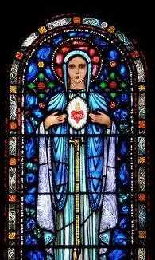
What are some key spiritual takeaways from chapter two of Mirror of the Blessed Virgin Mary? (1)
In chapter two, we look more closely at the lines of the “Hail Mary” prayer. We learn that “ave” is short for “absque vae,” which honors Our Lady for being totally pure, without woe; this is to say that she lacks the stain of sin, and therefore, can fully rejoice in God. When we mirror Our Lady in this way, we can rejoice, too. “Ave” is a greeting, translating to “Hail,” which means “hello,” but in this greeting, we praise Our Lady for her stainlessness, hailing her as the pure Mother who is without woe, but totally full of grace

Slide 6
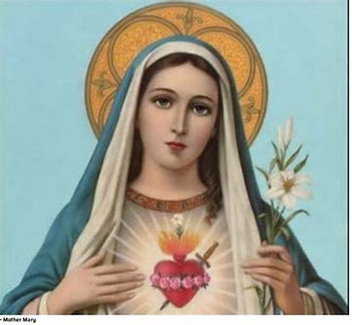
What are some key spiritual takeaways from chapter two of Mirror of the Blessed Virgin Mary? (2)
  There are five words in the first three lines of the prayer: “Hail Mary, full of grace,” “The Lord is with thee,” and “Blessed art thou amongst women.”
    This amounts to fifteen words total: fifteen is the number of progress, and the number of decades in the Holy Rosary. We make progress by honoring Our Lady and imitating her virtues, her humility, and her purity, the absence of woe in her
    Five is for the number of holy wounds that Christ bore, the number of love; ten is the number of happiness. Through the love and happiness Our Lady brings to our hearts, we make progress

Slide 7
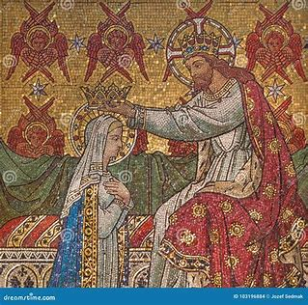
What are some key spiritual takeaways from chapter two of Mirror of the Blessed Virgin Mary? (3)
Mother Mary is free from nine stains/consequences of the Fall; she truly has angelic sweetness, mirroring the nine choirs of holy angels, who themselves reflect the divine perfections. Therefore, she is free of the punishments due to the fallen angels. She helps us to remain immaculate, to remain away from sin, that our hearts may be pure, and not weighted down with guilt, but instead, illuminated with the light of the Three Persons of God.
  She is free of three types of guilt (actual sin):
    Guilt of the heart
      Impure intentions/thoughts
    Guilt of the lips
      Impure words
    Guilt of the deeds (hands)
      Impure actions

Slide 8
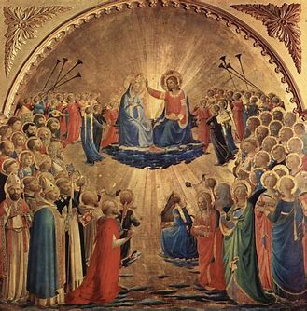
What are some key spiritual takeaways from chapter two of Mirror of the Blessed Virgin Mary? (4)
  Our Lady is free of three types of original misery (original sin):
    Woe of being born
      Woe of having concupiscence, inclination to sin (especially of the flesh)
    Woe of bringing forth
      Working/pain in labor
    Woe of dying
      Turning to dust
  Our Lady is also free of three types of hell (punishment for sins):
    She is free of the greatness of hell: the intensity of the terrible punishments
    She is free of the magnitude of hell: its largeness, its many pains
    She is free of the duration of hell: the punishments lasting forever

Slide 9
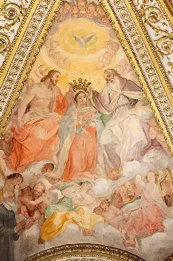
What are some key spiritual takeaways from chapter three of Mirror of the Blessed Virgin Mary?
“Mary” means: “a bitter sea,” “the star of the sea,” and “illuminated”
Mother Mary is the illuminatrix: she is illuminated by the Son of God, and radiates that light to the holy angels, and to us to give life. She is the bitter sea to the evil, consuming darkness with light, and washing away any stain. She is beloved for her purity; she is a lady to us all; like Queen Esther, she leans on the arm of the handmaid (the holy angels), and we are her handmaids who keep our eyes on Our Lady, the mistress of us all; we look at her hands, to see how we are to serve; through her hands, we receive the graces we need. Our Lady is the Star of the Sea, guiding us to Heaven; a sailor chooses one star as his reference point for the whole voyage, and for us, it is Our Lady
Mother Mary is like a cloud; she covers us from the fire of temptation; she is like the cloud over the temple, the Holy Spirit hovering over her
Our Lady is the Mother of God, and of man; any discord between them, then, is unbearable
We all can live in Mary’s Holy Name, imitating her in shining Christ’s light

Slide 10
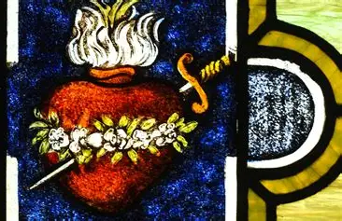
What are some key spiritual takeaways from chapter four of Mirror of the Blessed Virgin Mary? (1)
Our Lady had charity burning in her heart (counteracting the deadly sin of envy); she treasured God with great love in her Immaculate Heart, and could therefore counteract every other vice with virtue, flowing from love as the foundation for the home she made for Our Lord in her Immaculate Heart. In loving everyone, being totally without sin, she could not envy; she willed the good of all, since she willed what God willed, and God wills our salvation out of love for us
Our Lady was humble (counteracting the sin of pride), in that she submitted to the law, even in being without sin. She underwent the ritual purification required by Jewish law for women who underwent childbirth, all out of her humility, because she was already pure, and could not have been made impure by the birth of Our Lord. As St. Bonaventure points out, we are not always willing to submit to law of satisfaction for sin, in accordance with divine justice, even though we are sinners.
Our Lady went in haste to see St. Elizabeth; the shepherds went in haste to find Jesus. Charity always animates us to action; when we love Our Lord, we are eager to share His Heart. Our Lady saluted St. Elizabeth, just as the holy angel saluted her. She always had charitable greetings, and not only acknowledged others out of love, but remained loyal out of charity, staying with her cousin St. Elizabeth for three months. She kept her station. She was diligent, counteracting the sin of sloth, in lovingly caring for others, applying herself to serving God for His glory

Slide 11
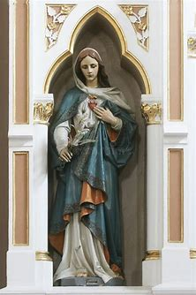
What are some key spiritual takeaways from chapter four of Mirror of the Blessed Virgin Mary? (2)
  Our Lady was meek. She was not angered over treatment of her Son (counteracting the sin of wrath with her meekness), but was patient and gentle; she had total trust in God. Our Lady served her cousin, St. Elizabeth, who was elderly; she engaged in good works and continued praying. She is still praying for us in Heaven
  Our Lady had the virtue of temperance, counteracting the sin of gluttony. Grace would not have found Our Lady if she was a glutton; she would have been full of sin, of the material, of the world, and not of grace. Our Lady was instead filled with virtue
  Our Lady humbly and patiently lived in poverty, counteracting the sin of greed. Her child was born in a manger; she did not demand material riches from God, but treasured the spiritual things in her Immaculate Heart
  With her perfect chastity, Our Lady counteracted the sin of lust. To the archangel St. Gabriel, who delivered the message that the Blessed Virgin was chosen to bear a child, Our Lady said “I know not man,” reflecting that she had no intention of knowing a man, but that she intended to remain a virgin. Jesus’ Presence within Our Lady glorified her virginity
  The greater one is, the more one must humble themselves; Our Lady is great, and humbled herself immensely
Our Lady found grace with God; our goal is not to gain favor with others, but with God; she teaches us to gain favor with God by remaining disposed to doing His will

Slide 12
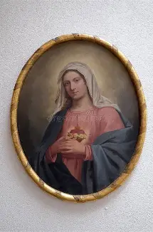
What are some key spiritual takeaways from chapter five of Mirror of the Blessed Virgin Mary? (1)
The grace of Our Lady is true, manifold, exceedingly useful, and immense
Our Lady was an immense vessel, because she contained God, and therefore, could contain immense grace; she has many graces, all of which help us, having real effects on our souls, for these graces come from God, and Our Lady glorifies God in serving as a channel through which the graces may flow
In becoming more like Our Lady, we can become more filled with grace, and serve as channels of grace to share with others

Slide 13
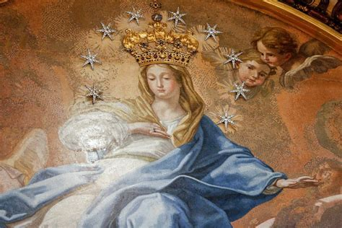
What are some key spiritual takeaways from chapter five of Mirror of the Blessed Virgin Mary? (2)
“Syria” means “watered,” and Our Lady is like the tree that grows in Syria; the white female tree bears fruit, but the male does not; Our Lady was to bear fruit, to bring forth Christ, without a man
Our Lady waters us with her grace; she brings us forth, into Heaven
Ruth is a type of Our Lady; her name means “seeing” or “hastening.” Ruth was quick to see, and to work; Our Lady sees what needs to be done, and takes action; Ruth would gather the ears of corn that the reapers had not gathered, and Our Lady gathers up the sinners, too; she has an abundance of grace that is useful to us all. She touches sinners with her grace by leading them to feel contrition, and repent; she fattens the good with greater mercy
Boaz married Ruth. “Boaz” means “strength,” and Boaz is like God, Who is strength, and filled Our Lady with His strength. Mother Mary is like a fruitful olive tree; Our Lord was in the olive garden, the Garden of Gethsemane, to redeem us from sin and bring us peace in reconciling us to God the Father

Slide 14
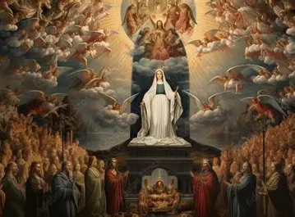
Reflection Question 1:
What most gave you a sense of wonder and awe for God in what you learned about Our Lady from your reading? What most resonated with you, or led you to see some aspect of our Marian devotion in a new light?

Slide 15
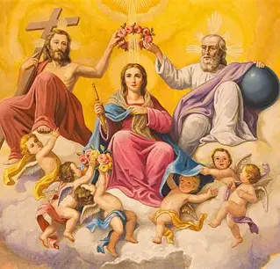
What most gave you a sense of wonder and awe for God in what you learned about Our Lady from your reading? What most resonated with you, or led you to see some aspect of our Marian devotion in a new light?
Our Lady contains Our Lord within her, holding His infinite love; she has immeasurable graces to pass on to us, numberless as the holy angels in Heaven
In mirroring Our Lady, we can broaden our hearts, and love all the more, being filled with more of her grace; the impact to be made in sharing God’s love will be immeasurable as well
There may be just punishment for our sins, but in His mercy, God has also willed that we have a Mother of Mercy, through whom we receive the graces needed to avoid sin, and to be forgiven when we do fall, that we may rise up again
Our Lady is the Mirror of Justice, and Our Lord is the Sun of Justice; Our Lady is a reflection of the Sun of Justice, showing us God’s kindness and mercy, which we need as sinners, in order to be led to total repentance, and heal, that we may be judged well by God, and be united with Jesus and Mother Mary in Heaven

Slide 16
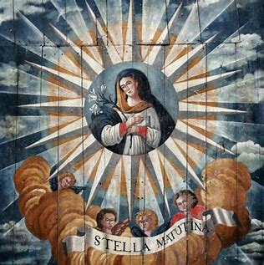
Reflection Question 2:
How does St. Bonaventure mirror Mary? Why, in general, is mirroring Mary so important to our journey to sainthood?

Slide 17
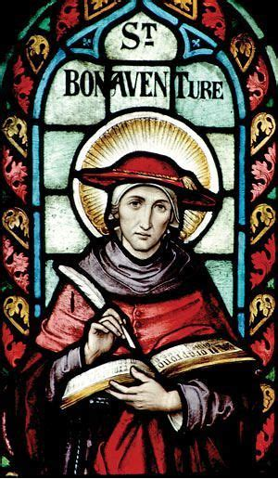
How does St. Bonaventure mirror Mary? Why, in general, is mirroring Mary so important to our journey to sainthood? (1)
Saint Bonaventure shared Our Lady’s spirit of humility
  When St. Bonaventure received the invitation to be a cardinal, he never developed a spirit of superiority; he was doing dishes when he received the promotion, and excused himself to dry his hands first before accepting his new cardinal hat
  Saint Bonaventure believed that we all can grow in holiness through perfectly doing small tasks, perfecting our gradual steps towards sanctity; his spirit was similar to that of St. Therese, who taught the “Little Way” of doing small things with great love

Slide 18
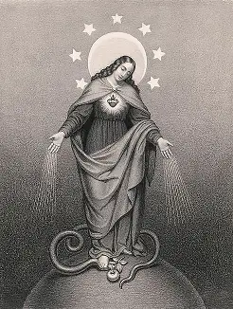
How does St. Bonaventure mirror Mary? Why, in general, is mirroring Mary so important to our journey to sainthood? (2)
Saint Bonaventure was faithful to God’s plan
  After St. Francis of Assisi passed away, St. Bonaventure carried forward the Franciscan order. He kept the mission of St. Francis of Assisi alive, helping to transition his religious family into a new era, making reforms, while honoring the original vision of St. Francis of Assisi, in ultimately doing God’s will, rather than his own. This mirrors how Our Lady modeled to others how to carry on Christ’s mission after He ascended into Heaven. She remained in this life to merit, to gain graces for us, and teach us how to receive the holy sacraments with love for her Son

Slide 19
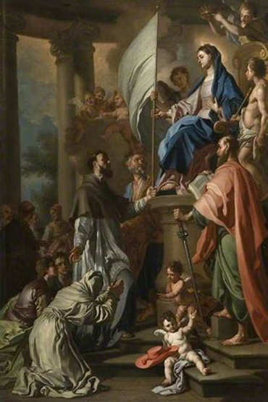
How does St. Bonaventure mirror Mary? Why, in general, is mirroring Mary so important to our journey to sainthood? (3)
Saint Bonaventure had spiritual joy
  Remembered for his cheerfulness, St. Bonaventure was a gentle and kind soul who brought others joy. He embraced the poverty of the Franciscan way of life to embrace the treasures of Our Lady’s Heart. In being detached from the spirit of the world, of temporal, material things, he could be attached to Jesus and Mother Mary, sharing their love for souls. Not being chained to the world allowed him to experience true freedom, and the joy that comes with it, which radiated outward from St. Bonaventure. Our Lady had seven sorrows, but she also had seven joys; she rejoiced in the saving work of God, which transcended all of the sorrows; even in sorrow, she could treasure God’s Providence, how He strengthened her in her suffering

Slide 20
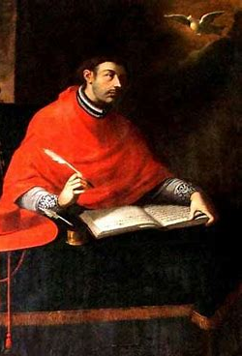
How does St. Bonaventure mirror Mary? Why, in general, is mirroring Mary so important to our journey to sainthood? (4)
Saint Bonaventure had great wisdom of the heart like Our Lady
  Saint Bonaventure had wisdom of the mind, but also had a heart burning with love for God; he was filled with wisdom, because he was open to the Holy Spirit’s inspiration, much like Our Lady, who conceived Our Lord when the Holy Spirit overshadowed her. Saint Bonaventure combined faith and reason, never hardening his heart with the knowledge he gained, or becoming prideful, but only rejoicing in the transcendence of God all the more, as God’s Wisdom is greatest. Our Lady is the Seat of Wisdom, because she treasures the things of God in her Heart, and her Heart reflects the Heart of Jesus, which is likened to a classroom or a library in which we learn His Way of love, the Way of the Cross, for to take the Way of the Cross is to shoulder burdens with and for others, so as to uplift them, and help to bring them to eternal joy, all out of love
  Saint Bonaventure wrote many scholarly works of great beauty and intelligence, but they also conveyed his spirit of love; the Psalter of the Blessed Virgin Mary touchingly captures his heartfelt devotion to Our Lady. Saint Bonaventure learned alongside St. Thomas Aquinas, the Angelic Doctor, and is therefore the Seraphic Doctor, because like the seraphim, he had a burning love for God that shone very brightly through all that he did

Slide 21
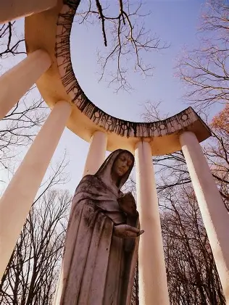
How does St. Bonaventure mirror Mary? Why, in general, is mirroring Mary so important to our journey to sainthood? (5)
Mirroring Mary helps to lead us to sainthood, because Our Lady was closest to Our Lord, Whom she reflected as the perfect mirror of love. To be united with the Father in Heaven, we are to unite ourselves with Jesus, the Son, like Our Lady
Our Lady is the Queen of All Saints. To fit her mold of Christlike holiness, of self-sacrificing love, is to be placed firmly on the path to sainthood, to earning the heavenly crown
Saint Bonaventure leads us on a “good adventure” to Heaven. It is a good adventure, because it is taken with Our Lady
In actuality, St. Bonaventure’s name means “good fortune,” honoring the healing that he received through the intercession of St. Francis of Assisi as a child, but he teaches us that this life is not simply about good fortune. Instead, we have the blessing of having Our Lady as the ultimate intercessor. She helps to lead us to healing in Christ, that we may have every good treasure in Heaven

Slide 22
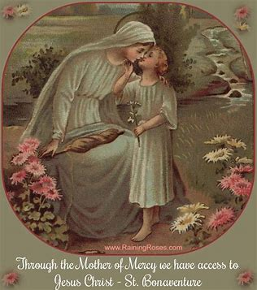
Reflection Question 3:
How do you salute Our Lady in your daily life? In the future, how might you reverence Our Lady like the holy angels do?

Slide 23
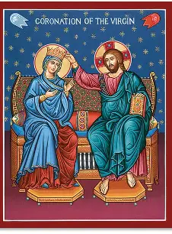
How do you salute Our Lady in your daily life? In the future, how might you reverence Our Lady like the holy angels do? (1)
Praying the Holy Rosary: placing the rosary beads on the heart, and treasuring within all that Our Lady treasures; responding to each event as she would; seeing from her perspective, and regarding each person with love, as a reflection of her Son
Venerating images of Our Lady: praying with Our Lady in a heart-to-heart conversation at the home shrine
  Visiting a statue or picture of Our Lady before and/or after a visit to Jesus in the tabernacle; blessing oneself whenever passing by a statue/image of Our Lady
Praying the Angelus: hearing the Angelus bells ring (if not externally, then internally, in the soul, our interior chapel), and going in prayer to honor Our Lady with the holy angels

Slide 24
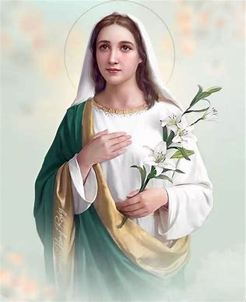
How do you salute Our Lady in your daily life? In the future, how might you reverence Our Lady like the holy angels do? (2)
Adoring Jesus to bring joy to the Heart of Our Lady: Kissing the crucifix; venerating the wounds of Christ, and making reparations for them
Praying the Little Office; meditating on key passages, treasuring them in the heart, and giving glory to the Persons of the Blessed Trinity
Thinking of Our Lady: treasuring her in our hearts, reflecting on our love for her, and on her goodness, allowing her image of holiness to guide us, and be our center point that we return to for inspiration throughout the day, like a draught of water that we continue to find refreshment in, or a bouquet of flowers whose fragrance we continue to absorb
We best honor Our Lady by imitating her, to ultimately imitate her Son; we salute each spiritual child with love, seeing them as being made in the image of God, and as being a beloved treasure in Mary’s Heart
We can receive Jesus daily, either through spiritual communion, or reception of the Holy Eucharist, welcoming Him into our hearts, and receiving the Word with a listening heart, hearing what God is calling us to

Slide 25
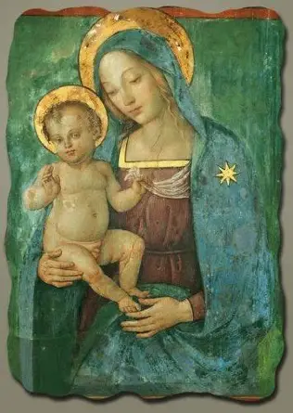
Reflection Question 4:
What does it mean to have an immaculate heart that mirrors the Heart of Mary?

Slide 26
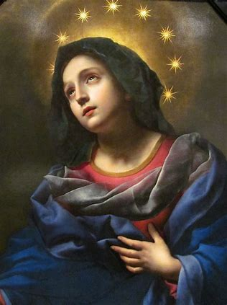
What does it mean to have an immaculate heart that mirrors the Heart of Mary?
To have an immaculate heart means to have a heart that is fully opened to God, and willing to do His will
The more we open ourselves to receiving God’s love, and are filled by it, the more we are purified, and the wider our capacity to love grows
As we come to love like God does, with self-sacrificing (agape) love flowing from mercy, we are further purified. We are led further away from sin, which is rooted in inordinate self-love, and in being detached from sin, we can be immaculate, like Mary, for the more we are rid of sin, the more room we have for grace, and the more our hearts can become like the Heart of Mary, an immense vessel containing every grace from God, for in her Heart, Mary treasures God, the giver of grace

Slide 27
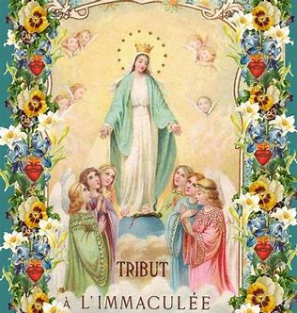
Reflection Question 5:
What do you love most about Our Lady’s Immaculate Heart? Why?

Slide 28
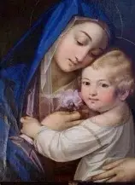
What do you love most about Our Lady’s Immaculate Heart? Why? (1)
Our Lady’s Heart is a treasury: Our Lady treasures everything about God, cherishing every gift that He gives to her. She treasured all seasons as opportunities to give glory to God, through the joys and the sorrows. Every treasure in Our Lady’s Heart shines with love, reflecting the love of God
Our Lady’s Heart rejoices: Mother Mary has hope in the Lord, and exalts Him for the miracles He has worked to lift up the lowly; she honors how He shines in all of His people. Our Lady’s Heart is so clean and pure, that she can see God’s Presence everywhere, including in herself, and praises Him by singing in her Heart with great love
Our Lady’s Heart is pure: a heart of true love is pure. Our Lady’s Heart truly wants to do God’s will, and does, out of love for Him

Slide 29
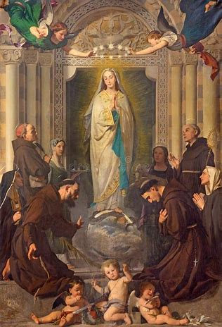
What do you love most about Our Lady’s Immaculate Heart? Why? (2)
Our Lady’s Heart is one of gentleness and fortitude. Our Lady is brave enough to choose to love, and to forgive. She remains by the Cross, and is not embittered by it. She continues to pour out a maternal love from her Heart, an angelic sweetness, loving her Son so much, that she wills to do God’s will to bring souls to Him through her own suffering, praying that every heart would come to know the love of her Son’s Sacred Heart. Our Lady is self-sacrificing; her Heart is a treasure, because it is the Heart of a mother. Our Lady’s Heart reaches out to bring nourishment to every soul by leading them to her Son, the Bread of Life, so that they will never truly die, but can live forever, sustained by Jesus’ everlasting love
Our Lady has a humble Heart that is patient and courageous; she is unshaken in Faith, unafraid to open her Heart to be filled by God. She is treasured in the Heart of God, preserved in His Temple; she remains in Him, that He may remain in her
Our Lady’s Heart is not her own; it belongs to God. It is the perfect mirror image of the Heart of Jesus, Who gave His life for us. We love the Immaculate Heart of Mary all the more for being so generous and good, as to be completely absorbed in loving others, most of all, God, Who loved us first. Our Lady rejoices in the opportunity to serve, to share God’s love, that others may know heavenly joy and angelic sweetness

Slide 30
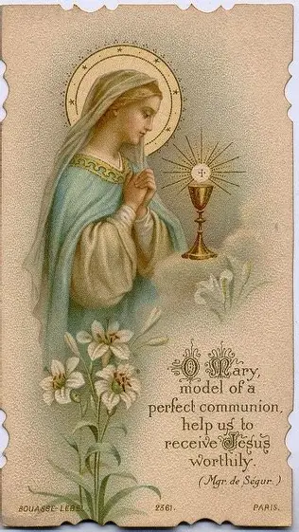
In our apostolate of spiritual motherhood, how may we mirror the Immaculate Heart of Mary?
We can imitate the Immaculate Heart of Mary in love for all spiritual children
  We love our priests, and therefore, the whole flock, praying for the whole Church in praying for our priests, who are her bridegrooms mirroring the Eternal High Priest, Our Lord, Jesus
  We gather the petitions of God’s people, and put them like flowers on the altars of our hearts, offering them to God in union with the priest, and Our Lady, who offers the Precious Blood of her Son to God the Father
We can imitate the Immaculate Heart of Mary in generosity of spirit
  We share our hearts in prayer, devoting our time and love to prayer
  This is similar to Our Lady, who spent her years of earthly life after Our Lord’s Ascension in prayer for the apostles, praying that they would bring the loving Heart of her Son to souls everywhere, and console His Heart, which longs for souls to be close to Him
We can imitate the Immaculate Heart of Mary in dedication and faithfulness
  Like Our Lady, and our priests, we mirror the Immaculate Heart of Mary in persevering in prayer, and in all that God calls us to do to honor Him

Slide 31
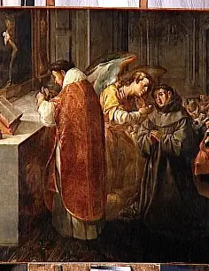
How does St. Bonaventure, a priest, mirror the Immaculate Heart of Mary? (1)
The thoughts of the Hearts of Jesus and Mother Mary are always with us, and St. Bonaventure similarly was always thinking of his spiritual children, because he was always thinking of Jesus and Mother Mary, who are perfectly loving and attentive to us. Saint Bonaventure was always thinking of Mother Mary, wanting to honor her, so naturally, he was thinking of all of the souls she loved, and of how he could bless them by sharing her love with them. He instituted special Marian devotional practices in his order as a result, including the ringing of a bell each evening to recall the Annunciation. In this way, he reminded his family in Christ to reverence Our Lady with the holy angels, and to always say “yes” to God like her. His heart mirrors Our Lady in hearing the word of God, and responding to it, helping others to listen to His call. Saint Bonaventure called others to prayer, to ponder God in their hearts; Our Lady prayed perpetually, in all that she did, in having a heart consecrated to God

Slide 32
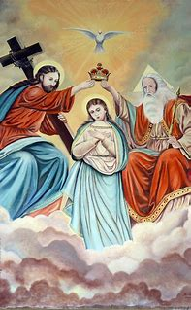
How does St. Bonaventure, a priest, mirror the Immaculate Heart of Mary? (2)
In the Prologue of Mirror of the Blessed Virgin Mary, St. Bonaventure writes that any attempt we make to praise Our Lady in words can never fully capture her grace, or by extension, the magnificence of God; he perceives himself as lowly, as unfit to verbalize Our Lady’s virtues, but he speaks to the importance of trying to do so anyway, out of love for God, so he mirrors Our Lady in his sense of humility, but also, in his sense of faith in God, in his spirit that rejoices in God as our Savior. He does not despair over our lowliness as human beings, but rejoices in the greatness of God that supplies what we are lacking in, and in the opportunity to serve God
In general, priests mirror the self-sacrificing love of Mother Mary, which is itself a reflection of the self-gift of Our Lord. They make constant intercession for us, and sacrifice themselves with Christ spiritually on the altar, comparably to the spiritual martyrdom of Our Lady

Slide 33
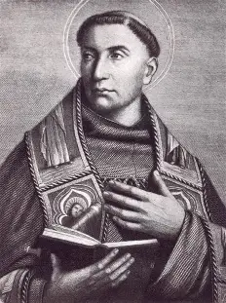
What may we learn from St. Bonaventure’s example, and how can this translate into our prayers for priests?
From St. Bonaventure’s example, we learn to always keep striving. We need not be discouraged, but should have hope; in knowing how immense the treasury of graces in Our Lady’s Heart is, we can have hope that we will receive them, and be opened to restoration in Christ, that in receiving His graces, we may share in His glory
We can keep praying for the sanctification and perseverance of our priests, that they, too, would have a spirit of hope, being consoled by the Hearts of Jesus and Mother Mary that so rejoice in all of our priests’ efforts to give glory to them. We pray that our priests would be blessed for sharing the graces of God with us as channels of His mercy, just like Our Lady. Moreover, we pray that she would comfort them, being a shining light in their lives to help them to always focus their hearts on God, and not be consumed by the many demands that are placed on their time. Instead, we pray that they would know that all of their time belongs to God, so He will sanctify it, helping them to bear fruit according to what will give Him the greatest glory. In our prayers, we ask that they would treasure all of their time used in service to God, and that in all things, no matter how seemingly small, they would rejoice, in seeing God shining through, rewarding them for every task completed with great love for Him
We pray that all of the faithful would be inspired by our priests who are guiding lights leading us to Our Lady, helping us to remain centered in Our Lord and His Mother. We pray in thanksgiving for our priests who help us to reflect the love radiating from the Hearts of Jesus and Mother Mary

Slide 34
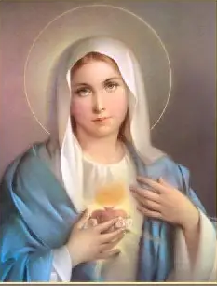
Closing Prayer: A Prayer for Continued Spiritual Growth by Katie Sadakierski
Dear Lord, You called St. Augustine to come to “take and read” Sacred Scripture to come to know Your Heart of love. Guide our hearts and minds to absorb the treasures that You want us to bring out into the world to help others to come to know You as we go forward, continuing to read of the wonders you have worked, especially in Your handmaiden, Mary, the Queen of our hearts. May we treasure in our hearts all that You choose to reveal to us, in union with Mary, that we, too, may be pleasing to You, bringing joy and hope to others through Your grace. Help us to apply what we learn from our readings with great love, and to persist with faith and confidence in You as we keep reading from the book of Your Heart, discovering Your greatness in each new chapter. Open the eyes of our souls to see the beauty in every word You have written for our sanctification, and to embrace You as the Author of our lives, just as Our Lady did, as we continue striving to mirror Mary, to cultivate hearts that flower with virtue like hers. Thank You, God, for bringing us together to rejoice in You, and lead us to carry this joy forward, until we meet again. Amen.

Slide 35
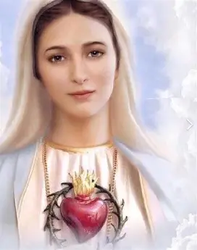
Announcements (1)
Seven Sisters Apostolate liturgical rosary prayer group sessions for special occasions
  Sunday, August 24, 2025: Bartlemas presentation at 3:00 p.m., parish library, with liturgical rosary at 3:30 p.m. for the occasion of a Holy Baptism
  Sunday, August 31, 2025: Liturgical rosary at 1:30 p.m. in the parish library for the occasion of a birthday; celebration to follow in parish hall
Religious education program opening year Holy Mass and blessing of catechists:
  Tuesday, August 26, 2025, 6:00 p.m., church

Slide 36
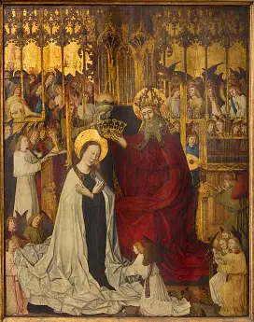
Announcements (2)
Next Seven Sisters Apostolate devotional gathering:
  Friday, August 29, 2025:
    4:30 p.m. liturgical rosary in parish library for the occasion of a Confirmation
    5:00 p.m. Eucharistic Adoration in church
    6:00 p.m. presentation on promoting vocations in parish hall
Next Seven Sisters Apostolate Book Club Meeting:
  Friday, September 12, 2025: 6:30 p.m. to 7:30 p.m.
    OLV parish library
      Chapters VI through IX (pages 57-105)

