Slide 1
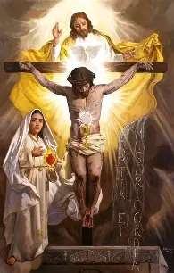
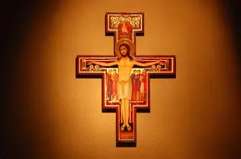
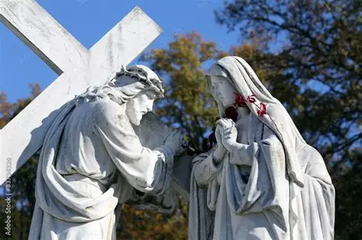
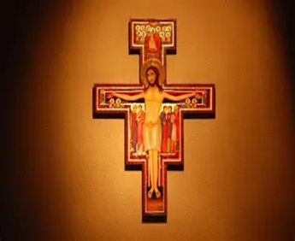

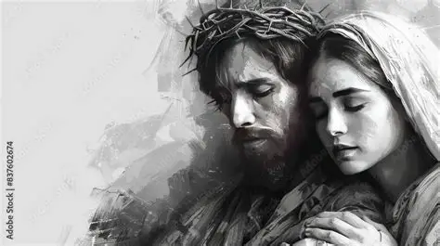
Honoring Our Lady during St. Michael’s Lent
Saturday, August 16, 2025
Katie Sadakierski

Slide 2
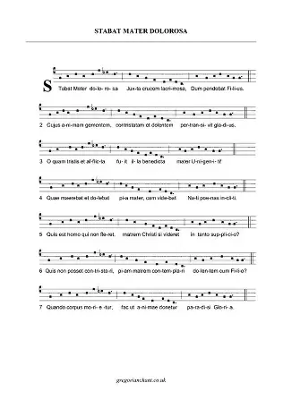
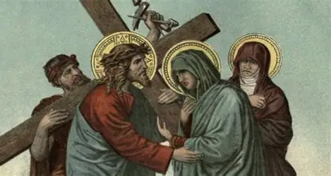
Outline
Introduction
Outline
Opening Prayer
Presentation
I. Devotion to the Holy Cross: Its characteristics, spiritual fruits, and practice throughout the liturgical year
II. The origins of the Stations of the Cross, and various types of Stations of the Cross devotions
III. How Our Lady models devotion to the Holy Cross
  How, and why, we should devote ourselves to the Holy Cross, too
Closing Prayer
Q & A

Slide 3
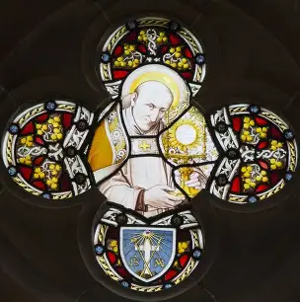
Opening Prayer: Stations of the Cross Opening Prayer (St. Alphonsus Liguori)
My Lord Jesus Christ, you have made this journey to die for me with infinite love. So many times I have sinned, but I repent sincerely because I love you. Pardon me, my God. I will love you all my life. Amen.

Slide 4
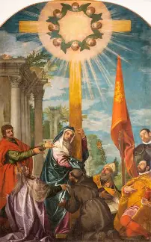
What are the Thirty Days of Our Lady?
The thirty days of Our Lady span from August 15 to September 15. We honor Our Lady on the Feast of the Assumption on August 15, when she was assumed into Heaven through the power of her Son, and culminate our period of devotion to Our Lady with observance of the Feast of Our Lady of Sorrows on September 15
During this month, we remember that Our Lady sorrowed because of her Son’s suffering on the Cross, the heavy weight of our sins that He took upon Himself to save us, and restore order. We also remember that through the power of the Holy Cross, Jesus’ victory over it, we are led to triumph, too, to reach Heaven to join Our Lord and Our Lady, who will lift our sorrows from us entirely. During the thirty days of Our Lady, we may offer special devotions for Our Lady, acts of love that will allow us to draw closer to her, that we may be strengthened to bear our crosses with love and grace like Our Lady

Slide 5
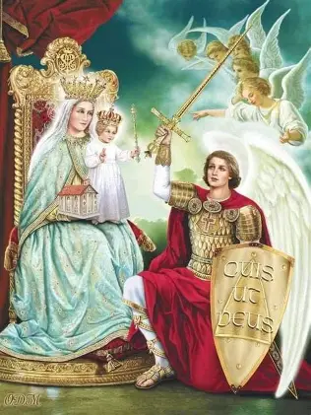
What is St. Michael’s Lent?
Saint Michael’s Lent is the period from the Feast of the Assumption on August 15 to the Feast of St. Michael the Archangel on September 29
These forty days (excluding Sundays) allow for purification in preparation for Advent, another penitential season, that begins about two months after Michaelmas
During St. Michael’s Lent, we may practice penance, or choose something to offer to Our Lady as a gift, such as additional time spent in prayer with her. We aim to further imitate the holy angels in adoring God during this time, looking to Our Lady, Queen of the Angels, to guide us

Slide 6
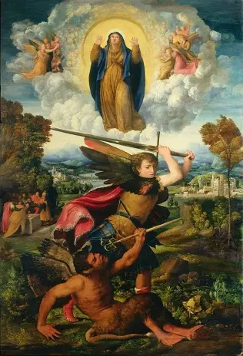
Why is St. Michael’s Lent the perfect time to honor Our Lady?
Saint Michael defeated Satan in the first battle, casting him out of Heaven for his disobedience to God the Father. Our Lady is also a spiritual warrior, crushing Satan under her heel, so St. Michael and Our Lady are closely linked, and we go to them both to help us to transcend our temptations, our human limitations, and to grow in holiness. Both Our Lady and St. Michael strengthen us, for they are figures of perfect love and faithfulness to God who help us to fulfill His will, too
Every time is the perfect time to honor Our Lady, but this time is especially powerful, as we use this season to prepare us to celebrate Advent, and welcome Jesus with great love, remembering the joy of His first coming. In this season, we compassionate with Our Lady in her sorrows, looking forward to rebirth in Christ. At the end of this season after Pentecost, during which we celebrate St. Michael’s Lent, we aim to focus our minds on the second coming of Christ. The readings at Holy Mass turn to Revelation, to the apocalypse, as we think of the end times, looking forward to Our Lord coming in glory, and preparing ourselves for judgment, that we may join the saints in being reborn into Heaven. Saint Michael and Our Lady prepare us for this, that we may be judged well; they help us now and at the hour of our death

Slide 7
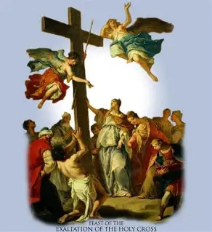
What is the Feast of the Exaltation of the Holy Cross?
The Feast of the Exaltation of the Holy Cross is celebrated on September 14
We celebrate the True Cross, discovered by St. Helena, the mother of the Emperor Constantine, and the power of the Holy Cross that is given through Christ’s victory over it, over sin, death, and darkness
This feast day falls during Our Lady’s thirty days, and therefore, during St. Michael’s Lent as well. To help us to persevere, and to offer all things out of love for God, we focus on the Cross, and embrace it, trusting that Our Lord will lighten the burden of carrying it, and make the experience sweet, healing us through this labor
Every time we pray the Stations of the Cross, we exalt in Our Lord’s glory, because even as we dwell on His suffering, we remember its purpose, and reflect on the triumph that comes from it

Slide 8
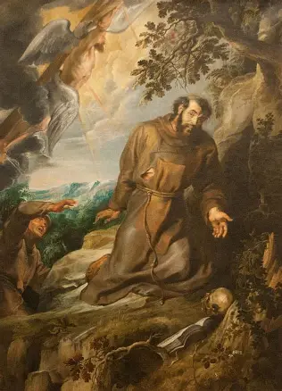
What is the Feast of the Stigmata of St. Francis of Assisi? Why do we celebrate it?
On September 17, we observe a feast day honoring the stigmata of St. Francis of Assisi
Saint Francis was rewarded for faithfully celebrating St. Michael’s Lent. He was given the spiritual gift of the stigmata, the five holy wounds of Christ that Our Lord sustained on the Cross. These wounds were imprinted on the body of St. Francis of Assisi, who had united himself with Christ’s Sacrifice in living out a penitential life of strict poverty and fasting, which purified him, allowing him to receive the riches of faith, hope, and love from Jesus’ Sacred Heart
September 17 commemorates when St. Francis of Assisi could receive something of the share of glory that Christ had, as a kind of foretaste of Heaven, where we see Christ’s glorified Body, bearing the holy wounds, the signs of love for us that He took on
This feast day increases our hope that God will bless us, too, for our efforts to follow Him faithfully, and to offer Him all that we can

Slide 9
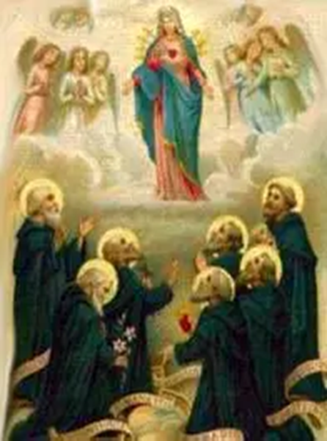
What are the Stations of the Cross? What role did Our Lady play in developing this devotion? (1)
Also called the “Via Crucis” (the Way of the Cross) or the “Via Dolorosa” (the Way of Sorrows), the Stations of the Cross guide us towards a greater love of the Crucified Christ, and Our Lady of Sorrows. We spend time in meditation with Our Lord as He suffers to redeem us from sin, giving His life for us as the greatest Martyr. Our Lady experiences a spiritual martyrdom in uniting her sorrows with those of Our Lord, the Man of Sorrows, during His Passion. Jesus entrusts us to her Immaculate Heart, giving us His Mother, that we may be healed in our sorrows, and led to embrace Him in Heaven, just as she did; from Our Lady, we are taught that through spiritual labor, even when painful and sorrowful, we can bear good fruits for the Father, offering up our experiences for His glory, as a testimony to His strength that helps us to bear all crosses gracefully
The Stations of the Cross devotion helps us to treasure the Sorrowful Mysteries in our hearts along with the Joyful, so as to be led towards the glorious, as we are purified in our suffering, made more godly, and prepared for greater heavenly rewards; we learn how to humbly receive joys and sorrows from Our Lady, whose Immaculate Heart treasures everything from God

Slide 10
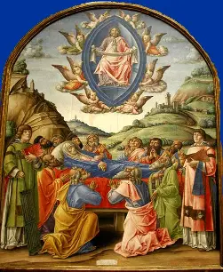
What are the Stations of the Cross? What role did Our Lady play in developing this devotion? (2)
It is believed that, shortly before her passing, Our Lady traveled to Jerusalem from her home in Ephesus that St. John had built for her, so that she could relive the events of Our Lord’s Passion a final time. This experience increased her sense of longing to be with Him, helping her to prepare her soul to depart from this earthly life, and enter into Heaven
Our Lady technically lived just outside of Ephesus, and likely, died in her home there. In the fourteen years of her life after Christ’s Passion, Death, Resurrection, and Ascension, she lived in a number of places, including the Cenacle, the upper room where the Holy Spirit descended upon the apostles, but at the time of her death. Two tombs for Our Lady were found, one in Ephesus, and one in Jerusalem, but since both are empty, there is still some mystery surrounding where she truly died. The apostles had gathered in Jerusalem before her death, but to be by Our Lady’s deathbed, may have traveled to Ephesus from there

Slide 11
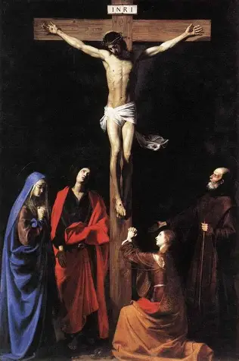
What are the Stations of the Cross? What role did Our Lady play in developing this devotion? (3)
Ultimately, when we reflect on the Passion, and Our Lady’s Compassion, we think of the glory that Our Lord and Our Lady would share in after sharing in such suffering. We meditate on the triumph that comes from the Cross, the uplifted beams raising us up to Heaven with them. As we prepare to honor Our Lady’s Assumption, her glorious entry into Heaven through the power of Our Lord, we think of how Our Lord was born to die, that the wood of the manger was the wood of the Cross. Our Lady and Our Lord were born so that we would have rebirth, through the victory of Christ over the Cross. We pray the Stations of the Cross to help us to carry the crosses we have in life with the graceful love of Jesus and Mother Mary, that we may be with them in Heaven, knowing the joy of Our Lady and Our Lord when they were reunited for eternity. We pray that, just as the holy angels accompanied Our Lady, to her destinations in this life, and then, on the way to Heaven, they would bear us up, too, giving us joy in the experiences of carrying our crosses
When the mystics, namely, Blessed Anne Catherine Emmerich, write of Our Lady at the end of her life, they emphasize her youthful appearance, affirming that she had not aged. Our Lady kept receiving her Son in Holy Communion, kept going to the altar of God, which gives joy to our youth. The Stations of the Cross remind us of our need for God’s love and mercy, especially through the graces of the sacraments, and help us to remain eternally young in spirit, with Christ, being uplifted by joy and hope even amidst life’s crosses

Slide 12
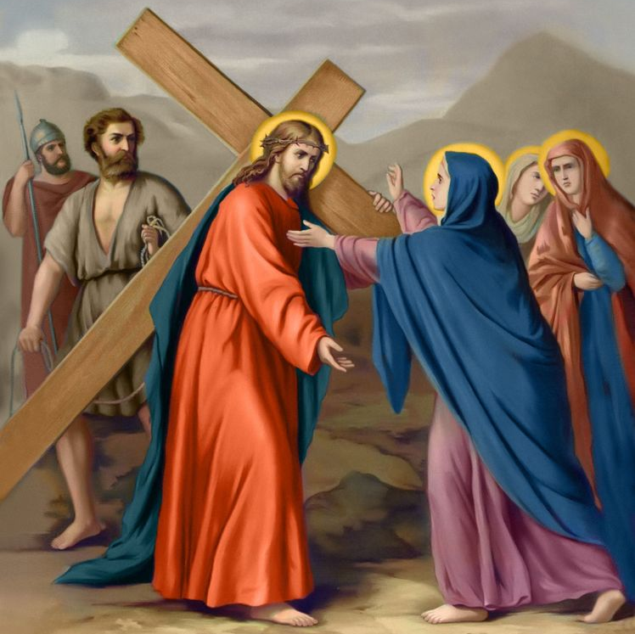
What are the Stations of the Cross? What role did Our Lady play in developing this devotion? (4)
The Stations of the Cross devotion was developed by Our Lady. After Our Lord’s passing from this life, Our Lady would walk to each of the sites of His Passion, retracing the steps of her Son, the Suffering Servant, and compassionating with Him, treasuring in her Immaculate Heart all that He had done. She placed stones on the sites to mark them as the stations of Christ’s Passion
In the Middle Ages, when European Christian pilgrims could not visit the Holy Land due to persecution and war there, they developed Stations of the Cross replicating the sites of the Passion in the Holy Land, which they could complete in their native land
  For a time, in the Holy Land, completing the Stations of the Cross was forbidden; if visiting the sites of the Passion, the Christian faithful could not stop to pray and meditate on them, and were required to cover their heads
  Crusaders were familiarized with the sites of the Passion during their time battling Muslims for the Holy Land, bringing back a zeal for the Stations of the Cross devotion back with them to Europe, as this devotion strengthened them in their battles

Slide 13
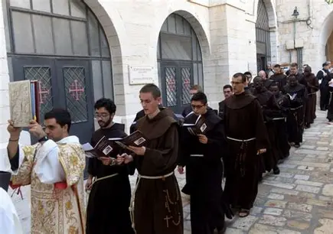
What are the Stations of the Cross? What role did Our Lady play in developing this devotion? (5)
When the Franciscans were appointed to oversee the sites of the Passion in the Holy Land in the fourteenth century, they came to promote the Stations of the Cross devotion, and devotion to the Holy Cross in general. Pilgrims could receive special indulgences for visiting the sites of the Passion in the Holy Land
This indulgence would be extended from the Franciscans to all of the faithful in the eighteenth century. The Franciscans would spread the Stations of the Cross devotion throughout Europe

Slide 14
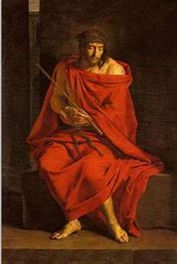
What are the Stations of the Cross? What role did Our Lady play in developing this devotion? (6)
At first, the Stations of the Cross would be reproduced in major European cities. They were works of art that pilgrims would come to visit from afar. Gradually, the Stations of the Cross spread to each parish, especially between the late 1600s and mid-1700s, being included inside of churches, whereas they had begun as an outdoor devotion
  It was at this time that the pope fixed the number of Stations at 14; before, they could vary regionally. Some of the stations included before were meditations on when Our Lord passed through the city gate, and the story of Simon the Pharisee
Originally, the Stations of the Cross began with Our Lord on Calvary, and pilgrims would work backwards towards Pontius Pilate’s praetorium, reliving all that had led up to the point of the Crucifixion. Now, we follow Christ’s steps in chronological order, from His condemnation by Pontius Pilate to His crucifixion

Slide 15
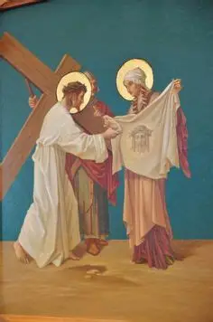
What are the traditional Stations of the Cross?
There are fourteen traditional Stations of the Cross, which give us a sense of how we are to respond with Christ, and meet Him when we are traveling on our own road to Calvary. We come to understand that this is the way to Heaven, as we experience the sweetness of Christ’s mercy in the Precious Blood poured from His Side for our salvation, even as we bear witness to the bitter chalice from which Christ was made to drink in suffering the Passion
Fourteen is a number of completion, combining two sets of seven, the number of perfection; it encompasses the seven joys and seven sorrows of Our Lady, the seven corporal and spiritual works of mercy, as well as the seven deadly sins and the seven contrary virtues
When praying the Stations of the Cross, we see how Our Lord enacted the spiritual works of mercy towards those who persecuted Him, embodying the contrary virtues in response to the deadly sins committed by the people who inflicted His suffering. We also see examples of those who treated Our Lord with compassion, like Our Lady and St. Veronica, learning more about how to practice the corporal works of mercy, and console the Heart of Mary with joy by mitigating the sorrows of her Son through faithfulness reminiscent of hers. Praying the traditional Stations of the Cross helps us to meditate on how our sins have wounded Christ, strengthening our resolve to avoid sin, and embrace the path of virtue, of forgiveness and love, that Our Lord followed

Slide 16
Name of the Traditional Station | Corresponding Scriptural Verse
Station 1: Jesus is Condemned to Death | Mark 15:15; Matthew 27:26; Luke 23:24-25; John 19:16
Station 2: Jesus Accepts the Cross | John 19:17
Station 3: Jesus Falls for the First Time | (No Scriptural verse)
Station 4: Jesus Meets His Sorrowing Mother | (No Scriptural verse)
Station 5: Simon of Cyrene Carries the Cross of Jesus | Mark 15:21; Matthew 27:32; Luke 23:26
Station 6: St. Veronica Wipes the Face of Jesus | (No Scriptural verse)
Station 7: Jesus Falls a Second Time | (No Scriptural verse)
Station 8: Jesus Meets the Women of Jerusalem | Luke 23:27-31
Station 9: Jesus Falls a Third Time | (No Scriptural verse)
Station 10: Jesus is Stripped of His Clothes | John 19:23-24
Station 11: Jesus is Nailed to the Cross | Mark 15:24; Matthew 27:35; Luke 23:33; John 19:18
Station 12: Jesus Dies on the Cross | Mark 15:37; Matthew 27:50; Luke 23:44-46; John 19:30
Station 13: Jesus’ Body is Taken Down from the Cross | John 19:31-38
Station 14: Jesus’ Body is Laid in the Tomb | Matthew 27:57-66; John 19:38-42

Slide 17
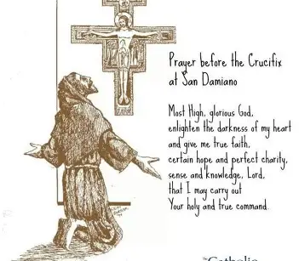
When may the Stations of the Cross be prayed? (1)
The Stations of the Cross may be prayed at any time, but there are certain occasions during which they are particularly fitting as a special devotion to practice
Most commonly, on Fridays during Lent
  Lent is the season in which we meditate on the self-sacrificing love of Our Lord, actively awaiting Easter by praying with Christ through His journey to Calvary. We go through a spiritual desert, a time of penitence in which we sorrow for our sins, making it the most appropriate time to pray the Stations of the Cross, since we aim to purify ourselves across the forty days through sacrifices, all offerings to God out of love, united with the loving Sacrifice made by Our Lord on the Cross. We meditate on Christ’s forty days in the desert, calling upon Him to help us to battle temptation, be strengthened by the power of His Holy Cross, and remain faithful, triumphing over sin with Him. We place our confidence in the greatness of God, and are inspired to persevere through carrying crosses like Our Lord
  Friday is the day of the week on which Our Lord’s Death on the Cross took place, so we express our sorrow for Jesus’ suffering by praying the Stations of the Cross on Fridays, keeping Our Lord company, sending Him our love and gratitude

Slide 18
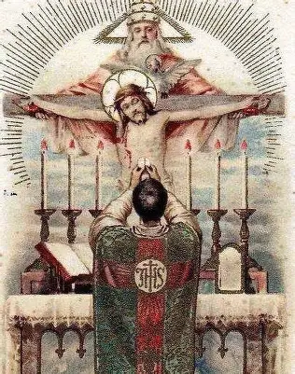
When may the Stations of the Cross be prayed? (2)
Before Holy Mass:
  Praying the Stations of the Cross before Holy Mass can prepare our hearts to be united with Christ’s Sacred Heart in deep prayer during the Holy Sacrifice of the Mass
  Meditating on the Stations helps us to more profoundly appreciate the love with which Our Lord offers Himself to us, and can help us to have the proper disposition, the spirit of contrition that hope, appropriate to praying the Holy Mass. We pray to have a spirit of contrition that will allow us to reverence Our Lord, and detach ourselves from sin, so that we may be filled with His grace, but also, to never despair in our sinfulness, instead discovering peace in spiritual union with Christ, in offering up everything to Him, and trusting Him to do what is best for our sanctification. We can then entrust ourselves to Our Lord during Holy Mass, praying to be the purest offerings we can be, as we pray for our purification through prayers of contrition and love during Holy Mass. The Stations of the Cross is the perfect prelude to our prayers at Holy Mass, helping us to enter into spiritual participation with Christ in the Passion, that as we experience the Passion with Him, we also can receive its graces, using them to bear good fruit for the Father like Jesus did, to merit for souls in need of grace

Slide 19
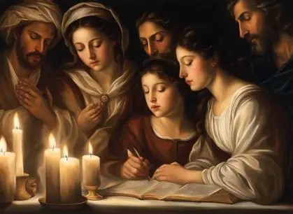
When may the Stations of the Cross be prayed? (3)
During Eucharistic Adoration:
  An individual may decide to use their missal or a Stations of the Cross booklet to pray the Stations during Eucharistic Adoration, reading the Scripture passages corresponding with the Stations, and meditating on how the self-sacrificing Eucharistic Heart of Jesus is Present in each Station, expressing love for us. However, engaging in the Stations of the Cross as a public devotion for a group is not necessarily appropriate for Eucharistic Adoration, since our sole focus should be on Our Lord in the Holy Eucharist; silence, or devotions specifically rooted in Eucharistic piety, are more conducive to the spirit of prayer that the faithful should have in Eucharistic Adoration. A period of Eucharistic Adoration may follow the Stations of the Cross, which can help us to enter more deeply into contemplative prayer on the Sacrifice of Our Lord, and the spiritual food He has given us through it. It is generally best to keep the devotions separate, so that our attention is not divided, and we may give Our Lord full glory when He is Present, exposed on the altar. Exposition of the Blessed Sacrament is not to take place solely to offer a period of Benediction; it must preface a period of Eucharistic Adoration
The faithful who may not visit a church can receive a special indulgence for praying the Stations of the Cross for a half hour at home at any time, but it is especially fitting to offer this meditation during the period when we recall Our Lord’s Death on the Cross at 3:00 p.m., the hour of divine mercy

Slide 20
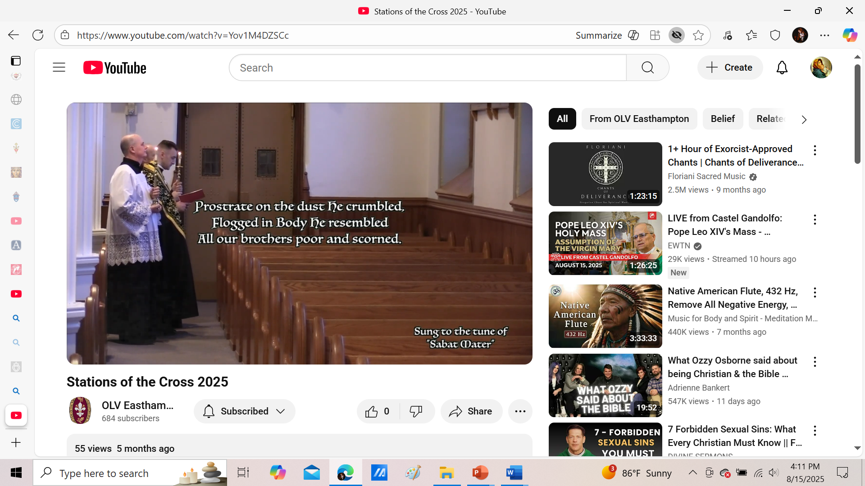
How are the Stations of the Cross prayed? (1)
The Stations of the Cross are traditionally celebrated by a priest. The celebrant, accompanied by servers bearing candles, leads the devotion by traveling from station to station in his church, reading aloud a Scriptural verse from a booklet at each station, after which the people read a responsory prayer, a meditation. Usually, the prayer at the station will be to emulate Christ in His virtue that He practiced during the event in the Passion that we are focusing on
The priest begins the meditation at each Station by expressing our adoration for Christ; we stand for this portion, then genuflect when we praise Jesus for redeeming us through His Death on the Holy Cross. When the priest reads the Scriptural verse, we will stand, then kneel during the meditation when we pray to imitate Christ in true charity
In praying together, priest and people, we come to understand the dynamic between Our Lord and Our Lady during the Passion; we more fully understand how Our Lord makes intercession for us through His Sacrifice, and Our Lady offers the Precious Blood of her Son to God the Father for the remission of our sins. We share in their experience of the Passion by offering our prayers in thanksgiving for our Redeemer, asking Him to save souls, and to use us as His instruments to do so

Slide 21
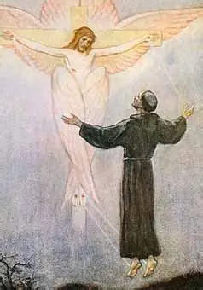
How are the Stations of the Cross prayed? (2)
Traditionally, after each Station, the faithful would pray one “Our Father,” one “Hail Mary,” and one “Glory Be.” We give glory to God the Father for giving us His Son, that we could be forgiven, receive our daily bread, and enter Heaven. We honor Our Lady for serving as a model of steadfast faith for us by the Cross, and being our mother, to deliver us from sin and death to life in her Son. We also give glory to God the Son for His Sacrifice, and God the Holy Spirit for filling Our Lord and Our Lady, then being sent to us to give us the Gifts needed to help us through our experiences of the Passion
Another custom is to begin one’s visit to each station with the Act of Contrition to place their heart in the right spirit of contemplation for each station, or to meditate on the Creed, that as we reflect on our beliefs, we consider how we are living them out, and upholding our baptismal promises, so that as we contemplate our faithfulness to Christ, we may identify how we can better devote ourselves to Him in the future, avoiding wounding Him

Slide 22
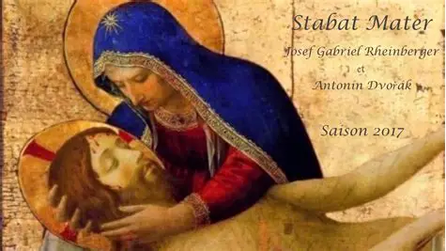
What is the Stabat Mater? (1)
The Stabat Mater (“At the Cross Her Station Keeping”) is a hymn honoring Our Lady’s fortitude and faithfulness in standing by the Cross of her Son; we see that her love flows from deep humility, her willingness to be obedient to God the Father. In standing by the Cross, her station keeping, Our Lady, the Sorrowful Mother, embodied her trust in God, which transcended any fear or anxiety. Her faith that God would fulfill His promise to save us, to deliver us from sin and the world, rose above, helping her to prevail. Our Lady would be rewarded for bearing her inner crosses, her spiritual martyrdom with Christ, with such hope. Despair is a sin against the Holy Spirit, so in exercising such hope, as the Mother of Hope, Our Lady honored her Spouse, the Holy Spirit. We pray to open our hearts to hope, so that we may be filled all the more deeply with the Holy Spirit, and serve God faithfully, with hearts of peace, standing by God, and keeping the stations He gives to us for our sanctification, that we may reach Heaven with Him

Slide 23
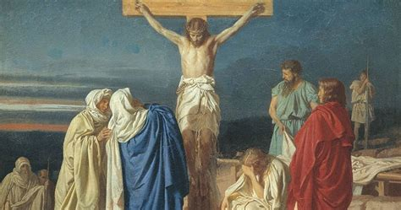
What is the Stabat Mater? (2)
“Stabat Mater” is commonly heard during Lent, including during the Stations of the Cross as the priest travels in between stations, and we pray in our hearts with Our Lady, remaining with Christ as she did. This hymn was written during the thirteenth century, and is a sequence that may be used on the Feast of Our Lady of Sorrows, too. It is based on the first Sorrow of Our Lady, the prophecy of St. Simeon that prefigures the Passion, foretelling that Our Lady’s Heart would be pierced as though by swords
In acts of love and devotion for Our Lady, we pray to remove these swords from her Immaculate Heart, and to replace them with the fruits of our love, that flowers that grow from devotion to, and imitation of, her in her holiness

Slide 24
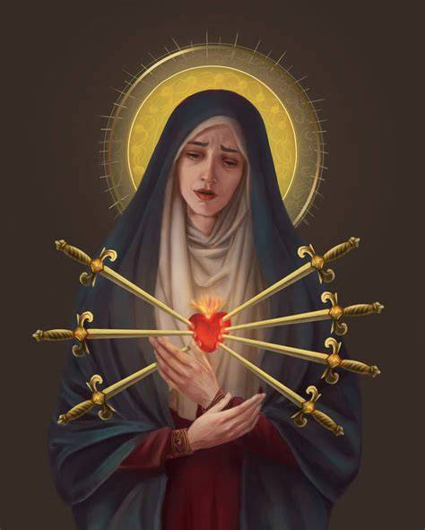
Why do we honor Our Lady of Sorrows in September after celebrating Our Lady’s Immaculate Heart in August? (1)
Because Our Lady has an Immaculate Heart, it is a sorrowful one that feels deeply the pain of others, and compassionates with the suffering
Our Lady sorrows not for herself, but for the wounds inflicted upon her innocent Son, and for all those who injure their own souls by persecuting Him, by not opening their hearts to receive His healing love
Since Our Lady is without sin, her Immaculate Heart being filled with every grace, only pure love for God, her Heart is particularly sensitive to the sins of her spiritual children, which wound her greatly, for they wound her Son Whom she so loves, and since, in her love for us, she longs for us to have the purity of heart needed to enter Heaven to join her

Slide 25
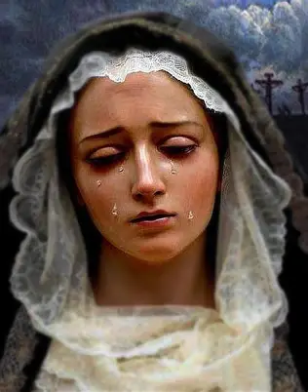
Why do we honor Our Lady of Sorrows in September after celebrating Our Lady’s Immaculate Heart in August? (2)
We pray that our hearts would similarly be touched by grace, so as to reach out with love for others, and never to despair, but to have hope in God’s mercy, not being consumed by sadness, but making reparation for sins out of contrition
Compassionating with the Sorrowful Heart of Our Lady helps to be like Our Lady in showing others mercy, and consoling them; we can further appreciate the depth of love, faith, hope, and strength that Our Lady had (in withstanding the suffering of her Son for our redemption), and that she can pass on to us. Meditating on Our Lady of Compassion helps us to have a deeper spirit of sorrow for our own sins, strengthening our resolve to avoid it, and to have a more immaculate heart, like Our Lady’s, that loves so generously and fully, being offered to others in total self-gift

Slide 26
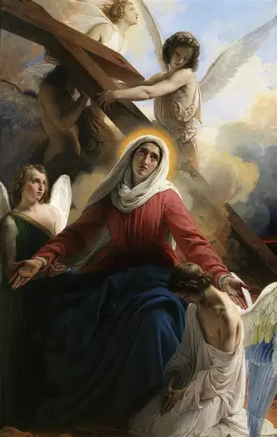
Why do we honor Our Lady of Sorrows in September after celebrating Our Lady’s Immaculate Heart in August? (3)
On August 15, we celebrate the Feast of the Assumption of Our Lady, remembering when she was brought up into Heaven through the power of her Son, Jesus. On September 15, we observe the Feast of Our Lady of Sorrows, recalling that Our Lady reached Heaven for having offered up her sorrows to God the Father with such love. We pray that she would help us to imitate her in serving God so steadfastly, and uniting our sacrifices with the Sacrifice of Christ, so that as we carry our crosses lovingly with Christ, sharing in His suffering, we would come to share in His glory, too

Slide 27
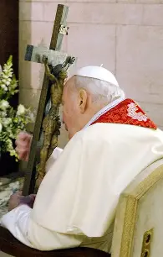
How did the Stations of the Cross change?
In the year 2000, Pope St. John Paul II added a fifteenth station to the Stations of the Cross devotion: the Resurrection (however, the custom of meditating on the Resurrection as the fifteenth station began in the 1960s after Vatican Council II)
The Resurrection is part of the Paschal Mystery: it is closely linked to the Passion and Death of Christ, so it was added as a station in the Stations of the Cross devotion to allow for deeper meditation on the cycle of dying and rising with Christ, especially as we look with hope towards Easter, aiming to keep its spirit in our hearts year-round, that we may place confidence in the faithful Heart of Christ that always reaches out with love to save us

Slide 28
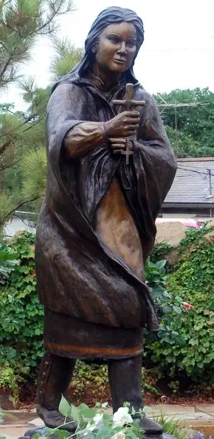
What are the outdoor Stations of the Cross, and who developed them?
The Stations of the Cross began as an outdoor devotion, as a means of uniting with Christ spiritually in visiting all of the sites in the Holy Land connected to His Passion, but soon, was shifted to an almost exclusively indoor devotion, as carvings of scenes representing the events at each station were used to adorn church walls. Originally, there were many more sites where Christ walked during or leading up to His Passion that were included in the devotion, sometimes as many as 37, over twice as many as we contemplate now in our Stations of the Cross devotion
However, in the 1600s, St. Kateri Tekakwitha revived the outdoor Stations of the Cross devotion, making crosses from twigs discovered in the woods, and using them to make stational shrines (similar to early Passion shrines) that could be visited for meditation on Christ’s Passion, or carving crosses into trees to signify the Stations of the Passion, allowing for anyone outdoors to keep their hearts centered on Christ, joining Him by the Cross out of love

Slide 29

What is the Marian Way of the Cross? (1)
The Marian Way of the Cross uses the traditional stations, not altering them at all, but is written from the perspective of Our Lady. We complete readings that imagine the viewpoint of Our Lady during the events of the Passion, or we simply pray with Our Lady, contemplating how she might have felt during each stage of her Son’s suffering
If we were to pray one particular prayer at each station during the Marian Way of the Cross, it would be a Marian prayer like the “Hail Mary,” asking Our Lady to “pray for us sinners,” so that we may turn away from sin, and treat her Son with the love that she does. This Stations of the Cross devotion most deeply allows us to understand something of the Heart of Mary, because we see how deeply she treasured her Son, and felt His suffering while He underwent the Passion. We come to feel more of her Compassion, considering the sacrifice made by Our Lady. God gave us His only Son, and so did Our Lady, in accepting God’s will for our salvation. We can appreciate the depth of this mystery, and the complexity of Our Lady’s sorrows, in praying the Marian Way of the Cross

Slide 30
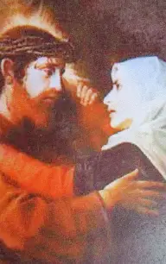
What is the Marian Way of the Cross? (2)
Sometimes the Marian Way of the Cross is called the “Via Matris,” because it is not simply the Way of Mary, but the way of the Mother. We contemplate Our Lady’s motherhood of Jesus, and her spiritual motherhood of ourselves, when we pray the Marian Way of the Cross, placing our losses into Our Lady’s hands, so that we may respond to them with her level of faith, and gain the grace that God wishes to give us in our grief. To understand Our Lady’s love for us as our spiritual mother is very healing, for in her own grief for her Son, she reaches out to us to help us, to save us from spiritual death, and bring us to victory over death through her Son

Slide 31
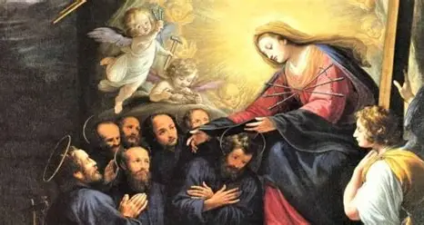
What is the Marian Way of the Cross? (3)
It is also an option to pray the Via Matris in correspondence with the Servite rosary, the chaplet of Our Lady’s Seven Sorrows, in which one visits seven stations aligning with each of the sorrows of Our Lady (in 1233, on the feast day of her Assumption, Our Lady appeared to seven holy men, asking them to found the Servite order to promote devotion to her seven sorrows)
  When praying the Via Matris as a group, the priest reads the Scriptural passage associated with one of Our Lady’s sorrows, and the people kneel afterwards to say a prayer to console Our Lady in her desolation. Then, they say a “Hail Mary,” and ask the Virgin Most Sorrowful to pray for us. At the conclusion of the service, three “Hail Mary” prayers are said, and a special prayer for the desolate Mother Mary

Slide 32
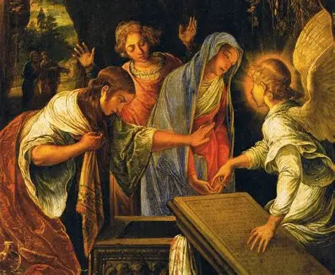
What is the Stations of the Resurrection devotion? (1)
The Stations of the Resurrection devotion was first developed in 1988, and is also called the “Via Lucis,” or the “Way of Light”
This stational devotion is a continuation of the Stations of the Cross devotion: it picks up where the Via Crucis leaves off, with the Resurrection that comes after Christ’s Death on the Cross. When we pray the Stations of the Resurrection, we meditate on the events in the life of the Risen Lord and His apostles taking place in the fifty days between Easter Sunday and Pentecost Sunday
In contemplating the Risen Lord, we contemplate the risen light, the ways in which the carrying of the Cross in union with Jesus allows us to reflect His light, and fully receive the light of His love into our hearts, that we may further radiate it outward
This devotion helps us to place hope in our own spiritual resurrection, as we consider how we can serve Our Lord like the apostles, so that we may join them in Heaven, in the meantime, making this world more heavenly through reflecting the love of the Risen Lord, Who came back to help His apostles, to prepare them for carrying on His mission in this life, that many souls would unite with Him in the next

Slide 33
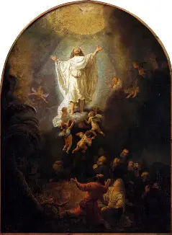
What is the Stations of the Resurrection devotion? (2)
Similar to the Stations of the Cross, when we pray the Stations of the Resurrection, we travel spiritually between fourteen different stations, meditating on Scriptural passages associated with each one
As we begin each station, we pray the versicle and responsory, “V. We adore You, O Christ, and we praise You. R. Because by the wood of the Cross and the light of the Resurrection, You have redeemed the world!”
Following each station, we pray the “Alleluia.” Whereas the Via Crucis aligns with the Sorrowful Mysteries, and is penitential in spirit, the Via Lucis aligns with the Glorious Mysteries, celebrating the fruits of the Cross, the redemption of the world, with a joyful spirit

Slide 34
Name of the Station of the Resurrection | Corresponding Scriptural Passage
1. Jesus Rises from the Dead | Matthew 28:5-6
2. The Disciples Discover the Empty Tomb | John 20:8
3. The Risen Lord Appears to St. Mary Magdalene | Luke 20:14-18
4. The Risen Lord Appears on the Road to Emmaus | Luke 24:13-16
5. The Risen Lord is Recognized in the Breaking of the Bread | Luke 24:28-31
6. The Risen Lord Appears to the Community of Disciples | Luke 24:36-40
7. The Risen Lord Breathes Peace and Gives the Power to Forgive | John 20:20-23
8. The Risen Lord Strengthens the Faith of St. Thomas | John 20:24-28
9. The Risen Lord Eats with the Disciples on the Shore of Tiberias | John 21:10-13
10. The Risen Lord Forgives St. Peter and Entrusts Him to Feed His Sheep | John 21:15-17
11. The Risen Lord Sends the Disciples into the World | Matthew 28:18-20
12. The Risen Lord Ascends into Heaven | Mark 16:19-20
13. Mary and the Disciples Keep Vigil in the Upper Room for the Spirit’s Coming | Acts 1:13-14
14. The Risen Lord Sends the Holy Spirit | Acts 2:2-4

Slide 35
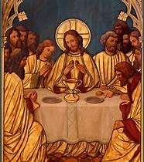
What is the Stations of the Holy Eucharist devotion? (1)
The Stations of the Holy Eucharist devotion is promoted by the Poor Clares of Perpetual Adoration in Alabama (the community once headed by EWTN’s Mother Angelica)
When we pray the Stations of the Holy Eucharist, we meditate on Scriptural passages from the Old Testament prefiguring the Holy Eucharist, and on Scriptural passages from the New Testament honoring Our Lord, Jesus Christ, as the True Bread
There are twelve stations of the Holy Eucharist in the original devotion, but new adaptations have been made in which there are fourteen stations, including the stories of the sacrifice of Abel, the sacrifice of Abraham, and St. John the Baptist pointing to Our Lord as the Lamb of God
The Stations of the Holy Eucharist help us to contemplate how Our Lord in the Blessed Sacrament feeds us with His gift of His loving Heart, the source of our life, and the means to our salvation, our eternal life

Slide 36
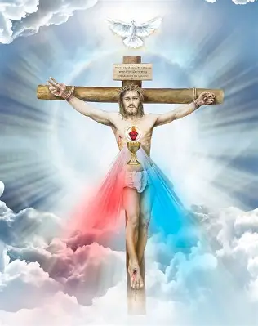
What is the Stations of the Holy Eucharist devotion? (2)
When we pray the Stations of the Holy Eucharist, we see how Our Lord has provided for us over time, and can have a deeper sense of joy, hope, and peace in knowing that He will continue to give us our daily bread; we are given the sustenance, the fortification, we need to carry our crosses on the road to Heaven
We begin each station of the Holy Eucharist by praying, “O Sacrament Most Holy, O Sacrament Divine. All praise and all thanksgiving be every moment Thine.” After each station, we pray, “Eucharistic Heart of Jesus, have mercy on us! Mary, Mother of the Eucharist, pray for us!”
In practicing this devotion, we deepen our devotion to Our Lady, too, because we contemplate the Presence of Our Lord that Our Lady always treasured in her Immaculate Heart; after her Son’s Ascension into Heaven, her Heart would be sustained amidst the cross of His physical absence by receiving Him in the Holy Eucharist, until she could be reunited with Him at the wedding feast of the Lamb in Heaven. She teaches us to cradle the Eucharistic Heart of Jesus deep within our own hearts as living tabernacles

Slide 37
Name of the Station of the Holy Eucharist | Corresponding Scriptural Passage
1. The Offering of Melchisedek | Genesis 14:17-20; Psalms 110:4
2. The Jewish Passover | Exodus 12:7, 11, 13
3. The Manna from Heaven | Exodus 16:4
4. The Old Temple/the Ark of the Covenant | 2 Chronicles 5:14; 6:1, 2, 18
5. Elijah and the Hearth Cakes | 1 Kings 19:7-8
6. Bethlehem: The House of Bread | Micah 5:2
7. The Wedding Feast at Cana | John 2:7, 9, 10
8. Multiplication of the Loaves | Mark 6:41-42, 44
9. The Bread of Life Discourse: Jesus, the Bread of Life | John 6:47-50
10. The Last Supper | Luke 22:19
11. The Road to Emmaus: | Luke 24:30-31
12. The Wedding Feast of the Lamb | Revelation 19:7, 9

Slide 38
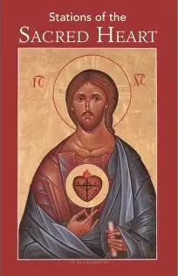
What is the Stations of the Sacred Heart devotion? (1)
The Stations of the Sacred Heart devotion was developed by the Sisters of the Visitation of Holy Mary in Tyringham, MA. Their booklet containing the prayers and meditations for this special devotion was published in 2019 by Marian Press at the National Shrine of the Divine Mercy in Stockbridge, MA
This devotion helps us to reflect on the love in Jesus’ Sacred Heart for us since He became Flesh in Our Lady’s womb at the Incarnation. We move not only through the events of the Passion of Our Lord in this devotion, but through all of the stages of salvation history in which Our Lord worked in the created world to convey the depth of God’s great love to us
Through praying this devotion, we come to see so many nuances of Jesus’ Sacred Heart, so many ways in which He loves us, and so generously expresses that love to heal, uplift, and sanctify us. We can come to treasure the Heart of Jesus as the Immaculate Heart of Mary does

Slide 39
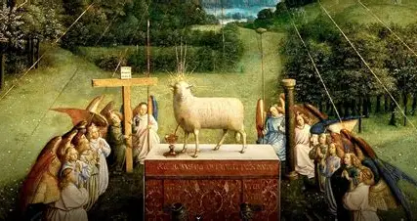
What is the Stations of the Sacred Heart devotion? (2)
There are fourteen Stations of the Sacred Heart, and at the beginning of each station, we pray the versicle and responsory, “V. We adore You, O Lord, and we love You. R. Because by Your Sacred Heart, You have made manifest Your love.”
During each Station, we read a Scriptural passage relating to the expression of love in the Sacred Heart being contemplated, then reflect, and say a prayer petitioning Our Lord to help us to imitate the unique way in which He expressed His love from His Heart
The concluding prayer after all of the stations is “Sacred Heart of Jesus, have mercy on us,” and a “Glory Be”

Slide 40
Name of the Station of the Sacred Heart | Corresponding Scriptural Passage
1. The Incarnation | John 1:14, 18; Luke 1:26-31, 35-38
2. The Nativity of Our Lord | Luke 2:6-20
3. The Temptation of Jesus in the Desert | Luke 4:1-8, 12-13
4. The Calling of the Apostles | Mark 10:21
5. The Multiplication of the Loaves and Fishes | Matthew 14:14, 19; Matthew 15:32-38
6. Jesus Comforts the Grieving Widow | Luke 7:11-17
7. Jesus Heals the Adulterous Woman | John 8:10-11
8. The Good Shepherd | Luke 15:3-7
9. Jesus Weeps for Jerusalem | Matthew 23:37-39; Luke 19:41-44
10. The Last Supper | Luke 22:14-20; John 13:23-25
11. The Garden of Gethsemane | Luke 22:39-46
12. The Piercing of the Heart of Jesus | John 19:31-37
13. Saint Thomas Places His Hand into Jesus’ Sacred Side | John 20:24-29
14. Jesus Asks St. Peter, “Do you love me?” | John 21:15-19

Slide 41

What is the Little Way of the Cross? (1)
The Little Way of the Cross is a special Stations of the Cross devotion inspired by St. Therese of Lisieux, who developed the “Little Way” of holiness, a path towards Heaven paved with small acts of great love offered to God the Father for His glory
The Little Way of the Cross uses the traditional Stations of the Cross, but incorporates additional prayers after the stations, and includes quotes from St. Therese for meditation at each Station. Following the Stations, participants may say the indulgenced prayer before the crucifix, the Prayer to the Holy Face, and meditate on an image of the Holy Face, such as the painting made by St. Therese’s sister, Pauline, of the Holy Face, painted after the style of the Shroud of Turin image, which increased devotion to the Holy Face in the nineteenth century, especially in St. Therese’s family, as each of her family members enrolled in the Confraternity of the Holy Face. Subsequently, participants may pray for the intercession of St. Therese, asking her to help souls to compassionate with Christ and live with the love and mercy that He exemplified during His Passion

Slide 42
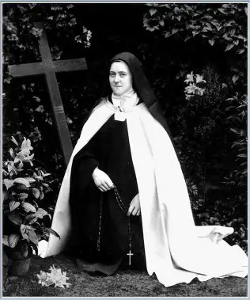
What is the Little Way of the Cross? (2)
Saint Therese’s full name in religion was St. Therese of the Child Jesus and the Holy Face: she had a deep devotion to the Holy Face of Jesus, seeing the love in Our Lord’s Face, the same Face of the Child Jesus she so adored. In praying the Stations of the Cross with St. Therese, we can go to Our Lord with compassion, much like St. Veronica did, looking upon His Face with love, and venerating it for the mercy it radiates. In gazing upon the Holy Face of Christ, we can open ourselves to receiving special graces, responding to Our Lord, as He looks at us with compassion, inviting us to unite our wounds with His, and to be healed. We come to understand something of the depth of Christ’s love behind His Sacrifice, and can be moved to contrition, to console the Heart of Jesus and receive His forgiveness, by practicing the Holy Face devotion; we can come to see that Christ went through His Passion to save all of us, so when we look upon His Face, we can see Him imploring us to care for each other, calling us to conversion, and to respond to the Presence of Christ that is within each person, shining through their faces that were made in God’s image. The Little Way of the Cross reminds us that we can take little steps each day to sacrifice in union with Christ, joyfully walking with Him, treasuring the opportunity to become closer to Christ’s Heart, to love Him more deeply and fully

Slide 43
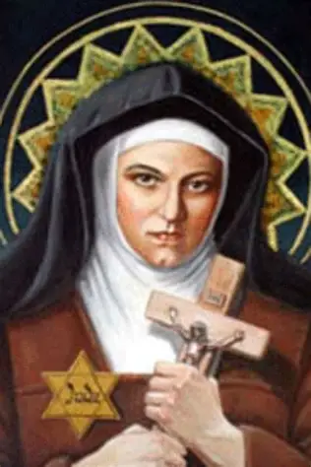
What is the Carmelite Way of the Cross?
The Carmelite Way of the Cross uses the traditional fourteen Stations, but includes meditations from Carmelite saints, including St. Elizabeth of the Trinity. Poems from the Carmelites St. Titus Brandsma and St. John of the Cross are included in between stations for reflection
Practicing the Carmelite Way of the Cross devotion helps us to understand the Passion through the lens of a very Marian religious community, that of the Carmelite order. “Carmel” means “God’s garden.” We can come to understand more about the Passion’s role in developing God’s garden in this life, and the next, by touching hearts with Christ’s merciful love, and leading them to conversion. Using the writings of Carmelite saints help us to be inspired by how brothers and sisters in Christ can unite in common love of Christ, coming together to console Him, and to build up Christ’s Church through their prayers, growing it from the drops of the Precious Blood shed for us, producing fruits that flower forth as a result of Christ’s self-giving love
The fifteenth station is also offered as an option in the Carmelite Way of the Cross

Slide 44
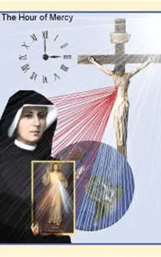
What is St. Faustina’s Way of the Cross? (1)
Saint Faustina’s Way of the Cross uses the fourteen traditional Stations of the Cross, but has a special emphasis on Our Lord’s Divine Mercy that is expressed at each station; in this sense, it conveys a spirit of hope
Saint Faustina’s Way of the Cross includes excerpts from her Diary. After the excerpt from the Diary is read, the people pray a special prayer of petition relating to the Diary reading, asking Our Lord to help them to emulate Him in His merciful love, by invoking the Merciful Jesus; then, they pray for Our Lord to have mercy on us. A verse honoring Our Lady of Sorrows is sung following these prayers (typically, the “Stabat Mater” is sung)

Slide 45
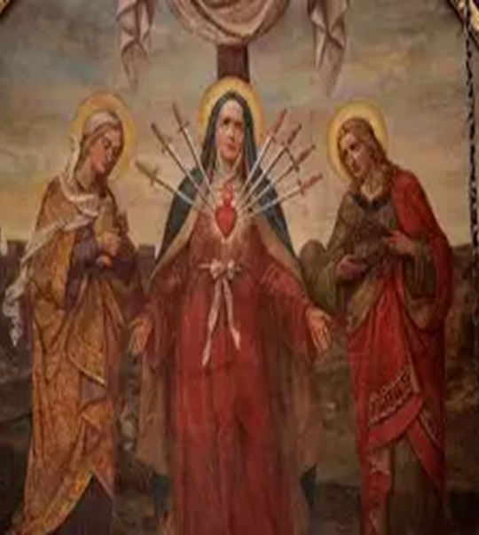
What is St. Faustina’s Way of the Cross? (2)
At the end of St. Faustina’s Way of the Cross, an “Our Father,” “Hail Mary,” and “Glory Be” are said for the intentions of the Holy Father, as we pray that God the Father would guide our pope in carrying his crosses, that he may lead the Church faithfully, and model to us how to glorify God in the Passion that we go through personally, and collectively, as a Church
We ultimately are reminded to be merciful with ourselves and each other, to see Christ in each person, and compassionate with them, channeling the spirit of Mary, Mother Most Merciful, who forgives all of her spiritual children who have wounded her Son, helping us to console His Sacred Heart, and therefore, her Immaculate Heart

Slide 46
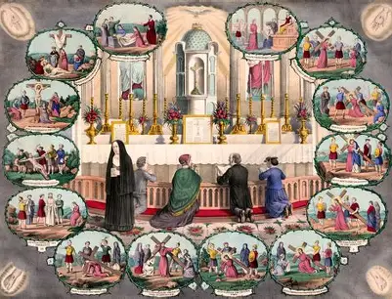
What is the scriptural Stations of the Cross?
In 1991, Pope St. John Paul II introduced a new Stations of the Cross devotion that only has stations honoring events cited directly in Scripture. Since Jesus’ meeting with His Mother, St. Veronica, and the three times during which He fell are not mentioned in Sacred Scripture, these stations are omitted from the Scriptural Stations of the Cross. Nine of the fourteen original stations are kept in the scriptural Stations of the Cross; five new stations that are supported by Scripture are introduced
  Jesus prays in the Garden of Gethsemane; Jesus, betrayed by Judas, is arrested; Jesus is condemned by the Sanhedrin; Jesus is denied by St. Peter; Jesus Promises Paradise to the Good Thief

Slide 47
Name of Station in the Scriptural Stations of the Cross | Corresponding Scriptural Verse
Station 1: Jesus in the Garden of Gethsemane | Matthew 26:36-41
Station 2: Jesus, Betrayed by Judas, is Arrested | Mark 14:43-46
Station 3: Jesus is Condemned by the Sanhedrin | Luke 22:66-71
Station 4: Jesus is Denied by St. Peter | Matthew 26:69-75
Station 5: Jesus is Judged by Pilate | Mark 15:1-5, 15
Station 6: Jesus is Scourged and Crowned with Thorns | John 19:1-3
Station 7: Jesus Bears the Cross | John 19:6, 15-17
Station 8: Jesus is Helped by Simon the Cyrenian to Carry the Cross | Mark 15:21
Station 9: Jesus Meets the Women of Jerusalem | Luke 23:27-31
Station 10: Jesus is Crucified | Luke 23:33-34
Station 11: Jesus Promises His Kingdom to the Good Thief | Luke 23:39-43
Station 12: Jesus Speaks to His Mother and the Disciple | John 19:25-27
Station 13: Jesus Dies on the Cross | Luke 23:44-46
Station 14: Jesus is Placed in the Tomb | Matthew 27:57-60

Slide 48
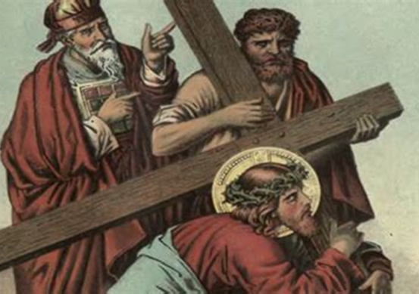
What does the Scriptural Stations of the Cross add to our understanding of Christ’s Passion?
After each station, we pray, “Lord Jesus, help us to walk in Your steps.” We also pray for specific virtues that Jesus exhibited at each station
  This helps us to make a stronger connection between Jesus’ actions, and our own lives, in terms of how Our Lord’s Sacrifice has shaped us, and helped us to grow in virtue; we are also inspired to reflect on how we may apply our learning at each Station, imitating Our Lord in His actions, and gaining clarity from meditating on His Passion about how we may similarly offer up our sacrifices and sufferings for the salvation of souls, uniting ourselves with Jesus, and experiencing the depth of love in His Heart
This Stations of the Cross devotion is rooted most firmly in Sacred Scripture, so that we may treasure the word of God in our hearts, just as Our Lady did
This devotion helps us to better appreciate all of the suffering Our Lord endured emotionally before the Passion, too, in the leadup to the walk to Calvary; we meditate on all of the events that set the Passion in motion, namely, Judas’ betrayal of Jesus. There is also a stronger correlation with the sacred mysteries of the Holy Rosary, as the Agony in the Garden, the first Sorrowful Mystery, is included in the Scriptural Stations of the Cross devotion, so we can deepen our understanding of the Holy Rosary, linking these two devotions to express a greater love for God

Slide 49
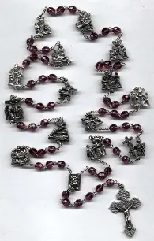
What is the Stations of the Cross rosary? (1)
The Stations of the Cross rosary allows us to pray the Stations of the Cross while using a tangible devotional item: a chaplet made up of 62 beads. In the chaplet:
There are fifteen single beads (technically, fourteen beads, and one centerpiece), one for each station in the modern Way of the Cross, including the Resurrection
Associated with each of the fifteen single beads are groups of three beads, for a total of sixty beads. Besides these sixty beads, there are two preparatory beads

Slide 50
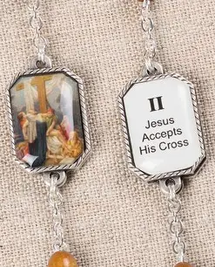
What is the Stations of the Cross rosary? (2)
Before praying the chaplet, on the first preparatory bead, one prays the Act of Contrition. Then, on the second preparatory bead (before the centerpiece), one prays the Prayer to Jesus Christ Crucified
On each of the large fifteen single beads in the chaplet, one prays the opening versicle and responsory associated with each Station: “V. We adore You, O Christ, and we bless You. R. For by Your Holy Cross, You have redeemed the world.”
On the first bead in each set of three beads, one prays the “Our Father.” On the second bead in each set of three beads, one prays the “Hail Mary.” On the third bead in each set of three, one prays the “Glory Be”
This chaplet helps us to keep track of the prayers at each Station, organizing them for us. We are reminded that Our Lady leads us by hand from Station to Station, helping us to treasure her Son in our hearts with her, remaining near to her Immaculate Heart of forgiveness and love, to be purified by it

Slide 51
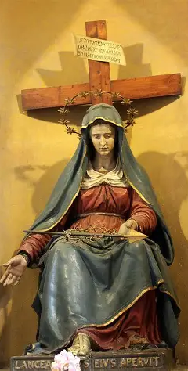
Why is devotion to the Holy Cross essential to devotion to Our Lady?
Devotion to the Holy Cross is closely linked to devotion to Our Lady; the two are inseparable
To love Our Lady is to love how she stood by the Cross, to love her Immaculate Heart of gentleness and strength, that could not be broken or shaken in faith by the things happening in the world. Her Immaculate Heart was conformed to the Cross, to God’s plan, having been given entirely to Him out of love, so it remained steadfast
In order to grow in devotion to Our Lady, we can meditate on the self-gift of Our Lord, Who gave His life for us on the Cross. We can reflect on how Our Lady shares in her Son’s Sacrifice, and consider how she gives herself as a gift, too, as the co-redemptrix, the one who redeems with Christ, in having brought the Redeemer into the world. In embracing the Cross, we embrace Our Lady, who stood by it, and welcomed every opportunity to glorify God, including by bearing the crosses He gave her. We learn from the Cross how to love each other, to see Christ in each person suffering and bearing His Cross, and we can respond with the love of Jesus and Mother Mary, helping them to shoulder the Cross. Through devotion to the Holy Cross, like Our Lady, we can bring Jesus’ love into the world, supporting each other in triumphing over the Cross by choosing to love and forgive, to be uplifted by God’s strength and mercy when we are otherwise weak

Slide 52
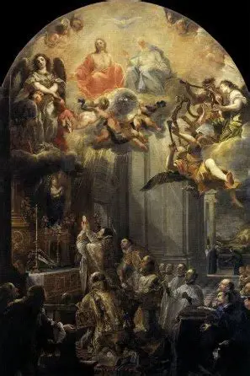
Announcements
Liturgical Rosary Prayer Group Session: Feast of Our Lady of Knock
  Glorious Mysteries for the intentions of Fr. Sliwa
  Sunday, August 17, 2025
    3:00 p.m., parish library
Consecration to the Holy Guardian Angels information session:
  Wednesday, August 20, 2025
    6:30 p.m., parish hall
Women Doctors of the Church learning series
  First session: Monday, September 8, 2025
    5:00 p.m., church

Slide 53

Closing Prayer: Stations of the Cross Closing Prayer (St. Alphonsus Liguori)
Jesus, I kneel before you and ask you: fill my heart with faith, hope, and charity, with true repentance for my sins, and a firm desire of amendment. Amen.
Our Father…
Hail Mary…
Glory Be…

