Slide 1
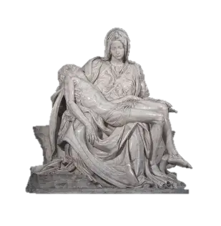
Living in God’s Image: Practicing Visio Divina in Union with Our Lady
Saturday, August 9, 2025
Katie Sadakierski

Slide 2
Outline
Introduction
Outline
Opening Prayer
Presentation
  I. The beauty of interweaving sacred art and biblical numerology into our spiritual lives
  II. Biblical numerology as reflected in sacred art: Applying knowledge of biblical numerology to visio divina
  III. The Immaculate Heart of Mary as the ultimate masterpiece of order, harmony, and balance
Closing Prayer
Q & A

Slide 3
Opening Prayer: Prayer before visio Divina (by Katie Sadakierski)
God our Father, we thank You for the blessing of coming together as a family to rejoice in the beautiful works of art that You have inspired. Open the eyes of our souls to see Your greatness shining through the masterpieces that have been made for Your glory. In Your goodness, open our hearts to receive Your love all the more deeply as we contemplate the masterpiece of each soul that has created art in Your Holy Name. Please guide our contemplation, that it may bear fruit for Your service. Through Christ our Lord. Amen.

Slide 4
How is God perfect order, balance, and harmony?
God is love, so in God, there is perfect order, balance, and harmony, because these outcomes can only flow from love, the root of all being, of life and virtue
God orders everything for His glory
Heaven is organized into ranks: every soul is accounted for
  There are ranks according to state of life, such as virgin or martyr, and degrees of glory to which one may shine, according to the measure of their love on Earth
  Ranks of holy angels are used to order the infinite number of holy angels God created, each to reflect one of His divine perfections, which are immeasurable
God knows the numbers of hairs on our heads. Everything has been designed for a specific purpose, serving as a unique way to honor Him
God creates everything to relate to each other; there is always complementarity in His plan. Since a virgin, Eve, would bring sin into the world by disobediently eating forbidden fruit from the Tree of the Knowledge of Good and Evil, God would counterbalance this by creating the Virgin Mary, the New Eve, to obediently bear Jesus, the Fruit of her womb, to give His life on the tree, the Cross, for our salvation

Slide 5
What are Fibonacci numbers?
“Fibonacci numbers” refers to a sequence of numbers that repeat in nature. A Catholic mathematician named Leonardo Bonacci made this discovery
Each number in the Fibonacci sequence is the sum of the two numbers that preceded it
  This signifies that God brings us all together for a special purpose; God adds so much to our lives through His love, and multiplies our good efforts in His generosity, supplying what we need
Usually, such natural elements as leaves and petals appear in sets of three and five: numbers of love and completion, communicating how God completes and loves us through what He provides for us in nature

Slide 6
Why do we create and engage with sacred art?
God is creative: God the Father created the world. He made the natural landscape, and He made the spiritual landscape of the human soul. Art reveals something to us about the nature of God, and about human nature
God creates unique human beings in His image. He allows human beings to participate in the creative act
When we apply our creativity, we reflect God’s creativity; we work in tandem with the Divine Artist to become the masterpieces we were intended by God to be
Creating and engaging with sacred art allows us to be close to God
The creation of art, and the ability to appreciate beautiful sacred art, is a means of giving glory to God. We can pray in thanksgiving for how He works through artists, inspiring them to create beautiful works that bring spiritual joy, and that allow them to use the talents He gave them

Slide 7
How is balance created in art? What does it reflect about God, and his work in us?
Artists create balance through many elements, whether color, line, shape, light, or other aspects of design
An artistic creation is a kind of feast, a balanced menu of many different dishes, all of which nourish us in different ways
Artists may create balance by juxtaposing opposites, creating a contrast between dissimilar elements
Artists may group figures or objects in certain numbers
God has made each of us uniquely. He made us interdependent. None of us has every talent. We rely upon each other, combining our talents to accomplish shared goals. There is balance in the pairing of opposites, a complementarity that reminds us of how Our Lord unites all things for God’s glory. God uses all of us in His saving work, just as the twelve apostles were all different, but were all called by Christ to build up His church; they all contributed to the unfolding of salvation history in their own way
Jesus is fully human and fully divine; Our Lady is fully a mother, and fully a virgin. Jesus and Mother Mary are perfectly balanced; God’s love allows for all things to work together for His glory

Slide 8
What is visio divina?
Just as lectio divina is a form of sacred reading in which we spiritually engage with God’s word, prayerfully taking it into our hearts through meditation and contemplation, visio divina is form of sacred viewing, in which we look at sacred art, art created for God’s glory, with the eyes of faith
There are five steps of visio divina, which help us to ascend the steps to Heaven, towards union with Christ, through contemplation of His goodness. These five steps help us to love Him better as we open our hearts to receive Him in what He expresses to us through this process:
  Choose the work of art to view; what is resonating with you? What does God call you towards?
    Clear your mind of distractions. Center yourself
  Respond to God’s call, and look at the painting, taking in all of its details
  Meditate on the painting: how does it make you feel? How do all of its elements come together? What story of God takes shape in this work? What is its deeper meaning, and how does that shape your knowledge of the Lord?
  Pray: Ask Our Lord to illuminate your mind with understanding to receive His insight from this process
  Contemplate: Spend time in silence in God’s Presence, receiving Him into your heart

Slide 9
How do biblical numerology and sacred art relate?
Sacred art reflects biblical numerology concepts; we see that figures are grouped in specific sets according to what numbers symbolize in the Holy Bible. The figural groupings, and in general, the appearance of numerical patterns, adds to the richly symbolic storytelling
We can apply our knowledge of biblical numerology, of the symbolic significance of numbers in the Holy Bible, to analyzing art. Beyond art analysis and appreciation, we can engage in visio divina, prayerfully engaging with art, asking Our Lord to teach us what He wants us to know through the art He has inspired for His glory, and as a means of revealing His love to us. God made us to perceive with our senses, and communicates to us in tangible ways that we can understand with our senses

Slide 10
Why does God communicate spiritual truths to us through numbers? What do they convey to us about the spiritual life? (1)
Just as the Church year is organized into patterns, rhythms, of dying and rising that are patterned after Our Lord’s life, numbers are balanced, signifying completion and incompletion
Numbers reveal to us the perfection of God; we can further appreciate His divine Wisdom, expressed through the total precision and beauty of numbers that are reflected in nature and in art
We are meant to engage faith and reason. God gave us the ability to reason; our logical and mathematical intelligence as humans reflects something of God’s intelligence. Our engagement with numbers further evidences that we were made in God’s image. God gave us reason to know Him, so that we could choose to love Him; faith and reason do not contradict each other, but go together

Slide 11
Why does God communicate spiritual truths to us through numbers? What do they convey to us about the spiritual life? (2)
God speaks to our minds through numbers, but also, to our hearts, in which He put a love for beauty and balance, order and harmony, so He reveals His beauty, truth, and goodness to us through numbers
Our Lord multiplies our efforts; we are simply to bring Him our incomplete, imperfect selves, and He will perfect and complete us through His love, restoring our souls to glory, that we may be glorified with Him in Heaven. Numbers reflect the rich tapestry of salvation history, telling the story of God’s love through time, which is the measure of change; numbers are also infinite, and reflect something about the boundlessness, the sheer magnitude, of God’s immeasurable love in eternity, the measure of changelessness
We are meant to each be the product of Christ’s teaching
Numbers teach us about balance, in that we only have true order, harmony, and balance through God; to be holy, we need moderation, a variety of virtues. Too much of anything distracts us from our true purpose: God is balance, so to live with balance is to honor and emulate Him

Slide 12
Where may we learn more about sacred art and biblical numerology?
Smarthistory: View videos on Catholic symbolism (i.e. numerical groupings) in renowned medieval, Renaissance, and Baroque works of art
Saint Augustine’s sermons
  Saint Augustine captures something of the genius of God in his sermons, namely, those written for the Christmas and Epiphany seasons, preaching about the rich symbolism of numbers that recur in Sacred Scripture. He captures the poetry and artistry that is within the pattern of numbers in the Holy Bible
Pope Benedict XVI’s Jesus of Nazareth series
  Pope Benedict XVI explains how numbers appear in Jesus’ earthly life, describing the significance of certain numerical patterns, and what they reveal about God’s greatness
    Book one: From the Baptism in the Jordan to the Transfiguration

Slide 13
What does the number one signify in the Holy Bible?
One signifies unity
In the number “one,” we are given a sense of God’s transcendence, His greatness, in having come first, namely, in having loved us first. He was in existence before all of creation
Oneness represents wholeness; there is a sense of peace communicated through the number one, in which there is the absence of division and brokenness
We believe in one God, and in one, holy, Catholic, apostolic Church

Slide 14
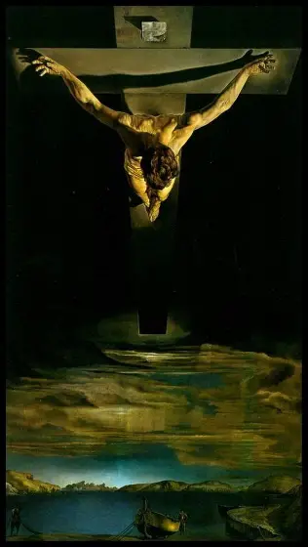
Christ of St. John of the Cross
by Salvador Dali
(1951)

Slide 15
How is the number one represented in sacred art?
In Salvador Dali’s painting of the Crucifixion, we are reminded that it is through the Sacrifice of the Prince of Peace, Our Lord, Jesus Christ, that we are made whole
We are truly united in Christ, Who shed His Most Precious Blood for all of us, for our healing. The aerial view of Christ causes Christ’s Body to resemble a chalice, or the arms of the dove, the Holy Spirit, outstretched to pour His light and gifts on the apostles. Our Lord sheds His Blood out of love, but here, we do not see so much of the Blood; only the contrast between dark and light, as Christ triumphs over the darkness of the world with His love
Often, we see paintings of the Crucifixion that include figures grouped around Our Lord’s Cross, namely, St. John, St. Mary Magdalen, and Mother Mary, but they are conspicuously absent in this painting; we are reminded that our salvation, our very life, begins and ends with Christ; He is the center of this life, and the next. This painting reminds us to keep Our Lord at the center of the heart. Though he is not visible, a fisherman is below Our Lord in the painting: Jesus, the Fisherman of souls, looks upon one for Whom He is giving His life out of love; each soul is precious to Jesus
Our Lord appears to be looking down into a reflecting pool in this image; we are reminded that if we are to be united, we are to see Christ reflected in each person, and love His Presence in the soul of every human being. We see the shadow of Christ’s arm reaching out to us to unify us through the Holy Cross: it is plunged into the ground, but reaches up, linking Heaven and Earth as one Church united by Christ

Slide 16
What does the number two signify in the holy bible?
The number two signifies complementarity
The Holy Bible is comprised of two testaments: the Old Testament and the New Testament
Our Lord has two natures: human and divine
We receive the sum of two when we add the number one twice, and one is the number of unity, so in the number two, we have a certain sense of unity as well
When we bring together two opposites, we have balance; the number two signifies something of how God gives us balance, bringing us from our broken human nature, to perfection in Christ; Jesus took on human flesh so that He could help us to become godly, like Him. We go from death to life when we progress with Christ, and open ourselves to being completed by Him

Slide 17
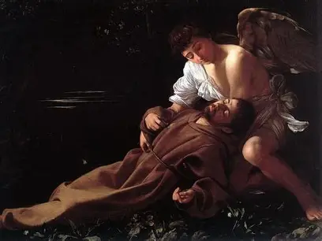
The Ecstasy of St. Francis by Caravaggio (1595)

Slide 18
How do we see the number two represented in sacred art?
In these two figures in the painting, we see a certain level of complementarity: there is a perfect contrast between the darkness of the background, of the world, and the light of the figures, who are illuminated from within by love for Christ
Saint Francis of Assisi reflects the light of Christ: in living in such perfect spiritual union with Christ, He reveals something of the mystery of Christ’s hypostatic union, the union between His divine and human natures. Saint Francis is human, but has a godly quality in his perfect love for Christ. He received the wounds of Christ for his faith, and points to his heart wounded by Christ’s love, a love that leads him to become insensible to the world, to transcend it, and be one with Christ. He takes on an angelic character in adoring Christ, dying with Him to rise with Him
Saint Francis lowers himself and decreases so that Christ may uplift him and increase within his soul. The holy angel supports him, as though to raise him up to Heaven to completely join Christ, not only in a mystical vision
There are no background elements, no other physical figures, to distract us from this painting of the work of Christ on a soul, the interplay between God and man

Slide 19
What does the number three signify in the Holy Bible? (1)
The number three is the number of the soul, for it is the number of the Persons of God in the Holy Trinity, and the Blessed Trinity dwells in our souls
There are three theological virtues: faith, hope, and love
  When we live with faith, hope, and love in our souls, we can become more like God. God’s Presence in our souls helps us to grow in these virtues, so that we may become more united to Him spiritually
There are three archangels named in Sacred Scripture, each of whom help us to live with faith, hope, and love: St. Michael, St. Gabriel, and St. Raphael
Three is a number of completion, because a story has three parts: a beginning, middle, and end. God’s story of love is completed through Christ, and in those who are united with Him in His saving work
There are three women named “Mary” who are associated with Our Lord and Our Lady: St. Mary Magdalen, St. Mary Salome (the mother of St. James the Greater and St. John the Beloved Apostle), and St. Mary of Cleophas (the mother of St. James the Lesser and St. Jude). Being like each of these women in spirit will allow us to remain close to Christ, for we will remain by Christ’s Cross with them, and go to anoint Him at the tomb, uniting ourselves with Him spiritually in love

Slide 20
What does the number three signify in the Holy Bible? (2)
There are three evangelical counsels: poverty, chastity, and obedience. Living these out according to our state of life will allow us to virtuously follow God, to reverence the Blessed Trinity
The Church has three states, three groupings of the communion of saints: the Church Militant (the Church on Earth), the Church Suffering (the Church in Purgatory), and the Church Triumphant (the Church in Heaven). Communion with Our Lord allows for communion with each other, and for us all to be united in the Church Triumphant, the Heaven of the Blessed Trinity, by practicing the three godly virtues. Praying for each other, sharing faith, hope, and love, will allow for us to be brought into deeper communion with each other
There are three hours between when Our Lord was placed on the Cross and perished: from 12:00 p.m. to 3:00 p.m. Meditating on this period and making reparations can help us to grow in virtue, especially as we unite our sufferings to the sufferings of Christ for the salvation of souls; sharing in Christ’s suffering can allow for us to share in His glory. Our Lord rose again on the third day, completing God’s plan for our salvation, our rise to Heaven with Our Lord
The Church has three powers: to teach, to govern, and to sanctify. When the Church fulfills this purpose through her apostles (the original twelve may be broken into four groups of three), souls are brought to Heaven

Slide 21
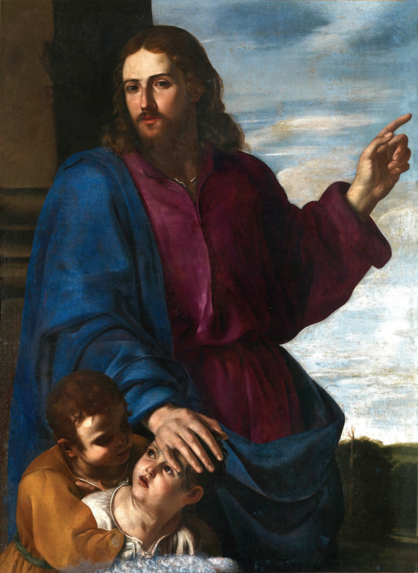
Christ Blessing the Children by Artemisia Gentileschi (1626)

Slide 22
How do we see the number three represented in sacred art?
Three figures are grouped in the painting: Our Lord, and two children, whom He blesses
We are most blessed when we live with faith, hope, and love, like Christ
In being childlike, we are like Christ, the Son of God, and can receive the greatest blessing; it is only in being like children that we may enter through the narrow gate of Heaven
This painting testifies to the Church’s threefold mission to govern, teach, and sanctify. Christ expresses His role as teacher with His hand outstretched in blessing, as though to instruct, to impart the blessing of His wisdom in the form of a lesson of love. He expresses His role in governance with His hand placed over the child’s head, in a protective, paternal way; Our Lord sanctifies through His charity, His closeness to the children, and attention to them

Slide 23
What does the number four signify in the Holy Bible? (1)
The number four symbolizes the body and nature, namely, human nature, and the natural world; it signifies the material rather than the purely spiritual
There are four seasons, and four corners of the Earth (four cardinal directions; when we follow Our Lord, we are always headed in the right direction)
  The natural world God created for us reveals His greatness; we are called to adore Him in all seasons, and to spread the good news of salvation in Christ to all the corners of the Earth, like Our Lady, who always praised Him
There are four Gospels in the New Testament, and four evangelists: Mark, Matthew, Luke, and John
  The four evangelists testify to how Our Lord helps us to overcome our human nature, and have a more godly one, like Him
There are four ends of prayer: thanksgiving, adoration, reparation, and petition
  Fulfilling these four ends of prayer, offering up our prayers to God, helps us to overcome our sinful human nature

Slide 24
What does the number four signify in the Holy Bible? (2)
There are four cardinal virtues: prudence, justice, temperance, and fortitude, natural virtues (human ones that we grow in through good works) that help us to gain the theological (godly) virtues that are infused by God within us
There are four marks, or outward signs, of the Church that make it visible: one, holy, Catholic, and apostolic
  Our Lord brings human beings together through His Church, that we may rise above this world, to Heaven
There are four graces promised to those who practice the devotion to Our Lady of Sorrows:
  Our Lady had superhuman strength and grace to withstand Christ’s Passion, suffer with Him, and offer it all up to God the Father. She gives similar graces from her Immaculate Heart to those devoted to her sorrows, helping them to transcend their human nature when going through sorrowful times

Slide 25
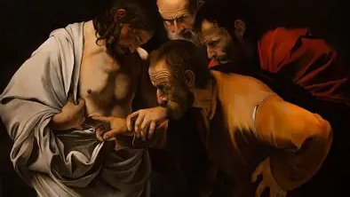
The Incredulity of Saint Thomas by Caravaggio (1603)

Slide 26
How do we see the number four represented in sacred art?
In this painting, St. Peter, St. John, and St. Thomas gather around Jesus. Saint John is the apostle to whom Our Lady, the Mother of the Church, is entrusted, and St. Peter is the apostle to whom Holy Mother Church herself is entrusted. When St. Thomas the Apostle doubts that Jesus has truly risen, he insists on placing his fingers in Christ’s wounds, touching his wounded side
Touching the Risen Lord leads St. Thomas to believe in the Resurrection. Our Lord helps him to overcome his doubtful human nature through the love and mercy He shares with St. Thomas
In total, there are four figures grouped together in the painting; we cannot see other figures in the background, which is totally dark, creating a contrast between St. Thomas’ doubt, and the light of understanding that comes from embracing Jesus’ love, from placing confidence in His Sacred Heart
Saint Thomas wears a torn shirt that, in a material way, mirrors the wound torn into Christ’s Flesh, His open Side. We see how Our Lord perfects St. Thomas in his woundedness. Saint Thomas’ hand is lovingly held, further expressing the mercy that Our Lord shows, in reaching out to God’s creation to touch their souls with grace, that they may be uplifted, and transcend this world, with all of its limitations
Saint Thomas’ fingers are plunged deeply into Christ’s Sacred Side: we see how expansive Jesus’ love is. Four represents the number of seasons and the evangelists: here, we are reminded that Jesus is with us in all seasons, extending a hand to lead us from doubt to faith, and to help us to evangelize, to spread the good news of His love, as we touch His wounds, using our challenging seasons of life to testify to Jesus’ faithfulness

Slide 27
What does the number five signify in the Holy Bible? (1)
The number five is the number of grace and love
Our Lord took on five holy wounds out of love for us on the Cross
There are five decades in each category of sacred mystery in the traditional Holy Rosary: five Joyful Mysteries, five Sorrowful Mysteries, and five Glorious Mysteries. Praying these consoles the wounded Heart of Christ as we express our love for Him, and receive His love into our hearts by uniting ourselves with His Mother’s Heart of love for Jesus
We console the Heart of Our Lady, wounded with Christ’s Heart spiritually, by making reparation for the five blasphemies against her Immaculate Heart on five First Saturdays in a row. On each First Saturday, we go to Holy Mass, receive Holy Communion, go to Confession, pray five decades of the Holy Rosary, and keep Our Lady company for fifteen minutes, sharing love with her Heart, just as her loving Heart led her to remain by Christ’s Cross

Slide 28
What does the number five signify in the Holy Bible? (2)
There are five intellectual virtues: understanding, science, wisdom, art, and prudence
  Through these virtues, we come to know and glorify God. Art is also a practical virtue, because we produce works for God, practicing the virtues through what we create out of love for God, in thanksgiving for His love
We have five senses, through which we can come to understand God’s love, and share His love
There are five means by which we satisfy God for the temporal punishment that our sins warrant:
  Prayer, fasting, almsgiving, performing the works of mercy, and patiently suffering the ills of life
  Charity covers many sins, and through offering these works up out of love, we may be healed by Christ’s love
    Eternal punishment is forgiven at Confession, but we still are to receive temporal punishment for our sins, as God’s justice demands, by suffering in this life and the next in Purgatory

Slide 29
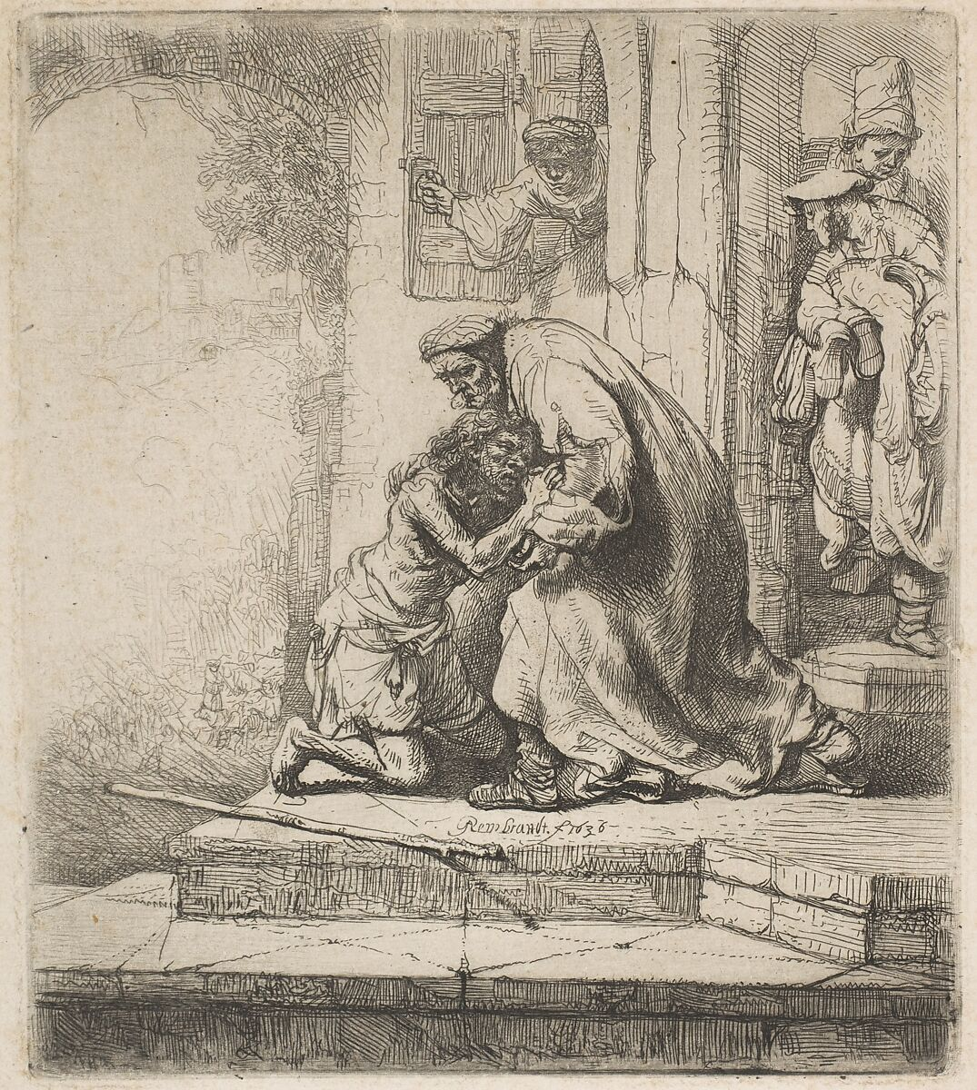
The Return of the Prodigal Son by Rembrandt van Rijn (1636) etching

Slide 30
How do we see the number five represented in sacred art?
In this early etching of one of his favorite stories, that of the Prodigal Son’s return, Rembrandt places five figures in the scene, reminding us that Our Lord heals us with His love, helping us to return to His Heart, to grace, through the mercy He extends to us with His wounded Hands outstretched
Three figures stand in the background, representing something of the virtues that the Prodigal Son will gain in returning to ask for his father’s forgiveness, and therefore, for the Lord’s mercy. The figure who stands alone, peering through the window, is believed to be the mother; she is representative of Our Lady, who opens the doors of our hearts to let in Christ’s mercy
The two figures grouped in the foreground, the father and son, stand in contrast to each other: the son in his tattered rags, the father in his resplendent robes, but their love for each other is palpable: there is complementarity in their mutual affection. The figure of the Son resembles that of Christ; we are reminded that He dwells in each person, and that the father is showing true charity in expressing mercy for the wounded son; the staff-like branch on the ground beside the son suggests the beams of the Cross, the tree on which Christ will give His life for our redemption from sin out of His mercy

Slide 31
What does the number six signify in the holy bible?
Six is a number of incompletion and imperfection, because it is in between five, the number of love, and seven, the number of charity, and love is what perfects us
The number six is associated with God’s mercy, because God reaches out to us to heal our imperfection in His mercy
Human labor is associated with the number six; there are six days on which we work during the week, and one on which we rest. Our works are incomplete without God, and are only perfected through His charity and mercy, when we offer them for Him
God created the world over the course of six days. He created the world out of His mercy and love
There are six precepts of the Church that we are to follow if we are to fully open our hearts to receiving God’s mercy and love

Slide 32
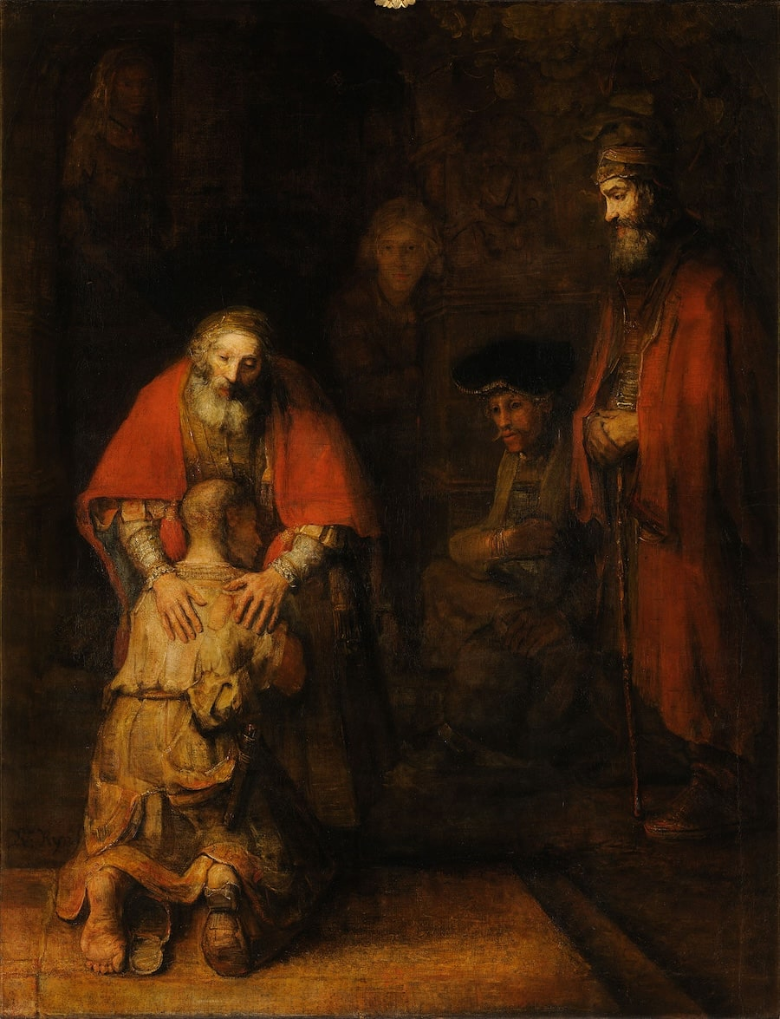
The Return of the Prodigal Son by Rembrandt van Rijn (1669)

Slide 33
How is the number six represented in sacred art?
In this masterpiece by Rembrandt, we see six figures placed together in the scene of the Prodigal Son returning to his father
The father and son are placed on the lefthand side in the foreground, in the light. They are the focal point of the painting, whereas the other four figures in the background are gathered in the shadows
Six is the number of mercy, but also, of incompletion. This image speaks to how the son is incomplete without his father, and therefore, returned home, so that he could be made perfect, healed, by the mercy of God extended to him through the loving heart of his father. After having sinned, he knelt before his father, humbly asking him pardon
His father responds with great compassion and tenderness, placing his hands on his son’s shoulders in a sheltering embrace. His left hand (our right) appears very masculine, strong and coiled tightly with muscle, whereas the right hand (our left) appears very feminine, gentle and soft; it does not grasp the son’s shoulder firmly, but is laid reassuringly on his back. These two hands suggest the complementarity between a mother’s love and a father’s love, saying something to us about the gentleness and strength of God
This painting, Rembrandt’s final work, is typical of the later works in Rembrandt’s oeuvre, in that its figures are distorted slightly; some would view the subjects as disfigured, not painted in crisp relief. Rembrandt’s earlier works are usually more popular, but his later works are most honest, and beautiful, in that they expose the rawness of the soul, disfigured until perfected and remedied by God’s mercy

Slide 34
What does the number seven signify in the Holy Bible? (1)
The number seven is the number of perfection and completion. Our Lord completed God’s plan for salvation through His seven offerings of the Precious Blood, given out of love for us
There are seven sacraments. In the seven sacraments, we receive God’s love, and are given the graces we need to join Our Lord in Heaven. Through God’s love, we are made perfect like Him, and are completed in His time
Seven Gifts of the Holy Spirit help us to perfectly complete God’s will by using the talents He gave us to serve as faithful soldiers for Christ. Seven is the number of the Holy Spirit, because the Holy Spirit inspires us to draw closer to Christ, that we may learn how to be the perfect children of God, like Jesus, with His perfect love that canceled out any fear, allowing Him to faithfully complete God the Father’s plan
Seven holy archangels stand before the throne of God; they are believed to hold the vials of the Most Precious Blood given through the seven sacraments
There are seven deadly sins, but seven contrary virtues that oppose them. When we practice these virtues, we are perfected, as we are made more like Christ, and can become immaculate like Our Lady, who was full of every virtue, and responded to her seven joys and seven sorrows with perfect love

Slide 35
What does the number seven signify in the Holy Bible? (2)
Seven is a number of charity. In practicing the seven corporal works of mercy and seven spiritual works of mercy with charity, we can be perfected, and bring others to seek out completion in Christ as they come to know His love through us
There are seven days in the week. Using them all to honor God allows us to grow in charity, and be perfected over time
Four plus three equals seven. Four is the number of the body, of nature, and three is the number of the soul. A human being is made up of a soul and a body. Using our bodies and souls to glorify God allows for us to be perfected; God’s Presence in our souls, which elevate our bodies, completes us

Slide 36
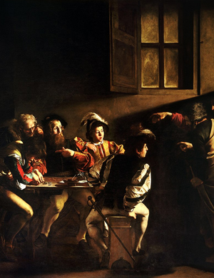
The Calling of St. Matthew by Caravaggio (1600)

Slide 37
How do we see the number seven represented in sacred art?
This painting depicts when Our Lord summoned St. Matthew forward to follow Him as one of His apostles; the figures are dressed in the style of clothing typical to the era; they look more like members of a royal court, like knights, rather than tax collectors, suggesting that they will serve as soldiers for Christ, being perfected in walking in union with Him. Dark as the background is, Christ’s mercy, expressed through His extended arm, releases a shaft of light to breathe new light and hope into the subjects
There are seven figures gathered in this painting: five on the left, and two on the right. Our Lord stands on the right, pointing to St. Matthew, reaching out to him. Saint Matthew is dining with the other tax collectors, who appear surprised that St. Matthew is being called by Christ, since tax collectors were widely disliked by the public for their profession
Jesus’ perfect charity is expressed in this painting; we see that He perfects and completes His Church by assembling the unlikeliest sinners, so that they may testify to the wondrous works of God, Who transforms them. Saint Matthew will come to share Christ’s mercy in applying the Seven Gifts of the Holy Spirit to bring people the seven sacraments, and complete the seven corporal and spiritual works of mercy, respectively
Five figures are grouped together to receive the love of Christ, Who is wounded for their redemption, that they may be raised to the Kingdom of Heaven, being exalted as His friends there, whereas on Earth, they may be scorned. The open window in the background suggests the transformation, the perfection and completion, that Christ opens His followers to

Slide 38
What does the number eight signify in the Holy Bible? (1)
The number eight is the number of spiritual resurrection. Baptismal fonts were traditionally eight-sided, because when we are baptized, we are brought into Holy Mother Church, and are opened to receiving the sacraments, namely, Holy Communion, which bring us to eternal life with God, that we may be raised from death
Eight is the number of infinity; its shape goes on forever, having no beginning or end, just like Jesus, the Alpha and the Omega
Our Lord’s love, which is infinite, carries us to eternity with Him, when we are united to His Sacred Heart, like Our Lady is
Many of Our Lady’s special feast days fall on the eighth of each month: her Immaculate Conception is celebrated on December 8, and nine months later, we celebrate her birthday on September 8. Our Lady was born to bring Christ into the world, that we may be brought to new life, to our own spiritual resurrection

Slide 39
What does the number eight signify in the Holy Bible? (2)
Because it is a number of spiritual resurrection, eight is also a number of joy. There are eight Beatitudes, which tell us what our attitude is to be if we are to be blessed. Our Lord taught the Beatitudes during His Sermon on the Mount
Our Lord rose from the dead on the eighth day after His entry into Jerusalem
Circumcision, which was an Old Testament equivalent of Holy Baptism, took place on the eighth day after a son was born. Our Holy Baptism is a spiritual circumcision in which we are cut off from original sin, the sin of the past, to be brought to new spiritual life
When we live out the Beatitudes, and unite ourselves with Christ, embodying His spirit as we die to the world and rise with Christ to new life, we know the joy of spiritual resurrection

Slide 40
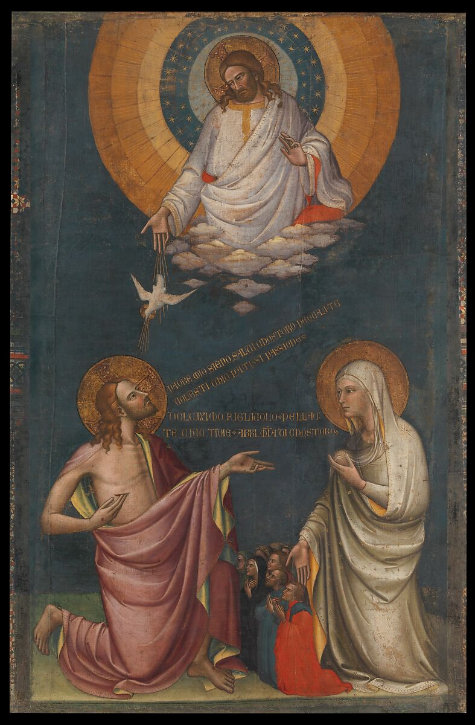
The Intercession of Christ and the Virgin by Lorenzo Monaco (~1402)

Slide 41
How do we see the number eight represented in sacred art?
Eight, the number of joy and spiritual resurrection, is represented in the eight figures who call down Christ’s mercy through the grace offered by Our Lady
The eight figures, who may have been patrons of the painter, ask Our Lady, Mother of Mercy, to help them. She intercedes on their behalf, going to Jesus, so that they may be led to Heaven, and know the joy of receiving His mercy
Jesus looks up to God the Father and God the Holy Spirit, extending His hand to offer their mercy to the eight figures. Our Lady asks Our Lord to show them His compassion, because she nourished Him from her own body; she asks Him to similarly nourish His people with the “milk of mercy”
This sweet refreshment is our means to spiritual resurrection; it is suggestive of the Precious Blood given through the sacraments, which we are called to receive to enter into eternal life with Christ, and partake of His merciful love forever
In being grouped in between Jesus and Mother Mary, the eight figures form a kind of bridge between Mother and Son; collectively, there are ten figures grouped together on the ground, representing the happiness that comes from uniting with Jesus and Mother Mary in this life, in order to be united with them in the next

Slide 42
What does the number nine signify in the Holy Bible?
The number nine has three as its root: when we add the number three a total of three times, we receive the number nine. In the Traditional Latin Mass, we ask God to have mercy nine times: three times for each Person of the Blessed Trinity
Nine is the number of angelic choirs in Heaven
There are nine Fruits of the Holy Spirit listed in Galatians in the Holy Bible
  Nine is a number of mystery, and a number of prayer, because the first novena was the nine days of prayer leading up to Pentecost, when the Holy Spirit brought His Gifts to Our Lady and the apostles. To be like them, and glorify God in union with the holy angels, using our talents to serve Him, we are to pray and meditate on the sacred mysteries, welcoming God into the upper rooms of our hearts
Imitating the holy angels in their holiness, in how they glorify each Person of God in the Blessed Trinity, allows us to produce good fruits for God
A mother carries a baby in her womb for nine months, just as Our Lady gave birth to Jesus, the Fruit of her womb, after nine months of pregnancy
Our Lord invites us to enter more deeply into His Heart by adoring it like the holy angels do, namely, by participating in the First Friday devotion of going to Holy Mass, receiving Holy Communion, and going to Confession on the first Friday of each month for nine consecutive months
  Similarly, one may observe the nine first Wednesdays of St. Joseph in honor of the Chaste Heart of St. Joseph, Jesus’ foster father

Slide 43
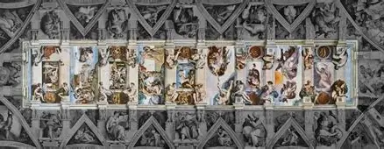
Nine Panels of the Sistine Chapel by Michelangelo (1508-1512)

Slide 44
How is the number nine represented in sacred art?
There are nine panels of the Sistine Chapel ceiling total
Collectively, they tell the story of God’s love in the Old Testament, the prophecy of Christ’s love fulfilled in the New, revealing the supreme majesty of the Blessed Trinity, at work in all time, in existence before the creation, bringing the created world into being out of love and mercy
  The nine stories of Genesis are further divided into groups of three, just as the holy angel choirs are split into three tiers: the first tier includes the seraphim, cherubim, and thrones; the second tier, of the powers, principalities, and dominions; and the third tier, of the virtues, archangels, and angels
In these panels, we see depicted the story of creation, the Fall of man, and the story of Noah
Nine is the number of prayer and mystery, so we are reminded to pray for conversion towards Christ, that as we enter more deeply into the sacred mysteries, we may compassionate with Him, and adore Him like the nine choirs of holy angels, making reparations for sins against Christ’s Heart through the nine offices of the Sacred Heart, and the nine First Fridays. We pray for cleansing from the Heart, which poured forth living water like the Flood that cleansed the created world of sin in Noah’s time

Slide 45
What does the number ten signify in the Holy Bible?
Ten symbolizes the old law, because there are Ten Commandments that were given from God the Father to Moses; it is a number of completion. We are complete when we follow God, embracing Him in our hearts
Ten is the number of happiness: it is the number by which happiness is multiplied. For example, when we multiply four, the number of nature and the body, by ten, we arrive at the number forty, which is the number of purification
Following God’s Ten Commandments allows us to be happy, for we do God’s will, which is out of love; God knows best what will make us happy, for we are happiest when in union with Him, when His will is perfectly fulfilled, as it is in Heaven. Our human nature is purified through closeness to God, through faithfulness to Him: we can transcend it, and become more like God, through His grace, discovering true happiness that is beyond this life
There are ten beads, ten “Hail Mary” prayers, in each decade of the Holy Rosary; meditating on each part of the life of Our Lady, so united with the life of Our Lord, brings us happiness as we reflect on her love, and come to an understanding of what it means to respond with faithful, holy love to God like Our Lady, that we may share in her joy
We have ten fingers and ten toes; five fingers on each hand, and five toes on each foot: we are to use them to do our work with love for God, to share His happiness with others

Slide 46
What does the number eleven signify in the Holy Bible?
Eleven is the number of faithful apostles. It is a number of incompleteness, because it is uneven, and is in between the numbers ten and twelve, which are numbers of completion and restoration
When Judas betrayed Our Lord, he made the group of apostles incomplete, breaking their unity
Our Lord’s Sacrifice would allow for restoration. His grace helps us to be faithful

Slide 47
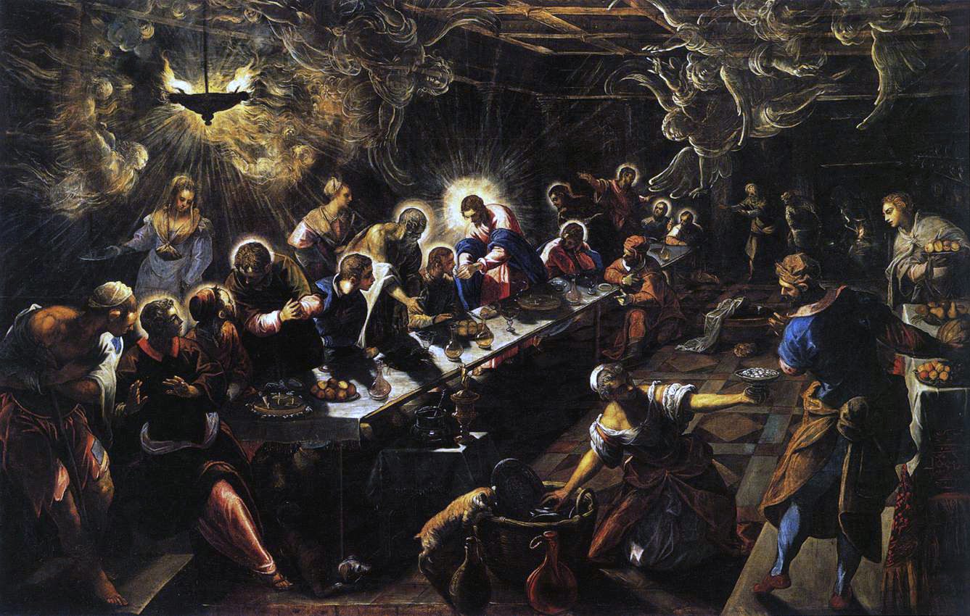
The Last Supper by Tintoretto (1592-1594)

Slide 48
How is the number eleven represented in sacred art?
Tintoretto experiments with perspective, creating a kind of canted angle shot; he draws our attention to Christ not by leading our eye to the foreground, but to a point in the background; using sloped lines converging in Christ creates this effect. The holy angels grouped towards the ceiling like incense smoke swoop towards Christ, also drawing our eyes to look upon Our Lord as the One they adore
This Mannerist work is suggestive of the Baroque style to come, which uses sharp contrast to convey spiritual truths
Our Lord has the brightest halo, distinguishing Him from the apostles, who are grouped unevenly around Him, not seated in a straight line; there is a restless, active spirit about this painting, which allows us to place ourselves into the scene, with the crowd; we are among many servants. Not only the apostles serve Christ, but many others, including us
Our Lord does not sit serenely, but is in motion, actively ministering to a soul; He is embodying what the apostles are to do when they receive the graces from the sacraments, namely, the Holy Eucharist, His Body
All of the eleven faithful apostles wear haloes, but Judas does not; since there are other figures at the table, servants who do not wear haloes, there is a sense of mystery as to the identity of Judas, which is meant to remind the viewer that they, too, must take care not to be unfaithful to Christ; the anonymity of Judas in this painting suggests that he is an everyman, that anyone could betray Christ, if not remaining focused on His light, and on serving Him

Slide 49
What does the number twelve signify in the Holy Bible? (1)
The number twelve is the number of the Church
Twelve stands for the twelve apostles in the New Testament, and also, for the twelve tribes of the Old Testament; the twelve tribes prefigured the Church, and the apostles built up Christ’s Church, carrying on His mission
Our Lady wears a crown of twelve stars in the Book of Revelation, because she brings together the old and new, uniting souls through Christ, her Son

Slide 50
What does the number twelve signify in the Holy Bible? (2)
Four times three equals twelve. Four is the number of the body, and of human nature, while three is the number of the soul. The twelve apostles helped God’s people to consecrate themselves to Him, enter the Church and receive the sacraments, so as to serve God well in body and soul
There are twelve months in the calendar year, which are each dedicated to a special devotion connected to Our Lady and Our Lord. All of time is sanctified by God
There are twelve promises of the Sacred Heart: if we are to be faithful children of Holy Mother Church, then we are to devote ourselves to the Sacred Heart, especially if we are to join the Church in Heaven, and be united eternally to the Sacred Heart

Slide 51
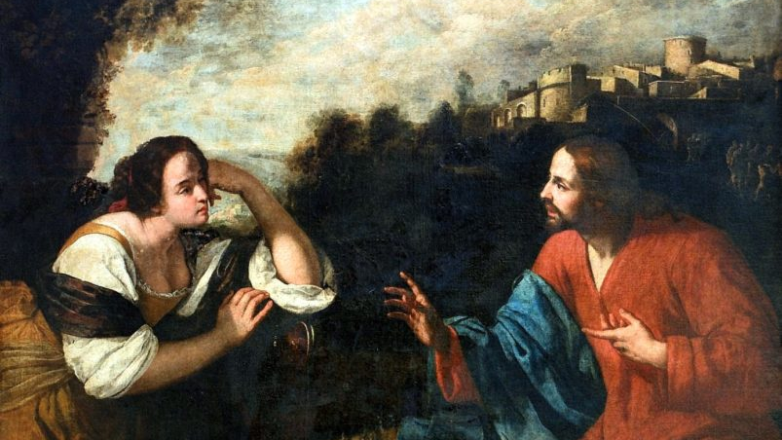
Christ and the Samaritan Woman by Artemisia Gentileschi (1637)

Slide 52
How is the number twelve represented in sacred art?
Artemisia Gentileschi was an artist of the Baroque period, when Catholic Counter-Reformation artists expressed the triumph and glory of the Church through dramatic, dynamic works of art starkly contrasting dark and light to convey the victory of Jesus over the darkness of sin, doubt, and error
This painting does not present the dramatic chiaroscuro technique that other Baroque works do, but it does have a contrast between darkness and light, making use of natural rather than artificial light, which is a different approach than is used in most Baroque art
In the background, we see the twelve apostles journeying together towards Christ; they are not in the foreground, like they are in so many paintings. We are reminded that the apostles are still developing, still in the shadows, learning to overcome their sins and reflect Christ. They will build the Church up in time, but in this scene, we see another aspect of the Church: a woman, who, as a Samarian, has been rejected, and is an outcast, coming to draw water from the well when no one else is present. Christ responds to her in love and compassion, inviting her to draw living water, mercy and love, from His Heart, through closeness to Him. He wears red and blue to signify His divinity cloaked in humanity (the red symbolizing the human Blood that He will spill for our salvation)
He speaks to the woman to welcome her to share the good news of His love, too, to help build up the Church

Slide 53
What does the number thirteen signify in the Holy Bible?
Thirteen is the number of Christ and His twelve apostles
Three is a number of completion, as is ten; Christ makes everything complete, when we follow Him like the apostles. Ten is the number by which happiness is multiplied, and three is the number of the Holy Trinity. Closeness to the Persons of God in the Holy Trinity brings us true happiness

Slide 54
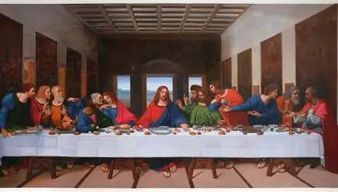
The Last Supper by Leonardo da Vinci (1495-1498)

Slide 55
How is the number thirteen represented in sacred art?
The twelve apostles are subdivided into groups of three: these four groups of three remind us of the human nature of the apostles, who will only be equipped to build up the Church through the grace of Christ in their souls, the movement of the Blessed Trinity within them, using them as instruments
Each grouping of three forms a triangular shape, representing the Trinity. Our Lord forms a pyramidal shape with His own Body, His arms outstretched to invite us to partake of the Bread, expressing that we receive the Blessed Trinity by receiving Him in the Holy Eucharist
Whereas the apostles are grouped closely together, some turned away from Christ, Our Lord sits alone in the center, the clear center point of the painting; all of the lines, the orthogonals, in the painting, lead the eye to Him. Saint John is dressed like Our Lord (in the inverse colors) because his deep love closely associates him with Our Lord
Christ and His apostles are clearly distinguished from each other; da Vinci, like a true Renaissance artist, uses linear perspective to alert us to Christ as the head of the Church, placing the largest, central window behind Christ’s Head, so that we will see that Christ is the true Light that we must be drawn towards, and immerse ourselves in

Slide 56
What does the number fourteen signify in the holy bible?
Fourteen is the sum we receive when we add seven twice
Seven is the number of perfection and completion; it is the number of Christ, His apostles, and Our Lady, who is the Queen of the Apostles and Mother of the Clergy
The number fourteen is similar to twenty-four in signifying something about restoration
There are fourteen Stations of the Cross
Fourteen total works of mercy (seven corporal and seven spiritual) should be practiced in order to be perfected spiritually
We are made complete, and led to glory, through our sorrows and our joys; Our Lady has seven sorrows and seven joys (fourteen total), so we are perfected in uniting our sorrows and joys with those of Our Lady, treasuring Christ amidst all of these experiences

Slide 57
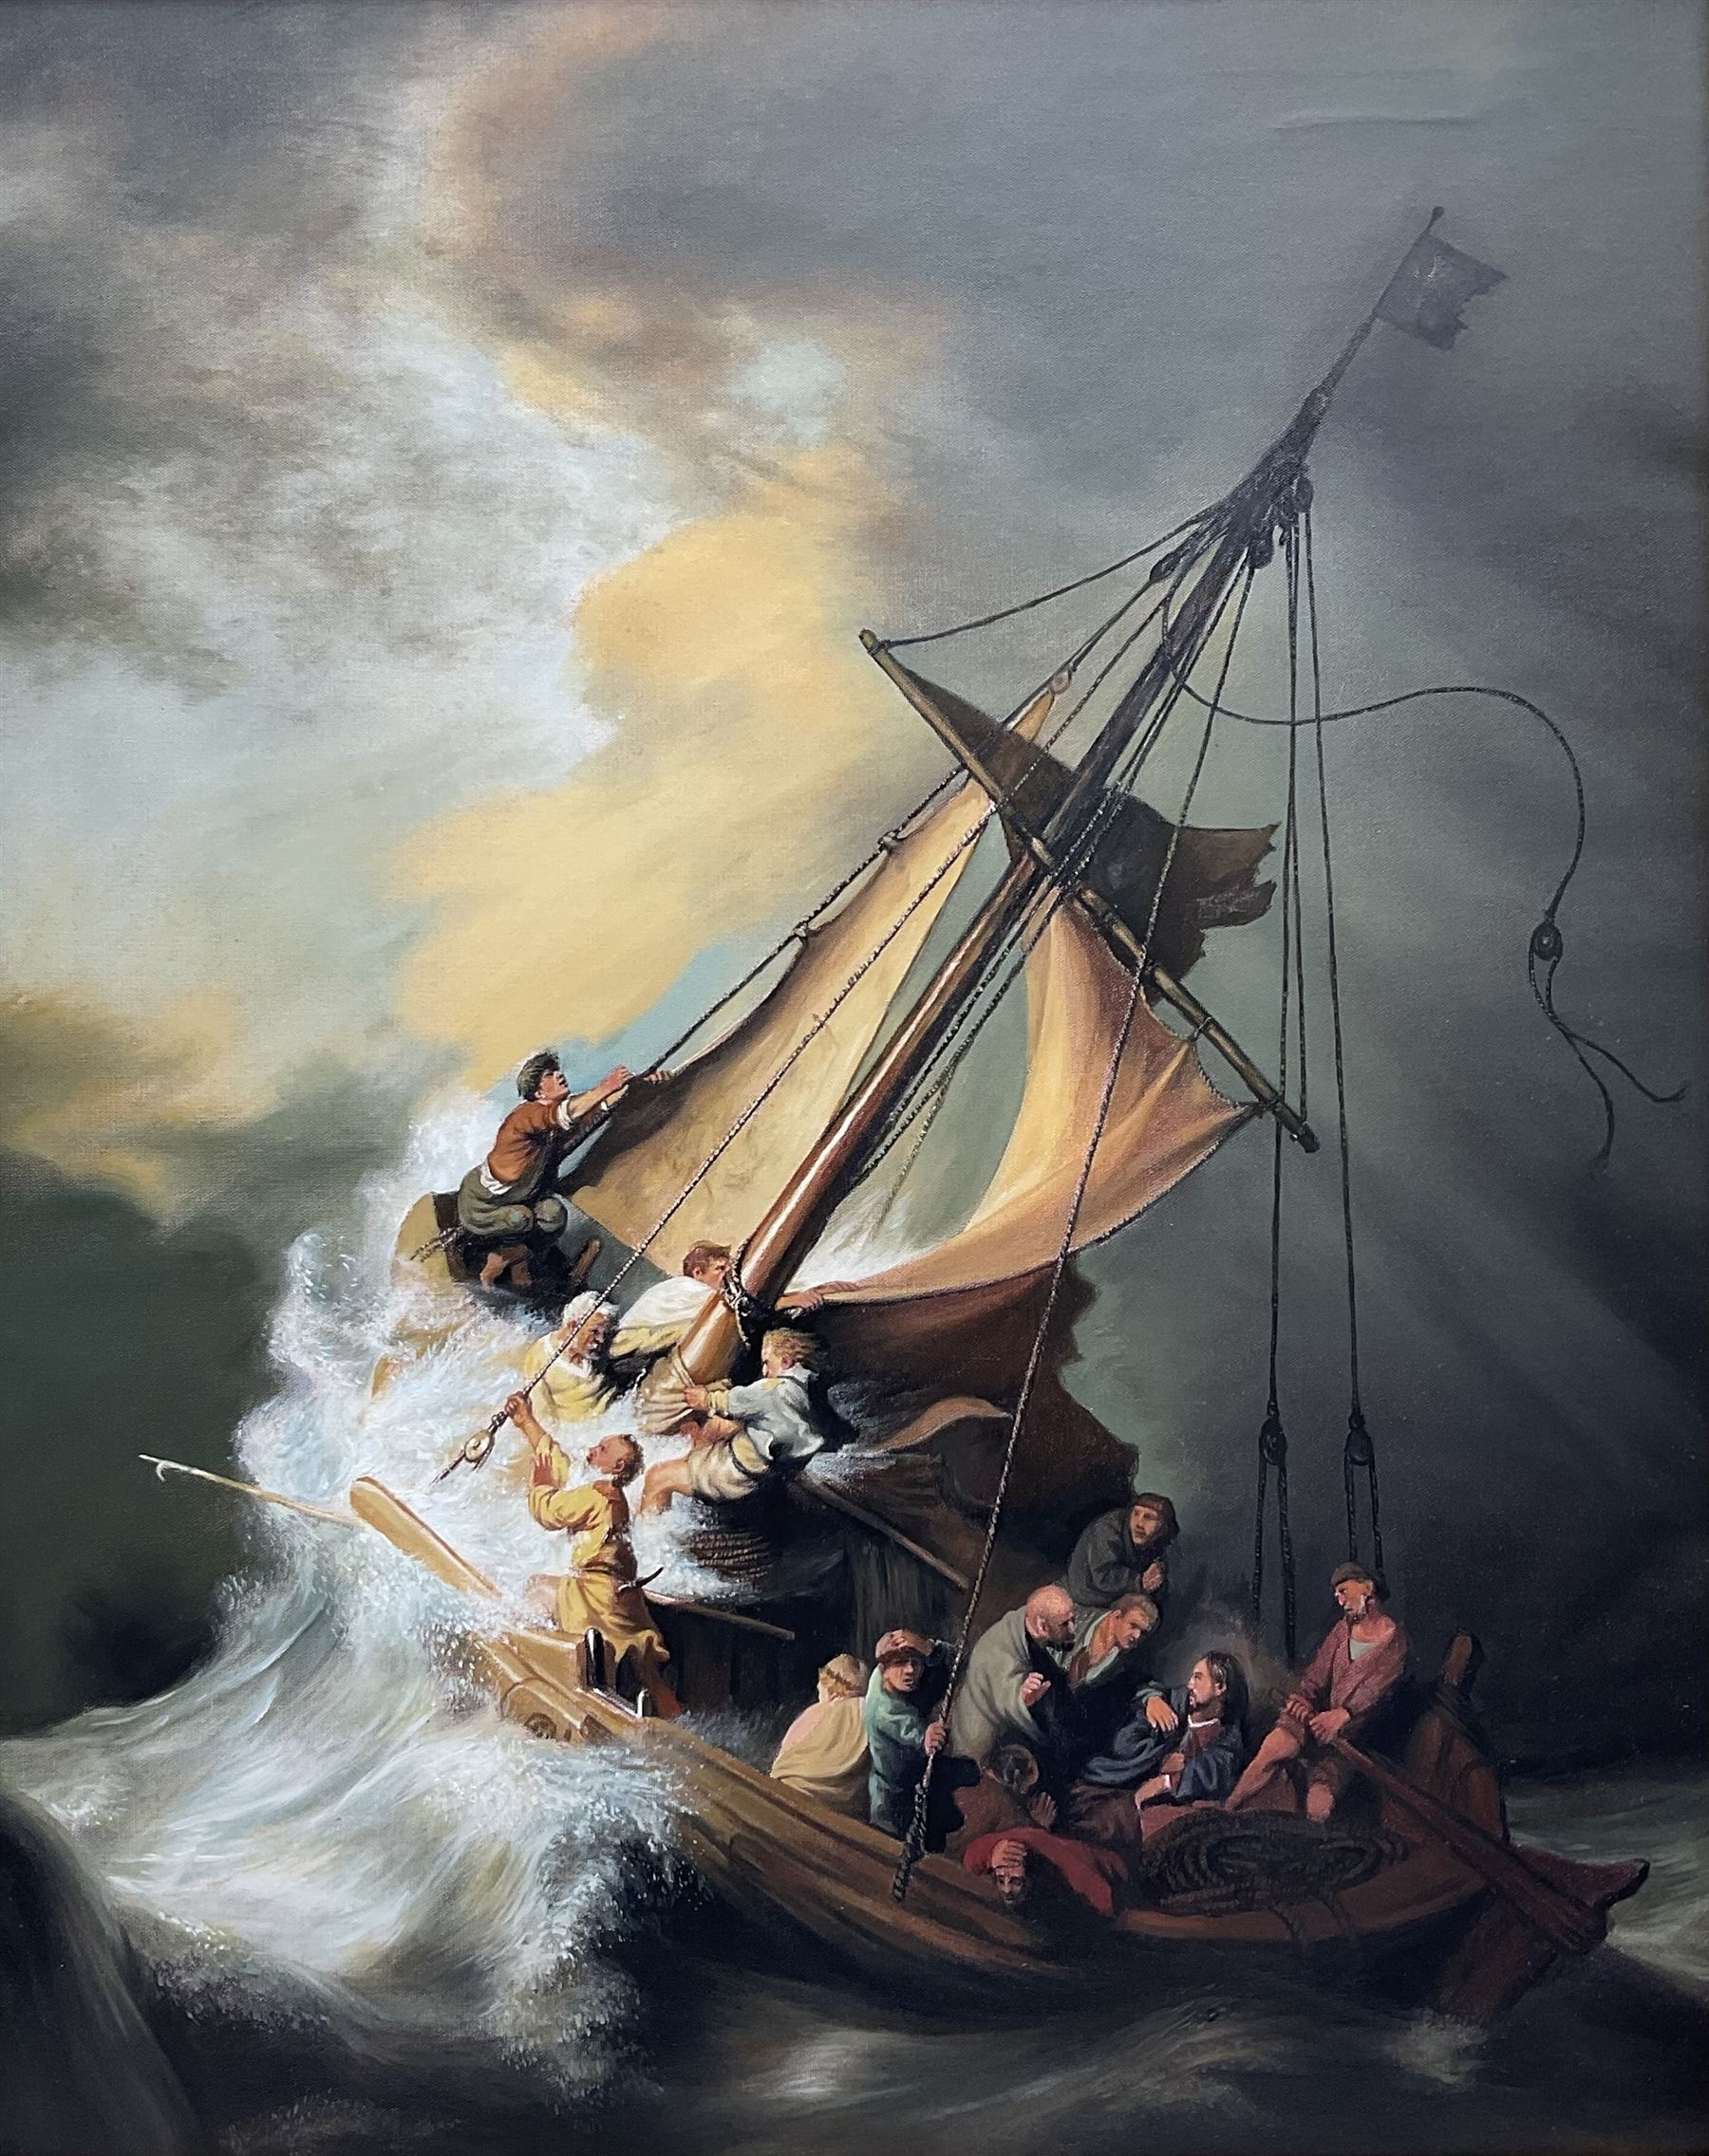
Christ in the Storm on the Sea of Galilee by Rembrandt van Rijn (1633)

Slide 58
How is the number fourteen represented in sacred art?
Rembrandt painted fourteen figures in the boat: Our Lord, His twelve apostles, and Rembrandt himself
In painting himself into the scene, Rembrandt reminds us that Our Lord remains with each of us, always; He is not a figure from the distant past, but is within us now to help us through the storms in life, drawing us to calm waters
We can place ourselves in these scenes, meditating on how we can respond to Christ in our lives with great love
Nine figures are grouped on the right with Christ; in remaining near to Him, we may be like the nine choirs of holy angels in adoring God
Five figures are grouped on the left, reminding us that through His love, Our Lord saves us and makes us more like the holy angels; being centered in His serenity, we, too, may remain at peace, grounded in an unchanging love

Slide 59
What does the number fifteen signify in the Holy Bible?
The number fifteen is the number of progress and ascent; it is the number of steps in the Temple
The Holy Rosary is composed of fifteen decades; the Holy Rosary is a biblical prayer. Its prayers have their roots in Sacred Scripture
Praying these fifteen decades helps us to make progress in our spiritual lives, as we draw closer to Our Lady, reflecting on how we may respond to God’s love with faith, hope, and love like she did. We may climb the steps on the ladder to Heaven through the graces she supplies to us; Jesus is the ladder, and Our Lady helps to hold the ladder, keeping us close to Christ
Five times three equals fifteen: five is the number of love, for the number of Christ’s holy wounds, and three is a number of completion, the number of the theological virtues, and the number of the Blessed Trinity
  When we multiply our love for God three times (loving God the Father, God the Son, and God the Holy Spirit), offering our wounds to Him for His healing, we make progress, and can ascend to Heaven to be with Our Lord one day
  Because each Person of the Trinity loves us, because Our Lord took on our wounds created by sin, redeeming us from sin, we can progress spiritually; Our Lady guides us in this progress

Slide 60
What does the number twenty-five signify in the holy bible? (1)
The number twenty-four is a number of restoration, because it is the number twelve added twice: it is the sum received when we add the twelve Tribes of the Old Testament to the twelve apostles of the New Testament. Our Lady brought together the past and present, helping to fulfill the Old Testament prophecies by giving birth to Our Lord, Who is the dawn of a new day; through her faithfulness to God, serving as the New Eve who undoes the consequences of sin brought about by Eve’s disobedience, Our Lady helps to restore order
  God the Father would restore through the work of the tribes and apostles
When we add one to twenty-four, we receive the number twenty-five: when we add Christ to the equation, all is restored

Slide 61
What does the number twenty-five signify in the holy bible? (2)
Tradition holds that on March 25:
  God the Father’s creation of the world took place
  The Fall of Man happened
  Our Lord was conceived in Our Lady’s womb (the Incarnation)
  Our Lord died
Jesus was conceived in order to die for the sins brought into the world by Adam and Eve, to restore balance and harmony to a fallen world. To do so meant returning God’s people to Him, that they would be faithful, and enter into new life with Him through their love and obedience to His will, which is always for us to love like He does

Slide 62
What does the number thirty-three signify in the Holy Bible?
The number thirty-three is the number of years Our Lord lived His earthly life for
It is believed that Our Lord was conceived in the womb of Our Lady on March 25, and that He died on March 25, at exactly the age of thirty-three
Three is a number of completion representing the Holy Trinity. The number thirty-three is comprised of two threes when written out: when three is added twice, one is left with a sum of six, which is the number of mercy. In Our Lord’s thirty-three years of life, He expressed His mercy
Our Lord is the Second Person of God, united to God the Father and God the Son. Because of Our Lord’s mercy, we can receive Him in Holy Communion, and the Persons of the Trinity that we receive in the Holy Eucharist can come to dwell in our souls. Our Lord completes us through His love and mercy; He broke His Body to heal our hearts broken by sin
Eleven is a number of faithfulness, and thirty-three is the number eleven added three times: Our Lord was perfectly faithful
  Our Lady faithfully cared for Our Lord during His thirty-three years, always thinking of Him and loving Him

Slide 63
What does the number forty signify in the Holy Bible? (1)
Forty is the number of purification
  There were forty hours between when Our Lord died and rose. Union with Him spiritually in these hours can allow for our purification, as we reflect on the pure, self-giving love of Our Lord
Often, the number forty signifies a period of struggle, a tribulation of some kind, that has to be overcome through God’s grace, that His servants may be purified, and brought to Heaven
The Israelites wandered in the desert for 40 years in order to be purified, and brought closer to God. There were times when they were ungrateful to God the Father, doubting Him, but their story only further illustrates how God provides for us in all times
However, the number forty may be used more generally to represent a long period of time, and it not necessarily to be interpreted literally; it may be used symbolically. Sometimes numbers are rounded up to forty in the Holy Bible

Slide 64
What does the number forty signify in the Holy Bible? (2)
  Our Lord was in the desert for forty days battling Satan. He overcame temptation through reliance on Sacred Scripture, through faith in the Father’s love
  Our Lord was already pure, and never sinned, but was living the entirety of the human experience otherwise, which includes temptation
  The season of Lent is forty days, so that through sacrifice made out of love for God, in connection to Jesus’ Sacrifice on the Holy Cross, we may be purified
  Through union with Our Lord when we go through temptation or spiritual dryness, we can transcend our limitations and be purified
Our Lady participated in the forty-day purification ritual required by Jewish law for women who had just given birth. She remained away from the Temple during that period, bringing Our Lord on the fortieth day after His Birth to be consecrated to God. We are purified through consecration to God. Our Lady was so pure, that even though she did not need to participate in the purification ritual, she did, out of obedience and faithfulness to God. Her Heart was full of the purest love for God, flowing from humility

Slide 65
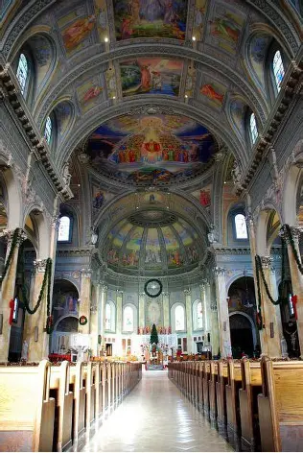
The 40 Angels of St. Ann, the Sistine Chapel of Woonsocket, RI

Slide 66
How is the number forty represented in sacred art?
Between 1941 and 1953, the Italian artist Guido Nincheri painted the stucco walls of the Catholic church named for St. Ann in Woonsocket, Rhode Island. He employed the same fresco technique, painting on wet walls, that Michelangelo used to paint the Sistine Chapel, earning St. Ann’s the nickname of the “Sistine Chapel in Woonsocket”
In the 1930s, the church was thriving: 6,000 parishioners were active at the church, necessitating that seven Holy Masses be celebrated each Sunday. Together, they raised thousands of dollars to decorate their church, which had blank walls. They were inspired to commission murals for the church after having installed stained glass windows from the same company as that used at Chartres Cathedral in France
Nincheri painted 40 parishioners as angels in his 175 frescoes (435 other parishioners are represented elsewhere in the scenes, too), and some saints: the nun who played the organ at the church was represented as St. Cecilia in the mural
In this way, the pure love of the parishioners that had contributed their treasure to beautifying their church for God’s glory was honored
Though St. Ann’s closed in the year 2000, the church was preserved so that visitors may still enjoy the beautiful art, and learn about local history

Slide 67
How is Our Lady’s Heart the perfect masterpiece? (1)
Piety is the order of the soul
In Our Lady’s Immaculate Heart, everything is well-ordered; she treasures all of the things of Christ. When we love Our Lord, our lives are ordered according to His plan: we adhere as closely as possible to His blueprint, willing to follow His will
  Our Lady’s love for God means that she loves His will above her own; her will is to do His will, as reflected in her prayer, “Be it done unto me according to Thy word”
Our Lady’s Heart contains every treasure: it is perfectly united to the Heart of Christ, as Our Lady compassionated with Christ in His Passion, and His Heart was formed near her own heart when He was in the womb. She loves Christ’s Heart totally, which is the ultimate treasury, and reflects it with her own love

Slide 68
How is Our Lady’s Heart the perfect masterpiece? (2)
As a reflection of Christ’s Sacred Heart, the Immaculate Heart is a masterpiece of love, because it is free of sin, and full only of grace, of virtue, like a painting that has all of the gems of design: order, balance, and harmony, all design elements working together perfectly to fulfill the artist’s purpose
Our Lady perfectly fulfilled the Divine Artist’s plan by saying “yes” to His will for her to be the Mother of God the Son, to bring Him into the world that, as He gave His life on the Cross, her spiritual children could be given new life in Him, made to be like “little Christs” out in the world. Because Our Lady’s Heart was the most beautiful masterpiece, all of God’s children were entrusted to her, and now, she helps to form every heart into the masterpiece that God intended, to be immaculate like she is, and to be totally open to being filled with God’s grace
The creation should bear the mark of the Creator, and the imprint of God is clearly on Our Lady’s Heart. She is made in the way that God intended for every human to be made, without sin, and full of every grace. Our Lady totally conforms to God’s image

Slide 69
Announcements
Liturgical Rosary Prayer Group Sessions:
  Monday, August 11, 2025
    8:45 a.m., parish library
  Wednesday, August 13, 2025
    4:30 p.m., parish library
  Thursday, August 14, 2025
    8:45 a.m., parish library
  Friday, August 15, 2025
    10:15 a.m., parish library
  Sunday, August 17, 2025
    3:00 p.m., parish library
Third Immaculate Heart of Mary talk:
  Saturday, August 16, 2025
    5:15 p.m., church

Slide 70
Closing Prayer: prayer after visio divina (by katie Sadakierski)
God our Father, the Divine Artist, thank You for speaking Your love into our hearts, and illuminating our minds with understanding through meditation on the majesty of Your Wisdom, as expressed through the harmonious works of art You have created in nature. Thank You for each person here in our family that You have made in Your image, and for the opportunity to be molded by You into reflections of Your Son, Jesus, and Your precious daughter, Jesus’ Mother, Mary. We pray that You would continue to shape us, to sing the melody of Your Heart into our own hearts, that we may more closely resemble You in faith, hope, and love. Guide our hands and hearts to create works of beauty to honor You, most of all, in how we live our lives. Inspire us to embrace the canvas that You give us on which to paint the story of Your mercy. Through Christ our Lord. Amen.

