Slide 1



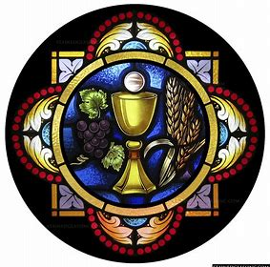

First Holy Communion Preparation Program
REY 2025-26
Thursday, August 28, 2025
Katie Sadakierski

Slide 2
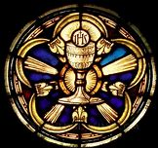
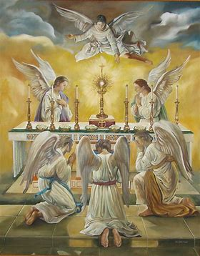

Outline: First Holy Communion Preparation
Sign-in & distribution of learning materials for sacramental preparation
Presentation
  Opening prayer & introduction
  Overview of sacrament preparation program
    Spiritual goals and suggested devotions for fulfilling them
    Patron saints of First Holy Communion
    Meaning of the sacrament of First Holy Communion
      Sacramental grace
    Program components & new initiatives this year
      Promoting Eucharistic piety through devotion to the holy angels and consecration to Jesus through Mary
  Overview of sacrament preparation learning materials & resources
    Lesson/activity books
    Prayer cards
    Activity boxes
Sacrament preparation timeline
      First Confession
      First Holy Communion
  Closing prayer
    Q & A
    Meet & greet/social

Slide 3
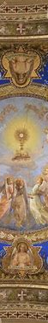
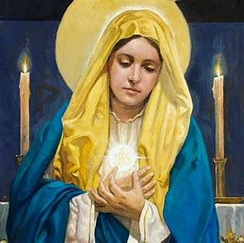
Opening Prayer: Prayer for the Intercession of Our Lady of the Most Blessed Sacrament
O Virgin Mary, Our Lady of the Most Blessed Sacrament, the glory of Christians, the joy of the universal Church, and the hope of the world, pray for us. Kindle in all the faithful a lively devotion to the most Holy Eucharist, so that they may be worthy to receive Holy Communion…
Our Lady of the Most Blessed Sacrament, pray for us. Let us with Mary Immaculate adore, thank… and console the most Sacred and beloved Eucharistic Heart of Jesus.
St. Augustine of Hippo, pray for us!
Our Lady, Queen of the Angels, pray for us!

Slide 4


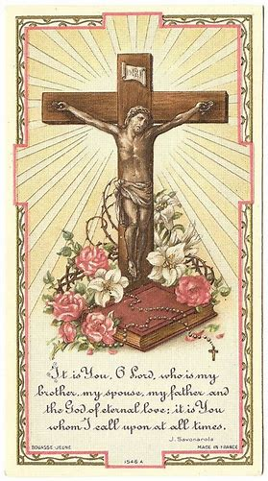

What is the “Body of Christ”?
Another term for “Holy Eucharist”
The bread turned into Jesus’ Body by the priest at Holy Mass
The Sacred Host we receive at Holy Communion
The resurrected Body of Our Lord, Jesus

Slide 5

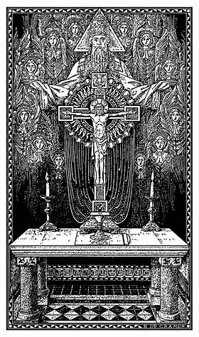

What is the “Holy Sacrifice of the Mass”?
Loving God as one Church
  Praying as a community, one family
  Asking God to help and bless us
  Telling God that we love Him
The Sacrifice of Jesus
  We remember Jesus giving His life on the Cross
The priest changes the bread into Jesus’ Body
  Jesus is offered to God the Father

Slide 6

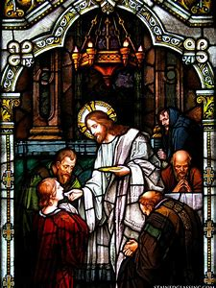
What is Holy Communion? What is the Holy Eucharist?
Holy Communion:
  We each receive the Body of Christ offered by the priest to God the Father at Holy Mass
  As a community, we become closer to God
Holy Eucharist:
  Another word for the “Body of Christ”
    The Sacred Host we receive at Holy Communion
  “Thanksgiving”

Slide 7

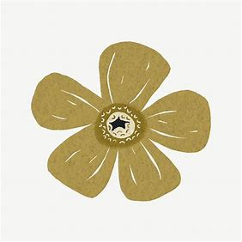

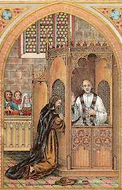

What is Confession, and why do we need to go to Confession before Holy Communion?
We tell the priest when we did not follow God’s rules
  God’s rules are for us to live with love
Jesus comes into our hearts at Holy Communion
  Confession helps us to make our hearts clean
  A clean heart is a heart full of love
When our hearts are clean, we are ready to receive Jesus, because Jesus is God, and God is love
  Confession helps us to turn away from things that do not bring us closer to Jesus

Slide 8


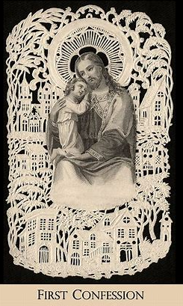
How do we prepare for Confession?
Do an examination of conscience
  Go over the 10 Commandments: God’s rules
  Think about how you followed God’s rules
Practice the “Act of Contrition” prayer
  Tell God that you are sorry for when you did not follow His rules
  Say that you love Him, and ask Him to help you to keep doing what is good

Slide 9

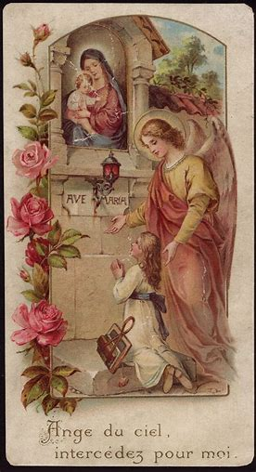
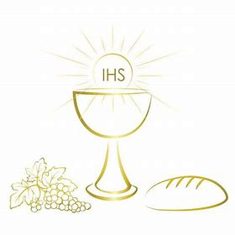
How do we use prayer to prepare for First Holy Communion? Which prayers should we use, and why?
Say three “Hail Mary” prayers each day
  Mother Mary helps us to become closer to her Son
Say an “Our Father”
  Ask God the Father to “give us this day our daily bread”
  Ask Him to help you to lovingly receive the Bread of Heaven
Say the “Glory Be”
  Thank the Father, the Son, and the Holy Spirit
  We receive all of Jesus at Holy Communion. Jesus is God, and He is united with God the Father and God the Holy Spirit

Slide 10

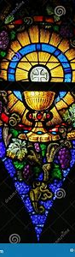

What is the difference between spiritual communion and sacramental Holy Communion?
Spiritual act of communion
  Short prayer to say at any time
  Ask Jesus to come into your heart
    Prepare to receive Jesus’ Heart
Sacramental Holy Communion
  Received at special times, such as at Holy Mass
  The greatest form of prayer
  Receive the bread changed into Jesus’ Body
    Jesus comes into our hearts most fully

Slide 11

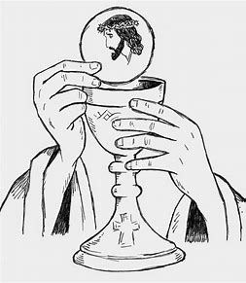
What is a spiritual communion prayer that we may say in preparation for the reception of Holy Communion?
“My Jesus, I believe You are in the Most Blessed Sacrament. Come into my heart. I embrace You.”
Jesus is really in the Holy Eucharist
Jesus comes to be with us in our hearts
Jesus is always with us to help us
Jesus’ love never ends

Slide 12
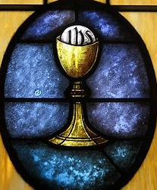
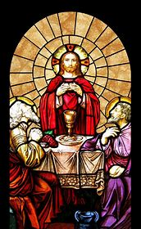
What are our First Holy Communion preparation program goals, and how will we fulfill them?
Grow in friendship with Jesus together
Love Jesus with joy
  Holy Mass
  Eucharistic Adoration
  Praying with sacramentals
  Prayer buddy initiative
  Special devotions:
    Sacred Heart enthronement
    Total consecration to Jesus through Mary

Slide 13

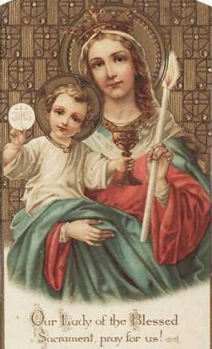
Who are our program patron saints, our heavenly “First Holy Communion friends”? (1)
Our Lady of the Blessed Sacrament
  A title for Mother Mary
  We receive Jesus in the Holy Eucharist
  Mother Mary is “Mother of the Most Holy Eucharist,” because she is the Mother of Jesus
  Mother Mary is our heavenly mother
  She prays for us, and is with us at Holy Communion
  Mother Mary loves her Son, and she loves us

Slide 14

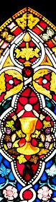
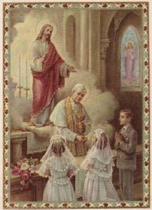
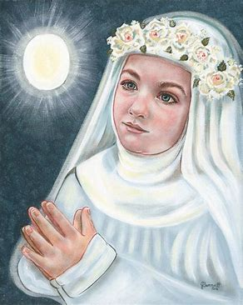
Who are our program patron saints, our heavenly “First Holy Communion friends”? (2)
Pope St. Pius X
  Patron of First Communicants
Blessed Imelda Lambertini
  A young person with a special love for the Holy Eucharist

Slide 15
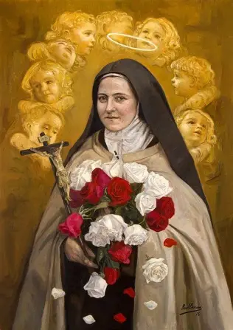
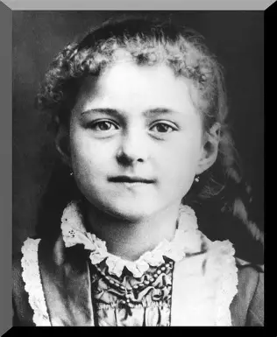
Who are our program patron saints, our heavenly “First Holy Communion friends”? (3)
Saint Therese of Lisieux will be our foremost patroness this year besides Mary, Mother of the Holy Eucharist, because she shows us the “Little Way” to Heaven. Saint Therese teaches us that nothing is too small for God, that we can take gradual steps to do all things with great love for God
The Little Way is the way of Mother Mary, because Our Lady is the greatest model of how to offer ourselves humbly with love to God. Saint Therese had a beautiful devotion to the Holy Eucharist, which grew from her love of Our Lady. She loved the Child Jesus, welcoming Him into her heart just like Our Lady did. She treasured the things of God in her Heart, every memory of Jesus’ love, much like Mother Mary
Saint Therese went to her nearby Eucharistic Adoration chapel during school recess; attended daily Holy Mass with her parents; and participated in Eucharistic processions, throwing rose petals on the ground where the procession would be crossing, as Jesus was carried through the streets in the monstrance, the holder with a small glass covering through which we see the Sacred Host

Slide 16
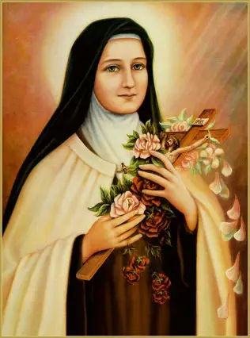
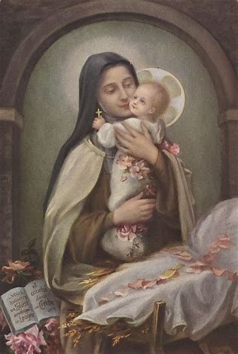
Who are our program patron saints, our heavenly “First Holy Communion friends”? (4)
Whenever a guest visited St. Therese’s family, she asked if they had just come back from Holy Mass; she would run to the door to see them, so that she could be near Jesus, knowing that they had received Him into their hearts in Holy Communion
Saint Therese was so overcome with joy at her First Holy Communion, that she cried, because it was such a gift to her to receive Jesus into her heart, and she wanted to give that gift back to Him by receiving Him with a heart full of love. She teaches us all to receive Holy Communion with joy and trust of a child, like every Holy Communion is our first
Saint Therese loved to be with her best Friend, Jesus, and His Mother, Mary, so she loved to be by the tabernacle at church, where the Sacred Host is kept; unlike the monstrance, it is closed, so we cannot see the Sacred Host, the bread that is Jesus’ Body, inside, but we know that He is there, looking at us with love and smiling
Saint Therese’s sister helped to prepare her for Holy Communion by making her a journal in which were written prayers for St. Therese to say each day. The pages had illustrations of flowers so that St. Therese could practice growing like a flower in her love for Jesus each day, preparing to receive Him in Holy Communion with a heart opened like petals of a flower with pure love for Our Lord. We will follow a similar program of preparation, which is outlined in the First Holy Communion preparation guidebook

Slide 17
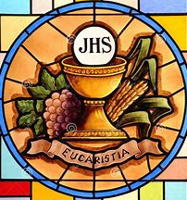
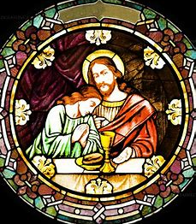
What is our First Holy Communion preparation timeline?
Monthly religious education classes: September 2025-April 2026
First Holy Communion retreat: Saturday, April 11, 2026, 11:00 a.m., parish hall
First Confession: Thursday, April 16, 2026, 6:00 p.m., church
First Holy Communion rehearsal: Thursday, April 23, 2026, 6:00 p.m., church
First Holy Communion Mass: Saturday, April 25, 2026, 11:00 a.m., church

Slide 18
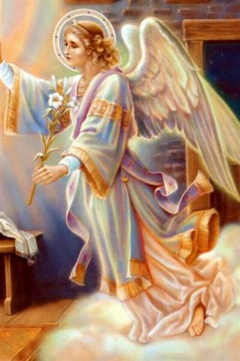
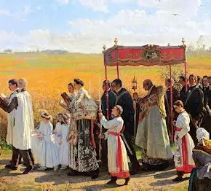
What is the significance of our date for the Holy Mass of First Holy Communion?
Our Holy Mass of First Holy Communion will take place on April 25, which is the Major Rogation Day. The Rogation Days are four days spent in preparation for Ascension Thursday, when we celebrate Our Lord rising up into Heaven. “Rogation” comes from the Latin “rogare,” meaning “to ask,” so on the Rogation Days, we pray for God’s mercy, specifically, asking for His blessing on the harvest. We pray to produce good fruits for God, to bring forth a good harvest from our hearts, many gifts of love to give to God. Mother Mary nurtures the growth of these gifts in our hearts, helping us to grow and offer all the more to God out of love, that we may receive Jesus, the Bread of Life, into our hearts with the greatest reverence, to honor Him. Holy Communion is when we embrace Our Lord as the True Wheat Who feeds us forever, giving us all we need to be strong and happy
April 25 is traditionally when we celebrate the Greater Litanies. In the time of Pope St. Gregory the Great, in the 500s A.D., when a serious sickness known as the plague was spreading through Italy, he called together the people to go on a procession, walking together as one family in Christ, and praying prayers asking for God’s mercy and assistance known as the litanies, so that they could call down healing from God. When they had processed and sung the litanies, Our Lady, St. Michael, and the holy angels appeared, and from thereon out, the plague ended; the people’s prayers were answered, and they were cured. At Holy Communion, we sing in our hearts with praise for God, asking Our Lady and the holy angels to be with us to help us to adore God. We receive Holy Communion, because it heals and strengthens us, preparing us for Heaven

Slide 19

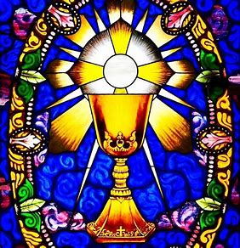
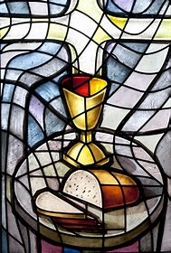
What resources are available to use in preparing for First Holy Communion? (1)
First Holy Communion informational booklet:
  Frequently-asked questions
    The significance of the sacrament; philosophy behind preparatory steps taken; explication of Church teachings
  Vocabulary
    Definitions of common terms relating to First Holy Communion and Confession
  Guidelines:
    Attire for Mass of First Holy Communion
      Links to suggested venues for First Holy Communion attire; class photos from past years included as a reference point
  Checklists
    Steps to prepare for First Holy Communion; remaining on track
  Timeline
    For preparation from August 2025 to April 2026, with recommended steps to take in preparation for First Holy Communion each month, especially in accordance with the devotional theme. We recommend being consistent and repeating practice of prayers to reinforce and deeply absorb concepts being taught

Slide 20
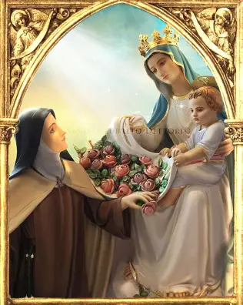
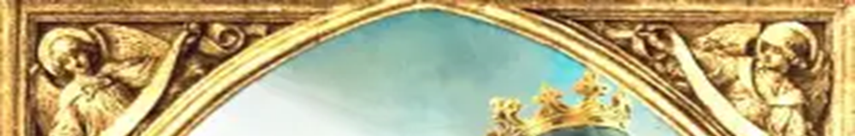
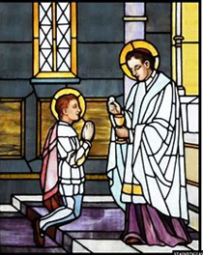
What resources are available to use in preparing for First Holy Communion? (2)
  Guide to Eucharistic Adoration
    Suggested prayers are provided for each month. It is highly recommended that families go to Eucharistic Adoration once a month, or make a visit to the tabernacle to be with Jesus. Each month, it is recommended that families say a prayer in honor of one of the nine choirs of holy angels, practicing adoring Jesus like they do. Being in Jesus’ Presence helps us to receive Him with love in the Holy Eucharist, and to he filled with His loving Presence
  Sacred Heart enthronement guide
    The First Holy Communion information booklet includes a guide to enthroning the Sacred Heart in the home, because in placing an image of the Sacred Heart of Jesus, and/or the Immaculate Heart of Mary in the home, we are reminded to keep Jesus and Mother Mary at the center of our hearts, making our hearts like Eucharistic Adoration chapels in which to honor them always, just as the tabernacle is kept at the heart of the church, for the Eucharistic Heart of Jesus, the Son who brightens and warms our hearts, is what everything depends upon, and revolves around

Slide 21
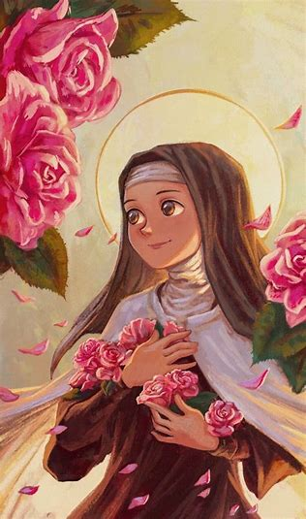
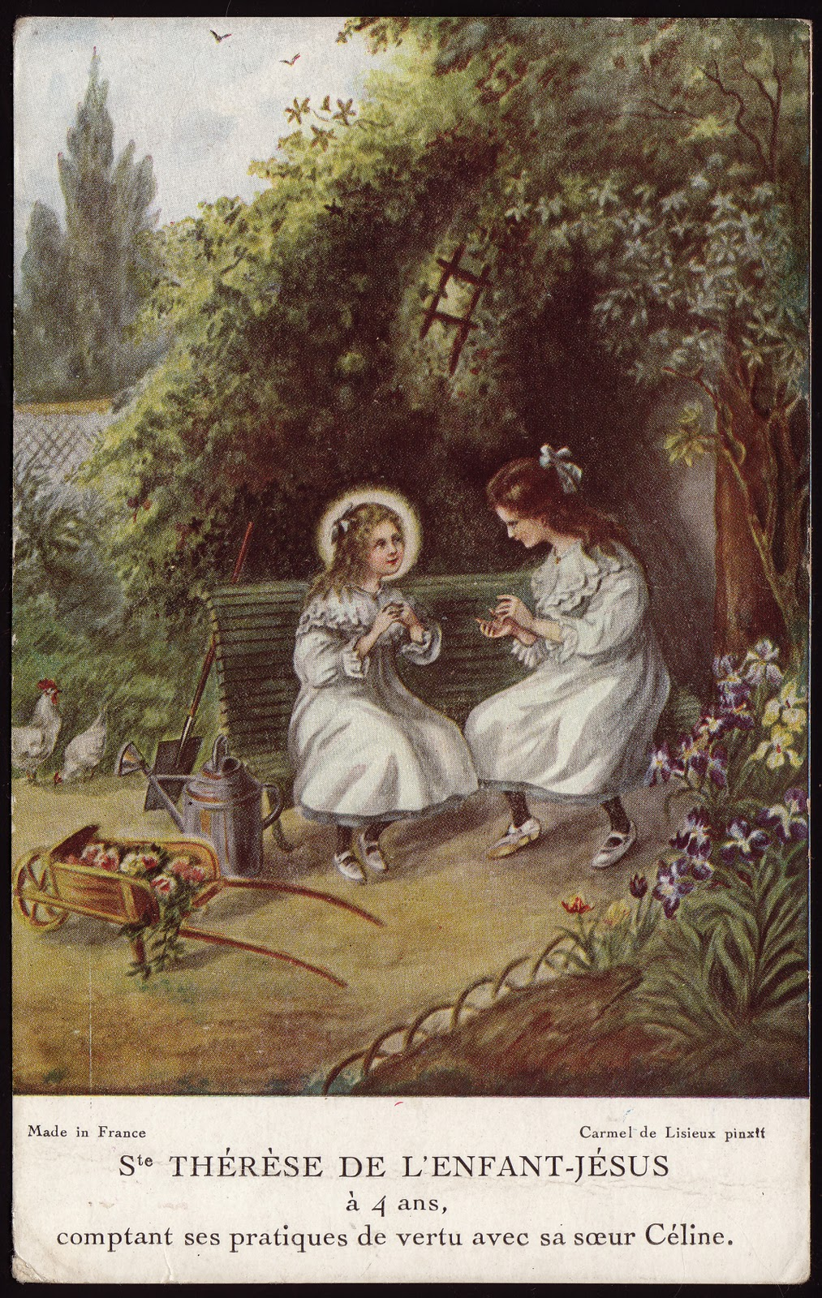
What resources are available to use in preparing for First Holy Communion? (3)
  Flower field guide
    Each month, students will learn about a different virtue, a holy quality that makes us more like Jesus and Mother Mary, through a flower representing that virtue. They will practice saying a special prayer each month to grow like a flower in that virtue, so that by the time they make their First Holy Communion, their hearts will be like beautiful gardens in which to welcome the Eucharistic Lord, the greatest Gardener Who helps us to grow. Students will practice being like St. Therese, the Little Flower, in living with the greatest virtues of faith, hope, and love, which make us most like God
Activity book
  Lessons on First Confession and First Holy Communion (Grade 2 activities)
Baltimore Catechism First Holy Communion book
  Correlates with lessons in activity book

Slide 22

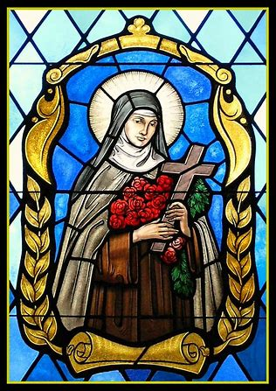
Which steps may be taken to further prepare for First Holy Communion? (1)
Participation in the Children of Mary Sodality
  Strongly recommended, especially as it has the endorsement of the saints (St. Therese was a member of the Children of Mary Sodality). The Sodality meets on the First Saturday of every month (with some exceptions, such as in April, due to Holy Week) in honor of the Immaculate Heart of Mary. Meetings are designed to increase Eucharistic piety through devotion to Our Lady, who reverently received Our Lord after He ascended into Heaven, and helps us to receive Jesus in the Holy Eucharist with a heart like hers, that we may receive the Bread of the Angels, our means to salvation, with great love, and one day rise up with Christ. Schedules for the Children of Mary Sodality are available in your workbooks. The first meeting will take place on Saturday, September 6, 2025, at 10:30 a.m. here in the parish hall

Slide 23
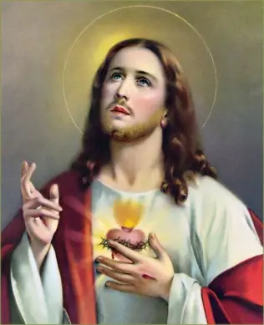

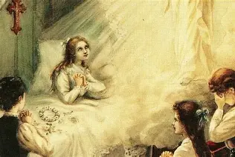
Which steps may be taken to further prepare for First Holy Communion? (2)
Consecration to Our Lady of Victories
  After she was born, St. Therese was consecrated to Our Lady, as her mother said a prayer of entrustment to Our Lady over St. Therese, bringing her to the family’s statue of Our Lady of Victories, an image similar to that on the Miraculous Medal. When St. Therese was very sick as a child, at age ten, she prayed to Our Lady of Victories to heal her, and after saying her prayer, turned to the statue, seeing Our Lady smile at her. Saint Therese was healed through the intercession of Our Lady, who helped her to be victorious in her battle with sickness, and after her healing, made her First Holy Communion to be further strengthened. Our students will also complete a consecration preparation process to be entrusted to Our Lady of Victories, that through the Heart of Mary, they may be brought to the Eucharistic Heart of Jesus, and win the spiritual battle to gain Heaven. The consecration preparation process will take place from the feast day of Our Lady of Victories in Hungary on March 23 to April 24, with the consecration happening on the day of the First Holy Communion, on Saturday, April 25. Students will prepare for the consecration by praying three “Hail Mary” prayers each day during the 33-day period, and we will together make the act of consecration, saying the special prayer, on April 25
Consecration to the holy guardian angels
  Students will also say a prayer of consecration to their holy guardian angel with the prayer of consecration to Jesus through Our Lady of Victories, just as St. Therese was consecrated to her holy guardian angel before making her First Holy Communion. Our holy guardian angels inspire us to do good works, keeping us safe from spiritual or physical danger, and guide us to remain close to Mother Mary, that we may have clean hearts like hers in which to receive Jesus, free of sin. They are teachers of holiness to us, helping us to serve Mother Mary and Jesus well

Slide 24
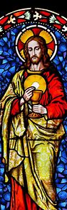
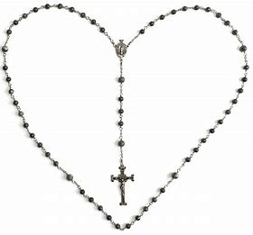

What resources are available to use in preparing for First Holy Communion? (3)
Folder for families
  Forms
  Answer keys/guides to sequencing cards
Box of supplementary learning materials
  Prayer cards
  Sequencing cards
  Vocabulary matching cards
  Devotional chaplet (good deed beads)

Slide 25
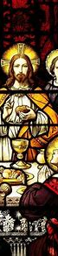

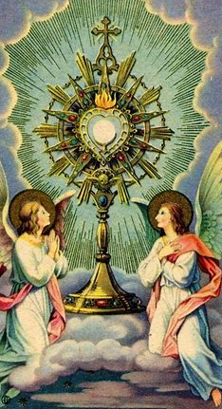
What steps are recommended to further prepare for First Holy Communion?
Eucharistic Adoration
Family meals
  Sharing First Holy Communion memories
  Eucharistic Bible stories
Sacrament scrapbook/family members’ pictures from First Holy Communion; home shrine photos and holy cards
Family prayer

Slide 26


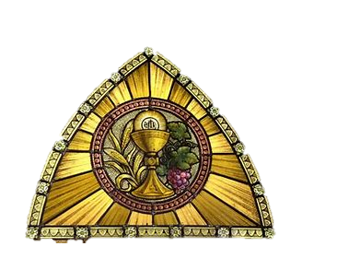
Closing Prayer: Hail Mary and Invocation to Mary, Mother of the Most Holy Eucharist
Hail, Mary, full of grace,
The Lord is with thee;
Blessed art thou among women,
And blessed is the fruit of thy womb, Jesus.
Holy Mary, Mother of God,
Pray for us sinners,
Now and at the hour of our death. Amen.
Mary, Mother of the Most Holy Eucharist, pray for our First Holy Communion students as they prepare to receive your beloved Son, Jesus.
Mother Mary, we ask that you pray also for their family members helping them to prepare for this most special sacrament, and for all in our parish family as we surround them with our love.

Slide 27
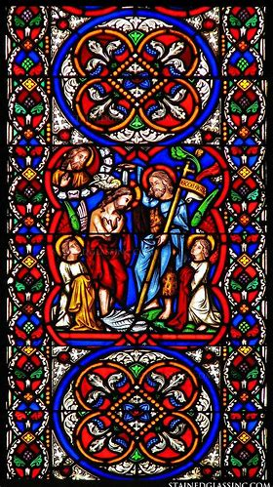
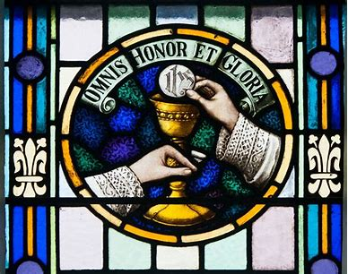
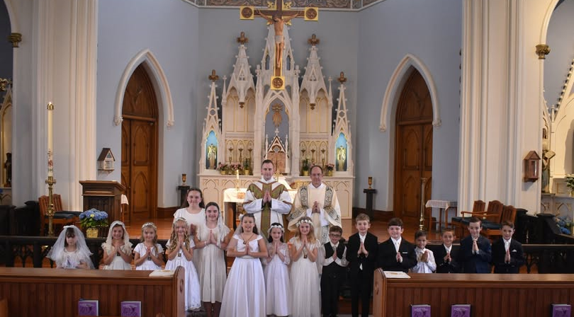
Our Lady of the Valley Parish 2025 First Holy Communion

