Slide 1
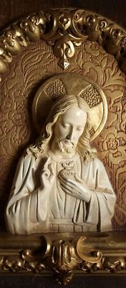
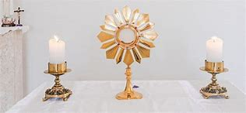
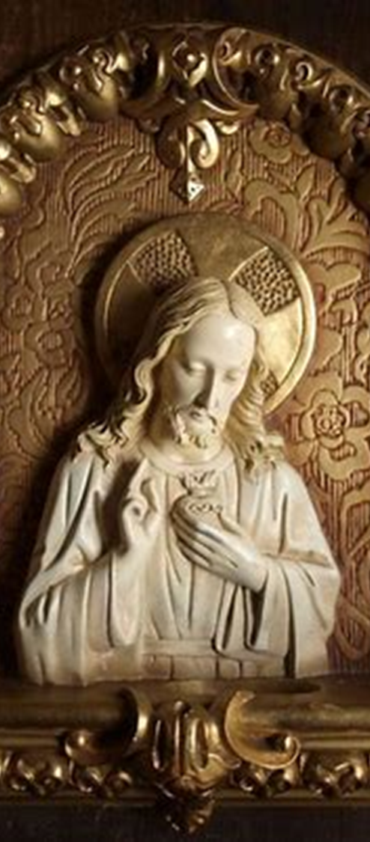
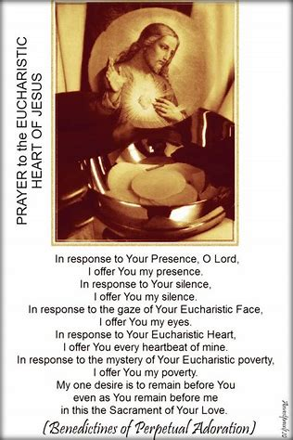
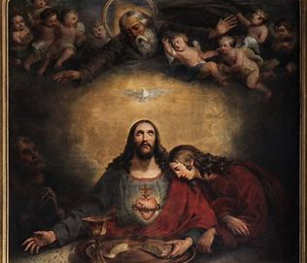
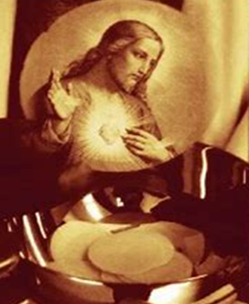
Consecration Preparation Program Session 4
Monday, August 11, 2025
Katie Sadakierski

Slide 2
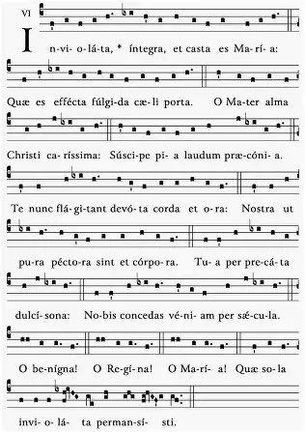
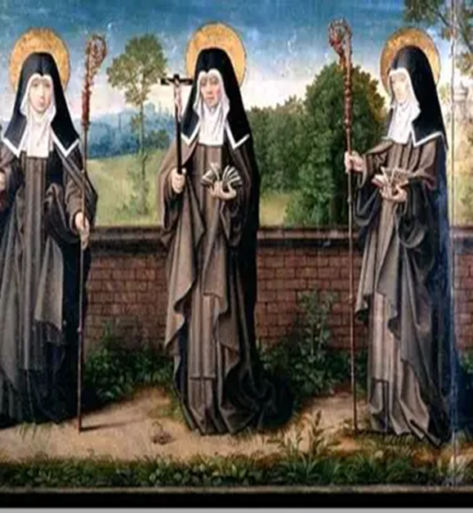
Outline: Consecration Preparation Session 4
I. Opening prayer
II. Presentation: Overview of topics
a. Total consecration and the way to Heaven: Treasures from the Marian heart of St. Clare of Assisi and Our Lady of the Way
b. Overview of consecration preparation prayers for week four
i. Reflecting on our experience of growing in self-knowledge in weeks one, two, and three: Takeaways from our consecration preparation
c. How the spiritual themes of weeks one, two, three, and four of our consecration preparation process interrelate: Knowledge of self as an outcome of self-emptying, and as preparation for knowing Our Lady and Our Lord
i. Uniting our hearts with the Heart of Jesus through knowledge of His Heart
III. Closing prayer
IV. Q & A

Slide 3
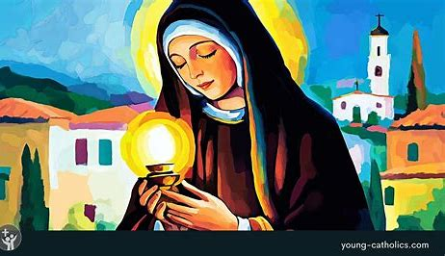
Opening Prayer: Collect Prayer for the Feast of St. Clare of Assisi
O God, who in your mercy led Saint Clare to a love of poverty, grant, through her intercession, that, following Christ in poverty of spirit, we may merit to contemplate you one day in the heavenly Kingdom. Through our Lord Jesus Christ, your Son, who lives and reigns with you in the unity of the Holy Spirit, God, for ever and ever.
Our Lady of the Way, pray for us.

Slide 4
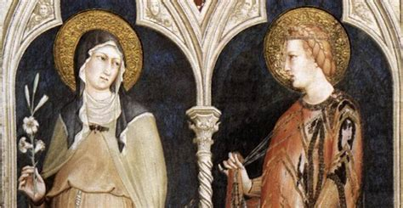
Who was St. Clare? What does she teach us about the spirit of total consecration? (1)
Feast day: August 11
Years of life: 1194-1253
Saint Clare was born on the Feast of Our Lady of Mount Carmel in the twelfth century. It was Our Lady of Mount Carmel who gave the brown scapular to the faithful as a way to put on her mantle, and radiate her love outwardly into the world. In a special way, St. Clare would be under the mantle of Our Lady; at the time of her death, her birthday into Heaven, she would receive a vision of Our Lady and a host of virgins from Heaven covering her body with Our Lady’s mantle, a most beautiful garment, the robe of the elect. Saint Clare’s guide to Heaven would be Our Lady, who brought her to dwell in Paradise with the rank of virgins, in the glorious light of the Son of God. Saint Clare had clothed herself in Christ’s love throughout her life, emulating Our Lady in reflecting the light of Jesus, the Light of the World, and at her death, would be rewarded for her charity, her life of mystical union with Christ as His bride. When Our Lady appeared to Clare, whose name means “light,” she would appear in such brilliant light, that it was enough to make the nighttime day. In dying to the world and to sin, St. Clare would come to dwell in the light with Our Lady; she had given herself to serving God, offering all of her earthly treasures to Mary, having given up her life of wealth and prosperity, with the result of receiving heavenly treasures, the greatest splendor

Slide 5
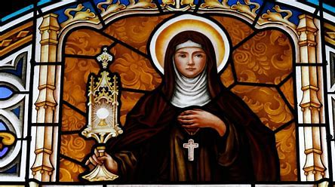
Who was St. Clare? What does she teach us about the spirit of total consecration? (2)
When Our Lady appeared to St. Clare, St. Clare saw that Our Lady was wearing a crown with a thurible on it; the virgins assembled around the Blessed Virgin also wore crowns, but none so brilliant as the crown of Our Lady. Through closeness to Our Lady, through conforming to her mold, we may come to share in her heavenly glory, and merit to wear heavenly crowns of virtue like hers
The thurible is the vessel in which the incense is smoked; Our Lady reminds us that we may enter Heaven through much prayer, namely, for her intercession, which can help us to be like fragrant incense, spreading the wonderful, rich aroma of holiness, to inspire others to lift their hearts and souls to prayer
The Blessed Sacrament is incensed during Eucharistic Adoration. Saint Clare offered herself on the altar with Christ, uniting herself with Our Lord in giving Him her joys and her sorrows alike, suffering with Him. When she physically could no longer attend Holy Mass due to illness at the end of her life, she prayed deeply, spiritually uniting herself with the Suffering Servant, in her sorrow over not being able to adore Our Lord at Holy Mass. Saint Clare’s heart was always in the tabernacle with Christ. Her faith during this challenging period was rewarded, for even as her body was broken like the Body of Christ on the Cross, her soul was strengthened as she continued to express faith in God through prayer, a kind of spiritual communion, and was granted the spiritual gift of being able to see the Holy Mass taking place in the nearby chapel, even while remaining bedridden in her cell (this is why St. Clare is the patron saint of television)

Slide 6
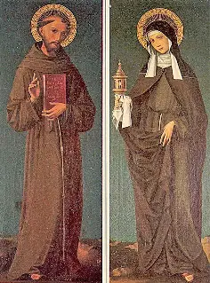
Who was St. Clare? What does she teach us about the spirit of total consecration? (3)
Like St. Clare, we can be spiritually united with Our Lord even when we physically cannot be with Him, by consecrating ourselves to Our Lord, giving ourselves to Him for His service, so that everything we do is in union with Him, offered as one continuous prayer, like incense always wafting up to the ceiling of the church, and being absorbed into the innermost soul as a message of the sweetness of God’s love, to be treasured in the heart forever
Saint Clare’s soul was always adoring Our Lord, acknowledging His Presence everywhere, including within herself; she was spiritually present in Christ’s Presence, loving Him wholeheartedly. Like Our Lady, she treasured everything about Him, and guarded these treasures. She came to love them so profoundly by immersing herself in the Eucharistic Presence of Christ, becoming one with Our Lord in spirit by sacrificing herself with Him, much like Our Lady. Saint Clare founded the female branch of the Franciscan order, the Poor Clares, and was a spiritual friend of St. Francis, a support in his suffering. She lived a Eucharistic life of love and care for others, much like Our Lady, prayerfully supporting all those who bring Christ’s Presence to others. After St. Francis of Assisi received the stigmata, the wounds of Christ, St. Clare compassionated with him, fulfilling the role of Our Lady who, in her Compassion for Christ, spiritually participated in the Passion with Him, when He was wounded on the Holy Cross
Saint Clare placed her confidence completely in the Eucharistic Heart of Jesus, having wed herself entirely to Christ, sublimating any of her desires to His will for her, which was her own will. When an army was set on invading her convent, she courageously approached the soldiers, wielding not a sword, but the monstrance. Uplifting the monstrance with the Sacred Host triumphantly, like the Cross, St. Clare brought the soldiers into the Presence of Christ, who were so moved, that they turned back, their hearts having been turned towards Christ, and away from sin and destruction. In her faith, hope, and love, St. Clare reflected the radiant Spirit of Christ

Slide 7
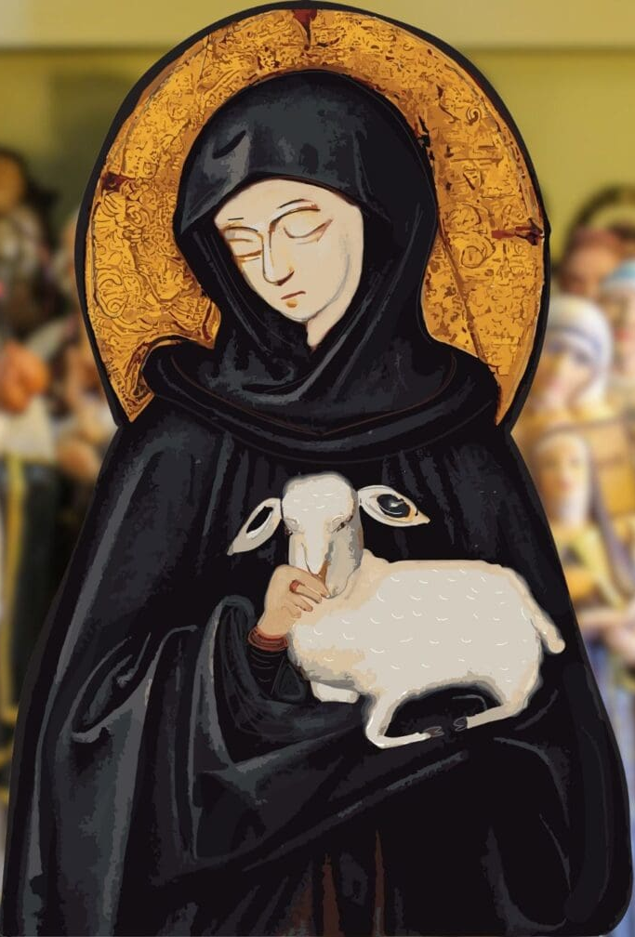
Who was St. Clare? What does she teach us about the spirit of total consecration? (4)
In being so hidden within Christ, like Our Lady, St. Clare could truly shine; it was Christ’s Heart that shone out from her heart, for St. Clare’s heart was united with the Immaculate Heart, in being filled with the gems of Christ’s virtue; she looked out with Christ from the monstrance, beholding others with compassionate love, a love that would not only lead her to heavenly glory, but set so many others on the path there, too; she fed others with her spirit, a soul filled with the Spirit of Christ, drawing others to be nourished by the True Bread, much like Our Lady
Saint Clare’s own sister, St. Agnes of Assisi, would be inspired to follow the path that St. Clare blazed towards the Holy Eucharist, and therefore, towards Heaven, battling family persecution, including attempted kidnappings aimed at preventing her from entering the convent, to ultimately win the crown of glory through union with Christ. Saints Clare and Agnes of Assisi were not martyred, but faced spiritual martyrdom, overcoming emotional suffering to be healed by joy and peace in Christ
Our Lady draws others to Our Lord through prayer and care for souls; St. Clare of Assisi would show that the way to Heaven is the Marian way of loving support given to others, a union of souls that comes from communion with Christ, which St. Clare had through her closeness to Christ in the Holy Eucharist
Saint Clare was a pioneer who was called to a deep level of fortitude. She had to be willing to leave behind all that she had ever known to embrace something better, something that would challenge her. Her perfect love canceled out her fear, and inspired others to greater courage, too, including her sister. Trusting in Our Lady to show her the way, St. Clare proved to be a spiritual guide molded by the greatest guide to Christ, Mother Mary: Our Lady of the Way

Slide 8
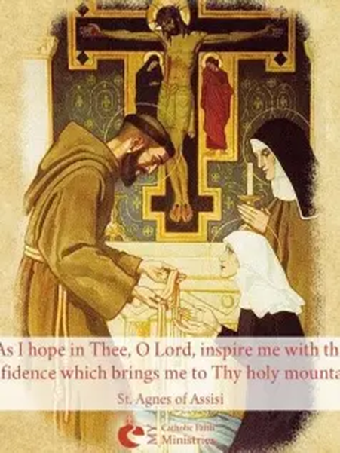
What is the San Damiano Cross? What does it teach us about consecration? (1)
Saints Clare, Agnes, and Francis of Assisi carried many crosses with Christ on their path to glory, and would show that the way of the Cross is the Marian way, the way to Heaven
The San Damiano Cross is the crucifix that St. Francis was praying before when he received a special call from God. When Jesus spoke to St. Francis through the Cross, His lips moving on the figure on the crucifix, He would convey what St. Francis’ path to Heaven would be
Our Lord told St. Francis of Assisi that his special mission would be to build up the Church, to restore what was broken, that many could come to adore Christ, broken in the bread given to feed our souls. Consecration helps to mend what is broken within us, as we give ourselves to Christ to be nourished by Him, that He may supply what is lacking within us, and build up our souls to glorify Him, that we may lovingly contain His Presence within us
Union with Christ, Who is perfect, perfects us

Slide 9
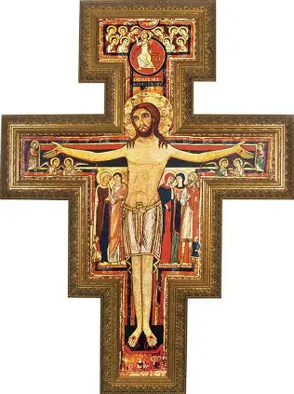
What is the San Damiano Cross? What does it teach us about consecration? (2)
The San Damiano cross features the resurrected Christ. It is a Roman cross inspired by the Byzantine style, using goldleaf detailing. Our Lord’s Body is illuminated from within: the soul of the Risen Lord radiates love that uplifts. Though we see the marks of the nails that flow forth Christ’s Most Precious Blood, that sweet refreshment for our souls, the nails are gone; similarly, when we detach ourselves from sin and the world, we are no longer pinned down and imprisoned as though by nails, but are liberated, freed to pursue a life of holy, self-giving love in union with Christ, that we may spiritually resurrect with Him
Surrounding Our Lord on this Cross are groups of holy figures, including Our Lady and St. John. Through communion with Christ, we enter into deeper communion with each other, supporting each others as friends of Christ, our greatest Friend Who laid down His life for us all, on the way to Heaven, helping each other to carry crosses, so that the experience is sweetened by Christ’s love, and the Passion becomes a song of thanksgiving to God the Father for His Providence. In consecrating ourselves to Christ, we can better serve God and His people, reaching union with Him as one Church, with all of her members working in harmony to give glory to Our Lord. We reach Heaven together, as a family; we come to know Christ through each other, seeing His Presence reflected in each soul, especially when we are united in the Holy Eucharist, receiving His Presence through Holy Communion, and bearing His light to others by holding Him within ourselves as living tabernacles, much like St. Clare

Slide 10
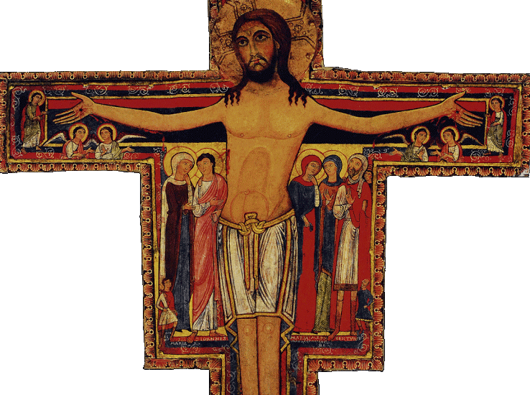
What is the San Damiano Cross? What does it teach us about consecration? (3)
Scallop shells on the border of the Cross remind us of Holy Baptism, our greatest pilgrimage from spiritual death and darkness to spiritual life and light, our means to entering Holy Mother Church, receiving Our Lord in the Holy Eucharist, and being born into Heaven. Pilgrims are given shells, and shells are used to pour the holy water onto baptismal candidates at Holy Baptism. We carry the Cross on our pilgrimage through life, but through it, Christ cleanses and revitalizes us with His Precious Blood, poured out in love for us. Consecration is a pilgrimage into the Hearts of Jesus and Mother Mary, as we seek to renew our baptismal promises, to live them out more deeply, and return to baptismal purity, that we may be saved, in union with the pure Hearts of Jesus and Mother Mary. We open ourselves to being filled by the Holy Spirit like Jesus and Mother Mary, in order to be sanctified through His love. The vines on the Cross remind us that in remaining close to the True Vine by receiving Holy Communion regularly in a state of grace, we can receive the nourishment we need, the love pumped from Christ’s Heart into our own hearts, to keep growing spiritually, until we are transplanted into the heavenly garden, to harvest the fruits Christ produced in us through the spiritual food of His loving Eucharistic Heart
We need not be discouraged on the pilgrimage, for every twist and turn that God wills for us is an opportunity to come to more deeply know Christ, to offer it up to Him for His glory

Slide 11
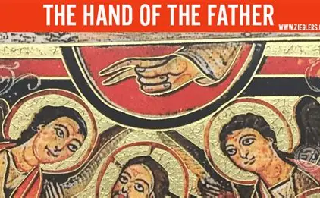
What is the San Damiano Cross? What does it teach us about consecration? (4)
The San Damiano cross features the hand of God the Father extended in blessing
  Consecration to Christ, allowing for a deeper union with Him, means that we can come to union with God the Father, for the closer we are to Christ, the more His Father will bless us, and love us as His children, too
Our Lord is the largest figure on the Cross, the center point. There are five figures grouped around Him who are the next largest in size, and three smaller figures placed near them, for a total of eight figures immediately surrounding Him. When we keep Our Lord at the center of our lives, of our hearts, we can join Him and other holy figures close to Him in glory; we are to be like the figures standing by His Cross, in order to stand by His throne in Heaven. Five is the number of love; three the number of the Blessed Trinity; and eight the number of infinity, of spiritual resurrection
When we consecrate ourselves to Christ as one Church, members of His Body united in love for Him, and for the Father and the Holy Spirit, the other two Persons of God in the Blessed Trinity, we can be raised to new life in them, rebaptized into Heaven
At the top of the Cross, we also see a smaller image of Our Lord emerging from the tomb victoriously with the Cross in hand. He is flanked by ten holy angels, ten being the number of happiness. Dying with Christ allows us to rise with Him; imitating the holy angels in adoring Christ and remaining immersed in heavenly things, the things of God that are true and eternal, that we may enjoy them forever in the joy of the next life. There are five holy angels on either side of Christ, because we come to true happiness by sharing in Christ’s five holy wounds, that in union with the Wounded Savior, we may be healed. The holy angels are given to God in service to Him; we, too, can give our wounds to Christ, and all that is within, to serve Our Lord when we consecrate ourselves to Him, that He may transform us, bringing all things together for our good

Slide 12
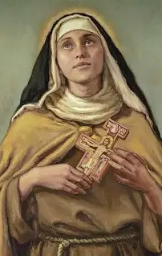
What is the San Damiano Cross? What does it teach us about consecration? (5)
On the back of the cross, we see an inscription in Latin. It is a prayer that, when translated into English, reads: “The Lord bless you and keep you. May He show His face to you and have mercy. May He turn His countenance to you and give you peace. The Lord bless you!”
This prayer is a call to consecration, to turn ourselves like flowers always towards the sun, always pointed in the direction of Christ’s Face. We consecrate ourselves to Our Lord, so that we would see Him in all people, and within ourselves; when we consecrate ourselves to Jesus through Mary, we are not only giving ourselves to God, but are receiving more of Him; it is a kind of exchange of hearts, in which we empty our hearts of a worldly spirit, and receive the Spirit of Christ to renew and uplift us. We come to more deeply see with the eyes of God, receiving His clarity, which flows from His love; when we see in this way, we see that we are all creations of God made in His love
We are reminded that when we look upon the crucifix, we look upon the Prince of Peace, seeing not the face of defeat, but the face of victory. When we see the San Damiano crucifix, we see the Risen Lord, remembering that He looks upon us with compassion, to bring us from death on the Cross to life forever in Heaven

Slide 13
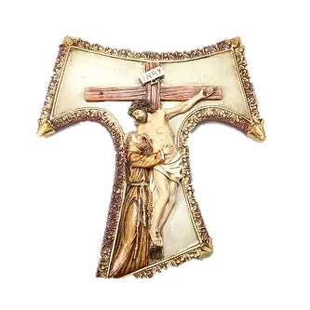
What is the tau cross? What does it teach us about consecration?
The tau cross is a cross typically given to Franciscans when they start out on a pilgrimage
Third-order (lay) Franciscans may also wear the tau cross as a symbol of devotion
“Tau” is the last letter of the Hebrew alphabet. It is believed that Ezekiel signed those chosen by God with this symbol
The “tau” letter resembles the capital letter “T.” It is a three-point rather than a four-point cross, in that it does not have a top vertical beam
Saint Francis of Assisi would sign his letters with this symbol, rather than with his name. The tau cross reminds us that we are still journeying towards Heaven, and that we need spiritual union with Our Lady and Our Lord to help us on the way. We are humbled in remembering our incompleteness, recalling that we need Jesus and Mother Mary to be fulfilled, because our journey can never be complete this side of Heaven; we may only be perfected and completed by God when we are purified in the next life, and chosen to stand in God’s Presence in the light of Heaven. Only through the Cross do we come to treasure Jesus and Mother Mary, knowing the depth of their joy and their sorrow, that we may know the depth of their glory in Heaven, the expansiveness of their Hearts that reach out like the cross beams, raising us up to Heaven as we are enfolded in their embrace
Only through consecration, through giving all that we have and are to Jesus and Mother Mary, may we store up treasures in Heaven, and become the best treasuries for the Hearts of Jesus and Mother Mary that we can be

Slide 14
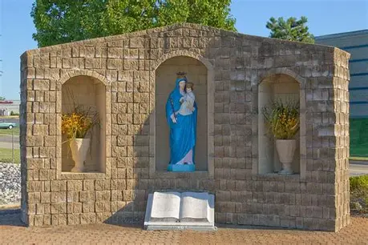
What is the feast day of Our Lady of the Way, and what does it teach us about total consecration?
The feast day of Our Lady of the Way, a special shrine in St. Charles, Missouri, is celebrated on August 11
The roadside shrine was constructed by volunteers; the parcel of land on which it was built was donated by the May Company. The shrine faces a highway, and is a reminder of Our Lady’s patronage to all those who pass by
The statue of Our Lady in the shrine is flanked by two flower vases, and a book rests at Our Lady’s feet. On the pages of the book is written a special prayer for the intercession of Our Lady of the Way, who is a patroness for everyone traveling on roads, and on the seven seas. In the prayer is the petition that we all would be granted the graces from Our Lady to travel in union with Our Lord, the Way, the Truth, and the Life, on the way to Heaven, by living our lives in harmony with the Ten Commandments, our roadmap to holiness
In celebrating this feast day, we are reminded that total consecration sets us more firmly on the right path to Heaven, as we give our pathway to Christ, offering us ourselves for Him to direct entirely. We do not rely on ourselves solely for direction, but go to Our Lord through Our Lady to guide us. She is like our GPS pointing us on the way to Christ, advising us about where to turn, so that we may turn closer to Christ, and away from sin

Slide 15
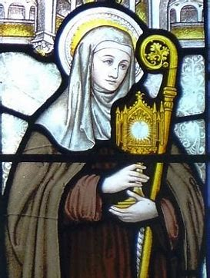
What is the spiritual theme of the fourth week of consecration preparation? How does this relate to the themes of the first, second, and third weeks?
The spiritual theme of week four is knowledge of Our Lord, Jesus Christ
In emptying ourselves of the spirit of the world, coming to know ourselves, and better acquainting ourselves with Our Lady, we come to know Our Lord; we unite ourselves with Jesus in living in a heavenly-minded, rather than worldly-minded, way; loving His Mother; and knowing who we are as children of God the Father. We journey with Jesus in 33 days, reliving the 33 years of His life, a life of knowledge of the Father’s goodness, and in service to the Father, flowing from love for this goodness; we join Jesus in humbling ourselves before the Father, in order to be totally united with Him

Slide 16
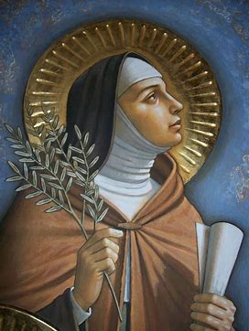
Which prayers will we say during week four?
Daily prayers on days 27-33, Week 4: August 11-August 17
Invocation of the Holy Spirit
Jesus Living in Mary Prayer
The Prayer of St. Augustine
Day 27: Litany of the Blessed Virgin
Day 33: Ave Maris Stella

Slide 17
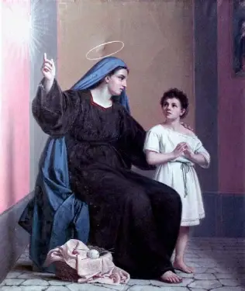
What is the Prayer of St. Augustine?
O Jesus Christ, You are my father, my merciful God, my great king, my good shepherd, my only master, my best helper, my beloved friend of overwhelming beauty, my living bread, my eternal priest. You are my guide to my heavenly home, my one true light, my holy joy, my true way, my shining wisdom, my unfeigned simplicity, the peace and harmony of my soul, my perfect safeguard, my bounteous inheritance, my everlasting salvation. My loving Lord, Jesus Christ, why have I ever loved or desired anything else in my life but You, my God? Where was I when I was not in communion with You? From now on, I direct all my desires to be inspired by You and centered on You. I direct them to press forward for they have tarried long enough, to hasten towards their goal, to seek the one they yearn for. O Jesus, let him who does not love You be accursed, and filled with bitterness. O gentle Jesus, let every worthy feeling of mine show You love, take delight in You, and admire You. O God of my heart and my inheritance, Christ Jesus, may my heart mellow before the influence of Your Spirit and may You live in me. May the flame of Your love burn in my soul. May it burn incessantly on the altar of my heart. May it glow in my innermost being. May it spread its heat into the hidden recesses of my soul and on the day of my consummation may I appear before You consumed in Your love. Amen.

Slide 18
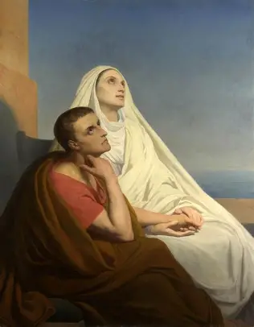
Why will we say the Prayer of St. Augustine during the fourth week of our consecration preparation program?
Saint Augustine is remembered for his dramatic conversion from sin to sanctity, from the world to Our Lord. Knowledge of Christ allows for our conversion, so we pray to come to a knowledge of Our Lord like St. Augustine had; he was invited by Our Lord to “take and read” His Word in Sacred Scripture. We pray to read of the wisdom in Christ’s Heart with Our Lady’s eyes, mind, and heart, that we may understand the depth of His love, and receive it with all of our hearts
We say this prayer to echo St. Augustine in adoration of Our Lord for His greatness in having such mercy as to reach out to each of us personally to bring about our conversion, that we may be with Him in Heaven
The prayer captures something of the glory of how Our Lord transfigures our souls, working within us to accomplish His plan for salvation; we see how we are vessels of His strength, like Our Lady, and can build upon our knowledge of Mother Mary that we gained in the third week by gaining knowledge of how Our Lord shaped Our Lady, making her the perfect treasure house in which to contain His Heart
We give thanks to God for all that He has done over our consecration preparation process, in helping to ready our souls to share in His glory, and be totally consecrated to Him, like the Son, that we may be filled with His light, and freed from the limits of the world, in order to know His boundless love in eternity. We pray to live out the spirit of consecration by reciprocating the love that Jesus has so generously shown us; our prayer is truly to honor Him like Our Lady did, with receptive hearts that welcome the light of His love

Slide 19
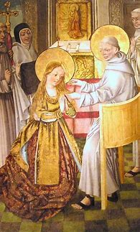
Why will we say the Litany of the Blessed Virgin during the fourth week of consecration preparation?
In the third week of our total consecration preparation process, we prayed the Litany of Loreto, another prayer of supplication petitioning Our Lady for her graces and intercessory prayers
Now, we will pray the Litany of the Blessed Virgin. Usually, these litany titles are used interchangeably to refer to the same prayer, but in our consecration guide, we are presented with a different litany to expand upon our knowledge of, and love for, Our Lady, as we meditate on her titles in a deeper way, seeing her virtues from new angles, and coming to appreciate aspects of her beautiful identity in Christ that we may not have seen before. Illuminated by the Holy Spirit’s enlightenment, our minds and hearts can perceive in this prayer that Our Lady does not shine on her own strength, through her own merits, but through Our Lord, Who gives her such depth of soul, such beauty with which to glorify God

Slide 20
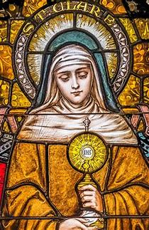
Why will we say the “Ave Maris Stella” prayer again at the close of week four?
Our Lady helps us to bear fruit for Our Lord over time; she works deeply within our souls. We are always in need of the graces that she delivers to us from her hands, and must pray to receive them regularly
We pray that Our Lady would “keep our life all spotless” “till we find in Jesus joy forevermore.” The journey to eternity with Our Lord is lifelong, so we continue to salute Our Lady, the Star of the Sea, as our continual north star, guiding us. She is the reference point we keep looking to in order to find our way through each phase in life: as humans, we are always inclined to sin, always in need of the graces from the sacraments of Confession and Holy Communion, so we continue to offer this prayer, that Our Lady would “Chase all evils from us,” and through leading us closer to Christ “peace confirm within us.” We may have moments of feeling peace, but if we are to have lasting peace in Heaven with Christ, if we are to live in steadfast faith in the unchanging love of God, if we are to have peace confirmed within us, then we need Our Lady, who is the Queen of Peace, to keep interceding for us

Slide 21
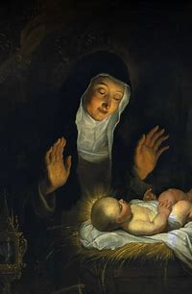
How do the prayers of the fourth week build upon the prayers of the first, second, and third weeks?
We prayed to be kept under the protection of Our Lady in the first week; in the second week, we prayed that Our Lady would shelter us under her mantle securely, always remembering our petitions, and hearing them; in the third week, we prayed that Our Lady would not abandon us, but that she would tend to us as she has tended to all of her spiritual children throughout time; now, we pray with St. Augustine to be made one with Christ. Our prayer is truly to be totally spiritually united to Christ. In the third week, we prayed to consecrate ourselves to Our Lady, and through this prayer, we pray in preparation to consecrate ourselves to Christ. We ask that Our Lady would intercede for us to help to bring us to union with Christ like that she has, that we may be consecrated to Christ through her. We channel St. Augustine’s spirit of faith, of hope for ongoing conversion, as we keep turning closer to Christ, striving to love Him more every day, that we may go to Heaven to love Him to the greatest possible extent forever, and shine as brightly in His glory as we possibly can

Slide 22
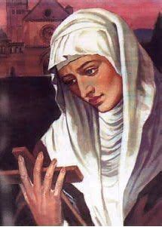
What spiritual insights has our Day Twenty reflection brought? (1)
Sacred Scripture: 1 Corinthians 1:4-8
  “I give thanks to God always for you because of the grace of God which was given you in Christ Jesus, that in every way you were enriched in Him with all speech and all knowledge- even as the testimony to Christ was confirmed among you- so that you are not lacking in any spiritual gift, as you wait for the revealing of Our Lord Jesus Christ, Who will sustain you to the end, guiltless in the day of Our Lord Jesus Christ.” (p. 77)
“Mary alone found grace before God without the help of any other creature. All those who have since found grace before God have found it only through her. She was full of grace when she was greeted by the Archangel Gabriel and was filled with grace to overflowing by the Holy Spirit when He so mysteriously overshadowed her. From day to day, from moment to moment, she increased so much this two-fold plenitude that she attained an immense and inconceivable degree of grace. So much so that the Almighty made her the sole custodian of His treasures and the sole dispenser of His graces. She can ennoble, exalt, and enrich all she chooses. She can lead them along the narrow path to Heaven and guide them through the narrow gate of life. She can give a royal throne, scepter and crown to whom she wishes. Jesus is always and everywhere the fruit and Son of Mary and Mary is everywhere the genuine tree that bears the Fruit of life, the true Mother who bears that Son.” (St. Louis de Montfort, p. 77)
“In your life, where do you experience the greatest need for the grace of God? In your prayer today place this aspect of your life in the hands of Mary and ask her to obtain from her Son the grace that you need. Continue to pray in this way each day.” (Fr. Hugh Gillespie, p. 78)

Slide 23
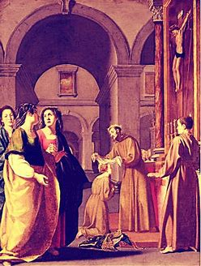
What spiritual insights has our Day Twenty reflection brought? (2)
We are grateful to God for Our Lady for her receptivity to God’s grace. In being filled with God’s grace, she is an immense vessel, one great enough to hold Christ, and has an immensity of graces to share with us. We can thank God for how Our Lady is passing on His graces to us, and have gratitude for the generosity of God in pouring His love into us. We can have hope for what He will continue to do in us, because we are still awaiting glory; the story is not over yet. Christ will come again in glory, to judge the living and the dead, at the end of time. We can use the time we have to take steps each day to glorify God, that He may judge us as having been good and faithful servants who loved Him and His people well
God gives us crosses, and works gradually in us, to do the deepest and greatest possible work in us, so that we will not be lacking in any gift, but can have a fullness of grace from Him, like Our Lady. Like Our Lady, we must persevere, keeping our faith amidst the trials, in the times when we cannot see God working. We pray that the eyes of our souls would be opened to see His love everywhere, that we may always look with hope

Slide 24
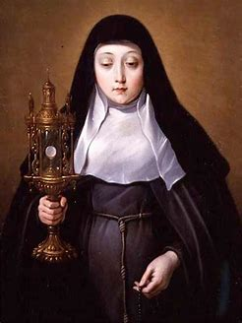
What spiritual insights has our Day Twenty reflection brought? (3)
Our Lady did not require the intercession of someone else; she already was filled with grace. We can go to her, then, to intercede for us, to pass along graces from her hands into ours. We can have confidence in what Our Lady can do for us; she can crush evil, so she can convert any soul, no matter how steeped in sin, just as the prayers of St. Augustine’s mother, Monica, for his conversion restored him to life in Christ. Saint Monica prayed with a Marian heart, always remaining by her son’s crosses, until from her, he learned to carry them with Christ
Too often, we focus on the punishments that God would give us for our sins, but this reading from St. Louis de Montfort reminds us to think of how Our Lady found grace with God, and was rewarded, so she will share those graces with those who are devoted to her, who also find favor with God for their humble, patient courage, their steadfast love. To be known and loved by Our Lady at all is a tremendous reward as it is, a sign of God’s love for us
Place your prayers in Our Lady’s hands; think of her holding your hands, carrying your sorrows and joys with you. You are not alone; offer Our Lady your joys and sorrows. Just as Our Lady had seven sorrows and seven joys, write seven joys and seven sorrows in your life down, and pray for Our Lady to use these joys and sorrows to help you to become closer to her Son; pray that she would give you the grace to use these experiences to best glorify God. In offering it all to Our Lady, prepare yourself for consecration, to be freed of any anxiety caused by sorrow, and to humbly receive each joy like she would
We need God’s grace in every aspect of our lives, and should never fear to pray for it, to approach Him for His mercy, especially by going to Our Lady for it; it is better to recognize that we need grace, to know our sins, and to pray for grace to transcend them, than to not be aware of them or to despair when we discover them. The clarity to see our sins is a clarity like that Our Lady has; it means our minds and hearts are being purified to see God; we are receiving the light of the Holy Spirit so that we will not sin against Him

Slide 25
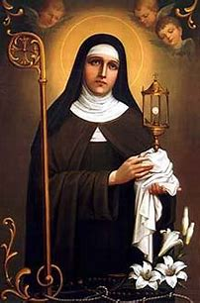
What spiritual insights has our Day Twenty-One reflection brought? (1)
Sacred Scripture: Genesis 3:14-15
  “And the Lord God said to the serpent: Because thou hast done this thing, thou art cursed among all cattle, and beasts of the earth: upon thy breast shalt thou go, and earth shalt thou eat all the days of thy life. I will put enmities between thee and the woman, and thy seed and her seed: she shall crush thy head, and thou shalt lie in wait for her heel.”
“God has established only one enmity- but it is an irreconcilable one which will last and even go on increasing to the end of time. That enmity is between Mary, His worthy Mother, and the devil, between the children and the servants of the Blessed Virgin and the children and followers of Lucifer. The most fearful enemy that God has set up against the devil is Mary, His holy Mother. From the time of the earthly paradise, although she existed then only in His mind, He gave her such a hatred for His accursed enemy, such ingenuity in exposing the wickedness of the ancient serpent and such power to defeat, overthrow and crush this proud rebel, that Satan fears her not only more than angels or men but in a certain sense more than God Himself. This does not mean that the anger, hatred, or power of God are not infinitely greater than the Blessed Virgin’s, since her attributes are limited. It simply means that Satan, being proud, suffers infinitely more in being vanquished and punished by a lowly and humble servant of God, for her humility humiliates him more than the power of God.” (St. Louis de Montfort, p. 80)
“What do you find to be the most difficult temptation to struggle against? What is your most persistent temptation? In your prayer tonight, place your struggle against this temptation into the hands of the Blessed Virgin and ask her help in overcoming this inclination to sin. Continue to pray in this manner each night.” (Fr. Hugh Gillespie, p. 80)

Slide 26
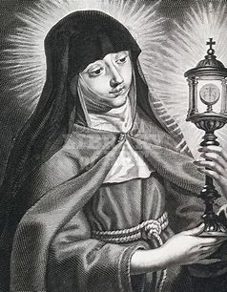
What spiritual insights has our Day Twenty-One reflection brought? (2)
Satan cannot have any power over us unless we give it to him. He has been reduced to crawling along the ground in the dirt; he has been cursed to be crushed by a human’s foot, the foot of Our Lady, for his evil. Our Lady, in her goodness, through the power of her Son’s Holy Cross, will triumph over evil every time. In uniting ourselves with her Immaculate Heart, we can know the same triumph
In her purity, Our Lady has a clear mind and a discerning heart, a pure wisdom, that can see through the deceptions of Satan. She can help us to see in the light of Christ, and not be deceived, but remain in the truth. The closer we become to Our Lady, the further away from Satan we become; the enmity, the wide distance, between the serpent and Our Lady increases with every child of Our Lady who mirrors her and is united with her in devotion to Christ
Our Lady is the Mother of man, and the Mother of Jesus, the God-Man, so it is unbearable to her when there is a gulf between us and Our Lord created by our sins; we are to pray for the grace to always remain close to Christ, and far from sin. Our Lady helps to close the gap between ourselves and Christ

Slide 27
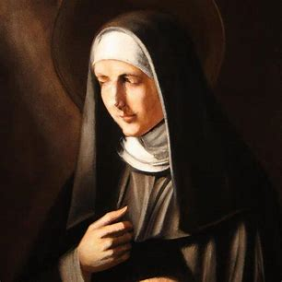
What spiritual insights has our Day Twenty-Two reflection brought? (1)
Sacred Scripture: Romans 8:28-30
  “We know that in everything God works for good with those who love Him, who are called according to His purpose. For those whom He foreknew He also predestined to be conformed to the image of His Son, in order that He might be the first-born among many brethren. And those whom He predestined He also called; and those whom He called He also justified; and those whom He justified He also glorified.” (p. 81)
“As in the natural life a child must have a father and a mother, so in the supernatural life of grace a true child of the Church must have God for his Father and Mary for his Mother. If he prides himself on having God for his Father but does not give Mary the tender affection of a true child, he is an imposter and his father is the devil. Since Mary produced the head of the elect, Jesus Christ, she must produce the members of that head, that is, all true Christians. A mother does not conceive a head without members, nor members without a head. If anyone wishes to become a member of Jesus Christ, and consequently be filled with grace and truth, he must be formed in Mary through the grace of Jesus Christ, which she possesses with fullness enabling her to communicate it abundantly to true members of Jesus Christ, her true children.” (St. Louis de Montfort, p. 81)
“Christ goes so far as to share even His Mother with us so that she might be our Mother as well. What does it mean for you to have Mary as your Mother?” (Fr. Hugh Gillespie, p. 82)

Slide 28
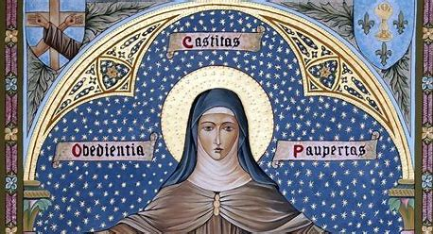
What spiritual insights has our Day Twenty-Two reflection brought? (2)
The Scriptural passage is not to suggest that there is predestination, in the sense that God determines to condemn and to save souls ahead of time; we all have an equal chance at personal salvation. Our Lord died for us all, and invites all to receive His mercy; He is the just Judge
Jesus is considered to be not the firstborn of natural children, but of spiritual children; Our Lady had no other children besides Jesus. Jesus is our Brother, in the sense that through dying for our sins, He reconciled us to God the Father, that through Holy Baptism, a sacrament made efficacious, effective, by His Precious Blood, we could be adopted as spiritual children of God the Father, becoming united to Him through Our Lord, His Son
God made us all in His image, and calls us all to conform to this image to closeness to Jesus Christ. The more we become like Our Lord, the more we can be glorified with Him. Conforming to the image of Christ means living with charity, lovingly carrying the Cross, and offering it up for the salvation of souls

Slide 29
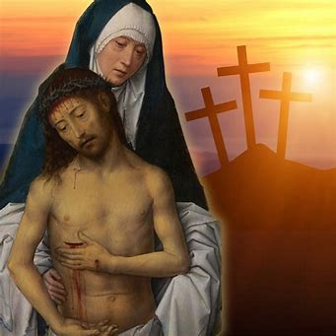
What spiritual insights has our Day Twenty-Two reflection brought? (3)
God loves us so much, that He sanctified humanity by sending His Son to take on human flesh and die for us; He sent His Son to be born from a woman. Our Lord could have been fully divine and fully angel, having equal angelic and divine natures, but instead, He is fully human and fully divine, to redeem us. Satan, meanwhile, is so evil, so prideful, that even though he is a creation of God, just like a human being is, he sees himself as being above God and man, therefore refusing to serve humans, and hating all the more when Our Lady, a human, rebukes him
This is all the more motivation to fight the spiritual battle with Our Lady
Our Lord battled temptation in the desert, and Our Lady loves her Son so much, that she will compassionate with us when we deal with temptations, just like He did, and will reach out to help us through them; she wants to help us to become more like her and her Son, so that we may know the full joy of glory in Heaven; her Immaculate Heart is full of such pure charity, that she genuinely wants each of us to be happy and to be rewarded with life in her Son, also willing what God wills, since God loves us so much, that He wants to be close to us, to pour out His love upon us
Mother Mary helps us to better serve Our Lord, the Head of the Church, as His members; she helps us to have a true spirit of charity like her, every virtue contrary to vice, so that in lovingly working together, we can lovingly serve Jesus; she helps our love for Christ to transcend any self-love that would prevent us from loving each other and glorifying God through our works as united members of His Mystical Body, the Church
Our Lord is generous, wanting us to have His most perfect, beautiful Mother, too, that we may receive something of the graces and gifts that He has in His Heart, formed in the womb of the Virgin Mary

Slide 30
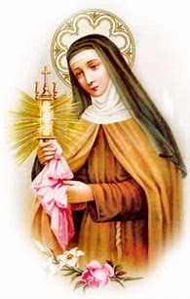
What spiritual insights has our Day Twenty-Three reflection brought? (1)
Sacred Scripture: Luke 2:6-7
  “And while they were there, the time came for her to be delivered. And she gave birth to her first-born Son and wrapped Him in swaddling cloths, and laid Him in a manger, because there was no place for them in the inn.” (p. 83)
“Mary is the most perfect and most holy of all creatures, and Jesus, Who came to us in a perfect manner, chose no other road for His great and wonderful journey. The Most High, the Incomprehensible One, the Inaccessible One, He Who Is, deigned to come down to us poor earthly creatures who are nothing at all. How was this done? The Most High God came down to us in a perfect way through the humble Virgin Mary, without losing any of His divinity or holiness. It is likewise through Mary that we poor creatures must ascend to Almighty God in a perfect manner without having anything to fear. God, the Incomprehensible, allowed Himself to be contained by the humble Virgin Mary without losing anything of His immensity. So we must let ourselves be perfectly contained and led by the humble Virgin without any reserve on our part. God, the Inaccessible, drew near to us and united Himself closely, perfectly and even personally to our humanity through Mary without losing anything of His majesty. So it is also through Mary that we must draw near to God and unite ourselves with Him perfectly, intimately and without fear of being rejected. Lastly, He Who Is deigned to come down to us who are not and turned our nothingness into God, or He Who Is. He did this perfectly by giving and submitting Himself entirely to the young Virgin Mary, without ceasing to be in time He Who Is from all eternity. Likewise it is through Mary that we, who are nothing, may become like God by grace and glory. We accomplish this by giving ourselves to her so perfectly and so completely as to remain nothing, as far as self is concerned, and to be everything in her, without any fear of illusion.” (St. Louis de Montfort, pp. 83-84)
“As St. Louis de Montfort shows us, when we confide our lives into the care of Mary we experience a profound union with Jesus Christ because we are participating in the most profound and the most basic movement of His life. In your prayer today, ask Jesus for a great confidence in and submission to the Virgin Mary.” (Fr. Hugh Gillespie, p. 84

Slide 31
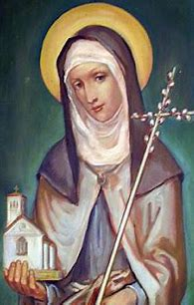
What spiritual insights has our Day Twenty-Three reflection brought? (2)
Our Lady delivered Our Lord so that we could be delivered from sin. She teaches us how to cooperate with God’s grace through her holy detachment, that we may deliver Christ into the world through His spirit of love and humility that we may embody, just as Our Lady reflected these virtues. Rather than being attached to material things, or to the favor of the world, she sought only to live in God’s grace, and gratefully received all that God gave, offering up her poverty for God’s glory, and embracing the spiritual richness of being filled by God, the heavenly things
Our Lady could recognize the true gift of Our Lord, Who was wrapped in the swaddling clothes, the first corporals holding the Bread of the Angels; she was not distracted by her humble surroundings, or fear that God did not favor her, because of these crosses, but had total joy and hope that flowed from closeness to the Sacred Heart of our Savior, our deliverer, Who frees us from worldly attachment that limits and pins us down. Our Lady teaches us to be delivered from anxiety, insecurity, and fear by being wrapped under her mantle, and in the garments of love that Christ wears, by going to her in our times of need, that we may be transformed from imperfect offerings, into perfect likenesses of Christ
Jesus, the perfect embodiment of humble love, of faithfulness and obedience to God the Father, chose to enter the world through the humble Virgin Mary; she helps us to enter Heaven by following the path of humility by humbly offering ourselves to God, not exalting ourselves in our sinfulness, but opening ourselves to God’s healing, so that in being freed from sin, we may rejoice in the greatness of Our Savior like the sinless Mother Mary
Our Lady is our confidante; she treasures all that we give her out of love in her Heart; we can go to her to share what weighs on our hearts, just as she would have lovingly listened to the words of her Son

Slide 32
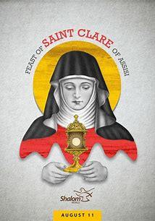
What spiritual insights has our Day Twenty-Three reflection brought? (3)
Not only did Our Lady retain her integrity when Christ was conceived within and born from her, remaining a virgin, but nothing of Our Lord’s divinity was reduced in being conceived within and born from Our Lady; He is incorruptible, so we consecrate ourselves to Him, as corruptible beings, so that we may not be corrupted by the world, but made steadfast in faith, hope, and love, like Christ; spiritual union with Him allows us to treasure the eternal things in our hearts, like Our Lady
There is no length to which God would not go to save us; Our Lord took the path of humility to save us. Our Lady leads us down this path, because it is the path of her Son; it is the path to our salvation; we strive to keep emptying ourselves of the world, because in having nothing of the spirit of the world, we can have everything, being filled with God. This need not necessarily mean living in perfect poverty free of possessions, but it means embracing Christ, not being so attached to the things of the world, that we cannot leave it behind to follow Our Lord and embrace Heaven; we are not to be consumed by worldly things; we are meant to have dominion over the earth, not to let the earthly things dominate us
We give all that we have to Our Lady to use for the best possible purposes, that everything may be fulfilled perfectly according to God’s plan; in not reserving anything for ourselves, giving all to her, we gain the most
God chooses to come close to us out of love; He chose to fill Our Lady, so as to complete us, to help us to be fulfilled, and wanting for nothing. Jesus entrusted Himself to the Virgin Mary’s care after Our Lady entirely entrusted herself to God the Father; we unite ourselves with Jesus and Mother Mary in the spirit of self-gift, of consecration
Our Lord was rejected by the world, so we do not fear rejection, but embrace the opportunity to receive Our Lord’s mercy, which is always available to us. We open our hearts like the doors of the inn to welcome Christ, that He may never be rejected, but consoled, adored and thanked for His love that opens Heaven to us; Our Lady teaches us how to keep opening ourselves to Christ when we give ourselves to her care; we place ourselves as students in her classroom, housed within Christ’s Heart, in order to keep learning from her

Slide 33
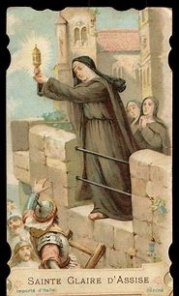
What spiritual insights has our Day Twenty-Four reflection brought? (1)
Sacred Scripture: Matthew 6:19-21
  “Do not lay up for yourselves treasures on earth, where moth and rust consume and where thieves break in and steal, but lay up for yourselves treasures in Heaven, where neither moth nor rust consumes and where thieves do not break in and steal. For where your treasure is, there will your heart be also.” (p. 85)
“Do not commit the gold of your charity, the silver of your purity to a threadbare sack or a battered old chest, or the waters of heavenly grace or the wines of your merits and virtues to a tainted and fetid cask, such as you are. Otherwise you will be robbed by thieving devils who are on the lookout day and night waiting for a favorable opportunity to plunder. If you do so, all those pure gifts from God will be spoiled by the unwholesome presence of self-love, inordinate self-reliance and self-will. Pour into the bosom and heart of Mary all your precious possessions, all your graces and virtues. She is a spiritual vessel, a vessel of honor, a singular vessel of devotion. Ever since God Himself personally hid Himself with all His perfections in this vessel, it has become completely spiritual, and the abode of all spiritual souls. It has become honorable and has been the throne of honor for the greatest saints in Heaven. It has become outstanding in devotion and the home of those renowned for gentleness, grace and virtue. Moreover, it has become rich as a house of gold, as strong as a tower of David and as pure as a tower of ivory.” (St. Louis de Montfort, p. 85)
“What are your best qualities? What are the greatest blessings that you have received? What is the most prized treasure of your heart? Do you have confidence to turn all of these over to the care and custody of Mary? In your prayer tonight, put all of the spiritual treasures that you receive during the day into the hands of Mary so that she can guard them and augment them for you. Continue to pray in this manner each night.” (Fr. Hugh Gillespie, p. 86)

Slide 34
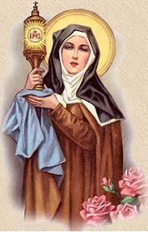
What spiritual insights has our Day Twenty-Four reflection brought? (2)
We can trust Our Lady with all of our treasures, because she will set them to the greatest possible advantage. God entrusted Jesus, His only Son, to Our Lady, and gives us a great gift in entrusting us to her, too; He trusts us to become like His Son through the help of Our Lady, because His mercy is so great
We may be flawed vessels, but Our Lady is perfect, the vessel filled with grace, so she can hold us, and our treasures, within the immensity of her grace-filled Heart, just as she held Christ within her. She helps us to be emptied of the world, so as to be filled with God’s grace, opening us up to transformation in Christ; she will take us deep within her mind, heart, and soul, remembering us, and guiding us towards sanctification, that we may become pure vessels like her to hold Our Lord, the Precious Blood and living water Who cleanses us completely. It is through the Holy Eucharist that we gain knowledge of Christ’s love. We receive it directly through His Heart, and are given graces of wisdom, inner light, by which to see the greatness of His love; to know Christ is to know His love. To know Him is to know ourselves as beings created out of God’s love; Our Lady leads us to this knowledge. She is the Seat of Wisdom, a wisdom from the treasury of her Heart. We gain knowledge of Christ by listening to Him with a Marian heart, receiving His word to treasure in our hearts
Our Lady is the defense tower, the tower of David; she helps to keep peace in our hearts, that they may not be disturbed, letting in anxiety, fear, or sin; she helps to ensure that our hearts are kept pure vessels in which to hold the treasures of God, without being compromised, just as Our Lady retained her integrity, never being corrupted, as the grace of God was within her totally

Slide 35
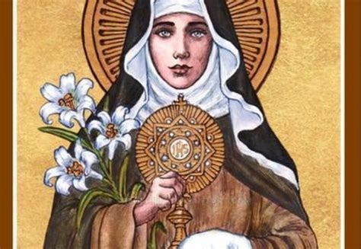
What spiritual insights has our Day Twenty-Four reflection brought? (3)
Our best qualities are those that are reflective of Our Lady, since she reflects Our Blessed Lord. The greatest blessings we can receive come from her hands, passed on to us from God; to hold these hands is a blessing unto itself, as we accept her guidance and support. It is telling to reflect on what we consider our treasures to be; the greatest treasures are those of Christ, like those Our Lady would cherish in her Immaculate Heart. Our Lady will only multiply and embellish the treasures we have, as though gilding sacred vessels to better glorify her Son contained within them, or illuminating the manuscripts of our lives to better reflect the beauty of God’s goodness, His love and mercy
Our goal in this process is to identify what, if any, obstacles prevent us from totally entrusting our treasures to Our Lady, and to pray for the grace to remove them, that we may become closer to Jesus through Mother Mary

Slide 36
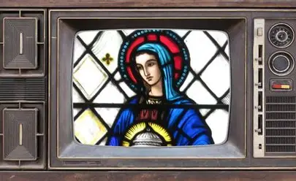
What spiritual insights has our Day Twenty-Five reflection brought? (1)
Sacred Scripture: 2 Peter 1:5-8
  “For this very reason make every effort to supplement your faith with virtue, and virtue with knowledge, and knowledge with self-control, and self-control with steadfastness, and steadfastness with godliness, and godliness with brotherly affection, and brotherly affection with love. For if these things are yours and abound, they keep you from being ineffective or unfruitful in the knowledge of Our Lord Jesus Christ.” (p. 87)
“To sum up, Mary becomes all things for the soul that wishes to serve Jesus Christ. She enlightens his mind with her pure faith. She deepens his heart with her humility. She enlarges and inflames his heart with charity, makes it pure with her purity, makes it noble and great through her motherly care. But why dwell on this? Experience alone will teach us the wonders wrought by Mary in the soul, wonders so great that the wise and the proud and even a great number of devout people find it hard to credit them.” (St. Louis de Montfort, p. 87)
“What aspect of your spirit is most like Mary? What aspect of your spirit is most unlike, and opposed, to her?” (Fr. Hugh Gillespie, p. 87)

Slide 37
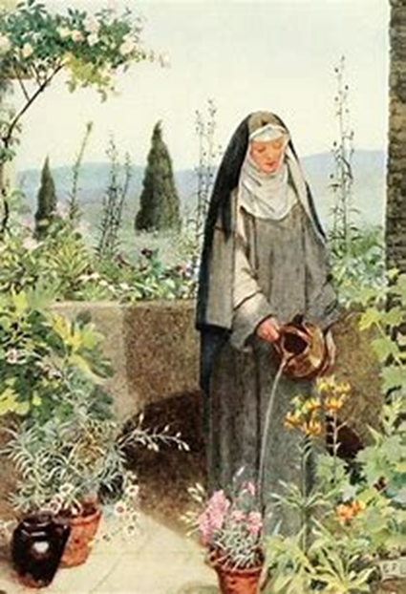
What spiritual insights has our Day Twenty-Five reflection brought? (2)
Our Lady contains every grace, and can therefore give us everything we need to be nourished; she leads us to her Son in the Holy Eucharist so that, through this spiritual food, we may be given every grace, too, and remain in a state of grace, so as not to lose it through sin
Our Lady is generous in her love; she shares her graces with us, that we may become better every day; she leads us from one virtue to the next, deepening and expanding each holy quality within us, that we may bear fruit to glorify God the Father, just as she did
In studying Sacred Scripture, we learn what it means to have a spirit like Our Lady’s by reading about Our Lord, for she reflects His spirit perfectly, teaching us how to fit not simply her mold, but the mold of Christ, which is what she conformed herself to
To understand how we are or are not reflecting Our Lady, the reflection of Our Lord, we are to pray for enlightenment from the Holy Spirit, her Spouse, who filled her spiritually; to have the spirit of Our Lady, we are to be filled by the Holy Spirit, with Whom she was united in a deep way, in order to produce good fruits for God the Father’s glory; to have a spirit like Our Lady’s means that we may avoid sinning against the Holy Ghost, namely, in always hoping in and following His inspiration, rather than ever despairing; to despair of not being like Our Lady would most certainly not allow for us to have a spirit like hers, because hers is a spirit of hope and trust in God
To be like Our Lady is to be patient with God’s gradual saving work, which happens in His time; therefore, we should be patient with ourselves as we are growing, and look with joy upon the seeds that God is cultivating, that they may bear the greatest possible fruit over time; Our Lady and Our Lord, as humans, were living within time, the measure of change, and grew gradually, too; this was part of their humble submission to God the Father, to live within the measure of time within His created world

Slide 38
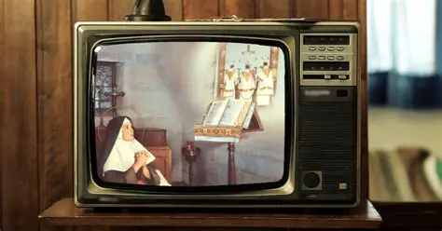
What spiritual insights has our Day Twenty-Six reflection brought? (1)
Sacred Scripture: 2 Corinthians 3:18
  “And we all, with unveiled face, beholding the glory of the Lord, are being changed into His likeness from one degree of glory to another; for this comes from the Lord Who is the Spirit.” (p. 88)
“Please note that I say that the saints are molded in Mary. There is a vast difference between carving a statue made by blows of hammer and chisel and making a statue by using a mold. Sculptors and statue-makers work hard and need plenty of time to make statues by the first method. But the second method does not involve much work and takes very little time. St. Augustine speaking to our Blessed Lady says, ‘You are worthy to be called the mold of God.’ Mary is a mold capable of forming people into the image of the God-man. Anyone who is cast into this divine mold is quickly shaped and molded into Jesus and Jesus into him. At little cost and in a short time he will become Christ-like since he is cast into the very same mold that fashioned a God-man. I think I can very well compare some spiritual directors and devout persons to sculptors who wish to produce Jesus in themselves and in others by methods other than this. Many of them rely on their own skill, ingenuity and art and chip away endlessly with mallet and chisel at hard stone or badly-prepared wood, in an effort to produce a likeness of Our Lord. At times, they do not manage to produce a recognizable likeness either because they lack knowledge and experience of the person of Jesus or because a clumsy stroke has spoiled the whole work.”

Slide 39
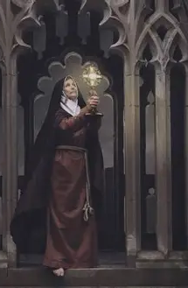
What spiritual insights has our Day Twenty-Six reflection brought? (2)
“But those who accept this little-known secret of grace which I offer them can rightly be compared to smelters and molders who have discovered the beautiful mold of Mary where Jesus was so divinely and so naturally formed. They do not rely on their own skill but on the perfection of the mold. They cast and lose themselves in Mary where they become true models of her Son. You may think this a beautiful and convincing comparison. But how many understand it? I would like you, my dear friend, to understand it. But remember that only molten and liquefied substances may be poured into a mold. That means you must crush and melt down the old Adam in you if you wish to acquire the likeness of the new Adam in Mary.” (St. Louis de Montfort, pp. 88-89)
“Am I truly willing to experience a total transformation of my person in Christ? Does the call to such a complete personal transformation give me fear? Am I attracted by the idea of being transformed into Christ? What is stronger within me- the fear of changing or the attraction to Christ?” (Fr. Hugh Gillespie, p. 89)

Slide 40
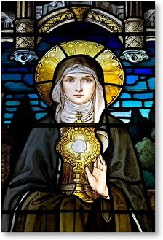
What spiritual insights has our Day Twenty-Six reflection brought? (3)
Veils are placed over holy things in this life; with unveiled faces, we behold the glory of God, in the sense that we fully humble ourselves before God, praying that He would make us holy, as we acknowledge our sinfulness and need for His grace in order to reach holiness; in Heaven, we may be unveiled, because we will be purified, and may look upon the pure Face of God. In His love, God will reveal everything to us in His glory then; we will not see Our Lord hidden in the Host, but unveiled, face-to-face
The more we love Our Lord, the more we may be glorified in Heaven. The more we love Him in this life, the more we give glory to Him, and the more we are being like God, Who is love, and Who will reward us for sharing in His love in this life by giving us the greatest degree of glory in Heaven. Each step taken out of love bridges the distance between ourselves and God, bringing us another step closer to glory, and then, to ever higher degrees of glory; in Heaven, we will shine as brightly as we loved in this life. Our Lady is the brightest star to lead us to the Son; she shares totally in the glory of Jesus in having shared totally in His suffering, and can give us a share of this glory, too
Mary molds herself to Christ and His Cross, so if we are to fit the Marian mold, we are to mold ourselves to the Cross, too
The Marian mold leaves the imprint of the letter “M” on our souls, marking us as children of Our Lady, in a spiritual sense; we the more we are like Our Lady, the more we bear testimony to the light; living in the Holy Name of Mary means living in the Holy Name of Jesus
We have the right intention in seeking to better ourselves, and be more like Jesus, but we become the most Christlike, perfect, and complete masterpieces by going to Our Lady, who is already Christlike, perfect, and complete in her cooperation with God’s grace, her total consecration of herself to Him

Slide 41
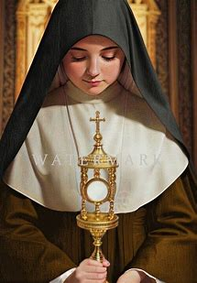
What spiritual insights has our Day Twenty-Six reflection brought? (4)
As the Divine Artist works on our souls, we may feel His hands molding and shaping the clay, which can be a very raw and vulnerable process, as we are remade from the inside out, but we can trust that the end product will be most beautiful, in fulfillment of God’s vision; we learn the most from the process, from the journey, and in entrusting our journey to God, are entrusting the product of it to Him, that He may bring the greatest good from it, giving us the most scenic and special route to amaze and inspire us with His goodness amidst the twists and turns
We need not fear; we can place this fear into Our Lady’s hands, who will teach us a perfect love that cancels out fear; she dealt with the most daunting crosses, but transcended them. Being changed by God is a possibility to embrace rather than to fear, for He is all good, and His plans are only to prosper us. He has eternity in view for us, which surpasses this life; He gives us what will profit us for eternity. Our Lady had a sense of Fear of the Lord, a sense of wonder and awe for His strength, of reverence, rather than of fear in a negative sense; she can teach us this similar reverence, that we may always remain close to Our Lord, and never have to fear being separated from Him
Fortitude is about taking a leap of faith out of love. When we serve God with love, we need not fear the outcome of the leap; we cannot fall when we are placed in Our Lady’s hands that catch us, that never lead us astray. Love is our path to Heaven
Knowledge of Christ gained through Our Lady is a knowledge to be shared. To be most like Jesus and Mother Mary, we are to know God’s love, and share it with others, helping them to be molded to Our Lady, the model of Christian love, and brought closer to the Two Hearts

Slide 42
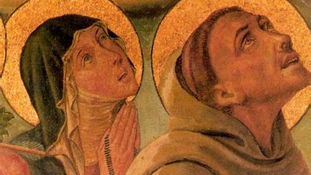

Slide 43
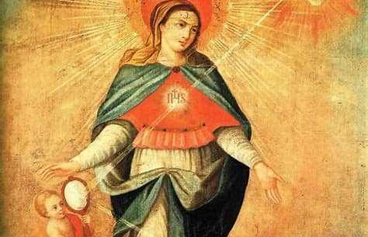

Slide 44
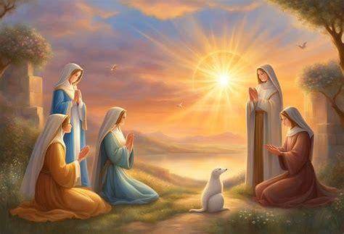
Announcements
Liturgical Rosary Prayer Group Session:
  Sunday, August 17, 2025
    3:00 p.m., parish library
Consecration Preparation Program Session 5:
  Sunday, August 17, 2025
    4:00 p.m., parish hall
Recitation of the Act of Consecration
  Sunday, August 17, 2025
    5:00 p.m., church
Brown scapular investiture ceremony
  Sunday, August 24, 2025
    ~2:00 p.m., church (after Traditional Latin Mass)

Slide 45

Closing Prayer: Litany of the Blessed Virgin (1)
Lord, have mercy. Lord, have mercy.
Christ, have mercy. Christ, have mercy.
Lord, have mercy. Lord, have mercy.
God our Father in Heaven, have mercy on us.
God the Son, Redeemer of the world, have mercy on us.
God the Holy Spirit, have mercy on us.
Holy Trinity, one God, have mercy on us.
Holy Mary, pray for us.
Holy Mother of God, pray for us.
Most honored of virgins, pray for us.
Chosen daughter of the Father, pray for us.
Mother of Christ the King, pray for us.
Glory of the Holy Spirit, pray for us.
Virgin daughter of Zion, pray for us.
Virgin poor and humble, pray for us.
Virgin gentle and obedient, pray for us.
Handmaid of the Lord, pray for us.
Mother of the Lord, pray for us.
Helper of the Redeemer, pray for us.
Full of grace, pray for us.
Fountain of beauty, pray for us.
Model of virtue, pray for us.
Finest fruit of the redemption, pray for us.
Perfect disciple of Christ, pray for us.

Slide 46

Closing Prayer: Litany of the Blessed Virgin (2)
Untarnished image of the Church, pray for us.
Woman transformed, pray for us.
Woman clothed with the sun, pray for us.
Woman crowned with stars, pray for us.
Gentle Lady, pray for us.
Gracious Lady, pray for us.
Our Lady, pray for us.
Joy of Israel, pray for us.
Splendor of the Church, pray for us.
Pride of the human race, pray for us.
Advocate of peace, pray for us.
Minister of holiness, pray for us.
Champion of God’s people, pray for us.
Queen of love, pray for us.
Queen of mercy, pray for us.
Queen of angels, pray for us.
Queen of patriarchs and prophets, pray for us.
Queen of apostles and martyrs, pray for us.
Queen of confessors and virgins, pray for us.
Queen of all saints, pray for us.
Queen conceived without original sin, pray for us.
Queen assumed into Heaven, pray for us.
Queen of all the earth, pray for us.
Queen of heaven, pray for us.
Queen of the universe, pray for us.

Slide 47

Closing Prayer: Litany of the Blessed Virgin (3)
Lamb of God, You take away the sins of the world, have mercy on us.
Lamb of God, You take away the sins of the world, have mercy on us.
Lamb of God, You take away the sins of the world, have mercy on us.
Pray for us, holy Mother of God, that we may be made worthy of the promises of Christ.
God of mercy, listen to the prayers of Your servants who have honored Your handmaid Mary as mother and queen. Grant that by Your grace we may serve You and our neighbor on earth and be welcomed into your eternal kingdom. We ask this through Christ our Lord. Amen.

