Slide 1
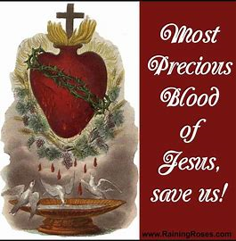
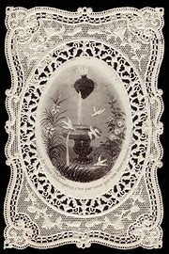
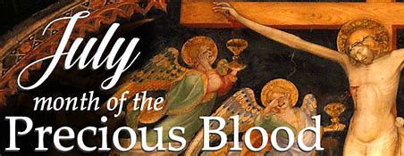
Two Hearts Guild Meeting 7
Friday, July 4, 2025
Katie Sadakierski

Slide 2
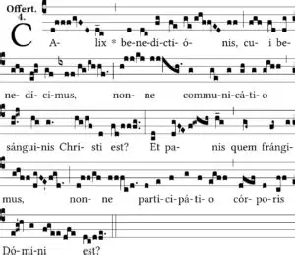
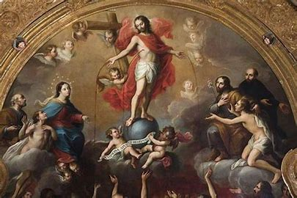
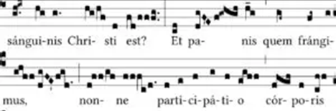
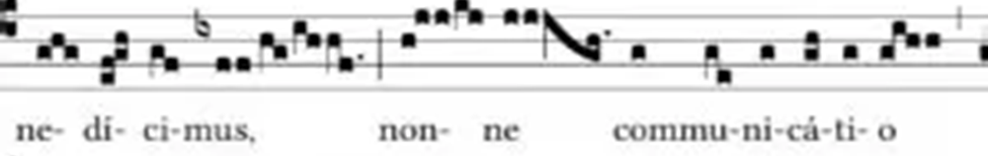
Two Hearts Guild Meeting 7 Outline
Welcome & Opening Prayer
Meeting presentation
  I. Devotion to the Precious Blood in July
  II. The virtue of humility, and how Our Lord and Our Lady nurture growth in this virtue
  III. Exercising devotion to the Precious Blood as a part of our Two Hearts devotion
Announcements
Closing Prayer
Q & A

Slide 3
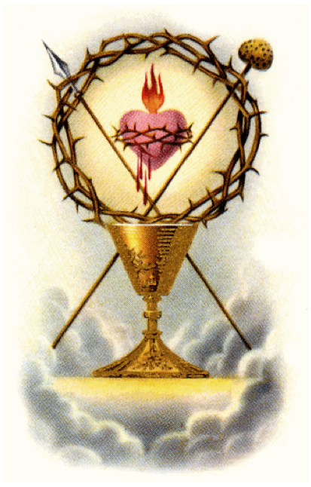
Opening Prayer: An Offering of the Precious Blood for Souls
O my God, I beg of Thee, in union with the Immaculate Heart of Mary, through the merits of the Precious Blood offered to Thee in every Sacrifice of the Mass throughout the world, to grant that, this day, one sinner may be converted, one mortal sin be averted, one soul in doubt be converted to truth, one soul about to die in sin receive the grace of repentance and a happy death, and the deliverance of that soul in Purgatory which is nearest Heaven. I wish, by this offering, to console the Heart of Jesus in Agony for souls lost through the teaching of error against the true Church of Christ Jesus, our Lord. Amen.

Slide 4
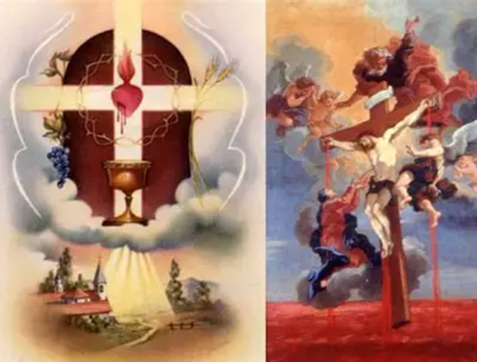
What is the “Precious Blood?” Why and how do we honor it? (1)
The Precious Blood is the Blood of Our Lord that was poured forth for our salvation
  When Our Lord shed His Blood, it was the first time that bloodshed resulted in true peace
  Our Lord shed His Most Precious Blood for us out of love
    Our Lord’s Blood is precious, because it is from His Heart, and His Heart is a treasury; every drop of the Most Precious Blood is a gem, for everything from Christ’s Heart is given out of love
    Jesus is God: when we receive the Sacred Host, we receive God. Jesus is united to the Father and the Holy Spirit, so we receive all three Persons of God in the Trinity when we receive the Holy Eucharist
    We may receive Jesus under two species: in the consecrated Bread, or the consecrated Wine, but when we receive Our Lord under one species, in the Sacred Host, the consecrated Bread, we receive Jesus’ Body, Blood, Soul, and Divinity

Slide 5
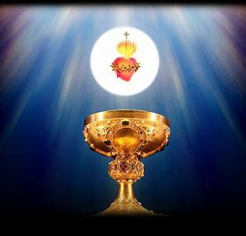
What is the “Precious Blood?” Why and how do we honor it? (2)
Within the context of the Holy Mass, the Precious Blood refers to the consecrated Wine
July: Month of the Precious Blood
  Follows the Month of the Most Sacred Heart in June, because Jesus pumps the lifeblood from His Heart into our hearts
July 1: Feast of the Precious Blood (and the founding anniversary of our parish); the feast day was instituted by Pope Pius IX in 1849 for the first Sunday of July, but Pope St. Pius X transferred the feast day to July 1, setting a fixed date
  Devotion to the Precious Blood predated the institution of the feast day; the early Church fathers wrote about the Precious Blood of Christ
  Our parish family members may not all be related by blood in a natural sense, but we are all spiritually related through the Precious Blood of Christ, as members of His Mystical Body; His Heart of love unites us all; He shed His Blood for all of us, that we may be cleansed by His Blood, purified, so that we may join the wedding feast of the Lamb in Heaven, drinking the sweet nectar of Christ’s Blood from His Side, like St. Catherine of Siena did

Slide 6
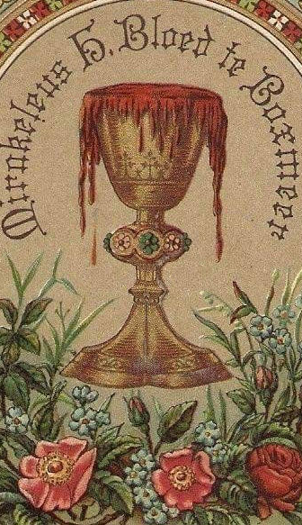
How is the Month of the Precious Blood the perfect connecting point between the Month of the Sacred Heart and the Month of the Immaculate Heart? (1)
The Hearts of Jesus and Mother Mary are united by the Precious Blood, through which their love flows, reaching each other, and us
  Jesus was given His Precious Blood by His Mother; in the womb of Our Lady, He was nourished by nearness to her Immaculate Heart; her blood gave Him life, and now, He offers His lifeblood to us in the Holy Eucharist, His Eucharistic Heart, that we may live forever in Heaven
  Our Lady teaches us how to humbly receive Christ in the Holy Eucharist, but also, how to share His lifeblood with others, leading others to new life in Him by living out His love
We can serve as tributaries, streams; we may be used as instruments of God, channels of His love, looking to Our Lady, the greatest channel of grace, as an example
  Christ’s Heart is an ocean of mercy: when we receive His love, His Body and Precious Blood, we receive His Heart, and can then share it with others, serving as tributaries that branch from the ocean of mercy. We lead others to be cleansed by Christ’s love by going to His Heart, the ocean of mercy

Slide 7
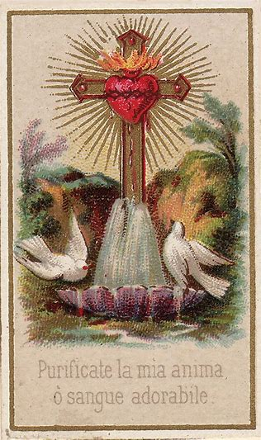
How is the Month of the Precious Blood the perfect connecting point between the Month of the Sacred Heart and the Month of the Immaculate Heart? (2)
Chambers of the Heart: when we travel through all of the rooms in Christ’s Heart, beholding with love and wonder each of the treasures housed therein, we gain a foretaste of the heavenly mansion; we strive to occupy Christ’s Heart in this life, that we may be absorbed into Christ’s Heart in the next life; Our Lady is the ultimate guide, showing us the way to the Way, the Truth, and the Life
  We may lead others through the chambers of Christ’s Heart, showing them the gems of virtue therein, by modeling Christ’s virtues through our actions
Arteries: we are like arteries through which the Precious Blood flows; we are connected to Christ, the True Vine; we are branches. We are called to give and receive Christ’s love through His Precious Blood; Our Lady models how to do this, in her closeness to Christ
Spiritual union: if we are to understand the love in Christ’s Heart, so as to imitate it, then we must understand the virtue of humility from which love grows. Our Lord humbly offered His Precious Blood to save us, and express His love
  Humility and charity: these virtues are united in Christ and in Our Lady; they lead us to deeper spiritual union with both Jesus and Mother Mary

Slide 8
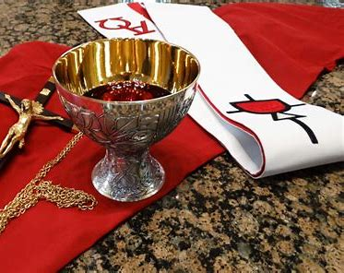
What is the virtue of humility? (1)
The virtue of humility is united with charity: it is a virtue of gratitude. We receive God’s grace humbly, that we may share His love, humbly honoring God for all that He does
God’s creation is good, so we should have respect and love for ourselves and others; this is a way to glorify Him; but to have humility is to have balance, to put God first, and to not have an inordinate self-love, or an inordinate attachment to the things of the world; humility is to love the eternal things, above all else
It is a type of love, but the opposite of self-love; it is not pride, or self-loathing. We need not deprecate ourselves, but can simply say “thank you” to God for everything, not despairing in our weaknesses, or exalting ourselves for our strengths, but giving gratitude to God for His greatness that helps us to turn our weaknesses into strengths, that we may use the gifts we have been given to serve Him
To be humble is to graciously receive God’s gifts: we praise Him for all that He has given to us: our lives, and the lives of others. We do not glory in ourselves, but glorify God for how He blesses us, shining through us and our friends

Slide 9
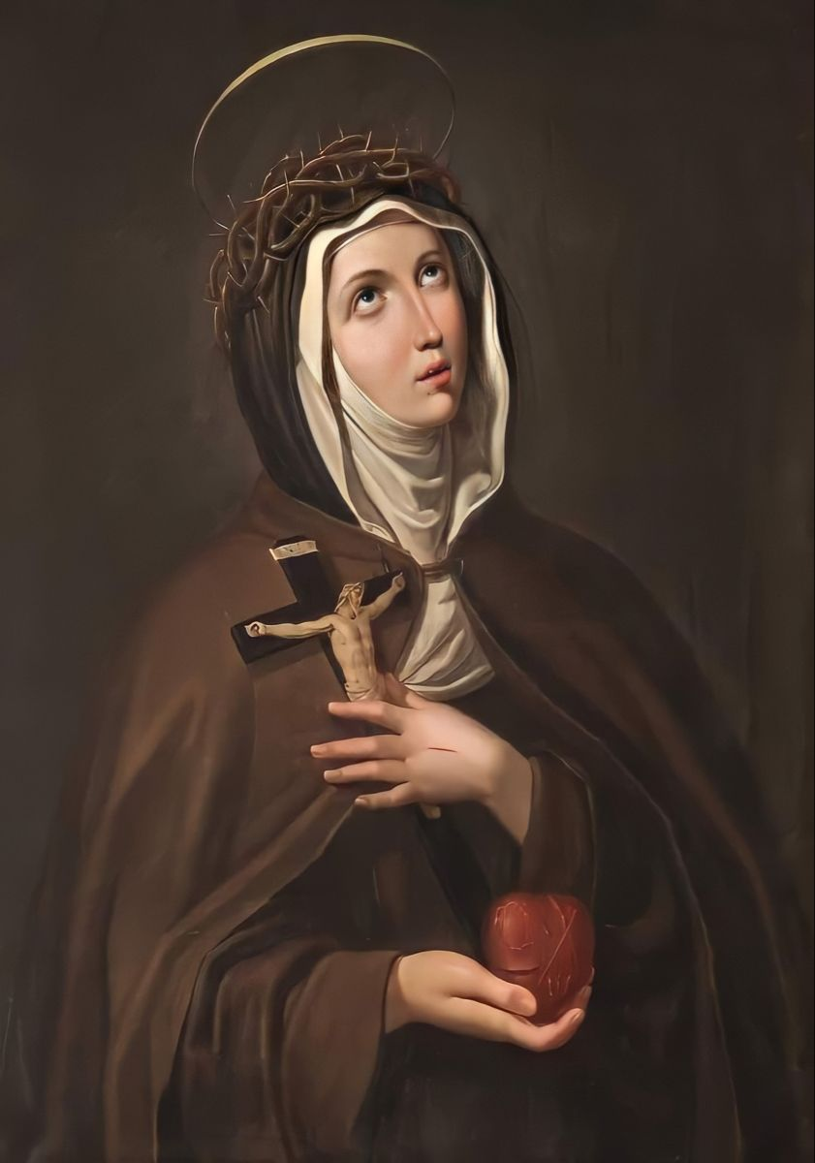
What is the virtue of humility? (2)
When we are humble, we have a sense of joy, because we delight in the opportunity to serve God; we do not seek more of the earthly pleasures for ourselves, or measure success in earthly terms, but we rejoice in every experience as a means to coming closer to Christ’s Heart, and reaching Heaven, where we may receive real and lasting treasures for our souls that never pass away
Humility allows us to be true friends with Christ; He humbled Himself entirely for us, so in sharing in His spirit of humility, we truly come to share in His life; we look to Heaven, to Christ, instead of to ourselves
All of the saints in Heaven are unique, having used their different gifts and talents to go to Heaven, but the one quality they all share is humility, because humility is the root of love, and we go to Heaven when we have loved God and His people, keeping Christ’s New Commandment to love each other as we love ourselves, and to love God with all of our hearts, minds, souls, and strength
Humility brings peace; we no longer have to be restless in searching for worldly honors, but can trust in God to give us what we need for our salvation; it is a virtue of faith, for the humble heart hopes and believes in God’s Providence

Slide 10
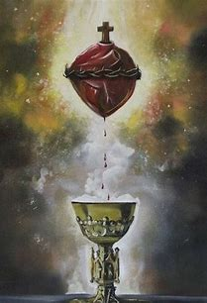
How does the virtue of humility relate to the virtue of kindness?
Our focal virtue for June was kindness, as we considered the priest as an embodiment of Christ’s kindness, looking at how, when a priest is ordained, he is clothed in Christ’s love, that he may share the kindness of Christ with others
The priestly heart mirrors the Heart of Jesus, which is a Heart of kindness and humility
In his love and kindness, the priest opens himself to Christ’s Heart of love, humbly submitting to God in order to be used as a vessel for Christ’s lifeblood, an instrument of His love
If we are to live with kindness, we must be rooted in humility, for when we humbly realize God’s greatness, we seek always to glorify Him, and to share His kindness with others; we live with a spirit of humility when we know that we are all children of God, all made by Him in His image, and therefore, all deserving of kindness and respect, for we all have dignity as human beings
To share God’s kindness, the gifts from His Heart, we must be immersed in the Precious Blood, devoted to the Holy Eucharist, and clothed in the love of Christ that we receive therein
  Jesus is hidden in the Blessed Sacrament; He is clothed in love, veiled in the appearance of bread, but the Holy Eucharist is fully Christ; there is nothing of the substance of bread remaining; there is only the substance of Christ, His love; in receiving Christ in the Holy Eucharist, we are enveloped in His love, so that we may radiate His Presence outward, shining His light, just as Christ’s love shines through the Holy Eucharist; even though we cannot see Him with the eyes of our bodies, we can see His love with the eyes of our souls. This love is illuminated in souls that receive Christ humbly, that are open to Him

Slide 11
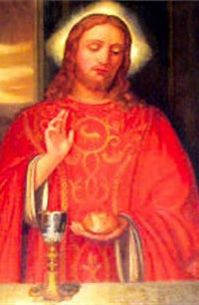
How did Our Lord live out the virtue of humility?
Our Lord chose to come down from Heaven, and to take on human Flesh, in order to save us by His Body and Blood, to nourish our souls forever; He lowered Himself to us as a human to lift us up, and give us a taste of the divine, to help us to become more godly
  He submitted to entering the womb of His Mother, of being carried along with her, wherever she chose to go
  He humbly submitted to being born, and in modest conditions at that; He was not born into a palace, outfitted with every comfort; He was not luxuriously accommodated, but was subject to the conditions that animals were, being placed in a manger, a feeding trough
  This prefigured that Christ would humbly choose to remain with us in the altar bread to feed our souls, to sustain us
  Jesus humbly experienced every aspect of the human condition, except for sin; He humbly submitted to being baptized, even though He was already without sin; He humbly cared for His people, healing, feeding, and listening to them; sharing His knowledge of God the Father by teaching; and offering all of His time to sharing God’s love, not demanding to be served, but instead, serving every soul
Shedding of the Precious Blood
  Jesus humbly submitted to suffering and death; He was wounded in every way, subjected to every indignity; He was betrayed by friends; blasphemed; scourged; crowned with thorns and humiliated; made to carry the Cross, and to be crucified like a criminal
  Christ fully exercised the virtue of humility by placing Himself on the Cross, being vulnerable; He was kind, gentle, patient, and forgiving, never placing Himself above anyone, but taking the lowest place, accepting the bitterest treatment to give us every sweetness
  He was willing to do all things out of love, to share the Precious Blood, with all of its sweetness, for our healing; He is the Divine Physician; He let out Blood to give us the revitalization we need

Slide 12
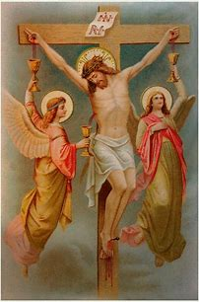
Which saints had a devotion to the Precious Blood of Our Lord?
Devotion to the Precious Blood flowers from devotion to the Sacred Heart; if we love Christ’s Heart, then we love the Precious Blood that flows from it, adoring Christ for His love and mercy
Our Lady of the Precious Blood (feast day: July 1)
St. Gaspar del Buffalo (feast day: October 21)
St. Catherine of Siena (feast day: April 30)
St. Veronica Giuliani (feast day: July 9)
St. Veronica (feast day: July 12)
St. Gemma Galgani (feast day: April 11)
St. Gertrude (feast day: November 16)
St. Francis de Sales (feast day: January 29)
St. Margaret Mary Alacoque (feast day: October 17)

Slide 13
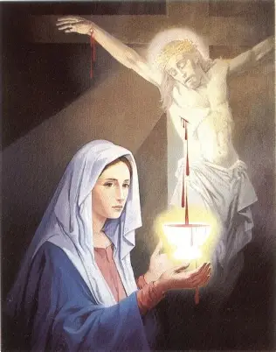
Why do we invoke Our Lady under the title of “Our Lady of the Precious Blood”?
Our Lady is the human being closest to Christ’s Heart, so she compassionates most with Him as He sheds His Precious Blood; Christ and Our Lady are so united, that when He offers Himself, she offers something of herself, too, spiritually participating, deep within her Heart, in all of Christ’s suffering
Our Lady models to us how we may compassionate with Christ, and offer ourselves to the faithful service of God, like she did, standing by the Cross, and giving Jesus our love as He pours out His love in the Precious Blood
Our Lady was not a priest, an apostle, but was a disciple, a student and follower of Christ. She humbly served as a handmaiden of the Lord, doing what He called her to do. Our Lady said to the servers at the Wedding at Cana, when the water was turned into wine, to “do as He tells you.” She teaches us to humbly follow Jesus, trusting in His mercy; He will tell us what we need to do for our salvation, that we may be turned from water into wine, enriched by Christ’s love, transformed by the graces of Holy Baptism with its cleansing water, and the graces of the Holy Eucharist, in which we are transfigured by the resurrected Body and Blood of Our Lord
We invoke Our Lady to help us to grow closer to Our Lord, and to receive the sweetness of the Precious Blood into our hearts, that we might become holier and more loving, more humble and generous in spirit, in sharing our time and talent, that all may treasure Christ

Slide 14
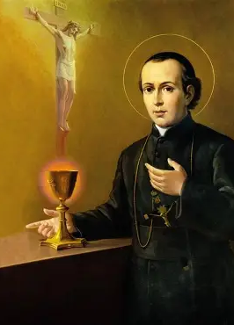
Who is St. Gaspar del Buffalo, and how did he practice devotion to the Precious Blood?
St. Gaspar was named after all of the three magi: Gaspar, Melchior, and Balthasar. Like them, he would adore Christ’s Heart, and offer many gifts to Christ in return for the gifts Christ gave to him
He preached on the Precious Blood at a time when it was unpopular, helping others to appreciate that the Precious Blood is the foundation of our Faith, from which other devotions can flow
  He saw devotion to Mary as hinging upon devotion to the Precious Blood, teaching that Our Lady received her graces from the shedding of Christ’s Blood, as fruits of Christ’s Sacrifice
  He saw that we are brought to greater union with Christ by pouring ourselves out as He did, and offering ourselves as victims of love like Christ, the Victim Whom we receive in the Sacred Host (the very word “Host” comes from the Latin “hostia” for “victim”)
He founded the Congregation of the Missionaries of the Precious Blood, supporting the missions to teach about Christ’s Sacrifice to people around the world, that their hearts might be touched by Christ’s Sacred Heart

Slide 15

How does St. Catherine of Siena model devotion to the Precious Blood? (1)
Saint Catherine of Siena humbled herself before Christ: she spoke of devoting oneself to Christ by starting out at His feet; we spiritually prostrate ourselves before the altar, humbly putting ourselves in God’s Presence, and working our way up to Christ’s Heart, up to Heaven
We decrease, so that Christ might increase; we empty ourselves of sin and self-love, so that Christ may fill us entirely
St. Catherine of Siena was a true servant, giving everything she had to help others, from food and clothing, to her care; she even lived on the Holy Eucharist, the Body and Blood of Christ, alone for several years. She passed from this life at age 33, just like Our Lord did, because she shared so deeply in all of the events of His life, spiritually participating in all of the sacred mysteries
Saint Catherine had asked Our Lord, in a mystical vision, about why He permitted that His Sacred Side be pierced after the Crucifixion, and He said it was to show the depth of His love, the greatness of His love that transcended death, that overcame human limitations; the magnitude of His love is the secret of His Heart, which is what He shared with St. Catherine of Siena. Christ has so much to give from His Heart; there is no limit to what He can do out of love
Saint Catherine wrote about immersion in the Precious Blood; she had a special love for priests, a devotion to praying for them, and believed that they should always be treated with respect, because in administering the sacraments, they are perpetually immersed in the Precious Blood. She was close to her spiritual director, Blessed Raymond of Capua, whom she compared to St. John the Apostle, the loving priest who was near to Christ’s Heart
An excellent resource on this subject is The Secret of the Heart, a book on St. Catherine’s devotion to the Sacred Heart and the Precious Blood, which helps us to understand why we should love the Precious Blood as deeply as she did

Slide 16
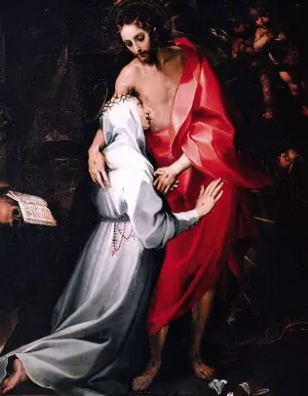
How does St. Catherine of Siena model devotion to the Precious Blood? (2)
Saint Catherine cared for the sick, tending to their wounds; she kissed their wounds, and drew out poisons from them herself; as her reward, Christ gave her a mystical vision in which she drank the Precious Blood from Christ’s Sacred Side. She wrote about how sweet it tasted, saying that she never wanted to leave Christ’s Side. This gave her a longing for Heaven; she came to share in Christ’s longing for souls, wanting everyone to experience the sweetness of being cleansed by Christ’s Blood, shed for our redemption from His Heart
In loving the Sacred Heart, St. Catherine could love the Precious Blood being pumped from it, into our hearts; she was a Bride of Christ, and exchanged hearts with Christ, not physically, but spiritually; she did, however, have a scar near her heart as a visible sign that this experience happened, and bore the wounds of Christ interiorly, so that she could feel His pain, and compassionate with God’s wounded people, serving them as she would Christ
Saint Catherine’s last words were “The Blood, the Blood,” a testament to her love for Christ’s Precious Blood, and her love for His Heart that was willing to pour out everything for our healing; she was telling us that the Precious Blood is our key to Heaven, that when we pour out ourselves in service to Christ, we unite our hearts more deeply to the Heart of Christ, that we may be united with Him in Heaven
St. Catherine of Siena shows us how to live out devotion to the Precious Blood through generosity of spirit, through a willingness to give of ourselves, and to humbly share God’s love from our hearts for His glory

Slide 17
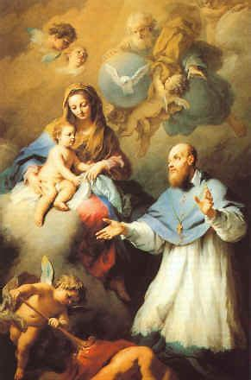
How did St. Francis de Sales honor the Precious Blood of Our Lord?
Increasing Eucharistic devotion, preaching about the Blessed Sacrament to unbelievers
  To spread devotion to the Holy Eucharist is to spread devotion to the Precious Blood, for when we receive the Holy Eucharist, we receive Christ’s Body, Blood, Soul, and Divinity
Practice of the virtue of humility
  Self-gift: emulation of Christ’s total offering of Himself, of His Heart, and the Precious Blood flowing from it; St. Francis de Sales offered himself to his flock, caring for his people as a bishop, and guiding his Visitation sisters as a spiritual father
    Saint Francis de Sales founded a religious community of women who emulate Our Lady in her visitation to St. Elizabeth, in bringing Christ’s love to others; we understand Christ’s love through the lens of the Precious Blood, which was spilled out of love for all souls
  Saint Francis de Sales teaches us that devotion to the Precious Blood is cultivated through contrition; when we have lively sorrow for our sins, and deeply appreciate the Sacrifice of Christ offered out of love, to redeem us from sin, then we can love the Precious Blood that Christ shed all the more
    He wrote that when we go into the confessional, we should go before the priest as though we are kneeling before Christ’s feet at Calvary, being washed in His Blood from the Cross, as we are cleansed spiritually of our sins. He says that when we confess our sins, our hearts are opened to receiving the Precious Blood, which heals us

Slide 18
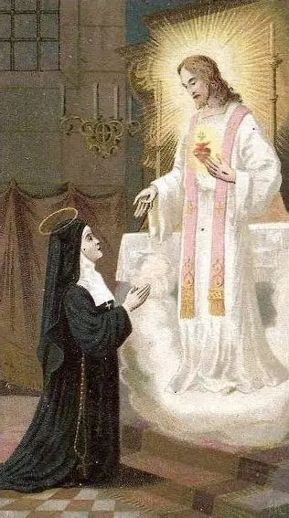
How did St. Margaret Mary Alacoque exercise devotion to the Precious Blood, and practice the virtue of humility?
Abandonment to God’s will: St. Margaret Mary humbly offered herself to God, willing to suffer anything for love of Him, and submitted to His plan for her to spread devotion to the Sacred Heart, to share Jesus’ revelations, even when she was criticized and questioned
Embracing the Cross
  Union with Christ in His Agony in the Garden: the second offering of the Precious Blood
    In His Passion, Christ sweat Blood, so great was the anguish He faced; this speaks to the degree of His faith, hope, and love, for He was willing to endure the deepest suffering for our eternal glory
  First Thursday devotion: Thursday is the day devoted to the Holy Eucharist in a special way
    St. Margaret Mary kept vigil with Christ the evening of the first Thursday of each month, in preparation for celebrating the first Friday devotion; she humbly offered her time to Christ
    She spent a holy hour between 11:00 p.m. and midnight keeping Christ company, spreading this devotion as a means of increasing love for the Holy Eucharist, that souls may be prepared to receive Christ’s Body and Blood on the first Friday with the fullest love in their hearts, to make reparation for unworthy Communions or other irreverences towards the Blessed Sacrament
    To be devoted to the Precious Blood is also to be devoted to the five holy wounds of Christ, since the Precious Blood flows from them; St. Margaret Mary learned from Christ just how deeply wounded His Heart is during His second revelation to her, when He spoke of His willingness to suffer for His people, again and again, and the consolation it brings His Heart for people to draw near to Him, making up for those who turn away from Him, and do not keep Him company as He suffers

Slide 19
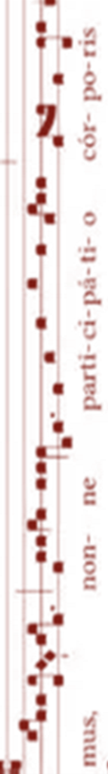
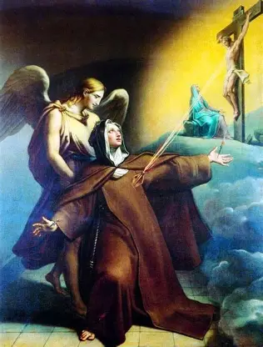
How did St. Veronica Giuliani live out devotion to the Precious Blood? (1)
On her deathbed, St. Veronica Giuliani’s mother entrusted each of her daughters to one of the holy wounds of Christ, praying that they would be sheltered within His wounds: she entrusted Veronica to the wound below Christ’s Heart
Saint Veronica would console the Heart of Jesus in a special way, devoting herself to Him in religious life. In loving Christ’s wounded Heart, she would love the Precious Blood that flowed from it, and heal the wounds of others, bringing them near to Christ
Through the Precious Blood, we are united with Christ, and need never know the sorrow of being separated from Him; immersion in the Precious Blood is immersion in Christ’s Heart, in His love, which is a joyful thing
Saint Veronica Giuliani had a diary of 22,000 pages describing the visions she received. In particular, she received mystical visions of Hell; she saw the sorrows of Mary and Jesus over the sins of humankind. She visited the “seven sites” of Hell, and learned about the grave responsibility of clergy to lead people away from sin; she saw that priests and religious are more harshly judged, and that their unfaithfulness has serious consequences for all souls

Slide 20
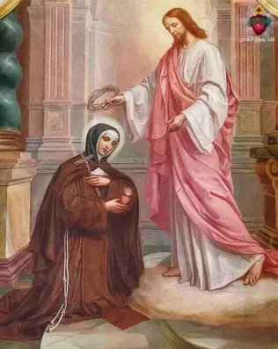
How did St. Veronica Giuliani live out devotion to the Precious Blood? (2)
Saint Veronica had great purity of heart, humbly placing herself before God, so she was chosen by God in a special way to receive spiritual gifts, including the mystical visions; she prayed very deeply for the salvation of souls, that they would not experience the seven sites of Hell that she saw
Saint Veronica Giuliani had the wounds of Christ, which bled. The wounds were unexplainable. After her passing from this life, an autopsy revealed crosses and thorns marked on her heart. She totally united herself with Christ’s suffering, offering her prayers and experience of the wounds of Christ just as Christ offered His Most Precious Blood for souls to be saved
Saint Veronica Giuliani warned of Christ’s Sacrifice being treated irreverently; she cautioned against Christ’s Body and Blood being trampled, speaking to the importance of receiving Christ’s Body and Blood with great love and respect; she spread devotion to Christ’s Blood through defending Our Lord faithfully, and honoring Him in the Holy Eucharist; she could appreciate the gift of Holy Communion, because while her wounds were being investigated for authenticity, she was cut off from receiving daily Communion; even her diary was taken from her, so she had to receive Christ into her Heart, trusting in His love for her, which she believed in, because of how Christ had shed His Precious Blood, which she was sharing in mystically

Slide 21
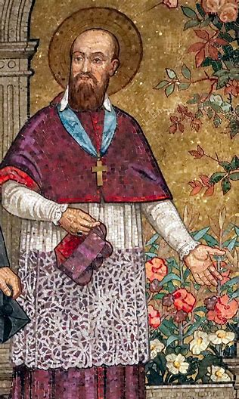
How did St. Veronica Giuliani live out devotion to the Precious Blood? (3)
Saint Veronica Giuliani would help to lead souls towards the Truth, towards following Christ, the Way, the Truth, and the Life, with greater reverence, that they may join in the wedding feast of the Lamb in Heaven. She had a vision when she was three of Christ picking flowers with her, telling her that He is the True Flower. Saint Veronica Giuliani would help souls to pick Christ as the True Flower, and not to be distracted by worldly things; her prayers and writings on Christ’s revelations would help souls to adorn their hearts with many flowers of virtue for Christ
She did all things in union with Our Lady, having sought to console the Sorrowful Heart of Mary since she was a child; she wanted to pick flowers of virtue to offer as consolations to Our Lady, that Our Lady would rejoice in seeing her Son be honored by a pure soul afire with love for Christ
Saint Veronica Giuliani was always merciful and kind, just like Jesus and Mother Mary; she did not rebuke souls in a fiery way, but gently guided people to the Truth; out of love, she wanted to save souls from eternal suffering. She warned against pride as the ultimate sin leading to eternal fire, which points to humility as the ultimate virtue leading to eternal life, for humility is the opposite of pride; it is the contrary virtue. We make our heart a kind of vase in which to enthrone Christ, the True Flower, humbly adorning the heart to make it a beautiful dwelling place, that we may receive Christ with great love, as the King of our hearts

Slide 22
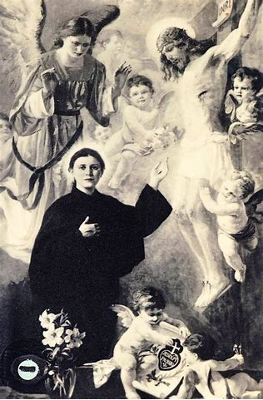
How did Sts. Gemma Galgani and Gertrude the Great live out devotion to the Precious Blood?
Saint Gemma Galgani had the wounds of Christ; she experienced the great outflow of the Precious Blood that Christ offered
  Saint Gemma’s favorite and only possessions were her crucifix and rosary beads; she looked to Christ on the Cross constantly; the Crucified Christ was her Teacher and model. She united herself with Him entirely, offering her prayers and sufferings for the salvation of souls. Always fighting very hard for souls, she never gave up, always going to Jesus’ Heart of mercy to save souls
Saint Gertrude the Great is remembered for her devotion to the holy souls. She offered the Precious Blood of Christ for the release of souls from Purgatory, giving the graces from her Holy Communion (the Body and Blood of Christ) to the holy souls, that they might be uplifted quickly to Heaven. In this way, she was like Our Lady, especially Our Lady of Suffrage, who gives refreshment to the holy souls; our prayers, flowing from the love we receive in Jesus’ Body and Blood, refreshes souls as well
Saint Gertrude had the greatest love, in praying to do God’s will; she placed His will above her own, wanting only to do what God wanted, since she trusted entirely that God wills all things out of love, for our good. She entrusted all things to the Sacred Heart, knowing that every good gift flows from Christ’s Heart, from the Precious Blood that carries to our souls the nutrients we need to keep living well, to keep breathing in and absorbing the loving Spirit of Christ

Slide 23
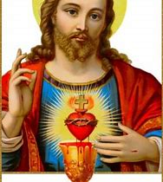
What is St. Gertrude’s Prayer to the Sacred Heart of Jesus?
“O Sacred Heart of Jesus, living and life-giving fountain of eternal life, infinite treasury of the Divinity, and glowing furnace of love, Thou art my refuge and my sanctuary. O adorable and glorious Savior, consume my heart with that burning fire that ever inflames Thy Heart. Pour down on my soul those graces that flow from Thy love. Let my heart be so united with Thine, that our wills may be one, and mine may in all things be conformed to Thine. May Thy will be the rule of both my desires and my actions.”

Slide 24
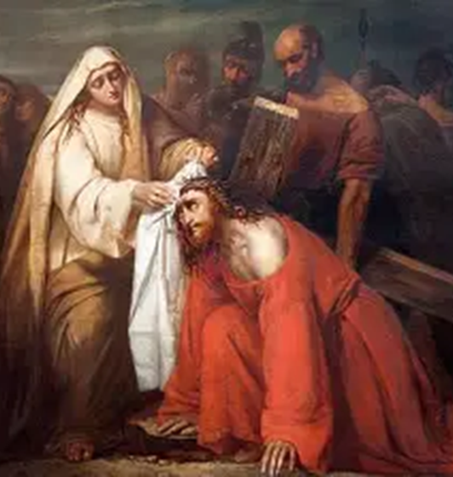
How did St. Veronica live out devotion to the Precious Blood? How may we emulate her in living out this devotion, and the virtue of humility?
Saint Veronica lovingly wiped the Precious Blood from Christ’s Holy Face as He was carrying the Cross to Calvary. When He stumbled, His eyes clouded by Blood, she cleansed the Blood from His Face, helping Him to see. All along, the eyes of her soul could see His love and beauty; her compassion, reflecting her devotion to the Precious Blood of Christ, help us to see God’s goodness and mercy, which she radiated
  The Precious Blood was shed out of mercy, to save us from sin, and to help us to grow in faith and love for Christ, so as to reach Heaven; in showing mercy to others, we live out the virtue of humility, not placing ourselves above anyone, but coming to the feet of Christ, Who transcends us; we also practice devotion to the Precious Blood, which was humbly offered for our redemption, as Christ placed Himself on the Cross with great humility and vulnerability in order to rescue us
Saint Veronica responded to Christ with humble courage. She placed Christ ahead of herself and her safety, taking refuge in His Heart
Saint Veronica took a risk by reaching out to assist Christ, to serve Him as He was being persecuted by others, but her love transcended any fear; it was most important to her to humbly assist the Lord, and console His Heart
The name “Veronica” means “true image.” God rewarded St. Veronica for her compassion; the image of the Face of Christ was impressed upon her veil that she used to cleanse the Holy Face. Saint Veronica is a true image of Christ’s humility and compassion, of His fortitude; the Precious Blood purifies our hearts, and the pure of heart see God, so it helps us to see Christ living humbly among us. When we receive the Precious Blood with great love in our hearts, we are equipped to serve Christ within each Person, to see that we are all born from Christ’s Blood, from the Sacred Side, from the depths of His Heart of love; as we serve God humbly, others can see His true image in us

Slide 25
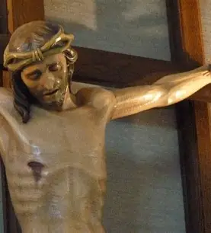
How do the Visitation sisters today practice devotion to the Precious Blood of Our Lord?
Charism of hospitality
Prayers of the Divine Office and the Little Office of the Blessed Virgin Mary
Cloistered life
Devotion to the Two Hearts
Crafting liturgical vestments for priests
Praying the Holy Mass; participating in special roles in the liturgy (i.e. chantress)

Slide 26
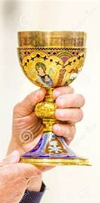
How does Our Lady model devotion to the Precious Blood to us? (1)
Our Lady gave Christ His Body and Blood; in saying “yes” to God the Father’s plan for her to be the natural mother of Christ, His only Son, she showed devotion to the Precious Blood, because she was willing to give Christ the Blood of her blood and the Flesh of her flesh, that He may offer all of Himself for the redemption of humankind
Our Lady offered the Precious Blood of her Son to God the Father for our salvation. As Jesus shed His Precious Blood, Our Lady united her sufferings with His, going through a spiritual martyrdom; we can similarly unite our wounds to the wounds of Christ, praying that He would heal and cleanse them with His loving Heart, and the Precious Blood flowing from it
  Like Our Lady, we can draw from Christ’s strength to remain faithful, reflecting His spirit of fortitude, of humble and patient courage, that flows from His undying, boundless love

Slide 27
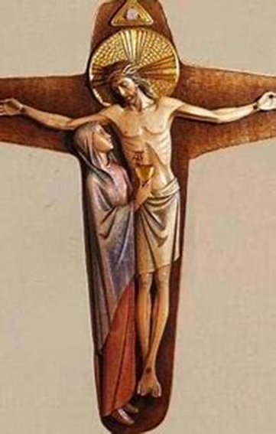
How does Our Lady model devotion to the Precious Blood to us? (2)
  Our Lady humbly received Christ in Holy Communion, partaking of His Body and Blood, after His Ascension into Heaven. She received Him reverently, humbly taking into her Immaculate Heart His lifeblood, that His love would flow into everything she offered, including prayers for the Eucharistic missionaries, the apostles going out to bring Christ’s Body and Blood to everyone. Her prayer was for everyone to receive healing from Christ’s love, given through His Body and Blood in the Holy Eucharist
Our Lady remained by the Cross as Christ poured out His Precious Blood for us. Our Lady shows us how to be faithful, how to offer ourselves, with all of our time, talent, and treasure, to Jesus
Our Lady shows us how to place our confidence in the love of God, to trust in the efficacy of the Precious Blood, putting faith in what miracles God can work out of love for us, through pouring forth His Precious Blood

Slide 28
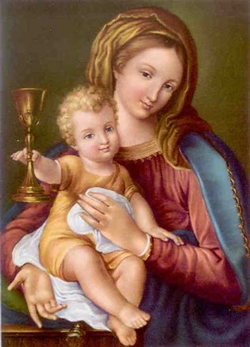
How does devotion to the Precious Blood relate to the devotions to the Two Hearts?
To be devoted to the Precious Blood is to be devoted to the Two Hearts, because Our Lady experienced a spiritual martyrdom with Christ as He shed His Blood, which was Blood of her blood; therefore, Our Lady’s Immaculate Heart is totally united to the Sacred Heart of Jesus; the same lifeblood connects them
The Precious Blood carries God’s love, and this love is ultimately what unites Jesus and Mother Mary
The more we love the Precious Blood, the more united our hearts may be to the Two Hearts, since this Blood, shed to save mankind, flows between them, all the more so because Our Lady is the Co-Redemptrix. Our Lady said “yes” to God’s plan for salvation, agreeing to be the Mother of the Redeemer. She shares in Christ’s saving work, collaborating with Him in the salvation of souls; their Hearts are united around the same purpose; Jesus offers His Blood out of love of souls, and Our Lady offers His Blood to God the Father to save souls

Slide 29
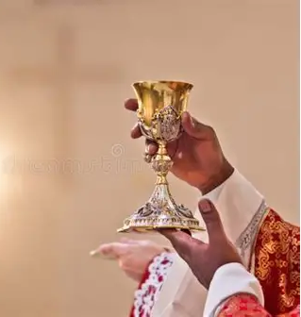
How do priests live out devotion to the Precious Blood? (1)
Sacred liturgy: the priests celebrate the Holy Mass, which is an unbloody re-presentation of Christ’s Sacrifice
  The Holy Mass has seven stages; corresponding with Last Words of Christ as He gave His life for us on the Cross, offering every last drop of His life for our salvation; also, there are seven offerings of the Precious Blood, seven times in which Christ offered His Blood for us; the priest offers himself, and all of our petitions, at each stage, that we may be perfected and completed, and come to receive Christ in Heaven; they offer us the Precious Blood at Mass, so that by the Lamb’s pure Blood, we may be cleansed, and prepared for the wedding feast of the Lamb in Paradise
Consecration of the wine: the priests change the wine into the Precious Blood of Christ
  Priests offer their own lives to Christ; pouring out all they have in their hearts for Him. They consecrate all that they are, body, mind, and soul, to Christ, that they may love Him with all of their hearts, minds, souls, and strength, and inspire others to do the same
Elevation of the chalice: the priest lifts the chalice to Heaven
  He offers the Precious Blood of Christ, Who is lifted up on the Cross, to God the Father in union with Our Lady
Immersion in the Precious Blood
  Priests administer the sacraments, which became efficacious after Christ’s Death, after He shed His Precious Blood for us. Because of Christ’s loving Presence, which we receive in the sacraments, the sacraments have an effect on our souls; they help us to faithfully serve Christ, and to pour out all we have for His glory

Slide 30
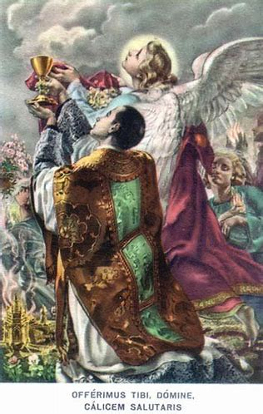
How is priestly devotion to the Precious Blood reflected in the ordination ritual, and how they continue to live it out daily?
Prostration before the altar: the priest offers himself to God the Father, like Christ pouring out His Blood as an offering to God the Father for our salvation
  The priest takes up the Cross: he forms the shape of a cross with his body, humbly placing himself at Christ’s feet, and uniting himself with Christ in self-sacrificing love
  The priest embodies his willingness to lay down his life for the sheep out of love for God, and for them; he takes on Christ’s spirit, enfolding himself in the garments of Christ, the garments of love, that he may serve as a good shepherd
  The priest prepares himself to be immersed in the Precious Blood, that he may cleanse others with the Blood of the Lamb, reconciling them to Christ for their salvation, their full healing
Renewing/remaining faithful to their ordination promises: committing to continuing to pour themselves out for love of God; the ordination ritual is played out every day as the priest consecrates himself anew to Christ; the Precious Blood keeps flowing, being offered continuously, as the Holy Mass is said each day
  Making a promise of obedience to the bishop, and keeping it; giving their life to God out of obedience, just like Christ in His self-offering
    Reflecting Christ’s humility, submission to God the Father; offering Christ’s Precious Blood in union with Him to God the Father for the remission of sins, and adoring Our Lord with the holy angels, who bear the offerings up on high to God the Father

Slide 31
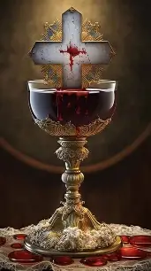

How might both Seven Sisters and Fasting Brothers Apostolate members practice devotion to the Precious Blood for priests, and grow in the virtue of humility this month? (1)
Litany of the Precious Blood
Chaplet of the Precious Blood
Stations of the Cross
Contemplation and exercise of the Nine Offices of the Sacred Heart
Meditation on the Seven Offerings of the Precious Blood
Offerings of Holy Communion
Acts of Adoration to the Sacred Heart
Litany of Humility

Slide 32
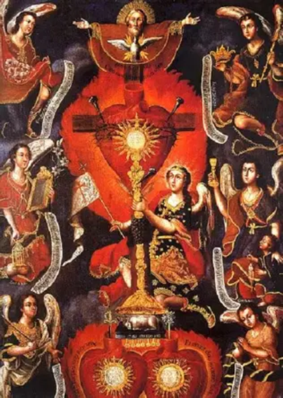

How might both Seven Sisters and Fasting Brothers Apostolate members practice devotion to the Precious Blood for priests, and grow in the virtue of humility this month? (2)
Meditation on the Holy Mass readings for the Feast of the Precious Blood
Listen to chants that promote devotion to the Precious Blood, and reflect on their lyrics: i.e. “Adoro Te Devote” or “Calix Benedictionis…”
Sacred Scripture: “I came to serve, not to be served”
Sorrowful Mysteries of the Holy Rosary
  Glorious Mysteries to follow
Abandonment to God’s Providence
  Union with Christ in the Agony of the Garden; during the Crucifixion

Slide 33
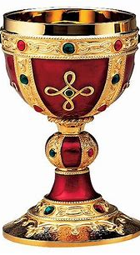
What is the Litany of the Precious Blood?
The Litany of the Precious Blood is a prayer of supplication, a petition we offer to God for His mercy through the graces given in the outpouring of the Precious Blood
We invoke Christ with special titles honoring His Precious Blood, using 24 different petitions
The Litany of the Precious Blood may be recited publicly, especially in honor of the Feast of the Precious Blood
This litany is the perfect complement to the Litany of the Sacred Heart; we can connect these titles together, noting their parallels; we see how the Precious Blood flows from the Sacred Heart as a result of the kindness and mercy of Christ’s Heart, for example
The Litany of the Precious Blood may be said in personal devotions throughout the year, especially in the month of July; it is contained in most Roman missals
Each time we pray the Litany, it is as though we are lifting up the chalice with the priest, offering Christ, in His love, to God the Father, and imploring His compassion
  We can use the Litany of the Precious Blood to pray for priests, invoking Christ under each title to have mercy on our priests

Slide 34
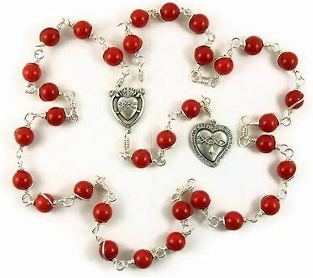
What is the Chaplet of the Precious Blood?
The chaplet of the Precious Blood is 40 beads in total: forty is the number of purification, reminding us that we are purified through Christ’s Precious Blood, shed out of love, for the remission of sins
There are 33 beads on which we pray the “Our Father”: 30 beads arranged into 6 groups of five, and 3 preparatory beads
On the 7 single beads, one for each offering of the Precious Blood, we say the “Glory Be”
At the conclusion of each set, we ask Our Lord to help His servants, whom He redeems with His Precious Blood
We meditate on the 33 years of Christ’s life, and how, across these 33 years, He offered His Precious Blood seven times for our salvation, to heal and help us, that we might serve Him well, and be rewarded for our service by going to Heaven
  We pray in a special way for Christ’s servants, the priests, who are immersed in the Precious Blood, and help to share the love of Christ’s Sacred Heart with us
  We might pray the Chaplet of the Precious Blood to prepare us for Holy Mass, to relive the ultimate offering of the Precious Blood, Christ’s Sacrifice on Calvary
  Our chaplets are white and red, for the purifying love of Christ given through His Blood, and gold and red, for the chalice that holds the Precious Blood, and for the royal dignity of Christ the King, Whose love makes our hearts golden like His

Slide 35
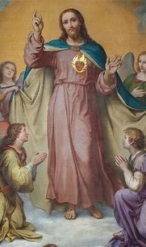
What are the Nine Offices of the Sacred Heart? (1)
The nine Offices of the Sacred Heart help us to respond to Christ’s Heart with love; they are also called the nine “elevations,” because we lift our hearts to God in prayer as we offer ourselves to Him, like the priests offering the chalice of the Precious Blood to God the Father
We meditate on how we are offering ourselves to Christ, and being present to adore His heart, to shine His light inward and outward
We might practice a different office each First Friday, as we complete the nine First Fridays devotion, or meditate on a different office each month for nine months, thinking about how each month, we can be like one of the holy angels in adoring Christ, as there are nine different choirs of holy angels, all of whom reverence the Presence of God in Heaven, reflecting His light
These nine offices are like stairs we climb, that help us to ascend from Christ’s feet, to His Heart, to His Face, that we may receive the Kiss of Christ in the Holy Eucharist, His Body and Blood, to enter into deeper communion, friendship, with Him
During a vigil, a special holy hour to keep watch with Christ, keeping His Sacred Heart company, one may choose to meditate on all of the offices, and to say special prayers to practice the offices; this vigil is offered in reparation to Christ’s Sacred Heart, for times when His Body and Blood have not been treated with reverence

Slide 36
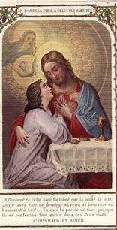
What are the Nine Offices of the Sacred Heart? (2)
The first Office of the Sacred Heart is Worshipper: we humbly appear before God the Father, and unite our prayers with those that Jesus offers to us in the Blessed Sacrament, His Body and Blood
The second Office of the Sacred Heart is Lover: we show fidelity and devotion to Christ, giving hearts of pure love to Him; we preserve our innocence to come before Him
The third Office of the Sacred Heart is Victim: we offer ourselves to the Sacred Heart of Jesus, just as He offers Himself to us as a Victim in the Blessed Sacrament, a pure sacrifice for our spiritual nourishment

Slide 37
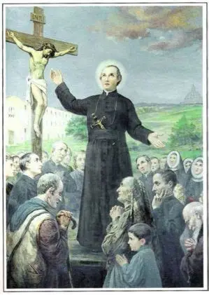
What are the Nine Offices of the Sacred Heart? (3)
The fourth Office of the Sacred Heart is Disciple: we approach the Heart of Jesus as students. We go to Jesus’ Heart to learn how to love
The fifth Office of the Sacred Heart is Faithful Servant: we give up our will, and inclinations, sublimating everything to Christ for His service and glory. We imitate the obedience that Christ models to and through His priests
The sixth Office of the Sacred Heart is Suppliant: we unite our petitions, our supplications, for souls to the Heart of Jesus, calling down His mercy on them, and offering our prayers in union with the Heart of Mary, Mother of Mercy

Slide 38
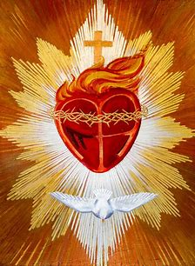
What are the Nine Offices of the Sacred Heart? (4)
The seventh Office of the Sacred Heart is Promoter: the promoter helps other souls to come to know the Heart of Jesus. They spread His message of love, drawing others to approach the Sacred Heart for His mercy and love. Promoters are teachers and guides who raise awareness of Christ
The eighth Office of the Sacred Heart is Zealous Friend: the zealous friend goes above the office of promoter, taking it a step further by striving to all that they can to deepen devotion to Christ, beyond teaching about Him; the zealous friend puts all into practice, and helps others to journey closer to Christ’s Heart, beyond the initial entry point; they are such close friends of Christ, that they feel His longing for souls, and want to console His Heart by bringing people to Him
The ninth Office of the Sacred Heart is Reparator: the reparator calls down God’s pardon, His mercy, seeking to make reparations for whenever Christ has not been treated with respect and love; they pray with love to make up for the irreverences towards the Blessed Sacrament, the Body and Blood of Christ, committed in the world

Slide 39
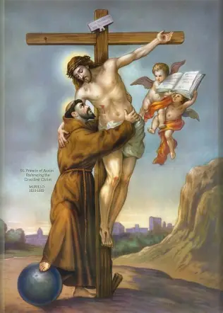
What are the Seven Offerings of the Precious Blood? (1)
This devotion involves meditating on each of the seven times in Christ’s life when He offered His Precious Blood, from the time of His infancy, to after His Death; five of the offerings are the Sorrowful Mysteries of the Holy Rosary
We pray a special prayer in which we offer the merits, the graces, from each of Christ’s seven offerings of Blood to God the Father, asking Him for His mercy. We offer our prayers for the salvation of souls, and as a means of thanking and adoring Christ for His offerings of Blood, given out of love for us; we imitate Christ in making intercession, offering prayers out of love to help others; we unite with priests in praying for others, offering petitions on their behalf
When we do all things in union with Christ, God the Son, we grow closer to God the Father, because God the Father is well-pleased with His Son, so we open ourselves to receiving God’s mercy and love all the more fully when we imitate Christ, that God the Father may be well-pleased with us, too, seeing in us a reflection of Jesus’ love
We pray seven “Glory Be” prayers for seven different intentions, praying for seven kinds of healing in the world, in reparation for different kinds of sins; we give glory to God the Father for His goodness and generosity in loving us so much, that He sent His only Son to die for us, to shed His Precious Blood to save us from sin, and open Heaven to us, with all of its glory

Slide 40
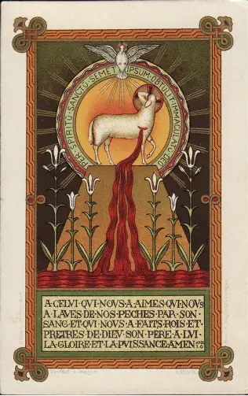
What are the Seven Offerings of the Precious Blood? (2)
The first offering of the Precious Blood is the Circumcision of Our Lord, offered for the propagation and exaltation of Holy Mother Church, and for all of her sacred ministers (ecclesiastical authorities; popes, cardinals, bishops, priests)
  We pray for the leaders in our Church who pour themselves out for our salvation; the offering of Christ’s Blood at His circumcision was enough to have saved the world, but Jesus chose to pour Himself out still more
The second offering of the Precious Blood is the Agony in the Garden, offered for peace in the world, for conversion of souls, and happiness among the Christian people
  We pray in memory of Jesus’ suffering, recalling that He sweat Blood in the Garden of Gethsemane as He awaited His arrest; we pray that souls would be freed from anguish, and know the peace of being near Christ our Savior
The third offering of the Precious Blood is the Scourging, offered for the repentance of sinners, conversion of unbelievers, and the eradication of heresies
  We pray for those who wound Christ with their unbelief, that they would console Christ’s Heart with faith, and accept the love He offers to them
The fourth offering of the Precious Blood is the Crowning with Thorns, offered for our friends and relatives, the poor and sick, and all those for whom God wants us to pray
  We pray for all those who are suffering, that Our Lord would comfort them amidst their trials, and bring them to their heavenly coronation; we pray that Our Lord would help us to accompany our friends and relatives lovingly in this life, as we journey on the road to Heaven

Slide 41
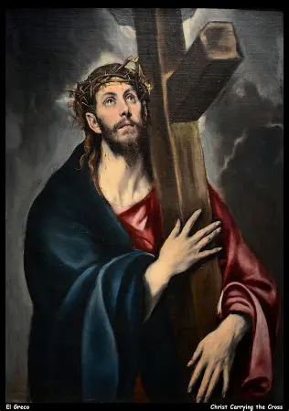
What are the Seven Offerings of the Precious Blood? (3)
The fifth offering of the Precious Blood is the Carrying of the Cross, offered for the dying, that they would be brought to eternal life
  We pray for strength and faith among the dying as they carry their cross to the end, that they would be raised to new life with Christ in glory
The sixth offering of the Precious Blood is the Crucifixion, offered for all those who have a devotion to the Precious Blood, who adore Christ and aim to spread devotion to Him
  We pray for joy and glory for those who are united to Christ in His offering of the Precious Blood, that they would know the sweetness of being on the Cross with Christ, never despairing, but treasuring the opportunity to be close to His Sacred Heart, and to receive His Precious Blood
The seventh offering of the Precious Blood is the Piercing of the Sacred Side, offered for all of our temporal and spiritual wants, the holy souls, especially the souls of priests, and all those who were devoted to consoling the Hearts of Jesus and Mother Mary
  We pray for Christ’s mercy on souls of the living and the deceased, that they would receive the outpouring of love from Christ’s Heart, being consoled by it, just as they have consoled the Hearts of Jesus and Mary with their devotion

Slide 42
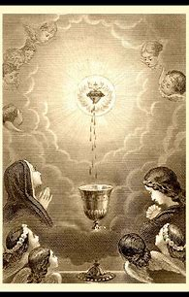
What are the five visits to the Blessed Sacrament?
Five is the number of love in the Holy Bible, in honor of the five holy wounds of Christ that were taken on out of love for us
We may offer each of our visits to the Blessed Sacrament for a specific intention, out of love. Just as Christ offered His Precious Blood for the salvation of souls, we, too, can offer His Body and Blood up to God the Father in prayer for a special petition. Each time we go into the church, we may kneel by the Blessed Sacrament (or stand in reverent adoration, like Our Lady) and keep Christ company, thanking Him for His generous offering of Himself, of His love
During our first visit, we may thank God the Father for giving us the gift of His Son, namely, in the Holy Eucharist, and offer the treasures of Christ’s Heart up to God the Father
In the second visit, we may thank Jesus for having given us the gift of Himself in the Holy Eucharist, and for revealing His Heart to us
At the third visit, we may thank our Redeemer for the benefits we have received spiritually through the Holy Eucharist, and ask that His plan may be fulfilled perfectly in us
We offer the fourth visit in reparation for sacrilegious receptions of Holy Communion among people in the world, or for any irreverent actions taken against the Holy Eucharist, and we consecrate ourselves to the Sacred Heart of Jesus
Our fifth visit is to adore Jesus’ Heart, where He resides in all of the tabernacles around the world
All of the visits build upon each other, helping us to more deeply treasure Christ, and all that He offers to us, in our hearts, that we may come to a deeper love of His Body and Blood presented to us in the gift of the Holy Eucharist

Slide 43
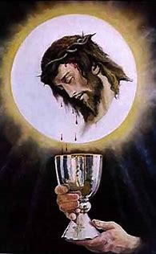
What are some prayers of adoration for the Sacred Heart that may be said?
Pray to unite your heart with the Heart of Jesus
Contemplate each virtue of Christ’s Heart, praying to emulate this virtue
Enthrone Christ’s Heart within your own heart
Pray in thanksgiving to the Holy Trinity that you receive in the Holy Eucharist, which is Christ’s Heart (Christ in union with each Person of the Blessed Trinity)
Ask Our Lady, whose Immaculate Heart is united to the Sacred Heart of Jesus, to pray for you

Slide 44
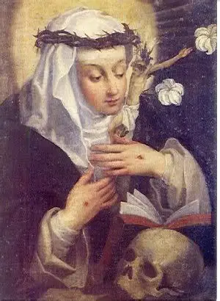
What is the Litany of Humility?
The Litany of Humility is a series of petitions offered to God to help us to be freed from the sin of pride, that, in being freed of inordinate self-love, we may have true liberty of spirit, following God’s will, and loving Him with all of our hearts
In embracing humility, we can have the greatest joy; we unite ourselves most deeply with Christ, the humble servant, the Lamb of God Who humbly placed Himself on the altar
We pray to be more like Christ, to not desire glory for ourselves, but to do all things for His glorification, and to find fulfillment in serving Him above all else
When we pray this litany, we are ultimately praying for the key to Heaven, because all saints in Heaven have humility; we are privileging eternal things over earthly ones
Humility helps us to blossom: it opens our hearts to receiving Christ; when we do not exalt ourselves, and do not assume that we already know everything, or are already perfect, then we can grow exponentially, opening ourselves to greater wisdom, and to knowing Christ all the better in each other, seeing His Heart reflected in others; we open ourselves to many friendships through friendship with our humble Savior
Humility helps us to approach the sacraments worthily; we have a stronger appreciation of the sacrament of Confession, realizing the need for us, as sinners, to be cleansed of our sins, before we may receive Our Lord, Who is all good, all humble, all perfect, in the Holy Eucharist, His Body and Precious Blood, which is a treasure, an honor for us to receive
Humility opens our hearts to more fully treasuring what God has given us as gifts from His Heart, rather than attaching ourselves to the fleeting things of the world
It is better to pray for growth in a specific virtue, like humility, than to pray simply to eliminate a certain sin from our souls; we can focus on the good, and see God’s Presence as we gradually draw closer to Him

Slide 45
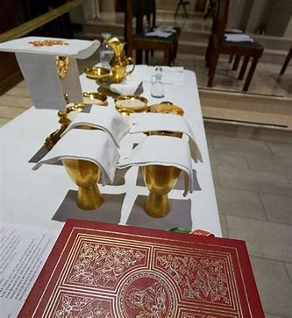
Announcements: Upcoming Adult Education Opportunities, Devotions, and Holy Masses at OLV
Bethlehem House baby shower basket preparation
  Wednesday, July 9, 2025
    6:30 p.m., parish hall
Seven Sisters Apostolate baby shower for Bethlehem House
  Sunday, July 13, 2025
    3:00 p.m., parish hall
Total consecration preparation program: Wednesday, July 16-Sunday, August 17, 2025
Next First Friday TLM
  Friday, August 1, 2025
    6:00 p.m., church
Next Two Hearts Guild meeting:
  Friday, August 1, 2025
    7:00 p.m., parish hall

Slide 46

Closing Prayer: Prayer to Jesus in the Tabernacle
Dear Jesus, present in the Sacrament of the altar, be forever thanked and praised. Love, worthy of all celestial and terrestrial love, Who, out of infinite love for me, ungrateful sinner, didst assume our human nature, shed Thy most precious Blood in the cruel scourging, and didst expire on a shameful Cross for our eternal welfare!
Now, illumined with lively faith, with the outpouring of my whole soul and the fervor of my heart, I humbly beseech Thee, through the infinite merits of Thy painful sufferings, give me strength and courage to destroy every evil passion which sways my heart, to bless Thee in my greatest afflictions, to glorify Thee by the exact fulfilment of all my duties, supremely to hate all sin, and thus to become a saint.

