Slide 1
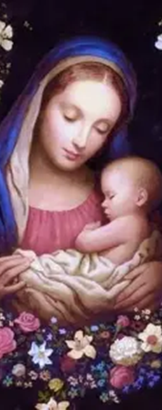



Seven Sisters Apostolate Baby Shower for Bethlehem House
Katie Sadakierski
Sunday, July 13, 2025

Slide 2
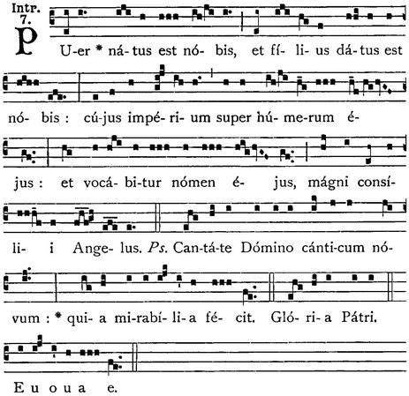



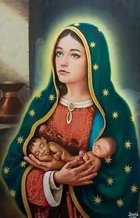
Outline
Welcome & opening prayer
Remarks: Pam Hibbard, Bethlehem House ministry coordinator
  The mission of Bethlehem House
  Supporting the ministry of Bethlehem House
    Q & A with Pam
Presentation:
  How the ministries of prayers for priests and for life relate
  Why and how we celebrate new life in our Faith
  Our spiritual children, and how we care for them
    Q & A
Closing prayer
Spiritual adoption
  Prayers before the Blessed Sacrament for our spiritually-adopted sons and daughters

Slide 3
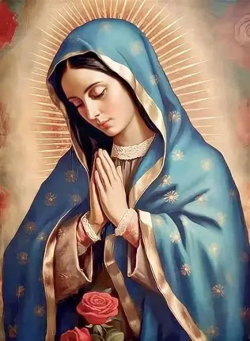
Opening Prayer: “Jesus, Living in Mary”
O Jesus, living in Mary,
Come and live in Thy servants,
In the spirit of Thy holiness,
In the fullness of Thy might,
In the truth of Thy virtues,
In the perfection of Thy ways,
In the communion of Thy mysteries.
Subdue every hostile power
In Thy spirit, for the glory of the Father.
Amen.

Slide 4

What is Bethlehem House?
Bethlehem House is a crisis pregnancy resource center on Our Lady of the Valley Parish’s Sacred Heart campus (33 Knipfer Avenue) which has been in operation since 2006
The Bethlehem House ministry supports mothers in need, providing them with resources required to care for their infants and toddlers
Bethlehem House offers women facing crisis pregnancies both material supplies, and information needed to help them with the transition into motherhood, that they may raise their children well, and have hope for the journey ahead
“Bethlehem” means “House of Bread.” Bethlehem is where Our Lord, Jesus Christ, was born. Bethlehem House nourishes souls with joy and peace, fulfilling corporal and spiritual needs, in that the spirit of the mother is uplifted by the loving service she is given, a reflection of Gods’ Providence
We pray that every child would be welcomed with the love with which the Christ Child would be welcomed, and that all those who serve the Lord and His people at Bethlehem House would be blessed for honoring the Presence of Jesus in the soul of every mother and child

Slide 5
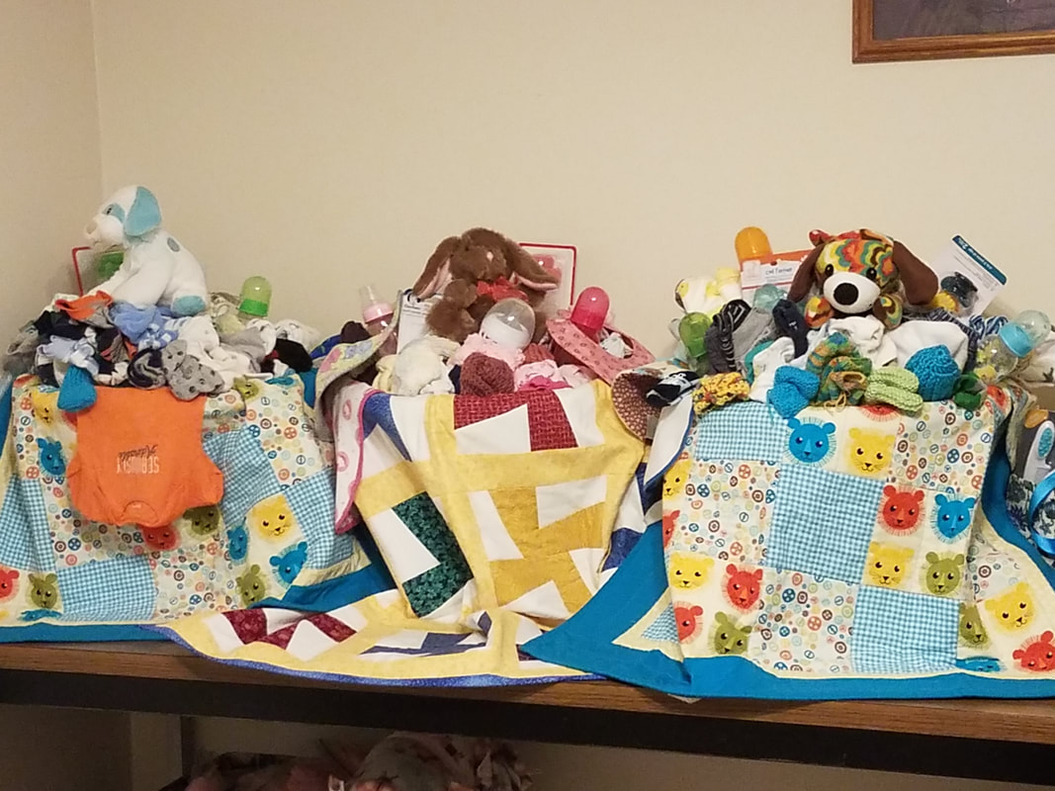
What is the mission and ministry of Bethlehem House?
As a faith-based organization, Bethlehem House receives its clients with Jesus’ and Mother Mary’s love, treating them with dignity, by welcoming them as they would the Holy Family
The mission of Bethlehem House is to support mothers in choosing and sustaining life, empowering and strengthening them when they are facing challenges, namely, financial hardship
Bethlehem House is a place of trust in, and gratitude for, God: it is fueled by prayer, namely, prayers of thanksgiving for the gift of life, and all that God gives us to bless us in our lives. A chapel in the facility allows for unity in prayer; it honors the intercession of Jesus, Mother Mary, and the saints in enabling the operations of the ministry

Slide 6
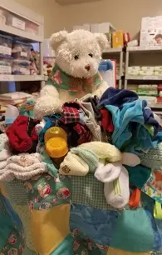
What services does Bethlehem House offer?
Bethlehem House provides emergency supplies to mothers for their babies when they complete needs-based assessments, and qualify as clients. Supplies may be provided for their babies up to 18 months
Baskets of supplies mothers may receive include diapers, baby wipes, clothing, bibs, blankets, baby shampoo, and baby booties
Based on their level of need, mothers may also receive such items as feeding supplies, high chairs, pack & play sets, diaper bags, baby bathtubs, and car seats for their babies
Bethlehem House works with local colleges and universities to provide needed supplies as well

Slide 7
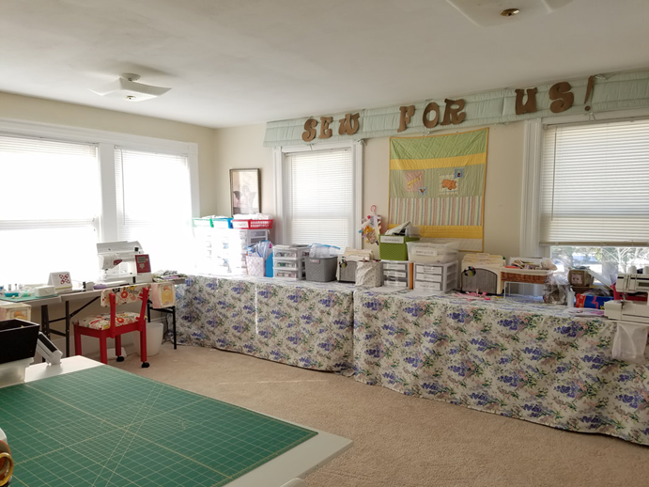
How may we support the ministry of Bethlehem House?
There are a number of ways in which we may support the ministry of Bethlehem House with our time, talents, and treasure:
  Knitting: Bethlehem House provides patterns for volunteers to use to knit sweaters, booties, mittens, hats, and baby blankets for clients’ baskets
  Sewing: Patterns are provided for volunteers to use to sew bibs, quilts, burp pads, and diaper bags
  Office support: Volunteers are needed for assistance with data entry on Excel, social media outreach & advertising, blogging on the website, answering the phone and scheduling appointments with clients, and creating newsletters for the ministry
  Organization: sorting supplies and creating baby supply baskets
  Networking: fundraising, working events, and liaising with local churches or other organizations; distributing flyers
  Maintenance (indoor and outdoor): house-cleaning, yardwork, painting, general maintenance and cleanup

Slide 8
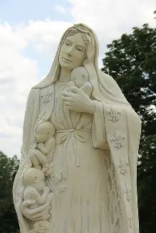
How are the ministries of prayer for priests and prayer for life related?
Priests bring us spiritual life. When we pray for priests, we are praying in support of their ministry to bring souls to eternal life in Christ, so we are helping them to sustain life, as they accompany the faithful in their journeys to Jesus’ and Mother Mary’s Hearts, aiding them in cooperating with God’s grace, and avoiding sin, which brings spiritual death
To pray for life is to pray for the souls that priests will minister to; it is to pray for future priests, the future mothers of priests, future men and women religious, and all those who are made by God to love and serve Him
Praying for priests, and for life, are interconnected missions, in that they are ministries of love offered for God’s glory, and in imitation of Christ, the Eternal High Priest, Who sacrifices His life as a prayer of love. To engage in prayer for others is to share in the mission of the priest, who unites himself with Christ in making constant intercession for the souls entrusted to his care, and all those in the universal Church

Slide 9
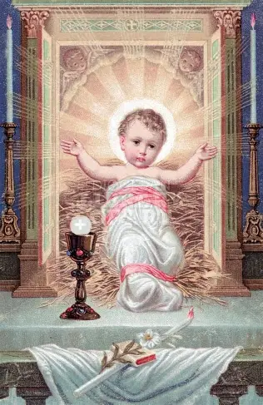
How do we celebrate new life in our Faith? (1)
Reception of the Holy Eucharist: when we receive the Holy Eucharist, we receive all of Christ. We receive the Christ Child, and the Crucified Christ. He gives us the graces to be like Him through the Holy Eucharist; we receive His Heart, a Heart of childlike trust in God the Father, sweetness, and innocence. We also receive the strength and courage of the Crucified Christ, Who went to the Cross like a faithful lamb
Receiving Jesus’ kind and merciful Heart in the Holy Eucharist leads us to a deeper empathy. We come to more deeply share in the sacred mysteries with mothers experiencing crisis pregnancies, compassionating with their crosses of anxiety, while also sharing in the joy of bringing forth new life. We are given new life in being given new eyes to see life with, as we come to behold Christ’s Presence illuminating all things
The Holy Eucharist gives us new spiritual life, for in the Holy Eucharist, we receive the resurrected Body of Christ, the Risen Lord, and are led to eternal glory, where we may behold Christ’s glorified Body, shining in the light of Heaven. Our Lord leads us to Heaven through the Holy Eucharist, helping to raise us to new life with Him, for we reach union with Him through taking on His Cross and Passion, but also, His loving response to it, His patience and goodness
We express thanksgiving for Jesus’ Presence in the Holy Eucharist, which gives us joy and peace, helping us to see that God always remains with us, is in us, and in the people around us, reflecting the light of His love. We come to love Him more deeply, offering everything up for His glory, and receiving all as a gift from Him, so that our lives are truly made new, in becoming continuous prayers offered to Him with purpose and intention
We receive the Holy Eucharist reverently, in union with Our Lady, that we may welcome Christ into hearts like hers, and therefore, love Jesus totally. We thank Our Lady for her openness to new life, and welcome Christ lovingly as she did

Slide 10
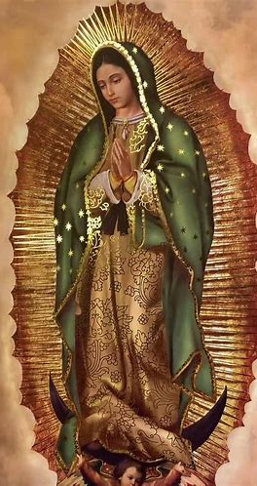
How do we celebrate new life in our Faith? (2)
The sacred liturgy itself: at every Holy Mass, when the priest transubstantiates the bread and wine into the Body and Blood of Christ, Our Lord is reborn on the altar; when we receive Holy Communion, we are renewed by the Risen Lord, and are led closer to eternal life with Him
  The sacred liturgy helps us to receive new life in Christ, as we spiritually unite ourselves with Christ at each stage of His life, each phase of salvation history, learning about Who He is, that we may become more like Him, becoming new creations in Christ all the time, as we are transformed and purified by His love; the sacred liturgy feeds our souls, leading us to new wisdom that helps us to understand who we are in Christ, and to live our lives differently in response to what we learn, that we may love Him better all the time
  Liturgical calendar: feast days (birthdays into Heaven); we look forward to our own birthdays in Heaven, praying to be like the Christ Child in humility and sweetness, that we may love Him with pure hearts like Mother Mary’s; we are always celebrating the lives of those who loved Christ, because they shaped other lives, helping them to reach eternal life; none of their lives have ended, but have continued in glory, inspiring us to follow them in charity, that we may have eternal life as well; we cannot get to Heaven alone, but through supporting other lives in the journey; we all learn from each other; Jesus blessed His apostles as He went up to Heaven, and Mother Mary did not go up to Heaven alone, either, but was raised up by her Son; Jesus died for all of us, that we could live for Him, together, as one Family; Heaven will not be solitary, but will be a family of lives made new and perfected by Christ, too
Catechism: to learn about Christ is to know Him better, and to know Him better is to love Him better; love gives us life of the soul
  We transmit life by transmitting our Faith, teaching it not only in a formal sense in speaking about it, but also, in how we live it out and embody Christ’s spirit, a Eucharistic spirit of self-sacrifice

Slide 11
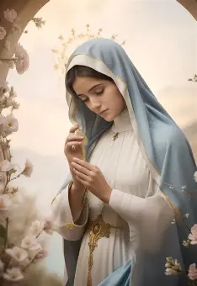
Why do we celebrate new life in our Faith?
Every life is created by God. God is good, and so is His creation. Every person is made in the image and likeness of God, reflecting His beauty, truth, and goodness in a special, unique way. Each soul is a sign of how deeply and personally God loves us
God is love; He is worthy of all praise, so we praise Him by celebrating new life. God’s love is always worth celebrating, because love is undying; it is good for our souls; it is what gives us life in the first place, and makes life meaningful, helping us to live in reflection of God, and in fulfillment of the Commandments, which are designed in accordance not only with what will bring us happiness in this life, but happiness in the next life, too
There is joy and hope in new life; when new life is brought forward, it is a sign of God’s love for us. He creates, sustains, and renews life, purely out of the love in His Heart, that we may share in all of His gifts, receiving all of His goodness, and knowing the joy of being near to His Heart
New life on Earth, whether the birth of a child, or the new life that we receive spiritually when receiving the Holy Eucharist, helps us to uplift our hearts with confidence in God, as we look forward to eternal life in Heaven

Slide 12
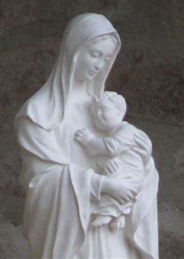
Who are the children we spiritually adopted?
They are God’s precious children, our spiritual sons and daughters who reflect His light, and help us to love Him all the more
22 children were spiritually adopted
10 boys and 12 girls were spiritually adopted
Names honoring Our Lady were most popular for girls
Names honoring St. John, St. Joseph, and St. Michael were most popular for boys
Names connected to Our Lady and to the Holy Rosary for the devotions and feast days (i.e. for St. Therese) in the month of October were also chosen
Ann
Dominic
Christian
Elizabeth Bridget
Catherine
Monique
Brianna
Christopher
Adella
Lisa Marie
Mary (2)
Michael (3)
Robert Joseph
Joseph
Therese
Jacinta Marie
Marie-Therese
Daniel John
John Michael

Slide 13
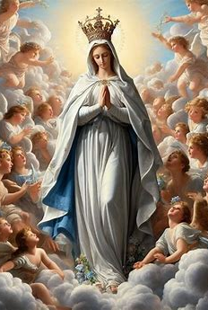
What do our spiritually-adopted children’s names mean? What do their names say about them? (1)
Michael: “One who is like God”
  When we spiritually adopted children in October 2024, we had just celebrated Michaelmas, and the Feast of the Holy Guardian Angels. It being October 13, we were celebrating Our Lady, Mystical Rose. To honor St. Michael is to honor Our Lady as well, because we pray that both St. Michael and Our Lady would be with us “now and at the hour of our death.” As a holy angel, St. Michael venerates Our Lady, Queen of the Angels, serving her in her heavenly court. We pray that our spiritual sons named Michael would always be like God, in embodying great love, just as St. Michael lovingly and faithfully served God, remaining loyal to Him, and defending all others who serve God
Mary/Marie: “Drop of the sea,” “beloved”
  Mother Mary is the greatest of all of the saints, so to name a spiritual daughter after her is the ultimate honor. All of Sts. Louis and Zelie Martin’s children, including the four who passed away, were named “Marie,” which is French for “Mary,” and went by their middle names. Saint Therese was “Marie Therese.” The Martin boys were named “Marie Joseph” to honor St. Joseph in addition to Our Lady. Our Lady is like a drop of the sea in the ocean of Christ’s mercy, humbly reflecting Our Lord, and participating in God’s plan for salvation. She is beloved by God, and therefore, was chosen for the special role of being the Mother of the Savior. Through her intercession, we come to understand our identities as beloved children of God, and can love His people well, helping everyone to see how beloved they are, as precious treasures cherished in the Heart of Our Lady, like so many drops in the Star of the Sea’s merciful, maternal Heart

Slide 14
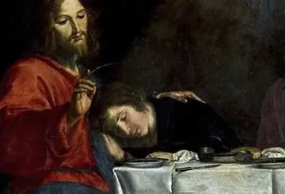
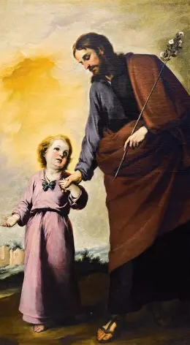
What do our spiritually-adopted children’s names mean? What do their names say about them? (2)
John: “God is gracious”
  Saint John the Beloved Apostle reflected God’s love in his fidelity to his greatest Friend, Our Lord, Jesus. He cooperated with God’s grace, and reciprocated the kindness and mercy that Jesus had shown him. This name attests to God’s goodness, His graciousness, in giving us such a wonderful saint as John. It also is an expression of gratitude for our spiritual sons, as we thank God for His graciousness in giving us such precious souls to love and pray for
Joseph: “raised by God”
  Saint Joseph was a humble man who led a life of quiet simplicity. He was raised up by God the Father to fulfill the amazing vocation of raising the Christ Child in his home at Nazareth. Although the Christ Child was subject to St. Joseph, His foster father, St. Joseph was raised by Him, as he learned from the Christ Child, the perfect embodiment of virtue, how to serve our heavenly Father with ever-greater faith, hope, and love. Saint Joseph’s soul, like that of Our Lady, was receptive to God’s grace; he avoided sin, living a life of pure love, and was therefore filled with the Holy Spirit, so that he would be raised up to Heaven, and reunited with the Christ Child he had loved so much in this life. We adopted our spiritual children on a special feast day of Our Lady of Fatima, October 13, recalling her sixth visit to the Fatima children, when the miracle of the sun took place, and St. Joseph appeared in a vision with the Christ Child, calling all to repent, to remain together as a faithful family of Christ in the Church, and to honor His Commandments, following the Son of God

Slide 15
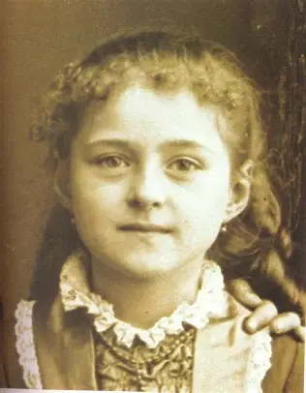
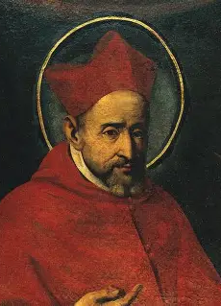
What do our spiritually-adopted children’s names mean? What do their names say about them? (3)
Therese: “to harvest,” “summer”
  Saint Therese of Lisieux’s feast day is celebrated on October 1 in the modern calendar, and October 3 in the traditional calendar. On October 13, when we adopted our spiritual children, we celebrated Our Lady, the Mystical Rose, so it is only fitting to honor her by naming a spiritual child for the Little Flower, St. Therese. As a baby, when St. Therese was sick, she was healed through her mother’s prayers for the intercession of St. Joseph, who is the Hope of the Sick. She would turn to prayer as she grew, helping many others to follow the “Little Way” of doing all things with great love for God, so that many souls would flower in virtue, and become like her, harvesting good fruits for God, so that all of life would be like an eternal summer, shining with the light of the Son of God’s love. The story of this soul reminds us that our prayers of intercession for our spiritual children are powerful, and through the grace of God in His mercy, can heal, and lead souls to Heaven, to the unending warmth, joy, and brightness of summer
Robert: “shining with glory,” “bright”
  The name “Robert” reminds us that each of our spiritual children is a bright light for God, and that through our prayers, they will be born to use the gifts that God gave them for His glory. Our prayers help to lead souls to glory, as our spiritual children can use their lives to help others, and bring them to Heaven

Slide 16
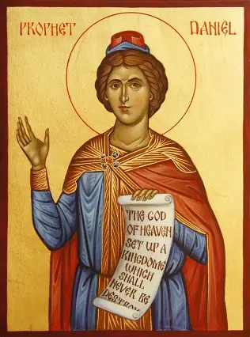
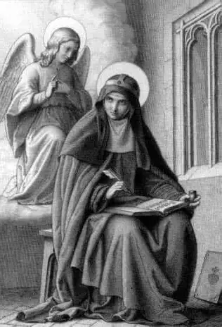
What do our spiritually-adopted children’s names mean? What do their names say about them? (4)
Daniel: “God is my judge”
  In the Old Testament, Daniel is given special spiritual gifts of prophecy and wisdom from God, which he uses to interpret the dreams of a king, but he gives all glory to God, and recognizes that the dreams not only have to do with the experiences of his king, but foreshadow the coming of Christ the King, the Messiah. Daniel is faithful to God, and gives all glory to Him. His faith saves him from the lion’s den; he is totally unharmed. We are reminded that when we put our faith in God, we do not hope in vain. Jesus is our Savior, and will deliver us from harm, bringing us safely to Heaven when we are faithful to Him; He has our spiritual children in His hands, and will guard them faithfully
Bridget: “strength,” “virtue”
  Saint Bridget of Sweden’s feast day is traditionally celebrated in October, the day after the Feast of Our Lady of the Holy Rosary. She had visions of Our Lord, especially of the Passion, and developed special prayers to say in devotion to Him. In her efforts to honor God, she did demonstrate great strength, especially in spiritually participating in the Passion of Our Lord through her mystical visions, which she could lovingly respond to because of her virtuous heart rooted in Our Lady’s Immaculate Heart of compassion and fortitude. We are reminded to offer the Precious Blood of Jesus to God the Father with Mary for the salvation of souls, and to pray for the merits of the Passion, the fruits of Christ’s Sacrifice, to those in need, including our spiritual children and their mothers

Slide 17
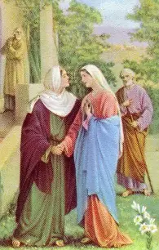
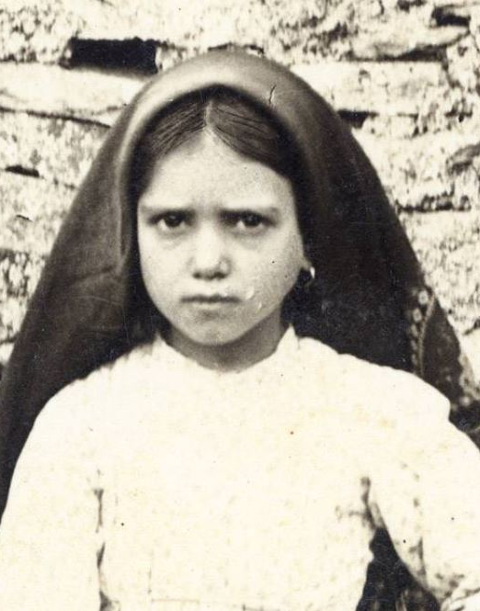
What do our spiritually-adopted children’s names mean? What do their names say about them? (5)
Elizabeth/Lisa: “devoted to God,” “God is my oath”
  “Lisa” is derived from “Elisheba,” the name of Aaron’s wife in Scripture, which would be adapted to “Elizabeth.” This name reminds us of St. Elizabeth, who rejoiced in the love of her cousin, Mary, and the nearness of Mary’s Son, Jesus; it honors the spirit of humility St. Elizabeth had in receiving Jesus and Mother Mary into her heart. We emulate St. Elizabeth and Mother Mary in their loving visitation in how we visit our spiritual children with our prayers, and go in haste to their mothers to support them in their time of need, by praying to God for them
Jacinta: “hyacinth”
  Our spiritual children were adopted on the feast day of Our Lady of Fatima, so the name “Jacinta Marie” honors her in a special way, because this flower of Fatima, St. Jacinta, was one of the precious shepherd children Our Lady appeared to. Saint Jacinta reflected Our Lady’s spirit of fortitude; she was willing to sacrifice for those who would not or could not, for the conversion of sinners, and the consolation of Christ’s Heart. From her sacrifices, many good fruits for God would bloom. Saint Jacinta was faithful to the end, just like Our Lady; both embraced the Cross, and shared in Christ’s victory. Prayer and penance brought St. Jacinta to Heaven, and no doubt, many others to whom the merits of her prayers were applied; she reminds us that our prayers will help our spiritual children, too, and that when they grow, their prayers can help to save souls, too, all through the grace of Our Lady

Slide 18
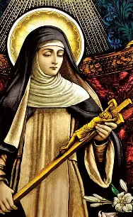
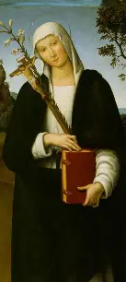
What do our spiritually-adopted children’s names mean? What do their names say about them? (6)
Catherine: “pure”
  God’s love purifies; this name reminds us to pray that everyone would embrace life, so as to receive God’s love through each born and unborn person, and be purified by it. Loving each other sanctifies us; it is how we can love God, the Creator of each person. Our spiritual children are pure souls; loving and praying for them makes us purer, like them, and therefore, more like Christ. Saint Catherine of Siena exchanged her Heart with Christ’s, and she drank the Precious Blood from His Sacred Side, treasuring its sweetness. She teaches us to be united with Christ in embracing the Cross, and seeing the sweetness of His Heart beating near to our hearts throughout our journeys as we carry crosses for His glory. She inspires us to pray for conversion, that hearts would be changed, and that all of our hearts would become more Christlike; we pray that St. Catherine would help parents of the unborn to choose life, not despairing when they face crisis pregnancies, but turning to Christ, so that they may see their child is not a Cross, but pure sweetness, the reflection of Christ that brings joy to life, making any crosses light
Monique (Monica): “advisor,” “unique”
  This name honors St. Monica, the mother of St. Augustine, whose great love for her son led her to continue praying for him, even when his conversion seemed impossible. Never giving up, she trusted in God’s timing, and had faith that He would deliver her son from sin, bringing him to spiritual life. Saint Monica reminds us to never stop praying for conversion, but to focus on God’s love, that we may never despair, but always have trust in what God can do; every soul is precious, and worth praying for. It is a gift for souls to be saved, and to become part of the heavenly family

Slide 19
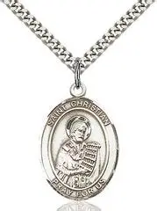
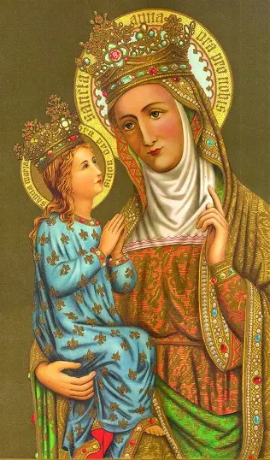
What do our spiritually-adopted children’s names mean? What do their names say about them? (7)
Christian: “follower of Christ,” “little Christ”
  We are each called to be good followers of Christ, and our prayers can help to form new Christians who will honor Him by living with love. Through prayer, we all help each other to become better Christians; our spiritual children will help us to keep becoming better followers of Christ, as we faithfully pray for them, just as Christ prays for us. The “little Christs” we pray for help us to become more like Christ; we all are His little ones, needing His love and guidance
Brianna: “grace,” “merciful,” “favored by God”
  “Brianna” is derived from “Ann,” for the mother of Mary, who would be the Mother of God. This name reminds us of what a special role we have in praying for the parents of our spiritual children, who will each have special vocations in the future, which we help to nurture through our prayers. The fact that we have the opportunity to pray for each other is a sign of God’s love, mercy, and favor; we can pray for special graces for each other, and each help to bring Christ’s spirit of love into the world

Slide 20
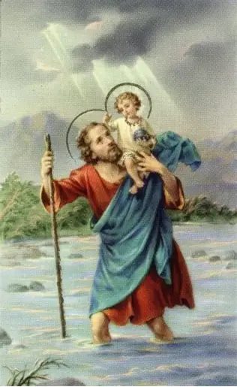
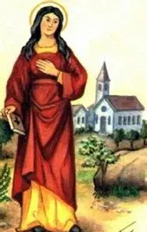
What do our spiritually-adopted children’s names mean? What do their names say about them? (8)
Christopher: “Christ-bearer,” “carrying Christ”
  Saint Christopher carried the Christ Child across the river to safety; he is the Christ-bearer, not only because he physically carried Jesus on his shoulders, but because he was a bearer of Christ’s image, reflecting the love with which Jesus and Mary carry all of us. We pray for St. Christopher to intercede for the mothers who bear our spiritual children, that he may help them as they carry children who reflect the Christ Child
Adella: “noble,” “serene”
  We adopted our spiritual children in the month of October, the traditional month in which we celebrate the feast day of Christ the King. Saint Adela was royal (the youngest daughter of William the Conqueror), and built churches and monasteries in her kingdom. We pray for St. Adella to intercede for our spiritual children, that all would recognize their dignity that reflects the royal dignity of Christ the King

Slide 21
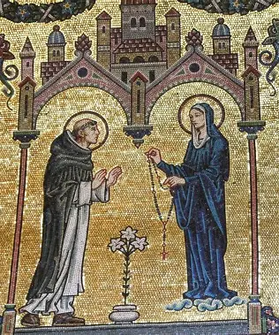
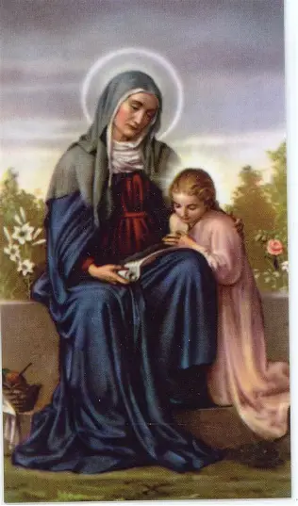
What do our spiritually-adopted children’s names mean? What do their names say about them? (9)
Dominic: “of the Lord,” “belonging to God”
  We spiritually adopted our children in the month of October, the Month of the Most Holy Rosary. The Holy Rosary was given to St. Dominic to share with the world as a devotion to help lead the faithful closer to Jesus through Mother Mary. Praying the Holy Rosary helps us to belong all the more to God as His children. To name a spiritual son “Dominic” is to entrust him to God, that his spirit may always praise God
Ann: “grace,” “merciful,” “favored by God”
  Saint Ann is the mother of Our Lady. She consecrated Mother Mary to God, having promised God the Father that she would do so if He worked the miracle of giving her a child in her advanced age. Opening herself to God’s grace, Ann humbly received His gift, a sign of His favor, a reward for her faithfulness, for she never stopped praying, always believing that God would be faithful to her. Saint Ann would give birth to Mary, Mother of Mercy, who was given to her as an expression of God’s mercy. Saint Ann had dealt with much persecution from others, for infertility was seen as a curse, but God the Father turned her barrenness to blessedness, just as He would for Our Lady, making the Virgin a Mother. Naming a spiritual daughter “Ann” helps to give her a special closeness to Our Lady, helping her to cultivate a Marian heart, just as St. Ann nurtured Mary, shaping her Immaculate Heart through her love. This name is a reminder that when women face crisis pregnancies, God is with them, providing for their needs, just as He will provide for this baby named Ann

Slide 22
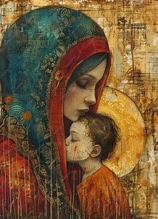
In general, what does it mean to spiritually adopt someone, and to care for a spiritual child? How does this process compare to caring for a natural child?
Food (umbilical cord)
  Offer your Holy Communion for your spiritual child
Water (amniotic fluid)
  Renew your baptismal promises; bless yourself with holy water; pray for the living water to bring healing and life to the spiritual child and their family
Shelter (the womb)
  Make visits to the Blessed Sacrament in honor of your spiritual child; ask Mary, Mother of the Holy Eucharist, to carry your child safely to their birth, and ultimately, to keep leading them closer to Jesus
  Treat yourself as a living tabernacle, thinking about how you respond to Christ’s Presence within you, and radiate this outward, bringing His Heart to others
Clothing (the skin; baby clothes)
  Clothe your child in Christ’s love; pray the Stations of the Cross/Stations for Life in their honor. Meditate on the Incarnation, meditating on how Christ took on human Flesh to save us from sin, and to make us whole; offer your crosses in union with Christ’s Cross. Practice devotion to the Holy Face
Comfort (the mother’s voice)
  Pray the Holy Rosary for your spiritual child, meditating on how Jesus and Mother Mary are with us through every step of our spiritual lives

Slide 23
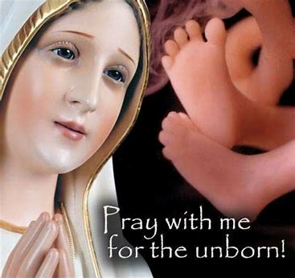
How do we continue to care for our spiritual children?
Continuing to renew special graces that come from spiritual adoption/serving as a spiritual mother
Reconsecrating ourselves and our spiritual children to Jesus and Mary; recommitting ourselves to the mission of prayer
Honoring the Mystical Rose: praying for her intercession in our children’s lives
  Asking Our Lady of Fatima and Our Lady of Guadalupe to guide us
Praying for the intercession of Sts. Zelie and Louis Martin, on whose wedding date the children were born
Praying for the intercession of St. Teresa of the Andes, who was born on July 13

Slide 24
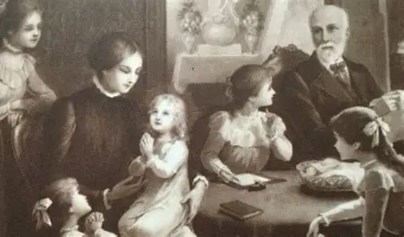
Who are Zelie and Louis Martin? Why are they powerful intercessors for us, and our spiritual children? (1)
Saints Louis and Zelie Martin are the father and mother of St. Therese of Lisieux
In 2015, they became the first married couple to be canonized together; they reflect the virtues of faith, hope, and love that were embodied by such holy couples as Sts. Joachim and Anne, and St. Joseph and Mother Mary
July 12 is the feast day of Sts. Louis and Zelie Martin, because this is their wedding anniversary. Since they were married at midnight, however, July 13 is technically the date on which they were wed
Saints Louis and Zelie Martin are wonderful intercessors for us and our spiritual children, because they followed God’s will so faithfully. Their love for each other flowed from love for Him. They lived in harmony, because they did all things in union with Jesus and Mother Mary, entrusting each of their children to Our Lady’s care
Originally, Sts. Louis and Zelie Martin had each wanted to enter religious life, but they responded to God’s call for them to marry, and discovered the great happiness that He had planned for them, in the form of their children. All five of their daughters would become nuns, and one would become a saint; another is on the road to sainthood
They demonstrate that when we open our hearts to loving God, and listen to what He is speaking into our hearts, then the seeds of faith, hope, and love that are planted can flourish, and bear the greatest fruit for God. When He works within us, we can have an impact that goes beyond ourselves; our love can transcend the limits of time and space

Slide 25
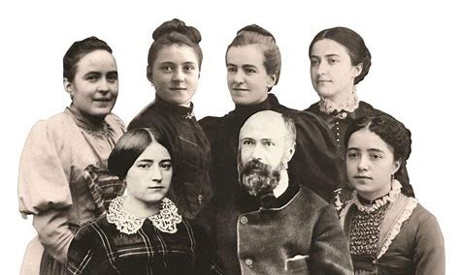
Who are Zelie and Louis Martin? Why are they powerful intercessors for us, and our spiritual children? (2)
If St. Zelie and St. Louis had never married, then St. Therese would not have been born, and generations of people would not have had the opportunity to follow her Little Way to Heaven; many other little flowers would not have grown from the Little Flower
Besides being the natural parents of a saint, they were excellent spiritual parents to all, and truly nurtured the spirituality of each of their natural children to perfection, cultivating a garden for God that would glorify Him greatly. They teach us that to be a spiritual parent is a tremendous gift, and that entrusting our spiritual children to Our Lady helps them to realize their purpose, to use their gifts for God, while allowing us to fulfill our vocations to the best possible extent
They teach us that love unites us all eternally as one family. When we invest in our spiritual children on Earth, growing alongside them, then we can be like plants transferred to God’s garden together, where we may continue to glorify Him; when flowers thrive, and outgrow the pots in which they were planted, then they need to be placed in bigger vessels to contain them; this is just like how, when we love to the very deepest degree that we can, with the biggest hearts, God transfers us to Heaven, where our love may go on infinitely, like His, never to be contained, but to always be poured out in prayer for others
Praying for our spiritual children helps to ensure that they, too, will have this opportunity in Heaven
Saints Zelie and Louis would have continued their mission of prayer in Heaven; their prayers would have helped their daughters to reach heavenly splendor

Slide 26
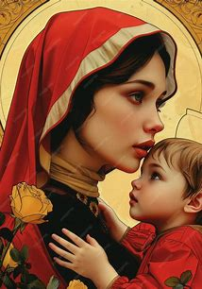
How is our baby shower akin to a shower of roses?
Saint Therese promised that she would spend her Heaven doing good on Earth. She said that she would let fall a “shower of roses” on souls, bringing many blessings to those who request her intercession. Saint Therese prayed forward all that her parents shared with her
We thank our spiritual parents who have shaped our faith by praying for the next generation, sharing our love with them. We call down many blessings like roses on the babies we have spiritually adopted, asking that St. Therese would intercede for them, and that her parents, Sts. Louis and Zelie Martin, would intercede for our spiritual children’s natural parents, that they would raise their children with the godly love that Sts. Zelie and Louis Martin had for their children
The gift of life is a blessing. Each spiritual child we celebrate is like a rose in God’s garden that we may nurture with our prayers. As we donate items to Bethlehem House in honor of our spiritual children, we praise God for the children He has delivered, and ask that He would continue to provide for all clients being served by Bethlehem House

Slide 27
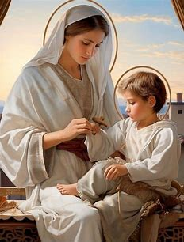
How does God reveal His Heart through children (including the unborn)? (1)
The child demonstrates trust: Jesus was vulnerable, revealing all of His Heart to us, so that we could know the depth and breadth of His love. He willed that His Sacred Side should be pierced to show us His Heart of mercy and boundless love
  He risked His life, and then gave it to us entirely, for His love transcended any fear. Jesus chose to go into the womb, to be born into the world, with all of its dangers, so that He could free us from them. Jesus allowed Himself to be carried by His Mother everywhere in the womb, trusting her entirely. He chose to be raised in a family, to be subject to St. Joseph, His foster father; He entrusted Himself to their care. Trust stems from love; we place trust in those we love, so Jesus shows us how to love in this way, and calls us to have integrity, that our loved ones may trust in us to do God’s will
  King Herod had a campaign of infanticide, engineered to slaughter the Christ Child, but St. Joseph, Our Lady, and the holy angels protected Our Lord from any harm. God revealed His mercy through the guardians He gave to His Son to watch over Him, and shows us that He will be merciful to us, too, sending us, as His children, all that we need to help each other, and remain in His grace, near to His Heart, and away not only from physical danger, but spiritual danger.
  Jesus was vulnerable in going on the Cross; He trusted entirely in the plan of His Father, believing in the goodness of His Father, knowing that He would provide all that was needed, bringing about the fulfillment of His plan for our salvation
  The child is not anxious, but has peace when they trust; likewise, we are to glorify God by placing our confidence in Him, which consoles the Heart of Jesus; Jesus is wounded by our doubt. He is happiest when we are undisturbed, continuing in our works and prayers to glorify Him, always with a spirit of hope in His mercy, faith in His love

Slide 28
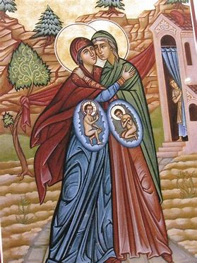
How does God reveal His Heart through children (including the unborn)? (2)
  Joy: Saint John the Baptist leapt for joy in the womb of his mother, St. Elizabeth, when Our Lady approached, carrying Jesus within her. Saint John rejoiced in being so near to the Sacred Heart. Young children have joy, because they have love; they have a sense of wonder for everything. They have pure hearts, and the pure of heart see God, so in seeing God’s greatness in everything, they can have true happiness. When we look at all things in life as gifts from Christ’s Sacred Heart, expressions of His love for us that are designed to bring us closer to Him, and help us to feel more of His love, then we can always be happy, rejoicing in the opportunity to be near to Him, not in spite of, but especially when, we are on the Cross, spiritually united with the Crucified Christ
    To visit each other with great love, like how Our Lady visited St. Elizabeth, is to acknowledge the Presence of the Christ Child in each person; we are all vulnerable in some way, all in need of support, so we can rejoice in the opportunity to serve God by helping each other, and can rejoice in how Jesus speaks to us through each person’s heart, loving us through their care
  Humility: The child accepts care, placing himself or herself in the arms of his or her mother; we, too, can humbly place ourselves in the Hearts of Jesus and Mother Mary, going to them for all of our needs, humbly petitioning them for their guidance and care, rather than striving to go through life alone, without recourse to them. We can humbly thank them for all that they do to care for us, and console them simply by delighting in their presence with us, humbly receiving them; Jesus’ humble Heart shone through everything He did, because He retained His childlike purity throughout His life. On the Cross, He entrusted St. John, and all of God’s children to Our Lady, which demonstrates to us that He wants us to humbly be led by our Mother and teacher, Mary

Slide 29

How does God reveal His Heart through all lives, born and unborn?
God’s plan for life, for how we are to share His Heart with others, reveals His love
  God communicates His love through both men and women; complementarity in creation is needed to reveal the fullness of God’s love, and for us to be made whole in Christ. We all have qualities, gifts, and talents that reflect the greatness of God; we only have a sense of the magnitude of God’s greatness when we come together collectively to glorify Him. Each of us is called to reveal God’s love in a different way, to share it according to the vocation we were given
    Sometimes parents have gender reveal parties for their unborn babies, not only for practical reasons, to plan for items needed for the babies, but to celebrate the unique person their child will be, for gender is part of God’s plan for our salvation; it is part of our God-given identity, the masterpiece God is creating us to be
  God expresses His love and mercy through His plan for life: He gave men and women the opportunity to share in His act of creation, and the act of sustaining life as they care for their children, teaching them and promoting their growth, especially in the virtues, reflecting how He tends to each of us personally
  The fact that we were made in God’s image, and reflect His creativity, is a testament to His love; He shares His goodness with us
  We are made interdependent; we all are unique. No one has every quality, or the same identity. We were made for community, so that we could know the love of the Blessed Trinity, which is a family, a union between the Persons of God. We are sanctified by serving each other, for we serve God in this way

Slide 30
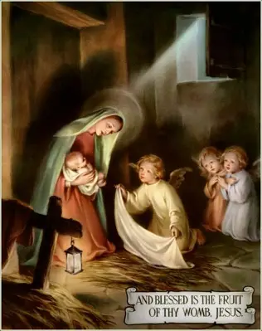
Which prayers/devotions might we practice to remain close to our spiritually-adopted children, and to practice being good spiritual mothers by being good children of God?
Chaplet for the Unborn: meditating on the love of God the Father and Our Lady for the unborn children we have spiritually adopted, we can unite with the Hearts of Mary, and Jesus, the Son of God the Father and Our Lady, in expressing love for our spiritual children
Litany to Jesus in the Womb of Mary
  Spiritually uniting ourselves with the Christ Child in order to more deeply pray for the unborn, and glorify Our Lord for humbly taking on Flesh, and being born of Mary, coming down from Heaven as an Infant to grow as we do, and compassionate with us at each stage of life, so that He could redeem us
  We can come to more profoundly appreciate each child as a reflection of the Christ Child, and understand God’s plan; Jesus teaches us that every life has value and meaning, including the that of the unborn child, because He, too, was a Child in the womb once
Praying with the crucifix: while holding the rosary, or in contemplation of the image
  Meditating on our vulnerability; our own need for God, we can unite in prayers of humility, going to the Crucified Christ to pray for His mercy to be poured into the unborn, that the hearts of their parents may be turned to God, compelled to choose life
Jesus Living in Mary Prayer
  Honoring the Presence of Christ within each person, we can pour our love for God into service to our neighbors, treating each person as a living tabernacle holding Our Lord within them, like Our Lady did
Visio divina: Contemplate the Madonna of the Streets painting
  Consider Our Lady’s love for each of her spiritual children, and emulate this perfect charity; be pro-life in loving every life created by God, born and unborn

Slide 31
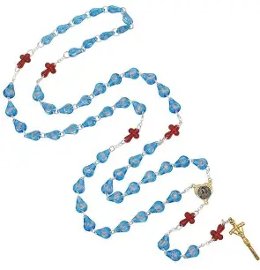
What is the Chaplet for the Unborn?
March 24-25, 2013: Our Lady promised that whenever the chaplet is prayed, healing for an abortion will happen, and hearts will be changed; she presented the chaplet as a weapon to fight abortion, calling abortion the crime whose end would change the world
  March 25: Feast of Mary, Mother of the Unborn (Annunciation feast day/Incarnation)
20-bead chaplet
  Similar in design to Two Hearts chaplet: five sets of 1 “Our Father,” 3 “Hail Mary” prayers (4 prayers in each of the five sets)
  United Hearts centerpiece
  Five special pro-life intentions prayed on each set

Slide 32
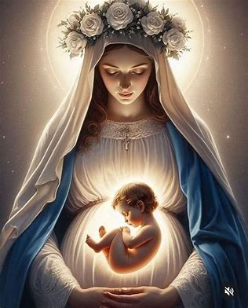
What is the Litany to Jesus in the Womb of Mary?
A prayer of supplication with 27 invocations imploring the mercy of the Infant Jesus, honoring Him in special ways for the miracle of His conception, growth in the womb, and Birth, signs of His great compassion
  In praying for Christ’s mercy, we pray to be merciful to others, imitating the Christ Child’s gentleness, especially as we pray for the unborn
  We pray to see each unborn life as a reflection of Christ, that we may defend the unborn as we would defend Our Lord, and our Faith that is founded upon the love of Our Lord
  We pray to spiritually join Christ in Our Lady’s womb, so that we may grow in virtue, becoming as much like Him as we can, so that we may help others to grow well, in union with Jesus and Mother Mary
The Litany conveys the depth of Christ’s love for us, in going in to the womb of Mary, in order to enter each of our hearts and souls; He chose to experience all that we do as humans (except for sin) to empathize with us and minister to us, serving us with the greatest outpouring of love, beyond what can be measured

Slide 33
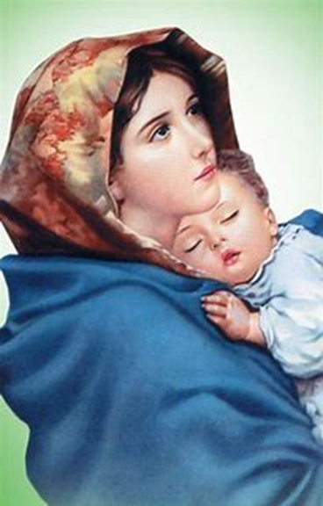
What is the Madonna of the Streets painting?
Painted by Roberto Ferruzzi, the portrait was exhibited first in 1897; it is on the Bethlehem House prayer cards now
The Italian artist Roberto Ferruzzi met a thirteen-year-old girl, Angelina Cian, holding her baby brother, and painted her; he was moved by how tenderly she cared for the child. The subject’s very name suggests her angelic sweetness, and reminds us that to be like the holy angels means to be guardians of life, especially precious young lives that are vulnerable, just as the Christ Child was
This painting has become much-beloved as a Madonna and Child painting; it is also called the “Restful Madonna,” for it demonstrates to us how lovingly our Blessed Mother cares for us, showing us how we should rest under her mantle, channeling her spirit of peace that comes from faith and trust in God
The painting also underscores that we are all called to care for each other as brothers and sisters in Christ; not everyone is called to be a natural parent, but we are all called to be spiritual parents. The saints are our spiritual parents, so if we are to be like them, and join them in Heaven, then we are to shine their light, the light of Christ, and care for each other, since He is in each soul; Mother Mary sees Him in each of us, and loves us. When we contemplate this image, we can consider what it means to look with the eyes of Mary, and practice seeing from this perspective, beholding and tending to the Christ Child within each person

Slide 34
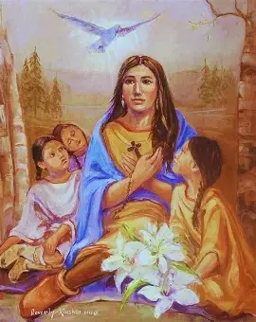
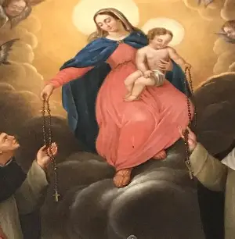
Announcements (1)
Liturgical rosary prayer group sessions:
  Monday, July 14, 2025: St. Kateri Tekakwitha
    8:45 a.m., parish library
      Prayers for Fr. Barrent’s intentions
  Wednesday, July 16, 2025: Our Lady of Mt. Carmel
    4:30 p.m., parish library
      Prayers for Fr. Roux’s intentions
  Tuesday, July 22, 2025: St. Mary Magdalene
    9:00 a.m., parish library
      Prayers for Fr. Barrent’s intentions
Consecration preparation program:
  Wednesday, July 16, 2025
    7:00 p.m., parish hall

Slide 35
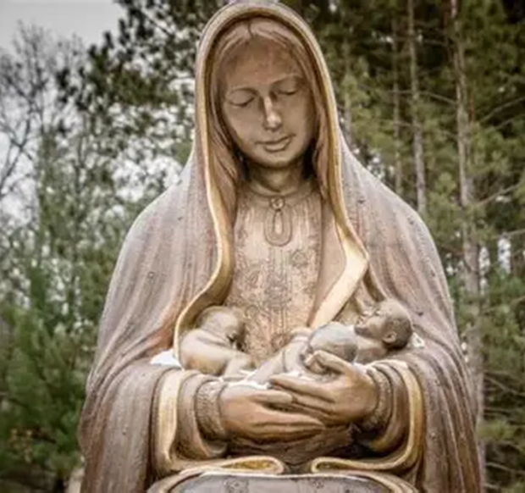
Announcements (2)
Next Two Hearts Guild meeting (8):
  Friday, August 1, 2025, 7:00 p.m., parish hall
Next Seven Sisters Apostolate gatherings:
  Book club meeting 1
    Friday, August 22, 2025, 6:30 p.m., OLV parish library
  Holy hour for vocations & presentation on promoting vocations
    Friday, August 29, 2025
      Eucharistic Adoration: 5:00 p.m., church
      Presentation: 6:00 p.m., parish hall

Slide 36
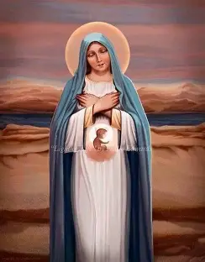
Closing Prayer: Prayer to Mary, Mother of the Unborn
O Mary, Mother of the Unborn, protect the gift of human life which your Divine Son has allowed to be given.
Give strength and joy to all parents as they await the birth of the precious child they have conceived.
Give courage to those who are fearful, calm those who are anxious and guide all of us, with your motherly care, to treasure and protect the miraculous gift of human life.
We ask this through your Son, Jesus Christ our Lord. Amen.
Mary, Mother of the Unborn, pray for Us!

Slide 37
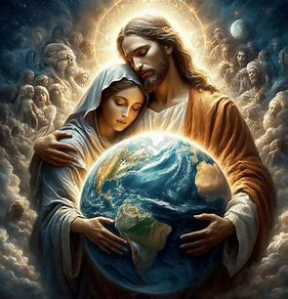
How is spiritual adoption like consecration?
Spiritual adoption is a form of entrustment: we pray for a child in the womb who is in danger of being aborted, asking Our Lady, Mother of the Unborn, to protect them, that they may be born, having the opportunity to live a life for Christ, receive new life in Him, and journey towards the next life with Him. We entrust this soul to Our Lady, petitioning her for her intercession for the child, and the child’s parents; we pray that she would nurture parents, helping them to embrace new life with faith, hope, and love, just as she did
Spiritual adoption is like consecration, in that when we prepare for consecration, we pray to give ourselves to Jesus through Mary; we entrust ourselves to them, and as we prepare, we grow in Our Lady’s womb, becoming more like Christ, so that we may be spiritual twins of Christ, becoming “fruit” of Our Lady’s womb, just like Our Lord, by mirroring His virtues. We are spiritual children of Our Lady, and therefore, through the maternal Heart of Mary, we become closer to those whom we spiritually adopt; we all are given to Our Lady in a special way, through the love of Christ, who entrusted us all to her from the Cross

Slide 38
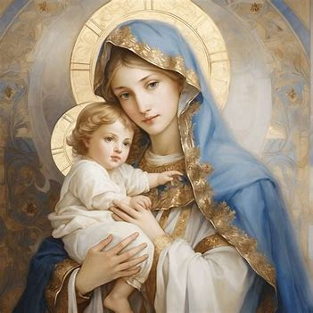
How may we begin anew the spiritual adoption process?
Select a gift bag from the sign-in table, and open it to discover whether you received a Chaplet for the Unborn with blue or pink “Our Father” beads, signifying whether you have adopted a boy or a girl
Name your spiritual child. Choose a first and middle name by selecting two slips of paper from one of the name card baskets (one of which contains girls’ names, and the second of which contains boys’ names)
Complete a spiritual adoption card for our basket of intentions: write the name of the child you have adopted
Bring a personal prayer card home to continue praying for the child you have spiritually-adopted, writing their name on the card to keep with you as you keep your child in prayer, treasuring them in your heart
Pray for nine months daily from Sunday, July 13, 2025, through Monday, April 13, 2026
  Pray for the intercession of Pope St. Martin I and St. Margaret of Castello, on whose feast day the children will be born

