Slide 1
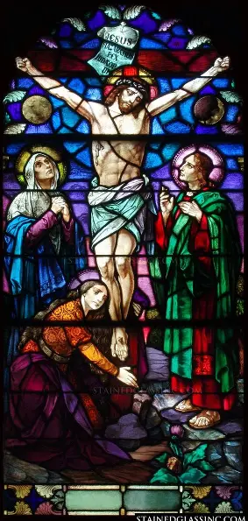
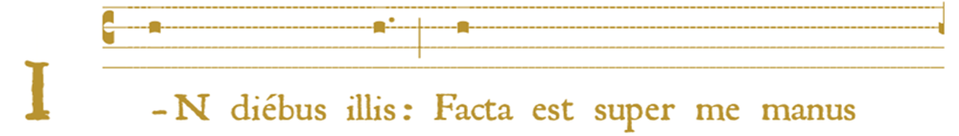

Holy Mass Learning Series Track 2, Session 4
Katie Sadakierski
Tuesday, July 15, 2025

Slide 2
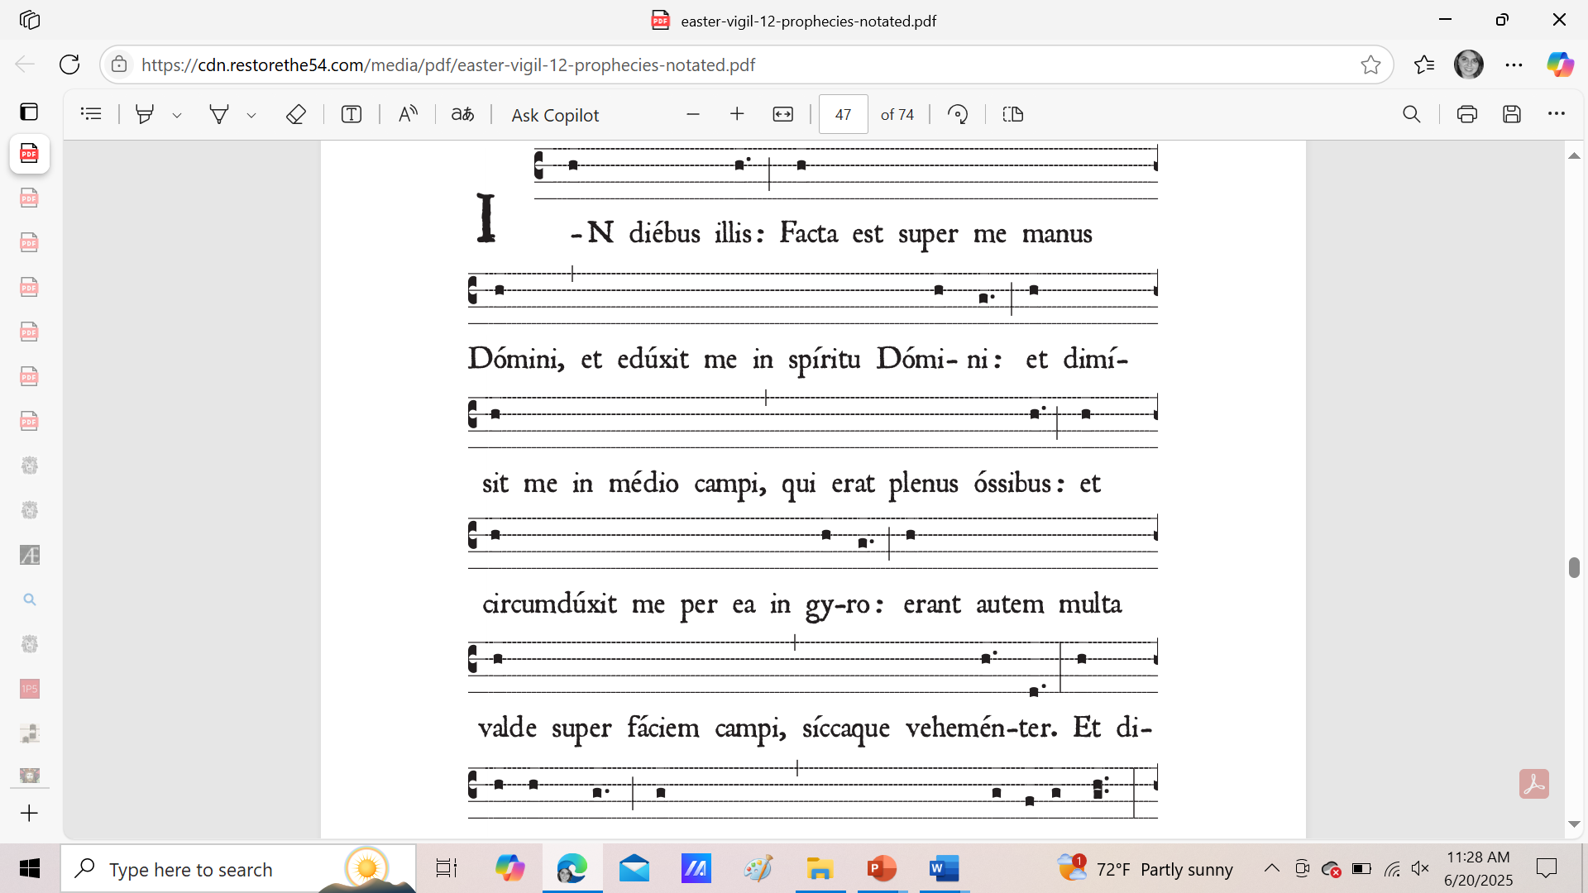
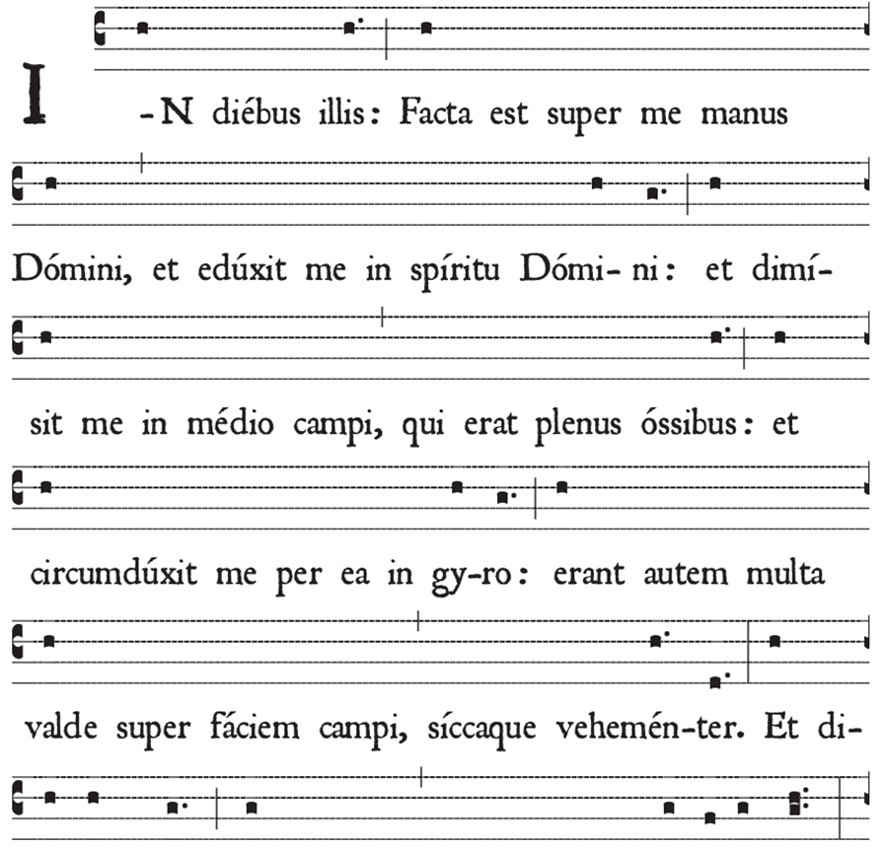
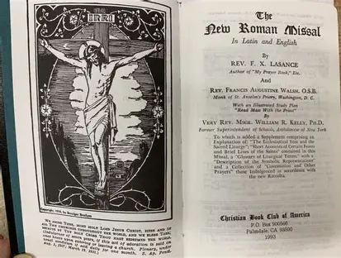

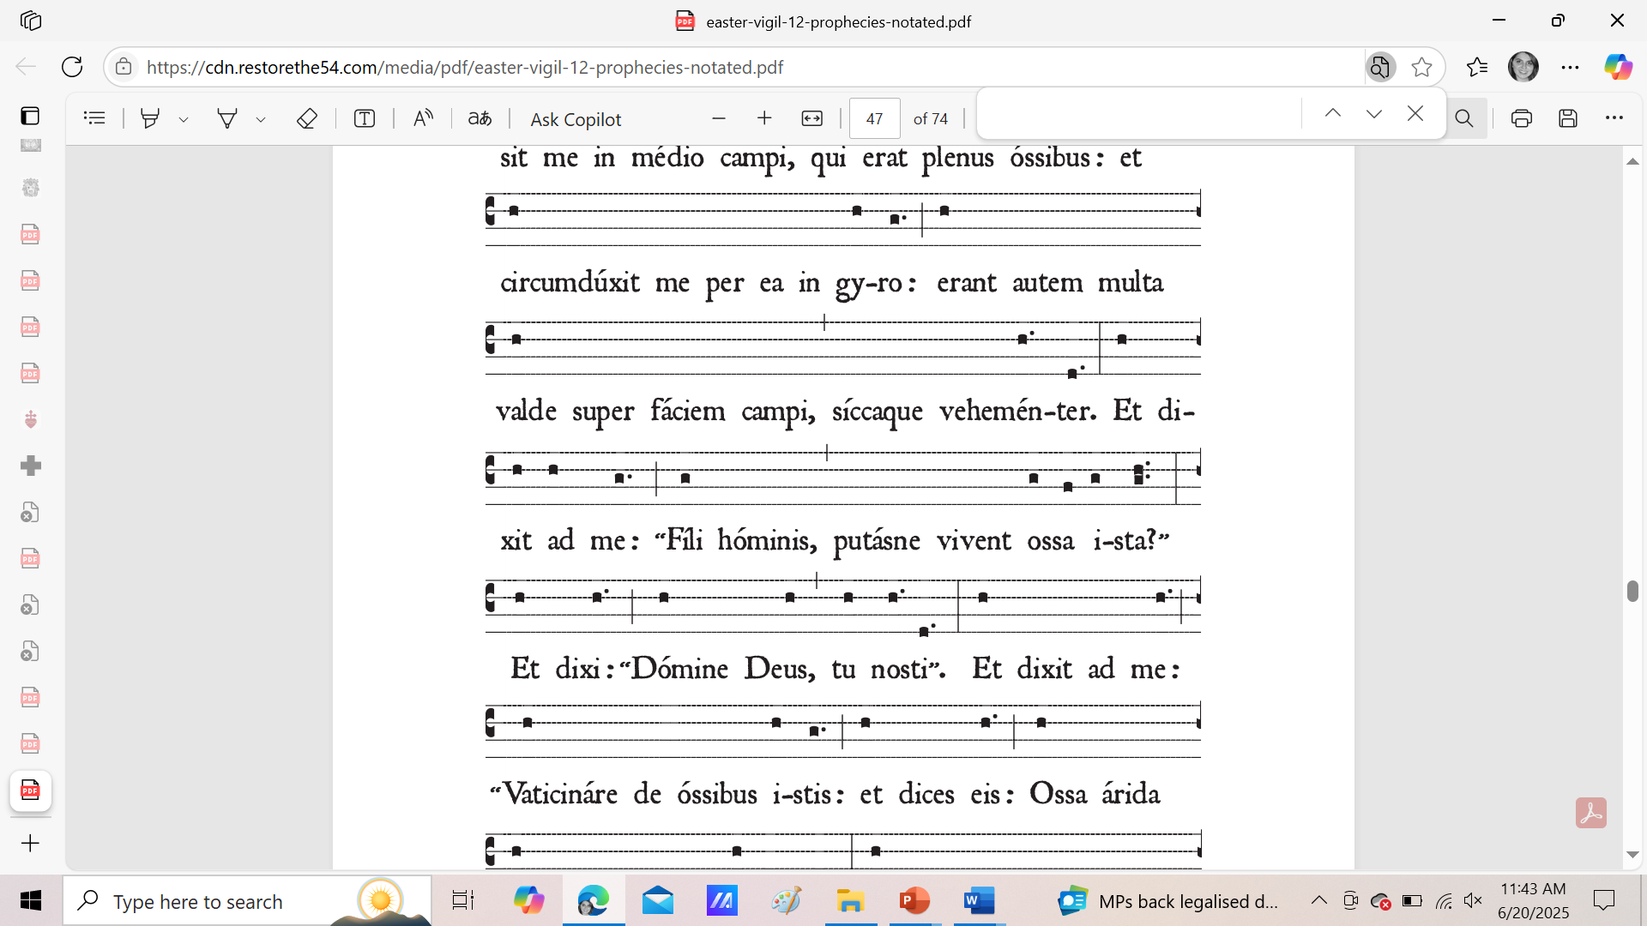
Outline: Track 2, Course 4
Opening prayer
Course outline
Overview of topics
    Father Lasance’s New Roman Missal
    Overview: Father Francis Xavier Lasance’s perspective on the parts of the Holy Mass, as illustrated in the New Roman Missal he compiled
    Advantages of using Fr. Lasance’s New Roman Missal, and the insights this resource provides
Closing prayer
Q & A

Slide 3
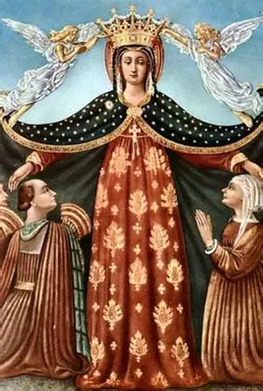
Opening Prayer: Psalm 10 (St. Bonaventure’s Psalter of the Blessed Virgin Mary)
I trust in our Lady; because of the sweetness of the mercy of her name.
Her eyes look upon the poor: and her hands are stretched out to the orphan and the widow.
Seek after her from your youth: she will glorify you before the face of the peoples.
Her mercy will deliver us from the multitude of our sins: and will bestow on us fruitfulness of merits.
Stretch out to us thy arm, O glorious Virgin: and do not turn away from us thy glorious face.
Glory be to the Father..

Slide 4

What is the New Roman Missal?
The New Roman Missal is a handheld missal for use among the lay faithful. It is a dialogue missal that provides all of the Latin liturgical texts with English translations, including the responses for the people. It was printed in 1937, and reprinted in 1945
The New Roman Missal is also colloquially referred to as the “Fr. Lasance” missal, because it was compiled by Father Francis Xavier Lasance
The New Roman Missal contains the traditional readings for the sacred liturgy in the Roman Catholic rite prior to the reforms of 1955: it consists of the readings for the Holy Mass, in additional to supplemental prayers and devotions

Slide 5
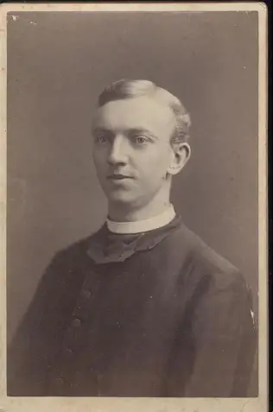
Who was Fr. Lasance?
Father Francis Xavier Lasance (1860-1946) began his ministry as a parish priest, but soon was beset with what would become a serious chronic condition: migraines, severe headaches that would prevent him from serving at a parish
He began to serve the sick as a hospital chaplain, and would also minister to religious sisters. Outside of these particular ministries, Father Lasance would devote his time to writing devotional books for the Catholic faithful.
He is remembered for his many books of prayers centered around certain devotions, such as to the Sacred Heart, the Holy Eucharist, or the Blessed Virgin Mary, as well as guides to living a Catholic life, notably, for boys and girls, which are still printed today
Father Lasance was a talented and impactful writer who was accessible to general audiences, in writing in a clear, instructive manner, while also presenting information in a poetic way that could capture the heart as well as engage the mind; Father Lasance offered a beautiful perspective through which laypeople could understand their Faith, and more deeply pray the Holy Mass
Father Lasance was successful in his endeavors to glorify God, because he lived out the counsels he gave in his guides to living a good Catholic life, and he united all that he did with the sacrifices of Christ, placing himself spiritually on the Cross with Christ during his suffering. As a result, Fr. Lasance is remembered for being a person of hope and good cheer, carrying forward the joyful spirit of the Holy Mass, which is a celebration of new life in Christ

Slide 6
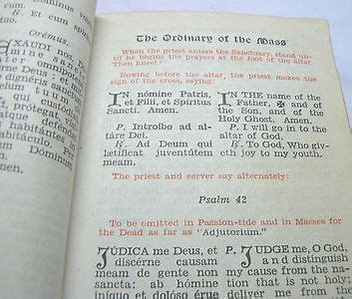
What does the Fr. Lasance Missal contain? (1)
Ordinary of the Mass
Proper of the Season
Proper of the Saints
Common of the Saints
Votive Masses
Marriage Ceremony
Nuptial Mass
Masses for the Dead
Forty Hours’ Devotion
Proper for the United States
Masses for Religious Orders

Slide 7
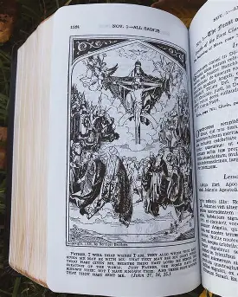
What does the Fr. Lasance Missal contain? (2)
Introduction
A Study Plan
Requisites and Prayers for Holy Mass
Prayers and Ceremonies of Mass
The Ecclesiastical Year and the Sacred Liturgy
Accounts of Feasts and Lives of the Saints
Symbolic Representations
Glossary of Liturgical Terms
The Liturgical Calendar
General Devotions
Index
Notes

Slide 8
How is the layout of the Fr. Lasance Missal different from that of the 1962 Roman Catholic Daily Missal? (1)
Fr. Lasance’s New Roman Missal (1945)
1962 Roman Catholic Daily Missal
Latin texts with their English translations appear together on the same page, side by side
Provides clearer instructions as to what the people should be doing at each part of the Holy Mass
When it is time for Proper prayers to be integrated into the Ordinary of the Mass, it is indicated, and page numbers where the Propers may be found are provided (there is not a table of contents in the missal)
The “Collect” is referred to as “The Prayer”
All of the Latin texts on the left pages; the English translations are on the right
Provides clear rubrics in terms of the postures of the priest, but not for the people
A table of contents is provided in the missal, but in the Ordinary of the Mass, page numbers where the Propers may be found are not provided

Slide 9
How is the layout of the Fr. Lasance Missal different from that of the 1962 Roman Catholic Daily Missal? (1)
Fr. Lasance’s New Roman Missal (1945)
Roman Catholic Daily Missal (1962)
More clearly explains the different roles of the minor orders in chanting the prayers during the Solemn High Mass; i..e, that the epistle is chanted by the subdeacon, and the Gospel by the deacon
Indicates that the Mass rubrics provided are for the Low Mass, but has footnotes with rubrical instructions for the High and Solemn High Masses
Includes additional prayers said for the orations
Includes illustrations of key parts of the Holy Mass
Provides a less clear division of roles among servers at Solemn High Mass; there is not a complete breakdown of differences between the Solemn High Mass, the High Mass, and the Low Mass
Has some information about Solemn High Masses provided in sidebars of text
Does not include illustrations of the priest’s postures during the parts of the Holy Mass

Slide 10
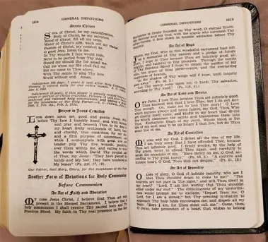
How do the texts of the Fr. Lasance Missal compare to those of the 1962 missal?
The English translations of the Latin differ slightly; there is not a word-for-word correlation
Overall, the same meaning is retained
The Fr. Lasance missal provides more straightforward instruction in encouraging the faithful to participate in the Holy Mass spiritually by praying the vesting prayers that the priest prays before Holy Mass, so that the faithful may prepare for Holy Mass by putting on the garments of Christ, not outwardly like the priest does, but inwardly, so that we may be clothed in Christ’s love, and express that in our outward actions of reverence
The Father Lasance and St. Andrew missals make it more evident than the 1962 missal does what the faithful should be praying and doing at each point of the Holy Mass in order to deeply participate in the sacred mysteries with Christ; there are also many prayer resources for the faithful to use to help them to prepare to receive God’s grace, such as prayers for specific virtues, and to one’s patron saint, so that we will keep reaching out to our heavenly friends to help us to honor Christ well at the heavenly wedding feast of the Lamb, and be united with the Church Triumphant, the Church in Heaven
  The 1962 missal further captures the spirit of change afoot in the wake of the Vatican II council, with a greater emphasis on accessibility and community; there are prayers for children in the 1962 missal to help them to develop a friendship with Our Lord, which adults may read, too, to understand the humble childlike trust and wonder that we are called to have at the Holy Mass

Slide 11
What is unique about how the Fr. Lasance missal addresses the “Asperges Me?” (1)
Fr. Lasance’s New Roman Missal (1945)
Roman Catholic Daily Missal (1962)
Specifies that the priest will sprinkle with holy water the altar three times, then himself, his assistants, and the congregation; fully captures the Trinitarian aspect of the ritual
Notes that the “Gloria Patri” during the sprinkling rite is omitted on Passion Sunday and Palm Sunday
Includes the names of the psalms chanted during the sprinkling rite (Psalm 50)
Reprints lines of the antiphons in full
Specifies that the people should be seated while the celebrant vests for Mass after the sprinkling rite (the celebrant entered the church in the alb and stole, sometimes, the cope as well; now, he will put on the chasuble)
Does not specify that the priest will sprinkle with holy water the altar, himself, the assistants, and the congregation, or how many times
Does not note that the “Gloria Patri” is omitted on certain days
Does not include the names of the psalms chanted during the sprinkling rite
Does not reprint the antiphons in full when they are repeated
Does not specify that the people should be seated while the priest vests

Slide 12
What is unique about how the Fr. Lasance missal addresses the “Asperges Me?” (2)
Fr. Lasance’s New Roman Missal (1945)
Roman Catholic Daily Missal (1962)
At the conclusion of the sprinkling rite, the priest prays to God the Father: “send down from heaven Thy holy angel, that he may watch over, foster, safeguard, abide with and defend all who dwell in this house.”
This translation suggests permanence; that we are meant to pray and live out the Holy Mass well, so that we may come to our true home in Heaven, and remain there forever
At the conclusion of the sprinkling rite, the priest prays, “send Thy holy angel from heaven, to guard, cherish, protect, visit, and defend all that are assembled in this place.”
This translation suggests that the people are visiting the church for Mass temporarily; they are gathered in a space together. It is not communicated so clearly that they live in Christ’s Heart as members of the Mystical Body, the universal Church

Slide 13
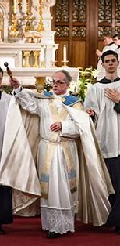
What is unique about how the Fr. Lasance missal addresses the “Asperges Me?” (3)
The St. Andrew missal tends to emphasize how we express contrition in the Holy Mass. Dom Lefebvre points out all of the prayers that are sacramentals, like the “Confiteor,” absolving us of venial sins, and reminding us to renew the graces of our Holy Baptism, that we may receive Our Lord at Holy Communion with pure hearts; Dom Lefebvre mentions that the sprinkling with holy water, the aspersion, is a Jewish custom, and a sacramental; he also provides the reminder that each church has its own guardian angel, encouraging us to pray to our personal guardian angels, as well as all of the angel guardians who watch over us, to keep our souls pure, that we may adore Jesus in the Holy Eucharist like the holy angels do
The Fr. Lasance missal does not provide historical notes on the “Asperges Me,” but begins its commentary with the preparatory prayers at the foot of the altar that follow it, since this is understood to be the official part of the Holy Mass (when the priest removes the cope, the cloak over the chasuble, indicating that he will now celebrate the Holy Mass, since the cope is only worn outside of the Holy Mass)
The St. Andrew Missal and the Fr. Lasance missal both identify the first part of the Holy Mass as being a dedicated preparation period for us, lasting from the Asperges Me to the Gloria; we begin with contrition, that we might end in glory. However, only the St. Andrew missal divides the parts of the Gloria with headers to show which parts are dedicated to each Person of God in the Holy Trinity; we can more clearly see the symbolic meaning of the prayers of the Holy Mass through the St. Andrew Missal commentary and formatting
The St. Andrew Missal is clearer in communicating that our preparation is not encompassed only by the prayers at the foot of the altar, but that the whole of Mass is a preparation for Holy Communion, as we prepare to receive Christ after being cleansed by His Precious Blood of our sins; we understand preparation as meaning purification through Dom Lefebvre’s perspective

Slide 14
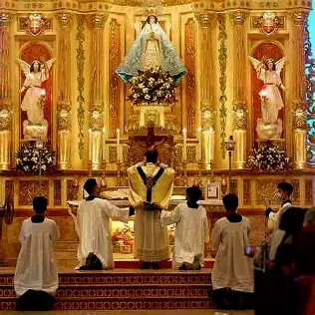
What is unique about the Fr. Lasance missal’s commentary on the Introit and Collect?
Father Lasance explains that the word “Introit” means “he who enters.” This prayer is not only an introduction to what the spiritual theme of the Holy Mass will be, but refers to the fact that, in the past, this prayer would be chanted by the choir as the priest processed into the Holy Mass, so it was sung literally as the priest was entering; this was the introduction to the Holy Mass
The Fr. Lasance missal indicates that, not only are there three distinct parts of the Collect prayer (the praise of God, the petition, and summary), but that in the third line, the Three Persons of God are always invoked. This missal also makes the progression between the Introit and the Collect, the thematic continuity, clearer, in showing us that after the priest enters at the Introit, we are invited to enter in the Collect prayer, the collected prayers of the people, when the priest gathers up our petitions, and invites us to pray; we are called to welcome God into our hearts, to receive the introduction to Himself that He is giving to us, so that we may understand His Heart of love, and how deeply His Heart feels for us

Slide 15
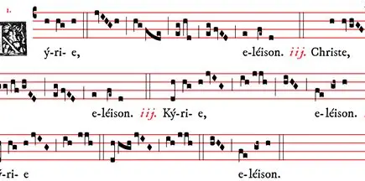
What is unique about how the Fr. Lasance missal describes the “Kyrie Eleison”?
The St. Andrew Missal emphasizes the number of invocations in the “Kyrie,” pointing out that there are nine invocations. The St. Andrew missal helps us to appreciate the presence of the nine ranks of holy angels at Mass, whose prayer of adoration for Our Lord we will then echo in the “Gloria,” and whose intercession we pray for in the Confiteor, and the incensing of the altar
The St. Andrew Missal points out that when the priest incenses the altar at the beginning of Holy Mass, and we call down God’s mercy, we pray to be blessed by God, Whom we honor by lifting up our prayers like incense, that the holy angels might bear up our offerings to God the Father
Whereas the St. Andrew missal indicates that we continue the prayer of the “Kyrie,” the “Lord have mercy” when we pray the “Gloria,” praising God for His mercy, the Fr. Lasance missal points out the contrast between the two prayers, helping us to appreciate that we must feel sorrow and contrition for our sins, recognizing the need for God’s mercy, before we can fully rejoice; then, we see how God has been with us, uplifting us through our crosses, we can more wholeheartedly thank Him and adore Him, giving glory to Him for His goodness and mercy; Fr. Lasance expresses that we not only continue the prayer of the “Kyrie” with the “Gloria,” but that we deepen it, building upon each part of the Holy Mass as we grow with Jesus, in love for God the Father; we begin Holy Mass by remembering why Christ came from Heaven, in order to save us from our sins; then we celebrate His Btrth; and by the end of Holy Mass, are celebrating His Resurrection, and looking forward to our rebirth in Heaven, that we may join the Risen Lord in eternal glory; the St. Andrew Missal more clearly indicates that at this time, the faithful are to respond with acts of contrition, prayers of sorrow for past sins, in order to repair our friendships with God, and enter into His Kingdom like the saints

Slide 16
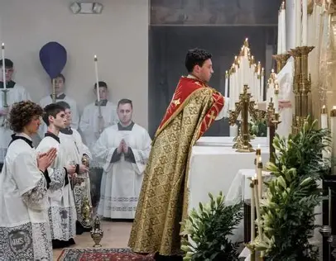
What is unique about how the Fr. Lasance missal describes the Epistle and the Gradual?
The Father Lasance missal explains that the reading of Scriptural texts is a tradition dating back to the early Church, saying that these reading of lessons from Sacred Scripture in public was a practice in the Temple
The Father Lasance missal comments on practical aspects of the arrangement of the Holy Mass, too, noting that the “Gradual” was introduced to engage the faithful in between the Epistle and Gospel; it is two verses of psalms chanted by the choir, since the people enjoyed hearing the singing, whereas the full psalm used to be read by the deacon
Father Lasance writes that the “Alleluia” is said twice at the end of the Gradual, but not during the penitential season of Lent; “Alleluia” means “praise the Lord”
From the St. Andrew Missal, we have a stronger sense of how the Epistle factors into the second part of the Holy Mass, the instruction period, ranging from the Collect to the Creed, as the St. Andrew Missal points out how this part of the Holy Mass is Christ teaching us, speaking to us through Sacred Scripture, just as He preached to the apostles and disciples, instructing them in how to worship God the Father and live good lives for His glory; the St. Andrew Missal also more clearly indicates that at this time, we are to respond with acts of faith in Christ’s teaching, prayers expressing that we believe in what He instructs

Slide 17
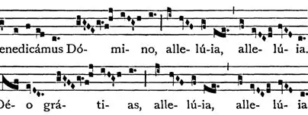
How does the formatting of the Gradual prayer differ between the Fr. Lasance and Roman Catholic Daily Missals?
Fr. Lasance’s New Roman Missal (1945)
1962 Roman Catholic Daily Missal
The Alleluia (when proper to the season) is integrated into the Gradual, not listed separately
The Alleluia prayer is listed separately from the Gradual prayer

Slide 18
How does the ritual of the Prayer before the Gospel differ between the Fr. Lasance and Roman Catholic Daily Missals?
Fr. Lasance’s New Roman Missal (1945)
1962 Roman Catholic Daily Missal
At a Solemn High Mass, the deacon asks the priest for a blessing after the priest has read the Gospel quietly to himself; this is in preparation for the deacon to chant the Gospel reading
The deacon asks the priest for a blessing before the Gospel is read

Slide 19
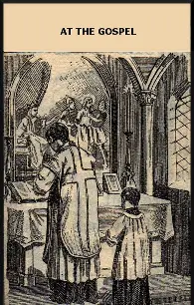
What is unique about the Fr. Lasance missal’s commentary on the Gospel?
Father Lasance writes that the Old English word “Gospel” comes from “god” meaning “good” and “spell,” meaning “speak,” so to proclaim the Gospel is to speak the good news of God, to spread the message of His love, which we are empowered to do through receiving God’s love in Holy Communion; we hear the written word of God spoken aloud to sustain us with His love, then we learn how to live it out through Sacred Tradition, through the sacrament of the Holy Eucharist, when we receive the Word made Flesh, and come to embody Christ’s spirit through union with Him
In the past, longer texts were read, but eventually, in the fourth century, key passages were chosen by Pope St. Damasus, and compiled into a book for liturgical use; separate volumes of psalms, epistles, and liturgical instructions for the celebrant were compiled as well, until all were eventually combined into the missal
During the Gospel, catechumens would leave; they would not remain for the Gospel, sermon, Creed, and Mass of the Faithful until having been baptized

Slide 20
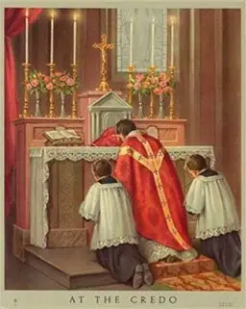
What is unique about the Fr. Lasance missal’s commentary on the Creed?
In the days of the early Church, when candidates for the sacraments of initiation, namely, Holy Baptism, were learning about the Faith, they could not hear the “Creed” until after they had passed their examinations, called the “scrutinies.” Only after having been approved, could they learn the prayer, and then profess the beliefs stated within it
In the fourth century, the Nicene Creed was developed to directly oppose heresies and affirm the Truth of Church teachings. Before that, the Apostles’ Creed was used exclusively in the liturgy
The Saint Andrew Missal divides the Creed into sections, distinguishing which parts honor each Person of God, and indicating that when one genuflects during the Creed, it is to adore the Word made flesh, similarly to the Last Gospel; we have a sense here of the unity between the parts of the Holy Mass, a unity made possible through the Holy Trinity

Slide 21
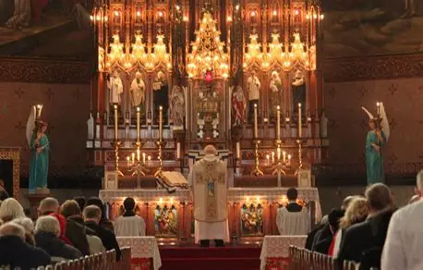
What is unique about the Fr. Lasance missal’s commentary on the Offertory?
Father Lasance writes that a psalm was sung at this part of the Holy Mass as the faithful walked to the sanctuary to bring up their offerings
In the St. Andrew Missal, Dom Lefebvre writes that at this point, we may, in spirit, place ourselves on the paten that the priest uplifts, preparing ourselves to be united with the consecrated Christ, that we may make ourselves good offerings, taking ourselves up to the altar with Christ on a spiritual level; in this third part of the Holy Mass, from the Offertory to the Preface, we offer acts of self-surrender and oblation

Slide 22
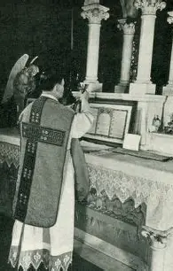
What is unique about the Fr. Lasance missal’s commentary on the Offering of the Chalice?
At a Solemn High Mass, the Fr. Lasance Missal points out, the subdeacon would receive the paten from a deacon, and cover it with the humeral veil worn over his shoulders (which is usually donned for Benediction of the Blessed Sacrament); he would then go to the foot of the altar steps, standing behind the priest, and covering his eyes with the paten; this expresses reverence for the humility of Christ, Who is veiled in the Host; we pray to be worthy to look upon His Holy Face. Spiritually, in union with the subdeacon, we imitate the holy angels in covering their faces before God
An image of the arrangement of the altar in the Fr. Lasance missal depicts eight sacred items on the altar: the corporal, the Host, the chalice, the pall, the burse, the purificator, the paten, and the chalice veil; eight is the number of infinity; if we are to gain Heaven, then we are to pray to have hearts like Christ, hearts of order, balance, and harmony, in which all of the virtues are arranged as flowers to please God the Father
In the St. Andrew Missal, this image of the altar arrangement lists six different categories of sacred items, grouping the corporal, host, and chalice together as one, then listing the burse, pall, purificator, chalice veil, and paten separately; it gives a greater sense of the unity of the offering, and the union we are to have with Christ, the immaculate Bread, in offering ourselves with hearts of pure love for God the Father

Slide 23
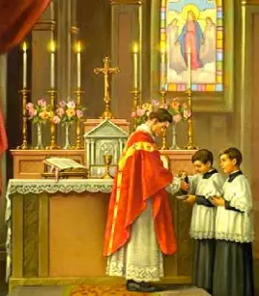
What is unique about the Fr. Lasance missal’s commentary on the Secret prayer?
Father Lasance writes that the “secret” prayer is said in a “secret” voice, that is, inaudibly, because this prayer is said directly from the priest to God the Father; he speaks on behalf of the people; the priest has exclusivity with God the Father, being another Christ, so he spiritually goes to the mountain alone to pray to the heavenly Father, bringing the petitions of the people in his heart
The Saint Andrew Missal provides a different insight, explaining that there used to be so many offerings for the Sacrifice given by the faithful, that not all of them could be brought up to the altar, and had to be set apart, so the name of the “Secret” prayer comes from the Latin for “prayers over the oblations set apart,” the “oratio super secreta”

Slide 24
What is unique about the Fr. Lasance missal’s commentary on the Commemoration of the Church/Commemoration of the Living?
The Fr. Lasance missal points out another threefold prayer said in honor of the Blessed Trinity, in the form of the commemoration of the Church: we pray that through Our Lord, Jesus, God the Father would receive and bless the gifts, presents, and sacrifices being offered to Him; we are called to offer all of ourselves, our sacrifices, our gifts, and presents, that we may embody the love of the Blessed Trinity, and receive it fully into our souls, going forward to radiate this light into the world, and bring others to eternal life in the Trinity, which we receive in Holy Communion; we humbly offer in thanksgiving the gifts given to us by God, offering the presents back to Him, that we may receive the True Presence of Christ humbly and gratefully; and we anticipate the unblemished sacrifice of the Lamb of God to be made
This gives us a sense of the spirit of consecration and oblation that we are to have in this fourth part of the Holy Mass, spanning form the Preface to the “Pater Noster,” going with Jesus into Jerusalem, to share in His suffering and His eventual glory. At this time, we offer prayers of gratitude and hope, knowing that our offerings, when united with Christ’s self-gift, transcend us, and may be made pleasing to God the Father, that we may be healed by Him, and given new life
The names of the living people for whom the fruits of the Holy Mass were being offered were written on tablets called “diptychs,” and read aloud at this point, as the St. Andrew Missal mentions; we carry these names in our hearts as we pray; we are also reminded of the Ten Commandments written on the tablets given to Moses, as we pray to live them out, and worthily receive Our Lord in Holy Communion; Jesus calls us to live with love, as He does, so that we may fully receive the graces from His love in Holy Communion, and come to live eternally with Him in Heaven; we are reminded that our names are written on Christ’s Heart, for He continues to make intercession for us; He has not forgotten us, in His love and clemency

Slide 25
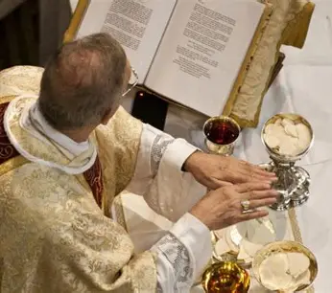
What is unique about the Fr. Lasance missal’s commentary on the Hanc Igitur?
Both the Fr. Lasance and St. Andrew Missals mention that the priest spreads his hands over the offerings in imitation of Old Testament priests who did likewise with the victims being sacrificed on their altars; however, the St. Andrew Missal elaborates that, whereas Old Testament priests offered vicarious sacrifices, Christ is fully Priest and Victim, so when the priest spreads his hands over the offerings as the bell is rung, it is to signify that Christ consecrates Himself to God the Father as a Sacrifice for us, offering Himself for us, in reparation for our sins, and cleansing us with His Precious Blood

Slide 26
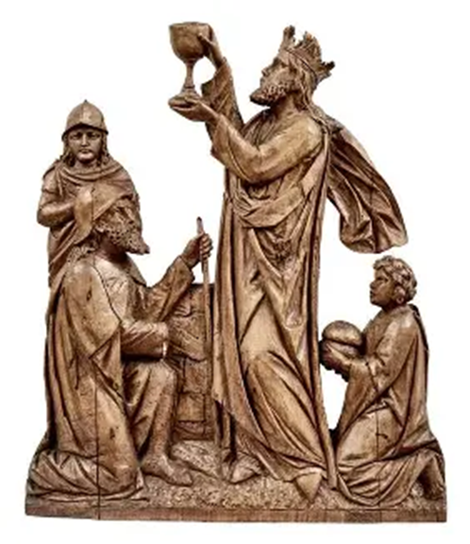
What is unique about the Fr. Lasance missal’s commentary on the Consecration and Elevation of the Host?
During the consecration, Fr. Lasance writes that we are spiritually gathered in the upper room, preparing to receive Our Lord
The Fr. Lasance missal makes mention of the fact that as the Host was elevated, in the Middle Ages, the people would jostle each other to see Jesus; the St. Andrew Missal mentions that the Host was elevated to undo the effects of heresy, that heretics may look upon the Body of Christ, and be healed, as the priest raises the Eucharistic King, Christ, Who is the sovereign Priest of the world, ruling Heaven and Earth, prevailing over darkness, sin, and death as He is uplifted from the Cross, into Heaven, to help His people transcend their crosses, and be raised to Heaven with Him
In the Fr. Lasance missal, we read that the altar bell was rung to remind the faithful to prepare themselves for Holy Communion (three times, for each Person of God to be received in the Holy Trinity), and that the church bells were tolled to remind the faithful working in the fields to unite their works with the saving work of Christ, His Sacrifice
The altar servers were directed to lie prostrate on the ground, like Christ on His Cross, showing total reverence and humility towards Him, until the “Our Father”

Slide 27
How does the catechetical material on the consecration and elevation differ between the Fr. Lasance and Roman Catholic Daily Missals?
Fr. Lasance’s New Roman Missal (1945)
Roman Catholic Daily Missal (1962)
Provides the response that the people should pray interiorly during the elevation of the Sacred Host (saying in their hearts, “My Lord and my God,” rather than praying out loud); lists information about the indulgence to be gained from this practice
This explicit instruction to echo St. Thomas the Apostle’s words of faith in our hearts is not given

Slide 28
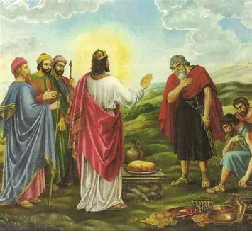
What is unique about the Fr. Lasance missal’s commentary on the Prayers after the Consecration?
Both the St. Andrew Missal and Fr. Lasance missal mention that in the prayers after the consecration, the priest prays that the sacrifice would be acceptable to God, just as sacrifices made to Him by Old Testament figures, such as Melchizedek and Abraham, were
The Father Lasance missal explains that Melchizedek, Abraham, and Abel were Old Testament types of Our Lord, figures hinting at Jesus’ coming: Melchizedek offered the bread and wine just as Jesus offered His Body and Blood, instead of animal sacrifices customary to the time; Abraham was willing to offer His only Son as a sacrifice to God, just as God the Father sent His only Son, Jesus, to be sacrificed for us; and Abel was killed out of envy by his brother, Cain, just as Our Lord was killed by those who envied and despised Him for His innocence and goodness
All of these sacrifices speak to God’s love for us, as Jesus was a greater sacrifice than any of those in the Old Testament, so we pray to offer ourselves in union with the Sacrifice of Christ

Slide 29
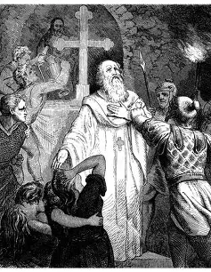
What is unique about the Fr. Lasance missal’s commentary on the Commemoration of the Departed?
We read in the Fr. Lasance missal that the departed are commemorated with a threefold prayer (in honor of the Holy Trinity, as a petition that the souls will soon be in the Heaven of the Blessed Trinity), so that refreshment, relief from suffering, and release into Heaven, may be given to the holy souls in Purgatory; we pray for light to be granted to them, meaning that we pray that they may look upon God’s Face in the light of glory, in Heaven; we pray for their peace as they are being purged of their sins, and awaiting Heaven, looking to the Lamb of God to help them, in bringing His peace, an eternal peace that only He can give, for peace only comes from union with Christ, the union that we have when purified of sin
We read that these prayers were inscribed on the stones in the Catacombs by early Christians; they were united in suffering with the holy souls, and prayed for them with compassion, that they may soon be all united in Heaven together
We also learn that fifteen canonized martyrs are invoked in the prayer following, as we pray to be like the martyrs in loving Jesus, the greatest Martyr, and immolating ourselves with Him; the priest begins the prayer with three audible words, “To us sinners,” before speaking inaudibly; this is a reminder that we must die to sin to rise with Christ, as spiritual martyrs united with Him in the sacrifice
The Saint Andrew Missal mentions that in the past, the names of the dead were written on tablets that were read aloud in the invocations; these tablets were called “diptychs,” similar to “triptychs,” on which three connected scenes are painted

Slide 30
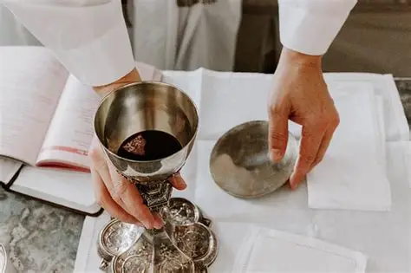
What is unique about the Fr. Lasance missal’s commentary on the Breaking of the Host?
Father Lasance writes that the breaking of the Host is in union with Christ, Who broke the bread and blessed it, and that after the Host is broken, the particle is placed into the chalice. This represents that Christ’s Body and Blood are united, glorified, so that we receive all of Christ when receiving Him under one species, the Sacred Host. Whereas the separate consecration of the Host and Chalice signify Christ’s Death, recalling to us that natural death is the separation of body and soul, the commingling of the Body and Blood when the Host particle is placed in the Chalice represents the Resurrection, when Jesus is glorified, and comes to raise us to new life, that we may be healed of brokenness, and made one with Him
In the St. Andrew Missal’s commentary on the fraction of the Host, Dom Lefebvre writes that the Host is broken into three particles. This recalls the unity of the Three Persons of God in the Trinity, Who are totally whole, totally Present, even in fractions of the consecrated Host; the priest makes the Sign of the Cross three times over the chalice, honoring the Precious Blood of Christ shed for our redemption, and the Body of Christ broken for our sins, to make us whole, and to bring us true peace through spiritual union with the Blessed Trinity; in uniting ourselves with Christ, we become like the peaceful Lamb of God

Slide 31
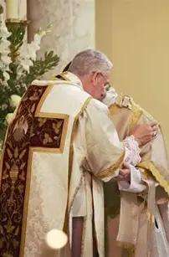
What is unique about the Fr. Lasance missal’s commentary on the “Pater Noster” and the Kiss of Peace? (1)
The Fr. Lasance missal describes the historical roots of the “Our Father” prayer, saying that it has been included even in the earliest forms of the liturgy, for this is the prayer that Our Lord taught His disciples to pray. Father Lasance notes that this prayer is a link to the Sacrifice itself, and an acknowledgment of the sanctification that we receive from it; we learn that we are prepared to receive Holy Communion by petitioning God the Father to receive it worthily, in union with His Son, for He sent us His Son to save us; we pray to Him in humility, as His adopted children
In the Fr. Lasance missal, it is mentioned that the Kiss of Peace used to refer to the priest kissing the Blessed Sacrament itself, giving honor to the Prince of Peace, Our Lord, Jesus Christ, because in receiving the Lamb of God in the Holy Eucharist, we may receive true peace. It also was mentioned that in early times, not only the priest and deacon would exchange a sign of peace after the priest kissed the Blessed Sacrament, receiving Christ’s love to give to others, but that the people would all exchange a kiss of peace, passing it along through the whole assembly; however, men and women were separated in the church (usually seated on different sides)

Slide 32
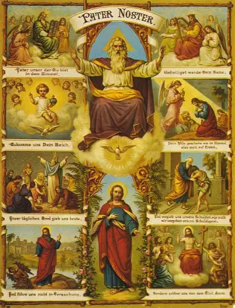
What is unique about the Fr. Lasance missal’s commentary on the “Pater Noster” and the Kiss of Peace? (2)
The St. Andrew Missal does not make mention of historical customs connected to the Kiss of Peace, but does note that we receive the Kiss of Peace from Jesus in Holy Communion, stating that we prepare to receive Holy Communion by reciting the “Our Father,” in which we pray to receive “our daily bread.” This is a prayer for reception of the Holy Eucharist, so it is a prayer to receive God’s love in Holy Communion, that we may share God’s love with others, being brought into deeper communion with God, and with others, to ultimately unite in Heaven, where we will forever be in the peace of the Blessed Trinity; through the graces received from the Body of Christ, we are strengthened as members of the Mystical Body to glorify God in harmony, as the St. Andrew Missal points out; we are praying to be good neighbors who embody God’s mercy when we pray the “Our Father.” We are taking on the spirit of the Lamb of God, a spirit of humility, gentleness, and acceptance that is a reflection of God the Father’s merciful love, when we pray the “Our Father,” and we truly live out the theme of the fifth part of the Holy Mass, “communion,” ranging from the “Pater Noster” to the ablutions, in which we offer acts of love and desire to God, expressing our longing to be with Him, and asking Him to lead us to true spiritual union with Him through the Gift of Jesus’ Eucharistic Heart, a Heart of perfect love

Slide 33
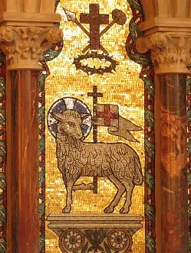
What is unique about the Fr. Lasance missal’s commentary on the Agnus Dei?
Father Lasance emphasizes the tender beauty of the “Lamb of God” prayer, in which we praise Our Lord for His innocence and mercy, petitioning Him to grant us peace by helping us to be made gentle and compassionate through our crosses and sacrifices, just like He was; we pray to offer all to God with serenity, just as Our Lord did; and we come to more deeply adore Christ for His love, His willingness to give His life for us, in going humbly and meekly to be sacrificed for our sins, just like a lamb, not resisting, but choosing to make reparations for us
The St. Andrew Missal holds that when the “Agnus Dei” prayer is said three times, it is to serve as an echo of St. John the Baptist proclaiming Jesus, the Lamb of God, as the Messiah to the Jewish people, telling them that it was the Lamb of God Who would save them by bringing peace through His Sacrifice
We prepare to receive the peace of the Lamb of God by humbly submitting to God the Father, and receiving the sustenance He has given us, the sacrifice of His Son, just as Jesus, the Lamb of God, humbly gave Himself to God the Father to bring about our salvation, consecrating Himself to the Father’s service; we now receive the consecrated One in the consecrated Host

Slide 34
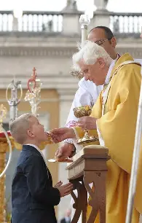
What is unique about the Fr. Lasance missal’s commentary on Holy Communion?
Father Lasance explains that the priest prays in acknowledgment of his unworthiness to receive God before his reception of Holy Communion, because God loves a humble heart of contrition, and will hear with mercy the petitions of humility that come before Him, so we aim to glorify and please God through prayers of contrition
The St. Andrew Missal provides information about the traditions for reception of Holy Communion at an ordination Mass that are rooted in the early Church customs, sharing that the newly ordained priests say “Amen” themselves when receiving Holy Communion at their ordination Mass, whereas the celebrant usually prays over each communicant, saying “Amen” himself. In this way, the new priest expresses the belief and faith in God that flows from his priestly heart, for “Amen” means “I believe”

Slide 35
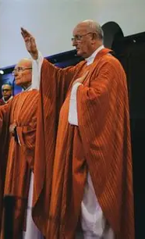
What is unique about the Fr. Lasance missal’s commentary on the Blessing?
The Father Lasance missal indicates that it was not until the tenth century that the blessing was added to the Holy Mass; the custom prior to that was simply to refrain from blessing the people. However, Masses for the dead have kept the traditional custom of not blessing the people
The St. Andrew missal does not include this historical note about the blessing, but it does emphasize the spirit of thanksgiving we are to have at this point, the greatest response we can have to receiving the Holy Eucharist; this is in keeping with the theme of the sixth part of the Holy Mass, thanksgiving, in which the people are called to make acts of gratitude from the Communion to the end, offering their hearts gratefully to God the Father through Our Lord, Jesus, Whom they just received; they offer the Heart of Jesus in their Holy Communion back to God the Father to please Him
  Until the end, we are called to thank God, in every season, for all He gives us is a Gift: Christ is Present everywhere, in everything we experience, so we can thank Him for being with us

Slide 36
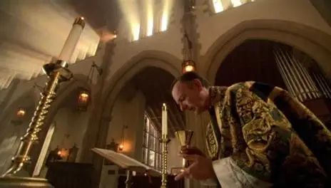
What is unique about the Fr. Lasance missal’s commentary on the Last Gospel?
Father Lasance writes that the Last Gospel is generally the Prologue of the Gospel of St. John, but that on certain feast days, it changes; he specifies that when the Last Gospel changes (and is treated as a Proper), then the priest signs the book, and not the altar
The St. Andrew Missal does acknowledge that on certain feast days, the Last Gospel changes, but does not specify that the priest makes the Sign of the Cross on the book rather than on the altar in these cases; the St. Andrew Missal only points out that the people make the Sign of the Cross on their foreheads, lips, and hearts, just like the priest does at the beginning of the Last Gospel, and that they are called to reflect on their Holy Communion when they genuflect at the line “And the Word was made Flesh.” This reminds the people that we receive the resurrected Flesh of Our Lord, Jesus, Who was born to die for us; in humble love, He took on flesh for us, to help us to become more godly; we are called to imitate Jesus, the Word made Flesh, to be like Him in His charity, that He may keep living in us

Slide 37
How does the language of the prayer before the “Pater Noster” differ between the Fr. Lasance and Roman Catholic Daily Missals?
Fr. Lasance’s New Roman Missal (1945)
Roman Catholic Daily Missal (1962)
“Admonished by salutary precepts”
More powerful language: We are rebuked for our sins; we accuse ourselves of sin now, expressing our contrition and owning up to sin, so that we may be purified and absolved of them, healed by Christ’s mercy; we make bold to say the “Our Father” in order to be saved
“Taught by the precepts of salvation”
Gentler language: We learn from Christ how to live virtuously, in accordance with the Commandments of God the Father, so we pray to Him to help us to receive our daily bread, and become more like His Son, Whom we receive

Slide 38
How do the directives on postures for the end of the Holy Mass/the Leonine prayers differ between the Fr. Lasance and Roman Catholic Daily Missals?
Fr. Lasance’s New Roman Missal (1945)
Roman Catholic Daily Missal (1962)
Directs the people to stand and remain in the pew until the priest has entered the sacristy; the people show reverence until the very end, doing all in union with the priest, who acts on behalf of Christ
Simply states that the people should say the Leonine prayers kneeling

Slide 39
How do the devotions for before Confession differ between the Fr. Lasance and St. Andrew Daily Missals?
Fr. Lasance’s New Roman Missal (1945)
St. Andrew Daily Missal (1945)
Prayer Before Confession
Examination of conscience
Seven Deadly Sins and their Opposite Virtues
Four Sins Crying to Heaven for Vengeance
Nine ways of being accessory to another’s sin
Seven spiritual and corporal works of mercy
Examination of the Ten Commandments
Examination of the Precepts of the Church
Examination of conscience
  Ten Commandments
  Capital sins
Prayer to the Holy Ghost
Confiteor
Reflects on the need for cultivating a spirit of contrition ahead of receiving the sacrament, since this is part of the matter that validates the sacrament

Slide 40
How do the devotions for before Confession differ between the Fr. Lasance and Roman Catholic Daily Missals?
Fr. Lasance’s New Roman Missal (1945)
Roman Catholic Daily Missal (1962)
Reflection before Confession
Prayer before Confession
Examination of conscience
  Ten Commandments of God & examination on them
  Six Commandments of the Church (precepts) & examination on them
  Seven Deadly Sins (and their Opposite Virtues)
  Four sins that cry to Heaven for vengeance
  Nine ways of being accessory to another’s sin
  Seven spiritual works of mercy and corporal works of mercy
  Preliminary examination
Reflection on last Confession: consider whether proper thanksgiving was made for Holy Communion since sacrament was last received
Prayer Before Confession
Examination of Conscience
  The Commandments of God
  The Precepts of the Church
  The Seven Capital Sins

Slide 41
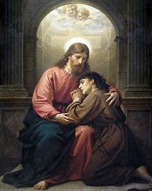
What is the Confession ritual in the St. Andrew Daily Missal?
The priest prays that the Lord would be on the heart and lips of the penitent, that they may rightly confess their sins (similar to the prayer before the Gospel that the priest says, or the threefold blessing of the people before the Gospel is proclaimed at Holy Mass)
The Absolution formula echoes the prayer that the priest says over the communicant at Holy Communion: at Holy Communion, he asks God to preserve the soul “unto life everlasting,” and during the Absolution at Confession, prays that God would forgive the soul and have mercy, bringing them to “life everlasting”

Slide 42
How do the devotions/counsels for after the examination of conscience & Confession differ between the Fr. Lasance and Roman Catholic Daily Missals?
Fr. Lasance’s New Roman Missal (1945)
Roman Catholic Daily Missal (1962)
The penitent is advised to approach the priest in the confessional as he/she would Jesus Christ
Act of Contrition (3 forms)
Invocations (i.e. to Our Lady)
The Confiteor
Thanksgiving after Confession
  “Sacred Heart of Jesus, I trust in Thee.”
Affections and Resolutions Before Confession (after examination of conscience)
Prayer after Confession

Slide 43
How do the devotions/counsels for after the examination of conscience & Confession differ between the Fr. Lasance and St. Andrew Daily Missals?
Fr. Lasance’s New Roman Missal (1945)
St. Andrew Daily Missal (1945)
The penitent is advised to approach the priest in the confessional as he/she would Jesus Christ
Act of Contrition (3 forms)
Invocations (i.e. to Our Lady)
The Confiteor
Thanksgiving after Confession
  “Sacred Heart of Jesus, I trust in Thee.”
Renew contrition while completing penance assigned by the priest at Confession
Ensure that you make satisfaction for your sins after confessing them (satisfaction for sins is part of the matter of the sacrament, needed for it to take effect on the soul)
Recite Psalm 102
Pray the “Sub Tuum Praesidium” prayer to Our Lady (“Under Thy Protection”)

Slide 44
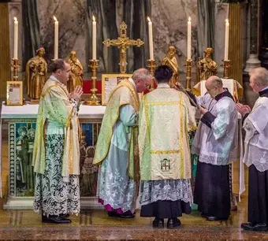
How does the Solemn High Mass compare to the High Mass?
Solemn High Mass
High Mass
Members of the minor orders actively assist at the Holy Mass: a deacon and subdeacon, besides the master of ceremonies and servers
The subdeacon chants the Epistle
The choir chants the Gradual
The deacon chants the Gospel (after the celebrant prays it quietly by himself)
The deacon wears the humeral veil, holding the paten with it from the time of the Offertory to the “Pater Noster.” He holds the paten before his eyes, imitating the holy angels who cover their faces in the presence of God
  Similar to Benediction at Eucharistic Adoration, the humeral veil is worn to signify that Christ is truly Present to bless the people
The priest is not assisted by a deacon and subdeacon; only the master of ceremonies and servers
The celebrant chants all of the Proper prayers
The humeral veil is not worn

Slide 45
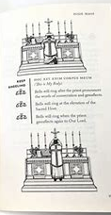
What differentiates the Fr. Lasance missal from other pre-1955 missals? (1)
The Father Lasance missal provides a separate section addressing the significance of each part of the Holy Mass (in English only, without the Latin text), which is apart from the prayers of the Ordinary of the Holy Mass themselves, and helps the laypeople to familiarize themselves with the structure and meaning of the Holy Mass before delving into the unbroken Latin-English prayers of the Ordinary later in the missal. This material is part of the introductory text at the beginning of the missal, whereas other missals, such as the Saint Andrew Daily Missal (1945) or the Roman Catholic Daily Missal (1962), include commentary within the margins, or above, the texts of the Ordinary of the Holy Mass prayers
The Father Lasance missal makes it clear that everyone is called to holiness, and can understand and live out the spirit of the Holy Mass; it is not esoteric in its language, but does not have the same mystical and monastic quality that the Saint Andrew Daily Missal has, which is the best option for a contemplative follower of Christ who is seeking further details on the meanings of the liturgical seasons, the feast days, and how they all interrelate; the Father Lasance missal explains more generally why we participate as we do in the parts of the Holy Mass, but his compilation emphasizes the “what” of the liturgy as a whole more than the “why.” There are solid historical notes in the Fr. Lasance missal concisely illuminating how the parts of the Holy Mass honor traditions of the Church, but the St. Andrew Missal delves more profoundly into our liturgical roots, especially in terms of feast days and the composition of special liturgies for feast day Masses, making it an excellent companion for those who treasure Gueranger’s The Liturgical Year . The Saint Andrew and Father Lasance missals both encourage deep inner participation in the Holy Mass, but the Saint Andrew Missal more clearly recommends how we should offer ourselves to Christ in union with the priest, whereas the Fr. Lasance missal tends to emphasize the action of the priest, and God’s saving action on us, rather than on purely our response, or receptivity, to it

Slide 46
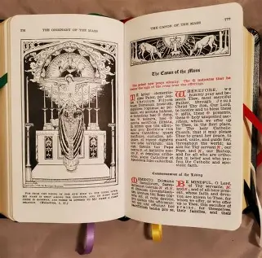
What differentiates the Fr. Lasance missal from other pre-1955 missals? (2)
The Father Lasance missal helps us to become closer to the saints through biographical notes on each represented in the liturgical calendar; he introduces them to us individually, whereas the St. Andrew missal synthesizes information, demonstrating how it all connects, especially in terms of relating to the liturgical calendar; the Fr. Lasance missal also lacks the range of chant notation and Office readings that the St. Andrew missal does, further testifying to the St. Andrew missal’s ability to weave everything together, especially in terms of the Holy Mass itself, and accompanying liturgical devotions, such as the Divine Office
In the Father Lasance missal, there is a clearer distinction made between the commentary and the rubrical instructions themselves; they are not all combined together
The Father Lasance missal divides the Holy Mass into six key parts, just like the St. Andrew missal, but uses slightly different terminology (for instance, the St. Andrew missal calls the “Canon” part of the Holy Mass the “consecration and oblation), and less directly makes connections between the parts of the Holy Mass, and the corresponding parts of Christ’s life; the illustrations in the St. Andrew missal show how Christ is Present in the parts of the Holy Mass, whereas the St. Andrew missal focuses on the minister himself

Slide 47
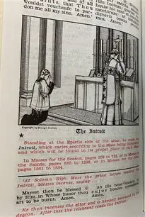
What are some advantages of using the Fr. Lasance missal for personal devotions?
The Fr. Lasance missal is exceptionally well-organized and clearly, cohesively written; it systematically presents information so that it may be easily found and easily interpreted
Its instructive tone, helpful layout, and abundant resources make it an excellent choice for teaching the Holy Mass, and is the perfect reference to share with students. The Ordinary and Proper parts of the Holy Mass are clearly distinguished: the parts of the Holy Mass that change, that are Proper to the season, are marked with stars in the Ordinary section
The Father Lasance missal offers illustrations depicting the action at each part of the Holy Mass, which helps the faithful to understand more deeply what is taking place at each part of the Holy Mass, and how they may respond to it spiritually
  There is a table indicating when the faithful should sit, kneel, or stand during a Low Mass, High Mass, Solemn High Mass, or Requiem (funeral) Mass

Slide 48
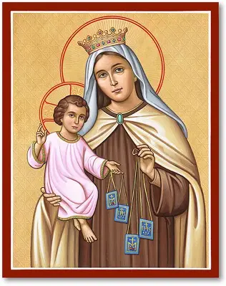
Announcements
Liturgical rosary prayer group sessions:
  Wednesday, July 16, 2025: Feast of Our Lady of Mount Carmel; intentions of Fr. Roux
    4:30 p.m., parish library
  Tuesday, July 22, 2025: Feast of St. Mary Magdalene; intentions of Fr. Barrent
    9:00 a.m., parish library
Summer 2025 Consecration preparation program session 1
  Wednesday, July 16, 2025
    7:00 p.m., parish hall
Holy Mass learning series track 2, session 5:
  Thursday, July 17, 2025
    6:00 p.m., parish hall

Slide 49
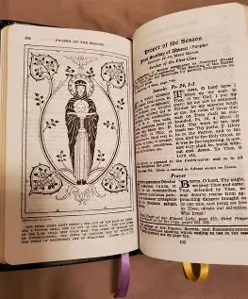
Closing Prayer: Psalm 12 (St. Bonaventure’s Psalter of the Blessed Virgin Mary)
Save me, O Mother of fair love: fount of clemency and sweetness of piety.
Thou alone makest the circuit of the earth: that thou mayst help those that call upon thee.
Beautiful are thy ways: and thy paths are peaceful.
In thee shine forth the beauty of chastity, the light of justice, and the splendor of truth.
Thou art clothed with the sunrays as with a vesture: resplendent with a shining twelve-starred crown.
Glory be to the Father, etc.

