Slide 1
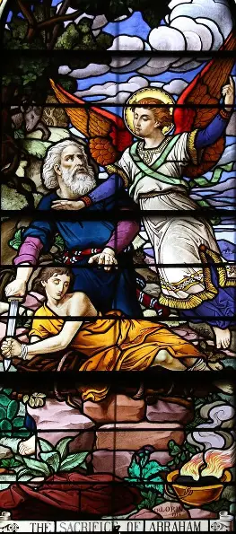
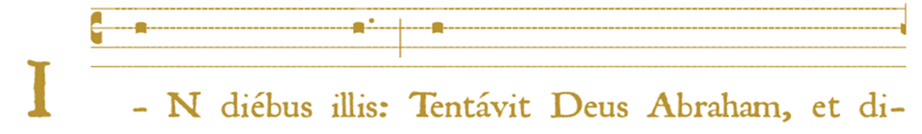
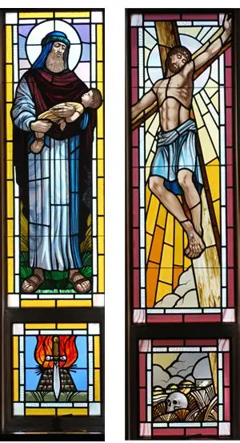
Holy Mass Learning Series Track 2, Session 3
Katie Sadakierski
Thursday, July 10, 2025

Slide 2
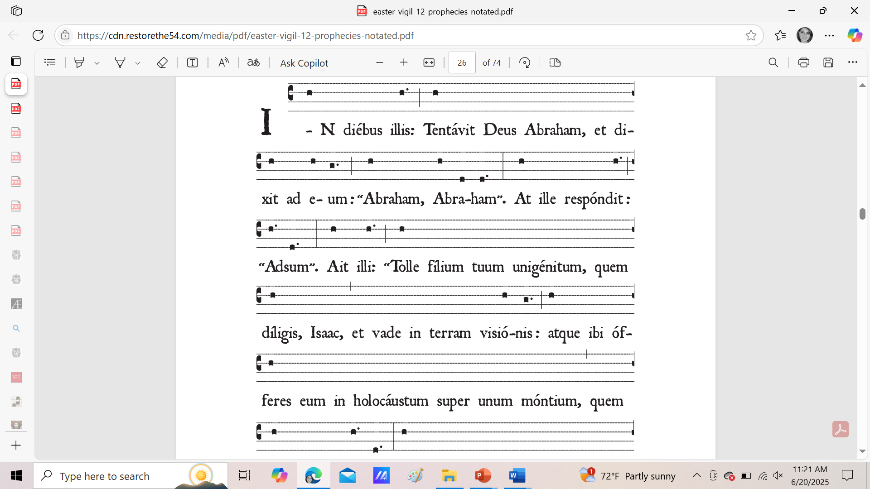
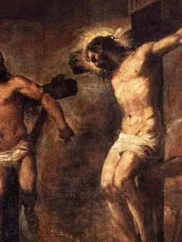
Outline
Opening prayer
Course outline
Overview of topics
  The 1945 reprint of the Saint Andrew Daily Missal as a guide to the pre-1955 liturgy in the Roman rite
    The content and layout of the Saint Andrew Daily Missal compared to the 1962 Roman Catholic Daily Missal
    What the unique features and perspective offered by the Saint Andrew Daily Missal can teach us about the Holy Mass in general
    Why we should use these resources: the advantages of having the Saint Andrew Daily Missal as a reference
Closing prayer
Q & A

Slide 3
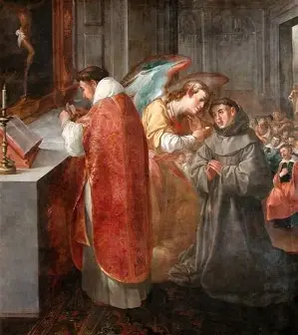
Opening Prayer: Prayer of St. Bonaventure
Pierce, O most sweet Lord Jesus, my inmost soul with the most joyous and healthful wound of Thy love, and with true, calm and most holy apostolic charity, that my soul may ever languish and melt with entire love and longing for Thee, may yearn for Thee and for thy courts, may long to be dissolved and to be with Thee. Grant that my soul may hunger after Thee, the Bread of Angels, the refreshment of holy souls, our daily and super substantial bread, having all sweetness and savor and every delightful taste. May my heart ever hunger after and feed upon Thee, Whom the angels desire to look upon, and may my inmost soul be filled with the sweetness of Thy savor; may it ever thirst for Thee, the fountain of life, the fountain of wisdom and knowledge, the fountain of eternal light, the torrent of pleasure, the fullness of the house of God. May it ever compass Thee, seek Thee, find Thee, run to Thee, come up to Thee, meditate on Thee, speak of Thee, and do all for the praise and glory of Thy name, with humility and discretion, with love and delight, with ease and affection, with perseverance to the end; and be Thou alone ever my hope, my entire confidence, my riches, my delight, my pleasure, my joy, my rest and tranquility, my peace, my sweetness, my food, my refreshment, my refuge, my help, my wisdom, my portion, my possession, my treasure; in Whom may my mind and my heart be ever fixed and firm and rooted immovably. Amen.

Slide 4
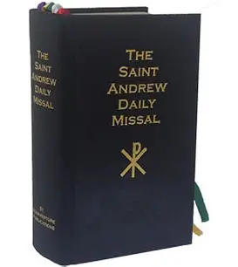
What is the St. Andrew missal?
The St. Andrew Missal is a daily missal for use among the Catholic faithful that was reprinted in 1945
It is named after St. Andrew, whose feast day marks the beginning of the liturgical year. Our liturgical year begins not in January with the calendar year, but with Advent. The date of the first Sunday of Advent is always the first Sunday closest to the feast day of St. Andrew, which is November 30
Saint Andrew the Apostle was the first apostle to bring others to Christ; Christ invited him to come and follow Him. Saint Andrew, the fisherman brother of St. Peter, accepted the invitation, and led his brother to Christ, helping others to respond to Jesus’ call
Saint Andrew teaches us that faith is what allows for new beginnings; he had faith, and through his faith, helped to build up Christ’s Church, which is why we begin our new liturgical year by commemorating him, and imitating his behaviors, being guided by his spirit of openness to Christ, that we, too, may begin anew, helping to lead others to spiritual rebirth in Heaven
This missal honors what we might call the “Easter spirit” of the liturgy, the sense of new beginnings, which we have through receiving new life in Christ in the Sacred Host (the Body of Christ) consecrated at the Holy Mass

Slide 5
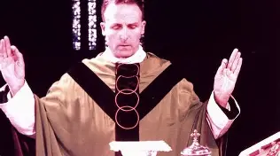
Who compiled the St. Andrew Missal?
Dom Gaspar Lefebvre (1880-1966) compiled the Saint Andrew Missal
Belgian Benedictine monk (related distantly to Archbishop Marcel Lefebvre; prior to becoming a bishop, Marcel Lefebvre went on retreat to Dom Gaspar Lefebvre’s abbey)
  Lived out his vow of poverty to the fullest extent; did not have an office, but worked from his monastic cell, writing on any scrap of paper that he could find, including the backs of envelopes; responded to every letter sent to him
Student of Blessed Dom Columba Marmion
Liturgical scholar
  Growing up, he was influenced by Dom Prosper Gueranger’s The Liturgical Year
  Wrote numerous volumes on the liturgy and liturgical traditions, including books on Our Lady’s connection to the liturgy
First published the Saint Andrew Daily Missal in France in 1920; has been through several printings since then, and translated into multiple languages
Goal was to help people to know, love, and live the Holy Mass; guiding vision was for people to seek sanctification not merely for their own sake, but to praise the Holy Trinity in Heaven

Slide 6
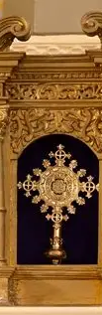
What does the St. Andrew Missal contain?
Vespers for Sundays and feast days; prayers after the Divine Office
Chant notation
Table of moveable feasts
Morning and evening prayers
Meditations on the feast days
The Ordinary of the Holy Mass
Propers for the temporal and sanctoral cycles of the liturgical year
Common of the Saints
Various Collects
Votive Masses
Local feast day readings
List of stational churches in Rome
Ritual texts for the sacraments: Holy Baptism, Confession, Confirmation, the nuptial Mass, burial service, Holy Orders
Litanies and prayers
Index
Liturgical calendar
Supplements for religious orders (i.e. Order of St. Benedict)
Supplement for the Dioceses of the U.S.

Slide 7
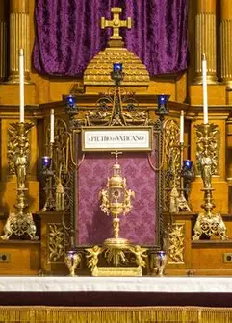
What are stational churches?
Stational churches are churches in Rome that are designated as “stations” for worship on certain feast days
On the appointed feast day, the faithful would gather in one church, then process together, singing the Litany of the Saints or chanting the psalms, to the stational church; this practice was referred to as “making the station”
  Through prayer, we bring ourselves into the presence of the saint being celebrated; we join the communion of saints in honoring the souls who have loved God so wholeheartedly, and who continue to inspire us to do the same
Spiritually, we can still go on these pilgrimages together as we pray the Holy Mass in stages, moving from one Station of Christ’s life to the next

Slide 8
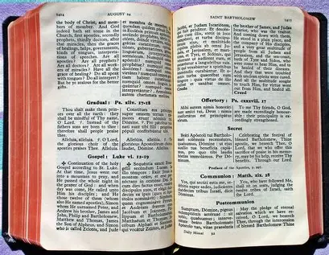
How is the layout of the St. Andrew Missal different from, or similar to, the layout of the 1962 missal?
St. Andrew Daily Missal (1945)
Roman Catholic Daily Missal (1962)
More clearly explains seasonal changes in readings (i.e. the Gradual being replaced by the Alleluia in Paschaltide) within the text of the Ordinary of the Mass
Divides the Holy Mass into six subdivisions
Does not include illustrations of the postures of the Holy Mass for each part
Places the Latin texts with English translations alongside each other on the same page (in two separate columns)
Cues for when to stand, sit, or kneel are provided
Has notes providing deeper insight into the parts of the Holy Mass above the prayer texts for each part, within the same column, and not on the margins of the page
The individual parts of the Holy Mass are not numbered (i.e. each prayer text)
Assumes knowledge of the faithful: simply lists certain Propers of the Holy Mass, and notes that they change “as the season requires”
Divides the Holy Mass into six subdivisions
Does not include illustrations of the postures of the Holy Mass for each part
Places Latin texts on the lefthand pages of the book; places the English translations on the righthand pages of the book (readings and translations are on opposite pages)
Cues for when to stand, sit, or kneel are not provided
Has notes explaining the significance of each part of the Holy Mass in the margins
Individual parts of the Holy Mass are numbered (i.e. each distinct prayer text)

Slide 9
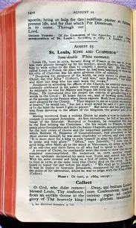
How does the content of the St. Andrew Daily Missal different from that of the 1962 Roman Catholic Daily Missal?
St. Andrew Daily Missal (1945)
Roman Catholic Daily Missal (1962)
Feast days are ranked according to six different categories
Octaves for certain feast days are included (i.e. for Sts. Peter and Paul)
Vigils for certain feast days are included (i.e. All Saints Day)
The Confiteor before Holy Communion is included in the rubrics for the Ordinary of the Mass
Prophecies are included (i.e. for the Holy Saturday Easter vigil Mass)
Designates when Last Gospel changes (indicates which text is to be used in its place)
Lists additional feast days as holy days of obligation in the universal Church (i.e. the Feast of the Epiphany, the Feast of Sts. Peter and Paul, Corpus Christi, and St. Joseph’s feast day)
Saint Joseph is not invoked in the Canon; his name is not included in the text
Feast days are ranked according to four different categories
Does not include octaves for certain key feast days
Does not include vigils for certain key feast days
The Confiteor before Holy Communion had already been suppressed, and is not listed in the Ordinary of the Mass
Prophecies for Holy Week are not included; the reforms to the Holy Week liturgy had been made
The Last Gospel is not a Proper, and does not change; it is only mentioned in the rubrical texts when the Last Gospel is not read
Does not include a list of holy days in the universal Church; some had already been suppressed; only lists holy days by country (English-speaking nations: England, Ireland, Canada, United States, etc.)
St. Joseph is invoked in the Canon; his name is included in the prayer text

Slide 10
How is the St. Andrew Missal layout different from, or similar to, that of the Fr. Lasance Missal?
St. Andrew Daily Missal (1945)
Fr. Lasance’s New Roman Missal (1945)
Does not include illustrations of the parts of the Holy Mass to clarify postures of the priest and people at key junctures of the liturgy, but does offer an illustration for each subdivision to depict how Christ speaks to us through the parts of the Holy Mass at that time
Places the Latin texts with English translations alongside each other on the same page (in two separate columns)
Cues for when the people should sit, stand, or kneel or provided for the parts of the Holy Mass
Refers to the “Collect” prayer as the “Collect”
Includes illustrations of the parts of the Holy Mass to provide instruction as to what the priest and people should be doing at a given moment, but not illustrations of Jesus from Sacred Scripture to draw parallels between how He ministered to His people in His earthly life, and how He ministers to them now through the Holy Mass
Places the Latin texts with English translations alongside each other on the same page (in two separate columns)
Cues for when the people should sit, stand, or kneel or provided for the parts of the Holy Mass
Refers to the “Collect” as “The Prayer”

Slide 11
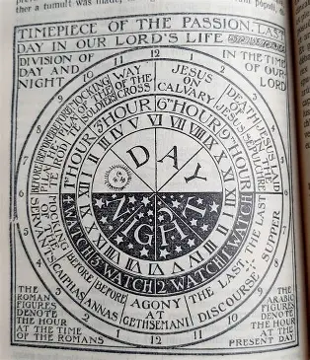
How do the prayers of the St. Andrew Missal compare to the prayers in the 1962 Roman Catholic Daily Missal?
There are many more prayers and devotions for personal use offered than in the 1962 Roman Catholic Daily Missal, especially for before and after Holy Mass/reception of Holy Communion
The full ritual for Confession is provided (including the prayer of absolution), whereas only the penitent’s method of confessing (formula) is provided in the 1962 missal
More information about indulgences to be received from prayers, along with details about the form and matter of sacraments, is provided in the St. Andrew Daily Missal than in the 1962 Roman Catholic Daily Missal
There tends to be more description of what the priest is doing, namely, in terms of the symbolism of each gesture, in the 1962 Roman Catholic Daily Missal, but the St. Andrew Missal is clearer about what the people should be doing and contemplating at each part of the Holy Mass; the St. Andrew Missal offers the richest resources when it comes to meditations on the liturgical year, and the mystical elements of our Faith; the ample chant notation and Mass supplements for religious orders adds an especially monastic element to the St. Andrew Daily Missal. The 1962 Roman Catholic Daily Missal does not have such an abundant array of musical notation and information on chant, i.e. tones, but it does have some texts for Vespers, just like the St. Andrew Daily Missal
The St. Andrew Daily Missal better illustrates the seamless integration between the Holy Mass and the Divine Office; we see how Christ speaks through both of these common prayers of the Church, His Bride; we have a greater sense of the unity between these expressions of His sacred liturgy; the Divine Office sanctifies us through leading us through each hour of the day with Christ, expanding upon our understanding of the Sacrifice of the Holy Mass; the Holy Mass gives us the graces to participate more interiorly and fully in the Divine Office; it prepares us to pray it

Slide 12
Prayers Before Holy Mass/Holy Communion
St. Andrew Daily Missal (1945)
Fr. Lasance’s New Roman Missal (1945)
Recommends praying the prayers that the priest uses (before and after the Holy Mass)
Psalms: 83, 84, 85
Prayer of St. Ambrose
Prayer of St. Thomas Aquinas
Act of Faith, Act of Hope, Act of Contrition, Act of Love
Includes vesting prayer of the priest and the blessing of holy water ritual
An Act of Faith and Adoration
Act of Hope
Act of Love and Desire
Act of Contrition
Act of Humility
“Domine, non sum dignus”
Offering to be Made at the Beginning of Mass
Prayers of St. Ambrose
Offering of Masses for the Dying
Psalms: 83, 84, 85, 115, 129, and antiphon/Oremus
Prayer of St. Thomas Aquinas
Devotions for days of the week (to use before daily Mass)
Prayer to the Blessed Virgin
Prayer to St. Joseph

Slide 13
Prayers Before Holy Mass/Holy Communion
St. Andrew Daily Missal (1945)
Roman Catholic Daily Missal (1962)
Recommends praying the prayers that the priest uses (before and after the Holy Mass)
Psalms: 83, 84, 85
Prayer of St. Ambrose
Prayer of St. Thomas Aquinas
Act of Faith, Act of Hope, Act of Contrition, Act of Love
Includes vesting prayer of the priest and the blessing of holy water ritual
Prayer Before Holy Communion (derived from Psalm 85: an appeal to God’s mercy, beginning with the phrase “incline Your ears”)
Prayer of St. Ambrose
Prayer of St. Thomas Aquinas
Direction of Intention
Commemoration of the Passion of Christ
Act of Faith, Act of Hope, Act of Love, Act of Humility

Slide 14
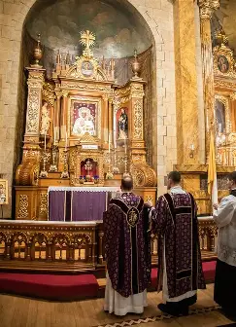
How to Assist at Mass
The Holy Mass is not only about activity, but about receptivity; we receive from Christ, that we may have something to give Him; He loved first, so that we may love back
Our role is to be present, to open our hearts to what Christ is seeking to give to us
Prepare for Holy Mass by reading the vesting prayers of the priest, and interiorly vest yourself, putting on the garments of Christ, that you may offer yourself in union with Him during Holy Mass; clothe yourself in His virtues
Dom Lefebvre says that to participate exteriorly in the Holy Mass, applying the fruits of their contemplation, they may read liturgical prayers with the server aloud (when permissible), singing the chants at High Mass, and receiving Holy Communion, which is the greatest form of participation in the Holy Mass
Dom Lefebvre identifies three steps that the faithful may take to participate interiorly during the Holy Mass:
  Reconstruct the historical context of the part of Jesus’ life that we are commemorating in each stage of the Holy Mass
  Offer to God the fruits of the sacred mysteries in which we spiritually participate
  Ask God for graces, that we may receive them; interiorly pray with the priest

Slide 15
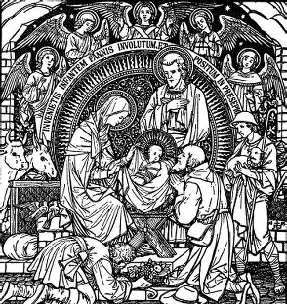
First Part of the Holy Mass
The parts of the Holy Mass from the Asperges Me to the Collect
We spiritually participate in Christ’s Nativity, recalling the first “Gloria” that was sung by the holy angels in praise of Jesus when He was born
We prepare ourselves to welcome the Christ, Who always remained pure and innocent like a child, into our hearts
We focus on opening our hearts to being purified by God; we express contrition to detach ourselves from sin, so that we may receive all of God’s grace most fully into our souls, and be cleansed
  We make acts of contrition to be purified by God’s love

Slide 16
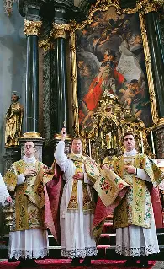
Asperges Me
The priest sprinkles the altar, the clergy, and the people with holy water (the blessing of himself is not mentioned), and prays in a low voice the “Miserere” or “Confitemini” (the quiet tone underscores the humility and contrition to be cultivated at the Holy Mass, as we prepare to receive Our Lord)
The holy water that we are blessed with cleanses us of venial sins, because it reminds us of our Holy Baptism, and of the greatness of God, instilling a stronger spirit of contrition in us, which we need for absolution
Dom Lefebvre writes that the people are sprinkled with water in honor of the Jewish tradition of using hyssop, a healing herb, for sprinkling
  In the “Asperges Me” prayer, we ask that Our Lord would cleanse us with hyssop and purify us
  Hyssop has a sweet smell, but a bitter taste; this reminds us to make up for the bitterness of sin by embracing God’s sweetness, and bringing a loving heart like Jesus’ into all that we do, in order to spread the fragrance of holiness, drawing other people to seek out the Source of the sweetness: Our Lord, Jesus Christ
    We do penance that might at first seem bitter, but when we offer our suffering for Christ, and become more united to His Heart in love, our sacrifices become sweet
    Dom Lefebvre mentions that every church has its own guardian angel, so when the priest prays that God would send His holy angel to protect the church, he is referring to the parish’s own guardian angel; we continue to call upon the holy angels, who are pure spirits, to help us to be purified, and adore Christ like they do

Slide 17
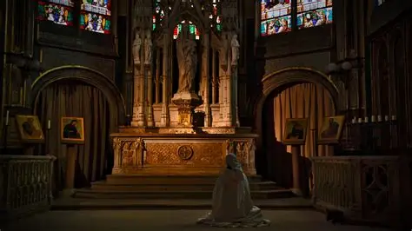
Preparatory Prayers at the Foot of the Altar (1)
The priest makes the Sign of the Cross and says Psalm 42, unless it is a Mass for the Dead or a Mass in the season of Passiontide
  Psalm 42 asks God to deliver us from the unjust and deceitful man; this would not be fitting for a Mass of the Dead, in which the soul has already been delivered from earthly things
Emphasizes that when the server speaks alone, he speaks on behalf of the whole congregation (the spirit of favorability for the dialogue Mass, and exterior participation of all of the people, would increase after 1955)
Dom Lefebvre notes that the public confession, the Confiteor, is a step towards further purifying ourselves. When the priest makes this public statement of contrition, he is witnessed not only by the faithful in attendance at the Holy Mass, but by the Church Triumphant; this captures the full-circle nature of the Holy Mass, and its interconnectedness, the unity that Christ’s Sacrifice brings among His people
He mentions that, like the sprinkling of holy water, called the “aspersion,” the public confession is a sacramental that forgives venial sins
The whole of the Mass is meant to clear away any venial sins, and free us of attachment to sin, so that we may receive Holy Communion in a state of grace, and continue to receive all of God’s graces

Slide 18
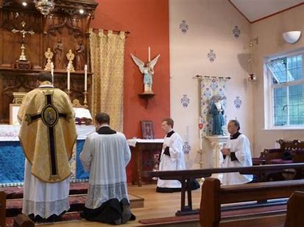
Preparatory Prayers at the Foot of the Altar (2)
Just prior to the Introit, the priest ascends to the altar, continuing the prayer for cleansing from sin
The server kneels on the first step on the left side of the altar (indicating that we all spiritually are striving to ascend the steps to Heaven, and throughout the Holy Mass, are moving in stages closer to Our Lord)
The priest kisses the altar stone holding the relics inside; the altar stone with the relics reminds us that we all are to emulate the saints in imitation of Christ, the original Martyr Who gave His life for our salvation, and Whose Sacrifice we recall at each Holy Mass
  We pray that through the merits of the saints, our sins will be forgiven

Slide 19
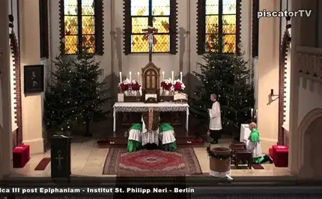
Introit, Kyrie, Gloria
The changing readings during the Holy Mass, the first of which is the Introit, teach us something about how we are to remain pure, in a state of grace, and be forgiven of our sins
The priest offers nine supplications: 3 “Kyrie eleison” prayers to God the Father; 3 “Christe eleison” prayers to God the Son, Who is given a distinct Name, Jesus Christ, to reveal His Mission as the Anointed One Who is God our Savior; and 3 “Kyrie eleison” prayers to the Holy Spirit; there are nine prayers of petition for God’s mercy, in honor of the nine choirs of angels
Dom Lefebvre writes that the “Gloria” is the song of the holy angels at Christ’s Birth; we echo the holy angels in praising God through this prayer, giving glory to Him for His mercy. He answers our prayer for mercy by sending us Jesus, our Savior, to sacrifice His life for us. Just as He laid down in the manger, the Lamb of God is laid down on the altar, offered for our redemption, that we may reach Heaven; we continue the prayer of the “Kyrie” for God’s mercy, that we may remain in God’s grace, and someday join Our Lordi n Heaven to give glory to Him with the holy angels forever
Each Person of the Trinity is praised in the Gloria: God the Father is glorified with the line “O Lord God, heavenly King, God the Father almighty.” God the Son is glorified with the line “O Lord, the only-begotten Son, Jesus Christ.” God the Holy Spirit is glorified with the line: “With the Holy Ghost, in the glory of God the Father.” We continue to pray in preparation to welcome each Person of God into our souls at Holy Communion

Slide 20
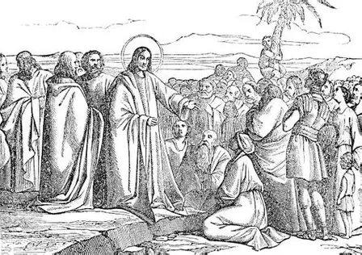
Second Part of the Holy Mass
The second part of the Holy Mass spans from the Collect to the Creed
The first part of the Holy Mass is a time of preparation, when the people readied their souls to receive Jesus by offering acts of contrition, opening themselves to being purified by God. The second part of the Holy Mass is a time for instruction, when the people offer acts of faith, learning about and expressing their beliefs
The second part of the Holy Mass recalls when Jesus preached and taught; we imitate the disciples in learning from Jesus and praying with Him. We listen to what He teaches, so that our souls may be enlightened, filled with understanding that can allow us to love Jesus more, and see the way to Heaven, the Way of Jesus, illuminated

Slide 21
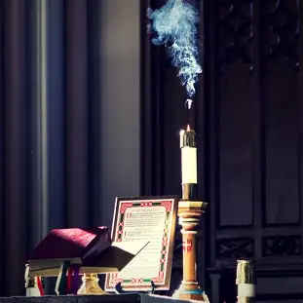
Collect, Epistle, and Inter-lectionary Texts
The priest begins the second part of the Holy Mass by kissing the altar, just as the first part of the Holy Mass began when the priest concluded the preparatory prayers, ascended the altar, and kissed it; he continues to extend Christ’s mercy, His Spirit of love and forgiveness, through the Sacrifice; the altar represents Christ’s Body, so as the priest adores Christ, He shares Jesus’ love with us
The Collect, the collected prayers, help us to reflect on what Jesus, Mother Mary, and the saints teach us; the Collect is a prayer of praise and petition, as we thank God for the lives of His saints, and ask that we would become more like them through God’s grace, so that we may join them in Heaven, and receive God’s love and mercy
The people are seated for the instruction offered through the Epistle; we meditate on what the writers of the epistles, such as St. Paul, teach us about Christ’s love, and what it means to embody this love as His disciples
Between the lessons we receive in the Epistle and Gospel, we have the inter-lectionary texts: the Gradual, which is replaced by an Alleluia during Paschaltide; the Alleluia; or the Tract, which replaces the Alleluia during Lent
  These songs remind us of God’s love; Jesus speaks to us through the psalms; they are songs of His Heart, capturing the entirety of the human condition, which He went through to sanctify and redeem us

Slide 22
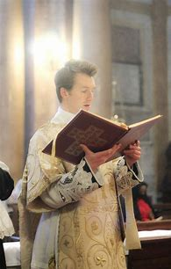
Gospel
The Gospel is the words of Our Lord, which is why the priest reads them; Jesus speaks through His priest
The priest stands at the middle of the altar to pray in preparation for proclaiming the Gospel; he asks God to cleanse his heart and his lips so that he may proclaim the Gospel well
The server carries the missal to the Gospel side of the altar; at the High Mass, the book is placed on the altar after the priest has blessed the incense; he kneels on the top step, asking the priest for a blessing
Kneeling is a gesture of humility: this posture reminds us that we ascend to Heaven, advancing in holiness, by humbling ourselves, like Christ did; we must place ourselves in the arms of Mary, like we remembered Jesus doing in the first part of the Mass; and we are to share what we learn about God’s love, teaching and spreading the good news of God like Jesus did
The priest and the people make a threefold sign of the Cross on themselves, praying for God to come into our minds and hearts, that we may live out the Gospel message, preaching it not only in word, but in action
Dom Lefebvre writes that the Sign of the Cross helps to protect us from evil; it purifies us, as we remember Christ’s pure Sacrifice that He offered out of love; through the Gospel message, we learn from Christ how to live with love, to lead others to spiritual rebirth, and be reborn in Him ourselves
The book is incensed after the Gospel is read at the High Mass; at Low Mass, the server stands by the priest’s right side (like Jesus sitting at the right hand of the Father)

Slide 23
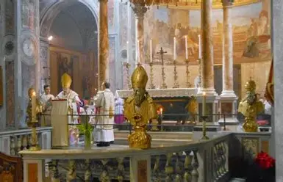
Sermon
The sermon is not an official (required) part of the liturgical rubrics, but it is said on Sundays after the Gospel. Sermons are meant to further the instruction that the people receive, as the priest illuminates minds with understanding of the Gospel message by speaking to them about it
The St. Andrew Missal stipulates that the sermon may be preached only after parish announcements have been made: the priest is to give people notices about upcoming penitential days; requests for prayers for couples to be married, dying or sick parishioners; or those who have passed away
Pastoral letters from the bishop may be read in place of the sermon, or in addition to
We learn from each other, especially in spiritually caring for each other through prayer; we learn Christ’s way of love, compassion, and kindness

Slide 24
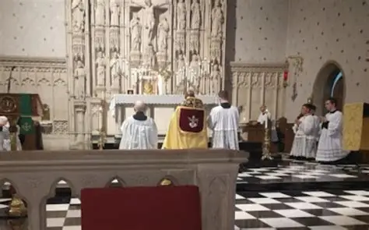
Creed (1)
After having learned about how to live out our beliefs from the readings and the priest’s sermon that capture how Christ embodied the virtue of faith, we affirm our beliefs by reciting the Creed
Dom Lefebvre specifies that the Creed has its origins in the First Council of Nicaea (325 A.D.), and that it was revised at the Council of Constantinople in 381 A.D.
The Creed is prayed not only on Sundays, but on feast days of apostles and doctors who taught it; we learn from them how to live out our beliefs as well
Within this prayer, we honor the Father, the Son, and the Holy Spirit, just like we do during the “Gloria.” The Creed also echoes the “Gloria” in tracing the path of Jesus’ Sacrifice, of His saving work. It goes through stages of salvation history within this one prayer, just like the “Gloria.” Other prayers, like the Preface, change with the seasons, and over time, go through the stages of salvation history

Slide 25
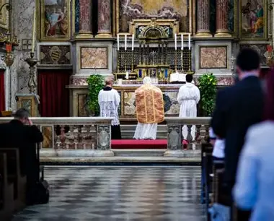
Creed (2)
  At the beginning of the Creed, we honor the Father: we say, “I believe in one God, the Father Almighty”
  We go on to glorify God by expressing our faith in God the Son, as we say, “And in one Lord Jesus Christ”
  We give glory to the Holy Spirit with our belief by saying “And I believe in the Holy Ghost”
  Belief in the Three Persons of the Trinity bring us all together; they unite us in their love. We will be further unified when we receive them in the Holy Eucharist, the Source and Summit of our Faith
  We conclude the prayer by saying that we believe in “one, holy, catholic and apostolic Church,” the marks of the Church, which we bear in our hearts in how we live. We make the Sign of the Cross at the end to purify ourselves before the Mass of the Faithful, when we will exercise our beliefs and receive Holy Communion

Slide 26
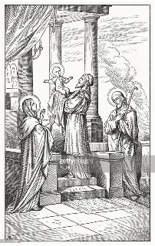
Third Part of the Holy Mass
The part of the Holy Mass spanning from the Offering to the Preface
We recall Jesus’ Presentation at the Temple, remembering His humble submission to God the Father, as He was consecrated to His service
  We imitate Christ in making this humble offering, which anticipated His Sacrifice on the Cross, and prepare for the consecration
We lift up to God acts of self-surrender and oblation
  Together with the sacrifice on the altar, we offer ourselves to God
We abandon ourselves to God’s will, trusting in His Providence; we further express our faith, applying the belief we professed in God when we prayed the Creed

Slide 27
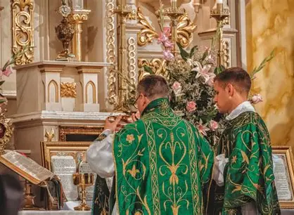
The Offertory
The priest begins the third part of the Holy Mass similar to how he began the two preceding parts, praying that the Lord would be with us; we are preparing to welcome Him most fully into our hearts, so that we may be with Him always in Heaven
Dom Lefebvre describes how the priest offers up the bread, placing it on the corporal after having signed it with the Cross, explaining that we are called to place ourselves spiritually on the paten, and to offer ourselves to God, holding nothing back; throughout the day, we offer ourselves again and again, not taking anything back
The priest blesses the water and combines it with the wine in preparation for the consecration, when Christ will again make His Sacrifice, the water and Blood flowing from His opened side. The water represents the faithful to be united with Christ in Holy Communion, just as the water and wine are made one; this does not take place in Masses for the Dead (the faithful departed may already be united with Christ in Heaven, and can no longer partake of the Holy Eucharist for union with Him in this life)
Dom Lefebvre advises us to offer ourselves as drops of water to Christ; we continue to reflect on cleansing, offering ourselves as pure gifts to God
The priest says the prayer of the three young men who were placed in the fiery furnace as a punishment for practicing their faith; he echoes them in expressing hope and trust in God, praying that He would accept the sacrifices of ourselves that we offer to Him (the Canticle of Daniel commemorating the three young men may be said after Holy Communion, too)

Slide 28
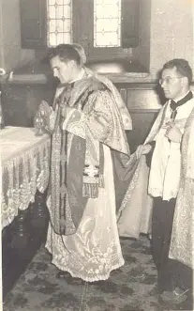
The Incensing of the Offerings
Dom Lefebvre illuminates how this part of the Holy Mass circles back to the sprinkling rite just prior to the start of the Holy Mass
During the sprinkling rite, when the altar, priest, and people are blessed with holy water, we pray for God to cleanse us, to sweeten our souls, that we may be purified, and receive His love with true contrition and adoration
Similarly, during the incensing of the offerings, the bread, wine, and people are incensed, because we offer ourselves to God with the sacrifice, praying to have the sweet fragrance of holiness to please Him, and spread His love to all (but in a Mass for the Dead, only the priest is incensed)
The incense stands for the graces that the Holy Sacrifice will obtain for us through God’s mercy, in touching our souls deeply, opening us to receiving God’s love as He increases our capacity to give and accept love
The bread and wine are incensed in the shape of the Cross. We place ourselves on the Cross with Christ as offerings in union with Him, the Victim; we present ourselves to God with faith that He will accept our offerings, in His mercy; in offering ourselves to the Father in union with Christ, we have faith that God will raise us to new life with Him
We keep in mind that our goal is to make our hearts thuribles that give off the sweet fragrance of our faith, hope, and love for God

Slide 29
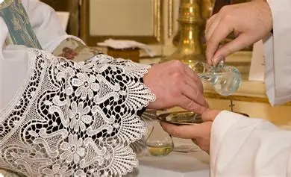
The Washing of the Hands
We continue the offertory, the offering of ourselves, in further prayers for purification; just as we did during the sprinkling rite, we recall our Holy Baptism, praying for God to cleanse us
The priest cleanses his fingers after receiving the offerings and incensing the altar, preparing for the consecration. We strive to purify ourselves as much as possible before consecrating ourselves to God, so that we may be the best offerings we can possibly be, but we also place confidence in God’s graces to effect deep inner transformation in us
The priest washes the tips of his fingers, even if the incense has not been used, in reverence for the Body of Christ that he will soon touch
Dom Lefebvre explains that this part of the Holy Mass is a sacramental that cleanses us of any traces of impurity before the consecration, so he expresses that we must have true contrition in order to receive all of the graces of the sacrament of the Holy Eucharist, to be truly absolved

Slide 30
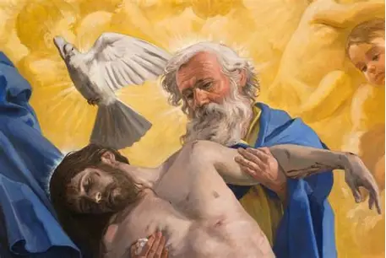
Prayer to the Most Holy Trinity
At this time, the priest bows deeply at the middle of the altar, and at Low Mass, the server kneels on the first step
  This posture again shows humility in the Presence of the Blessed Trinity, the Persons of God soon to be received in the Holy Eucharist
In this prayer, the priest asks that the Holy Trinity would accept the offerings made in remembrance of the saints, including Sts. Peter, Paul, and those whose relics are included in the altar stone
The people offer themselves to glorify the Blessed Trinity, in union with Christ, Who gave His life on the rock of Calvary, and built the Church on St. Peter, the rock
With the priest, we make offerings for Christ, Whose suffering is complete; we continue the Sacrifice by offering our sufferings in union with Jesus

Slide 31
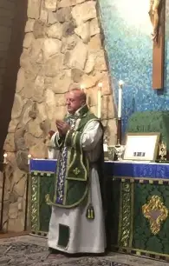
Orate, fratres and Secret
The priest kisses the altar and turns to face the people, to extend the blessing to them, marking the beginning of a new part of the Holy Mass, for all new beginnings flow from Christ’s love, the Kiss of eternal life that we will receive in the Holy Eucharist
He exhorts the faithful to pray together that the sacrifice will be acceptable to God; there is power in prayer, and when we present ourselves as one Church, with great love for God, we are truly presenting ourselves as Christ did, for He lives within a family, doing all things with great love for others; He does not work alone. Our Lady works with Him as the co-redemptrix
As Dom Lefebvre explains, in the past, there were so many offerings given by the people for the Holy Mass, that only some could be taken onto the altar, “set apart” for this special purpose, so the priest would say a prayer over them, for the “oblations set apart” (in Latin, “oratio super secreta”)
From this title of the prayer, the “Secret” gained its name. We present ourselves quietly and humbly, like Christ, the obedient Lamb, Who is set apart to serve and save the people. We accept God’s plan for how we are to offer ourselves to Him, to be set apart for His service

Slide 32
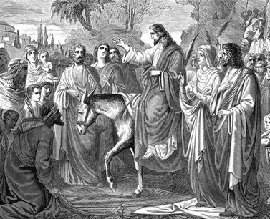
Fourth Part of the Holy Mass
The fourth part of the Holy Mass spans from the Preface to the “Pater Noster”
This part of the Holy Mass is dedicated to consecration and oblation; we offer acts of gratitude and hope, growing in virtue with Christ as we move through stages of His life with Him, being healed and saved by His love
  We are preparing to relive Christ’s Sacrifice, but share His hope in God the Father’s faithfulness, trusting that Jesus’ Death will not be the end of the story, but that there will be spiritual resurrection. We thank God in advance for the miracles He will work to express fully the level of hope we have in Him
We recall when Jesus made His triumphal entry into Jerusalem, remembering His quiet strength, and His royal dignity reflected in His humility; only God could so lovingly lower Himself to walk among the people with such mercy and grace
We anticipate when Jesus will rise again triumphantly, preparing to receive His resurrected flesh in Holy Communion

Slide 33
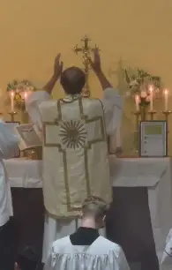
The Preface(s) and the Sanctus
Dom Lefebvre shares that the Canon is the most traditional prayer of the sacred liturgy, having been composed before the fifth century A.D.
The Common Preface is the opening prayer that prefaces the Canon; this prayer does not change. It praises God for His greatness, and follows the natural order of things, in engaging the faithful, who are God’s creations, in adoring the Creator
In between the Preface prayers is the “Sanctus.” We praise God for His holiness, and in our hearts, pray that we, too, would always come in the Name of the Lord, going before God as pure offerings, and imitating His holiness; the “Benedictus” part of the prayer follows the elevations in the pre-1955 liturgy (it is not all sung at once in the High Mass)
The Proper Preface is a prayer of thanksgiving that highlights a different stage of salvation history, according to the liturgical season; we praise God for each of His saving works

Slide 34
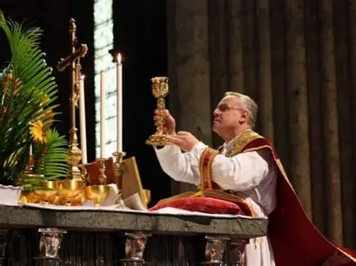
Canon
Dom Lefebvre refers to the Canon as the “Rule of Consecration.” The word “canon” means “rule.” It is a kind of rule of life, the right measure, that teaches us how to reach eternal life through offering ourselves to God the Father like Christ does
The priest kisses the altar and makes three signs of the Cross over the host and chalice to signify that through Jesus’ Sacrifice on the Cross, we receive the blessing of the Three Persons of God in the Blessed Trinity
The Canon prayer begins with the words “Te igitur,” as we humbly beseech God the Father, praying that He would accept the gifts we offer to Him
In the St. Andrew Daily Missal, an illustration appears before this prayer. It depicts the crucifix on the altar, with God the Father, God the Holy Spirit, and the holy angels present. Dom Lefebvre explains that the letter “T” in the “Te igitur” text was typically made into a Cross, because it is through Jesus’ Sacrifice on the Holy Cross that the Father and the Son are given glory; the Sacrifice of the Holy Mass that has its climax in the consecration is a re-presentation of Christ’s Sacrifice on the Holy Cross, through which we are renewed; at the consecration, Christ is lifted up onto the Cross, that we may be lifted up to Heaven through the redemption He has purchased for us with His life

Slide 35
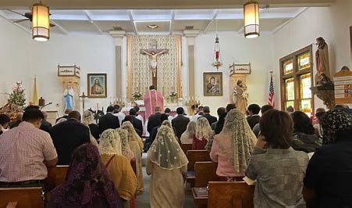
Prayer for the Living
We are reminded that as we climb Calvary Hill, we are going into spiritual battle with Christ; through His Sacrifice, He helps us to triumph over sin and death, to win the battle against evil
The priest prays for the living heads of the Church Militant, the Church on Earth, who guide the troops, such as the pope and the diocesan bishop
He also prays for living members of the Mystical Body of Christ, all of the troops for whom the fruits of the Holy Mass are being offered
This part of the Holy Mass was formerly called the “Reading of the Diptychs,” as Dom Lefebvre points out, because in the past, the priest would read from tablets, diptychs, on which were written the names of the living who were to be commemorated
The priest also invokes souls living in Heaven, calling upon 24 different saints to help us to be pure offerings, that we may join them in eternal life someday; Our Lady, the greatest saint, is also invoked
The missal divides the saints whose intercession we pray for into three categories: first, we ask for the help of the apostles, from whom the Church grew; then we pray for the help of popes, who also formed the foundation of the Church; lastly, we ask for the intercession of martyrs, whose bravery helped the Church to grow, as their powerful witness of love for Christ would inspire others to accept Christ, the greatest Martyr, into their hearts

Slide 36
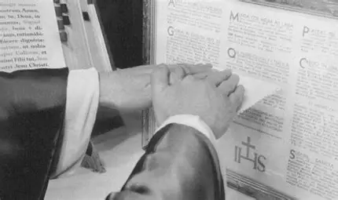
Prayers in Preparation for the Consecration
The priest spreads his hands over the offerings, imitating the traditional actions of the Old Testament high priests who would spread their hands over the victims sacrificed on the altar to expiate the sins of the people
The gesture is meant to signify that Christ gives Himself in place of us, shouldering the weight of our sins, and appeasing God by cleansing our sins away with His Blood, that we may be set free
The priest prays that the bread and wine would become the Body and Blood of Christ, making the Sign of the Cross over the host and chalice
At the Low Mass, the server ascends the stairs and kneels by the priest so that he may raise the priest’s chasuble as the priest elevates the host and chalice on the altar
  This signifies to us that, through Christ, we are raised to new life, lifted to Heaven

Slide 37
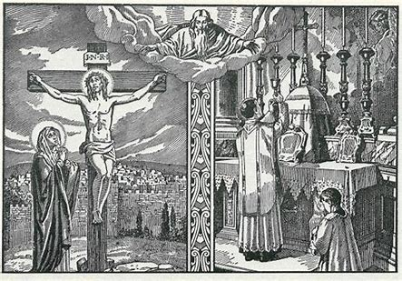
Transubstantiation and Major Elevation
The priest transubstantiates the bread and wine into the Body and Blood of Our Lord: the substance of the material items is changed, so that they no longer have any of the substance of bread and wine, but only the substance of Jesus, Who is Truly Present in the transubstantiated Bread and Wine
The priest is a minister, an instrument, but Jesus is Truly the Priest and Victim. The Sacrifice is bloodless; Jesus can no longer die; but is Fully Present in the consecrated Bread and Wine; the Body and Blood are not separated; we receive Jesus under one species, the Sacred Host, which contains His Body and Blood
Jesus is offered to God the Father with all of His immeasurable merits
The people look up at the Host, and then the chalice, when each are respectively raised, then look down in humility and reverence. We raise our eyes to Heaven, looking upon Christ, and trusting in His mercy and love, which opened Heaven to us.
Dom Lefebvre says the elevation is completed to oppose heretics who denied the Real Presence of Christ
The faithful who say “My Lord and my God” when the Host and chalice are elevated at Holy Mass each day may be granted an indulgence once per week, but they are only to say this prayer interiorly, not aloud
After the elevations, at the Low Mass, the server goes back to the first step, kneeling on the right side

Slide 38
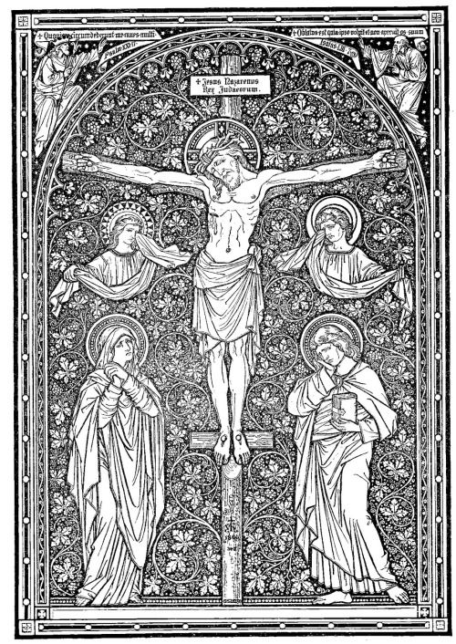
Oblation of the Victim to God
The priest offers the resurrected Body of Christ to God the Father; we are praying that through receiving the Body of Christ, we would be brought to glory, too, as we unite ourselves with the Risen Lord
The priest continues to pray that the offering would be accepted by God the Father, for the Sacrifice would only have its effects on souls if it was truly acceptable. The Old Testament offerings were pleasing to God, so we place our hope in Our Lord, knowing that His Sacrifice would be all the more pleasing to His Father
Then, the priest bows deeply, honoring the Lamb of God Who is adored in Heaven, and places His glorified Body on the altar, giving all of His prayers and past merits for us, that our offering may be fully acceptable to God the Father

Slide 39
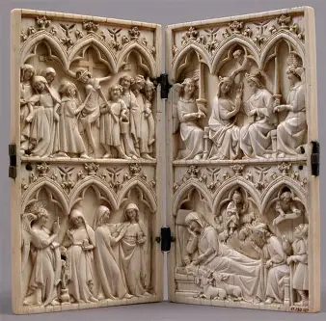
Commemoration of the Dead
The second “reading of the diptychs” occurs as the priest prays for departed souls, offering the Precious Blood for them (historically, the names of the dead for whom the intentions of the Holy Mass were to be offered would be written on tablets)
Dom Lefebvre quotes St. Jerome, who said that the holy souls are given much relief when the Holy Mass is offered for them; the prayers help them through their suffering as they await Heaven
As the priest strikes his breast in contrition, he also prays for the Church Militant, invoking fifteen apostles and martyrs, that they may assist the faithful in reaching Heaven

Slide 40
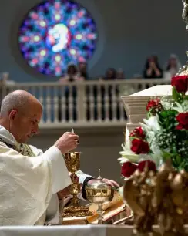
End of the Canon and Minor Elevation
As the priest completes the Canon prayer, he lifts the chalice and Host slightly above the altar in a minor elevation, which recalls when the Old Testament priests would lift the sacrificed victims
The drops of water in the chalice represent us; we are offered in union with Christ’s Blood. We lift our hearts in prayer, giving our joys and sorrows to God, that He would redeem them, and sanctify us, helping us to use our experiences to glorify God the Father, just as Jesus did
Ultimately, when we receive Holy Communion, we will be offered to God with Jesus, as Christ will come within us, making the offering complete

Slide 41
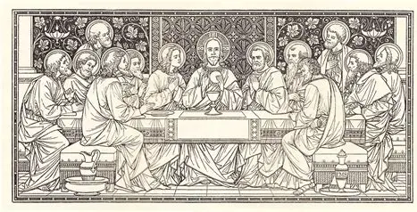
Fifth Part of the Holy Mass
The fifth part of the Holy Mass spans from the Pater Noster to the Ablutions
We prepare for and receive Holy Communion, entering into deeper communion with God as we spiritually participate in the Last Supper with Jesus, recalling when He instituted the sacrament of the Holy Eucharist, blessing and breaking the bread to give to His people, that they would be nourished
In response to Christ, we offer acts of love and desire, uplifting our hearts as offerings to God, in our yearning to be spiritually united to God entirely, out of pure love for Him

Slide 42
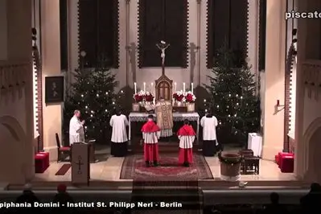
Pater Noster
The priest gazes upon the Host as he extends his hands and prays the “Our Father,” for it is through communion with God the Father that we are brought into communion with each other; we are to extend peace to others if we are to receive Christ’s Heart of love and peace
To imitate Christ in His loving Heart, and to be more deeply united to Him, we are to treat others with respect and dignity

Slide 43

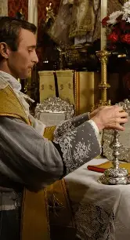
Fraction of the Host
In shedding His Precious Blood, Christ brings true peace
The priest takes a particle of the Host, and breaks It into three pieces, making the Sign of the Cross three times over the chalice with It
In breaking His Body for us, Christ makes us whole; we are purified when we receive the love of God the Father, God the Son, and God the Holy Spirit in the Holy Eucharist; the Persons of God perfect us and complete us, bringing us into true unity; we are more fully integrated through them
The priest drops a particle of the Host into the chalice, which prefigures the Communion, when we will receive Christ, and be united with Him; this ultimately foreshadows heavenly union with Christ

Slide 44
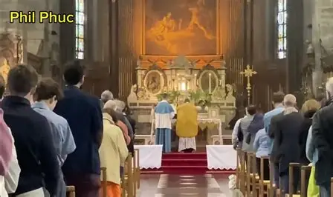
Agnus Dei
We continue the petition of the Kyrie, and anticipate both Holy Communion and the Last Gospel (when the Prologue of St. John is read)
We pray for the Lamb of God to have mercy on us, to bring us peace through union with Him in His Sacrifice
We echo the words of St. John the Baptist bearing testimony to the Light of the World, the shining Lamb of God Whose Sacrifice transfigures us all
Saint John the Baptist referred to the Savior as the “Lamb of God” when he was proclaiming Christ as the Messiah to the Jewish people. He draws our attention to the fact that our dear Savior is as gentle and obedient as a Lamb; He had the divine strength to bear suffering, and to forgive, in such a way that only the Messiah could
We prepare to receive Jesus’ peace into our hearts at Holy Communion, which will help us to become like the Lamb of God

Slide 45
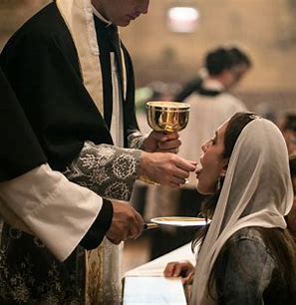
Holy Communion
In preparation for Holy Communion, three prayers are said, in which we petition God for peace, healing, and grace, that we may open our hearts to fully receiving these gifts in the Holy Eucharist
Dom Lefebvre says that at this time, we place our faith in the merits of the Church, for in her, the Bride of Christ, this sacrament was prepared
In receiving the Holy Eucharist, then, we are even more deeply united with Christ, and to all of God’s children in the Church; the union bears fruit for the glory of the Holy Trinity
The priest kisses the altar, then exchanges the kiss of peace to the deacon, since it is from Christ, and the Kiss of Peace He gives in His Sacrifice, that all love flows. The kiss of peace is not given at Low Masses or Masses for the Dead
The priest genuflects before he receives the Host, and says the prayer of the centurion three times before his Communion; he humbles himself, like Christ, and like the centurion, whose humility led to his prayer for the healing of his servant to be granted. Similarly, the priest prays on our behalf, making intercession for us, that we should be healed, especially through his own healing, that he may be all the more Christlike in ministering to us

Slide 46
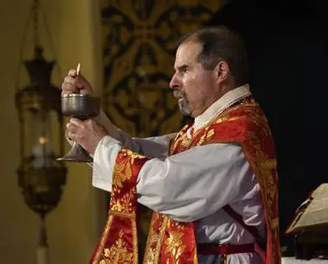
Holy Communion
The priest gives the absolution to the people before they receive Holy Communion; it is another sacramental, washing away the last remnants of sin, that they may be totally purified, and receive all of God’s graces from Christ, the immaculate bread; this completes the prayers of the washing of the hands and the sprinkling rite
When he holds up the Host, showing it to the people, the priest tells them to behold the Lamb of God, echoing St. John the Baptist again
In the Extraordinary Form, the priest says the “Amen” for each person when they receive Holy Communion. At ordination Masses, the newly-ordained say the “Amen” himself when they receives Holy Communion from the priest, since this imitates the practice of early Christians, and signifies the priestly authority conferred upon the newly ordained

Slide 47
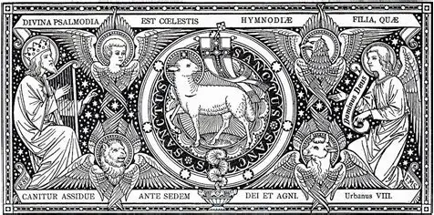
Sixth Part of the Holy Mass
The sixth part of the Holy Mass spans from the Communion to the end (the Last Gospel, or the Leonine prayers after the Low Mass)
This part of the Holy Mass is dedicated to thanksgiving for Christ’s Sacrifice, the offering of Himself that He gives to us for our sustenance
In this part of the Holy Mass, we recall when the apostles were sent forth after singing together with Christ; we, too, are to go forward with Christ’s song of love on our hearts, that we may share it, and invite everyone to join in the chorus praising Christ with the holy angels, just as we did at the beginning of the Holy Mass; we end Holy Mass much as we started it, with praise of the Blessed Trinity; we look forward to the adoration of the Lamb of God in Heaven, to the fulfillment, the consummation of all things, and anticipate it by offering acts of gratitude to God the Father, in union with Christ, Who thanked His Father before the Passion
  We have gratitude amidst suffering, because we know that through it, we are brought to Heaven forever with Christ

Slide 48
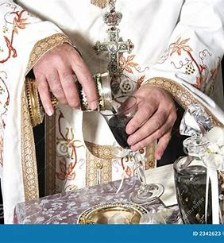
Ablutions
Jesus gives thanksgiving to God the Father in our hearts; we pray with the priest in the name of the Church as we express our gratitude to God, praising Him for His goodness and generosity
The priest goes to the Epistle side of the altar to cleanse his fingers; we learn from Christ what it means to be pure, to be a spotless Host, like the Lamb of God, free of sin
The deacon pours wine and water into the chalice, and the priest prays that he would be kept totally cleansed from sin; through the water and Blood that flowed from Christ’s Side, from which the Church was born, and the purifying sacraments of Holy Baptism and Holy Communion were given to us, we pray to be pure of heart, like Christ, that we may lovingly give from our hearts like He did, carrying forward the spirit of love that is the Holy Mass
We pray that, as He lives within us, He would help us to continue to be pure and loving
The server takes the chalice veil to the Gospel side, and the Missal to the Epistle side of the altar; veils are placed over holy items. We pray to be veiled from sin, protected from evil, and sheltered within Christ’s Heart, that we may remain in God’s grace, and be kept holy, like Him
At Low Mass, the server kneels on the lowest step on the left; if we are to advance in holiness, to keep growing closer to Heaven, then we are to keep lowering ourselves, going back to Christ’s feet, and always preparing our souls anew to receive His Kiss of Peace in Holy Communion, until we may receive it forever in Heaven

Slide 49
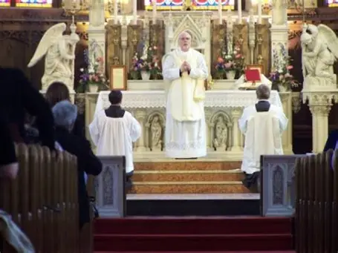
The Ite, Missa Est and Blessing
The priest goes to the altar and kisses it, praying that the Lord would be with the faithful
The faithful pray in thanksgiving for the blessing God has given to them, the Kiss of Peace from Jesus that they received in the Holy Eucharist. Through It, they have been granted the great Gift of the Precious Blood of Christ, Christ’s merits being applied to them for their salvation
The priest bows and reflects on the purpose of the Sacrifice of the Holy Mass He has celebrated for God, through which He offered the Precious Blood of the Son, making Jesus, the Victim, Present on the altar to save us
Before giving the final blessing, the priest kisses the altar again, unless it is a Mass of the Dead
  Jesus never ceases to bless us, to extend His love to us

Slide 50
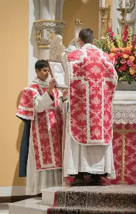
The Last Gospel
When we genuflect at the words “the Word was made Flesh,” we are reminded of our Holy Communion, through which Christ comes to dwell among us. All of the Holy Mass is Christ reaching out to us, becoming closer, until He comes to dwell within our souls
We are to go forth, and live in such a way that Christ may always shine in us, alive within us, and dwell among us forever, so that we may bring souls to Him out of love, and come to dwell with Him forever in Heaven by living out His Commandment to love

Slide 51
Prayers after Holy Mass/Holy Communion
St. Andrew Daily Missal (1945)
Roman Catholic Daily Missal (1962)
Psalms (private prayers of thanksgiving)
  Psalm 22, Psalm 26, Psalm 33
Indulgenced hymns, especially Eucharistic and Marian ones, i.e. Magnificat, Tantum Ergo, Adore Te and Te Deum (includes information on indulgences)
Canticle of Daniel (Canticle of the Three Young Men); Psalm 150
“Obsecro Te”
Prayer to Patron Saint
Renewal of Baptismal Vows
Prayer for Perseverance
Offering of all the Masses in the World
Prayer for Obtaining Indulgences
Prayer of St. Bonaventure
Prayer of St. Thomas Aquinas
Prayer of St. Augustine
Anima Christi
Act of Resignation
Prayer to Jesus Crucified
Eucharistic Offering
Universal Prayer for All Things Necessary to Salvation
Prayer to the Blessed Virgin
Prayer to St. Joseph
Prayer to Our Guardian Angel
Memorare
Act of Thanksgiving, Act of Adoration, Act of Expiation, Act of Petition
An Oblation (St. Ignatius)
Canticle of Daniel and Psalm 150
Prayer of St. Bonaventure
Prayer of St. Thomas Aquinas
Prayer of St. Augustine
Anima Chrsiti
St. Francis Xavier’s Hymn of Love
Petitions of St. Augustine
Te Deum
Adoro, Te Devote
Indulgenced Prayer Before a Crucifix
Thanksgiving of the Eucharistic Crusader
Act of Resignation
Prayer After Communion; Act of Confidence; Act of Love; Act of Petition
Thanksgiving for Small Children
Prayer to the Blessed Virgin Mary
Prayer to St. Joseph
“I Beseech Thee”
Memorare
Litany of the Most Holy Name of Jesus

Slide 52
Prayers after Holy Mass/Holy Communion
St. Andrew Daily Missal (1945)
Fr. Lasance’s New Roman Missal (1945)
Psalms (private prayers of thanksgiving)
  Psalm 22, Psalm 26, Psalm 33
Indulgenced hymns, especially Eucharistic and Marian ones, i.e. Magnificat, Tantum Ergo, Adore Te and Te Deum (includes information on indulgences)
Canticle of Daniel (Canticle of the Three Young Men); Psalm 150
“Obsecro Te”
Prayer to Patron Saint
Renewal of Baptismal Vows
Prayer for Perseverance
Offering of all the Masses in the World
Prayer for Obtaining Indulgences
Prayer of St. Bonaventure
Prayer of St. Thomas Aquinas
Prayer of St. Augustine
Anima Christi
Act of Resignation
Prayer to Jesus Crucified
Eucharistic Offering
Universal Prayer for All Things Necessary to Salvation
Prayer to the Blessed Virgin
Prayer to St. Joseph
Prayer to Our Guardian Angel
Memorare
Act of Thanksgiving, Act of Adoration, Act of Expiation, Act of Petition
An Oblation (St. Ignatius de Loyola)
Includes information on indulgences
Anima Christi
Benedicite and Psalm 150
Prayer of St. Thomas Aquinas
Prayer of St. Bonaventure
Prayer to Jesus Crucified
Adoro Te Devote
Oblation and Thanksgiving
Act of Faith and Adoration
Act of Hope
Act of Love
Act of Consecration
“Suscipe” prayer of St. Ignatius (oblation)
Invocations: “Eucharistic Heart of Jesus, have mercy on us!”
  “Divine Heart of Jesus, covert sinners, save the dying, set free the holy souls in Purgatory.”

Slide 53

What differentiates the St. Andrew missal from other pre-1955 missals? (1)
Inclusion of readings from the Divine Office with chant notation
Extensive commentaries on the liturgical year: meditations on traditions and significance of each feast day with the feast day Mass readings
More of an emphasis on the mystical meaning of the Holy Mass, and not only on the mechanics of the liturgy
Not only teaches the parts of the Holy Mass, in terms of prayers being said by the priest in the moment, but provides instruction for preparation of the soul at each part: has a strong emphasis on interior participation, and what our disposition should be for each part of the Holy Mass
Divides the prayers to demonstrate how each part honors a Person of God in the Blessed Trinity: the Father, the Son, and the Holy Spirit

Slide 54

What differentiates the St. Andrew missal from other pre-1955 missals? (2)
Highlights the link between Holy Baptism and the Holy Mass, providing many excellent prayers in preparation, and thanksgiving, for Holy Communion, including prayers to renew baptismal promises in order to more fully welcome Christ into our souls
Divides the texts of the Holy Mass into six subdivisions, outlining the key spiritual themes in each subdivision; demonstrates how Christ speaks to us in each
Explains the historical roots of the parts of the Holy Mass very clearly; ties in sacred art and culture to illustrate points
  Describes very poetically how the priest responds to Christ in each part of the Holy Mass, and how we may, too
Benedictine character (i.e. promotion of plainchant and texts of Holy Masses for the Benedictine order); evident that it was produced by a monk, and helps all of the faithful to live out something of the contemplative spirit

Slide 55

What are the advantages of using the St. Andrew Missal for personal devotions?
The St. Andrew Missal can help us to live more intentionally by living in accordance with the rhythms of the liturgical year, and practicing the traditions of our Faith
It provides us with the resources we need to praise God, to uplift our hearts in love for Him through prayer, especially song
It helps us to unite us one Church in prayer, especially through the prayers of the Divine Office it integrates, and to better understand religious communities’ charisms, as we meditate on the readings from their special Masses, praying with and for them
It helps us to deepen our personal relationship with Christ as we contemplate His Presence at the Holy Mass, namely, how He is actively working with, for, and in us
It provides a rich, wide variety of prayers for various occasions to use in honoring Our Lord, and calling down special graces from Him as we offer prayers of adoration, petition, thanksgiving, and reparation; the St. Andrew Missal captures the unity between the States of the Church, helping us to pray with and for each other, to call upon our heavenly friends, the saints and holy angels, to help us to become more like them

Slide 56

Announcements
Holy Mass Learning Series Track 2, Session 4:
  Tuesday, July 15, 2025
    6:00 p.m., OLV parish hall
Liturgical Rosary Session:
  Prayers for Fr. Sliwa
  Readings for the Feast of St. Benedict of Nursia
    Friday, July 11, 2025
      9:45 a.m., OLV parish library

Slide 57

Closing Prayer: Prayer for the Intercession of Blessed Dom Columba Marmion
O Holy Spirit, Love of the Father and the Son,
establish Thyself as a furnace of love
in the center of our hearts
and bear constantly upwards, like eager flames,
our thoughts, our affections, and our actions
even to the bosom of the Father.
V. Pray for us, Blessed Columba Marmion.
R. That our lives may be hid with Christ in God.

