Slide 1
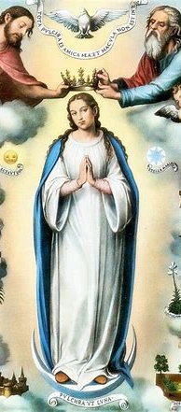
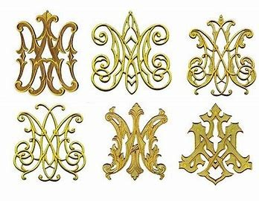

Rel. Ed. Class Session 9
Thursday, May 1, 2025
Katie Sadakierski
Our Lady of the Valley

Slide 2
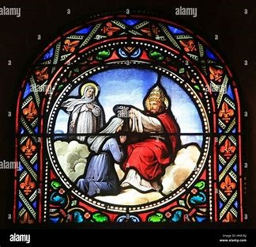

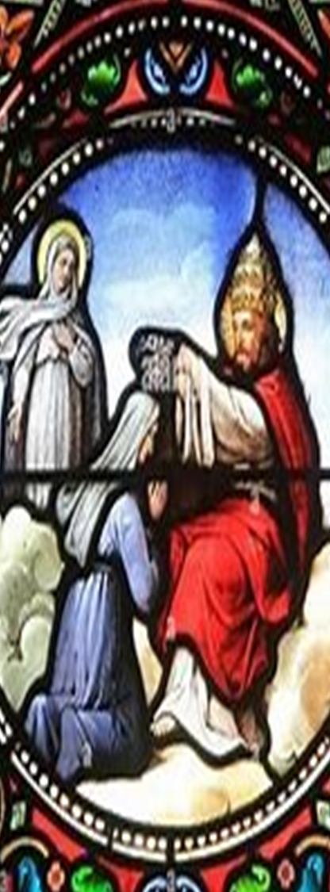


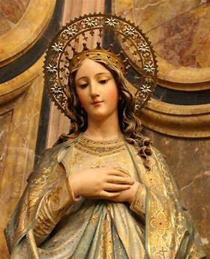

May 2025 Religious
Education Class Outline
Opening prayer
Overview of monthly theme and activities
Learning centers
Announcements
Closing prayer

Slide 3



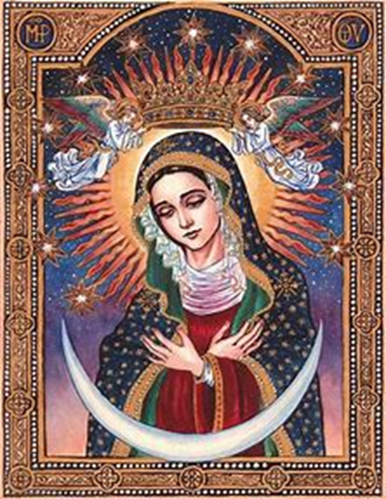

Opening Prayer: “Hail, Holy Queen”
Hail, Holy Queen, Mother of mercy. Hail, our life, our sweetness, and our hope. To thee do we cry, poor banished children of Eve. To thee do we send up our sighs, mourning and weeping in this valley of tears. Turn then, most gracious Advocate, thine eyes of mercy towards us. And after this our exile, show unto us the blessed fruit of thy womb, Jesus. O clement, O loving, O sweet Virgin Mary.
Pray for us, O Holy Mother of God. That we may be made worthy of the promises of Christ.

Slide 4




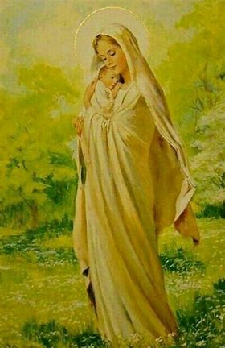
Overview of May 2025
May theme: the Month of Mary
  Our Lady, Queen of Heaven; Mary, Queen of the May
Saint of the month: St. Simon Stock
Altar this month: white and green altar cloths (white for Our Lady; green for life, the coming season of Pentecost)
  Images of Our Lady’s Coronation in Heaven
  Lilies
  The Immaculate Heart of Mary

Slide 5






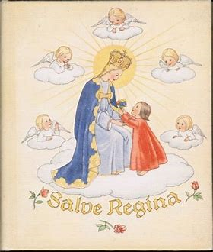
May 2025 Grades PK-2 Activities
PK/K: Being crowned with virtues like Our Lady; making a crown of flowers for Mother Mary
Grade 1: How Mother Mary reflects Jesus’ light of love, and how we can shine Jesus’ light, too
Grade 2: Celebrating First Holy Communion; how our Church family comes together to honor Jesus in the Holy Eucharist, and how we can continue sharing Jesus’ love
Tonight’s learning center (parish hall): celebrating Mary, the Queen of the May with a May crowning; making baskets of “May Day” flowers to honor Our Lady

Slide 6






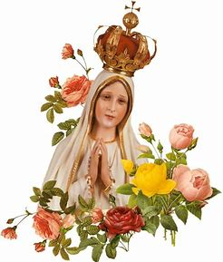
Grades 3-6
Grade 3: Our Lady’s gift of the Miraculous Medal, and how it helps us to grow closer to her Son
Grade 4: How we can offer gifts of prayer to Our Lady out of love, and bless others with spiritual bouquets
Grade 5: How Our Lady has appeared to her spiritual children around the world, and helped us to grow in faith, hope, and love
Grade 6: How the Litany of Mary honors Our Lady, and how we can use the gift of sacred song to praise God for creating her
Tonight’s learning center (parish library): writing reports on Marian apparitions around the world, and how Our Lady has called us to follow Our Lord

Slide 7





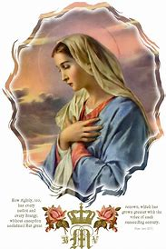
Grades 7-9
Grade 7: The Visitation of Our Lady to St. Elizabeth; how Our Lady visits us spiritually, and how we can visit her in prayer, so as to bring her love to others
Grade 8: How Our Lady expresses her love and kindness through the spiritual gifts given in sacramentals/prayer (i.e. the Miraculous Medal)
Grade 9: Our Lady’s grace and kindness; opening ourselves to receiving graces and growing in virtue like Our Lady
Tonight’s learning center (church): reflecting on the Litany of the Blessed Virgin Mary, the “Magnificat,” and how we rejoice in the Lord like Our Lady does

Slide 8

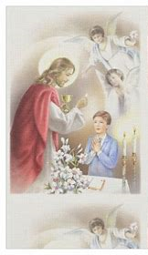


Announcements 1: Religious Education
End-of-year religious education program surveys
  Hard copies on sign-in table
  Online surveys to be emailed
Mass of First Holy Communion: Saturday, May 3, 2025, 11:00 a.m., church
  Reception: 12:00 p.m., parish hall

Slide 9




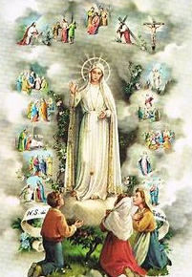
Announcements 2:
Parish-Wide Devotions
Next First Friday Mass: Friday, May 2, 2025, 6:00 p.m.
Next First Saturday Blessing of Sacramentals: Saturday, May 3, 2025, after 9:00 a.m. Mass
Next First Sunday Eucharistic Adoration: Sunday, May 4, 2025, 2:00 p.m. to 5:00 p.m.

Slide 10

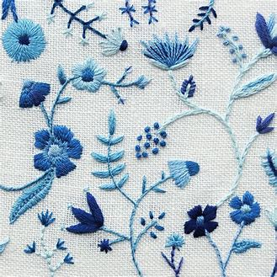

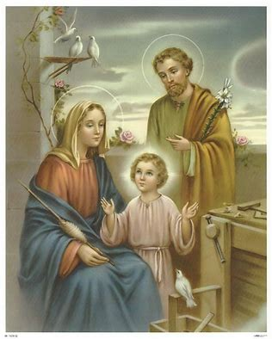
Closing Prayer: “Memorare to St. Joseph” for the Feast of St. Joseph the Worker
Remember, O most pure spouse of the Virgin Mary, Saint Joseph, my beloved patron, that never hath it been heard that any one invoked thy patronage and sought thine aid without being comforted. Inspired by this confidence, I come to thee and fervently commend myself to thee. Ah, despise not my petition, dear foster-father of our Redeemer, but accept it graciously. Amen.

