Slide 1
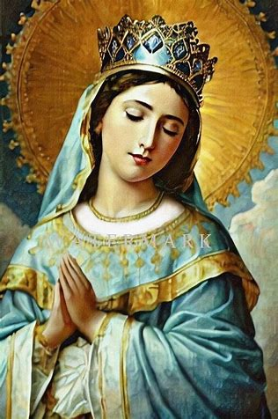


Just My Type: Mary and Marian Types in Sacred Scripture
Katie Sadakierski
Saturday, May 31, 2025
Feast of the Queenship of Our Lady

Slide 2
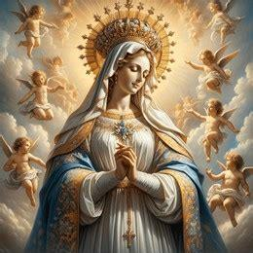

Marian Presentation 3 Outline
Welcome & Opening Prayer
Meeting presentation
  I. Introduction to biblical typology
  II. Exploration of Marian typology: Marian types in the Old Testament, and how they are fulfilled in the New Testament
  III. Applying our biblical typology takeaways: Living like Our Lady, and devoting ourselves more deeply to Mother Mary
Announcements
Closing Prayer
Q & A

Slide 3
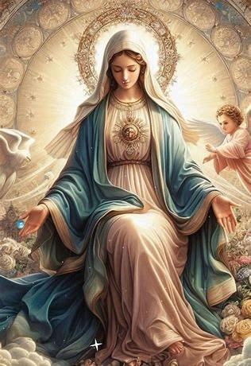
Opening Prayer: Hail, Holy Queen
Hail, Holy Queen, Mother of mercy. Hail, our life, our sweetness, and our hope. To thee do we cry, poor banished children of Eve. To thee do we send up our sighs, mourning and weeping in this valley of tears. Turn then, most gracious Advocate, thine eyes of mercy towards us. And after this our exile, show unto us the blessed fruit of thy womb, Jesus. O clement, O loving, O sweet Virgin Mary.
Pray for us, O Holy Mother of God. That we may be made worthy of the promises of Christ.

Slide 4
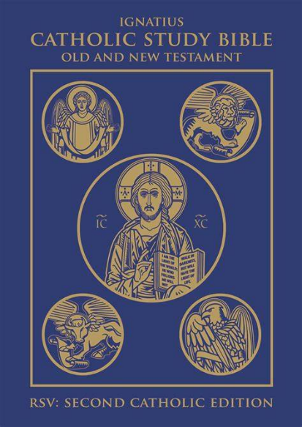
What is biblical typology? What are biblical “types”?
Biblical typology is an area of theological study that compares the Old and New Testaments of the Holy Bible
When we study biblical typology, we look at how the Old Testament foreshadows the New Testament, and how the New Testament completes the Old Testament. We see how the two parts of the Bible tell one continuous story
We explore how Christ in the New Testament fulfills Old Testament prophecies; we can even go line-by-line finding parallels
Biblical “types” are symbols in the Old Testament that stand for people in the New Testament, hinting at what is to come

Slide 5
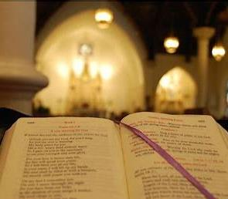
Why should we study biblical typology?
Biblical typology helps us to appreciate the Wisdom of God
We can see how God perfectly ordered and planned everything out of love for us
We that God has always loved us and been faithful to us, since the beginning of time. Biblical typology opens the eyes of our souls to see that throughout history, God has been sharing His love with and through His creation.
As we read the stories of God’s people, we see that people throughout time can impact each other, and are interconnected, because we were all made by and for God. This gives us an appreciation for the unity we have in Christ, and inspires us to live well for Him.
We learn from the example of the people we study in the Old and New Testaments of the Bible, coming to a heightened awareness of what it means to be a good Christian, and of how we are called to fulfill this role
In coming to a deeper appreciation of the complementarity between the Testaments, we can come to love Jesus more, observing that in Him, there is true unity, as He is the Alpha and the Omega, the beginning and the end of time, Who brings all things together for our good

Slide 6
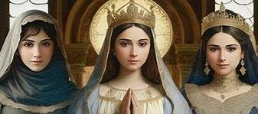
What is “Marian typology”?
Marian typology is a specific branch of biblical typology in which we examine Marian types in Sacred Scripture, looking at how people and symbolic images in the Old Testament prefigure Mother Mary in the New Testament
Studying Marian typology helps us to further appreciate the connections between the Old and New Testaments, and to understand God the Father’s plan for Jesus and Mother Mary to work together in bringing about His plan for salvation. We better comprehend how Our Lady serves as our universal Mother

Slide 7
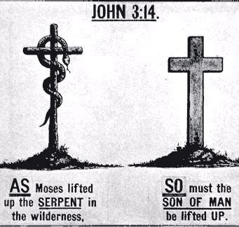
Why is biblical typology essential to our understanding of, and devotion to, Mother Mary?
Biblical typology deepens our understanding of Mother Mary. In reading about the women in the Old Testament who prefigure her, we see different aspects of her personality and mission embodied, and can more fully appreciate the richness of Our Lady’s soul, which encompasses all of the virtues that we may see in individuals in the Old Testament
Biblical typology helps us to understand the many roles that Our Lady fulfills in being a spiritual mother, and above all, the Mother of the Savior, as we study each Marian type in the Old Testament
In more fully understanding all that Our Lady is, we can come to love Mother Mary more, turning to her in our daily lives for every need that we may have
Reading the Old Testament to understand more about Mother Mary is a key to her Heart. Our Lady was taught to read Scripture, and would have prayed the psalms. We pray with her when we study the Old Testament writings, and use the psalms to praise God as she would have. Our Lady would have learned about God’s faithfulness through the psalms, and was faithful to God in response

Slide 8
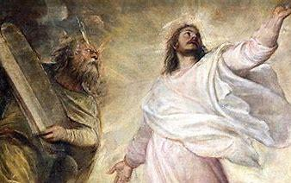
How is Jesus prefigured in the Old Testament, and how does this relate to Our Lady? (1)
Moses:
  Moses receives the law, the Ten Commandments, from God. He leads God’s people to safety, out of bondage, and into their freedom; the seas are parted to let them through
  Jesus gives the new law that makes Mosaic law obsolete. He frees God’s people from sin, opening the gates of Heaven to them
Joshua:
  Joshua fought the battle of Jericho, and the walls came down
  Jesus fought the ultimate spiritual battle for us, giving His life to save us from sin, and the old temple was destroyed; Jesus is the New Temple
  The name “Jesus” or “Yeshua” in Jesus’ language of Aramaic, is derived from the name “Joshua”

Slide 9
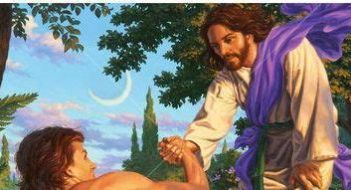
How is Jesus prefigured in the Old Testament, and how does this relate to Our Lady? (2)
Adam:
  Adam disobeys God with Eve, not following His instructions to avoid eating fruit from the Tree of the Knowledge of Good and Evil. With Eve, he brings sin into the world
  Jesus obeys God the Father, and redeems humanity from sin by dying on a tree, the Cross, for our salvation. He is the Fruit of Mary’s womb, and bears good fruits by giving His life with total faith, hope, and love
  Sin was brought into the world through the collaboration of Adam and Eve. Redemption came about through the collaboration of Jesus, the New Adam, and Mary, the New Eve. Mary is the helpmate of Jesus, the co-redemptrix, just as Eve was the helpmate of Adam
  Adam was the archetype of man: he was the ideal man, before he sinned. Jesus is the new archetype of man. Eve was the archetype of woman, the ideal woman, before she sinned. Her name in Hebrew was originally “Ishshah,” because “Ish” means “man,” and she was taken from man, being made from Adam’s rib, so she is “ishshah,” meaning “woman.”
  Mary is established as the new archetype of woman, the ideal woman, when Jesus calls her “woman” at the wedding at Cana, and when He says, “Woman, behold your son” from the Cross, giving St. John to Mary as her spiritual child

Slide 10
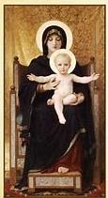
How does the Wisdom literature of the Old Testament prefigure Our Lady?
The Old Testament writings feminize Wisdom: “Sophia,” a female name, means “Wisdom”
The Wisdom literature prefigures Our Lady: Wisdom makes her home in Jerusalem, and bears fruit (Ecclesiasticus 24:15-20)
  Our Lady bore Jesus, the Fruit of her Womb, Who gave His life for us in Jerusalem; Our Lady makes her home with Christ; she stands by the Cross with Him, and bears much fruit for our souls by offering her Son to God the Father, and all of her suffering, for our salvation, out of love
Our Lady is the seat of wisdom: she holds divine wisdom incarnate, Our Lord, Jesus Christ, within her
  Our Lady was wise to trust in God, saying “yes” entirely to His plan, knowing that His plan is designed in His perfect wisdom
  She pondered sacred things in her Immaculate Heart, treasuring the things of God, which demonstrates her true wisdom of the heart that surpasses wisdom of the mind
  Our Lady spreads her holiness like the fragrance of spices, and brings healing by giving birth to Jesus, the remedy for every ailment, as prefigured in the Old Testament: “I gave a sweet smell like cinnamon and aromatical balm: I yielded a sweet odor like the best myrrh” (Ecclesiasticus 24:20)

Slide 11
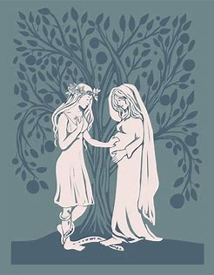
How is Eve in the Old Testament a Marian Type? How does she differ from Our Lady?
“Eve” means “life”: Our Lady brings us to new life in Christ, for she gave birth to Jesus, that through His Passion, Death, and Resurrection, we would be reborn into Heaven
Eve is the antithetical Marian type: in serving as an opposite of Mary (telling us what she is not) she teaches us more about what Mary is
Eve is a virgin betrothed to Adam who disobeys God, eating fruit from the Tree of the Knowledge of Good and Evil, after having listened to the deceptive advice of the serpent, the fallen angel. Mary is a virgin betrothed to St. Joseph who obeys God, bearing the fruit of the tree of Jesse, Our Lord, Jesus, after having responded affirmatively to God’s call, as conveyed through the message of God’s holy angel, St. Gabriel
Eve is the natural mother of children in the world. She brings sin into the world, and as a result, must experience pain in labor
Our Lady is the spiritual mother of children in the world. She is free of sin and brings grace into the world. As a result, she does not experience pain in labor as she gives birth to Jesus, the sinless Savior, but she goes through spiritual labor pains when she witnesses her Son suffering on the Cross for our salvation, our spiritual rebirth

Slide 12
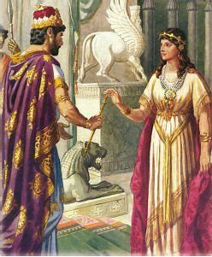
How is Esther in the Old Testament a Marian type?
“Esther” means “star” in Hebrew
Our Lady is the “Stella Maris,” the “Star of the Sea,” and the “Stella Matutina,” the “Morning Star”
Esther is compassionate. She hears the cries of her people, the Jews, and helps to free them from death, saving them after it was decreed by an official of the king that they should be killed
Our Lady of Compassion hears the petitions of her people. She helped to free God’s people by giving birth to Jesus, the Savior Who redeems humankind from sin, lifting them up from spiritual death, to new life
Esther is a leader, a beautiful queen. She bravely intercedes on behalf of her people, petitioning her husband, the king, to help them
Our Lady is a guiding star who reflects Christ’s light, and leads us closer to Him, for He is the sun around which we are to orbit, receiving light and warmth that we need to survive. Our Lady is the beautiful Queen of Heaven, Mother of Christ the King, who intercedes for us, bringing our prayers of petition to her Son to answer

Slide 13
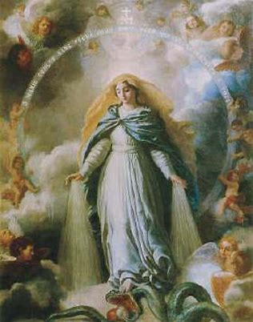
How is Judith in the Old Testament a Marian type? How does she differ from Our Lady?
Judith helps to save her people. When a king sends his general to overtake the Jewish people, Judith slays the general, rescuing her people
An angel inspires Judith to save her people, and leads her to victory, helping good to triumph over evil
Our Lady brought life into the world by giving birth to Jesus, that we all might have victory over sin and death; she crushes the serpent’s head under her heel
  Our Lady responded affirmatively to the message given to her by the archangel, St. Gabriel

Slide 14
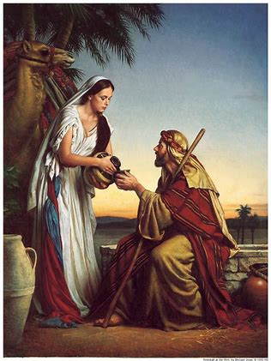
How is Rebecca in the Old Testament a Marian type? How does she differ from Our Lady?
Rebecca is the beautiful wife of Isaac. She would gather water from the well. She served God faithfully, continuing in this task until He called her to marry Isaac
Rebecca had twin sons, Jacob and Esau. She knew that Esau was favored by Isaac to receive his blessing, but wanted Jacob to receive the blessing, so she conspired with Jacob to deceive Isaac into giving Jacob the blessing
To deceive Isaac, Rebecca dresses her favorite son, Jacob, in Esau’s clothes so that Jacob may receive his father’s blessing
Our Lady gives birth to Christ, Who is God clothed in human flesh, so that He may bring the Father’s blessing to the human race, and redeem them from sin
  Rebecca was faithful to God in her service, just like Our Lady, but Our Lady did not use deceit; she was totally pure of heart

Slide 15
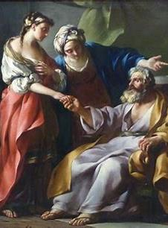
How is Sarah in the Old Testament a Marian type?
Abraham’s wife, Sarah, dealt with infertility. God worked a miracle to reward her for her faithfulness, so that as an elderly woman, she would give birth, no longer infertile. She would become the “mother of nations”
  God promised Abraham that he would be a father, his descendants numerous, as many as the stars. Abraham was so faithful to God, that he was willing to sacrifice his only son, Isaac; God blessed him for his fidelity
Our Lady was “barren” too, but in a different way; she was a virgin who bore the Child Jesus, giving her consent to the Holy Spirit to overshadow her, so that from her barrenness, would come blessedness. Our Lady was rewarded for her faithfulness to God; she had consecrated herself to God entirely, and was without any sin, filled only with grace
  Our Lady is the mother of all peoples, because as the Mother of Jesus, our Savior, she would become the spiritual mother of all whom Jesus died for and redeemed from sin

Slide 16
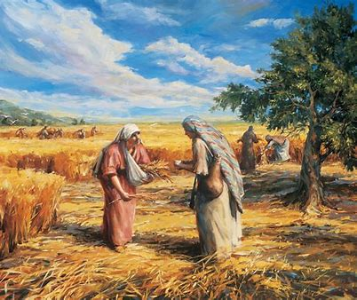
How is Ruth in the Old Testament a Marian type?
When Ruth was widowed, she could have left her in-laws to return to her parents, but she chose to remain with her mother-in-law, Naomi
Naomi had encouraged Ruth to return to her parents, because in the wake of Ruth’s husband’s death, Ruth had no way to support herself, but Ruth was devoted to Naomi, and to her new Jewish faith; she determined not to go home to her family, since they were not Jewish
Ruth was faithful and loving; she risked her own life to remain with Naomi out of love, earning her daily bread by gleaning: going through the fields for wheat that the harvesters had not gathered
Our Lady is faithful to God, just like Ruth was faithful to Naomi. She gives birth to Christ, the wheat, Who brings about the greatest spiritual harvest
The friendship between Ruth and Naomi is similar to the friendship between Our Lady and St. Elizabeth; Ruth remains with Naomi to help her, and Our Lady goes out to St. Elizabeth to help her in her time of need

Slide 17
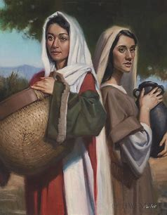
How is Rachel in the Old Testament a Marian type?
Rachel is the wife of Jacob (son of Isaac) and the beautiful mother of Joseph in the Old Testament
  Joseph is sold into slavery for twenty pieces of silver
  Joseph goes on to preserve the grain to feed his people in their time of famine
Mary is the beautiful mother of Jesus in the New Testament
  Jesus is sold out by Judas for thirty pieces of silver. Judas’ betrayal leads Jesus to be arrested as a criminal and crucified for crimes He did not commit
  Jesus is the grain Who gives His Body to feed His people, and preserve their lives, that they may avoid the spiritual famine brought about by sin, and be led to eternal life

Slide 18
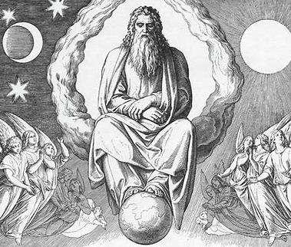
Why is the earth itself seen as a Marian type in the Old Testament?
The earth created by God, which we read about in the Book of Genesis’ creation story, is virginal
God creates Adam from clay: man is dust, and to dust, he shall return (after Adam brought sin and death into the world through his disobedience)
The Virgin Mary gives birth to Jesus, Who uplifts man from the dust, overcoming sin and death by giving His life for us on the Cross, which allows us to share in His glory, to have life beyond this earthly one
We are spiritually reborn from Mary and Jesus, the Word made flesh; we are made into new creations through their love

Slide 19
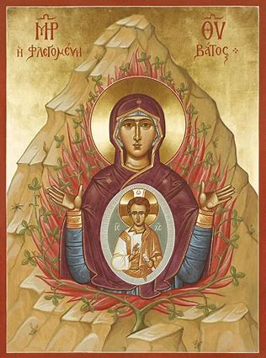
How is the burning bush a Marian type?
When God gave the Ten Commandments to Moses in the Old Testament, He did not show His Face to Moses, as this would have been overwhelming. God speaks to us in a way that we can understand, so He spoke to Moses in a way that Moses could comprehend with his senses (a phenomenon called a “theophany,” a visual appearance of God with spoken words/sound)
Moses saw a burning bush, and heard the voice of God speaking. As the bush was burning, it was not consumed; it was not destroyed by the flames
Similarly, when Mother Mary was overshadowed by the Holy Spirit, and conceived Christ within her body, she was not consumed. When Jesus, the New Moses (the new lawgiver), was born of Mary, He passed through her like a light passing through glass, not hurting her. Our Lady remained a virgin, while still being fully a mother

Slide 20
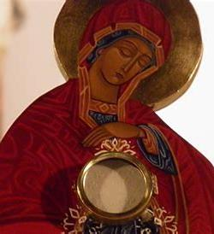
Why is Our Lady called the “New Ark of the Covenant” or “Ark of the New Covenant”? (1)
In the Old Testament, the Ark of the Covenant was carried under a tent by the Israelites when they wandered through the desert. The Presence of God in the form of a cloud overshadowed the Ark; Our Lady, the New Ark, would be overshadowed by the Holy Spirit in order to carry Christ within her
The Ark of the Covenant held signs of God’s love and faithfulness. It was a kind of treasure chest full of treasures from God that attested to the kinds of miracles He had worked: the manna from Heaven, Aaron’s staff (Aaron was the brother of Moses who served as a priest in the Old Covenant), and the tablets on which were written Ten Commandments
The Ark of the Covenant was like a time capsule that attested to God’s movement in the lives of His people throughout their history
When the Ark of the Covenant was brought before King David, he humbly expressed his thanks to God, and his sense of wonder and awe for what was given to Him. Saint Elizabeth responds similarly when her cousin, Mary, comes to visit her while pregnant with Jesus. When Mother Mary, carrying Jesus, is before St. Elizabeth, St. Elizabeth humbly expresses her gratitude and delight
  2 Kings (Samuel) 9: “And David was afraid of the Lord that day, saying, ‘How shall the ark of the Lord come to me?’
  Luke 1:43: “And whence is this to me, that the Mother of my Lord should come to me?”

Slide 21
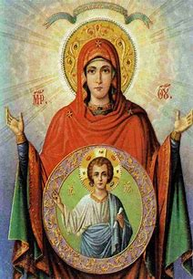
Why is Our Lady called the “New Ark of the Covenant” or “Ark of the New Covenant”? (2)
Mother Mary is the New Ark of the Covenant, because she held Jesus within her. She like a tent, a tabernacle, containing Jesus, the new manna from Heaven, the Bread of Life Who nourishes us with His Body
Jesus is the king Who leads us. He has the spiritual authority of a priest, for He is the Eternal High Priest Who makes constant intercession for us, sacrificing His life for our salvation
Jesus is also the new lawgiver, the one Who gives the New Commandment to love each other as we love ourselves, and to love God with all of our hearts, minds, souls, and strength
Jesus is the fullness of time, the embodiment of God’s love, and brings everything together. He is priest, prophet, and king. Each item in the Old Ark of the Covenant is a symbol of what Christ would be, as priest, prophet, and king
This reminds us that we have a threefold call to holiness, too, as we are called to be like Christ, and to exercise the common priesthood to help everyone to come to know Him

Slide 22
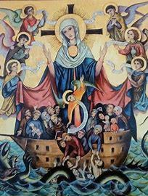
How is Noah’s ark a Marian type in the Old Testament?
Noah’s ark is different from the Ark of the Covenant
The Ark of the Covenant is a receptacle holding tangible signs of how God has kept His promises to His people, His covenants, or agreements, with His children
Noah’s ark is a boat that was built to save animals and people from the destructive flood that God sent to cleanse the world from sin
Our Lady is similar to Noah’s ark, because she held Christ within her, and He is the Savior Who would rescue people from the destruction of sin, cleansing them with the living water from His Sacred Side, pierced on the Cross
Noah built the ark when God called him to; God called Our Lady to serve as the “ark” holding Jesus; both Noah and Our Lady said “yes” to God’s plan
The sign of God’s covenant with Noah, of his agreement with Noah, was a dove that came holding an olive branch after the flood
Jesus is the Prince of Peace Whose Passion started in the Garden of Gethsemane, an olive garden; He brought peace through His Sacrifice, restoring order by redeeming humanity from sin

Slide 23
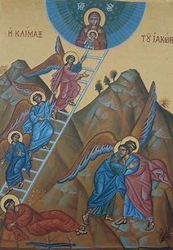
How is Jacob’s ladder a Marian type?
In the Old Testament, Jacob’s ladder was a bridge between Heaven and Earth. The holy angels would go back and forth, going up and down the ladder, bringing messages from Heaven to Earth, and from Earth to Heaven
This represents Our Lady’s role as a bridge between Heaven and Earth. When we pray for Our Lady to help us, she brings our petitions to Jesus in Heaven, and then responds to us. She helps us to climb the ladder to Heaven
In giving birth to Jesus, Who came down from Heaven to save souls on Earth, and to open up the gates of Heaven to us, Mother Mary served as a bridge between Earth and Heaven

Slide 24
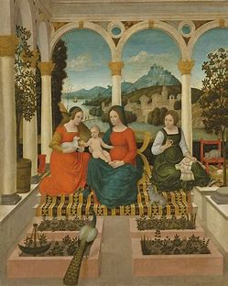
How is the closed door of the temple a Marian type?
The closed door of the Temple in the Old Testament prefigures Mother Mary’s perpetual virginity
The Temple was the Holy of Holies where God was Present
The door to the Temple remained closed to protect what was within
Our Lady was inviolable. She was similar to a temple, because she held Jesus, our Savior, within her: God was Present in her womb. The door to the temple would remain closed; we not only believe that Our Lady was a virgin at the time of Christ’s Birth, but that Our Lady remained a virgin for life

Slide 25
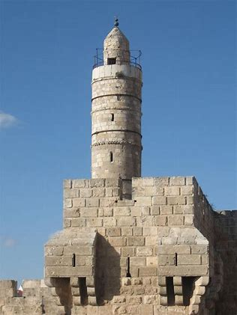
How is the Tower of David a Marian type?
The Tower of David is a tower of defense in battle
  It is impenetrable; no opponents can break through. The tower remains strong, keeping people safe
  It is a fortress on the tallest peak in Jerusalem
  David is the King who prefigures Christ
Our Lady protects and defends us in the spiritual battle, keeping us close to Jesus
  Our Lady is impenetrable, not only in a physical sense, but in a spiritual one: her faith cannot be shaken. She is unbreakable, because she stands by the Cross on Calvary Hill in Jerusalem, the tallest spiritual mountain to climb, remaining faithful to God, full of strong hope and love, without collapsing, without yielding to fear, sorrow, or anxiety
  Our Lady helps us to remain strong when we face tall spiritual mountains to climb, leading us to progress gradually through stages of ascent
  Remaining sheltered in the Hearts of Christ the King and Our Lady, Queen of Heaven, we are kept safe from spiritual danger

Slide 26
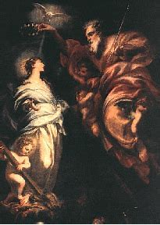
How does Our Lady fulfill Old Testament prophecies?
It was prophesied in the Old Testament that a virgin would give birth to the Savior, and Our Lady, a virgin, gave birth to Jesus after the Holy Spirit overshadowed her
  Our Lady was consecrated to God completely: her parents had prayed for a child, and promised to consecrate their child to God if He gave them one. Our Lady was immaculately conceived, totally free of sin from the beginning of her existence, so that she could be consecrated for the special purpose of giving birth to Christ, the Savior. She was given in service to God at the age of three, when she went to live in the Temple. Her virginity was consecrated to God
  St. Matthew quotes this prophecy from Isaiah 7:14
    “Behold a virgin shall conceive, and bear a son, and his name shall be called Emmanuel.”

Slide 27
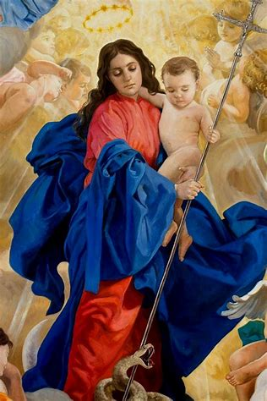
What is the Protoevangelium?
The Protoevangelium is the “first gospel,” from the root word “proto” meaning “first.” The root “evangel” refers to the Gospel, the good news. To “evangelize” is to spread the good news
This writing is not actually one of the four Gospels in the New Testament, but prefigures them; it is the Book of Genesis in the Old Testament, and is the “first gospel,” because it tells the story of Adam and Eve, and foretells the coming of the New Adam and the New Eve
This is not to be confused with the Protoevangelium of James, which is not a biblical work, but an early Church writing that retold events recorded in the New Testament, without aligning completely with the narratives of the evangelists

Slide 28
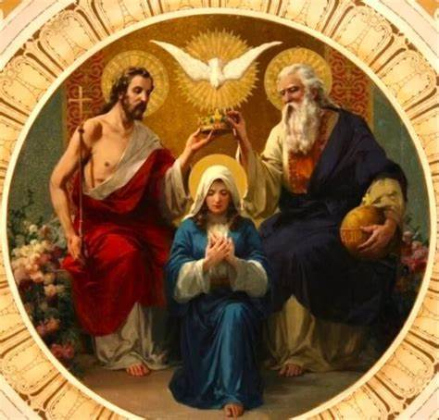
How does Our Lady harmonize the two Testaments of the Bible?
Mary is the Mother of Jesus, Who is the fullness of time. Jesus brings together past, present, and future. Our Lady, in giving birth to Christ, participates in redemption with Him, serving as the co-redemptrix; she is the spiritual mother of everyone, so she, too, brings people together, transcending time and place
Our Lady represents the Old Testament, because she was faithful to Jewish law, an obedient daughter of Israel, but she fully embraced Jesus as the new lawgiver, and accepted the new law, so she represents the New Testament as well, bridging the two Testaments
Our Lady brings together Sacred Scripture and Sacred Tradition, for she gives birth to Jesus, Who institutes all of the sacraments that make up Sacred Tradition; Sacred Scripture is the word of God, and Sacred Tradition is the Word made Flesh; Jesus brings all of the Scriptural prophecies to life
Our Lady was loyal to God the Father, God the Son, and God the Holy Spirit, following their will. She said “yes” to God the Father’s plan for her to give birth to Jesus, the Savior prefigured in the Old Testament, Who fulfilled all past prophecies in the New Testament

Slide 29
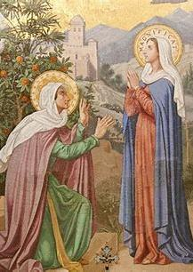
From her words and actions recorded in Scripture, what does Our Lady teach us about honoring God? (1)
“Let it be done unto me according to Thy word”
  Our Lady gives herself entirely to the service of God. She trusts in Him to do what will be best. She humbly offers herself as a vessel, through which miracles may be worked
  Our Lady always reflects and echoes Christ. He was obedient to God, saying “Thy will be done” and embracing the Cross
“My soul doth magnify the Lord”
  Our Lady honors God by giving Him all of the glory, never taking any credit for herself. She wants to shine for God, instead of placing herself in the spotlight. Our Lady knows that she is a creature of God, a creation, who is meant to adore the Creator

Slide 30
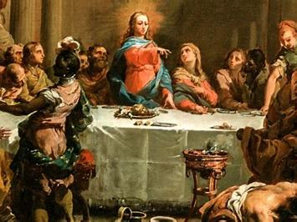
From her words and actions recorded in Scripture, what does Our Lady teach us about honoring God? (2)
“Your father and I have sought Thee”
  When Our Lady found Jesus after He had been lost at the Temple, she expressed her worry for Him, asking where He had been. She reminds us that when we are anxious, or dealing with loss, we should always seek out Jesus, in Whom we find all that we need; we should never give up in seeking out Jesus
“Do what He tells you”
  Our Lady called the servants at the Wedding at Cana to follow Christ’s instructions so that He could help the newlywed couple after they ran out of wine at their wedding feast. In being obedient to Jesus, great miracles can be worked; Jesus will receive our open hearts, and fill them with His love. Our Lady implores us to go to her Son when we are in need; she teaches us to be faithful to Him, like she was

Slide 31
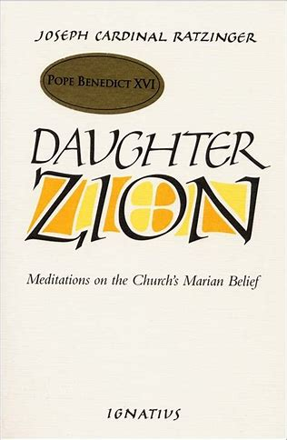
How may we carry our learnings about Marian typology going forward, or how might we learn more about this subject?
Read Daughter Zion by Cardinal Ratzinger (Pope Benedict XVI) to understand the Church’s Marian belief, especially as applied from Scriptural analysis
Pray the Scriptural rosary
  Use a booklet with Scripture verses associated with each Mystery
Pray the Little Office of the Blessed Virgin Mary, or say seven “Glory Be” prayers per day, meditating on the joys and sorrows in Our Lady’s life, and thanking God for her
Contemplate how to apply the virtues that Mary and her types exhibit: pray to grow in faithfulness to God, and to open the eyes of your soul to see how God has been faithful to you in your life
Engage in visio divina: look at paintings of Old Testament scenes featuring Marian types such as Esther, and spend time contemplating how they prefigure Our Lady; journal about the similarities or differences you see, and think about how you can embody the spirit of Our Lady, inviting her more deeply into your heart, and cherishing her as a treasure therein

Slide 32
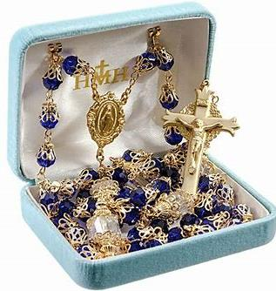
How does the Holy Rosary allow us to grow closer to Our Lady through Scripture?
The Holy Rosary is a Scriptural prayer
  The “Hail Mary” prayer comes from lines in Sacred Scripture, starting with the archangel St. Gabriel’s greeting to Mother Mary: “Hail, Mary, full of grace, the Lord is with Thee.”
One can pray a Scriptural rosary by meditating on the lines of Sacred Scripture that have to do with each Mystery, such as the Annunciation or the Nativity of Our Lord, which are part of the Joyful Mysteries of the Holy Rosary
Our Lady has asked people throughout history to pray the Holy Rosary. Fulfilling her request will console her Immaculate Heart. Our Lady gives us what we need to be fulfilled, so praying the Holy Rosary will make us happy, too, as we meditate on the faithfulness of our Blessed Mother to God, meditating on her fidelity as we pray each Mystery
We also contemplate Jesus’ goodness and faithfulness when we pray the Holy Rosary, which brings the greatest joy to Our Lady, because she loves for her Son to be given glory. We learn from the example of Jesus, and with Mary’s guidance, can become more like Him, so that we become closer sons and daughters to Mother Mary

Slide 33
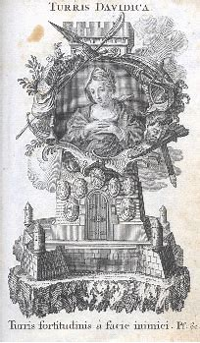
How does praying the Litany of the Blessed Virgin Mary allow us to deepen our relationship with Our Lady through Scriptural engagement?
The word “litany” means “supplication”
  When we pray litanies, we are asking God to help us, to provide for us, and praising Him with special titles as we recall His faithfulness, remembering how He has provided for His people since time began
  In praying the Litany of the Blessed Virgin Mary, we meditate on Our Lady’s faithfulness to God, and ask her to pray for us, that we might serve God faithfully as she did
The titles that we use to honor Mother Mary in the Litany of the Blessed Virgin Mary are Scripture-based (i.e. the Tower of David or the Mystical Rose)
Each title links to an image of Our Lady in Scripture, helping us to see how she reflects the beauty, truth, and goodness of God. We come to love her more in meditating on what a wonderful creation of God she is

Slide 34
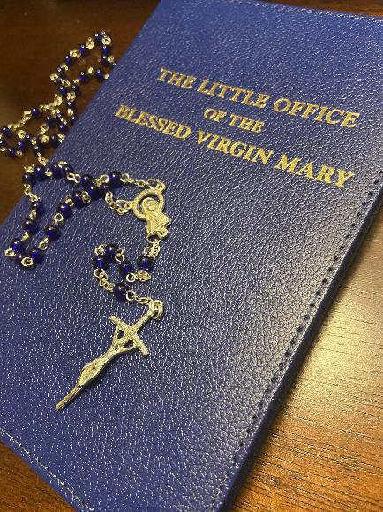
How does the Little Office of the Blessed Virgin Mary allow us to deepen our engagement with Our Lady through Scripture?
The Little Office of the Blessed Virgin Mary includes an office of prayer for each canonical hour of the day; there are eight hours in total that one may pray
During each hour of prayer, one meditates on psalms from the Old Testament that prefigure Our Lady, and some readings directly relating to, or quoting, Our Lady from the New Testament, such as the “Magnificat”
This devotion allows us to praise God throughout the day like Our Lady did, and to keep Our Lady in our hearts, that we may think of her virtues often, and remember that she is with us, watching over us as our heavenly Mother

Slide 35
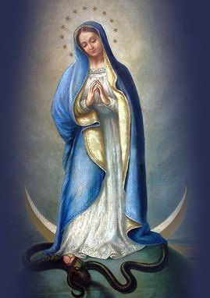
Why is Marian devotion so powerful in the spiritual battle?
Scriptural prayers and Marian prayers separately are powerful, but together, when one uses a prayer that is both Scriptural and Marian, such as the Holy Rosary, they are equipping themselves all the better to fight against sin
Jesus battled temptations in the desert by quoting Scripture, remaining focused on the truths imparted by His heavenly Father; He teaches us that Sacred Scripture keeps us close to God, because as the inspired word of God, it is the truth, and God is perfect beauty, truth, and goodness
Sacred Scripture attests to the goodness of Mother Mary, our spiritual mother, helping us to increasingly know and love her, to remain close to her.
Our Lady crushes Satan under her heel, so being devoted to Our Lady brings us nearer to Christ, and distances us more from evil, as God put enmity between the woman and the serpent (Eve and the serpent/Mother Mary and Satan). Our Lady will protect us from evil, since we are her spiritual children, and she has a claim on us, since Jesus paid the price of our sins with His life

Slide 36
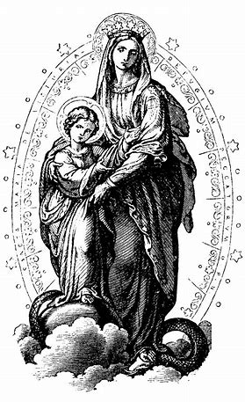
What does the Book of Revelation teach us about Our Lady?
In the Book of Revelation, the apocalyptic literature written by St. John, we read of his dream, his vision, involving a “woman clothed in the sun, wearing a crown of twelve stars, with the moon under her feet.” This is a vision of Our Lady. As the New Eve, she battles the dragon, just like Eve facing the serpent
Our Lady is the moon who reflects the light of Jesus, the sun
She wears a crown of twelve stars to represent the twelve tribes of Israel from the Old Testament, and the twelve apostles in the New Testament, whom Christ brings together. Twelve is the number of the Church, and Our Lady makes us stronger sons and daughters of Holy Mother Church by leading us closer to Jesus, the Bridegroom of the Church, that we may serve Him well
The Book of Revelation hints at our spiritual rebirth, linking back to Genesis, the story of creation. In the Book of Genesis, after Adam and Eve disobey God, they are clothed with skins, kept within the earthly realm. God clothes the woman in the sun, in Christ, in the Book of Revelation, hinting at our birthday in Heaven, into the light of glory, when we are faithful to Christ like Our Lady

Slide 37
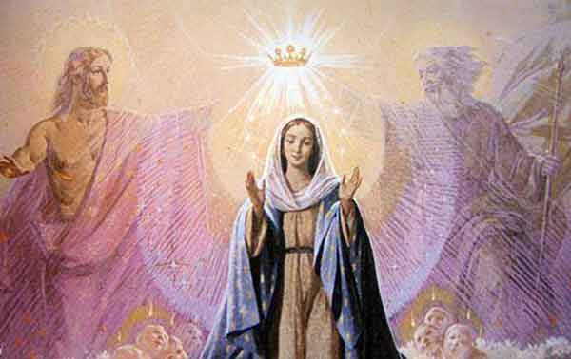
Closing Prayer: “Hail Mary”
Hail, Mary, full of grace,
The Lord is with thee;
Blessed art thou among women,
And blessed is the fruit of thy womb, Jesus.
Holy Mary, Mother of God,
Pray for us sinners,
Now and at the hour of our death. Amen.

