Slide 1
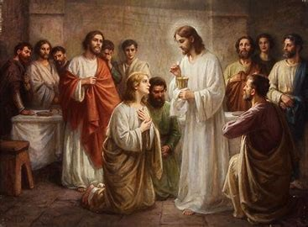
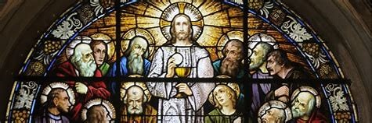



Rel. Ed. Class Session 8
Thursday, April 3, 2025
Katie Sadakierski
Our Lady of the Valley

Slide 2
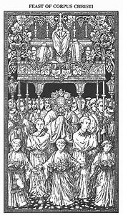


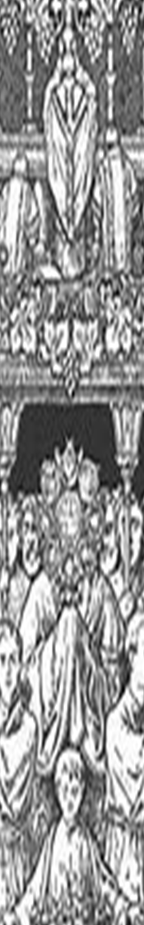

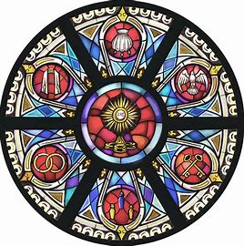


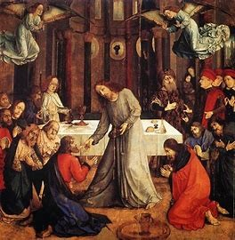
April 2025
Class Outline
Holy Mass
Opening prayer
Overview of monthly theme and activities
Learning centers
Announcements
Closing prayer

Slide 3
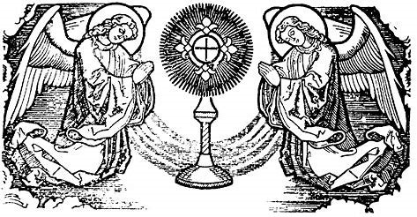
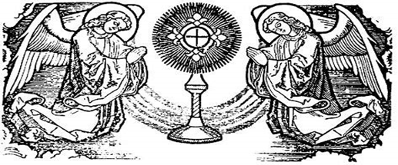
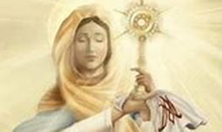


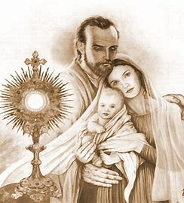
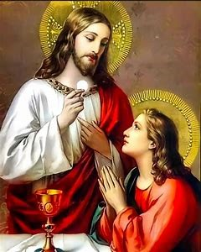


Opening Prayer: “Our Father”
Our Father, Who art in Heaven,
Hallowed be Thy Name.
Thy kingdom come.
Thy will be done on Earth, as it is in Heaven.
Give us this day our daily bread.
And forgive us our trespasses,
As we forgive those who trespass against us.
And lead us not into temptation,
But deliver us from evil. Amen.

Slide 4
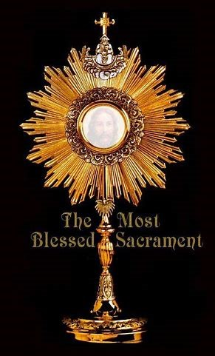

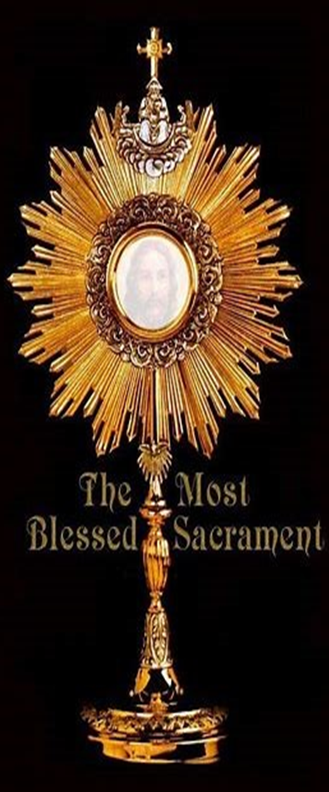
Overview of April:
Month of the Holy Eucharist
April theme: Mary, Mother of Mercy; Our Lady of Good Counsel; Mary, Mother of the Most Holy Eucharist
Saint of the month: St. Louis de Montfort
Altar this month:
  Liturgical colors: Purple (Lent) and white (Easter)
  Divine Mercy holy water
  Eucharistic and Marian St. Benedict blessing hanger
  The Resurrection of Our Lord sacred images
  Crucifix
“Mary is the safest, easiest, shortest, and most perfect way of approaching Jesus.” –St. Louis de Montfort

Slide 5



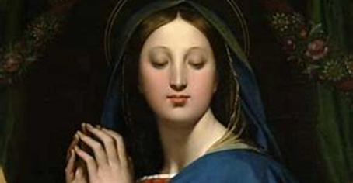
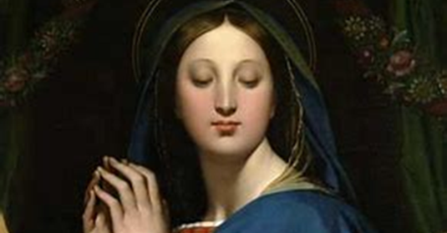
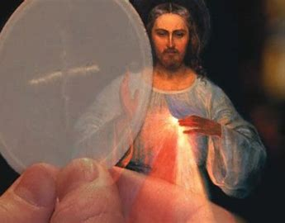
Grades PK-2:
April 2025 Activities
Week 1: Ways of sharing our faith; having faith in Jesus, our Friend
Week 2: Signs of our faith in the Church and the world around us; how Jesus changes us for the better
Week 3: Having faith in Jesus’ Presence in the Holy Eucharist; receiving the light of Jesus’ love into our hearts, and shining His light
Tonight’s learning center (parish hall): Making Divine Mercy chaplets

Slide 6


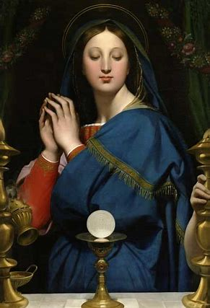
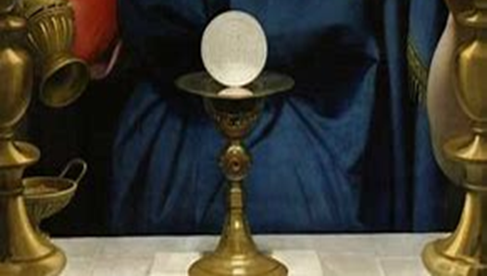
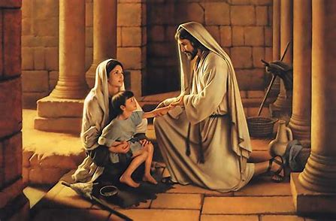

Grades 3-6:
April 2025 Activities
Week 1: Celebrating Holy Week; how Jesus brings hope; signs of new life as signs of Jesus’ love
Week 2: Having faith in Jesus like the saints
Week 3: Eucharistic miracles, and how they build our faith in Jesus
Tonight’s learning center (parish library): Stories of God’s mercy in Scripture Bible scavenger hunt; the corporal and spiritual works of mercy

Slide 7


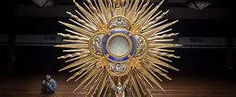

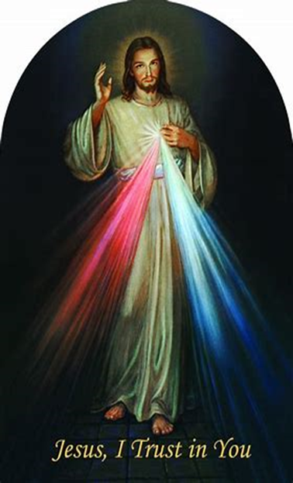
Grades 7-9:
April 2025 Activities
Week 1: How we celebrate our faith during Holy Week; the connection between the Chrism Mass and Confirmation; Confirmation as inner renewal/an inner experience of Easter
Week 2: Signs of Jesus’ beauty, truth, and goodness in Scripture, and around us, that increase our faith; practicing our faith through using sacramentals: rosaries, images/sacred art
Week 3: Reflecting on Lent, and looking forward to Easter: practicing our faith in the seasons ahead
Tonight’s learning center (church): Praying and living the Divine Mercy chaplet; imitating the Holy Spirit, and using the Gifts of the Holy Spirit, in showing others mercy

Slide 8





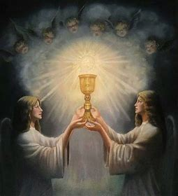

Announcements 1: Parish-Wide Holy Week/Easter Schedule of Masses and Devotions (1)
Lenten Mission Talk: Monday, April 7, 2025, 6:00 p.m., church
Gorzkie Zale: Wednesdays during Lent at 5:30 p.m. in the church
  Wednesday, April 9, 2025; Wednesday, April 16, 2025
Stations of the Cross: Fridays during Lent at 5:00 p.m. in the church
  Friday, April 4, 2025; Friday, April 11, 2025
Holy Thursday Mass: Thursday, April 17, 2025
  6:00 p.m., church
Good Friday Commemoration of the Passion: Friday, April 18, 2025
  3:00 p.m., church

Slide 9





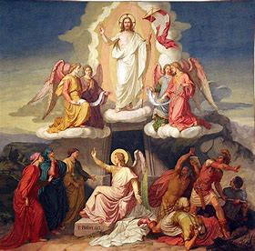

Announcements 2:
Parish-Wide Holy Week/Easter
Schedule of Masses and Devotions (2)
Blessing of Easter Food: Saturday, April 19, 2025, parish hall
  11:00 a.m.; bring ham, bread, cheese, butter, eggs, horseradish, salt (traditional)
Easter Vigil Mass (Holy Saturday): Saturday, April 19, 2025
  8:00 p.m., church
Easter Sunday Masses: Sunday, April 20, 2025
  7:00 a.m. (Polish)
  8:30 a.m. (English)
  11:00 a.m. (English)
  12:30 p.m. (Latin)
Divine Mercy Sunday: Sunday, April 27, 2025
  Hour of mercy: 3:00 p.m.

Slide 10


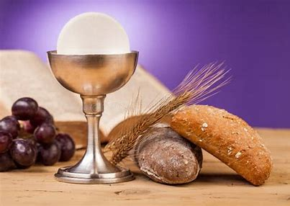
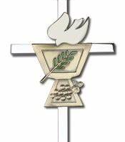

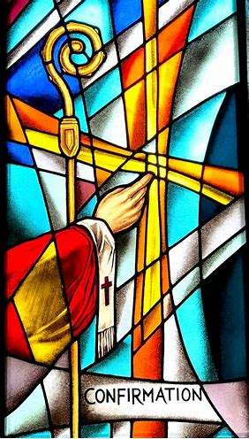


Announcements 3:
Confirmation 2025
Confirmation Mass keepsake video order forms available
Confirmation Rehearsal: Thursday, April 24, 2025
  6:00 p.m., church; bring questions; have service logs
Confirmation Service Log Deadline:
  Confirmation rehearsal (Thursday, April 24, 2025)
Mass of Confirmation: Wednesday, April 30, 2025
  5:30 p.m., church
  Reception in parish hall to follow (~6:30 p.m.)
    Survey on food allergies/accommodations has been sent

Slide 11
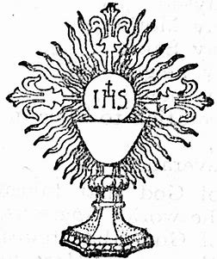



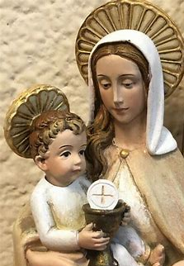
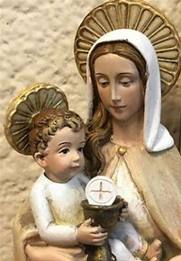
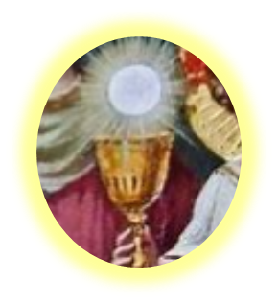
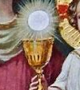

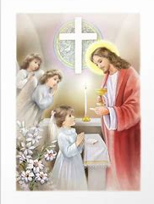

Announcements 4:
First Holy Communion
Mass of First Holy Communion keepsake video order forms available
First Holy Communion Retreat: Saturday, April 5, 2025, 11:00 a.m. to 1:30 p.m.; meet in parish hall
  Bring photos or special supplies for pew banners; bring prayer cards; have questions ready for First Confession rehearsal
First Confession for First Holy Communion class: Thursday, April 10, 2025, 6:00 p.m., church
  May bring prayer cards
First Holy Communion Rehearsal: Tuesday, April 29, 2025, 6:00 p.m., church
  Bring questions
Mass of First Holy Communion: Saturday, May 3, 2025, 11:00 a.m., church; bring pew banners
  Reception in parish hall to follow (~12:00 p.m.)
    Survey on food allergies/accommodations to come

Slide 12

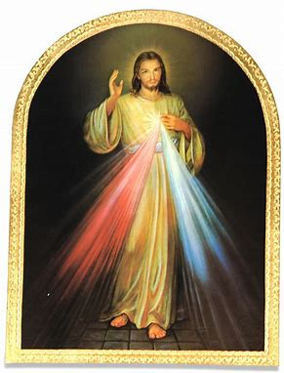


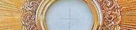

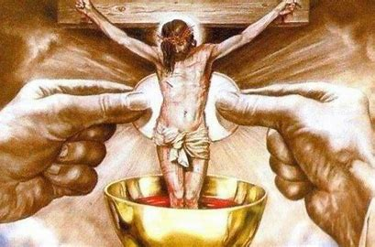
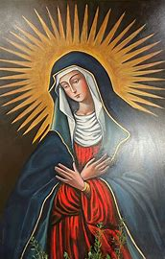
Announcements 5: April 2025 Special Parish-Wide Devotions
Next First Friday Mass: Friday, April 4, 2025, 6:00 p.m.
  Two Hearts Guild meeting: 7:00 p.m., parish hall
Next First Saturday Blessing of Sacramentals: Saturday, April 5, 2025, after 9:00 a.m. Mass
  Bring Easter, First Holy Communion, or Confirmation gifts to be blessed
Next First Sunday Adoration: Sunday, April 6, 2025, 2:00 p.m. to 5:00 p.m.
  Exposition of the Blessed Sacrament: 2:00 p.m.
  Benediction: 5:00 p.m.

Slide 13

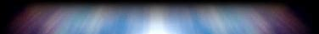

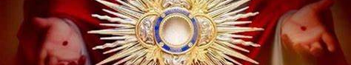
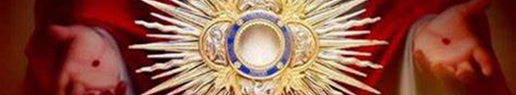
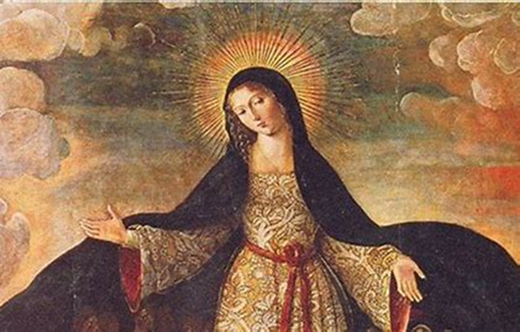
Announcements 6: Adult and PK-12 Religious Education
Little Office of the Blessed Virgin Mary prayers during Holy Week (see full schedule on website or printout)
  First session: Sunday, April 13, 2025 (Palm Sunday), 3:00 p.m., parish library
Next class meeting: Thursday, May 1, 2025, 6:00 p.m., parish hall
  All grades: Bring prayer cards and completed activities
  Grades 7-9: Bring prayer journals and completed activities
    Confirmation students may still attend

Slide 14
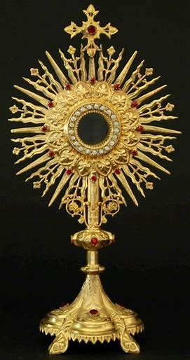

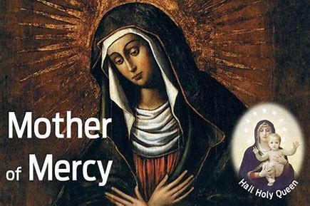
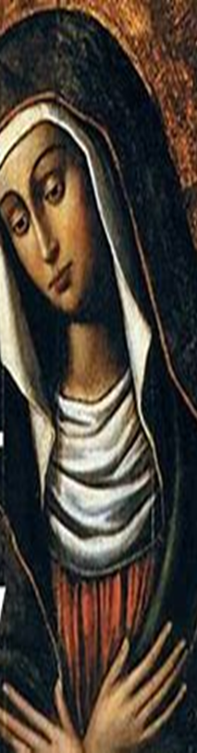

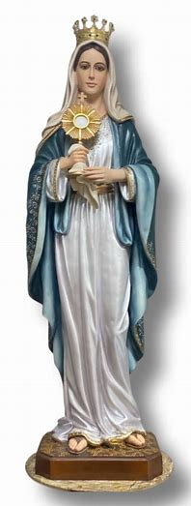
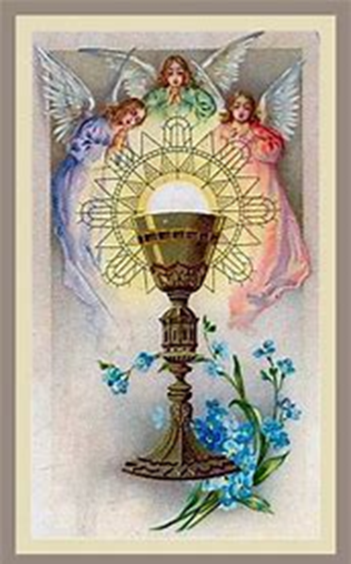

Closing Prayer: “Hail Mary” & Invocation
Hail, Mary, full of grace,
The Lord is with thee;
Blessed art thou among women,
And blessed is the fruit of thy womb, Jesus.
Holy Mary, Mother of God,
Pray for us sinners,
Now and at the hour of our death. Amen.
O Mother of the Most Holy Eucharist, pray for us.

