Slide 1
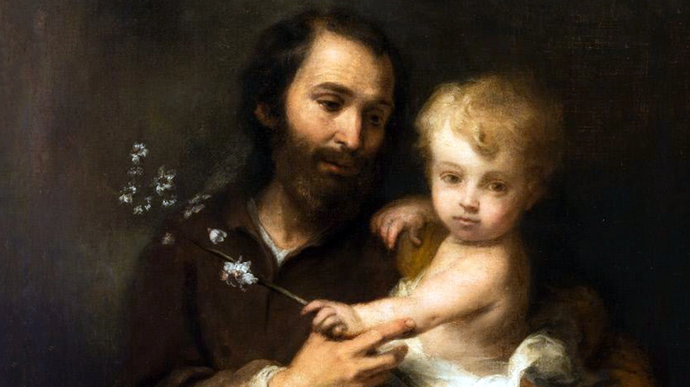
Guild Meeting 3
Two Hearts
Friday, March 7, 2025
Katie Sadakierski

Slide 2
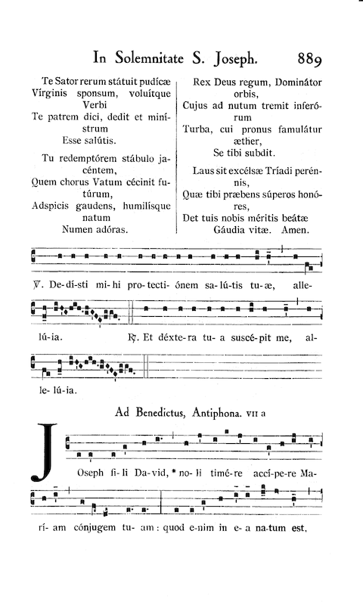
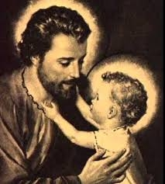
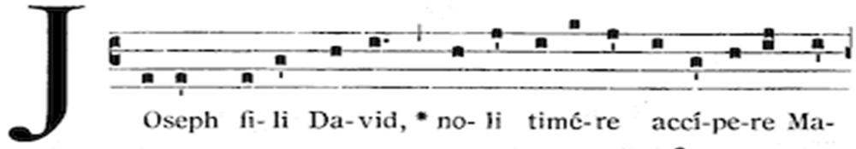
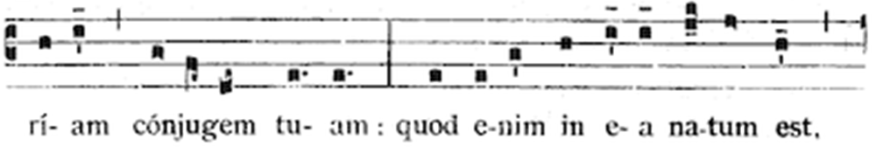

Two Hearts Guild Meeting 3 Outline
Welcome & Opening Prayer
Meeting presentation
  I. St. Joseph and devotion to the Two Hearts
  II. The virtue of faith: consoling the Two Hearts like St. Joseph
  III. Exercising devotion to the Three Hearts like the saints
Announcements
Closing Prayer
Q & A

Slide 3
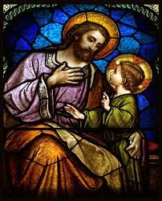
Opening Prayer 1: Prayer to St. Joseph
Saint Joseph, Guardian of virgins and father, to whose faithful care Christ Jesus, innocence itself, and Mary, Virgin of virgins, were entrusted, I ask and beg of thee, through these two dearest pledges, Jesus and Mary, preserve me from all defilement, and make it always possible for me unsullied in mind, pure in heart, and chaste in body to give to Jesus and Mary my holiest service. Amen.

Slide 4
Opening Prayer 2: Angelus of St. Joseph
V. The angel of the Lord appeared to Joseph in a dream.
R. “Joseph, Son of David, do not be afraid to take Mary, your wife, into your home.”
V. “For that which is conceived in her is of the Holy Spirit.”
R. “And she shall bring forth a son.”
V. “And you shall call his name Jesus.”
R. “Because He is the one who is to save his people from their sins.”
V. Pray for us, O virgin father of Jesus.
R. That we may be made worthy of the promises of Christ.
V. Let us pray.
All. Pour forth we beseech you, O Lord, your grace into our hearts; that we, to whom the Incarnation of Christ you Son was made known by the message of an angel, may by his passion and cross be brought to the glory of his resurrection. Through the same Christ our Lord, Amen.

Slide 5
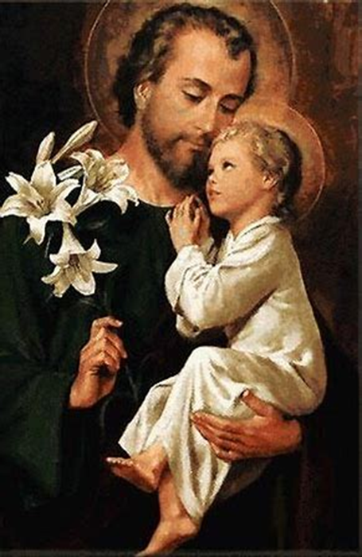
Why is March celebrated as the month of St. Joseph?
March 19 is the Feast of St. Joseph (solemnity in modern calendar, first-class feast day in traditional calendar)
  Some traditions hold that March 19 was the date of St. Joseph’s passage into the next life
    St. Joseph’s feast day used to be a holy day of obligation
      1742: all feast days in Lent omitted, except for Chair of St. Peter, St. Joseph, and Annunciation of Our Lord to Our Lady
      Cut in 1911; returned in 1917; then, in 1983, Code of Canon Law affirmed that bishops in dioceses may suppress this Feast as a holy day of obligation
March is the month of the Feast of the Annunciation (March 25)
  St. Joseph experienced an Annunciation, too; not only Our Lady

Slide 6
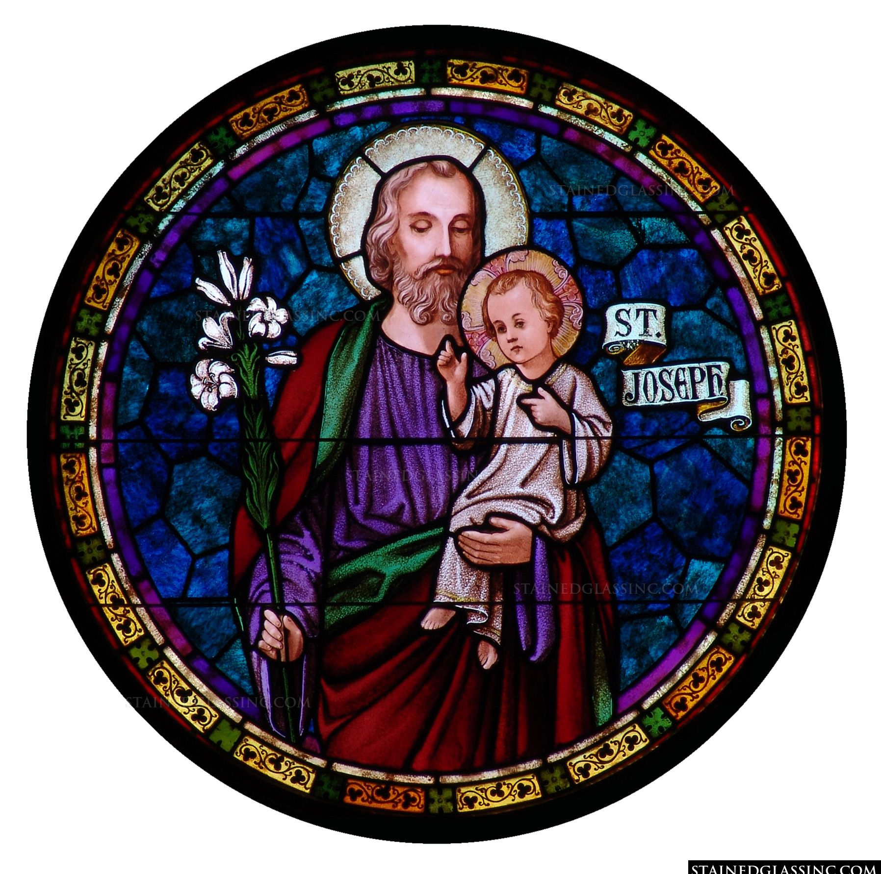
Who is St. Joseph? (1)
Foster father of Jesus
  Chosen by God the Father to be the adoptive father of His only Son
  Jesus is both human and divine: needed a human father to nurture His human nature, too
Chaste spouse of Our Lady
  Our Lady was espoused to the Holy Spirit; St. Joseph respected her spiritual union. He, too, lived a life of perfect chastity as a perpetual virgin

Slide 7
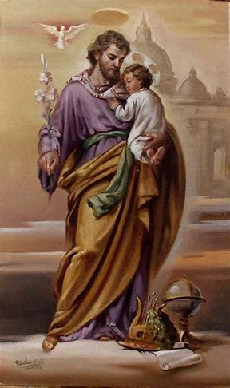
Who is St. Joseph? (2)
Head of the Holy Family
  The protector of Jesus and Mother Mary. He led his family away from any danger
Universal patron of Holy Mother Church: spiritual father for us all
  Was made universal patron by Pope Pius IX on December 8, 1870 (Feast of the Immaculate Conception of Our Lady); devotion to St. Joseph honors Our Lady, is devotion to her, too
    Blessed Jean Joseph Lataste offered his life for this cause
      Added to Eucharistic Prayer I in 1962 by Pope John XXIII; then added to other three Eucharistic prayers in 2013 (had been mandated by Pope Benedict XVI; born “Joseph” Ratzinger)

Slide 8
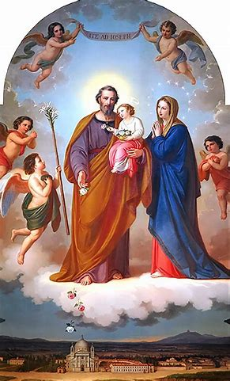

Why do we honor
St. Joseph?
Jesus and Mother Mary loved St. Joseph; we become holier by loving what they love. Jesus devoted 30 of His 33 years of life to St. Joseph and Mother Mary
  It brings Jesus and Mother Mary joy for us to honor St. Joseph, since they love him. Our devotion to him consoles their Hearts
  Jesus was obedient to St. Joseph. If we are to become closer to God the Father, we must make ourselves like God the Son, imitating His actions
St. Joseph is the most respected, the highest-ranking, among the saints after Our Lady
  We venerate St. Joseph; our form of veneration for him is called “protodulia” (we respect him as the first among saints)

Slide 9
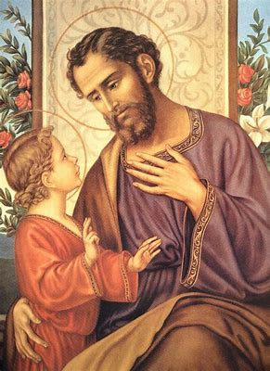
What does St. Joseph teach us about honoring Jesus and Mother Mary?
St. Joseph led his family with great care and tenderness
He was strong in his faith, taking decisive action informed by prayer
Shows us how to balance gentleness with fortitude, in a different way than Jesus and Mother Mary do
  Not called to same sacrifices that Jesus and Mother Mary were; but shared in Our Lady’s sorrows; faced difficult decisions, had to exercise bravery in trusting in God
  Lived a humble, hidden life; sacrificed in daily life, working hard to provide for Our Lady and Jesus
    Teaches us that we honor Jesus and Mother Mary not only through monumental actions, but through offering our works and prayers quietly to them, with great love

Slide 10

What is the Chaste Heart of St. Joseph?
The Chaste Heart of St. Joseph is a heart of pure love given in service to God the Father through service to Jesus and Mother Mary, the Sacred and Immaculate Hearts
Chaste Heart symbols:
  Adorned with lilies (for purity); white is the liturgical color of St. Joseph’s feast day, honoring his purity, just as Our Lady is honored with the color white in Marian celebrations
  Pierced with a sword: loves Our Lady, and sorrows when her Immaculate Heart is pierced; shares her pain (was not present at Crucifixion of Our Lord, but was for St. Simeon’s Prophecy about the pierced Heart, Our Lady’s first Sorrow)
  Topped with a flame: a sign of chaste love and devotion

Slide 11
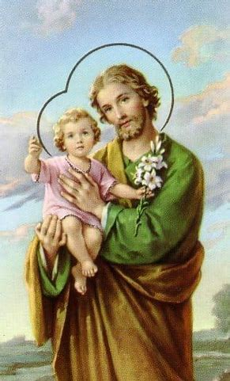
How did St. Francis de Sales live out devotion to St. Joseph?
St. Francis de Sales looked to St. Joseph as a role model
Was a bishop, a spiritual father drawing upon St. Joseph’s example to held him to serve as a strong and gentle leader who would successfully defend the Faith, and combat heresy
  Converted 72,000 Calvinists; certainly, St. Joseph would have had a hand in this. St. Joseph defended Holy Family, the first domestic Church, from any danger
While praying Divine Office, contemplated image of St. Joseph holding the Christ Child; saw it as an image inspiring deeper love for, and faith in, God the Father

Slide 12
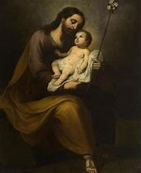
How did St. Margaret Mary Alacoque practice devotion to the Sacred Heart like St. Joseph? How might we imitate her in honoring the Sacred Heart like St. Joseph?
During His Sacred Heart revelations, Jesus asked St. Margaret Mary Alacoque to pray each day to Mary, His Mother, and to St. Joseph, His “sweet guardian”
To guard Jesus’ Heart from irreverence, we pray to St. Joseph
Like St. Margaret Mary, we can adore Our Lord in Eucharistic Adoration, offering our prayers of thanksgiving to Him for the gift of our spiritual parents, St. Joseph and Mother Mary
  St. Joseph was one of the greatest adorers of Christ; in our prayers, we can hold Jesus close to our hearts, like him
  St. Joseph is the dispenser of the treasures of the Sacred Heart: Our Lady is the closest to Jesus, the supernatural source of grace; she brings these treasures to St. Joseph to give them to us, since he is the earthly father of Christ, not supernatural

Slide 13
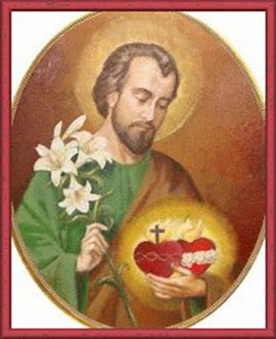
Why is devotion to St. Joseph part of devotion to the Two Hearts? What is the “Three Hearts” devotion?
St. Joseph brings us closer to Jesus and Mother Mary
  The Chaste Heart is united with the Sacred Heart and the Immaculate Heart
  St. Joseph shows us how to respond with love to Jesus and Mother Mary by treating them with gentleness. He protected them, and we, too, can defend our Faith, consoling the Hearts of Jesus and Mary, making reparations for irreverences towards them in the world
    From St. Joseph, we learn to respond to the Presence of Jesus and Mother Mary with the greatest sense of dignity and honor. St Joseph is a knight who fights the good fight against evil, out of love for what is good, and comes from God
  To become closer to the Two Hearts, we can go to St. Joseph (ite ad Joseph). He protected their Hearts, and will guard ours from sin

Slide 14
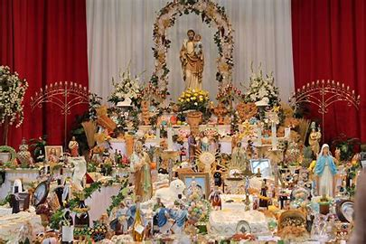
Why is the holy priesthood connected to St. Joseph? How might we honor the spiritual fatherhood of our priests on St. Joseph’s Day? (1)
St. Joseph was not a priest, but demonstrates the courage, faith, and love that priests should have as fathers guarding the flocks entrusted to them by God
  Priests preserve the treasures of our Faith, just as St. Joseph preserved Jesus and Mary. St. Joseph is a model of purity of heart that is needed to love Jesus and Mary
St. Joseph’s Day altar tradition (for family table): recalls priests offering bread and wine on the altar for the salvation of souls, remission of sins
  St. Joseph offered himself to the service of God to protect Jesus, the living Chalice of the Precious Blood, and Our Lady, the living ciborium who held Jesus, the Bread of Life, in her womb
  Priests gather us around God’s table, bringing us the Bread of Heaven, so that we may all be reunited in eternal glory, at the wedding feast of the Lamb

Slide 15
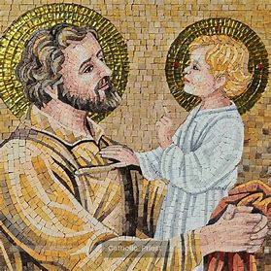
Why is the holy priesthood connected to St. Joseph? How might we honor the spiritual fatherhood of our priests on St. Joseph’s Day? (2)
St. Joseph’s Day altar: three tiers (Holy Trinity; Holy Family; theological virtues)
Climb “tiers” (stairs) to Heaven by imitating St. Joseph’s virtues; love for Holy Trinity and Holy Family
  Symbols: carpentry tools (carpenter’s square: guides carpenters in making right angles; St. Joseph always did the right thing, is our guide)
  Breads: pray while baking; before consuming, say “grace,” offering prayers for priests who give us the Bread of Life
  Breads are shaped like monstrances, chalices, crown of thorns, and burning Hearts
    St. Joseph protected Christ, holding Him close to his Heart, like the monstrance holding the Sacred Host
    St. Joseph protected Jesus until it was time for Jesus to be offered to God the Father like the Chalice of the Precious Blood at Holy Mass
    St. Joseph taught and raised Jesus in faith, showing Him how to sacrifice, to prepare Him for His Sacrifice
    St. Joseph models how to love God with a heart that is on fire

Slide 16
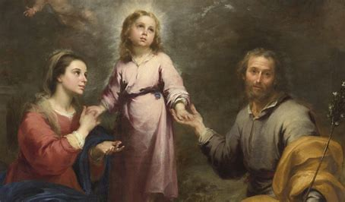
Why is the holy priesthood connected to St. Joseph? How might we honor the spiritual fatherhood of our priests on St. Joseph’s Day? (3)
Meditate on the Holy Mass readings for the Feast of St. Joseph, praying for the priests who celebrate Mass that day
Offer a canonical hour of the Little Office of the Blessed Virgin Mary for the intentions of priests
  Say the Commemoration of St. Joseph prayer afterwards
Offer the Holy Rosary for priests
  Say the Prayer to St. Joseph after the Holy Rosary

Slide 17
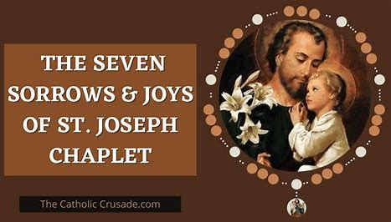
How might the Seven Sisters Apostolate honor St. Joseph? (1)
During weekly holy hours, Seven Sisters Apostolate members may honor St. Joseph by asking for him to intercede for their priest, especially through:
  Reflection on the Seven Sorrows and Seven Joys of St. Joseph; relate to lives and devotions of priests; consider how their perspective is like that of St. Joseph
    Doubt of St. Joseph/Message of the Angel
    Poverty of Jesus’ Birth/Jesus’ Birth
    Circumcision of Jesus/the Holy Name of Jesus
    The Prophecy of St. Simeon/the Effects of the Redemption
    Flight into Egypt/Overthrow of the Idols in Egypt
    The Return from Egypt/Life with Jesus and Mary in Nazareth
    Losing Jesus in Jerusalem/Finding Him in the Temple

Slide 18
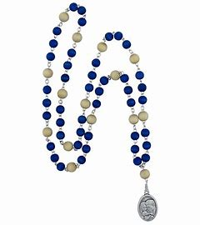
How might the Seven Sisters Apostolate honor St. Joseph? (2)
  Praying the Josephian Rosary
  Praying the Chaplet of St. Joseph
  Praying the Litany of St. Joseph
  Listen to the “Joseph, Fili David” chant; meditate on the lyrics
Offering a novena to St. Joseph
  St. Joseph’s Cloak novena

Slide 19
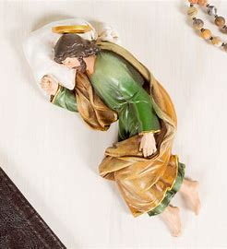
How might the Fasting Brothers Apostolate honor St. Joseph?
Meditate on St. Joseph’s sacrifices for his family; priest’s sacrifices for parish family as you offer your fast
Pray for the intercession of St. Joseph; go to him as your patron
  Ask him to help you to uphold the three Lenten pillars of charity, fasting, and prayer, like he did throughout his life
Use the sleeping St. Joseph statue in your devotions
  Place prayer intentions (i.e. successful fast) under the statue; ask St. Joseph to take care of them

Slide 20
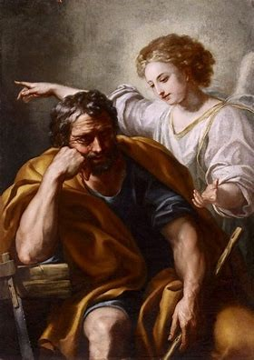
How did St. Joseph live out the virtue of faith? (1)
St. Joseph trusted in God amidst times of fear or uncertainty
God sent St. Joseph answers to his prayers in dreams when St. Joseph slept, having entrusted himself entirely to God, surrendering himself in faith
  Angels brought St. Joseph messages from God, and St. Joseph did not doubt them; in his purity, he was close to the holy angels

Slide 21
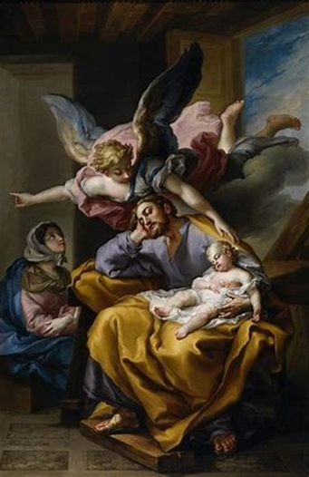
How did St. Joseph live out the virtue of faith? (2)
Faced three challenges with faith, putting them into prayer, and demonstrating hope in God the Father’s response by taking action, listening to what God called him to do:
  Angelic visit 1 (Annunciation to St. Joseph): St. Joseph believed that Our Lady had been unfaithful to him during their engagement, and planned to divorce her quietly upon learning that she was with child. When an angel told him not to fear, and to marry Our Lady, who was overshadowed by the Holy Spirit, he followed through. He accepted God the Father’s plan for him to become the foster father of Jesus, and the chaste spouse of Our Lady. He was chosen for his holiness, his faithfulness to God. God was faithful to him, answering his prayers
  Angelic visit 2: St. Joseph followed instructions to lead his family out of Israel, and into Egypt, to protect the Christ Child from King Herod’s murderous plot designed to eliminate Christ the King as a threat to his throne
  Angelic visit 3: St. Joseph followed instructions to lead his family back to Israel once King Herod had perished. He sought to find the safest place for his family to settle, knowing that King Herod’s son, Archelaus, had started his rule. In a fourth message, it was revealed that he should take his family to Nazareth, so that the prophecy about the Savior being a Nazarene would be fulfilled

Slide 22
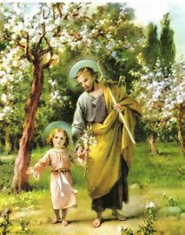
Why should we practice the virtue of faith in March, and how can we imitate St. Joseph in living out this virtue?
Lent falls during March
Devotion to St. Joseph strengthens our Lenten practices
St. Joseph helps us to live with faith, because he shows us how to persevere in the journey to Heaven, even when God’s messages may not be completely understandable, and we may not see the full picture yet
St. Joseph undertook long journeys with his family, walking great distances to bring them to safety. He made sacrifices, dealing with difficult conditions while traveling, but was ultimately happy to serve God the Father, Jesus, and Mother Mary out of love
  He will help to bring us safely through the Lenten desert, fortifying us on our mission to go deeper into the Hearts of Jesus and Mother Mary

Slide 23
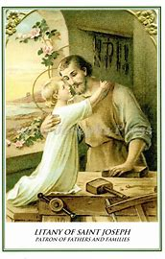
What is the Litany of St. Joseph? How does it compare to the Litany of the Sacred Heart or the Litany of Loreto?
The Litany of St. Joseph honors St. Joseph using special titles. We call upon him, asking him to pray for us, through invoking him with titles that honor his virtues
Similar imagery and holy qualities honored (when compared to Litany of Loreto for Our Lady, and Litany of the Sacred Heart for Jesus)
  St. Joseph: Mirror of patience; Our Lady: Mirror of justice; Jesus: Sun of justice

Slide 24
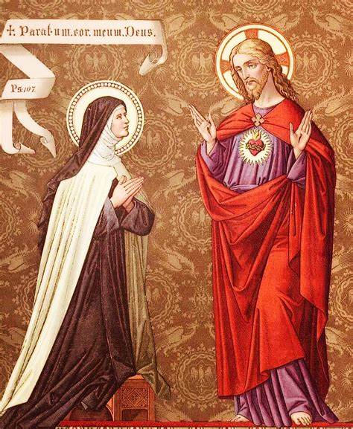
Who is St. Teresa Margaret of the Sacred Heart? What does she teach us about living out devotion to the Two Hearts?
Years of life: 1747-1770 (23)
Feast day: March 11
Carmelite nun (community with devotion to St. Joseph)
  Received locution: direct calling from St. Teresa of Avila
Cared for the sick tirelessly; sweet-natured and cheerful
Rejoiced in helping others, tending to souls like Our Lady
Her love for Jesus brought health to the sick (St. Joseph is invoked as “Hope of the Sick,” Our Lady as “Health of the Sick”)
Learned devotion to the Sacred Heart from her father as a child; favorite words were “God is love”
To express love for Sacred Heart, kissed five holy wounds of Christ on the crucifix, even while dying; inclined herself towards the Blessed Sacrament; mind, heart, and soul were given entirely to the Heart of Jesus

Slide 25
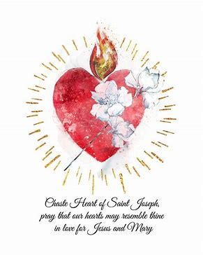
Which spiritual practices are used to venerate St. Joseph?
Wednesday devotions: always to St. Joseph, but First Wednesday of the month honors the Chaste Heart of St. Joseph
    Feast of the Chaste Heart is the first Wednesday after the Feast of the Sacred Heart (this year, July 2; Feast of the Visitation, following the Sacred Heart feast day on June 27)
    Wednesday is the middle of the week, a pivot point; St. Joseph, as head of Holy Family, was pivotal, making decisions to lead his family. After his death, Jesus began His public ministry (age 30)
  Prayers to St. Joseph: Memorare to St. Joseph
  Office of St. Joseph/Liturgy of the Hours of St. Joseph
  Holy Mass
    Confession
  Observance of Wednesday as a penitential day
    Fast/abstinence; sacrifice

Slide 26
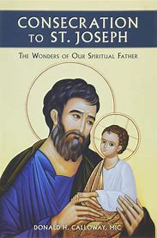
What is consecration to St. Joseph? What does it entail to fulfill it?
Entrustment to St. Joseph to allow for deeper entrustment to Jesus and Mother Mary
  A fuller integration into the Holy Family
May follow 33-day preparation process (similar to St. Louis de Montfort’s total consecration to Jesus through Mary program); end on a feast day connected to St. Joseph, saying the “Act of Consecration” prayer
  Pray the Litany of St. Joseph every day (in addition, may pray “Memorare to St. Joseph” or other prayers for St. Joseph’s intercession)
  Read a daily spiritual reflection on St. Joseph (usually on one of his Litany titles)
  Read further information about practicing devotion to St. Joseph like the saints; about his life; or about the relationships he had with Jesus and Mother Mary

Slide 27
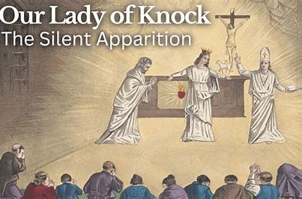
How did devotion to St. Joseph begin? How did it come to be connected to Sacred Heart/Immaculate Heart devotion(s)?
More recent devotion (growing within the last 150 years)
  St. Joseph always is near to the Two Hearts; they are united in love for God the Father
Apparitions of St. Joseph helped to ignite greater devotion to him
  1879: Our Lady of Knock appeared in Ireland with the Lamb of God, St. John the Evangelist, and St. Joseph (shed light on the Paschal Mystery); Our Lady was silent, just like St. Joseph was in the Holy Bible; teaches us to behold the Holy Mass, Christ’s Sacrifice with wonder, in the silence of our hearts, that we may hear the love He is speaking into our hearts. St. Joseph bowed head towards Our Lady out of respect and humility
  1917: Our Lady of Fatima, Portugal appeared to three shepherd children
    St. Joseph also appeared with the Christ Child; they made the Sign of the Cross, blessing the world (Miracle of the Sun, October 13)
    St. Joseph shepherded the Holy Family, and shepherds the universal Church as her patron

Slide 28
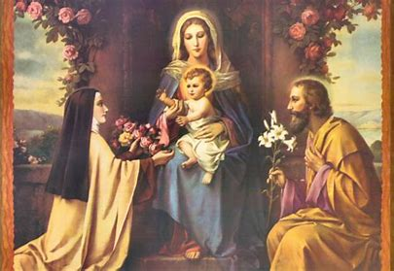
Who are some additional saints who had special devotions to St. Joseph? (1)
St. Teresa of Avila: Carmelite spiritual mother, Doctor of the Church
  Received visions of St. Joseph and Christ Child when praying to him in times of need; was healed by St. Joseph when gravely ill
    Our Lady commended St. Teresa for her devotion to St. Joseph
  Experienced his intercession; he helped her to work out difficulties in founding new convents, ensured that the Carmelite order would flourish; St. Teresa dedicated 2/3 of her monasteries to St. Joseph
  Promoted devotion to St. Joseph, emphasizing his power as an intercessor
    Carmelite tradition: leave items needed in front of St. Joseph, trusting that he will replenish them; elections of St. Joseph as prior of Carmelite convents
St. Therese of Lisieux: Carmelite, Little Flower; Doctor of the Church
  Invoked St. Joseph as the “Guardian of Virgins” (from the Litany of St. Joseph), especially when traveling (before entering the convent)

Slide 29
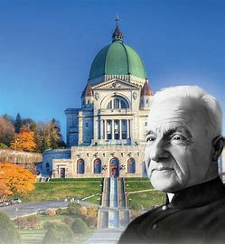
Who are some additional saints who had special devotions to St. Joseph? (2)
St. Andre Bessette (feast day: January 6): miracle worker
  Religious brother, not priest in Congregation of the Holy Cross (first Holy Cross saint)
  Greeter at Catholic college in Montreal; exemplified God’s love
  Founded St. Joseph’s Oratory with funds ($200) from cutting hair
  Collected oil from votive lamps burning at St. Joseph’s statue; used in healings
St. Faustina (feast day: October 5): Divine Mercy saint
  St. Joseph appeared to her; gave her a kind smile, and asked her to pray an “Our Father,” a “Hail Mary,” a “Glory Be,” and the “Memorare” each day
St. Gertrude (feast day: November 16): saint of the Holy Souls
  Saw him in a vision of Heaven; noted that other saints bowed to him respectfully, delighted in hearing his name be praised

Slide 30
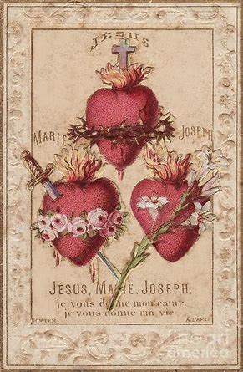
Upcoming Event Announcements: April 2025 First Friday Holy Masses & Two Hearts Guild Meeting
Next First Friday Masses: Friday, April 4, 2025
  8:00 a.m. (with Eucharistic Adoration)
  6:00 p.m. (Traditional Latin Mass)
Next meeting: Friday, April 4, 2025
  7:00 p.m., parish hall

Slide 31
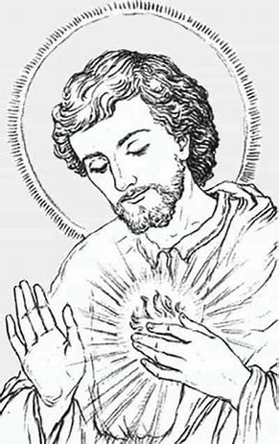
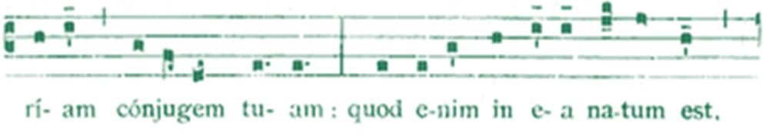
Upcoming Event Announcements: March 2025 Liturgical Rosary Prayer Group Sessions
Monday, March 17, 2025: 9:30 a.m., parish library
  Liturgical Rosary for the Feast of St. Patrick (Joyful Mysteries)
    Prayer intentions: Fr. Barrent
Wednesday, March 19, 2025: 6:45 p.m., parish library
  Liturgical Rosary for the Feast of St. Joseph (Glorious Mysteries)
    Prayer intentions: Fr. Sliwa
Wednesday, March 26, 2025: 4:30 p.m., parish library
  Liturgical Rosary for the Feast of St. Margaret Clitherow (Glorious Mysteries)
    Prayer intentions: Fr. Barrent

Slide 32
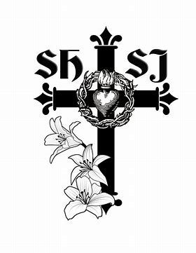
Upcoming Event Announcements: Parish-wide Devotions and Holy Masses for March 2025 (1)
Stations of the Cross: Fridays during Lent, 5:00 p.m. (church)
  March schedule: March 7, March 14, March 21, March 28
Gorzkie Zale: Wednesdays during Lent, 5:30 p.m. (church)
  March schedule: March 12, March 19, March 26

Slide 33
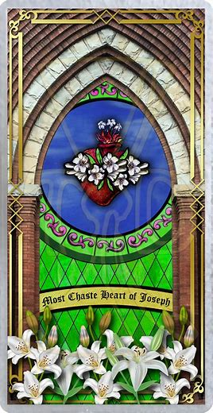
Upcoming Event Announcements: Parish-wide Devotions and Holy Masses for March 2025 (2)
Lenten talks for men and women: Mondays during Lent, 6:00 p.m. (church)
  March schedule: March 10, March 17, March 24, March 31
    Topic: Pope Pius XII’s encyclical on the Sacred Heart, “Hauretis Aquas”
Holy Masses for the Feast of St. Joseph: Wednesday, March 19, 2025
  12:00 p.m. (Traditional Latin Mass)
  6:00 p.m.

Slide 34
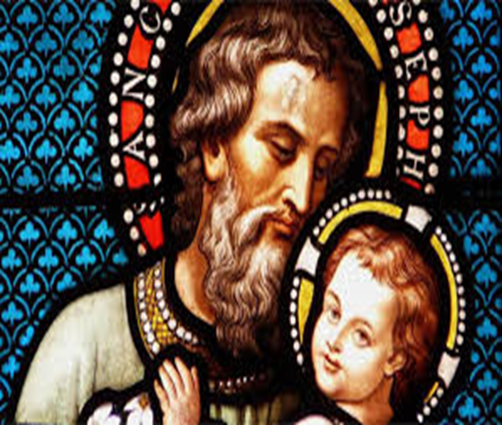
Closing Prayer: Memorare to Saint Joseph
Remember, O most pure spouse of the Virgin Mary, Saint Joseph, my beloved patron, that never hath it been heard that any one invoked thy patronage and sought thine aid without being comforted. Inspired by this confidence, I come to thee and fervently commend myself to thee. Ah, despise not my petition, dear foster-father of our Redeemer, but accept it graciously. Amen.

