Slide 1
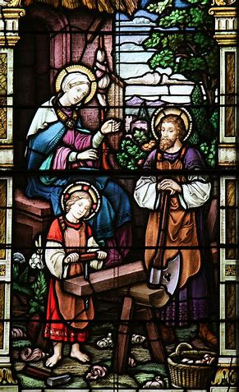
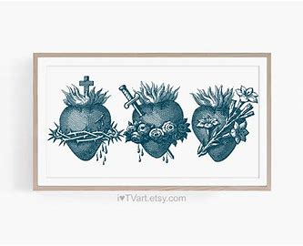

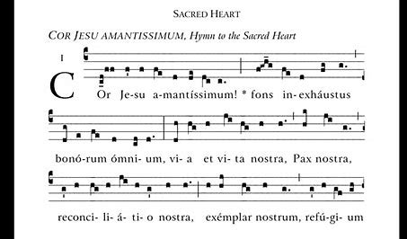
Two Hearts Guild Meeting 2
Friday, February 7, 2025
Katie Sadakierski

Slide 2
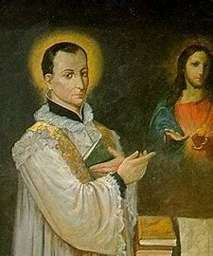
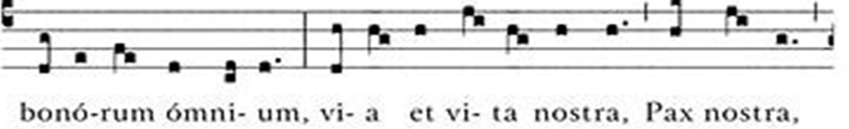
Outline: Two Hearts Guild Meeting 2
Opening prayer
Presentation
  I. St. Margaret Mary and priestly devotions to the Holy Family, Sacred Heart, and Immaculate Heart
  II. The virtue of charity: consoling the Two Hearts
  III. Exercising devotion to the Holy Family and Two Hearts
Announcements
Closing prayer
Q & A

Slide 3
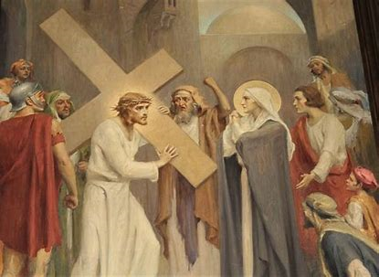
Opening Prayer: Hail Mary (3x)
Hail, Mary, full of grace,
The Lord is with thee;
Blessed art thou among women,
And blessed is the fruit of thy womb, Jesus.
Holy Mary, Mother of God,
Pray for us sinners,
Now and at the hour of our death. Amen.
Most Sacred Heart of Jesus, have mercy on us. (3x)
Sweet Heart of Mary, be our salvation. (3x)
Immaculate Heart of Mary, pray for Fr. Sliwa, Fr. Barrent, and Fr. Roux. Amen.

Slide 4
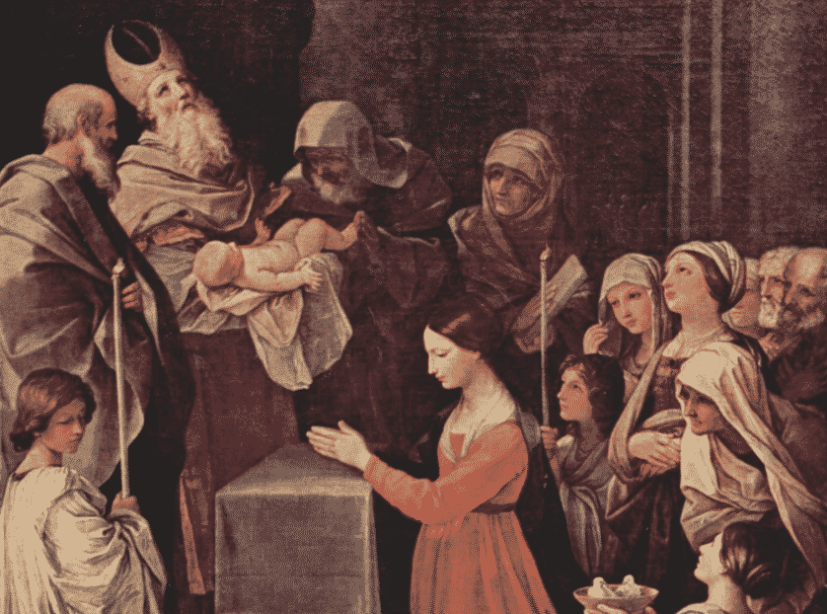
Why is February the month of the Holy Family?
Feast of the Holy Family (traditional): Sunday after Epiphany (January 12 this year)
Candlemas: February 2 (the Feast of the Presentation of Our Lord)
The Holy Family travels to the temple together
  St. Joseph and Mother Mary follow the Jewish law, bringing their firstborn Son to the Temple
As one family, the Church travels closer to Heaven, to God, Who is love

Slide 5
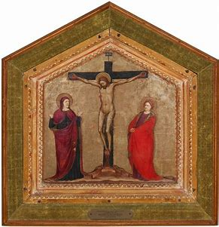
What is the virtue of charity, and why should we strive to grow in this virtue this month?
Charity = love
The theological virtues of faith, hope, and love help us to be more godly; these virtues come from God, Who helps us to become more like Him
Charity is the greatest of all of the virtues; no greater charity than self-sacrificing love, like Christ’s
  Love is at the center of the Holy Family, all communities
The natural virtues are fortitude, temperance, prudence, and justice
  These virtues can grow from our good works

Slide 6
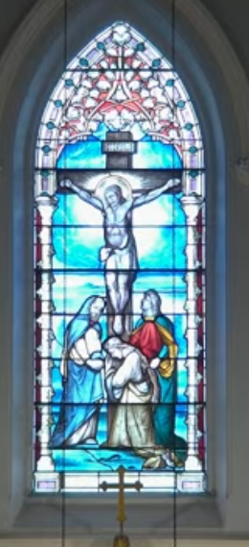
How do Our Lady and Our Lord embody the virtue of charity?
Our Lord puts others before Himself
  While on the Cross, He spoke to console, enlighten, and prepare others, even though it physically pained Him, requiring all of His strength
  Jesus provided for His Mother: He entrusted her to St. John’s care
  Jesus ensured that Our Lady would have many spiritual children to love her, and for her to care for in turn
  Jesus was more pained by the suffering of His Mother than by His own; but also allowed Our Lady to share in His heavenly reward, fruitfulness, since she shared in His suffering
  Jesus sacrificed His life for the salvation of souls; Jesus and Mother Mary were composed, accepted God the Father’s will out of love
  Our Lady offered up her suffering for others. She stood by the Cross

Slide 7
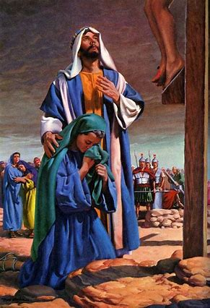
Why are Jesus and Mother Mary called the New Adam and the New Eve? How do these titles reflect their charity? (1)
Jesus and Mother Mary follow God the Father’s plan for salvation
God willed that we should have a mother (Mary), and that Jesus should live in a family as a reflection of His love
Love renews; through God’s love, and our love for Him, we are saved
Devotion to the Two Hearts helps us to love God the Father well, like Jesus and Mother Mary

Slide 8
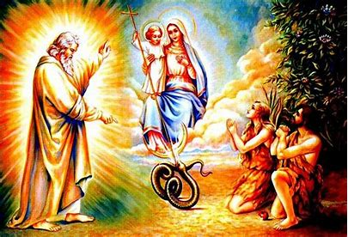
Why are Jesus and Mother Mary called the New Adam and the New Eve? How do these titles reflect their charity? (2)
Love is about balance; it flows from order (harmony with God’s plan, since God’s plan is an expression of His love)
  Love is not only singular; is rooted in community
God the Father willed that redemption, the restoration of grace, should be the perfect counterpoint to the fall from grace
  Sin entered the world through the collaboration of a man and woman (Adam and Eve)
    Redemption happens through the collaboration of a man and woman (Jesus and Mother Mary)
  Sin entered the world through taste: the forbidden fruit
    Redemption comes about through the Holy Eucharist (the Heart of Jesus)
  Sin entered the world through disobedience (because of self-love/pride)
    Redemption happens through obedience out of humble love for God the Father

Slide 9
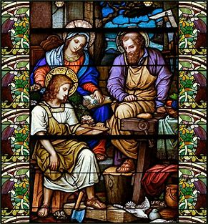
How does devotion to the Holy Family fit into devotion to the Two Hearts?
The family is united in love
The Holy Trinity is one community of love; each Person of God in the Holy Trinity expresses love uniquely
The Holy Family is a reflection of the Blessed Trinity, an earthly trinity
St. Joseph completes the Holy Family: he shows us how to honor Mother Mary and Jesus. He protects their Hearts
Devotion to the Holy Family is a way to honor St. Joseph, expressing devotion to him as well; St. Joseph helps us to open our hearts to Jesus and Mother Mary, and to let into our hearts only what would give glory to Jesus and Mother Mary

Slide 10
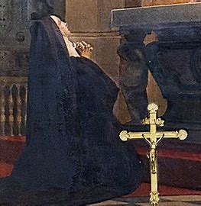
What did the Holy Family mean to St. Margaret Mary Alacoque? What can we learn from her devotion to the Holy Family?
When there was discord in her own family, St. Margaret Mary found order and peace in the Holy Family
  St. Margaret Mary’s mother did not accept her vocation to religious life
Amidst her father’s passing, St. Margaret Mary looked forward to eternal life with the Holy Family in Heaven
St. Margaret Mary lived in poverty after her father’s death, and her immediate family’s disputes with other relatives
  She found the greatest riches in Christ’s Heart, full of love to nourish her

Slide 11
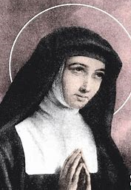
How did St. Margaret Mary Alacoque express devotion to Our Lady’s Immaculate Heart?
Meditated on the compassion in Our Lady’s Heart
Our Lady does not sorrow out of despair; she feels for the pain of others. Her Heart goes out to us
St. Margaret Mary sought to console Our Lady’s Heart
  Prayed seven “Hail Mary” prayers per day to honor the seven sorrows of Mary
  Expressed love for the Sacred Heart

Slide 12
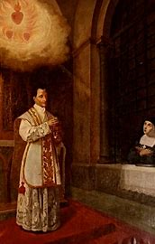
Who was St. Claude de la Colombiere? How did he embody charity?
Born on Candlemas in 1641
Feast day: February 15
St. Margaret Mary Alacoque’s confessor and spiritual director
Helped St. Margaret Mary to spread devotion to the Sacred Heart; both saints were chosen by Jesus to promote the devotion
  Believed her witness to Christ; revelations she shared about the Sacred Heart; opened his heart to listening and understanding

Slide 13
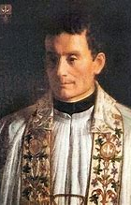
Who was Venerable Francis Mary Paul Liberman? How did he embody charity?
1802-1852; died on Candlemas
Jewish scholar initially seeking arguments against Christianity
Came to see the truth and beauty of the Catholic Faith, experienced inner conversion like St. Paul; humbly entrusted himself to God, repented
Chose first two names for godparents (Francis and Mary); third name for St. Paul
  Love of Jesus and Mary bring us together, allow for order in soul
Spread devotion to the Immaculate Heart; founded Congregation of the Immaculate Heart of Mary (then became Congregation of the Holy Ghost); was a Spiritan priest
  Devotion to the Sacred Heart opens our hearts to truly seeing and feeling God’s love

Slide 14
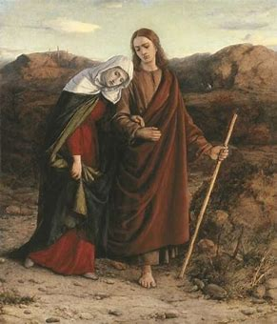
What does it mean to live out devotion to the Two Hearts? Why is it important to honor both Jesus’ and Mother Mary’s Hearts?
Jesus shows us how to devote ourselves to the Immaculate Heart
  It consoles His Heart more when we make reparations to the Immaculate Heart and meditate on Our Lady’s compassion than when we make reparations to His Sacred Heart and meditate on His Passion
St. John shows us how to take Our Lady into our hearts
  Was a devoted spiritual child

Slide 15
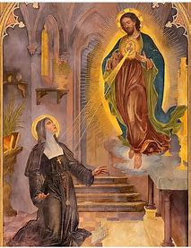
What does it mean to consecrate ourselves to the Two Hearts? How is consecration an act of love?
Consecration: not always a formal process, prayer
May simply offer all works of the day to the Hearts of Jesus and Mother Mary
Entrustment: offer yourself to Jesus and Mother Mary, place yourself in the shelter of their Hearts
Consecration is a form of self-gift; we give out of love, to be of service, and to help others
  Jesus and Mother Mary work through our hearts, helping us to love
Jesus and Mother Mary consecrated themselves to God the Father
Consecration at Holy Mass: God’s gift of love to us

Slide 16
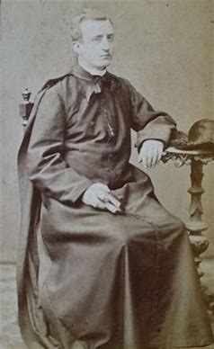
How do we care for those in our church family, sharing the love of the Two Hearts? What does it mean for us to live with love like the members of the Holy Family?
Be immersed in Christ’s Presence; be filled with His love to respond with love to all others in our family (the universal Church and parish)
Everyone in the Church is gathered up in Christ’s Heart; He gave His life for all
Blessed Columba Marmion: carry forward all special intentions from others in your heart; even if not speaking each individual intention aloud, God reads your heart, feels your love for others whose intentions you carry forward to His altar
  Be present; focus on prayer as a means of union with God, expression of love, not only on the words/intentions themselves (contemplation: passive prayer)
Will what God wills: “Thy will be done,” entrust prayers to Him, have hope and faith in His Providence

Slide 17
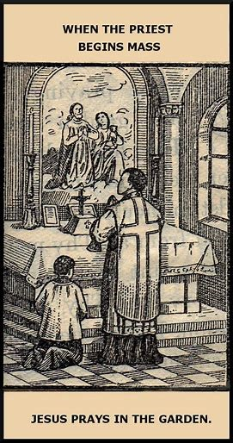
How does our participation in the apostolates at OLV help us to live out devotion to the Two Hearts? (1)
Holy hour (Seven Sisters):
  Keep vigil with Christ; relive His agony in the Garden (similar to St. Margaret Mary’s First Thursday devotion)
  Feel the compassion of Our Lady’s Heart: she saw Christ in His agony; He could see her, as though through a mirror; they suffered in seeing each other’s sorrow
  Console both Hearts; Our Lady loves the priests, her sons, who resemble her Son, the Eternal High Priest; and Jesus loves His apostles
  Cultivate interior lives, have a praying heart, like Our Lady, and like Our Lord, going up to the mountain to meditate; make intercessions, like Our Lady and Our Lord

Slide 18
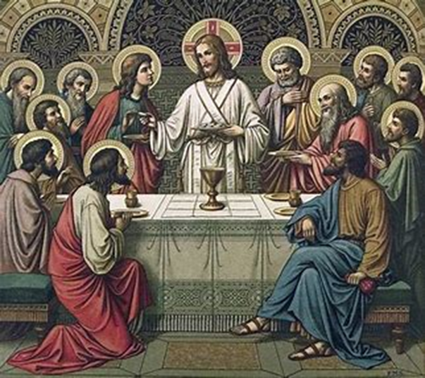
How does our participation in the apostolates at OLV help us to live out devotion to the Two Hearts? (2)
Fast (Fasting Brothers):
  Anticipate the Passion with Christ; be with Him as He waits in the Garden of Gethsemane (like fasting before Holy Mass)
  Anticipate the heavenly feast; being filled by the Holy Eucharist
  A sacrifice is made in the spirit of love that Christ had in giving Himself on the Cross as spiritual food for ourselves, and Our Lady in standing by Him
  Offer fast for another person (priest), just as Jesus and Mother Mary put others first

Slide 19
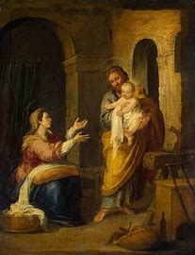
How may we continue to exercise devotion to the Holy Family/the Two Hearts? (1)
Seven Sisters:
  Pray the Litany of the Holy Family for your priest; pray that Our Lord and Our Lady would help him to make our parish a happy home for the Holy Family to dwell in
  Pray the Chaplet of the Two Hearts for your priest; ask that your priest is kept close to the Two Hearts, and may always feel their love
  Meditate on what your priest does for our parish family; ask God to bless him for these gifts he gives
  Pray in compassion for your priest; pray the Chaplet of the Seven Sorrows of Our Lady, or simply meditate on her sorrows, which flowed from sorrow for the suffering of her Son; ask Our Lady to help your priest, turning any of his sorrows into joys
    Say seven “Hail Mary” prayers in honor of Our Lady’s sorrows

Slide 20
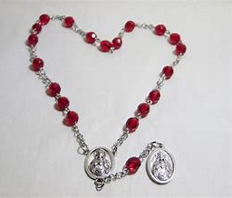
What is the Chaplet of the Two Hearts? How can praying it help us to grow in charity?
20 beads
15 “Hail Mary” prayers
5 “Our Father” prayers
  Meditate on five themes: Sacred Heart of Jesus, Immaculate Heart of Mary, Passion of Our Lord, Compassion of Our Lady (seven sorrows), and the Two Hearts
    Console the Hearts of Jesus and Mary; offer up your crosses in union with theirs, out of love; can be more compassionate to others
United Hearts prayer; pray to unite your heart to the Two Hearts to love ever more deeply

Slide 21
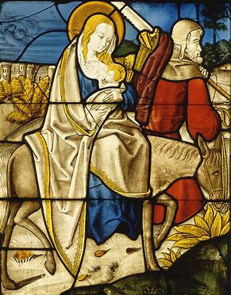
How may we continue to exercise devotion to the Holy Family/the Two Hearts? (2)
Fasting Brothers:
  While fasting, meditate on the sacrifices of the Holy Family; traveling amidst uncomfortable conditions (i.e. journey to Bethlehem, flight into Egypt); contending with hunger (not only bodily, but yearning for home)
  Offer fast in thanksgiving for journeys our priests make for us, their sacrifices for their parish family

Slide 22
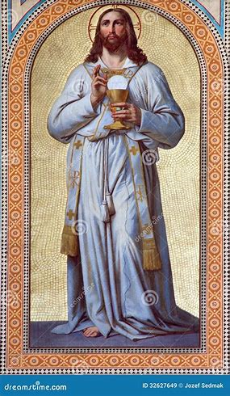
How do we exercise the virtue of charity in our prayers/fasting for priests? (1)
Seven Sisters
  In prayer, meditate on what you love about your priest; thank God for how your priest lives out his love for God
    Listen to chants honoring Christ’s loving Heart: “Cor Jesu Amantissimum”
  After holy hour, identify one of your priest’s qualities or devotions that you might imitate to express love for God in the future; consider how you might thank your priest in person for his ministry
  When praying the Mysteries of the Holy Rosary, connect them to the life of the priest; meditate on how each Mystery is a reflection of God’s love, and how this is communicated through the heart of the priest

Slide 23
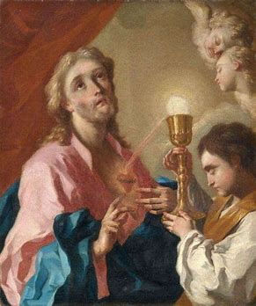
How do we exercise the virtue of charity in our prayers/fasting for priests? (2)
Fasting Brothers
  Call upon St. Joseph as you fast. Channel his love for His family; for God the Father; and offer your fast with his fatherly spirit of charity
  Ask that your priest would always be sustained by God’s love, and that the graces from your fast may strengthen him
Both Apostolates
  Gift of time and self; mirroring the priest’s sacrifice; emulating his love
  Looking to Jesus as our ultimate model; reflecting His love like Our Lady does

Slide 24
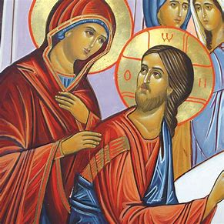
How might we continue to grow in our January virtue of peace/exercise devotion to the Most Holy Name of Jesus? (1)
Seven Sisters:
  Call upon Jesus’ Holy Name, asking Him to help your priest
  Pray the Chaplet of the Holy Name during your holy hour; meditate on Jesus’ titles (i.e. “King”; ask Jesus to reign in your priest’s heart, so that he may always have the joy and peace of being led by Jesus in His ministry

Slide 25
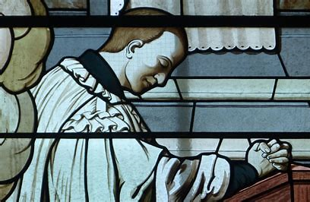
How might we continue to grow in our January virtue of peace/exercise devotion to the Most Holy Name of Jesus? (2)
Fasting Brothers:
  While fasting, call upon Jesus’ Holy Name to strengthen you; meditate on how His love saves and sustains us through sacrifices (the name “Jesus” means “God saves”)
  Think about how your priest’s life is lived in Jesus’ Name, for His glory, and meditate on how Jesus works to save His priests through prayer and sacrifice, so that they may help to save souls in turn, leading them to the peace of Heaven
Both:
  Complete the First Friday devotion; Our Lord promises peace in the family to devotees of the Sacred Heart

Slide 26
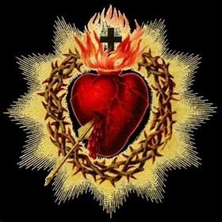
Going forward, how may we practice devotion to the Sacred Heart on First Fridays?
First Friday of each month (9 in a row):
  Participation in Holy Mass
    Act of Spiritual Communion; another devotion, such as Stations of the Cross; meditate on readings for the Mass of the Sacred Heart
    Abstain from meat (full abstinence); offer other acts of penance
  Sacramental Confession
  Act of Reparation to the Sacred Heart (prayer)
  Pray for the intentions of the Holy Father (“Our Father” and “Hail Mary”)

Slide 27
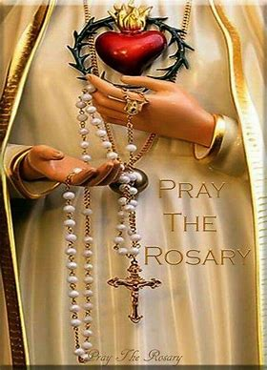
Going forward, how may we practice devotion to the Immaculate Heart on First Saturdays?
First Saturday of each month (5 in a row):
  Participation in Holy Mass
    Sacramental Confession (if not completed for First Friday; should be at least eight days before)
  Pray five decades of the Holy Rosary (Saturday: Glorious Mysteries) in reparation for blasphemies against the Immaculate Heart
  Meditation on the Mysteries of the Holy Rosary; keep Our Lady company for 15 minutes
  Act of Reparation to the Immaculate Heart prayer
  Take as a penitential day; abstain from meat (partial abstinence)

Slide 28
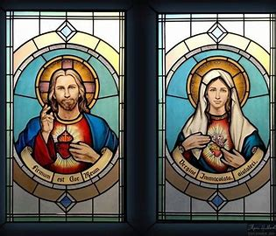
How may we track our completed First Friday and First Saturday devotions?
Passport booklet
  We journey deeper into the Hearts of Jesus and Mother Mary
    The virtues are a roadmap to Heaven; in the Heart of Jesus, we discover the treasury of virtues
      Use virtue chart from meeting 1
  Check off months when devotion is completed
    Collect stickers for the passport at each Two Hearts Guild meeting
    Use nine- and five-bead chaplets as trackers; pray the Act of Reparation on a bead for each consecutive month

Slide 29
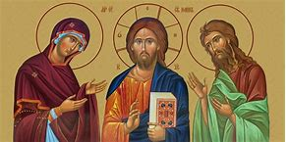
Announcements
Next First Friday Mass:
  Friday, March 7, 2025
    6:00 p.m., church
Next Two Hearts Guild meeting:
  Friday, March 7, 2025
    7:00 p.m., parish hall
      Snow date: Friday, March 14, 2025

Slide 30
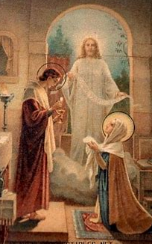
Closing Prayer: Prayer to the Immaculate Heart of Mary
Immaculate Heart of Mary, full of love for God and mankind, and of compassion for sinners, I consecrate myself to you. I entrust to you the salvation of my soul.
May my heart be ever united with yours, so that I may hate sin, love God and my neighbor, and reach eternal life with those whom I love.
May I experience the kindness of your motherly heart and the power of your intercession with Jesus during my life and at the hour of my death. Amen.

