Slide 1
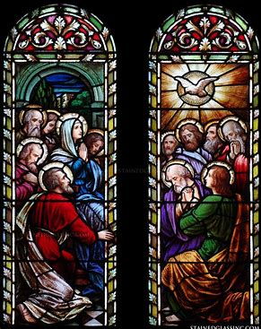
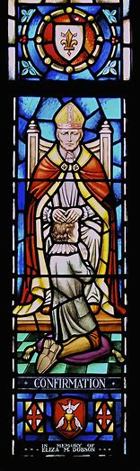
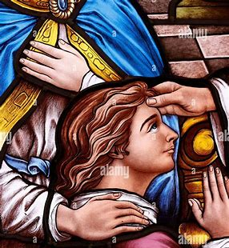
Confirmation
Sacrament Learning Series Session 4
Tuesday, February 25, 2025
Snow date: Thursday, February 27, 2025
Katie Sadakierski

Slide 2
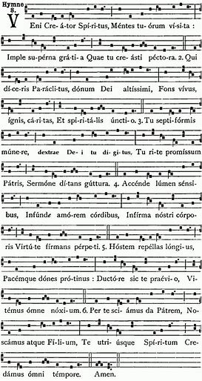
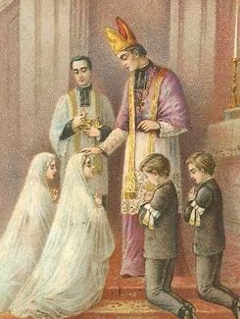
Course 4 Outline
Opening prayer
Presentation
  I. Meaning and history of the sacrament of Confirmation
  II. Order of the ritual of Confirmation
  III. Preparing for Reception and Renewal of the Graces of Confirmation
Closing prayer
Q & A

Slide 3
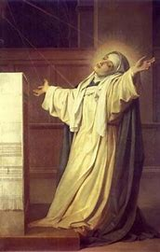
Opening Prayer: Prayer Before Any Work
Come, Holy Ghost, fill the hearts of Thy faithful and kindle in them the fire of Thy love.
Send forth Thy spirit, and they shall be created.
And Thou shalt renew the face of the earth.
Let us pray: O God, Who hast taught the hearts of the faithful by the light of the Holy Ghost, grant that by the gift of the same Spirit we may be always truly wise and ever rejoice in His consolation. Through Christ our Lord. Amen.

Slide 4
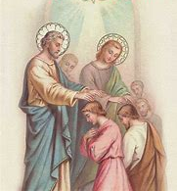
What is the sacrament of Confirmation?
Firmitas/firmans: strength
The sacrament by which we are fortified, through God’s grace, to uphold our baptismal promises
Commemoration of Pentecost, when the Holy Spirit descended like tongues of fire on the twelve apostles and Our Lady in the upper room
A fuller outpouring of the Gifts of the Holy Spirit

Slide 5
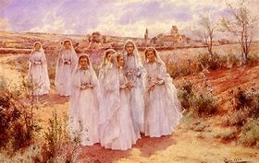
To which natural stage of life does Confirmation correspond?
Maturation
  Roughly corresponds to adolescence; but biological age differs from spiritual age; one may be young biologically, but spiritually advanced
Confirmation is the next stage in the sacramental life cycle after Holy Baptism
  Go from birth to adulthood
  Was traditionally received before First Holy Communion; completes Holy Baptism and prepares soul to receive Jesus in Holy Communion

Slide 6
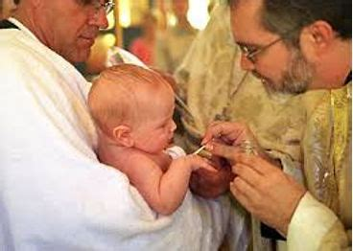
Does Confirmation make one an “adult” in the Church?
Confirmation helps one to make progress in the spiritual life, but does not confer “adulthood” in the Church
We are all called to be children of God, to be childlike in trusting in our heavenly Father
Spiritual maturation is a lifelong process
In the Eastern Catholic rite, babies are confirmed after Holy Baptism
  Early church: sacraments of Holy Baptism and Confirmation received together

Slide 7
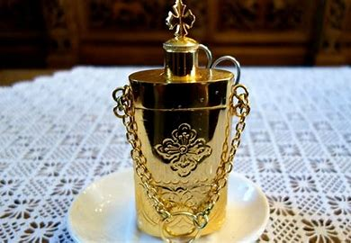
What is “chrismation” in the Eastern Catholic rite?
“Chrismation” is in reference to the “chrism” oil used in the Confirmation anointing of the candidates
Eastern Catholic Church emphasizes sacred mystery and wonder for God
Infants receive the sacraments of Holy Baptism and Confirmation together
  Seamless transition between sacramental stages: fullness of the Holy Spirit’s Gifts received at once

Slide 8
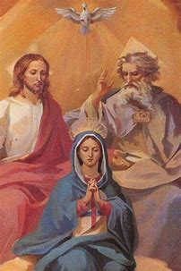
Who is the Holy Spirit? Why must we receive the Holy Spirit?
The Third Person of the Holy Trinity
  Culmination of the love of the Father and of the Son
The Holy Spirit gives us His Gifts to help us to fulfill God’s plan for us
  Inspires us to do good works
  Inspires us to seek out Jesus
  Helps to purify us
  Makes us spiritually fruitful/productive
  Is our Comforter and Advocate

Slide 9
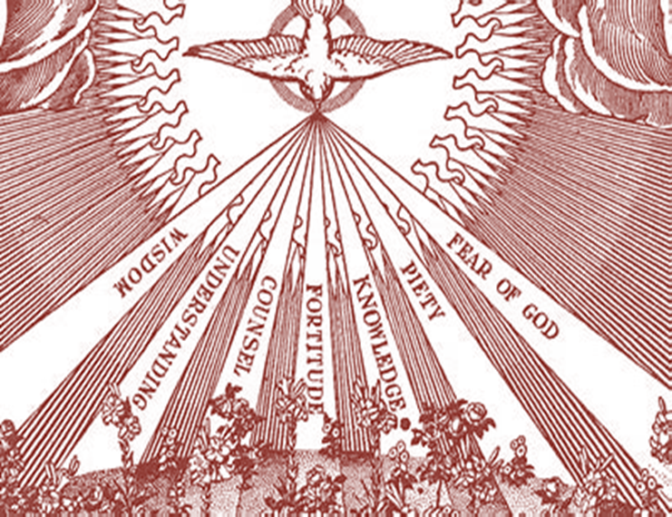
What are the Seven Gifts of the Holy Spirit?
Fortitude: strength and courage
Wisdom: knowledge of how to use Gifts; see as God does
Knowledge: foundations of Faith
Counsel: right judgment
Understanding: deeper awareness
Piety: holiness/faithfulness
Fear of the Lord: wonder and awe for God; reverence

Slide 10
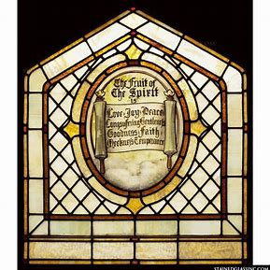
What are the Fruits of the Holy Spirit?
Outcomes of using Gifts of the Holy Spirit for God’s glory
9 Fruits listed in Galatians
  12 total
Peace
Joy
Kindness
Patience
Goodness
Gentleness
Self-control
Love
Faithfulness

Slide 11
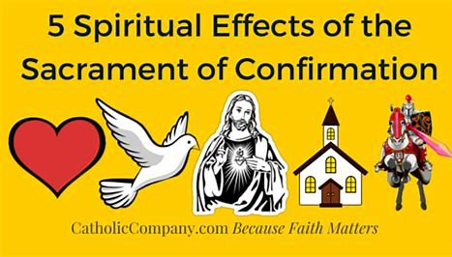
What effects does Confirmation have on our souls?
Have graces needed to defend/live out our Faith
Become better disposed to receive Holy Communion reverently
Prepares us to use God-given gifts to continue Christ’s mission of love
Brings us into a closer relationship with Holy Mother Church
  Stronger filial devotion

Slide 12
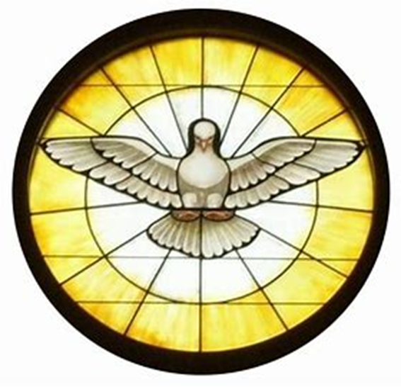
What is the Scriptural basis for Confirmation? (1)
Acts of the Apostles 2:1-11
  Pentecost: Descent of the Holy Ghost
  Holy Spirit comes like wind, like a dove, or tongues of flame on the apostles so that they will be equipped to build the Church, go out and baptize all nations

Slide 13
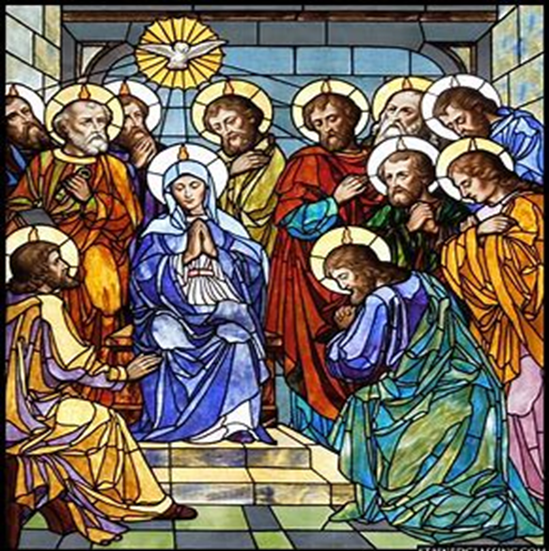
What is the Scriptural basis for Confirmation? (2)
  Eleven faithful apostles are present, plus Matthias, Judas Iscariot’s replacement
  We are called to be faithful like the apostles, receive the Holy Spirit humbly to be filled with His grace, do His will, through God’s strength

Slide 14
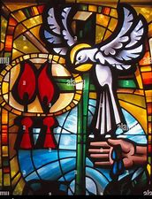
How are the sacraments of Holy Baptism and Confirmation related? (1)
Confirmation completes the sacrament of Holy Baptism
Confirmation gives us the Gifts of the Holy Spirit (first received at Holy Baptism) more fully
At Confirmation, baptismal promises are renewed

Slide 15
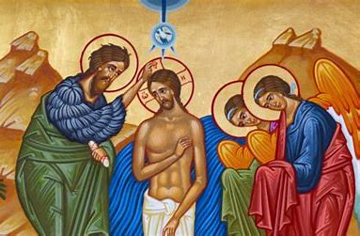
How are the sacraments of Holy Baptism and Confirmation related? (2)
Belief is affirmed at Confirmation
  Candidate baptized as an infant may now make promises for themselves
Holy Baptism makes a person a child of God for life
  Confirmation makes them a soldier for Christ who will fight the good fight for God’s glory

Slide 16
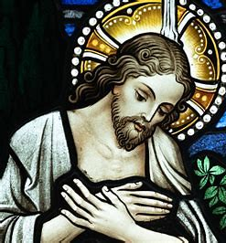
Why do we renew our baptismal promises at Confirmation?
Expression of the link between Holy Baptism and Confirmation
  Call upon the Holy Ghost to lead us away from sin, keep our souls pure, so that we may maintain baptismal innocence; trust in His power as our advocate
Strengthen resolve to live out commitment to God
  Affirm beliefs as a son or daughter of God; express devotion
Prepare for next steps in journey of faith

Slide 17
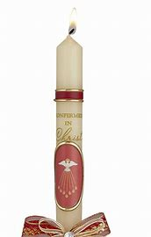
What are some symbols of Confirmation? How do they remind us of our Holy Baptism? (1)
Dove: symbol of the Holy Spirit/peace
  The Holy Spirit brings peace with His loving Presence, first received at Holy Baptism
Candle: reminder of Holy Baptism
  We are called to use the Gifts received at Confirmation to shine the light of God’s love in the world

Slide 18
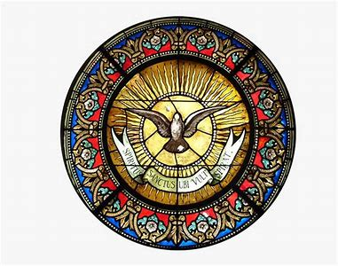
What are some symbols of Confirmation? How do they remind us of our Holy Baptism? (2)
Flames/color red
  The Holy Spirit brought the holy fire of God’s love to the apostles, enkindling in their hearts a deeper passion for their Faith, so that they would have the zeal needed to convert people
  Red is the color of the Holy Spirit, and God’s love

Slide 19
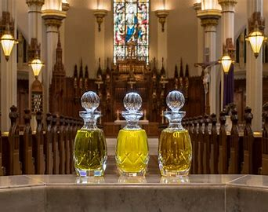
What is the form and the matter of Confirmation?
Form and matter are not merely symbolic; confer God’s grace
Form: The words spoken by the celebrant (minister performing the sacrament)
  “Be sealed with the Gifts of the Holy Spirit.”
Matter: Sacred chrism oil
    Blessed at Chrism Mass (priests renew promises)
    Holy oil is used for anointing (setting apart something/someone for God’s service)
    Christ is the “Anointed One,” consecrated to God the Father

Slide 20
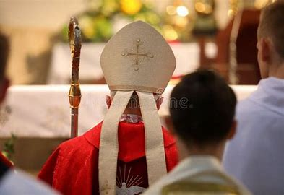
Who is the ordinary minister of Confirmation?
The bishop
  Bishop has the fullness of the sacrament of Holy Orders (ordains priests); is successor to the apostles
  As spiritual father of diocese, is sending forth new soldiers for Christ to carry on Jesus’ mission in his flock
    In special cases, bishop may grant faculty to priest to administer sacrament of Confirmation

Slide 21
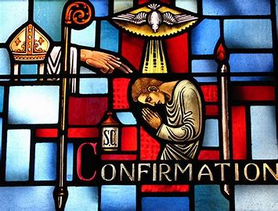
What is the order of the ritual Mass of Confirmation in the Roman Rite? (1)
Greeting; Confiteor; Kyrie; Collect; Gloria
Liturgy of the Word
  First Reading; Second Reading; Gospel; sermon, Creed
Renewal of baptismal promises
Presentation of the candidates
Laying on of hands
Anointing of the candidates

Slide 22
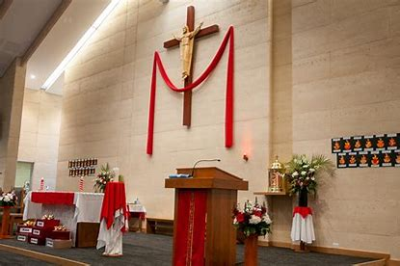
What is the order of the ritual Mass of Confirmation in the Roman Rite? (2)
Offertory; Canon
Consecration of the Host, consecration of the wine
Holy Communion
Ablutions
Solemn blessing and dismissal

Slide 23
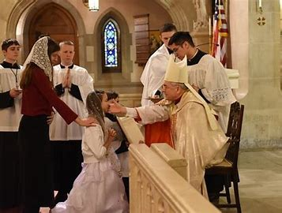
How does the traditional rite of Confirmation differ from the modern rite?
Traditional rite
  Colée: blow to the cheek; at Holy Baptism, receive breath of life; now, must have fortitude to bring others to life in Christ, leading them to the Church through courageous witness
    Mirrors dubbing ritual of knights; last “insult” one will receive; from then on, will bravely defend the Church as a soldier of Christ
    Reminder to live with honor, suffer for Christ, like the apostles
Modern rite
  1971: Blow to the cheek omitted from ritual
    Sometimes is still included; may be a light tap

Slide 24
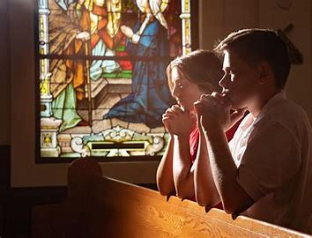
What practices should we engage in to prepare for Confirmation? How may we renew the graces of Confirmation? (1)
Go to Confession
  Be in right disposition to receive sacrament
  Be in a state of grace to renew all of God’s graces from the sacraments
Regularly pray to use the Gifts of the Holy Spirit to glorify God
Pray for your patron saint’s intercession
  Pray for all those preparing for the sacrament of Confirmation, and ask for the graces of this sacrament to be renewed in all who have been confirmed already

Slide 25
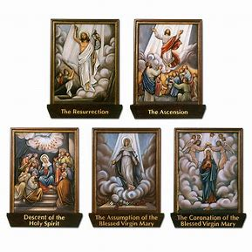
What practices should we engage in to prepare for Confirmation? How may we renew the graces of Confirmation? (2)
Contemplate Scriptural passages relating to the Holy Spirit/Confirmation:
  Acts 8:14-17
  Acts 19:4-6
  2 Corinthians 1:21-22
Pray the Glorious Mysteries of the Holy Rosary
  Meditate especially on the Third Glorious Mystery, the Descent of the Holy Ghost

Slide 26
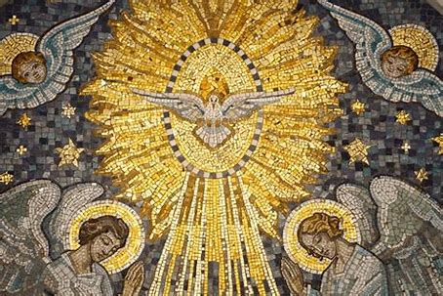
What practices should we engage in to prepare for Confirmation? How may we renew the graces of Confirmation? (3)
Listen to the “Veni, Creator Spiritus” chant and meditate on its lyrics; reflect on the Holy Spirit’s movement in your life
Ask the Holy Spirit to guide you in choosing your Confirmation patron saint and sponsor, according to what will most glorify God
  If already confirmed, pray for the Holy Spirit to continue to bless your sponsor, and to draw you closer to both your patron saint and sponsor

Slide 27
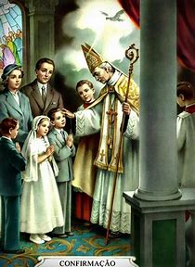
Why do we choose a sponsor at Confirmation?
Just as we have a sponsor at Holy Baptism to help us to start out on the right path, a sponsor at Confirmation helps us to continue on the path to Heaven
Sponsors are with us every step of the way on our faith journey
Sponsors are signs of the unity between the sacraments of Holy Baptism and Confirmation
  They help to lead us to accept all of God’s grace into our hearts

Slide 28
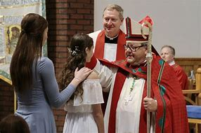
What conditions must be met for a person to serve as a Confirmation sponsor?
Be a practicing Catholic
Be at least 16 years of age
Have received the sacraments of initiation
If married, have been married in the Church
May not be a parent of the candidate
  Optional, but recommended: be a godparent of the candidate

Slide 29
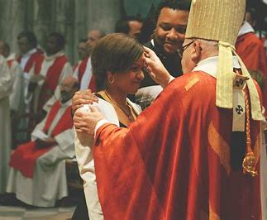
How does one choose a Confirmation sponsor? (1)
A sponsor should be a role model, example of faith
  Earthly companion one may look up to, who demonstrates how to live a life consistent with Church teaching, following God’s plan
  Someone candidate aspires to be like in application of virtue

Slide 30
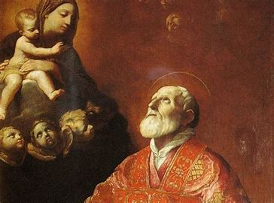
How does one choose a Confirmation sponsor? (2)
Sponsors must be faithful friends who will pray for candidates
  People to accompany us in journey of faith, encourage us on the road to Heaven
    Accountability partners; keeping on right path to Christ

Slide 31
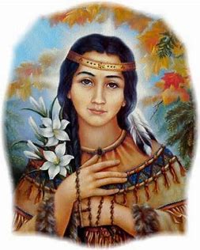
Why do we choose a patron saint at Confirmation?
Patron saints are heavenly friends to encourage us in our path of holiness
They demonstrate to us how to remain faithful to God and reach Heaven
Saints pray for us, guising us closer to God, so that we may reach eternal glory, and meet them in Paradise
Patron saints are close companions we may remain connected to throughout our lives
  They accompany us in our journeys of faith, communicating God’s love to us

Slide 32
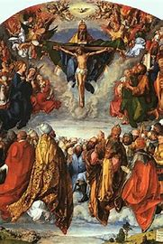
What considerations should one make when choosing a Confirmation patron saint?
A heavenly friend whose virtues you admire
  Someone who models to you how to live a holy life, apply the Gifts of the Holy Spirit
Meaning of saint’s name
  A name you seek to live up to, embody in this new chapter of your life
Patronage of saint
  Someone whose intercession you may pray for in your vocation/state of life and occupation

Slide 33
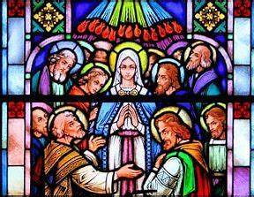
Who are some additional saints (besides our personal patrons) we may ask to intercede for us in preparing for Confirmation/renewing its graces?
St. Philip Neri
  Patron of Confirmation
    Experienced a personal Pentecost; received the Gifts of the Holy Spirit, had heart enlarged; felt love of God
  Patron of joy
    Inspired, knew how to share joy with others fully
Our Lady of the Cenacle
  Title honoring Our Lady’s presence in the upper room

Slide 34
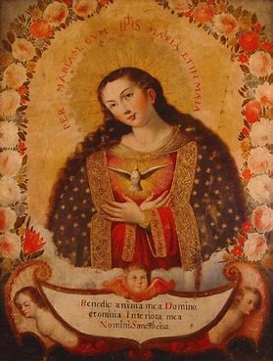
What is Our Lady’s role at Confirmation? How may she support us in preparing for this sacrament? (1)
Our Lady was present at Pentecost, waiting with the apostles in the upper room
  Received graces needed to be universal spiritual mother (of the Church)
  Already was full of grace, received Holy Spirit at conception
Our Lady accompanies us at Confirmation
  The Holy Spirit is her spouse

Slide 35
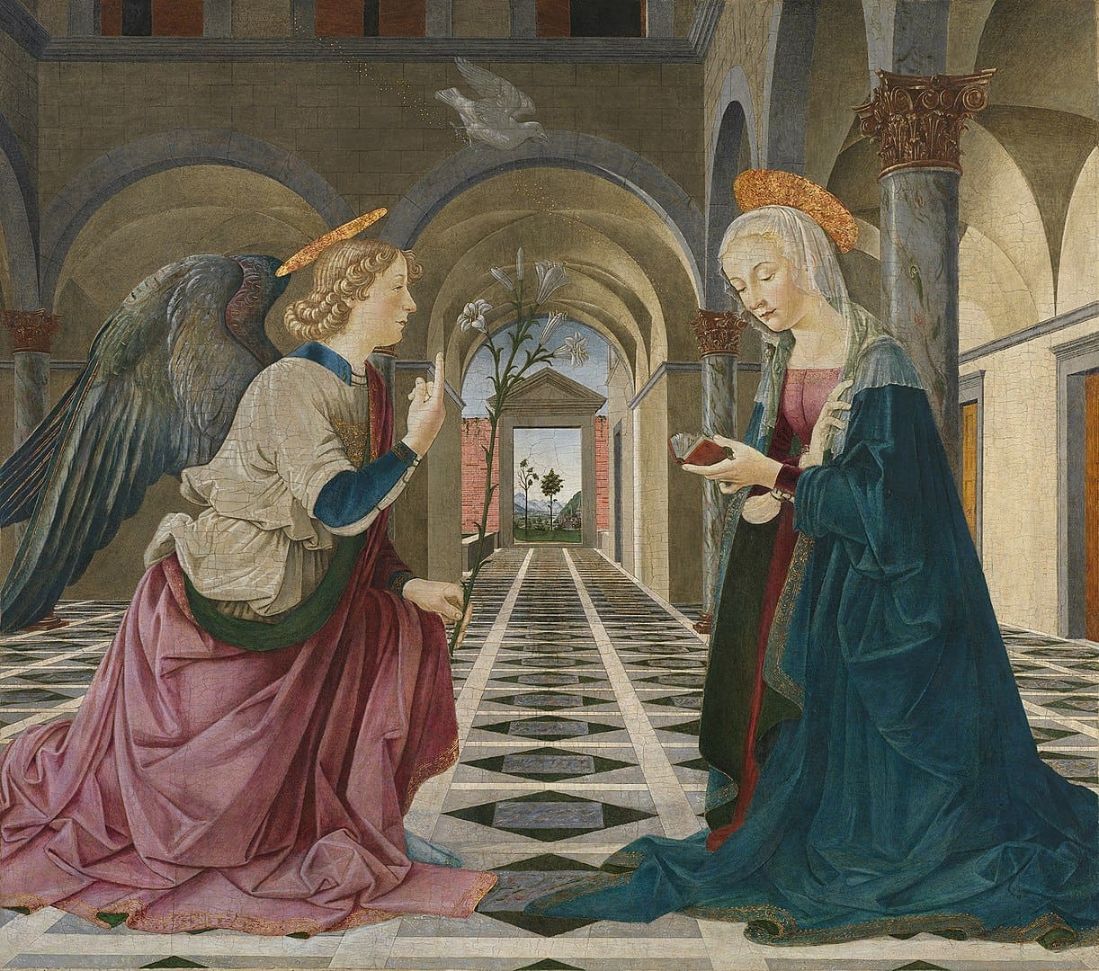
What is Our Lady’s role at Confirmation? How may she support us in preparing for this sacrament? (2)
Our Lady passes on graces to us from God
  Mediatrix of All Graces
Our Lady helps to prepare us to respond lovingly to the Holy Spirit, like she did
Supports us in saying “yes” to God’s plan bravely, in the same way she did

Slide 36

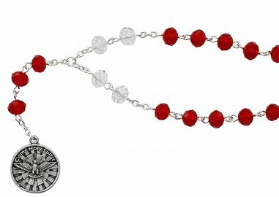
How may we continue to practice devotion to the Holy Spirit, well after Confirmation? (1)
Pray the Chaplet of the Holy Spirit
Pray the Chaplet of the Seven Gifts of the Holy Spirit
Pray the “Veni, Creator Spiritus,” or “Veni, Sancte Spiritus”
Pray a daily consecration prayer to the Holy Spirit

Slide 37
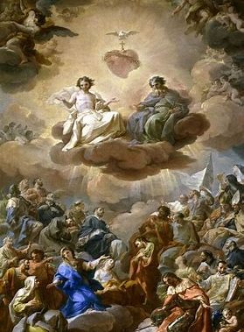
How may we continue to practice devotion to the Holy Spirit, well after Confirmation? (2)
Pray the Litany of the Holy Ghost
Pray for the intercession of Our Lady and the Holy Spirit together
Pray St. Alphonsus Liguori’s prayer for the Seven Gifts of the Holy Spirit

Slide 38
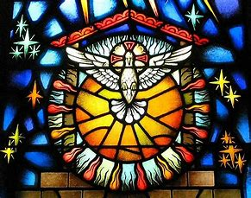
Closing Prayer: Petition for the Grace of the Holy Ghost
Come, Holy Ghost, Sanctifier all powerful, God of love, Thou Who didst fill the Virgin Mary with grace, Thou Who didst wonderfully transform the hearts of the Apostles, Thou Who didst endow all Thy martyrs with a miraculous heroism, come and sanctify us. Illumine our minds, strengthen our wills, purify our consciences, rectify our judgments, set our hearts on fire, and preserve us from the misfortune of resisting Thine inspirations. Amen.

