Slide 1
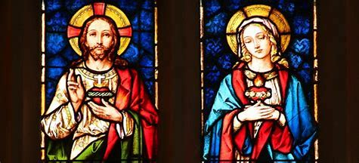
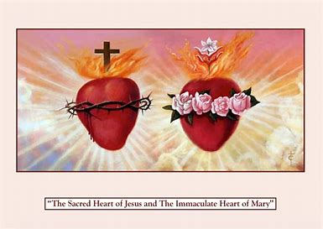

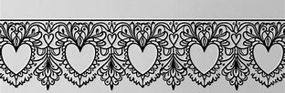
“Loving the Sacred Heart of Jesus and Immaculate Heart of Mary”
Tuesday, February 18, 2025
Katie Sadakierski

Slide 2
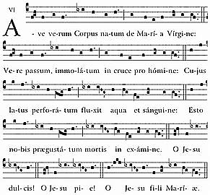
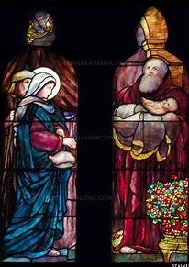
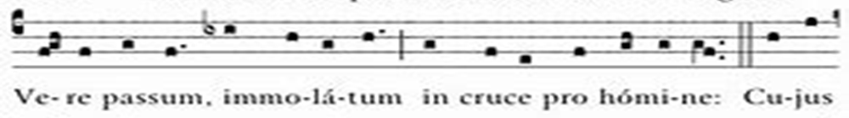
Seven Sisters Apostolate Event 4 Outline
Welcome & opening prayer
Presentation: The Purification of Our Lady, and Loving Jesus and Mary with Pure Hearts at Lent
  Preparing to console the pierced Hearts of Jesus and Mary at Lent; having a heart like Mary’s Immaculate Heart
  Prayers of reparation as a form of love; love as sacrifice; serving as a spiritual mother through prayer, and spiritually accompanying others
  Being faithful to the Heart of Jesus like Our Lady of Compassion during Lent
  Thanking God the Father for His gifts (Our Lady, the Holy Eucharist, and the holy priesthood) at Lent
Announcements & closing prayer
Rosary spiritual bouquet cards for Fr. Sliwa
Holy Rosary recitation for the intentions of Fr. Sliwa: Sorrowful Mysteries
Visit to the Blessed Sacrament

Slide 3
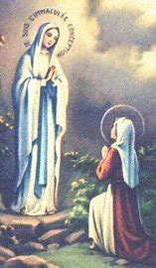
Opening Prayers: Prayer to St. Bernadette and Prayer to Our Lady of Sorrows
O Saint Bernadette, who, as a meek and pure child, did eighteen times at Lourdes contemplate the beauty of the Immaculate Mother of God and receive her messages, and who afterwards wished to hide yourself from the world in the convent of Nevers, and to offer thyself there as a victim for the conversion of sinners, obtain for us the grace of purity, simplicity and mortification that we also may attain to the vision of God and of Mary in Heaven. Amen.
Blessed Virgin Mary, Our Lady of Compassion, I turn to you with filial confidence. You shared fully in the work of Our Lord Jesus Christ, whose Death brought life to the world. Help me now to understand the truth about the divine compassion. Teach me to accept the sufferings that come into my life as you accepted obediently your own deep sorrows. Loving Mother of the Redeemer, you consecrated yourself by submitting to the divine plan. Obtain for me the grace to make my own submission to the same wise providence, now and at the hour of my death. Amen.

Slide 4
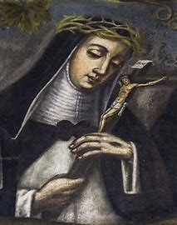
Which devotion(s) and feast days do we celebrate in February?
February: Month of the Holy Family
February 2: Feast of the Purification of Our Lady (Candlemas); World Day of Prayer for Consecrated Life
February 6: Feast of St. Dorothy
February 11: Feast of Our Lady of Lourdes
February 12: Feast of the Seven Holy Founders of the Servite Order
February 13: Feast of St. Catherine de Ricci
February 14: Feast of St. Valentine
February 15: Feast of St. Claude de la Colombiere
February 18: Feast of St. Simeon; Feast of St. Bernadette
  Two-year anniversary of Fr. Sliwa’s pastoral installation Mass

Slide 5
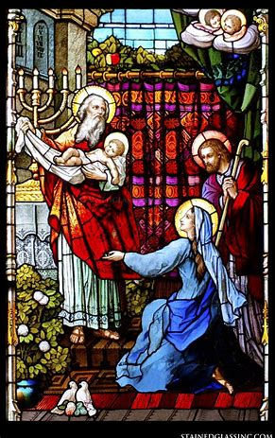
What was the Presentation at the Temple? How does this sacred mystery relate to the Hearts of Jesus and Mother Mary? (1)
Jesus consecrated to God the Father; St. Joseph and Mother Mary brought Him to be presented at the temple as a sign of faithfulness to God
Prophecy of St. Simeon: first Sorrow of Our Lady
  St. Simeon foresaw the suffering of Our Lady, her compassion for Our Lord amidst His Passion
  Compared her suffering to the piercing of the heart with a sword
  Said that the thoughts of many hearts would be revealed through Our Lady’s pierced Heart
    Suffering allows for compassion; helps us to relate to Jesus and Mother Mary, to love them better; helps us in expressing our love through our prayers for others
    Our Lady, Queen of Martyrs: went through martyrdom of the heart

Slide 6
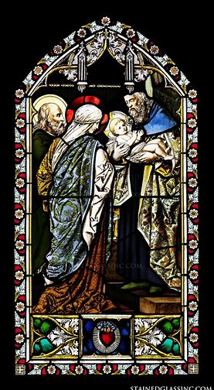
What was the Presentation at the Temple? How does this sacred mystery relate to the Hearts of Jesus and Mother Mary? (2)
In November, honored Our Lady’s Presentation at the Temple
  Because she was faithful to God and consecrated herself to the heavenly Father, He gave her the graces to withstand suffering, serve as the Mother of Our Lord/our spiritual mother
The great love of the Hearts of Jesus and Mary are revealed in this mystery; Our Lady was willing to undergo suffering with her Son to fulfill God’s plan for our salvation
  Experienced pain in our spiritual birth (brought about by Christ’s Death on the Cross); shared in Christ’s fruitfulness, would become the heavenly Mother of us all
  Our Lady and Our Lord show us how to present ourselves to God the Father with love; wholeheartedly, without reserve, surrendering ourselves to God

Slide 7
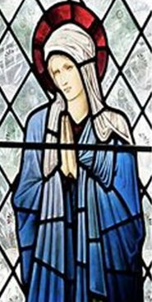
How does the Purification of Our Lady relate to Lent?
40: number of purification; Our Lady remained away from the temple for 40 days (from Christmas Day to Candlemas)
40 days of Lent: Jesus’ 40 days of fasting in the desert; Israelites’ 40 years wandering in the desert
Season of pilgrimage and exile
Our Lady leads us to our true home: Heaven. Brings us to Jesus’ Heart through her Heart to guide us towards eternal life, and God’s unending love
Hearts purified through sacrifice; sins “shriven” away to leave room in heart only for love
Lent gives us hearts like Jesus’ and Mary’s: humble, generous, and faithful

Slide 8
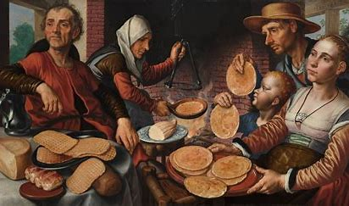
How may we honor the Sacred and Immaculate Hearts in the Season after Septuagesima (pre-Lent) & in the season of Lent? (1)
Fasting
  Be strengthened against temptations; spiritual senses sharpened
  Let go of sins, grow in virtue; habitual grace undoes habitual sin; persistence in prayer allows for an end to persistence in sin
  Septuagesimatide: three Sundays leading up to Lent’s start
  Shrovetide: three days leading up to Ash Wednesday
    Eat the last of dairy/meat products traditionally forbidden at Lent
    Go to Confession; do away with sin; be fed by Christ’s love
Holy hour: keep Jesus in the Blessed Sacrament company
    Be fed by Christ’s love in the Holy Eucharist
      Treat each holy hour as a vigil with Christ in the garden, like St. Margaret Mary; prepare heart to receive Jesus in Holy Eucharist; come to appreciate sacrifice of priest in giving us the Holy Eucharist

Slide 9
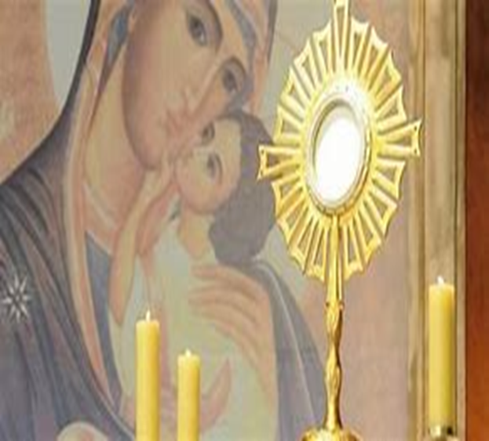
How may we honor the Sacred and Immaculate Hearts in the Season after Septuagesima (pre-Lent) & in the season of Lent? (2)
Listening to chants (Eucharistic hymns): “Ave, Verum Corpus”: “Hail, True Body”
    Jesus gave His Body for us to be spiritually fed; nourishes us with His Body, Blood, Soul, and Divinity; is Truly Present in the Holy Eucharist, wants to come down to us out of love, just like He did in the Incarnation
    Jesus is the Son of Mary; the God-Man is someone’s Son; is beloved; Body and Blood comes from her; venerate her for her sacrifices, too; giving us, God the Father the Precious Blood of her Son for the remission of sins (is not priest, but has priestly heart); stands by Cross at Holy Mass with priest
    Priest gives himself body, mind, and soul to God to bring us Christ’s Body in the Holy Eucharist; we, too, can consecrate ourselves to God, according to our state of life

Slide 10
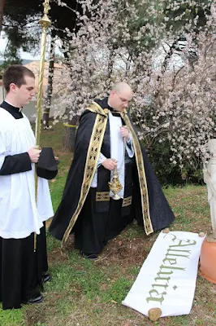
How may we honor the Sacred and Immaculate Hearts in the Season after Septuagesima (pre-Lent) & in the season of Lent? (3)
Compassionating with Jesus and Mother Mary
  Empathize with them in sorrows, so as to most fully feel their joys at Easter
      “Bury” the alleluia (literally and figuratively; “deposed,” like Christ’s Body); wait until the end of the season to sing the “Alleluia”
      Keep eternity in view; suffering is temporary; when united with the Heart of Christ, joy will be full; “Alleluia” is what St. John heard being sung in Heaven; is cry of triumph and praise for God
    Joy comes from obedience to God’s plan, fulfilling His will to love

Slide 11
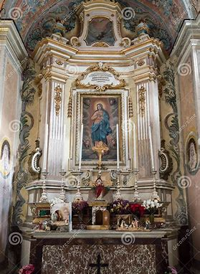
How do we express devotion to the Sacred Heart of Jesus in our Seven Sisters Apostolate?
Jesus makes constant intercession for us from Heaven; priests are made priests for life through the indelible mark that the sacrament of Holy Orders gives
  They continue to make intercessions for us. Our Lady prays for her priests, and all of her spiritual children. Her prayers converted the good thief, leading him to Heaven
  Our prayers can nurture the current vocations of priests, and future vocations. We join Our Lady in praying from our hearts for others, asking that all would come to know, love, and imitate Jesus in living virtuously
In praying for priests, we honor the priestly Heart of Jesus
  Vocations come from the Heart of Jesus

Slide 12
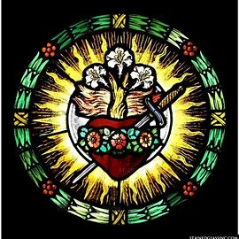
How do we express devotion to the Immaculate Heart of Mary in our Seven Sisters Apostolate?
Our calling: to remain loyal to God the Father; stand by the altar, the Cross, offering prayers to support the priests
Unite hearts with the Heart of Jesus; console His Heart to console Our Lady’s Heart; humbly receive Christ’s saving action in our hearts
Serve God like Our Lady by being a model of compassion and maternal love
  Reaching out to others in need, especially through prayer
  Praying for special intentions
  Being spiritually present for others; sharing in the experiences of others in their spiritual lives, accompanying them with love; i.e. being present as one receives the sacraments, discerns their vocation

Slide 13
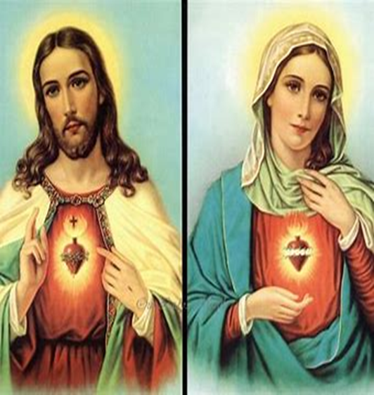
How do the Two Hearts complement each other? Why are they both needed?
Joys and sorrows are braided together: glory comes from balance in the spiritual life
Men and women have different talents, reflect different aspects of God’s love
A spiritual father and a spiritual mother are needed to experience fullness of God’s love
The Hearts of Jesus and Mother Mary are united in love of God the Father, and of us
  Twin flames of love burn in the Hearts; they are connected by pure love
  Jesus and Mother Mary teach us how to live out our unique vocations

Slide 14
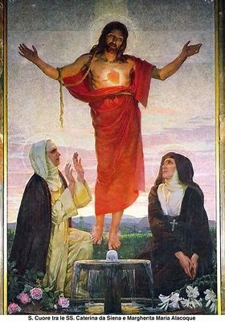
Who was St. Catherine of Siena, and how did she influence/practice devotion to the Sacred Heart? (1)
Family life: treated father and mother as Jesus and Mother Mary
Mystical union with Christ; consecrated virginity to God at age seven
  Bride of Christ: was given His ring to wear
  Had invisible wounds of Christ
    Died at age 33; had lived on the Holy Eucharist alone during illness
Devotion to the Sacred Heart predated that of St. Margaret Mary Alacoque
Was called to be a tertiary Dominican out in the world, not a nun
  Served the poor and the sick

Slide 15
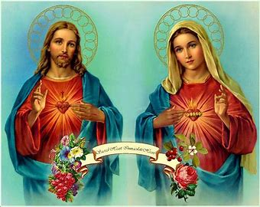
Who was St. Catherine of Siena, and how did she influence/practice devotion to the Sacred Heart? (2)
Drew upon love of Jesus, the Sacred Heart to bring people together in time of division
  Healed conflict between anti-popes through writings angling for peace; convinced pope to return to Rome amidst Avignon papacy
Wrote about the secret of the Sacred Heart revealed to her
  Asked Jesus about why His Sacred Side was opened; He was showing the boundlessness of His love, its breadth and depth that could not be contained
  Layered imagery: Christ’s Heart as wine cellar, classroom, library; Christ’s Body as bridge, staircase to Heaven
  Demonstrates what it means to appreciate the gifts in the treasury of the Sacred Heart, and to make a total self-gift out of love for Jesus

Slide 16
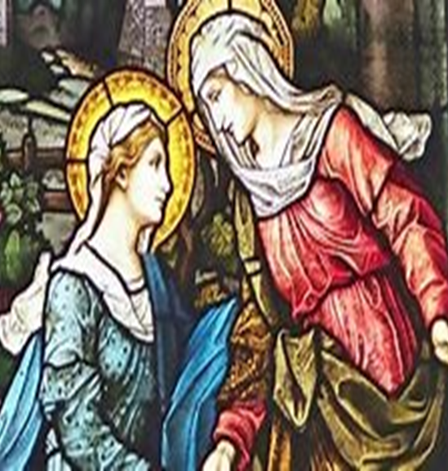
How do St. Francis de Sales & St. Jane Frances de Chantal exemplify how to practice devotion to the Hearts of Jesus and Mary?
St. Francis de Sales: chosen to serve as bishop
  Chosen to found the Visitation order with aid of St. Jane Frances de Chantal
St. Jane Frances de Chantal: chosen to serve as nun after being widowed, living a married state of life
  Chosen to help found the Visitation order; support St. Francis de Sales
Both chosen to spread devotion to the Two Hearts

Slide 17
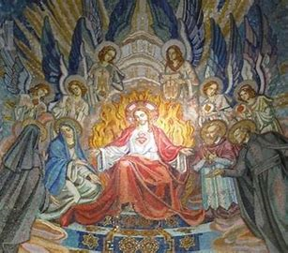
How do St. Margaret Mary Alacoque & St. Claude de la Colombiere exemplify how to practice devotion to the Hearts of Jesus and Mary?
St. Margaret Mary: nun chosen to spread devotion to the Sacred Heart
  Rested head on the Heart of Christ
    Led to Jesus’ Heart by St. John the Evangelist (feast day: December 27), who loved the Sacred Heart
    Like Our Lady in loving Christ’s Heart
    Was in Presence of Eucharistic Heart at Adoration when Christ appeared to her
St. Claude de la Colombiere: priest chosen to support the spread of devotion to the Sacred Heart
  A St. Joseph-like figure to St. Margaret Mary Alacoque; a guardian of her soul; also like St. John in having the Hearts of Jesus and Mary entrusted to him in a special way, through being chosen for spreading devotion to them
  Confessor and spiritual director; wisdom of the heart

Slide 18
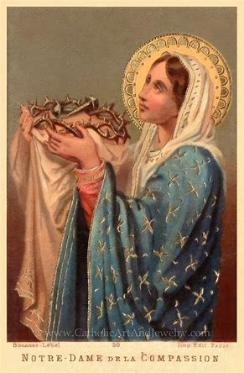
How may we express thanksgiving for our priests in this holy season?
Offer the Holy Rosary for the intentions of priests; meditate on the Sorrowful Mysteries; thank God for the sacrifices they make, and for offering their sufferings in union with those of Jesus
Pray the Servite Rosary, invoking Mary, Mother of the Clergy and Our Lady of Compassion, asking her to respond to the prayers of her priests with mercy; thank God for Our Lady, our Mother of Mercy who helps us all to love each other
  Mater Misericordiae: Mary, Mother of Mercy (corde= heart; to be compassionate means that your heart goes out to someone in their times of need)
    This is what it means to be like Our Lady

Slide 19
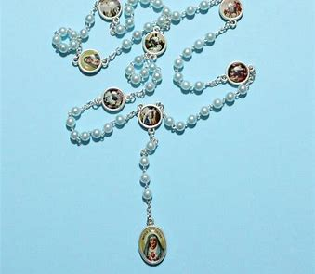
What is the Servite Rosary? How does it promote deeper devotion to the Two Hearts?
Servite order: devotion to Our Lady of Sorrows; promote devotions that console the Immaculate Heart
Meditate on the Sorrows of Our Lady
  (1) Prophecy of Simeon; (2) Flight into Egypt; (3) Loss of Jesus at the Temple; (4) Mary Meets Jesus on the Way to Calvary; (5) The Crucifixion of Our Lord; (6) Deposition of Our Lord’s Body from the Cross; (7) Burial of Jesus’ Body in the Tomb
  Understand Mary’s sorrow as flowing from love of Jesus, suffering when He suffers; see all that Our Lord endured out of love for us; love as sacrifice
Pray seven “Hail Mary” prayers for each of the seven Sorrows
  49 “Hail Mary” prayers total; express contrition for sin, ask Our Lady to “pray for us sinners”
  7 “Our Father” prayers
  3 “Hail Mary” and “Virgin Most Sorrowful, pray for us” invocations for Our Lady’s tears; one “Our Father,” “Hail Mary,” and “Glory Be”

Slide 20
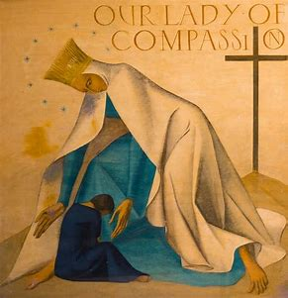
How do we pray the Sorrowful Mysteries of the Holy Rosary for Priests? (1)
Meditate on how the Sorrowful Mysteries of Our Lord relate to the experiences of priests; how are the lives of priests lived in union with the life of Christ, the Eternal High Priest, the Man of Sorrows?
  Offer thanksgiving to God for how priests console the Heart of Jesus with their life; offer your prayers and acts of reparation to console Jesus’ and Mother Mary’s Hearts, too
    Pray a Mystery for each of Christ’s holy wounds: share your love for Him as you reflect on how Jesus took on His wounds for you out of love, and modeled to all priests, laity how to do the same
    Reflect on how priests have supported you in your times of suffering, showing you Christ’s love and mercy while you carried your crosses; think about how you can be their spiritual friend and support them in prayer
    View guide (printout available)

Slide 21
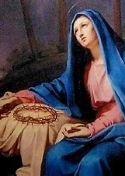
How do we pray the Sorrowful Mysteries of the Holy Rosary for Priests? (2)
First Sorrowful Mystery: Our Lord’s Agony in the Garden
  The priest patiently waits with Jesus; he offers up times of anxiety to Christ, remaining with Him in prayer; he prepares to offer Holy Mass to relive the Passion of Our Lord
Second Sorrowful Mystery: The Scourging of Our Lord at the Pillar
  The priest takes on suffering for Christ; he receives adversities with patience, responding calmly with words of love to hurts that cut; in his woundedness, he relates to others, and draws upon his steadfast faith to heal others’ wounds
Third Sorrowful Mystery: Our Lord’s Crowning with Thorns
  The priest accepts humiliations for God’s glory, and joyfully serves Him, even when his ministry is misunderstood by others; he endures suffering to lead others to their heavenly crowns

Slide 22
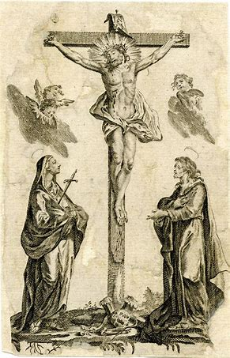
How do we pray the Sorrowful Mysteries of the Holy Rosary for Priests? (3)
Fourth Sorrowful Mystery: Our Lord Carries the Cross
  The priest shoulders the weight of the Cross with Christ, offering up his crosses for the salvation of souls; he absorbs our pain into his heart, and lifts burdens from us so that we will not have to carry them; he brings our prayers to Christ, so that we never carry our crosses alone; this makes each cross sweet
Fifth Sorrowful Mystery: The Crucifixion of Our Lord
  The priest gives himself entirely to God. He shares in Christ’s fruitfulness; through his sacrifices, he becomes a spiritual father to many, and leads souls to Heaven. He offers all he has out of love, pouring out himself to bring us healing from Jesus’ Body and Blood

Slide 23
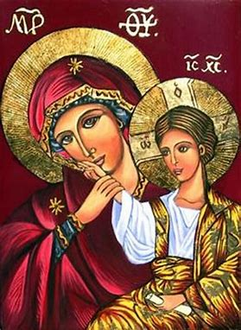
Upcoming Event Announcements: Seven Sisters Apostolate & Two Hearts Guild
March First Friday & First Saturday Masses:
  Saturday, March 1, 2025, 9:00 a.m., church; blessing of sacramentals to follow
    4:00 p.m. Vigil Mass
  Friday, March 7, 2025, 8:00 a.m., church; Eucharistic Adoration to follow
  Friday, March 7, 2025, 6:00 p.m., church
Two Hearts Guild meeting 3: Friday, March 7, 2025, 7:00 p.m. to 8:00 p.m., parish hall
Seven Sisters event 5: Tuesday, March 25, 2025, 6:00 p.m. to 7:30 p.m.
  Meet in parish hall

Slide 24
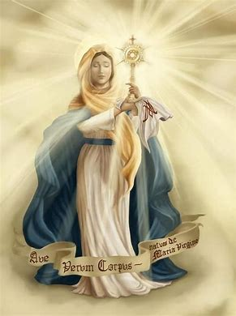
Upcoming Event Announcements: Sacrament Learning Series for Adults
Sacrament learning series session 3: Thursday, February 20, 2025, 6:00 p.m. to 7:30 p.m., parish hall
  Presentation topic: Holy Communion
Sacrament learning series session 4: Tuesday, February 25, 2025, 6:00 p.m. to 7:30 p.m., parish hall
  Presentation topic: Confirmation
Sacrament learning series session 5: Tuesday, March 4, 2025, 6:00 p.m. to 7:30 p.m., parish hall
  Presentation topic: Holy Matrimony, Holy Orders, Extreme Unction

Slide 25
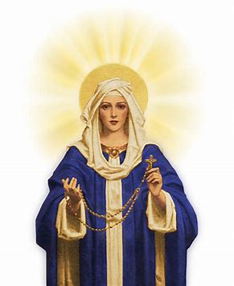
Upcoming Event Announcements: Liturgical Rosary
Liturgical rosary prayer group session 6: Thursday, February 27, 2025, 5:30 p.m., parish library
  Feast day readings: St. Gabriel of Our Lady of Sorrows
  Intentions: Fr. Barrent
Liturgical rosary prayer group session 7: Wednesday, March 19, 2025, 6:45 p.m., parish library
  Feast day readings: St. Joseph
  Intentions: Fr. Sliwa

Slide 26
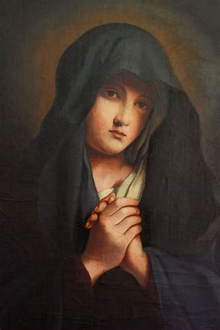
Closing Prayer: Consecration to Our Sorrowful Mother
Holy Mary, Mother of God and Queen of Martyrs, I do this day choose you as my model, protectress, and advocate. Receive me as your special servant, as a partaker in your sufferings. Give me strength always to remain close to Jesus your Son who died on the cross for me. Accept every good work that I may perform and offer it to your Son for me. Dear Mother, stand by me in all my actions, that they may be directed to the glory of God. Amen.
Our Lady of Compassion, pray for us. (3x)

