Slide 1
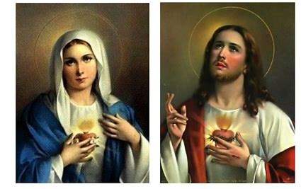
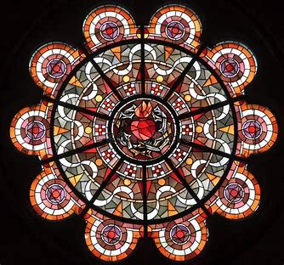


Two Hearts Guild Meeting 1
Friday, January 24, 2025
Katie Sadakierski

Slide 2
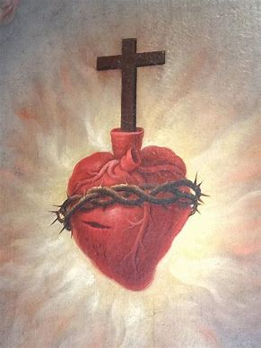
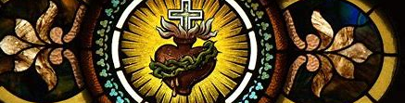
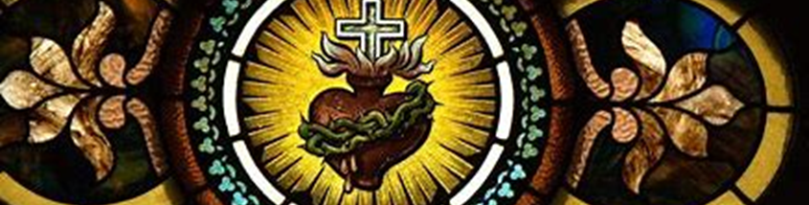

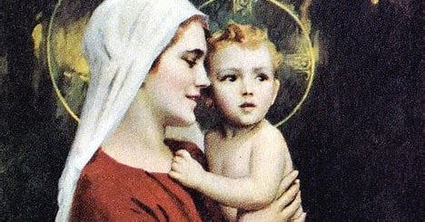
Outline
Welcome & Opening Prayer
Introduction to the Two Hearts Guild
Meeting presentation
  I. St. Francis de Sales: Practicing Devotion to the Sacred Heart and the Holy Name of Jesus
  II. Why and How we Honor the Sacred Heart and the Holy Name
Announcements
Closing Prayer
Q & A

Slide 3

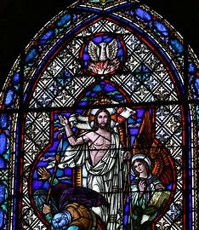
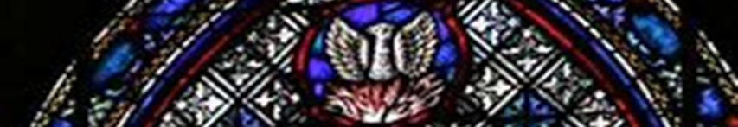
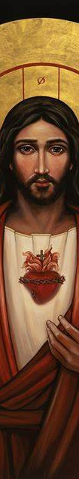

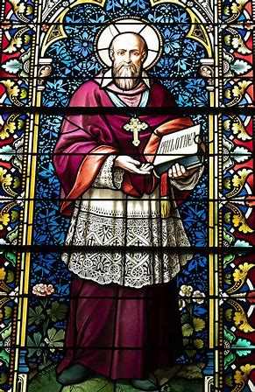

Opening Prayer: The Prayer of St. Francis de Sales
Be at peace.
Do not look forward in fear to the changes of life; rather look to them with full hope as they arise.
God, whose very own you are, will deliver you from out of them.
He has kept you hitherto, and He will lead you safely through all things; and when you cannot stand it, God will bury you in his arms.
Do not fear what may happen tomorrow; the same everlasting Father who cares for you today will take care of you then and every day.
He will either shield you from suffering, or give you unfailing strength to bear it.
Be at peace, and put aside all anxious thoughts and imagination.

Slide 4
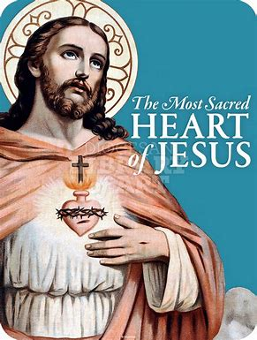
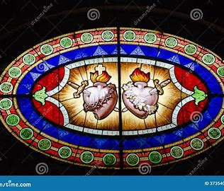

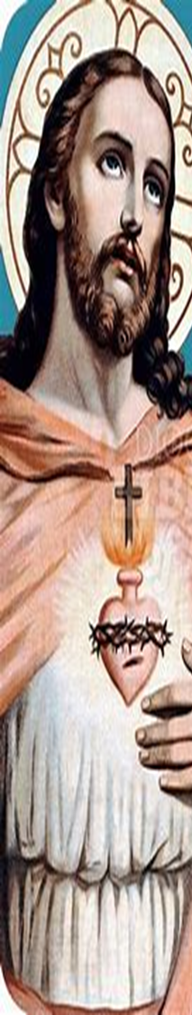
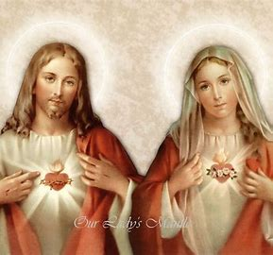
Introduction: What is the Two Hearts Guild?
Seven Sisters Apostolate
  Holy hour offered by a woman in the apostolate
  every day of the week for the intentions of a priest
Fasting Brothers Apostolate
  Fast offered by a man in the apostolate each day of the week
  (except for Sunday) for the intentions of a priest
Building solidarity, unity in Christ
  Shared mission of prayer and penance; adoration of Christ through thanksgiving
  for holy priesthood
  Opportunities for prayer, fellowship, catechesis, and special projects
Harnessing the complementary virtues of the
Two Hearts to strengthen ministry of prayer

Slide 5
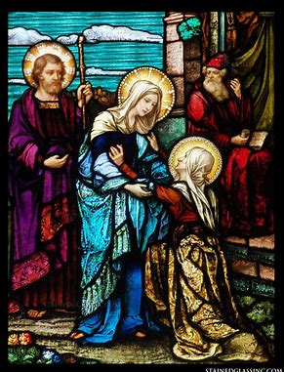
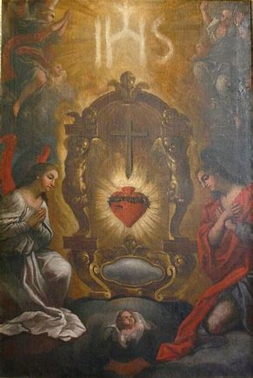

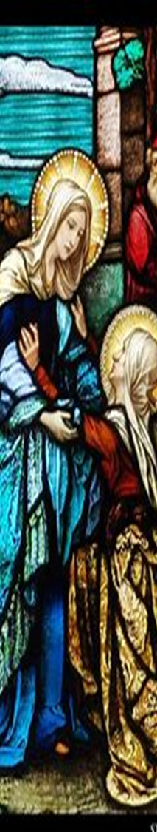
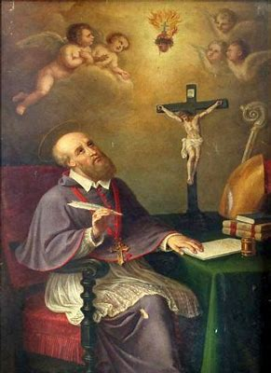
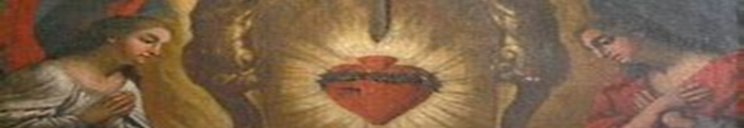
Who is St. Francis de Sales?
Feast day: January 24 (new calendar); January 29 (traditional)
1567-1622
  Helped to lead Counter-Reformation through promoting
  devotion to the Sacred Heart
Co-founder of the Visitation order
Bishop of Geneva
Doctor of the Church
Devotee of the Sacred Heart
Patron saint of writers, adult education, the deaf

Slide 6
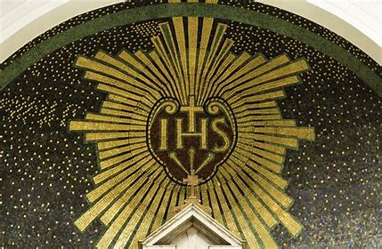

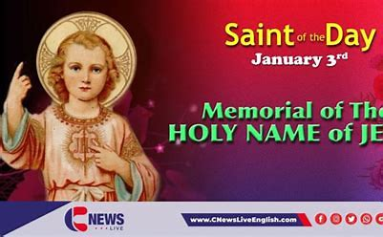
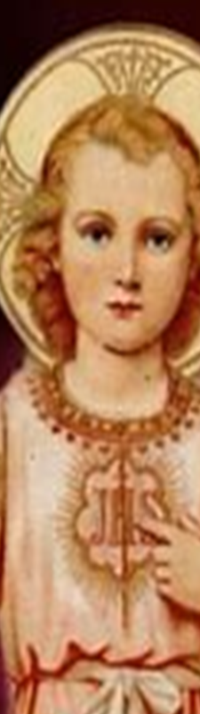
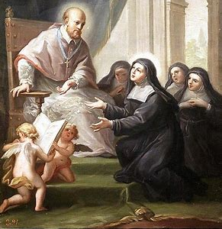
Who is St. Jane Frances de Chantal?
Feast day: August 21
1572-1641
Co-founder of Visitation order
  St. Francis de Sales was spiritual director
Mother and wife
  After being widowed, became a nun
Patron of widows, mothers, wives

Slide 7

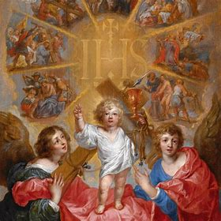

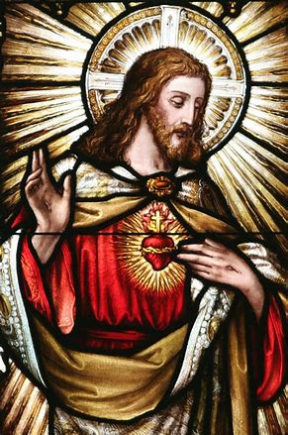
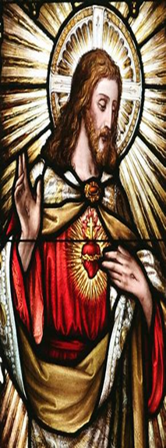
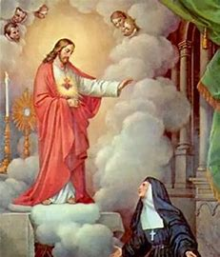

Who is St. Margaret Mary Alacoque?
1647-1690
Visitation sister
Apostle of the Sacred Heart
Received visits from the Sacred Heart between 1673 and 1675
Spread First Friday devotion
Patron of devotees of the Sacred Heart

Slide 8

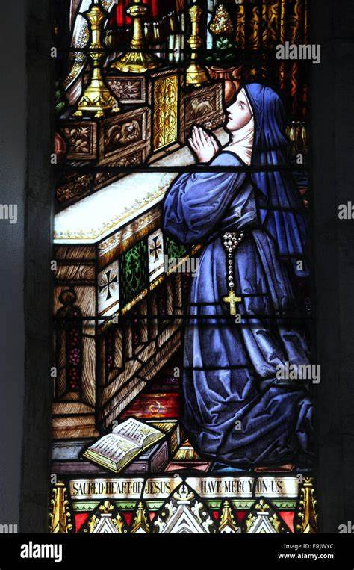
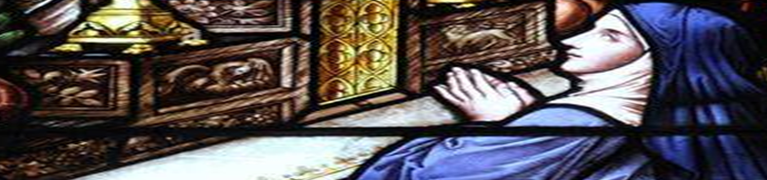

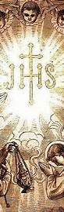
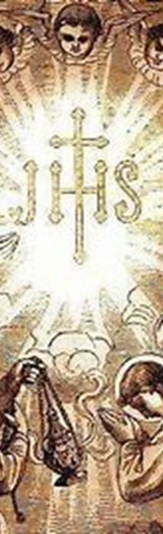

Why do we honor the Holy Name of Jesus in January?
Feast of the Circumcision of Our Lord: January 1
  Jewish tradition: son named eight days after birth, during
  circumcision ritual
  First offering of the Precious Blood
    Praise Jesus’ Holy Name for His love
Feast of the Holy Name: January 3 (new calendar); Sunday before
Epiphany in traditional calendar
Feast of the Baptism of Our Lord: January 13
  Sign of Jesus’ holiness; chose to be baptized, out of love
  Today, is customary to receive “baptismal” name, name at Baptism

Slide 9
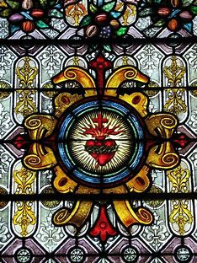



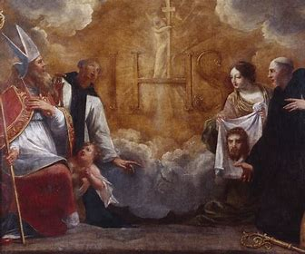


How does devotion to the Holy Name of Jesus connect to devotion to the Sacred Heart?
To praise the Holy Name is to honor
the love of the Sacred Heart
Holy Name of Jesus means “God saves”
  God’s love saves us
Parallels between litanies used to praise
the Holy Name and the Sacred Heart: adore
Jesus as King, Source of peace; keep Him as the center of our hearts (enthrone Him)

Slide 10

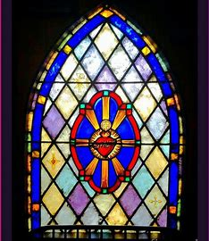


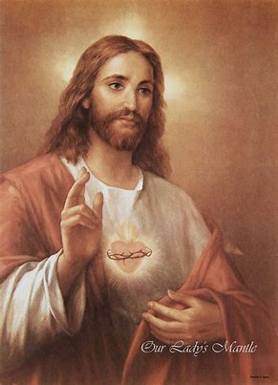
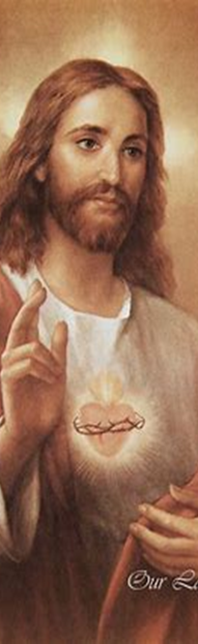
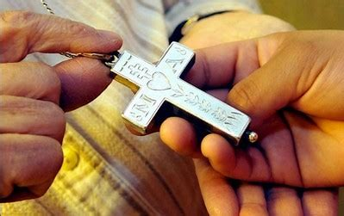
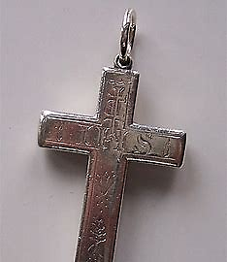
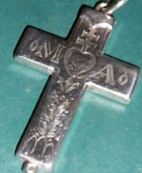
How did St. Francis de Sales encourage devotion to the Holy Name of Jesus? The Holy Name of Mary?
Visitation sister profession crosses: have letters
“IHS” and “MA”
IHS: First three letters of Jesus’ Name in Greek
MA: abbreviation for “Maria,” and acronym
for “Mons Amoris,” “Mount of Love” (Calvary)
Invoking the Names of Jesus and Mary an
expression of faith, hope, and love

Slide 11
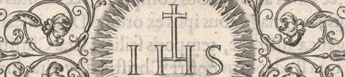
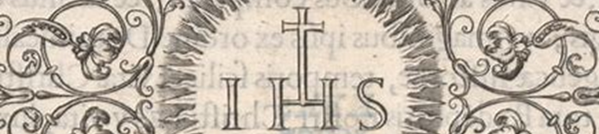
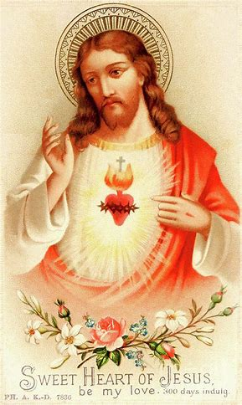


How did St. Francis de Sales encourage devotion to the Sacred Heart?
Visitation symbol: Sacred Heart pierced with lance, riddled with arrows
  Inspired by St. Sebastian
    Being wounded by Jesus’ love; consoling His Heart by loving It with the faithfulness of Our Lady
    Visiting each other like Our Lady visited St. Elizabeth, tending to her needs
      Tend to the wounds of Jesus with love
“The measure of loving God is to love without measure”

Slide 12

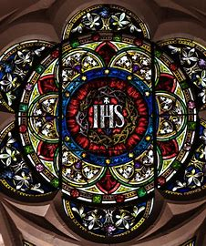
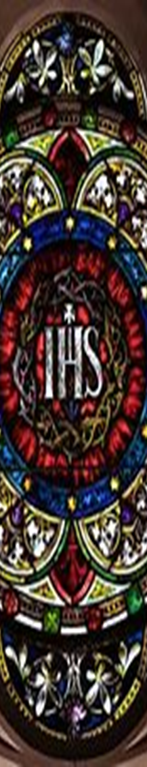
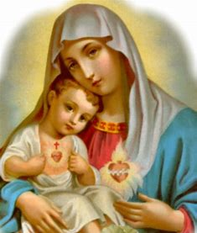


Why and how should we practice devotion to the Holy Name of Jesus? The Sacred Heart?
Holy Name fills us with wonder for Jesus’ greatness
  Adore God in His transcendence
Is an effective means of reaching the Heart of Jesus
Cultivates a more personal relationship with Jesus
  Adore God in His immanence
Pray the Chaplet of the Holy Name & Litany of the Holy Name
Pray the Chaplet of the Sacred Heart & Litany of the Sacred Heart
Invocations; aspirations throughout day
Eucharistic Adoration; Benediction and Divine Praises

Slide 13
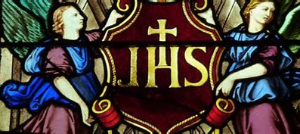
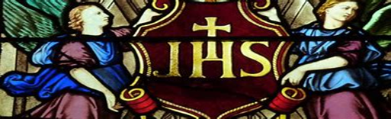
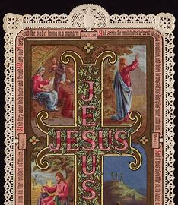
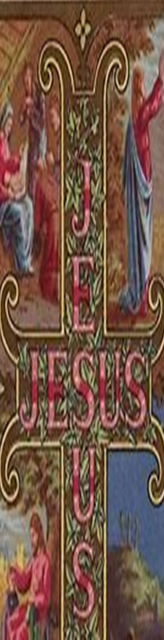
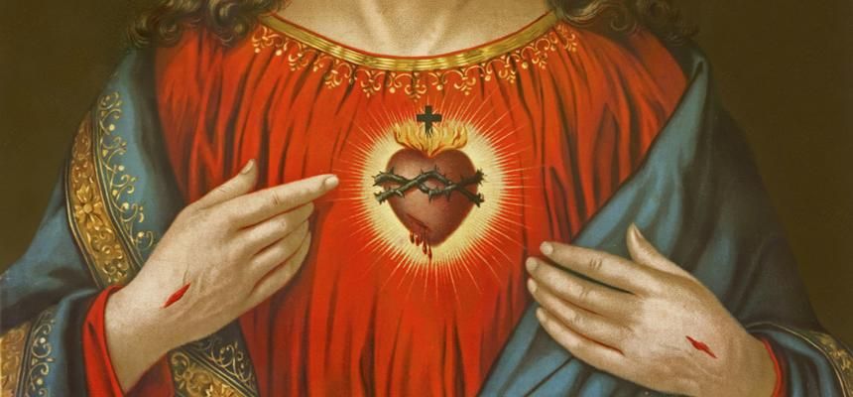
What does it mean to live with peace as a devotee of the Sacred Heart? How can spiritual mothers and spiritual fathers embody Jesus’ and Mary’s spirit of peace?
Unite all life experiences, doings to crosses,
wounds of Christ; offer up for Jesus,
the salvation of souls
Give all to Jesus; trust in His mercy,
goodness: “Jesus, I trust in You”
Invoke Jesus, Prince of Peace and Our Lady, Queen of Peace
Live with love; “nothing difficult for one
who loves”; do all things out of love for God, one another

Slide 14


How can we grow in the virtue of peace in this month, and going forward? Why is peace an important virtue of the Sacred Heart?
Turn to prayer; turn heart to God
  Prayer unites us with God, and God is peace, since God is love
Meditate on the sacred mysteries; Holy Rosary
Keep Jesus in the Blessed Sacrament company
Peace in soul allows us to remain focused on God
  Peace is the root of joy; can love all that God gives us as gifts
Peace is an outgrowth of love
  Fruit of the Holy Spirit
  Good works produce good fruit
    Allow for conversion of souls

Slide 15




Announcements
Wednesday, January 29, 2025
  Liturgical Rosary: 4:30 p.m., parish library
Sunday, February 2, 2025
  Eucharistic Adoration: 2:00 p.m. to 5:00 p.m.
Friday, February 7, 2025
  First Friday Latin Mass: 6:00 p.m.
  Two Hearts Guild Meeting 2: 7:00 p.m.
    Snow date: Friday, February 21, 2025, 7:00 p.m.

Slide 16





Closing Prayer: Prayer to the Sacred Heart for Inner Peace
Holy Heart of Jesus, Sweet Sanctuary of rest, bring peace to my soul and settle my spirit. I vow to place all of my worries and fears into the wound of Your Sacred Heart there to be tended to in accordance with Your perfect will, which desires only the best and the highest good. Your love alone is enough, and I surrender to it, clinging to the hope of a swift resolution and trusting with confidence in all of Your promises. Amen.
Most Sacred Heart of Jesus, have mercy on us. (3x)
Sweet Heart of Mary, be our salvation. (3x)
Immaculate Heart of Mary, pray for Fr. Sliwa, Fr. Barrent, and Fr. Roux. Amen.

