Slide 1
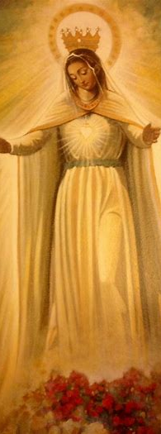
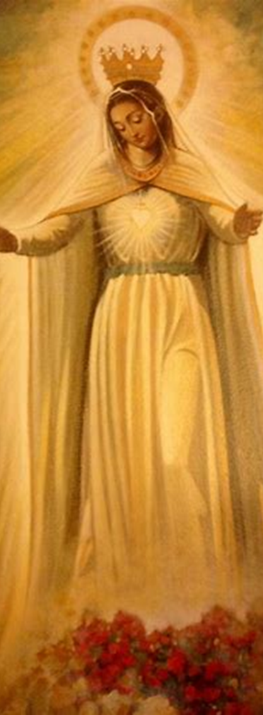
Divine Office Learning Series Course 3
Katie Sadakierski
Our Lady of the Valley Parish
Tuesday, December 17, 2024

Slide 2
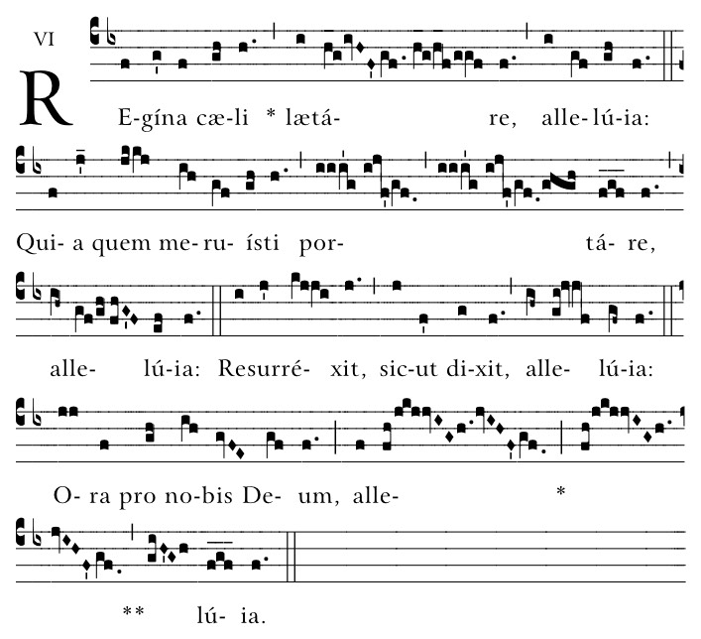
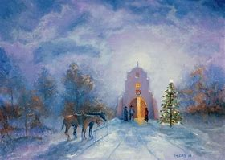
Course Outline
Chant demonstration (in church, 6:00 p.m. to 6:30 p.m.)
  Chanting the Little Office of the Blessed Virgin Mary
    Practicing the prayers of Sunday Vespers during Advent; Office 2
Opening prayer
Presentation: Overview of topics (parish hall, 6:30 p.m. to 7:30 p.m.)
  Modes and tones of chant:
    Considerations for the liturgical season(s)
    Variances across the canonical hours
  Chant as a vehicle of personal spiritual expression within the context of communal worship; private vs. public devotions
      The experience of chanting the Little Office in religious communities versus in the parish/home setting
Closing prayer
Q & A

Slide 3
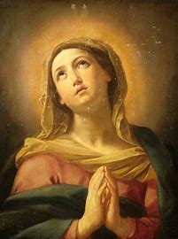
Opening Prayer: Prayer Before the Divine Office
Open, O Lord, my mouth to bless thy holy Name; cleanse also my heart from all vain, evil, and wandering thoughts; enlighten my understanding and kindle my affections; that I may worthily, attentively, and devoutly say this Office, and so be meet to be heard before the presence of thy divine Majesty. Through Christ our Lord. Amen.
Hail Mary…

Slide 4
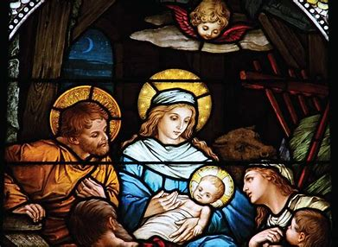
How do tones of chant differ according to the liturgical seasons? Which modes are most often associated with Advent?

Slide 5
Does the tone we use to chant vary according to the spirit of the canonical hour? Or does it only depend on the set mode of the hymn/antiphon?

Slide 6
Even after reciting/chanting the prayers of each canonical hour, how might we bring its spirit into our daily lives?

Slide 7
How does private recitation of the Little Office/Divine Office differ from public recitation? How does the experience of chanting the Office within a religious community differ from reciting/chanting it? outside of this context?

Slide 8
What do you identify as being the greatest spiritual benefits of chanting the Office, versus reciting it? How might the prayers of the Little Office, specifically, enhance our interior lives?

Slide 9
What are some other considerations we should keep in mind when reciting/chanting the Little Office?

Slide 10
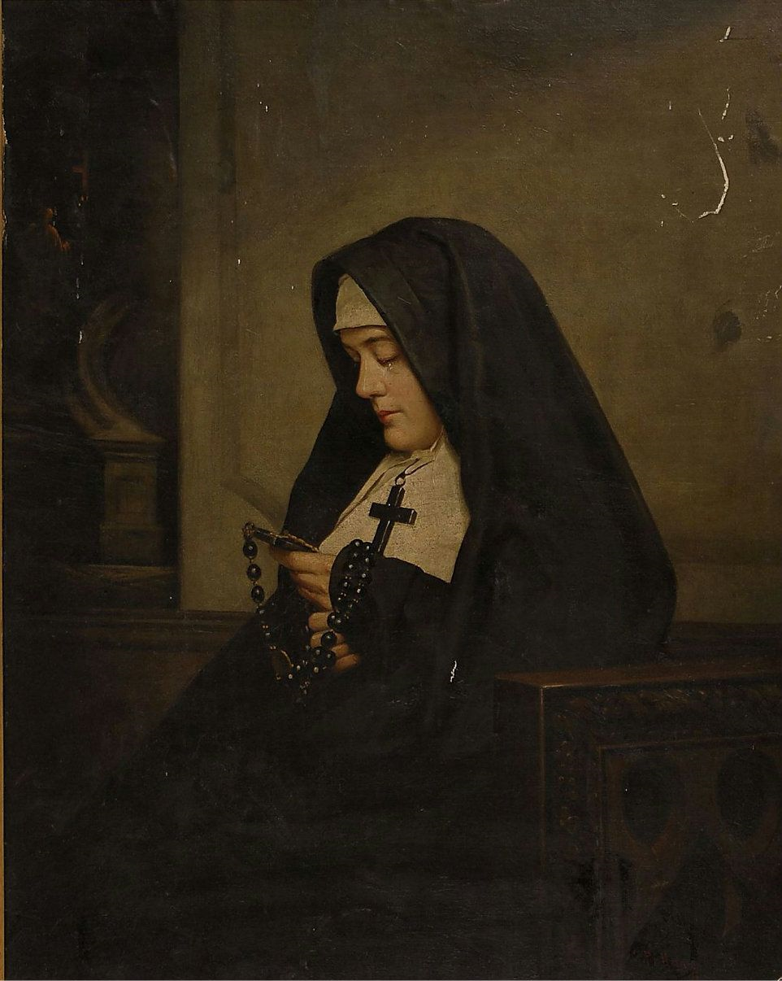
Closing Prayer
Everlasting praise, honor, power, and glory be given by all creatures to the most holy and undivided Trinity, to the Humanity of our crucified Lord Christ Jesus, to the fruitful purity of the most blessed and most glorious Mary ever Virgin, and to the company of all the Saints; and may we obtain the remission of all our sins through all eternity. Amen.
Our Father…
Hail Mary…

Slide 11
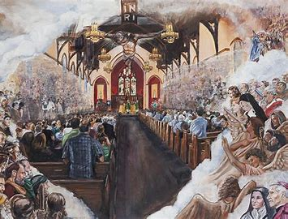
Special Announcements
Next Divine Office learning series session (4):
  Friday, December 20, 2024
    6:00 p.m., parish hall
    Consecration to St. Michael to follow
Vespers
  Sunday, December 22, 2024
    2:30 p.m., church (after Traditional Latin Mass)
      Bring Little Office book

Slide 12
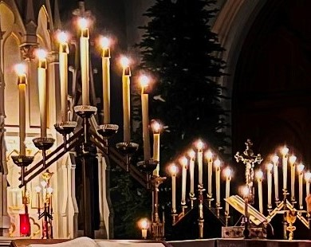
Q & A
Group-wide questions
Individual questions
  Personal copies of Divine Office/Little Office readings
  Navigating the breviaries

