Slide 1
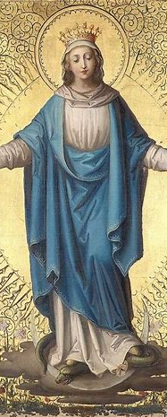

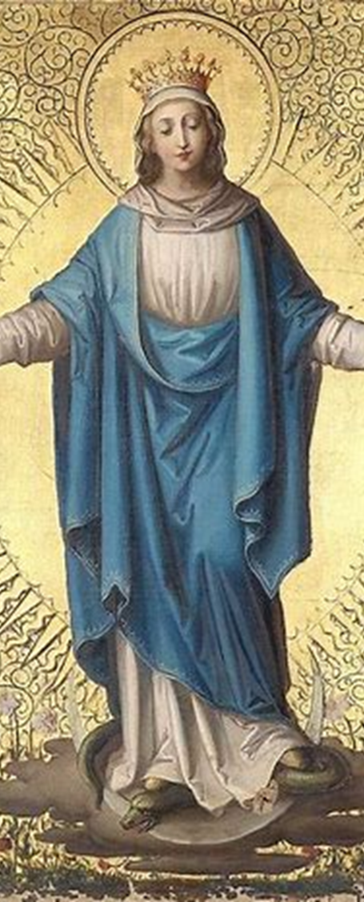
Divine Office Learning Series Course 2
Katie Sadakierski
Our Lady of the Valley Parish
Tuesday, December 10, 2024

Slide 2

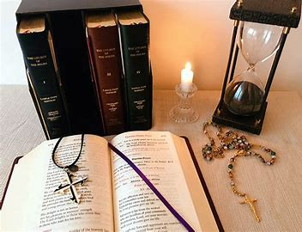
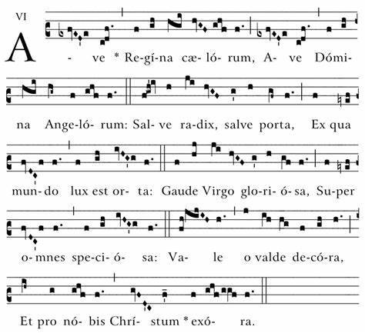
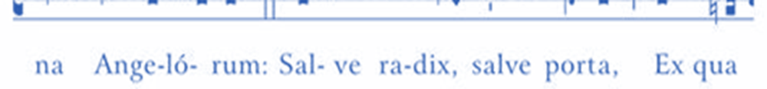
Course Outline
Opening prayer
Presentation: Overview of topics
  History of Gregorian chant & the role of sacred music in worship
  Guide to reciting and chanting the canonical hours of the Little Office
    Decoding the Divine Office
  Responding to the spirit of lyrics of chant in our interior lives
Closing prayer
Q & A

Slide 3
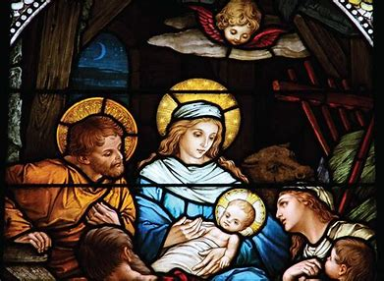
Opening Prayer: Hail Mary
Hail, Mary, full of grace,
The Lord is with thee;
Blessed art thou among women,
And blessed is the fruit of thy womb, Jesus.
Holy Mary, Mother of God,
Pray for us sinners,
Now and at the hour of our death. Amen.

Slide 4

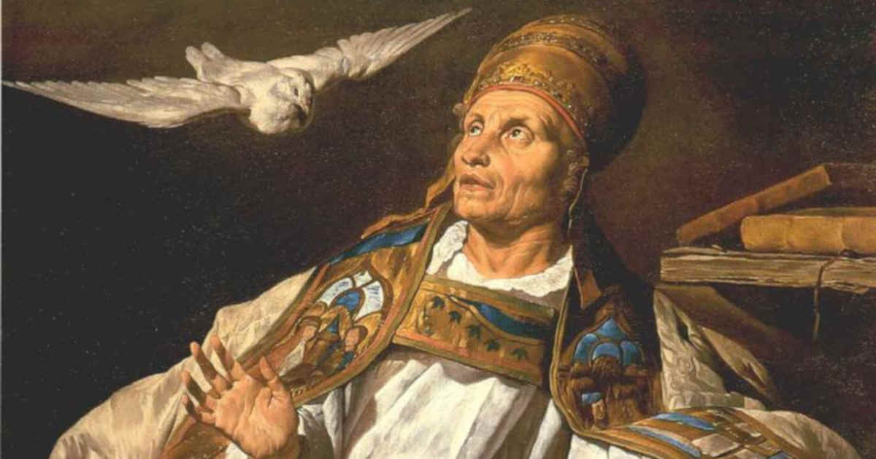
Who was Pope St. Gregory I? What was his contribution to sacred music in the Church?
Benedictine
Tradition holds that Pope St. Gregory I (540-604 A.D.) finalized arrangement of Gregorian chant (set sacramentary to music), but many chants are believed to have been in existence well before his time
  Divine inspiration: sought to replicate song of angels he heard in a mystical vision
  Compiled chants, revised, selected for specific liturgies
    More recent research suggests that chants may have been developed in the eighth century during the Carolingian dynasty, when Charlemagne was king, and the pope was Gregory II
Trained men in plainsong
Promoted use of plainchant in the Church
Patron saint of singers, musicians

Slide 5
What is Gregorian chant versus Old Roman chant? What similarities do they share?
Gregorian Chant
Old Roman Chant
Plainchant (Church music of the early Middle Ages)
  Single melodic line; monophonic
  Latin
  Contemplative; simple
  No musical accompaniment
  Predated polyphony (multiple parts in harmony; combination of multiple tones/melodic lines)
Predated Gregorian chant; used in Roman liturgy
Use of soloists (following Jewish tradition)
Uses modes, melodic patterns expressing emotions, similar to those used in Gregorian chants
More elaborate than Gregorian chant
Specific characteristics unknown; limited availability of full manuscripts

Slide 6
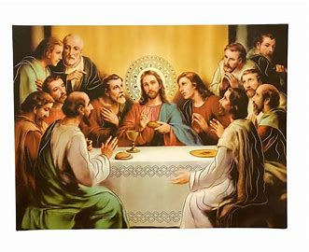
How is sacred music itself a form of prayer? Why should we use sacred music in prayer?
Jesus and the apostles sang hymns at the Last Supper before going to the Mount of Olives, where Jesus experienced the Agony in the Garden
Jesus thanked God the Father at the beginning of His Passion
Song elevates worship, helps us to express adoration of God in a more transcendent way that comes from the depths of the soul
Music goes beyond what words can convey; follows rhythms of heart
  God does not always speak in words; speaks deep within. God speaks according to languages the soul will understand; is above the ordinary

Slide 7
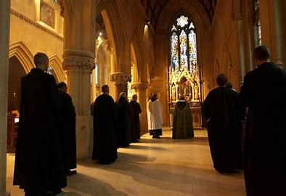
How can praying the Divine Office be a form of “audio divina”?
Listening with the ears of the heart (St. Benedict of Nursia; the Rule of St. Benedict); divine listening/reading of lyrics
Meditation, Prayer, Contemplation; peace and joy
Attunement to God’s voice
  Know what He is calling us to do in order to respond
Hearing the beauty, truth, and goodness of God
Using the human voice to praise God
  Appreciating Wisdom of Creator through creation

Slide 8
How do we pray the Little Office? What is the sequence of prayers we say? (1)
Canonical Hour | Order of Prayers
Matins | Invitatory with Psalm 94 Hymn One of three nocturns (according to day of week) Versicle and response, with “Our Father” and absolution Three lessons (each preceded by blessing, responsory, versicle, and response); “Te Deum” after the first lesson
Lauds | Three psalms with antiphons Canticle of the Three Children, with antiphon Psalm 148 with antiphon The Little Chapter Hymn with versicle and response Canticle of Zechariah with antiphon Prayer with concluding versicle and responses
Same sequence every day for each canonical hour; same readings in Little Office; Divine Office differs by day of the week
Major hours (4):
  Include Little Chapters
  Include Gospel canticles
  Incorporate more of the psalms
  Also include nocturns (vigils, night watches) and lessons
  Hymns, vesicles, antiphons, and responses
  Incorporate major Marian antiphons for seasons
Minor hours (4): fewer readings
  Include Little Chapters
  Some psalms, hymns, prayers, versicles, and responses

Slide 9
Canonical Hour | Order of Prayers
Prime, Sext, None | Hymn Three psalms, with one antiphon Little Chapter with versicle and response Prayer, concluded with versicle and responses
Vespers | Five psalms, with antiphons The Little Chapter Hymn, with versicle and response Canticle of Mary, with antiphon Prayer, concluded with versicle and responses
Compline | Three psalms, without antiphons Hymn The Little Chapter, with versicle and response Canticle of St. Simeon with antiphon Concluding prayer, with versicles and blessing Anthem of the Blessed Virgin, according to the season (one of the four seasonal Marian antiphons)

Slide 10
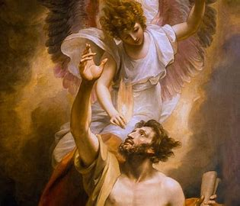
What are the prayers before and after the Divine Office? Why are these particular prayers said?
Before: “Aperi, Domine”: “Open thou my mouth, O Lord” (and “Hail Mary” in the Little Office)
  Our Lady speaks through us; ask for her intercession
  We speak as one Church
  Similar to threefold Gospel blessing at Mass: pray to praise God well, with our hearts, minds, and lips
After: “Sacrosanctae et individuae Trinitati”: “everlasting” praise to the Holy Trinity; then an “Our Father” and “Hail Mary”
  We continue to bless God for His goodness

Slide 11
How is each day of the week we pray in the Divine Office sanctified?
Respond to God’s Presence in a unique way each day
Appreciate another aspect of divine revelation, or another sacred mystery
Devotional theme for each weekday to direct intentions
  Meditate on Office readings in light of the daily theme; respond to the sacred
Day of the Week | Devotional Theme
Sunday | Holy Trinity
Monday | Holy Spirit
Tuesday | Holy Angels
Wednesday | St. Joseph
Thursday | Holy Eucharist
Friday | Passion of Christ/Sacred Heart
Saturday | Our Lady/Immaculate Heart

Slide 12
What are the canonical hours of the Divine Office?
Name of Canonical Hour | Time of Day for Prayer
Matins | 2:00 a.m.
Lauds | 5:00 a.m.
Prime: Hour 1 after dawn | 6:00 a.m.
Terce: Hour 3 | 9:00 a.m.
Sext: Hour 6 | 12:00 p.m.
None: Hour 9 | 3:00 p.m.
Vespers | 6:00 p.m.
Compline | 7:00 p.m.
8 hours: traditionally, 7 prayed in daylight; sometimes, Matins and Lauds counted together, so a total of 7 hours were listed (counteract seven deadly sins)
  Matins: nighttime, three nocturns: 3 sets of psalms each
  Lauds: dawn; joy, hope, resurrection, Canticle of Zechariah
  Prime: early morning prayers, full sunrise
  Terce: Holy Spirit (descent of the Holy Ghost)
  Sext: midday prayer; spiritual battle; “beware the noonday devil”; recalling Christ’s Passion
  None: midafternoon prayer; recalling Christ’s Death
  Vespers: evening prayers (late afternoon, dusk); thanksgiving, Canticle of Mary
  Compline: second set of evening prayers; nightfall (before bed); Canticle of Simeon; personal: examination of conscience; preparation for a holy death, spirit of trust and surrender

Slide 13
What are the major versus the minor canonical hours of the Divine Office?
Clergy obliged to pray all hours; laypeople may pray morning and evening prayers
Hours at specific times of day (typically, with fewer readings):
  Prime, Terce, Sext, None
Overarching categories:
  Matins/Lauds
    Morning prayers
  Vespers/Compline
    Evening prayers
Major Canonical Hours | Minor Canonical Hours (Little Hours)
Matins | Prime
Lauds | Terce
Vespers | Sext
Compline | None

Slide 14
How do the canonical hours of the Divine Office differ from the reformed Liturgy of the Hours?
Divine Office (traditional) | Liturgy of the Hours (reformed)
Matins | Office of Readings (major hour)
Lauds | Morning Prayer (major)
Terce | Midmorning prayer (minor)
Sext | Midday prayer (minor)
None | Afternoon/midafternoon prayer (minor)
Vespers | Evening prayer (major)
Compline | Night Prayer (minor)
Fewer hours in the liturgy of the hours; major and minor hours categorized somewhat differently
  Arrangement differs
Different titles for canonical hours in the liturgy of the hours
Liturgy of the hours: permits options
  May pray major morning and evening prayers, choosing at least one minor hour in between (not necessarily all)

Slide 15
What is our exterior participation in the prayers of the Little Office?
Stand | Sit | Kneel
Introduction to the Office (Sign of the Cross)
Opening hymn
 | Psalms (may sit or stand; depends on local customs)
 | Readings (besides Gospel)
Gospel canticle (sign of the Cross)
Concluding prayers
Anthem of the Blessed Virgin |  | *Anthem of the Blessed Virgin, if outside of hours from Saturday Vespers to Sunday Compline
Sign of the Cross
  At the “Deus in adjutorium” (beginning of hours)
  At each Gospel canticle (Canticle of Zechariah, Canticle of Mary, Canticle of Simeon)
  At the end of Compline: “Benedicat et custodiat…”
    Sign of Cross with thumb on the lips: “Domine, labia”… and on heart at “Aperi, Domine”
Anthem of the Blessed Virgin
  Stand at Paschal time; and in hours from Saturday Vespers to Sunday Compline
  At all other times, kneel

Slide 16
How do we know which prayers to pray each day? Do we pray the same canonical hours every day?
Divine Office (Angelus Press 2022 edition) Monday through Saturday texts | Divine Office (Angelus Press 2022 edition) Sunday texts
Prime | Lauds
Sext | Prime
Compline | Sext
 | Vespers
 | Compline
May pray all eight canonical hours each day
  Divine Office: set of readings specific to each day of the week
  Little Office: same readings for each day of the week. Pray Marian prayers during all eight canonical hours daily
    Nocturns differ according to weekday; roughly follows schedule of Holy Rosary (same prayers for Tuesdays and Fridays; Wednesdays and Saturdays; Mondays, Thursdays, and Sundays)

Slide 17
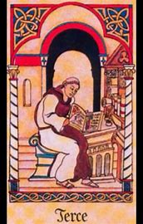
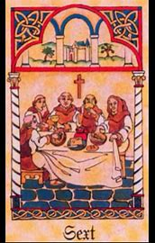
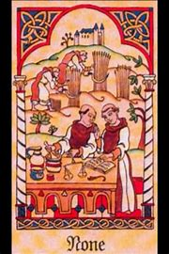
How do the prayers of the Divine Office each day differ from each other, and what are their commonalities? What spirit does each day have?
All help us to participate in the sacred mysteries, share in the events in the lives of Jesus and Mother Mary
Each canonical hour for every day represents a different phase in the Passion, much like the Holy Mass
  Also provide points of meditation on events in Christ’s life besides the Passion; each hour can be used to commemorate a different stage in salvation history
Readings and intentions may differ each day in the Divine Office, but commemorations may remain the same
Even while praying the same readings together, can personalize devotions by meditating on a different mystery or focusing prayers on a special intention

Slide 18
Canonical Hour | Commemoration (choose one) | Intention
Matins | The Nativity The Agony in the Garden The Last Judgment | Conversion of sinners (in honor of the Holy Trinity) For the clergy, the whole Church, the community, or for entrance into Heaven
Lauds | The Resurrection | For our persecutors (in honor of the holy angels)
Prime | Jesus Being Led to Pilate | For pardon of sin and virtues most needed, in honor of Jesus’ scourging For remission of sins, conversion, or a cheerful spirit
Terce | The Crowning with Thorns The Scourging The Descent of the Holy Ghost | For all Christian states and rulers, in honor of Jesus crowned with thorns For true mortification, for the grace of the Holy Ghost, or for conversion of unbelievers

Slide 19
Canonical Hour | Commemoration (choose one) | Intention
Sext | The Fall of Man The Crucifixion The Ascension The Calling of the Gentiles | For all those afflicted and in sorrow, in honor of Jesus Crucified For those in mortal sin, for the spread of Christ’s Kingdom, or for the grace to be faithful
None | The Death of Christ The Binding of Satan | For those in their agony, in honor of our Lord’s Death For increase of faith in the Real Presence, for perseverance of the righteous, or for the grace to be heavenly-minded
Vespers | The Ordination of the Apostles | For all those who have died, in honor of Our Lady For parents, friends, relatives, benefactors, or enemies; for the grace of prayer; or for perseverance in clinging to the Cross
Compline | The Institution of the Holy Eucharist Our Lord’s Burial Eternal Rest in Paradise | For final perseverance, in honor of the saints For the faithful departed, for abundant peace, or for perfection of charity

Slide 20
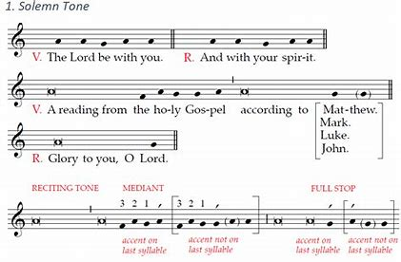
In chant, what is the difference between tones?
Solemn: sol, la, and fa
  Formal; lends well to singing in community (for religious)
  Vibrato; lengthened note
  Lower register
Simple: more common; sung on “do”
  Brighter, airer
  Higher register
  Shorter notes
  Less formal; lends well to personal devotions (for laity)

Slide 21
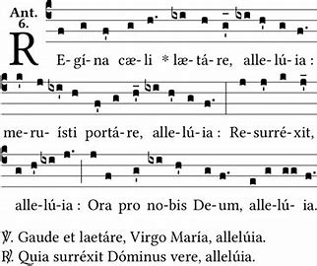
How do we know the mode in which to sing from reading musical notation?
Read notation from left to right: find flow of melody
  Most markings indicate pitches on major scale; the whole and half steps; semitones or whole tones
  Neume: groupings of notes connected to each other
  Custos is guide note at end of line
Mode: identify in chant notation when looking at numeral (i.e. “V” means “mode 5”)
Asterisk after opening line (indicates intone: lead cantor/celebrant will sing, then choir members join in to sing the following lines)
Intonation introduces mode
Chants notated using two clefs to designate tone/where half and whole steps fall: F clef and C clef
  Can be on different lines of 4-line staff; is at beginning of chant (C clef resembles letter C, indicates that you begin on “Do,” but F clef had upside- down “L” attached to its left; indicates that you start on “Fa”)
  You may choose starting pitch

Slide 22
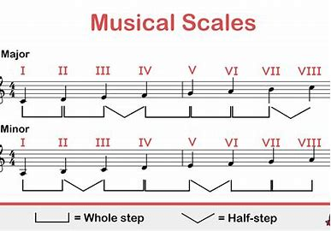
What are “modes” in music? What are the major and minor modes, and how do they differ in tone?
Scales called “modes”; octave: eight notes
  Do = C, Re = D, Mi = E, Fa = F, Sol = G, La = A, Ti = B, Do = C
C major scale the “mother” of all modes
Identify first note; count spaces and lines from bottom to top (Do, Re… ascending order); represent piano keys
Eight modes in chant (Gregorian mode: Church mode); 7 modes in diatonic system
  Have tones and semitones; each has a unique pattern that conveys emotion
  Whole and half steps (piano keys); regardless of key, retains pattern; keep going down keyboard
    Half steps between E and F and B and C
  Starting and ending on different notes, while playing the same scale, changes sound; degrees are altered

Slide 23
Medieval Gregorian Church Mode (eight modes)
Diatonic: Greek “Natural” Modes (seven-note scale)
Mode Number | Mode Name & Finalis
Mode I | Dorian (finalis is D)
Mode II | Hypodorian (finalis is D)
Mode III | Phrygian (finalis is E)
Mode IV | Hypophrygian (finalis is E)
Mode V | Lydian (finalis is F)
Mode VI | Hypolydian (finalis is F)
Mode VII | Mixolydian (finalis is G)
Mode VIII | Hypomixolydian (finalis is G)
Major Modes: Happier tones | Minor Modes: Sadder tones
Ionian: Mode I (key of C; C major) | Aeolian: Mode VI (notes begin on A minor when in C major)
Lydian: Mode IV (F major) | Dorian: Mode II (notes begin on D minor when in C major)
Mixolydian: Mode V (G major) | Locrian: Mode VII (notes begin on B minor when in C major)
 | Phrygian: Mode III (notes begin on E minor when in C major)

Slide 24
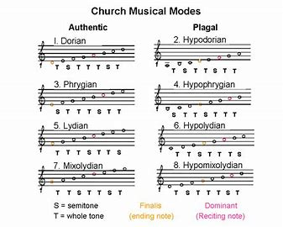
Are different modes of chant used according to different seasons, or different arrangements of the Masses? Which emotion does each mode/tone convey? (1)
Four modes were added to Gregorian chant in the sixteenth century (i.e. Ionian and Aeolian)
Music theorists confused Greek modes with Gregorian church modes, leading the Gregorian modes to be given Greek names, too
The seven-mode diatonic scale commonly used in Western music today has emotions associated with each mode, according to the story of the song
Modes in Gregorian chant convey something about the spirit of the season, just like liturgical colors, and the stage of salvation history we are reliving with Jesus and Mother Mary
The eight modes we use in chant are according to the medieval model
  Modes are typically referred to by number rather than by the Greek name
  Mode is based on the finalis: the tonal center (final note in the mode; tonic note, where mode rests); the reciting tone (the pitch/note used most frequently); and the range of pitches
    Scale might shift, going from plagal to authentic (in some arrangements)

Slide 25
Are different modes of chant used according to different seasons, or different arrangements of the Masses? Which emotion does each mode/tone convey? (2)
Mode (Greek) | Emotion
I (Ionian) | Happy
II (Dorian) | Bittersweet; melancholy, with some optimism; bright spot
III (Phrygian) | Tense, foreboding
IV (Lydian) | Calm, mystical, sense of wonder; otherworldly
V (Mixolydian) | Vibrant, versatile (often used in blues, folk)
VI (Aeolian) | Sad, wistful
VII (Locrian) | Unsettled
Gregorian Mode Number | Dominant Season(s)
Mode I (high) | Advent
Mode II | Christmas, Lent, after Pentecost
Mode III | Less common; Christmas
Mode IV | Easter, after Epiphany
Mode V | After Pentecost, after Epiphany
Mode VI | Easter
Mode VII | Advent, after Pentecost
Mode VIII (low) | Advent, Lent
In modern music, a specific emotion is associated with each mode
The medieval Gregorian Church modes do not have certain emotions associated with them
All of the modes appear throughout the Church year
Psalm tone is chosen to match the mode (there are eight different Gregorian psalm tones)
Certain modes appear more frequently in certain seasons

Slide 26
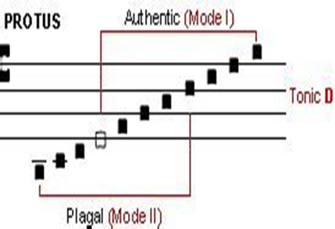
What are “plagal” chants, versus “authentic” chants?
Identify mode by end note
Authentic: set by St. Ambrose before St. Gregory
  Higher range
Plagal: set by St. Gregory
  Smaller range
Authentic (higher range) | Plagal (lower range)
Mode I (end note: re) | Mode II (end note: re)
Mode III (end note: mi) | Mode IV (end note: mi)
Mode V (end note: fa) | Mode VI (end note: fa)
Mode VII (end note: sol) | Mode VIII (end note: sol)

Slide 27
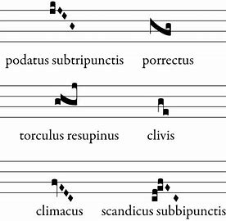
How did Gregorian chant influence music as a whole? How does Gregorian chant notation differ from notation across other genres of music?
Neumatic system: small groups of notes per syllable
  System of recording plainchant; influenced Western music
    Standardization: songs could be shared and learned widely; otherwise, depended on oral tradition
  Free-flowing melody; neumes used to show shape of melody on the scale
  System of sight reading developed (solfege; do-re-mi)
Four-bar scale
  Other genres: five-bar

Slide 28
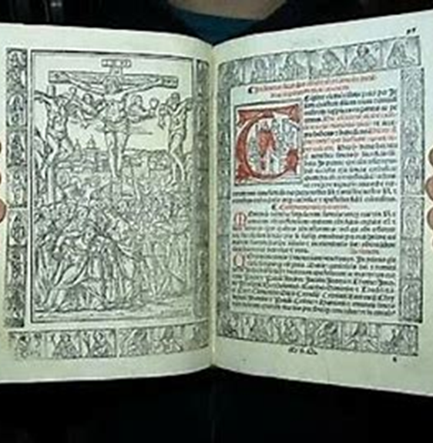
How do we know how to pronounce Latin words? (1)
Ecclesiastical (Church) Latin pronunciation guide (copies)
  In words with two syllables, put stress on the first syllable
    Pater: PA-ter
    Dona: DO-na
    Regnum: REG-num
  In words with more than two syllables, put stress on the second-to-last syllable (if syllable is long)
    Regina: Reg-IN-a
    Perdona: Per-DON-a
    Divinus: Div-IN-us
  In words with more than two syllables, put stress on the third-to-last syllable (if syllable is short)
    Populus: POP-u-lus
    Dominus: DOM-in-us

Slide 29
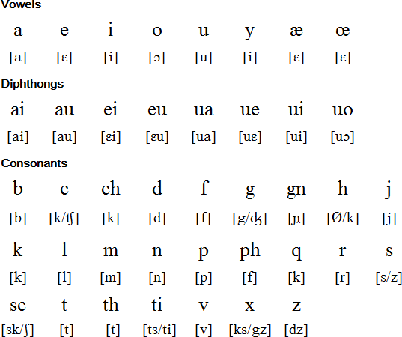
How do we know how to pronounce Latin words? (2)
Sc: before “e,” “ae,” “i,” “oe,” or y”
  Pronounce with “sh” sound
  Scientia: Shee-en-see-ah
H in the middle of a word is heavier in than in English pronunciation
  Nihil: Nee-hill
C: before “ae,” “e,” “oe,” “i,” or “y”
  Pronounce as “ch”
    Caeli: Chay-lee
J: pronounce as “y”
  Jesu: Iesu (ye-su)

Slide 30
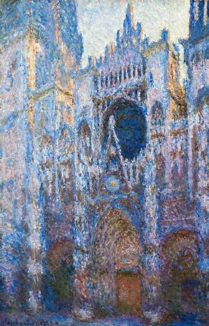
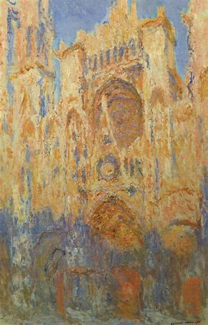
How do we apply this knowledge to praying Sunday Vespers?
Will use Office 2 for Advent (pages 96-104)
Prayers before the Office
Versicles and responses; “Glory Be” and antiphon
Recitation:
  Psalm 109; “Glory Be” and 2 antiphons
  Psalm 112; “Glory Be” and 2 antiphons
  Psalm 121, “Glory Be” and 2 antiphons
  Psalm 126, “Glory Be” and 2 antiphons
  Psalm 147, “Glory Be” and 2 antiphons
The Little Chapter: Isaiah 11:1, 2
Hymn: Ave, Maris Stella; versicle and response, antiphon
Canticle of Mary (Magnificat), and “Glory Be”; antiphon, versicle, and response
Prayer, versicles and responses
Prayers after the Office

Slide 31
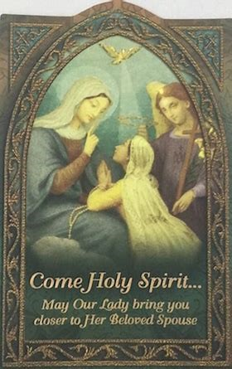
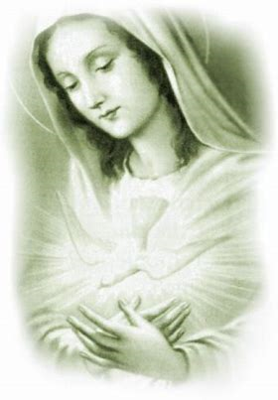
How do we respond to the prayers of the Divine Office? How do they shape our spiritual life, in terms of action and contemplation, each day, and in general?
Respond with open heart to the prayers of the Office
  Receive from God, be in His Presence → have more to give
Offer up all of day to God
Psalms: crying out to God; outpouring of heart to God
Inspire contemplation, from which action flows
  Understanding provides insight into how to act/live for God

Slide 32
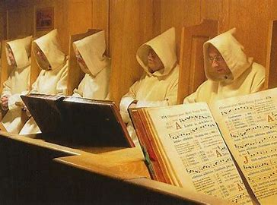
To pray the Office, must chant always be incorporated, or may the prayers be recited? What are the spiritual benefits of recitation versus chant of the Divine Office?
Chant recommended, but not required
Recitation and chant allow for balance of interior and exterior participation, similar to at Holy Mass
Recitation: deep interior experience
  May focus more deeply on meanings of texts
Chant: more active form of prayer; art form that can edify, inspire
  Can share spiritual experience with others, express emotions to convey love of God in unison
  Arrive at deeper appreciation of Church’s traditions

Slide 33
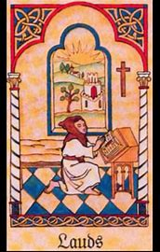
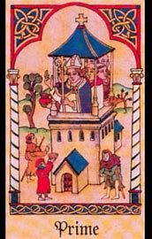
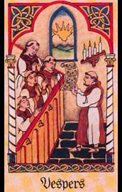
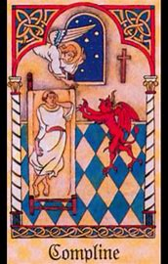
Closing Prayer
Our Father, Who art in Heaven,
Hallowed be Thy Name.
Thy kingdom come.
Thy will be done on Earth, as it is in Heaven.
Give us this day our daily bread.
And forgive us our trespasses,
As we forgive those who trespass against us.
And lead us not into temptation,
But deliver us from evil. Amen.

Slide 34
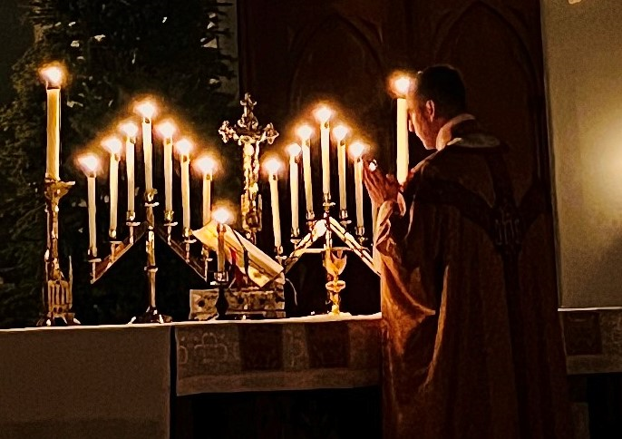
Special Announcements (1)
Seven Sisters Apostolate Talk & Devotions
  Friday, December 13, 2024 (snow date: Thursday, December 19, 2024)
    Presentation (6:00 p.m., parish hall): Responding to Christ like Our Lady at Advent
    Recitation of the Holy Rosary and Eucharistic Adoration: 6:30 p.m. to 7:30 p.m.
      Prayers for priests
Rorate Caeli Mass (High Mass)
  Saturday, December 14, 2024
    6:30 a.m., church

Slide 35
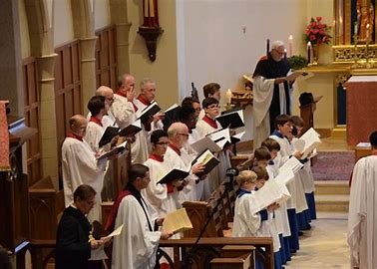
Special Announcements (2)
Lessons and Carols
  Saturday, December 14, 2024
    6:30 p.m., church
Next Divine Office learning series session (3):
  Tuesday, December 17, 2024
    6:00 p.m., church
      Parish hall: 6:30 p.m. to 7:30 p.m.

Slide 36
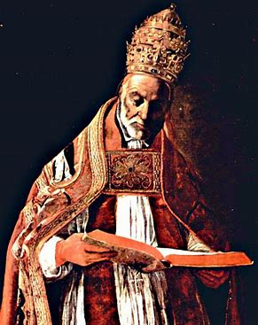
Q & A
Group-wide questions
Individual questions
  Personal copies of Divine Office/Little Office readings
  Navigating the breviaries

