Slide 1
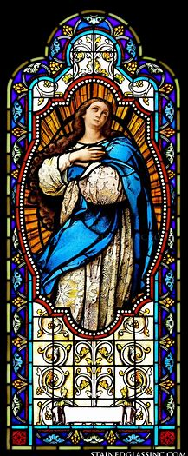




Divine Office Learning Series Course 1
Katie Sadakierski
Our Lady of the Valley Parish
Tuesday, December 3, 2024

Slide 2
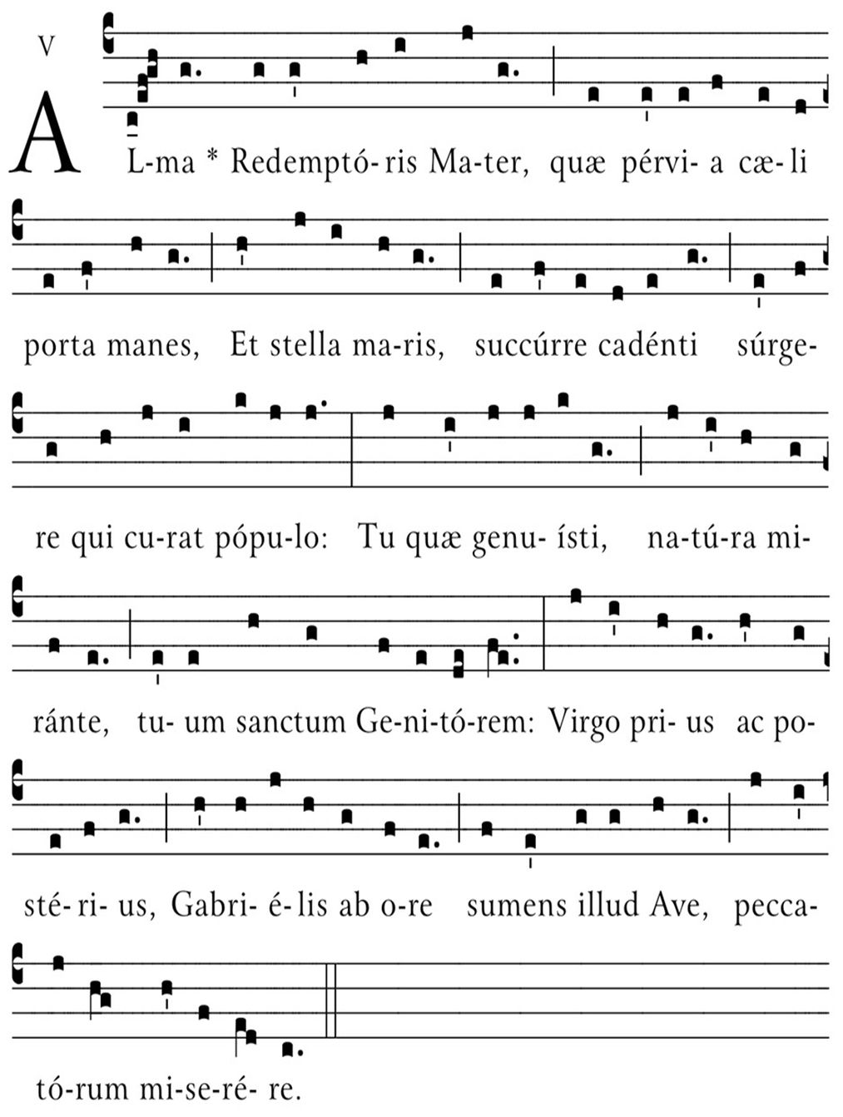

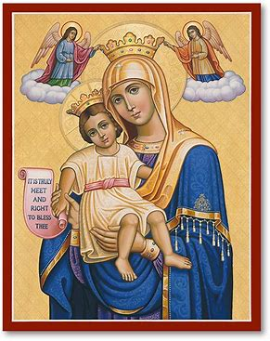
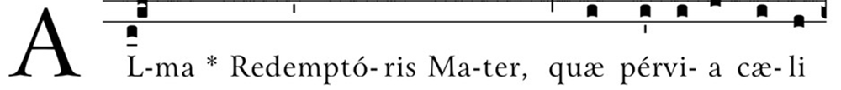
Course Outline
Opening prayer
Presentation: Overview of topics
  The significance of sacred music to the Church in each season (Advent emphasis)
  Introduction to the Divine Office: History and philosophy
  Introduction to the Little Office of the Blessed Virgin Mary
  Praying the liturgical seasons with the Little Office like Our Lady
    Understanding the meaning of the Marian antiphons, and how to respond to what God reveals to us through them
Closing prayer
Q & A

Slide 3
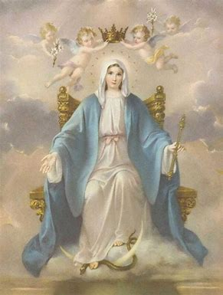
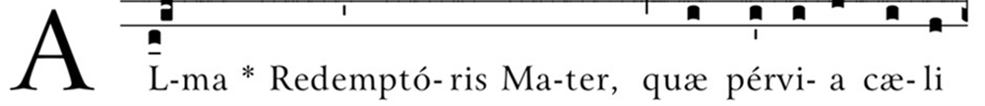
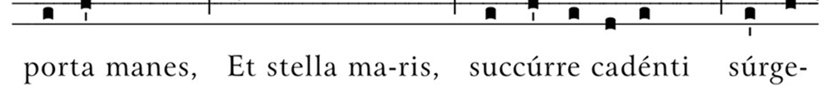
Opening Prayer: Hail Mary
Hail, Mary, full of grace,
The Lord is with thee;
Blessed art thou among women,
And blessed is the fruit of thy womb, Jesus.
Holy Mary, Mother of God,
Pray for us sinners,
Now and at the hour of our death. Amen.

Slide 4

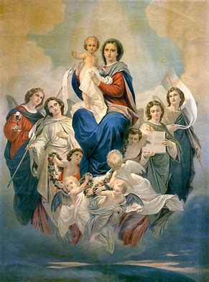

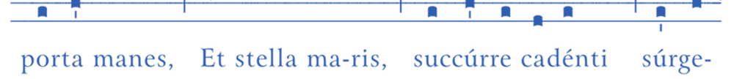
Who are our heavenly patrons for our learning series?
The holy angels
  Archangels
    St. Gabriel
    St. Michael
    St. Raphael
Angels sing to praise God

Slide 5
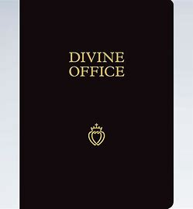

What is the Divine Office?
Office of readings for each day of the week
Psalms: the universal experience of the Church
  Collective voices
Prayer texts for the Mystical Body of Christ
  One Church united in praying together (all states of the Church)
    Indulgences associated with recitation; benefits soul
  Continuation of the themes from the Mass readings each day; expanding upon God’s lesson
    Emphasis on the Old Testament; Mass typically an emphasis on the New Testament

Slide 6
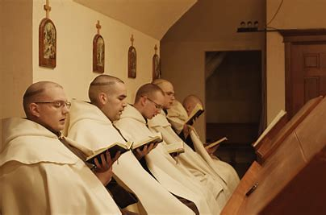
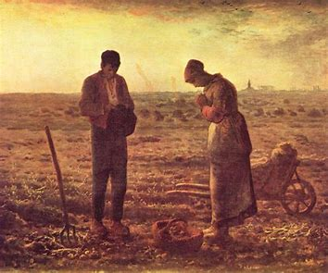
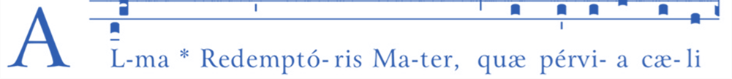

When did the Divine Office begin to be said as a liturgical devotion in the Church?
Old Testament: descendants of Aaron (Moses’ brother), the Levite priest, offered a morning and evening sacrifice to God
Early Christian Greek hymn honoring the Holy Trinity written at end of 3rd century; Gallican, Old Roman, Mozarabic hymns influenced, not only Jewish psalms
St. Anthony of the Desert’s followers sang psalms with him (4th century)
Church Fathers preached on psalms often in sermons
Grew as a devotion in monastic communities during the Middle Ages
  Not standard; typically contained psalms, Office of the Dead, Litany of the Saints, collected prayers
Farmers prayed psalms in the fields
  Mothers memorized psalms, taught children
Standardization and reforms
  Council of Trent
  1911 (Pius X)
  Vatican II

Slide 7
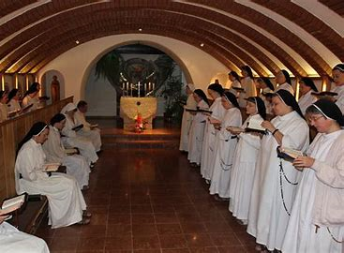
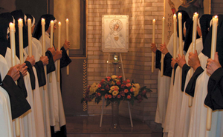


Why should we pray the Divine Office?
Spiritually beneficial to pray together
  God’s plan for our growth
    “Ekklesia” (Church community)
Power of prayer
Directs intentions during the day; uplifts heart
  Reminder of the sanctity of time, God’s constant Presence
Maintains focus on God
  Enthronement of Jesus as King of our hearts and homes

Slide 8
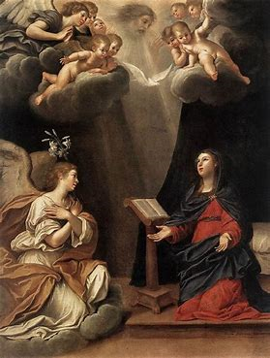


How does praying the Divine Office illuminate the meaning of the Advent season? Why is it especially significant to start this devotion now?
Advent a penitential season
  Prayers of contrition
  Spiritual awareness; examination of conscience
Keeping vigil: waiting with Our Lady for the Birth of Christ
  Developing appreciation and love for God, His Providence
  Cultivating relationship with Jesus and Mother Mary
    Can fully celebrate joy of Christmas
      Growing in virtues

Slide 9
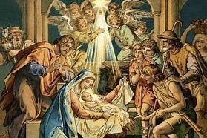


Why do we use song to praise God?
“Singing is praying twice” (St. Augustine)
Imitates the actions of the angels
  Gloria
  Sanctus
Conform to truer image of God
  Cultivate Gift of fear of the Lord; sense of wonder
  God as creative
    Source of all beauty, truth, and goodness
Good for the soul to praise God
  Follows the natural/supernatural order

Slide 10
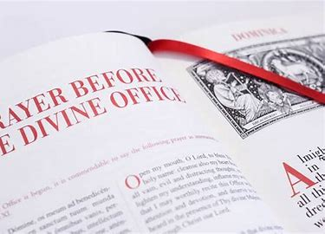


How is the Divine Office organized?
Traditionally, two volumes (now, one may be used)
  Psalter (psalms); Ordinary: all other readings (chapters, etc.)
Prayers before the Office
Canonical hours for each day of the week:
  Dominica (Sunday): Lauds, Prime, Sext, Vespers, Compline
  Feria Secunda (Monday): Prime, Sext, Compline
  Feria Tertia (Tuesday): Prime, Sext, Compline
  Feria Quarta (Wednesday): Prime, Sext, Compline
  Feria Quinta (Thursday): Prime, Sext, Compline
  Feria Sexta (Friday): Prime, Sext, Compline
  Feria Sabbato (Saturday): Prime, Sext, Compline
Chant notation
Prayers after the Office

Slide 11
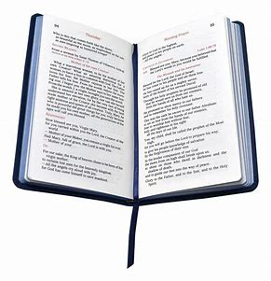


How are the readings for each hour of the Office organized?
Basic structure: chapter, responsory, versicle, prayer
Psalms
  Songs: Old Testament Wisdom literature
Canticles
  Songs from readings elsewhere in the Bible (not taken from the Book of Psalms)
Hymns
  Songs of worship/adoration
Little Chapter (capitula)
  Short reading
    Lectio: longer “lesson”
  Versicle

Slide 12
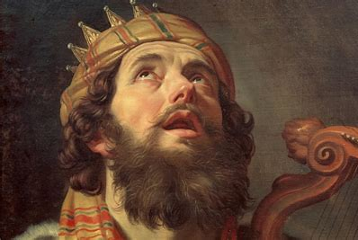


What are the psalms? Why are the psalms integrated into the Divine Office?
Jewish tradition to pray 150 psalms
Divine Office: pray 150 psalms each week
Holy Rosary: 150 “Hail Mary” prayers
  Based on Jewish tradition
Powerful expression of relationship to God
  Attest to God’s faithfulness
Full range of human emotions captured in prayer

Slide 13
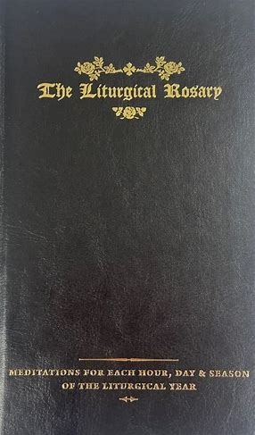
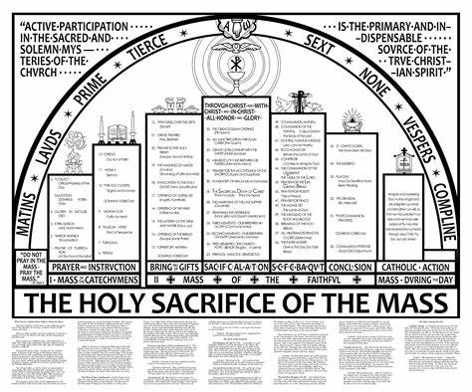


How is the Divine Office connected to the Holy Mass?
Liturgy: Public prayer
  Holy Mass
    Pre-Vatican II: one-year lectionary cycle, fewer Scriptural readings (i.e., from Old Testament); Divine Office expanded upon
  Worship of God in community
Liturgical devotions: extension of liturgy (outside of Holy Mass); praise and thanksgiving
  Divine Office
    Praising God seven times a day (Matins and Lauds combined); perfection
    Rise, convene in choir stalls at each hour (religious communities)
  Holy Rosary
    Liturgical Rosary: hymns, psalms for each Mystery, according to the feast day, or canonical hour theme for each day of the week; deeper meditation on connection to Mysteries/themes of the liturgical year

Slide 14
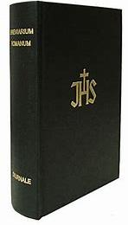
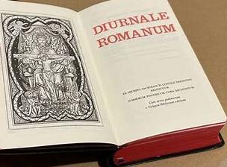


What is the Diurnale (Breviarium Romanum)?
Latin
Propers for the seasons
  Feast days: prayers for the major hours (some for the little hours on higher-ranking feasts)
Rituals for priests (when traveling)
  Extreme unction
  Blessings

Slide 15
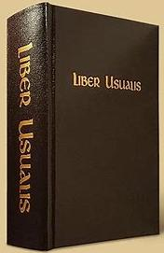
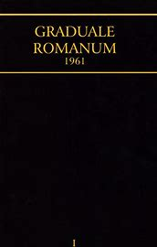


What is the Liber Usualis? What is the Graduale?
Liber Usualis (1952 and 1963)
  Originally published in 1912 (monks of Solesmes Abbey)
  Latin chants for choirs
  Musical notation for the Divine Office and the Holy Mass
Graduale Romanum (1908, 1961, 1974)
  Latin chants
  Musical notation specific to the Holy Mass; liturgical book used therein

Slide 16
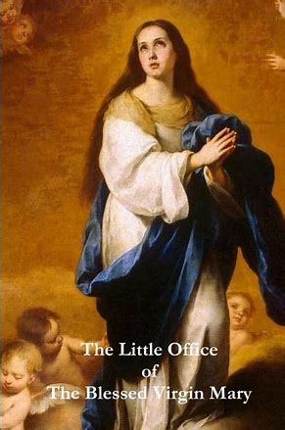


What is the Little Office of the Blessed Virgin Mary?
Abbreviated version of the Office from the Common of Our Lady
  Compilation of Marian readings
May still be prayed in addition to the Divine Office, rather than in place of
  After Council of Trent, clergy no longer required to pray Little Office in addition to Divine Office
    Some religious communities exclusively pray the Little Office
  Pope Pius V had Little Office printed in Breviary as part of it; used to be a separate book

Slide 17
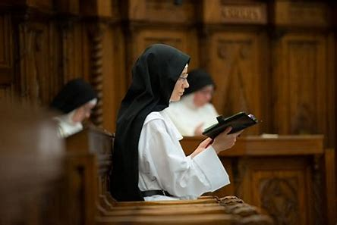


How is the Little Office of the Blessed Virgin Mary organized?
Eight canonical hours
Two ribbon bookmarks
  Chants
  Readings (for recitation)
Same prayers every day (not different prayers according to the days of the week)
3 categories within the Little Office
  Office 1: Office Throughout the Year (Candlemas to vigil of First Sunday of Advent)
  Office 2: Advent Office (Vespers on Saturday before First Sunday of Advent to Christmas Eve)
  Office 3: Christmastide Office (Vespers on Christmas Eve to Candlemas)

Slide 18
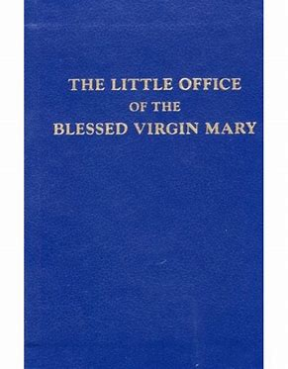
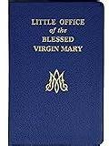


What is included in the Little Office, in terms of prayers and added resources?
Latin with English translations of readings
Psalms/standard readings
  Prayers before and after the Little Office
Meditations/guides
Indulgences
Commemorations
Additional Marian prayers
  Angelus
  Litany of Loreto
Chants
  Musical notation

Slide 19


How does the 1961 Little Office differ from the 1988 version? (1)
1961
1988
  Based on 1911 Pope Pius X texts
  Not a range of options for prayers
  Latin-English
  Same daily prayers, according to canonical hour being prayed
  Reformed texts (Pope John Paul II)
  English
  Options to choose from for daily prayers
  Liturgy of the hours incorporates intercessions, and has different devotional themes to direct intentions
  Organized according to the days of each week
  No canonical hour divisions: two general categories, rather than eight distinct canonical hours
    Morning and evening prayers

Slide 20


How does the 1961 Little Office differ from the 1988 version? (2)
1961
  Specific prayer intentions for each day of the week to guide daily prayers
  Includes Gregorian chants/musical notation
  Includes calendar of special feast days according to John XXIII’s ranking system
1988
  General theme for each day of the week
  No chants/musical notation

Slide 21
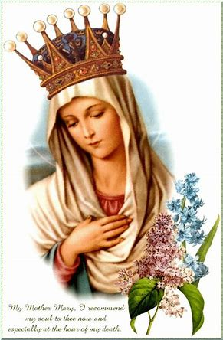


How was the Little Office prayed before 1961?
Commemorations followed prayers
  St. Joseph
  All of the saints in general
  In private recitation: say Anthem of the Blessed Virgin after Lauds, in addition to after Compline

Slide 22

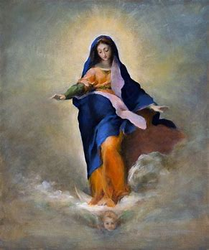


Why is praying the Little Office of the Blessed Virgin Mary so essential to growing in our faith?
Reminder of the sacraments
    Traces course of human life
  Memento mori
  Preparation for Heaven
Increase receptivity/openness to Christ
  Each hour represents a ray of light; follow movement of sun (and Son of God) throughout day
Allows for building community
  Meant to worship God together
    Liturgy: public worship
      Divine Office a liturgical devotion
      Unite prayers with Holy Mother Church

Slide 23

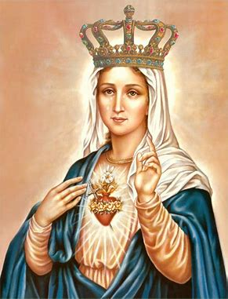


What does Our Lady teach us about praying the Divine Office?
Interior participation in the prayers of the Church
  Singing in the heart to praise God
Patience and faithfulness
Reflective disposition
  Attunement to depth, nuances of God’s revelation
    Repetition in Little Office
      Similar advantages to one-year cycle of Mass readings in Extraordinary Form
Treasuring the sacred in our hearts

Slide 24


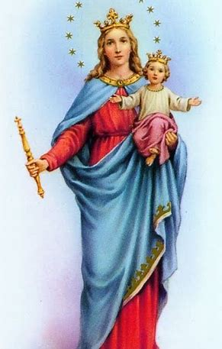


What are the Marian antiphons? How do they help us to understand the spirit of each liturgical season?
Alma Redemptoris Mater
  Advent and Christmas
Ave Regina Caelorum
  Lent
Regina Caeli
  Easter
Salve, Regina
  Pentecost

Slide 25


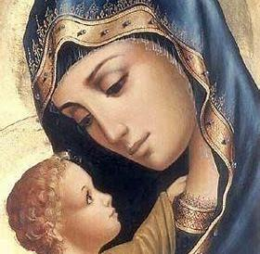


What is the “Alma Redemptoris Mater”?
Marian antiphon from First Sunday of Advent to Candlemas (February 2)
“Loving Mother of our Redeemer”
  Gate of Heaven
  Star of the Sea
  Allusion to the Annunciation; link to Christmas
    Our Lady’s fiat and mercy; allusion to purpose of Jesus’ Birth (His Passion and Death); Church’s new year

Slide 26


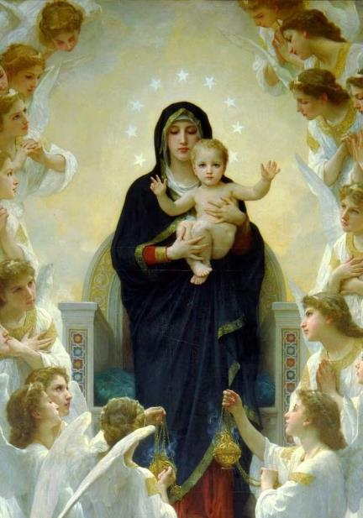


What is the “Ave Regina Caelorum”?
Marian Antiphon from after Candlemas to the Easter vigil on Holy Saturday; Church’s wintertime
“Hail, Queen of Heaven”
  Angelic reverence
  Door; light passing through
    Allusion to the Resurrection: joy
  Root of Jesse; lineage of Christ
  Spiritual beauty of Our Lady
    Song of joy
  Our Lady’s intercession

Slide 27


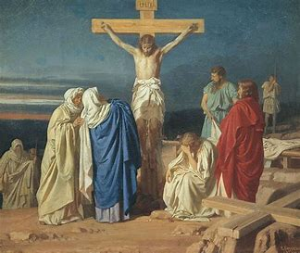


What is the “Stabat, Mater”?
“By the Cross, Her Station Keeping”
Lenten Marian song
  Honors Our Lady’s faithfulness in standing by Christ’s Cross
Seeing the Crucifixion of Our Lord through Our Lady’s eyes
  Sharing in the Passion with Our Lady and Our Lord

Slide 28
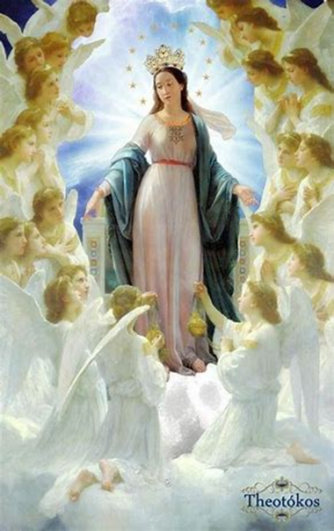
What is the “Regina Caeli”?
“Queen of Heaven”
Marian antiphon from the Easter vigil on Holy Saturday to Pentecost Sunday; Church’s springtime
Joy in Jesus having fulfilled God the Father’s promises in the Old Testament
  Asking for Our Lady’s intercession
  Recognizing that she is worthy of veneration for having given birth to the Son of God, the Risen Savior
  Jesus and Mary as the means to Heaven: cause of our joy

Slide 29
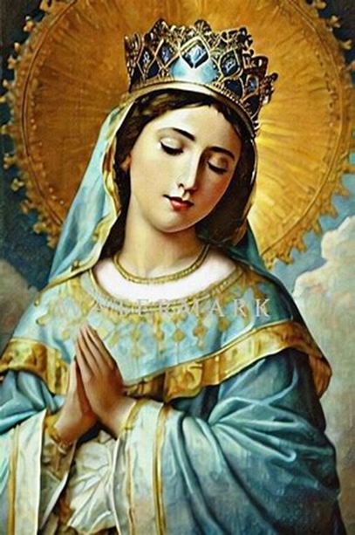
What is the “Salve, Regina”?
“Hail, Holy Queen”
  Sung version of the spoken prayer (i.e. said during the Leonine prayers and in the Holy Rosary)
Marian antiphon from Pentecost Sunday to the first Sunday of Advent
  Petition to Our Lady
  Our Lady as the means to our redemption (Co-Redemptrix, Mother of the Redeemer), channel of grace leading us to the Way, the Truth, and the Life
  Hopeful tone: Pentecost a time of growth, Church’s summertime

Slide 30
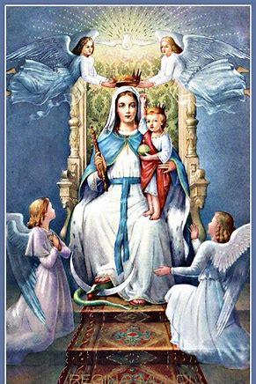
In summary, how do all of the Marian antiphons interrelate?
Teach how to respond to Jesus, practice virtue
Allow us to more deeply venerate Our Lady
  Emphasize her role in salvation history, and in our lives; acknowledge her as key to salvation in Christ
They culminate, enhancing our understanding of how to participate in the liturgical year as a whole
Sacred mysteries
  Understand purpose, in light of the Holy Rosary
  Participate in the mysteries with Jesus and Mother Mary

Slide 31
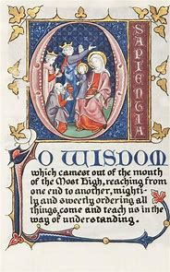
What are the “O Antiphons”?
Titles for Jesus
  Honoring the Savior to be born
Songs from Vespers during Advent
  “Golden Nights”
  Song “O Come, O Come Emmanual” or “Veni, Veni Emmanuel” incorporates
Antiphons in the seven days leading up to Christmas Eve
  Travel with Our Lady of Expectation
  December 17-23

Slide 32
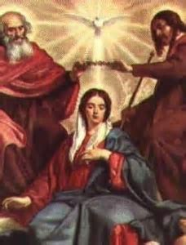
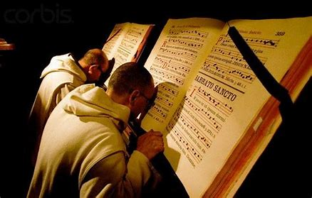
Closing Prayer: Our Father
Our Father, Who art in Heaven,
Hallowed be Thy Name.
Thy kingdom come.
Thy will be done on Earth, as it is in Heaven.
Give us this day our daily bread.
And forgive us our trespasses,
As we forgive those who trespass against us.
And lead us not into temptation,
But deliver us from evil. Amen.

Slide 33
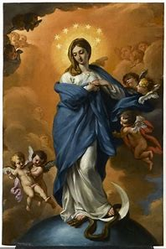
Special Announcements
Mass for the Feast of the Immaculate Conception
  Sunday, December 8, 2024: 12:30 p.m. (TLM)
  Monday, December 9, 2024: 8:00 a.m., 6:00 p.m. (Ordinary Form)
    Act of Consecration to the Immaculate Conception after 6:00 p.m. Mass
      Blue scapular investiture
      Reception (parish hall)
Next Divine Office learning series session (2):
  Tuesday, December 10, 2024
    6:00 p.m., parish hall

Slide 34
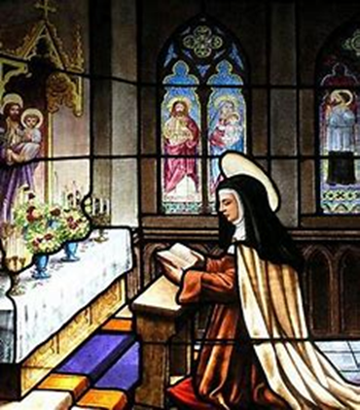
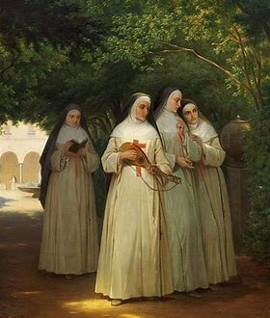
Q & A
Group-wide questions
Individual questions
  Personal copies of Divine Office/Little Office readings
  Navigating the breviaries

