Slide 1




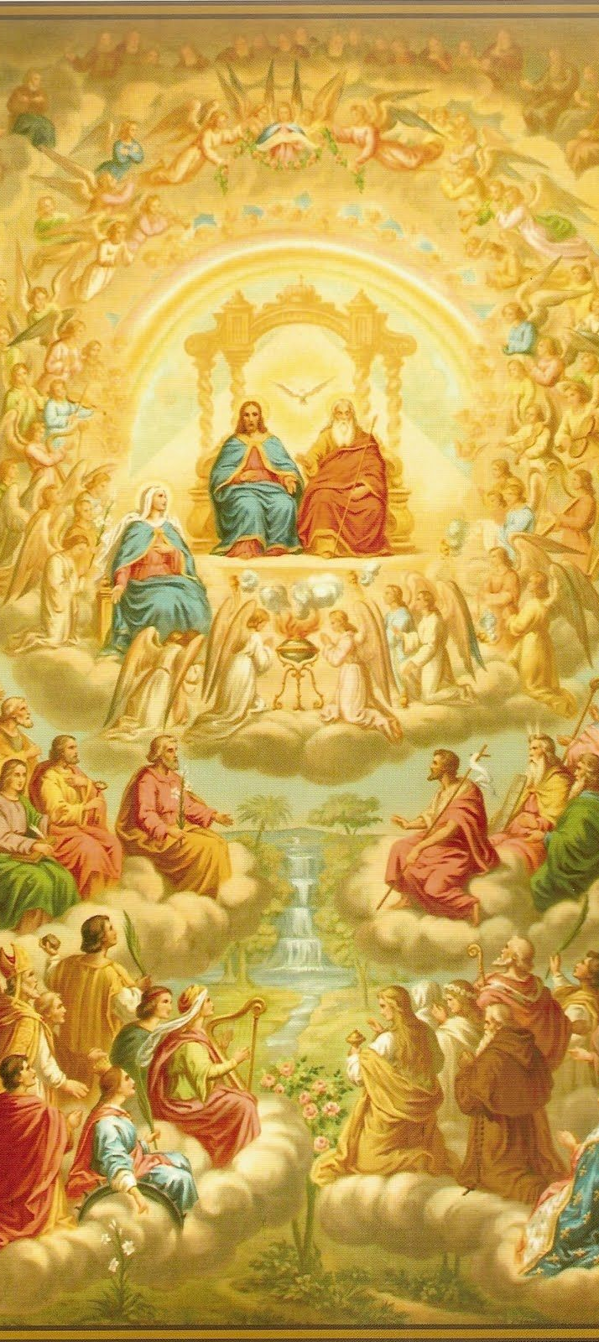
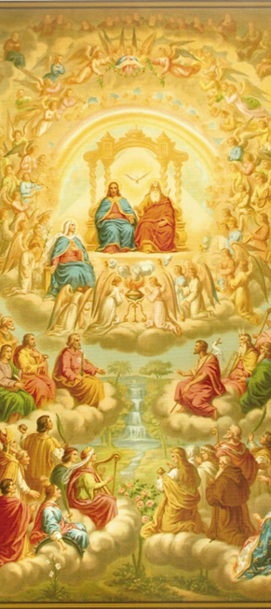
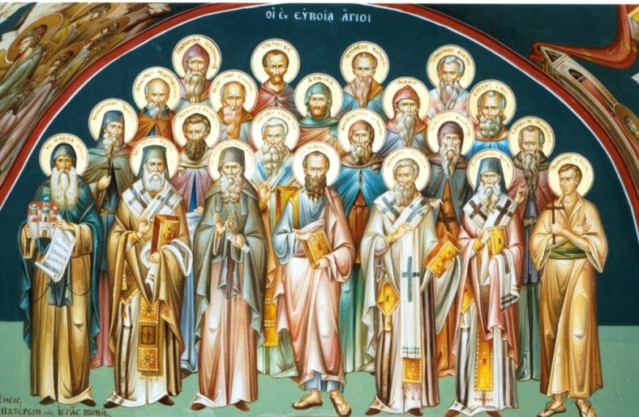
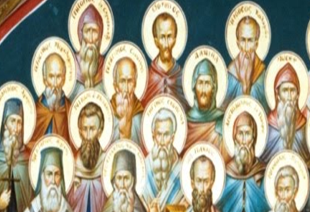




Rel. Ed. Class Session 3
November 7, 2024
Katie Sadakierski
Our Lady of the Valley

Slide 2


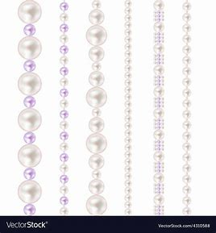


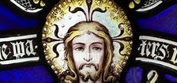
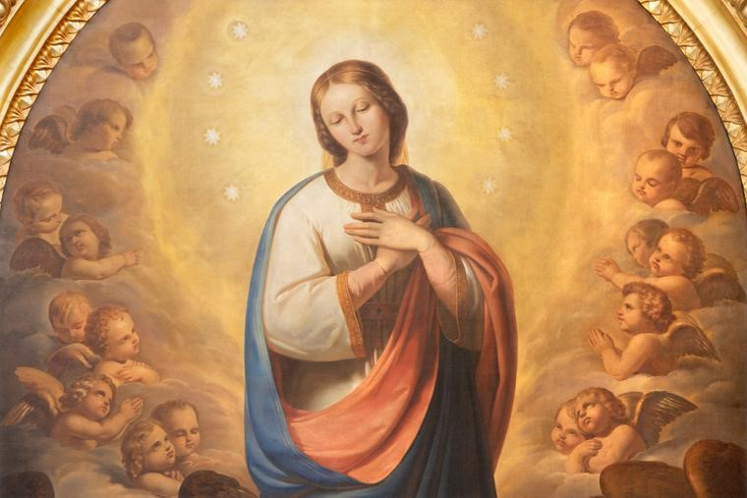

November Class Outline
Opening prayer
Overview of monthly theme and activities
Learning centers
Announcements
Closing prayer
Information session: Consecration to the Immaculate Conception

Slide 3





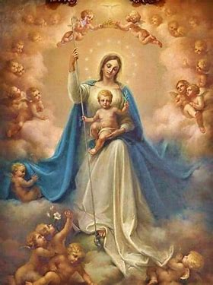

Opening Prayer: Hail Mary & Special Praises/Invocations
Hail, Mary, full of grace,
The Lord is with thee;
Blessed art thou among women,
And blessed is the fruit of thy womb, Jesus.
Holy Mary, Mother of God,
Pray for us sinners,
Now and at the hour of our death. Amen.
Blessed be God in His Angels and in His Saints.
Our Lady, Queen of All Saints, pray for us.

Slide 4

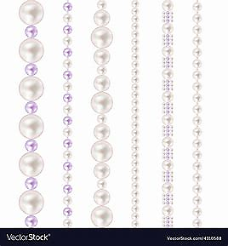
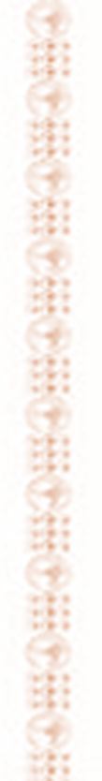

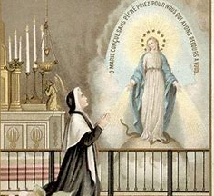

Overview of November
November theme: The saints in Heaven
Saint of the month: St. Catherine Laboure
Altar this month: All Saints’ Day
  Liturgical colors: White and green
  Crucifix, holy card images, patron saint medals
  All Saints’ and All Souls’ St. Benedict blessing hangers
    Prayers for priests
“Whenever I go to the chapel, I put myself in the Presence of our good Lord, and I say to Him, “Lord, I am here. Tell me what You would have me do.” –St. Catherine Laboure
“See the Face of God in everyone.” –St. Catherine Laboure

Slide 5


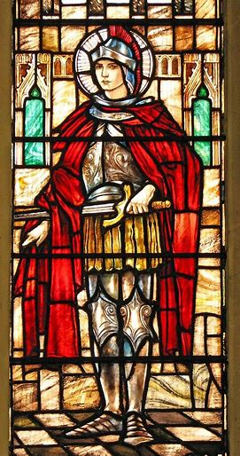




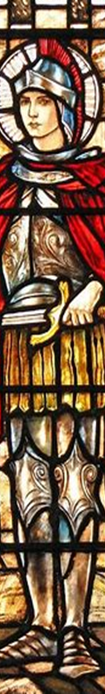
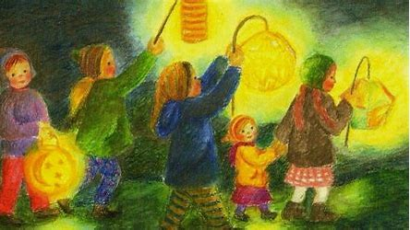

Grades PK-2
Week 1: how we pray at Mass for all in God’s family; how the saints help us
Week 2: saying grace at meals, giving thanks for God’s gifts: food for our bodies and food for our souls (the Holy Eucharist)
Week 3: thanking God for His goodness, shining through the Holy Mass and the holy saints
Tonight’s learning center (parish hall): celebrating St. Martin’s feast day by making lanterns for Martinmas; lantern prayer walk

Slide 6

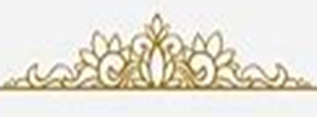

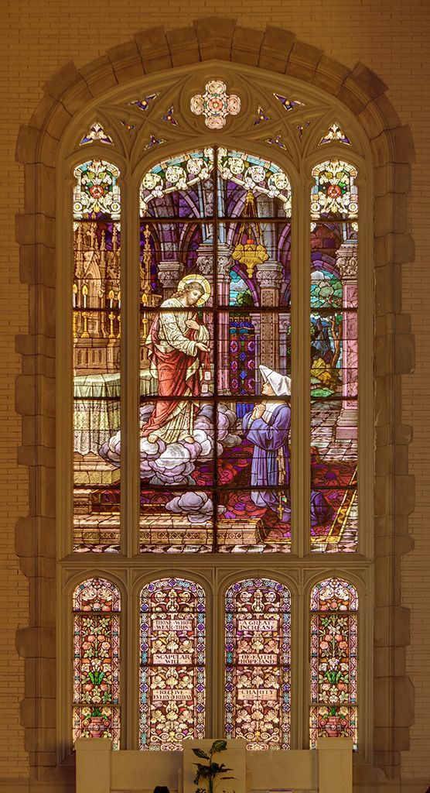


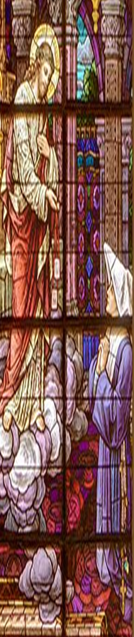
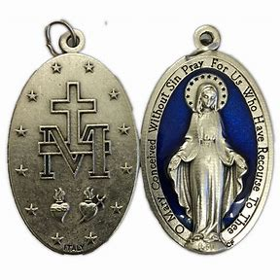
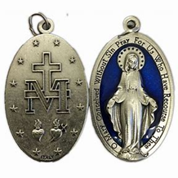
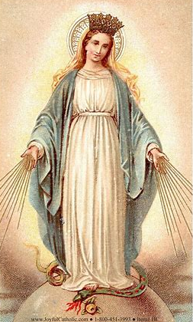

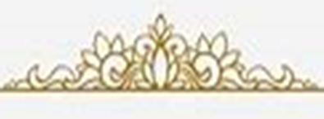
Grades 3-6
Week 1: the saints, our helpers on the way to Heaven; the Holy Eucharist as the key to Heaven
Week 2: feeding the souls of our friends: works of mercy and caring for others like the saints
Week 3: how we pray in thanksgiving to God; Scripture as food for our souls; God’s Providence in the story of the feeding of the multitudes
Tonight’s learning center (parish library): writing newspaper articles on saints with feast days in November; designing patron saint medals

Slide 7


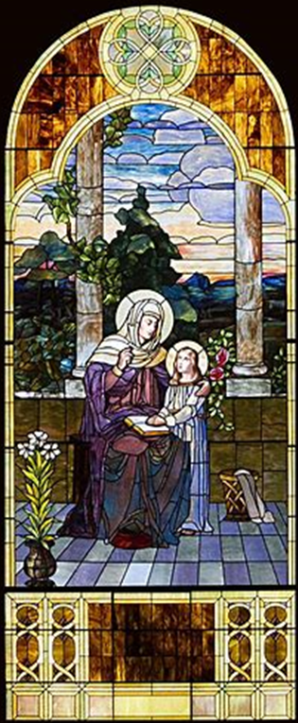




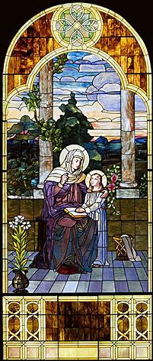

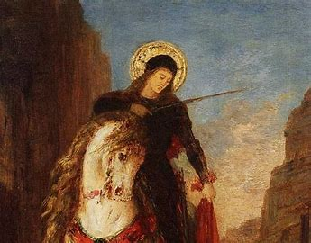


Grades 7-9
Week 1: finding balance in our spiritual lives; offering prayers to the saints, and prayers for the souls in Purgatory
Week 2: counting our blessings and keeping gratitude journals; expressing our thanks to God
Week 3: thanking God as one Church; the Holy Mass as prayer; the communion of saints and the Mystical Body of Christ
Tonight’s learning center (church): the saints represented in the sacred art of our church

Slide 8






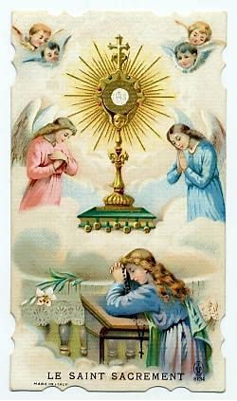


Announcements 1
Next First Friday Mass: 6:00 p.m., Friday, December 6, 2024
Next Blessing of Sacramentals: Saturday, December 7, 2024, following 9:00 a.m. Mass
Next First Sunday Eucharistic Adoration: 2:00 p.m. to 5:00 p.m., Sunday, December 1, 2024

Slide 9





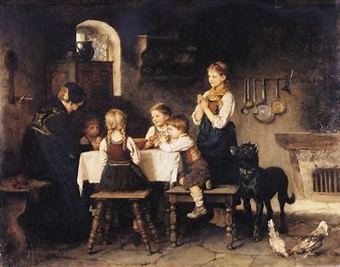





Announcements 2
Veteran’s Day Mass: Monday, November 11, 2024, 9:00 a.m., church
Thanksgiving Day Mass: Thursday, November 28, 2024, 9:00 a.m., church
Next class meeting: Thursday, December 5, 2024, 6:00 p.m., parish hall
  All grades: Bring prayer cards and completed activities
  Grades 3-6: May bring Bibles
  Grades 7-9: Bring prayer journals

Slide 10


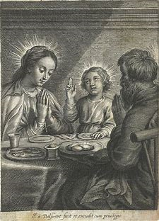
Service opportunity: OLV Take & Eat Ministry
Coordinator: Lisa York
  New volunteers: pre-register
  Opportunity for children to color pictures to be sent with meal deliveries
  Schedule: OLV Parish website (events page calendar)
  Contact by phone or email
    Phone number: 413-626-8837
    Email: ljyork37@gmail.com

Slide 11


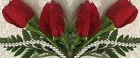

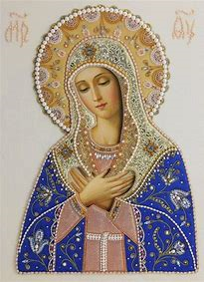
Closing Prayer: Hail, Holy Queen and Invocation
Hail, Holy Queen, Mother of mercy. Hail, our life, our sweetness, and our hope. To thee do we cry, poor banished children of Eve. To thee do we send up our sighs, mourning and weeping in this valley of tears. Turn then, most gracious Advocate, thine eyes of mercy towards us. And after this our exile, show unto us the blessed fruit of thy womb, Jesus. O clement, O loving, O sweet Virgin Mary.
Pray for us, O Holy Mother of God. That we may be made worthy of the promises of Christ.
Invocation
Queen of Heaven, pray for us.

