Slide 1
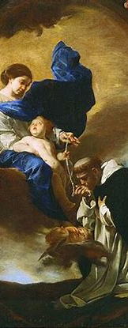
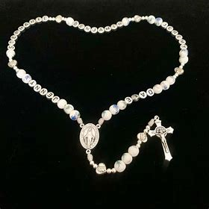
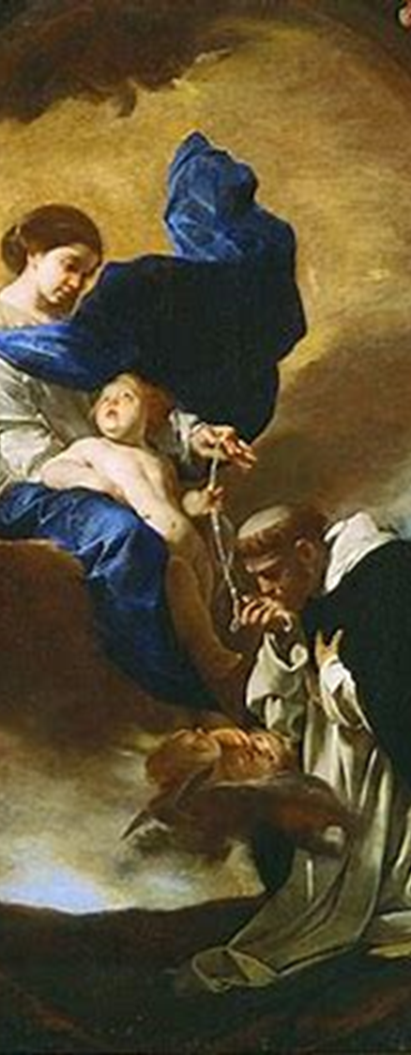
OLV Holy Mass Learning Series: Course 7
November 15, 2024
Katie Sadakierski

Slide 2
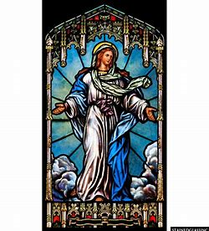

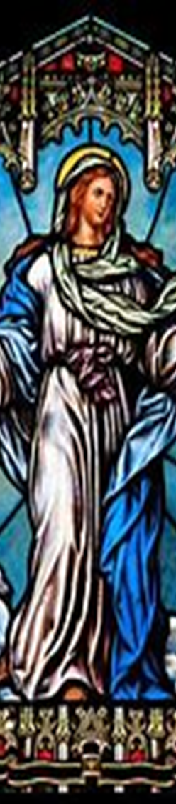
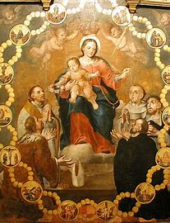
Course 7 Outline
Opening prayer
Overview of topics
  What it truly means to participate in the Mass
  How we participate at Mass reverently, regardless of the form of the Mass
  How the Mass incorporates all ends of prayer
  Understanding styles of prayer
  How we bring the spirit of the Holy Mass to our daily lives
  Popular liturgical devotions in the Church
  How Sacred Scripture and Sacred Tradition complement each other
Closing prayer
Q & A

Slide 3
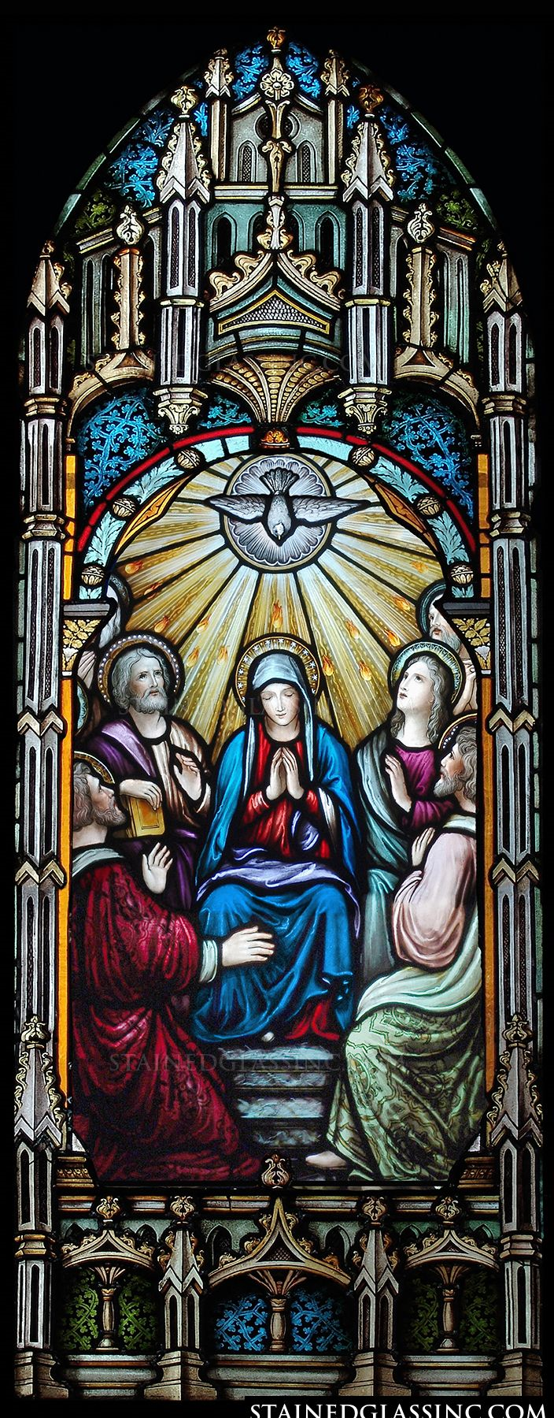
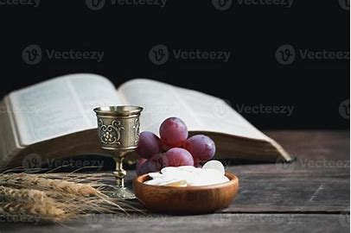
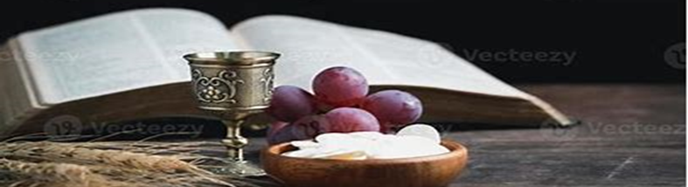
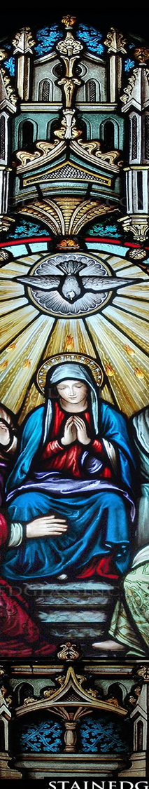
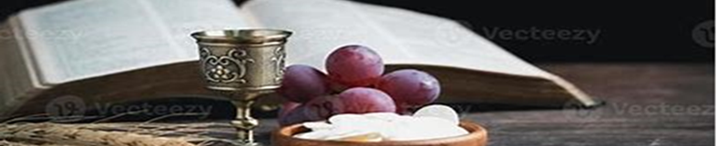
Opening Prayers: Prayer for the Gift of Wisdom
& Golden Hail Mary
Holy Spirit, divine Consoler, I adore You as my true God, with God the Father and God the Son.
I adore You and unite myself to the adoration You receive from the angels and saints.
I give You my heart and I offer my ardent thanksgiving for all the grace which You never cease to bestow on me.
Grant me the gift of wisdom, so that I may rightly direct all my actions, referring them to God as my last end; so that, having loved Him and served Him in this life, I may have the happiness of possessing Him eternally in the next. Amen.
Hail, Mary, full of grace,
The Lord is with thee;
Blessed art thou among women,
And blessed is the fruit of thy womb, Jesus.
Holy Mary, Mother of God,
Pray for us sinners,
Now and at the hour of our death. Amen.

Slide 4
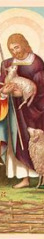
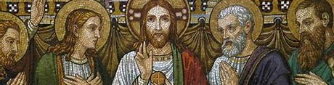

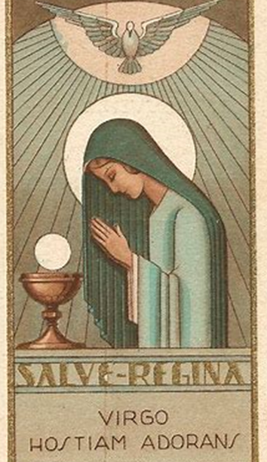
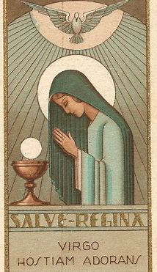
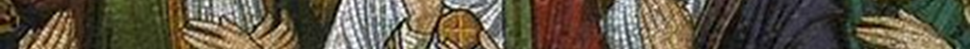
Course 7 Objectives
Objectives
  # 19, 20, 21, 22
    Understanding the four ends of prayer, the need for a balance of them all; the role of prayer in our lives, in perfecting our souls and helping those of others (effects of prayer); the Holy Mass as a prayer; the use of sacramentals in prayer; and the variety of devotions/prayer styles available to the faithful

Slide 5
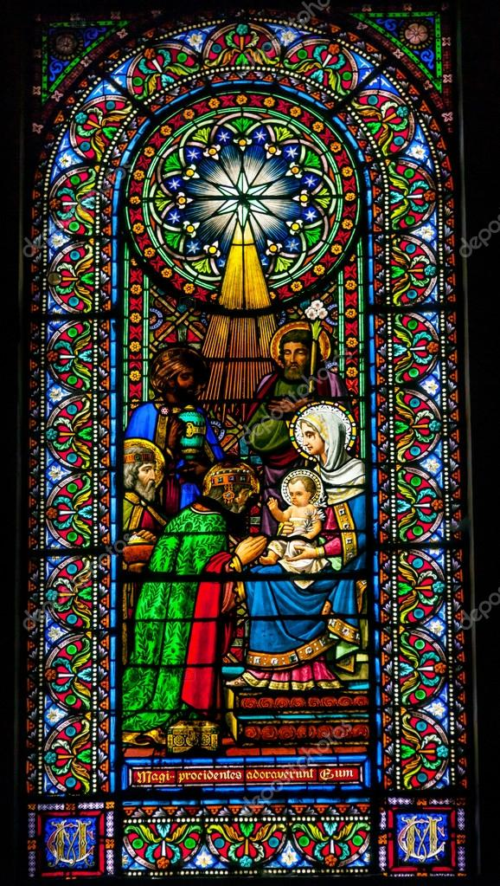
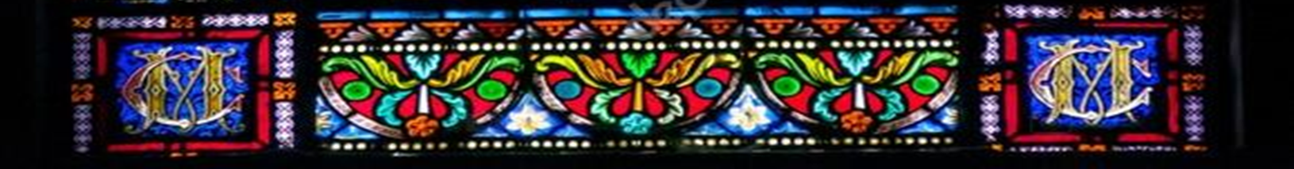
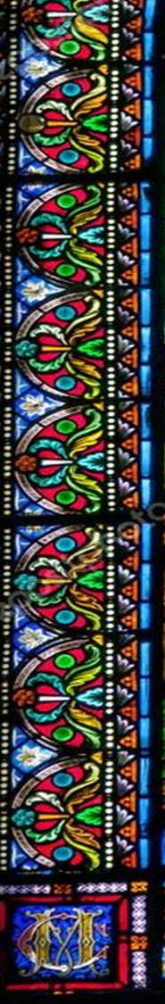
Vocabulary
Adoration (prayer)
Devotion (liturgical devotion, popular devotion)
Eucharistic Adoration
Petition (prayer)
Reparation
Sacramental
Sacred Scripture
Sacred Tradition
Thanksgiving (prayer)

Slide 6
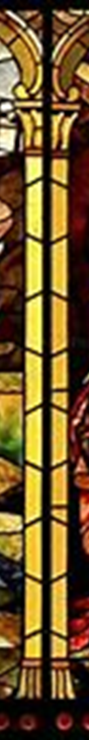
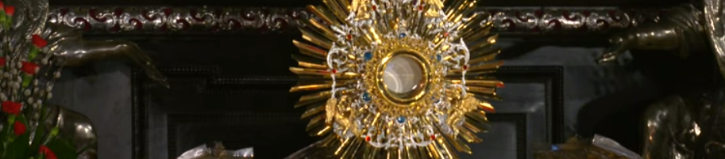
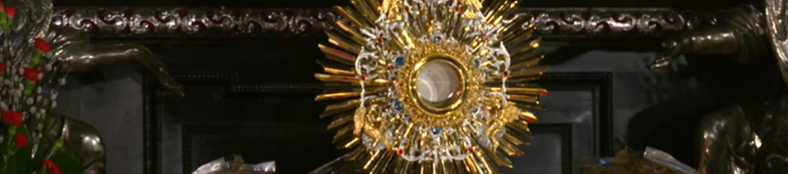
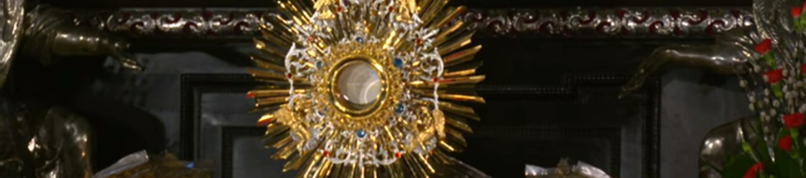
Recap
21. Consecration of the Host and consecration of the Wine
2. Preparatory Prayers at the Foot of the Altar
16. Secret prayer
25. Holy Communion
6. Dominus vobiscum
8. Epistle
4. Kyrie, eleison
12. Credo
14. Lavabo
19. Canon
10. Gospel
23. Pater Noster
24. Agnus Dei
15. Orate, fratres
18. Sanctus
22. Commemoration of the dead
3. Introit
5. Gloria
9. Gradual and Alleluia/Tract
11. Sermon
28. Last Gospel
1. Asperges Me
20. Hanc igitur/Quam oblationem
27. Blessing and dismissal
17. Preface
26. Post-Communion
7. Collect
13. Offertory

Slide 7
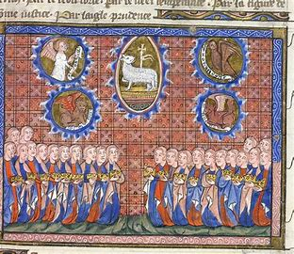
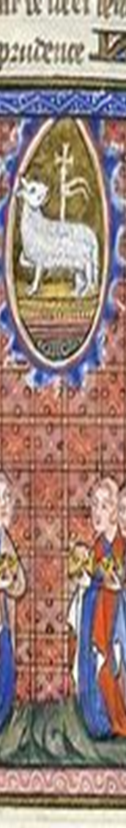
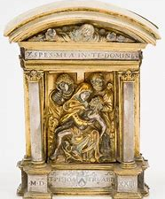
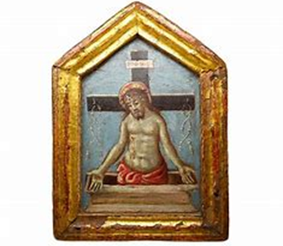
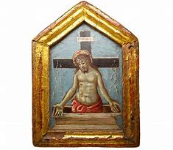
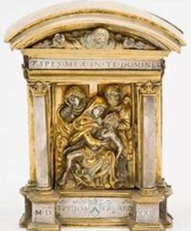
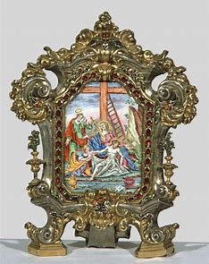
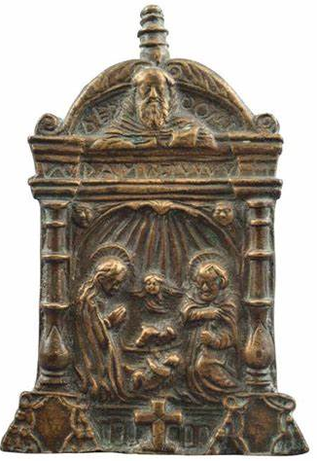
Recap: What is the pax board?
May be highly decorative; gilt
  Metal etchings
  Wooden boards with paintings
  Resemblance to Stations of the Cross, tabernacle
Crucified Christ
  Ecce, homo
  Holy Face
Agnus Dei
Nativity of Christ
Convey spirit of Christ, the Holy Mass; represent sacred mysteries

Slide 8
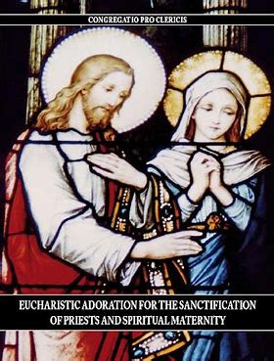
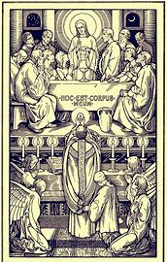
What does it mean to participate reverently in the Holy Mass, regardless of the Form of the Mass?
Purity of heart
  Sincerity of intention
    Love for Jesus
Balance of interior and exterior participation in Holy Mass
  Spiritual engagement/attention
    Focus on Holy Eucharist, Christ’s Sacrifice, God’s Presence
Responding to God’s voice speaking into the heart

Slide 9
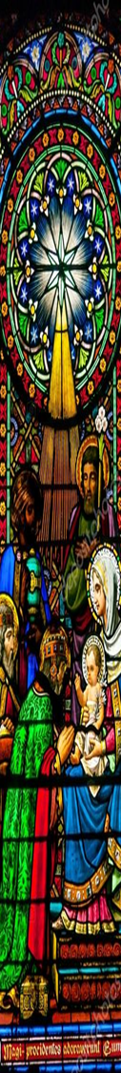
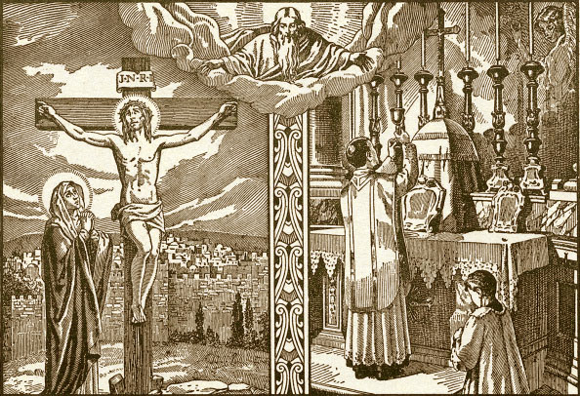
What are the purposes of prayer? How does the Holy Mass fulfill these purposes?
T.A.R.P. acronym
  Thanksgiving
  Adoration
  Reparation
  Petition
Jesus’ life is a prayer, relived at Holy Mass
  He thanks God the Father at the start of His Passion (Canon)
  Jesus sacrifices His life in love for God the Father; we offer Jesus to God the Father (offertory)
  Jesus offers His life for the redemption of sinners (consecration)
  He asks God to forgive the people (prayers after the consecration)

Slide 10
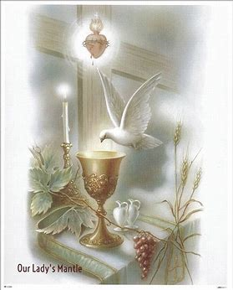


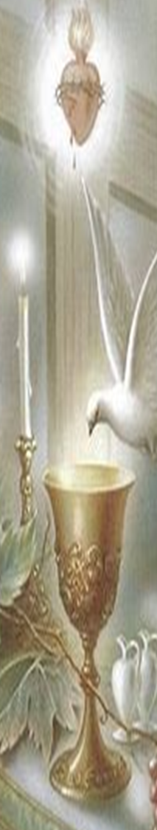
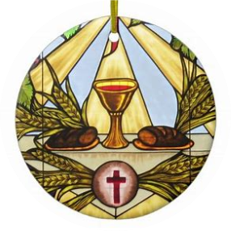
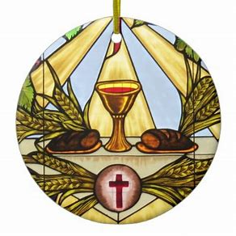

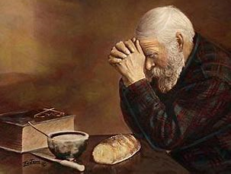
What are prayers of thanksgiving?
Gratitude to God
  Thanksgiving after receiving Holy Communion
  Thanksgiving in all times; whether prayer request is fulfilled as expected, or otherwise
    “Thank God ahead of time”
Holy Mass
  Canon
  Holy Eucharist Itself
  Preface

Slide 11
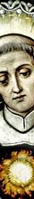



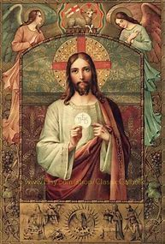
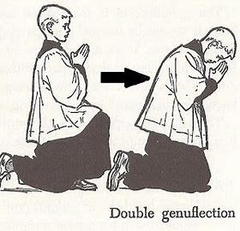

What are prayers of adoration?
Prayers of love for God
  Praise and glorification
Prayers at Eucharistic Adoration
  St. Alphonsus Liguori
  St. Thomas Aquinas
    Eucharistic hymns: “Adoro, Te Devote”
Holy Mass
  Gloria
  Sanctus

Slide 12
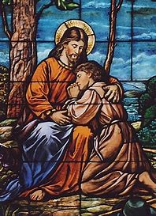


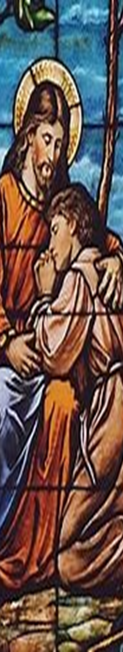
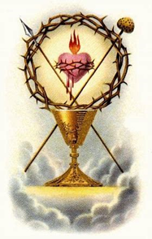

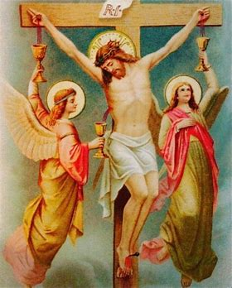
What are prayers of reparation?
Prayers of repentance
  Said to repair a broken relationship with God
    May be said on others’ behalf
Act of Reparation to the Sacred Heart (First Friday)
Holy Mass
  Confiteor
  Domine, non sum dignus

Slide 13
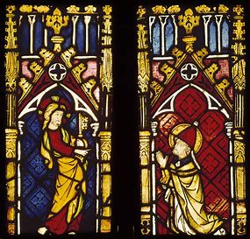

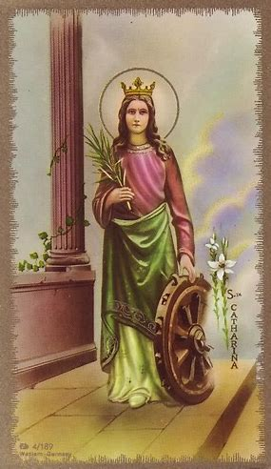
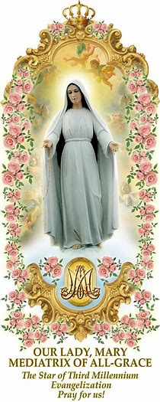
What are prayers of petition?
Asking God to fulfill a request
  Special intentions
Holy Mass
  Agnus Dei
  Kyrie eleison
  Prayers of the Faithful/Universal Prayer

Slide 14



What are some styles of prayer?
Salesian
  Visual prayer, immersive
Ignatian
  Examen; examination of past actions, plan for future; analytical; mental prayer
Thomistic/Dominican
  Scholarly exploration; study of theology in academic sense; inquisitiveness
Franciscan
  Spontaneous prayer; immersion in art and nature; prayer with others

Slide 15




How do I discern my style of prayer?
Through prayer itself!
  Being attuned to God’s voice, our response to it
Spiritual reading/lectio divina
  Prayer journaling
Quiz/self-assessment
Conversation with others
  Spiritual direction

Slide 16





How do we bring the spirit of the Holy Mass into our daily lives?
Spirit of joy, love, and hope
  Drawing others into friendship with Christ; teaching, evangelizing
  Embodying Christ’s spirit (words and actions)
Feast day celebrations
  Immersion in liturgical seasons
Friendship with patron saints
  Invocations
Family prayer
  Church family: praying for others
    Liturgical planner: monthly list of prayer intentions

Slide 17



What does it mean to continue the prayer of the Holy Mass?
Having awareness of God’s Presence: acknowledgment
Enthroning Christ as King
  Remembering His Sacrifice
  Being guided by example of lives lived by Jesus and Mother Mary

Slide 18




What does it mean to live “eucharistically”?
Spirit of love
  Faith, hope, charity
  Wholeheartedness
Offer self-gift
  Be authentically present
  Have sense of generosity
  Share what has been given by God; return gifts to Him for His glory

Slide 19


What are liturgical devotions?
Popular devotions in the Church
  Personal devotions/cultural customs
Liturgical devotions: prayers of the Church (public prayer, extension of liturgy)
  Holy Rosary
    Participate in sacred mysteries
  Divine Office (Liturgy of the Hours)
    Continues the prayer of the Holy Mass; prepares soul for next Mass
  Eucharistic Adoration/Visits to the Blessed Sacrament
    Continue immersion in Christ’s Real Presence
    Meditate on Christ’s Sacrifice; be in His Presence, remain focused
      Make thanksgiving after Mass

Slide 20








What is the Holy Rosary?
“Crown” of prayers
  Joyful, Sorrowful, Glorious Mysteries
Supplementary chaplet devotions
  Chaplet of the Blessed Sacrament
  Stations of the Cross Rosary
  Servite Rosary
  Franciscan Crown Rosary

Slide 21







What is the Divine Office? Does it differ from the Liturgy of the Hours?
Divine Office
  Traditional prayer texts
    Prayers of the Church
  One volume
    Two at most
      Diurnale: Propers
      Divine Office: Ordinary
Liturgy of the hours
  Reformed prayer texts
  Four volumes

Slide 22






What is Eucharistic Adoration?
Real Presence of Jesus
  Time to cultivate personal relationship with Him
Blessed Sacrament exposed on the altar
  In monstrance: outside of tabernacle
40 hours devotion
  Honors period from Christ’s Death to His Resurrection
Perpetual adoration
  Unlimited time with Jesus
Visits to the Blessed Sacrament
  Prayers at the communion rail; kneeling before the tabernacle

Slide 23







How do we grow in devotion to God?
Developing personal devotions
  Connection of personal experiences to lives of Jesus and Mary
  Finding meaning in experiences: God gives meaning
  Prayer: private devotions (Holy Rosary)
  Community; practicing popular devotions, traditions together
  Spiritual reading and reflection: awareness of what resonates, noting responses

Slide 24








How does Sacred Scripture complement Sacred Tradition?
Sacred Scripture
  Holy Bible
    Inspired word of God
    Historical record
      Documentation of past traditions; guidelines for their celebration
Sacred Tradition
  Living word (Jesus: Word made flesh)
  Sacraments
    Made efficacious through Jesus’ Death

Slide 25





How do we draw Sacred Scripture and Sacred Tradition together in our lives?
Readings for the Holy Mass
  Liturgical calendar
    Feast day celebrations/prayer
Holy Rosary
  Scriptural Rosary
Divine Office
  Liturgical Rosary

Slide 26





Closing Prayers: The Prayer of St. Francis de Sales & St. Alphonsus Liguori’s Act of Spiritual Communion
Be at peace.
Do not look forward in fear to the changes of life; rather look to them with full hope as they arise.
God, whose very own you are, will deliver you from out of them.
He has kept you hitherto, and He will lead you safely through all things; and when you cannot stand it, God will bury you in his arms.
Do not fear what may happen tomorrow; the same everlasting Father who cares for you today will take care of you then and every day.
He will either shield you from suffering, or give you unfailing strength to bear it.
Be at peace, and put aside all anxious thoughts and imagination.
Amen.
My Jesus, I believe that Thou art present in the Blessed Sacrament. I love Thee above all things and I desire Thee in my soul. Since I cannot now receive Thee sacramentally, come at least spiritually into my heart. As though Thou wert already there, I embrace Thee and unite myself wholly to Thee; permit not that I should ever be separated from Thee.

Slide 27






Special Announcements
Seven Sisters Apostolate devotional event
  Feast of the Presentation of Mary: Thursday, November 21, 2024
    6:00 p.m.
Office of the Dead devotions
  Feast of St. Sylvester: Tuesday, November 26, 2024
    4:00 p.m., St. Stanislaus Cemetery
Thanksgiving Day Mass
  Thursday, November 28, 2024
    9:00 a.m.

Slide 28





Q & A / In-Class Reflection
Survey: post-learning series
  Tray: collect in person
  Delivery to parish office
  Email
Divine Office learning series: begins Tuesday, December 3, 2024
  Registration form with full schedule
  Little Office order form
  Pre-learning series survey
Course 7 reflection prompts
  Pages 191-195
Spiritual development plan
  Page 196

