Slide 1
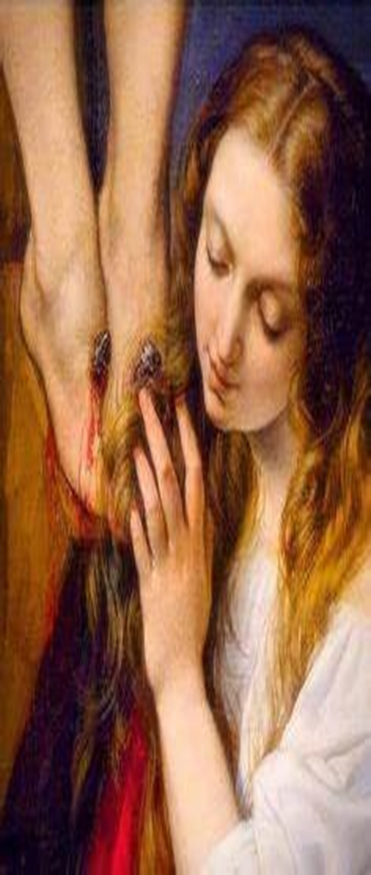
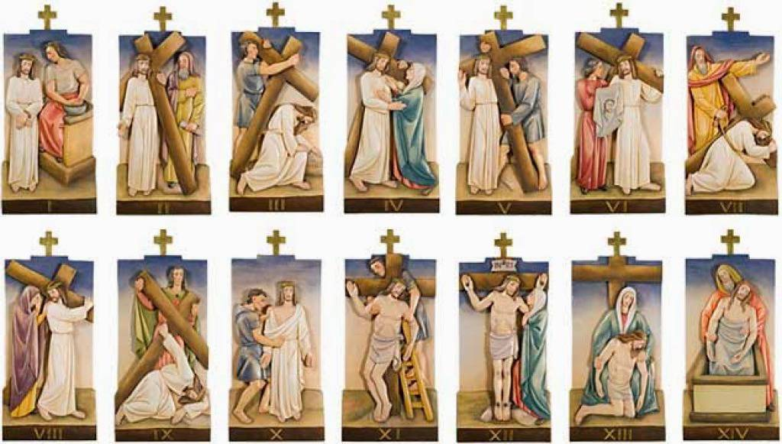



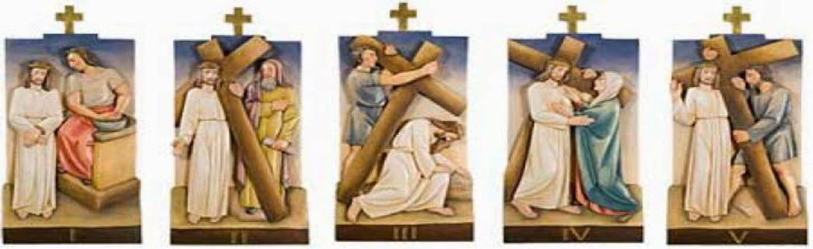
OLV Holy Mass Learning Series: Course 5
October 25, 2024
Katie Sadakierski

Slide 2
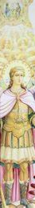



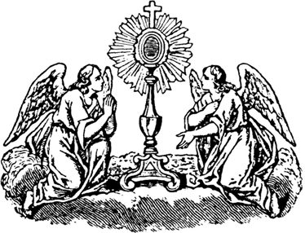

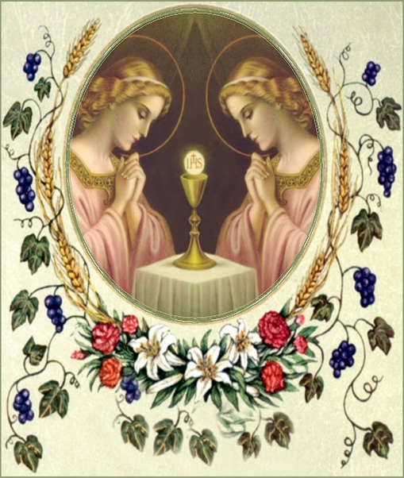


Course 5 Outline
Opening prayer
Course outline for the week
Overview of topics
  Looking at the Mass in depth:
    The Preface to the Quam oblationem
  Contemplative prayer: saints who lived the Mass
Closing prayer
Q & A

Slide 3
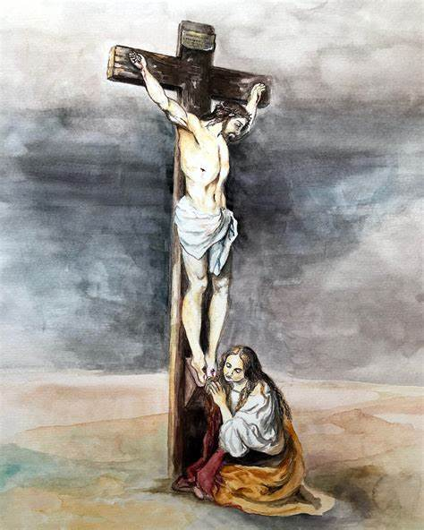


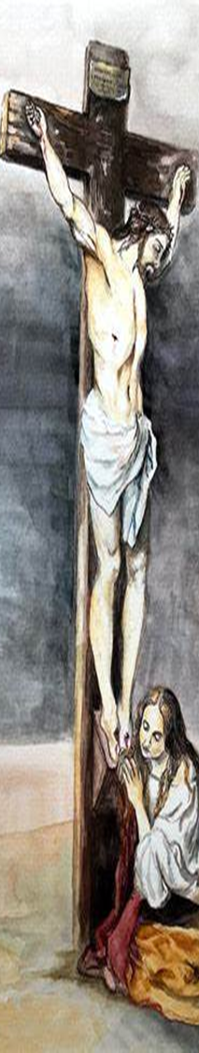
Opening Prayer: Prayer for the Gift of Fortitude
Holy Spirit, divine Consoler, I adore You as my true God, with God the Father and God the Son.
I adore You and unite myself to the adoration You receive from the angels and saints.
I give You my heart and I offer my ardent thanksgiving for all the grace which You never cease to bestow on me.
Grant me the gift of fortitude, so that I may overcome courageously all the assaults of the devil, and all the dangers of this world which threaten the salvation of my soul. Amen.

Slide 4
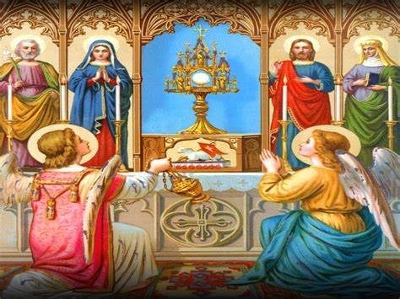


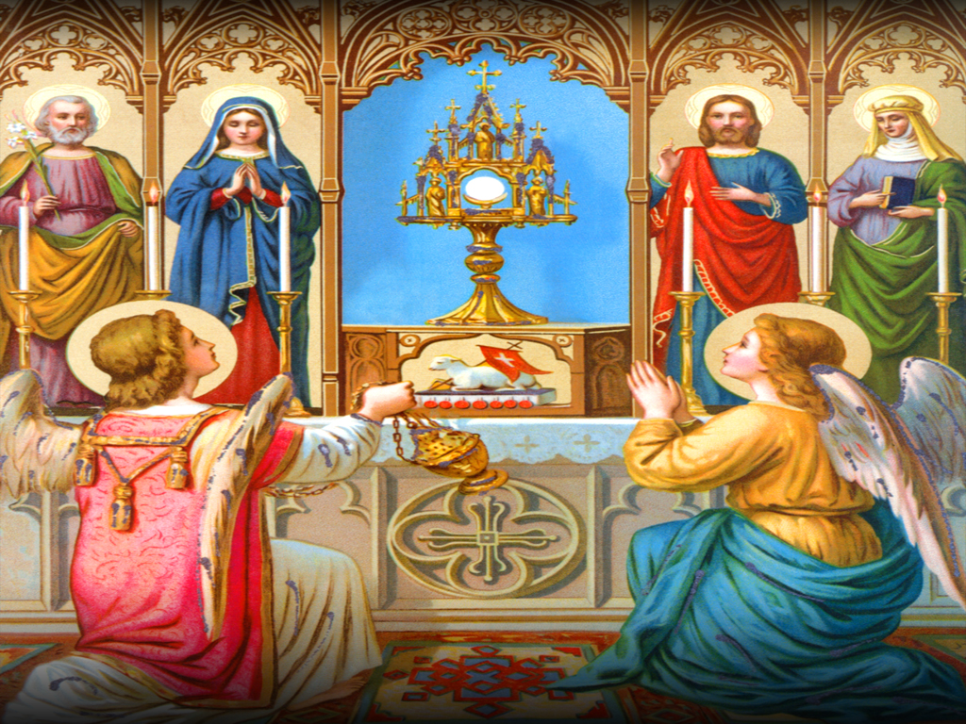
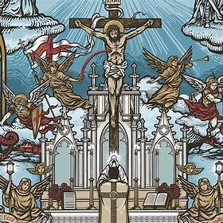

Readings and Objectives
Readings:
  Ordinary of the Ordinary Form of the Mass: pages 13-16 (PDF)
  Ordinary of the Extraordinary Form of the Mass: pages 27-30 (PDF)
  Optional: The Mass in Slow Motion, chapters (part 2 of) 9 and 10 (pp. 90-104, print; pp. 109-123, PDF)
Objectives:
  # 3, 4

Slide 5





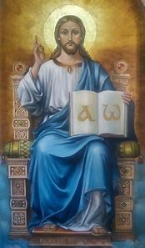

Vocabulary
Canon
Commemoration
Contemplative prayer
First-class feast
Hanc igitur
Memorial
Preface
Quam oblationem
Sacrament
Sanctus
Second-class feast
Solemnity
Third-class feast

Slide 6






Recap
2. Preparatory Prayers at the Foot of the Altar
4. Kyrie Eleison
6. Dominus vobiscum
8. Epistle
12. Credo
14. Lavabo
10. Gospel
3. Introit
5. Gloria
7. Collect
9. Gradual and Alleluia
11. Sermon
15. Orate, fratres
1. Asperges Me
13. Offertory
16. Secret Prayer

Slide 7
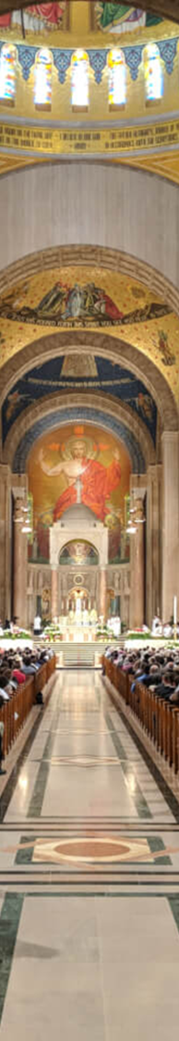



In the Extraordinary Form, which prayers in the Mass of the Faithful are part of the Ordinary? Which prayers are the Propers?
Ordinary | Propers
 | Preface
Sanctus
Canon
Commemoration of the Living
 | Communicantes
Hanc igitur
Quam oblationem

Slide 8
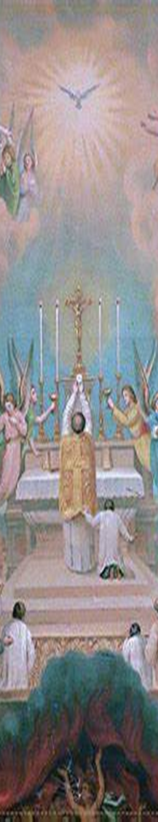
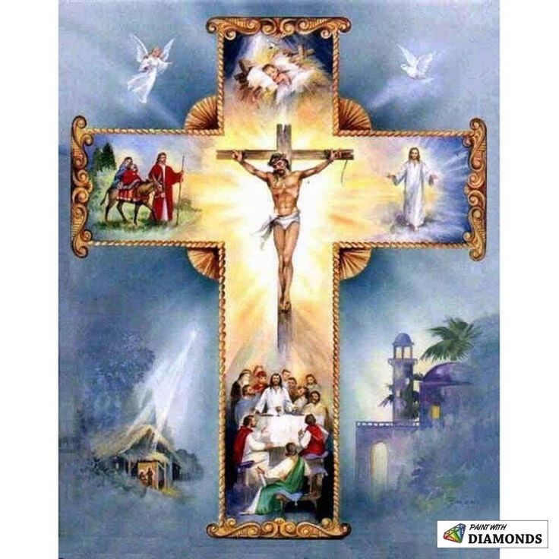
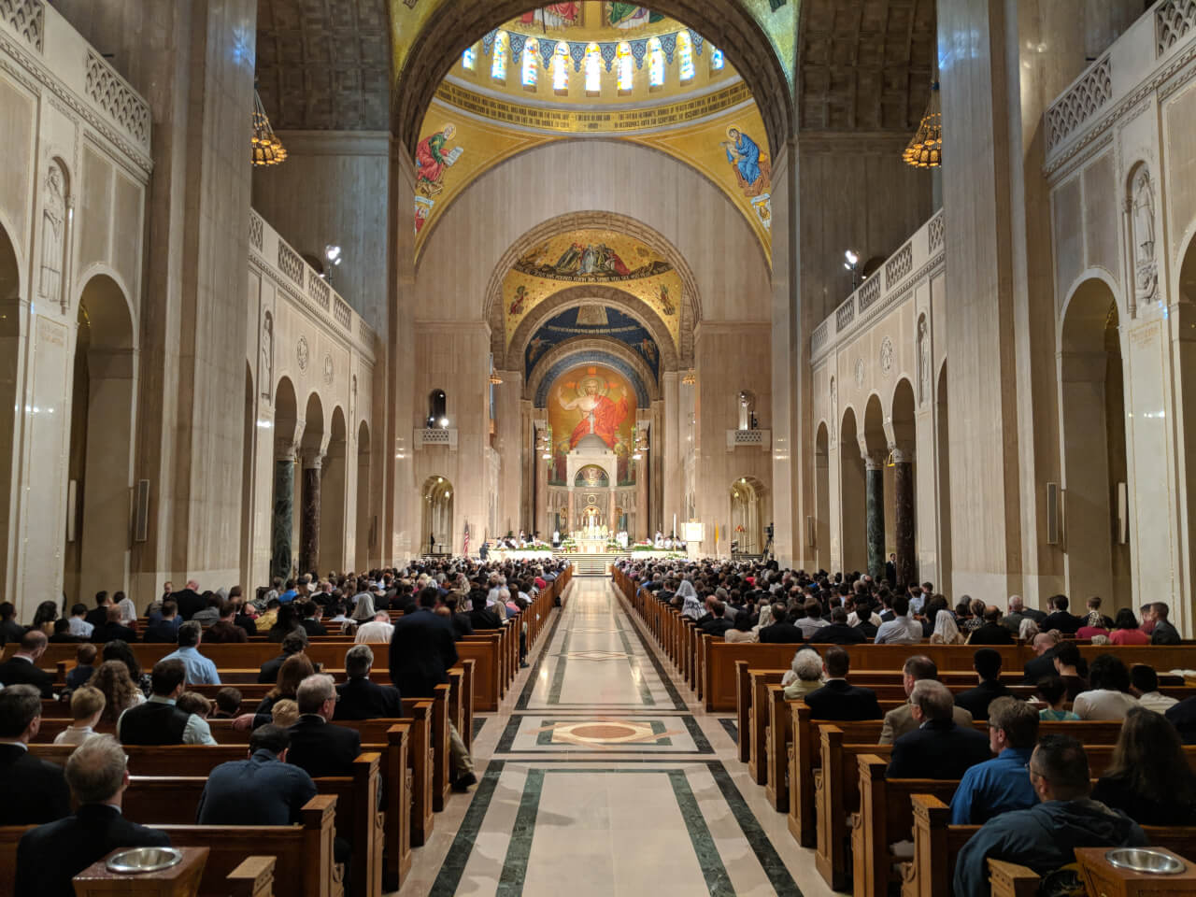
What is the “Preface” in the Extraordinary Form? What is its equivalent in the Ordinary Form?
Divine justice
Thanksgiving
  Uplifted hearts
Adoration and glorification
Stages of salvation history
Concentration on God
  Eyes directed to the altar

Slide 9
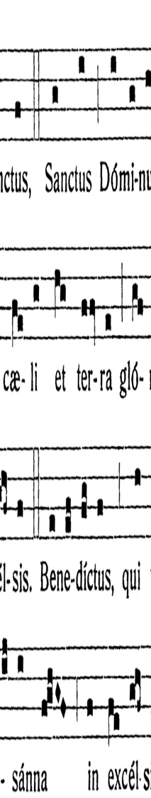
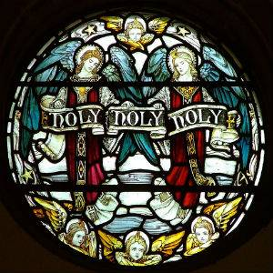

What is the “Sanctus” in the Extraordinary Form? What is its equivalent in the Ordinary Form?
Holy, holy, holy
  Song of the angels
  Song of praise: similar to the “Gloria”
Greek: “hagios, hagios, hagios”
“Blessed is He Who comes in the Name of the Lord”
  Jesus’ entry into Jerusalem

Slide 10
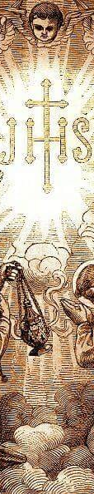


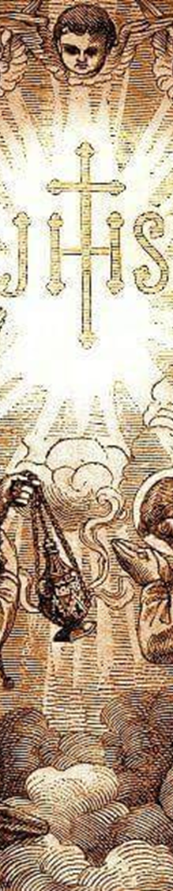
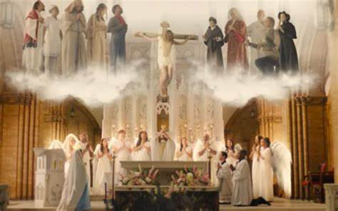

What is the role of the holy angels at the Holy Mass?
Praising God with the angels: Angelic presence at the Holy Mass
  Adoring the Blessed Sacrament
  Lifting our hearts by lifting up
  the Holy Name of God in prayer and song
  Guarding our souls from spiritual danger
  Accompanying us in our journey: drawing
  near at Holy Communion

Slide 11
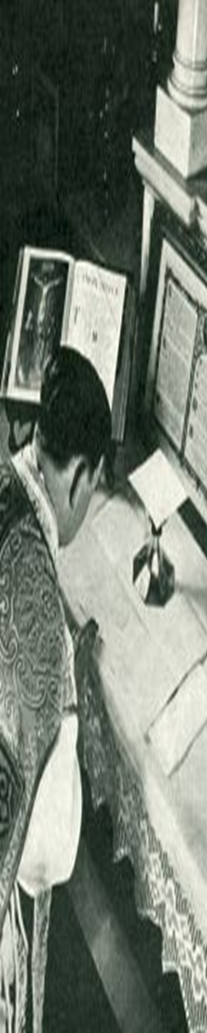


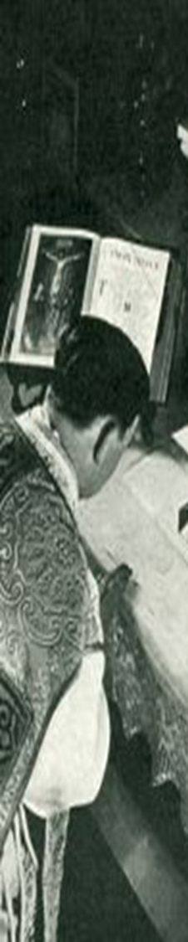
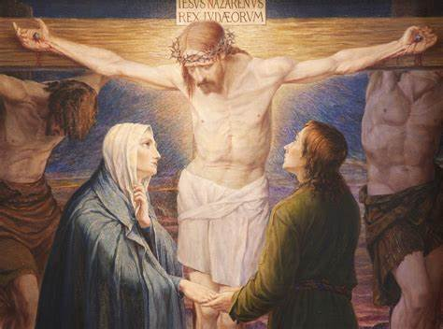

What is the “Canon” in the Extraordinary Form, and what is its equivalent in the Ordinary Form?
Canon: prayers before the consecration
  Prayer for the Church and Ecclesiastical Authorities
  Commemoration of the Living
  Invocation of 24 saints
Eucharistic Prayer (Ordinary Form)
  4 versions
  Eucharistic Prayer 1: closest to TLM Canon

Slide 12
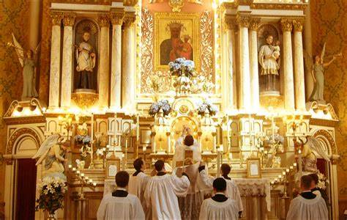



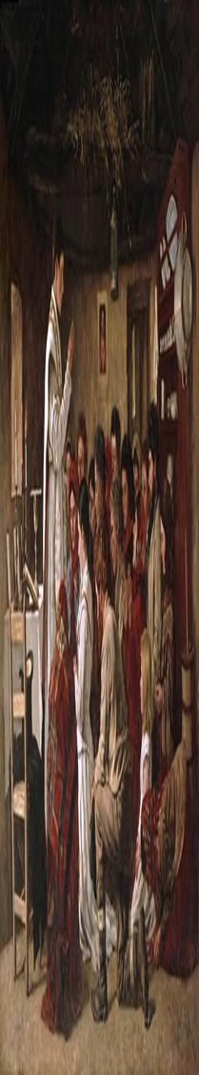


What is the “Commemoration of the Living” in the Holy Mass? What is the “Communicantes” prayer?
Prayer of petition
  Asking God to bless and protect those gathered
  in the parish church, and in the Universal Church
  Communicantes: beginning of the invocation
  of the saints prayer; differs according to the season
  Pray to be in communion with the saints,
  and therefore, with God

Slide 13
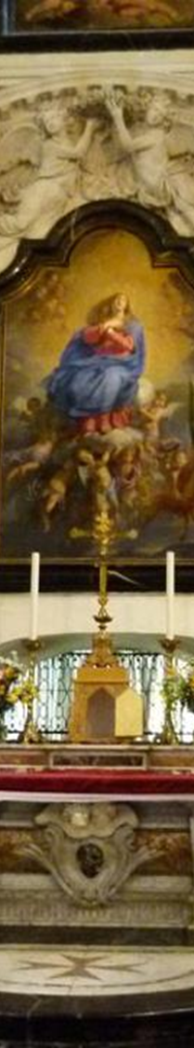

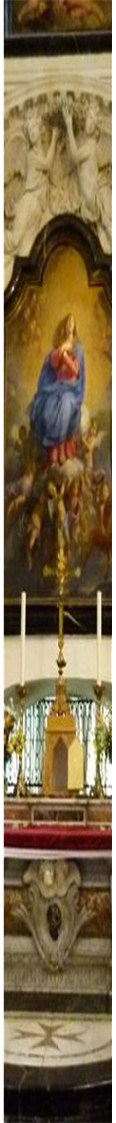
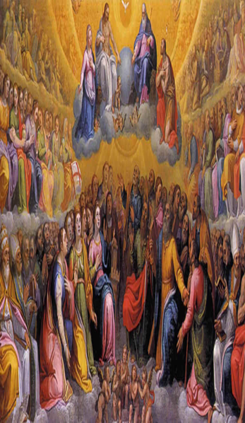

What are the classes of feast days?
Extraordinary Form
  First-class feast day: Principal feast days of Our Lord and Our Lady
  Second-class feast day: Sundays after Pentecost, Ember Days, Pre-Lent Sundays (Septuagesima, etc.)
  Third-class feast day: Some saints’ birthdays into Heaven
  Fourth-class feast day: Commemorations of saints
Ordinary Form
  Solemnity: Highest holy days
  Feast: Second-highest holy days
  Memorial: Third-highest holy days
  Optional memorial

Slide 14



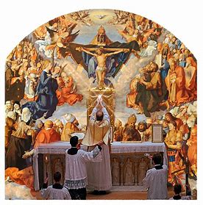

What is a “Commemoration”?
Differs from Commemoration of the Living (Church on Earth)
Remembering the communion of saints (Church in Heaven)
  Optional feast day readings (commemorations)
    Collect
    Postcommunion

Slide 15
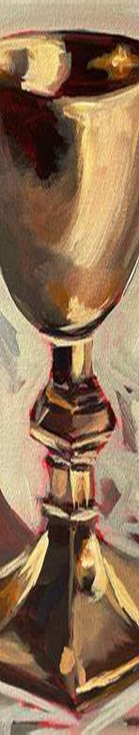


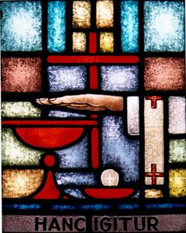
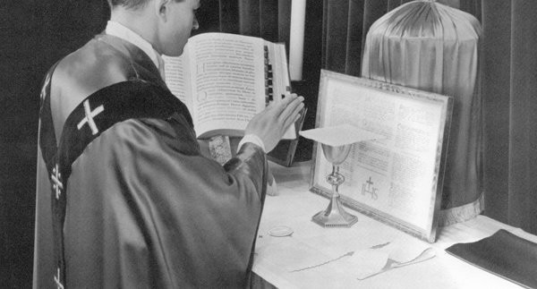

What are the “Hanc igitur” and “Quam oblationem” prayers in the Extraordinary Form? Is there an equivalent of each prayer in the Ordinary Form?
Hanc igitur
  Priest lays hands over the offerings
    Gesture represents sacrifice of Christ
  Bells are rung
  Ordinary Form: “Therefore, O Lord, we pray…”
Quam oblationem
  Five blessings of the offerings
  Ordinary Form: “Be pleased, O God, we pray…”

Slide 16
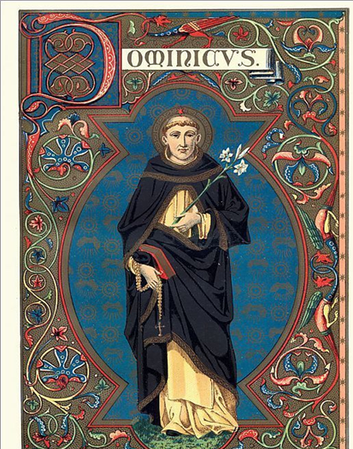


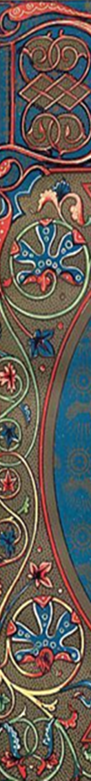
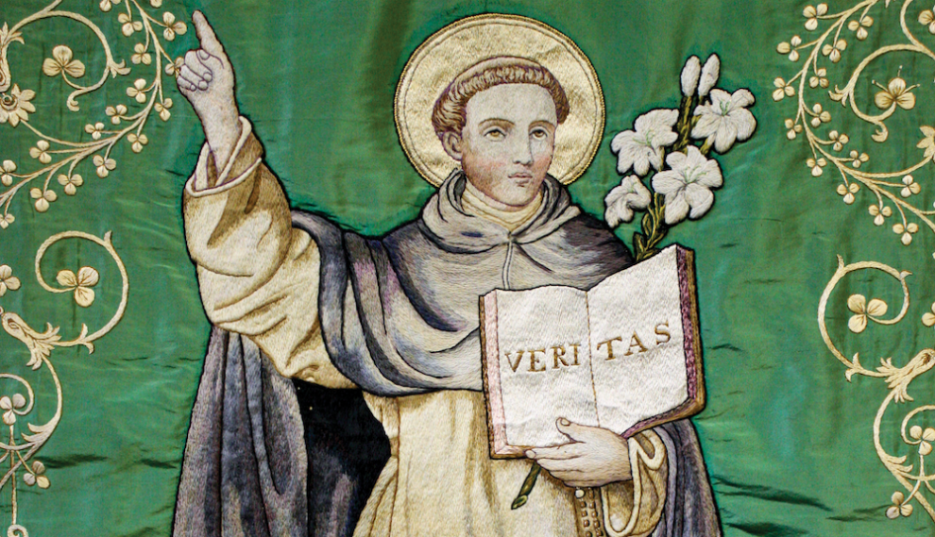
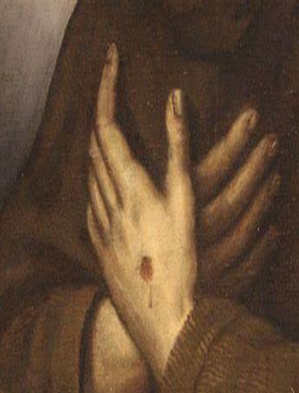
What is contemplative prayer? How does it enable us to live the Mass?
Highest level of prayer
Passive prayer
  Listening to God
  Ecstasy
Attuned to God’s voice
Recognize Truth

Slide 17
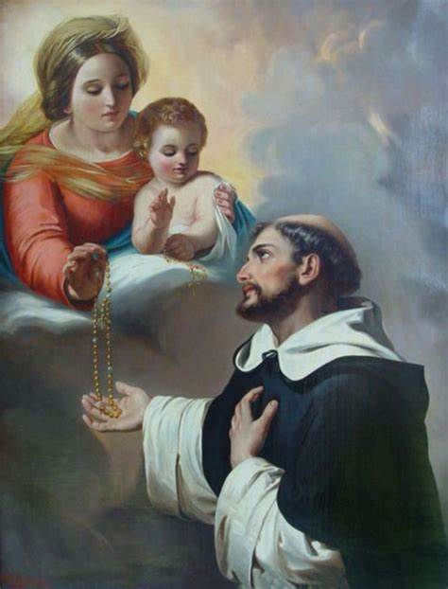


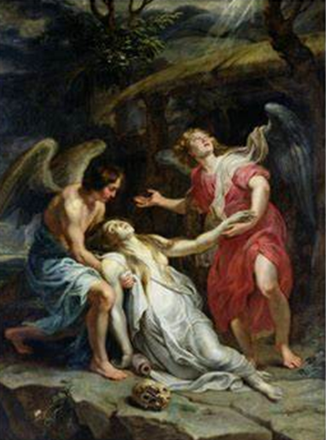
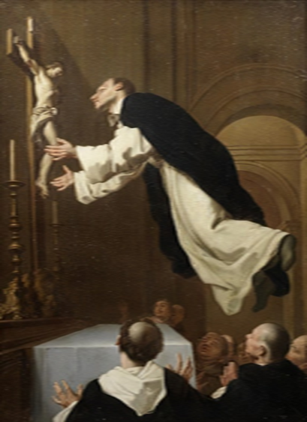
Who is St. Dominic de Guzman? How did he love and live the Holy Mass?
Founder of the Dominican
Order
Recipient of the Holy Rosary
Levitated while saying Holy
Mass
  Immersed in peace and joy of
  Jesus

Slide 18
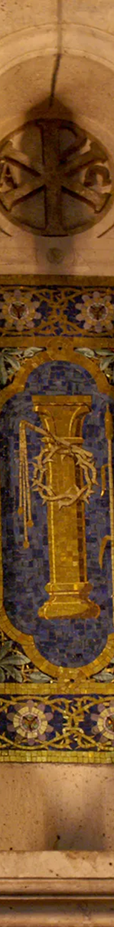

To summarize, what are key differences between the beginning parts of the Mass in the Extraordinary and Ordinary Forms? (1)
Extraordinary Form | Ordinary Form
The priest places his hands on the altar and makes a slight arc with his hands before extending them to say the Preface prayer | The priest raises and extends his hands before the Preface prayer
There are nineteen Preface Prayer readings, one to accord with each major feast day or liturgical season | There are nearly fifty Preface Prayer readings available, with multiple options for each season
Specific choirs of angels are invoked in the Preface Prayers | The angels generally are invoked, but not always according to distinct choirs, in the Preface Prayers; the Preface Prayers tend to be shorter than in the Extraordinary Form
The people kneel during all of the “Sanctus” | The people kneel at the end of the “Holy, holy, holy”
The priest blesses himself and bows his head during the “Sanctus” | Rubrical instructions do not specify that the priest should bow his head or bless himself during the “Sanctus”

Slide 19
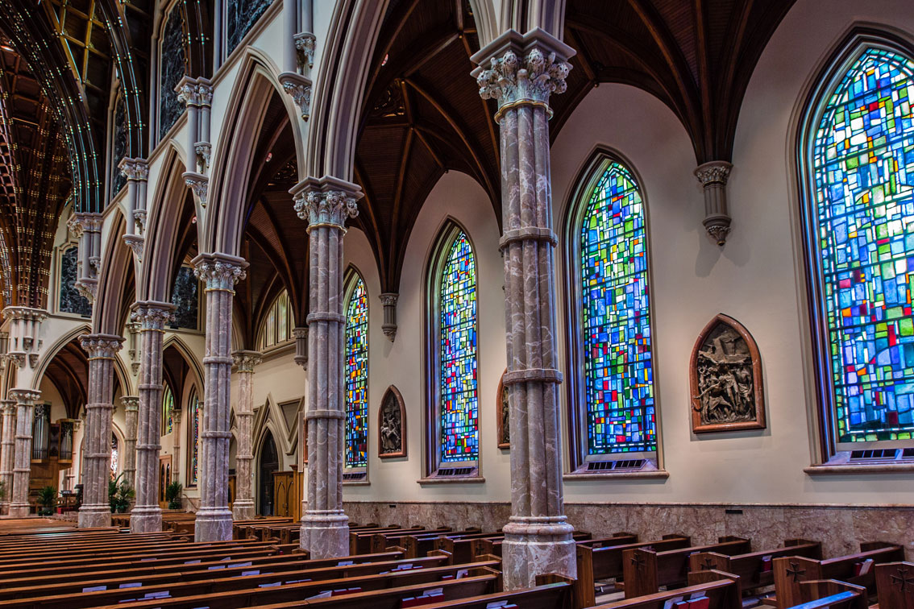

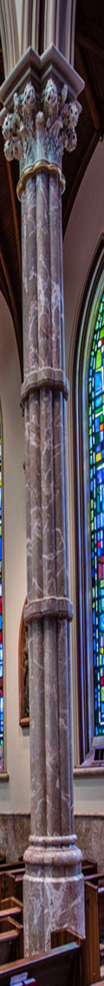
To summarize, what are key differences between the beginning parts of the Mass in the Extraordinary and Ordinary Forms? (2)
Extraordinary Form | Ordinary Form
The “Sanctus” is always sung at the High Mass, and is spoken aloud during the Low Mass; at the High Mass, the people may join the cantors in singing, but at the Low Mass, only the priest prays the prayer aloud | The priest has the option to sing or say the “Sanctus,” which the people may also join in
The Canon remains the same; there is one prayer that the priest says in every Mass, within which the full grouping of saints is invoked | For the Canon, four Eucharistic Prayer options are provided. Some (options two and three( are shortened forms that invoke some of the saints from the original prayer. Eucharistic Prayer II is most frequently used at Sunday Masses
The priest spreads his hands over the offerings during the “Hanc igitur” prayer During the “Quam oblationem,” the priest makes the Sign of the Cross a total of five times over the offerings | The priest extends his hands during the “Hanc igitur” prayer The priest spreads his hands over the offerings during the “Quam oblationem,” but does not make the Sign of the Cross over them; the priest makes the sign of the cross over both the bread and wine (at the same time) during the prayers for the Church in the Eucharistic Prayer

Slide 20
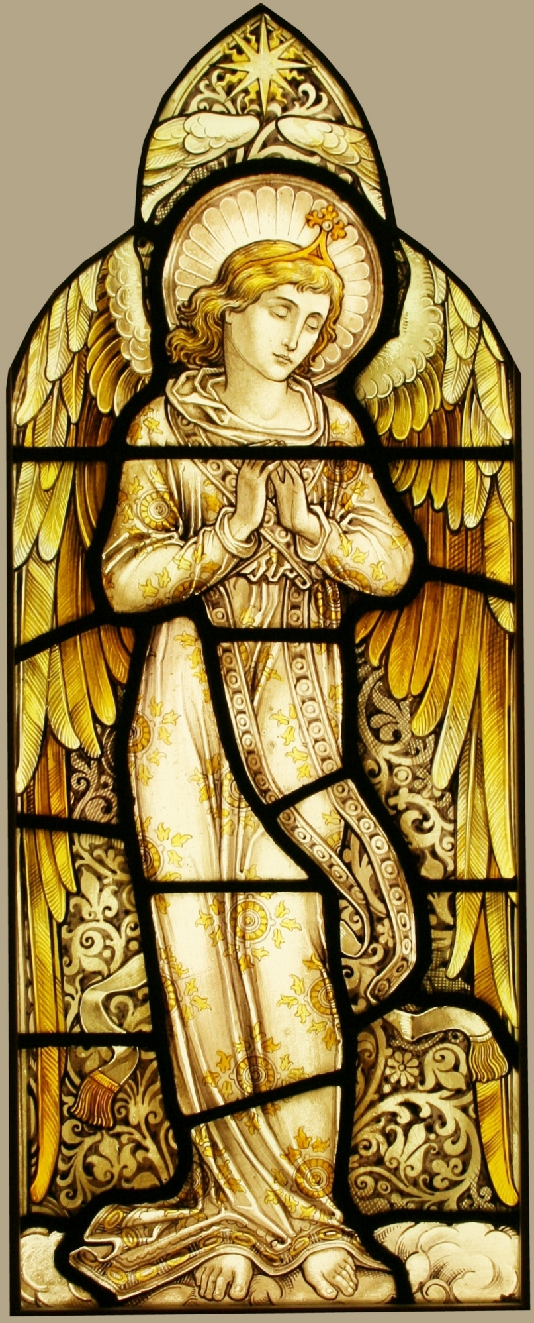


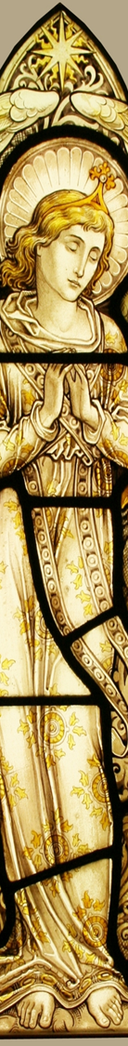
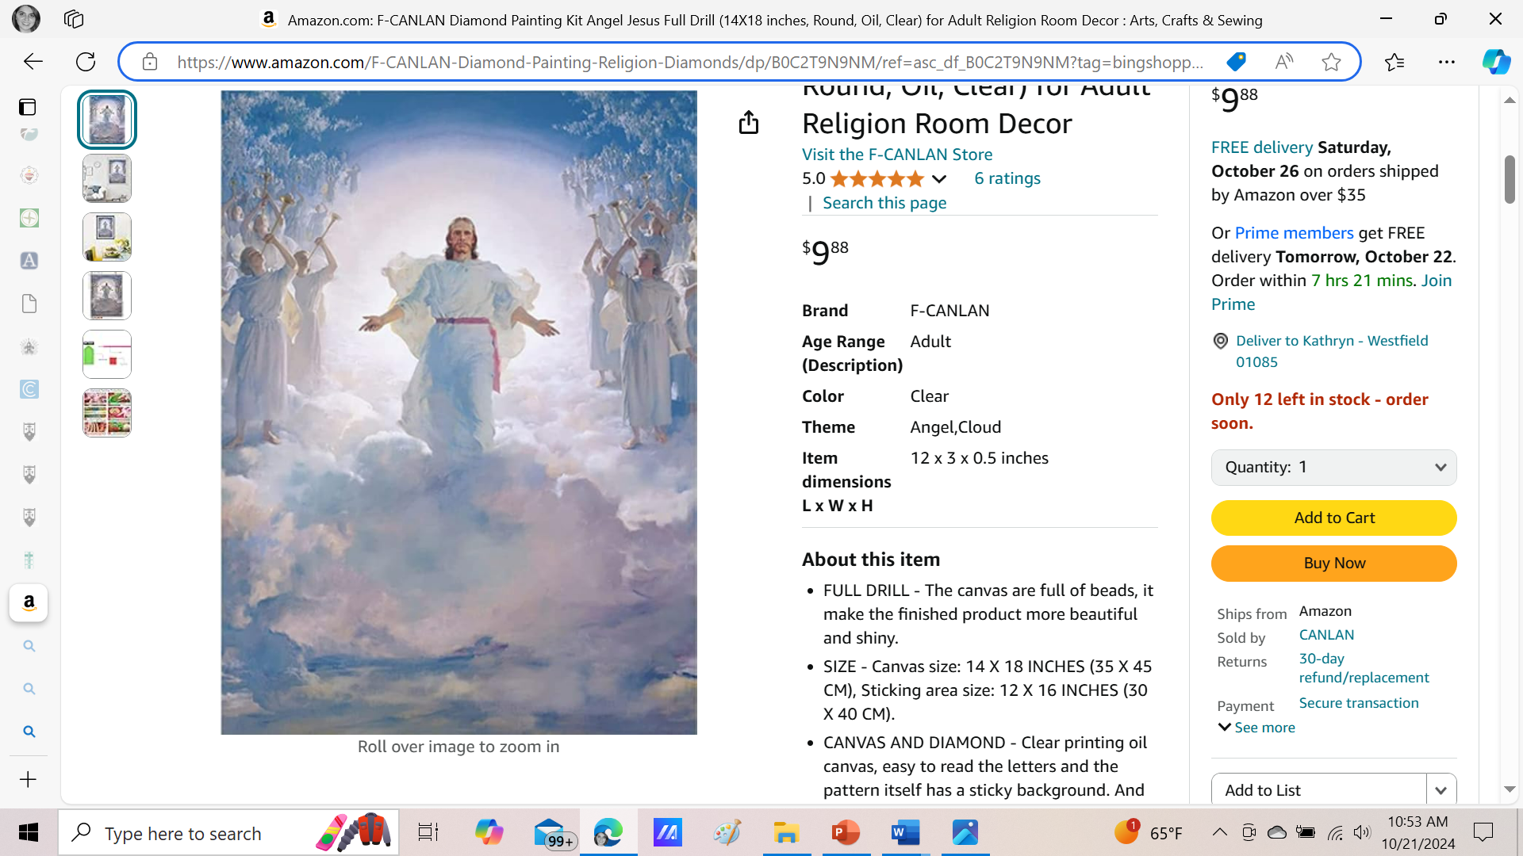

Closing Prayer: Prayer to the Archangels for Protection and Healing
Heavenly King, You have given us archangels to assist us during our pilgrimage on earth.
Saint Michael is our protector; I ask him to come to my aid, fight for all my loved ones, and protect us from danger.
Saint Gabriel is a messenger of the Good News; I ask him to help me clearly hear Your voice and to teach me the truth.
Saint Raphael is the healing angel; I ask him to take my need for healing and that of everyone I know, lift it up to Your throne of grace and deliver back to us the gift of recovery.
Help us, O Lord, to realize more fully the reality of the archangels and their desire to serve us.
Holy angels, pray for us. Amen.

Slide 21


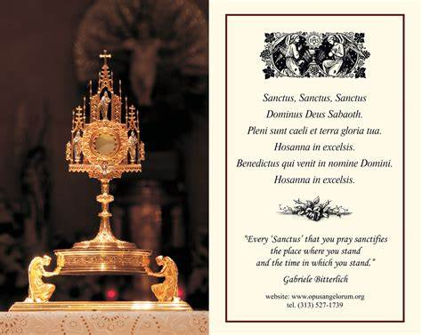
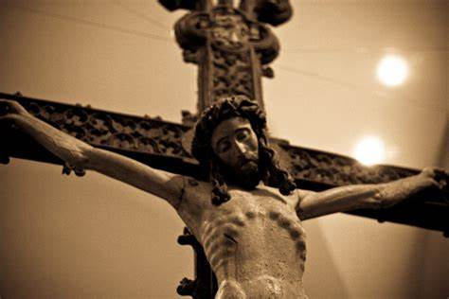

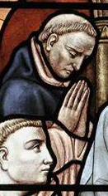


Announcements: Upcoming Masses and Special Devotions at OLV
Hallowtide Triduum Masses
  Vigil of All Saints’ Day (All Hallows’ Eve)
    Thursday, October 31, 2024: 6:00 p.m. (Ordinary Form)
  All Saints’ Day
    Friday, November 1, 2024: 8:00 a.m. (Ordinary Form) and 6:00 p.m. (Ordinary Form); 12:00 p.m. (TLM)
  All Souls’ Day
    Saturday, November 2, 2024: 9:00 a.m. (Ordinary Form), 4:00 p.m. (Ordinary Form), 6:00 p.m. (TLM)
Eucharistic Adoration:
  Sunday, October 27, 2024: 2:00 p.m. to 5:00 p.m. (Benediction: 5:00 p.m.)
  Sunday, November 3, 2024: 2:00 p.m. to 5:00 p.m. (Benediction: 5:00 p.m.)

Slide 22
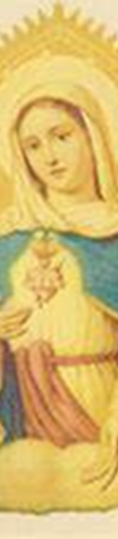




Q & A / In-Class Reflection
Course 5 reflection prompts:
  Pages 135-138
Submission of forms:
  Roman missal & The Mass in Slow Motion orders
  Divine Office learning series planning survey
Next learning series session (6):
  Friday, November 8, 2024
    6:00 p.m., parish hall

