Slide 1

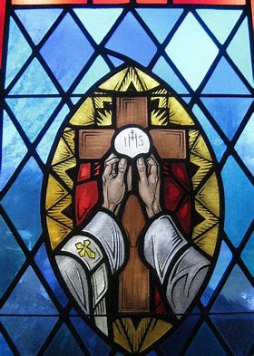


OLV Holy Mass Learning Series: Course 1
September 13, 2024
Katie Sadakierski

Slide 2
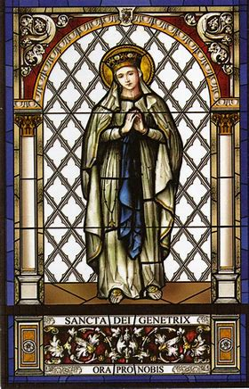
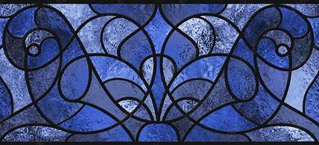
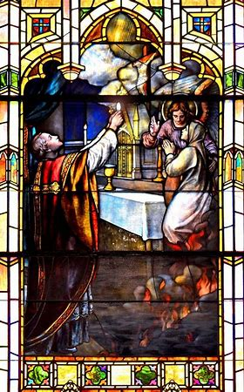
Course 1 Outline
Opening Prayer
Introduction to series & overview of topics
  Church history at a glance: the Traditional Mass and the development of the New Mass
  The Roman missal
  Key differences between the Ordinary and Extraordinary Forms of the Mass
Closing prayer
Q & A

Slide 3
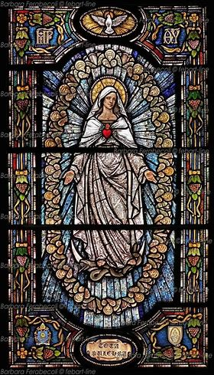
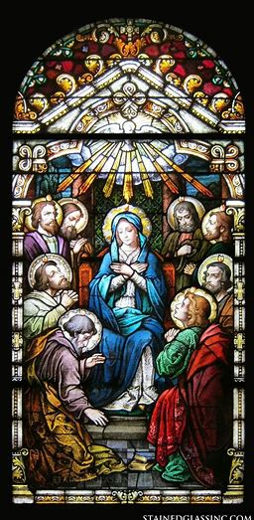
Opening Prayer
Holy Spirit, divine Consoler, I adore You as my true God, with God the Father and God the Son.
I adore You and unite myself to the adoration You receive from the angels and saints.
I give You my heart and I offer my ardent thanksgiving for all the grace which You never cease to bestow on me.
Grant me the gift of knowledge, so that I may know the things of God and, enlightened by Your holy teaching, may walk, without deviation, in the path of eternal salvation. Amen.

Slide 4
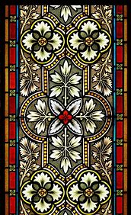
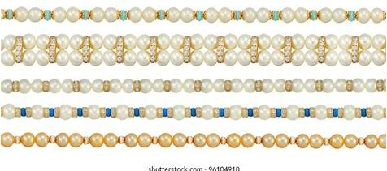
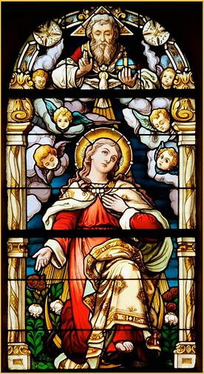
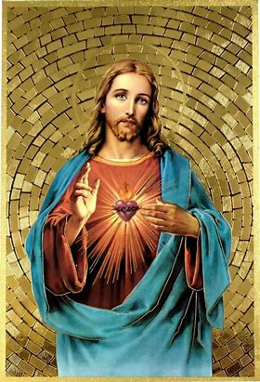
Learning Series Introduction
In-class reflections
  In-class texts: Ordinary of Ordinary Form and Ordinary of Extraordinary Form (printouts by parts of Mass/subdivisions)
Flocknote
  Follow-up emails
    Links to resources
      Readings: optional
        Knox

Slide 5

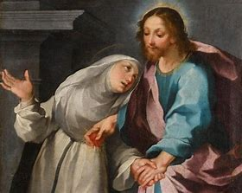
Learning Series Resources
Workbook
  Notepaper
  Session highlights
  Glossary
  Prayer guides
  Recommended resources for further reading
Folder
  Surveys
  Missal order forms

Slide 6


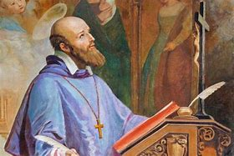
Who is the patron saint of our learning series?
St. Francis de Sales
  Founder of the Visitation Sisters (Visitandine) religious community
    Sacred Heart devotion
  Patron of adult education
    Patron of writers
      Saint of kindness
“Charity is never idle.”
1567-1622

Slide 7
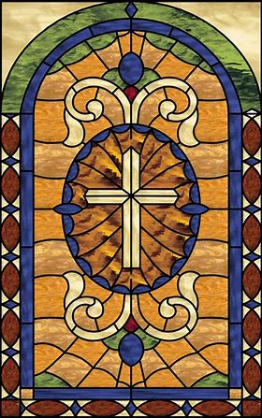
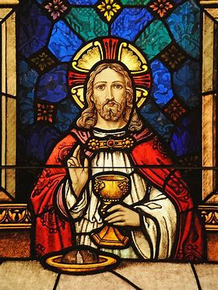
Reading & Objectives
Reading
  Optional: The Mass in Slow Motion introduction (pp. ix-xviii, print; pp. 8-17, PDF)
Objectives
  # 1, 2, 13, 17, 18

Slide 8
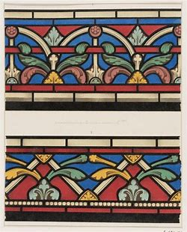
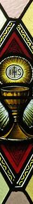
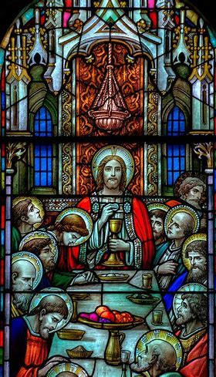
Vocabulary
Missal
Liturgical calendar
Sanctoral calendar
Proper (of the Mass)
Ordinary/Order (of the Mass; Ordo Missae)
Temporal calendar
Ecumenical council
Ordinary Form
Extraordinary Form
Tridentine
Usus antiquior
Rite
Liturgy
Mass
Vernacular
Liturgical calendar
Indult

Slide 9


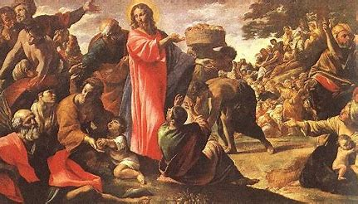

What is the general structure of the learning series, and each course in it? How does it mirror the structure of the Mass?
Rhythms of the Mass: balance
  Interior participation
  Exterior participation
Seven parts
  Biblical number: perfection and completion

Slide 10

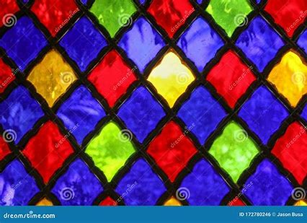
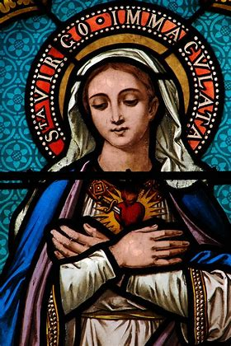
What is the “liturgy”?
Public worship of God
  Community prayer
    Holy Mass
Outside of the Holy Mass:
  Liturgical devotions
  Liturgy of the hours/Divine Office
    The prayer of the Church

Slide 11

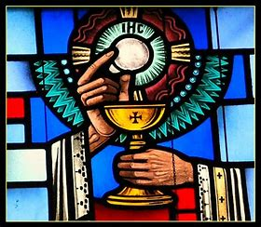
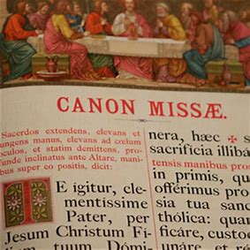
What is the Holy Mass? What does “Mass” mean?
Mass: from Latin “missa”
  Missa cantata
Various rites/expressions
Memorial
Propitiation
Wedding feast

Slide 12

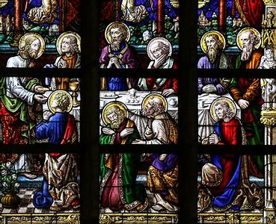
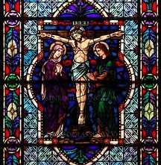
How is the Holy Mass a memorial?
Re-presentation of Christ’s Sacrifice
Institution of the Holy Eucharist
Sacred memory

Slide 13
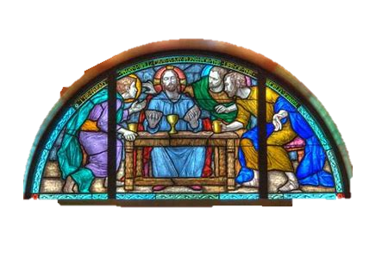
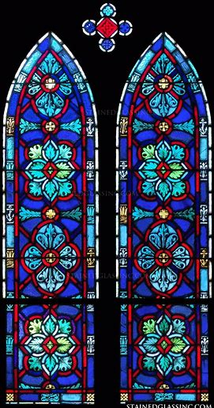
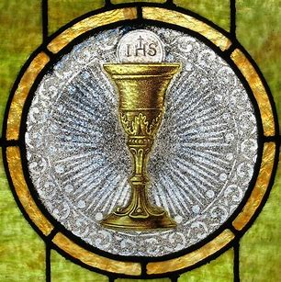
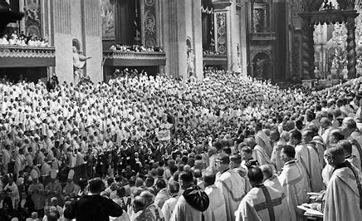
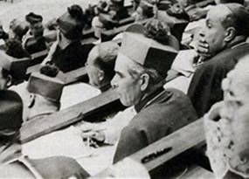
How did the liturgy develop? How are issues related to the Church and the liturgy addressed?
Ecumenical councils (21)
  Addressing heresies
    Affirming truth of Church teachings
  Uniting Church by bringing bishops together
    Trent (1545-1563)
    Vatican Council II (1962-1965); 21st council

Slide 14
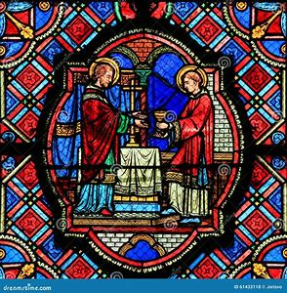
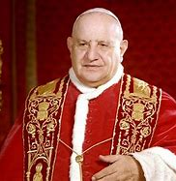
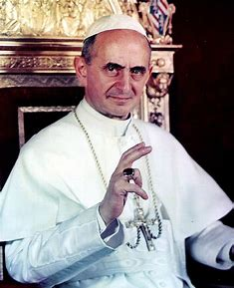
Why did Vatican Council II convene?
What was happening in the world at the time of Vatican II?
Letting the “fresh air” in
  Modernization
Historical backdrop
  War/political conflict
  New waves of thought
  Changing culture
  Technological advancement
John XXIII
Paul VI

Slide 15
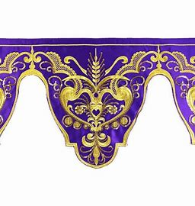
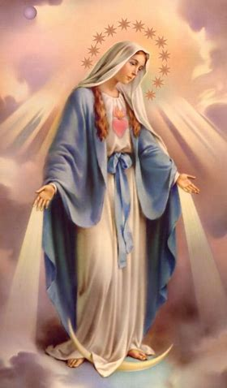
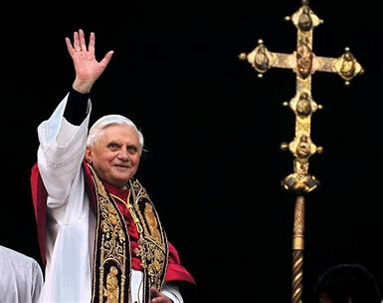

What were the consequences of Vatican II? How were the schema of Vatican II implemented?
Mediatrix of all graces: not made dogma
Press invited to council sessions
Introduction of a new form of the Mass
Summorum Pontificum and resurgence of the old form of the Mass
Mediatrix of All Graces
Pope Benedict XVI

Slide 16


What changes were made to the Holy Mass, Roman missal, and liturgical calendar?
Before Vatican II | After Vatican II
Mass: said in Latin only (language of the Church) | Mass: said in the vernacular (language of the people)
Rubrics: Ordinary is fixed | Rubrics: Options for prayers permitted; liturgical creativity afforded
Mass: said only ad orientem | Mass: said versus populum
Holy Communion: only reception kneeling and on the tongue; priest as sole provider; minor orders active | Holy Communion: permitted by hand; lay Eucharistic ministers permitted; minor orders dissolved
Missal/lectionary: 1-year cycle of readings | Missal/lectionary: 3-year cycle of readings
Liturgical calendar: eight seasons (Proper of Seasons) | Liturgical calendar: seven seasons (Proper of Time)
Liturgical calendar: Feast day classification; first-class, second-class, third-class; octaves for feast days (privileged, common, simple); Ember Days; abstinence from meat every Friday | Liturgical calendar: New classification system: solemnities, memorials, feasts; new dates of feast days; elimination of octaves; no Ember Days; abstinence from meat every Friday only during Lent

Slide 17
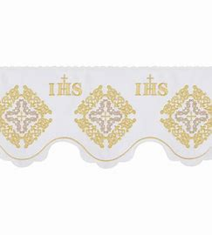
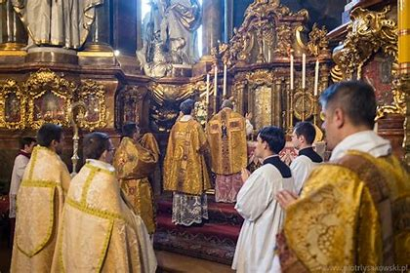
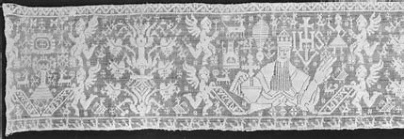
What is the Ordinary Form of the Mass? What is the Extraordinary Form?
Two forms of the Roman Rite
  Eastern rite: Byzantine (in communion)
Ordinary Form: Novus Ordo (new order) Mass
  Ordinary: the norm; regularly offered in parishes
Extraordinary Form:
  Traditional Latin Mass
    Tridentine Mass (misnomer)
    Usus antiquior (ancient usage)
    Mass of the Ages

Slide 18
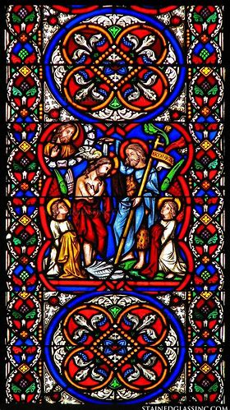
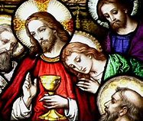

Why were changes made to the Mass, missal, and liturgical calendar? What were the implications of these changes?
Goal: Exercise of common priesthood/threefold call to holiness
Goal: Increased participation of laypeople
Goal: widespread, deepened understanding of faith
Outcome: Increased emphasis on Mass as feast; meal
shared by community of faithful

Slide 19

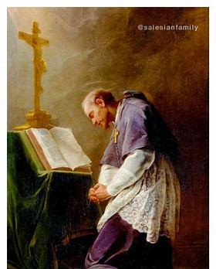
Why should we learn about the roots of our Catholic Faith?
Going forward → going back
Historical reflection: informed decision-making
Spiritual development: conscience formation
Communion with states of the Church
Discernment of God’s will
Celebration of our Faith
  Understanding of God; who we are in Him

Slide 20


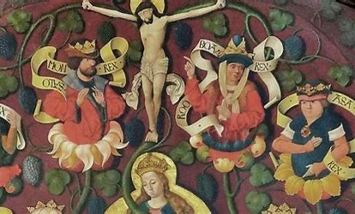
Why do we study the old and new rites of the Roman Mass?
Comparable to biblical typology
Understand the old to understand the new; vice versa
Appreciate nuances, rich layers of meaning of Faith; depth and breadth of God’s love
Know more about God → Love God more
Know past to understand present, more reverently honor God in future

Slide 21
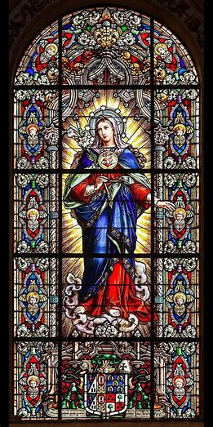
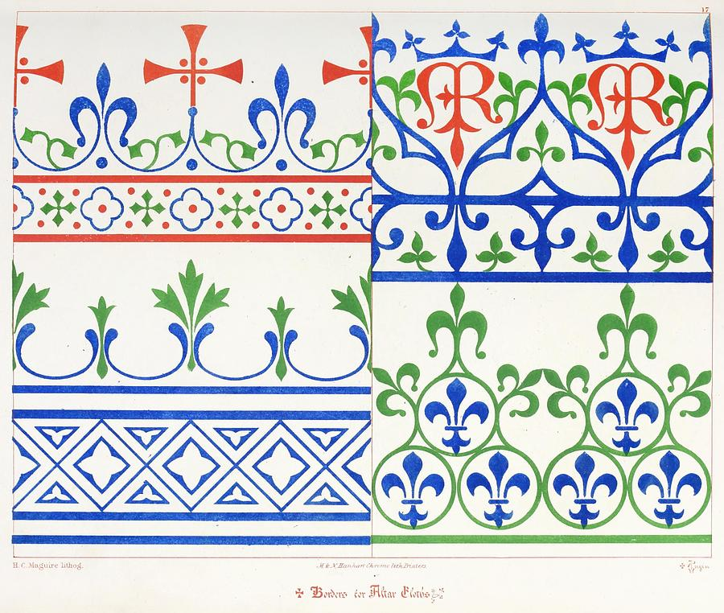

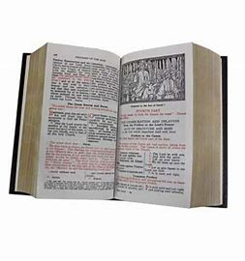
What is the Roman Missal?
Multiple versions according to rites: 1962 (Extraordinary Form), 1970 (Ordinary Form)
Book of:
  Prayers and special devotions
  Teachings of Church; guide to Mass
  Mass readings

Slide 22
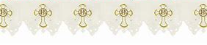
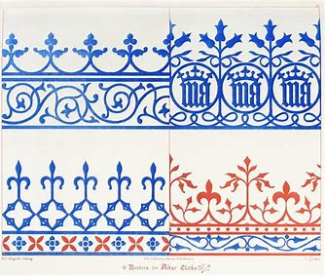
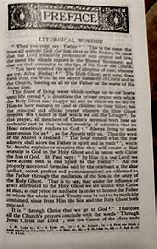
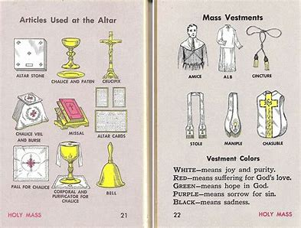
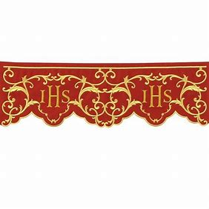
Why do we use the Roman missal at Mass?
Formal/pre-written prayers
Interior participation and exterior participation
Union with God
Contemplative prayer/focus; promote centrality of God
Spiritual growth: Gifts of knowledge, wisdom, and understanding

Slide 23



How is the Missal organized? Which parts of the Mass may we find within it?
Ordinary of the Mass
  Ordinary Form
    Liturgy of the Word and Liturgy of the Eucharist
  Extraordinary Form
    Six subdivisions
      Mass of the Catechumens (2)
      Mass of the Faithful (4)
Proper of the Mass
  Temporal calendar: Proper of the Seasons
  Sanctoral calendar: Proper of the Saints

Slide 24



What are some key differences between the Ordinary and Extraordinary Forms of the Holy Mass? (1)
Ad orientem (Extraordinary)
Versus populum (Ordinary)

Slide 25



What are some key differences between the Ordinary and Extraordinary Forms of the Holy Mass? (2)
Reception of Communion kneeling and on the tongue
Reception of Communion by hand

Slide 26



How do we see these differences reflected in their respective Roman missals?
1962 Roman Catholic Daily Missal and 1970 Daily Roman Missal
Organization
Texts of prayers
Variety of content
1962
1970

Slide 27



What is the Ordinary of the Mass?
Unchanging prayers of the Mass
Psalm 42, Confiteor, Creed, prayers of consecration, Last Gospel (Extraordinary Form)
  Some slight seasonal changes
  More flexibility, margin for change afforded in Ordinary Form

Slide 28

What are the Propers of the Mass?
Changing Mass readings
  Accord with the spirit of each liturgical season
  Stages in salvation history
Introit, Collect, Epistle, Gradual, Alleluia/Tract, Gospel, Offertory, Preface, Communicantes, Communion, Postcommunion
  Commemorations

Slide 29


What is the temporal calendar?
Proper of the Seasons
  Feast days related to Jesus and Mary
    Mainly first- and second-class feast days
    “Temp” = “time”

Slide 30


What is the sanctoral calendar?
Proper of the Saints
  Saint feast days
    Mainly second- and third-class
  “Sanct” = “holy”

Slide 31




What is the “Latin Novus Ordo” Mass?
Ordinary of the Ordinary Form
  Ordinary Form Mass rubric, liturgical calendar, and 3-year lectionary cycle (the same)
    Said in Latin

Slide 32




How do the two rites converge in this liturgy?
Shared language
Different rubrics
Not an equal balance/
convergence of rites

Slide 33



What constitutes the “sacred liturgy”?
Sacrifice of the Mass: spirit, Heart of Christ
  Holy Communion
    Real Presence of Christ
      Valid: confection of the Holy Eucharist; form and matter present

Slide 34



Closing Prayer: Prayer of St. Thomas Aquinas
Grant me, O Lord my God,
a mind to know you,
a heart to seek you,
wisdom to find you,
conduct pleasing to you,
faithful perseverance in waiting for you,
and a hope of finally embracing you. Amen.

Slide 35


Q & A /In-Class Reflection
Course 1 reflection prompts
  Pages 54-7 of workbook
Q & A:
  Group-wide or individual
Course 2 of learning series:
  Friday, September 27, 2024, 6:00 p.m., parish hall
    Religious education Mass on Friday, September 20

