Slide 1
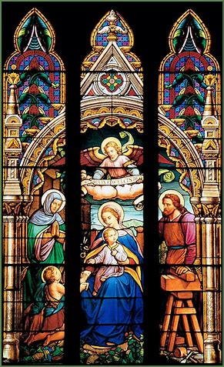
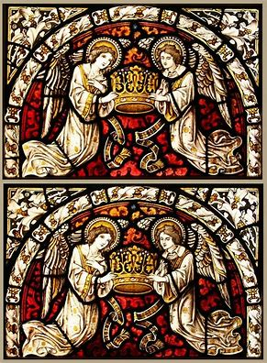
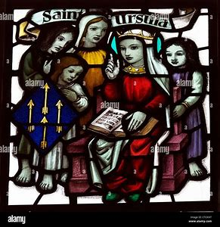
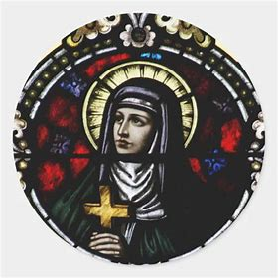
Catechist Workshop 2
Thursday, October 10, 2024
Katie Sadakierski

Slide 2

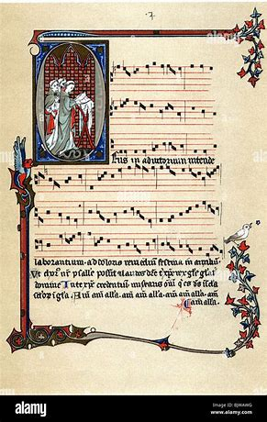
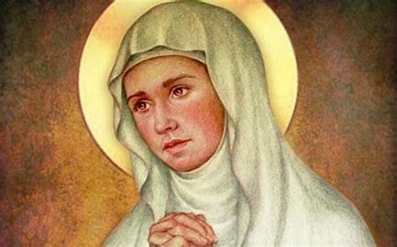

Catechist Workshop 2 Outline
Welcome & Opening Prayer
Workshop presentation
St. Ursula and St. Angela Merici: Teachers of Teachers
Applications: Lessons from the Life of St. Angela Merici
Closing Prayer

Slide 3
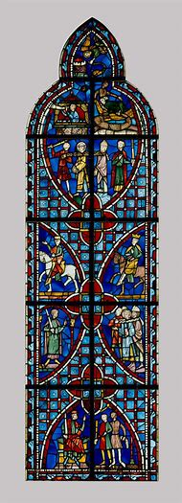
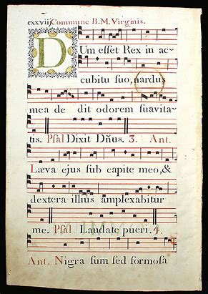
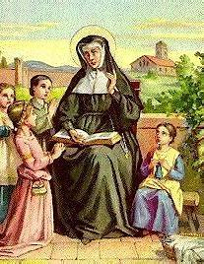
Opening Prayer: Prayer to St. Angela Merici for Catholic Teachers
(from Catholic Exchange)
St. Angela, we pray for many teachers, especially in our Catholic faith. We need good catechesis today in the Church and it is apparent that the Lord is calling many to this mission. Please pray, Saint Angela, that many will answer and that through education, many will come to better know, love and serve our Lord. Amen.

Slide 4
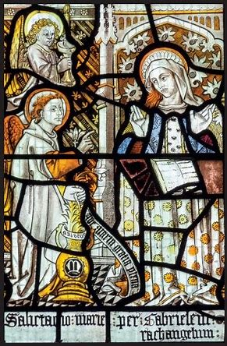
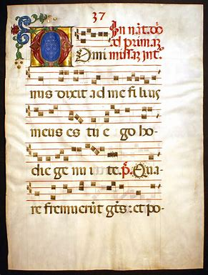
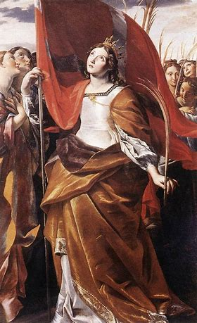
Workshop 2 Patron Saint:
St. Ursula
Years of life: lived in 4th century; exact years unknown
Canonization: 12th century
Feast day: October 21
Patronage: students, Catholic education, holy death

Slide 5
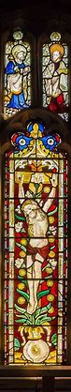
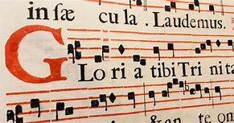
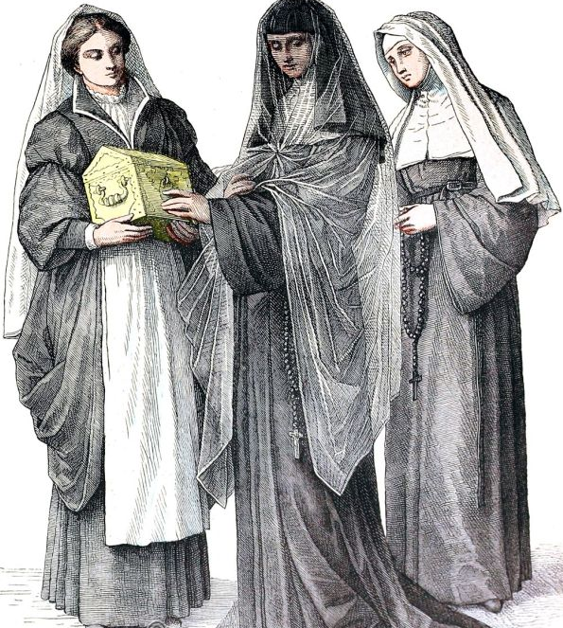
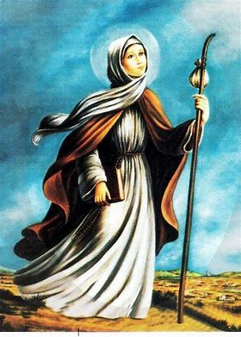
Who Did St. Ursula Inspire?
St. Angela Merici
  Feast day: June 1
  Years of life: 1474-1540
  Canonization: 1807
  Patronage: educators, the sick, people with disabilities, and those grieving the loss of parents

Slide 6
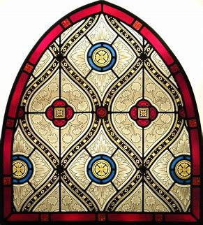
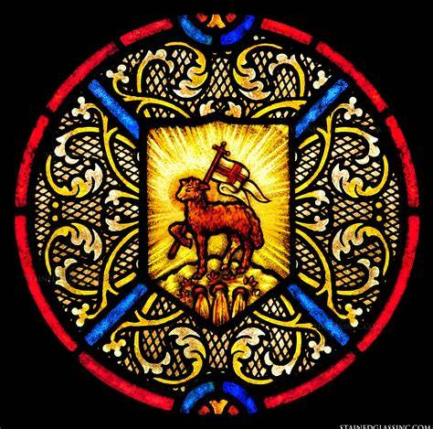
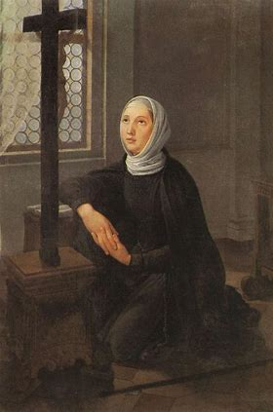
How was St. Angela Inspired by St. Ursula?
Fortitude
  Courage and strength
Piety
  Faithfulness
Fear of the Lord
  Wonder
  Purity

Slide 7
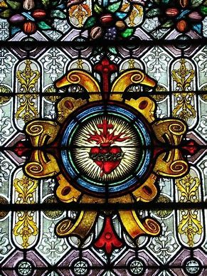
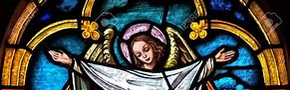
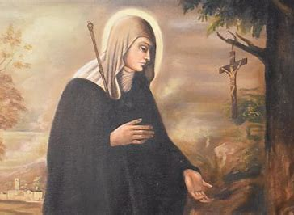
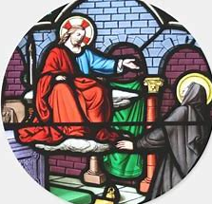
The Vocation of Catechist: St. Angela’s Call from God
Mother Teresa’s “call within a call”: “Come be My light”
  Call to serve the poor, teach the merciful way of God through example
St. Angela: mystical vision
  Call to found a company of women

Slide 8
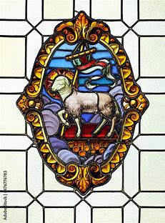
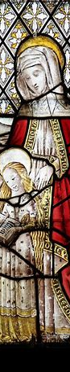
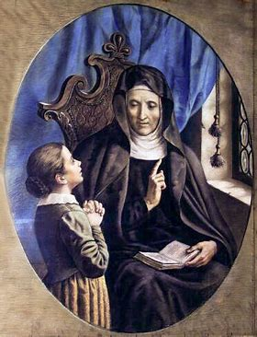
What Was Unique About St. Angela Merici’s Teaching Ministry?
Developed first teaching order for women
Ministry focused on the education of girls
Taught children and adults

Slide 9
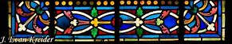
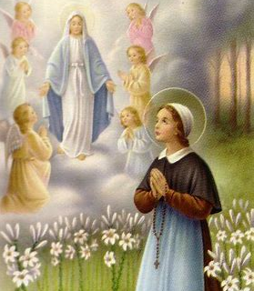
What is the Ursuline Approach to Education?
Ahead of their times, but loyal to tradition
Vows: poverty, chastity, obedience, and teaching
Positive reinforcement
Integrated curriculum with emphasis on religion
Care of the whole person

Slide 10
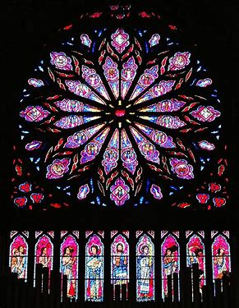
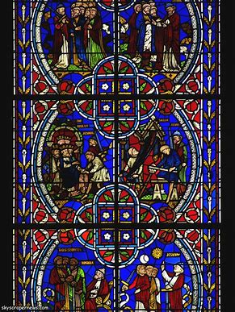
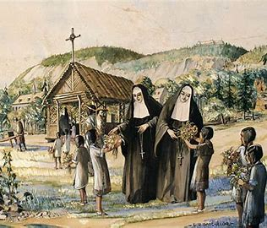
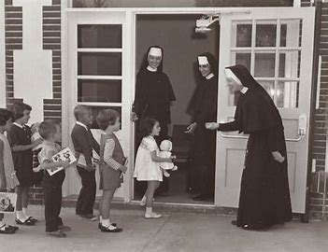
What devotions/traditions did the Ursulines practice with students? What methods did they use to teach?
Sodalities
Marian crownings
Team teaching
Frequent attendance of Holy Mass

Slide 11
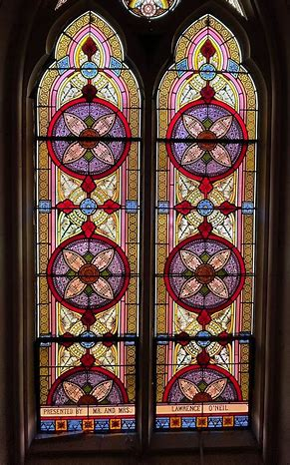
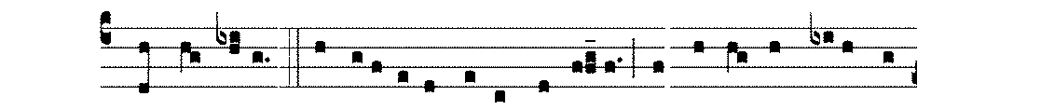
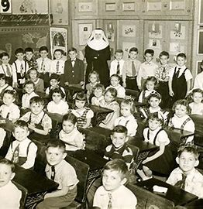
Ursuline Sacrament Preparation
Feast days
Confession
First Holy Communion
Confirmation

Slide 12
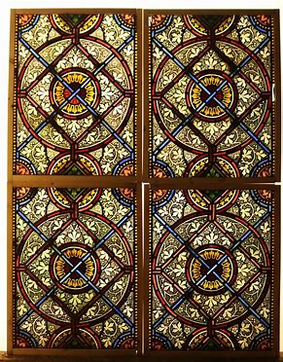
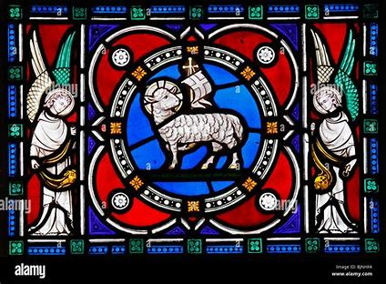
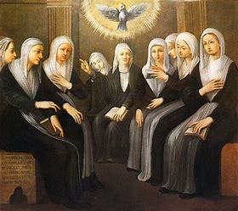
What Marian Virtues did St. Ursula and St. Angela Merici Live Out?
“Mother Most Prudent”
  Practical wisdom
  Spiritual wisdom: Inspiration of Holy Spirit
  Trust in God’s Providence

Slide 13
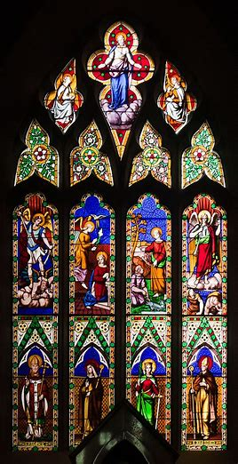
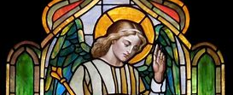
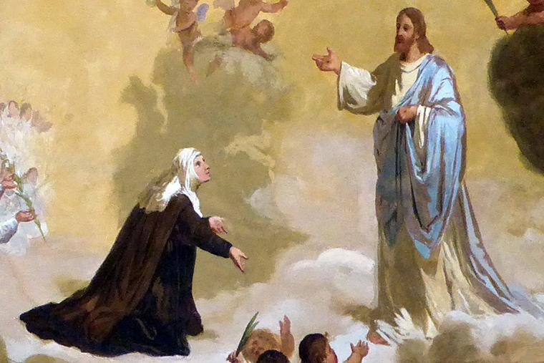
How Can We Apply the Ursuline Approach to Religious Education?
“My very own sisters, it is necessary that we be vigilant, and so much more so, as the undertaking is of such importance that there could be no greater, in which lie our life and well-being, and in which we are called to a life of such glory that we are spouses of the Son of God, and will become queens in heaven.” ~Prologue of the Rule of the Company of Saint Ursula #15–17

Slide 14
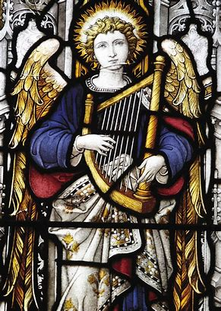
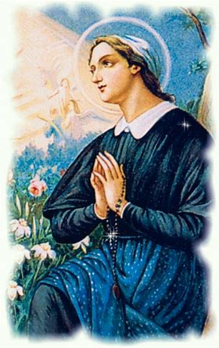
Wisdom from St. Angela Merici
“Mothers and sisters most dear to me in Christ: in the first place strive with all your power and zeal to be open. With the help of God, try to receive such good counsel that, led solely by the love of God and an eagerness to save souls, you may fulfill your charge. Only if the responsibilities committed to you are rooted in this twofold charity will they bear beneficial and saving fruit.” - St. Angela Merici, Spiritual Testament

Slide 15
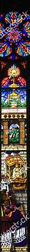
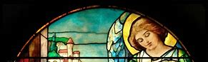
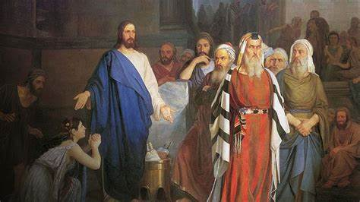
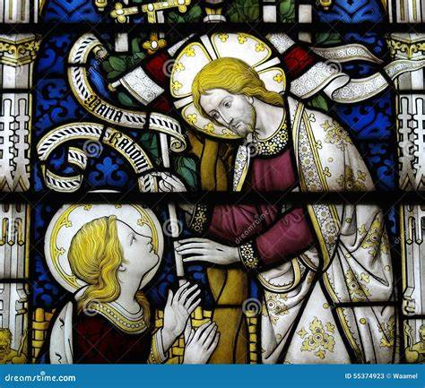
Teachers in the Scriptures: Through passages in the New Testament of the Bible, how do we see Jesus teaching? What does Jesus say about teachers?
Matthew 13:31-32
Matthew 23:1-3
John 7:14-17

Slide 16
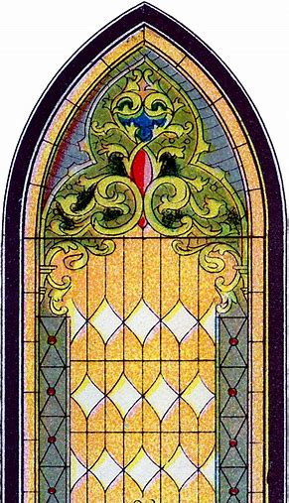
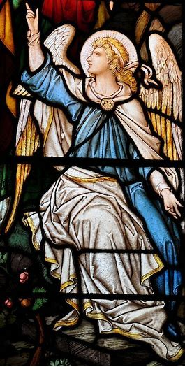
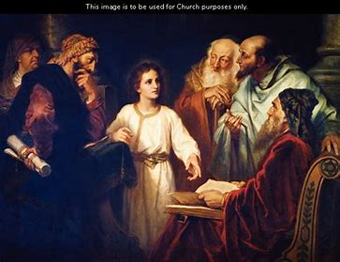

Scriptural Scavenger Hunt: How are the Scriptures reflected in St. Angela’s educational philosophy?
Psalm 132:12
Luke 6:40
Matthew 28:20

Slide 17


Closing Prayer: Litany of St. Angela Merici (condensed)
St. Angela, gifted with the graces of prayer and contemplation, pray for us.
St. Angela, our Mother and Advocate, pray for us.
Lamb of God, Who takes away the sins of the world: spare us, O Lord.
Lamb of God, Who takes away the sins of the world: hear us, O Lord.
Lamb of God, Who takes away the sins of the world: have mercy on us.
V. Pray for us, O glorious Mother Saint Angela:
R. That we may be made worthy of the promises of Christ.

